Slide 1
Google Workloads for Consumer Devices: Mitigating Data Movement Bottlenecks
Amirali Boroumand
Saugata Ghose, Youngsok Kim, Rachata Ausavarungnirun,
Eric Shiu, Rahul Thakur, Daehyun Kim, Aki Kuusela, Allan Knies, Parthasarathy Ranganathan, Onur Mutlu

Slide 2
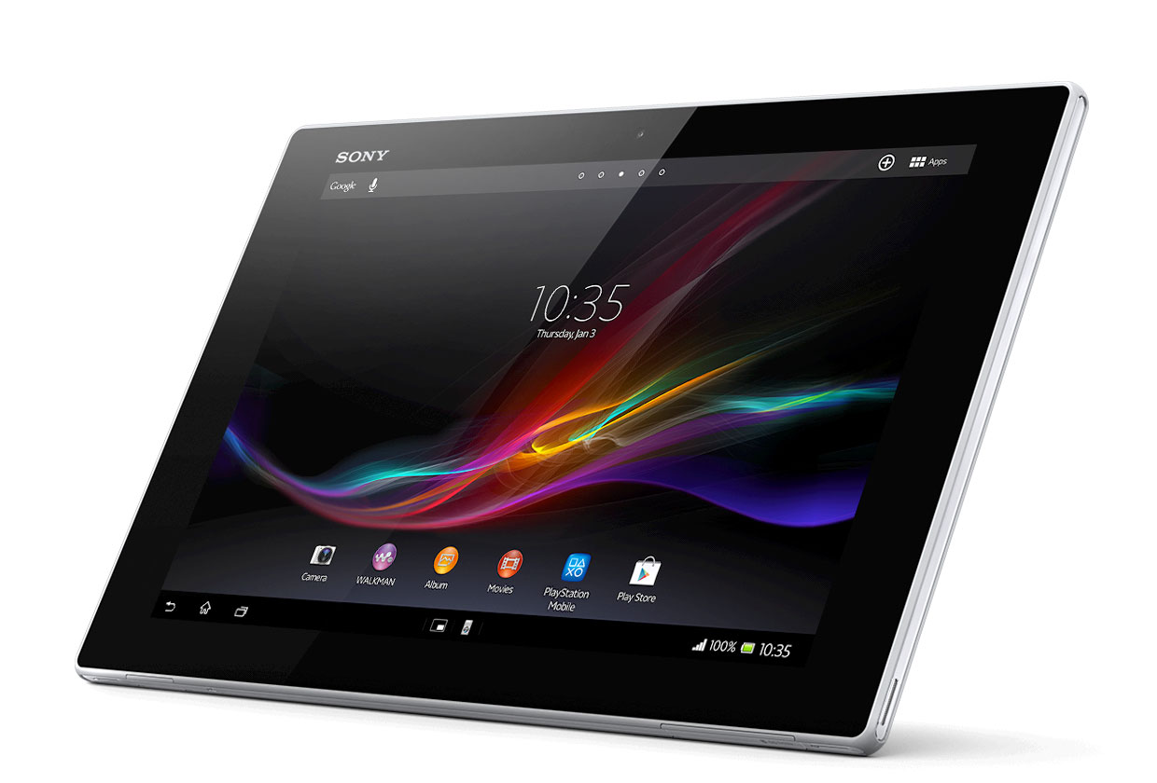
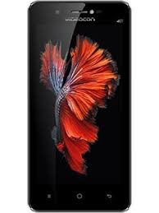
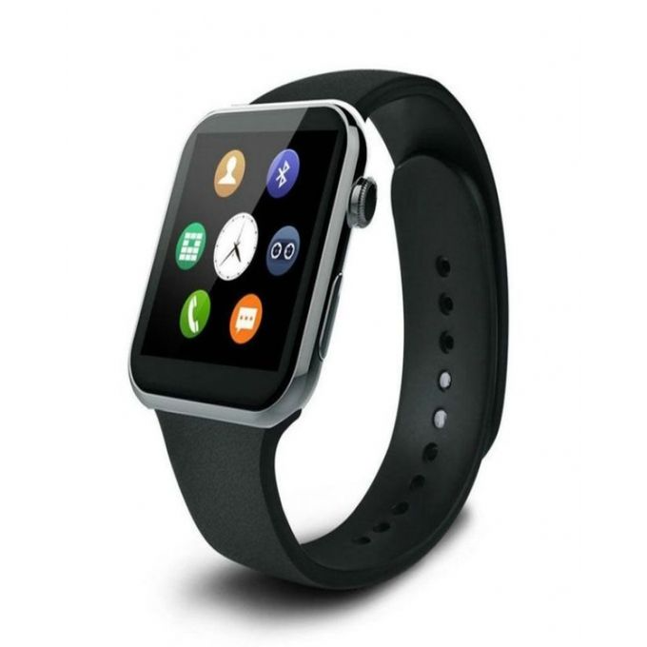
Consumer Devices
Consumer devices are everywhere!
Energy consumption is a first-class concern in consumer devices
Notes:
Consumer devices like tablets smartphone and wearable are now everywhere and used by billions of people.
One of the major challenge in these devices is battery limitation which makes the energy consumption a critical concern …

Slide 3
Popular Google Consumer Workloads
Chrome
TensorFlow Mobile
Google’s web browser
Google’s machine learning framework
Video Playback
Video Capture
Google’s video codec
Google’s video codec
Notes:
In this work, we take a look at widely-used google consumer workloads, to figure out the major sources of energy consumption.
We look at Google Chrome web brower. We take a look at Tensorflow, Google’s machine learning framework, and we also take a look at two important video related workloads, video playback and video capture, both rely on Google’s vp9 codec technology.

Slide 4
Energy Cost of Data Movement
1st key observation: 62.7% of the total system energy is spent on data movement
Data Movement
SoC
DRAM
CPU
L2
CPU
L1
CPU
CPU
Compute Unit
Processing-In-Memory (PIM)
Potential solution: move computation close to data
Challenge: limited area and energy budget
Notes:
Throughout our analysis, we make a key observation that out of all sources of energy consumption, data movement is a major contributor to the total system energy. We find that across all of the workloads, on average around 62.7% of total system energy is spent on data movement.
One way to reduce data movement cost is to move computation close to data, or …
One potential solution to address this cost it do move computation close to data, or in other words, do procesing in memory. However, the challenge is that these devices.
One potential solution to mitigate data movement cost and reduce total system energy is to execute data-movement heavy portions of application close to data, or in other words, do processing in memory. However, consumer devices are extermely limited in terms of area and power budget. So the question is can we move part of the data movement heavy portion given the limited area and energy budget. Our

Slide 5
Using PIM to Reduce Data Movement
2nd key observation: a significant fraction of the data movement often comes from simple functions
We can design lightweight logic to implement these simple functions in memory
Small embedded low-power core
Small fixed-function accelerators
PIM Core
PIM Accelerator
PIM Accelerator
PIM Accelerator
Offloading to PIM logic reduces energy and improves performance, on average, by 55.4% and 54.2%
Notes:
To figure out if we can use processing in memory, we dig deeper into our analysis and we make another key observation that majority of data movement often comes form simple functions and pritmitives. We find that these simple function can be implemented in memory as either a small embedded core, or group of small fixed function accelerators. Our result shows that offloading these function to PIM logic can significantly reduce data movement for each function and reduce energy on average around 55% and improve perforamcne around 54%.
our PIM core can reduce significant portion of data movement, reduce enregy by 49.1% for each function and improve performance up to 2.2X. While using group of fixed function accelerator reduce energy by 55.4% and improve performance by up to 2.5X.
Or use Saugata’s approach : Reduces total system energy by an average of 55.4%
Reduces execution time by an average of 54.2%
Our result show that both of them can significantly reduce the data movement for each function.
Feedback: talk about result more
Don’t talk about specific detail like MemCopy, MemSet stuff like that
Main take away: data movement come from simple functions that are simple enough to implement in PIM
We find that these functions and primitves can be implemented as PIM logic using either (1) a small low-power general-purpose embedded core or (2) a group of small fixed-function accelerators (PIM accelerators). Our Analysis shows that both are cost-feasible to use in consumer devices. We find that they eliminate a significant fraction of dat amovement, and reduce energy consumption for each of these operation on average by 49 and 55%.

Slide 6
Google Workloads for Consumer Devices: Mitigating Data Movement Bottlenecks
Amirali Boroumand
Saugata Ghose, Youngsok Kim, Rachata Ausavarungnirun,
Eric Shiu, Rahul Thakur, Daehyun Kim, Aki Kuusela, Allan Knies, Parthasarathy Ranganathan, Onur Mutlu
Location: Virgina EF
Time: 11:10 AM
Notes:
Please drop by our talk during session 1 if you would like to learn more about data movement in Google workloads.

