Slide 1
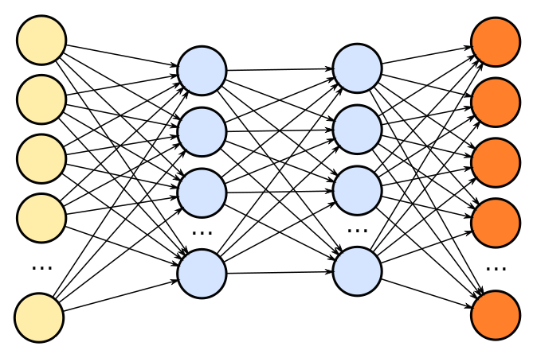
Google Workloads for Consumer Devices: Mitigating Data Movement Bottlenecks
Amirali Boroumand, Saugata Ghose, Youngsok Kim, Rachata Ausavarungnirun, Eric Shiu, Rahul Thakur, Daehyun Kim, Aki Kuusela, Allan Knies, Parthasarathy Ranganathan, Onur Mutlu
Google Consumer Workloads
Data Movement Cost
Goals
We look at widely-used Google workloads to identify major sources of energy consumption:
1st key observation: 62.7% of total system energy is spent on data movement
1
Understand the data movement related bottlenecks in modern consumer workloads
SoC
Data Movement
DRAM
2
Analyze the benefits of processing-in-memory (PIM) to mitigate data movement cost
CPU
L1
L2
CPU
CPU
Chrome
TensorFlow Mobile
CPU
Compute Unit
Google’s web browser
Google’s machine learning framework
Processing-in-Memory (PIM)
3
Investigate the PIM logic that can maximize energy efficiency given the limited area and energy budget in consumer devices
Video Playback and Video Capture
2nd key observation: a significant fraction of data movement often comes from simple functions
Google’s video codec
Browser
Scrolling
Tab Switching
Chrome Rendering Pipeline
Texture Tiling
Chrome employs a multi-process architecture
Color Blitting
CPU
CPU-Only
Memory
time
CPU
CPU + PIM
PIM
Chrome Process
HTML
HTML Parser
Rasterization
Rasterization
Linear
Main operations during tab switching:
Context switch
Load the new page
Render Tree
Layout
Rasteriza-tion
Composit-ing
Linear
Bitmap
…
CSS
CSS Parser
Read Bitmap
Bitmap
idle
Conversion
Texture Tiling
Texture Tiling
Conversion
high
Texture
data movement
Invoke
Tiles
Render Process (tab 1)
Render Process (tab 2)
Render Process (tab n)
Write Back
Texture
Compositing
Chrome uses compression to reduce each tab’s memory footprint
Invoke
Tiles
Compositing
Texture tiling is a good candidate for PIM execution
CPU
Compressed Tab
DRAM
Linear Bitmap
Texture Tiling
Tiled Texture
To study data movement during tab switching, we perform an experiment:
A user opens 50 tabs (most-accessed websites)
Scrolls through each for a few second
Switches to the next tab
ZRAM
Requires simple primitives: memcopy, bitwise operations, and simple arithmetic operations
Google Docs
Gmail
Google Calendar
Word- Press
Twitter
Ani- mation
AVG
PIM Core
PIM Accelerator
41.9% of page scrolling energy is spent on texture tiling and color blitting
Compression and decompression contribute to 18.1% of the total system energy
9.4% of the area available for PIM logic
7.1% of the area available for PIM logic
1
2
PIM core and PIM accelerator are feasible to implement in-memory texture tiling
19.6 GB of data move between CPU and ZRAM
Color Blitting
CPU
CPU-Only
Memory
time
CPU
CPU + PIM
PIM
Swap out N pages
Uncompressed
Swap out N pages
Uncompressed
Generates a large amount of data movement
Read N Pages
Pages
Other tasks
Pages
Accounts for 19.1% of the total system energy during scrolling
compression
Compress
high
No off-chip data movement
Compress
Color blitting is a good candidate for PIM execution
Write back
data movement
ZRAM
77% of total energy consumption goes to data movement
49.1% of total data movement comes from texture tiling and color blitting
Requires low-cost operations: Memset, simple arithmetic, and shift operations
Other tasks
ZRAM
Color blitting is feasible to implement in PIM logic
Both functions can benefit from PIM execution and can be implemented at PIM logic
TensorFlow Mobile
Video Playback and Capture
Evaluation
Inference
Prediction
Compressed video
VP9 Decoder
Display
57.3% of the inference energy is spent on data movement
63.5% of the system energy is spent on data movement
54.4% of the data movement energy comes from packing/unpacking and quantization
80.4% of the data movement energy comes from sub-pixel interpolation and deblocking filter
Sub-pixel interpolation: interpolates the value of pixels at non-integer location
Deblocking filter: a simple low-pass filter that attempts to remove discontinuity in pixels
On average, energy consumption reduces by 49.1% using PIM core and 55.4% using PIM accelerator
Matrix
Packing
Packed Matrix
floating point
Quantization
integer
Captured video
Compressed
Reorders elements of matrices to minimize cache misses
Converts 32-bit floating point to 8-bit integers
VP9 Encoder
Up to 40% of the inference energy and 31% of inference execution time
Packing’s data movement accounts for up to 35.3% of the inference energy
Up to 16.8% of the inference energy and 16.1% of inference execution time
Majority of quantization energy comes from data movement
59.1% of the system energy is spent on data movement
A simple data reorganization process that requires simple arithmetic
A simple data conversion operation that requires shift, addition, and multiplication
Majority of the data movement energy comes from motion estimation
Chrome Browser
Video Playback and Capture
TensorFlow Mobile
Motion estimation: compresses the frames using temporal redundancy between them
On average, energy consumption reduces by 44.6% using PIM core and 54.2% using PIM accelerator

