Slide 1





Google Neural Network Models for Edge Devices:
Analyzing and Mitigating
Machine Learning Inference Bottlenecks
Amirali Boroumand Saugata Ghose Berkin Akin
Ravi Narayanaswami Geraldo F. Oliveira Xiaoyu Ma
Eric Shiu Onur Mutlu
PACT 2021
Notes:
Hi, I’m Geraldo, a PhD Student at ETH Zurich.
Today I will present our work “Google Neural Network Models for Edge Devices: Analyzing and Mitigating Machine Learning Inference Bottlenecks”
This work was lead by Amirali Boroumand during his internship at Google.

Slide 2

Executive Summary
Context: We extensively analyze a state-of-the-art edge ML accelerator (Google Edge TPU) using 24 Google edge models
  Wide range of models (CNNs, LSTMs, Transducers, RCNNs)
Problem: The Edge TPU accelerator suffers from three challenges:
  It operates significantly below its peak throughput
  It operates significantly below its theoretical energy efficiency
  It inefficiently handles memory accesses
  Key Insight: These shortcomings arise from the monolithic design of the Edge TPU accelerator
  The Edge TPU accelerator design does not account for layer heterogeneity
  Key Mechanism: A new framework called Mensa
  Mensa consists of heterogeneous accelerators whose dataflow and hardware are specialized for specific families of layers
  Key Results: We design a version of Mensa for Google edge ML models
  Mensa improves performance and energy by 3.0X and 3.1X
  Mensa reduces cost and improves area efficiency
Notes:
First, I will give an overview of this work.
[CLICK] In this work, we extensively analyze 24 edge NN models from Google while running inference on the Google Edge TPU accelerator for various types of NN models
[CLICK] We identify that while running NN inference, the accelerator suffers from three main challenges
[CLICK] it operates significantly below its peak throughput
[CLICK] it operates significantly below its theorical peak energy efficiency
[CLICK] and its memory system is not efficient
[CLICK] Our analysis leads to the key insight that these challenges arrive due to the monolithic one-size-fit-all design of the accelerators, which does not account for heterogeneity across different NN layers
[CLICK] To solve this issue, we propose Mensa, a framework that maps the execution of a particular NN layer to its most appropriate hardware accelerator
[CLICK] We extensively evaluate Mensa for Google NN models and we observe that it improves performance and energy efficiency by 3.0x and 3.1x compared to the baseline Edge TPU accelerator while reducing area and cost across 24 edge ML models
[NEXT]

Slide 3
Outline
1
Introduction
2
Edge TPU and Model Characterization
3
Mensa Framework
4
3
Mensa-G: Mensa for Google Edge Models
5
Evaluation
6
Conclusion
3
Introduction | TPU and Model Characterization | Mensa Framework | Mensa-G | Evaluation | Conclusion
● ● ● | ● ● ● ● ● ● ● ● ● ● | ● ● ● | ● ● ● ● ● | ● ● | ●
Notes:
Here is the outline for this talk.
First, I will give a brief introduction of our work.
Second, I will discuss key bottlenecks of the Google Edge TPU accelerator and different NN models
Third, I will discuss our proposal called Mensa, and fourth, our realization of Mensa called Mensa-G, which targets Google Edge NN models.
Fifth, I will provide a glance of the key results in our work and
Finally I will conclude the talk.
[NEXT]

Slide 4
Outline
1
Introduction
2
Edge TPU and Model Characterization
3
Mensa Framework
4
3
Mensa-G: Mensa for Google Edge Models
5
Evaluation
6
Conclusion
4
Introduction | TPU and Model Characterization | Mensa Framework | Mensa-G | Evaluation | Conclusion
● ● ● | ● ● ● ● ● ● ● ● ● ● | ● ● ● | ● ● ● ● ● | ● ● | ●
Notes:
So let’s start with the introduction of our work
[NEXT]

Slide 5




Why ML on Edge Devices?
  Significant interest in pushing ML inference computation directly to edge devices
Privacy
Connectivity
Latency
Bandwidth
Introduction | TPU and Model Characterization | Mensa Framework | Mensa-G | Evaluation | Conclusion
● ● ● | ● ● ● ● ● ● ● ● ● ● | ● ● ● | ● ● ● ● ● | ● ● | ●
Notes:
[CLICK] There is a large interest recently in executing machine learning tasks directly in edge devices, as oppose to sending it to the cloud.
And there are a couple of reason for that:
[CLICK] Its much better from a privacy perspective.
[CLICK] It allows you to always run ML inference even if there is no internet connectivity .
[CLICK] It enables you to do inference much faster, especially for latency sensitive applications like autonomous cars,
[CLICK] and you are no longer limited to network bandwidth.
[NEXT]

Slide 6

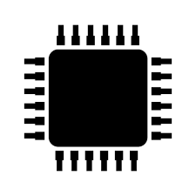
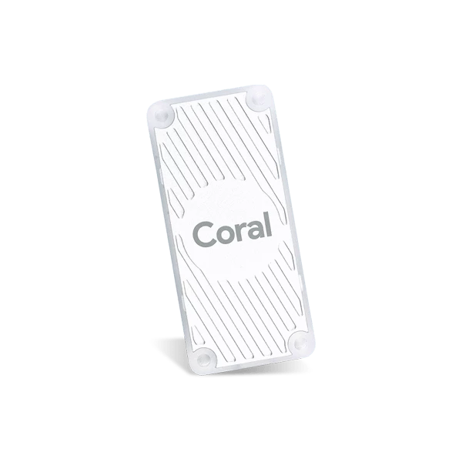

Why Specialized ML Accelerator?
  Edge devices have limited battery and computation budget
Limited Power Budget
Limited Computational Resources
  Specialized accelerators can significantly improve
  inference latency and energy consumption
Apple Neural Engine (A12)
Google Edge TPU
Introduction | TPU and Model Characterization | Mensa Framework | Mensa-G | Evaluation | Conclusion
● ● ● | ● ● ● ● ● ● ● ● ● ● | ● ● ● | ● ● ● ● ● | ● ● | ●
Notes:
[CLICK] But the problem is that, these edge devices, have limited battery and computation budget, and as a result, it becomes very challenging to run resource-intensive ML tasks directly on them.
[CLICK] Thus, industry has started looking at specialized accelerators specifically designed for edge devices to improve inference and energy consumption.
[NEXT]

Slide 7


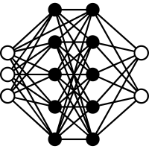


Myriad of Edge Neural Network Models
RNN
Transducers
LSTMs
Speech Recognition
Language Translation
CNN
RCNN
Face Detection
Image Captioning
  Challenge: edge ML accelerators have to execute inference efficiently across a wide variety of NN models
Introduction | TPU and Model Characterization | Mensa Framework | Mensa-G | Evaluation | Conclusion
● ● ● | ● ● ● ● ● ● ● ● ● ● | ● ● ● | ● ● ● ● ● | ● ● | ●
Notes:
[CLICK] At the same time, neural network are evolving rapidly, which has led to all sorts of different models each targeting different applications.
[CLICK] The major challenge is to design an edge accelerator that can efficiently execute inference across a wide variety of NN models
[NEXT]

Slide 8
Outline
1
Introduction
2
Edge TPU and Model Characterization
3
Mensa Framework
4
3
Mensa-G: Mensa for Google Edge Models
5
Evaluation
6
Conclusion
Introduction | TPU and Model Characterization | Mensa Framework | Mensa-G | Evaluation | Conclusion
● ● ● | ● ● ● ● ● ● ● ● ● ● | ● ● ● | ● ● ● ● ● | ● ● | ●
Notes:
Next, I will describe our analysis of various NN models running on the Google edge TPU accelerator
[NEXT]

Slide 9
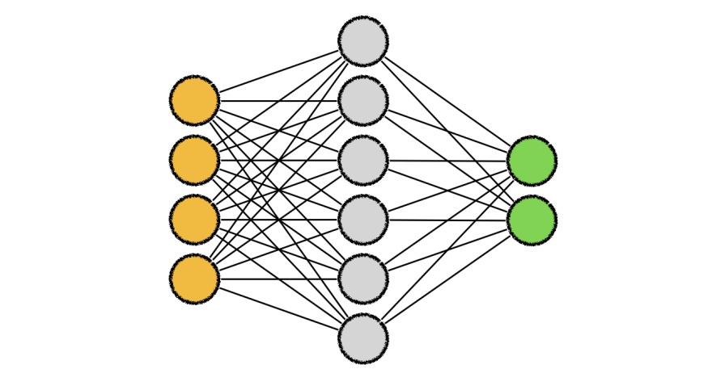
Edge TPU: Baseline Accelerator
*
=
ML Model
Input Activation
Output Activation
Parameter
Dataflow
PE Array
4MB
on-chip buffer
DRAM
Buffer
64x64 array
2TFLOP/s
Introduction | TPU and Model Characterization | Mensa Framework | Mensa-G | Evaluation | Conclusion
● ● ● | ● ● ● ● ● ● ● ● ● ● | ● ● ● | ● ● ● ● ● | ● ● | ●
Notes:
We analyze Google edge models using the Google edge TPU as a baseline accelerator. Edge TPU is systolic-based accelerator with a generic tiled architecture. Here I give you a high level overview of how it works.
[CLICK] The ML model is stored in DRAM.
[CLICK] The model is fetched from DRAM layer by layer.
[CLICK] Each layer includes prameters (i.e., input/ouput data) and activation (i.e., pre-trained weights) for that particular layer
At a high level, the accelerator has 4 key components:
[CLICK[ a PE array to perform multiply and accumulation,
[CLICK] a large SRAM-based on-chip buffer to hold parameters and activations and
[CLICK] a dataflow which specify how parameters and activaitons are mapped to the PE array,
[NEXT]

Slide 10
Google Edge NN Models
  We analyze inference execution using 24 edge NN models
6 RNN
Transducers
2 LSTMs
Speech Recognition
Language Translation
13 CNN
3 RCNN
Google Edge TPU
Face Detection
Image Captioning
Introduction | TPU and Model Characterization | Mensa Framework | Mensa-G | Evaluation | Conclusion
● ● ● | ● ● ● ● ● ● ● ● ● ● | ● ● ● | ● ● ● ● ● | ● ● | ●
Notes:
[CLICK] We analyze inference execution on the accelerator using 24 edge NN models that serve as internal benchmarks for the Google Edge TPU, including
[CLICK] 6 RNN Transducers, used for applications such as automatic speech recognition.
[CLICK] 13 convolutional neural networks (CNNs), typically used for applications such as image classification and object detection
[CLICK] 2 long short-term memories (LSTMs), used for applications such as language translation and and handwriting recognition, and
[CLICK] 3 recurrent convolutional neural networks (RCNNs), used for applications such as image captioning
[NEXT]

Slide 11
Major Edge TPU Challenges
We find that the accelerator suffers from
three major challenges:
1
Operates significantly below its peak throughput
2
Operates significantly below its peak energy efficiency
3
Handles memory accesses inefficiently
Introduction | TPU and Model Characterization | Mensa Framework | Mensa-G | Evaluation | Conclusion
● ● ● | ● ● ● ● ● ● ● ● ● ● | ● ● ● | ● ● ● ● ● | ● ● | ●
Notes:
[CLICK] We found three major challenges faced by the edge TPU accelerator when executing inference for the 24 different models.
The accelerator
[CLICK] Operates significantly below its peak throughput
[CLICK] Operates significantly below is peak energy efficiency
[CLICK] Handles memory accesses inefficiently
I will go into more details on each one of these three challenges next.
[NEXT]

Slide 12
(1) High Resource Underutilization
  We find that the accelerator operates significantly below
  its peak throughput across all models
Peak = 2 TFLOP/s
CNNs and RCNNs:
only 52.2% of peak throughput
LSTMs and Transducers:
less than 1%
of peak throughput
Introduction | TPU and Model Characterization | Mensa Framework | Mensa-G | Evaluation | Conclusion
● ● ● | ● ● ● ● ● ● ● ● ● ● | ● ● ● | ● ● ● ● ● | ● ● | ●
Notes:
[CLICK] First, the accelerator operates below it peak throughput during inference execution
[CLICK] To illustrate such issue, we rely on a roofline model, where the X axis shows the arithmetic intensity of different models, in FLOP/byte, and the Y axis should the achieved throughput in TFLOPs/s. The peak throughput of the edge TPU accelerator is of 2 TFLOPs/s. We make two observations.
[CLICK] First, we observe that Transducer and LSTM models have the greatest underutilization, with both achieving less than 1% of peak throughput
[CLICK] Second, while CNN and RCNN models do somewhat better, they achieve only 52.2% of peak utilization on average
[NEXT]

Slide 13
(2) Low Energy Efficiency
  The accelerator operates far below
  its upper bound energy efficiency
Best CNN model: 50.7% of upper bound energy efficiency
Peak = 1.42 TFLOP/J
LSTMs and Transducers:
33.1% of upper bound energy efficiency
Introduction | TPU and Model Characterization | Mensa Framework | Mensa-G | Evaluation | Conclusion
● ● ● | ● ● ● ● ● ● ● ● ● ● | ● ● ● | ● ● ● ● ● | ● ● | ●
Notes:
[CLICK] Second, we observe that the Edge TPU operates far below its theoretical maximum energy efficiency.
[CLICK] Again, we use a roofline model to illustrate such issue. This time, the Y axis shows the energy of different models while executing inference on the edge TPU accelerator, in TFLOPs/J. The peak energy efficiency of the accelerator is 1.42 TFLOPS/J. We make two observations.
[CLICK] First, the energy efficiency is particularly low (33.1% of the maximum) for LSTM and Transducer models,
[CLICK] Second, even the best CNN model achieves only 50.7% of the maximum efficiency.
[NEXT]

Slide 14
(3) Inefficient Memory Access Handling
  Parameter traffic (off-chip and on-chip) takes
  a large portion of the inference energy and performance
  46% and 31% of total energy goes to off-chip parameter traffic and distributing parameters across PE array
Introduction | TPU and Model Characterization | Mensa Framework | Mensa-G | Evaluation | Conclusion
● ● ● | ● ● ● ● ● ● ● ● ● ● | ● ● ● | ● ● ● ● ● | ● ● | ●
Notes:
[CLICK] Third, we. observe that the memory hierarchy of the edge TPU is not efficient
[CLICK] I illustrate such observation with this figure that shows the energy breakdown of different components of the accelerator architecture while executing inference for different models.
[CLICK] From the figure, we observe that 46% of total energy goes for the off-chip traffic to DRAM and 31% of the total energy consumption goes to distributing parameters across PE array
[NEXT]

Slide 15
Major Edge TPU Challenges
We find that the accelerator suffers from
three major challenges:
1
Operates significantly below its peak throughput
2
Operates significantly below its peak energy efficiency
3
Handles memory accesses inefficiently
  Question: Where do these challenges come from?
Introduction | TPU and Model Characterization | Mensa Framework | Mensa-G | Evaluation | Conclusion
● ● ● | ● ● ● ● ● ● ● ● ● ● | ● ● ● | ● ● ● ● ● | ● ● | ●
Notes:
[CLICK] After identifying such challenges, the next question is from where such challenges come from.
[NEXT]

Slide 16
Model Analysis:
Let’s Take a Deeper Look
Into the Google Edge NN Models
Introduction | TPU and Model Characterization | Mensa Framework | Mensa-G | Evaluation | Conclusion
● ● ● | ● ● ● ● ● ● ● ● ● ● | ● ● ● | ● ● ● ● ● | ● ● | ●
Notes:
To answer this question, we further characterize our NN models
[NEXT]

Slide 17
Diversity Across the Models
Insight 1: there is significant variation in terms of
layer characteristics across the models
Layers from
CNNs and RCNNs
Layers from
LSTMs and Transducers
Introduction | TPU and Model Characterization | Mensa Framework | Mensa-G | Evaluation | Conclusion
● ● ● | ● ● ● ● ● ● ● ● ● ● | ● ● ● | ● ● ● ● ● | ● ● | ●
Notes:
We draw key two insights from our model analysis
[CLICK] First, we observe a large variation in terms of layer characteristics across different models.
[CLICK] To illustrate, the figure shows the total parameter footprint vs. the FLOP/B ratio (or reuse) across the layers of representative CNNs, LSTMs, and Transducers
[CLICK] We observe from the figure that that layers from LSTMs and Transducers have larger parameter footprints and lower reuse than layers from CNNs.
[NEXT]

Slide 18
Diversity Within the Models
Insight 2: even within each model, layers exhibit
significant variation in terms of layer characteristics
For example, our analysis of edge CNN models shows:
1
2
Variation in MAC intensity: up to 200x across layers
Variation in FLOP/Byte: up to 244x across layers
Introduction | TPU and Model Characterization | Mensa Framework | Mensa-G | Evaluation | Conclusion
● ● ● | ● ● ● ● ● ● ● ● ● ● | ● ● ● | ● ● ● ● ● | ● ● | ●
Notes:
[CLICK] Second, even within a single model, layers show variation in terms of layer characteristics
[CLICK] For example, we observe that layers in a single CNN models show
[CLICK] a varying MAC intensity of up to 200x across different layers
and
[CLICK] a varying flop/byte ratio of up to 244x across different layers
[NEXT]

Slide 19
Root Cause of Accelerator Challenges
The key components of Google Edge TPU are completely
oblivious to layer heterogeneity
Dataflow
DRAM
PE Array
Buffer
Off-chip
bandwidth
Edge accelerators typically take a monolithic approach:
equip the accelerator with an over-provisioned PE array and
on-chip buffer, a rigid dataflow, and fixed off-chip bandwidth
  While this approach might work for a specific group of layers, it fails to efficiently execute inference across a wide variety of edge models
Introduction | TPU and Model Characterization | Mensa Framework | Mensa-G | Evaluation | Conclusion
● ● ● | ● ● ● ● ● ● ● ● ● ● | ● ● ● | ● ● ● ● ● | ● ● | ●
Notes:
[CLICK] The main conclusion of our analysis is that the key components of the Edge TPU are oblivious to the layer heterogeneity of different NN models and even within a single NN model
[CLICK] The monolithic design approach of the edge TPU leads to inefficiency and resources under-utilization, since the accelerator design over-provised the size of the PE array and on-chip buffer, while assuming a rigid dataflow and fixed off-chip memory bandwidth
[CLICK] leading to the three accelerator challenges related to performance, energy and memory we identified in our analysis
[NEXT]

Slide 20
Outline
1
Introduction
2
Edge TPU and Model Characterization
3
Mensa Framework
4
3
Mensa-G: Mensa for Google Edge Models
5
Evaluation
6
Conclusion
Introduction | TPU and Model Characterization | Mensa Framework | Mensa-G | Evaluation | Conclusion
● ● ● | ● ● ● ● ● ● ● ● ● ● | ● ● ● | ● ● ● ● ● | ● ● | ●
Notes:
Next, I will describe our proposal to cope with such issues
[NEXT]

Slide 21
Mensa Framework
  Goal: design an edge accelerator that can efficiently run
  inference across a wide range of different models and layers
  Instead of running the entire NN model on
  a monolithic accelerator:
1
  Mensa: a new acceleration framework for edge NN inference
2
Introduction | TPU and Model Characterization | Mensa Framework | Mensa-G | Evaluation | Conclusion
● ● ● | ● ● ● ● ● ● ● ● ● ● | ● ● ● | ● ● ● ● ● | ● ● | ●
Notes:
[CLICK] Based on our analysis and insights, the goal of our work is to design an edge NN accelerator that can efficiently run inference across a varying number of different models and layers.
[CLICK] To this end, instead of designing a one-size-fit-all monolithic accelerator
[CLICK] We propose Mensa, a new acceleration framework for NN inference
[NEXT]

Slide 22
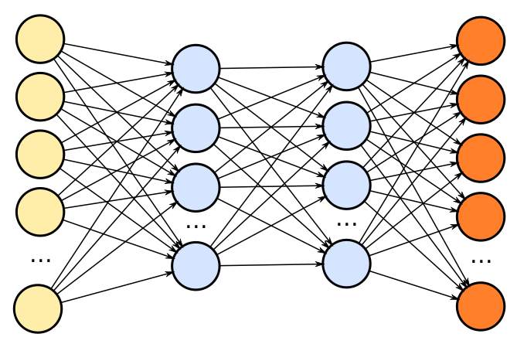
Mensa High-Level Overview
Edge TPU Accelerator
Mensa
Model A
Model B
Model C
Model A
Model B
Model C
Runtime
Family 1
Family 2
Family 3
PE
PE
PE
PE
PE
PE
PE
PE
PE
PE
PE
PE
PE
PE
PE
PE
Buffer
PE
PE
PE
PE
PE
PE
PE
PE
NoC
PE
PE
PE
PE
PE
PE
PE
PE
PE
PE
PE
PE
PE
PE
PE
PE
PE
PE
PE
PE
PE
PE
PE
PE
PE
PE
PE
PE
PE
PE
PE
PE
Buffer
PE
PE
PE
PE
PE
PE
PE
PE
Buffer
PE
PE
PE
PE
PE
PE
PE
PE
Buffer
PE
PE
PE
PE
PE
PE
PE
PE
PE
PE
PE
PE
PE
PE
PE
PE
PE
PE
PE
PE
PE
PE
PE
PE
PE
PE
PE
PE
PE
PE
PE
PE
PE
PE
PE
PE
PE
PE
PE
PE
NoC
NoC
NoC
PE
PE
PE
PE
PE
PE
PE
PE
PE
PE
PE
PE
PE
PE
PE
PE
PE
PE
PE
PE
PE
PE
PE
PE
PE
PE
PE
PE
PE
PE
PE
PE
PE
PE
PE
PE
PE
PE
PE
PE
PE
PE
PE
PE
PE
PE
PE
PE
Monolithic Accelerator
PE
PE
PE
PE
PE
PE
PE
PE
PE
PE
PE
PE
PE
PE
PE
PE
PE
PE
PE
PE
PE
PE
PE
PE
PE
PE
PE
PE
PE
PE
PE
PE
PE
PE
PE
PE
PE
PE
PE
PE
PE
PE
PE
PE
PE
PE
PE
PE
PE
PE
PE
PE
PE
PE
PE
PE
PE
PE
PE
PE
PE
PE
PE
PE
PE
PE
PE
PE
PE
PE
PE
PE
PE
PE
PE
PE
PE
PE
PE
PE
PE
PE
PE
PE
PE
PE
PE
PE
PE
PE
PE
PE
PE
PE
PE
PE
Acc. 1
Acc. 2
Acc. 3
Introduction | TPU and Model Characterization | Mensa Framework | Mensa-G | Evaluation | Conclusion
● ● ● | ● ● ● ● ● ● ● ● ● ● | ● ● ● | ● ● ● ● ● | ● ● | ●
Notes:
[CLICK ] In a baseline system, different machine learning models are execute in a single, monolithic edge accelerator, which leads to performance and energy issues.
[CLICK] On the other hand, Mensa distributes the layers from an NN model using a runtime scheduler across a collection of smaller hardware accelerators that are catered the properties of different layer types. By specializing each accelerator to a subset of layers, Mensa avoids the shortcomings of current monolithic edge ML accelerators, resulting in a highly-efficient and high-performance accelerator with a much smaller area.
Next I will give an brief overview of Mensa’s ruy
[NEXT]

Slide 23

Mensa Runtime Scheduler
  The goal of Mensa’s software runtime scheduler is to identify which accelerator each layer in an NN model should run on
Generated once
during initial setup
of a system
NN model
Accelerator characteristics
Scheduler
Layer
Mapping
Layer
characteristics
Each of the accelerators
caters to
a specific family of layers
Layers tend to group
together into a small
number of families
Introduction | TPU and Model Characterization | Mensa Framework | Mensa-G | Evaluation | Conclusion
● ● ● | ● ● ● ● ● ● ● ● ● ● | ● ● ● | ● ● ● ● ● | ● ● | ●
Notes:
[CLICK] The goal of Mensa’s software runtime scheduler is to identify which accelerator each layer in an NN model should run on. It works as follows
[CLICK] The scheduler gets a NN model as an input.
[CLICK] It also has two other pieces of information: (1) the characteristics of each layer; and (2) the key characteristics of the available hardware accelerators.
[CLICK] As I will show next, different layers tend to group into a smaller set of layer families with sharing key properties
[CLICK] In this way we can have a small pool of edge accelerators where each accelerator caters to a specific family of layers
[CLICK] We collect the characteristics of the accelerators and layers once prior to inference execution
[CLICK] With all this information, the scheduler generates a per-layer mapping between layers and accelerators by utilizing a mapping heuristic.
[NEXT].

Slide 24
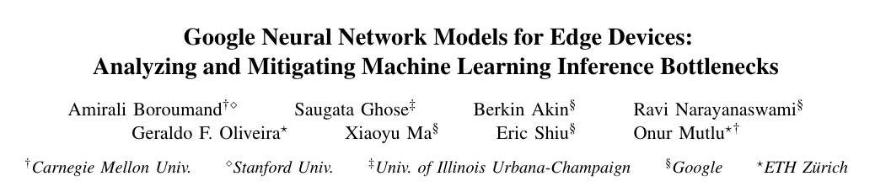
Mensa Runtime Scheduler
  The goal of Mensa’s software runtime scheduler is to identify which accelerator each layer in an NN model should run on
Generated once
during initial setup
of a system
NN model
Accelerator characteristics
Scheduler
Layer
Mapping
Layer
characteristics
Each of the accelerators
caters to
a specific family of layers
Layers tend to group
together into a small
number of families
Introduction | TPU and Model Characterization | Mensa Framework | Mensa-G | Evaluation | Conclusion
● ● ● | ● ● ● ● ● ● ● ● ● ● | ● ● ● | ● ● ● ● ● | ● ● | ●
Notes:
[We invite you to check our paper for more details about our scheduling heuristics.
[NEXT].

Slide 25
Outline
1
Introduction
2
Edge TPU and Model Characterization
3
Mensa Framework
4
3
Mensa-G: Mensa for Google Edge Models
5
Evaluation
6
Conclusion
Introduction | TPU and Model Characterization | Mensa Framework | Mensa-G | Evaluation | Conclusion
● ● ● | ● ● ● ● ● ● ● ● ● ● | ● ● ● | ● ● ● ● ● | ● ● | ●
Notes:
We highlight how our Mensa framework can be employed in practice by proposing Mensa-G, which targets Google Edge NN models
[NEXT]

Slide 26
Identifying Layer Families
  Key observation: the majority of layers group into
  a small number of layer families
Family 1
Family 1
Family 2
Family 5
Family 2
Family 4
Family 5
Family 3
Family 3
Family 4
  Families 1 & 2: low parameter footprint, high data reuse and MAC intensity
  → compute-centric layers
  Families 3, 4 & 5: high parameter footprint, low data reuse and MAC intensity
  → data-centric layers
Introduction | TPU and Model Characterization | Mensa Framework | Mensa-G | Evaluation | Conclusion
● ● ● | ● ● ● ● ● ● ● ● ● ● | ● ● ● | ● ● ● ● ● | ● ● | ●
Notes:
First, we need to decide how many accelerators we need based on the key characteristics of our NN models.
[CLICK] We make a key observation that the majority of the layers we target fall into five major families in terms key characteristics that impact hardware design
[CLICK] First, we find two Families of layers (families 1 and 2) that have low parameter footprint and high data reuse and MAC intensity. We call such layers compute-centric layers.
[CLICK] Second, we find three families of layers (families, 3, 4 and 5) that have high parameter footprint , low data reuse and MAC intensity. We call such layers data-centric layers.
[NEXT]

Slide 27
Mensa-G: Mensa for Google Edge Models
Based on key characteristics of families, we design three accelerators to efficiently execute inference across our Google NN models
Pascal
Act. Buffer
Param. Buffer
32x32
PE Array
DRAM
32 GB/s
Pavlov
Act. Buffer
DRAM
8x8
PE Array
256 GB/s
Jacquard
Act. Buffer
Param. Buffer
16x16
PE Array
DRAM
256 GB/s
Introduction | TPU and Model Characterization | Mensa Framework | Mensa-G | Evaluation | Conclusion
● ● ● | ● ● ● ● ● ● ● ● ● ● | ● ● ● | ● ● ● ● ● | ● ● | ●
Notes:
[CLICK] Based on the key characteristics of the 24 NN models and their layers, we design three specialized accelerators
[CLICK] Pascal
[CLICK] Pavlov
[CLICK] And Jacquard
I will give a brief overview about each accelerator next .
[NEXT]

Slide 28
Mensa-G: Mensa for Google Edge Models
Based on key characteristics of families, we design three accelerators to efficiently execute inference across our Google NN models
Pascal
Families 1&2 → compute-centric layers
- 32x32 PE Array → 2 TFLOP/s
- 256KB Act. Buffer → 8x Reduction
- 128KB Param. Buffer → 32x Reduction
- On-chip accelerator
Act. Buffer
Param. Buffer
32x32
PE Array
DRAM
32 GB/s
Pavlov
Act. Buffer
DRAM
8x8
PE Array
256 GB/s
Jacquard
Act. Buffer
Param. Buffer
16x16
PE Array
DRAM
256 GB/s
Introduction | TPU and Model Characterization | Mensa Framework | Mensa-G | Evaluation | Conclusion
● ● ● | ● ● ● ● ● ● ● ● ● ● | ● ● ● | ● ● ● ● ● | ● ● | ●
Notes:
[CLICK] So here is Pascal
[CLICK] Pascal is a compute-centric accelerators that is designed for the compute-centric layers of families 1 and 2
[CLICK] It has a 32x32 PE array since layers from Families 1 and 2 perform a large number of MAC operations, so we want to size Pascal’s PE array to efficiently perform these in parallel.
[CLICK] We reduce the size of the activation buffer in Pascal from 2 MB in the Edge TPU to 256 kB in Pascal. This reduction is possible due to our specialized dataflow design for Pascal.
[CLICK] We reduce the size of the parameter buffer from 4 MB in the Edge TPU to 128 kB in Pascal, because layers in Families 1 and 2 have small parameter footprints.
[CLICK] Given the low off-chip memory bandwidth requirements of Pascal, we keep the accelerator on the CPU die.
[NEXT]

Slide 29
Mensa-G: Mensa for Google Edge Models
Based on key characteristics of families, we design three accelerators to efficiently execute inference across our Google NN models
Pascal
Families 1&2 → compute-centric layers
- 32x32 PE Array → 2 TFLOP/s
- 256KB Act. Buffer → 8x Reduction
- 128KB Param. Buffer → 32x Reduction
- On-chip accelerator
Act. Buffer
Param. Buffer
32x32
PE Array
DRAM
32 GB/s
Pavlov
Family 3 → LSTM data-centric layers
- 8x8 PE Array → 128 GFLOP/s
- 128KB Act. Buffer → 16x Reduction
- No Param. Buffer → 4MB in Baseline
- Near-data accelerator
Act. Buffer
DRAM
8x8
PE Array
256 GB/s
Jacquard
Act. Buffer
Param. Buffer
16x16
PE Array
DRAM
256 GB/s
Introduction | TPU and Model Characterization | Mensa Framework | Mensa-G | Evaluation | Conclusion
● ● ● | ● ● ● ● ● ● ● ● ● ● | ● ● ● | ● ● ● ● ● | ● ● | ●
Notes:
[CLICK] Next we have Pavlov. Pavlov caters to layers in Family 3, which are data-centric and mainly consist of data-centric LSTM layers.
[CLICK] Because Family 3 layers have low MAC intensity, and mainly perform matrix-vector multiplications, we design a much smaller PE array for Pavlov than that in the Google Edge TPU. We empirically choose an 8x8 array size to balance latency, utilization, and energy.
[CLICK] Due to the small activation footprint of layers in Family 3, we use a 128 kB buffer for parameters .
[CLICK] while our dataflow design for Pavlov allows us to eliminate the parameter buffer and stream parameters directly from DRAM.
[CLICK] We decide to place Pavlov inside the memory device to accommodate the large off-chip memory bandwidth requirements of Family 3 layers.
[NEXT]

Slide 30
Mensa-G: Mensa for Google Edge Models
Based on key characteristics of families, we design three accelerators to efficiently execute inference across our Google NN models
Pascal
Families 1&2 → compute-centric layers
- 32x32 PE Array → 2 TFLOP/s
- 256KB Act. Buffer → 8x Reduction
- 128KB Param. Buffer → 32x Reduction
- On-chip accelerator
Act. Buffer
Param. Buffer
32x32
PE Array
DRAM
32 GB/s
Pavlov
Family 3 → LSTM data-centric layers
- 8x8 PE Array → 128 GFLOP/s
- 128KB Act. Buffer → 16x Reduction
- No Param. Buffer → 4MB in Baseline
- Near-data accelerator
Act. Buffer
DRAM
8x8
PE Array
256 GB/s
Jacquard
Families 4&5 → non-LSTM data-centric layers
-16x16 PE Array → 256 GFLOP/s
-128KB Act. Buffer → 16x Reduction
-128KB Param. Buffer → 32x Reduction
- Near-data accelerator
Act. Buffer
Param. Buffer
16x16
PE Array
DRAM
256 GB/s
Introduction | TPU and Model Characterization | Mensa Framework | Mensa-G | Evaluation | Conclusion
● ● ● | ● ● ● ● ● ● ● ● ● ● | ● ● ● | ● ● ● ● ● | ● ● | ●
Notes:
[CLICK] Finally, we have Jacquard, which caters to layers in Families 4 and 5 that are primarily non-LSTM data-centric layers.
[CLICK] While layers in Families 4 and 5 have low MAC intensity, they perform more MAC operations on average than Family 3 layers. Because of that, we empirically select a 16x16 PE array in Jacquard.
[CLICK] We use a 128KB buffer for activations
[CLICK] and a 128 KB buffer for parameters in Jacquard
[CLICK] Similar to Pavlov, we place Jacquard inside the memory due to the high memory bandwidth demand of layers in Families 4 and 5.
[NEXT]

Slide 31
Mensa-G: Mensa for Google Edge Models
Based on key characteristics of families, we design three accelerators to efficiently execute inference across our Google NN models
Pascal
Families 1&2 → compute-centric layers
- 32x32 PE Array → 2 TFLOP/s
- 256KB Act. Buffer → 8x Reduction
- 128KB Param. Buffer → 32x Reduction
- On-chip accelerator
Act. Buffer
Param. Buffer
32x32
PE Array
DRAM
32 GB/s
Pavlov
Family 3 → LSTM data-centric layers
- 8x8 PE Array → 128 GFLOP/s
- 128KB Act. Buffer → 16x Reduction
- No Param. Buffer → 4MB in Baseline
- Near-data accelerator
Act. Buffer
DRAM
8x8
PE Array
256 GB/s
Jacquard
Families 4&5 → non-LSTM data-centric layers
-16x16 PE Array → 256 GFLOP/s
-128KB Act. Buffer → 16x Reduction
-128KB Param. Buffer → 32x Reduction
- Near-data accelerator
Act. Buffer
Param. Buffer
16x16
PE Array
DRAM
256 GB/s
Introduction | TPU and Model Characterization | Mensa Framework | Mensa-G | Evaluation | Conclusion
● ● ● | ● ● ● ● ● ● ● ● ● ● | ● ● ● | ● ● ● ● ● | ● ● | ●
Notes:
We invite you to check our paper for more details about the accelerators, their design and specialized dataflows.

Slide 32
Outline
1
Introduction
2
Edge TPU and Model Characterization
3
Mensa Framework
4
3
Mensa-G: Mensa for Google Edge Models
5
Evaluation
6
Conclusion
Introduction | TPU and Model Characterization | Mensa Framework | Mensa-G | Evaluation | Conclusion
● ● ● | ● ● ● ● ● ● ● ● ● ● | ● ● ● | ● ● ● ● ● | ● ● | ●
Notes:
Finally, we provide a brief overview of our evaluations

Slide 33
Energy Analysis
Baseline Google Edge TPU accelerator
Baseline Google Edge TPU accelerator
using a high-bandwidth off-chip memory
Introduction | TPU and Model Characterization | Mensa Framework | Mensa-G | Evaluation | Conclusion
● ● ● | ● ● ● ● ● ● ● ● ● ● | ● ● ● | ● ● ● ● ● | ● ● | ●
Notes:
[CLICK] We analyze the inference energy of our Mensa-G proposal against the
[CLICK] baseline edge TPU accelerator and
[CLICK] the baseline edge TPU using a high-bandwidth off-chip memory device as its main memory.
In the plot, values are normalized to the baseline edge TPU system. We draw the following observations
[NEXT]

Slide 34
Energy Analysis
Mensa-G lowers on-chip/off-chip parameter traffic energy by 15.3x by scheduling layers on the accelerator with the most appropriate dataflow and memory bandwidth
Mensa-G reduces the dynamic energy of the on-chip buffer and NoC by 49.8x over Base+HB by avoiding overprovisioning and catering to specialized dataflows
Mensa-G improves energy efficiency by 3.0X
compared to the Baseline
Introduction | TPU and Model Characterization | Mensa Framework | Mensa-G | Evaluation | Conclusion
● ● ● | ● ● ● ● ● ● ● ● ● ● | ● ● ● | ● ● ● ● ● | ● ● | ●
Notes:
[CLICK] Fist, Mensa-G placement of accelerators and careful dataflow design enables to reduce the energy consumed by on-chip and off-chip parameter traffic by 15.3x on average compared to the baseline.
[CLICK] Second, Mensa-G reduces the dynamic energy of on-chip buffers and Noc by almost 50x compared to the Baseline system with high bw memory.
[CLICK] We conclude that Mensa-G reduces energy by 66% and improves inference energy efficiency by 3.0x compared to the baseline edge TPU.
[NEXT]

Slide 35
Throughput Analysis
Mensa-G improves throughput by 3.1X
compared to the Baseline
Introduction | TPU and Model Characterization | Mensa Framework | Mensa-G | Evaluation | Conclusion
● ● ● | ● ● ● ● ● ● ● ● ● ● | ● ● ● | ● ● ● ● ● | ● ● | ●
Notes:
[CLICK] We also analyze Mensa-G’s throughput compared to the Baseline edge TPU and Baseline edge TPU with the high bandwidth off-chip memory
[CLICK] We observe that Mensa-G’s improve throughput compared to the baseline edge TPU by 3.1X on average
[NEXT]

Slide 36
More in the Paper
Details about Mensa Runtime Scheduler
Details about Pascal, Pavlov, and Jacquard’s dataflows
Energy comparison with Eyeriss v2
Mensa-G’s utilization results
Mensa-G’s inference latency results
Introduction | TPU and Model Characterization | Mensa Framework | Mensa-G | Evaluation | Conclusion
● ● ● | ● ● ● ● ● ● ● ● ● ● | ● ● ● | ● ● ● ● ● | ● ● | ●
Notes:
We invite you to check our paper for more details on
[CLICK] Mensa runtime scheduler
[CLICK] our accelerator’s dataflows
[CLICK] comparison against prior state-of-the-art edge NN accelerators
[CLICK] Mensa-G’s utilization results
[CLICK] and Mensa-G’s inference latency results
[NEXT]

Slide 37
More in the Paper
Details about Mensa Runtime Scheduler
Details about Pascal, Pavlov, and Jacquard’s dataflows
Energy comparison with Eyeriss v2
Mensa-G’s utilization results
Mensa-G’s inference latency results
Introduction | TPU and Model Characterization | Mensa Framework | Mensa-G | Evaluation | Conclusion
● ● ● | ● ● ● ● ● ● ● ● ● ● | ● ● ● | ● ● ● ● ● | ● ● | ●

Slide 38
Outline
1
Introduction
2
Edge TPU and Model Characterization
3
Mensa Framework
4
3
Mensa-G: Mensa for Google Edge Models
5
Evaluation
6
Conclusion
Introduction | TPU and Model Characterization | Mensa Framework | Mensa-G | Evaluation | Conclusion
● ● ● | ● ● ● ● ● ● ● ● ● ● | ● ● ● | ● ● ● ● ● | ● ● | ●
Notes:
Next, we conclude our talk.

Slide 39
Conclusion
Context: We extensively analyze a state-of-the-art edge ML accelerator (Google Edge TPU) using 24 Google edge models
  Wide range of models (CNNs, LSTMs, Transducers, RCNNs)
Problem: The Edge TPU accelerator suffers from three challenges:
  It operates significantly below its peak throughput
  It operates significantly below its theoretical energy efficiency
  It inefficiently handles memory accesses
  Key Insight: These shortcomings arise from the monolithic design of the Edge TPU accelerator
  The Edge TPU accelerator design does not account for layer heterogeneity
  Key Mechanism: A new framework called Mensa
  Mensa consists of heterogeneous accelerators whose dataflow and hardware are specialized for specific families of layers
  Key Results: We design a version of Mensa for Google edge ML models
  Mensa improves performance and energy by 3.0X and 3.1X
  Mensa reduces cost and improves area efficiency
Introduction | TPU and Model Characterization | Mensa Framework | Mensa-G | Evaluation | Conclusion
● ● ● | ● ● ● ● ● ● ● ● ● ● | ● ● ● | ● ● ● ● ● | ● ● | ●
Notes:
[CLICK] In this work, we extensively analyze 24 edge NN models from Google while running inference on the Google Edge TPU accelerator for various types of NN models
[CLICK] We identify that while running NN inference, the accelerator suffers from three main challenges
[CLICK] it operates significantly below its peak throughput
[CLICK] it operates significantly below its theorical peak energy efficiency
[CLICK] and its memory system is not efficient
[CLICK] Our analysis leads to the key insight that these challenges arrive due to the monolithic one-size-fit-all design of the accelerators, which does not account for heterogeneity across different NN layers
[CLICK] To solve this issue, we propose Mensa, a framework that maps the execution of a particular NN layer to its most appropriate hardware accelerator
[CLICK] We extensively evaluate Mensa for Google NN models and we observe that it improves performance and energy efficiency by 3.0x and 3.1x compared to the baseline Edge TPU accelerator while reducing area and cost across 24 edge ML models
[NEXT]

Slide 40
Google Neural Network Models for Edge Devices:
Analyzing and Mitigating
Machine Learning Inference Bottlenecks
Amirali Boroumand Saugata Ghose Berkin Akin
Ravi Narayanaswami Geraldo F. Oliveira Xiaoyu Ma
Eric Shiu Onur Mutlu
PACT 2021
Notes:
Thanks for listening

