Slide 1





HARP: Practically and Effectively Identifying Uncorrectable Errors in Memory Chips
That Use On-Die Error-Correcting Codes
Minesh Patel, Geraldo F. Oliveira, Onur Mutlu
https://arxiv.org/abs/2109.12697
https://github.com/CMU-SAFARI/HARP
Notes:
Hi, I’m Minesh, and today I will introduce our work HARP, which was done at ETH Zürich by the SAFARI research group.

Slide 2
HARP Summary
Motivation: state-of-the-art memory error mitigations often require the processor to identify which bits are at risk of error (i.e., profiling)
Problem: on-die ECC complicates error profiling by altering how errors appear outside of the memory chip
Goal: understand and address the challenges on-die ECC introduces
Contributions:
  ​Analytically study on-die ECC’s effects and identify three key challenges
    Exponentially increases the number of at-risk bits
    Makes individual at-risk bits harder to identify
    Interferes with commonly-used memory data patterns
  ​Hybrid Active-Reactive Profiling (HARP):
    Separately identifies (1) raw bit errors and (2) errors introduced by on-die ECC
    Effectively reduces profiling with on-die ECC into profiling without on-die ECC
Evaluation: demonstrate that HARP overcomes the three challenges
HARP identifies all errors faster than two baselines, which sometimes fail to achieve full coverage of at-risk bits
Case study showing that HARP identifies all errors faster than the best-performing baseline (e.g., by 3.7x for a raw per-bit error probability of 0.75)
https://github.com/CMU-SAFARI/HARP
Notes:
I will start off with a high-level summary of this talk
[CLICK] Our motivation for this work is that…
…
[CLICK] All of our artifacts are open-sourced on GitHub at the link shown on the slide.

Slide 3
HARP Outline
Memory Error Mitigation and Profiling
On-Die ECC’s Impact on Error Profiling
HARP: Practical and Effective Profiling
Evaluations
Conclusion and Takeaways
Notes:
Here’s an outline of my talk about HARP. We’ll start with some background on memory errors, mitigation, and profiling [CLICK]

Slide 4
Scaling-Related Memory Errors
Density scaling increases memory error rates
Data Retention
Write Recovery
Variable
Retention Time
shrinking capacitance
increasing bitline and contact resistances
shrinking capacitance
worsening leakage
worsening leakage
Uncorrelated single-bit errors are the primary challenge with continued DRAM process scaling
Notes:
Let’s take a look at scaling-related memory errors
[CLICK] As manufacturers scale storage densities, various error mechanisms cause memory error rates to increase
[CLICK] Here are three example scaling-related errors from DRAM, which occur for various circuit-level reasons
[CLICK] The key point I want to make here is that each of these error mechanisms manifests as uncorrelated, single bit errors
And these represent the primary challenge for continued DRAM technology scaling today
[CLICK]

Slide 5
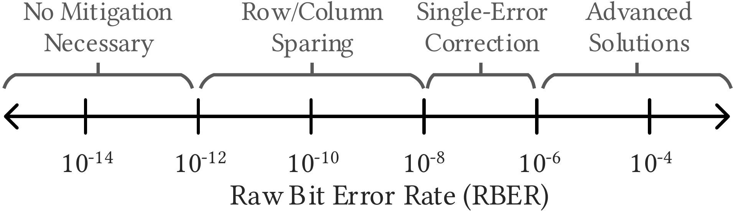
Increasing Single-Bit Error Rates
Higher error rates require more sophisticated solutions
Past
Present
Near Future
On-Die ECC
??
Reproduced from prior work [Kline+,HPCA’20], [Nair+,ISCA’13]
Notes:
[CLICK] As error rates continue to increase, we need more sophisticated error-mitigation solutions
[CLICK] Here is an illustration of the types of error mitigation mechanisms that are suitable at different error rates
[CLICK] In the past, error rates have been low enough such that no mitigation was needed or simple mechanisms such as row and column sparing sufficed.
[CLICK] Today, manufacturers are using on-die ECC to mitigate moderate error rates
[CLICK] In the near future, prior works project that advanced solutions will be necessary to manage high error rates, up to and exceeding 10^-4
Let’s take a look at some examples of advanced solutions
[CLICK]

Slide 6
Error Mitigation at High Error Rates
Large research space
Software
In-Processor
In-Memory
Bit-Repair Mechanisms
Page retirement
Task replication
Application fault tolerance
…
Bit-Repair Mechanisms
Error Correcting Codes
Checkpoint + recovery
…
Row/Column Sparing
On-Die ECC
…
state-of-the-art
for addressing
scaling-related errors
Cost and efficiency depend on error characteristics
Notes:
[CLICK] Error mitigation is a large research space with solutions spanning the entire system stack
[CLICK] Here are some example mitigation techniques in the software
[CLICK] In the processor
[CLICK] and within the memory die itself
[CLICK] Which mechanism is most appropriate depends on the particular error characteristics of the errors that need to be mitigated
[CLICK] We focus on bit repair mechanisms that operate within the processor.
These mechanisms are state-of-the-art for addressing memory scaling related errors at high error rates.

Slide 7
Memory Repair Mechanisms
Identify and repair any bits that are at-risk of error
Memory Controller
Unreliable Memory
Repair Mechanism
Error-Prone
Data Store
write data
write data
To/from CPU
Error Profile
repaired
read data
read data
Must know which bits are at-risk
Determined through
“Error Profiling”
Notes:
Let’s take a closer look at repair mechanisms
[CLICK] These mechanisms first identify, then repair any bits that are at risk of error
[CLICK] Here we have a picture of a system that uses a repair mechanism.
We have an unreliable memory and a memory controller that contains the repair mechanism.
The repair mechanism itself repairs any bits marked within an error profile, which is essentially a list of at-risk bits.
[CLICK] When the CPU performs a write operation, the data is written through the repair mechanism.
[CLICK] When the CPU performs a read operation, the data is first repaired before being returned.
[CLICK] However, the repair mechanism can only repair bits that it knows are at-risk of error.
As a consequence, the repair mechanism is dependent on identifying at-risk bits
[CLICK] This process is known as error profiling.
Now let’s look at how profiling is done

Slide 8
Error Profiling Algorithms
Active
Induce worst-case conditions
Profiler
Type?
Check for errors
Passively monitor the memory chip
Reactive
Mark erroneous
bits as at-risk
Repeat until all at-risk bits identified
Notes:
There are two major types of profilers
[CLICK] known as active and reactive profilers.
Active profilers deliberately induce worst-case operating conditions to make errors more likely to appear.
In contrast, reactive profilers passively monitor the memory chip to capture errors that occur during runtime.
[CLICK] Regardless of the approach, both profilers check for errors that occur
[CLICK] And mark any erroneous bits discovered as at-risk of error
[CLICK] This process repeats until all at-risk bits are identified
[CLICK]

Slide 9
Error Profiling
Induce worst-case conditions
requires observing
at-risk bits fail
Active
Profiler
Type?
Check for errors
Passively monitor the memory chip
Reactive
Mark erroneous
bits as at-risk
Repeat until all at-risk bits identified
Notes:
However, this process depends on observing an at-risk bit fail so that it can be marked as such.
[CLICK]

Slide 10
Profiling a Memory Chip with On-Die ECC
On-die ECC changes how errors appear to the profiler
Q: How does on-die ECC
affect error profiling?
Unreliable Memory
Profiler
On-Die
ECC
Error-Prone
Data Store
write data
read data
Goal: understand and address the challenges
that on-die ECC introduces for error profiling
Notes:
Unfortunately, on-die ECC introduces a new complication for profiling in modern memory chips
[CLICK] This is because on-die ECC changes how errors appear to the profiler
[CLICK] Here is a diagram showing how on-die ECC interferes with profiling
[CLICK] As the profiler reads and writes data, on-die ECC interposes between the profiler and the data store, and we want to know what effect on-die ECC has
[CLICK] Therefore, our goal in this work is to ….

Slide 11
HARP Outline
Memory Error Mitigation and Profiling
On-Die ECC’s Impact on Error Profiling
HARP: Practical and Effective Profiling
Evaluations
Conclusion and Takeaways
Notes:
Now, let’s talk about on-die ECC’s impact on error profiling

Slide 12
Profiling a Memory Chip
Profiler’s goal: identify all bits that are at risk of error
Profiler cannot see into the memory
Memory Chip
(Without On-Die ECC)
Memory Chip
(With On-Die ECC)
Data Store
Data Store
raw data
On-Die ECC
raw data
post-correction data
Profiler marks the bits
that are observed to fail
Notes:
Here I will illustrate a memory chip with and without on-die ECC
[CLICK] A profiler’s goal is to identify all bits that are at risk of error.
[CLICK] In a memory chip without on-die ECC, the data observed outside of the DRAM chip is the same as the raw data in the data store
[CLICK] For a chip with on-die ECC, post-correction data is observed, which is not necessarily the same as the raw data within the memory chip
[CLICK] In either case, the profiler cannot see directly into the memory
[CLICK] Instead, the profiler simply observes errors at the interface and declares those bits to be at risk of error, regardless of what occurs within the memory itself

Slide 13

Error Profiling Without On-die ECC
Only one source of errors: when the physical bit fails
Memory Chip
E
  Error
E
E
-
-
  No Error
“Direct” error
-
Same errors inside
and outside of the chip
E
E
-
-
Profiler identifies these bits
error profile = $union(\text{direct} \text{errors})$
Notes:
Let’s examine each case individually in more detail
[CLICK] Without on-die ECC, there is only one source of errors: when the physical bit fails
[CLICK] We refer to this as a ‘Direct” error because the observed error at the interface is caused by the underlying bit failing
[CLICK] In this example, the profiler observes two errors and identifies these bits to be at risk
[CLICK] Therefore, the error profile is calculated simply as the union of all direct errors observed

Slide 14
Error Profiling With On-Die ECC
Two different sources of errors
Memory Chip
E
  Error
  data
  metadata
  No Error
E
-
-
-
-
E
E
-
On-Die ECC
  systematic encoding
Direct error
Indirect error
E
-
E
-
Appears before and after error correction
Occurs when on-die ECC
mistakenly corrects a bit
Profiler identifies these bits
error profile = $union(\text{direct} \text{errors}\text{,} \text{indirect} \text{errors})$
Notes:
With on-die ECC,
[CLICK] There are now two sources of errors
[CLICK] Here is a memory chip that uses on-die ECC.
[CLICK] Note that we assume a systematic encoding, which means that data bits are preserved as-is by the encoding process, and additional metadata bits are added alongside.
Here, three errors occur: one in the data bits and two in the metadata bits.
[CLICK] For sake of example, let’s suppose that the profiler observes only two errors at the memory interface
[CLICK] We categorize these differently.
The first is a direct error, which appears before and after error correction. This is the same as we saw previously in the case without on-die ECC
[CLICK] The second is what we call an “indirect error”, which occurs as a result of on-die ECC’s undefined behavior when faced with uncorrectable errors.
Note that the corresponding data bit at the position of the indirect error did not fail
[CLICK] Here, the profiler identifies two bits to be at risk
[CLICK] Therefore, the error profile is now calculated as the union of all direct and indirect errors observed

Slide 15
A Closer Look at Indirect Errors
Indirect errors depend on the raw bit error pattern
  data
  metadata
X
  At Risk
X
-
-
-
-
X
X
  Not at risk
-
P1
P2
E
-
-
-
-
E
E
E
-
-
-
-
E
-
Pre-correction
On-Die ECC
On-Die ECC
Post-correction
E
-
E
-
E
-
-
E
Direct error
(same position)
Indirect error
(different positions)
Notes:
Let’s zoom in on indirect errors
[CLICK] Indirect errors depend on the particular raw bit error pattern that occurs
[CLICK] Here we have the same example as the previous slide, with three bits at risk of error
[CLICK] Let’s take a look at two example raw bit error patterns, P1 and P2
Note that both are uncorrectable error patterns for a single-error correcting ECC
[CLICK] We refer to these as pre-correction error patterns, in contrast to post-correction error patterns after on-die ECC correction
[CLICK] Let’s suppose that after on-die ECC correction, both P1 and P2 exhibit two post-correction errors
[CLICK] The leftmost error in each pattern is a direct error, which occurs in the same position
[CLICK] However, the rightmost error is an indirect error, whose position depends on the particular raw bit error pattern that happened to occur

Slide 16
A Closer Look at Indirect Errors
Indirect errors depend on the raw bit error pattern
Key observation:
Any bit can be at-risk of indirect errors
with different combinations of raw bit errors
  data
  metadata
X
  At Risk
X
-
-
-
-
X
X
  Not at risk
-
P1
P2
E
-
-
-
-
E
E
E
-
-
-
-
E
-
Pre-correction
On-Die ECC
On-Die ECC
On-die ECC causes statistical dependence between otherwise independent bits
Post-correction
E
-
E
-
E
-
-
E
Same position
Different positions
Notes:
In general, we observe that ANY BIT can be at-risk of INDIRECT ERRORS through different combinations of raw bit errors.
[CLICK] This means that on-die ECC introduces statistical dependence between otherwise independent bits.

Slide 17
Challenges Introduced by On-Die ECC
  Exponentially increases the at-risk bits
1
A small set of raw bit errors creates a combinatorially larger set of at-risk post-correction bits
  Harder to observe each at-risk bit
2
At-risk post-correction bits can only be exposed by specific raw bit error patterns
  Interferes with data patterns
³
Data patterns must consider combinations of raw bits instead of just individual bits alone
Notes:
Because of this, we identify three key challenges that on-die ECC introduces for error profiling
[CLICK] First, on-die ECC exponentially increases the number of at-risk bits the profiler must identify
This is because a small set of raw bit errors can give rise to a combinatorially larger set of post-correction errors
[CLICK] Second, on-die ECC makes each at-risk bit harder to observe
This is because each indirect error can only be exposed using a specific combination of pre-correction errors
[CLICK] Third, on-die ECC interferes with commonly-used memory data patterns
This is because data patterns must now consider multiple bits at once

Slide 18









Challenge 1: Combinatorial Explosion
N at-risk bits can fail in $2^{N}$ ways
X
-
-
-
-
X
X
X
  At-Risk Bit
-
  Normal Bit
0
1
2
  $$\{ \}$$
  $$\{−, −\}$$
0
1
  $2^{3}$ unique
  error patterns
  $$\{ \}$$
  $$\{−, −\}$$
0
0
2
  $$\{ \}$$
  $$\{−, −\}$$
1
1
2
  $$\{ \}$$
  $$\{−, −,−\}$$
2
0
1
2
  Correctable
  Uncorrectable
Notes:
Let’s take a closer look at the first challenge.
[CLICK] This challenge is based on the principle that N at risk bits can fail in 2^N ways
[CLICK] Here we have the previous example with three at-risk bits. I will label them as 0, 1, and 2
[CLICK] These three bits can give rise to 2^3 unique error patterns based on all the different combinations of the three bits
[CLICK] four are correctable
[CLICK] and four are uncorrectable given a single-error correcting code.

Slide 19
Challenge 1: Combinatorial Explosion
N at-risk bits can fail in $2^{N}$ ways
Every uncorrectable pattern
can cause a unique indirect error
X
-
-
-
-
X
X
X
  At-Risk Bit
-
  Normal Bit
0
1
2
  $$\{ \}$$
  $$\{−, −\}$$
0
1
  $2^{3}$ unique
  error patterns
  $$\{ \}$$
  $$\{−, −\}$$
0
0
2
  $$\{ \}$$
  $$\{−, −\}$$
1
1
2
  $$\{ \}$$
  $$\{−, −,−\}$$
2
0
1
2
  Correctable
  Uncorrectable
Notes:
In the worst case, every uncorrectable error pattern can introduce a unique indirect error, and this is on top of any direct errors that might already occur

Slide 20
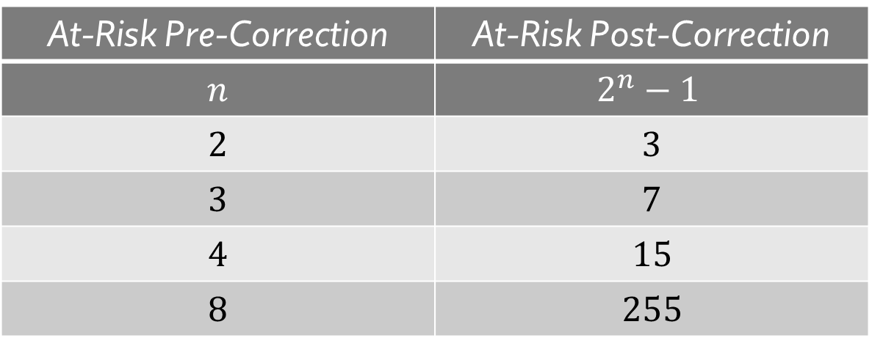
Challenge 1: Combinatorial Explosion
Exponential increase in the number of at-risk bits that the profiler must identify
Worst-Case Explosion of At-Risk Bits
At-Risk Pre-Correction | At-Risk Post-Correction
$$n$$ | $$2^{n}−1$$
$$2$$ | $$3$$
$$3$$ | $$7$$
$$4$$ | $$15$$
$$8$$ | $$255$$
Notes:
This results in an exponential increase in the number of at-risk bits that the profiler must identify
[CLICK] This table summarizes the worst-case scenario.
Given n at-risk bits pre-correction, we have 2^n-1 at-risk bits post-correction.
At high error rates, this quickly blows up the number of bits that the profiler needs to identify

Slide 21
Challenge 2: Identifying At-Risk Bits
Indirect errors only appear for specific ECC-dependent combinations of pre-correction errors
This makes identifying indirect errors slow and difficult
  The profiler can neither see nor control pre-correction errors
  Instead, the profiler is forced to blindly explore different pre-correction error combinations to achieve high coverage
The slow exploration can only be overcome
by transparency into on-die ECC
Notes:
The second challenge deals with identifying individual at-risk bits.
[CLICK] As we have seen, indirect errors only appear for specific, ECC-dependent combinations of pre-correction erros
[CLICK] Unfortunately, this makes identifying indirect errors both slow and difficult
[CLICK] This is because the profiler can neither see nor control which pre-correction errors occur,
[CLICK] and instead, is forced to rely on a blind guess-and-check exploration of different combinations of pre-correction errors in order to achieve high error coverage
[CLICK] We conclude that this slow exploration can only be overcome by transparency into on-die ECC, and we discuss this conclusion in more detail in our paper.

Slide 22
Challenge 3: Data Patterns
Profilers employ carefully-designed data patterns
0
1
0
1
0
1
0
1
0
1
0
1
0
1
0
1
0
1
0
1
0
1
0
1
1
0
1
0
1
0
1
0
1
1
1
1
1
1
1
1
1
1
1
1
1
1
1
1
0
0
0
0
0
0
0
0
1
1
1
1
1
1
1
1
Data-patterns induce worst-case circuit behavior
  Maximizes the chance of identifying errors
  Exercises different failure modes
Notes:
The third challenge relates to memory data patterns.
[CLICK] Profilers commonly use data patterns that are crafted for a particular circuit design.
We see some examples here with carefully-placed 1s and 0s
[CLICK] These patterns deliberately induce worst-case circuit behavior to make at-risk bits easier to identify and exercise different memory failure modes

Slide 23
Challenge 3: Data Patterns
On-die ECC breaks these data patterns in two ways
Memory Chip
1
0
1
0
1
0
1
0
1
On-Die ECC
?
?
?
?
?
?
?
?
1
0
1
0
1
0
1
0
?
?
?
?
?
?
?
?
  Carefully-Designed
  Obfuscated
  Multi-bit data patterns are difficult to design and use (discussed in our paper)
2
  Conventional data patterns induce single-bit worst case conditions
  On-die ECC requires multiple bits to fail concurrently to expose errors
Notes:
Unfortunately, on-die ECC breaks these patterns in two different ways
[CLICK] First, on-die ECC obfuscates the pattern so that it may no longer have the same physical behavior
[CLICK] Second, conventional data patterns are designed to induce worst-case conditions for a single bit.
[CLICK] However, on-die ECC requires multiple bits to fail together.
[CLICK] In general, designing and using mutli-bit worst-case patterns is difficult at best, and we discuss this further in our paper.

Slide 24
HARP Outline
Memory Error Mitigation and Profiling
On-Die ECC’s Impact on Error Profiling
HARP: Practical and Effective Profiling
Evaluations
Conclusion and Takeaways
Notes:
Now let’s see how HARP overcomes these three challenges.

Slide 25
Key Observation
Indirect errors are an artifact of on-die ECC
  data
  metadata
E
-
-
-
-
E
E
Direct error
On-Die ECC
Indirect error
Upper-bounded
by the ECC algorithm
E
-
E
-
An N-error correcting ECC can only cause at most N indirect errors at a time
Notes:
HARP is based on a simple key observation.
[CLICK] We observe that indirect errors can only be introduced by on-die ECC’s error-correction process
[CLICK] Here we have an example of a three-bit pre-correction error causing a two-bit post-correction error
[CLICK] Although any number of direct errors may occur simultaneously due to the data bits,
[CLICK] Only one indirect error may occur for a single error correcting ECC
[CLICK] This means that the number of indirect errors that can occur together is upper-bounded by the ECC algorithm
[CLICK] In other wors, an N-error correcting ECC can only cause at most N indirect errors at a time

Slide 26
Key Observation
Indirect errors are an artifact of on-die ECC
  data
  metadata
E
-
-
-
-
E
E
Direct error
On-Die ECC
Indirect error
Upper-bounded
by the ECC algorithm
E
-
E
-
Key idea:
Identify direct and indirect errors separately
An N-error correcting ECC can only cause at most N indirect errors at a time
Notes:
To exploit this observation, HARP’s key idea is to identify direct and indirect errors separately

Slide 27
Hybrid Active-Reactive Profiling (HARP)
  Active Profiling
1
Quickly identifies direct errors
Memory Controller
Memory Chip
Secondary ECC
Repair Mechanism
Active Profiler
On-Die
ECC
Data
Store
write data
To/from CPU
Error Profile
repaired
read data
on error detected
ECC bypass
Reactive Profiling
2
Safely identifies the indirect errors
Notes:
To this end, we introduce HARP, which implements this key idea to create a two-phase profiling algorithm
[CLICK] First, HARP uses an active profiler within the memory controller along with an on-die ECC bypass path (shown within the memory chip as a dashed orange line) to quickly identify all bits that are at risk of direct errors.
[CLICK] Second, HARP safely identifies all bits at risk of indirect errors using a secondary ECC in the memory controller.
Whenever either the active or reactive profilers identify an at-risk bit, they report it to the repair mechanism for subsequent repair.

Slide 28
Active Profiling Design
Memory Controller
Memory Chip
Repair Mechanism
Active Profiler
On-Die
ECC
Data
Store
Error Profile
on error detected
ECC bypass
Bypass only for reads
(returns data bits, ignores ECC metadata)
ECC bypass is a simple, low-overhead change
  No change to data transfer granularity or ECC algorithm
  Enables using existing profiling algorithms to identify bits at risk of direct errors as if there is no on-die ECC
Notes:
Let’s see the active profiling phase in more detail
[CLICK] This figure shows the components relevant to the active profiler alongside the repair mechanism that it supports.
[CLICK] The ECC bypass path is used only on profiler read operations, and it returns the raw data bits but not the metadata bits.
[CLICK] For this reason, the ECC bypass path is a simple, low-overhead change to the memory chip
[CLICK] It requires no changes to the memory data transfer granularity or the ECC algorithm
[CLICK] and enables using existing profiling techniques to identify bits that are at risk of direct errors, as if there is no on-die ECC at all

Slide 29
Active Profiling Design
Memory Controller
Memory Chip
Repair Mechanism
Active Profiler
On-Die
ECC
Data
Store
Error Profile
on error detected
ECC bypass
Bypass only for reads
(returns data bits, ignores metadata)
Reduces the task of profiling with on-die ECC
into a task of profiling without on-die ECC
with minimal modifications to on-die ECC
Able to use existing profiling algorithms as if there is no on-die ECC to identify bits at risk of direct errors
Does not identify bits at risk of indirect errors
Notes:
As a result, the active profiler effectively reduces the task of profiling a memory chip with on-die ECC into a task of profiling a memory chip without on die ECC, all with minimal modifications to on-die ECC itself.

Slide 30

Reactive Profiling Design
Memory Controller
Memory Chip
Secondary ECC
Repair Mechanism
On-Die
ECC
Data
Store
Error Profile
on error
detected
System designer must choose a suitable secondary ECC
Large ECC design space – only one requirement:
  Secondary ECC must correct $N$ errors per on-die ECC word given an $N$-error-correcting on-die ECC
  Requires aligning the two ECC words (details in our paper)
Notes:
On the other hand
[CLICK] the reactive profiler simply consist of a secondary ECC in the memory controller.
[CLICK] To enable this, the system designer must choose a suitable secondary ECC for their particular system
[CLICK] The ECC design space is large, and HARP only has one requirement:
[CLICK] The secondary ECC must be able to correct at least N errors per on-die ECC word given an N-error correcting on-die ECC, t
[CLICK] This requires aligning on-die ECC and secondary ECC words, and our paper discusses this in further detail

Slide 31
Improving Reactive Profiling
Reactive profiling slowly identifies indirect errors one-at-a-time as they occur during runtime
We can shorten this process by anticipating indirect error locations from the already-observed direct errors
D
  At-Risk of Direct Errors
D
D
?
?
?
  Unknown
Can predict a subset of indirect errors by knowing the
on-die ECC implementation (i.e., its parity-check matrix)
We introduce two HARP variants:
  HARP-A(ware) – knows the parity-check matrix
  HARP-U(naware) – does not know the parity-check matrix
Notes:
We further improve upon reactive profiling by incorporating an additional optimization
[CLICK] Reactive profiling as described slowly identifies bits that are at risk of indirect errors one-by-one as they fail during runtime
[CLICK] We observe that we can shorten this process by anticipating indirect error locations beforehand based on the direct errors that the active profiler has already identified
[CLICK] This illustration shows the how the process works: given bits known to be at risk of direct errors, we can predict a subset of all the bits at risk of indirect errors by knowing the on-die ECC parity-check matrix
[CLICK] Therefore, we introduce two HARP variants: HARP aware and HARP unaware, which do and do not know the ECC parity-check matrix, respectively

Slide 32
HARP Outline
Memory Error Mitigation and Profiling
On-Die ECC’s Impact on Error Profiling
HARP: Practical and Effective Profiling
Evaluations
Conclusion and Takeaways
Notes:
Now I will talk about our evaluations

Slide 33

Evaluation Methodology
We evaluate HARP using Monte-Carlo simulation
  Enables accurately measuring coverage (using a SAT solver)
  1,036,980 total ECC words
    Across 2769 randomly-generated (71, 64) and (136, 128) ECC codes
    ≈14 CPU-years (20 days on 256 cores) of simulation time
Artifacts are open-sourced
https://github.com/CMU-SAFARI/HARP
Notes:
I will briefly describe our evaluation methodology
[CLICK] We evaluate HARP using Monte-Carlo simulation,
[CLICK] where we can accurately measure error coverage. We do so using a SAT solver.
[CLICK] We simulate over a million total ECC words across many representative on-die ECC codes, amounting to about 14 CPU-years of simulation time
[CLICK] Our artifacts are open-sourced on both Zenodo and GitHub

Slide 34
Baseline Profiling Algorithms
We compare HARP with two baseline algorithms:
Naive: round-based profiling that ignores on-die ECC
  Each round uses different data patterns (e.g., random data)
  Profiler marks observed errors as at-risk bits
BEEP [Patel+,MICRO’20]: knows the exact on-die ECC implementation (i.e., its parity-check matrix)
  Same overall round-based strategy as Naive
  Data patterns designed using the known parity-check matrix
Notes:
We compare HARP against two baseline profiling algorithms
[CLICK] First, Naïve, which represents a basic round-based profiling algorithm that ignores on-die ECC.
Here, each profiling round consists of writing a data pattern to the memory chip and identifying any errors that occur.
[CLICK] Second, BEEP, which is aware of the on-die ECC implementation and uses this knowledge to guide how it choose data patterns.
Now, let’s look at three example results.

Slide 35
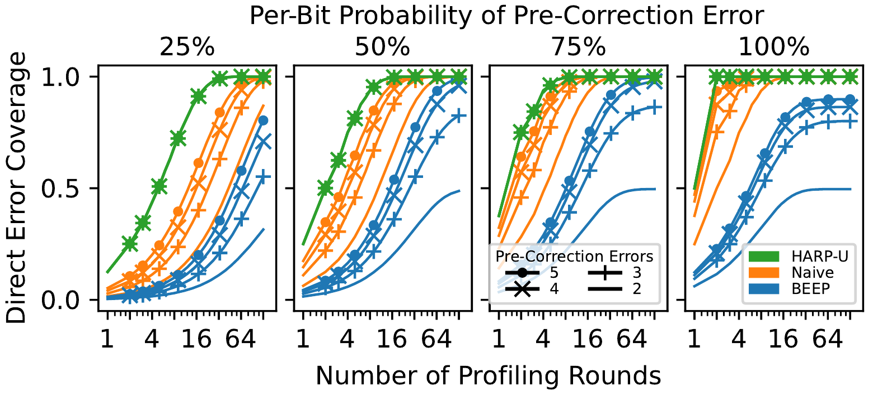
Coverage of Bits at Risk of Direct Errors
HARP achieves full coverage in all cases, outperforming both baseline algorithms
  BEEP fails to achieve full coverage because it does not explore different pre-correction error patterns
HARP is independent of the number of pre-correction errors because it directly reads raw data bit values
Notes:
First we will look at the coverage of bits at risk of direct errors that each profiling algorithm provides
[CLICK] This data shows the direct error coverage on the y-axis achieved over an x-axis number of profiling rounds.
- The different colors represent different profilers and the markers represent a different number of pre-correction errors injected per ECC word, ranging from 2 to 5.
[CLICK] The four different plot windows show different per-bit error probabilities for the injected errors, ranging from 25 to 100 precent.
We make two main observations from the data.
[CLICK] First, HARP achieves full coverage in all cases, outperforming both baseline algorithms
[CLICK] In particular, BEEP fails to achieve full coverage because it does not explore different pre-correction error patterns
[CLICK] Second, HARP’s performance is independent of the number of pre-correction errors because HARP directly reads raw data bit values that are not coupled by on-die ECC

Slide 36
Coverage of Bits at Risk of Direct Errors
HARP overcomes all three profiling challenges
by separating direct and indirect errors
HARP achieves full coverage in all cases, outperforming both baseline algorithms
  BEEP fails to achieve full coverage because it does not explore different pre-correction error patterns
HARP is independent of the number of pre-correction errors because it directly reads raw data bit values
Notes:
This analysis shows that HARP overcomes all three profiling challenges by separately identifying direct and indirect errors

Slide 37

Profiling Speed Evaluation
Goal: determine how many profiling rounds are necessary to prevent* N-bit error patterns
We inject 2 raw bit errors per ECC word
  Per-bit error probability = 1.0 (fails in every profiling round)
BEEP and Naive are
order(s) of magnitude slower
HARP only needs 3 rounds
to prevent multi-bit errors
Requires ECC-1
Requires ECC-6
*for 99th percentile coverage
Notes:
Next we look more closely at each profiler’s speed
[CLICK] Our goal in this analysis is to determine how many profiling rounds are necessary to prevent N-bit error patterns
Note that we report 99th percentile coverage because, as we have seen, the baseline profilers sometimes fail to achieve full coverage within the evaluated configuration
[CLICK] For this analysis, we inject 2 raw bit errors per ECC word, where each bit fails with a per-bit error probability of 1.0. In other words, each error occurs in every profiling round
[CLICK] Here is the resulting data. The X-axis shows the maximum number of post-correction errors that can occur simultaneously after a Y-axis number of profiling rounds have elapsed.
[CLICK] For example, X=1 means that a single-error correcting ECC (or ECC-1) is sufficient to protect against the remaining errors missed by the profiler
[CLICK] Similarly, X=6 means that a six-error correcting ECC is necessary to mitigate the remaining errors
[CLICK] We see that HARP only needs 3 profiling rounds to prevent all multi-bit error patterns
[CLICK] Whereas both baseline profilers are orders of magnitude slower to achieve the same result, if they even manage to do so at all

Slide 38
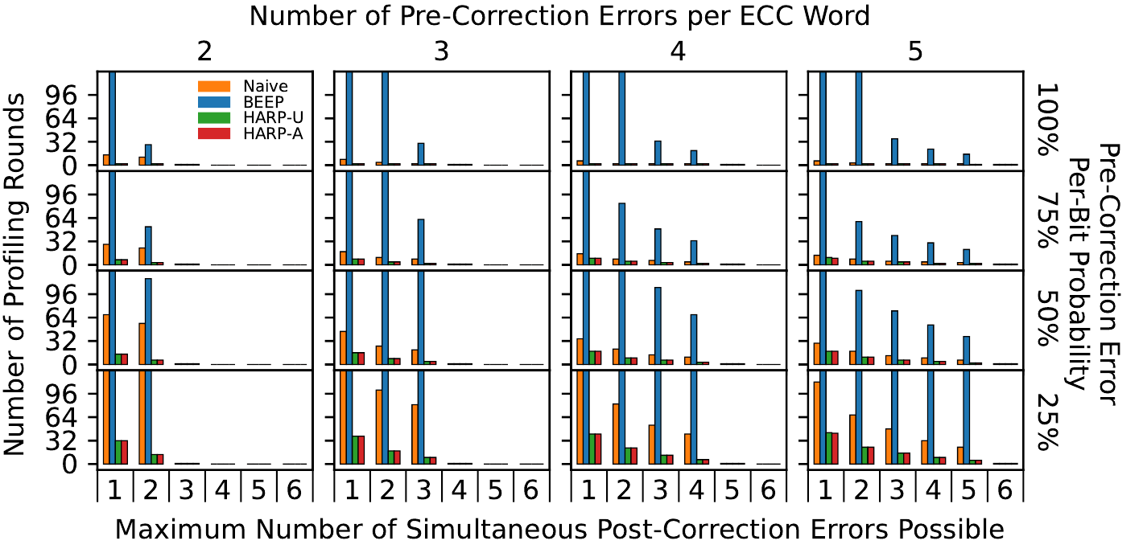
Profiling Speed Evaluation
HARP achieves high coverage of at-risk bits much faster than the baseline algorithms
Notes:
We repeat this analysis for
[CLICK] different numbers of pre-correction errors injected per ECC word, ranging from 2 to 5
[CLICK] and for different per-bit error probabilities, ranging from 25 to 100 percent
[CLICK] Overall, we find that HARP achieves high coverage of at-risk bits much faster than both baseline profiling algorithms.

Slide 39
Profiling Speed Evaluation
  HARP performs 20.6- to 62.1% faster
  than the best-performing baseline
HARP achieves high coverage of at-risk bits much faster than the baseline algorithms
Notes:
As an example result, HARP performs 20 to 62 percent faster than Naïve given a 50% per-bit probability of pre-correction error.

Slide 40
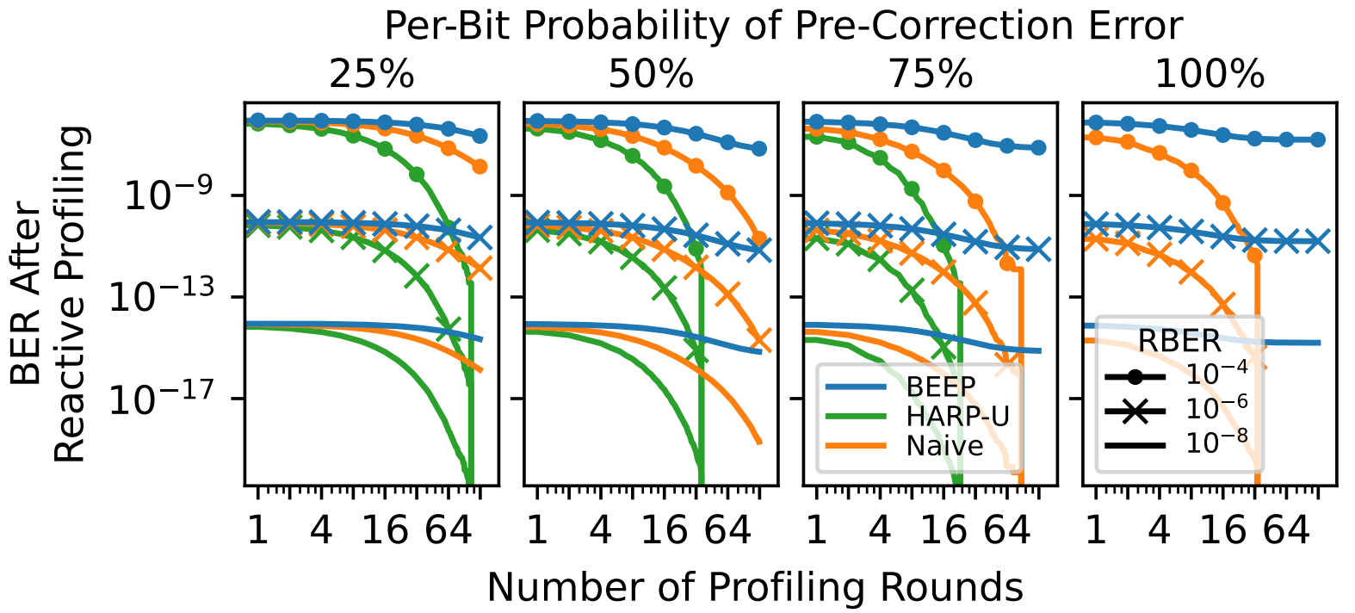
Case Study: DRAM Data-Retention
We consider a system that uses an ideal repair mechanism to safely reduce the DRAM refresh rate
We study how the end-to-end bit error rate (BER) changes when using different profilers
BEEP fails to reach zero BER
HARP always reaches zero BER
Notes:
Next, we conduct a case study on DRAM data-retention errors
[CLICK] We consider a system that uses an ideal repair mechanism that perfectly repairs all at-risk bits to safely reduce the DRAM refresh rate
[CLICK] We study how the end-to-end system bit error rate changes when using different profiling algorithms
[CLICK] Here is the data. The y-axis shows the BER after an X-axis number of profiling rounds.
The different colors represent different profiling algorithms, and the markers represent different raw bit error rates resulting from reducing the DRAM refresh rate by different amounts
[CLICK] We see that HARP always reaches zero BER in all configurations.
[CLICK] In contrast, BEEP fails to reach zero BER in any configuration. This is because, while HARP achieves full coverage of all direct errors, BEEP fails to do so, and Naïve is slow to do so.

Slide 41
Case Study: DRAM Data-Retention
  HARP reaches zero BER 3.7x faster
  than the best-performing baseline
We consider a system that uses an ideal repair mechanism to safely reduce the DRAM refresh rate
We study how the end-to-end bit error rate (BER) changes when using different profilers
Notes:
As an example result, we find that HARP reaches zero BER 3.7x faster than Naïve for a per-bit error probability of 0.75

Slide 42
HARP Outline
Memory Error Mitigation and Profiling
On-Die ECC’s Impact on Error Profiling
HARP: Practical and Effective Profiling
Evaluations
Conclusion and Takeaways
Notes:
Now I will conclude and give some final takeaways

Slide 43
Other Information in the Paper
Detailed analysis of on-die ECC
  How on-die ECC introduces statistical dependence between post-correction errors
  Differences between direct and indirect errors
Discussion about HARP’s design decisions
More evaluation results
  Coverage of direct and indirect errors
  Analysis of profiler bootstrapping
  Case study on the end-to-end memory bit error rate (BER)
Detailed artifact description
Notes:
We have many other analyses, discussions, and results in our paper.
First, we provide a detailed analysis of how on-die ECC impacts profiling, including the statistical dependence it introduces and the differences between direct and indirect errors
Second, we have more discussion on HARP’s design choices.
Third, we have more evaluation results, including the coverage of direct and indirect errors, an analysis of profiler bootstrapping, and a case study on how profiling impacts the end-to-end bit error rate
Finally, we provide a detailed description of our open-source artifacts

Slide 44
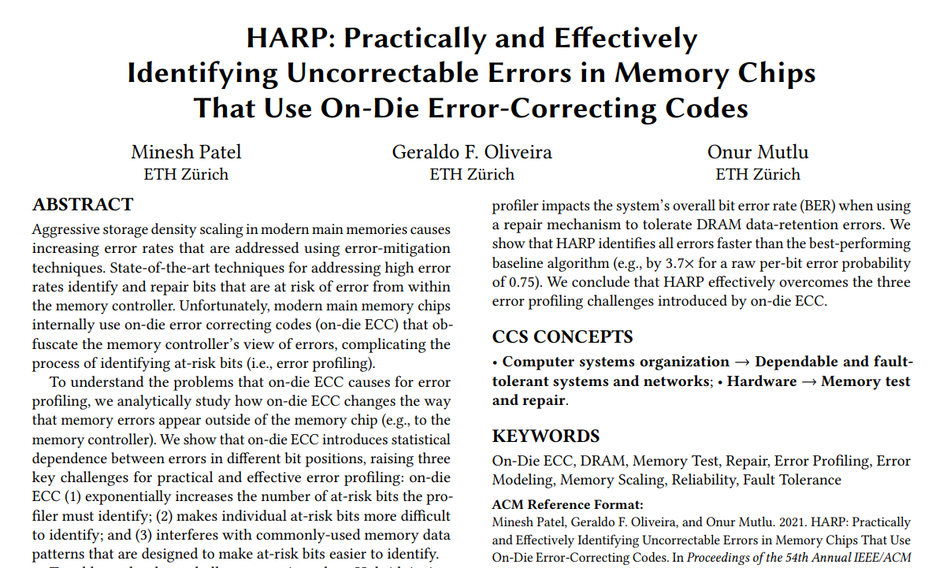
Other Information in the Paper
https://arxiv.org/abs/2109.12697
Notes:
We encourage you to take a look at the paper if you are interested in these details, and [CLICK]

Slide 45
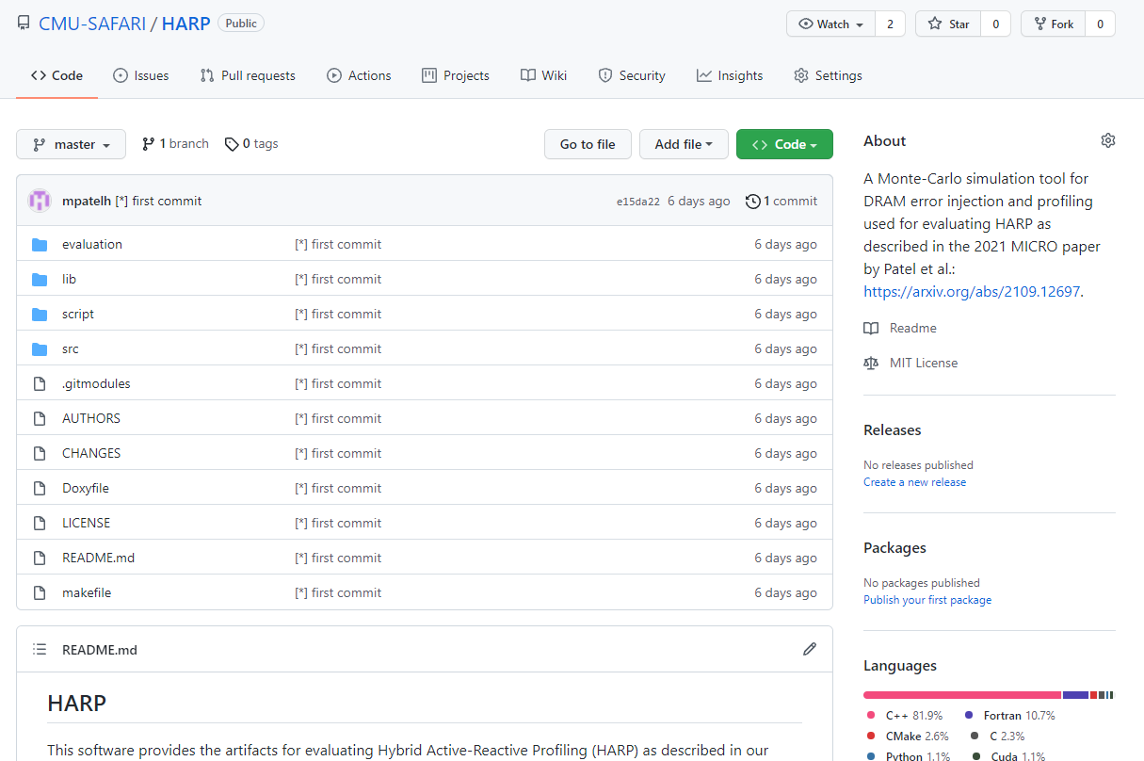
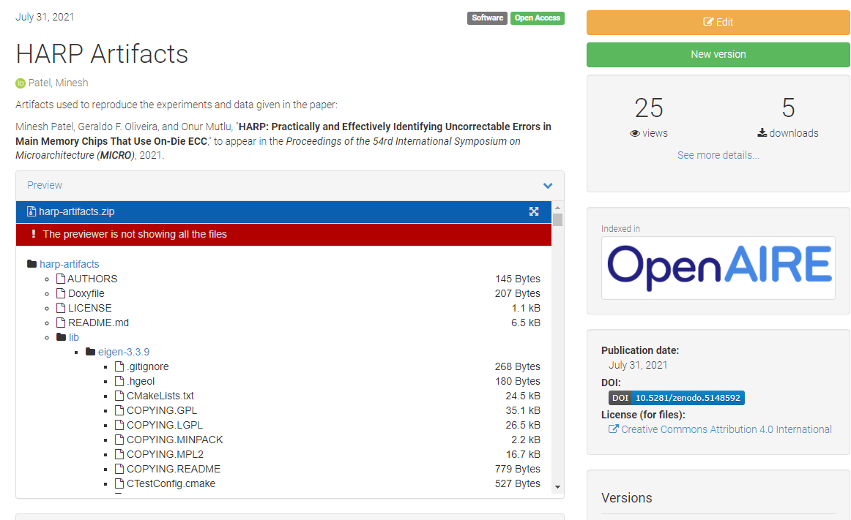
Artifacts are Open-Sourced
https://github.com/CMU-SAFARI/HARP
Notes:
Take a look at our artifacts, which are evaluated and available on both GitHub and Zenodo.

Slide 46
HARP Summary
Motivation: state-of-the-art memory error mitigations often require the processor to identify which bits are at risk of error (i.e., profiling)
Problem: on-die ECC complicates error profiling by altering how errors appear outside of the memory chip
Goal: understand and address the challenges on-die ECC introduces
Contributions:
  ​Analytically study on-die ECC’s effects and identify three key challenges
    Exponentially increases the number of at-risk bits
    Makes individual at-risk bits harder to identify
    Interferes with commonly-used memory data patterns
  ​Hybrid Active-Reactive Profiling (HARP):
    Separately identifies (1) raw bit errors and (2) errors introduced by on-die ECC
    Effectively reduces profiling with on-die ECC into profiling without on-die ECC
Evaluation: demonstrate that HARP overcomes the three challenges
HARP identifies all errors faster than two baselines, which sometimes fail to achieve full coverage of at-risk bits
Case study showing that HARP identifies all errors faster than the best-performing baseline (e.g., by 3.7x for a raw per-bit error probability of 0.75)
https://github.com/CMU-SAFARI/HARP
Notes:
Finally, I would like to conclude with a recap of my talk.
Our motivation is that state-of-the-art memory error mitigations often rely on error profiling
The problem that we tackle is that on-die ECC complicates error profiling.
Our goal in this work is to understand and address the challenges that on-die ECC introduces
TO this end, we make two main contributions.
First, we analytically…
Second, we introduce HARP, which separately…
We evaluate HARP relative to two baseline profiling algorithms and show that HARP overcomes the three profiling challenges, outperforming the baselines by a significant margin.
Finally, our artifacts are open-sourced on GitHub and Zenodo.
We hope that the studies, analyses, and ideas we provide will motivate rethinking profiling and on-die ECC to handle error detection and correction across the hardware-software stack.

Slide 47
HARP: Practically and Effectively Identifying Uncorrectable Errors in Memory Chips
That Use On-Die Error-Correcting Codes
Minesh Patel, Geraldo F. Oliveira, Onur Mutlu
Session 6A: Wednesday 20 October, 7:45 PM CEST
https://arxiv.org/abs/2109.12697
https://github.com/CMU-SAFARI/HARP
Notes:
Thank you, and this concludes my talk. Please read the paper and attend my session on Wednesday evening (European time) if you are interested in more details or the interactive Q&A.

Slide 48
Backup Slides
----------

Slide 49
Addressing High Error Rates
Unfortunately, coarse-grained mitigation is typically impractical at high error rates (e.g., >10⁻⁴)
Low BER
High BER
acceptable mitigation cost
unreasonable mitigation cost
High BERs demand fine-grained mitigation
Notes:
… and in order to address these errors, manufacturers typically employ error mitigation mechanisms.

Slide 50
Challenge 1: Combinatorial Explosion
  Pre-Correction
X
  At-Risk Bit
X
-
-
-
-
X
X
-
  Normal Bit
E
-
-
-
-
E
-
E
-
-
-
-
-
E
-
-
-
-
-
E
E
E
-
-
-
-
E
E
On-Die ECC
On-Die ECC
On-Die ECC
On-Die ECC
-
-
-
-
D
I
-
-
D
-
I
-
D
-
-
I
  direct and indirect error coincide
D
  Direct error
I
  Indirect error
X
X
X
X
  Post-Correction
REAPER (ISCA’17)
EIN (DSN’19)
BEER (MICRO’20)
HARP (MICRO’21)
Position (Ongoing)
Notes:
This is probably better with an animation (easier to understand)

Slide 51
Challenge 2: Bootstrapping (2/2)
The profiler cannot draw conclusions from having observed a bit not fail
Memory Chip
Memory Chip with on-die ECC
  data
  metadata
?
?
?
?
?
?
?
?
?
?
?
On-Die ECC
E
E
-
-
E
E
-
-
Physical bit did not fail
(i.e., no direct error)
Unknown!
REAPER (ISCA’17)
EIN (DSN’19)
BEER (MICRO’20)
HARP (MICRO’21)
Position (Ongoing)
Notes:
Backup slide, at best

Slide 52
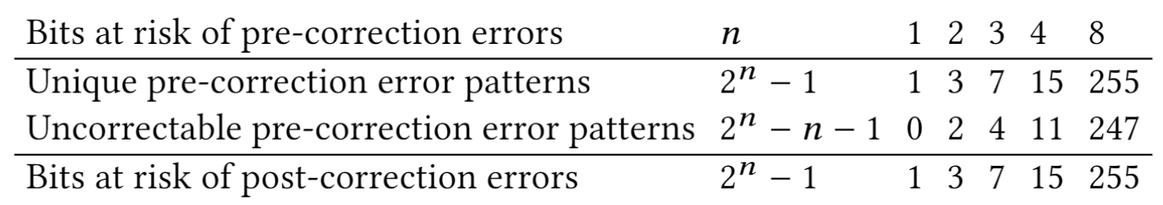
Combinatorial Explosion of Errors

Slide 53
Example Granularity Matching
Goal: The system designer wants to protect each on-die ECC word with at least as strong an ECC as on-die ECC
To DRAM
Chip [0]
To DRAM
Chip [1]
To DRAM
Chip [2]
To DRAM
Chip [3]
To DRAM
Chip [4]
120+8 bit (1EC Ham.)
120+8 bit codeword
120+8 bit codeword
120+8 bit codeword
32+6 bit codeword
112+16 bit (2EC BCH)
112 bits
112 bits
112 bits
112 bits
64 b
(128, 112) DEC
(128, 120) SEC
120 bits
120 bits
120 bits
120 bits
32 b
Current ECC
512 bits
64 bits
60B (480b) cache line
Notes:
There are many ways to implement…

Slide 54
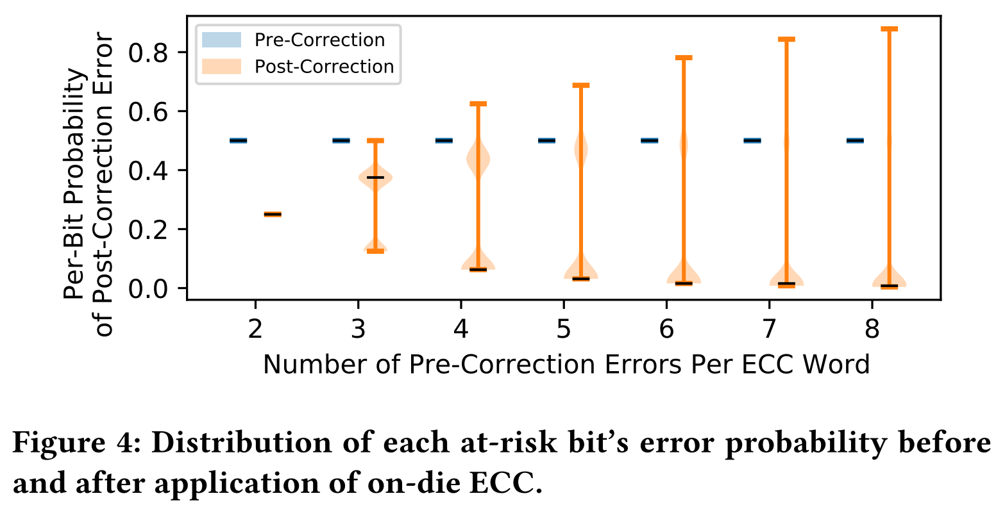
Per-Bit Error Probability of Each At-Risk Bit
70K ECC words per 1600 (71, 64) SEC Hamming codes

Slide 55






Challenge 1: Combinatorial Explosion
  Pre-Correction
X
  At-Risk Bit
X
-
-
-
-
X
X
-
  Normal Bit
0
1
2
  $2^{3}$ Possible pre-correction error combinations
  $$\{ \}$$
  $$\{−, −\}$$
0
0
1
  $$\{ \}$$
  $$\{ \}$$
  $$\{−, −\}$$
  $$\{−, −,−\}$$
1
0
2
0
1
2
  $$\{ \}$$
  $$\{−, −\}$$
2
1
2
  Correctable
  Uncorrectable
Notes:
Let’s take a closer look at the first challenge.
[CLICK] Here we have our example with three pre-correction errors. I will label them as 0, 1, and 2
[CLICK] Here are all the different combinations of the pre-correction erorrs that can occur.
We have 8 possibilities, of which
[CLICK] four are correctable
[CLICK] and four are uncorrectable for a single-error correcting code.

Slide 56
Challenge 1: Combinatorial Explosion
  Pre-Correction
Every combination can potentially
cause a unique indirect error
X
  At-Risk Bit
X
-
-
-
-
X
X
-
  Normal Bit
0
1
2
  Possible pre-correction error combinations
  $$\{ \}$$
  $$\{−, −\}$$
0
0
1
  $$\{ \}$$
  $$\{ \}$$
  $$\{−, −\}$$
  $$\{−, −,−\}$$
1
0
2
0
1
2
  $$\{ \}$$
  $$\{−, −\}$$
2
1
2
  Correctable
  Uncorrectable
Notes:
In the worst, case, each of four uncorrectable combination can cause a unique indirect error

Slide 57
Challenge 1: Combinatorial Explosion
Memory Chip
  data
  metadata
X
  At-Risk Bit
X
-
-
-
-
X
X
-
  Normal Bit
On-Die ECC
D
  At Risk of Direct Errors
D
I
I
I
I
  At Risk of Indirect Errors
Notes:
In this case, the three at-risk bits
[CLICK] can cause every bit to appear as an at-risk bit through some combination of direct and indirect errors.

Slide 58
Key Idea (1/2)
If we “somehow identify” all direct errors…
… we can safely rely on a secondary ECC to identify remaining indirect errors
Memory Controller
Secondary ECC
Repair Mechanism
To/from Memory Chip
To/from CPU
Error Profile
Notes:
And so we form a two-part key idea.
[CLICK] First, if we somehow identify all direct errors,
[CLICK] we can safely rely …
[CLICK] Here is an illustration showing a secondary ECC within the memory controller. With sufficient correction capability, the secondary ECC can reactively profile for indirect errors introduced by on-die ECC

Slide 59
Key Idea (2/2)
If we can read the raw data (but not metadata)…
… we can use existing profiling techniques to quickly identify all direct errors
Memory Controller
Memory Chip
Active Profiler
On-Die
ECC
Error-Prone
Data Store
To/from CPU
ECC Bypass
Notes:
Second,
[CLICK] if we can read the raw data …
[CLICK] we can use existing profiling techniques …
[CLICK] Here is an illustration of how an active profiler within the memory controller might use an ECC bypass path to directly read form the data store. In this way, the active profiler can profile for errors as if on-die ECC does not exist.

Slide 60
Hybrid Active-Reactive Profiling (HARP)
  Active Profiling
1
Quickly identifies direct errors
Memory Controller
Memory Chip
Secondary ECC
Repair Mechanism
Active Profiler
On-Die
ECC
Data
Store
write data
To/from CPU
Error Profile
repaired
read data
on error detected
ECC bypass
Reactive Profiling
2
Safely identifies the indirect errors
Notes:
HARP combines these two key ideas to create a two-phase profiling algorithm
[CLICK] First, HARP uses an active profiler within the memory controller along with an on-die ECC bypass path to quickly identify all bits at risk of direct errors.
[CLICK] Second, HARP safely identifies all bits at risk of indirect errors using a secondary ECC in the memory controller
[CLICK] Whenever either active or reactive profiling identify an at-risk bit, they report it to the repair mechanism for subsequent repair.

Slide 61
Active Profiling Design
  data
  metadata
E
-
-
-
-
E
E
Low hardware cost:
skipping ECC decoding
On-Die ECC
E
-
-
-
E
-
E
-
Bypass read
(returns raw data, ignores metadata)
Normal read
Able to use existing profiling algorithms as if there is no on-die ECC to identify bits at risk of direct errors
Does not identify bits at risk of indirect errors
Notes:
Let’s take a closer look at the active profiler.
[CLICK] Here is an illustration of how the ECC bypass path works.
On the left, the bypass path returns the raw data and ignores the ECC metadata.
On the right, a normal read operation performs on-die ECC decoding to determine the final read data using the ECC metadata.
[CLICK] This is an important distinction because it shows why the bypass path has low hardware cost. Similar bypass paths have been proposed in prior works, and we discuss this further in our paper.
[CLICK] Using the bypass path, the active profiler is able to use existing …
[CLICK] However, because the active profiler bypasses on-die ECC, it does not identify bits at risk of indirect errors

Slide 62
Active Profiling Design
  data
  metadata
E
-
-
-
-
E
E
Low hardware cost:
skipping ECC decoding
On-Die ECC
Reduces the task of profiling with on-die ECC
into a task of profiling without on-die ECC
with minimal modifications to on-die ECC
E
-
-
-
E
-
E
-
Bypass read
(returns raw data, ignores metadata)
Normal read
Able to use existing profiling algorithms as if there is no on-die ECC to identify bits at risk of direct errors
Does not identify bits at risk of indirect errors
Notes:
In this way, HARP effectively reduces the ….

Slide 63
ECC Bypass Costs
  data
  metadata
E
-
-
-
-
E
E
Low hardware cost:
skipping ECC decoding
On-Die ECC
E
-
-
-
E
-
E
-
Bypass read
(returns raw data, ignores metadata)
Normal read
Simply skips on-die ECC decoding
Details
Notes:
Let’s take a closer look at the active profiler.
[CLICK] Here is an illustration of how the ECC bypass path works.
On the left, the bypass path returns the raw data and ignores the ECC metadata.
On the right, a normal read operation performs on-die ECC decoding to determine the final read data using the ECC metadata.
[CLICK] This is an important distinction because it shows why the bypass path has low hardware cost. Similar bypass paths have been proposed in prior works, and we discuss this further in our paper.
[CLICK] Using the bypass path, the active profiler is able to use existing …
[CLICK] However, because the active profiler bypasses on-die ECC, it does not identify bits at risk of indirect errors

Slide 64
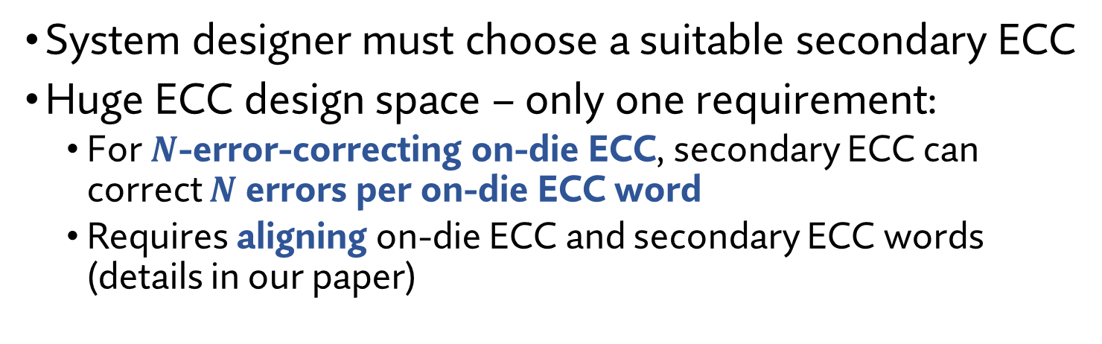
Reactive Profiling Design
Memory Controller
Memory Chip
Secondary ECC
On-Die ECC
To/from CPU
System designer must choose a suitable secondary ECC
Huge ECC design space – only one requirement:
  For $N$-error-correcting on-die ECC, secondary ECC can correct $N$ errors per on-die ECC word
  Requires aligning on-die ECC and secondary ECC words (details in our paper)
Notes:
On the other hand
[CLICK] the reactive profiler simply consist of a secondary ECC in the memory controller.
[CLICK] For this, the system designer must choose a suitable secondary ECC for their particular system
[CLICK] The ECC design space is huge, and HARP only has one requirement:
Given an N-error…
This requires aligning…

Slide 65
Hybrid Active-Reactive Profiling (HARP)
Memory
Controller
Memory Chip
1
  Active Profiling
Active Profiler
On-Die
ECC
Data
Store
Quickly identifies all direct errors
Bypasses on-die ECC on reads
Uses existing profiling techniques
ECC bypass
Memory Controller
2
Reactive Profiling
Secondary ECC
Repair Mechanism
Safely identifies indirect errors
Uses a secondary ECC at least as strong as on-die ECC
Notes:
To this end, we introduce HARP, which implements this key idea to create a two-phase profiling algorithm
[CLICK] First, during active profiling, HARP uses an on-die ECC bypass path (shown in the figure as a dashed orange line)
to quickly identify all bits at risk of direct errors by using existing profiling techniques
[CLICK] Second, HARP safely identifies all bits at risk of indirect errors using a secondary ECC that is at least as strong as on-die ECC

Slide 66
Challenge 2: Bootstrapping
Identifying a bit at risk of indirect errors is hard!
  Requires a specific pre-correction error pattern to occur
  However, the profiler cannot see pre-correction errors
Leads to a vicious cycle:
Profiler must test a bit
Profiler does not know if the bit has been tested
The profiler can only identify indirect errors
one-at-a-time in a guess-and-check process
Notes:
We refer to the second challenge as “Bootstapping”, for reasons that will soon be clear
[CLICK] On-die ECC makes identifying each bit at risk of indirect errors hard
This is because observing the bit fail requires a specific pre-correction error pattern.
However, the profiler cannot see pre-correction errors.
[CLICK] Therefore, we end up with a vicious cycle: the profiler must test a given bit, but it cannot know whether the bit has been tested.
[CLICK] As a result, the profiler is stuck identifying indirect errors one-at-a-time using a blind guess-and-check process

