Slide 1
Understanding Power Consumption and Reliability of High-Bandwidth Memory with Voltage Underscaling
Saber Nabavi | Behzad Salami | Osman Unsal
Adrian Cristal | Hamid Sarbazi-Azad | Onur Mutlu
Notes:
10 minutes talk + 5 minutes questions(?)
Hello and welcome to DATE2021. My name is Saber Nabavi and I will be presenting our paper on “Understanding Power Consumption and Reliability of High-Bandwidth Memory with Voltage Underscaling”.
Add text about date2021 to the bottom of the page

Slide 2
Executive Summary
DRAM has problems and one of them is Bandwidth.
HBM puts DRAM chips inside a package with GPU, FPGA, etc.
HBM uses the package’s power budget
Undervolting reduces power WITHOUT losing bandwidth.
Push undervolting too far, it will result unwanted bit-flips
This Work: power, bit flips and trade-offs
Evaluation Setup
Xilinx FPGA with 2 Stacks
HBM voltage rail
Main Results
19% voltage guardband
2.3X power savings
Fault-map to aid users to take advantage of undervolting
Notes:
To begin, I will give you the basic argument for this paper.
We already know that DRAM has problems and one of them is Bandwidth.
So as a solution, HBM puts DRAM chips inside a package next to the computing devices.
But HBM has to use the package’s power budget.
We use Undervolting to reduce power without losing bandwidth.
However the new challenge is that if we push Undervolting too far, it will cause some unwanted bit flips.
So in this work we try to understand how much power we can save, what are the types and rates of bit flips and how we can trade off among power, memory capacity and reliability.
We explore this using a Xilinx FPGA with two HBM stacks with a separate voltage rail for HBM.
Our experiments show that there is a 19% voltage guardband for HBM.
We can save power by a factor of 2.3X.
Fault map to aid users to take advantage of undervolting

Slide 3
Outline
Why HBM?
What is HBM?
Undervolting
Methodology
Results
Power
Reliability
The Trade-off
Notes:
Here is the outline of this talk.

Slide 4
Outline
Why HBM?
What is HBM?
Undervolting
Methodology
Results
Power
Reliability
The Trade-off
Notes:
Here is the outline of this talk.

Slide 5
Why HBM?
DRAM Limitations: Power, Latency, Bandwidth, etc.
Specially in data-intensive applications
Replace DRAM: PCM, MRAM, etc.
Have their own limitations
Improve DRAM:
Reduced Latency DRAM (RLDRAM)
Graphics DDR (GDDR)
Low-Power DDR (LPDDR)
High Bandwidth Memory (HBM) -> Bandwidth
HBM Use cases
NVIDIA A100, Xilinx Virtex Ultrascale+ HBM, AMD Radeon Pro
The Summit Supercomputer
Notes:
[CLICK] I want to start by explaining why we need HBM.
[CLICK] We know DRAM has problems such as power, latency and bandwidth especially when it comes to data-intensive application.
[CLICK] There are two ways to tackle these problems. One of them is to replace DRAM with an emerging memory technology such as PCM or MRAM.
[CLICK] But these technologies have their own limitations.
[CLICK] The other method is to improve DRAM
[CLICK] Which has resulted in the invention of Reduced Latency DRAM, Graphics DDR and Low-Power DDR. This is the category that HBM falls into because it focuses on improving DRAM bandwidth.
[CLICK] And because of that, HBM is already being used in high-end devices and of course the Summit Supercomputer.

Slide 6
Outline
Why HBM?
What is HBM?
Undervolting
Methodology
Results
Power
Reliability
The Trade-off
Notes:
Here is the outline of this talk.

Slide 7
What is HBM?
IDEA: Integrate stacks DRAM chips into the computing package
Use TSVs, µBumps and Silicon Interposer to connect everything
Eight 128bits wide channels per stack
Benefits:
An order of magnitude Higher Bandwidth
Smaller form factor
Lower energy per bit (7pJ vs 25pJ in DDRx)
Challenge:
Uses the package’s power budget
Save power but NOT lose bandwidth: Undervolting
Notes:
[CLICK] The main Idea behind HBM is to integrate stacks of DRAM chips into the computing package. Everything is connected using TSVs, ubumps and a silicon interposer.
[CLICK] This integration allows for 8 efficient memory channels that are 128 bits wide .
[CLICK] The benefits are an order of magnitude higher bandwidth, smaller form factor and lower energy consumption.
[CLICK] But a challenge is that HBM uses the package’s power budget.
[CLICK] So we need a power saving technique that saves power without losing bandwidth. Undervolting is one such technique.

Slide 8
Xilinx VCU128
SLR=Super Logic Region
(Reconfigurable Fabric)
HBM Stacks
2
AXI Ports
32
Switches
Memory Controllers (MC)
Pseudo Channels (PC)
32
Memory Array
Notes:
[CLICK] The hardware that we use for our experiments is a Xilinx VCU128 evaluation board.
[CLICK] There are 3 Super Logic Regions on this device that contain reconfigurable fabrics.
[CLICK] Super Logic Region number 0 is connected to the HBM stacks.
[CLICK] Each stack has 16 AXI ports that the user can use for accessing HBM.
[CLICK] Traffic from these ports are routed using switches to reach any of the 8 Memory Controllers in the stack.
[CLICK] Each Memory Controller is in charge of two Pseudo-Channels that work on their independent regions of the memory.
[CLICK] So when considering the entire HBM, we have 2 stacks, 32 AXI ports and their corresponding 32 Pseudo-Channels.

Slide 9
Outline
Why HBM?
What is HBM?
Undervolting
Methodology
Results
Power
Reliability
The Trade-off
Notes:
Here is the outline of this talk.

Slide 10
Undervolting
IDEA: Reduce supply voltage but keep Frequency
We can do this because of Voltage Guardband
Save power WITHOUT losing bandwidth
Catch:
Pushed beyond guardband, bit flips will appear!
But we can save even more power at the cost of these faults!
Our Work:
Undervolt HBM
Then push in too far!
Report power saving and bit flips
Trade-off among memory capacity, power and fault-rate
Notes:
[CLICK] The idea behind Undervolting is reducing supply voltage WITHOUT reducing operating frequency. We can do this because manufacturers provide a default voltage above the minimum that the chip needs to operate. This difference is called the Voltage Guardband.
[CLICK] The benefit of undervolting is that we save power without losing bandwidth.
[CLICK] The problem is that if Undervolting is pushed beyond the guardband, some unwanted bit flips manifest themselves.
[CLICK] But if our applications can tolerate a faulty memory, we can save more power.
[CLICK] So in this work we undervolt HBM.
[CLICK] Then we push it beyond the guardband and report power savings and the rate and types of bit flips.
[CLICK] In the end we show the possibility of a trade-off among memory capacity, power and fault-rate.

Slide 11
Outline
Why HBM?
What is HBM?
Undervolting
Methodology
Results
Power
Reliability
The Trade-off
Notes:
Here is the outline of this talk.

Slide 12
Methodology
Undervolting Mechanism
HBM supply voltage is driven by an on-board regulator
We control it from the host
10mV voltage steps
Power Measurements:
Change bandwidth utilization by enabling/disabling AXI ports
Measure power at all voltage steps
Measure idle power by disabling all AXI ports
Reliability Test
Test the entire memory vs. pseudo-channel
Write all 1s (to detect 1-to-0 bit flips)
Write all 0s (to detect 0-to-1 bit flips)
Notes:
The HBM supply voltage in our setup is driven by an on-board voltage regulator.
We control this regulator from the host and change the supply voltage at 10mV steps.
We have two sets of experiments: one for measuring power and one for reliability assessment.
For our power measurements, we change bandwidth utilization by enabling or disabling AXI ports.
Then we change the voltage at each bandwidth and measure power consumption.
We also measure IDLE power by disabling all AXI ports.
As for reliability, we test the entire HBM to understand how it behaves during Undervolting.
We also test each pseudo-channel to see how each of them react to Undervolting.
Our data patterns are either all 1s to detect 1-to-0 bit flips or all 0s to detect 0-to-1 bit flips.

Slide 13
Outline
Why HBM?
What is HBM?
Undervolting
Methodology
Results
Power
Reliability
The Trade-off
Notes:
Here is the outline of this talk.

Slide 14
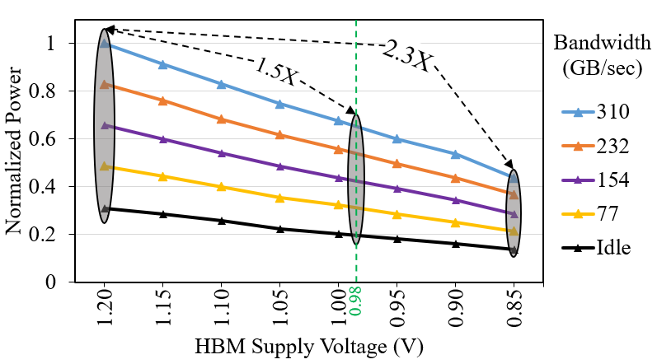
Power: Active and Idle
$Active Power=α×C_{L}×f×{V_{dd}}^{2}$
Notes:
We know that active power of DRAM is proportional to the square of its supply voltage.
Therefore we are expecting similar power reduction with Undervolting.
The graph here confirms our expectations. In this graph the Y axis shows power consumption normalized to power consumption of HBM at maximum load at nominal voltage.
The X axis shows voltage and we only included representative bandwidth utilizations.
In our experiments, 1.2V was the nominal voltage and 0.98 was the minimum voltage that HBM needed to work without faults. We can get a 1.5X power saving by just working in this range.
Pushing supply voltage further down to 0.85 will give us a 2.3X power saving.
As you can see, the power saving is independent from bandwidth utilization since we are only changing voltage and not the frequency.

Slide 15
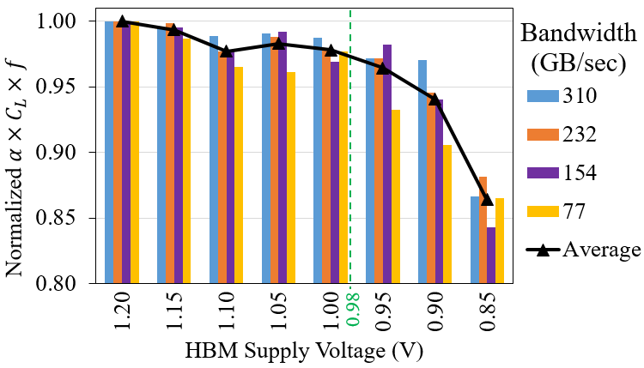
Power: α
$Active Load Capacitance=α×C_{L}×f$
Unit: farads per second
$f$ and $C_{L}$are constant
Bit Flips
<3%
14%
Notes:
Now, If we divide our power measurement numbers by V-squared, we are left with what we call the active load capacitance.
The unit for these values is “farads per second”. They show how much memory is being charged or discharged at every second.
Since f and C-sub-L are constant at each bandwidth we expect these values to remain the same.
However, our measurements shown in this figure do not confirm this.
This figure shows these values normalized to the maximum values at nominal voltage for each bandwidth.
Before 0.98, these values are withing 3% of what we expect but after that they start to drop. At 0.85 they are 14% lower that what they should be.
This is explained by taking the manifestation of bit flips into account. As we push supply voltage lower than 0.98, some memory bits stop responding. Therefore, their capacitance is not charged or discharged. This results in a drop in alpha as can be seen in this figure.

Slide 16
Outline
Why HBM?
What is HBM?
Undervolting
Methodology
Results
Power
Reliability
The Trade-off
Notes:
Here is the outline of this talk.

Slide 17
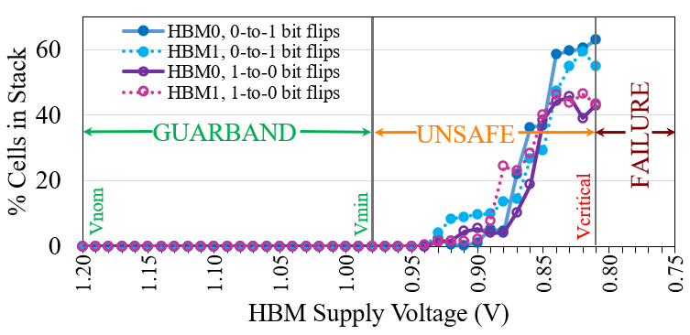
Reliability: the Regions
No Bit Flips
Exponential
Guardband:
Below nominal level ($V_{nom}=1.2V$)
No faults
Unsafe:
Below guardband ($V_{min}=0.98V$)
Exponential growth in bit-flips
Max out at 0.84V
Failure:
HBM crash point ($V_{critical}=0.81V$)
Restart with nominal voltage
0.98
0.81
Notes:
Let’s take a look at the general behavior of HBM stacks during Undervolting.
This figure shows the percent of each stack that is faulty at each voltage.
We observed 3 supply voltage regions: Guardband, Unsafe and Failure.
The guardband region starts at nominal 1.2 and ends at 0.98 with no faults.
The unsafe region starts below guardband and extends to 0.81 which is on the edge of crash point of HBM
In this region, the number of bit flips increases exponentially.
Our HBM stacks fail at 0.80 and all the voltages below that. Our memory cannot work with these voltages and the only way to recover it, is by restarting it with nominal voltage.

Slide 18
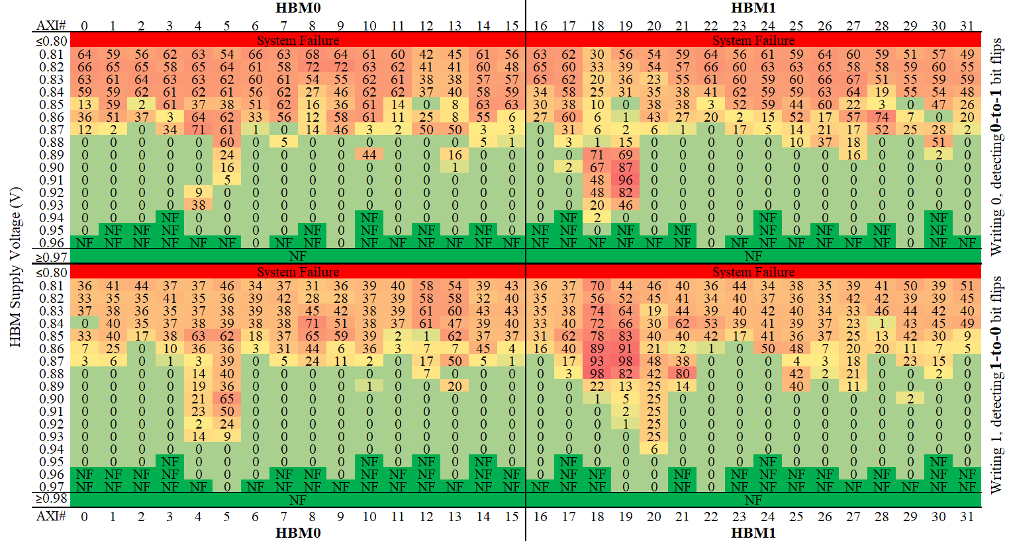
Reliability: the Variations
Notes:
Now let’s have look at how each AXI port (and it’s corresponding pseudo-channel) behaves during Undervolting.
We see 3 categories of variations. They are across HBM stacks, pseudo-channels and data patterns.
HBM0 has 13% lower fault rate than HBM1, even though they both have the same minimum and critical voltages.
Some pseudo-channels are more sensitive than others. For example, pseuso-channels number 4 and 5 from HBM0 experience higher fault rate than others in the same stack.
The first 1-to-0 bit flips show up at 0.97 while the first 0-to-1 bit flips show up at 0.96.
The average rate of 0-to-1 bit flips is 21% higher than that of 1-to-0 bit flips.

Slide 19
Outline
Why HBM?
What is HBM?
Undervolting
Methodology
Results
Power
Reliability
The Trade-off
Notes:
Here is the outline of this talk.

Slide 20
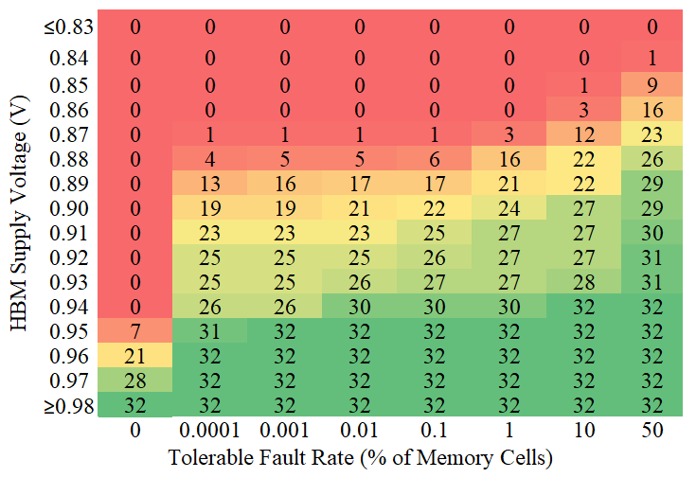
The Trade-Off
2.3X
1.6X
Notes:
We know that if an application is intrinsically resilient to faults, it can benefit more from Undervolting.
Here we have a table that shows how much power we can save depending on what fault rate an application can tolerate and how much memory it needs.
For example, If an application can not tolerate any faults, it can only push supply voltage downto 0.95 on 7 fault-free pseudo-channels to get 1.6X power savings.
A 2.3X power saving is possible if an application can tolerate more than 10% fault rate and does not need the entire HBM capacity.

Slide 21
Understanding Power Consumption and Reliability of High-Bandwidth Memory with Voltage Underscaling
Saber Nabavi | Behzad Salami | Osman Unsal
Adrian Cristal | Hamid Sarbazi-Azad | Onur Mutlu
Notes:
Thank you for joining me and I hope you enjoyed this as much as I did.

