Slide 1


An Experimental Analysis of
RowHammer in HBM2 DRAM Chips
Ataberk Olgun Majd Osseiran
A. Giray Yağlıkçı
Yahya Can Tuğrul
Steve Rhyner
Haocong Luo
Behzad Salami
Juan Gomez Luna
Onur Mutlu
Notes:
Hello all,
I am Ataberk and I will present our work, An Experimental Analysis of RowHammer in HBM2 DRAM Chips

Slide 2

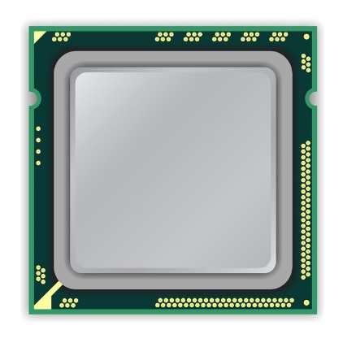
The RowHammer Vulnerability (I)
DRAM Chip
CPU
DRAM Module
Notes:
Let me first explain the RowHammer vulnerability
This is a typical DRAM-based computing sytem with a CPU and a DRAM module
[CLICK] We will look at a simplified depiction of this DRAM chip

Slide 3
The RowHammer Vulnerability (II)
DRAM Chip
Row 0
Row 0
Victim Row
Row 1
Row 1
Row 1
Victim Row
Row 2
Row 2
Row 2
Row 2
Row 2
Row 2
open
open
closed
closed
open
Aggressor Row
Aggressor Row
Row 3
Row 3
Row 3
Row 2
Victim Row
closed
Row 4
Row 4
Victim Row
Repeatedly opening (activating) and closing (precharging)
a DRAM row causes RowHammer bit flips in nearby rows
Notes:
This simple chip contains many DRAM rows.
In order to access data from a DRAM row, say row 2, the memory controller must first open or activate the row [CLICK].
After all requests are serviced from row 2, the memory controller must close or precharge the row [CLICK] in order to begin accessing data from another row.
[BACK & FORTH] Due to an increase in cell-to-cell interference, rapidly activating and precharging a DRAM row can result in bit flips in nearby rows [CLICK]
[FORTH & BACK] Continuing to access the same row results in even more failures in nearby rows. This phenomenon is known as RowHammer. [CLICK]
We refer to the rapidly accessed row as an aggressor row and the rows containing bit flips as victim rows.

Slide 4
A Simple Program Can Induce Bitflips
CPU
DRAM Module
loop:
mov (X), %eax
mov (Y), %ebx
clflush (X)
clflush (Y)
mfence
jmp loop
X
Y
  https://github.com/CMU-SAFARI/rowhammer
Notes:
A user-level program can induce RowHammer bitflips, in a similar way, in main memory by running this code on the bottom left.

Slide 5

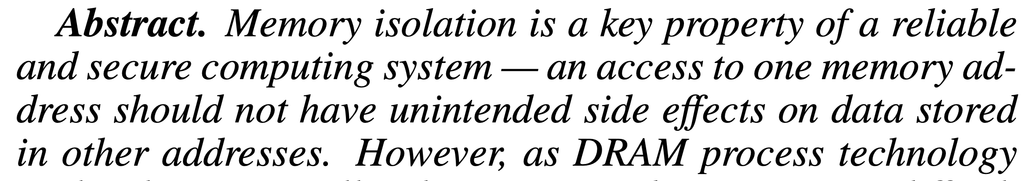
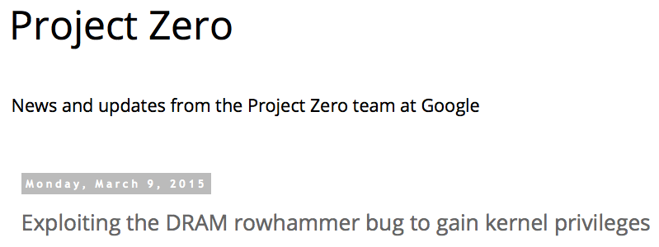
One Can Take Over a System
Flipping Bits in Memory Without Accessing Them: An Experimental Study of DRAM Disturbance Errors (Kim et al., ISCA 2014)
Exploiting the DRAM rowhammer bug to gain kernel privileges (Seaborn, 2015)
Notes:
Prior works, such as this one, shows that RowHammer is a widespread phenomenon affecting almost all types of DRAM chips from various manufacturers in the field.
[CLICK] RowHammer is a problem because the previous user-level program accesses one memory location and has unintended side effects on data stored in other addresses.
In other words RowHammer breaks memory isolation.
Memory isolation is a key property of reliable and secure computing systems.
[CLICK] and many prior works including this one have shown that RowHammer can be used to take over systems.

Slide 6
Most DRAM Modules Are Vulnerable (2020)
All tested DRAM types are susceptible to RowHammer bitflips
What about High Bandwidth Memory (HBM)?
Kim et al., ”Revisiting RowHammer: An Experimental Analysis of
Modern DRAM Devices and Mitigation Techniques," in ISCA, 2020.
Notes:
Many of the newer DRAM chips of different types are also vulnerable to RowHammer as demonstrated by a recent work.
[CLICK] Considering these recent developments in RowHammer, we ask the question, “what about new high bandwidth memory DRAM”? Does RowHammer exist in High Bandwidth Memory, and if so how does the RowHammer in real High Bandwidth Memory chips look like?

Slide 7
Executive Summary
Motivation: HBM chips have new architectural characteristics (e.g., 3D-stacked dies)
that might affect the RowHammer vulnerability in various ways
Understanding RowHammer enables designing effective and efficient solutions
Problem: No prior study demonstrates the RowHammer vulnerability in HBM
Goal: Experimentally analyze how vulnerable HBM DRAM chips are to RowHammer
Experimental Study: Detailed experimental characterization of RowHammer
in a modern HBM2 DRAM chip. Our study provides two main findings:
1. Spatial variation of RowHammer vulnerability
Different channels in a 3D-stacked HBM chip exhibit different RowHammer vulnerability
DRAM rows near the end of a DRAM bank are more RowHammer resilient
2. On-DRAM-die RowHammer mitigations
A modern HBM chip implements undisclosed on-DRAM-die RowHammer mitigation
The mitigation refreshes a victim row after every 17 periodic refresh operations
(e.g., similar to DDR4 chips)
Notes:
HBM chips harbor new architectural characteristics that might affect the RowHammer vulnerability
[CLICK] Understanding RowHammer enables designing effective and efficient solutions
[CLICK] However, no rigorous study demonstrates the RowHammer vulnerability in HBM
[CLICK] Our goal is to experimentally analyze how vulnerable real HBM chips are to RowHammer
[CLICK] Therefore, we perform a detailed experimental characterization of RowHammer in a modern HBM2 DRAM chip and we provide two main findings.
[CLICK] First, we show that there is substantial variation in RowHammer vulnerability in different physical locations of high bandwidth memory chips. Different channels in 3D-stacked HBM chips exhibit different vulnerability, and
[CLICK] DRAM rows near the end of a DRAM bank are more RowHammer resilient
[CLICK] Second, we show that a modern HBM chip implements undisclosed on-DRAM-die Rowhammer mitigation
[CLICK] We find that this particular mitigation refreshes a victim row after every 17 periodic refresh operations, resembling a mitigation prior work found in DDR4 chips

Slide 8
Outline
1. HBM DRAM Organization & Operation
2. DRAM Cell Leakage & RowHammer
3. HBM DRAM Testing Methodology
4. RowHammer Spatial Variation Analysis
5. On-die RowHammer Mitigation Analysis
6. Conclusion
Notes:
Here is the outline of my talk.

Slide 9
Outline
1. HBM DRAM Organization & Operation
2. DRAM Cell Leakage & RowHammer
3. HBM DRAM Testing Methodology
4. RowHammer Spatial Variation Analysis
5. On-die RowHammer Mitigation Analysis
6. Conclusion
Notes:
I will talk about HBM DRAM Organization next.

Slide 10
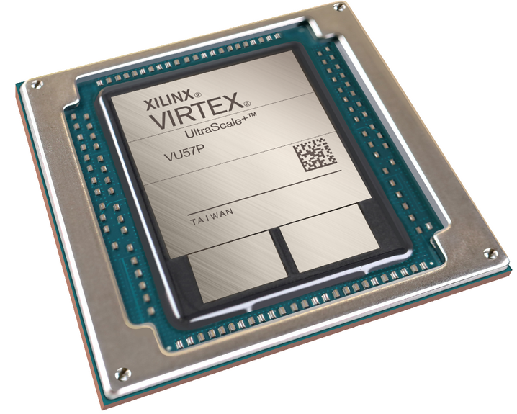
System with High Bandwidth Memory
Compute Chip (e.g., FPGA)
Inside one package
Memory Chip
(e.g., HBM DRAM)
https://www.hpcwire.com/off-the-wire/xilinx-adds-high-bandwidth-memory-capabilities-to-its-virtex-ultrascale-portfolio/
Notes:
A typical HBM2 DRAM system [CLICK] consists of a compute chip and multiple HBM2 DRAM chips.
[CLICK] All of these chips are integrated into a single package to form the HBM2 system.

Slide 11
HBM DRAM Organization (I)
HBM DRAM Chip
Channel
TSVs
Channel
DRAM Dies
Channel
TSVs
Channel
Channel
TSVs
Channel
FPGA
Buffer Die (Logic Die)
Through-Silicon Vias (TSVs)
Memory Controller
Silicon Interposer
HBM Interface
Notes:
Here is a different view of the same HBM system
[CLICK] The FPGA and the HBM chips reside in the same package and are connected by a Silicon Interposer
[CLICK] The memory controller in the FPGA communicates with the buffer die in the 3D-stacked HBM chip
[Click] over the HBM interface
[CLICK] The HBM2 chip contains multiple 3D-stacked DRAM dies
[CLICK] Each DAM die contains one or multiple DRAM channels
[CLICK] High-speed through silicon vias connect the 3D-stacked channels to the buffer die

Slide 12
HBM DRAM Organization (I)
HBM2 DRAM Chip
Channel
TSVs
Channel
DRAM Dies
Channel
TSVs
Channel
Channel
TSVs
Channel
FPGA
Buffer Die (Logic Die)
Through-Silicon Vias (TSVs)
Memory Controller
Silicon Interposer
HBM2 Interface
Notes:
Let’s now look at what is inside a DRAM channel

Slide 13
HBM DRAM Organization (II)
Subarray
Row of DRAM cells
Bank
TSVs
. . .
Row 1
Pseudo-Channel
Row 2
Row 3
Row 4
DRAM Channel
DRAM Bank
DRAM Subarray
Notes:
An HBM DRAM channel contains multiple pseudo-channels and each pseudo-channel contains multiple banks [CLICK]
Each bank is composed of multiple subarrays [CLICK]
And a subarray consists of many DRAM rows. [CLICK]
Each DRAM row contains many DRAM storage cells.

Slide 14
Outline
1. HBM DRAM Organization & Operation
2. DRAM Cell Leakage & RowHammer
3. HBM DRAM Testing Methodology
4. RowHammer Spatial Variation Analysis
5. On-die RowHammer Mitigation Analysis
6. Conclusion
Notes:
Let’s look at leakage in DRAM cells and the RowHammer phenomenon in more detail.
=========
Flow better: “Now let’s lok at a cell, its leakgea and rowhammer in more detail”

Slide 15
DRAM Cell Leakage
Each cell encodes information in leaky capacitors
wordline
access
transistor
charge
leakage
paths
capacitor
bitline
Stored data is corrupted if too much charge leaks (i.e., the capacitor voltage degrades too much)
[Patel+, ISCA’17]
Notes:
Each cell encodes data in fundamentally leaky capacitors [CLICK] Here is a simplified diagram of a DRAM cell, where the capacitor in red stores the data and the access transistor gates access to the data
[CLICK]
There are a number of leakage paths by which charge can enter or exit the capacitor.
[CLICK]
The important thing to note is that stored data can be corrupted if too much charge leaks
Which is the same as saying if the capacitor voltage degrades too much
[END]

Slide 16
DRAM Refresh
Refresh Operations
Refresh Window
100%
Vmin
Capacitor voltage (Vdd)
0%
REF
REF
REF
time
Periodic refresh operations preserve stored data
Notes:
Here, we have a simplified diagram of the capacitor voltage over time
We see that the voltage decreases over time in an exponential decay.
There’s a threshold Vmin under which we can no longer guarantee that we will correctly read the data that was originally stored in the cell.
[CLICK]
As long as a cell’s voltage remains above this line, we consider this a retention success.
[CLICK]
However, as soon as the voltage drops below Vmin, we consider this a retention failure
In order to prevent charge leakage failures, also known as retention failures, [CLICK] we issue periodic refresh operations to restore the charge in the cell. [CLICK] The interval between refresh commands are referred to as the refresh window.

Slide 17
RowHammer Bitflips
RowHammer
Bitflip
100%
Vmin
Capacitor voltage (Vdd)
0%
REF
REF
REF
time
RowHammer Attack:
Accesses to nearby row
Notes:
Now lets take a look at this diagram in the context of a RowHammer attack.
[CLICK] If enough activations are issued to a nearby row within a refresh window, the charge leakage rate can be accelerated to the point of failure.
Subsequent refresh commands now see this bit as a 0 value and maintain the discharged state of the cell

Slide 18
Problem & Goal
Problem
No prior study demonstrates
the RowHammer vulnerability in high bandwidth memory
Our Goal
Experimentally analyze how vulnerable
real high bandwidth memory chips are to RowHammer
Notes:
Let me re-iterate the problem we are tackling in our work.
No prior work rigorously studies the RowHammer vulnerability in high bandwidth memory
[CLICK] and our goal is to experimentally analyze how vulnerable real hbm chips are to RowHammer

Slide 19
Outline
1. HBM DRAM Organization & Operation
2. DRAM Cell Leakage & RowHammer
3. HBM DRAM Testing Methodology
4. RowHammer Spatial Variation Analysis
5. On-die RowHammer Mitigation Analysis
6. Conclusion
Notes:
I will now introduce the testing methodology we use in our experimental analysis

Slide 20
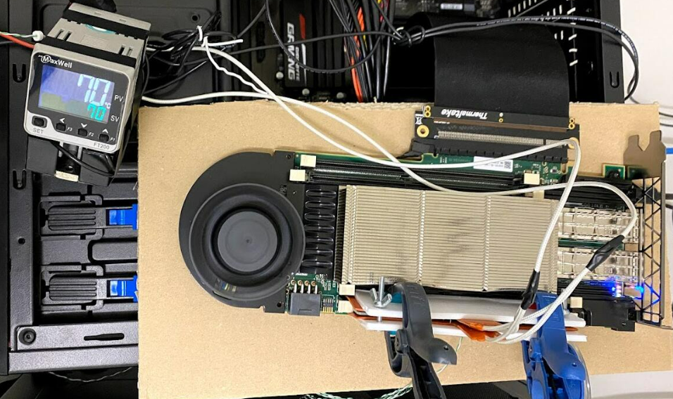

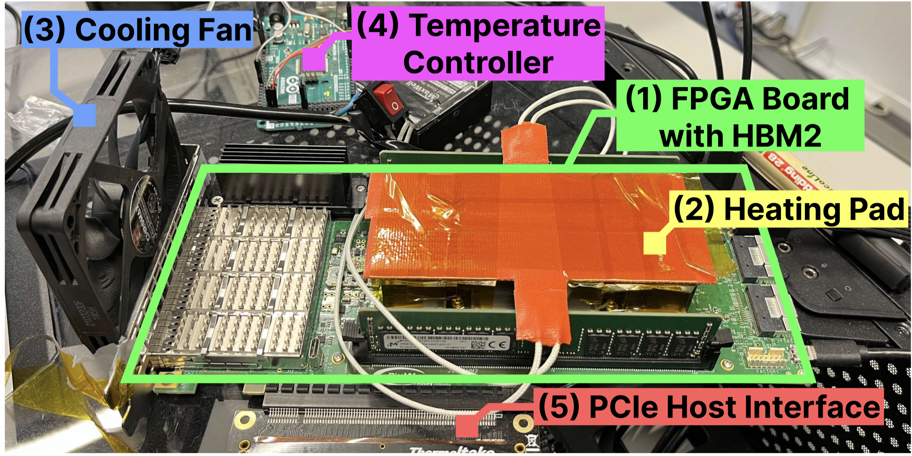
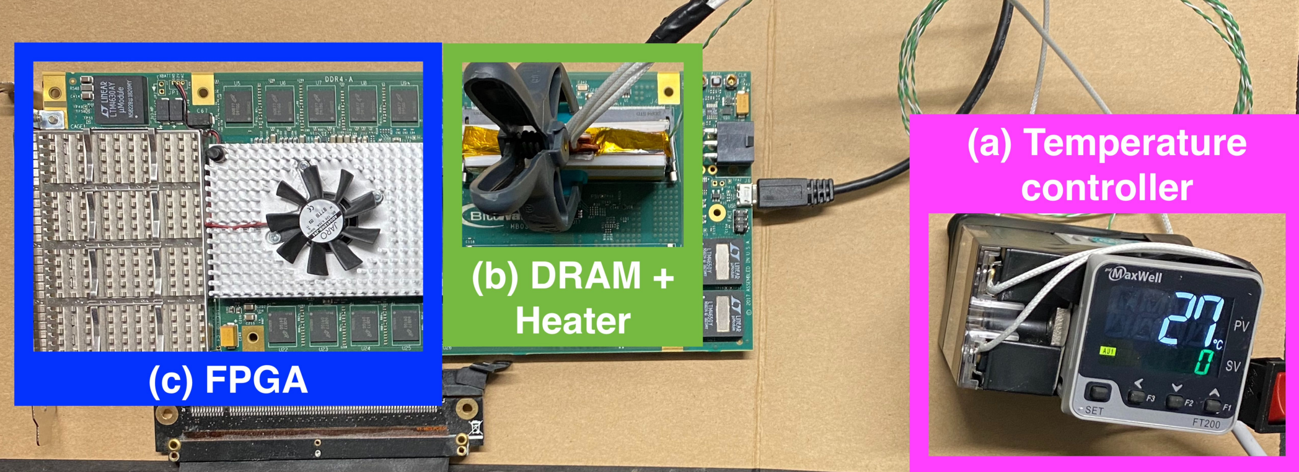
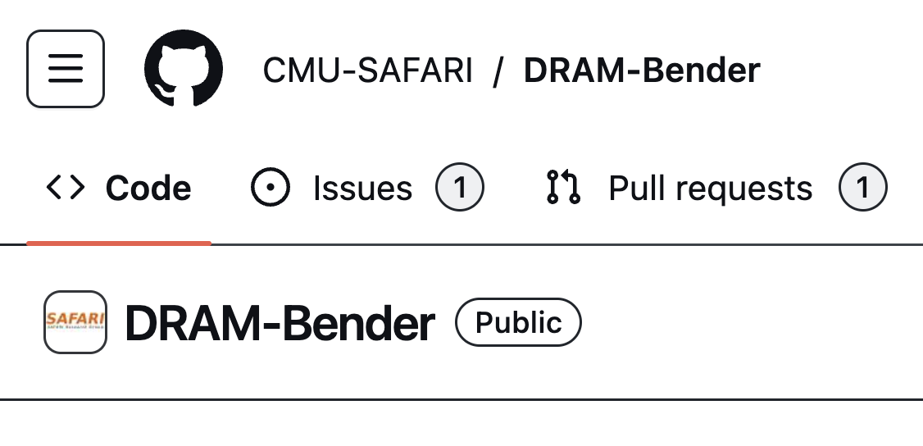
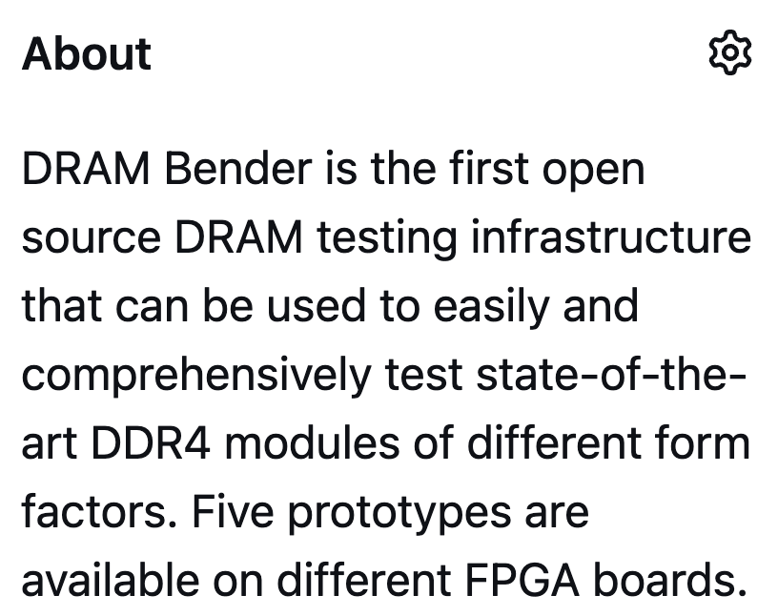
DRAM Testing Infrastructure
DRAM Bender DDR3/4 Testing Infrastructure
Adapt to work
with HBM2 chips
https://github.com/CMU-SAFARI/DRAM-Bender
Olgun et al., "DRAM Bender: An Extensible and Versatile FPGA-based Infrastructure
to Easily Test State-of-the-art DRAM Chips," in TCAD, 2023.
Notes:
Our infrastructure is based on DRAM Bender DDR3/4 testing infrastructure.
[CLICK] We adapt DRAM Bender to work with HBM2 chips

Slide 21
DRAM Testing Infrastructure
FPGA-based HBM2 Testing Setup (Bittware XUPVVH)
Fine-grained control over DRAM commands,
timing parameters (±1.66ns)
Olgun et al., "DRAM Bender: An Extensible and Versatile FPGA-based Infrastructure
to Easily Test State-of-the-art DRAM Chips," in TCAD, 2023.
Notes:
Here is a photo of our testing setup.
We use the Bittware XUPVVH HBM2 FPGA board.
We control the heating pad and the cooling fan using the Arduino temperature controller to keep the temperature of the testing setup stable.
[CLICK] This setup gives us fine-grained control over DRAM commands and we can have as low as a 1.66 ns delay between two consecutive DRAM commands we issue to the HBM chip.

Slide 22

RowHammer Testing Methodology (I)
To characterize our DRAM chips at worst-case conditions:
Prevent sources of interference during core test loop
  No DRAM refresh: to avoid refreshing victim row
  No RowHammer mitigation mechanisms: to observe circuit-level effects
  Test for less than a refresh window (32ms) to avoid retention failures
  Repeat tests for five times
Worst-case RowHammer access sequence
We use worst-case RowHammer access sequence
based on prior works’ observations
Double-sided RowHammer: repeatedly access
the two physically-adjacent rows as fast as possible
Record bitflips
in victim
Aggressor Row 1
Victim Row
Aggressor Row 2
Notes:
[CLICK x8]
We carefully re-use the rigorous RowHammer characterization methodology described in prior work where we prevent sources of interference and use the worst-case double-sided RowHammer access patterns.
==========
Go over quickly: We use the methodology in prior work and zap thru animations
Record bitflips everywhere for future works → add to google docs
To characterize our DRAM chips at worst-case conditions we take two measures:
[CLICK] First, we prevent external sources of interference such that our tests can run consistently as desired and without interruptions. To achieve this we disable:
[CLICK] DRAM refresh to avoid refreshing victim rows during a test,
[CLICK] and RowHammer mitigation mechanisms to ensure that we can directly observe circuit-level bit flips
[CLICK] we also ensure that our RowHammer tests complete in less than a refresh window to prevent retention failures from interfering with our results
[CLICK] and we repeat our tests five times to filter out the noise in measurements
[CLICK] Second, we issue the worst-case access sequence for inducing RowHammer bit flips based on observations from prior work
[CLICK] where we repeatedly activate the two physically-adjacent rows as fast as possible to perform double-sided RowHammer on a victim row
[CLICK] Finally, we record the bitflips induced on the victim row.

Slide 23
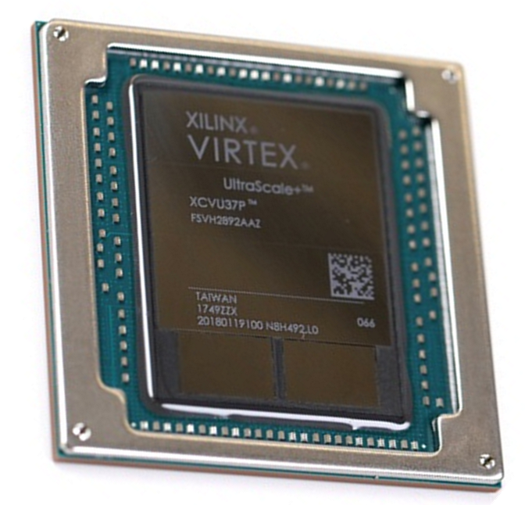
RowHammer Testing Methodology (II)
Tested HBM2 chip’s organization:
  8 channels
  2 pseudo-channels
  16 banks
  16384 rows (1 KiB each)
Test all channels, pseudo-channels, banks
Test first, middle, and last 3K rows in a bank
  9K out of 16K (more than half)
Keep HBM2 chip temperature at 85°C
Xilinx FPGA
with HBM2 DRAM chips
Notes:
[CLICK] Our HBM2 chip contains 8 channels, 2 pseudo-channels in each channel, 16 banks in each pseudo-channel, and around 16 thousand 1 KiB large rows.
[CLICK] We test all channels, pseudo-channels, and banks
[CLICK] We sample the first, middle, and last 3K rows in a bank for our experiments.
[CLICK] and we set the temperature controller’s target temperature to 85 degree celcius

Slide 24
Metrics
Bit error rate (BER):
The fraction of DRAM cells in a row
that experience a bitflip after 512K activations
Hammer Count for the First Bitflip (HC_{first}):
Aggressor row activation count
to cause the first bitflip in the victim row
Higher is worse
Lower is worse
Notes:
We measure two metrics:
[CLICK] The bit error rate is the fraction of cells in a DRAM row that experience a bitflip. We activate the aggressor rows 512 thousand times for this. We say that RowHammer vulnerability worsens as this metric becomes higher.
[CLICK] The hammer count for the first bitflip is the number of aggressor row activations required to cause the first bitflip in the victim row. As this metric becomes smaller, it means that we need a shorter time to induce a RowHammer bitflip.

Slide 25
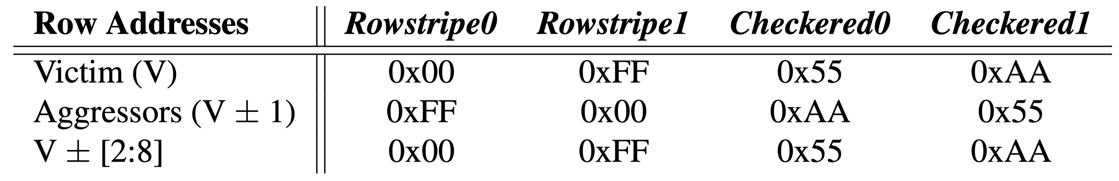
Tested Data Patterns
00000000000000000000000
…
…
…
00000000000000000000000
11111111111111111111111
00000000000000000000000
11111111111111111111111
00000000000000000000000
…
…
…
00000000000000000000000
Notes:
We use the data patterns depicted in this table to initialize DRAM rows prior to performing RowHammer.
I will explain how data gets laid out to DRAM rows based on the first Rowstripe0 data pattern:
[CLICK] We fill the victim row with all zeros,
[CLICK] The aggressors with all ones
[CLICK] And the 7 other rows neighboring each aggressor with all zeros

Slide 26
Tested Data Patterns
10101010101010101010101
…
…
…
10101010101010101010101
01010101010101010101010
10101010101010101010101
01010101010101010101010
10101010101010101010101
…
…
…
10101010101010101010101
Notes:
Here is another example showing what happens when we use the checkered0 data pattern

Slide 27
Tested Data Patterns
10101010101010101010101
…
…
…
10101010101010101010101
01010101010101010101010
10101010101010101010101
01010101010101010101010
10101010101010101010101
…
…
…
10101010101010101010101
Worst-case data pattern (WCDP) of a row: Causes smallest HC_{first} for a row
Notes:
We use these four different data patterns
[CLICK] and we determine the worst-case data pattern for each tested DRAM row as the data pattern that causes the smallest Hcfirst value for that row
[CLICK] note that this worst-case data pattern is always one of the four tested data patterns

Slide 28
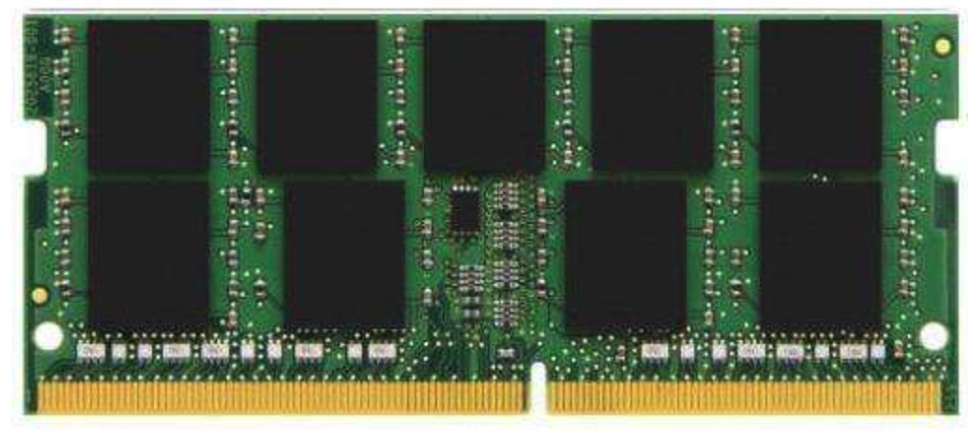
Two Main Analyses
1. Spatial variation of RowHammer vulnerability
How does the RowHammer vulnerability change across
channels, pseudo-channels, banks, rows in HBM?
2. On-DRAM-die RowHammer mitigations
Do real HBM chips implement
undisclosed RowHammer mitigations
resembling those that exist in DDR4?
Subarray
Row of DRAM cells
Bank
TSVs
. . .
Row 1
Pseudo-Channel
Row 2
Row 3
Row 4
DRAM Channel
DRAM Bank
DRAM Subarray
Notes:
We provide two main analyses in our study
[CLICK] We investigate how RowHammer vulnerability changes across different HBM components in terms of bit error rate and activation count to induce the bitflip.
[CLICK] and we investigate if the HBM chip implements undisclosed RowHammer mitigations that resemble the ones in real DDR4 chips.

Slide 29
Outline
1. HBM DRAM Organization & Operation
2. DRAM Cell Leakage & RowHammer
3. HBM DRAM Testing Methodology
4. RowHammer Spatial Variation Analysis
5. On-die RowHammer Mitigation Analysis
6. Conclusion
Notes:
I will first share the results of our RowHammer Spatial Variation analysis

Slide 30
Key Takeaways from Spatial Variation Analysis
Takeaway 1
Different 3D-stacked HBM2 channels exhibit different RowHammer vulnerability
Takeaway 2
DRAM rows near the end of a DRAM bank
experience smaller bit error rate (BER) than others
Takeaway 3
Activation count needed to induce the first RowHammer bitflip (HC_{first})
changes with the data pattern and the physical location of the DRAM row
Notes:
Starting with the three key takeaways we make from our analysis
First, Different 3D-stacked channels exhibit different RowHammer vulnerability
[CLICK] Second, DRAM rows near the end of a DRAM bank experience smaller bit error rate than other rows
[CLICK] Third, the activation count needed to induce the first RowHammer bitflip changes with the data pattern and the physical location of the DRAM row

Slide 31
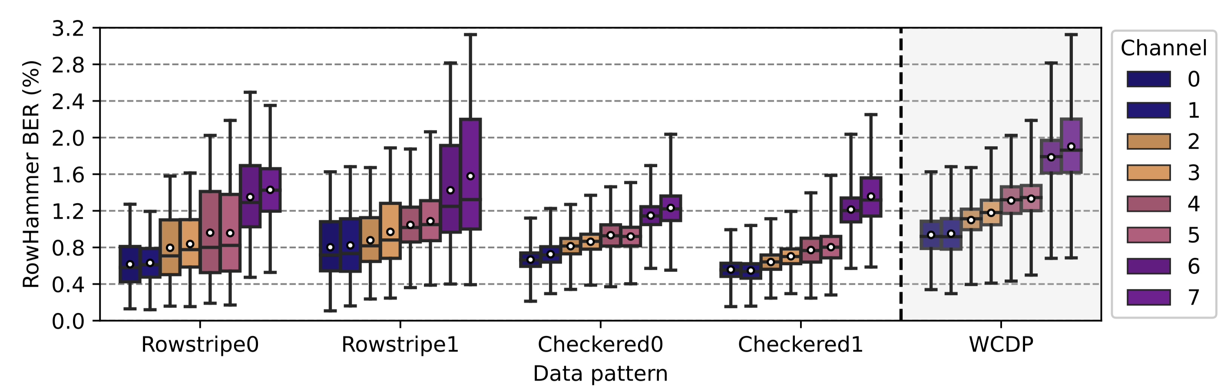
Spatial Distribution of BER (I)
There are bitflips in every tested DRAM row
across all tested HBM2 channels
BER varies across channels:
groups of two channels have different BERs
Notes:
This figure depicts the RowHammer bit error rate distribution across all tested rows on the y-axis and the data patterns we use on the x-axis.
Different bars show the distribution of bit error rate in different HBM2 DRAM channels
We make two observations from this figure.
[CLICK] First, we observe bitflips in every tested DRAM row in all tested channels.
[CLICK] Second, BER varies across channels. We find that groups of two channels have different bit error rates compared to other groups.

Slide 32
Spatial Distribution of BER (I)
~262 bitflips (out of 8192 in a row)
The data pattern affects the BER distribution
Up to ~262 bitflips in a row of 8K bits
with 512K aggressor row activations
Notes:
[CLICK] We see that the data pattern has an affect on the distribution of the bit error rate
and that our observations are consistent across different data patterns.
[CLICK] I highlight the distributions we get for the worst-case data pattern. We observe up to around 262 bitflips in a row of 8K bits with 512K hammers.

Slide 33
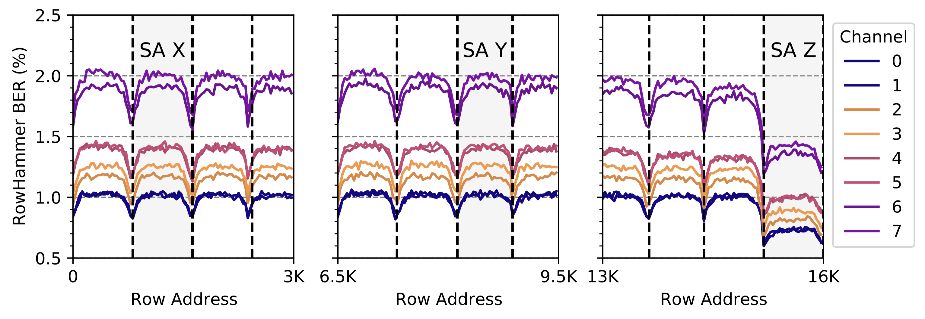
Spatial Distribution of BER (II)
SA start
SA end
Last subarray (SA)
BER is substantially smaller in the last subarray (i.e., last 832 rows)
BER periodically increases and decreases across rows:
BER is higher in the middle of a subarray
Notes:
This plot shows the bit error rate on the y–axis and row addresses on the x-axis. Different lines show the bit error rate for different channels
Note that we show the last 3 thousand rows on the x-axis.
The dashed vertical lines indicate reverse-engineered subarray boundaries. Because we show only the last 3K rows, the first subarray on the left is not shown completely in this figure.
[CLICK] We observe that the bit error rate is substantially smaller in the last subarray compared to other subarrays.
[CLICK] We also see that the bit error rate goes up and down as row addresses increase. The bit error rate is the higheset in the middle of a subarray and lowest at either ends of a subarray. We will explain this later in more detail.
===================
How do you reverse engineer subarray boundaries?

Slide 34
Spatial Distribution of BER (II)
BER is substantially smaller in the last subarray (i.e., last 832 rows)
BER periodically increases and decreases across rows:
BER is higher in the middle of a subarray
Notes:
We show the same plot for the first and the middle 3K rows.
We see that our second observation is valid for all tested DRAM rows.

Slide 35
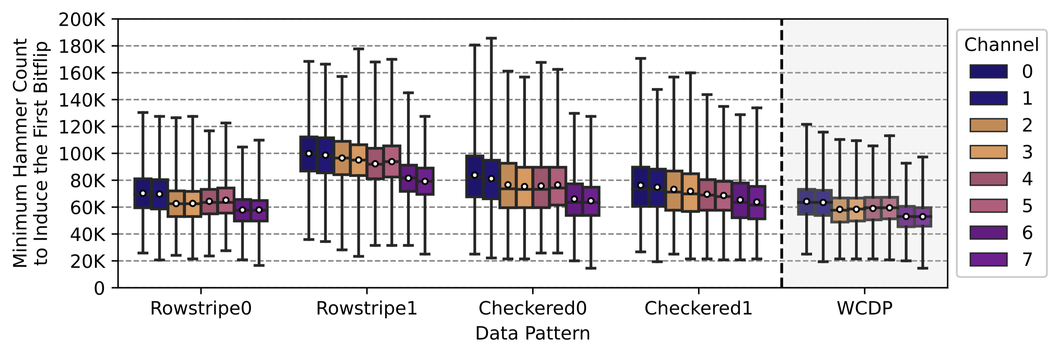
Spatial Distribution of HC_{first}
HC_{first} is as low as 14531 across all tested rows/channels:
Only ~1.3 ms to induce a RowHammer bitflip
HC_{first} distribution heavily depends on the data pattern
Notes:
This plot shows the Hcfirst distribution across rows in each channel on the y-axis and the data patterns on the x-axis. We use different boxes to plot hcfirst distributions for different channels.
[CLICK] We observe that Hcfirst is as low as around 14 thousand across all rows. This means that we can induce a bitflip in only around 1 milisecond.
[CLICK] We see that the Hcfirst distribution depends heavily on the data pattern we use to initialize DRAM rows.

Slide 36
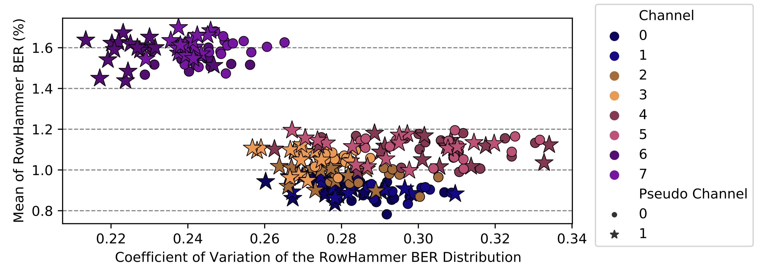
Variation in Bit Error Rate
Small distance on x and y axes
Two different banks in the same channel
Large distance on x and y axes
Banks in the same channel have similar variation in BER
Notes:
We also investigate the variation in BER across rows in each bank but I have to skip this due to time limits. I am happy to answer any questions on this.

Slide 37
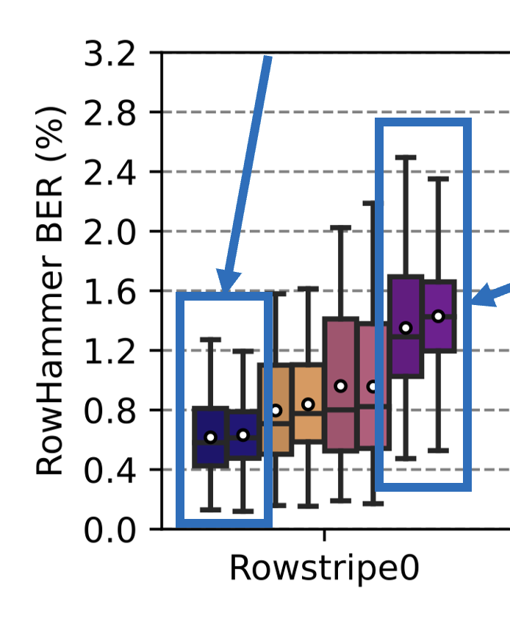
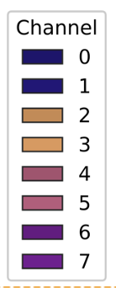
Hypotheses from Characterization
Similar BER & HC_{first}
within groups of two channels
suggests these channels
share DRAM dies
RowHammer BER
changes with the row’s proximity
to sense amplifiers and bank I/O
Notes:
We form two key hypotheses from our characterization study
[CLICK] First, we attribute the similarity in bit error rate and hcfirst within groups of two channels to their physical placement inside the HBM chip. We think that groups of two channels share the same DRAM die.
[CLICK] Second, RowHammer bit error rate changes with the row’s proximity to sense amplifiers. We think that the significant drop in bit error rate in the last subarrays can be due to the subarray’s proximity to bank I/O logic.

Slide 38
Implications on Attacks and Mitigations
Key Observation: RowHammer BER and HC_{first} vary across channels
Two implications for RowHammer attacks and mitigations
A RowHammer attack can use the most-RH-vulnerable
HBM2 channel to prepare for and perform the attack faster
A RowHammer mitigation can
allocate fewer resources for RowHammer-resilient channels and
more efficiently prevent RowHammer bitflips
Notes:
We make this key observation from our study.
[CLICK] This has two implications for RowHammer attacks and mitigations
[CLICK] First, attacks can use the most vulnerable channels to accelerate their preparation and attack phases. This allows an attacker to take over vulnerable systems more quickly.
[CLICK] Second, mitigations can allocate fewer resources to protect RowHammer-resilient channels and more resources to protect RowHammer-vulnerable channels. This would allow for more efficient RowHammer mitigation mechanisms.

Slide 39
Outline
1. HBM DRAM Organization & Operation
2. DRAM Cell Leakage & RowHammer
3. HBM DRAM Testing Methodology
4. RowHammer Spatial Variation Analysis
5. On-die RowHammer Mitigation Analysis
6. Conclusion
Notes:
I will now describe our second main analysis on on-DRAM-die RowHammer mitigations

Slide 40
Key Takeaways from on-die Mitigation Analysis
Takeaway 1
A modern HBM2 chip implements an undisclosed
on-DRAM-die RowHammer mitigation
Takeaway 2
This mitigation resembles the one in DDR4 chips from one major manufacturer
as shown in prior work
Hassan et al., "Uncovering In-DRAM RowHammer Protection Mechanisms:
A New Methodology, Custom RowHammer Patterns, and Implications,” in MICRO, 2021.
Notes:
Here are the two key takeaways from our study
First, the chip we test implements an undisclosed on-DRAM-die RowHammer mitigation mechanism
[CLICK] Second, this mitigation resembles the ones prior work has found in real DDR4 chips
===========================
Add reference to uTRR
How does U-TRR know beyond “every 17 refresh”?

Slide 41
On-Die RowHammer Mitigation Analysis (I)
HBM2 standard defines a “Target Row Refresh (TRR)-mode”
Memory controller and DRAM cooperate to prevent RH bitflips
Real DDR4 chips implement on-die mitigation mechanisms
Memory-controller-transparent, hidden behind periodic REF
Does a similar hidden mitigation mechanism exist in HBM2?
Notes:
The HBM2 standard defines a Target Row Refresh mode where the controller and the HBM chip cooperates to prevent RowHammer bitflips
[CLICK] However, we also know that real DDR4 chips implement on-die mitigation mechanisms that take actions in a memory-controller-transparent way, typically hidden behind the latency of a periodic refresh operation
[CLICK] We want to understand if a similar hidden mitigation mechanism exists in our HBM2 chip.

Slide 42
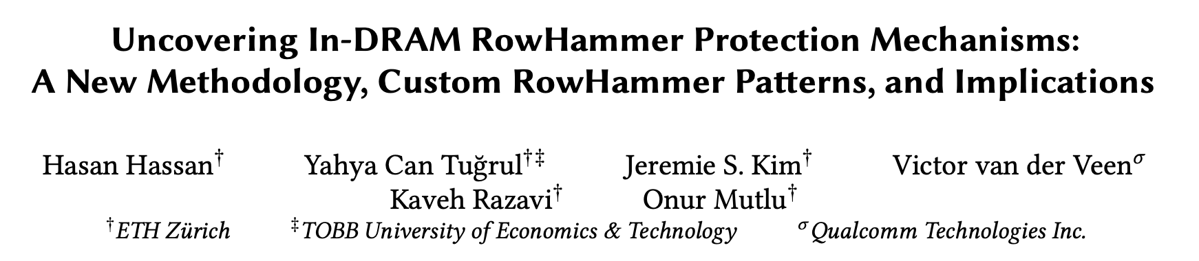
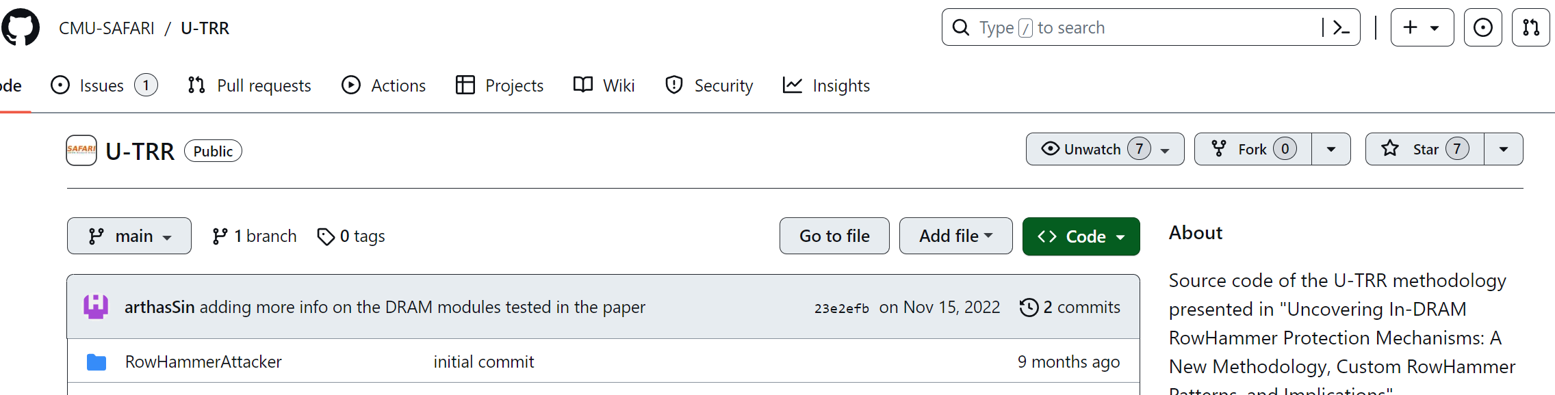
On-Die RowHammer Mitigation Analysis (II)
Hassan et al., "Uncovering In-DRAM RowHammer Protection Mechanisms:
A New Methodology, Custom RowHammer Patterns, and Implications,” in MICRO, 2021.
Key idea: Use data retention failures as a side channel
to detect when a row is refreshed by on-die mitigation
[Hassan+, MICRO’21, source code available at https://github.com/CMU-SAFARI/U-TRR]
Notes:
We use the methodology presented in this paper
[CLICK] Where the key idea is to use data retention failures as a side channel to detect when a row is refreshed by the on-die mitigation mechanism
[CLICK] We re-use the source code that is publicly available on this Github page.

Slide 43
Experimental Methodology
1. Identify a row (R) with T retention time
2. Wait for T/2
3. Hammer R+1 once
Sample as aggressor row
4. Issue a periodic REF command (trigger mitigation)
5. Wait for T/2, read out row R and check for bitflips
On-DRAM-die
Mitigation
Aggressor Row R + 1
Victim Row R
Refresh victim row
Refresh R
Mitigation refreshes R
Read R
time = 0
time = T/2
time = T
Timeline
[Hassan+, MICRO’21]
Notes:
Our experiment first
[CLICK] finds a DRAM row R with a retention time of T. This means that the row will harbor retention failures if we do not refresh its content for T units of time.
[CLICK] On the bottom we show a timeline of actions taken by us and the currently-hypothetical on-die mitigation mechanism. Initially, the row R is refreshed, so it can retain data correctly until time is T.
[CLICK] We wait for half T.
[CLICK] We activate and precharge R+1 (which is adjacent to R) once.
[CLICK] Let’s now look at what a hypothetical on-die mitigation would do
[CLICK] It will sample the hammering of R+1 as an aggressor row activation
[CLICK] after which we issue a periodic refresh command (to trigger the mitigation)
[CLICK] If the mitigation sampled R+1 as an aggressor row, it will refresh R as the victim row
[CLICK] We then wait for half T, read out row R and check for bitflips in row R.

Slide 44
Experimental Methodology
1. Identify a row (R) with T retention time
Row R experiences no bitflips
only if on-DRAM-die mitigation exists
2. Wait for T/2
3. Hammer R+1 once
Sample as aggressor row
4. Issue a periodic REF command (trigger mitigation)
5. Wait for T/2, read out row R and check for bitflips
On-DRAM-die
Mitigation
Aggressor Row R + 1
Victim Row R
Refresh victim row
Refresh R
Mitigation refreshes R
Read R
time = 0
time = T/2
time = T
Timeline
[Hassan+, MICRO’21]
Notes:
Row R will not experience any bitflips
Only if on-DRAM-die mitigation exists and has refreshed R at half T

Slide 45
Experimental Methodology
1. Identify a row (R) with T retention time
Row R experiences no bitflips
only if on-DRAM-die mitigation exists
2. Wait for T/2
3. Hammer R+1 once
Sample as aggressor row
4. Issue a periodic REF command (trigger mitigation)
5. Wait for T/2, read out row R and check for bitflips
On-DRAM-die
Mitigation
Row R experiences retention bitflips
if not refreshed at T/2
Aggressor Row R + 1
Victim Row R
Refresh victim row
retention bitflips
Refresh R
Row R not refreshed
Read R
time = 0
time = T/2
time = T
Timeline
[Hassan+, MICRO’21]
Notes:
Otherwise, row R will experience retention bitflips because it was not refreshred for T units of time.

Slide 46
HBM2 DRAM Chips Implement Undisclosed TRR
The HBM2 chip implements an undisclosed
on-die RowHammer mitigation mechanism
This mechanism performs a victim row refresh operation
every 17 periodic refresh (REF) operations
This mitigation resembles the one in DDR4 chips
from one major manufacturer
Notes:
We perform this experiment and find that
[CLICK] the HBM2 chip implements an undisclosed on-die mitigation mechanism
[CLICK] This mechanism performs a victim row refresh operation after every 17 periodic refresh operations.
[CLICK] Which resembles a TRR mechanism implemented in real DDR4 chips from one major manufacturer.
We intend to uncover more about the inner workings of this TRR mechanism as part of our future work

Slide 47
Outline
1. HBM DRAM Organization & Operation
2. DRAM Cell Leakage & RowHammer
3. HBM DRAM Testing Methodology
4. RowHammer Spatial Variation Analysis
5. On-die RowHammer Mitigation Analysis
6. Conclusion
Notes:
I will conclude my talk with a brief summary

Slide 48
Conclusion
We provide the first detailed experimental characterization
of RowHammer in a modern HBM2 DRAM chip
Different channels in 3D-stacked HBM chips exhibit different RowHammer vulnerability
DRAM rows near the end of a DRAM bank are more RowHammer resilient
Two implications for RowHammer attacks and mitigations:
Faster and more effective attacks
More efficient mitigations
A modern HBM chip implements undisclosed on-DRAM-die RowHammer mitigation
(e.g., similar to DDR4 chips)
Future Directions: To present more insights into how RowHammer behaves in HBM
Test more HBM DRAM chips, data patterns, at different temperature and voltage levels
Investigate read-disturb-based interference across different 3D-stacked HBM DRAM channels
Study the effects of the new read-disturb phenomenon, RowPress [Luo+, ISCA’23]
Luo et al., ”RowPress: Amplifying Read Disturbance in Modern DRAM Chips," in ISCA, 2023.
Notes:
We provide the first detailed experimental characterization of RowHammer in a modern HBM2 DRAM chip
We find that
[CLICK] different channels exhibit different vulnerability, and
[CLICK] DRAM rows near the end of a bank are more resilient.
[CLICK] These findings can be leveraged to develop powerful attacks and more efficient defenses
[CLICK] We identify an on-die RowHammer mitigation mechanism in HBM2 chips. This mechanism resembles existing ones found in DDR4 chips.
[CLICK] To present more insights into RowHammer’s behavior in high bandwidth memory,
We plan to test more chips and data patterns, and at different temperature and voltage levels
[CLICK] Investigate the effects of read-disturb interference across 3D-stacked channels.
[CLICK] Study effects of new read-disturb phenomenon such as RowPress that was very recently presented at ISCA

Slide 49
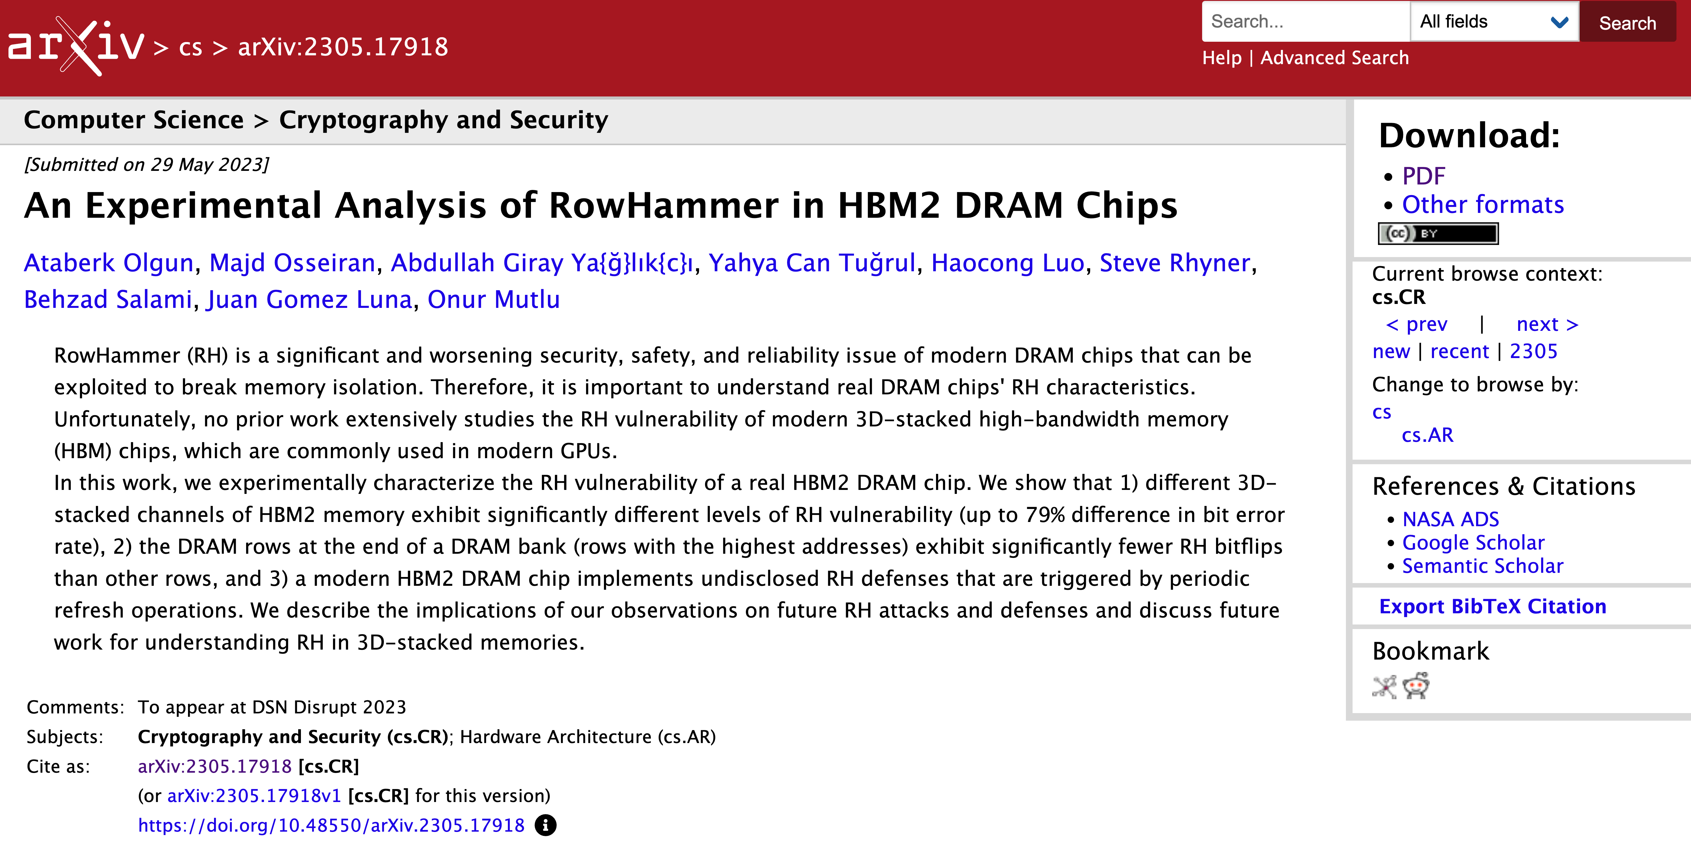
Available on ArXiv
https://arxiv.org/abs/2305.17918
Notes:
A version of our conference paper is available on arXiv on this link.

Slide 50

An Experimental Analysis of
RowHammer in HBM2 DRAM Chips
Link/QR code to full paper
https://arxiv.org/pdf/2305.17918
Ataberk Olgun Majd Osseiran
A. Giray Yağlıkçı
Yahya Can Tuğrul
Steve Rhyner
Haocong Luo
Behzad Salami
Juan Gomez Luna
Onur Mutlu
Notes:
Thank you very much for your attention. I will be happy to take your questions now.

Slide 51
Publicly-available HC_{first} Values
HC_{first} Scale
HC_{first} = ∞
(all good)
HC_{first} = 1
(DRAM is doomed)
HBM2 @ 14K
[This work]
DDR3 @ 139K
[Kim+, ISCA’14]
LPDDR4 @ 4.8K
[Kim+, ISCA’20]
DDR4 @ 10K
[Kim+, ISCA’20]
DDR3 @ 24K
[Kim+, ISCA’20]
*Not shown: Significant variance in HC_{first} across vendors and die variations

Slide 52
3. Hammer Count (HC) Effects
RowHammer bit flip rates increase
when going from old to new DDR4 technology node generations
RowHammer bit flip rates (i.e., RowHammer vulnerability)
increase with technology node generation
[Kim+, ISCA’20]
Notes:
We plot each of these curves across our DRAM type-node configurations per manufacturer
[CLICK] We find that newer DDR4 DRAM technology nodes show a clear trend of increasing RowHammer bit flip rates.
the same Hammer count value causes an increased RowHammer bit flip rate from DDR4-old to DDR4-new DRAM chips of all DRAM manufacturers
[CLICK] This indicates that RowHammer bit flip rates are increasing with newer technology node generations.
=======
spend more time.
Stronger second conclusion. Clear from this that rh bit flips increase with technology node generation. and we show DDR4 as an example.
rowhammer bit flip rates are increasing when going from old to new DDR4 technology nodes.

Slide 53
Mitigation Mechanism Evaluation
10⁵
10⁴
10³
10²
Ideal
TWiCe-ideal
PARA
LPDDR4-1x
LPDDR4-1y
DDR3-old
DDR3-new
DDR4-new
DDR4-old
10⁵
10⁴
10³
10²
HC_{first} (number of hammers required to induce first RowHammer bit flip)
Ideal mechanism is significantly better
than any existing mechanism for HC_{first} < 1024
Significant opportunity for developing a RowHammer solution
with low performance overhead that supports low HC_{first}
[Kim+, ISCA’20]
Notes:
We find that the ideal refresh-based mitigation mechanism is significantly better than any existing mechanism as HCFirst reduces below 1024 .
[CLICK] And this indicates significant opportunity for developing a RowHammer solution with low performance overhead that also scales to low HCFirst values

Slide 54
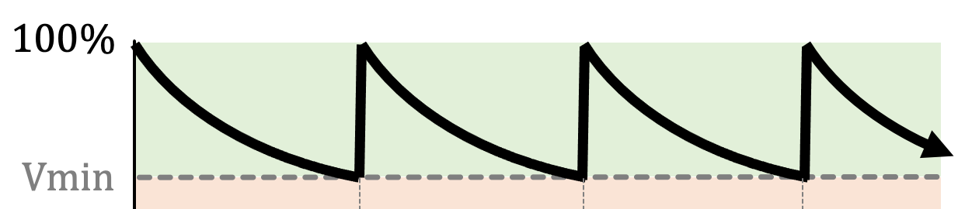
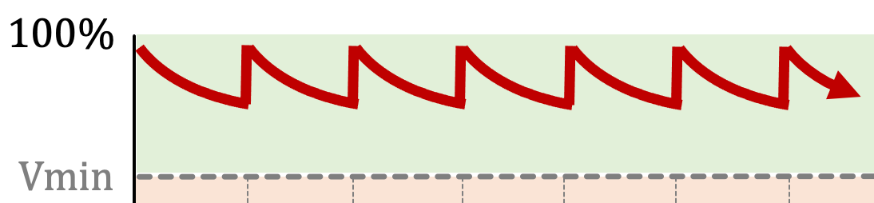

RowHammer Solution Approaches
More robust DRAM chips and/or error-correcting codes
Increased refresh rate
Physical isolation
Reactive refresh
Proactive throttling
Fewer activations possible
in a refresh interval
DRAM Bank
Aggressor Row
Isolation Rows
Large-enough distance
Cost, Power, Performance, Complexity
Victim Rows
DRAM Bank
Victim Rows
Refresh
Aggressor Row
Rapidly activated (hammered)
Victim rows
Refresh
Fewer activations allowed for aggressive applications
Notes:
There are four high-level RowHammer mitigation approaches.
[CLICK] The first approach is to increase refresh rate
[CLICK] which reduces the refresh window,
[CLICK] and thus the activation count that an attacker can reach in a refresh window.
[CLICK] The second approach is to physically isolate
[CLICK] potential victim rows with sensitive data
[CLICK] from aggressor rows that a potential attacker can hammer
[CLICK] by allocating isolation rows in between
such that the attacker cannot disturb sensitive data by performing RowHammer attack.
[CLICK] The third approach is reactive refresh.
[CLICK] In this approach, when an aggressor row is hammered
[CLICK] potential victim rows are refreshed to avoid bit-flips.
[CLICK] Finally the fourth approach suggests
[CLICK] throttling or slowing down memory accesses proactively such that no row’s activation rate can reach RowHammer threshold.

Slide 55

More Security Implications (I)
“We can gain unrestricted access to systems of website visitors.”
Rowhammer.js: A Remote Software-Induced Fault Attack in JavaScript (DIMVA’16)
Source: https://lab.dsst.io/32c3-slides/7197.html

Slide 56

More Security Implications (II)
  “Can gain control of a smart phone deterministically”
Drammer: Deterministic Rowhammer Attacks on Mobile Platforms, CCS’16
Source: https://fossbytes.com/drammer-rowhammer-attack-android-root-devices/

Slide 57
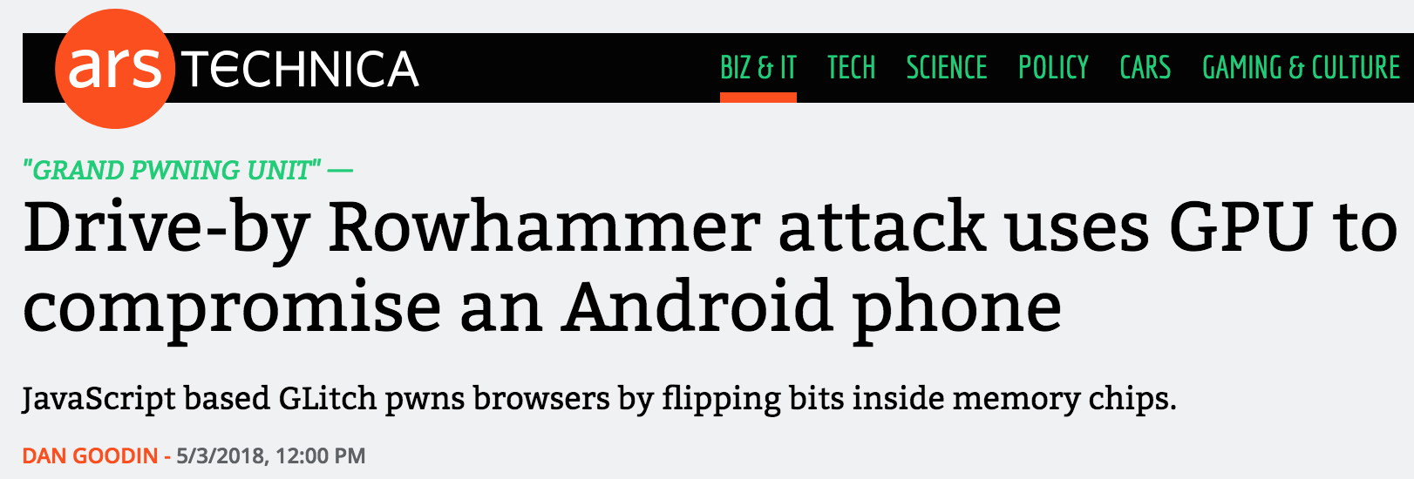

More Security Implications (III)
Using an integrated GPU in a mobile system to remotely escalate privilege via the WebGL interface. IEEE S&P 2018

Slide 58
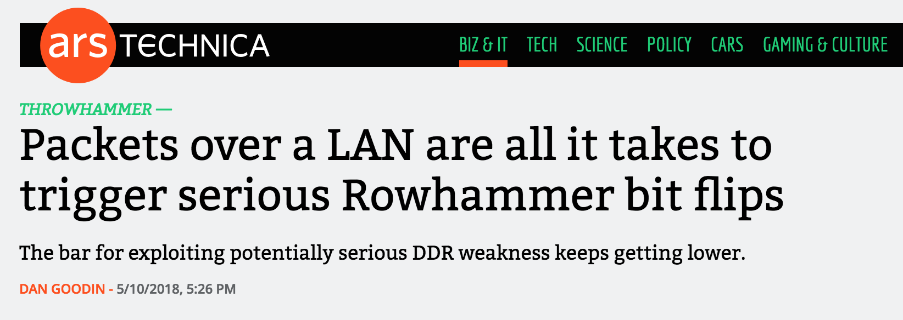
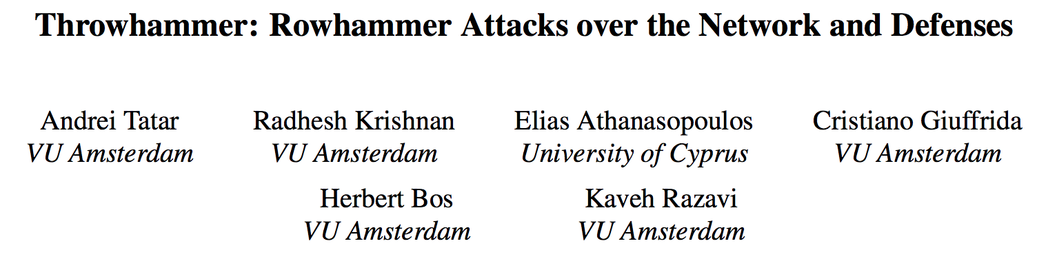
More Security Implications (IV)
Rowhammer over RDMA (I) USENIX ATC 2018

Slide 59



More Security Implications (V)
Rowhammer over RDMA (II)

Slide 60


More Security Implications (VI)
IEEE S&P 2020

Slide 61
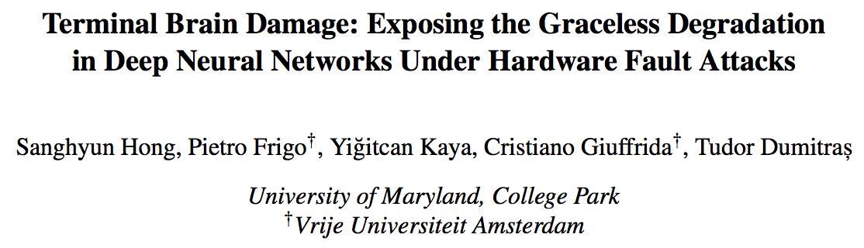
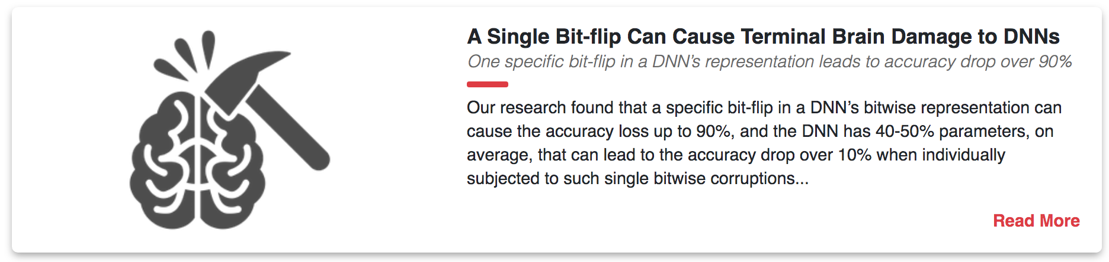
More Security Implications (VII)
USENIX Security 2019

Slide 62
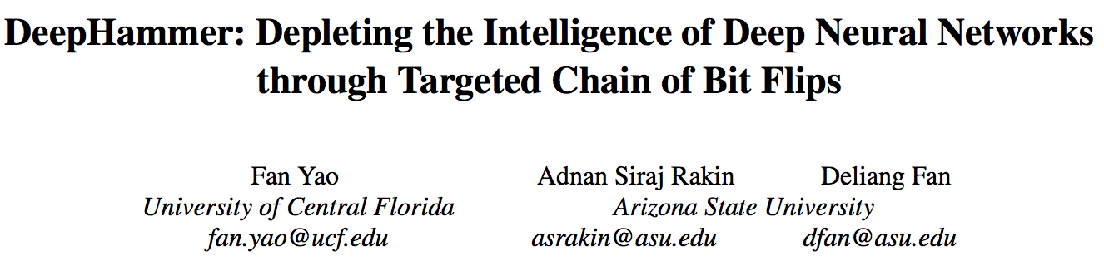
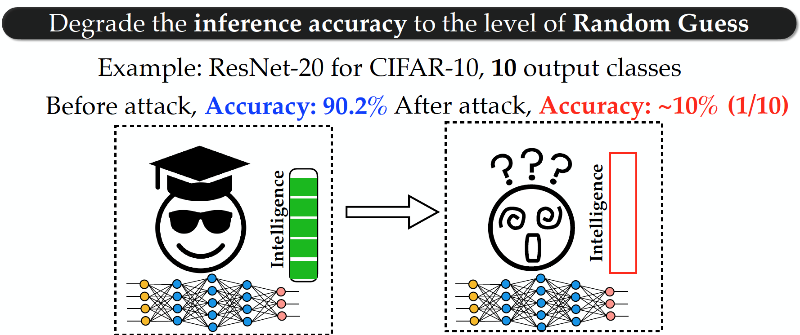
More Security Implications (VIII)
USENIX Security 2020

Slide 63

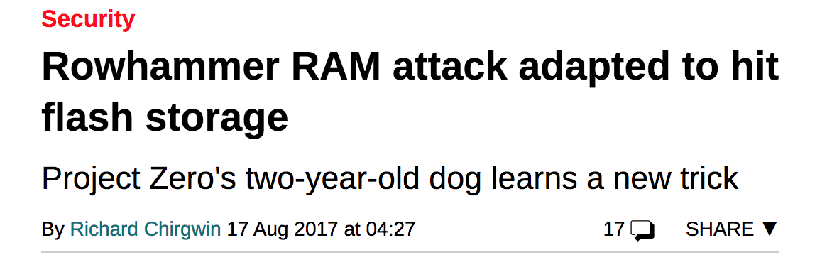
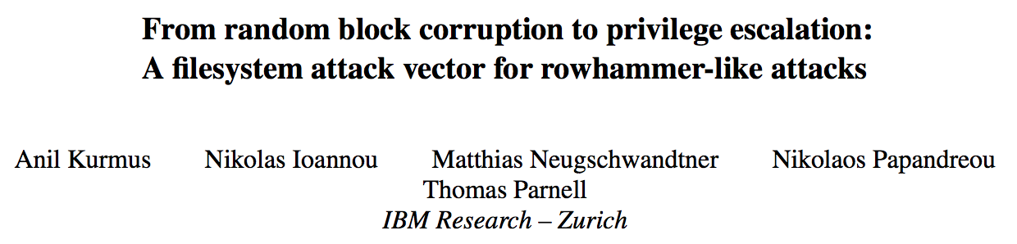
More Security Implications (IX)
Rowhammer on MLC NAND Flash (based on [Cai+, HPCA 2017])

Slide 64
DRAM Array Layout
Top View
Cross Section
Cell
Active Region
Bitline
Contact
BL
Capacitor
Wordline
Cell
SN
n+
WL
Storage Node (SN)
Channel
Bitline
P-Well

Slide 65
Mechanism 0: Reflecting Electric Field
BL
WL
P-Well
P-Well
N-Substrate

Slide 66
Mechanism 1: Electron Injection
BL
BL
e⁻
e⁺
A
V
Precharge
e⁻
e⁻
WL
e⁻
e⁻
e⁻
WL
e⁻
e⁻
e⁻
e⁻
e⁻
e⁻
e⁻
e⁻
e⁻
e⁻
P-Well
P-Well
Aggressor ACT
Recombination

Slide 67
Mechanism 2: Electron Drift
BL
BL
e⁻
e⁺
A
V
e⁻
e⁻
e⁻
e⁻
WL
WL
e⁻
e⁻
e⁻
e⁻
e⁻
e⁻
e⁻
e⁻
e⁻
e⁻
e⁻
e⁻
e⁻
e⁻
P-Well
P-Well
Aggressor ACT
Electron Drift

Slide 68
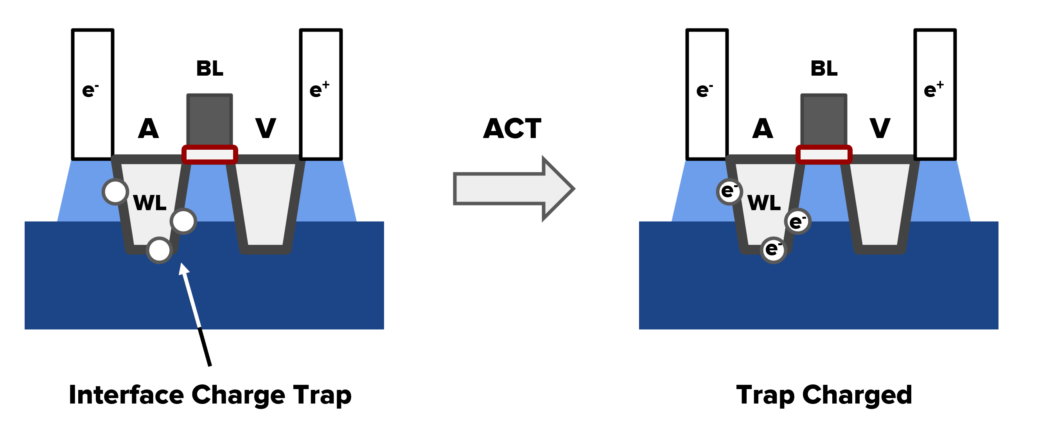
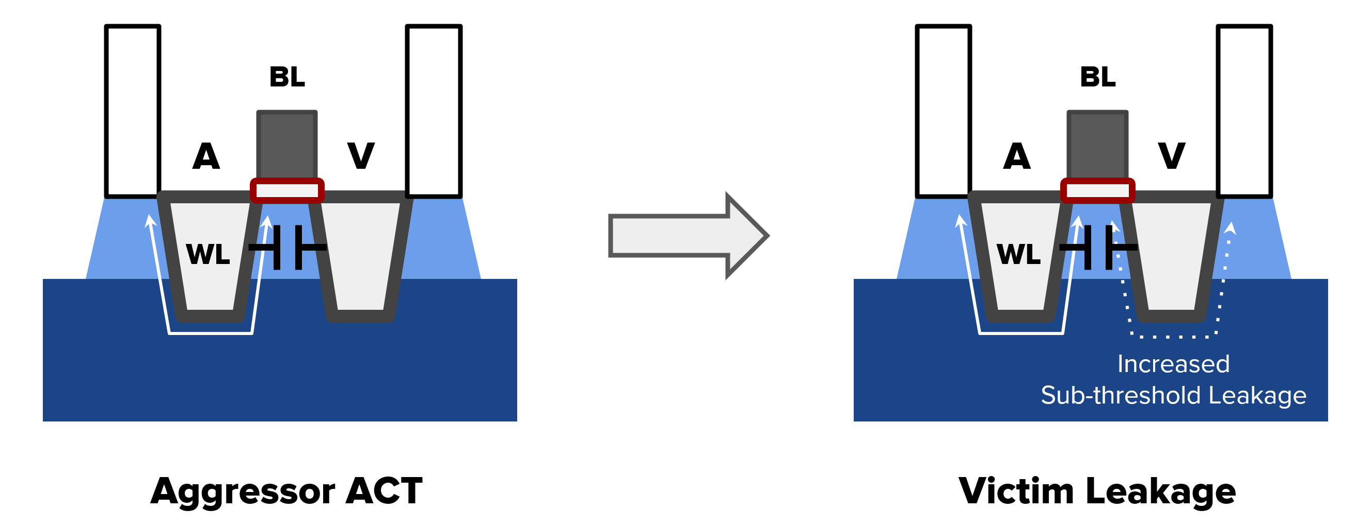
More
Charge traps
Wordline Crosstalk

Slide 69
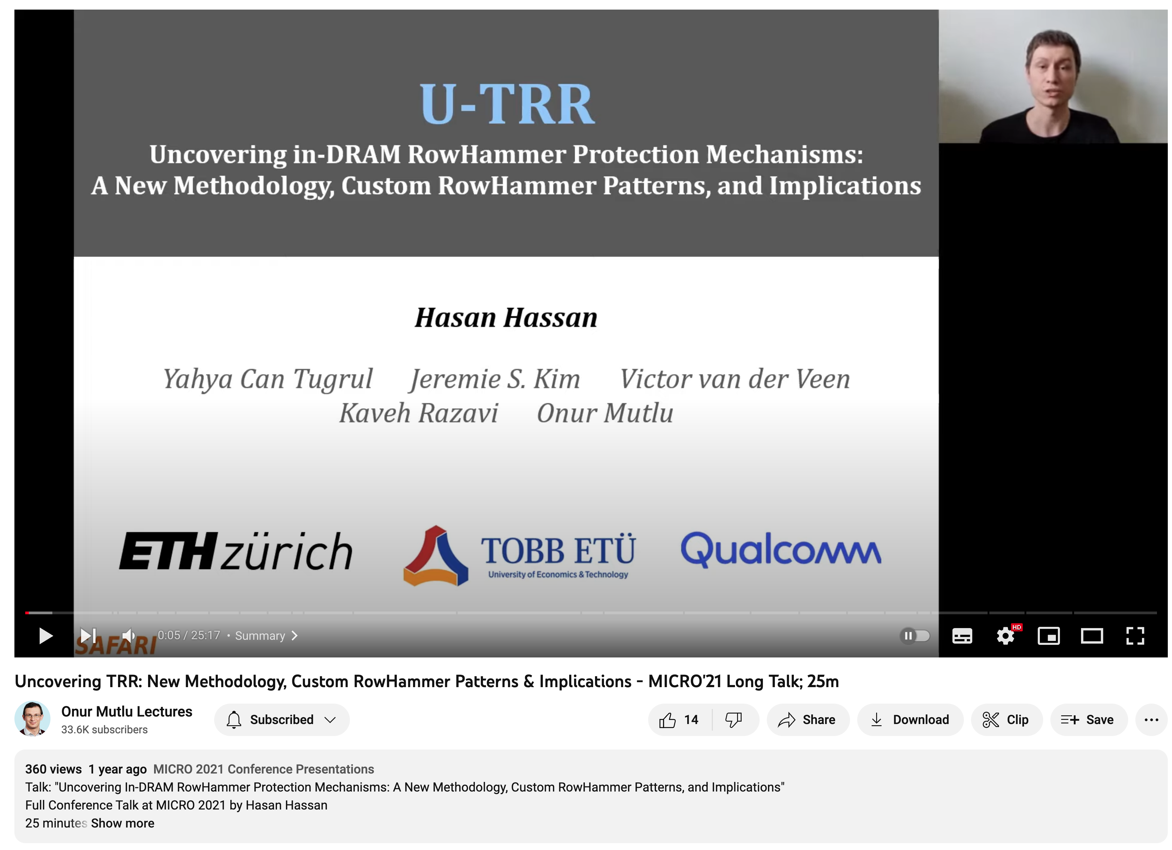
More on U-TRR
https://youtu.be/YkBR9yeLHRs

Slide 70
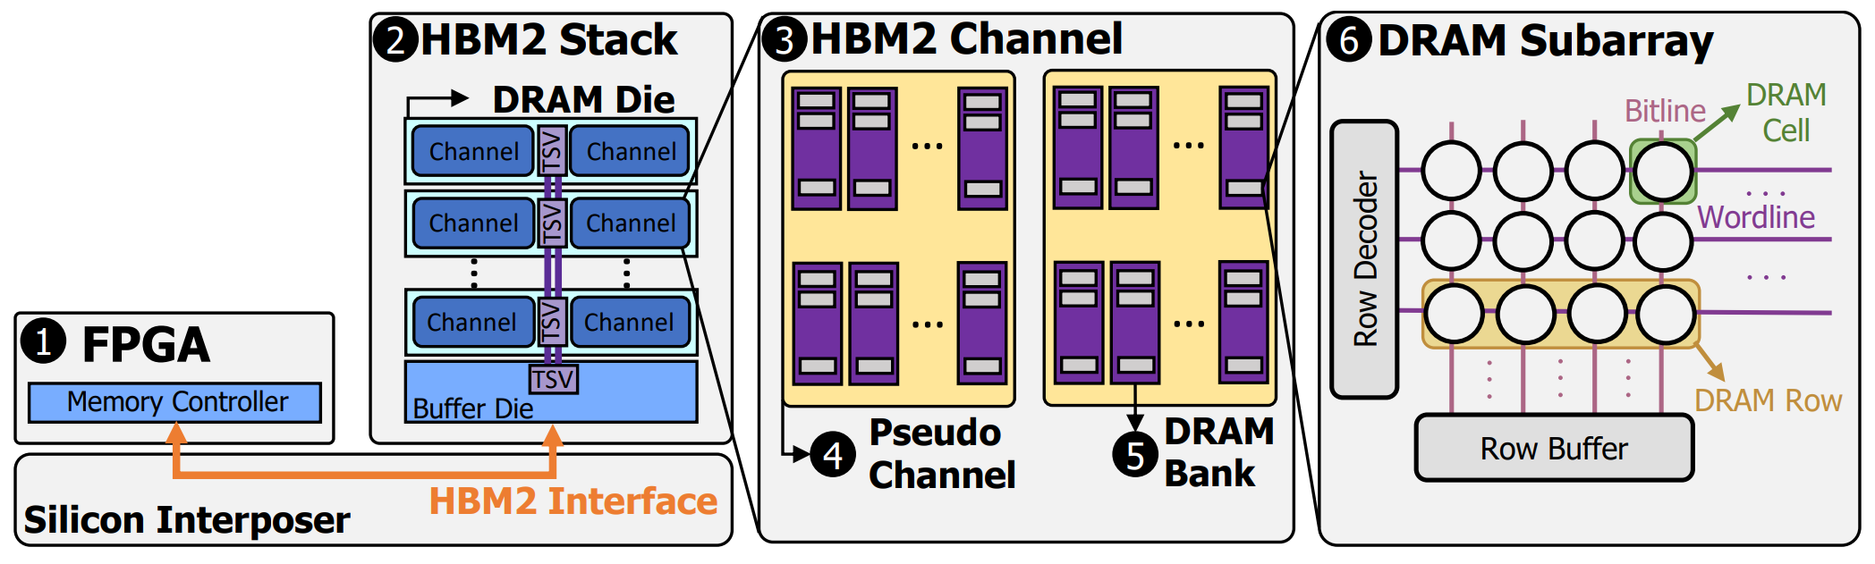
HBM2 Organization

Slide 71
Cell-to-Cell Variation
Different RowHammer vulnerabilities
100%
Vmin
Capacitor voltage (Vdd)
0%
REF
REF
REF
time
Some cells are more vulnerable
due to process variation and design-induced variation
Notes:
We note that due to manufacturing variation in DRAM circuit elements, [CLICK] different cells are affected by RowHammer at varying degrees. We see that we are able to Induce a RowHammer bit flip in the cells represented by the black and blue curves but not the green curve

Slide 72
Variation in Bit Error Rate
Mean BER (y) and BER variation (x) across rows in one bank
Variation in BER
across rows decrease
Variation in BER
across rows increase
Notes:
This plot will show the mean bit error rate and the variation in bit error rate across rows in each tested DRAM bank.
[CLICK] As we go left on the x-axis the variation in bit error rate decreases, meaning that the bit error rate of rows in the DRAM bank becomes closer to each other.
[CLICK] Here is where one bank resides on this plot. We use different shapes to indicate which pseudo-channel and different colors to indicate which channel the bank comes from. Therefore this point on the plot is in channel 6 and pseudo-channel 1.
[CLICK] We plot one point for each bank in all channels and pseudo-channels
[CLICK] Here is the complete plot

Slide 73
Variation in Bit Error Rate
Small distance on x and y axes
Two different banks in the same channel
Large distance on x and y axes
Banks in the same channel have similar variation in BER
Notes:
We see that banks in the same channel have similar variation in bit error rate. Here I highlight two different banks in the same channel as an example.
[CLICK] To visualize this observation, here are two different lines that show the distance between two banks from the same channel and two banks from different channels.
The points for banks in the same channel are significantly closer to each other than banks in different channels.

