Slide 1







Accelerating Long-Latency Load Requests
via Perceptron-Based Off-Chip Load Prediction
Rahul Bera, Konstantinos Kanellopoulos, Shankar Balachandran,
David Novo, Ataberk Olgun, Mohammad Sadrosadati, Onur Mutlu
https://github.com/CMU-SAFARI/Hermes

Slide 2
The Key Problem
Long-latency off-chip load requests
Often stall processor by
blocking instruction retirement from
Reorder Buffer (ROB)
Limit performance
Notes:
The key problem that we are trying to address in this work is stemming from Off-chip load request
[CLICK] As we know, these off-chip load requests often stall…,
[CLICK] which severely limits the performance of a core.

Slide 3

Traditional Solutions
1
Employ sophisticated prefetchers
2
Increase size of on-chip caches
Notes:
Architects have primarily relied on two key techniques to reduce latency of such loads:
[CLICK] By employing sophisticated data prefetchers
[CLICK] And Increasing size of the on-chip cache hierarchy

Slide 4
Key Observation 1
Many loads still go off-chip
50%
still go off-chip even with
a state-of-the-art prefetcher
50%
successfully prefetched
70% of the off-chip loads
block the ROB
# off-chip loads without any prefetcher
Notes:
In this work, we show that prior prefetchers successfully prefetch a significant fraction of the off-chip load requests.
[CLICK] However, nearly 50% of the off-chip loads in a system without any prefetcher are still going off-chip even in presence of a state-of-the-art prefetcher
[CLICK] And 70% of these off-chip loads even block the ROB.

Slide 5
Key Observation 2
50% still go off-chip
On-chip cache access latency
significantly contributes to off-chip load latency
L1
L2
LLC
Main Memory
L1
L2
LLC
Main Memory
Saved cycles
40% of the stalls can be eliminated by removing
on-chip cache access latency from critical path
Notes:
Now, if we focus on the off-chip loads that are still going to the main memory even in presence of a state-of-the-art prefetcher,
We observe that the on-chip cache access latency…
[CLICK] We show that nearly 40% of …

Slide 6
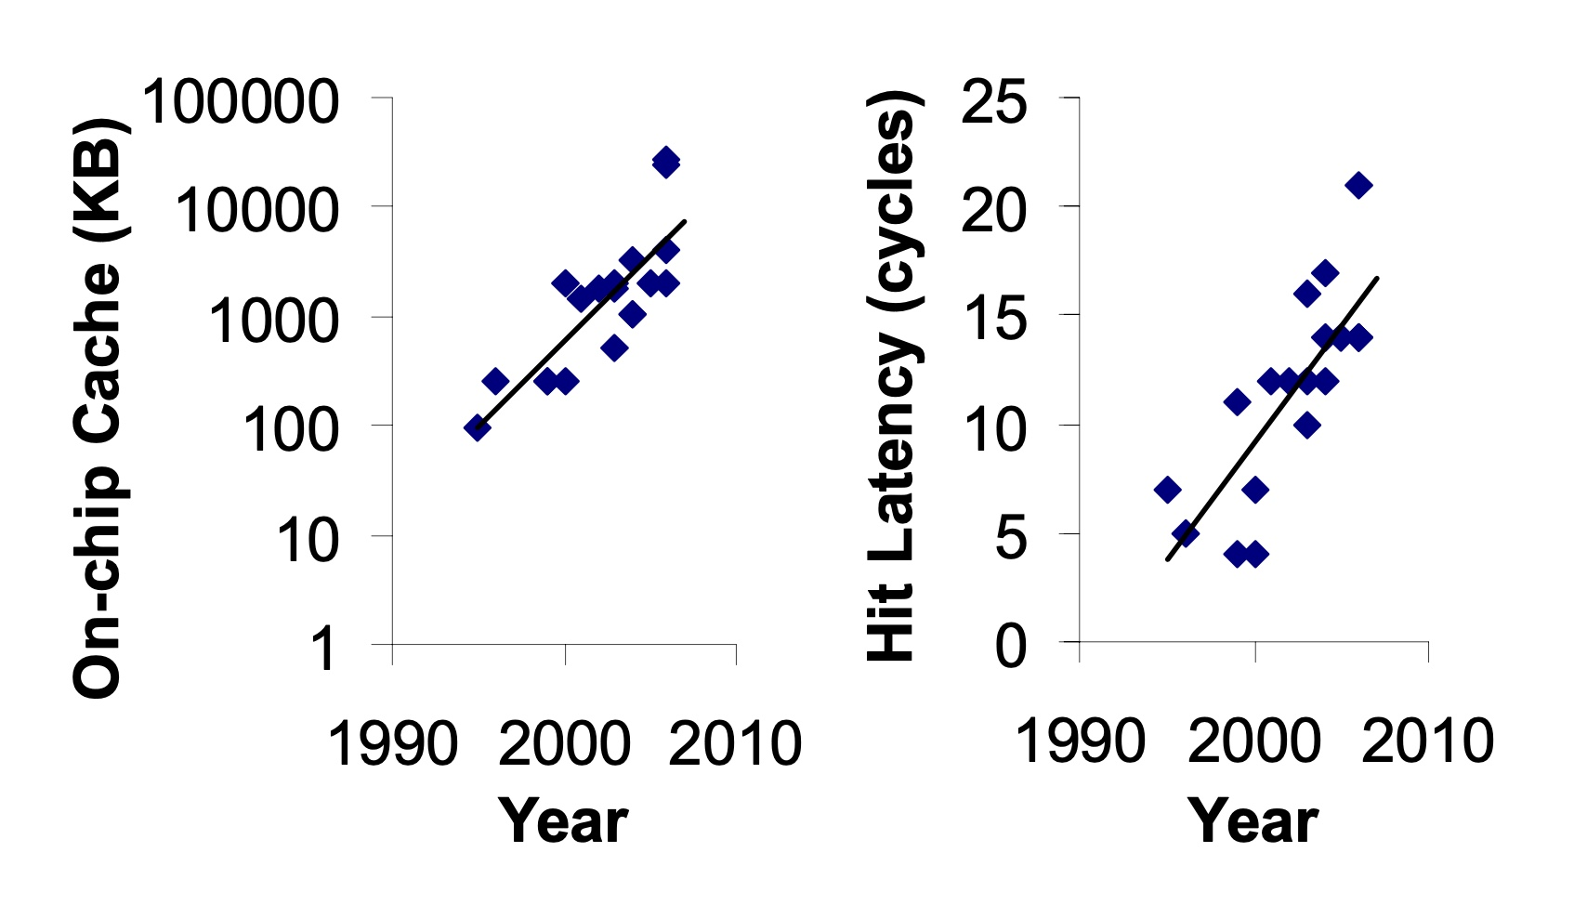
Caches are Getting Bigger and Slower…
On-chip Cache Size (KB)
Hardavellas+, “Database Servers on Chip Multiprocessors: Limitations and Opportunities”, CIDR, 2007
Notes:
As the cache hierarchy continue to grow in size and complexity, as noted by previous works,
As well as a trend that we see in recent processors,
This problem is only going to get exacerbated even more in future generation processors

Slide 7
Our Goal
Improve processor performance
by removing on-chip cache access latency
from the critical path of off-chip loads
Notes:
Thus to alleviate this problem, the goal of our work is to improve…

Slide 8

Predicts which load requests
are likely to go off-chip
Starts fetching data directly from main memory while concurrently accessing the cache hierarchy
Notes:
Towards this we propose Hermes, which is based on two key ideas.
[CLICK] Hermes predicts which…
[CLICK] Hermes starts fetching …

Slide 9




Key Contribution
Hermes employs the first
perceptron-based off-chip load predictor
That predicts which loads are likely to go off-chip
By learning from
multiple program context information
Notes:
To enable accurate off-chip prediction,
Hermes employs the first perceptron-based off-chip load predictor
[CLICK] that identifies loads …
[CLICK] by only learning from multiple…

Slide 10
Hermes Overview
Core
Latency tolerance limit of ROB
L1-D
Baseline
Processor is stalled
L2
L1
L2
LLC
Main Memory
LLC
MC
Off-Chip
Main Memory
Notes:
Now let me give you a brief overview of Hermes.
This is how a traditional cache hierarchy looks like in today’s processor.
[CLICK] And this is how the memory latency timeline looks like for an off-chip load in the baseline system
[CLICK] If the ROB has a latency tolerance limit up till here, the processor stalls for the remaining cycles

Slide 11




Hermes Overview
Perceptron-based
off-chip load predictor
Predict
Core
POPET
Train
Latency tolerance limit of ROB
L1-D
Issue a Hermes request
Baseline
Processor is stalled
L2
L1
L2
LLC
Main Memory
LLC
Hermes
L1
L2
LLC
Wait
Saved stall cycles
MC
Main Memory
Off-Chip
Main Memory
Notes:
Now Hermes employs an off-chip predictor named POPET.
[CLICK] For every load generated in the core, Hermes consults POPET to predict whether this load would go off-chip or not
[CLICK] If the load is predicted to go off-chip, Hermes waits for the address translation to finish, which happens in parallel with L1 cache access
[CLICK] And then issues a speculative memory request, which we call a Hermes request,
directly to the main memory controller to start fetching the data from the main memory,
While also concurrently accessing the cache hierarchy for such a load.
[CLICK] If the off-chip prediction is correct, the load would eventually miss the LLC and arrive at the memory controller
Where it will simply wait for the ongoing Hermes request to finish, thus hiding the entire cache access latency from its critical path.
Once the data returns from the main memory, Hermes returns the data to the core [CLICK],
Thus, saving the precious stall cycles induced by the off-chip load [CLICK], which in turn provides performance benefit.
[CLICK] Hermes trains POPET when the data finally returns to the core, closing the feedback loop.

Slide 12

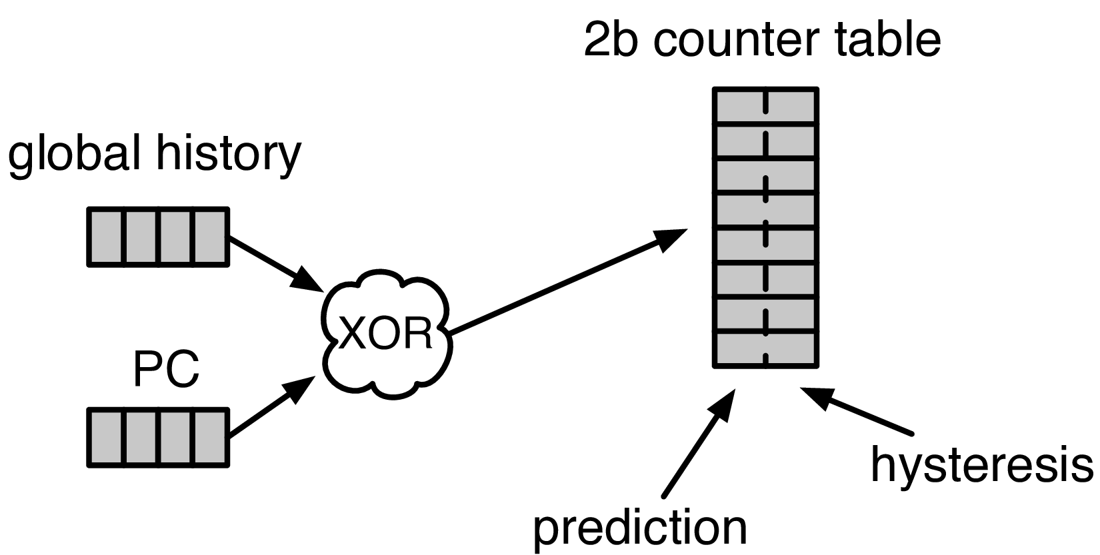


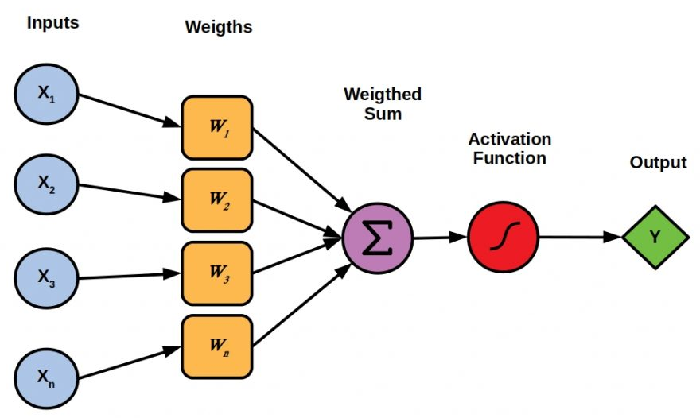

Designing the Off-Chip Load Predictor
History-based prediction
HMP [Yoaz+, ISCA’99] for the L1-D cache
Using branch-predictor-like hybrid predictor:
Global, Gshare, and GSkew
POPET provides
both higher accuracy and higher performance
than predictors inspired from these previous works
Tracking cache contents
MissMap [Loh+, MICRO’11] for the DRAM cache,
D2D [Sembrant+, ISCA’14], D2M [Sembrant+, HPCA’17], LP [Jalili+, HPCA’22] for the cache hierarchy
  Large metadata
  Metadata size increases with cache hierarchy size
  May need to track all cache operations
  Gets complex depending on the cache hierarchy configuration (e.g., inclusivity, bypassing,…)
Learning from program behavior
  Correlate different program features with off-chip loads
Low storage overhead
Low design complexity
Notes:
Now let’s discuss how to design this off-chip predictor.
So, there are multiple prior works that can be used either directly or with small modifications for off-chip load prediction.
These works can be broadly categorized into two classes.
[CLICK] History-based predictor introduced by HMP, uses a branch-predictor like hybrid predictor design
to identify which requests are going to miss L1 cache.
We can easily extend HMP’s design to predict loads that are going to miss the entire cache hierarchy.
[CLICK] Tracking-based methods, on the other hand, explicitly track cache contents
to predict which load requests are going to miss the cache hierarchy.
[CLICK] These tracking-based methods poses two key challenges…
[CLICK] First,…
[CLICK] Second,…
[CLICK] POPET takes a completely different approach to predict off-chip load requests by learning from program behavior.
[CLICK] It aims to correlate multiple different types of program features with off-chip load requests
to provide accurate predictions with much lower storage overhead and design complexity.
[CLICK] In our paper, we compare POPET against predictors inspired from these prior works and show that
[CLICK] POPET provides both higher accuracy and performance than them.

Slide 13

POPET: Perceptron-Based Off-Chip Predictor
Multi-feature hashed perceptron model^{[1]}
  Each feature has its own weight table
    Stores correlation between feature value and off-chip prediction
[1] D. Tarjan and K. Skadron, “Merging Path and Gshare Indexing in Perceptron Branch Prediction,” TACO, 2005
Notes:
Now let’s deep dive into our off-chip predictor design.
Our predictor, named as POPET, is designed using hashed-perceptron model.
[CLICK] where each feature has its own weight table
That stores the correlation between feature value and the off-chip prediction

Slide 14

Predicting using POPET
Uses simple table lookups, addition, and comparison
42
-4
0x7ffe0+12
3
3 >= -2
Predict that the load would go off-chip
Extract features from the load request
12
-5
Notes:
Hermes predicts using POPET using simple operations like table lookup, addition, and comparison.
Let me give you an example on how POPET’s prediction works.
POPET’s prediction works in three stages.
[CLICK] In the first stage, POPET extracts the features from the load request
[CLICK] In the second stage, each feature value is hashed and used as an index to retrieve the weights from each individual weight tables
[CLICK] In the third stage, the retrieved weights are accumulated and the cumulative weight is used to compute the activation function.
[CLICK] If the cumulative weight is higher than the activation threshold, POPET predicts that the load would go off-chip.

Slide 15
Training POPET
Uses simple increment or decrement of feature weights
42
-1
-4
0x7ffe0+12
3
3 >= -2
Predict that the load would go off-chip
-1
12
Shouldn’t be activated
-5
Cumulative weight < 𝜏_{act}
-1
Notes:
Now let’s understand how to train POPET.
For this let’s assume the previous example where the load is predicted to go off-chip.
[CLICK] But in reality, the load didn’t go off-chip
[CLICK] this means the activation which have triggered before, shouldn’t have triggered
Which means, the cumulative weight should be lower than the activation threshold
[CLICK] Now to adjust the feature weights, POPET again indexes each weight table using the hashed feature values
[CLICK] And simply decrement each weight from the individual weight tables.
Thus, by using simple increment and decrement operations, POPET continuously learns from program behavior to accurately predict off-chip loads.

Slide 16
Evaluation
Notes:
Now let’s evaluate Hermes.

Slide 17
Simulation Methodology
ChampSim trace driven simulator
110 single-core memory-intensive traces
  SPEC CPU 2006 and 2017
  PARSEC 2.1
  Ligra
  Real-world applications
220 eight-core memory-intensive trace mixes
LLC Prefetchers
Off-Chip Predictors
Pythia [Bera+, MICRO’21]
Bingo [Bakshalipour+, HPCA’19]
MLOP [Shakerinava+, 3rd Prefetching Championship’19]
SPP + Perceptron filter [Bhatia+, ISCA’20]
SMS [Somogyi+, ISCA’06]
History-based: HMP [Yoaz+, ISCA’99]
Tracking-based: Address Tag-Tracking based Predictor (TTP)
Ideal Off-chip Predictor
Notes:
We evaluate Hermes using ChampSim simulator,
[CLICK] using a wide range of memory-intensive traces spanning across SPEC CPU, PARSEC, Ligra, and real-world applications
[CLICK] We compare Hermes with five LLC prefetchers
[CLICK] and two off-chip predictors extended from prior works

Slide 18

Latency Configuration
Cache round-trip latency
  L1-D: 5 cycles
  L2: 15 cycles
  LLC: 55 cycles
Hermes request issue latency (incurred after address translation)
Depends on
  Interconnect between POPET and MC
0 cycles
24 cycles
6 cycles
Notes:
For our evaluation, we consider
[CLICK] a 5 cycle L1-D
[CLICK] 15 cycle L2
[CLICK] and 55 cycle LLC round-trip latency.
[CLICK] The latency for Hermes to issue a request directly to the main memory controller (after the address translation) depends on …
[CLICK] For this reason we sweep this latency from 0-cycles to 24-cycles in our paper.
[CLICK] But in this presentation, I am going to show you results considering a 6-cycle latency.

Slide 19
Single-Core Performance Improvement
5.4%
20.3%
11.5%
Hermes alone provides nearly
50% performance benefits of Pythia
with only 1/5th storage overhead
Hermes provides nearly 90% performance benefit of Ideal Hermes that has an ideal off-chip load predictor
Hermes on top of Pythia
outperforms Pythia alone in every workload category
Notes:
Let’s first analyze the single-core performance improvement.
[CLICK] This is how Hermes and a state-of-the-art prefetcher Pythia improves performance on top of a no-prefetching system.
[CLICK] The first takeaway is that Hermes alone provides nearly 50%...
[CLICK] Now if we combine Hermes with Pythia, that provides an additional 5.4% performance improvement on top of a strong baseline that has Pythia.
[CLICK] And finally, if we compare Hermes’s performance benefit with the Ideal Hermes that has an ideal off-chip predictor,
We see that Hermes provides nearly 90% performance benefit of the Ideal Hermes

Slide 20
Increase in Main Memory Requests
20.3%
5.4%
11.5%
For every 1% performance benefit,
increase in main memory requests
Pythia
2%
5.9%
Hermes on top of Pythia
1%
38.5%
Hermes alone
0.5%
5.5%
Hermes is more bandwidth-efficient
than even an efficient prefetcher like Pythia
Notes:
This performance improvement comes at a cost of increase in main memory requests.
This graph shows the increase in the main memory request over the no-prefetching system provided by the three configurations.
[CLICK] As we can see, Hermes increases the main memory requests by 5.5% on average on top of the no-prefetching system..
Whereas Pythia increases …
If we combine two together, then it increases the main memory request by an additional 5.9%.
[CLICK] Now, if we compare this increase in the main memory request with the performance improvement each of these configurations are providing,
We see that
[CLICK] For every 1% performance benefit, Pythia …
[CLICK] This basically shows that Hermes is much more bandwidth efficient than a traditional data prefetcher like Pythia.
And for this reason [NEXT]

Slide 21
Performance with Varying Memory Bandwidth
Pythia+Hermes
Pythia
Hermes
Baseline
~Intel Xeon 6258R
(Cascade Lake, 28C/6ch, 2020)
~AMD EPYC Rome 7702P (Zen 2, 64C/8ch, 2019)
~AMD Threadripper 3990x (Zen 2, 64C/4ch, 2020)
In bandwidth-constrained configurations,
Hermes alone outperforms Pythia
Hermes+Pythia outperforms Pythia
across all bandwidth configurations
Notes:
If we evaluate Pythia and Hermes over a wide range of memory bandwidth configurations, we see that,
[CLICK] In these extremely-bandwidth constrained configurations, which are in fact roughly modeling per-core main memory bandwidth of commercial processors,
Hermes even outperforms Pythia.
[CLICK] And if we combine both of them, the combination of Hermes and Pythia outperforms Pythia in every bandwidth configurations.

Slide 22
Performance with Varying Baseline Prefetcher
5.4%
6.2%
7.6%
5.1%
Hermes consistently improves performance
on top of a wide range of baseline prefetchers
7.7%
Notes:
And these observations are not only true for Pythia.
We evaluate Hermes combined with multiple prior baseline state-of-the-art prefetchers and find that
Hermes consistently improves performance on top of a wide range of baseline prefetchers.

Slide 23

Overhead of Hermes
4 KB storage overhead
1.5% power overhead*
*On top of an Intel Alder Lake-like performance-core ^{[2]} configuration
[2] https://www.anandtech.com/show/16881/a-deep-dive-into-intels-alder-lake-microarchitectures/3
Notes:
All of these performance benefit comes at a
[CLICK] modest 4KB storage overhead per core and
[CLICK] 1.5% power overhead on top an Intel Alder Lake-like performance-core configuration

Slide 24
More in the Paper
Performance sensitivity to:
  Cache hierarchy access latency
  Hermes request issue latency
  Activation threshold
  ROB size (in extended version on arXiv)
  LLC size (in extended version on arXiv)
Accuracy, coverage, and performance analysis against HMP and TTP
Understanding usefulness of each program feature
Effect on stall cycle reduction
Performance analysis on an eight-core system
Notes:
We have many more evaluation results:
For example, a wide range of performance sensitivity study by varying…in the paper.

Slide 25
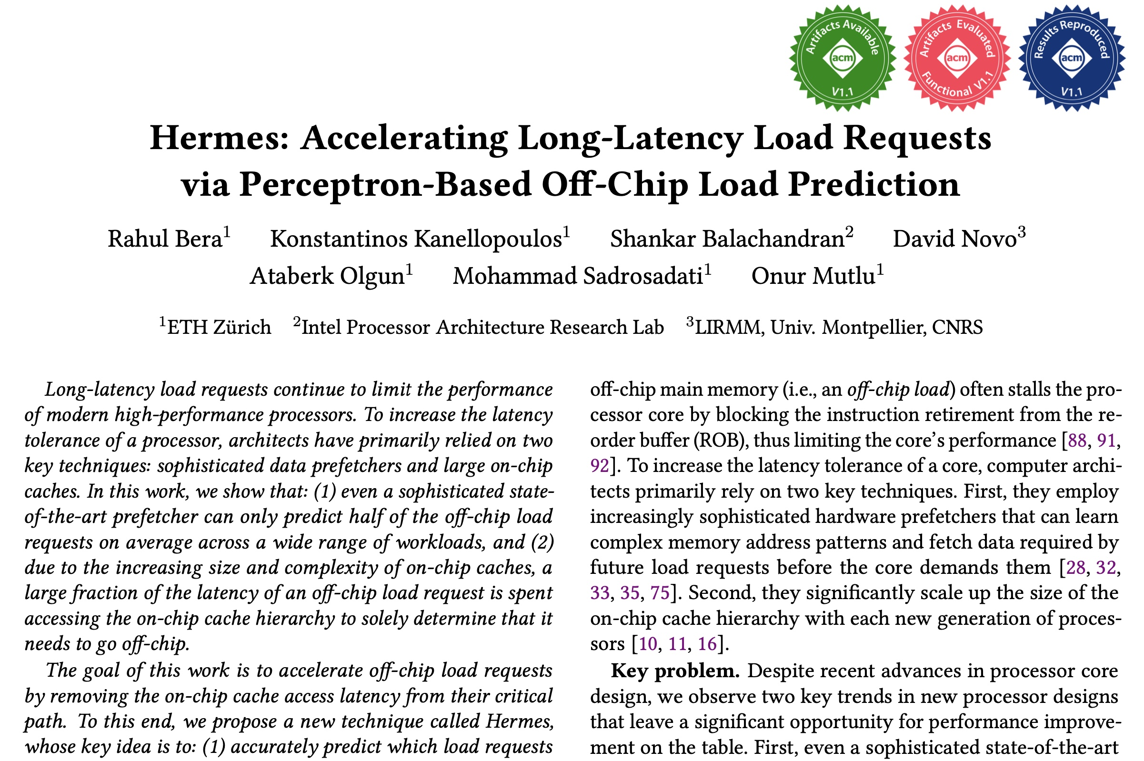
More in the Paper
Performance sensitivity to:
  Cache hierarchy access latency
  Hermes request issue latency
  Activation threshold
  ROB size (in extended version at arXiv)
  LLC size (in extended version at arXiv)
Accuracy, coverage, and performance analysis against HMP and TTP
Understanding usefulness of each program feature
Effect on stall cycle reduction
Performance analysis in eight-core system
https://arxiv.org/pdf/2209.00188.pdf
Notes:
We have many more evaluation results:
For example, a wide range of performance sensitivity study by varying…in the paper.

Slide 26
To Summarize…
Notes:
Thus to summarize…

Slide 27
Summary
Hermes advocates for off-chip load prediction,
a different form of speculation than
load address prediction employed by prefetchers
Off-chip load prediction can be applied by itself
or combined with load address prediction
to provide performance improvement
Notes:
Hermes advocates …
[CLICK] We show that off-chip load prediction…

Slide 28





Summary
Hermes employs the first
perceptron-based off-chip load predictor
High accuracy
(77%)
High coverage
(74%)
Low storage overhead
(4KB/core)
High performance improvement over best prior baseline
(5.4%)
High performance
per bandwidth

Slide 29
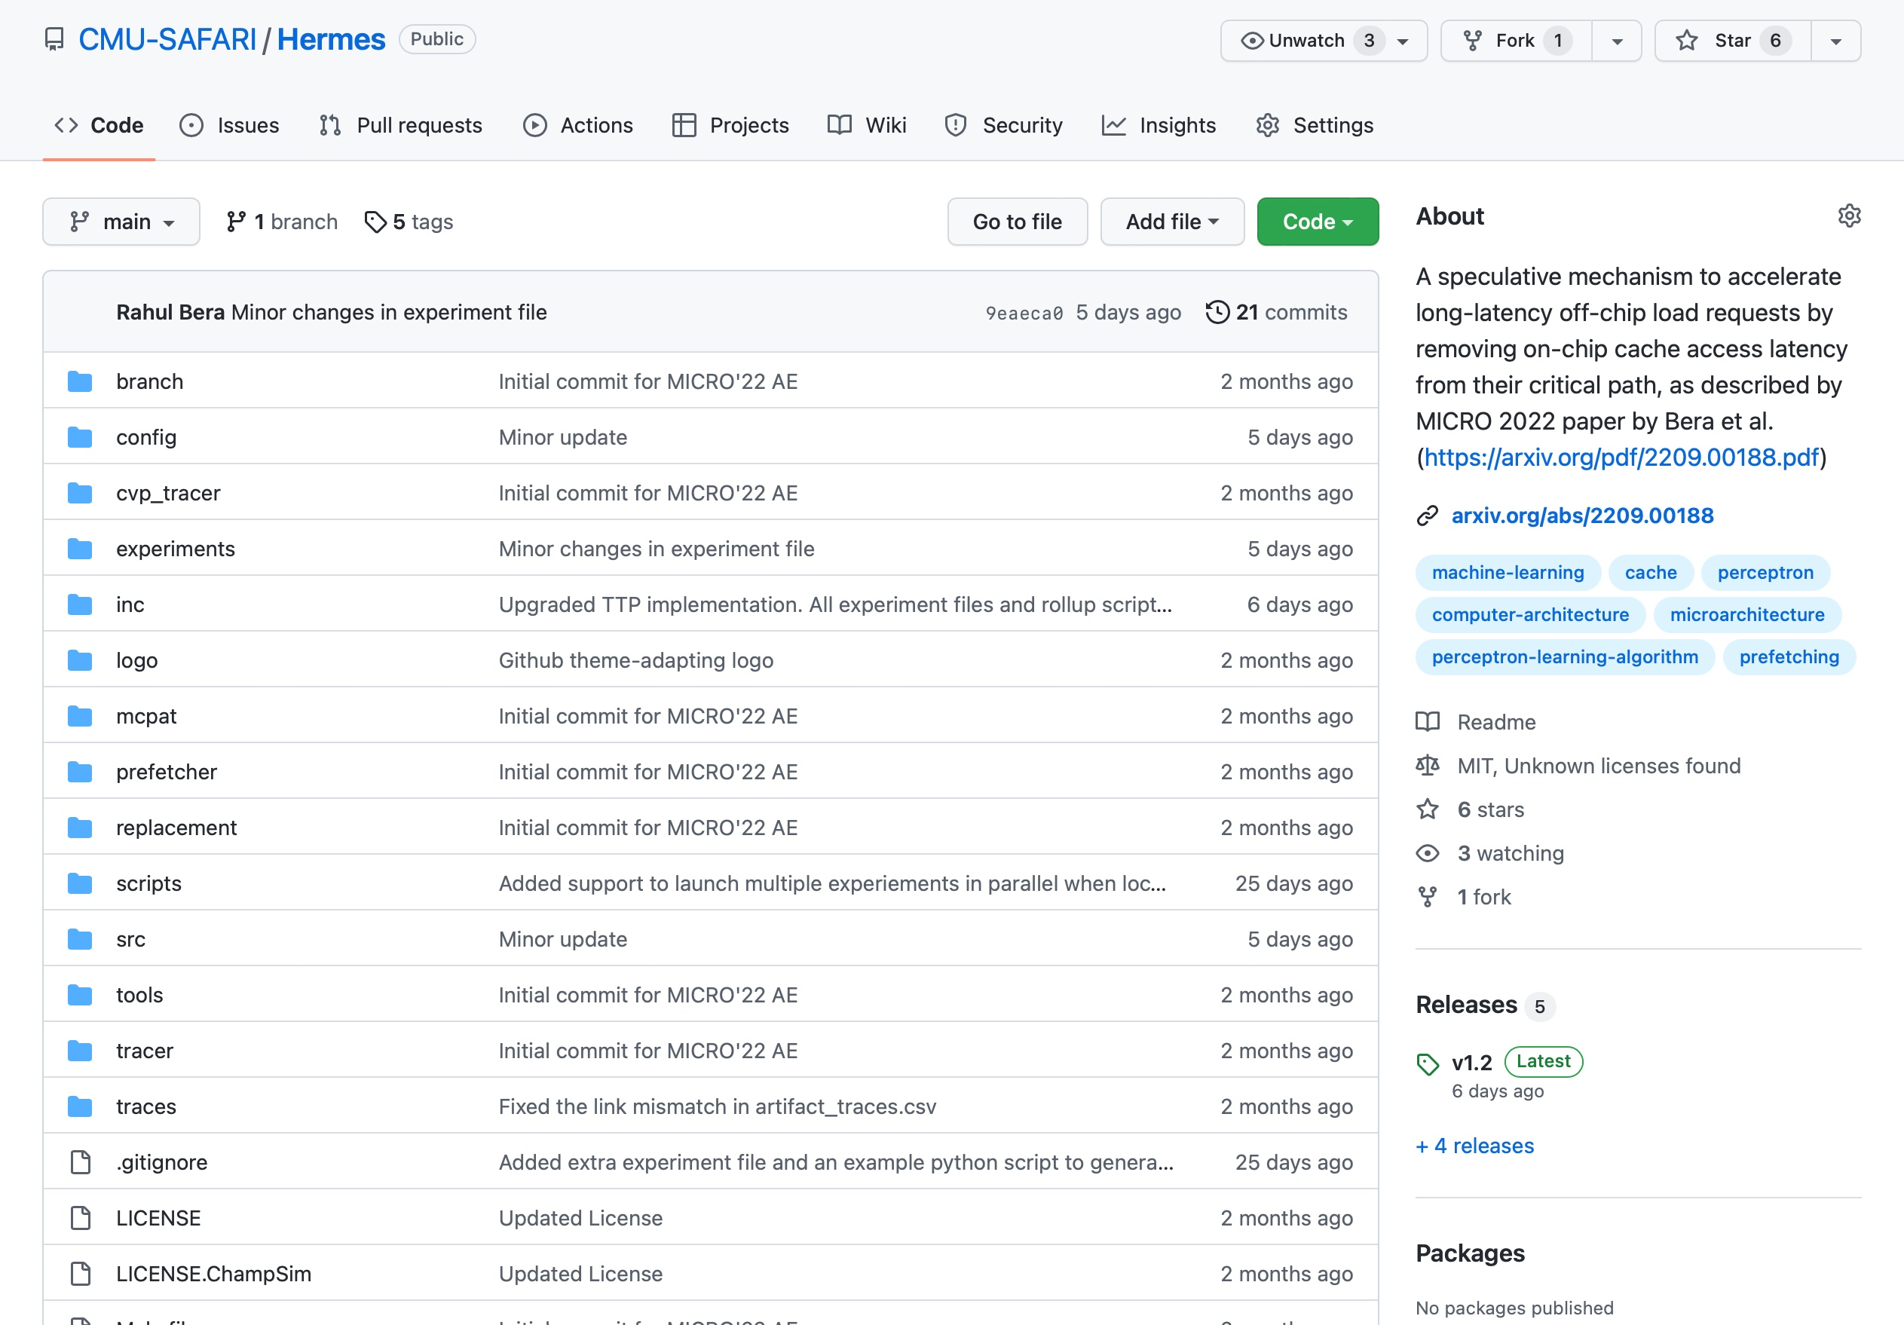
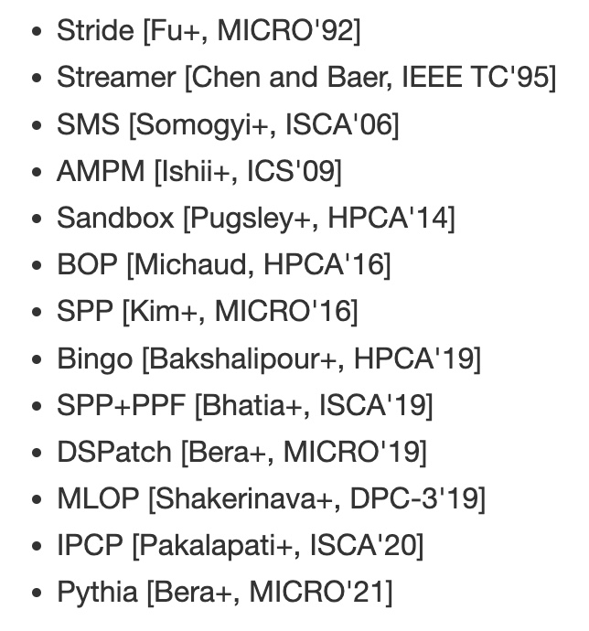
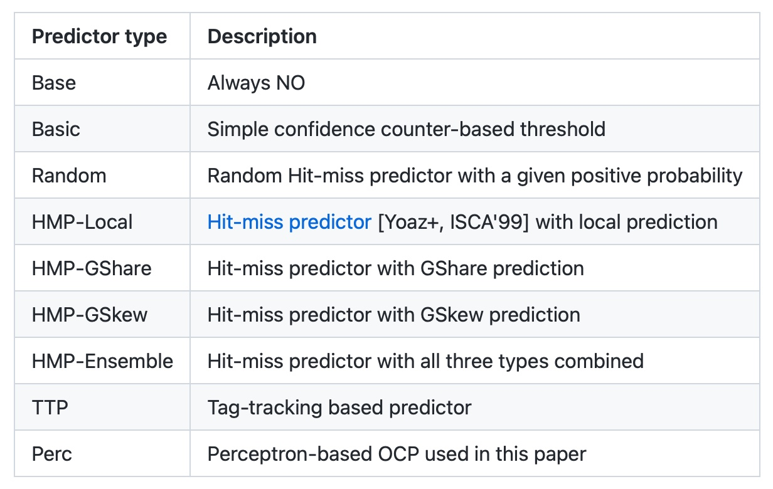
Hermes is Open Sourced
All workload traces
13 prefetchers
9 off-chip predictors
https://github.com/CMU-SAFARI/Hermes
Notes:
That’s why we open-source our artifact.
It can be freely downloaded from our GitHub repository.
In this artifact, [CLICK] you will get all the workload traces we have used to evaluate Hermes,
[CLICK] 13 types of data prefetchers proposed in the past and
[CLICK] 9 types of off-chip predictors out of the box

Slide 30
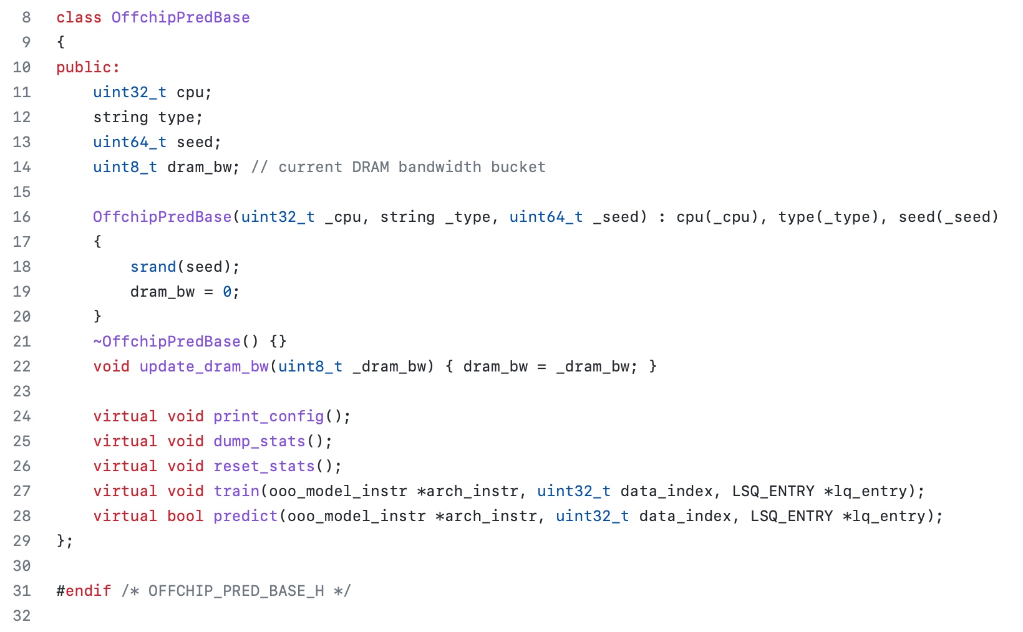
Easy To Define Your Own Off-Chip Predictor
Just extend the OffchipPredBase class
Notes:
But if you want to impalement your own off-chip predictor, that’s also very easy.
All you have to do is to extend the OffchipPred base class…

Slide 31
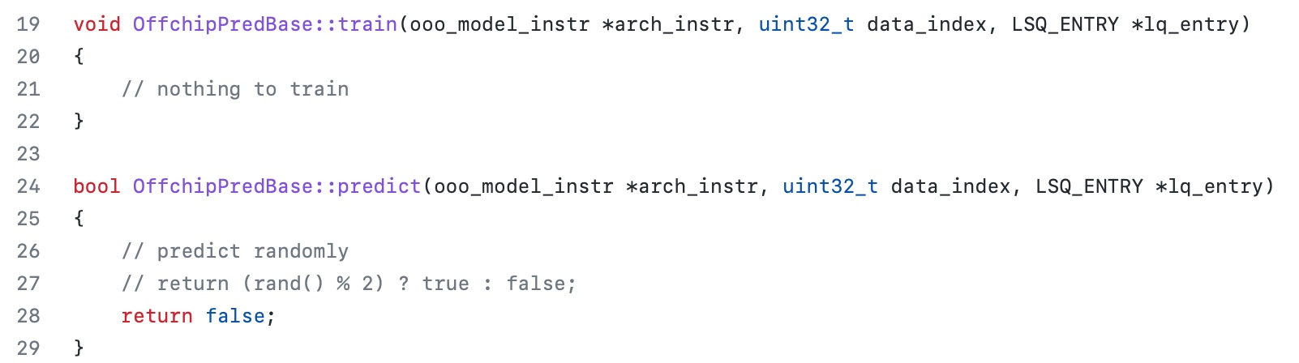
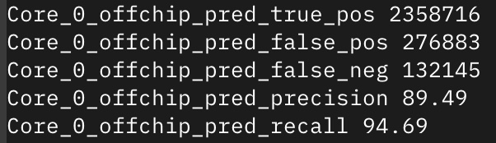
Easy To Define Your Own Off-Chip Predictor
Define your own train() and predict() functions
Get statistics like accuracy (stat name precision) and coverage (stat name recall) out of the box
Notes:
And define your own train() and predict() functions
[CLICK] the infrastructure will automatically provide statistics like precision and recall out of the box

Slide 32
Off-Chip Prediction Can Further Enable…
Prioritizing loads that are likely go off-chip
in cache queues and on-chip network routing
Better instruction scheduling
of data-dependent instructions
Other ideas to improve performance and fairness in multi-core system design...
Notes:
We hope that high-accuracy off-chip prediction can further enable a multitude of optimization possibilities, for example:
[CLICK] prioritizing loads … to improve performance and fairness in extreme core processors
[CLICK] better instruction scheduling for data dependent loads
[CLICK] and many more…

Slide 33
Accelerating Long-Latency Load Requests
via Perceptron-Based Off-Chip Load Prediction
Rahul Bera, Konstantinos Kanellopoulos, Shankar Balachandran,
David Novo, Ataberk Olgun, Mohammad Sadrosadati, Onur Mutlu
https://github.com/CMU-SAFARI/Hermes
Notes:
With that hope, I will conclude my talk.
I will be very happy to take any question from the audience.

Slide 34
Discussion
FAQs
  What are the selected set of program features?
  Can you provide some intuition on why these features work?
  What happens in case of a misprediction?
  What’s the performance headroom for off-chip prediction?
  Do you see a variance of different features in final prediction accuracy?
Simulation Methodology
  System parameters
  Evaluated workloads
More Results
  Percentage of off-chip requests
  Reduction in stall cycles by reducing the critical path
  Fraction of off-chip load requests
  Accuracy and coverage of POPET
  Effect of different features
  Are all features required?
  1C performance
  1C performance line graph
  1C performance against prior predictors
  Effect on stall cycles
  8C performance
  Sensitivity:
    Hermes request issue latency
    Cache hierarchy access latency
    Activation threshold
    ROB size
    LLC size
  Power overhead
  Accuracy without prefetcher
  Main memory request overhead with different prefetchers

Slide 35
BACKUP

Slide 36
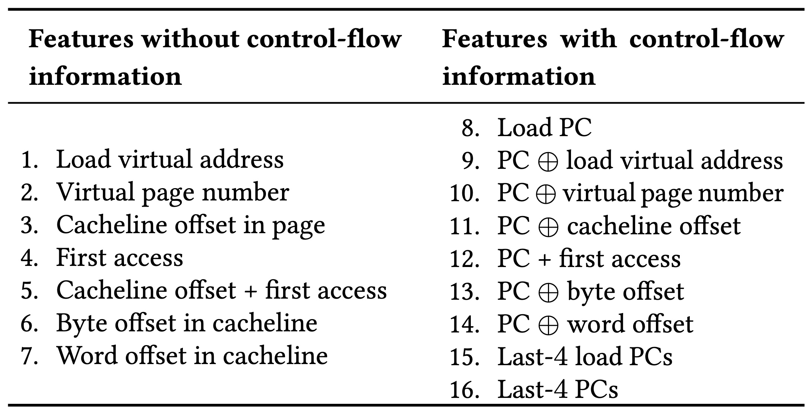
Initial Set of Program Features

Slide 37
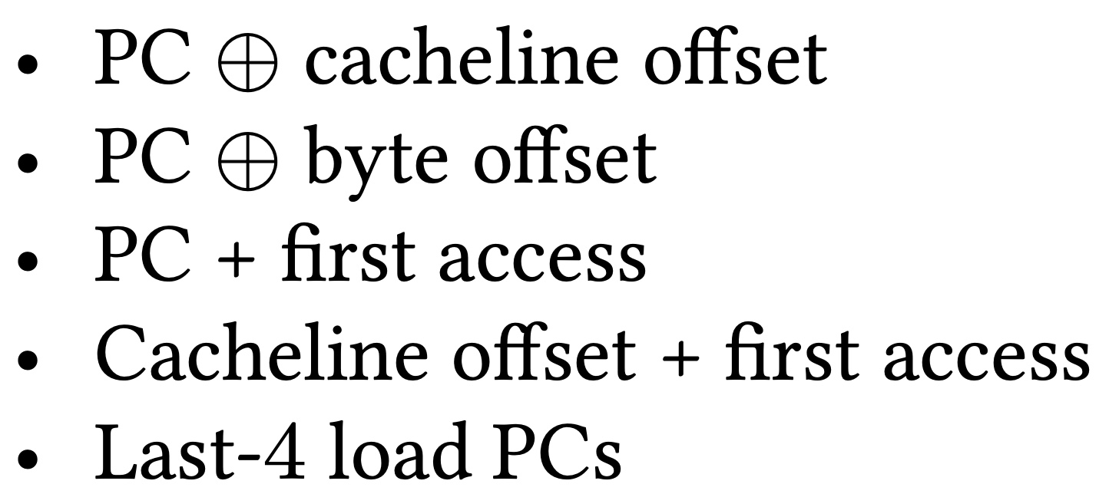

Selected Set of Program Features
A binary hint that represents whether or not a cacheblock has been recently touched
Five features

Slide 38
When A Feature Works/Does Not Work?
Trace: 462.libquantum-1343B
PC: 0x401442
…
Cacheline #42
Cacheline #43
…
Without prefetcher
With a simple stride prefetcher
PC + first access
Cacheline offset + first access
Cacheline offset + first access

Slide 39
What Happens in case of a Misprediction?
Two cases of mispredictions:
Predicted on-chip but actually goes off-chip
  Loss of performance improvement opportunity
Predicted off-chip but actually is on-chip
  Memory controller forwards the data to LLC if and only if a load to the same address have already missed LLC and arrived at the memory controller
No need for misprediction detection and recovery
No need for misprediction detection and recovery

Slide 40
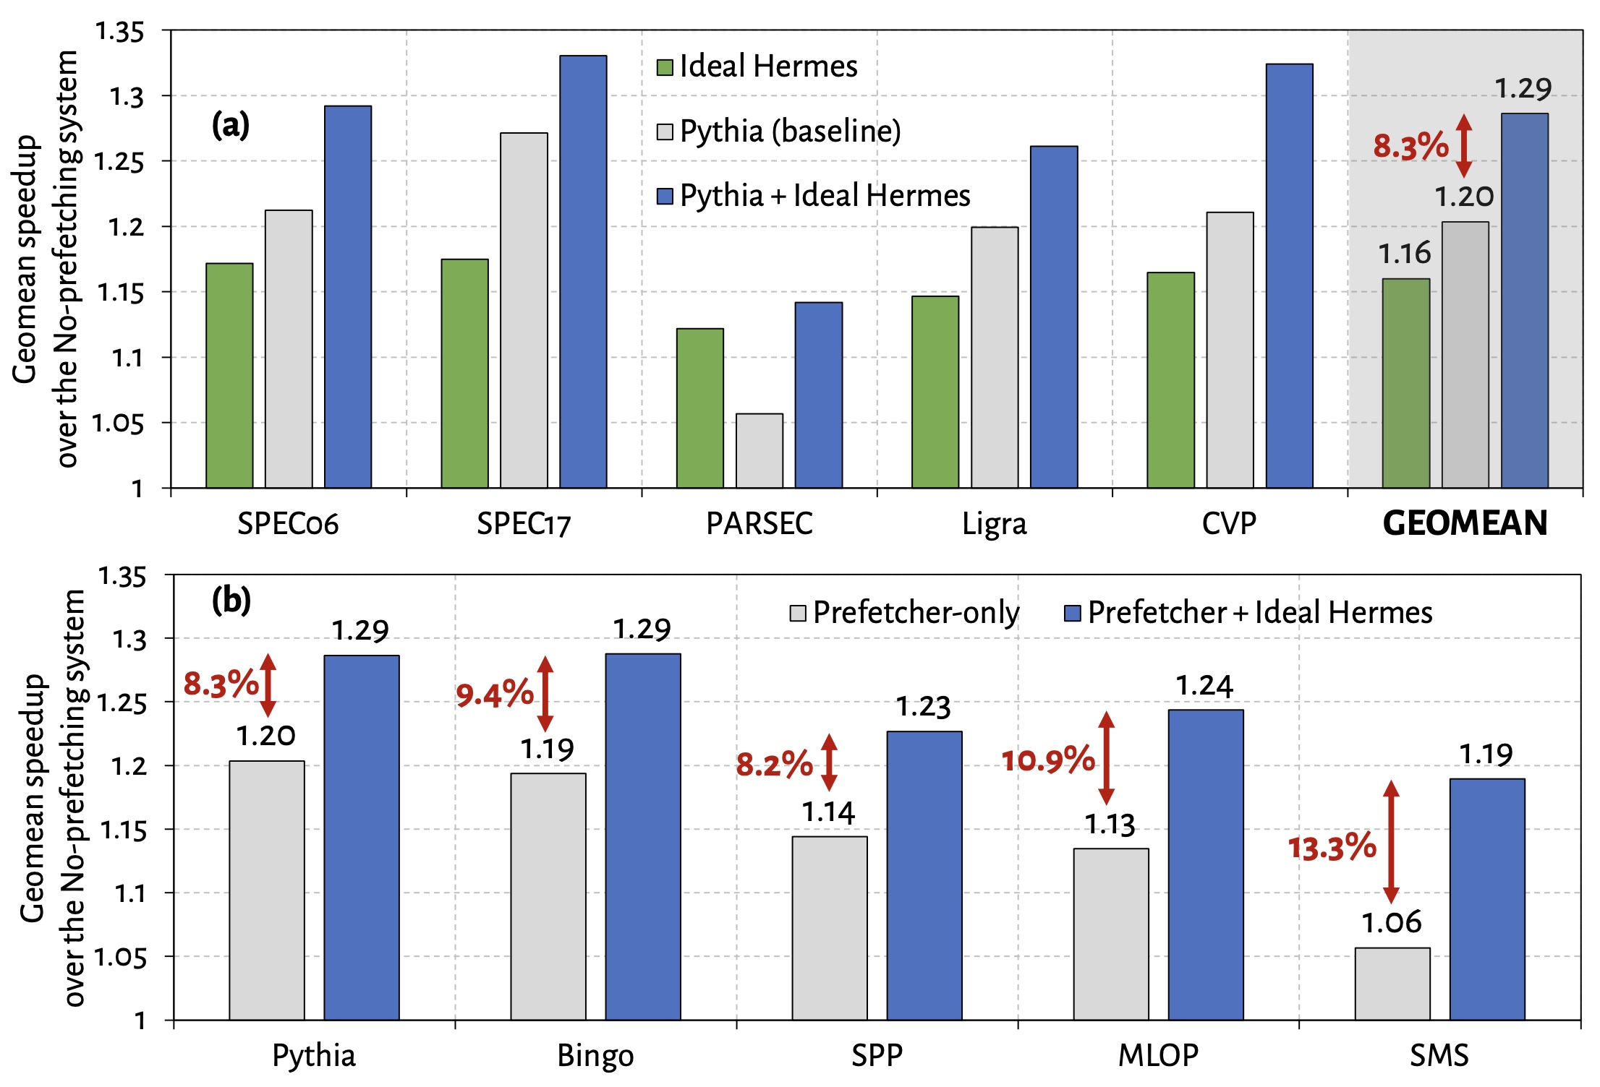
Performance Headroom of Off-Chip Prediction

Slide 41
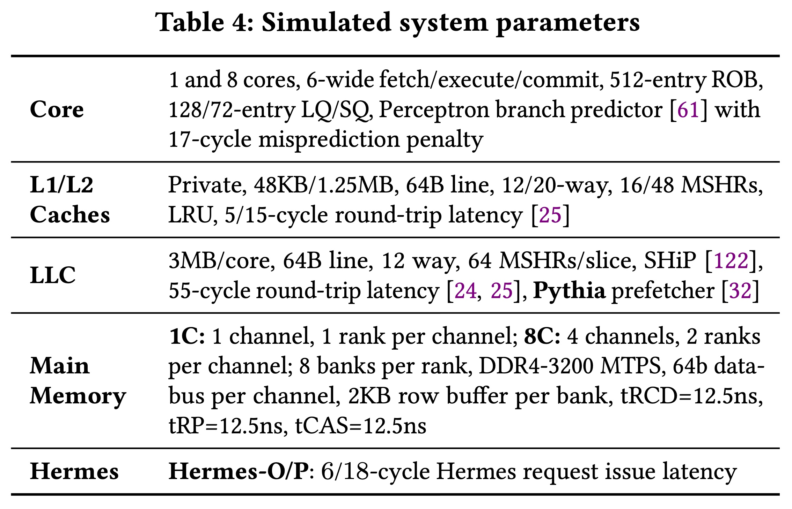
System Parameters

Slide 42
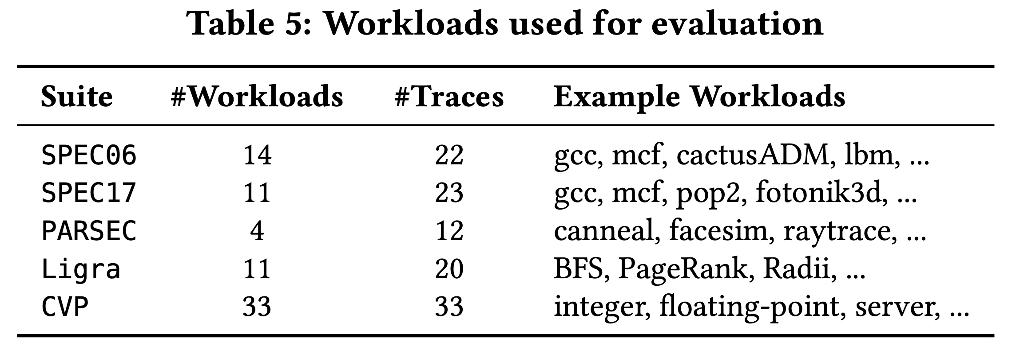
Evaluated Workloads

Slide 43
Observation: Not All Off-Chip Loads are Prefetched
50%
1
Nearly 50% of the loads are still not prefetched

Slide 44
Observation: Not All Off-Chip Loads are Prefetched
2
70% of these off-chip loads blocks ROB

Slide 45
Observation: With Large Cache Comes Longer Latency
On-chip cache access latency significantly contributes to the latency of an off-chip load
On-chip cache hierarchy access latency
58

Slide 46
Observation: With Large Cache Comes Longer Latency
On-chip cache access latency significantly contributes to the latency of an off-chip load
On-chip cache hierarchy access latency
40% of stall cycles caused by an off-chip load can be eliminated
by removing on-chip cache access latency from its critical path
58

Slide 47
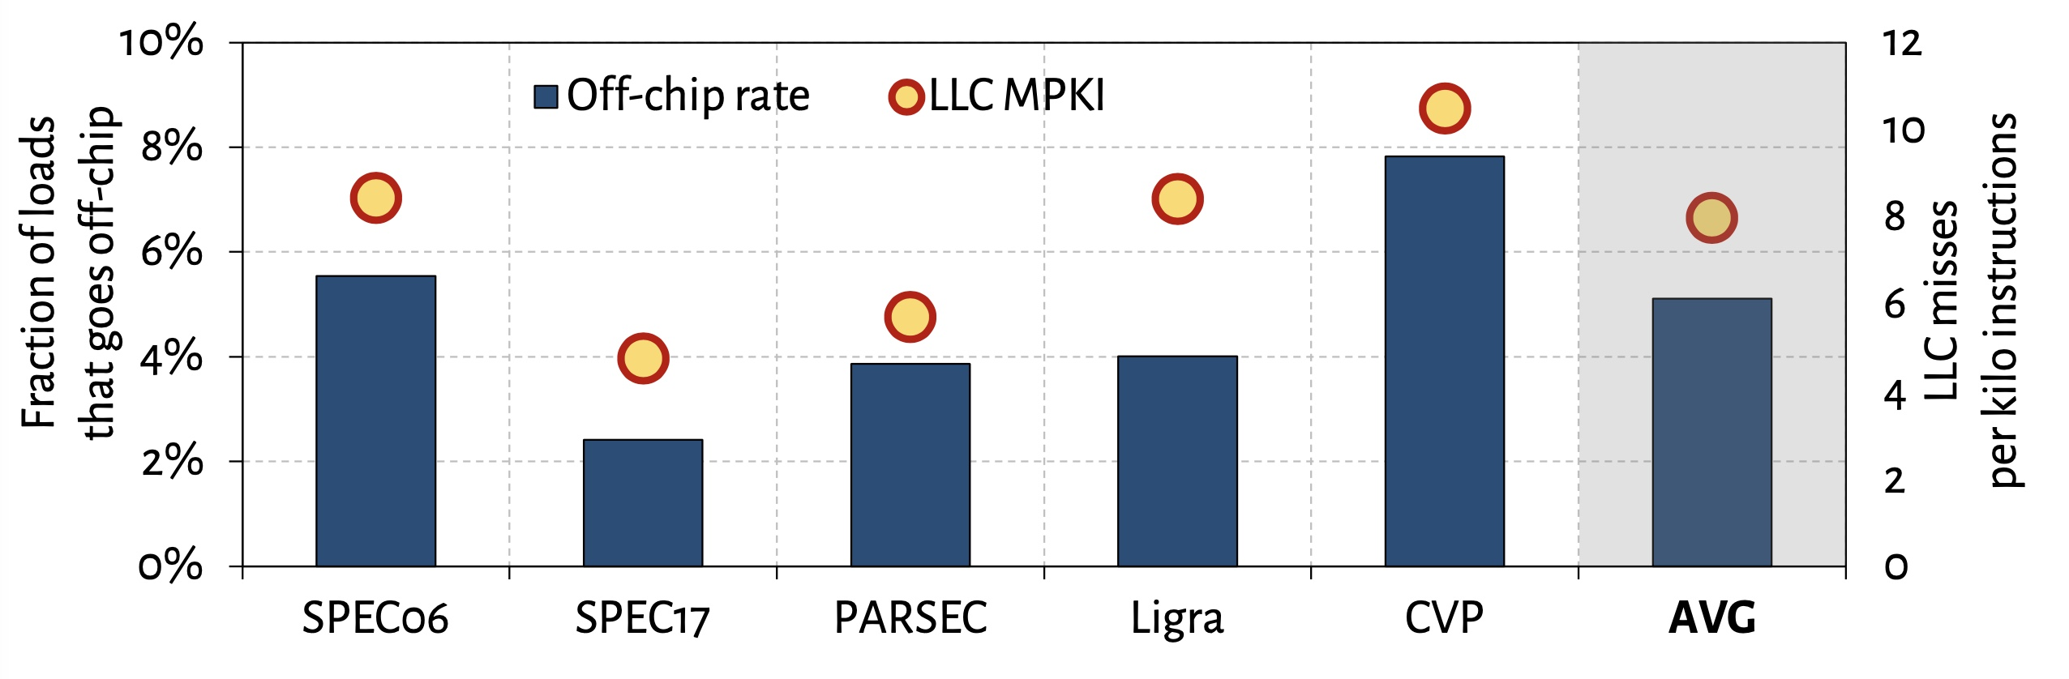
What Fraction of Load Requests Goes Off-Chip?

Slide 48
Off-Chip Prediction Quality: Defining Metrics
Accuracy
Coverage
Predicted off-chip
Actual off-chip
Predicted and actual off-chip

Slide 49
Off-Chip Prediction Quality: Analysis
Accuracy
77%
47%
16%
Coverage
95%
74%
22%

Slide 50
Off-Chip Prediction Quality: Analysis
Accuracy
77%
47%
16%
POPET provides off-chip predictions with high-accuracy and high-coverage
Coverage
95%
74%
22%

Slide 51
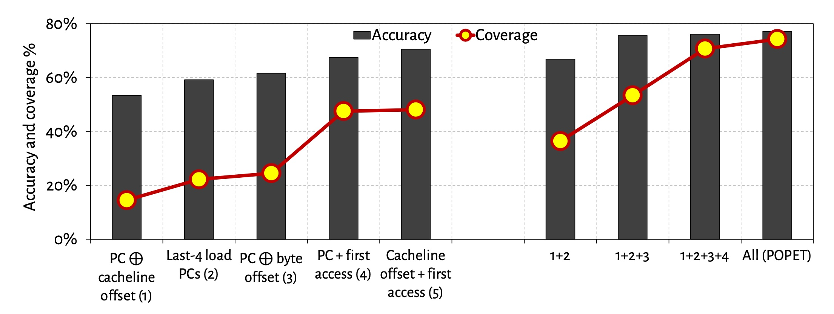
Effect of Different Features
Combination of features provides both higher accuracy and higher coverage than any individual feature

Slide 52
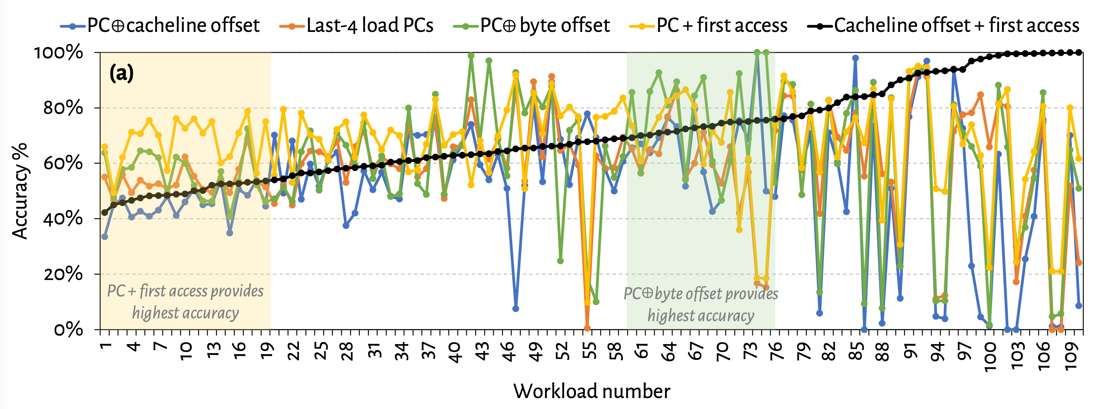
Are All Features Required? (1)
No single feature individually provides
highest prediction accuracy across all workloads

Slide 53
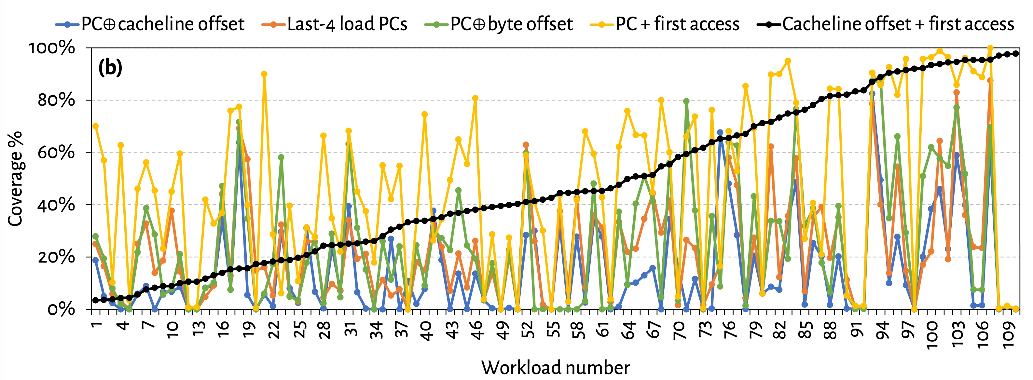
Are All Features Required? (2)
No single feature individually provides
highest prediction coverage also across all workloads

Slide 54
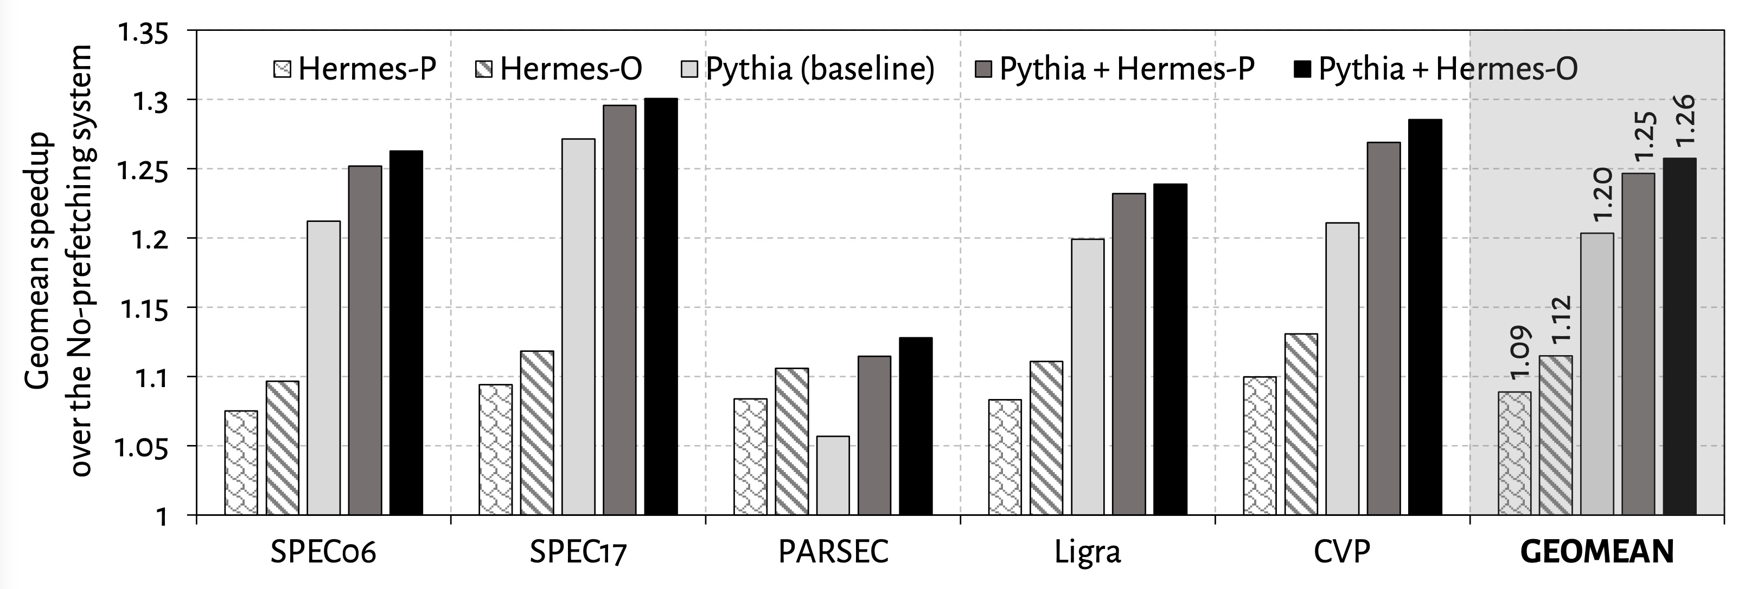
Single-Core Performance
Hermes in combination with Pythia
outperforms Pythia alone in every workload category

Slide 55
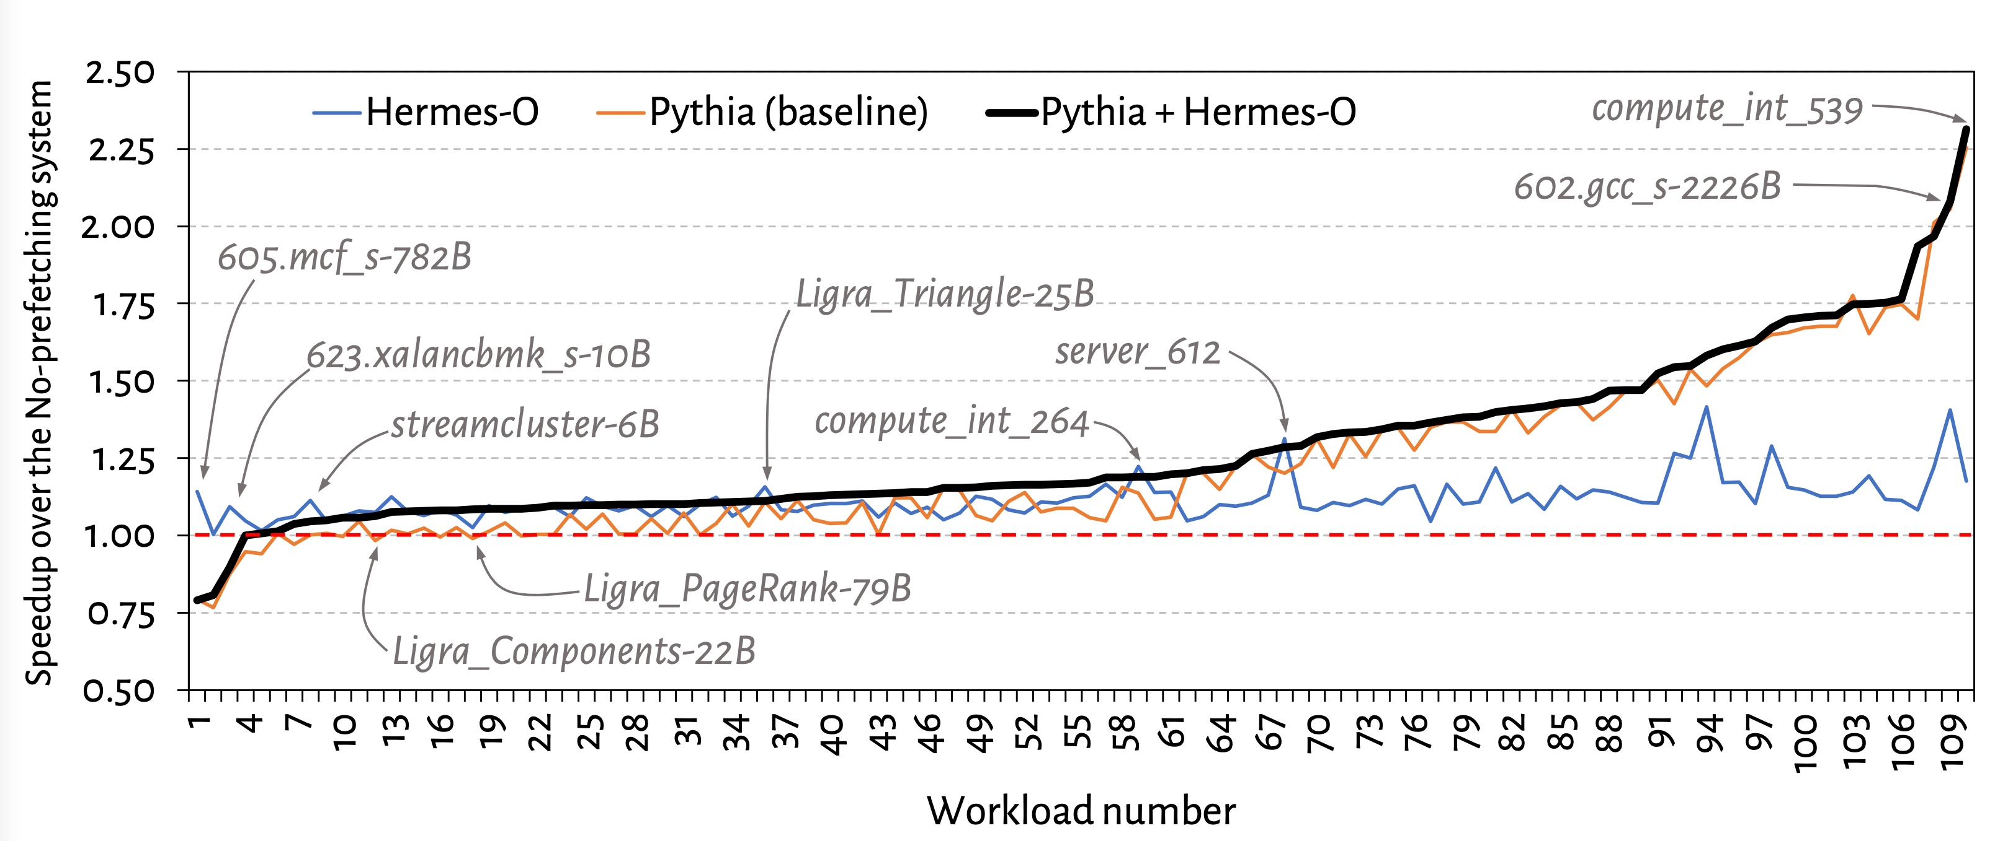
Single-Core Performance Line Graph

Slide 56
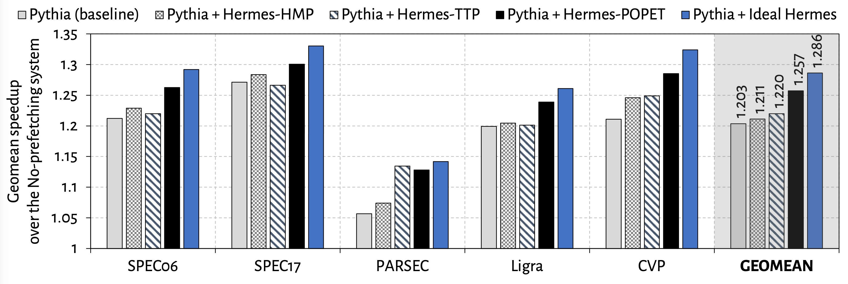
Single-Core Performance Against Prior Predictors
POPET provides higher performance benefit
than prior predictors
Hermes with POPET achieves nearly 90% performance improvement of the Ideal Hermes

Slide 57
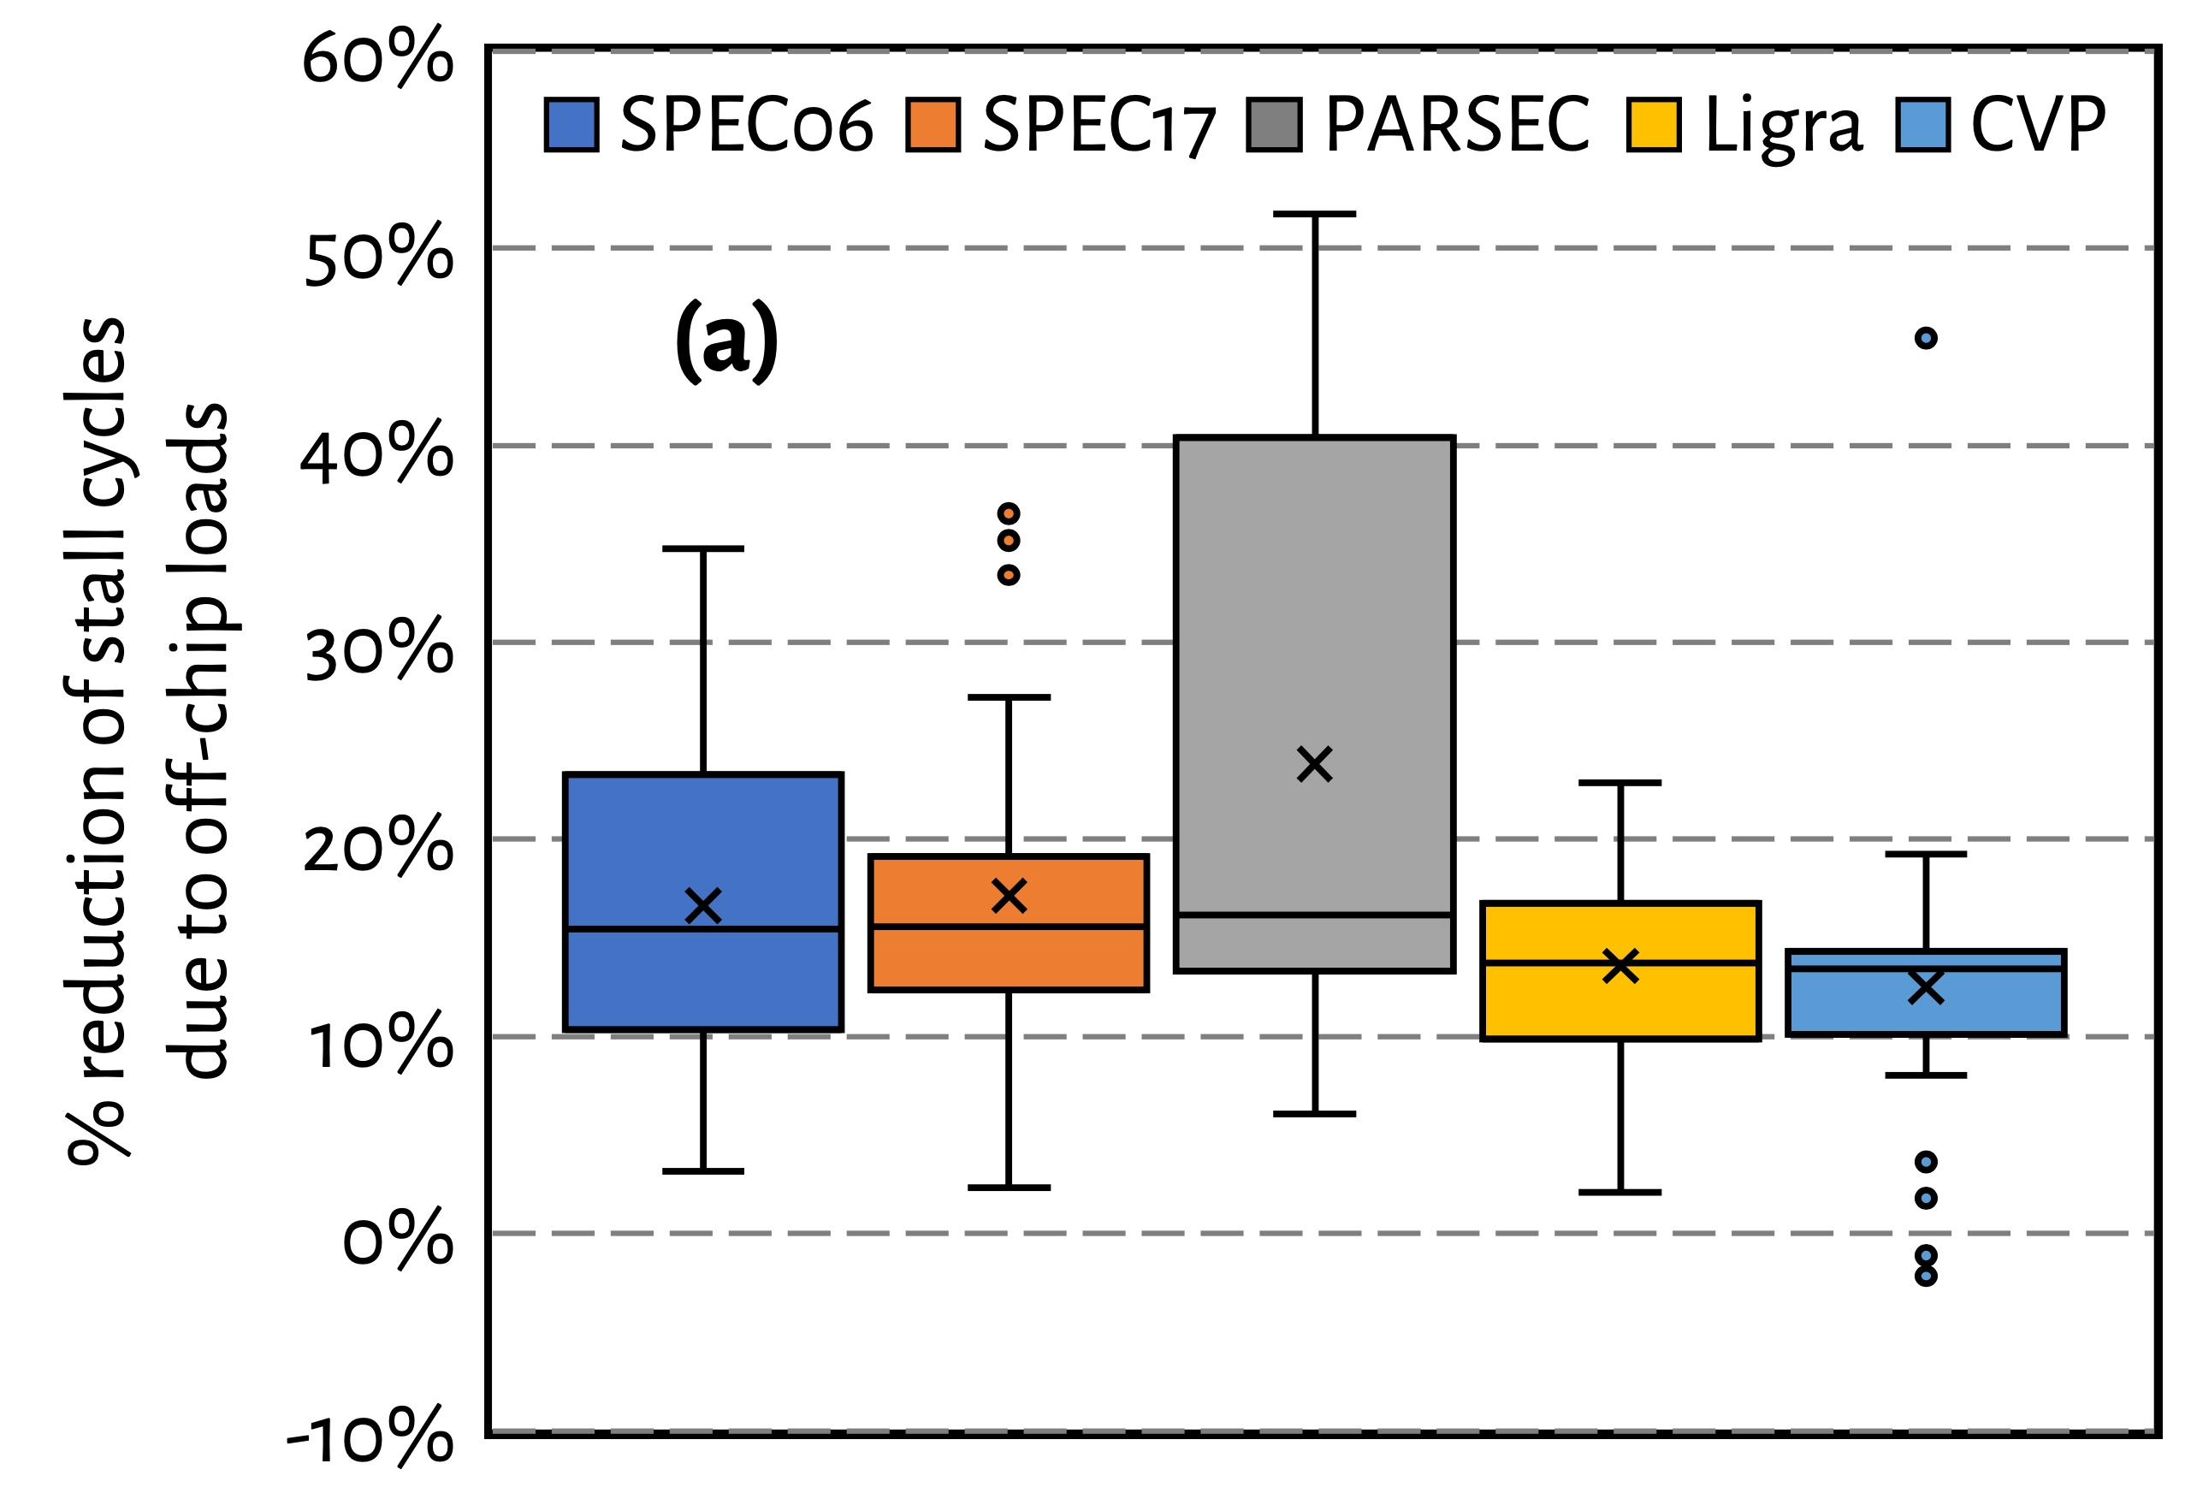
Effect on Stall Cycles
Hermes reduces off-chip load induced stall cycles
on average by 16.2% (up-to 51.8%)

Slide 58
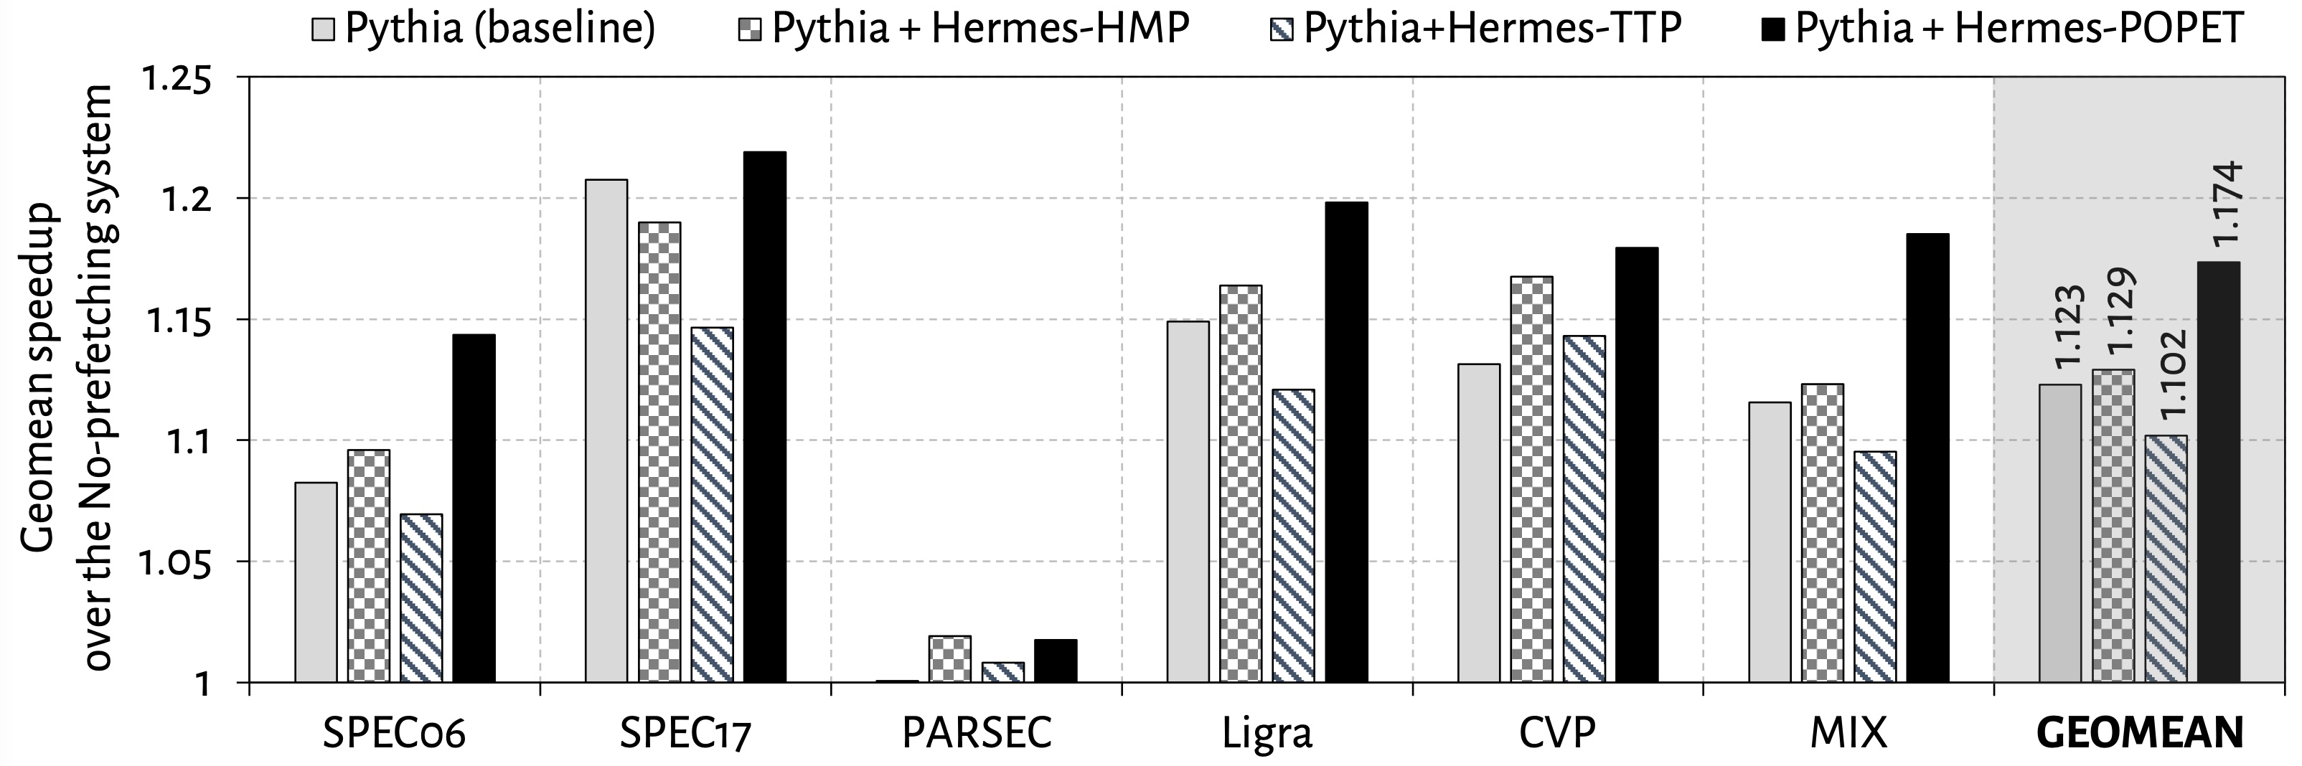
Eight-Core Performance
Hermes in combination with Pythia
outperforms Pythia alone by 5.1% on average

Slide 59
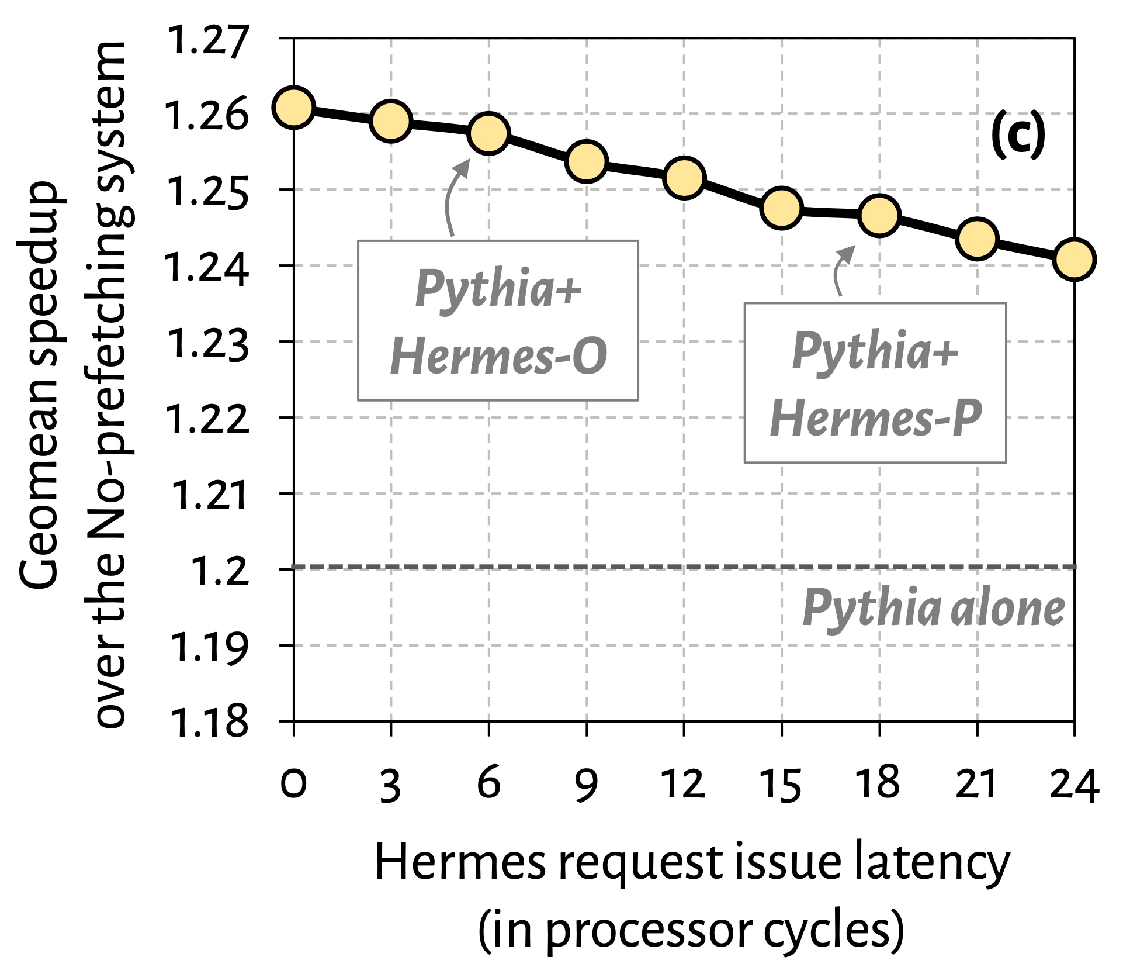

Effect of Hermes Request Issue Latency
3.6%
5.7%
Hermes in combination with Pythia outperforms Pythia alone even with a 24-cycle Hermes request issue latency

Slide 60
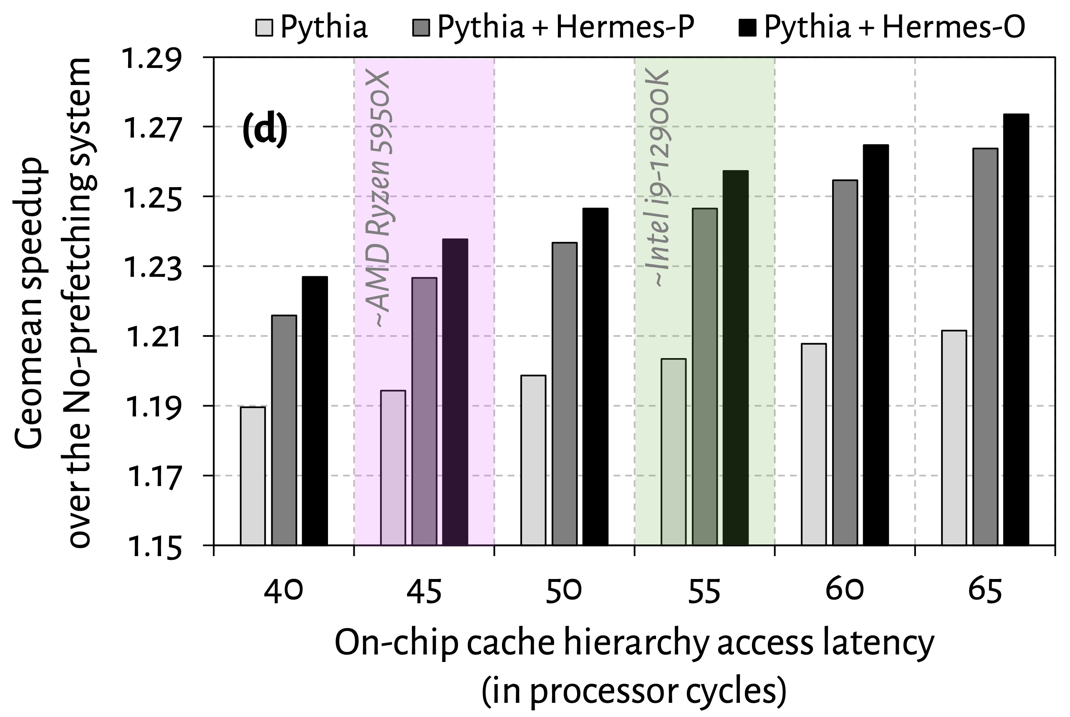
Effect of Cache Hierarchy Access Latency
6.2%
3.6%
Hermes can provide even higher performance benefit in
future processors with bigger and slower on-chip caches

Slide 61
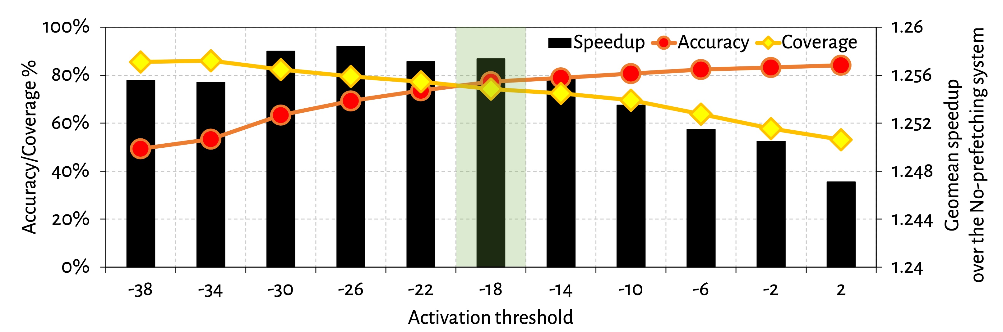
Effect of Activation Threshold
With increase in activation threshold
Accuracy increases
Coverage decreases

Slide 62
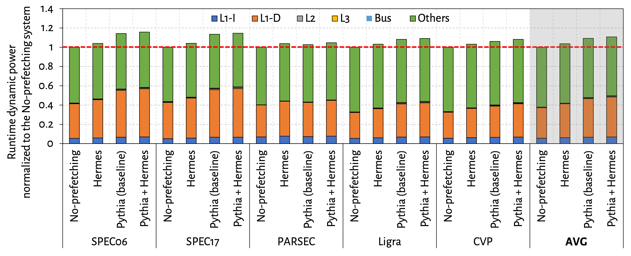
Power Overhead

Slide 63
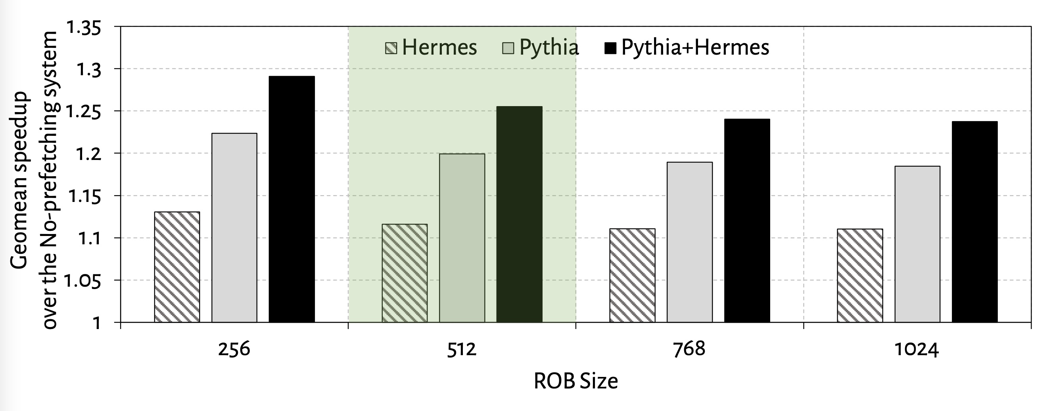
Effect of ROB Size
6.7%
5.3%

Slide 64
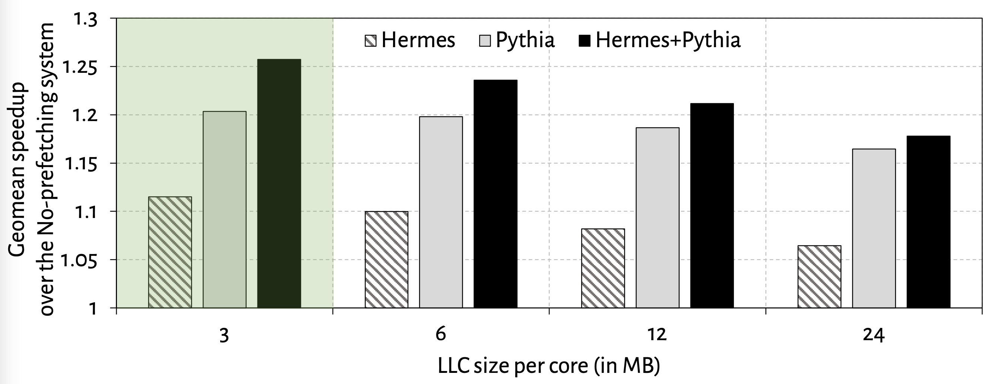
Effect of LLC Size
2.5%
1.3%

Slide 65
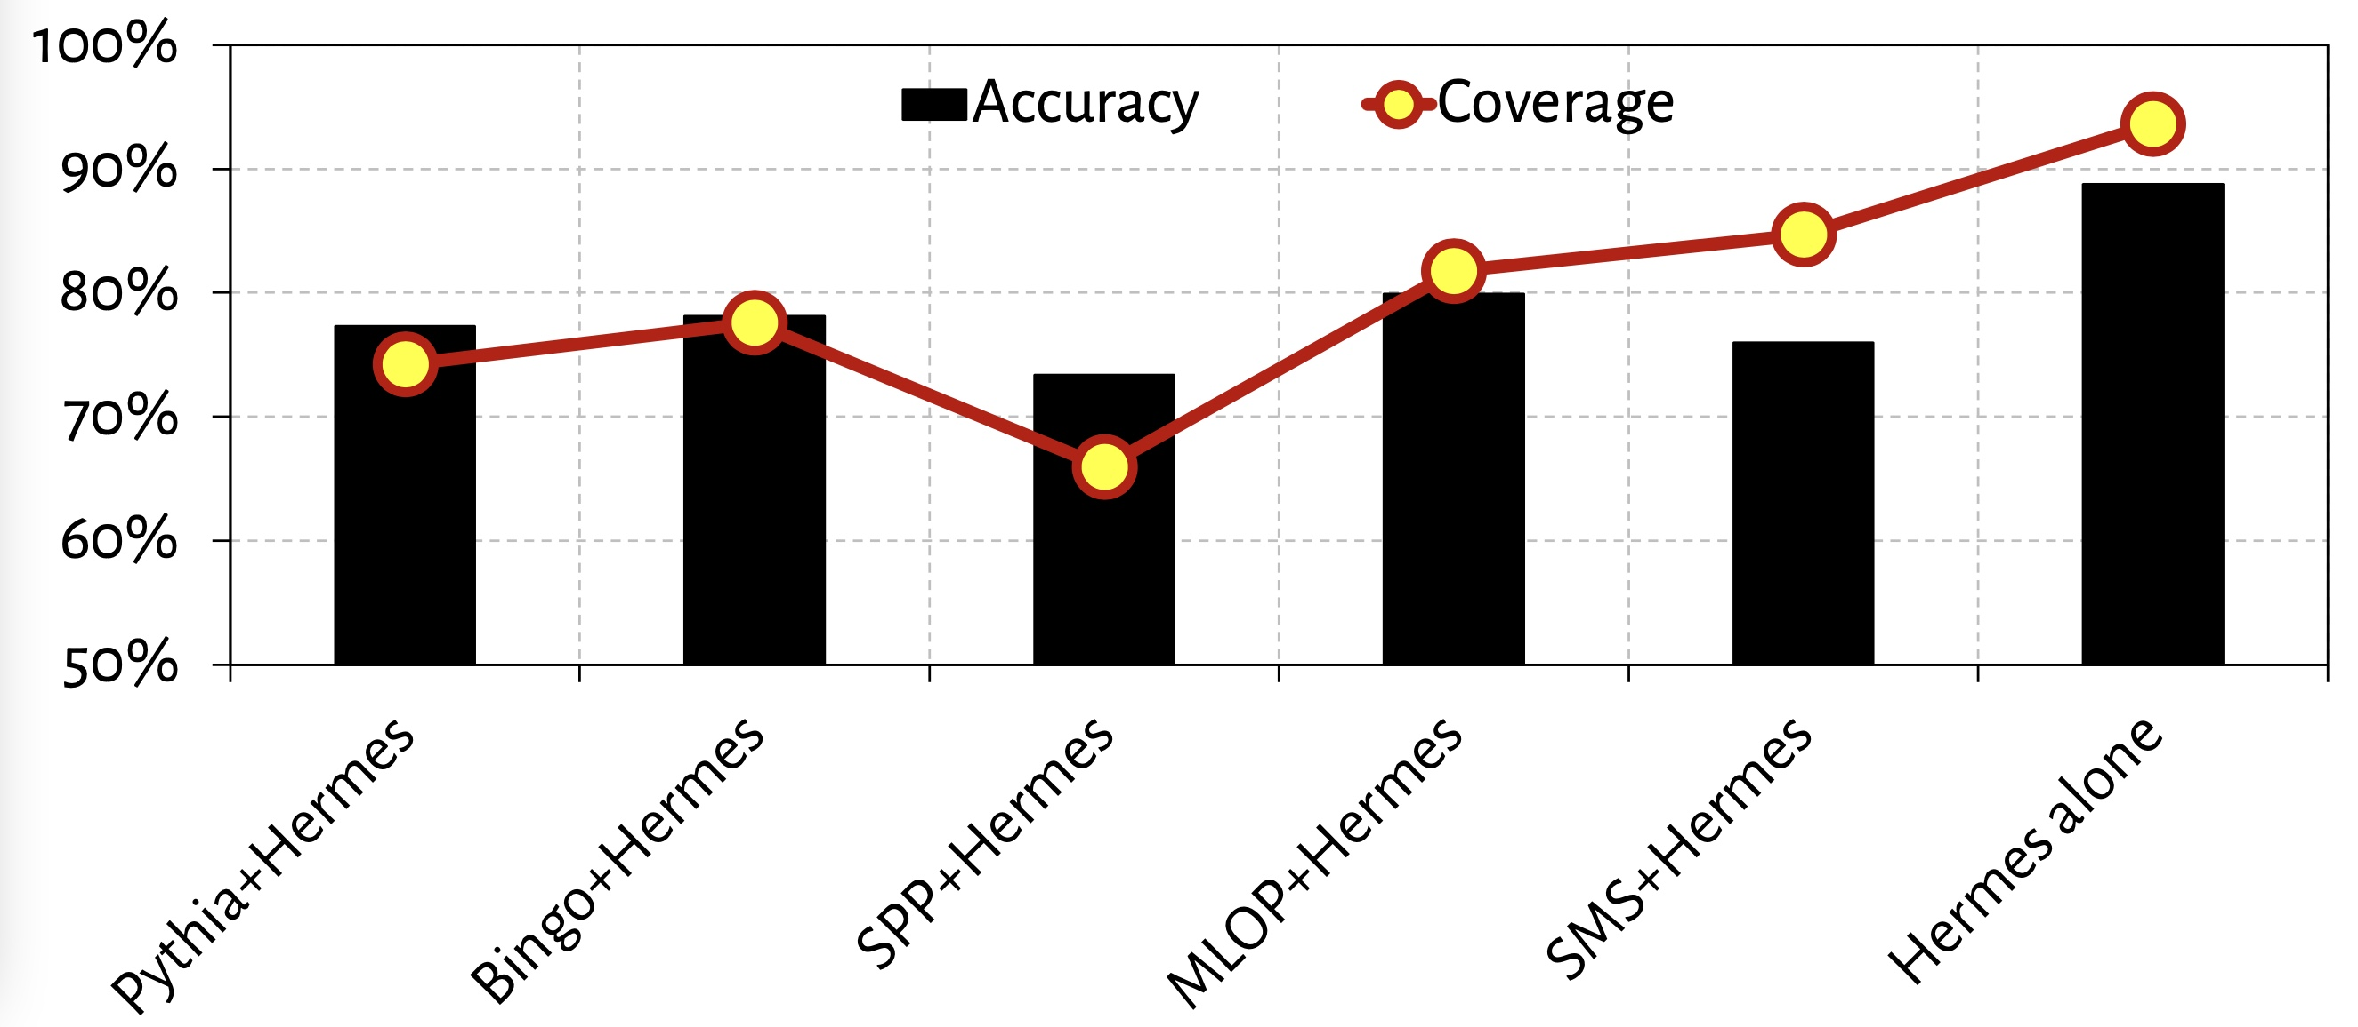
Accuracy and Coverage with Different Prefetchers
POPET’s accuracy and coverage increases significantly
in absence of a data prefetcher

Slide 66
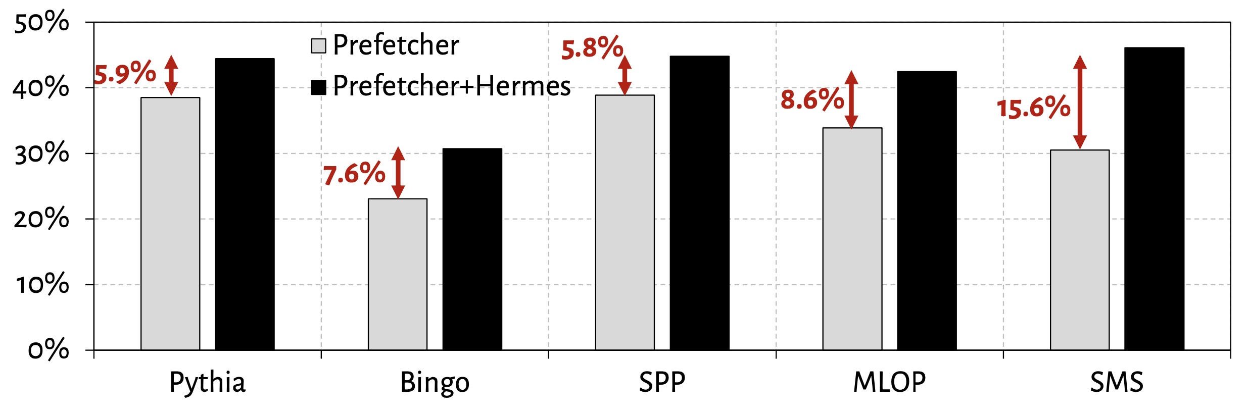
Increase in Main Memory Requests

