Slide 1



LEAPER:
Fast and Accurate FPGA-based System Performance Prediction via Transfer Learning
Gagandeep Singh, Dionysios Diamantopoulos,
Juan Gómez-Luna, Sander Stuijk,
Henk Corporaal, and Onur Mutlu
Notes:
Hello everyone
I’m going to present our work “…”
This work was done in collaboration with IBM Research and TU Eindhoven

Slide 2
Executive Summary
Background: Machine learning (ML)-based performance modeling has gained traction as a way to overcome the slow accelerator generation and implementation process on an FPGA
Problem: Three key shortcomings of prior ML-based techniques:
Models are trained for a specific environment
Training requires large amounts of data
Models trained using a limited number of samples are prone to overfitting
Goal: Overcome limitations of traditional ML-based techniques to provide accurate and fast prediction of performance and resource usage of accelerator implementation on an FPGA
Our contribution: LEAPER, a transfer learning-based approach for prediction of performance and resource usage for accelerator implementation on an FPGA
Transfer ML-based model from edge to cloud platforms
Transfer ML-based model across applications
Provide fast and accurate predictions of previously unseen accelerator optimization options
Key Results: Evaluate LEAPER across 5 state-of-the-art cloud FPGA-based platforms with 2 different interconnect technologies on 6 real-world applications
  Provides, on average, 85% accuracy when we use our transferred model for prediction in a cloud environment
  Reduces design-space exploration time for accelerator implementation on an FPGA by 10×, from days to only a few hours.
  Unlike state-of-the-art techniques, we show that classic non-neural network-based models are enough to build an accurate predictor to evaluate accelerator implementation on an FPGA
Notes:
First, I am going to start with an executive summary.
[CLICK]
[CLICK] We observe three key shortcomings of prior ML-based techniques:
First, these models trained for a specific environment cannot predict per formance or resource usage for a new, unknown environment.
Second, training these models require large amount of data (features extracted from design synthesis and implementation tools), which is cost-inefficient because of the time-consuming accelerator design and implementation process
Third, in some scenarios if we are not able to collect enough smaples, these ML-based models trained using a limited number of samples are prone to overfitting. For example, in a cloud system, renting a platform for data collection to build an ML model can be expensive
[CLICK] We extensively evaluate LEAPER on 5 state-of-the-art FPGA based cloud platform with 2 different interoncnect technolgoes on 6 real worklaodas
and show
LEAPER provides

Slide 3
Talk Outline
Motivation
LEAPER: Implementation
Evaluation of LEAPER and Key Results
Summary
Notes:
This is the outline of my talk.
First, I am going to start with the motivation for this work

Slide 4
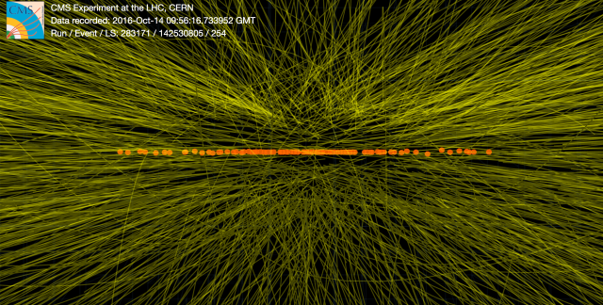
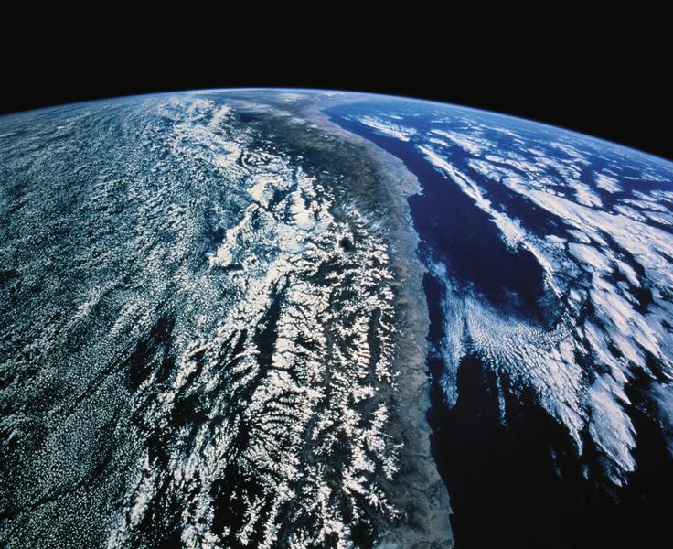
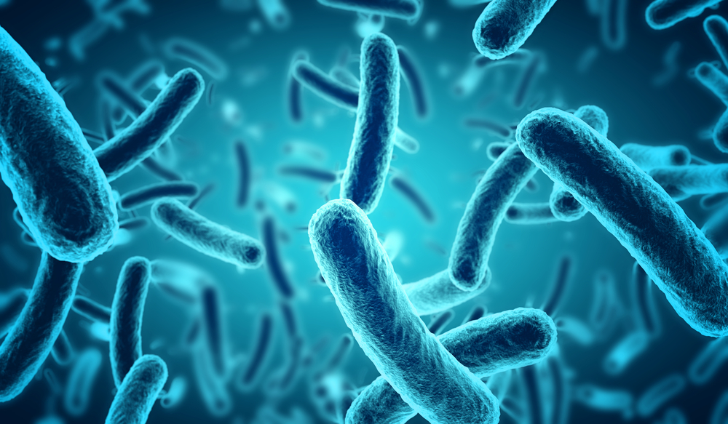
Wide Adoption of FPGAs
FPGAs provide a tradeoff between programmability and efficiency
FPGAs being deployed from edge to cloud for many applications
Particle Physics
Atmospheric Modeling
Genome Sequencing
Image sources: http://www.flometrics.com/fluid-dynamics/computational-fluid-dynamics
Naoe, Kensuke et al. "Secure Key Generation for Static Visual Watermarking by Machine Learning in Intelligent Systems and Services" IJSSOE, 2010
Notes:
[CLICK]
FPGAs provide a tradeoff between programmability and efficiency.
[CLICK]
the need for energy efficiency and flexible acceleration has boosted the widespread adoption of FPGAs, From collision detection in particle physics to atmospheric and geneome sequencing, [CLICK]

Slide 5
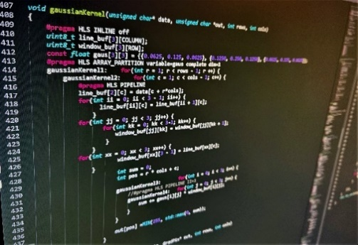

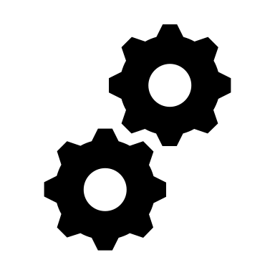

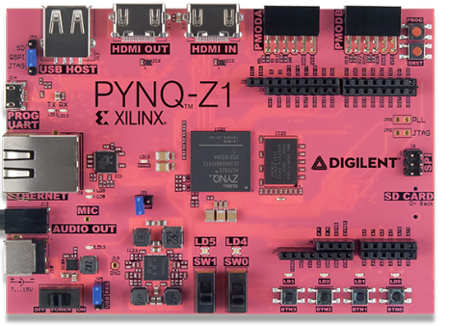
The Key Problem
Accelerator Implementation Process
Application:
C/C++/System C
Large Optimization Space
High-level Synthesis (HLS)
HLS Estimates
Logic Synthesis
Technology Mapping
Time Consuming
Process
(days or
months)
Machine Learning
Place and Route
Bitstream
Implementation Report:
Performance/Timing,
Resource Usage
Low Productivity
Notes:
However, the biggest issue with FPGA is it’s low productivity. Let’s look a typical accelerator implementation process on an FPGA [CLICK]
[CLICK] suppose we want to implement an accelerator for an application.
[CLICK] Nowadays, we can start with High-level Synthesis where we use C/C++ for designing.
Here a designer can choose different optimization options, eg., pipeling, array partitioning, reshaping, etc.
[CLICK] The configuration space of an application can be really large which could have thousand of options and there are complex interactions among its configuration options cause many developers to explore optimization techniques in an ad-hoc manner
[CLICK] Then we go through a time-consuming accelerator synthesis and implementation process [CLICK]
[CLICK] To finally generate a bitstream for an FPGA
This is an iterative process
[CLICK] Therefore, because of this low productivity a common challenge that past works have faced is how to evaluate the performance (or resource usage) of an accelerator implementation in a reasonable amount of time
To overcome this problem, researchers have recently employed machine learning (ML)-based techniques to predict the performance and resource usage of a given accelerator implementation quickly from application or HLS level.

Slide 6
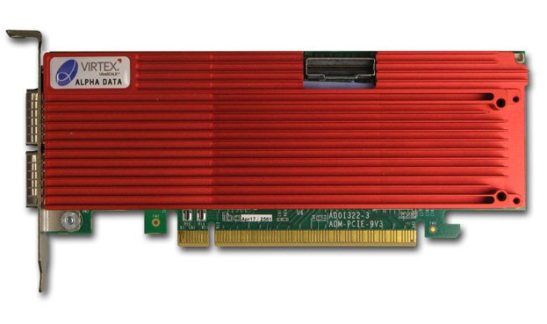
Traditional ML-Based Approach
Low-end FPGA
Fast bitstream generation
Cheap
Easily accessible
High-end FPGA
Slow bitstream generation
Expensive
Not easily accessible
Performance/
Resource Usage
Data collection:
Brute force
Performance/
Resource Usage
Data collection:
Brute force
Optimization Options
Optimization Options
ML Model
Design Space
ML Model
Design Space
Trained for Specific Environment
Notes:
Let’s look at the main shortcoming of a traditional approach.
For example if we have an low-end edge FPGA, which are small, FPGA bitstream generation is faster compared to generating bitstream for a high-end FPGA. FPGAs are cheaper and more affordable.
[CLICK] randomly select hundreds or thousands of optimization options
[CLICK] and execute these options on FPGA.
[CLICK] This way we collect large number of samples by going through extremely time-consuming FPGA process to
[CLICK] train an ML model as models trained using a limited number of samples are prone to serious overfitting problems
[CLICK]Then if we change an application or a device usually. For example a high-end FPGA which is expensive, slow bitstream generation, and not easily accessible as it requires integration with server-grad host CPU
we need to perform the complete process again, which takes days.
[CLICK] Because these ML-based predictors are trained for specific workloads, fixed hardware, and/or a set of inputs

Slide 7

Our Goal
Overcome limitations of traditional ML-based techniques to provide accurate and fast prediction of performance and resource usage of accelerator implementation on an FPGA
7
Notes:
The goal of our work is to overcome

Slide 8

Our Proposal
LEAPER
Transfer learning-based approach for prediction of performance and resource usage in an FPGA-based system
Notes:
To this end, we propose LEAPER
[CLICK] which is a transfer learning approach for predcition of performance and resource usage in a FPGA base systme

Slide 9

Transfer Learning
Transfer knowledge from previous experiences to solve new tasks
Similar to humans, algorithms can learn from experiences
Rather than learning from scratch

Slide 10
LEAPER
Low-end FPGA
Fast bitstream generation
Cheap
Easily accessible
High-end FPGA
Slow bitstream generation
Expensive
Not easily accessible
Performance/
Resource Usage
Data collection:
Design of experiments
Performance/
Resource Usage
Data collection:
Design of experiments
Data collection:
Brute force
Data collection:
Brute force
Transfer
Optimization Options
Optimization Options
ML Model
Design Space
ML Model
Design Space
Fast design-space exploration
Notes:
LEAPER
[CLICK]When we change an application or FPGA we can simply [CLICK] transfer our previously trained model to the new environment and
[CLICK] use only few samples from the new environment to build an accurate predictor for the new environment
[CLICK] rather than doing rather than doing random sampling,
[CLICK] we can use design of experiemnts to select only a few optimization options that are enough
[CLICK] to explore the complete space and [CLICK] build an accurate predictor.
Thus LEAPER, dramatically reduces the design space exploration time

Slide 11
Talk Outline
Motivation
LEAPER: Implementation
Evaluation of LEAPER and Key Results
Summary
Notes:
We now provide a brief overview of LEAPER implementation.

Slide 12
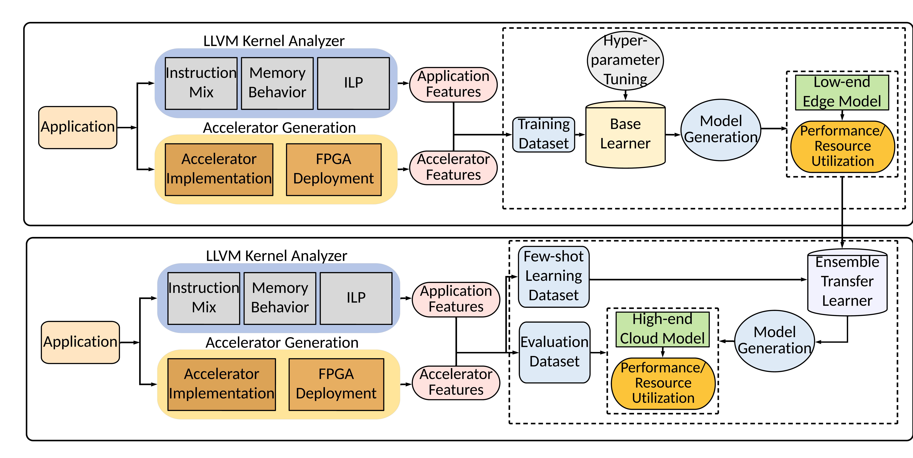
LEAPER: Implementation
Base Model Building
Target Model Building
Notes:
LEAPER consists of two parts: (1) base model building and (2) target model building

Slide 13
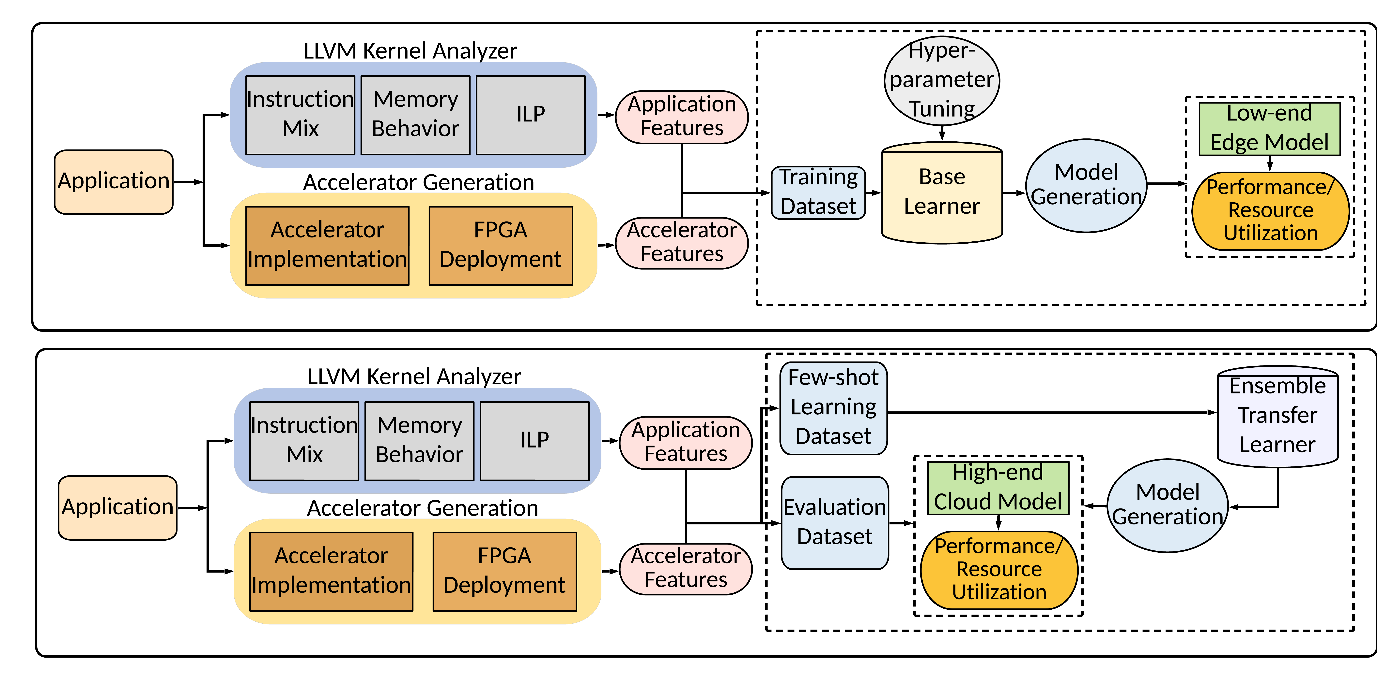
Base Model Building
Base Model Building
Notes:
The base model building has three phases.

Slide 14
Phase 1: LLVM Analyzer
Application Features
Instruction mix
ILP
Reuse distance
Memory traffic
Register traffic
Memory footprint
Base Model Building
Notes:
In the first phase we perform LLVM based kernel analysis:
Where we use microarchitectural independent dynamic profiling, which provides application characteristic independent of hardware used.
[CLICK] For eg., instruction mix, ILP, etc

Slide 15
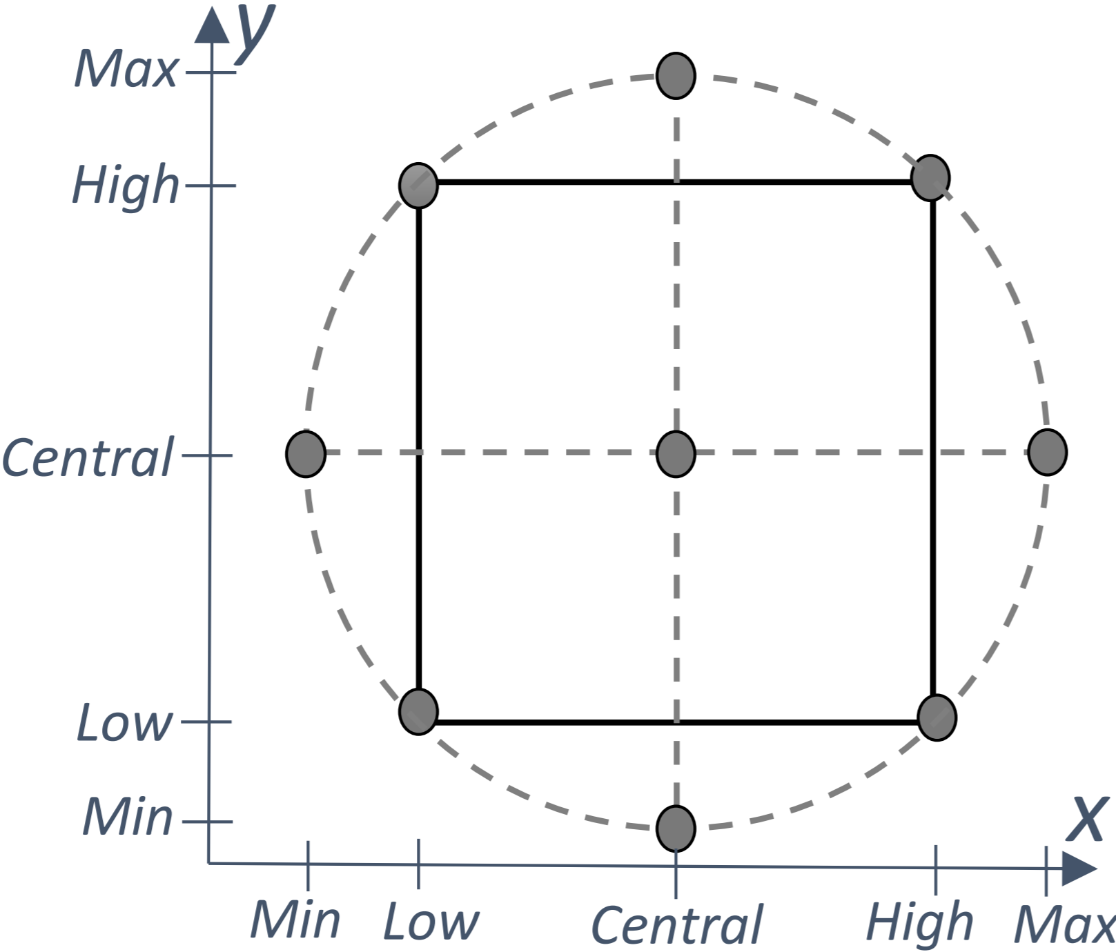
Phase 2: Accelerator Generation
Accelerator Optimization Options
Loop pipelining
Loop unrolling
Array partitioning
Inlining
Dataflow
Burst read/write
FPGA frequency
Base Model Building
Design of experiments technique to minimize the number of experiments while data collection
Notes:
In the next phase we implement this application on the FPGA
We make use of statistical technique called design of experiment to select a few data point that well represent the entire application space.
[CLICK] optimization options such as loop pipelining, unrolling, array partitioning.

Slide 16
Phase 3: Base Model Training
Application Features
Instruction mix
ILP
Reuse distance
Memory traffic
Register traffic
Memory footprint
Base Model Building
Accelerator Optimization Options
Loop pipelining
Loop unrolling
Array partitioning
Inlining
Dataflow
Burst read/write
FPGA frequency
Notes:
In the third phase 3 , we use features extracted form [CLICK] LLVM Analyzer and [CLICK] accelerator implementation phase to train our base learner which uses classic machine learning-based random forest and gradient boosting algorithm
During this phase, we perform additional tuning of our ML algorithm’s hyper-parameters.
Once trained, the base model can predict the performance and resource usage on the base environment. of previously-unseen configurations

Slide 17
Target Model Building via Transfer Learning
Target Model Building
Notes:
The second part of LEAPER is target model building, which is used to transfer a model to a different environment.
It also consists of three phases

Slide 18
Phase 1: LLVM Analyzer
Target Model Building
Notes:
Where we again perform LLVM Kernel analysis in case of change of application but if we just change the platform then we don’t need to perform this step.

Slide 19
Phase 2: Accelerator Generation
Target Model Building
Design of experiments technique to minimize the number of experiments while data collection
Notes:
And accelerator generation phase but only for a few optimization options, as few as 5-10, to build a few-shot learning dataset

Slide 20
Phase 3: Target Model Training
Target Model Building
Create a few-shot learning dataset to learn the change in distribution for the new environment (application/hardware platform)
Notes:
which is needed to learn the change in distribution while using a new environment.

Slide 21
Phase 3: Target Model Training
Transfer
Target Model Building
To transfer a model, LEAPER uses:
Few-shot learning dataset to train an ensemble of transfer learners
Transfer learner to perform a non-linear transformation of predictions from the base model to the target model
Notes:
We leverage our previously trained model to train an ensemble transfer learner. [CLICK]
which can be used for predicting for the new target environment without generating a model from scratch

Slide 22
Talk Outline
Motivation
LEAPER: Implementation
Evaluation of LEAPER and Key Results
Summary
Notes:
We now present our key results

Slide 23
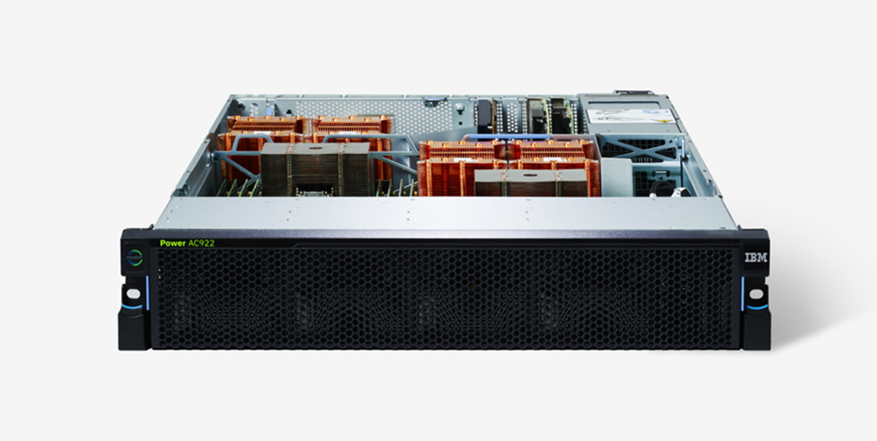
Evaluation Methodology (1/2)
Goal:
  Transfer ML-based model from edge to cloud platforms
  Transfer ML-based model across applications
  Predictions of previously unseen accelerator optimization options
Nimbix cloud as the target high-end platform with:
  5 FPGA configurations
  2 CAPI-based interconnects (CAPI1/CAP2)
PYNQ-Z1 ZYNQ as the base low-end platform
CAPI
POWER9 AC922
High-end FPGA
Low-end FPGA
Notes:
OUR GOAL is to evaluate performance of leaper on three different tasks:
[CLICK] We use the Nimbix cloud with [CLICK] CAPI-based FPGA system attached to a server-grade [CLICK] IBM POWER9 CPU system as our target system.
We evaluate 5 different FPGA configuration with 2 different CAPI-based interconnects.
We use cloud system as renting a cloud platform for data collection to build an ML model can significantly increase the total-cost- ownership (TCO) of a system.
[CLICK] We select the widely available PYNQ-Z1 board as our base system to our build base model. Which is a typical edge environment
[CLICK] We evaluate 6 real workloads from different application domains, such as machine learning, image processing, databases etc.

Slide 24
Evaluation Methodology (2/2)
6 real-world workloads:
  Image processing
    Histogram (HIST)
    Canny edge detection (CEDD)
  Machine learning
    Binary long short-term memory (BLSTM)
    Digit recognition (DIGIT)
  Databases:
    Relational operation (SELECT)
    Stream compaction (SC)
Programming tools:
  Xilinx design tools (Vivado and HLS)
  IBM CAPI-SNAP Framework

Slide 25
Performance Prediction: Transfer From Edge to Cloud
Transfer from low-end edge PYNQ-Z1 board to high-end cloud FPGA-based systems
Notes:
Accuracy is how close we are to the actual perfromacne of an implementation on the actual system
Over here we show the accuracy results when we us LEAPER to transfer models from our edge environment to 5 different cloud platform configurations and then the transferred model to predict performance in the new environment
On the x-axis the number of samples needed from the target environemnt while transfering model from edge environemnt.
We observe as we increase the number of labeled samples, the target model accuracy increases. However, the accuracy saturates and with 5-10 samples or shots, we can achieve an accuracy as high as 80- 90%.
However, when training with small sample sizes (in our experience, on the interval [5, 20]) the linear transfer model may get stuck in a local cost-minimum where the generated model may be biased. This is the reason for the non-monotonically decreasing error we observe in Tables 4, 6, and 8
There is a clear pattern indicating that configurations retain their relative performance profile across different hardware platforms.

Slide 26
Performance Prediction: Transfer From Edge to Cloud
Transfer from low-end edge PYNQ-Z1 board to high-end cloud FPGA-based systems
LEAPER can effectively transfer model from edge to cloud platform using only 5-10 samples
Reduces design-space exploration time by 10x than training from scratch
(from days to only a few hours)

Slide 27
Performance Prediction: Transfer Across Applications
Transfer across applications on low-end edge PYNQ-Z1 board
Notes:
We also evaluate LEAPER’s accuracy for transferring base models across various applications on the same edge platform
Our here we trained a model for BLSTM and transferred to different applications.
Each bar represents the amount of samples used from the target application
Applications benefits with more samples because distribution changes between application but most of the gains happen in 5 samples

Slide 28
Performance Prediction: Transfer Across Applications
Transfer across applications on low-end edge PYNQ-Z1 board
LEAPER can effectively transfer models
across applications with on
average 85% accuracy
Notes:
We also evaluate LEAPER’s accuracy for transferring base models across various applications on the same edge platform
Our here we trained a model for BLSTM and transferred to different applications.
Each bar represents the amount of samples used from the target application
Applications benefits with more samples because distribution changes between application but most of the gains happen in 5 samples

Slide 29
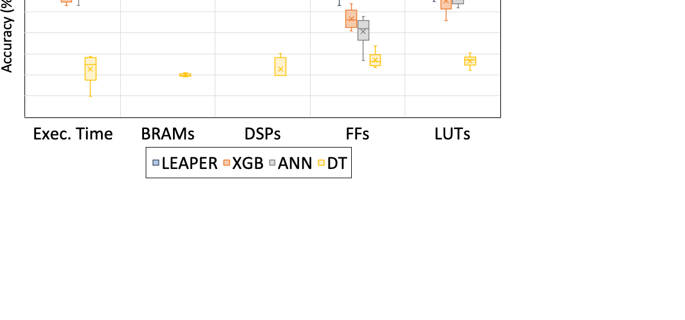
Prediction Comparison: Unseen Accelerator Optimizations
Prediction of previously unseen accelerator optimization options on the base platform
Comparison with three popular ML-based techniques: XGBoost (XGB), artificial neural network (ANN), and decision tree (DT)
Notes:
We also evaluate the accuracy of our base mode in predicting exec time, resource utilization for new optimization options that are not part of our training set. The model was trained using data collected by design of experiment technique.
And compare other ML-based techniques, XGBoost, NN, and Decision Trees.

Slide 30
Prediction Comparison: Unseen Accelerator Optimizations
Prediction of previously unseen accelerator optimization options on the base platform
Comparison with three popular ML-based techniques: XGBoost (XGB), artificial neural network (ANN), and decision tree (DT)
LEAPER provides both high accuracy and sample-efficiency compared to other
ML-based techniques

Slide 31
More in the Paper
Accuracy analysis for transferring resource usage models
Time and cost analysis to build ML models using LEAPER and traditional approach
Transfer to a wide range of cloud FPGA configurations and applications
Comparison to different transfer learning algorithms
Explainability analysis of LEAPER
Discussion on limitations
Notes:
We have many more evaluation results:
Accuracy analysis for transferring resource usage models, time cost analysis, explainability analysis etc
…in the paper.

Slide 32
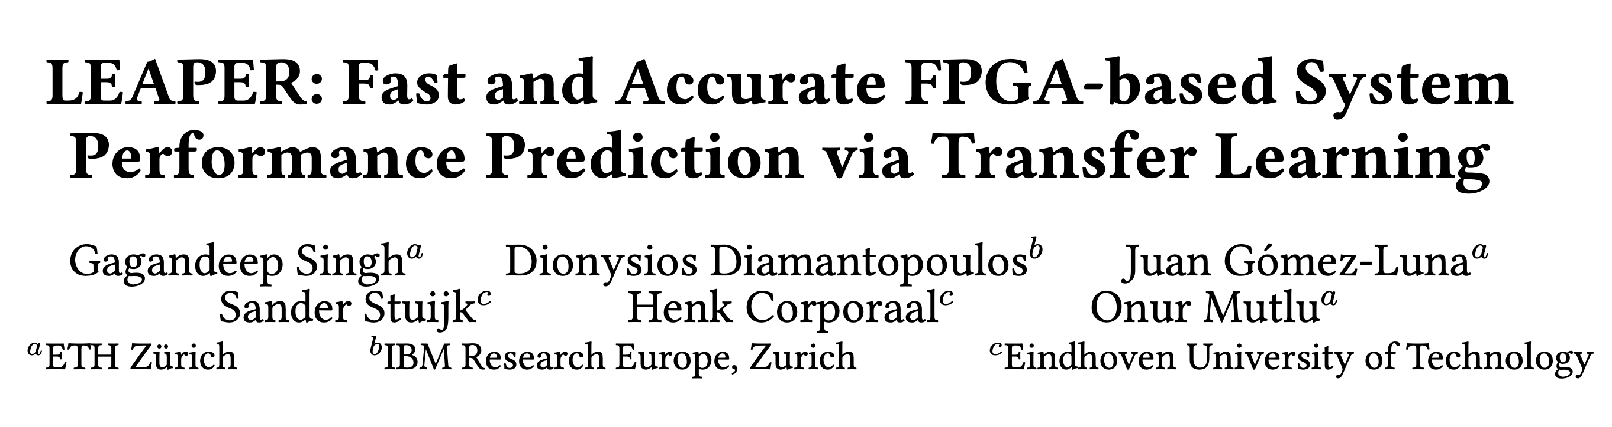
More in the Paper
Accuracy analysis for transferring resource usage models
Time and cost analysis to build ML models using LEAPER and traditional approach
Transfer to a wide range of cloud FPGA configurations and applications
Comparison to different transfer learning algorithms
Explainability analysis of LEAPER
Discussion on limitations
https://arxiv.org/pdf/2208.10606.pdf
Notes:
For more details we encourage you to read our paper

Slide 33
Talk Outline
Motivation
LEAPER: Implementation
Evaluation of LEAPER and Key Results
Summary
Notes:
Now I will conclude my talk

Slide 34
Summary
LEAPER transfers previously trained models to predict the performance and resource usage of accelerator implementation
LEAPER is cheaper (with 5-shot), faster (up to 10x), highly accurate (85%) at predicting performance and resource usage in a new environment than building model from scratch
Notes:
We introduced LEAPER, a transferring learning based framework where we advocate for the transfer of previously trained models to predict the performance and resource usage for FPGA-based systems
LEAPER is cheaper (with 5-shot), faster (up to 10x), highly accurate (85%) at predicting performance and resource usage in a new environment than building model from scratch

Slide 35
LEAPER:
Fast and Accurate FPGA-based System Performance Prediction via Transfer Learning
Gagandeep Singh, Dionysios Diamantopoulos,
Juan Gómez-Luna, Sander Stuijk,
Henk Corporaal, and Onur Mutlu
Notes:
We hope LEAPER it will inspire the development of new modeling techniques for FPGAs.
Thank you. I will be happy to take any questions

