Slide 1
Session 1A at 11.20 am
MEMCON
Detecting and Mitigating
Data-Dependent DRAM Failures
by Exploiting Current Memory Content
Samira Khan
Chris Wilkerson, Zhe Wang, Alaa Alameldeen, Donghyuk Lee, Onur Mutlu

Slide 2
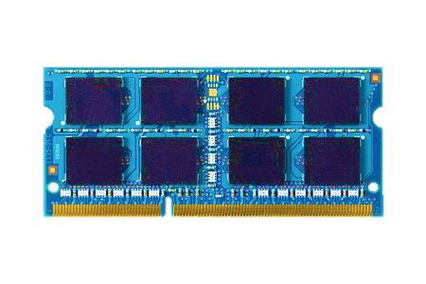
VISION: SYSTEM-LEVEL DETECTION AND MITIGATION
Detect
and
Mitigate
Unreliable
DRAM Cells
Reliable System
Detect and mitigate errors after
the system has become operational
ONLINE PROFILING

Slide 3
BENEFITS OF ONLINE PROFILING
Technology
Scaling
Reliable
DRAM Cells
Unreliable
DRAM Cells
Improves yield, reduces cost, enables scaling
Vendors can make cells smaller without a strong reliability guarantee

Slide 4
BENEFITS OF ONLINE PROFILING
LO-REF
HI-REF
LO-REF
HI-REF
LO-REF
Unreliable
DRAM Cells
Reduce refresh count by using a lower refresh rate,
but use higher refresh rate for faulty cells
2. Improves performance and energy efficiency
Reduce refresh rate, refresh faulty rows more frequently

Slide 5
DETECTION IS HARD DUE TO INTERMITTENT FAILURES
DATA-DEPENDENT FAILURE
1
1
1
NO
FAILURE
0
1
0
FAILURE
Some cells can fail depending on the
data stored in neighboring cells

Slide 6
HOW TO DETECT DATA-DEPENDENT FAILURES?
Test with specific data pattern in neighboring cells
L
0
R
D
0
1
LINEAR
MAPPING
X-1
X
X+1

Slide 7
HOW TO DETECT DATA-DEPENDENT FAILURES?
Test with specific data pattern in neighboring cells
L
0
R
D
0
1
LINEAR
MAPPING
X-1
X
X+1

Slide 8
HOW TO DETECT DATA-DEPENDENT FAILURES?
Test with specific data pattern in neighboring cells
L
0
R
D
0
1
LINEAR
MAPPING
X-1
X
X+1
0
0
1
0
0
1
SCRAMBLED
MAPPING
X-1
X
X+1

Slide 9
HOW TO DETECT DATA-DEPENDENT FAILURES?
Test with specific data pattern in neighboring cells
L
0
R
D
0
1
LINEAR
MAPPING
X-1
X
X+1
NOT EXPOSED TO THE SYSTEM
0
0
1
0
0
1
SCRAMBLED
MAPPING
X-4
X
X+2

Slide 10
MEMCON
0
1
0
SCRAMBLED
MAPPING
X-?
X
X+?
Detects data-dependent failures
without the knowledge of the
DRAM internal address mapping
65%-74%
Reduction in refresh count
40%-50%
Performance improvement using 32Gb DRAM

Slide 11
Session 1A at 11.20 am
MEMCON
Detecting and Mitigating
Data-Dependent DRAM Failures
by Exploiting Current Memory Content
Samira Khan
Chris Wilkerson, Zhe Wang, Alaa Alameldeen, Donghyuk Lee, Onur Mutlu

