Slide 1



MEMCON
Detecting and Mitigating
Data-Dependent DRAM Failures
by Exploiting Current Memory Content
Samira Khan
Chris Wilkerson, Zhe Wang, Alaa Alameldeen, Donghyuk Lee, Onur Mutlu

Slide 2
DRAM SCALING TREND
2X/1.5 YEARS
2X/3 YEARS
DRAM scaling is slowing down
Source: Flash Memory Summit 2013, Memcon 2014

Slide 3

DRAM SCALING CHALLENGE
Technology
Scaling
DRAM Cells
DRAM Cells
Manufacturing reliable cells at low cost
is getting difficult

Slide 4
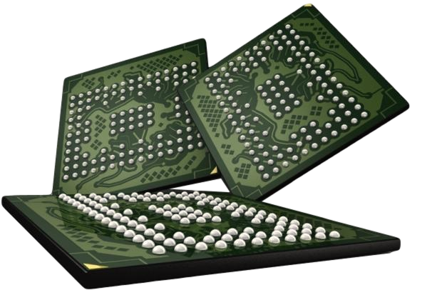

TRADITIONAL APPROACH
TO ENABLE DRAM SCALING
Manufacturing Time Testing
PASS
FAIL
1. Manufacturers perform exhaustive testing of DRAM chips
2. Chips failing the tests are discarded

Slide 5

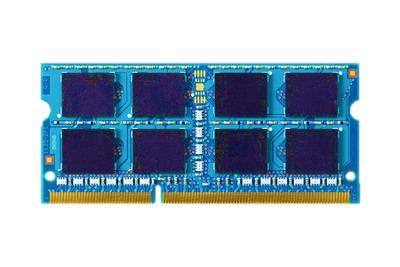
VISION: SYSTEM-LEVEL DETECTION AND MITIGATION
Not fully tested during
manufacture-time
Ship modules
with possible failures
2
1
PASS
FAIL
Detect and mitigate
failures online
3
Detect and mitigate errors after
the system has become operational
ONLINE PROFILING

Slide 6
BENEFITS OF ONLINE PROFILING
Technology
Scaling
Reliable
DRAM Cells
Unreliable
DRAM Cells
Improves yield, reduces cost, enables scaling
Vendors can make cells smaller without a strong reliability guarantee

Slide 7
BENEFITS OF ONLINE PROFILING
HI-REF
Reduce
Refresh
LO-REF
Reliable
DRAM Cells
Unreliable
DRAM Cells
Improves yield, reduces cost, enables scaling
Vendors can make cells smaller without a strong reliability guarantee
2. Improves performance and energy efficiency

Slide 8
DRAM CELLS ARE NOT EQUAL
Ideal
Real
Smallest cell
FAST
FAST
Large variation in retention time
Most cells have high retention time →
can be refreshed at a lower rate without any failure
Smaller cells will fail to retain data at a lower refresh rate
Notes:
Ideally, DRAM would have uniform cells which have same size, thereby having same access latency.
Unfortunately, due to process variation, each cell has different size, thereby having different access latency.
Therefore, DRAM shows large variation in both charge amount in its cell and access latency to its cell.

Slide 9
BENEFITS OF ONLINE PROFILING
LO-REF
HI-REF
LO-REF
HI-REF
LO-REF
Unreliable
DRAM Cells
Reduce refresh count by using a lower refresh rate,
but use higher refresh rate for faulty cells
Improves yield, reduces cost, enables scaling
Vendors can make cells smaller without a strong reliability guarantee
2. Improves performance and energy efficiency
Reduce refresh rate, refresh faulty rows more frequently

Slide 10
In order to enable these benefits,
we need to detect the failures
at the system level

Slide 11
CHALLENGE IN SYSTEM-LEVEL
DETECTION AND MITIGATION
Detect
and
Mitigate
Unreliable
DRAM Cells
Reliable System
Depends on accurately detecting DRAM failures
If failures were permanent,
a simple boot up test would have worked,
but there are intermittent failures

Slide 12
DATA-DEPENDENT FAILURE
NO
FAILURE
INTERFERENCE
DUE TO
COUPLING
0
0
FAILURE
0
1
1
Some cells can fail depending on the
data stored in neighboring cells
How can we detect these failures at the system level?
JSSC’88, MDTD’02
Notes:
Y. Nakagome, … Kiyoo Itoh, The Impact of Data-Line Interference Noise on DRAM Scaling, IJSSC’88
M. Redeker, B. F. Cockburn, and D. G. Elliott. An investigation into crosstalk noise in DRAM structures. MTDT, 2002 (Memory Technology, Design and Testing)
J. Liu et al. An experimental study of data retention behavior in modern DRAM devices: Implications for retention time profiling mechanisms, ISCA 2012

Slide 13
DETECTING DATA-DEPENDENT FAILURES
Testing with specific patterns in neighboring addresses
L
0
R
D
0
1
LINEAR
MAPPING
X-1
X
X+1
NOT EXPOSED TO THE SYSTEM
0
0
1
0
0
1
SCRAMBLED
MAPPING
X-1
X-4
X
X+2
X+1

Slide 14
CHALLENGE IN DETECTION
0
1
0
SCRAMBLED
MAPPING
X-?
X
X+?
How to detect data-dependent failures
when we even do not know
which cells are neighbors?

Slide 15
PROBLEM:
SCRAMBLED ADDRESS MAPPING
MEMCON: DRAM-Internal
Independent Detection
CAL’16, MICRO’17
DRAM
GOAL
System-Level Detection and Mitigation of Failures
KEY IDEA
CHALLENGE
MECHANISM
RESULTS

Slide 16
GOAL: MEMCON
0
1
0
SCRAMBLED
MAPPING
X-?
X
X+?
Detect data-dependent failures
without the knowledge of
the DRAM internal address mapping

Slide 17
CURRENT DETECTION MECHANISM
Initial Failure Detection and Mitigation
Execution
of Applications
Detection is done with some initial testing
isolated from system execution
Detect and mitigate all failures with every possible content
Only after that start program execution
RAPID HPCA’06, Rethinking Refresh IEEE Micro’08 , RAIDR ISCA’12, SECRET ICCD’12, Dtail SC’14, ProactiveDRAM ICCD’14, REAPER ISCA’17

Slide 18
CURRENT DETECTION MECHANISM
Detect every possible failure with all content before execution
(All possible
failing cell)
Unreliable
DRAM Cells
List of Failures
Initial Failure Detection and Mitigation

Slide 19
CURRENT DETECTION MECHANISM
Detect every possible failure with all content before execution
0
1
0
0
0
Pattern x, Cell A
(All possible
failing cell)
0
1
0
0
0
0
1
0
0
0
0
1
0
0
0
Unreliable
DRAM Cells
List of Failures
Initial Failure Detection and Mitigation

Slide 20
CURRENT DETECTION MECHANISM
Detect every possible failure with all content before execution
0
0
1
0
0
Pattern x, Cell A
Pattern y, Cell B
(All possible
failing cell)
0
0
1
0
0
0
0
1
0
0
0
0
1
0
0
Unreliable
DRAM Cells
List of Failures
Initial Failure Detection and Mitigation

Slide 21

CURRENT DETECTION MECHANISM
Detect every possible failure with all content before execution
0
0
0
1
0
Pattern x, Cell A
Pattern y, Cell B
Pattern z, Cell C
…
(All possible
failing cell)
0
0
0
1
0
0
0
0
1
0
0
0
0
1
0
Unreliable
DRAM Cells
List of Failures
Applications
Initial Failure Detection and Mitigation
Execution
of Applications

Slide 22
CURRENT DETECTION MECHANISM
Detect every possible failure with all content before execution
0
0
0
1
0
??
0
0
0
1
0
0
0
0
1
0
No Reliability Guarantee
0
0
0
1
0
Unreliable
DRAM Cells
List of Failures
Applications
Initial Failure Detection and Mitigation
Execution
of Applications
The problem is cannot detect all failures
when we do not know the address mapping

Slide 23
MEMCON: MEMORY CONTENT-BASED
DETECTION AND MITIGATION
NO NEED TO DETECT EVERY POSSIBLE FAILURE
0
1
0
1
0
0
1
0
0
0
Current content, Cell A
1
0
0
1
0
0
0
0
0
1
Unreliable DRAM Cells
with Program Content
List of Failures
Application
Simultaneous Detection and Execution
Based on current memory content of running applications
Need to detect and mitigate
only with the current content

Slide 24
MEMCON: HIGH-LEVEL DESIGN
Simultaneous Detection and Execution
HI-REF
0
1
0
1
0
LO-REF
HI-REF
0
1
0
0
0
HI-REF
Current content, Cell A
1
0
0
1
0
HI-REF
LO-REF
0
0
0
0
1
HI-REF
LO-REF
Application
Unreliable DRAM Cells
No initial detection and mitigation
Start running the application with a high refresh rate
Detect failures with the current memory content
  If no failure found, use a low refresh rate

Slide 25
PROBLEM:
SCRAMBLED ADDRESS MAPPING
MEMCON: DRAM-Internal
Independent Detection
CAL’16, MICRO’17
GOAL
KEY IDEA
CHALLENGE
MECHANISM
RESULTS

Slide 26
CHALLENGE WITH MEMCON
NEED TO DETECT FAILURE AT A WRITE
0
1
0
1
0
0
1
0
0
0
Current content, Cell ??
Write access
to row A
1
0
1
1
0
0
0
0
0
1
Unreliable DRAM Cells
with Program Content
Testing at every write is expensive!!!

Slide 27
MEMCON: COST-BENEFIT ANALYSIS
The cost of testing
Extra memory accesses to read and write rows
The benefit of testing
If no failure found, can reduce refresh rate

Slide 28
MEMCON: COST-BENEFIT ANALYSIS
Frequent testing introduces high cost
Cost
Write Interval Length
Testing
Testing
Short write interval →
High average cost
16 ms
HI-REF
Avg cost
64 ms
LO-REF
Avg cost
write₁
write₂
Time
Using HI-REF is better when write interval length is short

Slide 29
MEMCON: COST-BENEFIT ANALYSIS
The higher the write interval length,
the higher is the benefit
Cost
Testing
Testing
Write Interval Length
16 ms
HI-REF
Write Interval Length
64 ms
LO-REF
Benefit
write₁
write₂
Time
Can amortize the cost of testing with long intervals

Slide 30
MEMCON: COST BENEFIT ANALYSIS
What is the write interval that can amortize the cost?
MinWriteInterval
864 ms

Slide 31
MEMCON: MECHANISM
How much longer??
Write Requests
Time
MEMCON selectively initiates testing
when the write interval is long enough
to amortize the cost of testing
How do we predict the interval on a write access?

Slide 32
PROBLEM:
SCRAMBLED ADDRESS MAPPING
MEMCON: DRAM-Internal
Independent Detection
CAL’16, MICRO’17
GOAL
KEY IDEA
CHALLENGE
MECHANISM
RESULTS

Slide 33

32 seconds of execution on a real machine
Profiled with a custom FPGA-based infrastructure

Slide 34
WRITE INTERVAL CHARACTERISTICS
ACBrotherhood
Netflix
Write intervals follow a Pareto distribution
The longer the elapsed time after a write
→ The longer the write interval
Notes:
Actually we find that write intervals follow a pareto distribution. According to pareto distribution, if we plot the probability of write intervals in a log log scale, it should be linear and we find that distributions closely matches to that, the R2 values are pretty high.
We actually leverage a property of the pareto distribution to predict the write intervals. The decrasing hazard rate property of pareto distribution says that the longer the elapsed time after a write, the longer the write interval

Slide 35
WRITE INTERVAL CHARACTERISTICS
T
Current
Interval
Length
(CIL)
Remaining
Interval
Length
(RIL)
Write Requests
Time
Write Interval Length
The longer the CIL
→ It is expected that the longer the RIL
Notes:
So let’s define some terminology for write intervals. Current interval length is the elapsed time after a write and the RIL is remaining interval length. And pareto distrbtion says the the longer the CIL, it is expected that the longer the RIL

Slide 36
WRITE INTERVAL CHARACTERISTICS
If the interval is already 1024 ms long,
the probability that the remaining interval
is greater than 1024 ms is on average 76%
Notes:
In order to see if this is true, here is plot the probability of RIL being greater than 1024 ms when we vary CIL
And we see that it is true that the probability increases as we increase CIL. Actually, if the CIL becomes 1024 ms, the probability that the remaining interval length is greater than becomes on average 76%

Slide 37
How do we predict the interval on a write access?
How much longer??
Write Requests
Time
Notes:
So remember that, we are trying to predict the write interval on a write and trying to decide if MEMCON should initiate the testing

Slide 38
WRITE INTERVAL PREDICTION
Write Requests
Expected
RIL > 1024 ms
Wait for
1024 ms
Time
Write Interval Length
After a write, wait for a CIL, where P(RIL) > 1024 is high
If idle, predict the interval will last more than 1024 ms
Notes:
So we just wait for 1024 ms and if there is no other write, we can predict the the RIL would be more than 1024 ms

Slide 39
PROBLEM:
SCRAMBLED ADDRESS MAPPING
MEMCON: DRAM-Internal
Independent Detection
CAL’16, MICRO’17
GOAL
KEY IDEA
CHALLENGE
MECHANISM
RESULTS

Slide 40
MEMCON: REDUCTION IN REFRESH COUNT
UPPER BOUND
71% average reduction in refresh count,
very close to the upper bound of 75%

Slide 41
MEMCON: PERFORMANCE IMPROVEMENT DUE TO REDUCTION IN REFRESH COUNT
Single-Core
Four-Core
50%
40%
65%
52%
Refresh reduction leads to
significant performance improvement

Slide 42
MEMCON: SUMMARY
0
1
0
X-?
X
X+?
Problem:
SCRAMBLED MAPPING
Goal: MEMCON detects and mitigates data-dependent failures without the knowledge of the DRAM internal address mapping
Key Idea: Instead of detecting every possible failure, detects failure based on the current content
Challenge: Content changes with writes, testing at every write is expensive
Mechanism: Selective testing mechanism based on write interval length
Initiates a test only when can amortize the cost
65%-74%
Reduction in refresh count
40%-50%
Performance improvement using 32Gb DRAM (1 core)
Results:

Slide 43
MEMCON
Detecting and Mitigating
Data-Dependent DRAM Failures
by Exploiting Current Memory Content
Samira Khan
Chris Wilkerson, Zhe Wang, Alaa Alameldeen, Donghyuk Lee, Onur Mutlu

Slide 44
DATA-DEPENDENT FAILURE

Slide 45
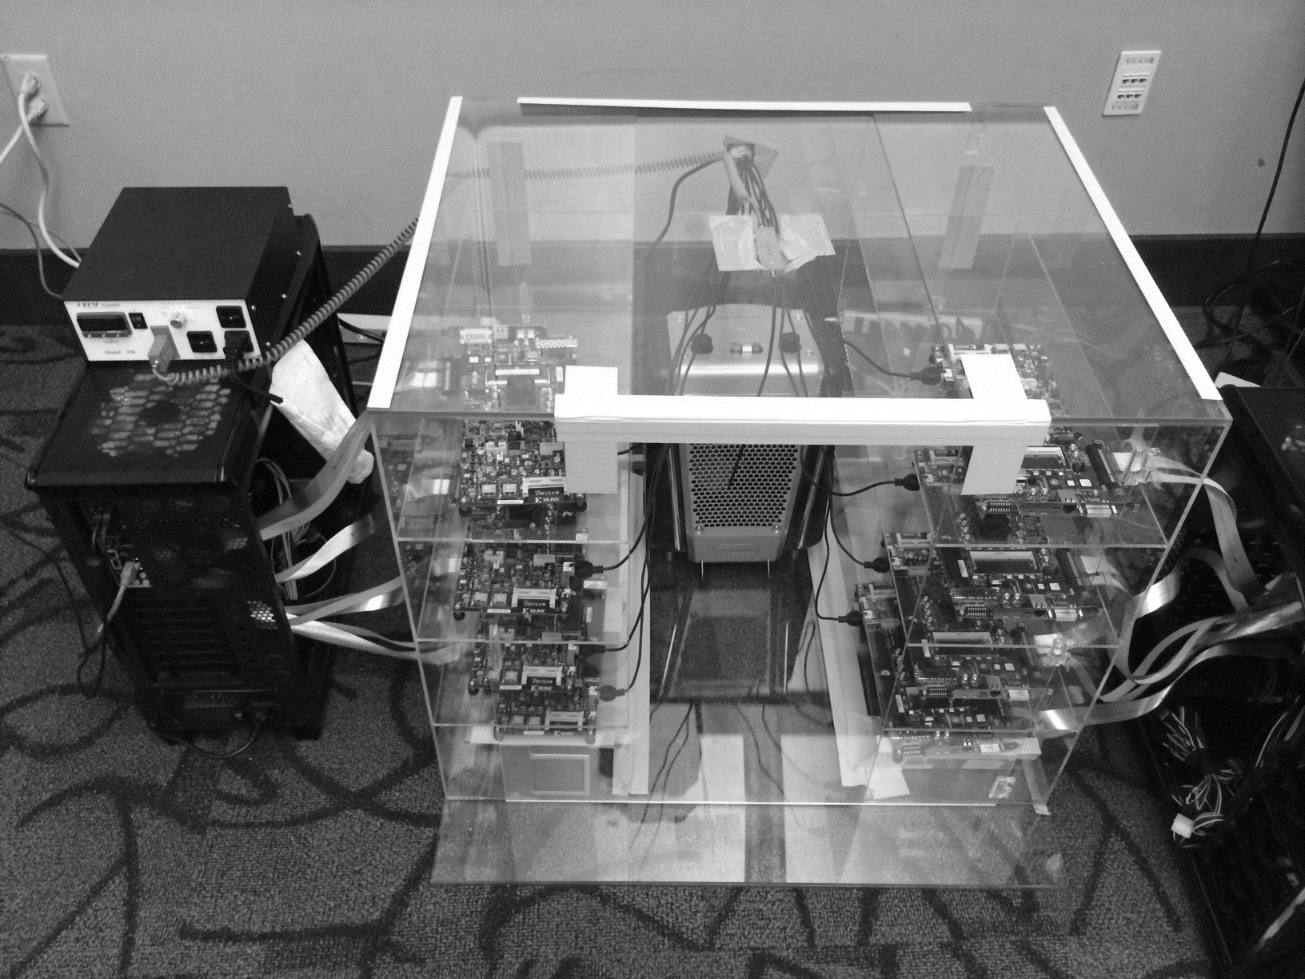
DRAM Testing Infrastructure
Temperature
Controller
FPGAs
Heater
FPGAs
PC
Notes:
This is the photo of our infrastructure, that we built mostly from scratch.
For higher throughput, we employ eight FPGAs, all of which are enclosed in thermally-regulated environment.

Slide 46
NUMBER OF FAILING ROWS
WITH PROGRAM CONTENT
Tested with program content in real DRAM chips
Program content exhibits significantly less failures

Slide 47
MEMCON: COST-BENEFIT ANALYSIS
Cost: Extra memory accesses to read and write rows
Benefit: If no failure found, can reduce refresh rate
Cost
Frequent Testing
Selective Testing
Cost
Testing
Testing
Testing
Testing
16 ms
HI-REF
Avg Cost
16 ms
HI-REF
16 ms
HI-REF
64 ms
LO-REF
64 ms
LO-REF
Avg Cost
t₁
t₂
t₃
t₁
t₂
t₃
Time
Time
Initiate a test only when the cost can amortized

Slide 48
MEMCON: READ AND COMPARE
Aggressively refreshed before testing
64 ms
LO-REF
16 ms
HI-REF
2. Wait for 64 ms
Memory Controller
3. Read and compare
0
0
1
0
1
00101
1. Read the entire row
Benefit: If no failure found,
can reduce refresh rate

Slide 49
MEMCON: COPY AND COMPARE
Aggressively refreshed before testing
64 ms
LO-REF
16 ms
HI-REF
2. Wait for 64 ms
Memory Controller
3. Read and compare
0
0
1
0
1
Copy the entire row
Keep ECC info in MC
0
0
1
0
1
01
0
0
1
0
1
Benefit: If no failure found,
can reduce refresh rate

Slide 50
MEMCON: COST-BENEFIT ANALYSIS
Cost: Extra memory accesses
to read and write rows while testing
Benefit: If no failure found,
can reduce refresh rate
1. READ AND COMPARE
  Read in-test row in the memory controller
2. COPY AND COMPARE
  Copy in-test row in some other region in memory

Slide 51
WRITE INTERVAL CHARACTERISTICS
ACBrotherhood
Netflix
Few long intervals
Few long intervals
Only a small fraction of the writes exhibit long intervals
but

Slide 52
WRITE INTERVAL CHARACTERISTICS
These long intervals constitute the majority of the time
spent on write intervals

Slide 53
PREDICTING WRITE INTERVAL
Quantum Length = CIL (e.g, 1024 ms)
Page X, Page Y
Page X, Page Y
Write Requests
One Write
No Write
Time
Quantum 1
Quantum 2
Quantum 3
Predicted to have a long write interval if
Receives a single write in quantum 1
And no write in quantum 2
Notes:
We use a simple mechanism to

Slide 54
MEMCON: REDUCTION IN REFRESH COUNT
UPPER BOUND
On average 71% reduction in refresh count,
very close to the upper bound of 75%

