Slide 1
2023 IEEE International Symposium on Performance Analysis of Systems and Software
Evaluating
Machine Learning Workloads
on Memory-Centric Computing Systems
Juan Gómez Luna, Yuxin Guo, Sylvan Brocard,
Julien Legriel, Remy Cimadomo, Geraldo F. Oliveira,
Gagandeep Singh, Onur Mutlu
https://arxiv.org/pdf/2207.07886.pdf
https://github.com/CMU-SAFARI/pim-ml
juang@ethz.ch
Monday, April 24, 2023

Slide 2
Executive Summary
Training machine learning (ML) algorithms is a computationally expensive process, frequently memory-bound due to repeatedly accessing large training datasets
Memory-centric computing systems, i.e., with Processing-in-Memory (PIM) capabilities, can alleviate this data movement bottleneck
Real-world PIM systems have only recently been manufactured and commercialized
  UPMEM has designed and fabricated the first publicly-available real-world PIM architecture
Our goal is to understand the potential of modern general-purpose PIM architectures to accelerate machine learning training
Our main contributions:
  PIM implementation of several classic machine learning algorithms: linear regression, logistic regression, decision tree, K-means clustering
  Workload characterization in terms of quality, performance, and scaling
  Comparison to their counterpart implementations on processor-centric systems (CPU and GPU)
    PIM version of DTR is 27x / 1.34x faster than the CPU / GPU version, respectively
    PIM version of KME is 2.8x / 3.2x faster than the CPU / GPU version, respectively
  Source code: https://github.com/CMU-SAFARI/pim-ml
Experimental evaluation on a real-world PIM system with 2,524 PIM cores @ 425 MHz and 158 GB of DRAM memory
Key observations, takeaways, and recommendations for ML workloads on general-purpose PIM systems

Slide 3
Outline
Machine learning workloads
Processing-in-memory
PIM implementation of ML workloads
Evaluation
Quality Metrics
Analysis of PIM Kernels
Performance Scaling
Comparison to CPU and GPU

Slide 4
Machine Learning Workloads
Machine learning training with large amounts of data is a computationally expensive process, which requires many iterations to update an ML model’s parameters
Frequent data movement between memory and processing elements to access training data
The amount of computation is not enough to amortize the cost of moving training data to the processing elements
  Low arithmetic intensity
  Low temporal locality
  Irregular memory accesses

Slide 5
Machine Learning Workloads: Our Goal
Our goal is to study and analyze how real-world general-purpose PIM can accelerate ML training
Four representative ML algorithms: linear regression, logistic regression, decision tree, K-means
Roofline model to quantify the memory boundedness of CPU versions of the four workloads
All workloads fall in the memory-bound area of the Roofline

Slide 6
Outline
Machine learning workloads
Processing-in-memory
PIM implementation of ML workloads
Evaluation
Quality Metrics
Analysis of PIM Kernels
Performance Scaling
Comparison to CPU and GPU

Slide 7
Processing-in-Memory (PIM)
PIM is a computing paradigm that advocates for memory-centric computing systems, where processing elements are placed near or inside the memory arrays
Real-world PIM architectures are becoming a reality
  UPMEM PIM, Samsung HBM-PIM, Samsung AxDIMM, SK Hynix AiM, Alibaba HB-PNM
These PIM systems have some common characteristics:
  There is a host processor (CPU or GPU) with access to (1) standard main memory, and (2) PIM-enabled memory
  PIM-enabled memory contains multiple PIM processing elements (PEs) with high bandwidth and low latency memory access
  PIM PEs run only at a few hundred MHz and have a small number of registers and small (or no) cache/scratchpad
  PIM PEs may need to communicate via the host processor

Slide 8
A State-of-the-Art PIM System
In our work, we use the UPMEM PIM architecture
  General-purpose processing cores called DRAM Processing Units (DPUs)
    Up to 24 PIM threads, called tasklets
    32-bit integer arithmetic, but multiplication/division are emulated*, as well as floating-point operations
  64-MB DRAM bank (MRAM), 64-KB scratchpad (WRAM)
* 8-bit integer multiplication is natively supported

Slide 9
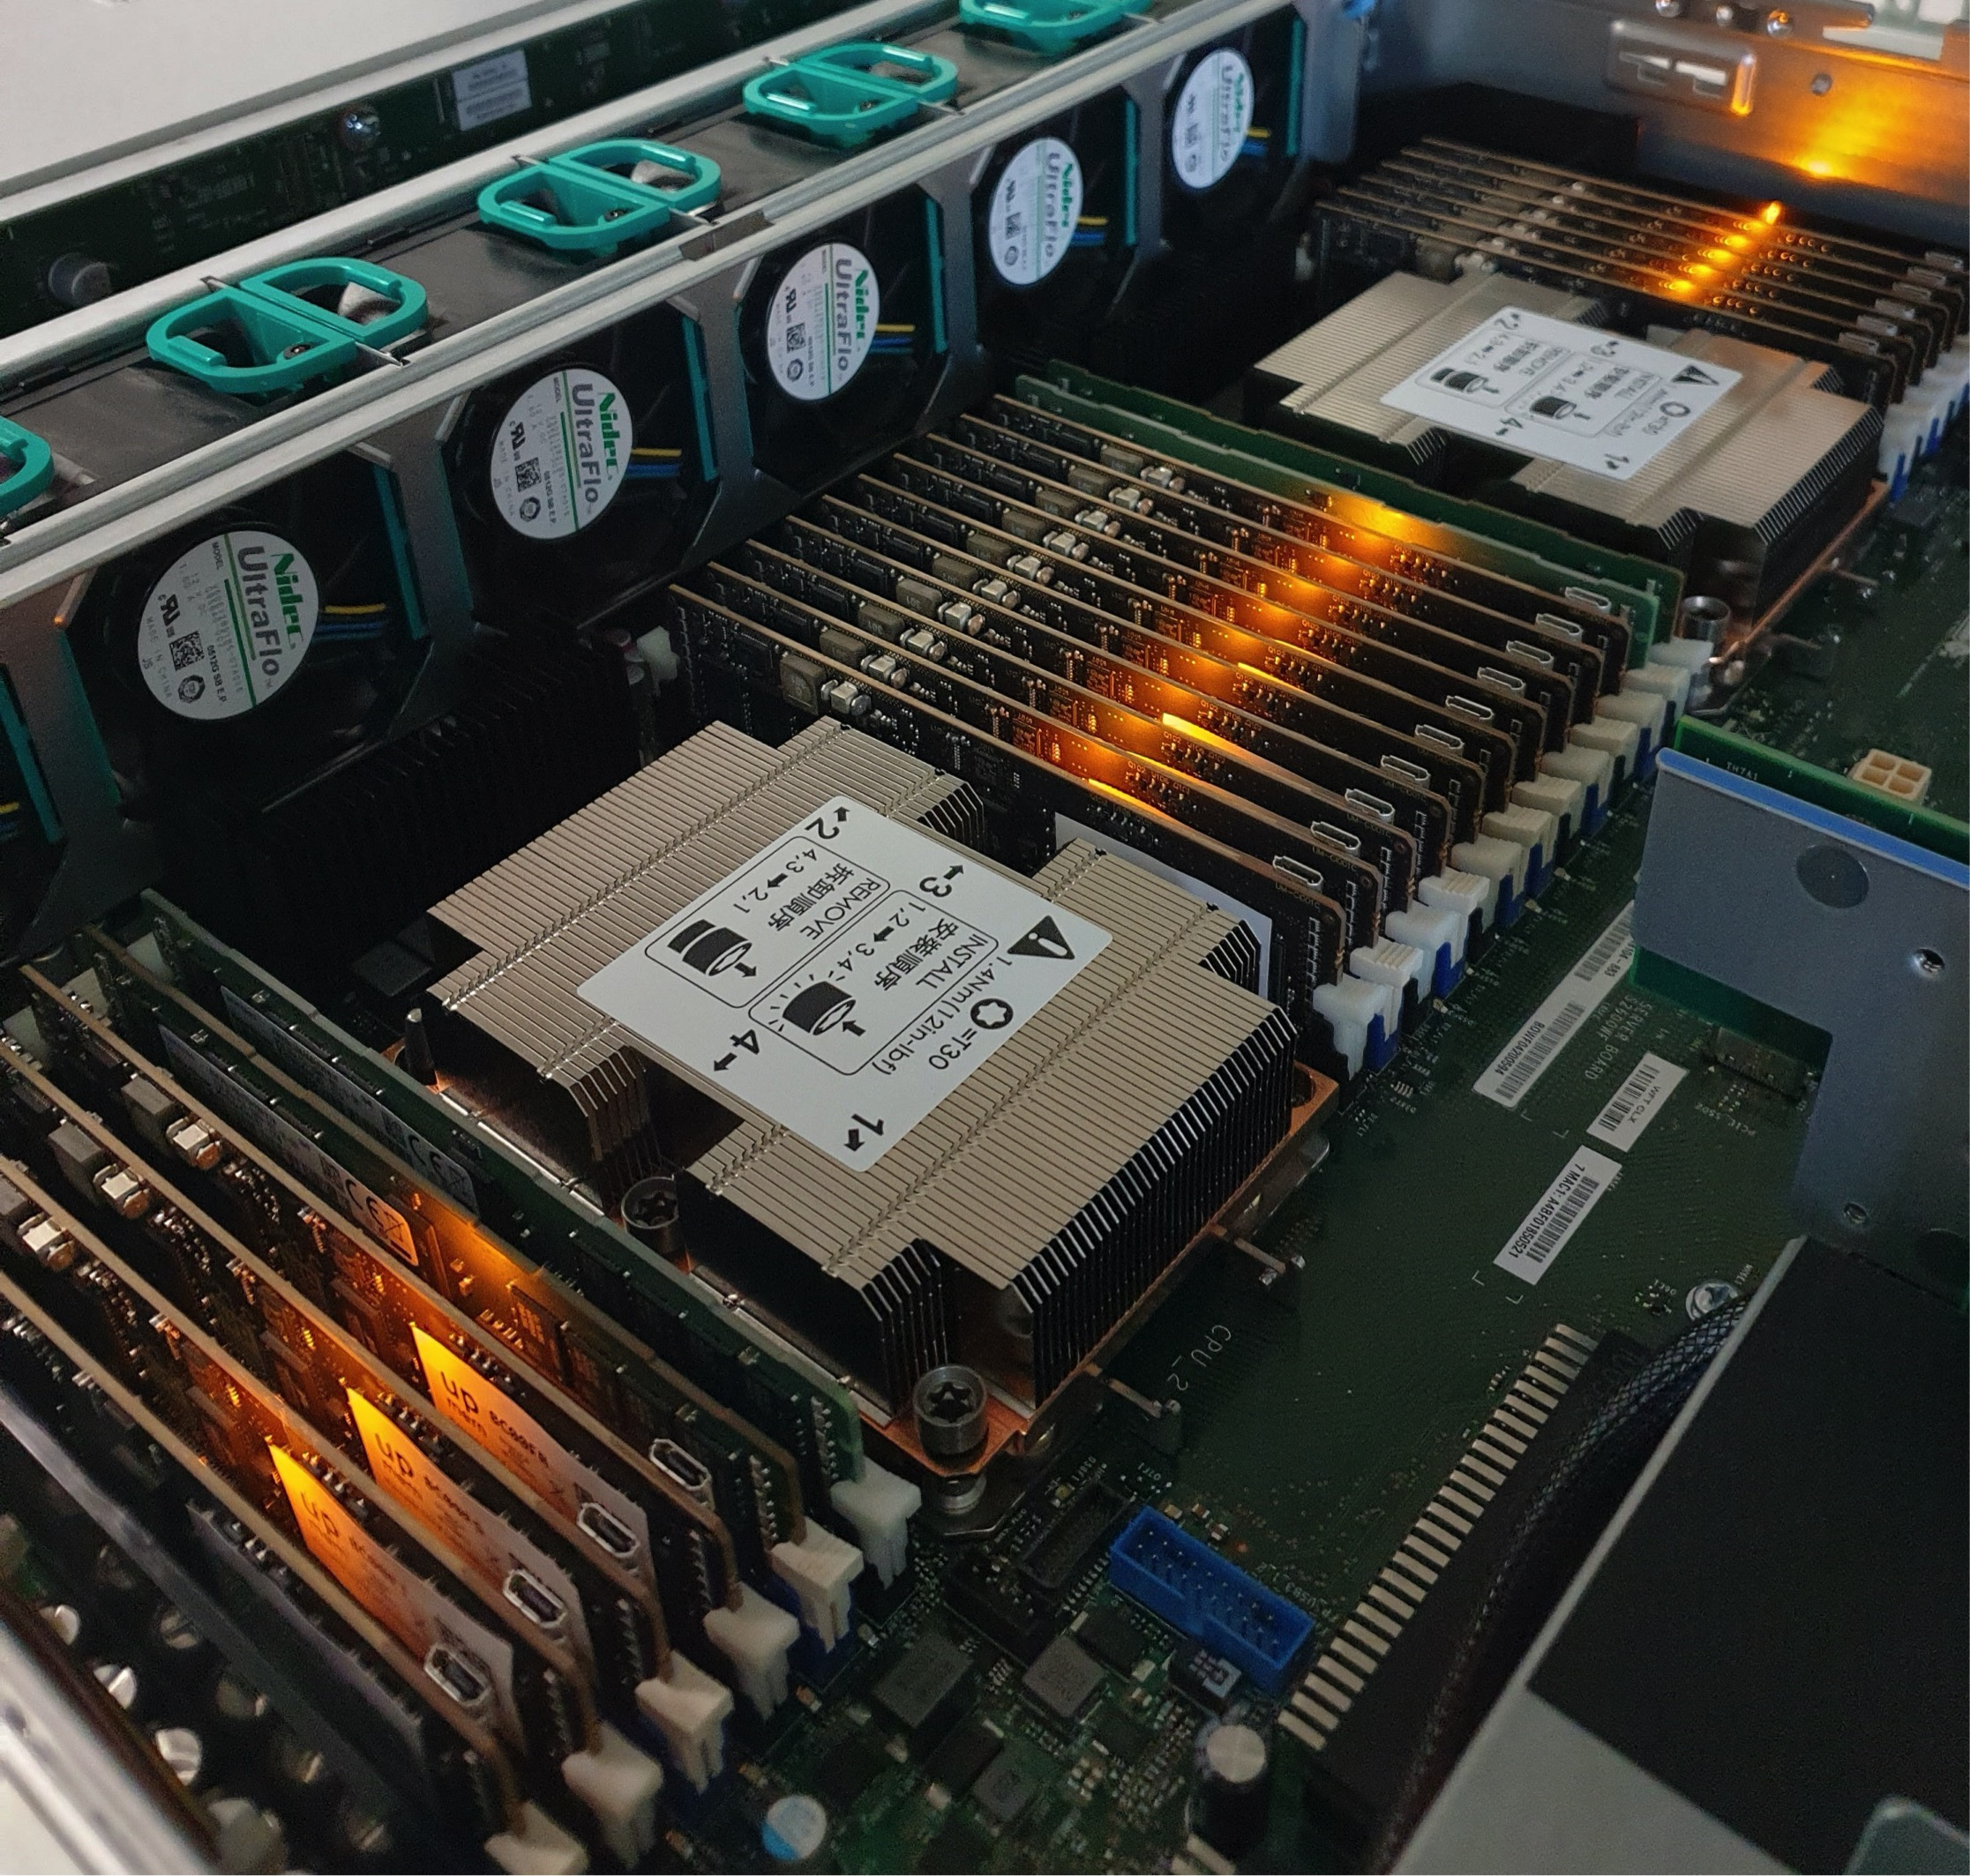
2,560-DPU UPMEM PIM System
20 UPMEM DIMMs of 16 chips each (40 ranks)
Dual x86 socket
UPMEM DIMMs coexist with regular DDR4 DIMMs
  2 memory controllers/socket (3 channels each)
  2 conventional DDR4 DIMMs on one channel of one controller
* There are some faulty DPUs in the system that we use in our experiments. Thus, the maximum number of DPUs we can use is 2,524

Slide 10
Outline
Machine learning workloads
Processing-in-memory
PIM implementation of ML workloads
Evaluation
Quality Metrics
Analysis of PIM Kernels
Performance Scaling
Comparison to CPU and GPU

Slide 11
ML Training Workloads
Four widely-used machine learning workloads:
  Linear regression (LIN)
  Logistic regression (LOG)
  Decision tree (DTR)
  K-means clustering (KME)
Diversity of our ML training workloads:
  Memory access patterns
  Operations and datatypes
  Communication/synchronization

Slide 12
Linear Regression
Linear regression (LIN) is a supervised learning algorithm where the predicted output variable has a linear relation with the input variable
  We use gradient descent as the optimization algorithm to find the minimum of the loss function
Our PIM implementation divides the training dataset (X) equally among PIM cores
  PIM threads compute dot products of row vectors and weights
  Each dot product is compared to the observed value y to compute a partial gradient value
  Partial gradient values are reduced and sent to the host
Four versions of LIN:
  LIN-FP32: training datasets of 32-bit real values
  LIN-INT32: 32-bit fixed-point representation
  LIN-HYB: hybrid precision (8-bit, 16-bit, 32-bit)
  LIN-BUI: custom multiplication based on 8-bit built-in multiplication

Slide 13
Logistic Regression
Logistic regression (LOG) is a supervised learning algorithm used for classification, which outputs probability values for each input observation variable or vector
  Sigmoid function to map predicted values to probabilities
Our PIM implementation follows the same workload distribution pattern as our linear regression implementation
Six versions of LOG:
  LOG-FP32: training datasets of 32-bit real values, Sigmoid approximated with Taylor series
  LOG-INT32: 32-bit fixed-point representation, Taylor series
  LOG-INT32-LUT: Sigmoid calculation with a lookup table (LUT)
    LOG-INT32-LUT(MRAM): LUT in MRAM
    LOG-INT32-LUT(WRAM): LUT in WRAM
  LOG-HYB-LUT: hybrid precision (8-bit, 16-bit, 32-bit), LUT in WRAM
  LOG-BUI-LUT: custom multiplication based on 8-bit built-in multiplication, LUT in WRAM

Slide 14
Decision Tree
Decision trees (DTR) are tree-based methods used for classification and regression, which partition the feature space into leaves, with a simple prediction model in each leaf
Our PIM implementation partitions the training set among PIM cores, which compute partial Gini scores to evaluate the host’s split decisions
The host sends commands to the PIM cores:
  Split commit to split a tree leaf
  Split evaluate to evaluate a split
  Min-max to query minimum/maximum values of a feature in a tree leaf
Data layout in split commit to maximize memory bandwidth with streaming accesses
This data layout also ensures memory accesses in streaming in split evaluate

Slide 15
K-Means Clustering
K-means (KME) is an iterative clustering method used to find groups in a dataset which have not been explicitly labeled
Our PIM implementation distributes the dataset evenly over the PIM cores
PIM threads evaluate which centroid is the closest one to each point of the training set
  Counter and accumulator per coordinate (per centroid)
Then, the host recalculates the centroids
Convergence to a local optimum when the updated centroid’s coordinates are within a threshold (Frobenius norm)

Slide 16
Outline
Machine learning workloads
Processing-in-memory
PIM implementation of ML workloads
Evaluation
Quality Metrics
Analysis of PIM Kernels
Performance Scaling
Comparison to CPU and GPU

Slide 17
Evaluation Methodology
Synthetic and real datasets
Evaluated systems
  UPMEM PIM system with 2,524 PIM cores @ 425 MHz and 158 GB of DRAM
  Intel Xeon Silver 4215 CPU
  NVIDIA A100 GPU
We evaluate:
  Quality metrics
  Performance of PIM kernels
  Performance scaling
  Comparison to CPU and GPU

Slide 18
2,560-DPU UPMEM PIM System
20 UPMEM DIMMs of 16 chips each (40 ranks)
Dual x86 socket
UPMEM DIMMs coexist with regular DDR4 DIMMs
  2 memory controllers/socket (3 channels each)
  2 conventional DDR4 DIMMs on one channel of one controller
* There are some faulty DPUs in the system that we use in our experiments. Thus, the maximum number of DPUs we can use is 2,524

Slide 19
Outline
Machine learning workloads
Processing-in-memory
PIM implementation of ML workloads
Evaluation
Quality Metrics
Analysis of PIM Kernels
Performance Scaling
Comparison to CPU and GPU

Slide 20
Evaluation: Quality Metrics
Linear regression
  Training error rate of LIN-FP32 is the same as the CPU version
  For integer versions, it remains low and close to that of LIN-FP32
Logistic regression
  LUT-based versions obtain lower training error rates that LOG-INT32, since they use exact values, not approximations
Decision tree
  Training accuracy only slightly lower than that of the CPU version
K-means clustering
  Same Calinski-Harabasz score and adjusted Rand index of PIM and CPU versions
We maintain the accuracy of all workloads
(or keep it close to the CPU baseline)

Slide 21
Outline
Machine learning workloads
Processing-in-memory
PIM implementation of ML workloads
Evaluation
Quality Metrics
Analysis of PIM Kernels
Performance Scaling
Comparison to CPU and GPU

Slide 22
Evaluation: Analysis of PIM Kernels (I)
Linear regression
All versions saturate at 11 or more PIM threads
Fixed-point representation accelerates the kernel by an order of magnitude over FP32
Key Takeaway 1. Workloads with arithmetic operations or datatypes not natively supported by PIM cores run at low performance due to instruction emulation (e.g., FP in UPMEM PIM).
Recommendation 1. Use fixed-point representation, without much accuracy loss, if PIM cores do not support FP.

Slide 23
Evaluation: Analysis of PIM Kernels (II)
Linear regression
LIN-HYB is 41% faster than LIN-INT32
LIN-BUI provides an additional 25% speedup
Recommendation 2. Quantization can take advantage of native hardware support. Hybrid precision can significantly improve performance.
Recommendation 3. Programmers/better compilers can optimize code by leveraging native instructions (e.g., 8-bit integer multiplication in UPMEM) .

Slide 24
Evaluation: Analysis of PIM Kernels (III)
Logistic regression
Very high kernel time of LOG-FP32 and LOG-INT32 due to Sigmoid approximation
LOG-INT32-LUT(MRAM) is 53x faster
than LOG-INT32
Recommendation 4. Convert computation to memory accesses by keeping pre-calculated operation results (e.g., LUTs, memoization) in memory.
LOG-HYB-LUT is 28% faster than LOG-INT32-LUT
LOG-BUI-LUT provides an additional 43% speedup

Slide 25
Evaluation: Analysis of PIM Kernels (IV)
Linear regression, logistic regression, decision tree, K-means clustering
The performance of all kernels saturates at 11 or more PIM threads. In the UPMEM PIM architecture, this means that the pipeline latency hides the memory latency
As a result, these kernels are compute-bound
on the UPMEM PIM architecture
LIN
LOG
DTR
KME

Slide 26
Evaluation: Analysis of PIM Kernels (V)
Linear regression, logistic regression, decision tree, K-means clustering
Key Takeaway 2. ML workloads that are memory-bound due to low arithmetic intensity in CPU/GPU become compute-bound when running on PIM.
The performance of all kernels saturates at 11 or more PIM threads. In the UPMEM PIM architecture, this means that the pipeline latency hides the memory latency
As a result, these kernels are compute-bound
on the UPMEM PIM architecture
Recommendation 6. Maximize the utilization of PIM cores by keeping their pipeline fully busy.
LIN
LOG
DTR
KME

Slide 27
Outline
Machine learning workloads
Processing-in-memory
PIM implementation of ML workloads
Evaluation
Quality Metrics
Analysis of PIM Kernels
Performance Scaling
Comparison to CPU and GPU

Slide 28
Evaluation: Performance Scaling (I)
Strong scaling: 256 to 2,048 PIM cores
PIM kernel time scales linearly with the number of PIM cores
Little overhead from inter PIM core communication and communication between host and PIM cores

Slide 29
Evaluation: Performance Scaling (II)
Strong scaling: 256 to 2,048 PIM cores
PIM kernel time scales linearly with the number of PIM cores
Key Takeaway 3. ML training workloads, which need large training datasets, benefit from large PIM-enabled memory with many PIM cores.
Even if PIM cores need to communicate via the host processor, the amount of data movement needed for intermediate results is tolerable.
Little overhead from inter PIM core communication and communication between host and PIM cores

Slide 30
Outline
Machine learning workloads
Processing-in-memory
PIM implementation of ML workloads
Evaluation
Quality Metrics
Analysis of PIM Kernels
Performance Scaling
Comparison to CPU and GPU

Slide 31
Comparison to CPU and GPU (I)
Linear regression and logistic regression
LIN
PIM versions are heavily burdened when they use operations that are not natively supported by the hardware
LOG
Several optimizations reduce the execution time considerably
(LIN/LOG up to 10x/3.9x faster than CPU)
and close the gap with GPU performance
(LIN/LOG still 4x/16x slower than GPU)

Slide 32
Comparison to CPU and GPU (II)
Decision tree and K-means with Higgs boson dataset
DTR
KME
PIM version of DTR is 27x faster than the CPU version and 1.34x faster than the GPU version
PIM version of KME is 2.8x faster than the CPU version and 3.2x faster than the GPU version

Slide 33
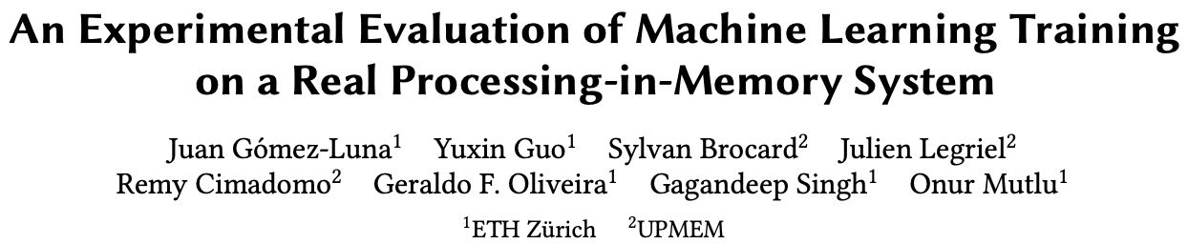
Long arXiv Version
Additional implementation details
More evaluation results
Extended observations, takeaways, and recommendations
https://arxiv.org/pdf/2207.07886.pdf
Source code: https://github.com/CMU-SAFARI/pim-ml

Slide 34
Comparison to CPU and GPU (III)
Decision tree and K-means with Criteo 1TB dataset
DTR
KME
PIM version of DTR is 62x faster than the CPU version and 4.5x faster than the GPU version
PIM version of KME is 2.7x faster than the CPU version and 3.2x faster than the GPU version

Slide 35
Comparison to CPU and GPU (IV)
Decision tree and K-means with Criteo 1TB dataset
Key Takeaway 4. ML workloads that require mainly operations natively supported by the PIM architecture,
such as decision tree and K-means clustering,
outperform their CPU and GPU counterparts.
DTR
KME
PIM version of DTR is 62x faster than the CPU version and 4.5x faster than the GPU version
PIM version of KME is 2.7x faster than the CPU version and 3.2x faster than the GPU version

Slide 36
Long arXiv Version
Additional implementation details
More evaluation results
Extended observations, takeaways, and recommendations
https://arxiv.org/pdf/2207.07886.pdf
Source code: https://github.com/CMU-SAFARI/pim-ml

Slide 37
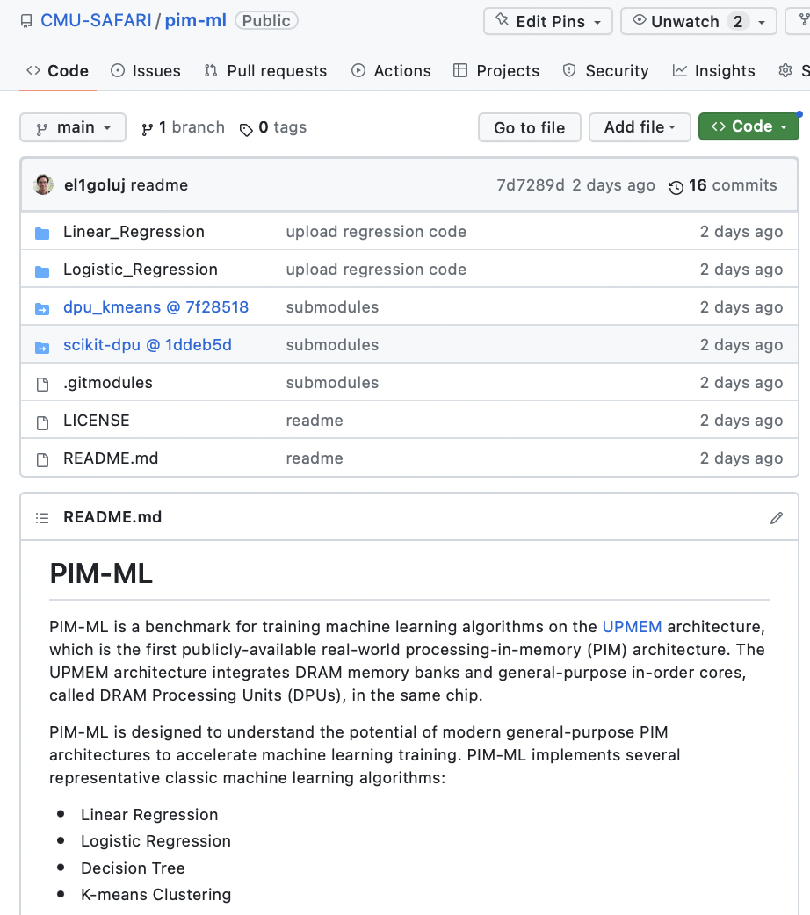
Source Code
https://github.com/CMU-SAFARI/pim-ml

Slide 38
Executive Summary
Training machine learning (ML) algorithms is a computationally expensive process, frequently memory-bound due to repeatedly accessing large training datasets
Memory-centric computing systems, i.e., with Processing-in-Memory (PIM) capabilities, can alleviate this data movement bottleneck
Real-world PIM systems have only recently been manufactured and commercialized
  UPMEM has designed and fabricated the first publicly-available real-world PIM architecture
Our goal is to understand the potential of modern general-purpose PIM architectures to accelerate machine learning training
Our main contributions:
  PIM implementation of several classic machine learning algorithms: linear regression, logistic regression, decision tree, K-means clustering
  Workload characterization in terms of quality, performance, and scaling
  Comparison to their counterpart implementations on processor-centric systems (CPU and GPU)
    PIM version of DTR is 27x / 1.34x faster than the CPU / GPU version, respectively
    PIM version of KME is 2.8x / 3.2x faster than the CPU / GPU version, respectively
  Source code: https://github.com/CMU-SAFARI/pim-ml
Experimental evaluation on a real-world PIM system with 2,524 PIM cores @ 425 MHz and 158 GB of DRAM memory
Key observations, takeaways, and recommendations for ML workloads on general-purpose PIM systems

Slide 39
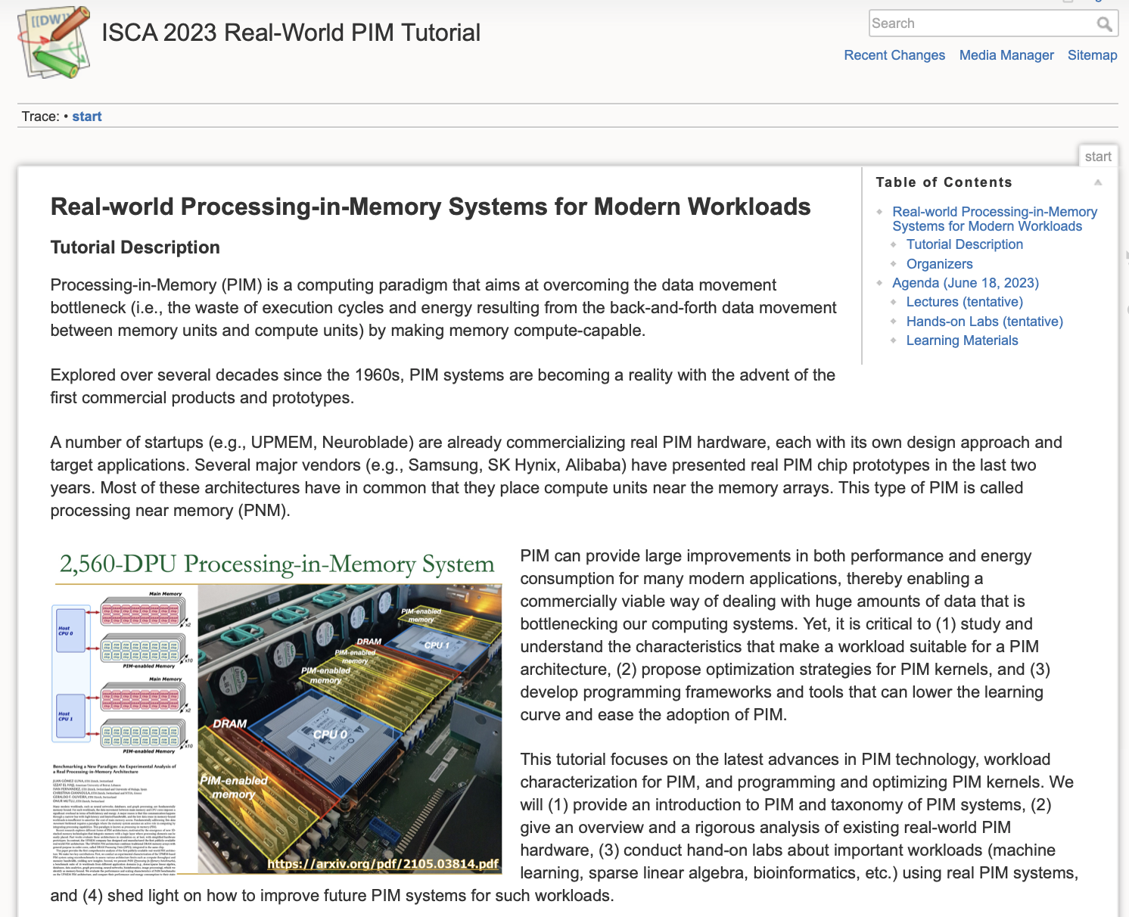
Real PIM Tutorial (ISCA 2023)
June 18th: Lectures + Hands-on labs + Invited lectures
https://events.safari.ethz.ch/isca-pim-tutorial/doku.php?id=start

Slide 40
2023 IEEE International Symposium on Performance Analysis of Systems and Software
Evaluating
Machine Learning Workloads
on Memory-Centric Computing Systems
Juan Gómez Luna, Yuxin Guo, Sylvan Brocard,
Julien Legriel, Remy Cimadomo, Geraldo F. Oliveira,
Gagandeep Singh, Onur Mutlu
https://arxiv.org/pdf/2207.07886.pdf
https://github.com/CMU-SAFARI/pim-ml
juang@ethz.ch
Monday, April 24, 2023

