Slide 1
Accelerating Generalized Linear Models with MLWeaving: A One-Size-Fits-All System for Any-Precision Learning
Zeke Wang, Kaan Kara, Hantian Zhang, Gustavo Alonso, Onur Mutlu, Ce Zhang
Systems Group, ETH Zurich
Notes:
I am Zeke, a post-doc from Systems group, ETH. BTW, I will become an Assistant Professor at Zhejiang University, Jan, 2020. It is my pleasure to talk about my recent work MLWeaving. It is a joint work with Kaan, Hantian, Gustavo, Onur and Ce.

Slide 2
Outline
Quick Background (5mins)
MLWeaving (10mins)
Stochastic Gradient Descent (SGD)
Arbitrary-precision Training
MLWeaving Memory Layout
MLWeaving Hardware Design
Synchronous vs. Asynchronous
Low Precision
Efficient Synchronous Design
Notes:
Here is the outline of this work. First, I will introduce the necessary background about stochastic gradient descent (SGD). SGD allows two interesting properties. First, SGD allows either synchronous or asynchronous execution. Second, SGD allows low precision. About two properties, SGD on CPUs is far from optimal.
Then, I will introduce our system MLWeaving. MLWeaving includes two contributions. First, MLWeaving allows arbitrary-precision training. Second, MLWeaving allows efficient synchronous design.
Now let us talk about the background.

Slide 3
OK, how does SGD work?
Notes:
Ok, how does GLM and SGD work?

Slide 4



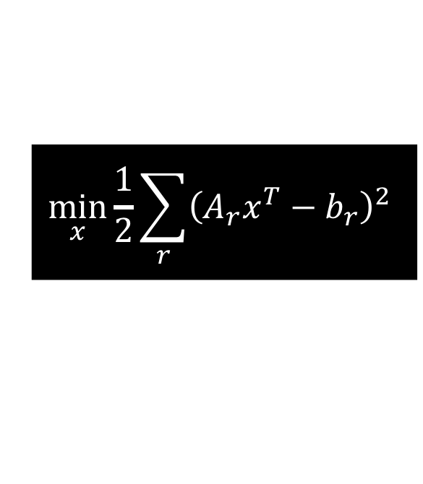
Stochastic Gradient Descent (SGD)
Linear Regression
$$\min_{x}{\frac{1}{2}\sum_{r}{{\left(A_{r}x^{T}−b_{r}\right)}^{2}}}$$
P2: Can be done in low precision
(not 32-bit floating point)
3
Gradient: dot(Ar, x)Ar
A_{r} = get_data()
4
1
x = get_model()
Data Ar
Model x
g = comp_grad(x,A_{r})
2
Training Data:
Database,
Sensor
Computing Device:
FPGA, GPU,
CPU
Model:
DRAM,
Cache
x = x – g
set_model(x)
P1: Model can be staled, especially when running on multiple cores.
Two Interesting Properties
Notes:
Typically, SGD has three components: training data, computing device and model. OK. how sgd works? First, SGD read one row Ar. Second, SGD read the model x. Third, compute the gradient. Fourth, accumulate gradient to the model x. Then, SGD repeats such a process until it converges. SGD has two interesting properties. First, the model x can be staled, especially when running on multiple cores. Second, the dataset and gradient can be low precision, not always full precision.

Slide 5
SGD on the CPU: synchronous or asynchronous?
Notes:
How about SGD on the CPU? Synchronous or asynchronous?

Slide 6
Sync. Single-Core SGD: Low Throughput
CPU – Single Core
Gradient g: dot(Ar, x)Ar
A_{r} = get_data()
Data Ar
Model x
g = comp_grad(x,A_{r})
x = x – g
set_model(x)
x = get_model()
Training Data:
Database,
Sensor
Computing Device:
FPGA,
GPU, CPU
Model x:
DRAM,
Cache
Read After Write (RAW) Dependency Regarding the Model x
Causes Problem When Using Multiple Cores.
Notes:
When SGD running on a single core, it is synchronous, but its throughput is low since only one core is used. We can observe that there is read after write dependency regarding the model x. Such a dependency will cause problem when mapping SGD on multiple cores. There are two state-of-the-art multi-core SGD implementations: Hogwild and Modelaverage. Both have to rely on asynchrony. First, I will talk about how HogWild works.

Slide 7
Async. Multi-Core SGD: High Throughput
Multi-core SGD relies on asynchrony.
  HogWild! [1]
ModelAverage [2]
[1] Hogwild: A Lock-Free Approach to Parallelizing Stochastic Gradient Descent. In NIPS. 2011.
[2] Parallelized Stochastic Gradient Descent. In NIPS. 2010.
Notes:
When SGD running on a single core, it is synchronous, but its throughput is low since only one core is used. We can observe that there is read after write dependency regarding the model x. Such a dependency will cause problem when mapping SGD on multiple cores. There are two state-of-the-art multi-core SGD implementations: Hogwild and Modelaverage. Both have to rely on asynchrony. First, I will talk about how HogWild works.

Slide 8
Synchrony vs. Asynchrony on CPUs
 | Hardware Efficiency (Throughput) | Statistical Efficiency (Convergence Rate)
Single-core SGD (Synchrony) | Low | High
Multi-core SGD (Asynchrony) | High | Low
Notes:
Let us summarize. For the single core SGD, it can be synchronous, so it needs fewer number of epochs to converge, but its throughput is low. For the multi-core SGD, it is async. So its throughput is higher but needs more epochs to converge.

Slide 9
Why Low Precision?
Notes:
For SGD, why we care about low precision?

Slide 10
Why Low Precision?
“It is a cat” (>0.5)
Full precision
Low precision
1.310245
about 1.3
X 0.602069
X about 0.6
0.788857897
about 0.78
Relax, It is only Machine Learning.
Notes:
Suppose the machine learning model contains a simple multiplication. If the multiplication is done in full precision. It is larger than 0.5, it means the figure contains a cat. Actually, we can also use low precision, the result is 0.78, which is also larger than 0.5. The low precision computation is able to show that the figure contains a cat.

Slide 11
Current Hardware Supports Limited Precisions
CPU
GPU
TPU
Char (8-bit),
Short (16-bit)
FP8 (8-bit),
FP16 (16-bit)
INT8 (8-bit)
Notes:
We know that machine learning training can benefit from low precision, but the current commercial hardware cannot support low precision very well. About low precision, CPU can only support 8-bit and 16-bit. GPU can only supports FP8 and FP16. TPU can only support 8-bit.

Slide 12
Goal of This Work
?
For Generalized Linear Model training, can we enable things that cannot be well done on CPUs?
!
Any-precision Training
High-throughput Sync. Design
Notes:
My work try to integrate FPGA-enhanced machine learning operators into Database. The goal of this work is to answer the following question: For GLM training, can we use FPGAs to enable things that cannot be well done on CPUs/GPUs?
Our answer is yes. First, we enable arbitrary-precision training to take advantage of low precision. Second, we achieve high-throughput synchronous hardware design.

Slide 13
Outline
Quick Background (5mins)
MLWeaving (10mins)
Stochastic Gradient Descent (SGD)
Arbitrary-precision Training
MLWeaving Memory Layout
MLWeaving Hardware Design
Synchronous vs. Asynchronous
Low Precision
Efficient Synchronous Design
Notes:
Now we talk about how MLWeaving enables arbitrary precision training. It contains two parts: MLWeaving memory layout and its corresponding hardware design.

Slide 14
Two Goals of Arbitrary-precision Training
1, One hardware design and one copy of dataset support any-precision training.
2, Our design achieves linear speedup with lower precision.
Notes:
Before we can talk about the detailed design, I would like to emphasize two goals of arbitrary-precision training using first principles thinking. The first goal is to use one hardware design and one copy of dataset to support any-precision. Second, we try to achieve linear speedup with lower precision. In order to achieve these two goals, we use software/hardware co-design approach to .

Slide 15


















MLWeaving Memory Layout
How most systems store ML data today:
1st feature
2nd feature
$$A_{1}^{[1]}$$
1
1
$$A_{2}^{[1]}$$
$$A_{2}^{[2]}$$
$$A_{2}^{[3]}$$
$$A_{2}^{[4]}$$
1st row A
$$A_{1}^{[1]}$$
$$A_{1}^{[2]}$$
$$A_{1}^{[3]}$$
$$A_{1}^{[4]}$$
$$A_{2}^{[1]}$$
2
2
2
Data
Compute
1
1
1
1
2
2
2
2
2nd row B
$$B_{1}^{[1]}$$
$$B_{1}^{[2]}$$
$$B_{1}^{[3]}$$
$$B_{1}^{[4]}$$
$$B_{2}^{[1]}$$
$$B_{2}^{[2]}$$
$$B_{2}^{[3]}$$
$$B_{2}^{[4]}$$
MLWeaving:
Observation 1:
Often memory bandwidth bound
1st row A
Observation 2: Low precision (e.g., 8 bit fixed point) often provides reasonable quality
Observation 3: Different training task might need different precision level even on the same dataset
Can we store the data in a new data structure that efficiently supports arbitrary precision data movement?
Notes:
Why we need MLWeaving memory layout? Because we have three observations. First, memory bandwidth is always the bottleneck. Second, low precision dataset always provides reasonable training quality, for example, 8-bit is typically enough. The third observation is that even on the same dataset, different training task might need different precision level, then we have to store the same dataset in several precisions. It increases the storage requirement. Here is the question: can we store the data in a new memory layout that supports arbitrary precision data movement? Our answer is yes. It is MLWeaving. Before talking about MLWeaving, we first talk about how the most systems store ML data today. It is stored row-wise. We first store the first row, first bit of the first feature, the second bit of the first feature, the third bit and the fourth bit. Then the first bit of the second feature, the second bit of the second feature, the third bit and the fourth bit. Now comes to the second row, first feature, followed by the second feature. Then, How MLWeaving store the data? It is also row-wise. We first store the first row.

Slide 16

















MLWeaving Memory Layout
How most systems store ML data today:
1st feature
2nd feature
$$A_{1}^{[1]}$$
1
1
1
$$A_{2}^{[1]}$$
2
2
2
1st row A
$$A_{1}^{[1]}$$
$$A_{1}^{[2]}$$
$$A_{1}^{[3]}$$
$$A_{1}^{[4]}$$
$$A_{2}^{[1]}$$
$$A_{2}^{[2]}$$
$$A_{2}^{[3]}$$
$$A_{2}^{[4]}$$
Data
Compute
1
1
1
1
2
2
2
2
2nd row B
$$B_{1}^{[1]}$$
$$B_{1}^{[2]}$$
$$B_{1}^{[3]}$$
$$B_{1}^{[4]}$$
$$B_{2}^{[1]}$$
$$B_{2}^{[2]}$$
$$B_{2}^{[3]}$$
$$B_{2}^{[4]}$$
MLWeaving:
Observation 1:
Often memory bandwidth bound
1st row A
Observation 2: Low precision (e.g., 8 bit fixed point) often provides reasonable quality
Observation 3: Different training task might need different precision level even on the same dataset
Can we store the data in a new data structure that efficiently supports arbitrary precision data movement?

Slide 17


MLWeaving Memory Layout
How most systems store ML data today:
1st feature
2nd feature
$$A_{1}^{[1]}$$
1
1
1
$$A_{2}^{[1]}$$
2
2
2
$$A_{1}^{[2]}$$
$$A_{1}^{[3]}$$
$$A_{1}^{[4]}$$
$$A_{2}^{[2]}$$
1st row A
$$A_{1}^{[2]}$$
$$A_{2}^{[2]}$$
$$A_{2}^{[3]}$$
$$A_{2}^{[4]}$$
Data
Compute
1
1
1
1
2
2
2
2
2nd row B
$$B_{1}^{[1]}$$
$$B_{1}^{[2]}$$
$$B_{1}^{[3]}$$
$$B_{1}^{[4]}$$
$$B_{2}^{[1]}$$
$$B_{2}^{[2]}$$
$$B_{2}^{[3]}$$
$$B_{2}^{[4]}$$
MLWeaving:
Observation 1:
Often memory bandwidth bound
1st row A
$$A_{1}^{[1]}$$
$$A_{2}^{[1]}$$
Observation 2: Low precision (e.g., 8 bit fixed point) often provides reasonable quality
Observation 3: Different training task might need different precision level even on the same dataset
Can we store the data in a new data structure that supports arbitrary precision data movement?
Notes:
Here is the difference. We store the first bits of all the features of the first row together, just the blue bits. Next store the second bits of the first row, yellow bits followed by the third and fourth bits. When the first row is done, we begin to deal with the second row.

Slide 18






MLWeaving Memory Layout
How most systems store ML data today:
1st feature
2nd feature
$$A_{1}^{[1]}$$
1
1
1
$$A_{2}^{[1]}$$
2
2
2
$$A_{1}^{[2]}$$
$$A_{1}^{[3]}$$
$$A_{1}^{[4]}$$
$$A_{2}^{[2]}$$
$$A_{2}^{[3]}$$
$$A_{2}^{[3]}$$
$$A_{2}^{[4]}$$
1st row A
$$A_{1}^{[3]}$$
$$A_{1}^{[4]}$$
$$A_{2}^{[4]}$$
Data
Compute
1
1
1
1
2
2
2
2
2nd row B
$$B_{1}^{[1]}$$
$$B_{1}^{[2]}$$
$$B_{1}^{[3]}$$
$$B_{1}^{[4]}$$
$$B_{2}^{[1]}$$
$$B_{2}^{[2]}$$
$$B_{2}^{[3]}$$
$$B_{2}^{[4]}$$
MLWeaving:
Observation 1:
Often memory bandwidth bound
1st row A
$$A_{1}^{[1]}$$
$$A_{2}^{[1]}$$
$$A_{1}^{[2]}$$
$$A_{2}^{[2]}$$
Observation 2: Low precision (e.g., 8 bit fixed point) often provides reasonable quality
Observation 3: Different training task might need different precision level even on the same dataset
Can we store the data in a new data structure that supports arbitrary precision data movement?

Slide 19











MLWeaving Memory Layout
How most systems store ML data today:
1st feature
2nd feature
$$A_{1}^{[1]}$$
1
1
1
$$A_{2}^{[1]}$$
2
2
2
1st row A
$$A_{1}^{[2]}$$
$$A_{1}^{[3]}$$
$$A_{1}^{[4]}$$
$$A_{2}^{[2]}$$
$$A_{2}^{[3]}$$
$$A_{2}^{[4]}$$
Data
Compute
1
1
$$B_{1}^{[3]}$$
$$B_{2}^{[3]}$$
$$B_{1}^{[1]}$$
$$B_{1}^{[2]}$$
1
1
2
2
2
2
$$B_{1}^{[3]}$$
$$B_{1}^{[4]}$$
$$B_{2}^{[1]}$$
$$B_{2}^{[2]}$$
$$B_{2}^{[3]}$$
$$B_{2}^{[4]}$$
2nd row B
$$B_{1}^{[1]}$$
$$B_{1}^{[2]}$$
$$B_{1}^{[4]}$$
$$B_{2}^{[1]}$$
$$B_{2}^{[2]}$$
$$B_{2}^{[4]}$$
MLWeaving:
Observation 1:
Often memory bandwidth bound
1st row A
$$A_{1}^{[1]}$$
$$A_{2}^{[1]}$$
$$A_{1}^{[2]}$$
$$A_{2}^{[2]}$$
$$A_{1}^{[3]}$$
$$A_{2}^{[3]}$$
$$A_{1}^{[4]}$$
$$A_{2}^{[4]}$$
Observation 2: Low precision (e.g., 8 bit fixed point) often provides reasonable quality
2nd row B
Observation 3: Different training task might need different precision level even on the same dataset
Can we store the data in a new data structure that supports arbitrary precision data movement?

Slide 20








MLWeaving Memory Layout
How most systems store ML data today:
1st feature
2nd feature
$$A_{1}^{[1]}$$
1
1
$$A_{2}^{[1]}$$
2
2
2
1st row A
$$A_{1}^{[2]}$$
$$A_{1}^{[3]}$$
$$A_{1}^{[4]}$$
$$A_{2}^{[2]}$$
$$A_{2}^{[3]}$$
$$A_{2}^{[4]}$$
Data
Compute
1
1
1
1
2
2
2
2
2nd row B
$$B_{1}^{[1]}$$
$$B_{1}^{[2]}$$
$$B_{1}^{[3]}$$
$$B_{1}^{[4]}$$
$$B_{2}^{[1]}$$
$$B_{2}^{[2]}$$
$$B_{2}^{[3]}$$
$$B_{2}^{[4]}$$
More complicated when a row has thousands of features, but you get the idea.
MLWeaving:
Observation 1:
Often memory bandwidth bound
1st row A
$$A_{1}^{[1]}$$
$$A_{2}^{[1]}$$
$$A_{1}^{[2]}$$
$$A_{2}^{[2]}$$
$$A_{1}^{[3]}$$
$$A_{2}^{[3]}$$
$$A_{1}^{[4]}$$
$$A_{2}^{[4]}$$
Observation 2: Low precision (e.g., 8 bit fixed point) often provides reasonable quality
2nd row B
$$B_{1}^{[1]}$$
$$B_{2}^{[1]}$$
$$B_{1}^{[2]}$$
$$B_{2}^{[2]}$$
$$B_{1}^{[3]}$$
$$B_{2}^{[3]}$$
$$B_{1}^{[4]}$$
$$B_{2}^{[4]}$$
Observation 3: Different training task might need different precision level even on the same dataset
If we need 3-bits?
If we need 1-bit?
Can we store the data in a new data structure that supports arbitrary precision data movement?
MLWeaving does not work out on CPUs. CPU does not have custom instruction for MLWeaving memory layout and then we have to group bits from different memory locations before the further computing.
Notes:
It will be more complicated when we have thousands of feature, but I am sure you get the basic idea now. What is the benefit of such a data structure? Let me give you one concreate example. If FPGA needs 1-bit precision, actually, we only need to read the bits in blue. If we need 3-bit precision, we only fetch the necessary bits, without wasting any memory bandwidth. So far so good?
Everything looks perfect right now? MLWeaving does not work out on CPUs. CPU does not have custom instruction for MLWeaving and then we have to group bits from different memory locations before the further computing.

Slide 21
Outline
Quick Background (5mins)
MLWeaving (10mins)
Stochastic Gradient Descent (SGD)
Arbitrary-precision Training
MLWeaving Memory Layout
MLWeaving Hardware Design
Synchronous vs. Asynchronous
Low Precision
Efficient Synchronous Design
Notes:
To fully take advantage of MLWeaving memory layout, we have to rely on the custom computation, in our case, it is FPGA.

Slide 22
















MLWeaving Hardware Design: Key Idea
MLWeaving memory layout:
Key idea of MLWeaving hardware design:
To use bit-serial multiplier to enable efficient data processing from the MLWeaving memory layout.
1st row A
$$A_{1}^{[1]}$$
$$A_{2}^{[1]}$$
$$A_{1}^{[2]}$$
$$A_{2}^{[2]}$$
$$A_{1}^{[3]}$$
$$A_{2}^{[3]}$$
$$A_{1}^{[4]}$$
$$A_{2}^{[4]}$$
2nd row B
$$B_{1}^{[1]}$$
$$B_{2}^{[1]}$$
$$B_{1}^{[2]}$$
$$B_{2}^{[2]}$$
$$B_{1}^{[3]}$$
$$B_{2}^{[3]}$$
$$B_{1}^{[4]}$$
$$B_{2}^{[4]}$$
The modern CPU does not support bit-serial multiplier.
Please read our paper about how bit-serial multiplier works.
Notes:
According to the properties of MLWeaving memory layout, the key idea of MLWeaving hardware design is to use FPGA to efficiently process data in the MLWeaving memory layout using bit-serial multiplier. Let me briefly talk about how bit-serial multiplier works.

Slide 23
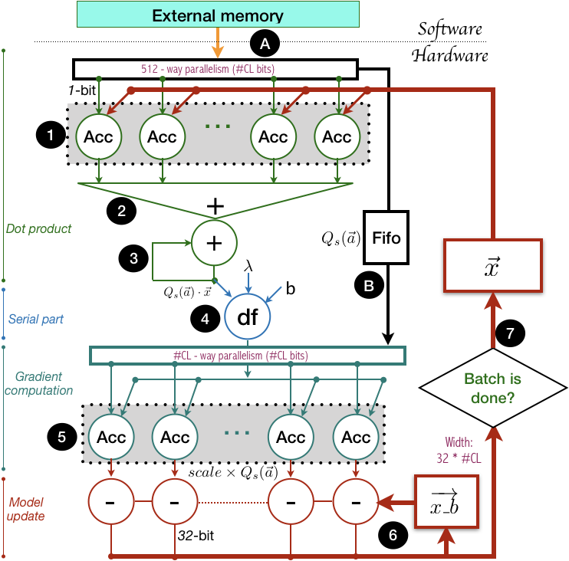











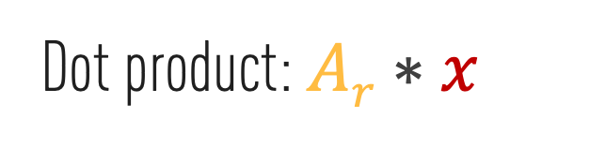



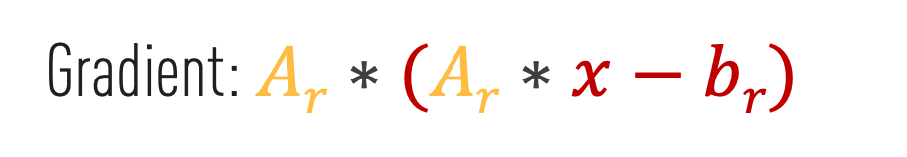


Custom Computation for MLWeaving
MLWeaving hardware design:
MLWeaving memory layout:
1st row A
$$A_{1}^{[1]}$$
$$A_{2}^{[1]}$$
$$A_{1}^{[2]}$$
$$A_{2}^{[2]}$$
$$A_{1}^{[3]}$$
$$A_{2}^{[3]}$$
$$A_{1}^{[4]}$$
$$A_{2}^{[4]}$$
Bit-serial Multiplier
2nd row B
$$B_{1}^{[1]}$$
$$B_{2}^{[1]}$$
$$B_{1}^{[2]}$$
$$B_{2}^{[2]}$$
$$B_{1}^{[3]}$$
$$B_{2}^{[3]}$$
$$B_{1}^{[4]}$$
$$B_{2}^{[4]}$$
Bit-serial
Bit-parallel
Dot product: $Ar∗x$
Bit-serial Multiplier
Gradient: $Ar∗(Ar∗x−br)$
Notes:
Now we show the exact MLWeaving hardware design powered by bit-serial multiplier. I do not want to go into details, just about bit-serial multipliers. There are two places where bit-serial multipliers are used. The first place is dot product calculation, it is there. The second place is gradient calculation.

Slide 24
Bit-serial multiplier + MLWeaving memory layout enable any-precision ML training.
Notes:
Now we can say that bit-serial multiplier plus MLWeaving memory layout enable any-precision machine learning training.

Slide 25
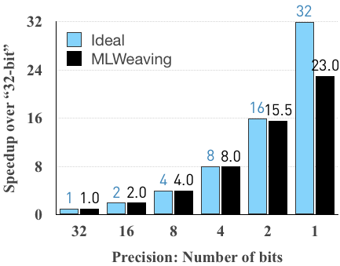
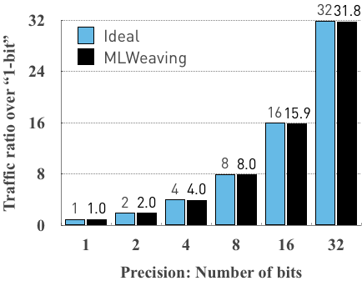
MLWeaving’s Performance: Almost Linear Speedup with Lower Precision
Computing time vs. Precision
Memory traffic vs. Precision
Notes:
What is the real performance characteristics of MLWeaving? It can achieve almost linear speedup with lower precision, illustrated in black. Except when the precision is 1 bit. The underlying reason why 1-bit cannot achieve linear speedup is due to the long pipeline latency, which cannot be amortized. However, people rarely use 1-bit precision to train because the dataset will loses too much useful information.

Slide 26
Outline
Quick Background (5mins)
MLWeaving (10mins)
Stochastic Gradient Descent (SGD)
Arbitrary-precision Training
MLWeaving Memory Layout
MLWeaving Hardware Design
Synchronous vs. Asynchronous
Low Precision
Efficient Synchronous Design
Notes:
Now we talk about our efficient synchronous design.

Slide 27
Synchronous SGD or asynchronous SGD on custom hardware?
Notes:
For SGD on FPGAs, should we use synchronous or asynchronous design?

Slide 28
SGD on Custom Hardware: The Best of Two Worlds
 | Hardware Efficiency (Throughput) | Statistical Efficiency (Convergence Rate)
Single-core (Synchrony) | Low | High
Multi-core (Asynchrony) | High | Low
Custom hardware (Synchrony) | High | High
Notes:
For the SGD on FPGA, we want the best of two worlds, both high throughput and fast convergence.
It is not difficult to achieve synchronous SGD on FPGA, the challenge is to achieve high throughput while preserving synchrony. It is not trivial to achieve the best of two worlds. Let us talk about the original synchronous design first.

Slide 29
Original Synchronous Implementation: Compute-Bound
Key idea: to keep the RAW dependency, regarding the model x.
Original Implementation
Cycles
Model
Read
Dot Product
Model
Write
Notes:
In order to preserve synchronous design, we have to keep the read after write dependency, regarding the model x.

Slide 30
Original Synchronous Implementation: Compute-Bound
Key idea: to keep the RAW dependency, regarding the model x.
Original Implementation
Cycles
Model
Read
1st batch
2rd batch
Dot Product
1st batch
2rd batch
Model
Write
1st gradient
2rd gradient
50% Utilization
Notes:
Let us discuss the original approach that preserves the RAW dependency. In the first step, the first batch of samples read the model and compute the gradient. The second step is to accumulate the gradient from the first batch to the model x. The third step, the second batch of samples read the updated model and compute their gradient. The fourth step is to accumulate the gradient from the second batch to the model x and so on. We can observe that the hardware pipeline has 50% utilization.

Slide 31
Optimal Synchronous Implementation: Memory-Bound
Cycles
Model
Read
1st batch
2rd batch
Original: Compute-bound
Dot Product
1st batch
2rd batch
Observation: Custom hardware can update the model (thousands of weights) at the granularity level: 64 weights, not the whole model.
Model
Write
1st gradient
2rd gradient
Cycles
Model
Read
1st batch
2rd batch
Dot Product
1st batch
2rd batch
With Chaining: Memory-bound
Model
Write
1st gradient
2rd gradient
Notes:
We can see that the original implementation of synchronous design is compute-bound. So can we improve the throughput of synchronous design? The answer is yes. We observe that FPGA can manage at the granularity of 64 features, not at the granularity of gradient/model. We introduce the chaining technique from computer architecture to overlap computation with the model access. We can do some aggressive control on the model update from the first batch. In particular, after the first part of gradient that is from the first 64 samples is accumulated into the model x, we can immediately inform the second batch to read this part of model. We can see the second batch can still read the up-to-date model, but the model update part significantly overlap with the computation.

Slide 32
Optimal Synchronous Implementation: Memory-Bound
Cycles
Model
Read
1st batch
2rd batch
Original: Compute-bound
Dot Product
1st batch
2rd batch
Observation: Custom hardware can update the model (thousands of weights) at the granularity level: 64 weights, not the whole model.
Model
Write
1st gradient
2rd gradient
Cycles
Model
Read
1st batch
2rd batch
Dot Product
1st batch
2rd batch
With Chaining: Memory-bound
Model
Write
1st gradient
2rd gradient
High throughput: “sync” is as fast as “async”.
Gap: gradient from 64 weights
Notes:
Now we can observe that the hardware pipeline is almost fully utilized, with a small gap there. Now our synchronous design is as fast as the asynchronous design and both are bounded by memory bandwidth on our tested FPGA.

Slide 33
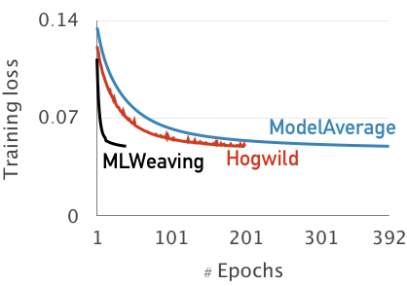
Effect of Sync. Design
Training loss vs. Number of Epochs
Our sync. design needs fewer epochs to converge.
ModelAverage and Hogwild on the multi-core CPU: Async.
MLWeaving on the custom hardware : Sync.
Notes:
Let us check the effect of our synchronous design. We check the training loss with respect to the number of epochs. ModelAverage and Hogwild are two asynchronous implementation of SGD. They use 14 cores and full-precision datasets. MLWeaving is the synchronous implementation of SGD on an FPGA. From the figure, we can observe that MLWeaving needs significantly less number of epochs to converge than the Hogwild. It means that our FPGA implementation needs less computation than the CPU implementation. The takeaway message is that if you want to implement something in hardware, please do something that cannot efficiently maps on CPU/GPU, then your FPGA design effort pays off.

Slide 34
Outline
Quick Background (5mins)
MLWeaving (10mins)
Stochastic Gradient Descent (SGD)
Arbitrary-precision Training
MLWeaving Memory Layout
MLWeaving Hardware Design
Synchronous vs. Asynchronous
Low Precision
Efficient Synchronous Design
Notes:
Let us to do the end to end comparison: compare the performance of MLWeaving on FPGA with multi-core SGD in terms of convergence speed.

Slide 35
System Integration
Intel HARP2 Platform:
Intel Broadwell 14-core CPU
Intel Arria 10 FPGA
We integrate MLWeaving into DoppioDB that is an open source solution for FPGA-enhanced databases based on MonetDB.
If you are interested to play with MLWeaving, please visit our demo DoppioDB 2.0 in the Hollywood ballroom, 11:00-12:30, 27-29 Aug, 2019.
Notes:
We implement our MLWeaving on the Intel CPU+FPGA platform that consists of a Xeon 14-core CPU and and an mid-size FPGA. Our MLWeaving is running on this FPGA. We integrate FPGA-enhanced machine learning operators into our Database DoppioDB 2.0.

Slide 36
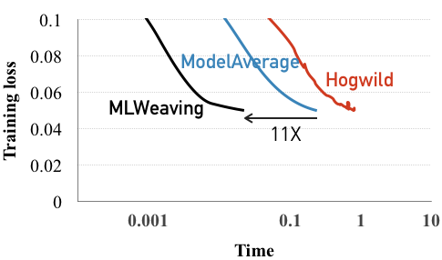
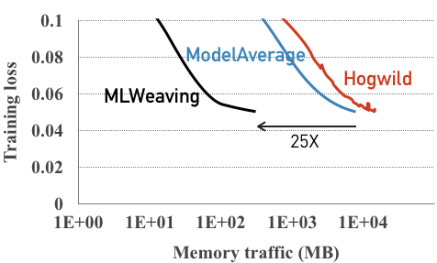
End-to-End Performance: MLWeaving
Training loss vs. Time
Training loss vs. Memory
ModelAverage and Hogwild on an Intel CPU: 14 cores, AVX2-enhanced, 8-bit dataset.
MLWeaving on an FPGA: 3-bit dataset.
Notes:
We do the end-to-end performance comparison between MLWeaving and CPU implementations Hogwild and ModelAverage. Here the CPU implementations uses 14 cores, AVX2 instructions and low-precision datasets, while MLWeaving uses the dataset with the precision of 3-bits. First we compare the wall clock time. We can see that MLWeaving is 11x faster than the fastest CPU implementation, even though the CPU has 4 times more memory bandwidth than our FPGA. Second, we compare the memory traffic. We can observe that MLWeaving needs 25X less memory traffic, indicating great energy efficiency of MLWeaving system, as the memory traffic always consumes the majority of the energy consumption of the modern computing system.

Slide 37
If you are interested to play with MLWeaving,
please visit our demo DoppioDB 2.0 in the Hollywood ballroom, 11:00-12:30, 27-29 Aug, 2019.
Any Questions?
Notes:
If you are interesting in our work MLWeaving,
please visit our demo in the Hollywood ballroom, 11:00-12:30, 27-29 Aug, 2019.

Slide 38
Motivations
Database
Generalized Linear Model
FPGA
Linear Model, Logistic Regression, SVM
?
For GLM training, can we enable things that cannot be well done on CPUs/GPUs?
!
Any-precision Training
High-throughput Sync. Design
Notes:
My work try to integrate FPGA-enhanced machine learning operators into Database. The goal of this work is to answer the following question: For GLM training, can we use FPGAs to enable things that cannot be well done on CPUs/GPUs?
Our answer is yes. First, we enable arbitrary-precision training to take advantage of low precision. Second, we achieve high-throughput synchronous hardware design.

Slide 39
Hogwild: Asynchrony
Gradient: dot(Ar, x)Ar
A_{r} = get_data()
g = comp_grad(x,A_{r})
x = x – g
set_model(x)
x = get_model()
Data Ar
Model x
Model:
Cache
Data Ar
Model x
Shared model x among cores
Gradient: dot(Ar, x)Ar
Problem? Cache-coherence is expensive, especially for dense data!
Notes:
Let us consider the case with only two cores. Two cores share the model x. Each core just access the model regardless of the other core. SGD can still converge when it is asynchronous, as SGD is a robust algorithm. However, the throughput of SGD is still not high since cache coherence overhead dominates the overall performance.

Slide 40
ModelAverage: Asynchrony
Gradient g: dot(Ar, x)Ar
A_{r} = get_data()
Data Ar
Model x
g = comp_grad(x,A_{r})
x = x – g
set_model(x)
x = get_model()
Training Data:
Database,
Sensor
Computing Device:
FPGA,
GPU, CPU
Model x:
DRAM,
Cache
Averaging
Data Ar
Model x
A copy of model x for each core
Gradient g: dot(Ar, x)Ar
Problem? Convergence might be slower.
Notes:
The second approach is ModelAverage. How does ModelAverage work? I also assume there are two cores. Each core has its own copy of the model x such that each core reads from and write to its own copy of the model x. After each epoch, two copies of the model x are averaged and then each core has the global model. Therefore, it does not have any issue from cache coherence. Seem perfect, actually no. What is the problem, its convergence might be slower, as the model that are used to compute the gradient is typically not the global model but local model.

Slide 41
How Bit-serial Multiplier Deals with Low Precision?
4 3 2 1
Each bit should be binary, but we use decimal for ease of understanding.
4-bit:
X 0 0 2 0
8 6 4 2 0
4 3 2 0
3-bit:
X 0 0 2 0
8 6 4 0 0
4 3 0 0
2-bit:
X 0 0 2 0
8 6 0 0 0
4 0 0 0
1-bit:
X 0 0 2 0
8 0 0 0 0
Normal Multiplier
Notes:
I will use one concrete example to illustrate how bit-serial multiplier works, say 4-bit times 4-bit multiplication.
In this example, we use decimal number for ease of understanding, it should be binary. The full precision is 4 bits 43 handred 21 times 20. When the precision becomes 3-bit, we mean 4321 becomes 4320, 2-bit means 4300, and 1-bit means 4000

Slide 42
How Bit-serial Multiplier Deals with Low Precision?
4 3 2 1
Initialization:
4-bit:
X 0 0 2 0
4
3
2
1
8 6 4 2 0
4 3 2 0
3-bit:
X 0 0 2 0
8 6 4 0 0
4 3 0 0
BSM
X 0020
2-bit:
X 0 0 2 0
8 6 0 0 0
Sum =
0
0
0
0
0
4 0 0 0
1-bit:
X 0 0 2 0
8 0 0 0 0
Normal Multiplier
Bit-serial Multiplier (BSM)
Notes:
. Now we can see how bit-serial multiplier works. Bit serial multiplier has two parts.

Slide 43
How Bit-serial Multiplier Deals with Low Precision?
4 3 2 1
Initialization:
4-bit:
X 0 0 2 0
4
3
2
1
Bit-Serial (S)
8 6 4 2 0
4 3 2 0
3-bit:
X 0 0 2 0
Bit-Parallel (P)
8 6 4 0 0
4 3 0 0
BSM
[i]
S
X 0020
Sum += P *
2-bit:
X 0 0 2 0
8 6 0 0 0
Sum =
0
0
0
0
0
4 0 0 0
1-bit:
X 0 0 2 0
8 0 0 0 0
Normal Multiplier
Bit-serial Multiplier (BSM)
Notes:
The first part is bit-serial part, which is shown in color. The second part is the bit-parallel part which is in black. The bit-serial multiplier does not do a multiplication as a whole, but accumulates bit by bit and stores the accumulation result in the variable sum.

Slide 44
Bit-serial Multiplier: 1-Bit Precision
4 3 2 1
1st Cycle:
4-bit:
X 0 0 2 0
4
3
2
4
3
2
1
1
8 6 4 2 0
4 3 2 0
3-bit:
X 0 0 2 0
Memory
8 6 4 0 0
4 3 0 0
BSM
Hardware
X 0020
2-bit:
X 0 0 2 0
8 6 0 0 0
Sum =
0
0
0
0
0
4 0 0 0
1-bit:
X 0 0 2 0
8 0 0 0 0
Normal Multiplier
Bit-serial Multiplier (BSM)

Slide 45
Bit-serial Multiplier: 1-Bit Precision
4 3 2 1
1st Cycle:
4-bit:
X 0 0 2 0
4
3
2
3
2
1
1
8 6 4 2 0
4 3 2 0
3-bit:
X 0 0 2 0
4 means 4000.
Memory
8 6 4 0 0
4
Hardware
4 3 0 0
BSM
X 0020
2-bit:
X 0 0 2 0
Sum += 20 * 4000
8 6 0 0 0
Sum =
0
0
0
0
0
4 0 0 0
1-bit:
X 0 0 2 0
8 0 0 0 0
Normal Multiplier
Bit-serial Multiplier (BSM)
Notes:
What if we we want 1-bit precision? At the first cycle, we fetch the most significant bit 4 out of memory and feed it into the bit-serial multiplier in the FPGA.

Slide 46
Bit-serial Multiplier: 1-Bit Precision
4 3 2 1
1st Cycle:
4-bit:
X 0 0 2 0
4
3
2
3
2
1
1
8 6 4 2 0
4 3 2 0
3-bit:
X 0 0 2 0
Memory
8 6 4 0 0
4 3 0 0
BSM
Hardware
X 0020
2-bit:
X 0 0 2 0
8 6 0 0 0
Sum =
8
0
0
0
0
4 0 0 0
Done with 1-bit precision, or proceed to the next bit.
1-bit:
X 0 0 2 0
8 0 0 0 0
Normal Multiplier
Bit-serial Multiplier (BSM)
Notes:
Then the result becomes 80000. It is done with 1-bit precision. If we want higher precision, we try to read the second bit.

Slide 47
Bit-serial Multiplier: 2-Bit Precision
4 3 2 1
2nd Cycle:
4-bit:
X 0 0 2 0
4
3
2
3
2
1
1
8 6 4 2 0
4 3 2 0
3-bit:
X 0 0 2 0
Memory
8 6 4 0 0
4 3 0 0
BSM
Hardware
X 0020
2-bit:
X 0 0 2 0
8 6 0 0 0
Sum =
8
0
0
0
0
4 0 0 0
1-bit:
X 0 0 2 0
8 0 0 0 0
Normal Multiplier
Bit-serial Multiplier (BSM)
Notes:
In the second cycle, we fetch the second bit 3 from memory and feed it into the bit-serial multiplier.

Slide 48
Bit-serial Multiplier: 2-Bit Precision
4 3 2 1
2nd Cycle:
4-bit:
X 0 0 2 0
4
3
2
2
1
1
8 6 4 2 0
4 3 2 0
3-bit:
X 0 0 2 0
3 means 300.
Memory
8 6 4 0 0
3
Hardware
4 3 0 0
BSM
X 0020
Sum += 20 * 300
2-bit:
X 0 0 2 0
8 6 0 0 0
Sum =
8
0
0
0
0
4 0 0 0
1-bit:
X 0 0 2 0
8 0 0 0 0
Normal Multiplier
Bit-serial Multiplier (BSM)
Notes:
3 here means 300.

Slide 49
Bit-serial Multiplier: 2-Bit Precision
4 3 2 1
2nd Cycle:
4-bit:
X 0 0 2 0
4
3
2
2
1
1
8 6 4 2 0
4 3 2 0
3-bit:
X 0 0 2 0
Memory
8 6 4 0 0
4 3 0 0
BSM
Hardware
X 0020
2-bit:
X 0 0 2 0
8 6 0 0 0
Sum =
8
6
0
0
0
4 0 0 0
Done with 2-bit precision, or proceed to the next bit.
1-bit:
X 0 0 2 0
8 0 0 0 0
Normal Multiplier
Bit-serial Multiplier (BSM)
Notes:
Then the accumulation result becomes 86000. It is done with 2-bit precision. If we want higher precision, we try to read the third bit.

Slide 50
Bit-serial Multiplier: 3-Bit Precision
4 3 2 1
3th Cycle:
4-bit:
X 0 0 2 0
4
3
2
2
1
1
8 6 4 2 0
4 3 2 0
3-bit:
X 0 0 2 0
Memory
8 6 4 0 0
4 3 0 0
BSM
Hardware
X 0020
2-bit:
X 0 0 2 0
8 6 0 0 0
Sum =
8
6
0
0
0
4 0 0 0
1-bit:
X 0 0 2 0
8 0 0 0 0
Normal Multiplier
Bit-serial Multiplier (BSM)
Notes:
In the third cycle, we fetch the third bit 2 from memory and feed it into the bit-serial multiplier.

Slide 51
Bit-serial Multiplier: 3-Bit Precision
4 3 2 1
3th Cycle:
4-bit:
X 0 0 2 0
4
3
2
1
1
8 6 4 2 0
4 3 2 0
3-bit:
X 0 0 2 0
2 means 20.
Memory
8 6 4 0 0
2
Hardware
4 3 0 0
BSM
X 0020
Sum += 20 * 20
2-bit:
X 0 0 2 0
8 6 0 0 0
Sum =
8
6
0
0
0
4 0 0 0
1-bit:
X 0 0 2 0
8 0 0 0 0
Normal Multiplier
Bit-serial Multiplier (BSM)
Notes:
Here 2 means 20.

Slide 52
Bit-serial Multiplier: 3-Bit Precision
4 3 2 1
3th Cycle:
4-bit:
X 0 0 2 0
4
3
2
1
1
8 6 4 2 0
4 3 2 0
3-bit:
X 0 0 2 0
Memory
8 6 4 0 0
4 3 0 0
BSM
Hardware
X 0020
2-bit:
X 0 0 2 0
8 6 0 0 0
Sum =
8
6
4
0
0
4 0 0 0
Done with 3-bit precision, or proceed to the next bit.
1-bit:
X 0 0 2 0
8 0 0 0 0
Normal Multiplier
Bit-serial Multiplier (BSM)
Notes:
Then the accumulation result becomes 86400. It is done with 3-bit precision. If we want full-precision, we have to proceed to the next bit.

Slide 53
Bit-serial Multiplier: 4-Bit Precision
4 3 2 1
4th Cycle:
4-bit:
X 0 0 2 0
4
3
2
1
1
8 6 4 2 0
4 3 2 0
3-bit:
X 0 0 2 0
Memory
8 6 4 0 0
4 3 0 0
BSM
Hardware
X 0020
2-bit:
X 0 0 2 0
8 6 0 0 0
Sum =
8
6
4
0
0
4 0 0 0
1-bit:
X 0 0 2 0
8 0 0 0 0
Normal Multiplier
Bit-serial Multiplier (BSM)
Notes:
I will use one concrete example to illustrate how bit-serial multiplier works, say 4-bit times 4-bit multiplication.

Slide 54
Bit-serial Multiplier: 4-Bit Precision
4 3 2 1
4th Cycle:
4-bit:
X 0 0 2 0
4
3
2
1
8 6 4 2 0
4 3 2 0
3-bit:
X 0 0 2 0
1 means 1.
Memory
8 6 4 0 0
1
Hardware
4 3 0 0
BSM
X 0020
Sum += 20 * 1
2-bit:
X 0 0 2 0
8 6 0 0 0
Sum =
8
6
4
0
0
4 0 0 0
1-bit:
X 0 0 2 0
8 0 0 0 0
Normal Multiplier
Bit-serial Multiplier (BSM)
Notes:
1 means 1.

Slide 55
Bit-serial Multiplier: 4-Bit Precision
4 3 2 1
4th Cycle:
4-bit:
X 0 0 2 0
4
3
2
1
8 6 4 2 0
4 3 2 0
3-bit:
X 0 0 2 0
Memory
8 6 4 0 0
4 3 0 0
BSM
Hardware
X 0020
2-bit:
X 0 0 2 0
8 6 0 0 0
Sum =
8
6
4
2
0
4 0 0 0
Done with 4-bit precision
1-bit:
X 0 0 2 0
8 0 0 0 0
Normal Multiplier
Bit-serial Multiplier (BSM)
Notes:
Then the accumulation result becomes 86420. It is done, and we can proceed to the multiplication.

