Slide 1




Exploiting Inter-Warp Heterogeneity to Improve GPGPU Performance
Rachata Ausavarungnirun
Saugata Ghose, Onur Kayiran, Gabriel H. Loh
Chita Das, Mahmut Kandemir, Onur Mutlu

Slide 2
Overview of This Talk
Problem: memory divergence
  Threads execute in lockstep, but not all threads hit in the cache
  A single long latency thread can stall an entire warp
Key Observations:
  Memory divergence characteristic differs across warps
  Some warps mostly hit in the cache, some mostly miss
  Divergence characteristic is stable over time
  L2 queuing exacerbates memory divergence problem
Our Solution: Memory Divergence Correction
  Uses cache bypassing, cache insertion and memory scheduling to prioritize mostly-hit warps and deprioritize mostly-miss warps
Key Results:
  21.8% better performance and 20.1% better energy efficiency compared to state-of-the-art caching policy on GPU

Slide 3
Outline
Background
Key Observations
Memory Divergence Correction (MeDiC)
Results

Slide 4
Latency Hiding in GPGPU Execution
Time
GPU Core
Status
GPU Core
Warp A
Warp B
Active
Warp C
Warp D
Lockstep
Execution
Stall
Thread
Active

Slide 5
Problem: Memory Divergence
Warp A
Cache Hit
Stall Time
Time
Main Memory
Cache Miss
Cache Hit

Slide 6
Outline
Background
Key Observations
Memory Divergence Correction (MeDiC)
Results

Slide 7
Observation 1: Divergence Heterogeneity
Mostly-hit warp
Mostly-miss warp
All-hit warp
All-miss warp
Reduced
Stall Time
Time
Key Idea:
Convert mostly-hit warps to all-hit warps
Convert mostly-miss warps to all-miss warps
Cache Miss
Cache Hit

Slide 8
Observation 2: Stable Divergence Char.
Warp retains its hit ratio during a program phase
  Hit ratio → number of hits / number of access

Slide 9
Observation 2: Stable Divergence Char.
Warp retains its hit ratio during a program phase

Slide 10
Observation 3: Queuing at L2 Banks
Request Buffers
Shared L2 Cache
Bank 0
Memory
Scheduler
Bank 1
Bank 2
To
DRAM
……
……
Bank n
45% of requests stall 20+ cycles at the L2 queue
  Long queuing delays exacerbate the effect of
  memory divergence

Slide 11
Outline
Background
Key Observations
Memory Divergence Correction (MeDiC)
Results

Slide 12
Our Solution: MeDiC
Key Ideas:
  Convert mostly-hit warps to all-hit warps
  Convert mostly-miss warps to all-miss warps
  Reduce L2 queuing latency
  Prioritize mostly-hit warps at the memory
  Maintain memory bandwidth

Slide 13
Memory Divergence Correction
Warp-type-aware Cache Bypassing
Mostly-miss, All-miss
Shared L2 Cache
Bank 0
Warp-type-aware
Memory Scheduler
Bank 1
Low Priority
Bank 2
N
Warp Type Identification Logic
Memory
Request
Bypassing Logic
High Priority
……
Y
To
DRAM
Bank n
Any Requests
in High Priority
Memory Scheduler
Warp-type-aware Cache Insertion Policy

Slide 14
Mechanism to Identify Warp Type
Profile hit ratio for each warp
Group warp into one of five categories
Periodically reset warp-type
All-hit
Mostly-hit
Balanced
Mostly-miss
All-miss
Higher Priority
Lower Priority

Slide 15
Warp-type-aware Cache Bypassing
Warp-type-aware Cache Bypassing
Mostly-miss, All-miss
Shared L2 Cache
Bank 0
Warp-type-aware
Memory Scheduler
Bank 1
Low Priority
Bank 2
N
Warp Type Identification Logic
Memory
Request
Bypassing Logic
High Priority
……
Y
To
DRAM
Bank n
Any Requests
in High Priority
Warp-type-aware Cache Insertion Policy

Slide 16
Warp-type-aware Cache Bypassing
Goal:
  Convert mostly-hit warps to all-hit warps
  Convert mostly-miss warps to all-miss warps
Our Solution:
  All-miss and mostly-miss warps → Bypass L2
  Adjust how we identify warps to maintain miss rate
Key Benefits:
  More all-hit warps
  Reduce queuing latency for all warps

Slide 17
Warp-type-aware Cache Insertion
Warp-type-aware Cache Bypassing
Mostly-miss, All-miss
Shared L2 Cache
Bank 0
Warp-type-aware
Memory Scheduler
Bank 1
Low Priority
Bank 2
N
Warp Type Identification Logic
Memory
Request
Bypassing Logic
High Priority
……
Y
To
DRAM
Bank n
Any Requests
in High Priority
Warp-type-aware Cache Insertion Policy

Slide 18
Warp-type-aware Cache Insertion
Goal: Utilize the cache well
  Prioritize mostly-hit warps
  Maintain blocks with high reuse
Our Solution:
  All-miss and mostly-miss → Insert at LRU
  All-hit, mostly-hit and balanced → Insert at MRU
Benefits:
  All-hit and mostly-hit are less likely to be evicted
  Heavily reused cache blocks from mostly-miss are likely to remain in the cache

Slide 19
Warp-type-aware Memory Sched.
Warp-type-aware Cache Bypassing
Mostly-miss, All-miss
Shared L2 Cache
Bank 0
Warp-type-aware
Memory Scheduler
Bank 1
Low Priority
Bank 2
N
Warp Type Identification Logic
Memory
Request
Bypassing Logic
High Priority
……
Y
To
DRAM
Bank n
Any Requests
in High Priority
Warp-type-aware Cache Insertion Policy

Slide 20
Not All Blocks Can Be Cached
Despite best efforts, accesses from mostly-hit warps can still miss in the cache
  Compulsory misses
  Cache thrashing
Solution: Warp-type-aware memory scheduler

Slide 21
Warp-type-aware Memory Sched.
Goal: Prioritize mostly-hit over mostly-miss
Mechanism: Two memory request queues
  High-priority → all-hit and mostly-hit
  Low-priority → balanced, mostly-miss and all-miss
Benefits:
  Mostly-hit warps stall less

Slide 22
MeDiC: Example
Mostly-miss Warp
All-miss Warp
Bypass
Cache
Cache Queuing Latency
Lower
queuing
latency
DRAM Queuing Latency
Cache/Mem Latency
Insert at
LRU
Mostly-hit Warp
All-hit Warp
High
Priority
Insert at
MRU
Lower
stall
time

Slide 23
Outline
Background
Key Observations
Memory Divergence Correction (MeDiC)
Results

Slide 24
Methodology
Modified GPGPU-Sim modeling GTX480
  15 GPU cores
  6 memory partition
  16KB 4-way L1, 768KB 16-way L2
  Model L2 queue and L2 queuing latency
  1674 MHz GDDR5
Workloads from CUDA-SDK, Rodinia, Mars and Lonestar suites

Slide 25
Comparison Points
FR-FCFS baseline [Rixner+, ISCA’00]
Cache Insertion:
  EAF [Seshadri+, PACT’12]
    Tracks blocks that are recently evicted to detect high reuse and inserts them at the MRU position
    Does not take divergence heterogeneity into account
    Does not lower queuing latency
Cache Bypassing:
  PCAL [Li+, HPCA’15]
    Uses tokens to limit number of warps that gets to access the L2 cache → Lower cache thrashing
    Warps with highly reuse access gets more priority
    Does not take divergence heterogeneity into account
  PC-based and Random bypassing policy

Slide 26
Results: Performance of MeDiC
21.8%
MeDiC is effective in identifying warp-type and taking advantage of divergence heterogeneity

Slide 27
Results: Energy Efficiency of MeDiC
20.1%
Performance improvement outweighs the additional energy from extra cache misses

Slide 28
Other Results in the Paper
Breakdowns of each component of MeDiC
  Each component is effective
Comparison against PC-based and random cache bypassing policy
  MeDiC provides better performance
Analysis of combining MeDiC+reuse mechanism
  MeDiC is effective in caching highly-reused blocks
Sensitivity analysis of each individual components
  Minimal impact on L2 miss rate
  Minimal impact on row buffer locality
  Improved L2 queuing latency

Slide 29
Conclusion
Problem: memory divergence
  Threads execute in lockstep, but not all threads hit in the cache
  A single long latency thread can stall an entire warp
Key Observations:
  Memory divergence characteristic differs across warps
  Some warps mostly hit in the cache, some mostly miss
  Divergence characteristic is stable over time
  L2 queuing exacerbates memory divergence problem
Our Solution: Memory Divergence Correction
  Uses cache bypassing, cache insertion and memory scheduling to prioritize mostly-hit warps and deprioritize mostly-miss warps
Key Results:
  21.8% better performance and 20.1% better energy efficiency compared to state-of-the-art caching policy on GPU

Slide 30
Exploiting Inter-Warp Heterogeneity to Improve GPGPU Performance
Rachata Ausavarungnirun
Saugata Ghose, Onur Kayiran, Gabriel H. Loh
Chita Das, Mahmut Kandemir, Onur Mutlu

Slide 31
Backup Slides

Slide 32
Queuing at L2 Banks: Real Workloads
53.8%

Slide 33
Adding More Banks
5%

Slide 34
Queuing Latency Reduction
69.8%

Slide 35
MeDiC: Performance Breakdown

Slide 36
MeDiC: Miss Rate

Slide 37
MeDiC: Row Buffer Hit Rate

Slide 38
MeDiC-Reuse

Slide 39
L2 Queuing Penalty

Slide 40
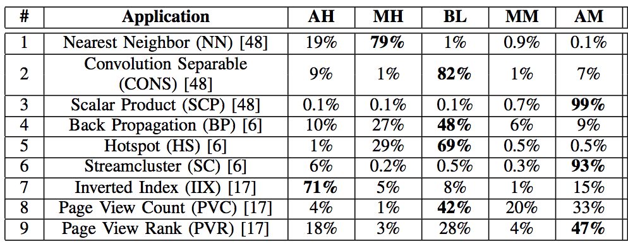
Divergence Distribution

Slide 41
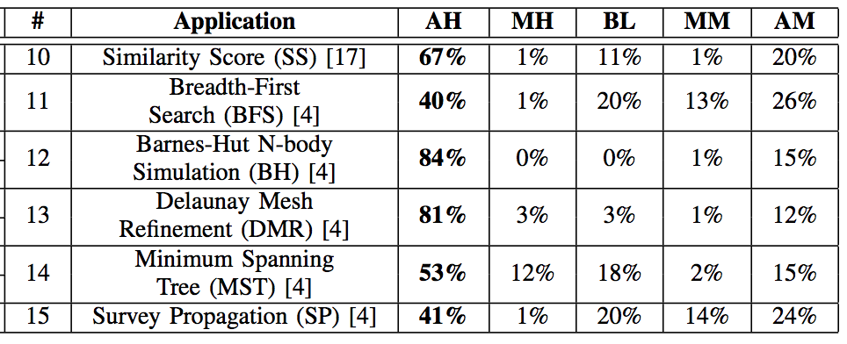
Divergence Distribution

Slide 42
Stable Divergence Characteristics
Warp retains its hit ratio during a program phase
Heterogeneity
  Control Divergence
  Memory Divergence
  Edge cases on the data the program is operating on
  Coalescing
  Affinity to different memory partition
Stability
  Temporal + spatial locality

Slide 43
Warps Can Fetch Data for Others
All-miss and mostly-miss warps can fetch cache blocks for other warps
  Blocks with high reuse
  Shared address with all-hit and mostly-hit warps
Solution: Warp-type aware cache insertion

Slide 44
Warp-type Aware Cache Insertion
Future Cache Requests
MRU
A1
A2
LRU
LRU
MRU
A7
B3
A8
A9
B2
MRU
A3
A4
LRU
LRU
B1
A5
A6
B2
MRU
L2 Cache

Slide 45
Warp-type Aware Memory Sched.
Memory Request
Warp Type
All-hit, Mostly-hit
Balanced, Mostly-miss, All-miss
High Priority Queue
Memory Request Queue
Low Priority Queue
FR-FCFS Scheduler
Memory Scheduler
FR-FCFS Scheduler
Main Memory

