Slide 1




MetaSys
A Practical Open-source Metadata Management System to Implement and Evaluate Cross-layer Optimizations
Nandita Vijaykumar, Ataberk Olgun, Konstantinos Kanellopoulos,
F. Nisa Bostancı, Hasan Hassan, Mehrshad Lotfi, Phillip B. Gibbons, Onur Mutlu

Slide 2
Executive Summary
Motivation: Hardware-software cooperative (cross-layer) techniques
improve performance, quality of service, and security
Problem: Cross-layer techniques are challenging to implement and evaluate in real hardware
because they require modifications across the stack
Our Goal is twofold:
1) Enable rapid implementation and evaluation of cross-layer techniques in real hardware
2) Quantify the overheads associated with a general metadata management system
Key Idea:
Develop a metadata management system (MetaSys) with hardware and software components
that are reusable across cross-layer techniques to minimize programmer effort
Prototype: Xilinx Zedboard prototype using RISC-V Rocket Chip:
Low on-chip storage (0.2%) and memory storage (0.2%) overhead metadata management
Evaluation: Graph prefetching and memory protection case studies,
extensive overhead characterization
MetaSys-based graph prefetcher performs similar to state-of-the-art specialized prefetcher
Low-overhead bounds-checking (14%) and return address protection (1.2%)
Single general metadata management system scales well
MetaSys Source Code: https://github.com/CMU-SAFARI/MetaSys

Slide 3
Outline
Background
  Cross-Layer Techniques
  Evaluating Cross-Layer Techniques
MetaSys
  Overview
  Components
  Operation
  FPGA Prototype
Case Studies
  Prefetching
  Memory Safety and Protection
Characterizing a General Metadata Management System

Slide 4






Hardware Performance Optimizations
Today
Optimize for performance by designing hardware
that infers and predicts program behavior
Caches
Memory Controllers
Prefetchers
Notes:
Start by looking at what is done in processors today
[CLICK] We design hardware structures such as caches, prefetchers and memory controllers and we make them specialize in
[CLICK] predicting program behavior. These components try to infer how a program behaves even sometimes the programmer intention by observing program execution.

Slide 5


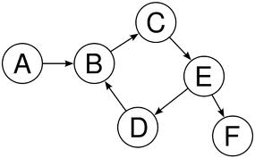
Cross-Layer Techniques
Future: Cross-Layer
Software can provide information (metadata) that the hardware is trying to infer
Float
Integer
Data Type/Layout
Char
Data Structures
Access Patterns
Software
Hardware
Notes:
Cross-layer techniques envision a future where software provides useful information (or metadata) that the hardware is trying to infer and that the hardware can use to perform better
[CLICK] For example, the software can provide data structures used and access patterns present in an application. Different parts of the application may work on different data types and software can provide this information
[CLICK] to hardware [CLICK] that today tries to infer and does so with some accuracy. Cross-layer interaction between software and hardware can more accurately provide program metadata to hardware such that hardware performs better.

Slide 6
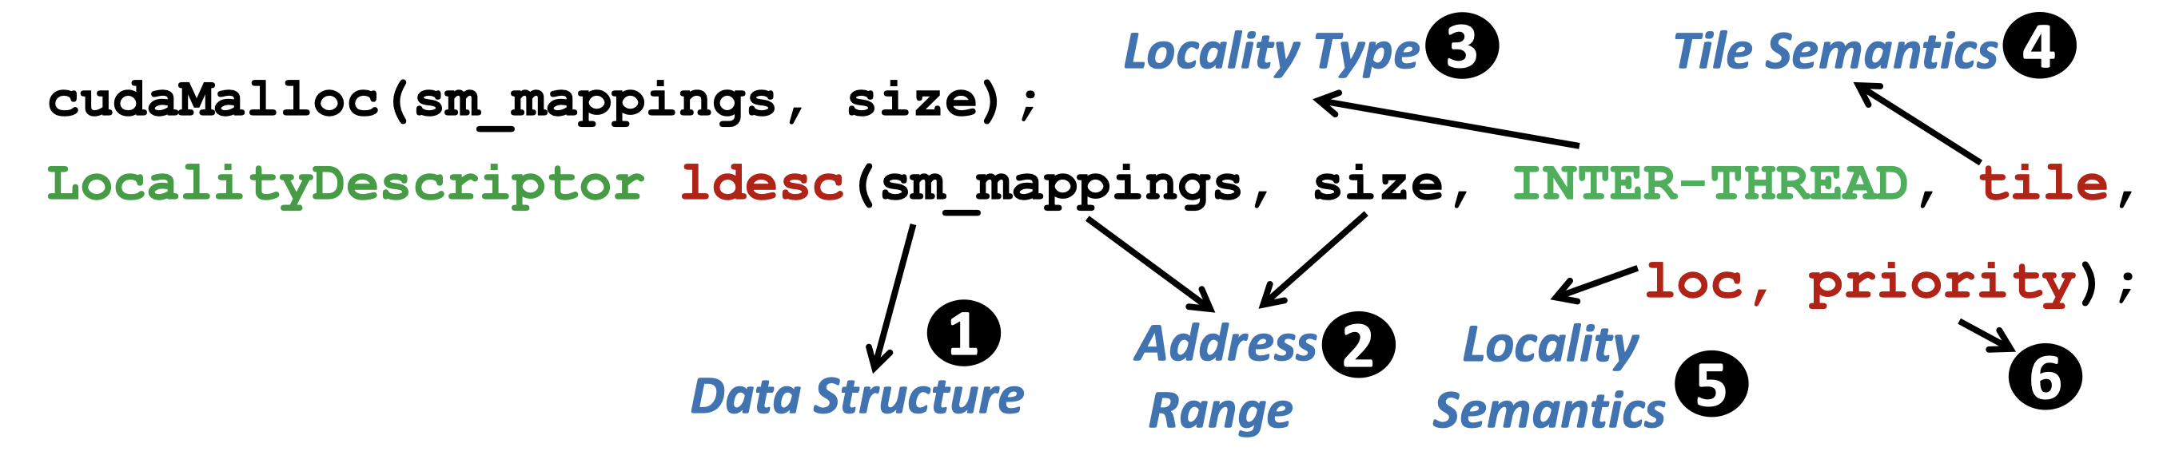
Example: Locality Descriptor (I)
Locality Descriptor [Vijaykumar+, ISCA’18a]
Express data locality (from software)
Exploit data locality (in hardware) in GPUs
The programmer or the compiler
describes key semantics
using a software interface
Float
Char
Data Structure
Metadata
[Vijaykumar+, ISCA’18a]

Slide 7
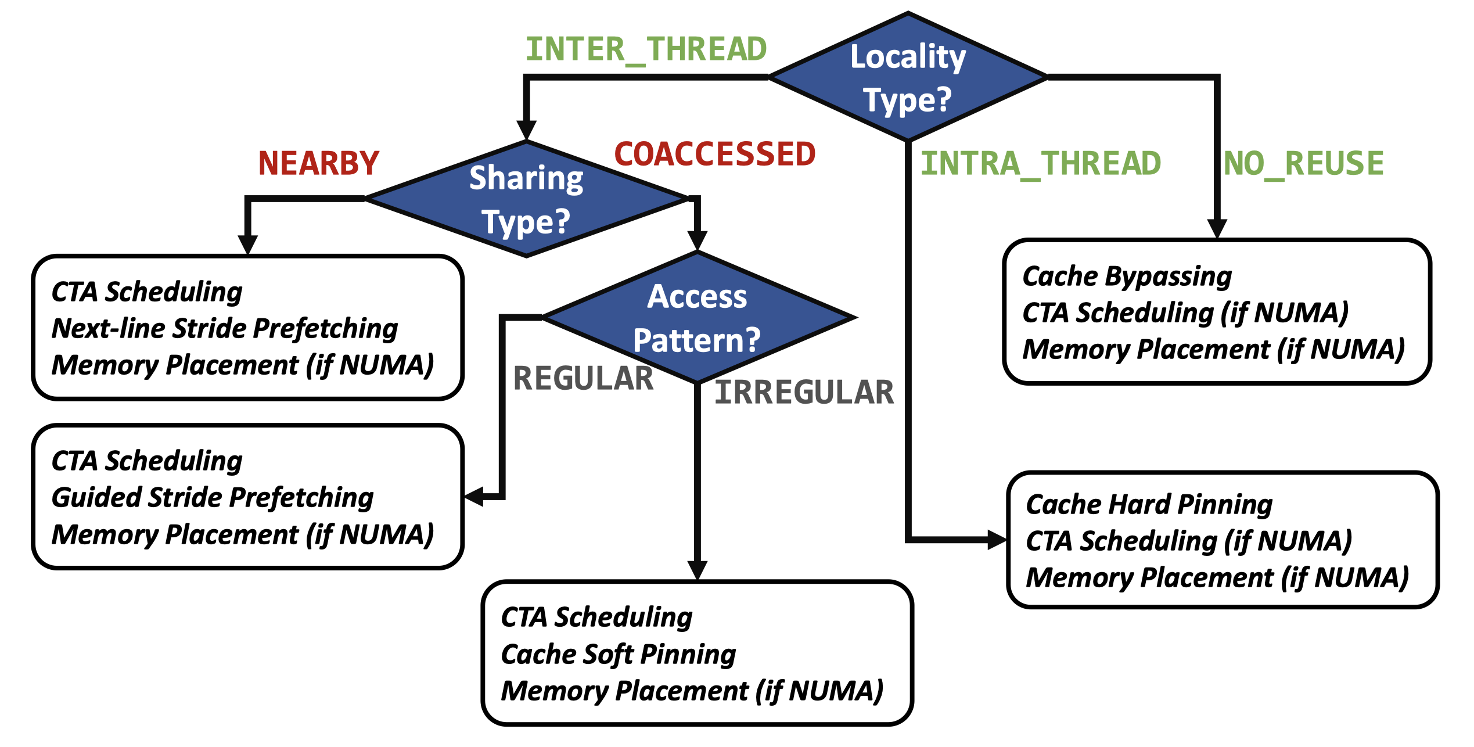
Example: Locality Descriptor (II)
Hardware optimizations
leverage key program semantics
to improve performance significantly (e.g., >50%)
[Vijaykumar+, ISCA’18a]
Notes:
To conclude, cross layer techniques
[CLICK] allow hardware to improve performance or enhance system security
and [CLICK] software to provide better programmability and portability
[CLICK] To provide these benefits, cross-layer techniques communicate metadata between software and hardware over a cross-layer interface

Slide 8
Benefits of Cross-Layer Techniques
Performance optimizations
Security enhancements
Quality of service improvements
Better programmability
Better portability
Hardware
Example prior work
[Vijaykumar+, ISCA’18a]
[Vijaykumar+, ISCA’18b]
[Koo+, ISCA’17]
[Yu+, CARVV’17]
Software
[Mukkara+, ASPLOS’16]
[Ma+, ASPLOS’15]
…
Hardware
Cross-Layer Interface
Software

Slide 9
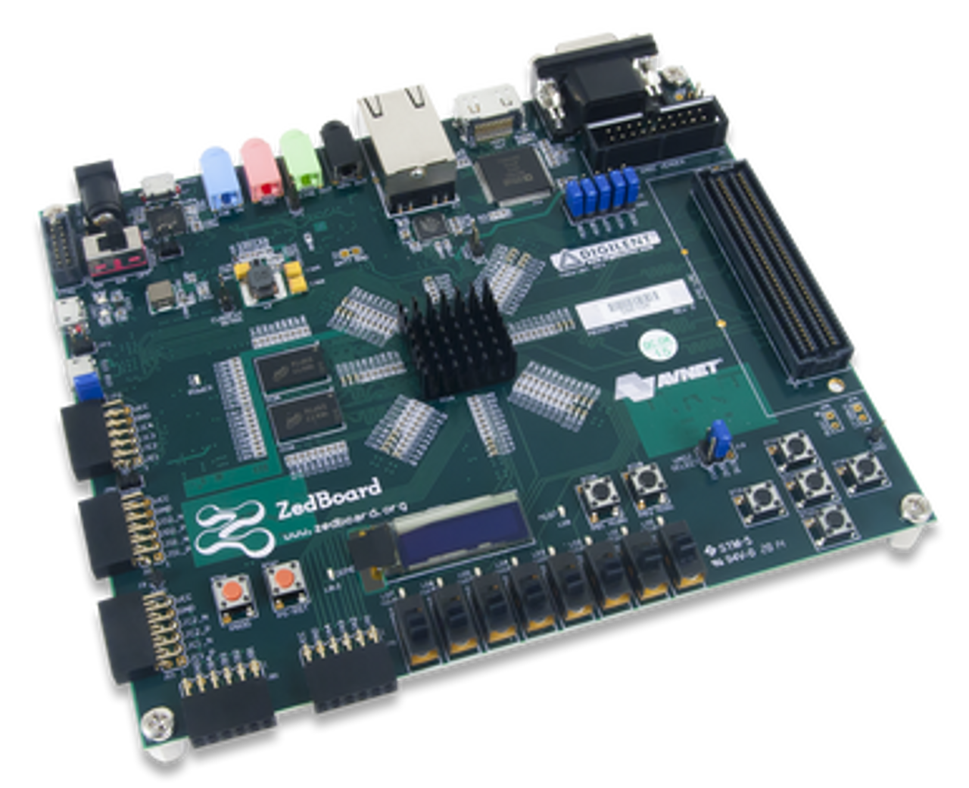
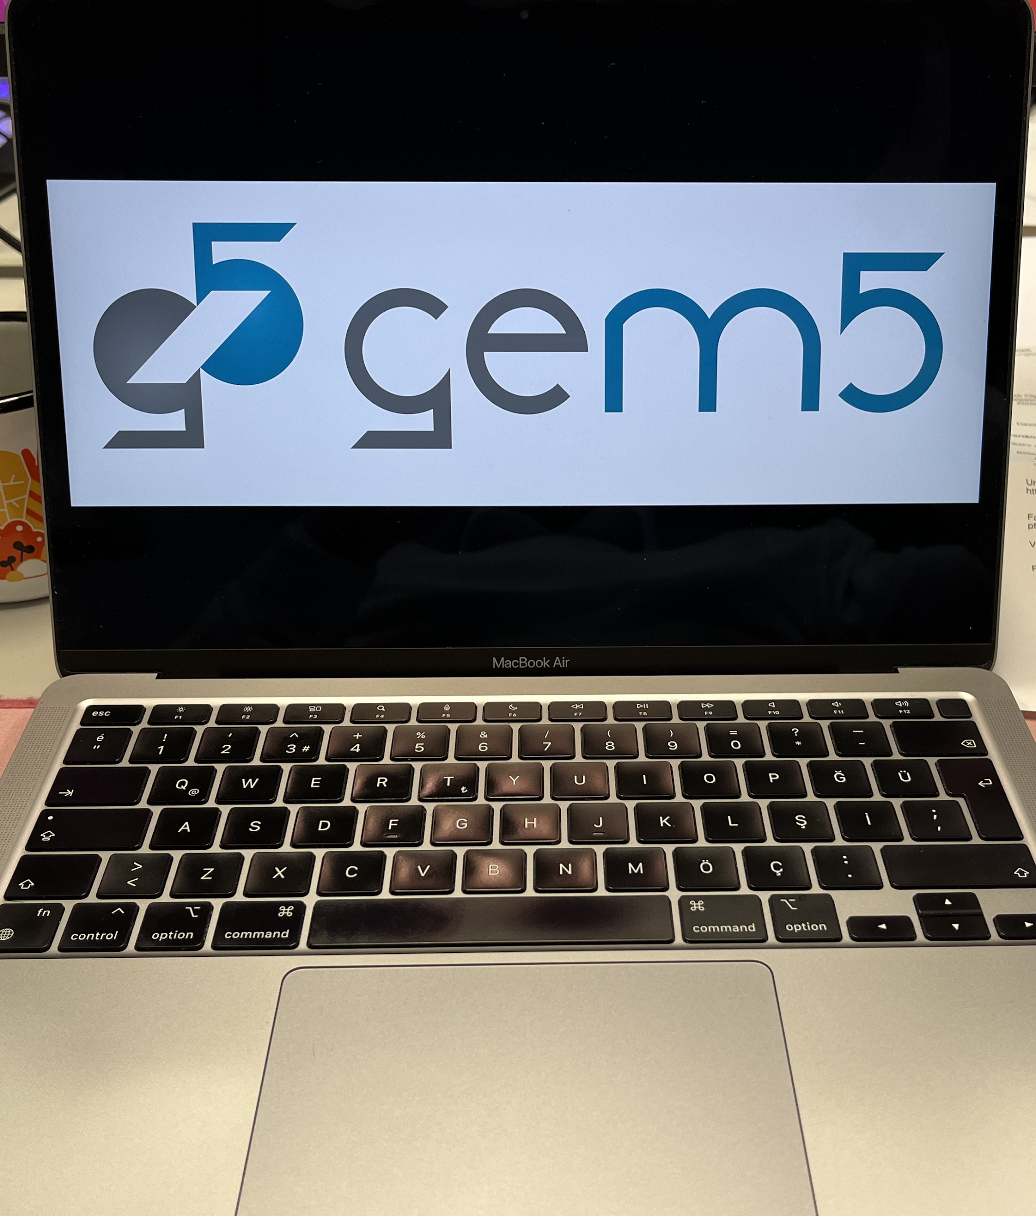
Cross-Layer Evaluation Infrastructure
Evaluating cross-layer techniques is non-trivial
Need a new infrastructure to evaluate a new cross-layer technique
Difficult given complexity (changes across the stack)
Cycle-accurate simulators
FPGA prototypes

Slide 10
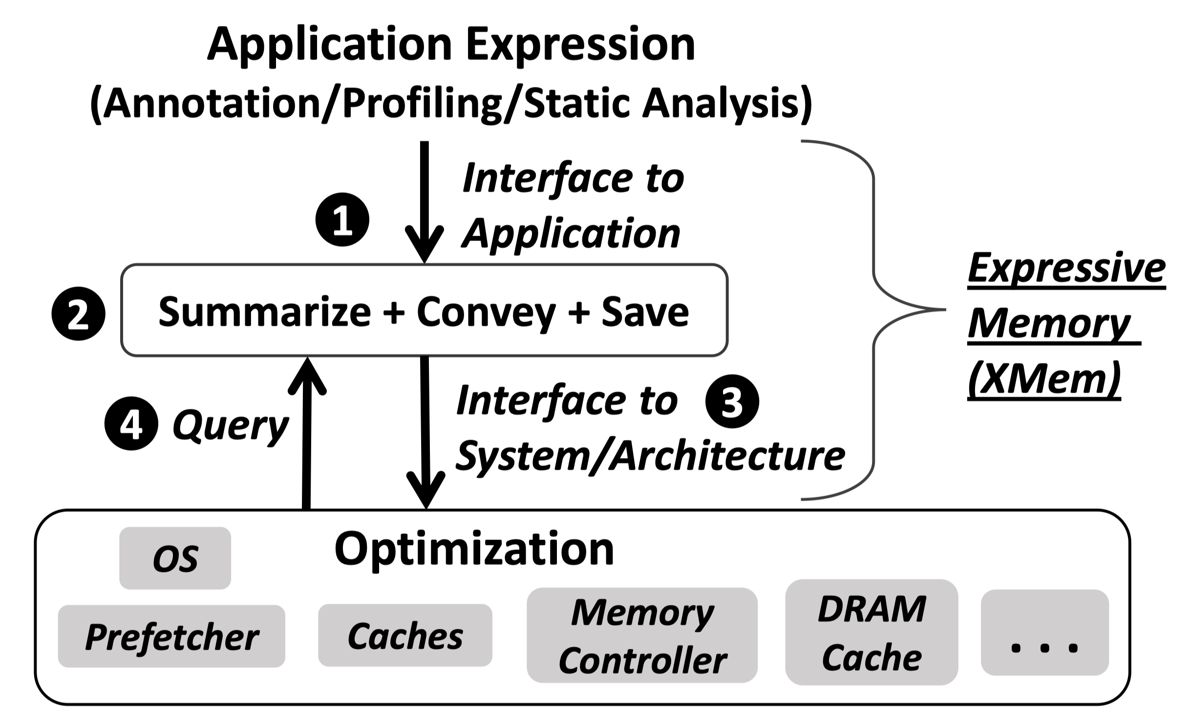
General Metadata Management System
A single general system can support multiple techniques
Key Benefit: Amortize the cost to implement each new technique
[Vijaykumar+, ISCA’18b]

Slide 11
Outline
Background
  Cross-Layer Techniques
  Evaluating Cross-Layer Techniques
MetaSys
  Overview
  Components
  Operation
  FPGA Prototype
Case Studies
  Prefetching
  Memory Safety and Protection
Characterizing a General Metadata Management System
Notes:
Reduce to four bullets

Slide 12
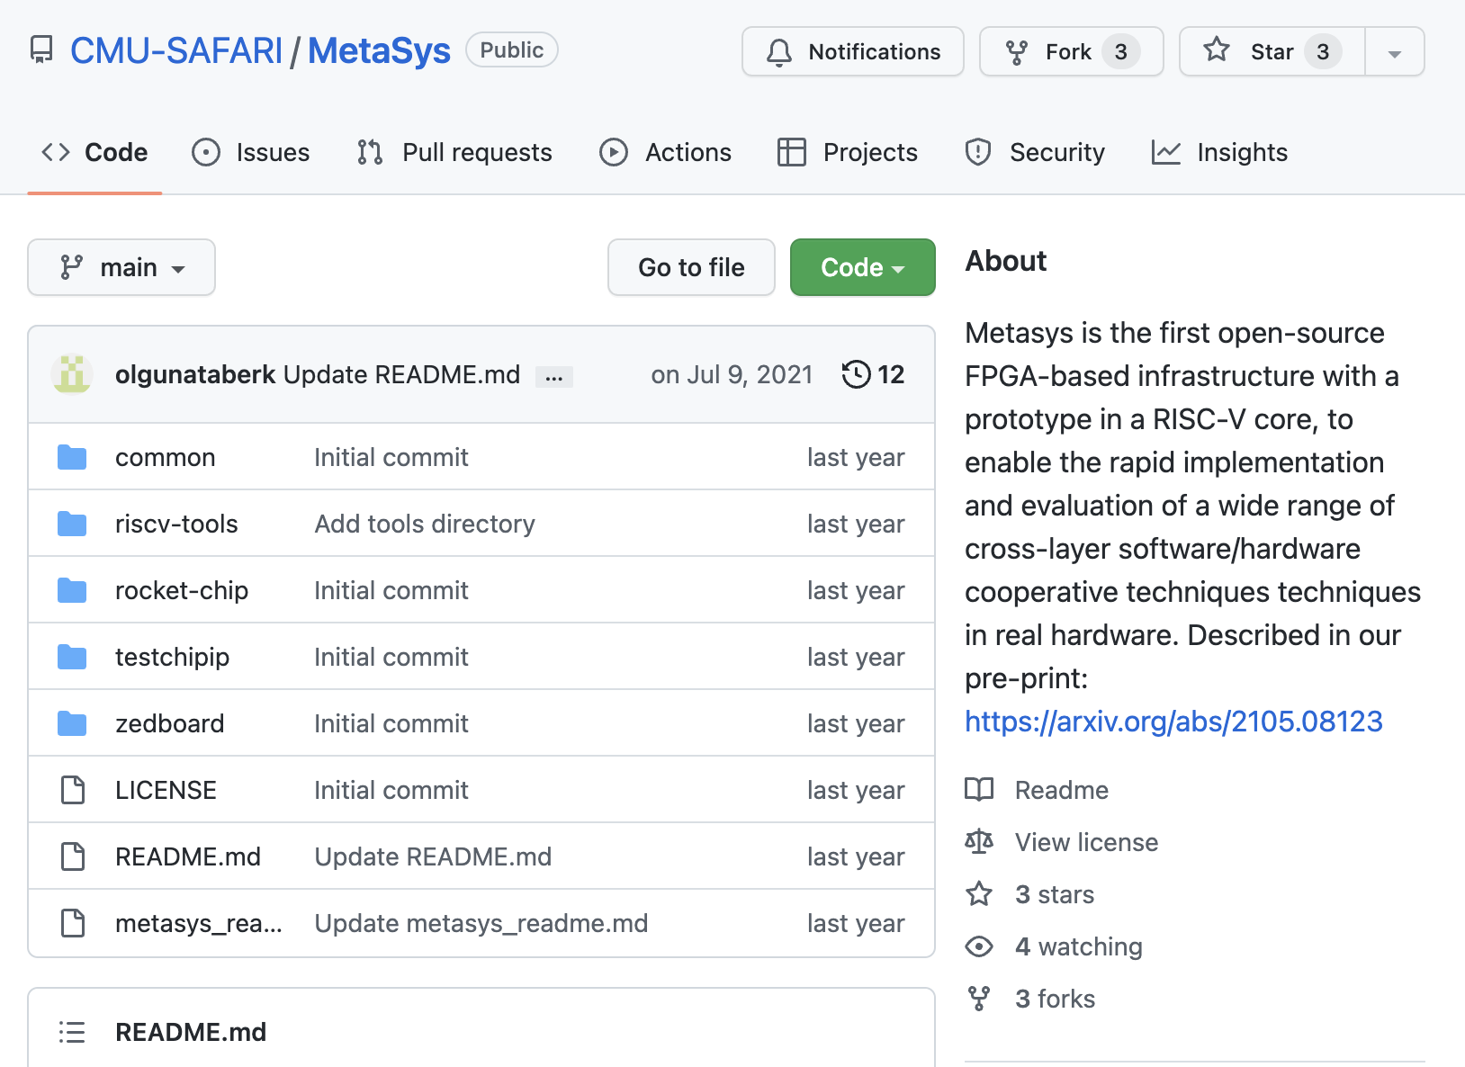
MetaSys: Overview
Goal: Enable rapid implementation and evaluation
of cross-layer techniques in real hardware
MetaSys: Open-source infrastructure
to evaluate cross-layer techniques end-to-end
MetaSys Source Code: https://github.com/CMU-SAFARI/MetaSys

Slide 13
MetaSys: Components
Tagged memory-based metadata management
Efficient metadata querying in hardware
1

Slide 14
MetaSys: Tagged Memory (I)
Tag memory addresses with metadata IDs
Optimization Client
Metadata
ID
Metadata
Example
Is <address>
accessed frequently?
Metadata Store
metadata ID
YES

Slide 15
MetaSys: Tagged Memory (II)
Processor
Core
Main Memory
TLB

Slide 16
MetaSys: Tagged Memory (II)
Map memory addresses
to metadata IDs
Processor
Core
Main Memory
Metadata
Mapping Table
TLB
Pointer
Metadata
Mapping Table
Metadata ID
Notes:
By default MMT resides in virtual address space, it exists per workload

Slide 17
MetaSys: Tagged Memory (II)
Map memory addresses
to metadata IDs
Processor
Core
Main Memory
Metadata
Mapping Table
Mapping Granularity
TLB
64 B
64 B
Pointer
. . .
. . .
. . .
Metadata
Mapping Table
4 KiB
4 KiB
ID == 0
ID == 1
Metadata ID
Notes:
By default MMT resides in virtual address space, it exists per workload

Slide 18
MetaSys: Tagged Memory (II)
Processor
Core
Mapping Management Unit
MetaSys
Instructions
Main Memory
Metadata
Mapping Table
TLB
Access & Manipulate
Metadata Table

Slide 19
MetaSys: Tagged Memory (II)
Processor
Core
Mapping Management Unit
MetaSys
Instructions
Main Memory
Metadata
Mapping Table
TLB
Retrieve
Metadata
ID
Metadata ID
Address Translation
Metadata Lookup Unit

Slide 20
MetaSys: Tagged Memory (II)
Processor
Core
Mapping Management Unit
MetaSys
Instructions
Main Memory
Metadata
Mapping Table
TLB
Retrieve
Metadata
ID
Address Translation
Metadata Lookup Unit
Metadata ID

Slide 21
MetaSys: Tagged Memory (II)
Processor
Core
Mapping Management Unit
MetaSys
Instructions
Main Memory
Metadata
Mapping Table
Metadata Mapping Cache
TLB
Retrieve
Metadata
ID
Metadata ID
Address Translation
Metadata Lookup Unit

Slide 22
MetaSys: Tagged Memory (II)
Processor
Core
Mapping Management Unit
MetaSys
Instructions
Main Memory
Metadata
Mapping Table
Metadata Mapping Cache
TLB
Retrieve
Metadata
ID
Metadata ID
Address Translation
Metadata Lookup Unit

Slide 23
MetaSys: Tagged Memory (II)
Processor
Core
Mapping Management Unit
MetaSys
Instructions
Main Memory
Metadata
Mapping Table
Metadata Mapping Cache
TLB
Retrieve
Metadata
ID
Map metadata IDs
to metadata
Address Translation
Optimization Client
Metadata ID
Metadata
Table
Metadata Lookup Unit
Metadata Table
Metadata

Slide 24
MetaSys: Tagged Memory (II)
Processor
Core
Mapping Management Unit
Main Memory
Metadata
Mapping Table
Metadata Mapping Cache
TLB
Initialize with metadata
Optimization Client
Metadata Lookup Unit
Metadata Table
Retrieve metadata IDs

Slide 25
MetaSys: Components
Tagged memory-based metadata management
Efficient metadata querying in hardware
1
Rich cross-layer interface
Communicate metadata from SW to HW
2

Slide 26
MetaSys: Cross-Layer Interface
Processor
Core
Mapping Management Unit
MetaSys
Instructions
Main Memory
Metadata
Mapping Table
Metadata Mapping Cache
TLB
Optimization Client
Metadata Lookup Unit
Metadata Table

Slide 27
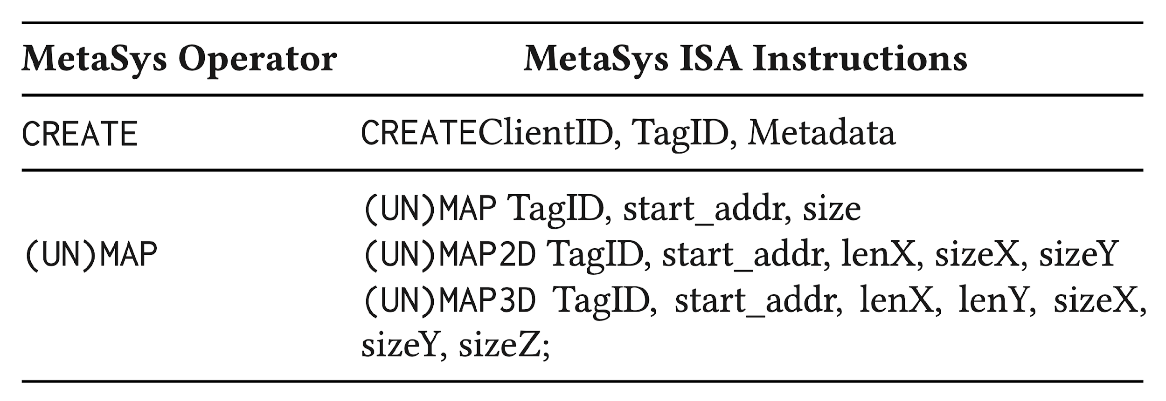
MetaSys: Cross-Layer Interface
Mapping Management Unit
Main Memory
Metadata Mapping Cache
Metadata
Mapping Table
Optimization Client
Metadata Table
Notes:
Refer to paper for more

Slide 28
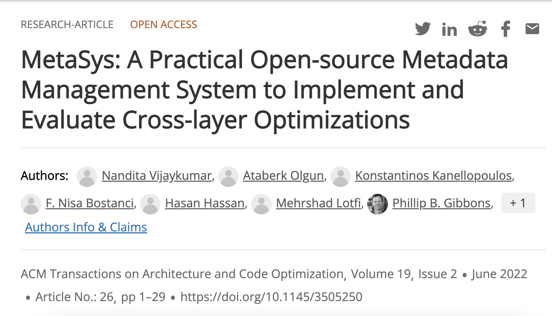
MetaSys: Cross-Layer Interface
Notes:
Refer to paper for more

Slide 29
MetaSys: Components
Tagged memory-based metadata management
Efficient metadata querying in hardware
1
Rich cross-layer interface
Communicate metadata from SW to HW
2
Flexible hardware and software modules
Facilitate implementing new HW optimizations
3

Slide 30
MetaSys: Hardware Modules (I)
Processor
Core
Mapping Management Unit
Main Memory
Metadata
Mapping Table
Metadata Mapping Cache
TLB
Optimization Client
Caches
Prefetchers
Bounds Checker
Memory Controller
Metadata Lookup Unit
Metadata Table
Notes:
Mention that this list can be expanded easily by developers. They just need to replicate what we have done.

Slide 31
MetaSys: Hardware Modules (II)
Processor
Core
Mapping Management Unit
Main Memory
Metadata
Mapping Table
Metadata Mapping Cache
commonly used across
cross-layer techniques
TLB
Optimization Client
Metadata Lookup Unit
Metadata Table

Slide 32
MetaSys: Software Modules
Processor
Core
Operating System
Mapping Management Unit
Main Memory
MetaSys Library
Metadata
Mapping Table
Metadata Mapping Cache
TLB
Optimization Client
Metadata Lookup Unit
Metadata Table
Notes:
Simple easy to modify operating system for adding new cross-layer optimizations
Metasys library exposes metasys instructions to the programmer in an organized way

Slide 33
Outline
Background
  Cross-Layer Techniques
  Evaluating Cross-Layer Techniques
MetaSys
  Overview
  Components
  Operation
  FPGA Prototype
Case Studies
  Prefetching
  Memory Safety and Protection
Characterizing a General Metadata Management System

Slide 34
MetaSys: Operation (MAP)
Map metadata ID
(to memory location)
MAP
Instruction
Metadata ID
“0”
Start Address
“0”
Size
“1 Unit”
1
Main Memory
Core
Mapping Management Unit
Metadata
Mapping Table
64 B
128 B
…
4 KiB
Notes:
NEEDS WORK

Slide 35
MetaSys: Operation (CREATE)
Associate metadata
(with metadata ID)
CREATE
Instruction
Client ID
“Cache”
Metadata ID
“0”
Metadata
“Hot”
2
Main Memory
Core
Mapping Management Unit
Metadata
Mapping Table
Prefetcher
Cache
Metadata Table
Metadata Table
Notes:
MAKE CLIENT MORE CONCRETE == CLIENT 0 PREFETCHER, CLIENT 1 CACHE

Slide 36
MetaSys: Operation (CREATE)
Associate metadata
(with metadata ID)
2
Metadata ID
“0”
Main Memory
Metadata
“Hot”
Core
Mapping Management Unit
Metadata
Mapping Table
Prefetcher
Cache
Metadata Table
Metadata Table

Slide 37
MetaSys: Operation (LOOKUP)
Lookup metadata
(with address)
3
Main Memory
Core
Mapping Management Unit
Metadata
Mapping Table
Should I evict my cached word
at address 0?
Prefetcher
Cache
Metadata Table
Metadata Table

Slide 38
MetaSys: Operation (LOOKUP)
Lookup metadata
(with address)
Check metadata table
(with metadata id)
3
4
Main Memory
Core
Mapping Management Unit
Metadata
Mapping Table
Metadata ID
“0”
It is used frequently (hot)
I will not evict address 0
Metadata Lookup Unit
Metadata
“Hot”
Prefetcher
Cache
Metadata Table
Metadata Table
Address
“0”

Slide 39
Outline
Background
  Cross-Layer Techniques
  Evaluating Cross-Layer Techniques
MetaSys
  Overview
  Components
  Operation
  FPGA Prototype
Case Studies
  Prefetching
  Memory Safety and Protection
Characterizing a General Metadata Management System

Slide 40
FPGA Prototype (I)
Cycle-accurate simulators
FPGA prototypes
Accurately evaluate feasibility of the metadata management system
  Implement all components (e.g., ports, wires, buffers)
Quickly run experiments
  Run workloads fast compared to simulation
Develop RTL as a basis for future work
  E.g., accurately measure area and power using synthesis tools
Notes:
Why we implement in FPGA, here are the reasons slide

Slide 41
FPGA Prototype (II)
Zedboard Zynq
FPGA board
RISC-V Rocket Chip
In-order
Rocket
Core
Mapping Management Unit
Metadata Mapping Cache
TLB
Optimization Client
Metadata Lookup Unit
Metadata Table
DDR4 Chips
Metadata
Mapping Table

Slide 42

MetaSys is Open Source
https://github.com/CMU-SAFARI/MetaSys
Link to Source Code

Slide 43
Outline
Background
  Cross-Layer Techniques
  Evaluating Cross-Layer Techniques
MetaSys
  Overview
  Components
  Operation
  FPGA Prototype
Case Studies
  Prefetching
  Memory Safety and Protection
Characterizing a General Metadata Management System

Slide 44
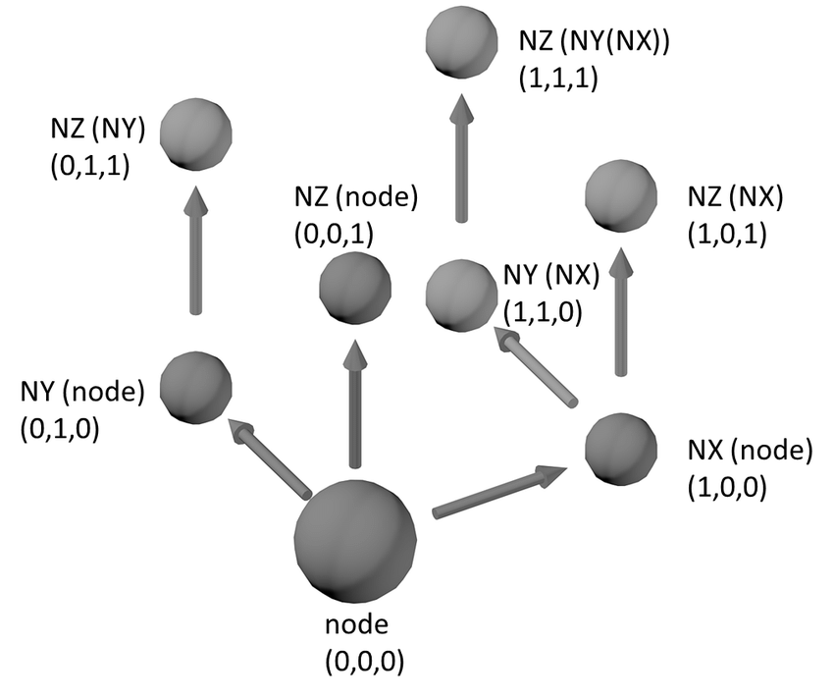
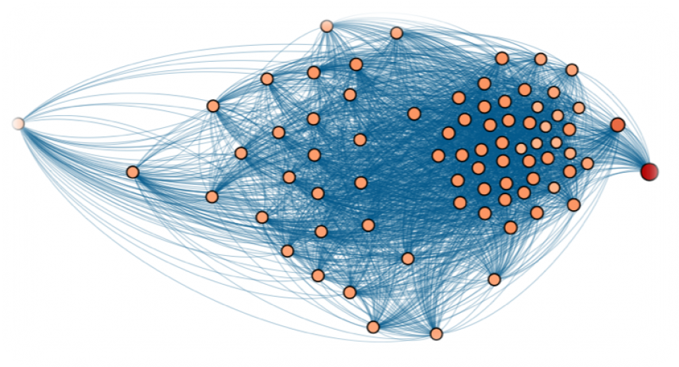
Cross-Layer Prefetching Techniques
Handle challenging access patterns
Graph processing
Pointer chasing
Linear algebra
…
Case Study #1
New cross-layer prefetching technique for graph applications
Leverage graph data structure semantics
  Instead of relying on program context or memory access history
Example Prior Work
[Ainsworth+, ICS‘16]
[Talati+, HPCA’21]

Slide 45
Graph Representation
Compressed sparse row (CSR) format
Work List
0
1
2
3
4
0
  Offsets List
0
0
2
3
4
7
2
1
  Edges List
3
4
4
0
2
3
4
4
3
  Properties
0
1
2
3
4

Slide 46
Traversing the Graph
Work List
0
1
2
3
4
Two types of indirection:
  Offsets List
0
0
2
3
4
7
1
Using a single value
2
Using a range of values
  Edges List
3
4
4
0
2
3
4
  Properties
Metadata required for prefetching:
Type of indirection
Base address of the next list
Size of elements in both lists
0
1
2
3
4

Slide 47
Graph Prefetching Using MetaSys
Initialize metadata
1
Map metadata IDs to work, offset, and edges lists
CREATE metadata to express the characteristics
{type, base, base_next, size, size_next}
of each list
2
Prefetch
Load/store instruction triggers
metadata lookup in prefetcher
3
find what the application will access next using metadata
Example
  Edges List
3
4
4
0
2
3
4
base_properties + (size_properties * )
  Properties
4

Slide 48
Evaluation Methodology
CPU | 25 MHz, in-order Rocket core
TLB | 16 entry data TLB, LRU policy
L1 D&I$ | 16 KiB, 4-way, 4 cycle, 64 B cache line, LRU, 2 MSHRs
DRAM | DDR3 1066 MT/s
Metadata Cache | NMRU policy, 128 entries, 38 bits/entry, 512 B granularity
Metadata Table | 256 entries, 64 B entry
Workloads from the Ligra benchmark (graph applications):
PageRank (PR), Shortest Path (SSSP), Collaborative Filtering (CF),
Teenage Follower (TF), Triangle Counting (TC), Breadth-First Search (BFS), Radius Estimation (Radii), Connected Components (CC)
Evaluated configurations:
Stride: Baseline system + a hardware stride prefetcher
GraphPref: Specialized graph prefetcher
MetaSys: Graph prefetching using MetaSys

Slide 49
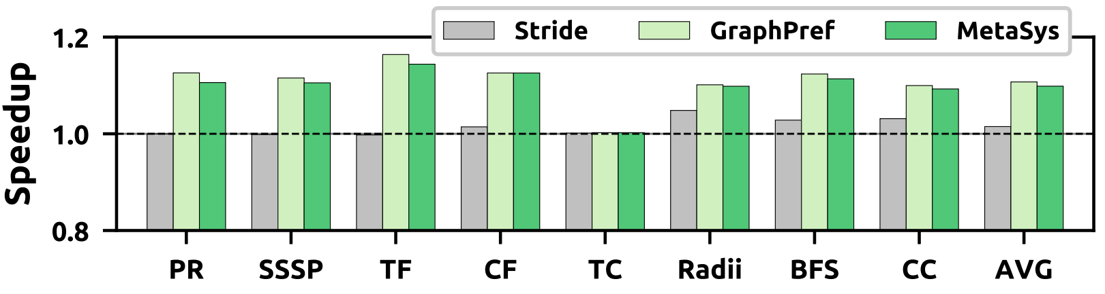
Results
MetaSys improves performance by 11.2% on average
Performs similar to the specialized prefetcher GraphPref
(within 0.2%)

Slide 50
Outline
Background
  Cross-Layer Techniques
  Infrastructure for Evaluating Cross-Layer Techniques
MetaSys
  Overview
  Components
  Operation
  FPGA Prototype
Case Studies
  Prefetching
  Memory Safety and Protection
Characterizing a General Metadata Management System

Slide 51
Memory Safety
Certain programming models are vulnerable to:
Buffer overflows cause unintentional memory modifications
Memory-unsafe: When there is no bounds checking for pointers
Software bounds checking: Computationally expensive
Hardware bounds checking: Too specialized
MetaSys allows bounds checking without additional hardware
char buffer[6];
string copy (buffer, “buffer overflow”)
b
u
f
f
e
r
o
v
e
r
f
l
o
w

Slide 52
Bounds Checking with MetaSys (I)
Array A = malloc (16 KB);
1
Allocate 16 KB of memory
MAP(Metadata ID M, Array A);
Map Metadata ID M != 0 to Array A
for (i = 0 ; i < 17 KB ; i++)
2
Loop exceeds allocated memory range
Execute a CREATE instruction with ID = M
before each STORE
CREATE(M);
STORE A[i], 1337;
3
Eventually, will cause buffer overflow
Metadata Lookup Unit
Bounds Check Unit
Array A
Out-of-bounds
Notes:
DESCRIBE THIS OVER CODE

Slide 53
Bounds Checking with MetaSys (I)
Array A = malloc (16 KB);
1
Allocate 16 KB of memory
MAP(Metadata ID M, Array A);
Map Metadata ID M != 0 to Array A
for (i = 0 ; i < 17 KB ; i++)
2
Loop exceeds allocated memory range
Execute a CREATE instruction with ID = M
before each STORE
CREATE(M);
STORE A[i], 1337;
3
Eventually, will cause buffer overflow
=
M
M
Metadata Lookup Unit
Bounds Check Unit
Array A
Out-of-bounds
Notes:
DESCRIBE THIS OVER CODE

Slide 54
Bounds Checking with MetaSys (I)
Array A = malloc (16 KB);
1
Allocate 16 KB of memory
MAP(Metadata ID M, Array A);
Map Metadata ID M != 0 to Array A
for (i = 0 ; i < 17 KB ; i++)
2
Loop exceeds allocated memory range
Execute a CREATE instruction with ID = M
before each STORE
CREATE(M);
STORE A[i], 1337;
3
Eventually, will cause buffer overflow
!=
M
0
Fail bounds check
Metadata Lookup Unit
Bounds Check Unit
Array A
Out-of-bounds
Notes:
DESCRIBE THIS OVER CODE

Slide 55
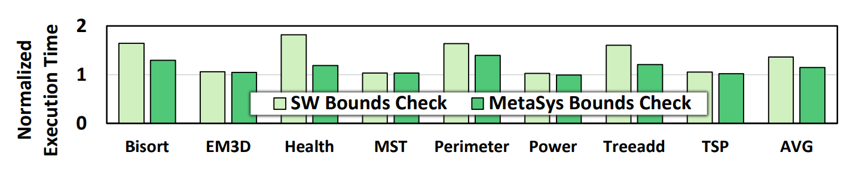
Bounds Checking with MetaSys (II)
Evaluation Methodology
Mapping granularity of 64 B
  Each 64 B non-contiguous memory location has an ID
Evaluate Olden benchmarks
Compare against a software bounds checker
(I) MetaSys bounds checking incurs 14% performance overhead on average
(II) Performs better than the software bounds checker
Notes:
Dashed line

Slide 56
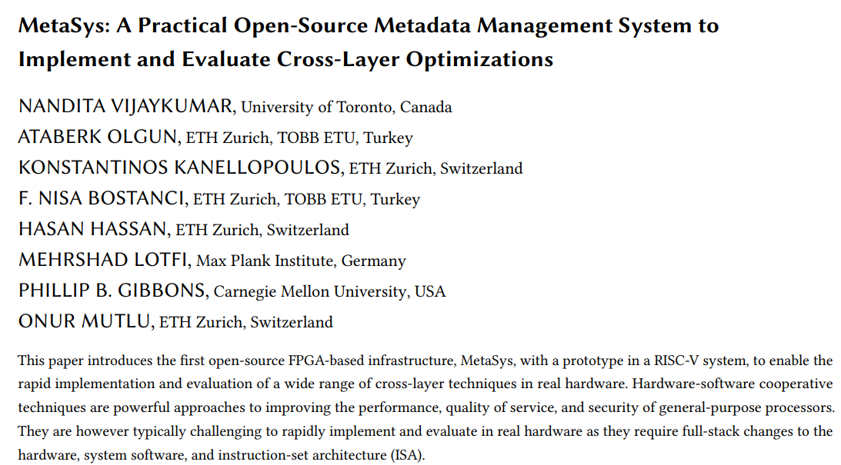
Return Address Protection with MetaSys
https://arxiv.org/pdf/2105.08123v2

Slide 57
Outline
Background
  Cross-Layer Techniques
  Evaluating Cross-Layer Techniques
MetaSys
  Overview
  Components
  Operation
  FPGA Prototype
Case Studies
  Prefetching
  Memory Safety and Protection
Characterizing a General Metadata Management System

Slide 58
Characterizing MetaSys
Sources of system overhead:
Handling dynamic metadata
  Communicating metadata SW → HW at runtime
Metadata management and lookups
  Components retrieve metadata IDs
Scaling to multiple components
  Multiple components access shared metadata support
Conduct detailed characterization study
to understand the overheads

Slide 59
Methodology
Multiple workloads
  Polybench, Ligra, and memory-intensive microbenchmarks
Baseline MetaSys configuration (reminder)
  512 B mapping granularity
  128 entry metadata mapping cache
  256 entry metadata table
  64 B metadata
Stress the metadata management system
  Perform metadata lookups for every memory access

Slide 60
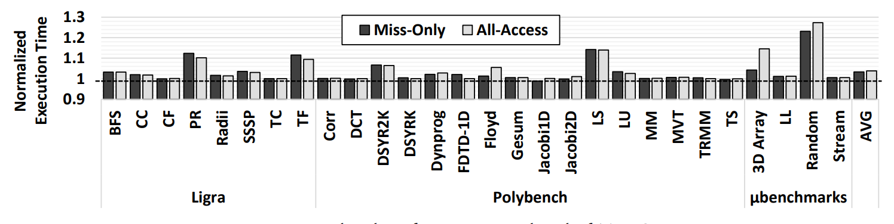
Overhead of Accessing Metadata
Average real workload lookup overhead is low: 2.7%
(~0% min, ~14% max)
Low spatial & temporal locality workloads have high overheads
(Random: 27%)
Miss-only and all-access are similar in performance
(0.05% difference)
Notes:
Miss-only is sometimes slower due to additional TLB misses. Frequent metadata accesses (in the all-access config) keep the translations inside the TLB whereas infrequent accesses cause them to be evicted from the TLB more often. Inducing additional delay on the critical path.

Slide 61
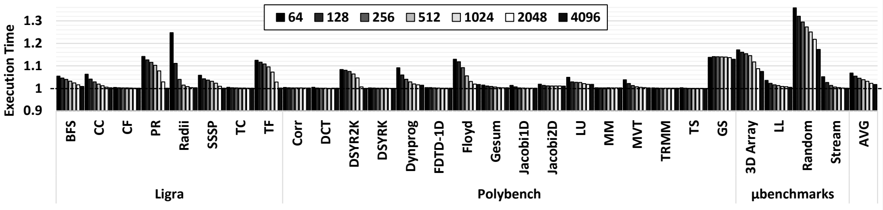
Effect of Mapping Granularity
Mapping Granularity
Most workloads have small performance overhead
even at the smallest mapping granularity
Some workloads experience high overhead
even at the largest mapping granularity

Slide 62
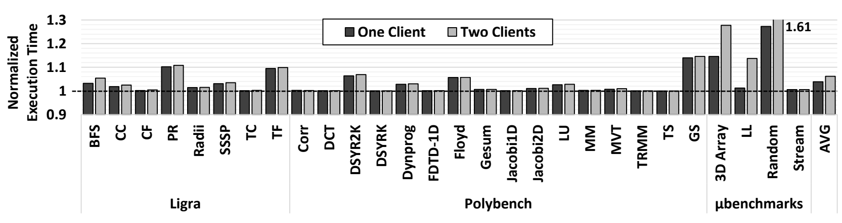
Effect of Multiple Clients
Client 0: Lookup on all memory accesses
Client 1: Lookup on all page table walk requests
Average real workload overhead is 0.3%
(over one client)
Microbenchmarks experience higher overhead with more clients
In the paper: Investigate mechanisms to alleviate their overheads

Slide 63
Outline
Background
  Cross-Layer Techniques
  Evaluating Cross-Layer Techniques
MetaSys
  Overview
  Components
  Operation
  FPGA Prototype
Case Studies
  Prefetching
  Memory Safety and Protection
Characterizing a General Metadata Management System

Slide 64
More in the Paper
More details on MetaSys Design
  OS Support
  Coherence/Consistency
  Timing Sensitivity of Metadata Lookups
  Software Library
  Area overhead (@ 22nm): 0.03 mm²
    0.02% of an Intel Ivy Bridge CPU core
In-depth characterization analysis
  Effects of address translation
  Effects of Metadata Mapping Cache size
  Performance overhead of MAP/CREATE instructions

Slide 65
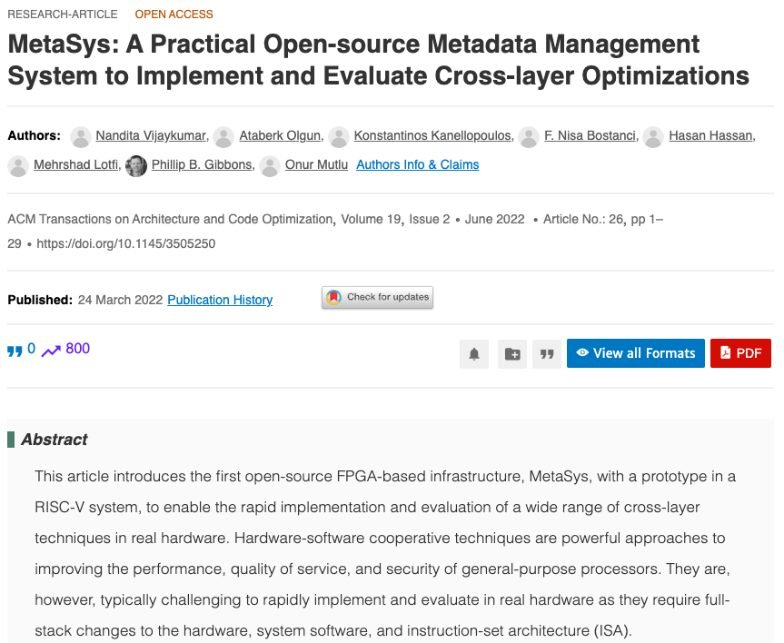
MetaSys Paper
https://dl.acm.org/doi/full/10.1145/3505250

Slide 66
Executive Summary
Motivation: Hardware-software cooperative (cross-layer) techniques
improve performance, quality of service, and security
Problem: Cross-layer techniques are challenging to implement and evaluate in real hardware
because they require modifications across the stack
Our Goal is twofold:
1) Enable rapid implementation and evaluation of cross-layer techniques in real hardware
2) Quantify the overheads associated with a general metadata management system
Key Idea:
Develop a metadata management system (MetaSys) with hardware and software components
that are reusable across cross-layer techniques to minimize programmer effort
Prototype: Xilinx Zedboard prototype using RISC-V Rocket Chip:
Low on-chip storage (0.2%) and memory storage (0.2%) overhead metadata management
Evaluation: Graph prefetching and memory protection case studies,
extensive overhead characterization
MetaSys-based graph prefetcher performs similar to state-of-the-art specialized prefetcher
Low-overhead bounds-checking (14%) and return address protection (1.2%)
Single general metadata management system scales well

Slide 67
MetaSys is Open Source
https://github.com/CMU-SAFARI/MetaSys
Link to Source Code

Slide 68
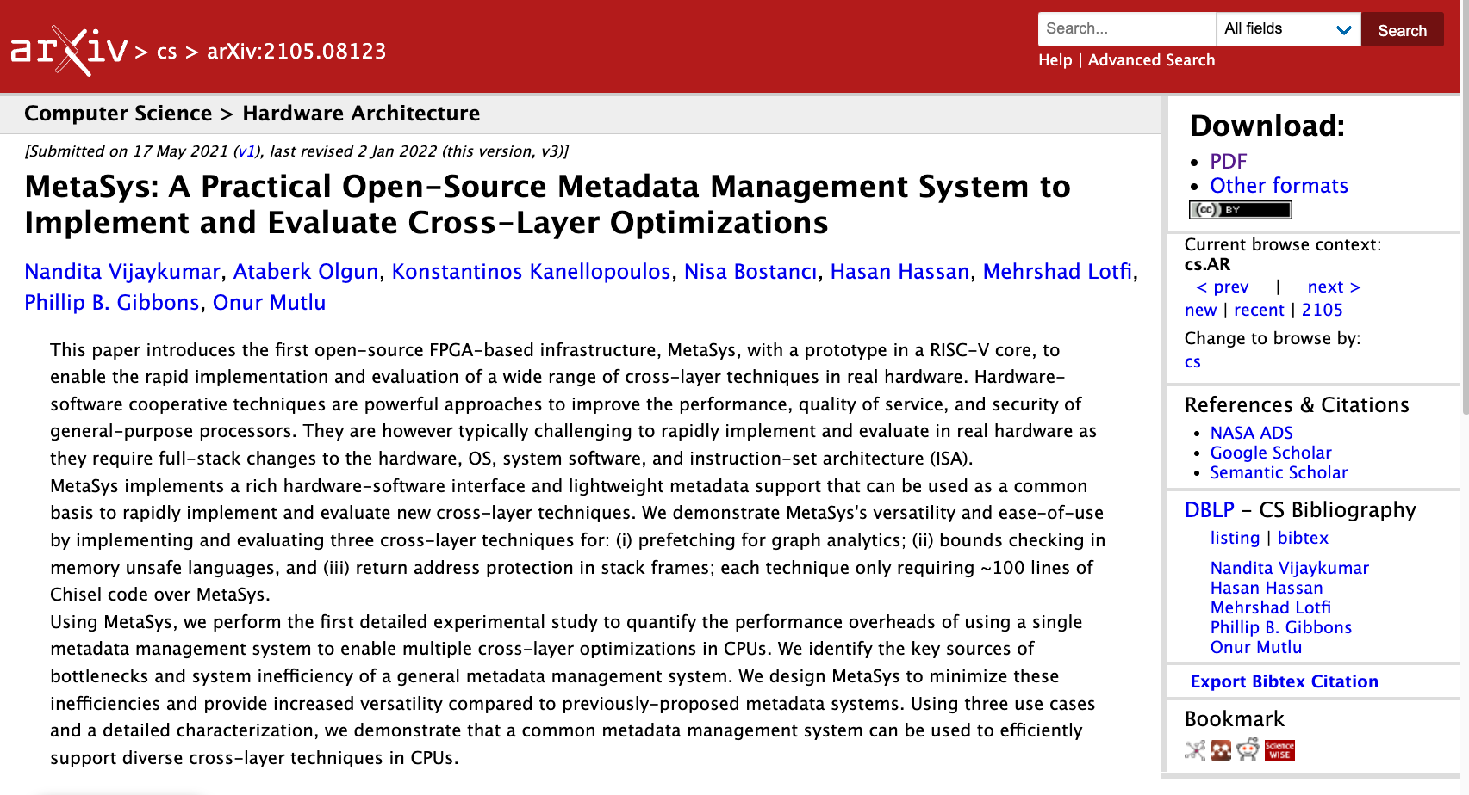
Updated Version on ArXiv
https://arxiv.org/abs/2111.00082
Notes:
An extended version of our conference paper is available on arXiv on this link where we discuss our framework in more detail.

Slide 69
MetaSys is Open Source
https://github.com/CMU-SAFARI/MetaSys
Link to Source Code

Slide 70
MetaSys
A Practical Open-source Metadata Management System to Implement and Evaluate Cross-layer Optimizations
Nandita Vijaykumar, Ataberk Olgun, Konstantinos Kanellopoulos,
F. Nisa Bostancı, Hasan Hassan, Mehrshad Lotfi, Phillip B. Gibbons, Onur Mutlu

Slide 71
Backup Slides

Slide 72
OS Support
Support for:
managing MMT in physical address space
flushing PMTs on context switch
updating MMT tags and invalidating MMC
on page swaps
trap into OS to perform checks
(e.g., on bounds check failure)

Slide 73
Coherence/Consistency
Private metadata tables of private components (e.g., L1 cache) are not coherent
Private metadata tables of shared components are coherent automatically
  Updates in PMTs due to CREATEs are visible to all threads immediately
  Guaranteeing consistency requires use of barriers and fences
Metadata mapping table shared across threads of the same process
  Point of coherence is the mapping table, on a MAP, MMC entries in other cores are invalidated
  Consistency still requires barriers and fences

Slide 74
Timing Sensitivity of Metadata
3 modes on how to handle a lookup:
Force stall: Memory instruction that triggered a lookup cannot commit until the optimization is complete
  Security use cases
No stall: Metadata lookups never stall the core, but they are always resolved
  E.g., in page placement, cache replacement
Best effort: Lookups may be dropped before they complete
  E.g., prefetcher training

Slide 75
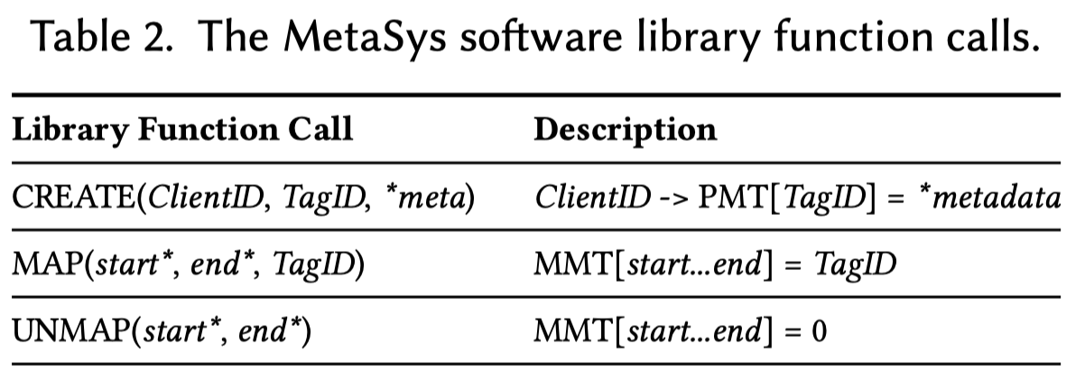
Software Library

Slide 76
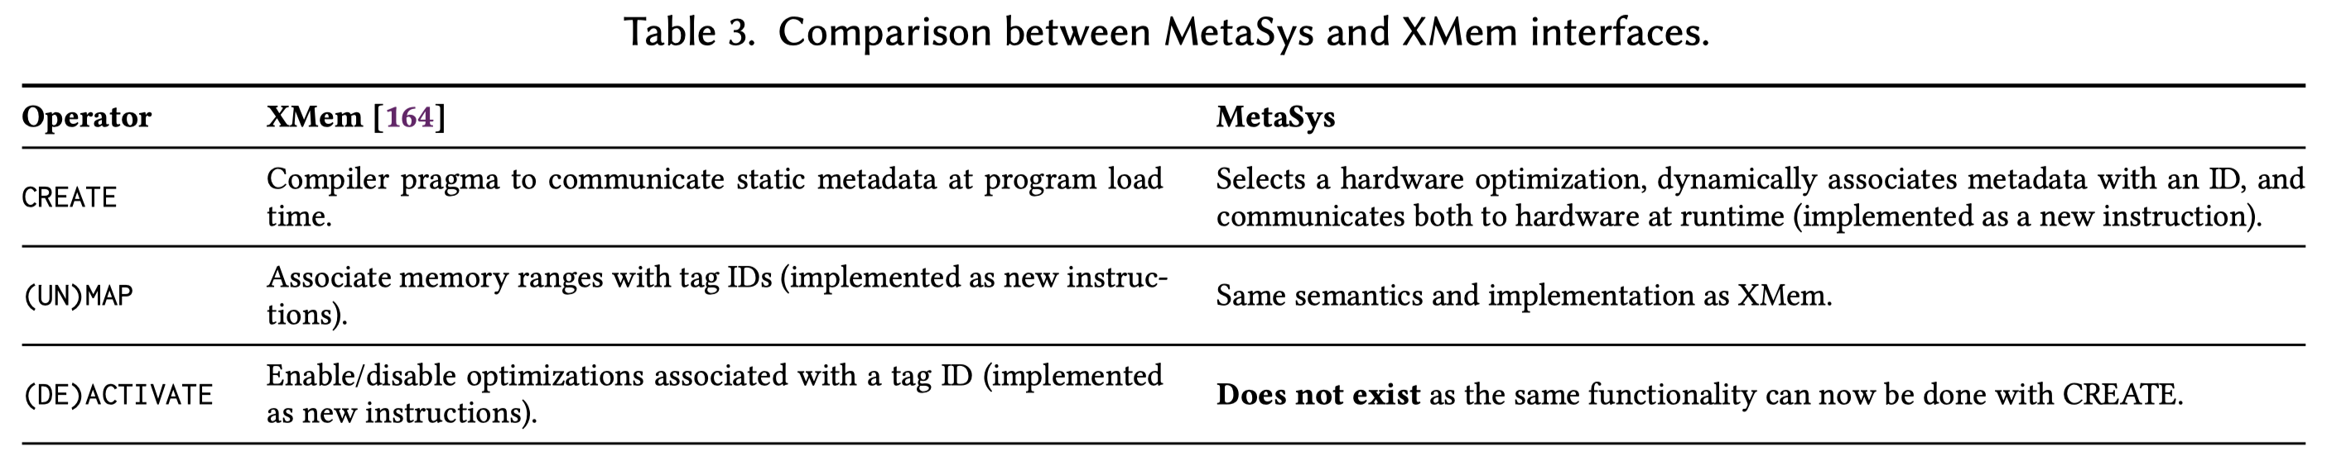
MetaSys vs XMem
Key difference:
The whole system is open-sourced
Differences in interfaces:

Slide 77
Existing Cross-Layer Infrastructure
PARD: Enable quality-of-service techniques
Tag programs with an ID
Propagate program ID with memory requests
Hardware enforces QoS requirements on memory requests
Cheri: Fine-grained memory protection
Capability registers replace address operands
Tag capabilities with an ID
Propagate capability IDs with memory requests
Hardware enforces bounds checking, pointer integrity, etc.
[Huang+, CARRV’17] [Woodruf+, ISCA’14]

Slide 78
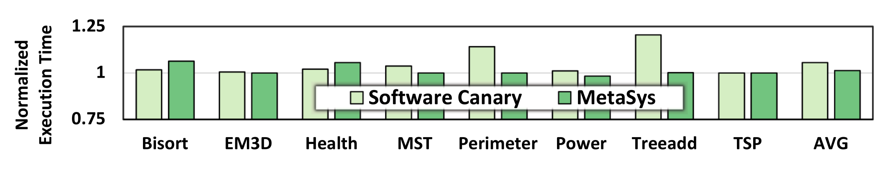
MetaSys: Return Address Protection
Map return addresses to metadata id 1
Return address protection client performs
metadata lookup on every store
If a store modifies a non-zero metadata tag,
cause exception
1.2% average performance overhead
(in contrast to software canary’s 5.5%)

Slide 79
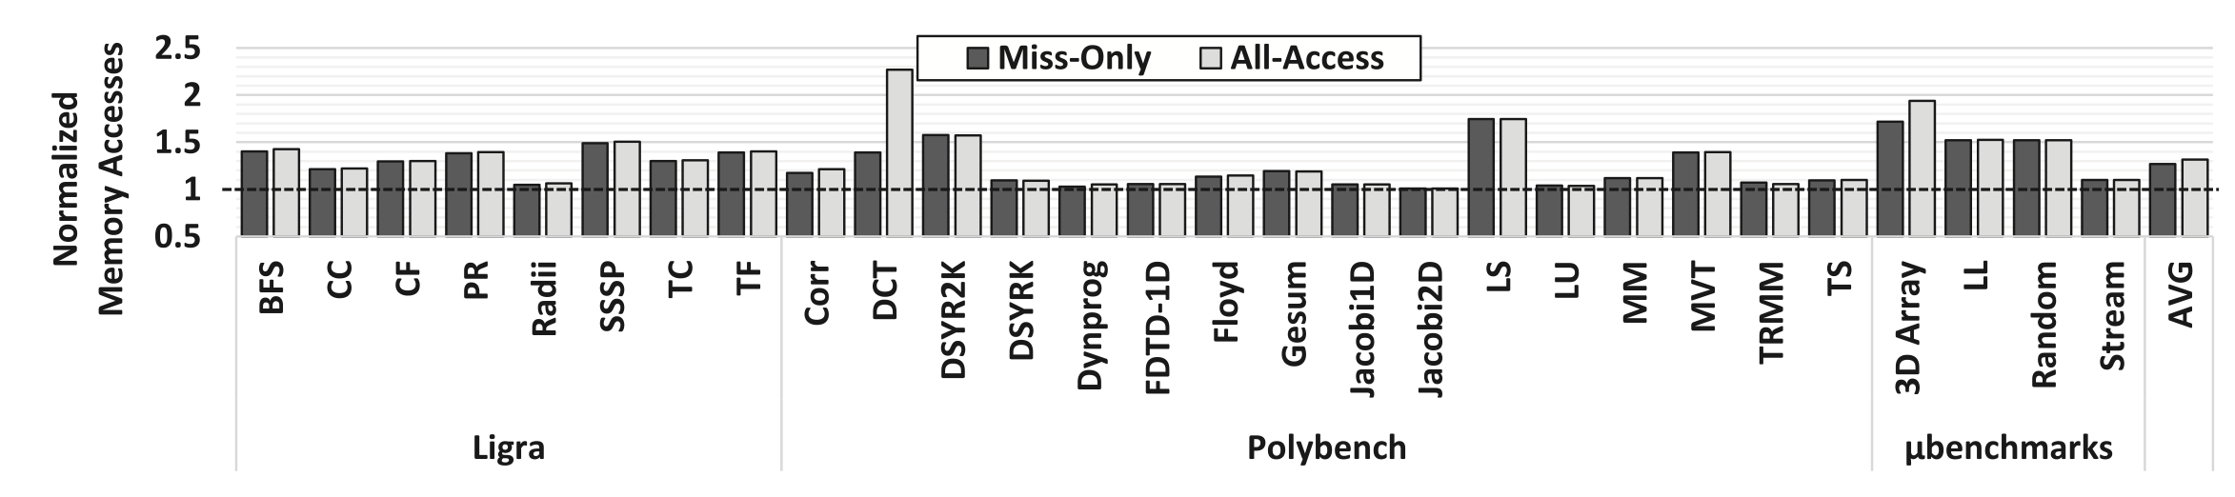
Additional Memory Accesses

Slide 80
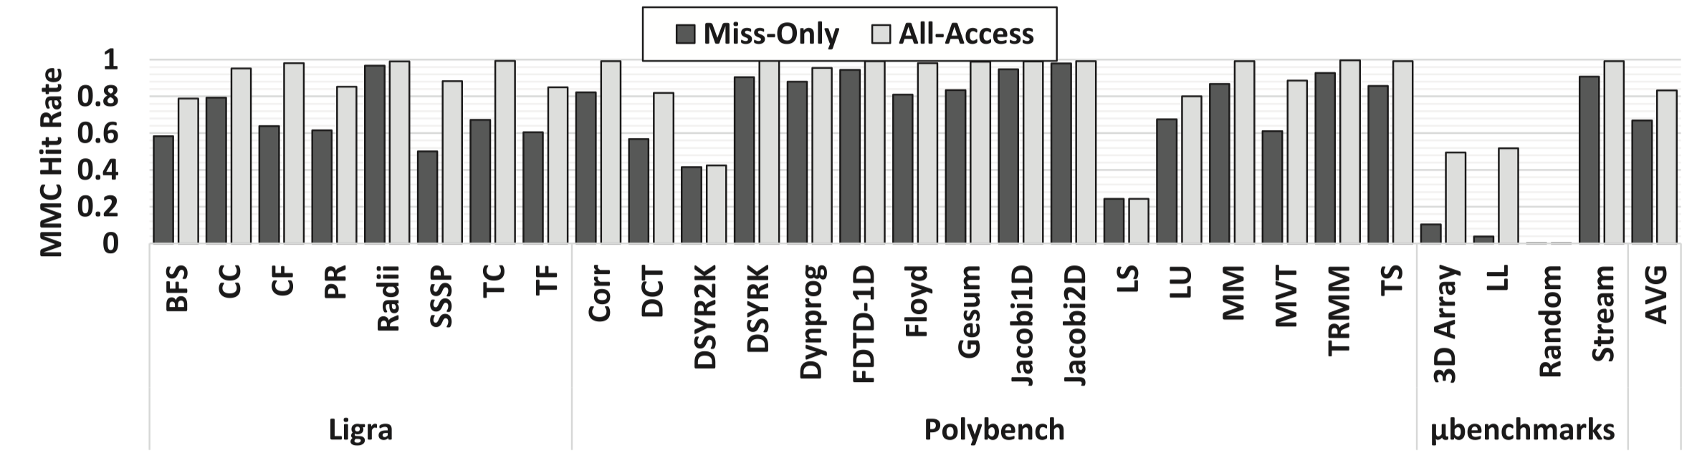
Metadata Mapping Cache Hit Rate

Slide 81
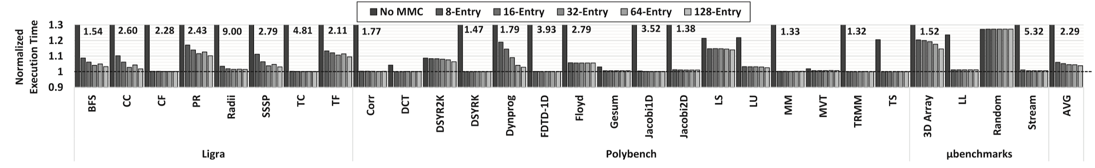
Effect of Metadata Mapping Cache Size

Slide 82
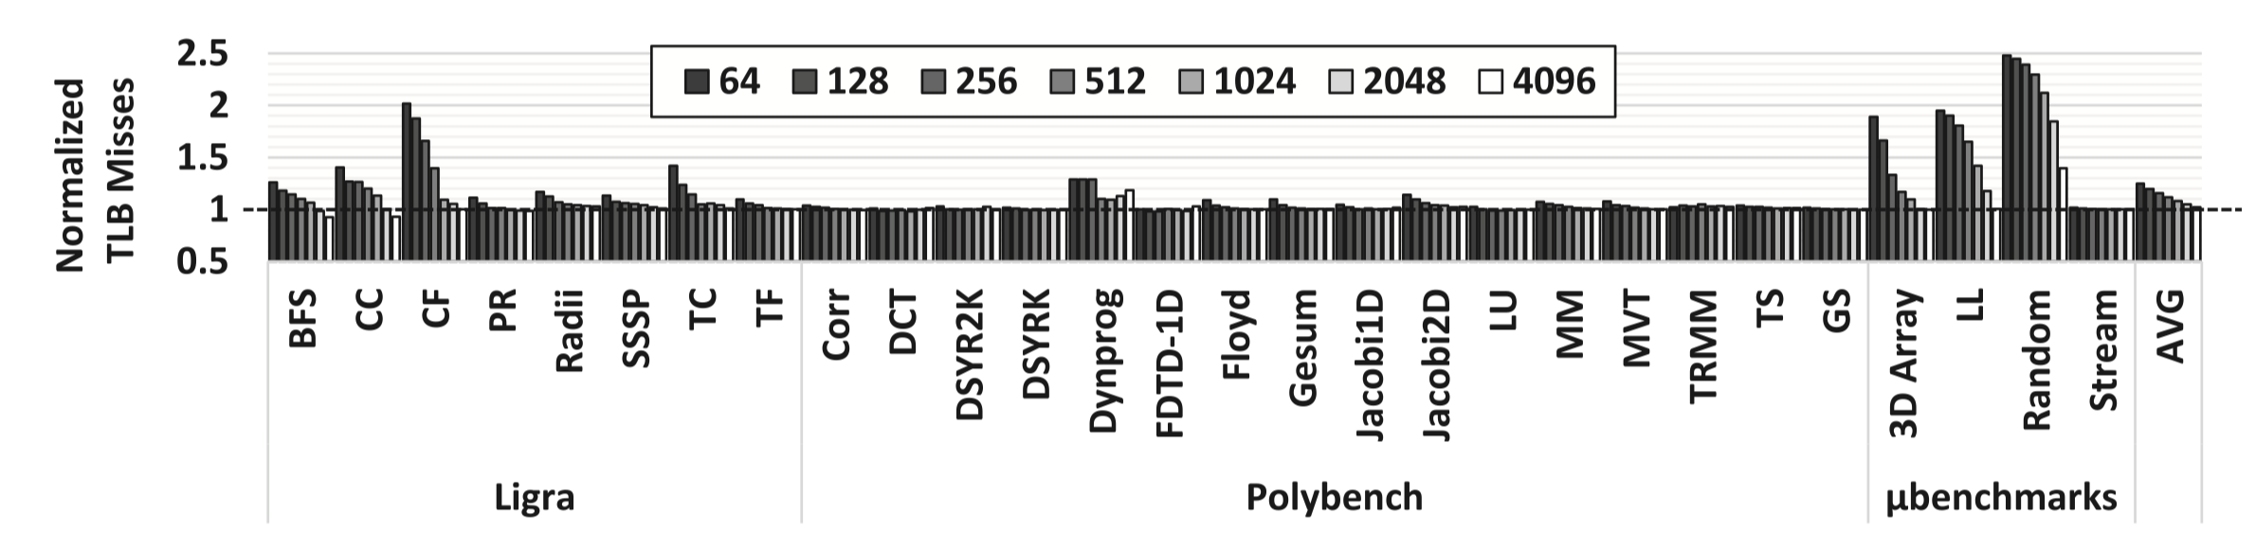
Tagging Granularity vs TLB Misses

Slide 83
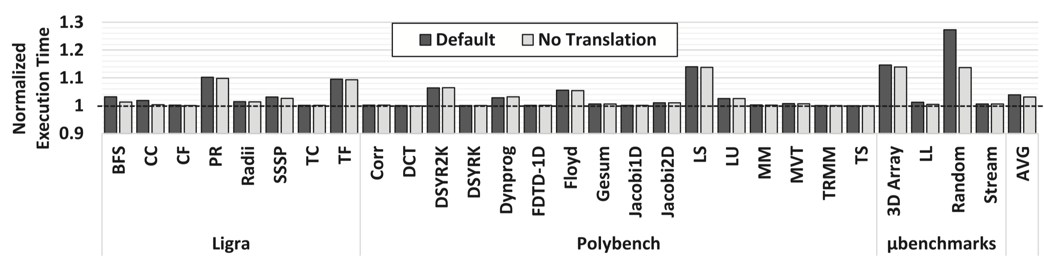
Effect of Address Translation

Slide 84
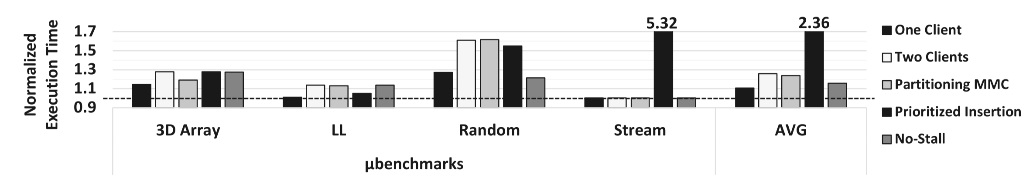
Alleviating Metadata Mapping Cache Contention

Slide 85
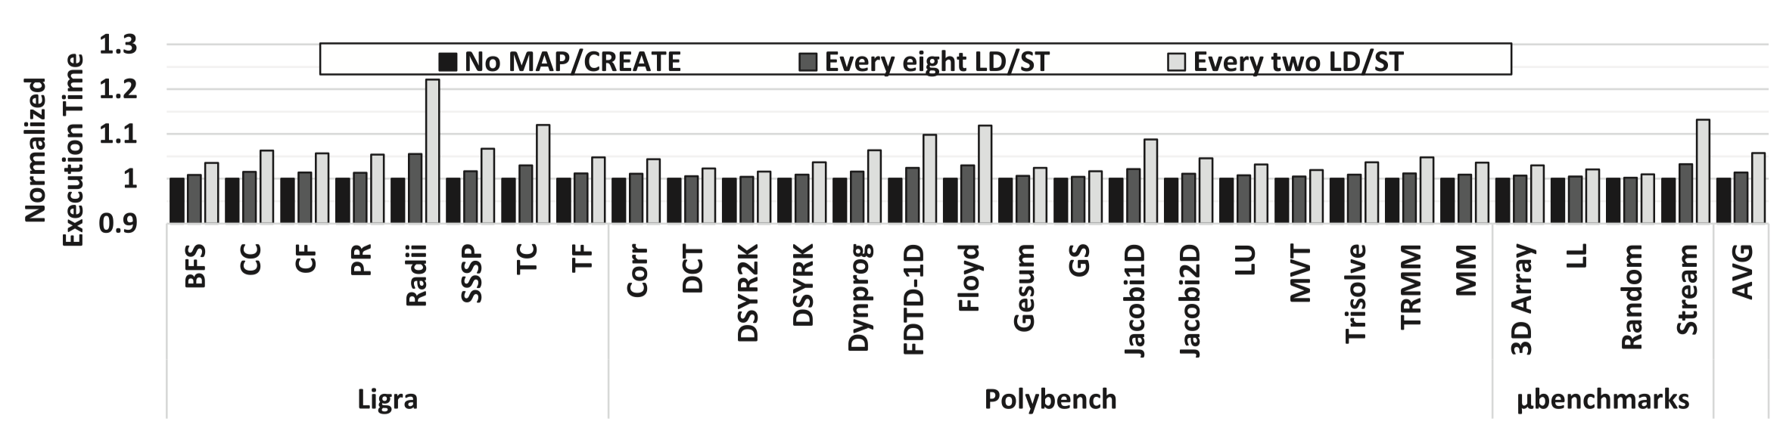
MAP/CREATE Instruction Overhead

Slide 86
This work introduces MetaSys:
1) A general metadata management system
2) Various hardware and software components
in a real prototype to minimize developer effort
[Vijaykumar+, ISCA’18b]
Notes:
Add a picture of the prototype

