Slide 1
MetaSys A Practical Open-Source Metadata Management System to Implement and Evaluate Cross-Layer Optimizations
Nandita Vijaykumar
Ataberk Olgun, Konstantinos Kanellopoulos, F. Nisa Bostanci
Hasan Hassan, Mehrshad Lotfi, Phillip B. Gibbons, Onur Mutlu

Slide 2
Executive Summary
Problem
Cross-layer techniques are challenging to implement because they require full-stack changes
Existing open-source infrastructures for implementing cross-layer techniques are not designed to provide key features:
Key Idea – Provide:
Rich dynamic HW/SW interfaces
Low-overhead metadata management
Interfaces to key hardware components (e.g., prefetcher)
Our goal is twofold:
Develop an efficient and flexible framework to enable rapid implementation of new cross-layer techniques
Perform a detailed limit study to quantify the overheads associated with general metadata systems
Notes:
HW-SW cooperative, cross-layer techniques can greatly improve performance, QoS and security of general purpose processors.
[CLICK] These techniques are hard to implement because they require changes across the whole stack,
[CLICK] and existing open-source infrastructure for implementing these techniques are not designed to facilitate the implementation of new techniques
[CLICK] MetaSys’s key idea is to provide a rich dynamic cross-layer interface to enable a large variety of cross-layer optimizations, a low-overhead metadata management subsystem to efficiently support cross-layer optimizations,
and standardized interfaces to important hardware components to enable quick integration of cross-layer optimizations
[CLICK] Our goal in MetaSys is two-fold:
First, we want to develop a new efficient and flexible framework enable quick implementation of new cross-layer techniques
Second, using this infrastructure we want to perform a detailed characterization study to quantify the overheads of general metadata systems

Slide 3
Outline
Background on Expressive Memory
MetaSys
Software Interface
Key Structures
FPGA Implementation
Evaluation
Notes:
Here is the outline of this talk
I will briefly describe the idea behind expressive memory, which is an important prior work that implements the first general cross-layer interface.

Slide 4
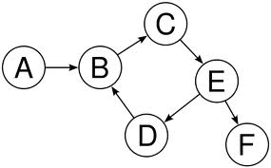
Higher-level information is not visible to HW
Code Optimizations
Data Structures
Access Patterns
Float
Integer
Char
Data Type
Software
Hardware
100011111…
101010011…
Instructions
Memory Addresses
Notes:
[CLICK] Higher-level information or metadata that is commonly available to the software or the developer typically is squeezed through
[CLICK] a restrictive interface
[CLICK] and converted into a combination of instructions and data residing in memory in current general purpose computing systems.
Because of this, the hardware is unaware of the higher-level information and cannot perform optimizations that could improve its performance, QoS or security.

Slide 5
With a richer abstraction: SW can provide program information can significantly help hardware
Float
Integer
Data Type/Layout
Char
Data Structures
Access Patterns
Software
Hardware
Data Placement
Prefetcher
Data Compression
Notes:
Given a richer abstraction instead of a restrictive interface between software and hardware,
[CLICK] we can convey high-level information about programs or data residing in memory which can enable the hardware to perform optimizations.
[CLICK] Specifically, by accessing metadata on data structures and access patterns, the hardware can make better placement decisions, or
[CLICK] improve prefetcher performance.
[CLICK] Similarly by accessing metadata on data types, for example the compressibility characteristics of a data type, the hardware can perform better data compression.

Slide 6
Outline
Background on Expressive Memory
MetaSys
Software Interface
Key Structures
FPGA Implementation
Evaluation
Notes:
Now I will describe MetaSys that provides a rich cross-layer interface to enable such optimizations.

Slide 7
Metadata: Data Semantics
Data Value Properties:
INT, FLOAT, CHAR,…
COMPRESSIBLE
Access Properties:
Read-Write Characteristics
Access Pattern
Access Intensity (“Hotness”)
Data Locality:
Working Set
Reuse
…
0xFFFFFF
OS
Memory
Controller
Prefetcher
Caches
Data
0x000000
Program information
Memory address space
Notes:
In a typical general purpose system, [CLICK] main memory stores program information and [CLICK] data
[CLICK] MetaSys, at a high-level, extends the information residing in main memory by additionally storing metadata or high-level program information, such as data types and characteristics associated with data types, access patterns used in accessing data, and locality of data structures.
[CLICK] This way, the higher-level program information is made available to a variety of components in the system such as the OS, memory controllers, prefetcher and caches via access to main memory.

Slide 8
The ATOM
An abstraction to express data semantics
Unique Atom ID
Data Value Properties:
INT, FLOAT, CHAR,…
COMPRESSIBLE
Access Properties:
Read-Write Characteristics
Access Pattern
Access Intensity
Data Locality:
Working Set
Reuse
…
Atom: X
Program
Attributes
Mapping
State
Atom
Valid/invalid at current execution point
Notes:
We use [CLICK] ATOMs to represent metadata in main memory.
[CLICK] An ATOM is mapped to a region in memory that typically [CLICK] contains a data structure
[CLICK] It encapsulates higher-level program information in its program attributes
[CLICK] And it maintains a simple state that indicates whether it is valid at a point in time
[CLICK] ATOMs are identified by unique ids

Slide 9
The Software Interface
Three Atom operators
Atom
1. CREATE
Atom
2. MAP/UNMAP
Create ID, Metadata
Program
Attributes
Mapping
Map ID, Start Addr., Size Map2D ID, …
State
3. ACTIVATE/DEACTIVATE
Activate ID
Deactivate ID
Notes:
MetaSys exposes operations to manipulate an atom
[CLICK] Using the CREATE operation, programmers can modify program attributes
[CLICK] Using MAP/UNMAP operations, programmers can map atoms to data structures
And [CLICK] Using ACTIVATE/DEACTIVATE operations, programmers can validate or invalidate an ATOM
[CLICKx3] We expose these three classes of operations as instructions in MetaSys

Slide 10
MetaSys Key Structures
Metadata Mapping Table
Metadata Mapping Cache
Memory Address | Atom ID
TLB
Atom ID
Attribute Table
Resides in Main Memory
Attributes
Metadata Lookup Unit
Virtual Address
Optimization
Client
Metadata Mapping Cache
Notes:
In this slide I will describe the key structures in MetaSys, and how a hardware module (or an optimization client) can retrieve program attributes to ultimately perform some optimization.
[CLICK] The optimization client is the hardware module that wants to retrieve some metadata to perform an optimization
[CLICK] It accesses the metadata (or atom) lookup unit using a virtual address, which looks up the metadata mapping cache that stores mappings between addresses and atom IDs
[CLICK] The Metadata lookup unit will translate the virtual address by accessing the TLB and then
[CLICK] access the metadata mapping table that resides in main memory.
[CLICK] The lookup unit will retrieve a valid mapping from the mapping table and place it in the metadata mapping cache
[CLICK] Finally, it will access the attribute table which stores metadata or attributes and [CLICK] convey it to the optimization client
Example optimization client: Dcache deciding on which cache block to replace

Slide 11
Outline
Background on Expressive Memory
MetaSys
Software Interface
Key Structures
FPGA Implementation
Evaluation
Notes:
I will quickly describe our prototype of MetaSys

Slide 12
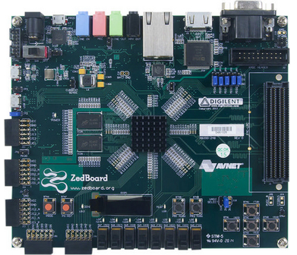
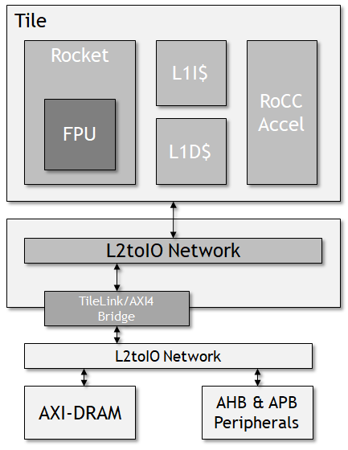
FPGA Prototype
Prototype on Xilinx Zedboard
within a real RISC-V system (Rocket Chip)
Zedboard
Rocket Chip
Notes:
We developed a prototype of MetaSys on the Zedboard FPGA that is integrated into the RISC-V rocket chip system
The figure on the right depicts a typical configuration of the rocket chip system. The system is pretty simple, in-order rocket cores execute RISC-V programs, small L1 caches and an accelerator that is tightly integrated with the l1 subsystem. It connects to a DRAM device over the AXI interface.

Slide 13
MetaSys in Rocket Chip
Implement two main components:
Atom Controller
Manages the attribute table (CREATE – (DE)ACTIVATE)
Performs atom mapping (MAP/UNMAP)
Physical address → Atom ID
Metadata Lookup Unit
Responds to clients:
Provides atom attributes
Contains the metadata mapping cache
Notes:
We make two modifications to rocket chip
[CLICK] We implement the atom controller which executes all MetaSys instructions
[CLICK] and the metadata lookup unit performs metadata lookups by accessing the metadata table in main memory

Slide 14
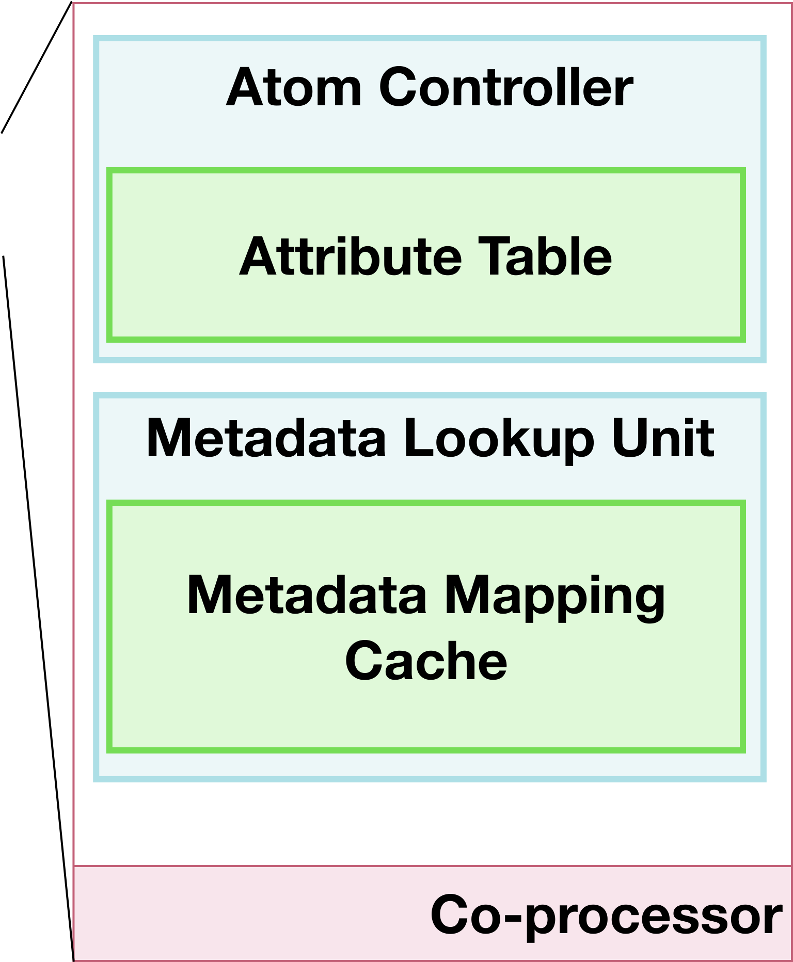
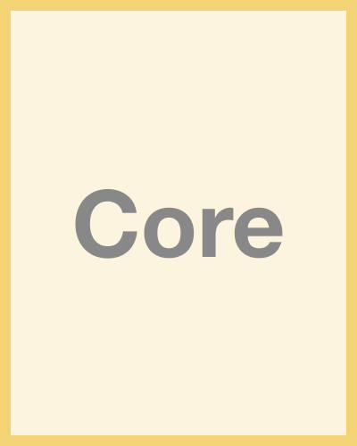
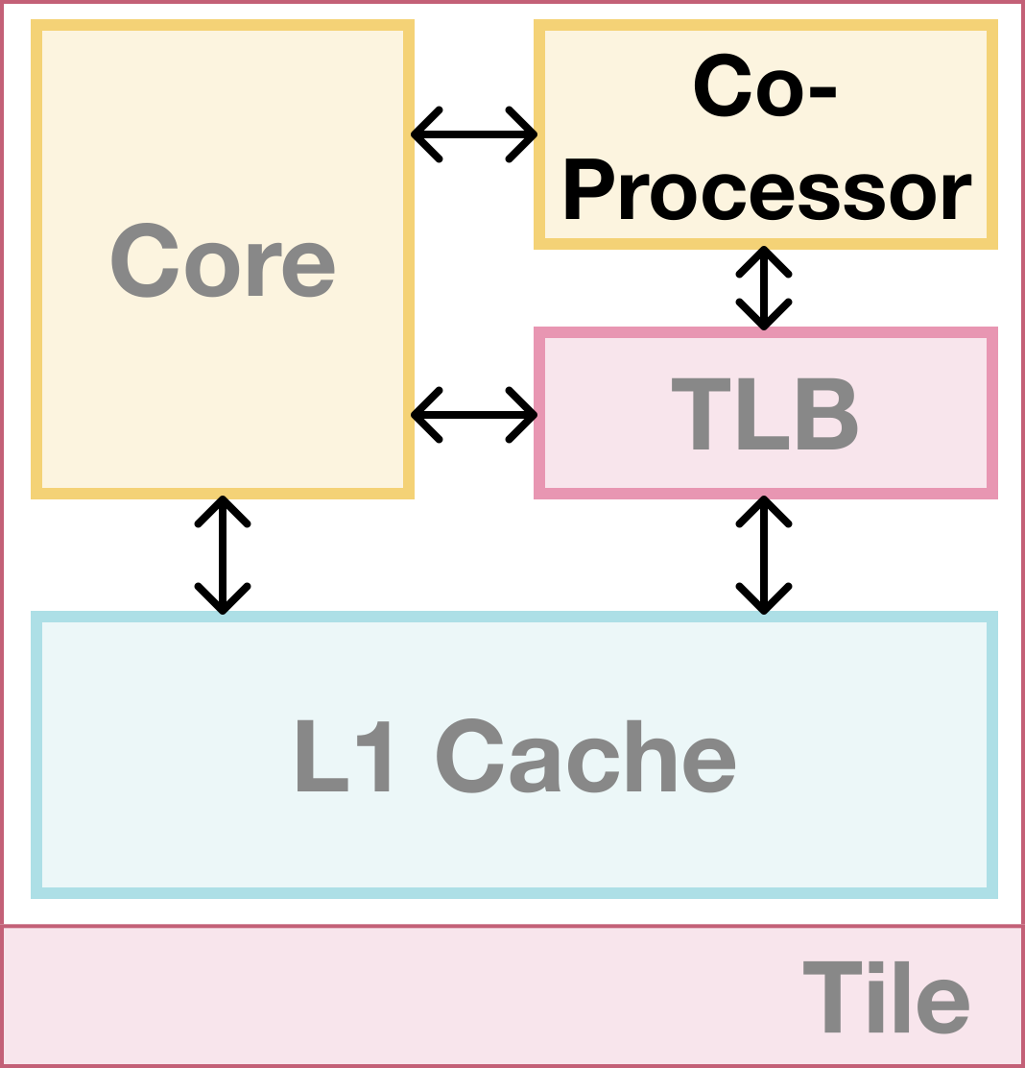
Changes in Rocket Chip
Instructions
User Program
Optimization
Client
Lookup IO
I: Address
O: Attributes
Notes:
[CLICK] We implement both components within the co-processor because it is tightly integrated with the core and can easily fetch instructions from the program
[CLICK] The user program interfaces with the atom controller to modify the attribute table using [CLICK] metasys instructions
[CLICK] and the optimization client communicates with the metadata lookup unit over what we call a Lookup IO which can convey attributes and addresses

Slide 15
Source on Github
https://github.com/CMU-SAFARI/MetaSys
Notes:
We fully open sourced our implementation on Github and you can access it using the link in this slide.

Slide 16
Outline
Background on Expressive Memory
MetaSys
Software Interface
Key Structures
FPGA Implementation
Evaluation

Slide 17
Characterizing Metadata Management
Our goal is twofold:
…
Perform a detailed limit study to quantify the overheads associated with general metadata systems
Quantify the overheads of performing lookups in MetaSys
Notes:
In line with our second goal, we perform a limit study using our FPGA prototype to quantify the overheads of performing lookups
[Pls check the paper for the full set of results and our analyses]

Slide 18
Evaluation Methodology
Run workloads on MetaSys prototype (Zedboard):
Microbenchmarks: Represent a variety of memory access patterns
Polybench: Scientific computation kernels
Ligra: Graph workloads
Notes:
We run a set of workloads on our prototype to test MetaSys under a diverse set of programs with different levels of computation/memory intensity
The table lists the configuration of components that we use in our system, we configure the metadata cache to have 128 entries and the metadata table to contain 256 entries.

Slide 19
Performance Overhead
Metadata lookups occur low performance overheads 2.7% on average
Notes:
X-axis: Workloads
Y-axis: Execution time normalized to baseline without general metadata support (no lookups)
Bars: represent the execution time when we perform a lookup per L1 miss, and per memory access

Slide 20
MMC hit rate
MMC can cover ~81% of all memory requests on average
MMC hit rate correlates with locality of application requests
Notes:
Y-axis: metadata mapping cache hit rate
Bars: similar to previous figure, black is when we lookup L1-misses only and gray is for all memory accesses

Slide 21
Impact of MMC size
Workloads with low temporal and spatial locality
are not sensitive to MMC size
Notes:
Y-axis: Normalized execution time (baseline: no lookups)
Bars: Each bar shows the normalized execution time for an MMC size depicted on the legend

Slide 22
Impact of Tagging Granularity
Performance impact increases with finer granularity
Notes:
Y-axis: Normalized to

Slide 23
Impact of Tagging Granularity on TLB misses
Fine tagging granularities increase TLB misses

Slide 24
Effect of Contention
One Client: All memory requests originating from rocket core
Two Clients: One client + all memory requests originating from the page table walker
Multiple clients do not significantly affect performance
(0.3% overhead on average)

Slide 25
Executive Summary
Problem
Cross-layer techniques are challenging to implement because they require full-stack changes
Existing open-source infrastructures for implementing cross-layer techniques are not designed to provide key features:
Key Idea – Provide:
Rich dynamic HW/SW interfaces
Low-overhead metadata management
Interfaces to key hardware components (e.g., prefetcher)
Our goal is twofold:
Develop an efficient and flexible framework to enable rapid implementation of new cross-layer techniques
Perform a detailed limit study to quantify the overheads associated with general metadata systems
Notes:
HW-SW cooperative, cross-layer techniques can greatly improve performance, QoS and security of general purpose processors.
[CLICK] These techniques are hard to implement because they require changes across the whole stack,
[CLICK] and existing open-source infrastructure for implementing these techniques are not designed to facilitate the implementation of new techniques
[CLICK] MetaSys’s key idea is to provide a rich dynamic cross-layer interface to enable a large variety of cross-layer optimizations, a low-overhead metadata management subsystem to efficiently support cross-layer optimizations,
and standardized interfaces to important hardware components to enable quick integration of cross-layer optimizations
[CLICK] Our goal in MetaSys is two-fold:
First, we want to develop a new efficient and flexible framework enable quick implementation of new cross-layer techniques
Second, using this infrastructure we want to perform a detailed characterization study to quantify the overheads of general metadata systems

Slide 26
MetaSys: A Practical Open-Source Metadata Management System to Implement and Evaluate Cross-Layer Optimizations
Nandita Vijaykumar
Ataberk Olgun, Konstantinos Kanellopoulos, F. Nisa Bostanci
Hasan Hassan, Mehrshad Lotfi, Phillip B. Gibbons, Onur Mutlu

Slide 27
Backup

Slide 28
Backup

Slide 29
Backup

Slide 30
Backup

Slide 31
Backup

Slide 32
Backup

Slide 33
Backup

Slide 34
Backup

Slide 35
Backup

Slide 36
Backup

Slide 37
Backup

Slide 38
Backup

