Slide 1

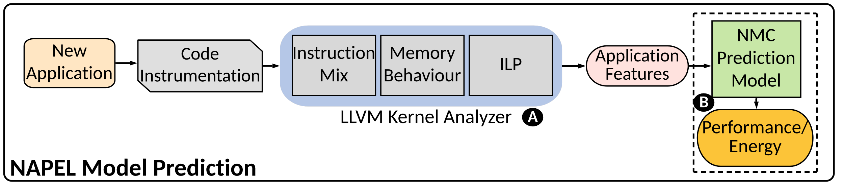
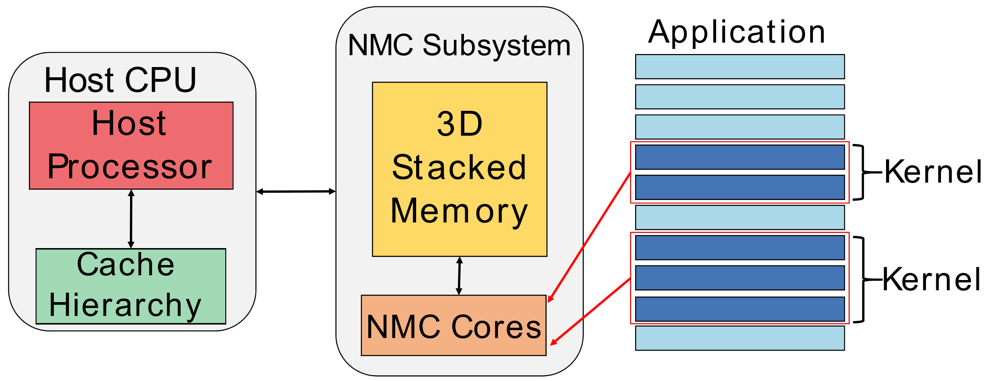
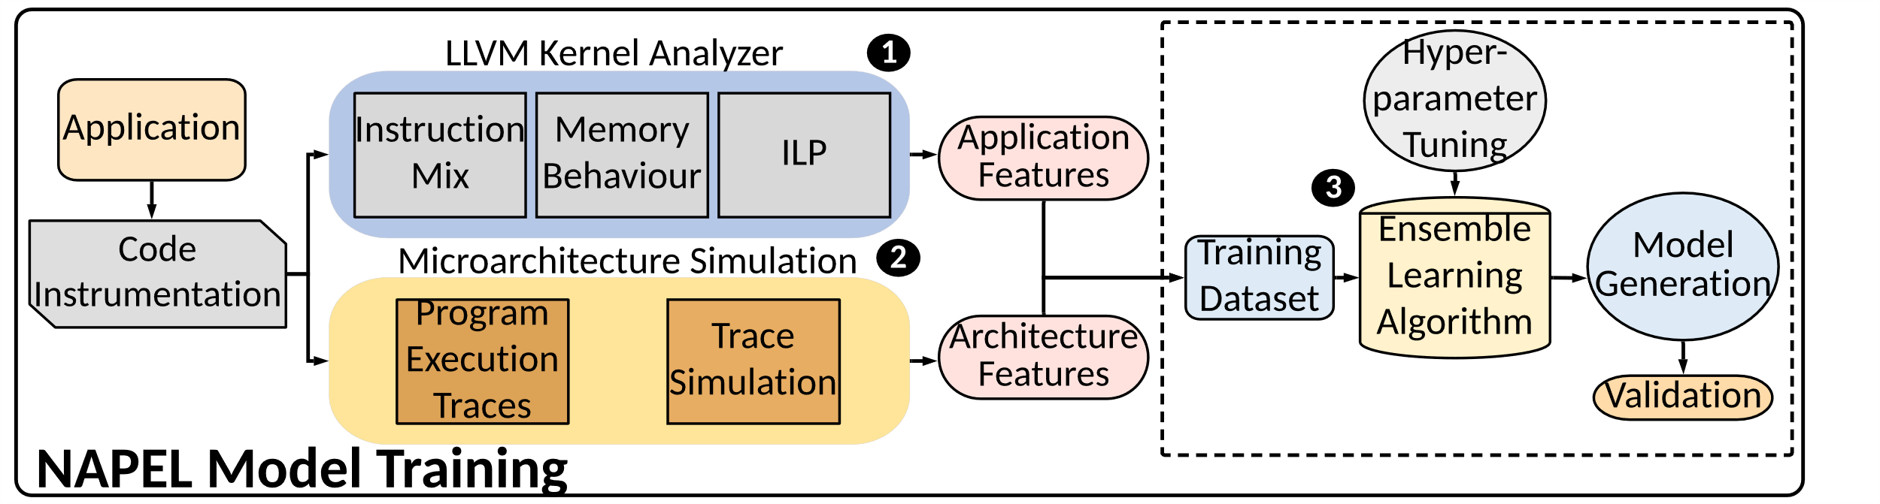
NAPEL: Near-Memory Computing Application Performance Prediction via Ensemble Learning
Gagandeep Singh, Juan Gomez-Luna, Giovanni Mariani, Geraldo F. Oliveira,
Stefano Corda, Sander Stuijk, Onur Mutlu, Henk Corporaal
Funded by the Horizon 2020 Framework Programme of the European Union
MSCA-ITN-EID
Motivation
Exorbitant amount of data
The high cost of energy for data movement
A paradigm shift towards processing close to the data i.e., near-memory computing (NMC)
However in early design-stage, simulation are extremely slow, imposing long run-time
NAPEL: Performance Prediction
via Ensemble Machine Learning
Fast and accurate performance and energy prediction for a previously-unseen application
Microarchitecture-independent characterization with architectural simulation responses to train an ensemble algorithm
Intelligent statistical techniques to extract meaningful data with minimum experimental runs
Phase 1: LLVM Kernel Analysis
Microarchitecture-independent kernel analysis to generate an application profile independent of the NMC architecture
Phase 2: Central Composite Design
Design of experiment techniques ¹ are used to reduce the number of experiments to train NAPEL
Central composite design (CCD) is applied to minimize the uncertainty of a nonlinear polynomial model that accounts for parameter interactions
In CCD, each input parameter can have five levels: min, low, central, high, maximum
Phase 3: Ensemble Machine Learning
We employ random forest (RF) as our ML algorithm, which embeds procedures to screen input features
With hyper-parameters tuning to optimize the accuracy of ML algorithm
NAPEL Prediction
Cross-platform prediction of a completely unseen application by only using micro-architectural independent application features
220x faster, on average, than our NMC simulator (min. 33x, max. 1039x)
NMC Architecture
Evaluation
MRE of 8.5% and 11.6% for performance and energy prediction
NAPEL is 1.7x (1.4x) and 3.2x (3.5x) better in terms of performance (energy) estimation than ANN and decision tree
NMC Suitability Analysis
NAPEL provides an accurate prediction of NMC suitability
MRE between 1.3% to 26.3% (average 14.1) for EDP prediction
Workloads with EDP<1, are not suitable for NMC and can leverage the host cache hierarchy
References
¹D. C. Montgomery, Design and anlysis of experiments, (2017)
²https://github.com/CMU-SAFARI/ramulator-pim/
256 DoE configurations for 12 evaluated applications
1
256
IBM POWER9
Ramulator-PIM²
(a) Performance prediction
Application Feature | Description
Instruction Mix | The fraction of instruction types (integer, floating point, memory, etc.)
ILP | Instruction-level parallelism on an ideal machine
Data/Instruction reuse distance | For a given distance δ, probability of reusing one data element/instruction (in a certain memory location) before accessing δ other unique data elements/instructions (in different memory locations)
Memory traffic | Percentage of memory reads/writes that need to access the main memory, assuming a cache of size equal to the maximum reuse distance
Register traffic | An average number of registers per instruction
Memory footprint | Total memory size used by the application
(b) Energy prediction
Max
y
High
Central
Low
x
Min
Min
Low
Central
High
Max

