Slide 1



NAPEL: Near-Memory Computing Application Performance Prediction via Ensemble Learning
Funded by the Horizon 2020 Framework Programme of the European Union
MSCA-ITN-EID
Gagandeep Singh, Juan Gomez-Luna, Giovanni Mariani, Geraldo F. Oliveira,
Stefano Corda, Sander Stuijk, Onur Mutlu, Henk Corporaal
56th Design Automation Conference (DAC), Las Vegas
4th-June-2019

Slide 2
Executive Summary
Motivation: A promising paradigm to alleviate data movement bottleneck is near-memory computing (NMC), which consists of placing compute units close to the memory subsystem
Problem: Simulation times are extremely slow, imposing long run-time especially in the early-stage design space exploration
Goal: A quick high-level performance and energy estimation framework for NMC architectures
Our contribution: NAPEL
  Fast and accurate performance and energy prediction for previously-unseen applications using ensemble learning
  Use intelligent statistical techniques and micro-architecture-independent application features to minimize experimental runs
Evaluation
  NAPEL is, on average, 220x faster than state-of-the-art NMC simulator
  Error rates (average) of 8.5% and 11.5% for performance and energy estimation
We open source Ramulator-PIM: https://github.com/CMU-SAFARI/ramulator-pim/

Slide 3





SKA
300PB
uploads on
180PB
searches on
98PB
15PB
15PB
3PB
Michael Wise, ASTRON, ”Science data Centre challenges”, DOME Symposium, 18 May, 2017

Slide 4
SKA
300PB
uploads on
180PB
searches on
98PB
Massive amounts of data
15PB
15PB
3PB
Michael Wise, ASTRON, ”Science data Centre challenges”, DOME Symposium, 18 May, 2017

Slide 5
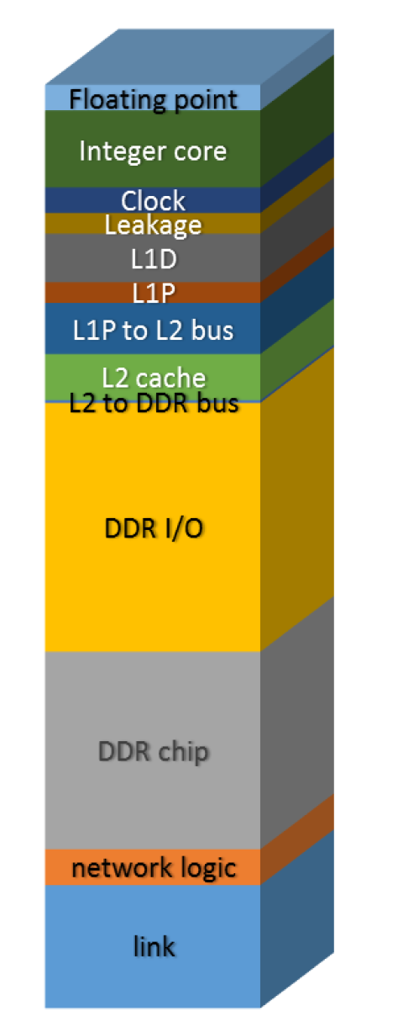
Compute Centric Approach
Processor
Integer core
Data Access
Memory hierarchies take advantage of locality
  Spatial locality
  Temporal locality
Not suitable for all workloads
  Graph processing
  Neural networks
Data access consumes a major part
  Applications are increasingly data hungry
Data movement energy dominates compute
  Especially true for off-chip movement
Data Movement
DDR I/O
DDR chip
link
System-level power break down*
* R. Nair et al., “Active memory cube: A processing-in memory architecture for exascale systems”, IBM J. Research Develop., vol. 59, no. 2/3, 2015

Slide 6
Compute Centric Approach
Processor
Integer core
Data Access
Memory hierarchies take advantage of locality
  Spatial locality
  Temporal locality
Not suitable for all workloads
  Graph processing
  Neural networks
Data access consumes a major part
  Applications are increasingly data hungry
Data movement energy dominates compute
  Especially true for off-chip movement
Data Movement
Data movement bottleneck
DDR I/O
DDR chip
link
System-level power break down*
* R. Nair et al., “Active memory cube: A processing-in memory architecture for exascale systems”, IBM J. Research Develop., vol. 59, no. 2/3, 2015

Slide 7
Paradigm Shift - NMC
Compute-centric to a data-centric approach
Biggest enabler – stacking technology

Slide 8
NMC Simulators
Simulation for:
  Design space exploration (DSE)
  Workload suitability analysis
NMC Simulators:
  Sinuca, 2015
  HMC-SIM, 2016
  CasHMC, 2016
  Smart Memory Cube (SMC), 2016
  CLAPPS, 2017
  Gem5+HMC, 2017
  Ramulator-PIM¹, 2019
¹Ramulator-PIM: https://github.com/CMU-SAFARI/ramulator-pim/

Slide 9
NMC Simulators
Simulation for:
  Design space exploration (DSE)
  Workload suitability analysis
NMC Simulators:
  Sinuca, 2015
  HMC-SIM, 2016
  CasHMC, 2016
  Smart Memory Cube (SMC), 2016
  CLAPPS, 2017
  Gem5+HMC, 2017
  Ramulator-PIM¹, 2019
Simulation of real workloads can be 10000x slower than native-execution!!!
¹Ramulator-PIM: https://github.com/CMU-SAFARI/ramulator-pim/

Slide 10
NMC Simulators
Simulation for:
  Design space exploration (DSE)
  Workload suitability analysis
NMC Simulators:
  Sinuca, 2015
  HMC-SIM, 2016
  CasHMC, 2016
  Smart Memory Cube (SMC), 2016
  CLAPPS, 2017
  Gem5+HMC, 2017
  Ramulator-PIM¹, 2019
Idea: Leverage ML with statistical techniques for quick NMC performance/energy prediction
¹Ramulator-PIM: https://github.com/CMU-SAFARI/ramulator-pim/

Slide 11
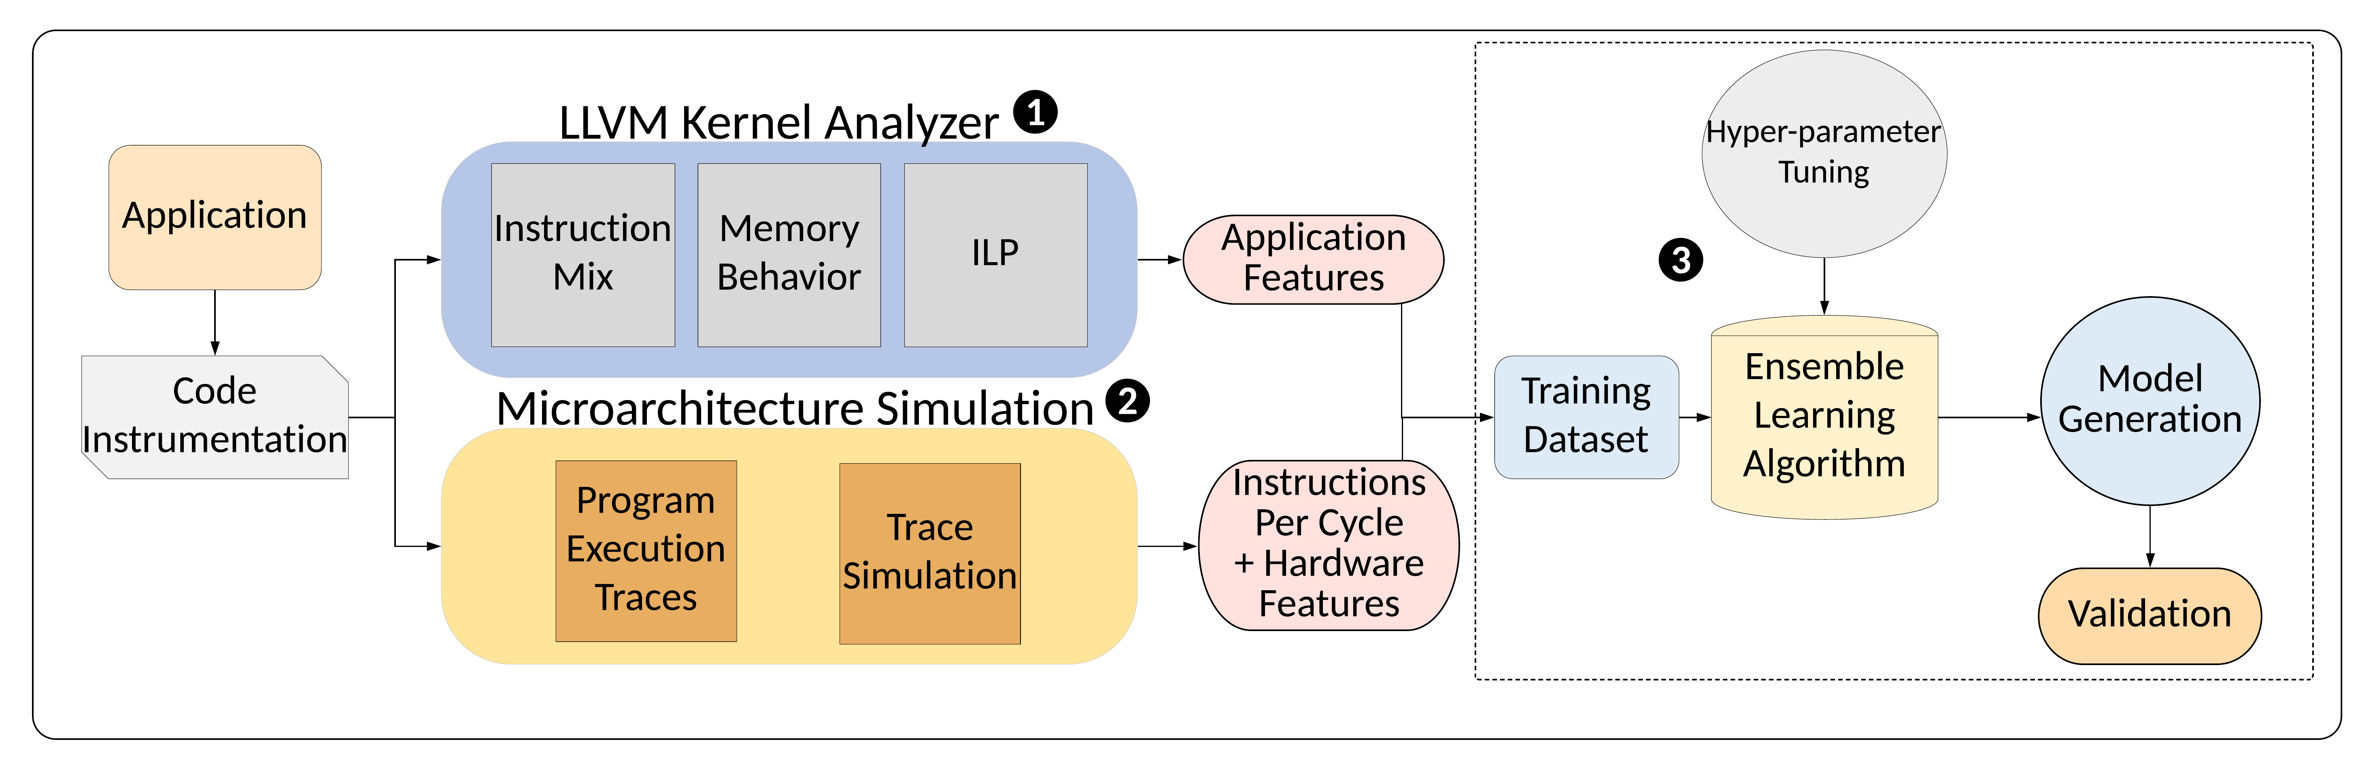
NAPEL: Near-Memory Computing Application Performance Prediction via Ensemble Learning
NAPEL Model Training

Slide 12
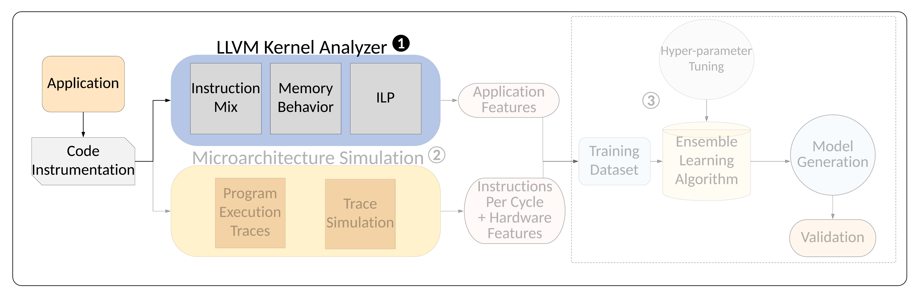
Phase 1: LLVM Analyzer

Slide 13
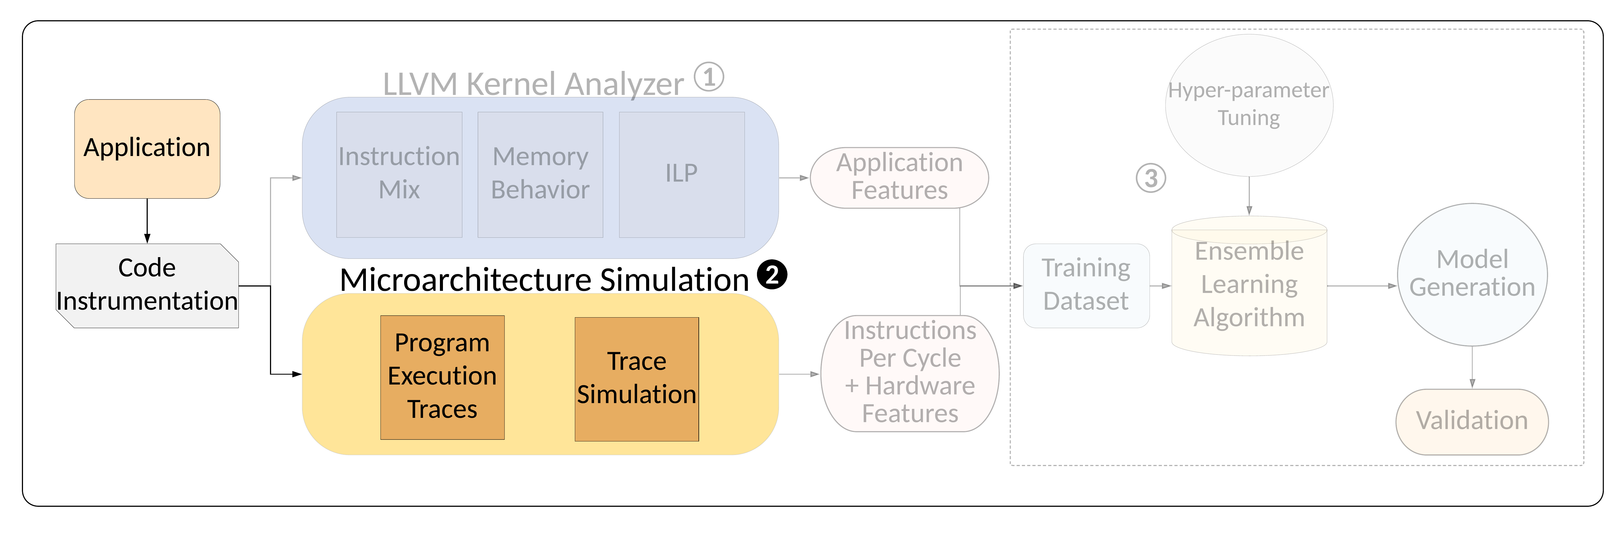
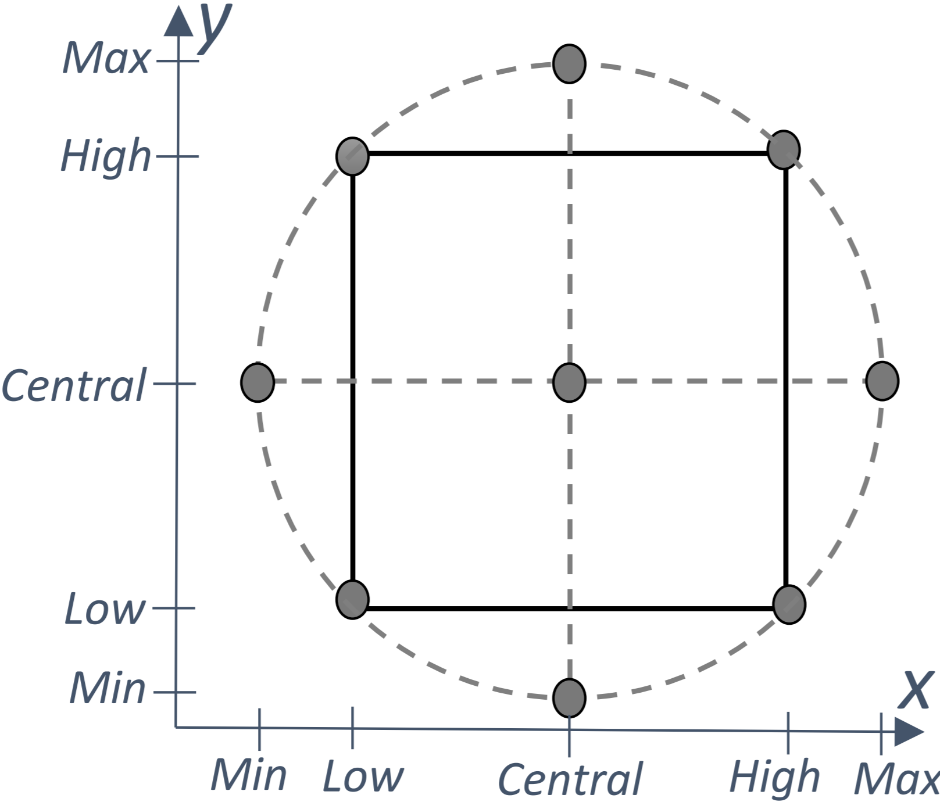
Phase 2: Microarchitecture Simulation
Central composite design of experiments technique to minimize the number of experiments while data collection

Slide 14
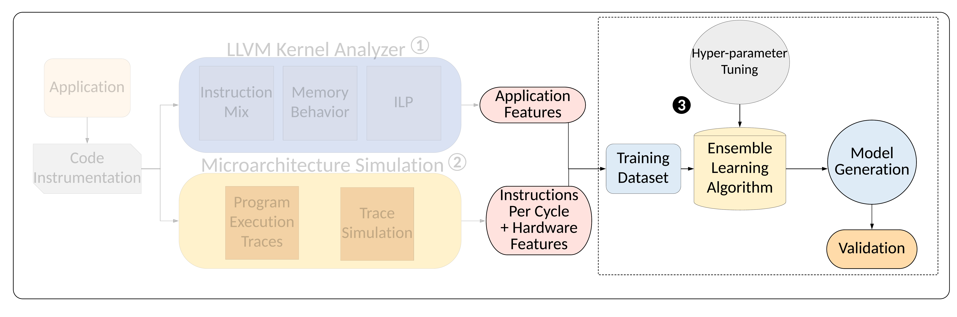
Phase 3: Ensemble ML Training
Application Features
Instruction Mix
ILP
Reuse distance
Memory traffic
Register traffic
Memory footprint
Architecture Features
Core type
#PEs
Core frequency
Cache line size
DRAM layers
Cache access fraction
DRAM access fraction

Slide 15
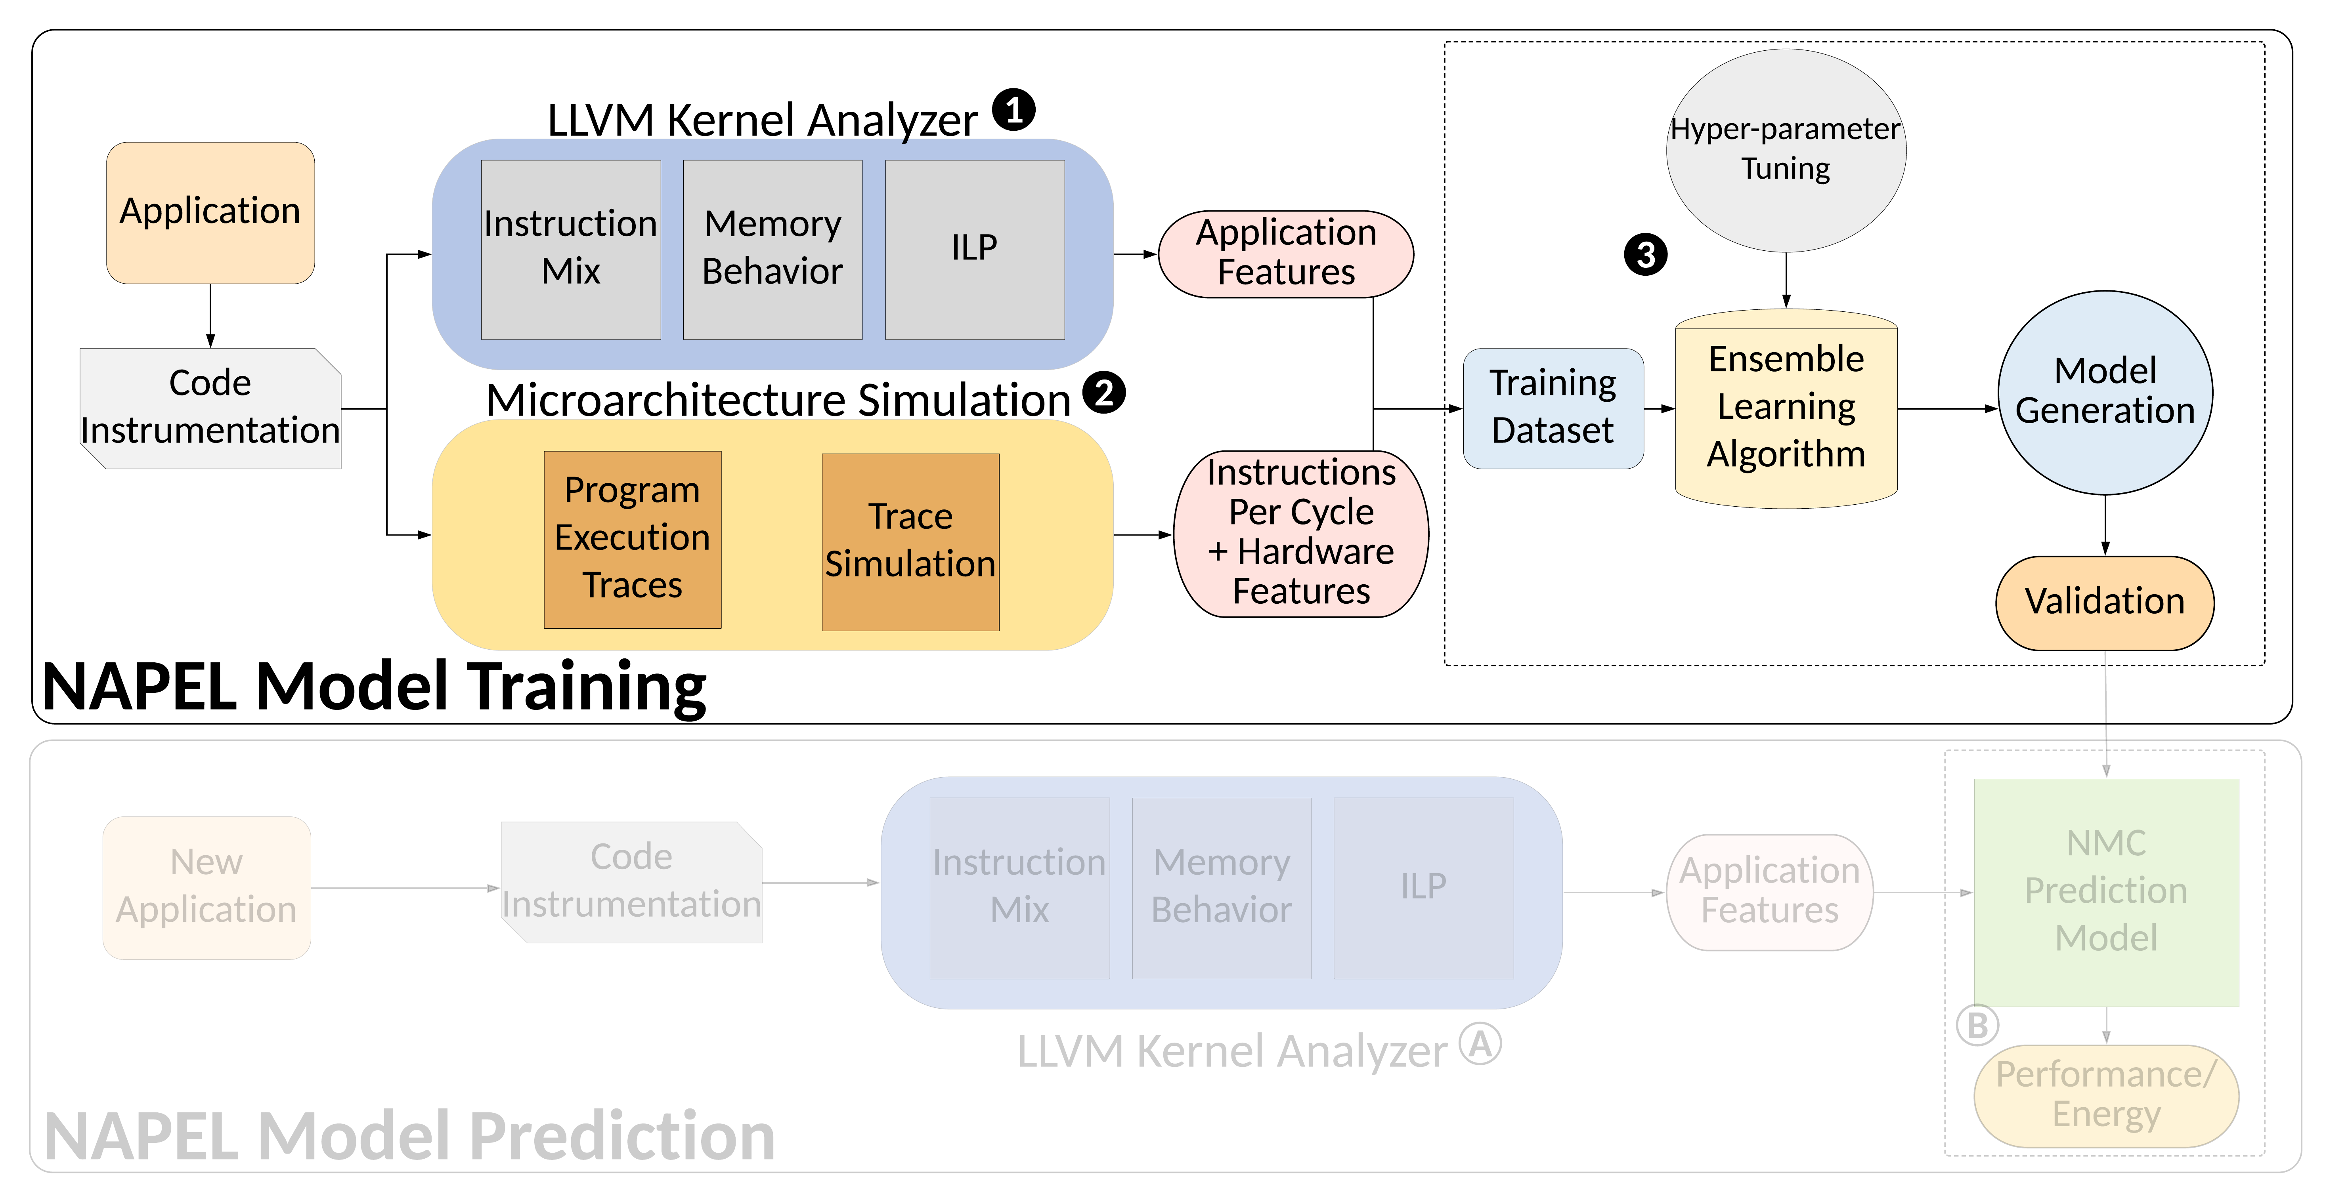
NAPEL Framework

Slide 16
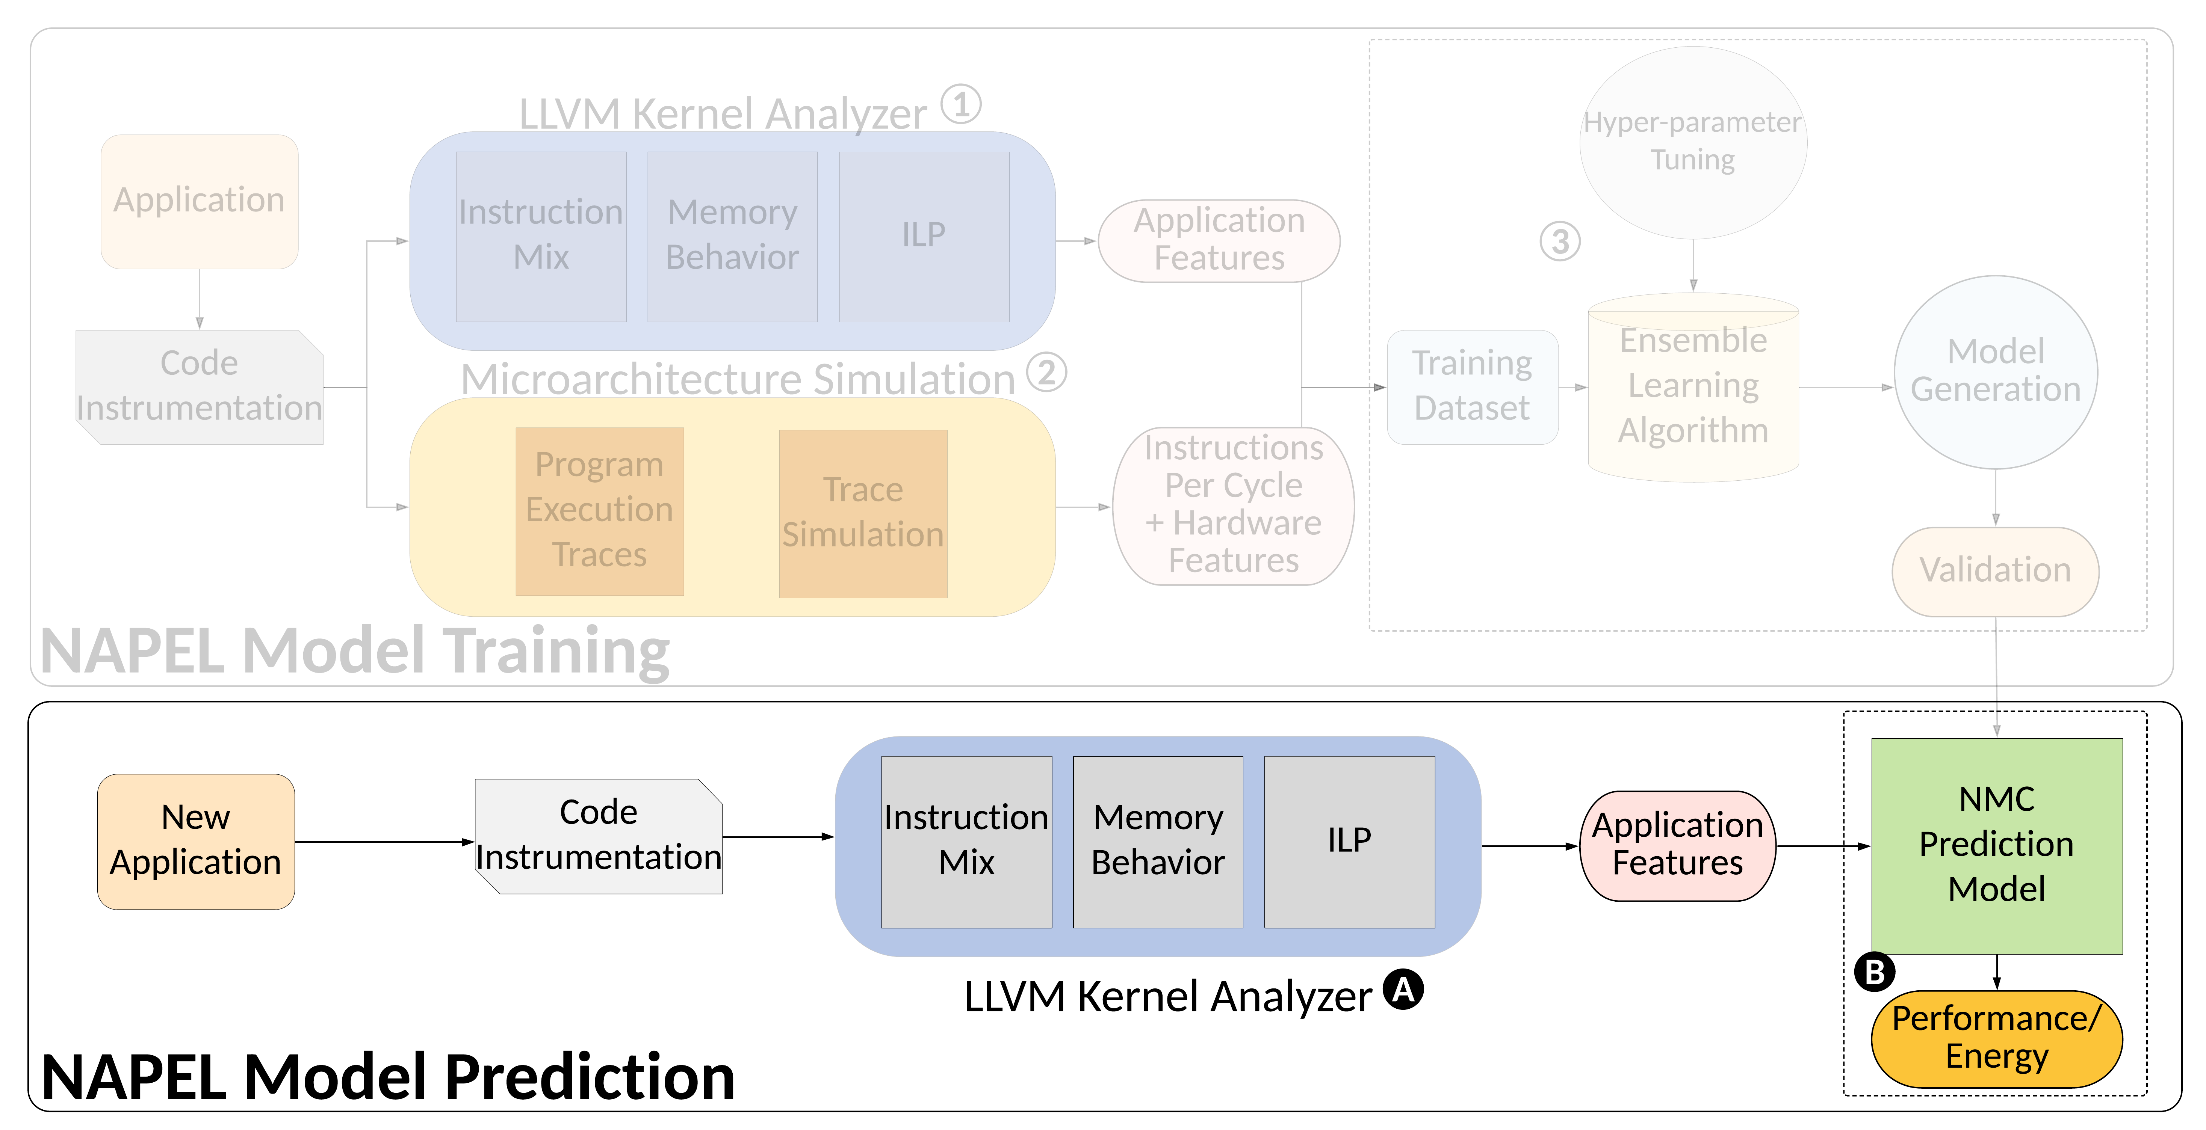
NAPEL Prediction

Slide 17
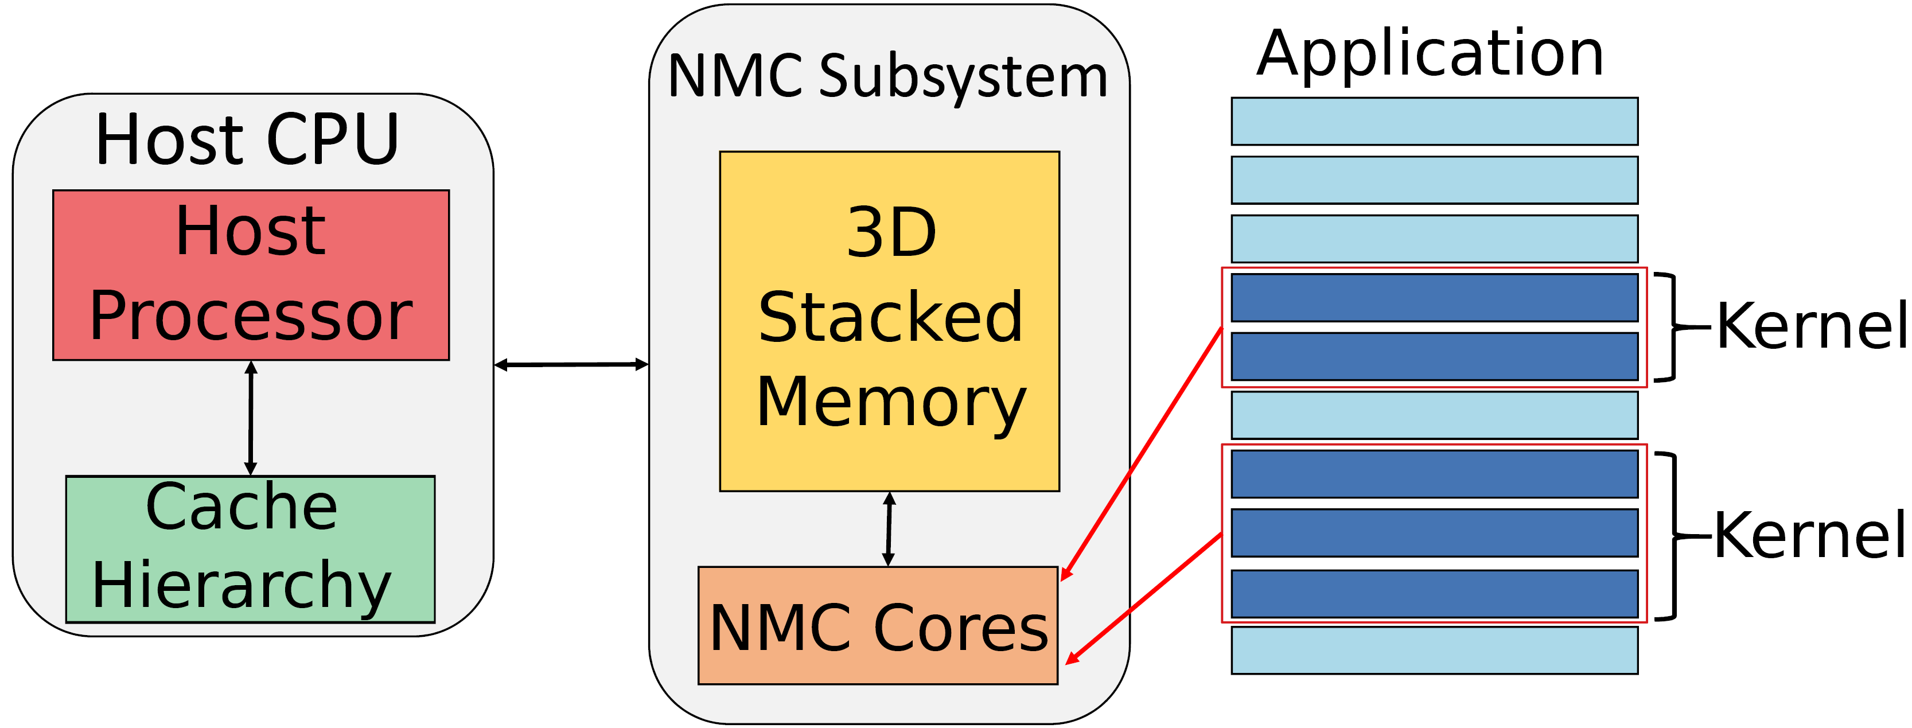
Experimental Setup
Host System
  IBM POWER9
  Power: AMESTER
NMC Subsystem
  Ramulator-PIM¹
Workloads
  PolyBench and Rodinia
  Heterogeneous workloads such as image processing, machine learning, graph processing etc.
Accuracy in terms of mean relative error (MRE)
¹https://github.com/CMU-SAFARI/ramulator-pim/

Slide 18
NAPEL Accuracy: Performance and
Energy Estimates
(a) Performance prediction
(b) Energy prediction

Slide 19
NAPEL Accuracy: Performance and
Energy Estimates
(a) Performance prediction
MRE of 8.5% and 11.6% for performance and energy
(b) Energy prediction

Slide 20
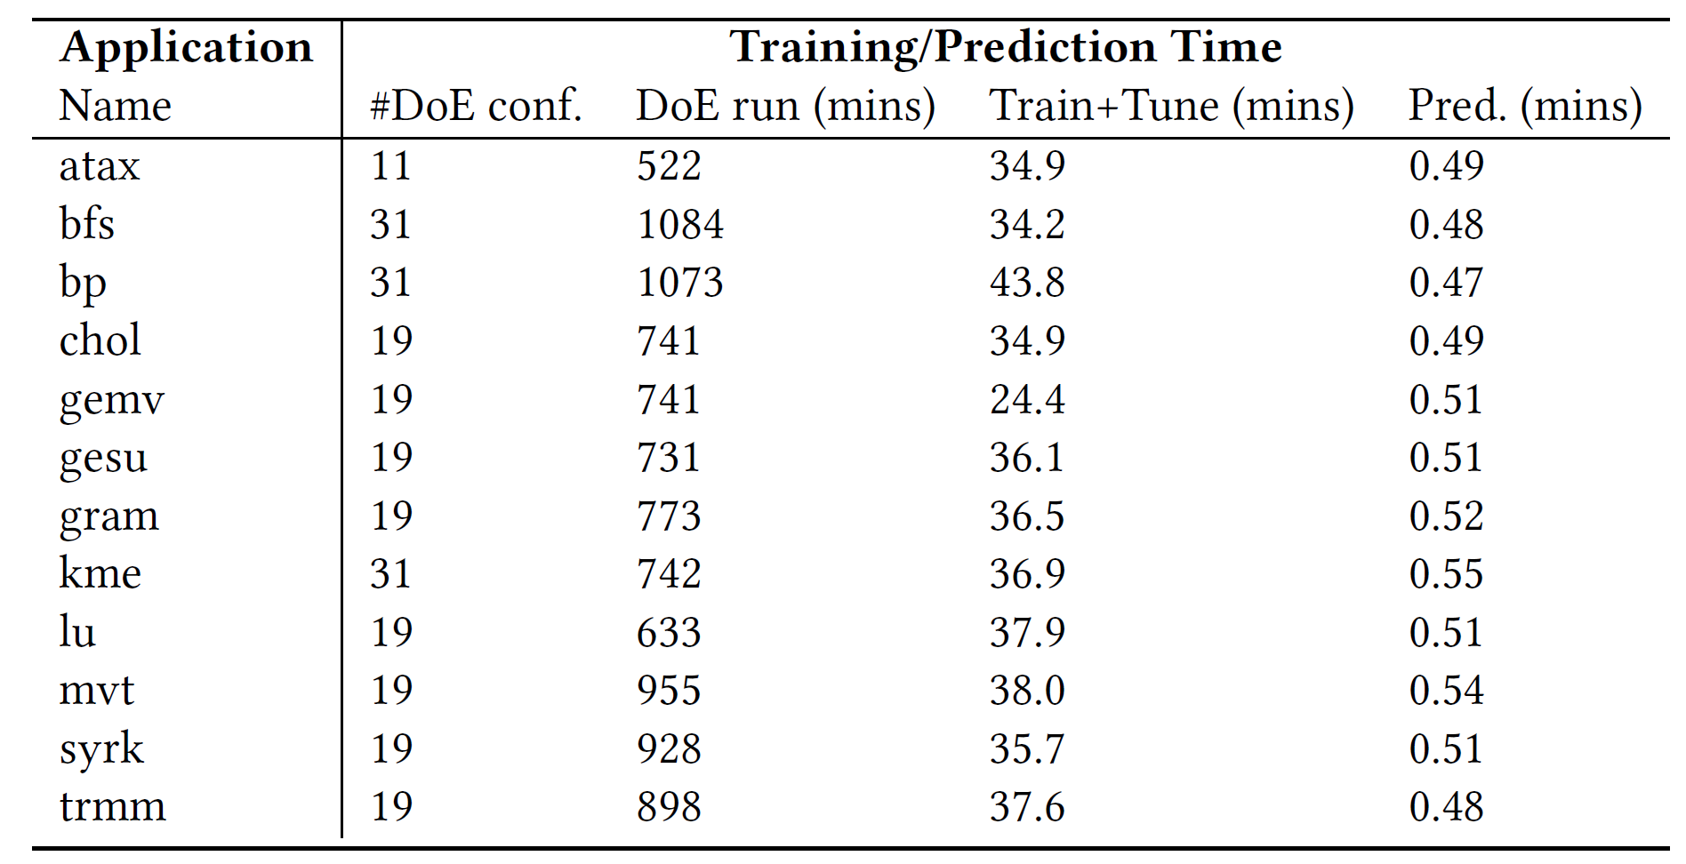
Speed of Evaluation
256 DoE configurations for 12 evaluated applications
1
256

Slide 21
Speed of Evaluation
256 DoE configurations for 12 evaluated applications
220x (up to 1039x) faster than NMC simulator
1
256

Slide 22
Use Case: NMC Suitability Analysis
Assess the potential of offloading a workload to NMC
NAPEL provides accurate prediction of NMC suitability
MRE between 1.3% to 26.3% (average 14.1%)

Slide 23
Conclusion and Summary
Motivation: A promising paradigm to alleviate data movement bottleneck is near-memory computing (NMC), which consists of placing compute units close to the memory subsystem
Problem: Simulation times are extremely slow, imposing long run-time especially in the early-stage design space exploration
Goal: A quick high-level performance and energy estimation framework for NMC architectures
Our contribution: NAPEL
  Fast and accurate performance and energy prediction for previously-unseen applications using ensemble learning
  Use intelligent statistical techniques and micro-architecture-independent application features to minimize experimental runs
Evaluation
  NAPEL is, on average, 220x faster than state-of-the-art NMC simulator
  Error rates (average) of 8.5% and 11.5% for performance and energy estimation
We open source Ramulator-PIM: https://github.com/CMU-SAFARI/ramulator-pim/

Slide 24
NAPEL: Near-Memory Computing Application Performance Prediction via Ensemble Learning
Funded by the Horizon 2020 Framework Programme of the European Union
MSCA-ITN-EID
Gagandeep Singh, Juan Gomez-Luna, Giovanni Mariani, Geraldo F. Oliveira,
Stefano Corda, Sander Stuijk, Onur Mutlu, Henk Corporaal
56th Design Automation Conference (DAC), Las Vegas
4th-June-2019

