Slide 1
``
NERO: A Near High-Bandwidth Memory Stencil Accelerator
for Weather Prediction Modeling
Gagandeep Singh, Dionysios Diamantopoulos, Christoph Hagleitner,
Juan Gómez-Luna, Sander Stuijk, Onur Mutlu, and Henk Corporaal
30th FPL, Sweden
31th August 2020
Notes:
Hi, I will be presenting NERO: A Near High-Bandwidth Memory Stencil Accelerator for Weather Prediction Modeling

Slide 2
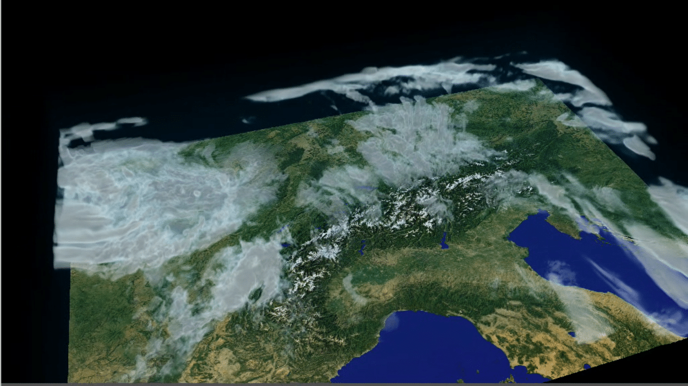
Stencil Computation in Weather Modeling
COSMO (Consortium for Small-Scale Modeling)
Around 80 complex stencils
Horizontal diffusion Vertical advection
Image Source: NVIDIA/MeteoSwiss: An example of COSMO simulation with cloud patterns over Switzerland and surrounding areas
2
Notes:
[CLICK] COSMO is a weather prediction model currently being used by a dozen nations including Switzerland, Germany, Italy etc.
[CLICK] It has around 80 different stencils.
Unlike the stencils found in literature weather model consists of complex stencils with varying amount of access patterns
Horizontal diffusion” and “vertical advection” are two complex stencils that are representative of the data access patterns and algorithmic complexity of the entire COSMO model.

Slide 3
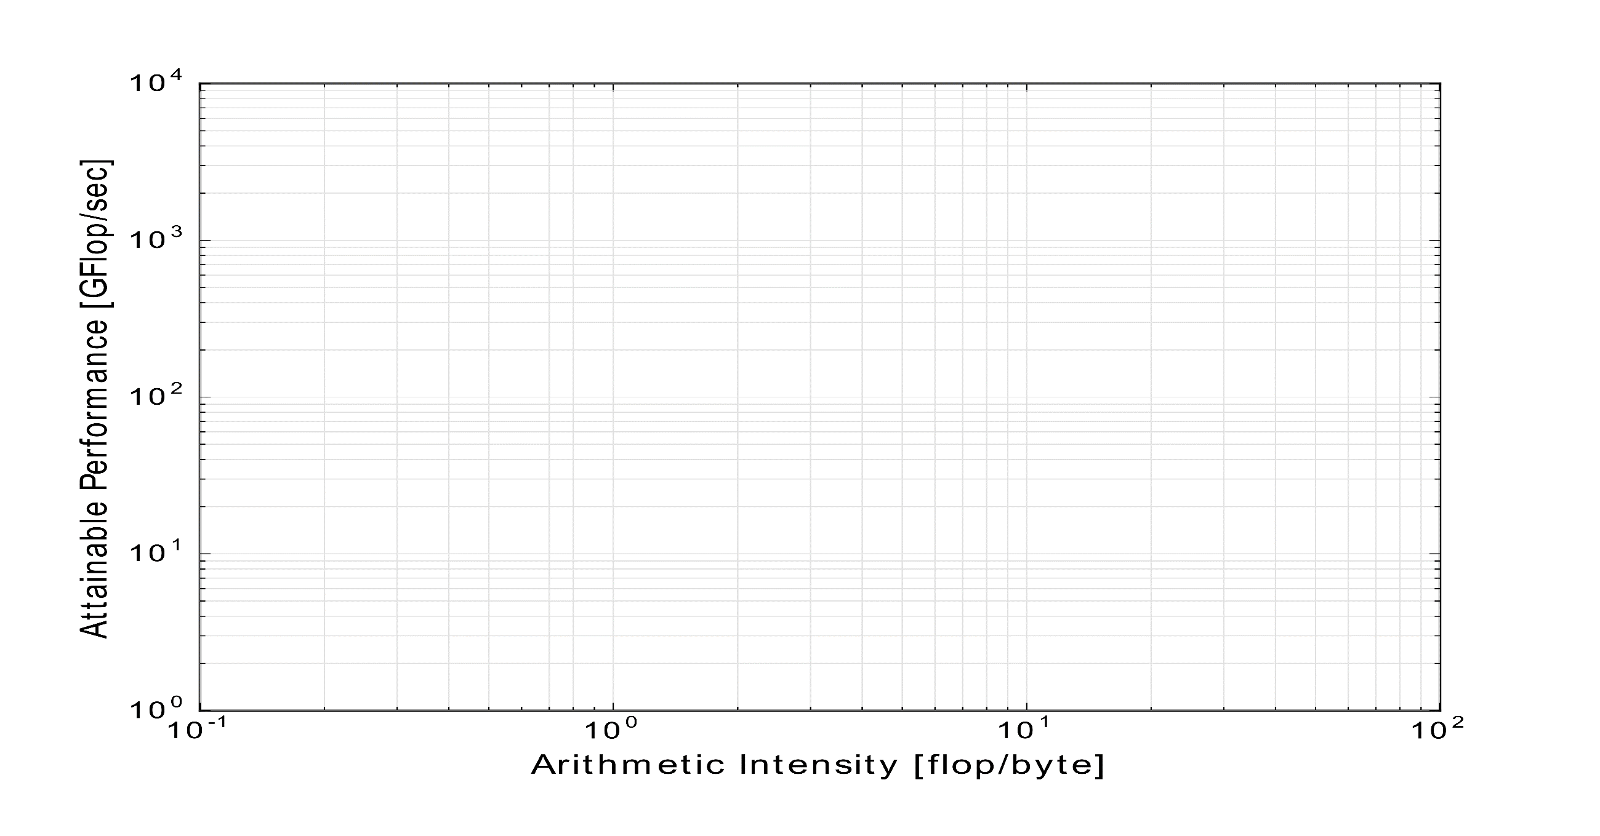
Motivation and Goal
Memory bound with limited performance and high energy consumption on IBM POWER9 CPU
$${10}^{4}$$
$${10}^{3}$$
POWER9 socket (486.4 Gflops/socket)
3.3 TBps L3-cache
Performance [Gflops]
$${10}^{2}$$
110 GBps DRAM
58.5 Gflops
(64 threads)
29.1 Gflops
(64 threads)
Vertical Advection
Horizontal Diffusion
$${10}^{1}$$
$${10}^{0}$$
$${10}^{−1}$$
$${10}^{0}$$
$${10}^{1}$$
$${10}^{2}$$
Arithmetic Intensity [flop/byte]
Goal:
Mitigate the performance bottleneck of weather prediction kernels in an energy-efficient way
Evaluate the use of near-memory acceleration using a FPGA+HBM connected through IBM CAPI2 (Coherent Accelerator Processor Interface)
Notes:
The figure shows a roofline plot for a state of the art IBM power9 system
[CLICK] after optimizing these two compound weather kernels using many software based techniques these kernels are still memory bound as shown in the figure and achieve a performance that is one order of magnitude smaller than the peak CPU performance. This lead to limited performance and high energy consumption
Considering the challenges weather kernels face on the conventional architectures, our goal is to mitigate the performance bottleneck of these kernels in an energy-efficient way
And evaluate the use of near memory acceleration using FPGA+HBM connected through IBM CAPI2 interface

Slide 4
NERO: A Near High-Bandwidth Memory Stencil Accelerator for Weather Prediction Modeling
First near-HBM FPGA-based accelerator for representative kernels from a real-world weather prediction application
Data-centric caching with precision-optimized tiling for a heterogeneous memory hierarchy
In-depth scalability analysis for both DDR4 and HBM-based FPGA
Notes:
To this end we present NERO
Nero First near-HBM FPGA-based accelerator for representative kernels from a real-world weather prediction application
[CLICK] We optimize NERO with a data-centric caching scheme with precision-optimized tiling for a heterogeneous memory hierarchy consisting of URAM, BRAM, HBM
[CLICK] Our contribution also includes in depth scalability analysis for both DDR4 and HBM-based FPGA boards

Slide 5
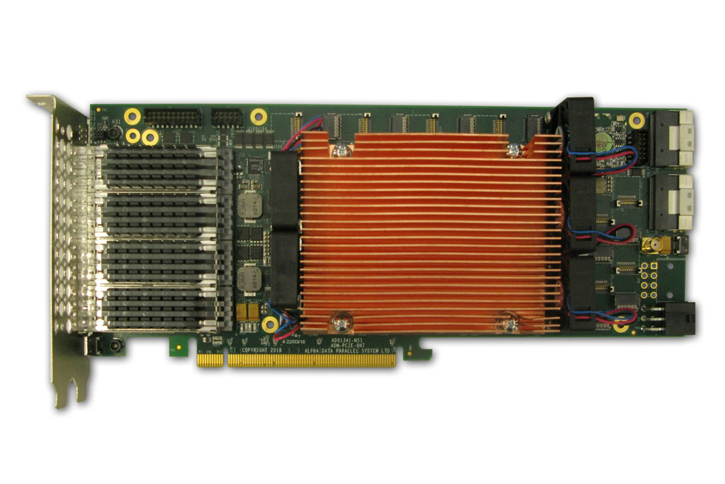
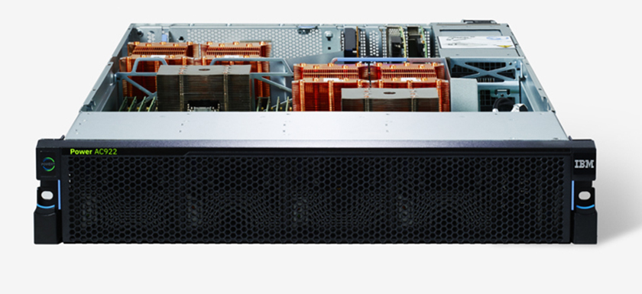
Heterogeneous System: CPU+FPGA
CAPI2
Source: AlphaData
Source: IBM
POWER9 AC922
HBM-based AD9H7 board
We evaluate two POWER9+FPGA systems:
1. HBM-based AD9H7 board
Xilinx Virtex Ultrascale+™ XCVU37P-2
Notes:
We evaluate two heterogeneous systems [CLICK] first with HBM-based alphadata 9h7

Slide 6
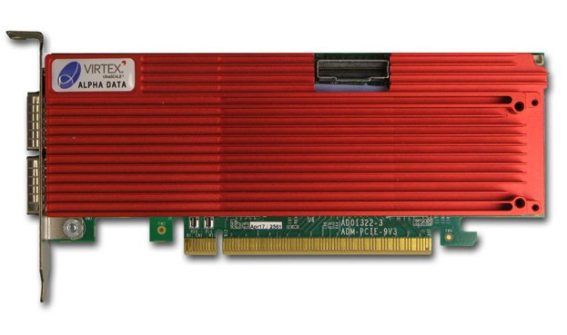
Heterogeneous System: CPU+FPGA
CAPI2
Source: AlphaData
Source: IBM
POWER9 AC922
DDR4-based AD9V3 board
We evaluate two POWER9+FPGA systems:
1. HBM-based AD9H7 board
Xilinx Virtex Ultrascale+™ XCVU37P-2
2. DDR4-based AD9V3 board
Xilinx Virtex Ultrascale+™ XCVU3P-2
Notes:
the second is DDR4 based alphadata 9v3 board

Slide 7
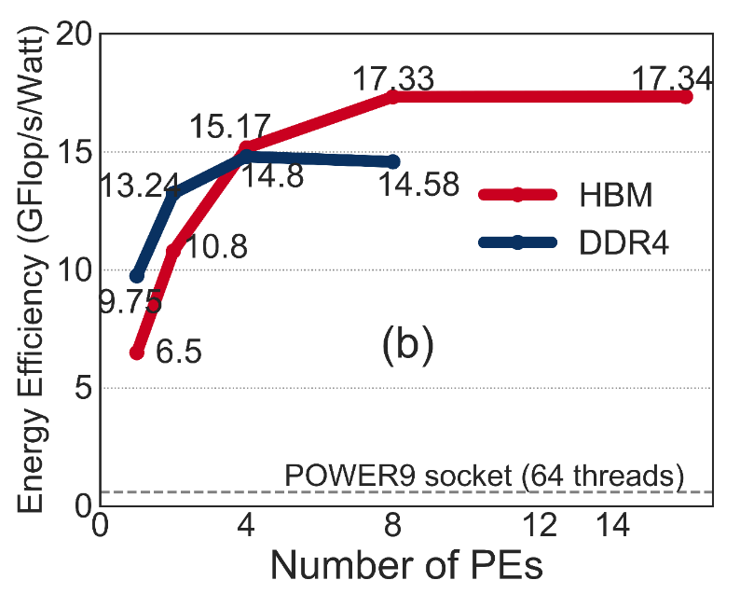
Results
NERO outperforms a 16-core IBM POWER9 system by 4.2x and 8.3x when running two compound stencils
NERO reduces energy consumption by 22x and 29x
NERO provides energy efficiency of 1.5 GFLOPS/Watt and 17.3 GFLOPS/Watt
Hardware acceleration on an FPGA+HBM is a promising solution for weather modeling
Notes:
In our evaluation we show that [CLICK] NERO outperforms a 16-core IBM POWER9 system by 4.2 times and 8.3 times for two compound weather kernels
Further, NERO reduces energy consumption by 22 times and 29times with an energy efficiency of 1.5 GFLOPS/Watt and 17.3 GFLOPS/Watt
We conclude that hardware acceleration on an FPGA+HBM fabric is a promising solution for weather prediction applications. We hope that our insights and observations would inspire developers of different high-performance computing applications that suffer from similar the memory bottleneck.

Slide 8
NERO: A Near High-Bandwidth Memory Stencil Accelerator
for Weather Prediction Modeling
Gagandeep Singh, Dionysios Diamantopoulos, Christoph Hagleitner,
Juan Gómez-Luna, Sander Stuijk, Onur Mutlu, and Henk Corporaal
30th FPL, Sweden
31th August 2020
Notes:
Thank you for listening to my talk.
For more details I invited you to read our FPL 2020 paper.

