Slide 1
NERO: A Near High-Bandwidth Memory Stencil Accelerator
for Weather Prediction Modeling
Gagandeep Singh, Dionysios Diamantopoulos, Christoph Hagleitner,
Juan Gómez-Luna, Sander Stuijk, Onur Mutlu, and Henk Corporaal
30th FPL, Sweden
31th August 2020
Notes:
Hi my name is Gagandeep Singh and I will be presenting NERO: A Near High-Bandwidth Memory Stencil Accelerator for Weather Prediction Modeling

Slide 2
Executive Summary
Motivation: Stencil computation is an essential part of weather prediction applications
Problem: Memory bound with limited performance and high energy consumption on multi-core architectures
Goal: Mitigate the performance bottleneck of compound weather prediction kernels in an energy-efficient way
Our contribution: NERO
First near High-Bandwidth Memory (HBM) FPGA-based accelerator for representative kernels from a real-world weather prediction application
Detailed roofline analysis to show weather prediction kernels are constrained by DRAM bandwidth on a state-of-the-art CPU system
Data-centric caching with precision-optimized tiling for a heterogeneous memory hierarchy
Scalability analysis for both DDR4 and HBM-based FPGA boards
Evaluation
NERO outperforms a 16-core IBM POWER9 system by 4.2x and 8.3x when running two compound stencil kernels
NERO reduces energy consumption by 22x and 29x with an energy efficiency of 1.5 GFLOPS/Watt and 17.3 GFLOPS/Watt
Notes:
To begin I will give a high level summary of the talk
[CLICK] The motivation of this talk is that Stencil computation is an essential part of weather prediction applications
[CLICK] Unfortunately these kernels are memory bound with limited performance and high energy consumption on traditional multi-core architectures
[CLICK] Our goal is to mitigate the performance bottleneck of complex compound stencils found in real world weather prediction applications in an energy-efficient way
[CLICK] To this end we present NERO: [CLICK] First near-High bandwidth memory FPGA-based accelerator for rep-ri-zen-tuh-tiv kernels from a real-world weather prediction application
[CLICK] We perform detailed roofline analysis to show weather prediction kernels are constrained by DRAM bandwidth on a state-of-the-art CPU system
[CLICK] We optimize NERO with a data-centric caching scheme with precision-optimized tiling for a heterogeneous memory hierarchy consisting of URAM, BRAM, HBM
[CLICK] Also we perform in depth scalability analysis for both DDR4 and HBM-based FPGA boards
[CLICK] In our evaluation we show that [CLICK] NERO outperforms a 16-core IBM POWER9 system by 4.2 times and 8.3 times for two rep-ri-zen-tuh-tiv kernels from a real-world weather prediction application
[CLICK] Further, NERO reduces energy consumption by 22 times and 29times with an energy efficiency of 1.5 GFLOPS/Watt and 17.3 GFLOPS/Watt

Slide 3
Outline
Background
CPU Roofline Analysis
FPGA-based Platform
NERO:
Near-HBM Accelerator for Weather Prediction Modeling
•
Precision-optimized Tiling
Setup
•
Evaluation
Results
Setup
Performance Analysis
Setup
Energy Efficiency Analysis
Setup
Summary
Setup
Notes:
Here is the outline for our talk today.
First we will discuss the background on stencils

Slide 4
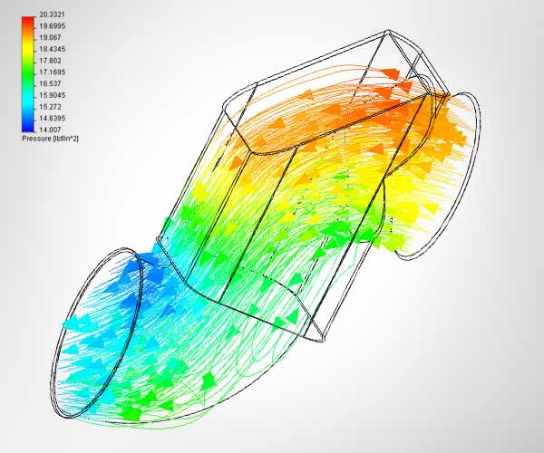
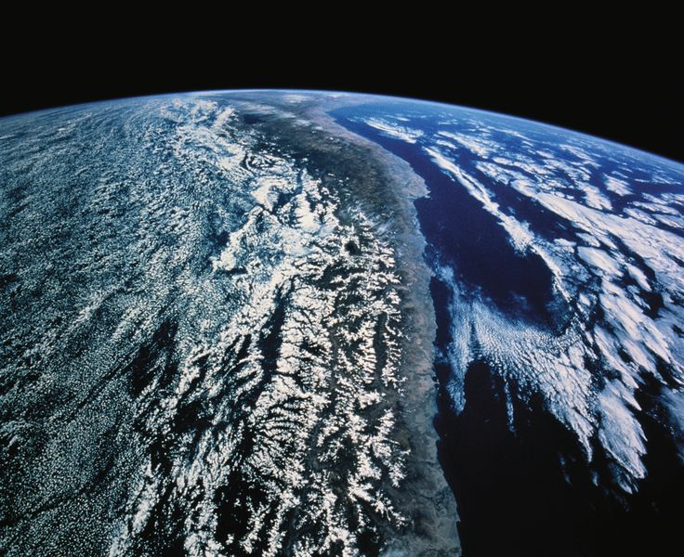
Stencil Computations and Applications
Stencil computations update values in a grid using a fixed pattern of grid points
Stencils are used in ~30% of high-performance computing applications
x
-,+,*
-,+,*
y
e.g., 7-point Jacobi
in 3D plane
Image sources: http://www.flometrics.com/fluid-dynamics/computational-fluid-dynamics
Naoe, Kensuke et al. "Secure Key Generation for Static Visual Watermarking by Machine Learning in Intelligent Systems and Services" IJSSOE, 2010
Notes:
[CLICK] Stencil computations update values in a multidimensional grid using a fixed pattern of grid points
To demonstrate, we show a basic elementary 7-point 3D Jacobi stencil, which is frequently used as a benchmark for stencil study.
This kernel accesses 7 elements to perform six additions and two multiplications at the same time.
[CLICK] Stencils are widely used! Around 30% of high performance computing applications make use of different stencils
[CLICK] including fluid dynamics, [CLICK] image processing, [CLICK] atmospheric modeling, etc.

Slide 5
Stencil Characteristics
High-order stencil computations are cache unfriendly
Limited arithmetic intensity
Sparse and complex access pattern
z
x
-,+,*
-,+,*
y
Read Array
Write Array
e.g., 7-point Jacobi in 3D plane
Mapping of 7-point Jacobi from 3D plane onto 1D plane
Image source: Xu, Jingheng et al. “Performance Tuning and Analysis for Stencil-Based Applications on POWER8 Processor” ACM TACO, 2018
Notes:
[CLICK] stencil computations that operate on multidimensional grid are cache unfriendly
[CLICK] They have limited arithmetic intensity as there is reuse only in neighboring pixels
[CLICK] Moreover, stencils have sparse and complex memory access pattern
On the left we show the stencil pattern of Jacobi 3d stencil and on the right is the mapping from 3D plane onto 1D plane
To update each grid point, seven input variables as well as one output variable needs to be accessed
From Figure, it is not hard to predicate that without careful design, cache misses caused by the remote access of the array elements would stall the program to a great extent.
This complicates efficient mapping on traditional platforms.

Slide 6
Stencil Characteristics
High-order stencil computations are cache unfriendly
Limited arithmetic intensity
Sparse and complex access pattern
Performance bottleneck
z
x
-,+,*
-,+,*
y
Read Array
Write Array
e.g., 7-point Jacobi in 3D plane
Mapping of 7-point Jacobi from 3D plane onto 1D plane
Image source: Xu, Jingheng et al. “Performance Tuning and Analysis for Stencil-Based Applications on POWER8 Processor” ACM TACO, 2018
Notes:
Therefore we see a performance bottleneck

Slide 7
Stencil Computations in Weather Applications
COSMO (Consortium for Small-Scale Modeling) weather prediction application
The essential part of the weather prediction models is called dynamical core
Around 80 different stencil compute motifs
~30 variables and ~70 temporary arrays (3D grids)
Horizontal diffusion and vertical advection
Complex stencil programs
Stencil LH
2 arrays
Stencil VDP
18 arrays
VDTuvw
17 arrays
VDQ
6 arrays
Stencil VDT
14 arrays
HAW
10 arrays
Bound
Bound
C
5 arrays
Halo Exchange
HAuv
8 arrays
Bound
VAuvw
13 arrays
Section of
COSMO CDAG
(Courtesy CSCS/ETH
and Ronald Luijten)
Halo Exchange
HApptp
10 arrays
FWSCvdh
14 arrays
Bound
Bound
VApptp
9 arrays
FWSCuv
14 arrays
Notes:
Lets take a look at the stencil computation in a real-world weather application
[CLICK] The Consortium for Small-Scale Modeling or COSMO is a weather prediction model currently being used by a dozen nations including Switzerland, Germany, Italy etc.
[CLICK] The central part of the COSMO model is called dynamical core or dycore,
[CLICK] which has around 80 different stencil compute motifs with varying amount of access patterns
[CLICK] These stencils make use of around 30 variables and 70 temporary arrays
[CLICK] The figure shows a small section of COSMO CDAG. where the blue nodes contain ‘complex composed stencils. These complex stencils are also found in other weather forecasting models such as IFS and ICON
[CLICK] Horizontal diffusion” and “vertical advection” are two complex stencils that are rep-ri-zen-tuh-tiv of the data access patterns and algorithmic complexity of the entire COSMO model. Earlier we showed Jacobi stencil that is an elementary stencil. That we usually find in literature.
[CLICK] However, stencil computations are complex in modern weather applications
%COSMO was built to meet the high-resolution forecasting requirements of weather services
%In weather / climate, horizontal stencils access neighbors in horizontal plane only but are executed over entire 3D grid. The vertical stencils access neighbors only in vertical dimension, and are also executed over entire 3D grid.
-integrated forecast system; and icon=icosahydral grid

Slide 8
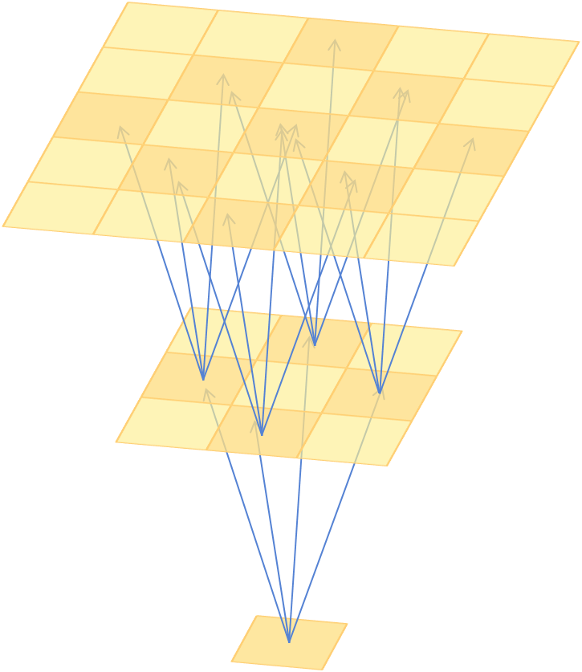
Example Complex Stencil: Horizontal Diffusion
Compound stencil kernel consists of a collection of elementary stencil kernels
Iterates over a 3D grid performing Laplacian and flux operations
Complex memory access behavior and low arithmetic intensity
Laplace
Flux
New value
Horizontal diffusion composition
(Courtesy CSCS/ETH
and Ronald Luijten)
DFG source: Gysi, Tobias, et al. “MODESTO: Data-centric Analytic Optimization of Complex Stencil Programs on Heterogeneous Architectures” ICS, 2015
Notes:
To demonstrate the complexity of weather stencils we explain horizontal diffusion which is a complex weather stencil from COSMO
[CLICK] Unlike elementary stencils, compound stencils consists of a collection of elementary stencil kernels.
[CLICK] Horizontal diffusion is one such kernel that iterates over a 3D grid performing laplacition and flux operations.
The picture show composition of horizontal diffusion stencil in which 2nd order Laplace stencil and first order flux stencil functions which are cascaded together
[CLICK] The bottom figure illustrates the data flow of horizontal diffusion using a directed graph, whose black node represent the input field and white nodes represent all the different stencils . The figure shows that each stencil inside horizontal diffusion has different access pattern. For instance, a single evaluation of the [CLICK] lap stencil accesses the input array at five offsets.
[CLICK] The graph shows that these stencils have complex memory access behavior which leads to low arithmetic intensity
We have provided more details on COSMO representative kernels in our paper.

Slide 9
Outline
Background
CPU Roofline Analysis
FPGA-based Platform
NERO:
Near-HBM Accelerator for Weather Prediction Modeling
•
Precision-optimized Tiling
Setup
•
Evaluation
Results
Setup
Performance Analysis
Setup
Energy Efficiency
Setup
Summary
Setup
Notes:
Now lets discuss how these complex stencils perform on a state-of-the-art multi-core system

Slide 10
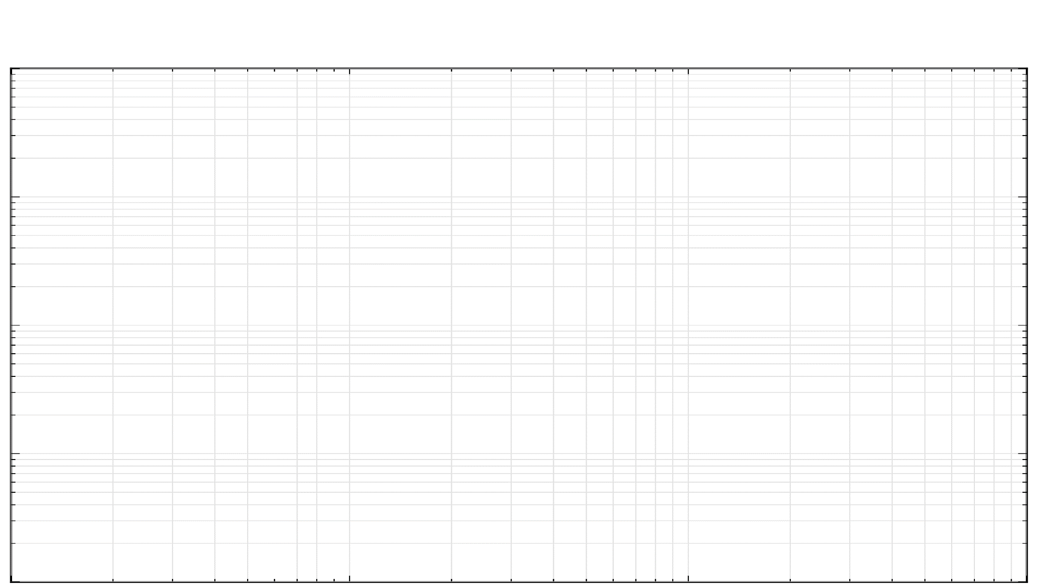
IBM POWER9 Roofline Analysis
$${10}^{4}$$
$${10}^{3}$$
POWER9 socket (486.4 Gflops/socket)
3.3 TBps L3-cache
Performance [Gflops]
$${10}^{2}$$
110 GBps DRAM
58.5 Gflops
(64 threads)
29.1 Gflops
(64 threads)
$${10}^{1}$$
5.1 Gflops
(1 thread)
Vertical Advection
Horizontal Diffusion
3.3 Gflops
(1 thread)
$${10}^{0}$$
$${10}^{−1}$$
$${10}^{0}$$
$${10}^{1}$$
$${10}^{2}$$
Arithmetic Intensity [flop/byte]
Notes:
The figure shows a roofline plot where x-axis is the arithmetic intensity which is flop/byte and on the y axis we have performance.
[CLICK] We show the peak for an IBM 16-core POWER9 socket with peak DRAM and L3 bandwidth.
[CLICK] The single thread performance of vertical advection in shown in blue and horizontal diffusion in green.
After optimizing these kernels for the POWER system using software based techniques they achieve [CLICK] 29.1 GFLOP/s and 58.5 GFLOP/s, respectively, for a complete POWER9 socket
We see their low arithmetic intensity limits their performance, which is [CLICK] one order of magnitude smaller than the peak performance, and results in a fundamental memory bottleneck that standard CPU-based optimization techniques cannot overcome.

Slide 11
IBM POWER9 Roofline Analysis
$${10}^{4}$$
$${10}^{3}$$
Weather kernels are
DRAM bandwidth constrained
POWER9 socket (486.4 Gflops/socket)
3.3 TBps L3-cache
Performance [Gflops]
$${10}^{2}$$
110 GBps DRAM
58.5 Gflops
(64 threads)
29.1 Gflops
(64 threads)
$${10}^{1}$$
5.1 Gflops
(1 thread)
Vertical Advection
Horizontal Diffusion
3.3 Gflops
(1 thread)
$${10}^{0}$$
$${10}^{−1}$$
$${10}^{0}$$
$${10}^{1}$$
$${10}^{2}$$
Arithmetic Intensity [flop/byte]
Notes:
Our roofline analysis reveal that these weather prediction kernels are DRAM bandwidth constrained on a multicore architecture

Slide 12
Outline
Background
CPU Roofline Analysis
FPGA-based Platform
NERO:
Near-HBM Accelerator for Weather Prediction Modeling
•
Precision-optimized Tiling
Setup
•
Evaluation
Results
Setup
Performance Analysis
Setup
Energy Efficiency Analysis
Setup
Summary
Setup
Notes:
Now we discuss about other hardware platforms that could be used for implementing weather prediction applications

Slide 13
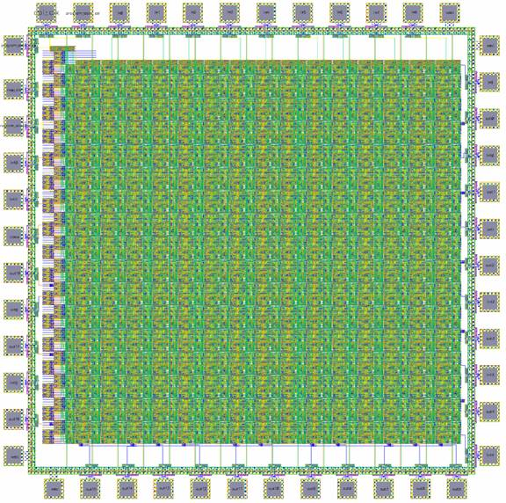
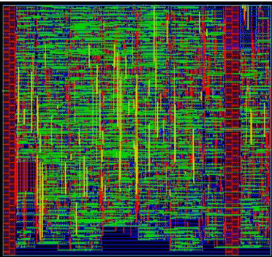
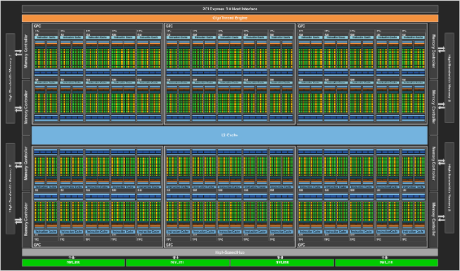
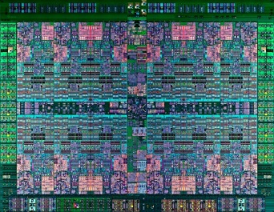
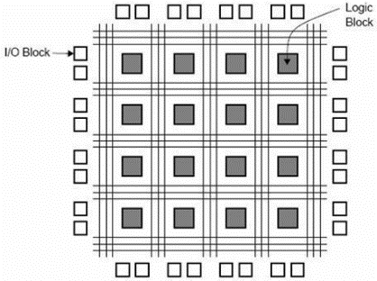
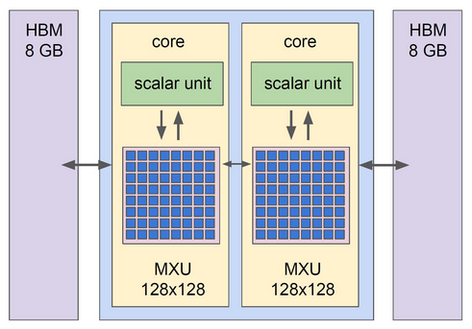
Silicon Alternatives
FPGAs are highly configurable!
CPUs
GPUs
FPGAs
ASICs
Control Unit (CU)
Registers
Arithmetic Logic Unit (ALU)
FLEXIBILITY
EFFICIENCY
Notes:
There are wide range of platforms [CLICK] that provide a tradeoff between flexibility and efficiency.
[CLICK] In our work we focus on FPGA based heterogeneous system. FPGA allows us to create domain specific memory hierarchy which can handle the irregular memory access patterns efficiently and offer significantly higher memory bandwidth with their on-chip memories

Slide 14
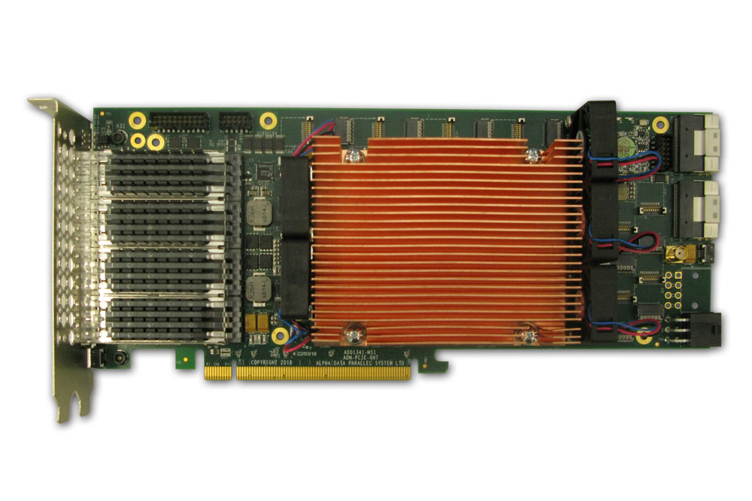
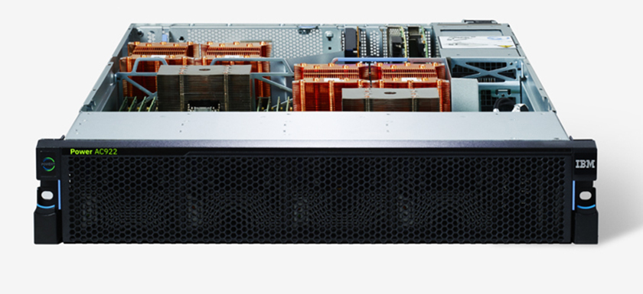
Heterogeneous System: CPU+FPGA
CAPI2
Source: AlphaData
Source: IBM
POWER9 AC922
HBM-based AD9H7 board
We evaluate two POWER9+FPGA systems:
1. HBM-based board AD9H7
Xilinx Virtex Ultrascale+™ XCVU37P-2
Notes:
Our heterogeneous system comprises of IBM POWER9 CPU connected to an FPGA board via CAPI2 interface.
[CLICK] In our evaluation we make use of two FPGA boards [CLICK] first is alphadat 9h7 with HBM memory

Slide 15
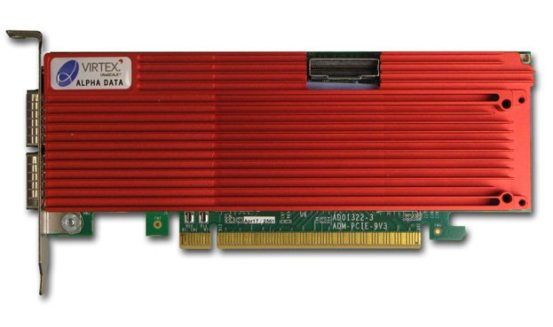
Heterogeneous System: CPU+FPGA
CAPI2
Source: AlphaData
Source: IBM
POWER9 AC922
DDR4-based AD9V3 board
We evaluate two POWER9+FPGA systems:
1. HBM-based board AD9H7
Xilinx Virtex Ultrascale+™ XCVU37P-2
2. DDR4-based board AD9V3
Xilinx Virtex Ultrascale+™ XCVU3P-2
Notes:
and the second is alphadata 9v3 with DDR4
Our CPU-FPGA heterogeneous platform offloads the rep-ri-zen-tuh-tiv weather kernels onto the FPGA
% with 98% of stencil execution time
%In the execution flow of our application:
Application data is stored in the HOST DRAM
Since our platform offers memory-coherent access of FPGA to the system memory, we build a pipelined execution, where communication time for transferring data from host to FPGA memory is masked with the actual FPGA processing
%Despite the low computational complexity, we were able to hide the memory access latency with the CAPI2 interface

Slide 16
FPGAs Have Tremendous Potential
$${10}^{4}$$
AD9H7 FPGA+HBM (3.6 Tflops)
7.26 TBps BRAM
$${10}^{3}$$
AD9V3 FPGA+DDR4 (0.97 Tflops)
1.62 TBps BRAM
POWER9 socket (486.4 Gflops/socket)
3.3 TBps L3-cache
Performance [Gflops]
410 GBps HBM
32 GBps DRAM
$${10}^{2}$$
110 GBps DRAM
58.5 Gflops
(64 threads)
29.1 Gflops
(64 threads)
$${10}^{1}$$
5.1 Gflops
(1 thread)
Vertical Advection
Horizontal Diffusion
3.3 Gflops
(1 thread)
$${10}^{0}$$
$${10}^{−1}$$
$${10}^{0}$$
$${10}^{1}$$
$${10}^{2}$$
Arithmetic Intensity [flop/byte]
Notes:
We annotate FPGA rooflines to our earlier CPU roofline plot to show the potential of FPGA boards. [CLICK] For Alpha data 9v3 card that has DDR4 as DRAM we have performance peak at 0.97 Teraflops [CLICK]
[CLICK] The roofline of alpha data 9H7 which has HBM memory is at 3.6 Tera flops [CLICK] with HBM bandwidth of 410 GBps
Apart from this tremendous performance potential FPGA also allows us to tailor the circuitry and build application specific heterogeneous memory hierarchy, which we exploit in our accelerator design.

Slide 17
Outline
Background
CPU Roofline Analysis
FPGA-based Platform
NERO:
Near-HBM Accelerator for Weather Prediction Modeling
•
Precision-optimized Tiling
Setup
•
Evaluation
Results
Setup
Performance Analysis
Setup
Energy Efficiency Analysis
Setup
Summary
Setup
Notes:
Now I will present our key contribution NERO

Slide 18
NERO: A Near High-Bandwidth Memory Stencil Accelerator for Weather Prediction Modeling
First near-HBM FPGA-based accelerator for representative kernels from a real-world weather prediction application
Data-centric caching with precision-optimized tiling for a heterogeneous memory hierarchy
In-depth scalability analysis for both DDR4 and HBM-based FPGA boards
Notes:
Considering the challenges weather kernels face on the conventional architectures, our goal is to mitigate the performance bottleneck of these kernels in an energy-efficient way
To this end we present NERO [CLICK] First near-HBM FPGA-based accelerator for representative kernels from a real-world weather prediction application
[CLICK] We optimize NERO with a data-centric caching scheme with precision-optimized tiling for a heterogeneous memory hierarchy consisting of URAM, BRAM, HBM
[CLICK] Our contribution also includes scalability analysis for both DDR4 and HBM-based FPGA boards where we change the number of memory ports and processing elements

Slide 19
NERO Design Flow
Notes:
Now we will go into the details of the architecture and dataflow sequence of NERO.

Slide 20
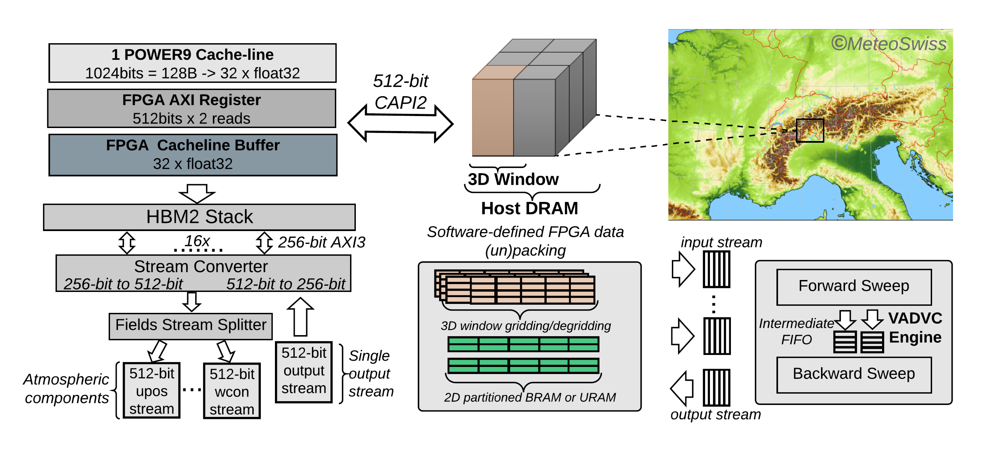
NERO Design Flow
input stream
Weather data in the host DRAM
Notes:
The weather data, based on the atmospheric model resolution grid, is stored in the DRAM of the host system
As the FPGA has limited resources we propose a 3D window-based grid transfer from the host DRAM to the FPGA, facilitating a smaller and a less power-hungry deployment.
The window size represents the portion of the grid a processing element would process.

Slide 21
NERO Design Flow
input stream
output stream
Cache-line transfer over CAPI2
Notes:
We employ the double buffering technique between the CPU and the FPGA to hide the transfer latency. We configure a buffer of 32 cache lines, between the AXI4 interface of CAPI2 and the FPGA, to exploit the CAPI2 bandwidth

Slide 22
NERO Design Flow
input stream
output stream
Data mapping onto HBM
Notes:
On the FPGA side, following the initial buffering, the transferred grid data is mapped onto the HBM memory
The FPGA consists of two HBM stacks each with 16 pseudo-memory channels.
A channel is exposed to the FPGA as a 256-bit wide port, and in total, the FPGA has 32 such ports.
In this work, we enable a single stack based on our resource and power consumption analysis for the vertical advection kernel.

Slide 23
NERO Design Flow
input stream
Data mapping onto HBM
Notes:
The HBM port provides 256-bit data, which is half the size of the CAPI2 bitwidth. Therefore, to match the CAPI2 bitwidth, we introduce a stream converter logic that converts a HBM stream to a CAPI compatible stream

Slide 24
NERO Design Flow
input stream
output stream
Data mapping onto HBM
Notes:
From HBM, a processing element reads a single stream of data that consists of all the fields that are needed for a specific COSMO kernel computation. Fields represent atmospheric components like wind, pressure, velocity, etc.
The processing elements use a field stream splitter logic that splits a single HBM stream to multiple streams, one for each field.
However, as there is only a single output stream for all weather kernels, we do not need extra logic to merge the streams.
In our design, we use a switch, which provides the capability to {bypass} the HBM, when the} grid size small, and map the data directly onto the FPGA's URAM and BRAM.

Slide 25
NERO Design Flow
Main execution pipeline
Notes:
We build an application-specific memory hierarchy by tailoring the cache levels and cache sizes to our kernels memory access patterns
We make use of memory reshaping techniques to configure our memory space with multiple parallel BRAMs or URAMs. We form an intermediate memory hierarchy by decomposing (or slicing) 3D window data into a 2D grid. This allows us to bridge the latency gap between the HBM memory and our accelerator.
Vertical advection is more computationally complex than horizontal with dependencies in the z-dimension.
Therefore, we demonstrate our design flow by means of the vertical advection kernel

Slide 26
NERO Design Flow
Main execution pipeline
Notes:
As shown, the main computation pipeline of vertical advection consists of a forward and a backward sweep logic. The forward sweep results are stored in an intermediate buffer to allow for backward sweep calculation. Upon completion of the backward sweep, results are placed in an output buffer that is followed by a degridding logic
All the tasks execute in a dataflow manner that enables task-level parallelism.
The degridding logic converts the calculated results to a 512-bit wide output stream.
To optimize a processing element we apply various optimization strategies, which are mentioned in our paper
%To optimize a PE we apply various optimization strategies. First, we exploit the inherent parallelism in a given algorithm through hardware pipelining. Second, we partition on-chip memory to avoid the stalling of our pipelined design, since the on-chip BRAM/URAM has only two read/write ports. Third, all the tasks execute in a dataflow manner that enables task-level parallelism.

Slide 27
NERO Design Flow
Complete design flow
Notes:
This is the complete design flow. All the tasks execute in a dataflow manner that enables task-level parallelism.
%Note that we show only a single port-based PE operation. However, for multiple PEs, we enable multiple HBM ports.

Slide 28
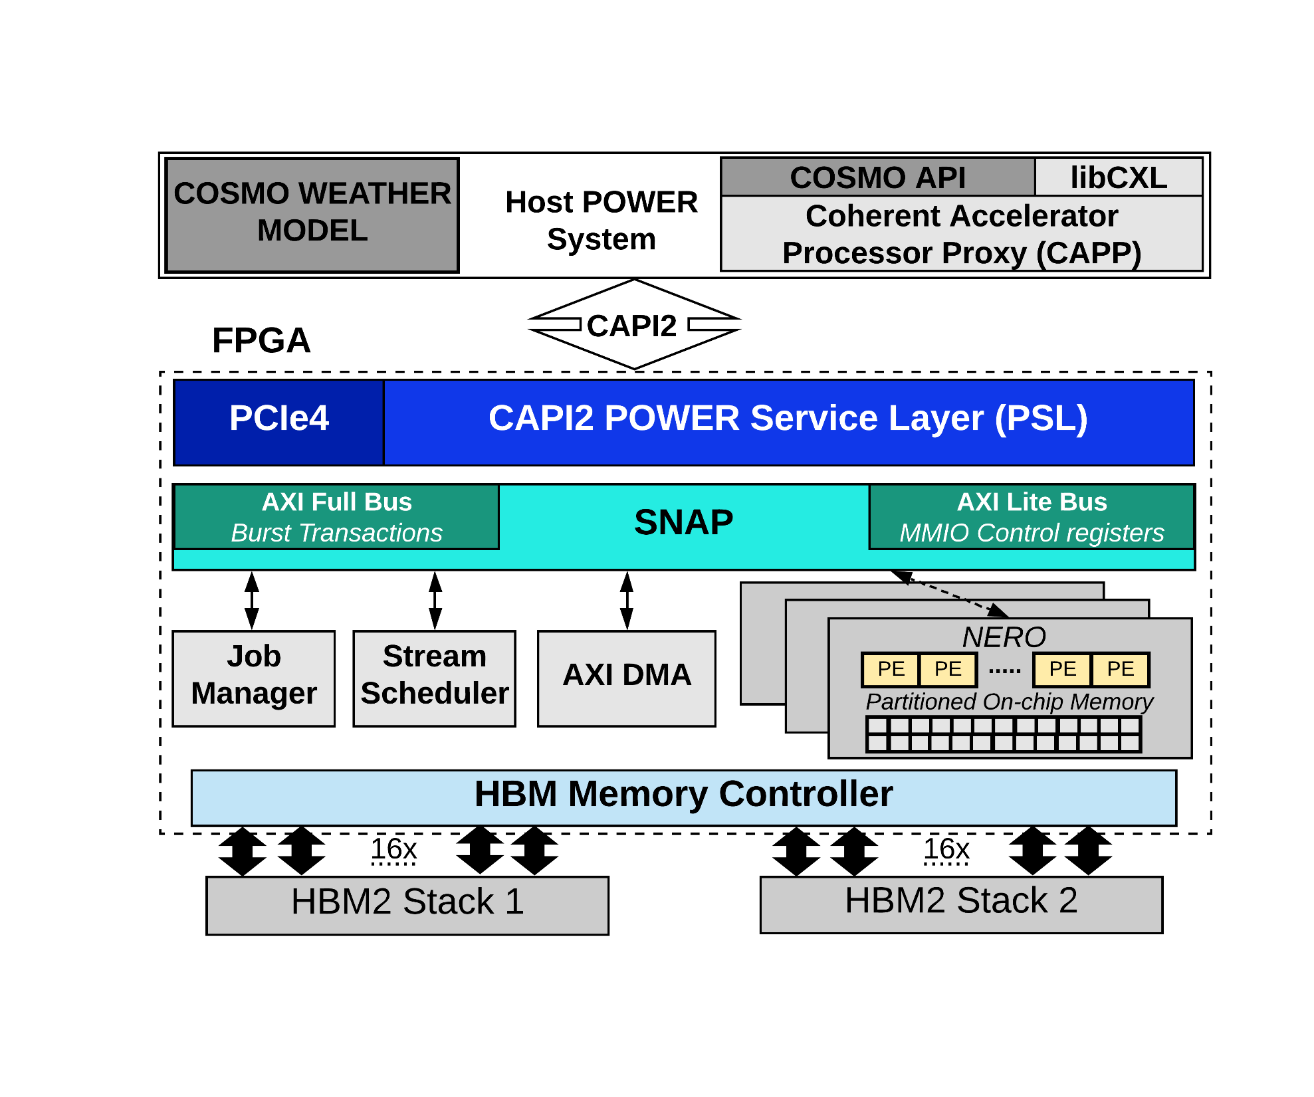
NERO Application Framework
NERO communicates to Host over CAPI2 (Coherent Accelerator Processor Interface)
Notes:
We also build an application framework to support our architecture design.
[CLICK] NERO communicates to CPU over a high-performance cache-coherent CAPI2 interface. NERO is acting as peers to CPU, by accessing the main memory through PSL, which is the CAPI end point on an FPGA

Slide 29
NERO Application Framework
NERO communicates to Host over CAPI2 (Coherent Accelerator Processor Interface)
COSMO API handles offloading jobs to NERO
Notes:
Our COSMO API handles offloading jobs to NERO with an interrupt-based queuing mechanism.
This allows for minimal CPU usage during FPGA operation.

Slide 30
NERO Application Framework
NERO communicates to Host over CAPI2 (Coherent Accelerator Processor Interface)
COSMO API handles offloading jobs to NERO
SNAP (Storage, Network, and Analytics Programming) allows for seamless integration of the COSMO API
https://github.com/open-power/snap
Notes:
We make use of SNAP framework that allows for seamless integration of the COSMO API
%In our application framework the job manager dispatches jobs to streams, which are managed in the stream scheduler and fetch data through DMA transfers
%The execution of a job is done by streams that determine which data is to be read from the host memory and sent to the PE array through DMA transfers

Slide 31
NERO Application Framework
NERO communicates to Host over CAPI2 (Coherent Accelerator Processor Interface)
COSMO API handles offloading jobs to NERO
SNAP (Storage, Network, and Analytics Programming) allows for seamless integration of the COSMO API
https://github.com/open-power/snap
Notes:
Please refer to our paper for more detailans on our application framework

Slide 32
Outline
Background
CPU Roofline Analysis
FPGA-based Platform
NERO:
Near-HBM Accelerator for Weather Prediction Modeling
•
Precision-optimized Tiling
Setup
•
Evaluation
Results
Setup
Performance Analysis
Setup
Energy Efficiency Analysis
Setup
Summary
Setup
Notes:
I now describe our precision optimized tiling scheme

Slide 33
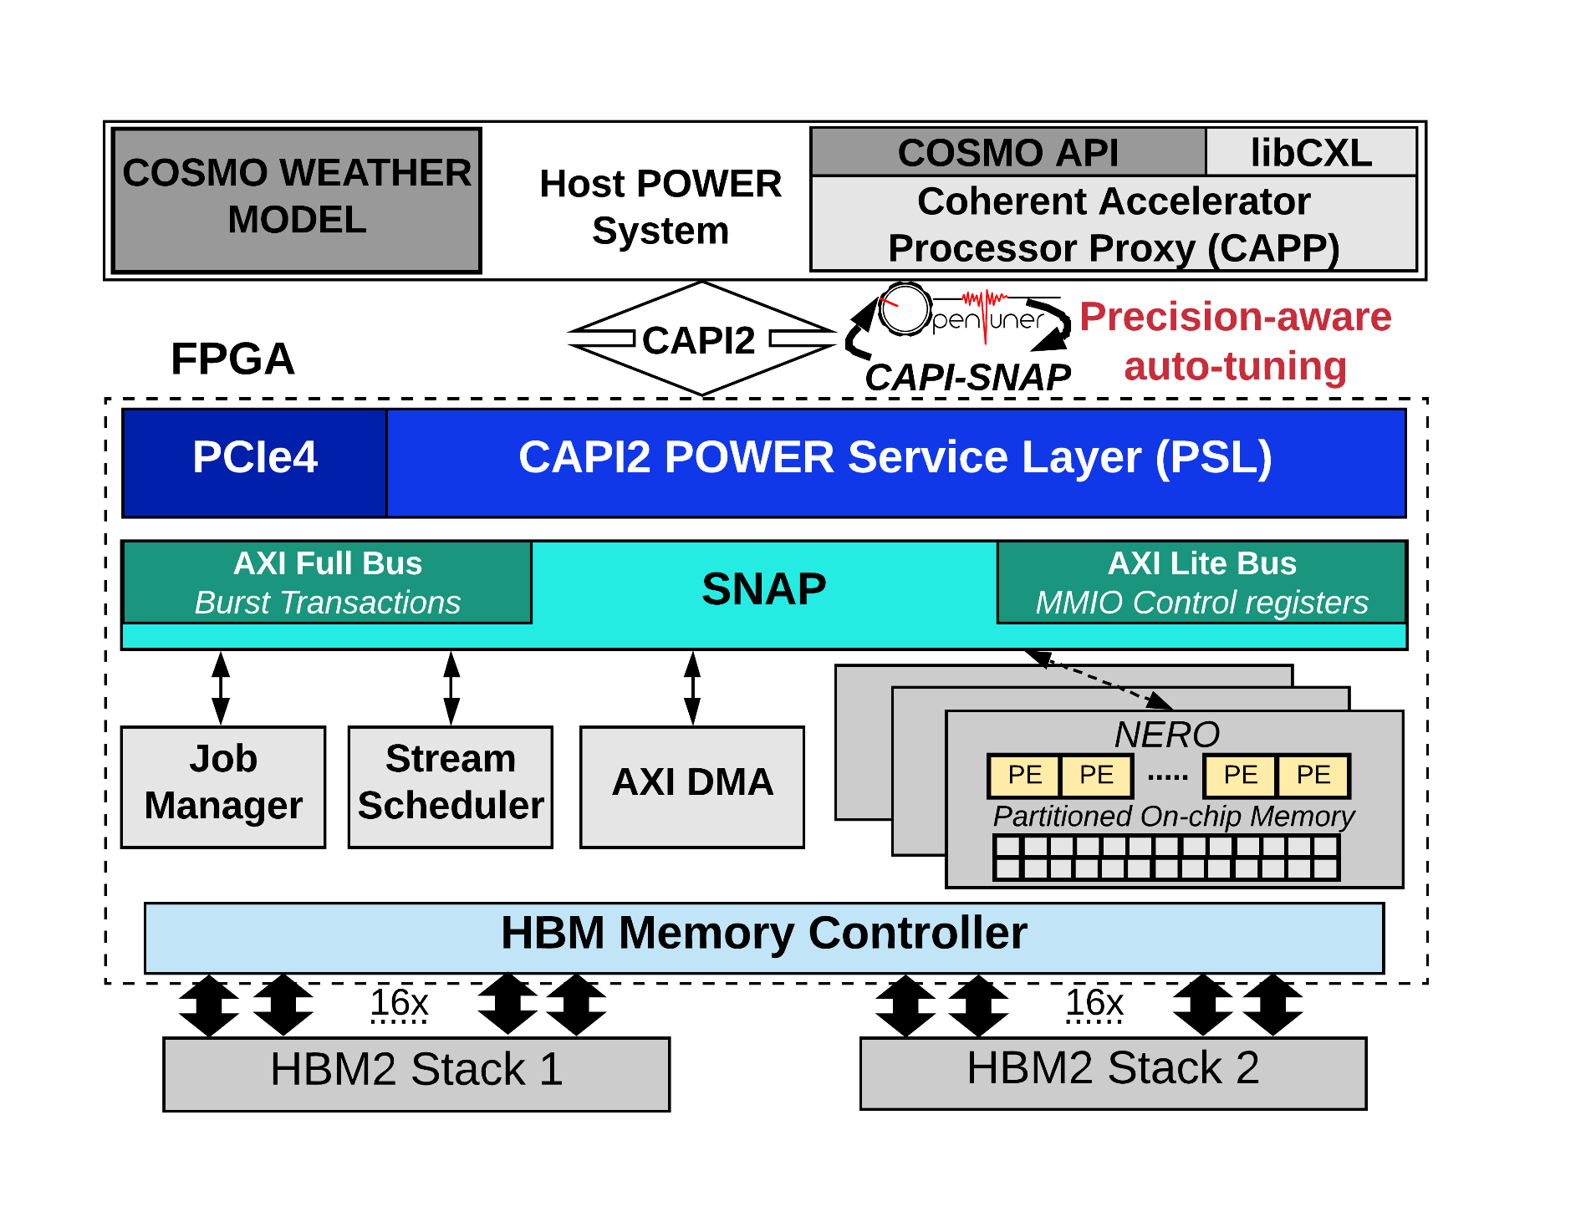
Precision-optimized Tiling
The best window size is critical
Formulate the search for the best window size as a multi-objective auto-tuning problem
Taking into account the datatype precision
We make use of OpenTuner
https://github.com/jansel/opentuner
Notes:
As mentioned earlier the window size represents the portion of the grid a processing element would process.
[CLICK] The best window size is critical in terms of the area vs. performance trade-off. Further, selecting an inappropriate window size leads to sub-optimal results.
Most FPGA developers manually optimize for the right window size and often adapt the design to use homogeneous tile sizes. However, manual optimization is tedious because of the huge design space, and it requires expert guidance.
[CLICK] therefore, instead of pruning the design space manually, we formulate the search for the best window size as a multi-objective auto-tuning problem
[CLICK] taking into account datatype precision
[CLICK] We make use of OpenTuner which uses machine-learning techniques to guide the design-space~exploration.

Slide 34
Precision-optimized Tiling
Notes:
I will now discuss the effect of different tiling with different precision.
Our auto-tuning technique tries to determine a Pareto-optimal solution in terms of performance and resource utilization for our 3D window dimensions.
%We run all our experiments using a 256 by 256 by 64 point domain similar to the grid domain used by the COSMO {weather prediction} model. Our auto-tuning technique tries to determine a Pareto-optimal solution (in terms of performance and resource utilization) for our 3D window dimensions.
%The auto-tuning with OpenTuner searches for every tile size in the x- and y-dimensions for vertical advection. Since, vertical advection has dependencies in the z-dimension; therefore, it cannot be parallelized in the z-dimension. For horizontal diffusion. we consider sizes in all three dimensions.

Slide 35
Precision-optimized Tiling
Single Precision
Notes:
Here we can see single precision results for vertical advection for a single processing element
We get a wide range of perf vs resource utilization points for different tile sizes.
[CLICK] By using the auto-tuning approach and our careful FPGA microarchitecture design, we can get Pareto-optimal results with a tile size of 64 by 2 for single-precision vertical advection
[CLICK] Also you can see here that the hand tuned designs are sub-optimal compared to our auto-tuned result

Slide 36
Precision-optimized Tiling
Single Precision
Half Precision
Notes:
However, for half-precision, we get a different tile size of 32 by 16 to get our pareto optimal point
[CLICK] As we can see a good tile-size for single-precision might lead to poor results when used with half-precision.

Slide 37
Precision-optimized Tiling
Single Precision
Half Precision
Pareto-optimal tile size depends on
the data precision
Notes:
Therefore, the Pareto optimal tile size depends on the data precision and it is critical to find the right size that maximizes the performance with minimal resource utilization
We employ a similar strategy for horizontal diffusion and you can find those results in our paper.
%to attain a single-precision performance of 30.3 GFLOP/s with a tile size of 16 by 64 by 8 and a {half-precision} performance of 77.8 GFLOP/s {with} a tile size of 64 by 8 by 64.
%In FPGA acceleration, designers usually rely on expert judgement to find the appropriate tile-size and often adapt the design to use homogeneous tile sizes. However, as shown before, such hand-tuned implementations lead to sub-optimal results in terms of either resource utilization~or~performance.

Slide 38
Outline
Background
CPU Roofline Analysis
FPGA-based Platform
NERO:
Near-HBM Accelerator for Weather Prediction Modeling
•
Precision-optimized Tiling
Setup
•
Evaluation
Results
Setup
Performance Analysis
Setup
Energy Efficiency Analysis
Setup
Summary
Setup
Notes:
Now I will present our evaluation results for performance analysis

Slide 39
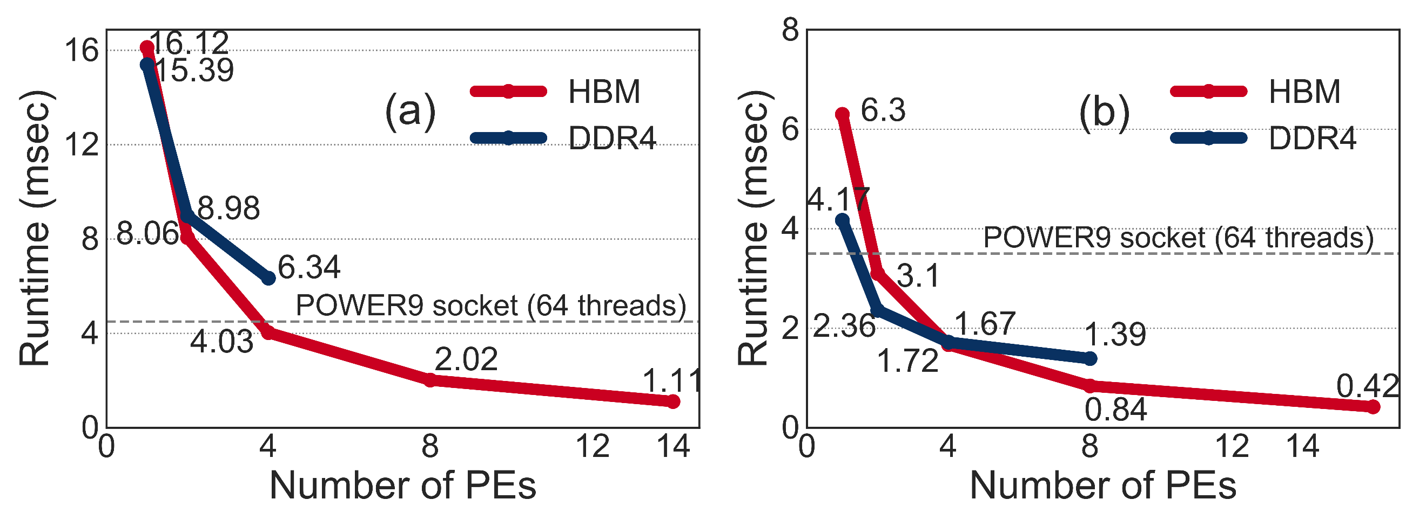
NERO Performance Analysis
Vertical Advection
Notes:
First, we discuss single-precision performance results for the vertical advection. We implement our design on both an HBM- and a DDR4-based FPGA board.
[CLICK] We performed in depth scalability analysis where we scale the number of processing elements and analyze the change in execution time.
For the DDR4-based design, we can accommodate only 4 processing elements on the 9V3 board, while for the HBM-based design, we can fit 14 processing elements before exhausting the on-board resources.
We make four observations from the figure.
[CLICK] First, for a single processing element, which fetches data from a single memory channel, {the} DDR4-based design provides higher performance than the HBM-based design}
This is because the DDR4-based FPGA has a larger bus width than an HBM port This leads to a lower transfer rate for an HBM port than for a DDR4 port. One way to match the DDR4 bus width would be to have a single processing elements fetch data from multiple HBM ports in parallel. However, using more ports leads to higher power consumption our experiments showed that this power consumption is around 1 Watt per HBM port).
[CLICK] Second, as we increase the number of processing elements, we observe a linear reduction in the execution time for the HBM-based design. This is because, we can evenly divide the computation between multiple processing elements , each of which fetches data from a separate HBM port.
[CLICK] Third, in the DDR4-based design, the use of only a single channel to feed multiple processing elements leads to a congestion issue that causes a non-linear run-time reduction. As we increase the number of accelerator processing elements, we observe that the processing elements compete for a single memory channel, which causes frequent stalls. This phenomenon leads to worse performance scaling characteristics for the DDR4-based design as compared to the HBM-based design.
[CLICK] Fourth, our full-blown HBM-based vertical advection implementation takes 1.11 msec to execute which is 120.7~GFLOP/s

Slide 40
NERO Performance Analysis
Vertical Advection
Horizontal Diffusion
Notes:
For horizontal diffusion implementation [CLICK] we achieve 0.42 msec, which is 485 GFLOPS
We also report half precision results in the paper

Slide 41
NERO Performance Analysis
Vertical Advection
Horizontal Diffusion
NERO is 4.2x and 8.3x faster than
a complete POWER9 socket
Notes:
By carefully designing the micro-archictecture architecture with application specific heterogeneous memory hierarchy, NERO is 4.2 times and 8.3 times faster for vertical advection and horizontal diffusion respectively than a complete~POWER9~socket.

Slide 42
Outline
Background
CPU Roofline Analysis
FPGA-based Platform
NERO:
Near-HBM Accelerator for Weather Prediction Modeling
•
Precision-optimized Tiling
Setup
•
Evaluation
Results
Setup
Performance Analysis
Setup
Energy Efficiency Analysis
Setup
Summary
Setup
Notes:
We also did energy efficiency analysis for our design

Slide 43
How Energy Efficient is NERO?
Vertical Advection
Notes:
Figure shows the energy efficiency which is GFLOPS per Watt for vertical advection on the HBM- and DDR4-based designs. We make three major observations from the figure.
[CLICK] First, the DDR4-based design is more energy efficient than the HBM-based design when the number of PEs is small} This observation is inline with our discussion about performance with small processing element counts
[CLICK] However, as we increase the number of processing elements , the HBM-based design provides better energy efficiency. This is because more data can be fetched and processed in parallel via multiple HBM ports.
[CLICK] Second, kernels like vertical advection, with intricate memory access patterns, are not able to} reach the peak computational power of FPGAs. The large amount of control flow in vertical advection leads to large resource consumption. Therefore, when increasing the PE count, we observe a high increase in power consumption with low energy efficiency.
[CLICK] Third, we achieve energy efficiency value of around 1.5 GFLOPS/Watt with 14 processing elements

Slide 44
How Energy Efficient is NERO?
Vertical Advection
Enabling many HBM ports might not always be the determining factor
Notes:
We conclude, enabling many HBM ports might not always be the determining factor to reach the target parallelism and energy efficiency

Slide 45
How Energy Efficient is NERO?
Vertical Advection
Horizontal Diffusion
0
Notes:
On the other hand for horizontal diffusion which is highly parallelizable in all the dimensions and has limited control flow. [CLICK] the energy efficiency keeps increasing with increase in PE count

Slide 46
How Energy Efficient is NERO?
Vertical Advection
Horizontal Diffusion
NERO reduces energy consumption
by 22x and 29x compared to
a complete POWER9 socket
NERO provides energy efficiency of
1.5 GFLOPS/Watt and
17.3 GFLOPS/Watt
Notes:
By executing these kernels on an HBM-based board, we reduce the energy consumption by 22 times for vertical advection and 29 times for horizontal diffusion compared to a 16-core POWER9 socket.
[CLICK] and NERO provides energy efficiency of 1.5 GFLOPS/Watt and 17.3 GFLOPS/Watt

Slide 47
Outline
Background
CPU Roofline Analysis
FPGA-based Platform
NERO:
Near-HBM Accelerator for Weather Prediction Modeling
•
Precision-optimized Tiling
Setup
•
Evaluation
Results
Setup
Performance Analysis
Setup
Energy Efficiency Analysis
Setup
Summary
Setup
Notes:
Now let me conclude

Slide 48
Summary
Motivation: Stencil computation is an essential part of weather prediction applications
Problem: Memory bound with limited performance and high energy consumption on multi-core architectures
Goal: Mitigate the performance bottleneck of compound weather prediction kernels in an energy-efficient way
Our contribution: NERO
First near High-Bandwidth Memory (HBM) FPGA-based accelerator for representative kernels from a real-world weather prediction application
Detailed roofline analysis to show weather prediction kernels are constrained by DRAM bandwidth on a state-of-the-art CPU system
Data-centric caching with precision-optimized tiling for a heterogeneous memory hierarchy
Scalability analysis for both DDR4 and HBM-based FPGA boards
Evaluation
NERO outperforms a 16-core IBM POWER9 system by 4.2x and 8.3x when running two compound stencil kernels
NERO reduces energy consumption by 22x and 29x with an energy efficiency of 1.5 GFLOPS/Watt and 17.3 GFLOPS/Watt
Notes:
[CLICK] The motivation of this talk is that Stencil computation is an essential part of weather prediction applications
[CLICK] Unfortunately these kernels are memory bound with limited performance and high energy consumption on traditional multi-core architectures
[CLICK] Our goal is to mitigate the performance bottleneck of complex compound stencils found in real world weather prediction applications in an energy-efficient way
[CLICK] To this end we present NERO: [CLICK] First near-High bandwidth memory FPGA-based accelerator for rep-ri-zen-tuh-tiv kernels from a real-world weather prediction application
[CLICK] We perform detailed roofline analysis to show weather prediction kernels are constrained by DRAM bandwidth on a state-of-the-art CPU system
[CLICK] We optimize NERO with a data-centric caching scheme with precision-optimized tiling for a heterogeneous memory hierarchy consisting of URAM, BRAM, HBM
[CLICK] Also we perform in depth scalability analysis for both DDR4 and HBM-based FPGA boards
[CLICK] In our evaluation we show that [CLICK] NERO outperforms a 16-core IBM POWER9 system by 4.2 times and 8.3 times for two rep-ri-zen-tuh-tiv kernels from a real-world weather prediction application
[CLICK] Further, NERO reduces energy consumption by 22 times and 29times with an energy efficiency of 1.5 GFLOPS/Watt and 17.3 GFLOPS/Watt
We conclude that hardware acceleration on an FPGA+HBM fabric is a promising solution for compound stencils present in weather prediction applications. We hope that our insights and observations would inspire developers of different high-performance computing applications that suffer from similar the memory bottleneck.

Slide 49
NERO: A Near High-Bandwidth Memory Stencil Accelerator
for Weather Prediction Modeling
Gagandeep Singh, Dionysios Diamantopoulos, Christoph Hagleitner,
Juan Gómez-Luna, Sander Stuijk, Onur Mutlu, and Henk Corporaal
30th FPL, Sweden
31th August 2020
Notes:
Thank you for listening to my talk.
For more details I invited you to read our FPL 2020 paper.

