Slide 1

NVMOVE: Helping Programmers Move to Byte-based Persistence
NVMOVE
Himanshu Chauhan
with
Irina Calciu, Vijay Chidambaram,
Eric Schkufza, Onur Mutlu, Pratap Subrahmanyam

Slide 2

Fast, but volatile.
Cache
DRAM
Critical Performance Gap
Persistent, but slow.
SSD
Hard Disk
Notes:
We are all familiar with this picture. We have caches/registers and dram …
And block-based devices such as .... That are...
And in between them lies a big performance gap.

Slide 3
Fast, but volatile.
Cache
DRAM
Fast, and persistent.
Non-Volatile Memory
Persistent, but slow.
SSD
Hard Disk
Notes:
NVM is the technology that promises to fill this gap, its both fast and persistent.

Slide 4
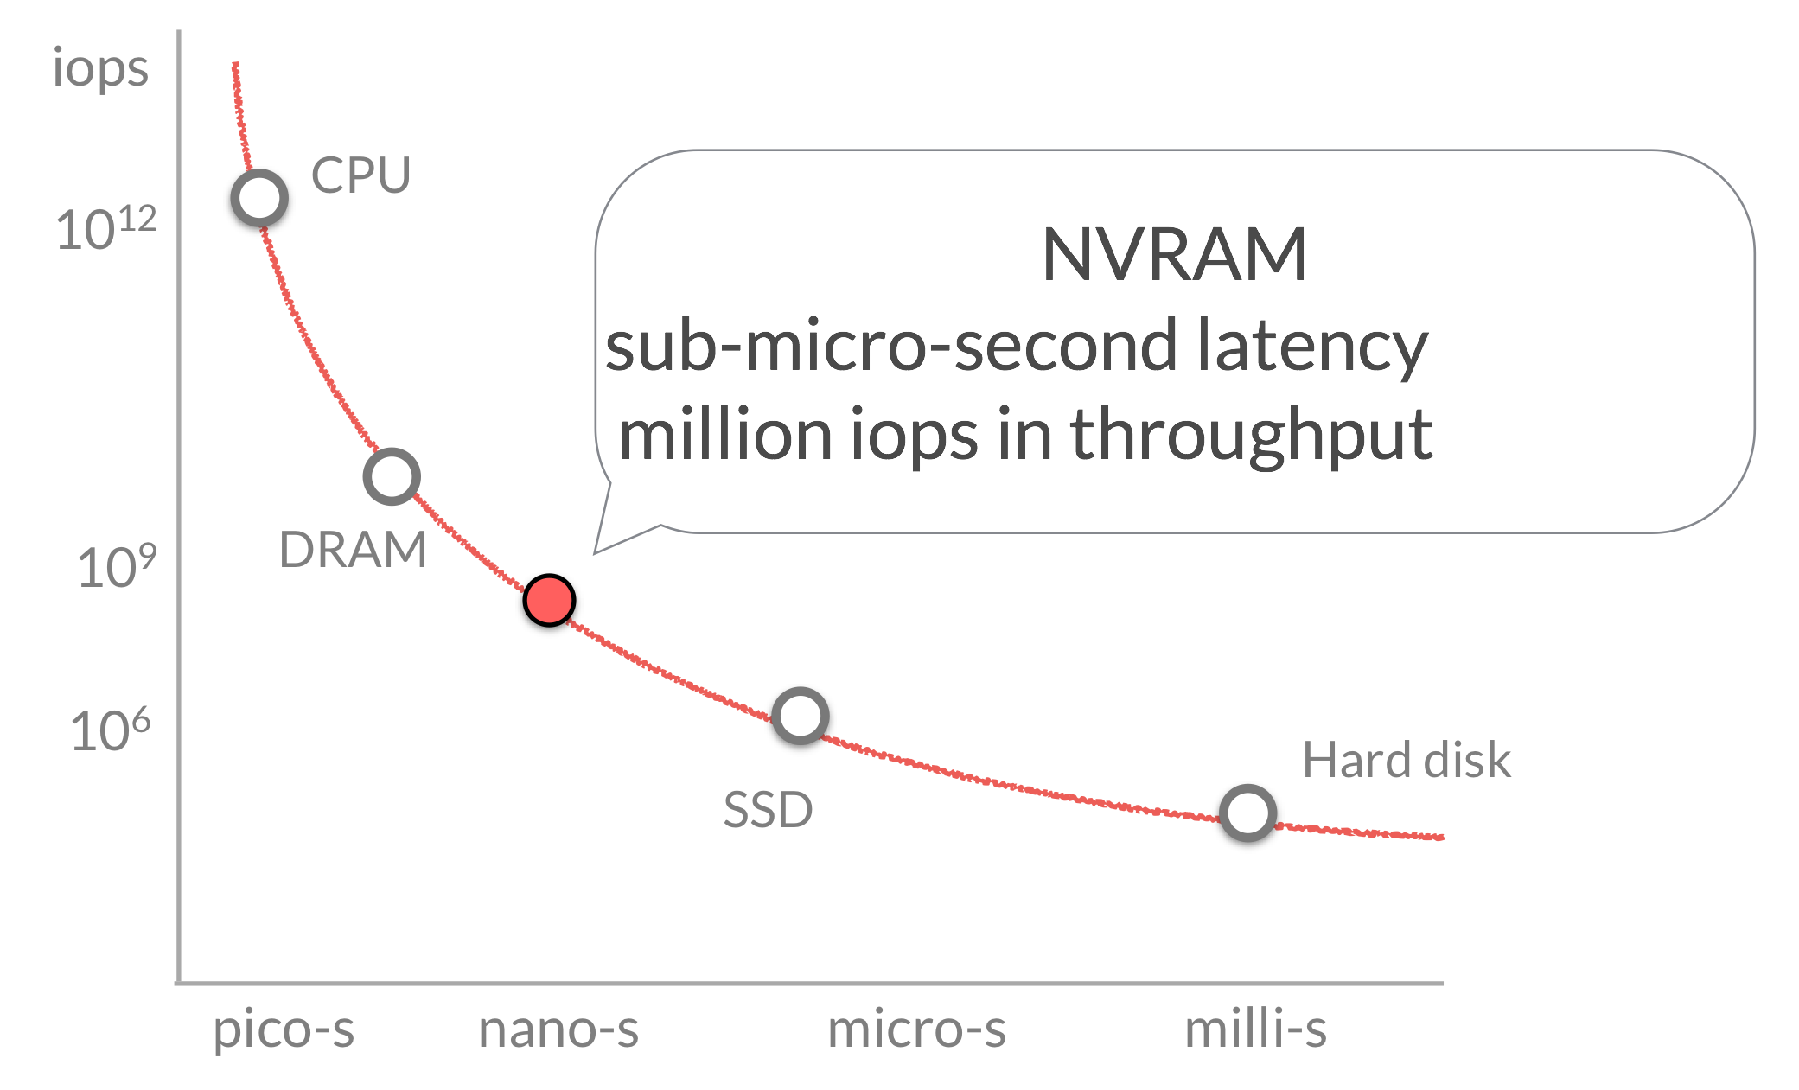
Cache
DRAM
SSD
Hard Disk
Notes:
In terms of throughput and latency, it sits roughly somewhere here. And thus has great potential for boosting performance of new applications.

Slide 5
Persistent Programs
typedef struct {
} node
1. allocate from memory
2. data read/write + program logic
3. save to storage
Notes:
Let us consider persistent prorgrams that save their state or data to storage.

Slide 6
Persistence Today
Notes:
Consider a binary search tree. If we want to persist it, we will have to perform these or very similar operations.

Slide 7
Persistence with NVM
Notes:
we know that this promise-land exists for programming new applications.
but what about exsiting persistent programs. how can we improve them to leverage nvm?

Slide 8

Changing Persistence Code
Present
NVM
/* allocate from volatile memory*/
node n* = malloc(sizeof(…))
/* allocate from non-volatile memory*/
node n* = pmalloc(sizeof(…))
node->value = val //volatile
update
…
node->value = val //persistent
update
…
/* persist to block-storage*/
char *buf= malloc(sizeof(…));
int fd = open("data.db",O_WRITE);
sprintf(buf,"…", node->id,
node->value);
write(fd, buf, sizeof(buf));
/* flush cache and commit*/
__cache_flush + __commit

Slide 9
Porting to NVM: Tedious
Identify data structures that should be on NVM
Update them in a consistent manner
Redis: simple key-value store (~50K LOC)
- Industrial effort to port Redis is on-going after two years
- Open-source effort to port Redis has minimum functionality

Slide 10

Changing Persistence Code
Present
NVM
/* allocate from volatile memory*/
node n* = malloc(sizeof(…))
/* allocate from non-volatile memory*/
node n* = pmalloc(sizeof(…))
node->value = val //volatile
update
…
node->value = val //persistent
update
…
/* persist to block-storage*/
char *buf= malloc(sizeof(…));
int fd = open("data.db",O_WRITE);
sprintf(buf,"…", node->id,
node->value);
write(fd, buf, sizeof(buf));
/* flush cache and commit*/
__cache_flush + __commit

Slide 11
Goal:
Port existing applications to NVM with minimal programmer involvement.

Slide 12


Slide 13

By Kiko Alario Salom [CC BY 2.0 (http://creativecommons.org/licenses/by/2.0)], via Wikimedia Commons

Slide 14
First Step:
Identify persistent types in
application source.

Slide 15
Persistent Types in Source
User defined source types (structs in C)
that are persisted to block-storage.
Application Code
Block Storage

Slide 16
Solution: Static Analysis
Notes:
we want to identify all possible candidates for persistence, irrespective of whether or not they are saved to storage in one particular run we observe.

Slide 17
Current Focus: C
types = structs

Slide 18

Application Code
write system call
Block Storage

Slide 19
node *n = malloc(sizeof(node))
node
iter *it = malloc(sizeof(iter))
/* persist to block-storage*/
char *buf= malloc(…))
int fd = open(…)
sprintf(buf,”…”,node->value)
write(fd, buf, …)
write system call

Slide 20
node *n = malloc(sizeof(node))
node
iter *it = malloc(sizeof(iter))
/* persist to block-storage*/
char *buf= malloc(…))
int fd = open(…)
sprintf(buf,”…”,node->value)
write(fd, buf, …)
write system call

Slide 21
node *n = malloc(sizeof(node))
iter
node
iter *it = malloc(sizeof(iter))
/* persist to block-storage*/
char *buf= malloc(…))
int fd = open(…)
sprintf(buf,”…”,node->value)
write(fd, buf, …)
write system call

Slide 22
node
/* write to network socket*/
…
write(socket, “404”, …)
/* write to error stream*/
…
write(stderr, “All is lost.”, …)
/* persist to block-storage*/
…
write(fd, buf, …)
write system call
Pipe
Storage
Network

Slide 23
node
Save to block-storage
Block Storage

Slide 24

node
Save to block-storage
Load/recover
Block Storage

Slide 25

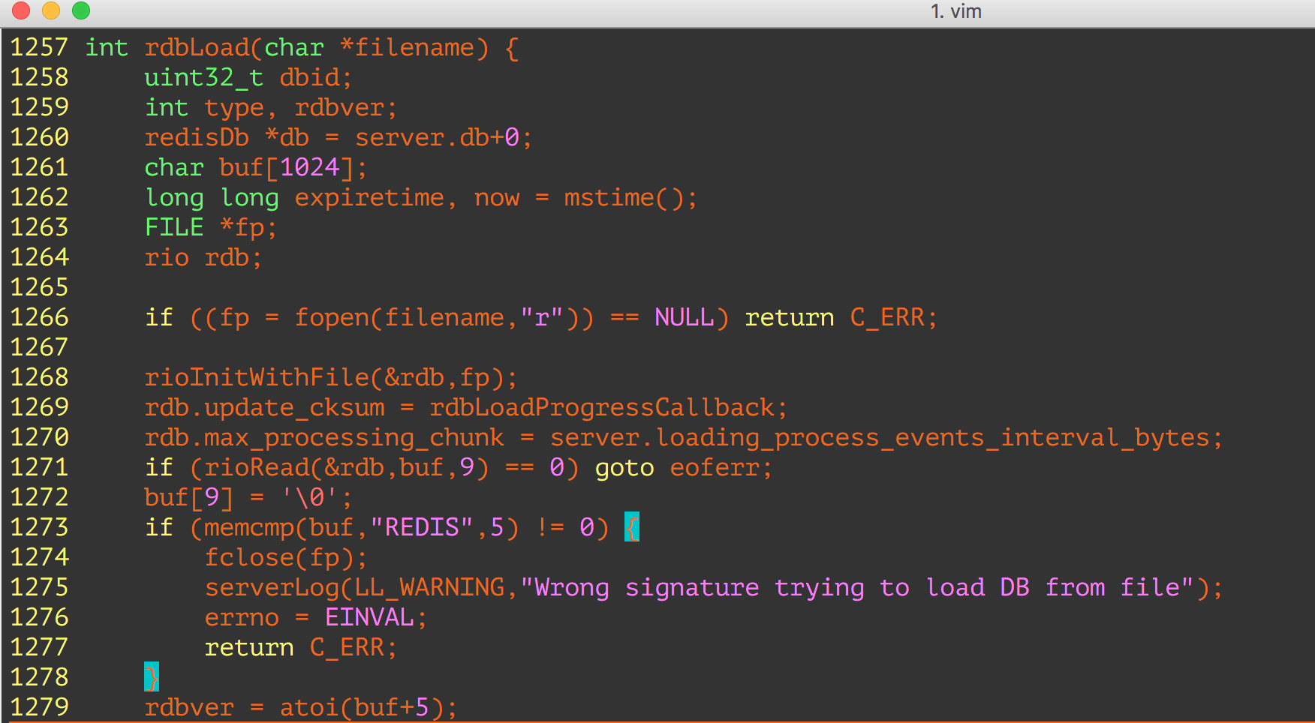
“rdbLoad” is the load/recovery function.

Slide 26
Mark every type that can be
created during the recovery.
*if defined in application source.

Slide 27
Call Graph from Load
rdbLoad
external
library

Slide 28
BFS on Call Graph from Load
rdbLoad
external
library

Slide 29
BFS on Call Graph from Load
Application type created/modified
external
library

Slide 30
NVMovE Implementation
Clang
  - Frontend Parsing
Parse AST and Generate Call Graph- Find all statements that create/modify types in graph
Currently supports C applications

Slide 31
Evaluation

Slide 32

In-memory data structure store
              strings, hashes, lists, sets, indexes
Persistence
            — data-snapshots(RDB),
            — command-logging (AOF)
~50K lines-of-code

Slide 33
Identification Accuracy
122 types (structs) in Redis Source

Slide 34
Identification Accuracy
Notes:
fortunately for us, an industrial team has already gone thru the painful and laborious process of manually porting redis to nvm. So all we had to do was to ask them for the list of types that they make persistent in their implementaiton.

Slide 35
Identification Accuracy

Slide 36
Identification Accuracy
Total types 122
NVMOVE identified persistent types 25
True positives (manually identified) 14
False positives 11
False negatives 0

Slide 37
Performance Impact
Notes:
I would like to emphasize that this is not the main result: we have already shown the Nvmove produces no false negatives.
This is just to get an estimate on the worst case performance using NVMove for NVM porting.

Slide 38
Redis Persistence
Snapshot (RDB)
Logging (AOF)
Data snapshot per second
Not fully durable
Append each update command to a file
Slow
Both performed by forked background process.

Slide 39
NVM Emulation
Emulate allocation of NVMovE identified types on NVM heap
          - Slow and Fast NVM
          - Inject delays for load/store of all NVM allocated types.
          - Worst-case performance estimate.
          Compare emulated NVM throughput against logging, and snapshot based persistence.

Slide 40
YCSB Benchmark Results
write-heavy (90% update, 10% read)
27K ops/s: No persistence
in-memory (=1.0)
Fraction of
in-memory
throughput

Slide 41
YCSB Benchmark Results
write-heavy (90% update, 10% read)
27K ops/s
in-memory (=1.0)
Possible Data loss
111 MB
Fraction of
in-memory
throughput

Slide 42
Performance without False-Positives
Slow NVM
1.04x
Fast NVM
1.49x
1.0
Speedup in throughput

Slide 43
First Step:
Identify persistent types in
application source.
Notes:
Recall that our …
Nvmove is correct in identfying those. However, as we saw the cost of false positives is not always negligibel in terms of performance. So,

Slide 44
Next steps:
Improve identification accuracy.
Evaluate on other applications.

Slide 45
Backup

Slide 46
Identification Accuracy
Iterators over persistent types.

Slide 47
Identification Accuracy
Different byte-alignments of the
same type.

Slide 48
Throughputs (ops/sec)
 | readheavy | balance | writeheavy
PCM | 28399 | 25,302 | 9759
STTRam | 41213 | 38,048 | 12155
AoF (disk) | 15634 | 6,457 | 2868
AoF (SSD) | 27946 | 17,612 | 6605
RDB | 46355 | 47,609 | 26605
Memory | 50163 | 48,360 | 27156

Slide 49
NVM Emulation
 | Read Latency | Cache-line Flush Latency | PCOMMIT Latency
STT-RAM (Fast NVM) | 100 ns | 40 ns | 200 ns
PCM (Slow NVM) | 300 ns | 40 ns | 500 ns
*Xu & Swanson, NOVA: A Log-structured File System for Hybrid Volatile/Non-volatile Main Memories, FAST16.

Slide 50
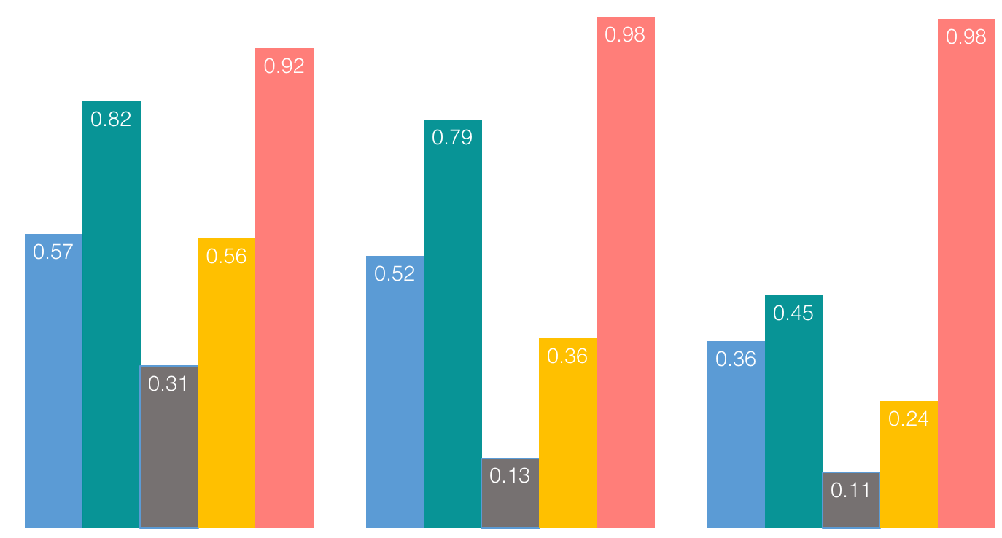
YCSB Benchmark Results
in-memory (=1.0)
Fraction of
in-memory
throughput
PCM
STT
AOF
(disk)
AOF
(ssd)
RDB
PCM
STT
AOF
(disk)
AOF
(ssd)
RDB
PCM
STT
AOF
(disk)
AOF
(ssd)
RDB
NVM
read-heavy

Slide 51
YCSB Benchmark Results
in-memory (=1.0)
Fraction of
in-memory
throughput
PCM
STT
AOF
(disk)
AOF
(ssd)
RDB
PCM
STT
AOF
(disk)
AOF
(ssd)
RDB
PCM
STT
AOF
(disk)
AOF
(ssd)
RDB
NVM
NVM
read-heavy
balanced

Slide 52
YCSB Benchmark Results
in-memory (=1.0)
Fraction of
in-memory
throughput
PCM
STT
AOF
(disk)
AOF
(ssd)
RDB
PCM
STT
AOF
(disk)
AOF
(ssd)
RDB
PCM
STT
AOF
(disk)
AOF
(ssd)
RDB
NVM
NVM
NVM
read-heavy
balanced
write-heavy

Slide 53
RDB Data Loss
111 MB
42 MB
26 MB
read-heavy
balanced
write-heavy

Slide 54

Performance without False-Positives
1.49x
Speedup
in
throughput
1.13x
1.15x
1.09x
1.03x
1.04x
1.0
PCM
STT
PCM
STT
AOF
(disk)
AOF
(ssd)
RDB
(disk)
PCM
STT
AOF
(disk)
AOF
(ssd)
RDB
(disk)
PCM
STT
PCM
STT
PCM
STT
read-heavy
balanced
write-heavy

