Slide 1
Brief Introduction
Onur Mutlu
omutlu@gmail.com
https://people.inf.ethz.ch/omutlu
23 October 2019
Academy of Europe Inauguration Presentation

Slide 2
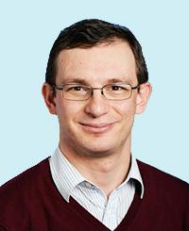
Onur Mutlu – ETH Zurich
Onur Mutlu
Full Professor @ ETH Zurich CS (EE), since September 2015
Strecker Professor @ Carnegie Mellon University ECE/CS, 2009-2016, …
Started the Comp Arch Research Group @ Microsoft Research, 2006-2009
Worked at Google, VMware, Microsoft Research, Intel, AMD
PhD from University of Texas at Austin in 2006
https://people.inf.ethz.ch/omutlu/; omutlu@gmail.com
Research, Teaching & Consulting in:
Computer architecture, systems, hardware security, bioinformatics
Memory systems; memory-centric computing systems
Hardware security, safety, predictability, reliability
Hardware/software cooperation
Architectures for bioinformatics, health, medicine, AI/ML
New execution models; architectures for new device technologies
…

Slide 3
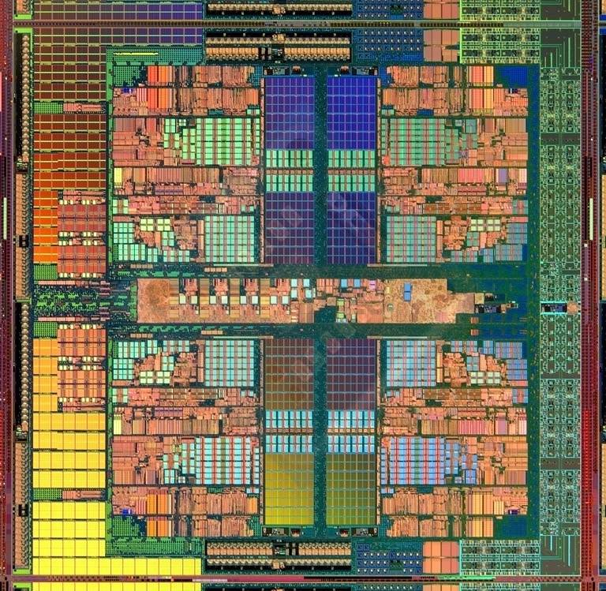
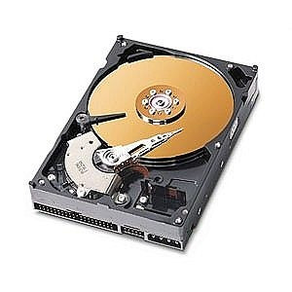
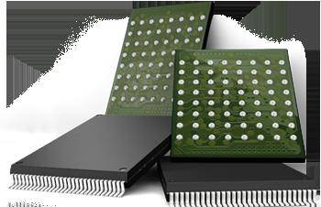
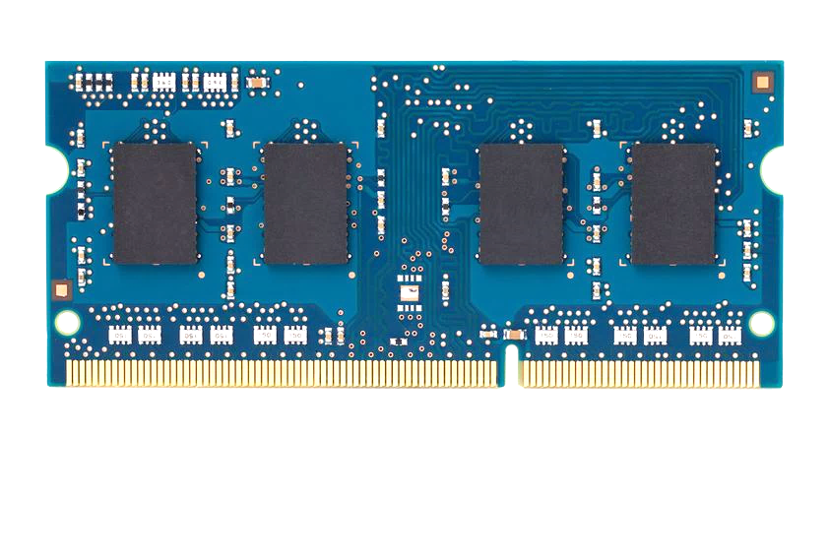
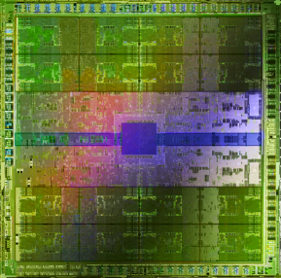
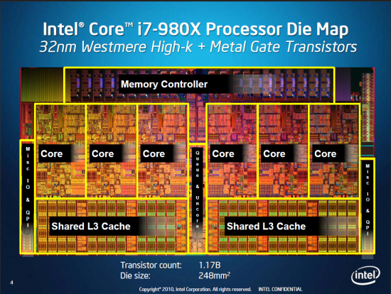
Current Research Mission
Computer architecture, HW/SW, systems, bioinformatics, security
Hybrid Main Memory
Heterogeneous
Processors and
Accelerators
Persistent Memory/Storage
Graphics and Vision Processing
Build fundamentally better devices
Notes:
Professor Mutlu’s research focus is all aspects of computer architecture, HW/SW interaction and bioinformatics.
He is looking for students to perform research in these areas.
He and his group, SAFARI, solve fundamental problems spanning:
Memory, memory, memory, storage, interconnects
Parallel architectures, heterogeneous architectures, GP-GPUs
System/architecture interaction, new execution models
Energy efficiency, fault tolerance, hardware security
Genome sequence analysis and assembly
His group does broad research spanning systems to logic with architecture at center

Slide 4
Four Key Directions
Fundamentally Secure/Reliable/Safe Architectures
Fundamentally Energy-Efficient Architectures
Memory-centric (Data-centric) Architectures
Fundamentally Low-Latency Architectures
Architectures for Genomics, Medicine, Health, AI/ML

Slide 5
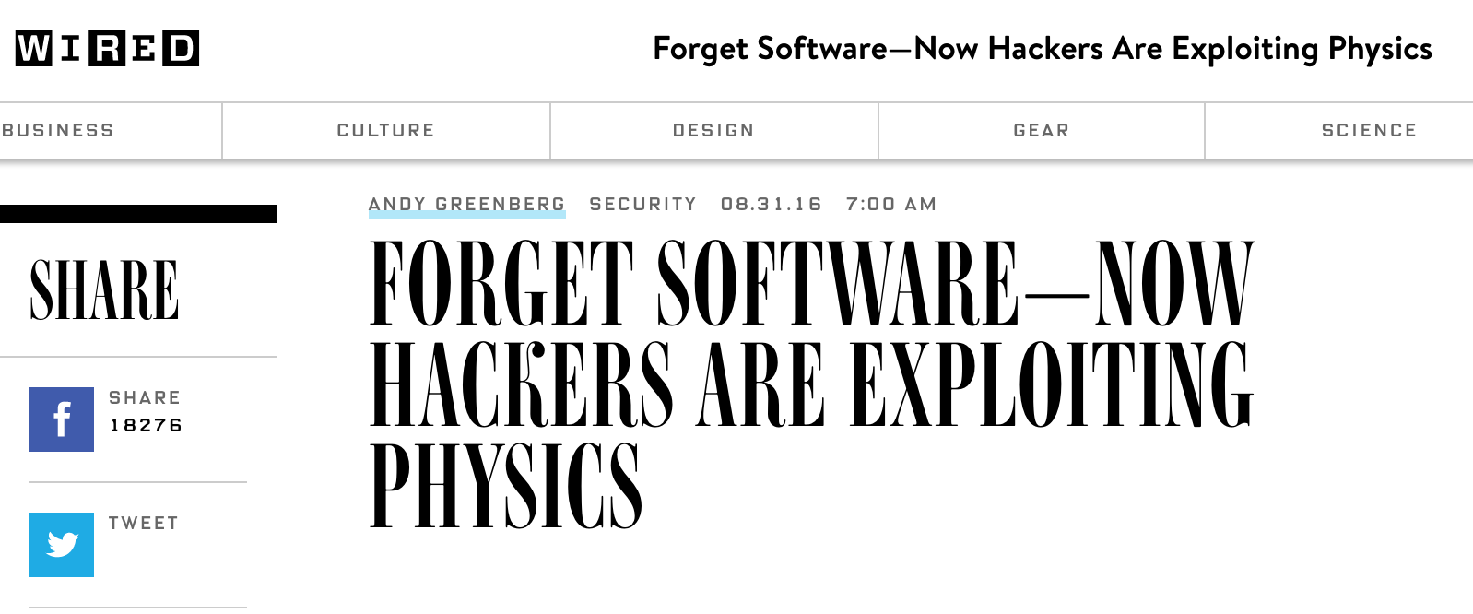
DRAM RowHammer Vulnerability
One can predictably induce bit flips in commodity DRAM chips
>80% of the tested DRAM chips are vulnerable
First example of how a simple hardware failure mechanism can create a widespread system security vulnerability

Slide 6
Hardware Security: RowHammer
Onur Mutlu and Jeremie Kim, "RowHammer: A Retrospective" IEEE Transactions on Computer-Aided Design of Integrated Circuits and Systems (TCAD) Special Issue on Top Picks in Hardware and Embedded Security, 2019. [Preliminary arXiv version]

Slide 7
New Paradigm: In-Memory Computation
Onur Mutlu, Saugata Ghose, Juan Gomez-Luna, and Rachata Ausavarungnirun, "Processing Data Where It Makes Sense: Enabling In-Memory Computation" Invited paper in Microprocessors and Microsystems (MICPRO), June 2019. [arXiv version]

Slide 8
Fundamentally Rethinking Memory
Onur Mutlu, "Memory Scaling: A Systems Architecture Perspective" Technical talk at MemCon 2013 (MEMCON), Santa Clara, CA, August 2013. [Slides (pptx) (pdf)] [Video] [Coverage on StorageSearch]
https://people.inf.ethz.ch/omutlu/pub/memory-scaling_memcon13.pdf

Slide 9
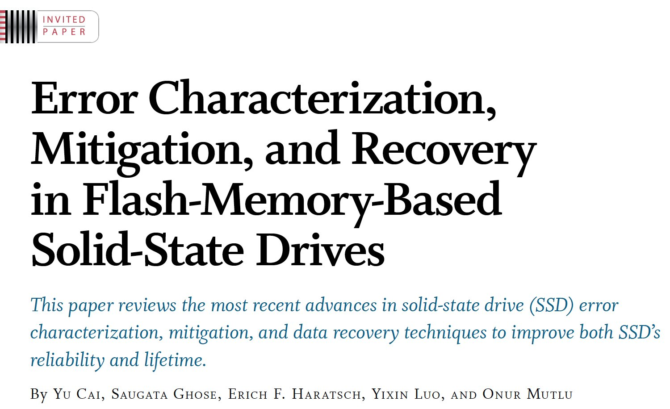
Reliable and Secure Data Storage
Proceedings of the IEEE, Sept. 2017
https://arxiv.org/pdf/1706.08642

Slide 10
Brief Introduction
Onur Mutlu
omutlu@gmail.com
https://people.inf.ethz.ch/omutlu
23 October 2019
Academy of Europe Inauguration Presentation

