Slide 1
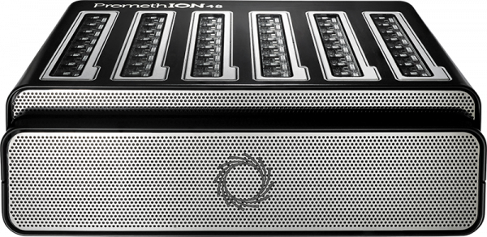
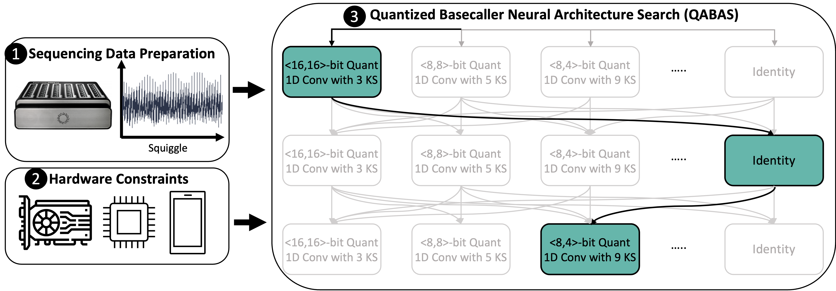
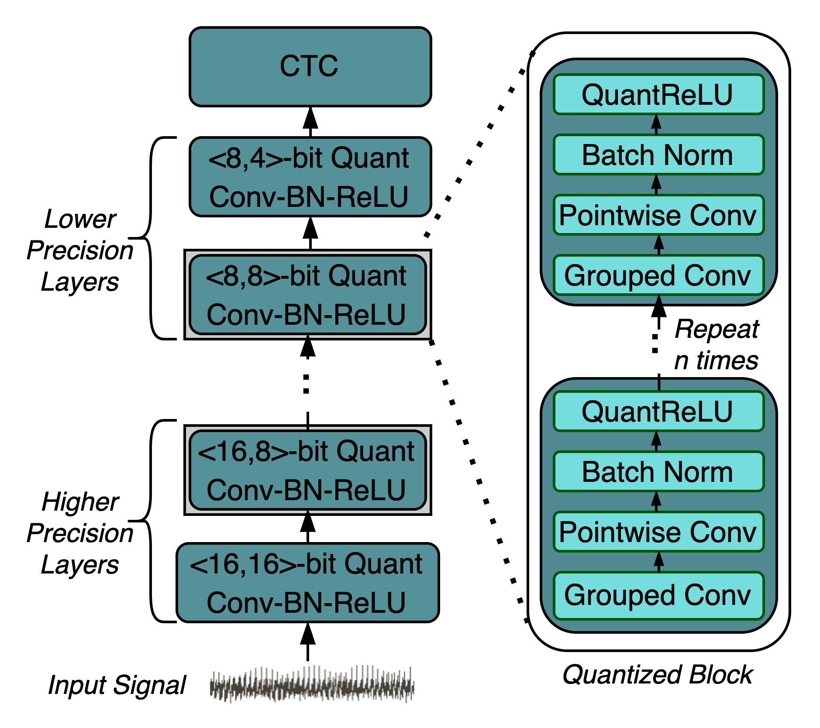
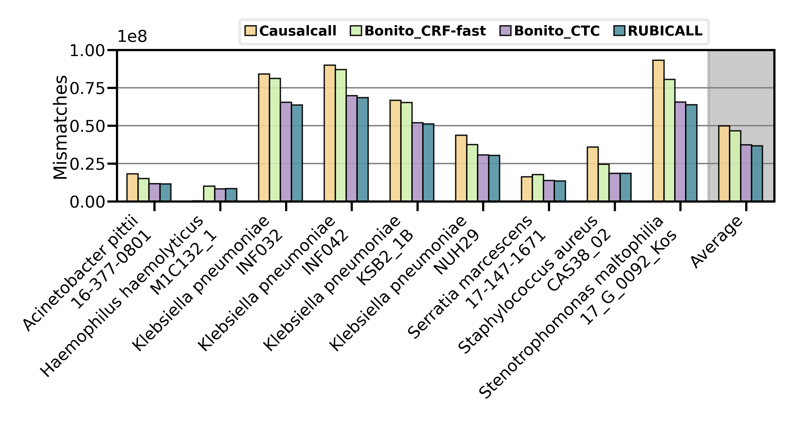
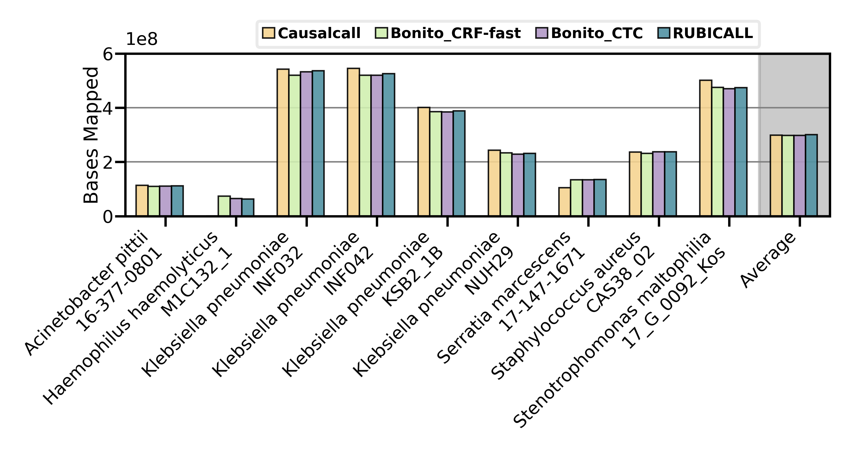
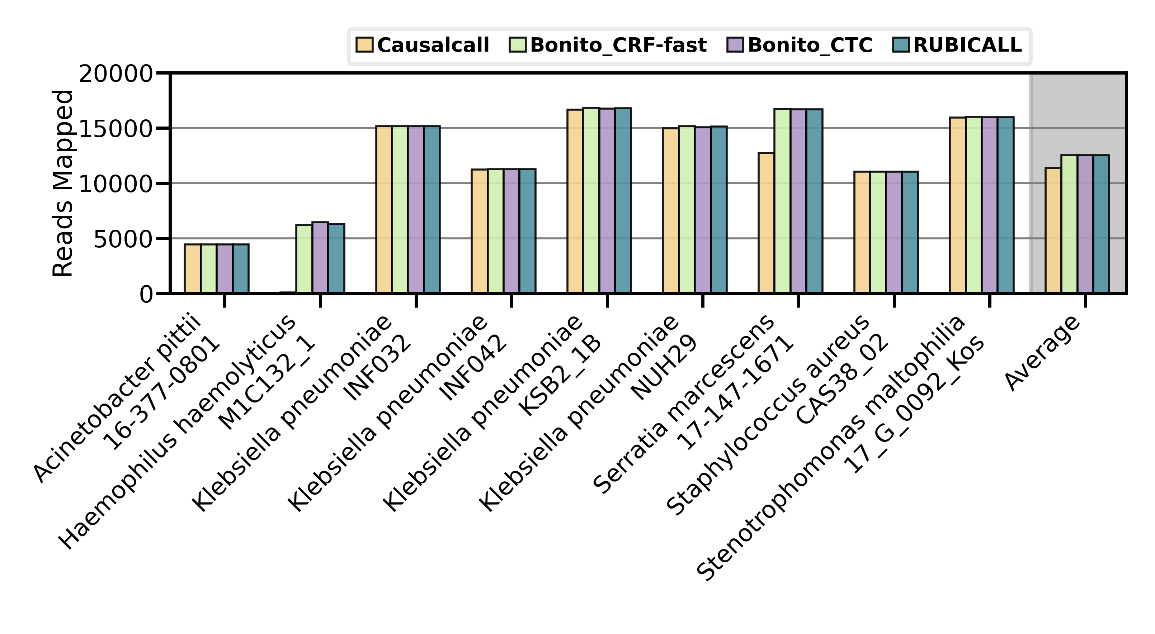
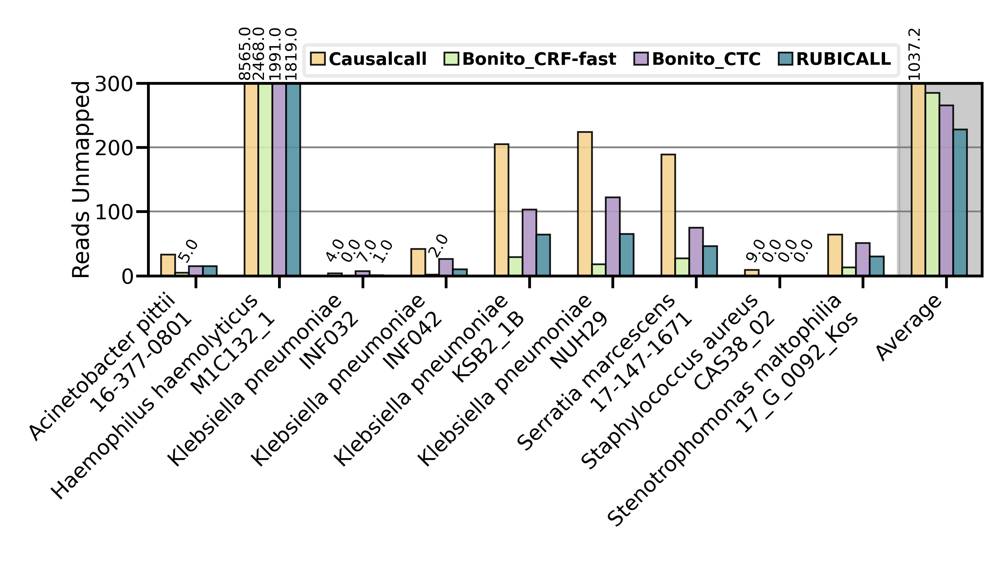
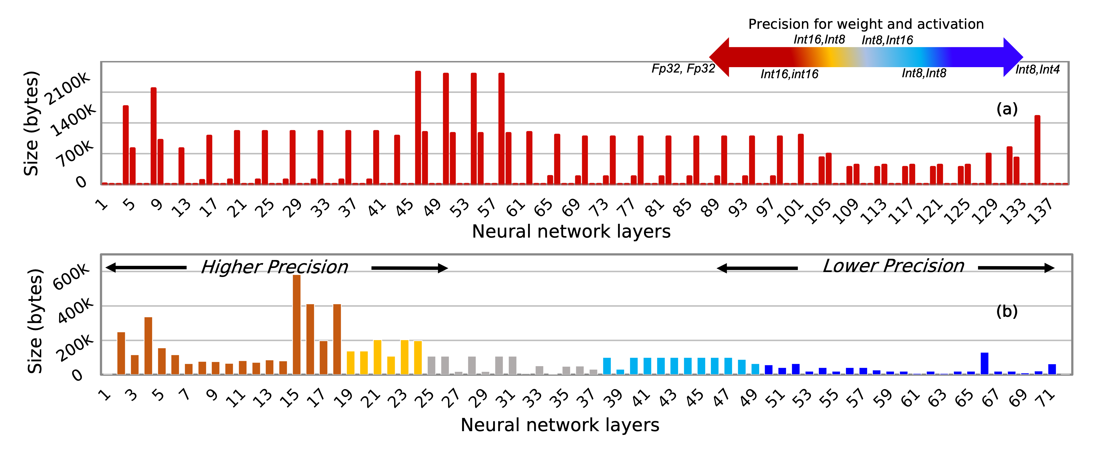
RUBICON: A Framework for Designing Efficient
Deep Learning-Based Genomic Basecallers
Gagandeep Singh¹ Mohammed Alser¹ Alireza Khodamoradi² Kristof Denolf²
Can Firtina¹ Meryem Banu Cavlak¹ Henk Corporaal³ Onur Mutlu¹
Full Paper
1 2 3
https://arxiv.org/abs/2211.03079
1: Background: Genomic Basecalling
2: Motivation: Analyzing a State-of-the-Art Basecaller
Basecalling is the first step in the genomics pipeline that converts noisy electrical signals to nucleotide bases (i.e., A, C, G, T)
KEY OBSERVATION 1: Effect of Pruning
Modern basecallers use complex deep learning-based models
Basecallers are often adapted from the speech recognition domain leading to over-parametrized models.
85% of weights can be pruned using unstructured pruning leading to 6.67x lower model size without any loss in accuracy.
Nanopore Sequencer
CCGTCAGTA
AGTCGAGCT
GTCCCACTA
TTTCCGTCA
GTAAGTCCA
KEY OBSERVATION 2: Effect of Quantization
Current basecallers use floating-point precision to represent each neural network layer present in a basecaller.
Basecallers can provide full accuracy with 4x lower bits for weights and activations.
Squiggle
The accuracy and speed of basecalling have critical implications
for all the steps in genome analysis
Our goal is to develop a comprehensive framework for specializing and optimizing
a deep learning-based basecaller that provides high efficiency and performance
3: RUBICON: A Framework for Designing Efficient Deep Learning-Based Genomic Basecallers
RUBICON provides five key modules:
QABAS: Quantization-aware basecalling architecture search
SkipClip: Skip connection removal by teaching
Pruning: Structured and unstructured pruning with knowledge distillation
Training: Model training with knowledge distillation
Basecalling: Integrated official ONT basecalling modules
QABAS: Quantization-Aware
Basecalling Architecture Search
RUBICALL: A Hardware-Optimized Basecaller
QABAS automates the process of finding efficient and high-performance hardware-aware genomics basecallers
QABAS uses neural architecture search (NAS) to evaluate millions of different basecaller architectures
RUBICALL is the first hardware-optimized basecaller that uses mixed-precision computation
RUBICALL is developed using QABAS and SkipClip from RUBICON
SkipClip: Skip Connection Removal by Teaching
SkipClip removes all the skip connections present in modern basecallers to reduce resource and storage requirements without any loss in basecalling accuracy
SkipClip uses knowledge distillation, where we train a smaller network (student) without skip connections to mimic a pre-trained bigger network (teacher) with skip connections
SkipClip removes a skip connection from the student network after every n epochs
During the search phases, QABAS automatically quantizes a neural network model by exploring and finding the best bit-width precision (e.g., 4-b, 8-b, and 16-b) for each neural network layer while jointly searching for the best kernel size (KS) and the number of layers (by using identity operator)
4: Evaluation & Key Results
Comparison of RUBICALL with State-of-the-art Basecallers
Downstream Analysis: Read Mapping
We evaluate RUBICALL using:
Versal ACAP VC2802, a cutting-edge spatial vector computing system from AMD-Xilinx (RUBICALL-MP) using mixed-precision computation
AMD Mi50 GPU (RUBICALL-FP) using 32-bit floating-point precision computation
Comparison to four basecallers:
(1) Bonito-CTC, an expert-designed convolutional neural network-based basecaller from ONT
(2) Bonito-CRF-fast, a throughput-optimized recurrent neural network-based basecaller from ONT
(3) Bonito-CRF-sup, an accuracy-optimized recurrent neural network-based basecaller from ONT
(4) Causalcall, a state-of-the-art hand-tuned basecaller
We map the resulting basecalled reads from each evaluated basecaller to the reference genome of the same species using the state-of-the-art read mapper, minimap2
KEY OBSERVATION
(a) Mismatches
(b) Bases Mapped
RUBICALL-MP provides the ability to basecall accurately, quickly, and efficiently scale basecalling by providing reductions in both model size and neural network model parameters.
Explainability Into QABAS Results
(c) Reads Mapped
(d) Reads Unmapped
KEY RESULTS
KEY OBSERVATION
RUBICALL uses 6.88x and 2.94x lower model size and parameters than an expert-designed basecaller (Bonito_CTC), respectively
RUBICALL provides 16.56x higher basecalling throughput without any loss in basecalling accuracy compared to Bonito_CTC by leveraging mixed precision computation
RUBICALL provides, on average, 2.97% higher basecalling accuracy with 3.19x higher basecalling throughput compared to the fastest basecaller (Bonito_CRF-fast)
RUBICALL provides 35.42x higher basecalling throughput compared to the most accurate basecaller (Bonito_CRF-sup) at the expense of 2.55% lower accuracy
RUBICALL provides the highest-quality read mapping with largest number of mapped bases and mapped reads than our evaluated basecallers
(a) Bonito_CTC
QABAS uses more bits in the initial layers than the final layers in RUBICALL.
QABAS learns that the input to RUBICALL uses an analog squiggle that requires higher precision, while the output is only the nucleotide bases (A, C, G, T), which can be represented using lower precision.
(b) RUBICALL
KEY OBSERVATION
RUBICALL has every layer quantized to a different quantization domain. The state-of-the-art basecallers use the same floating-point precision for all the neural network layers, which leads to high processing and memory demands.

