Slide 1





Demystifying Distributed Optimization Algorithms on a Real-World Processing-In-Memory System
PIM-Opt
Steve Rhyner Haocong Luo Juan Gómez-Luna Mohammad Sadrosadati
Jiawei Jiang Ataberk Olgun Harshita Gupta Ce Zhang Onur Mutlu

Slide 2
PIM-Opt: Summary
Problem: Modern machine learning (ML) training is a data-intensive workload and
processor-centric architectures commonly used for ML training suffer from the data movement bottleneck
Goal: Understand the capabilities of popular distributed Stochastic Gradient Descent (SGD) algorithms on real-world Processing-In-Memory (PIM) systems to accelerate distributed
ML training workloads
Contributions:
Implementation, analysis, and training of linear ML models on two large datasets using distributed SGD algorithms on a real-world PIM system (i.e., UPMEM)
Demonstrate scalability challenges of the UPMEM PIM system
  Discuss implications for future PIM hardware design
  Highlight the need for a shift towards an algorithm-hardware codesign
Evaluation:
Comparison of the UPMEM PIM to state-of-the-art CPU and GPU
  YFCC100M-HNfc6 dataset: UPMEM PIM is up to 1.9x/3.2x faster than the CPU/GPU
  Criteo 1TB Click Logs dataset: UPMEM PIM is up to 9.3x/10.7x faster than the CPU/GPU
Scalability challenges of the UPMEM PIM
  YFCC100M-HNfc6 (Criteo 1TB Click Logs) dataset: Speedup of 7.4x (3.9x) while the achieved test accuracy (AUC score) decreases from 95.5% (0.74) to 92.2% (0.72)
https://github.com/CMU-SAFARI/PIM-Opt

Slide 3
Outline
Background
Background
Motivation
UPMEM PIM System Implementation
Methodology
Evaluation & Key Results
Implications for PIM Hardware Design
Conclusion

Slide 4
Models & ML Training
Two of the most commonly trained linear binary classification models:
  Logistic Regression (LR)
  Support Vector Machines (SVM)
The goal of machine learning (ML) training is to find an optimal ML model by minimizing an objective function over a training dataset
Regularization techniques are used
  Prevent overfitting on the training dataset
  Control the model complexity

Slide 5
Algorithms
Stochastic Gradient Descent (SGD) is perhaps the most important and commonly deployed optimization algorithm for modern ML training
SGD is the main building block of most distributed optimization algorithms
Variants of SGD such as mini-batch SGD allow for parallelization by batching the training samples in each iteration

Slide 6
Distributed Optimization Algorithms
Centralized Topology
Decentralized Topology
Worker
Parameter
Server
Popular centralized optimization algorithms:
Mini-batch SGD with Model Averaging (MA-SGD)
Mini-batch SGD with Gradient Averaging (GA-SGD)
Distributed Alternating Direction Method of Multipliers (ADMM)

Slide 7
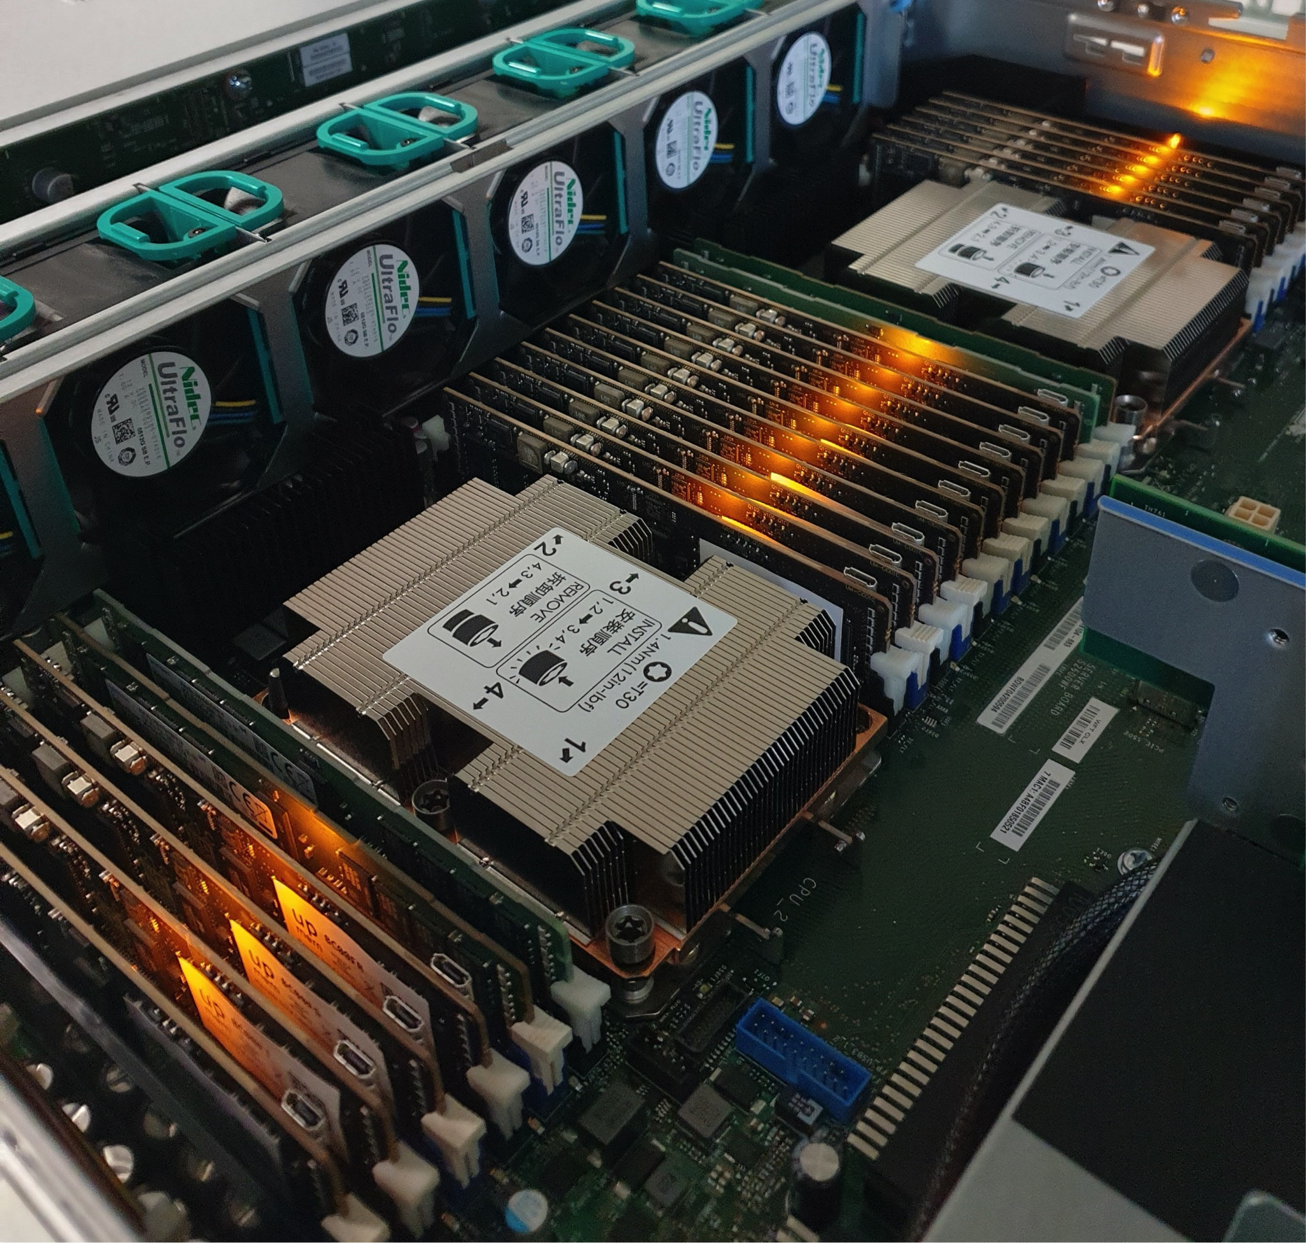
2,560-DPU UPMEM PIM System
20 UPMEM DIMMs of 16 chips each
(40 ranks)
Dual x86 socket
UPMEM DIMMs coexist with regular DDR4 DIMMs
  2 memory controllers/socket (3 channels each)
  2 conventional DDR4 DIMMs on one channel of one controller

Slide 8
UPMEM PIM System Architecture
UPMEM PIM Chip
Host CPU
Core
Core
Core
Memory
Controller
Memory
Controller
Bank
DDR4
Channel
DDR4
Channel
DRAM Array
(MRAM) 64MB
Main Memory
Module
UPMEM PIM
Module
High Bandwidth
Internal Data Bus
DRAM Processing
Unit (DPU)
UPMEM PIM Rank
Instruction
Memory
Working Memory
(WRAM) 64KB
Fine-grained
Multi-threaded Pipeline
x8
x8

Slide 9
Outline
Background
Motivation
Motivation
UPMEM PIM System Implementation
Methodology
Evaluation & Key Results
Implications for PIM Hardware Design
Conclusion

Slide 10

Key Problem
Data Movement Bottleneck
          Processor-centric design
            Highly-imbalanced systems
            Overly complex processors
          Applications are increasingly data hungry
          Stochastic Gradient Descent is memory-bound
The data movement bottleneck is a key limiter of
large-scale Machine Learning training
Data Movement
SoC
DRAM
CPU
L2
CPU
L1
CPU
CPU

Slide 11

Motivation
Processing-In-Memory is a promising solution
to perform large-scale ML Training
→ Processing-In-Memory is a promising solution
to perform large-scale ML Training
Processing-In-Memory is a promising solution
to perform large-scale ML Training
→ Alleviate the data movement bottleneck by placing compute units inside or near memory
How do we start?
By identifying key characteristics covering the design space
of both hardware and optimization algorithms

Slide 12
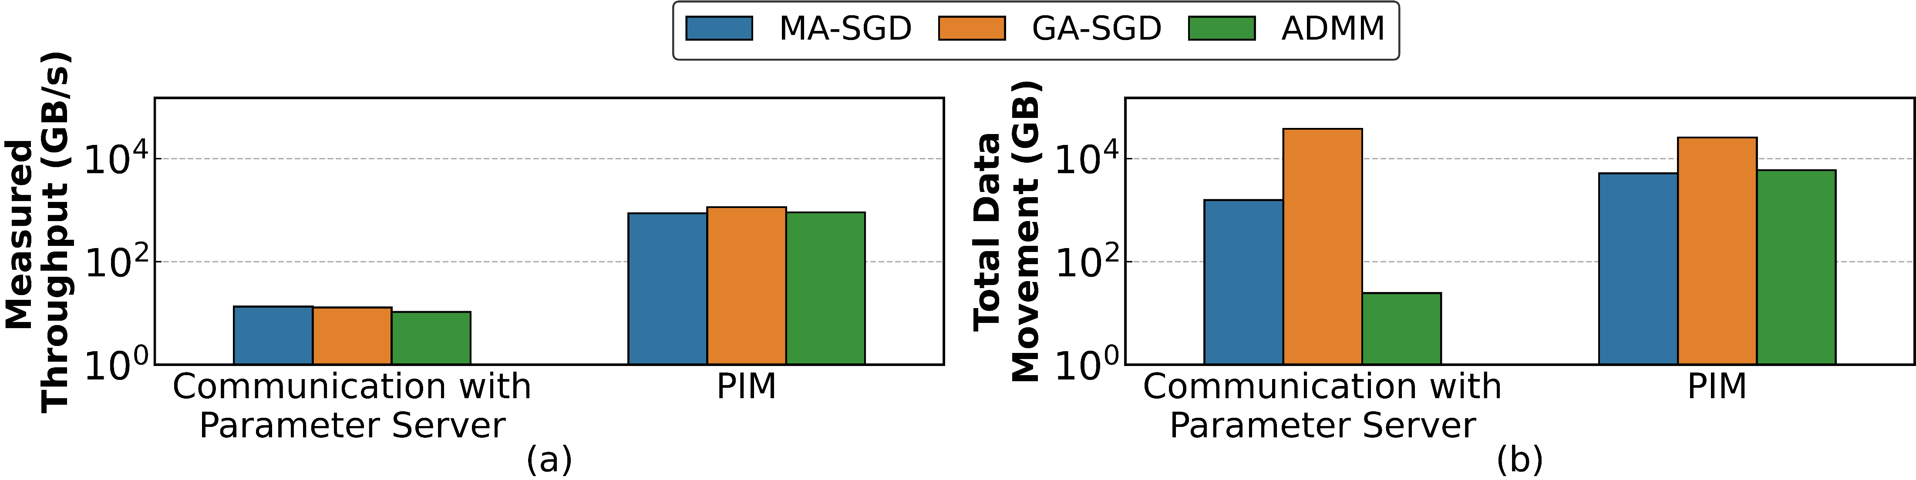
Motivation
1536.1x higher
64.6x higher
64x higher
64.6x higher
→ Minimize the communication
between the parameter server and PIM
→ Minimize the total data movement
between the parameter server and PIM
It is important to carefully choose
the optimization algorithms
that best fit PIM
The communication-efficient ADMM optimization algorithm is attractive for distributed ML training
on the UPMEM PIM system
The communication-efficient ADMM optimization algorithm is attractive for distributed ML training
on the UPMEM PIM system

Slide 13
Outline
Background
Motivation
UPMEM PIM System Implementation
UPMEM PIM System Implementation
Methodology
Evaluation & Key Results
Implications for PIM Hardware Design
Conclusion

Slide 14

UPMEM PIM System Implementation
Host-side
UPMEM-side
Distribute Partitions of
Training Data to DPUs
Training Data Partitions
DPU Set
DPU
DPU
DPU Program Invokation
Inter-DPU Synchronization
Local Models/Gradients
Distribute Global Model
to DPUs
Updated Global Model

Slide 15
UPMEM PIM System Implementation
Task Parallelism:
  Every DPU is a worker
  Every DPU uses 16 tasklets collaboratively to implement
  the mini-batch SGD optimizer
  Features of the training samples & model parameters are
  evenly distributed among tasklets
LUT-based Methods:
  Training of Logistic Regression involves computing the exponential function to evaluate the sigmoid
  UPMEM PIM system does not support transcendental functions
  → We use the TransPimLib library for efficient LUT-based
  computation

Slide 16
Outline
Background
Motivation
UPMEM PIM System Implementation
Methodology
Methodology
Evaluation & Key Results
Implications for PIM Hardware Design
Conclusion

Slide 17
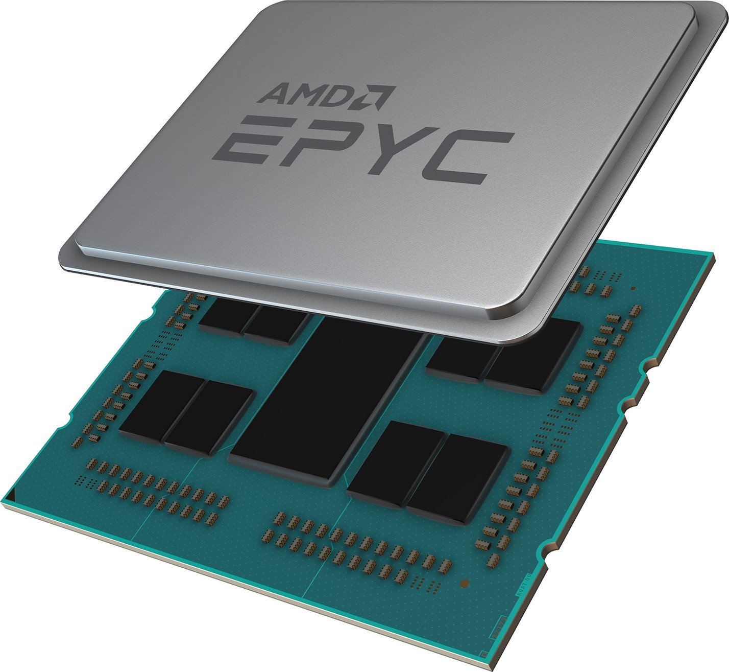
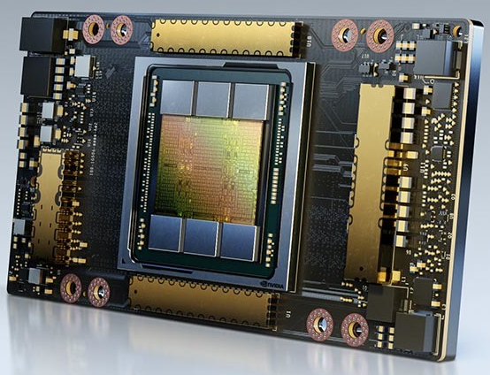
System Configurations
UPMEM PIM System:
  2x Intel Xeon Silver 4215
  8-core processor @ 2.50GHz
  2560 DPUs @ 350 MHz
  20×8 GB UPMEM PIM modules
CPU Baseline System:
  2x AMD EPYC 7742
  64-core processor @ 2.25GHz
GPU Baseline System:
  2x Intel Xeon Gold 5118
  12-core processor @ 2.30GHz
  1× NVIDIA A100 (PCIe, 80 GB)
Image source: https://gzhls.at/i/35/19/2113519-l3.jpg (AMD EPYC), https://www.nvidia.com/content/dam/en-zz/Solutions/Data-Center/a100/nvidia-a100-80-gb-og-social-1200x630.jpg (NVIDIA A100)

Slide 18
Baseline Implementations
CPU Baseline Implementation:
  Implementations use PyTorch
  We implement MA-SGD, GA-SGD, and ADMM, to train LR and
  SVM models, using the optimizers and communication libraries provided by PyTorch
  Each CPU thread is a worker
GPU Baseline Implementation:
  Implementations use PyTorch
  We only implement mini-batch SGD on the GPU
  → PyTorch does not provide a way to limit the amount of GPU resources the kernels use
  → Causing model averaging to be serialized on a single GPU
  For fair comparison, we do not use a cluster of GPUs for our baseline because the UPMEM PIM system is a single-server node

Slide 19
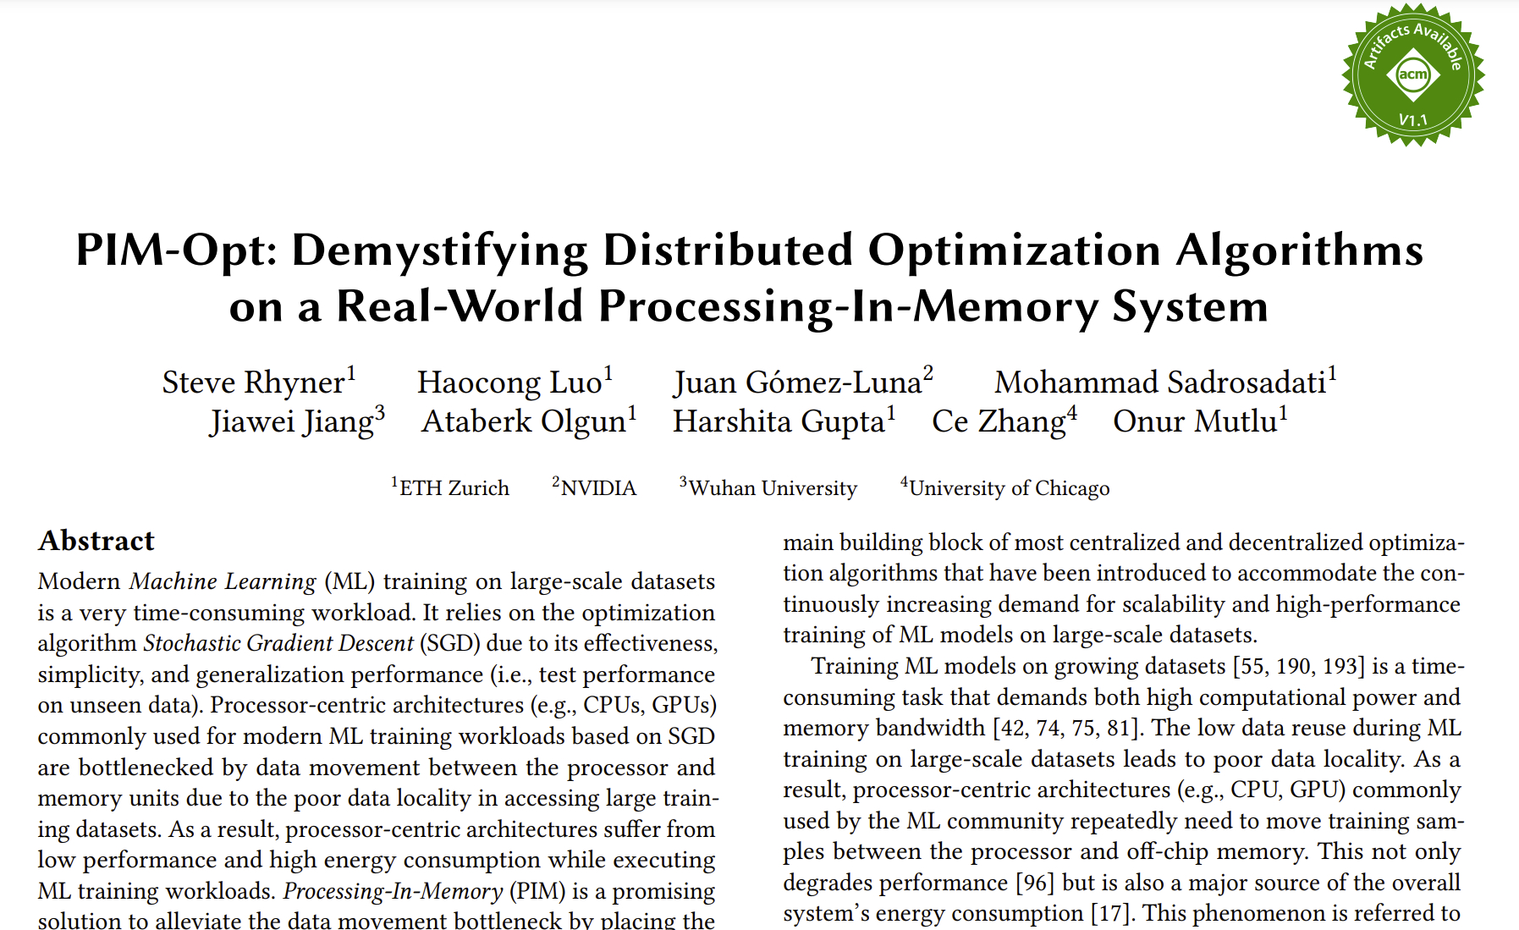
Experiment Implementation Details
https://arxiv.org/pdf/2404.07164v2

Slide 20
Outline
Background
Motivation
UPMEM PIM System Implementation
Methodology
Evaluation & Key Results
Evaluation & Key Results
Implications for PIM Hardware Design
Conclusion

Slide 21
YFCC100M-HNfc6
Dataset

Slide 22
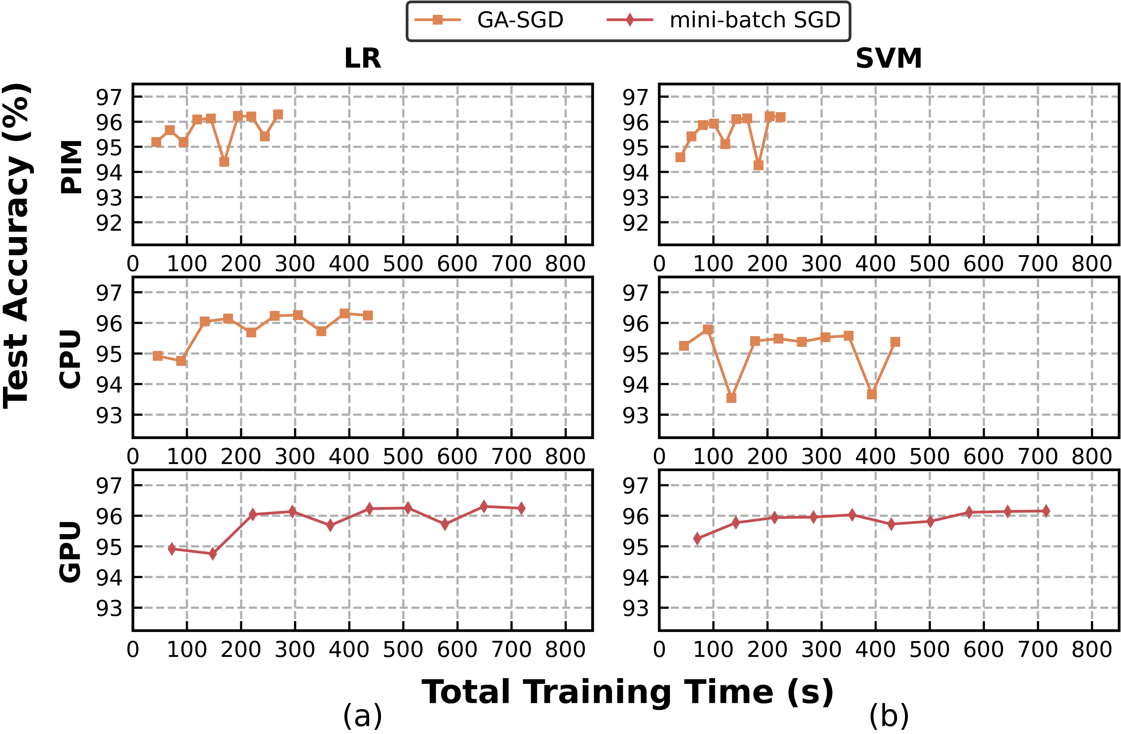
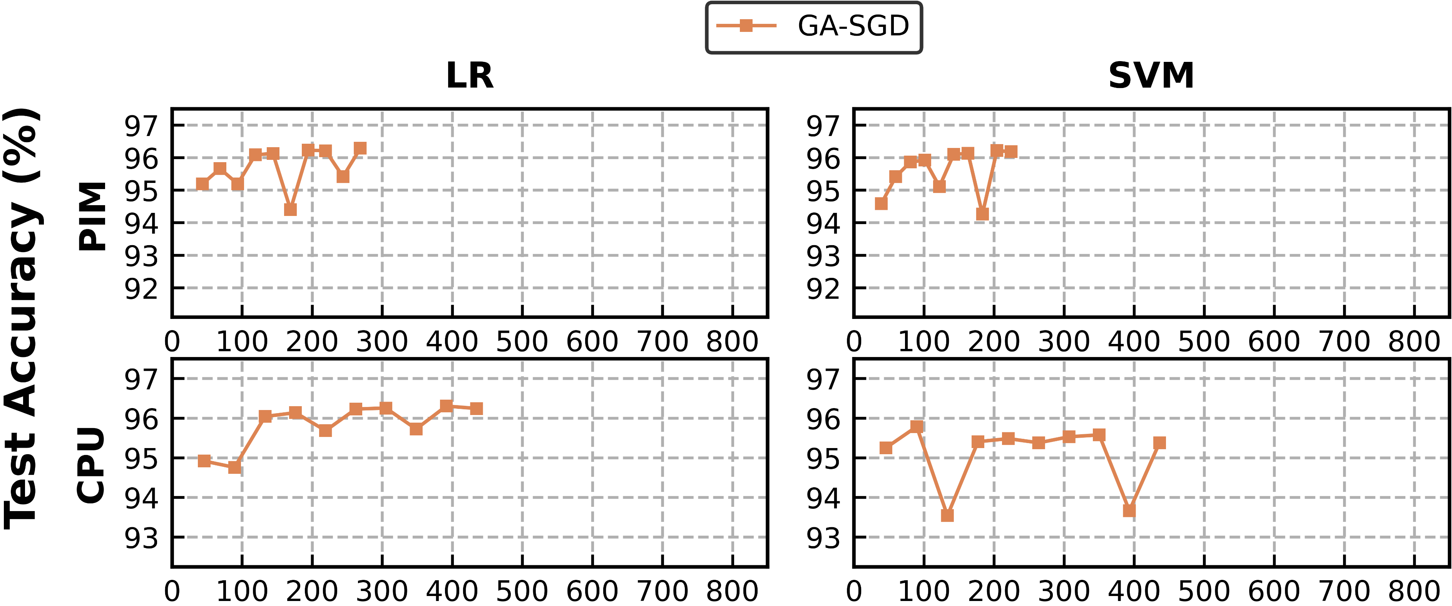
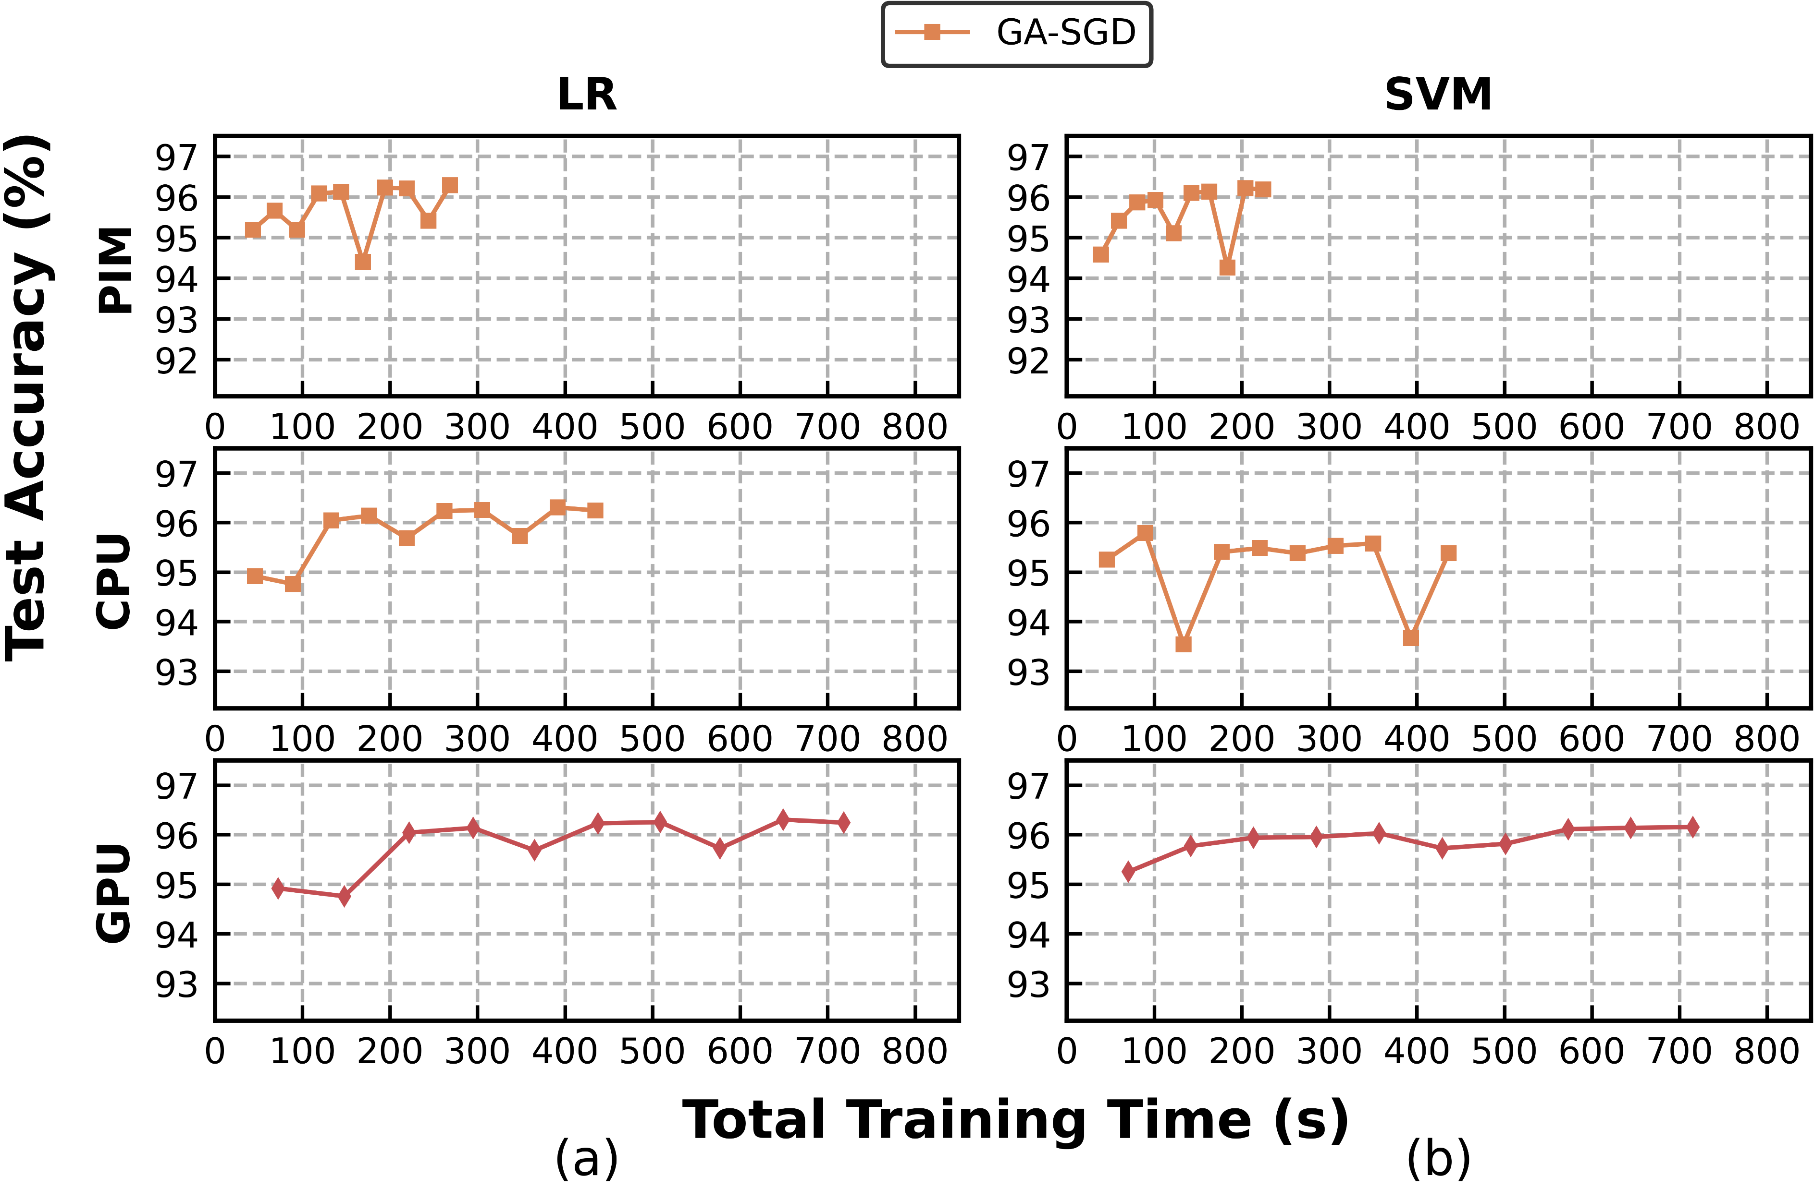
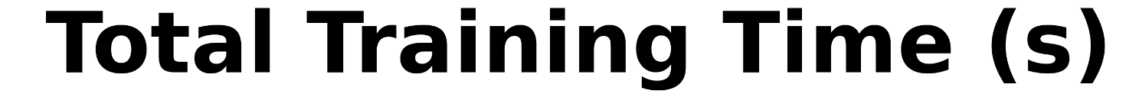
PIM Performance Comparison
3.2x higher
2.7x higher
1.6x higher
1.9x higher
    MA-SGD on the UPMEM PIM significantly outperforms
    MA-SGD on the CPU for both LR and SVM
    ADMM on the UPMEM PIM and on the CPU exhibits comparable performance for both LR and SVM
GA-SGD on the UPMEM PIM outperforms GA-SGD on the CPU for both LR and SVM
GA-SGD on the UPMEM PIM outperforms mini-batch SGD on the GPU for both LR and SVM

Slide 23
PIM Performance Comparison
3.2x higher
2.7x higher
1.6x higher
1.9x higher
The UPMEM PIM is a viable alternative to the CPU and the GPU
for training small dense models on large-scale datasets
GA-SGD on the UPMEM PIM outperforms GA-SGD on the CPU for both LR and SVM
GA-SGD on the UPMEM PIM outperforms mini-batch SGD on the GPU for both LR and SVM

Slide 24
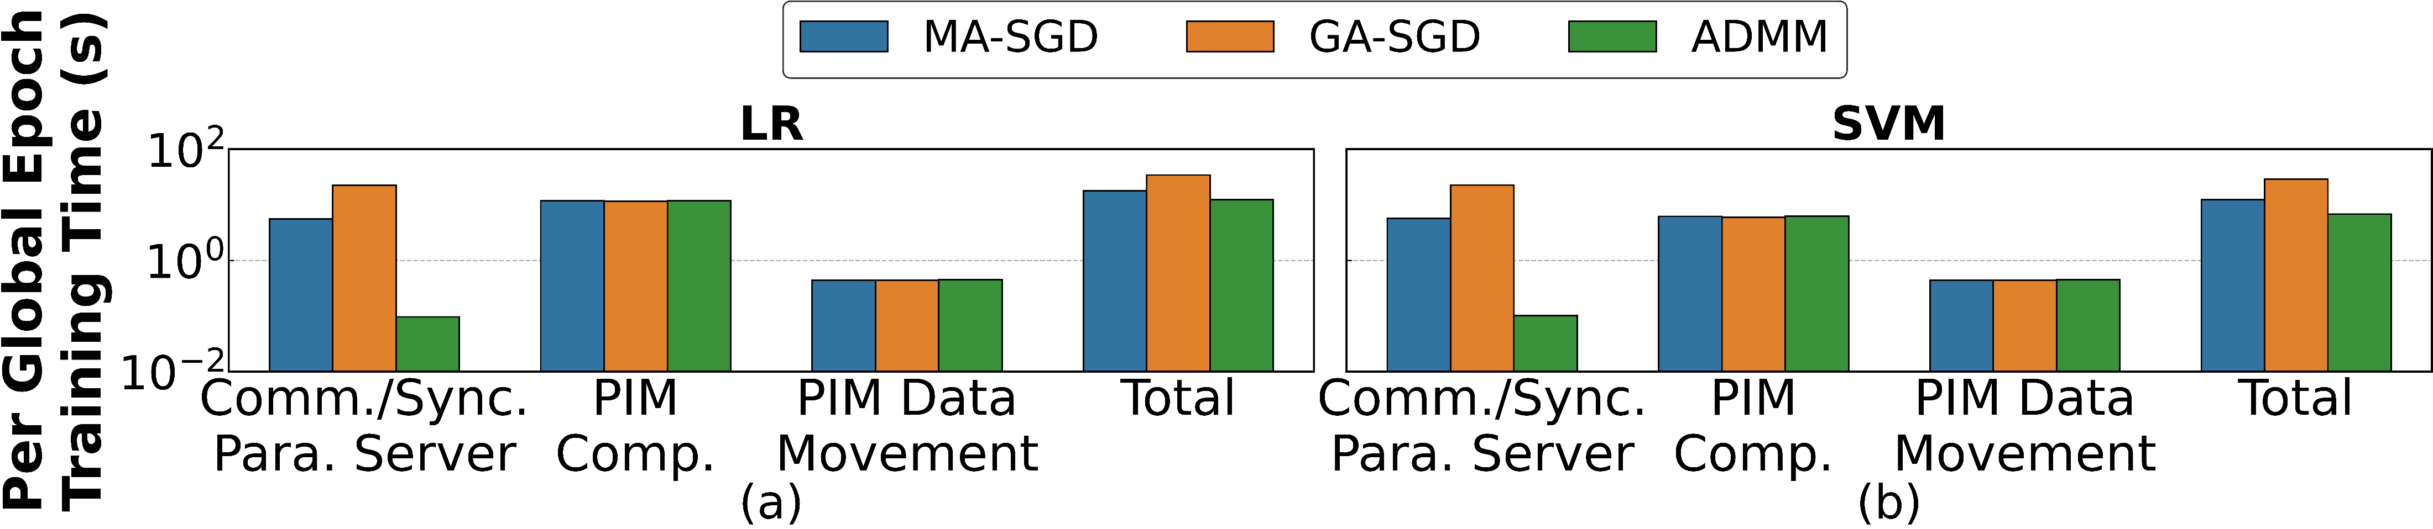
PIM Performance Breakdown
223.3x higher
14.1x higher
The UPMEM PIM is less suitable for ML models and optimization algorithms that require frequent communication and synchronization between PIM and the parameter server
Communication and synchronization between the parameter server and PIM is a bottleneck for MA-SGD/GA-SGD
For all combinations of optimization algorithms and models, PIM computation takes more time than PIM data movement on the UPMEM PIM

Slide 25
Criteo
Dataset

Slide 26
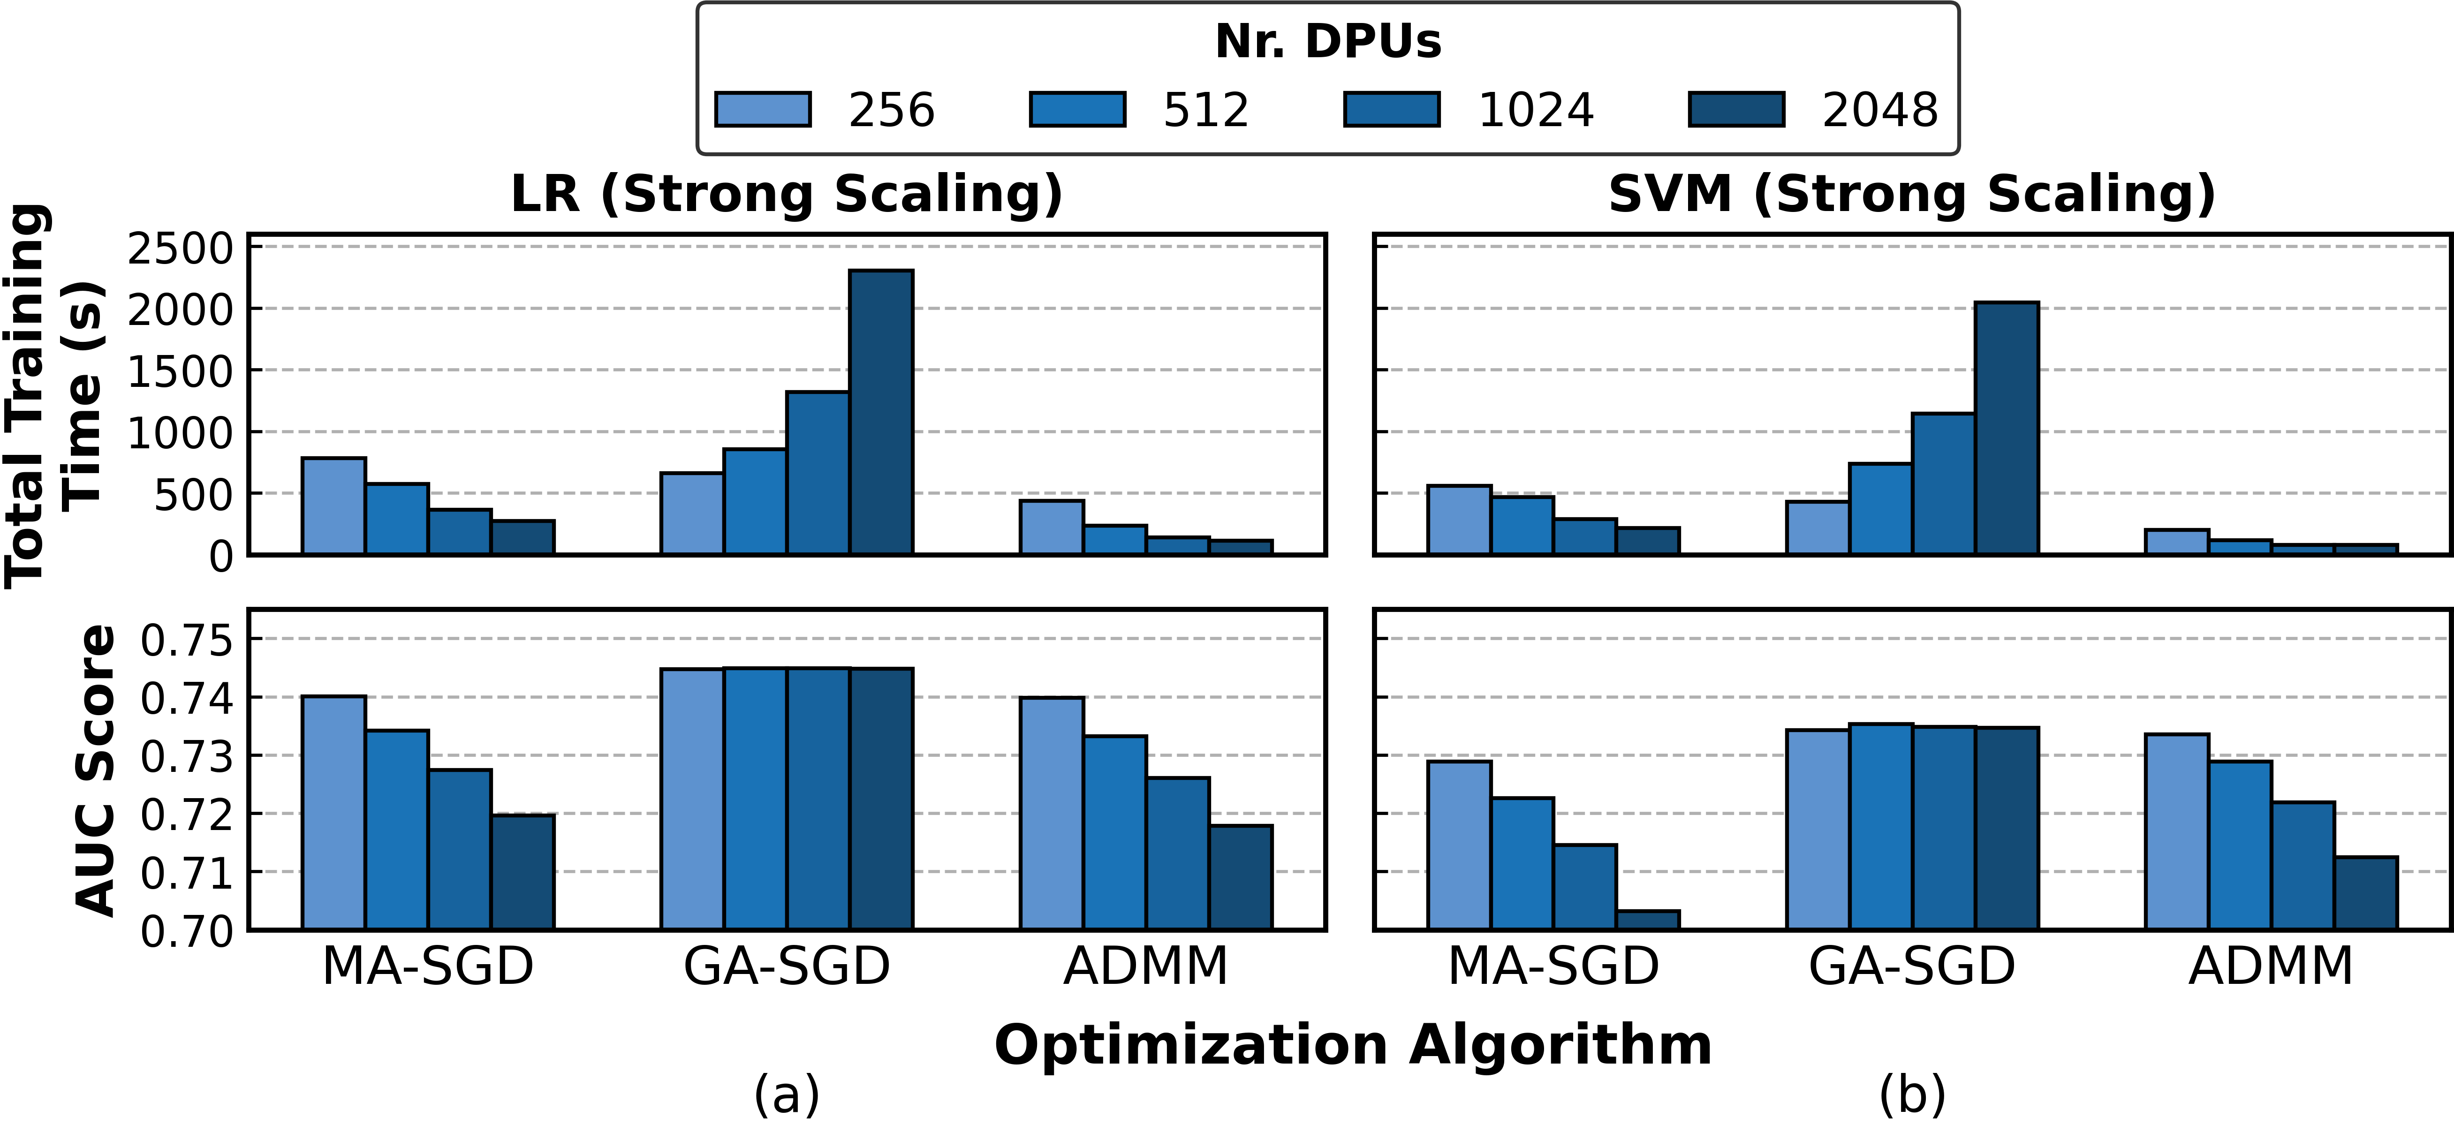
PIM Strong Scaling
Reduction by
2.9x
The scalability potential of the UPMEM PIM for training
high-dimensional sparse models is limited by its lack of
direct inter-DPU communication
Auc Score decreases from 0.74 to 0.72
For high-dimensional sparse models, for MA-SGD/ADMM on the UPMEM PIM we observe good strong scalability in terms of total training time, but poor in AUC Score

Slide 27
More in the Paper
Rigorous analysis of many combinations of algorithms, models, architectures, and datasets
For each YFCC100M-HNfc6 and Criteo 1TB Click Logs datasets, we examine
  PIM performance breakdown
  PIM performance comparison & algorithm selection
  Batch size sensitivity analysis
  Impact of scaling
    Weak Scaling
    Strong Scaling
Extended observations, takeaways, and implications for future PIM hardware design
https://arxiv.org/pdf/2404.07164v2

Slide 28
Outline
Background
Motivation
UPMEM PIM System Implementation
Methodology
Evaluation & Key Results
Implications for PIM Hardware Design
Implications for PIM Hardware Design
Conclusion

Slide 29
Implications for PIM Hardware Design
Our evaluation demonstrates that a real-world PIM system
(i.e., UPMEM) can be a viable alternative to state-of-the-art
processor-centric architectures for many distributed ML training
workloads
We argue that future PIM architectures should add interconnects
and/or shared memory among PIM processing units
  Enables implementation of decentralized optimization algorithms
  Decentralized parallel SGD algorithms are a promising solution to overcome scalability challenges of the real-world PIM system
We posit that a shift towards an algorithm-hardware codesign
perspective is necessary in the context of ML training using PIM
due to the high complexity of the design space

Slide 30
Outline
Background
Motivation
UPMEM PIM System Implementation
Methodology
Evaluation & Key Results
Implications for PIM Hardware Design
Conclusion
Conclusion

Slide 31
Conclusion
  We evaluate and train ML models on large-scale datasets with centralized optimization algorithms on a real-world PIM system (i.e., UPMEM)
  We show that it is important to carefully choose the distributed optimization algorithm that best fits the real-world PIM system and analyze tradeoffs
  We demonstrate that commercial general-purpose PIM systems can be a viable alternative to state-of-the-art processor-centric architectures (e.g., CPU, GPU) for many distributed ML training workloads on large-scale datasets
  Our results demonstrate the necessity of adjust PIM architectures to enable decentralized parallel SGD algorithms to overcome scalability challenges for many distributed ML training workloads
  Future work:
    Larger models: Deep neural networks, large language models, ...
    New compute paradigms and accelerators
      Rethinking the full stack
      Algorithm-hardware codesign
https://github.com/CMU-SAFARI/PIM-Opt

Slide 32


Demystifying Distributed Optimization Algorithms on a Real-World Processing-In-Memory System
PIM-Opt
arXiv
GitHub

Slide 33
Backup Slides

Slide 34




Mini-batch SGD with Model Averaging (MA-SGD)
Model Averaging
Mini-batch SGD
Local Models
Global Model

Slide 35
Mini-batch SGD with Gradient Averaging (GA-SGD)
Gradient Averaging
Mini-batch SGD
Local Gradients
Global Model

Slide 36
Alternating Direction Method of Multipliers (ADMM)
Computation of Global Model & Auxiliary Variables
Mini-batch SGD
Local Models
Auxiliary Variables

Slide 37
2,560-DPU UPMEM PIM System
20 UPMEM DIMMs of 16 chips each (40 ranks)
Dual x86 socket
UPMEM DIMMs coexist with regular DDR4 DIMMs
  2 memory controllers/socket (3 channels each)
  2 conventional DDR4 DIMMs on one channel of one controller

Slide 38
PIM Programming and Execution Model
UPMEM PIM Chip
DPU programs are written in C
    UPMEM SDK
    Runtime libraries
Execution model of a DPU is based on the Single-Program-Multiple-Data (SPMD) paradigm
Each DPU can run up to
24 tasklets
    Assigned statically at
    compile-time
Tasklets assigned to the same DPU share MRAM and WRAM
Bank
DRAM Array
(MRAM) 64MB
DRAM Array
(MRAM) 64MB
High Bandwidth
Internal Data Bus
DRAM Processing
Unit (DPU)
Instruction
Memory
Working Memory
(WRAM) 64KB
Working Memory
(WRAM) 64KB
Fine-grained
Multi-threaded Pipeline
Fine-grained
Multi-threaded Pipeline
x8

Slide 39
UPMEM PIM System Implementation
Data Partitioning:
  For both MA-SGD and ADMM, each DPU’s partition consists of multiple mini-batches of the training data
  For GA-SGD, each partition consists of a fraction of all the mini-batches of the training data
Synchronization:
  For MA-SGD, each DPU only processes one mini-batch from its assigned training data partition and updates its local model before synchronization on the host
  For GA-SGD, each DPU computes intermediate gradients from its assigned fraction of one mini-batch before synchronization on the host
  For ADMM, each DPU processes all assigned mini-batches and updates its local model for every mini-batch

Slide 40
Experiment Implementation Details
Data Format:
  UPMEM PIM system uses quantized training data and models both represented 32-bit fixed-point format
  → Floating-point operations are not natively supported
  → Quantization is necessary to enable fixed-point operations
  Baseline implementations use the FP32 floating-point format
  → Natively supported
  → Higher accuracy

Slide 41
Experiment Implementation Details
Regularization:
  Apply standard regularization techniques
  → Achieve lower generalization errors
Batch Size:
  For each experiment, we tune the batch size to ensure
  → High accuracy
  → High performance in terms of total training time
  → Fair comparison of algorithms & architectures

Slide 42
Experiment Implementation Details
Hyperparameter Tuning:
  For all evaluated workloads, we tune the learning rates and regularization terms
  All tested hyperparameters along with our complete codebase are open source at
  https://github.com/CMU-SAFARI/PIM-Opt
Datasets:
  YFCC100M-HNfc6: Small and dense model
  Criteo 1 TB Click Logs: Large and sparse model

Slide 43
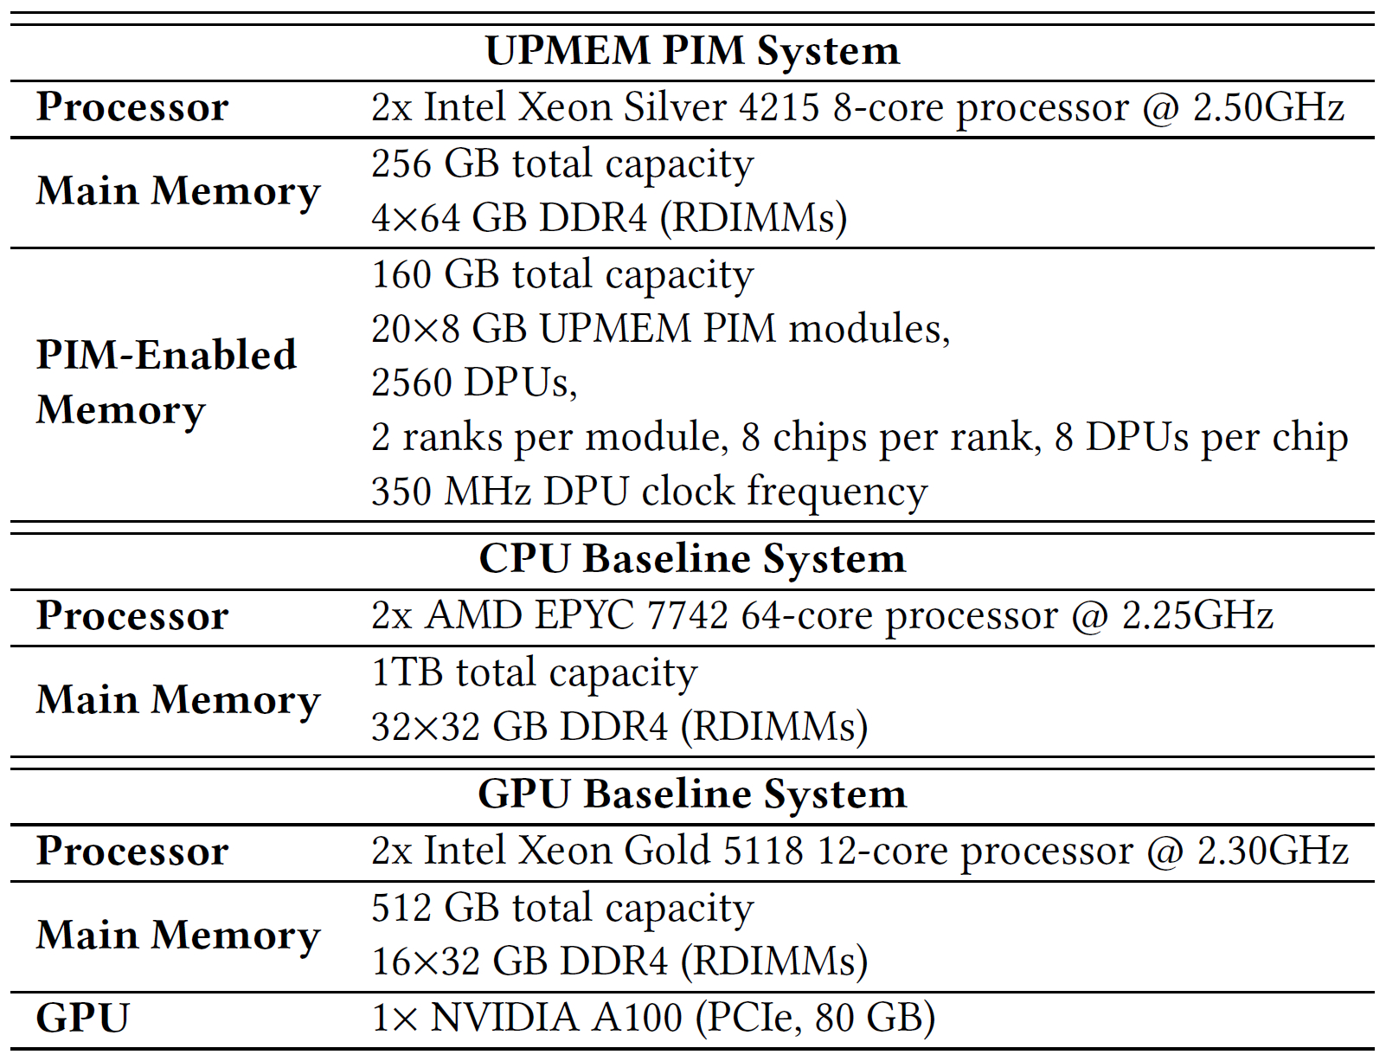
System Configurations

Slide 44
Experiment Implementation Details
Hyperparameter Tuning:
  For all evaluated workloads, we tune the learning rates and regularization terms
  All tested hyperparameters along with our complete codebase are open source at
  https://github.com/CMU-SAFARI/PIM-Opt
Initialization:
  For all implementations, the training data & model parameters initially reside in main memory
  For UPMEM PIM system and GPU baseline experiments, the initialization phase includes transferring the data from the main memory to the PIM DRAM bank and the GPU global memory

Slide 45
Datasets
YFCC100M-HNfc6:
  Popular multimedia dataset that consists of 97M samples
  Each sample has 4096 floating-point dense features and a collection of tags
  We randomly sample and shuffle data points and turn this subset into a binary classification task
  The total size of model parameters is 4 KB

Slide 46
Datasets
Criteo 1TB Click Logs (Criteo):
  Criteo is a popular click-through rate prediction dataset that consists of 4.37 b high-dimensional sparse samples with 1M features
  Each data point consists of label and 39 categorical
  While data points only consist of 40 parameters, the models/gradients consist of 1M variables
  The dataset is highly imbalanced
  We randomly sample and shuffle the dataset
  We use the area under the receiver operating characteristics curve (AUC score) to assess the generalization capabilities of models trained on Criteo
  The total size of the model parameters is 4MB

Slide 47
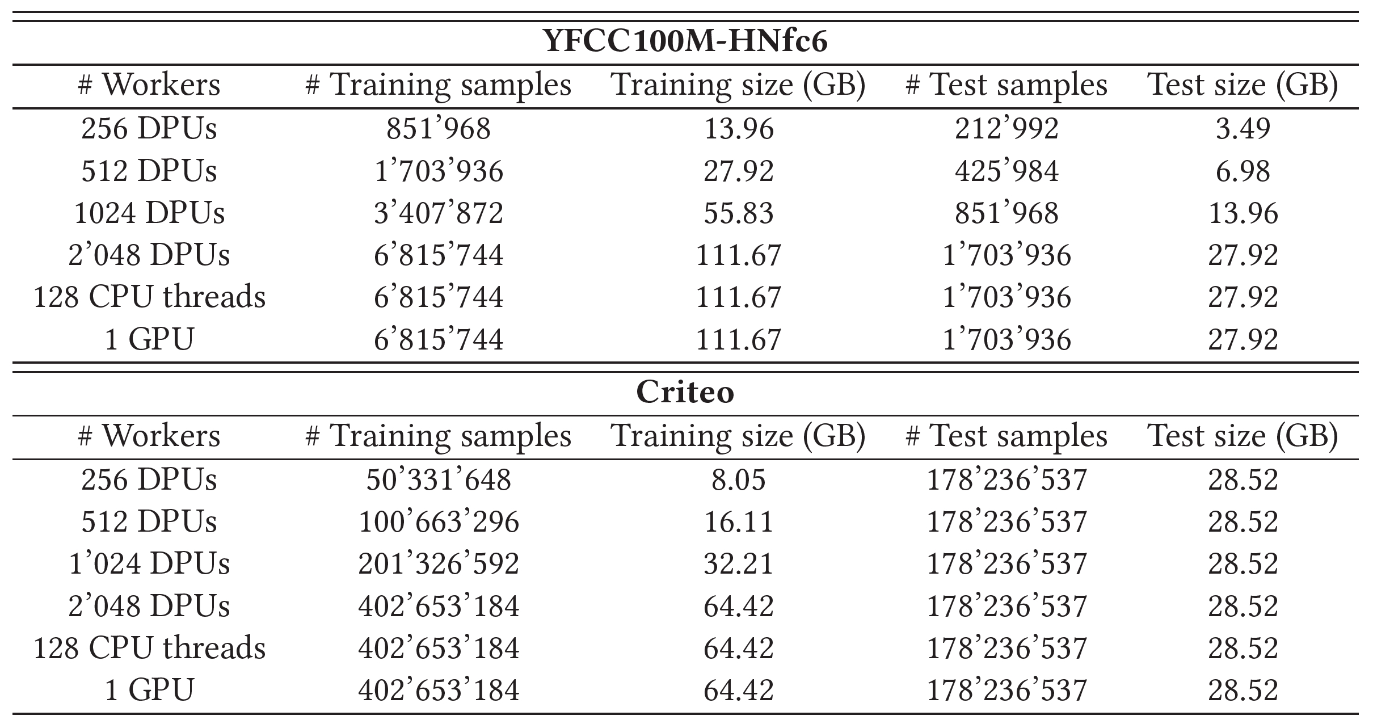
Datasets Configurations

Slide 48
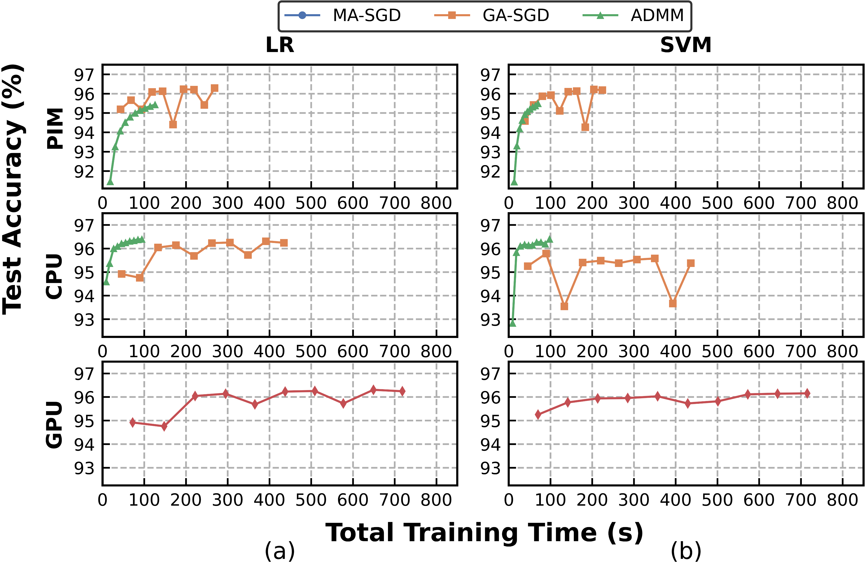
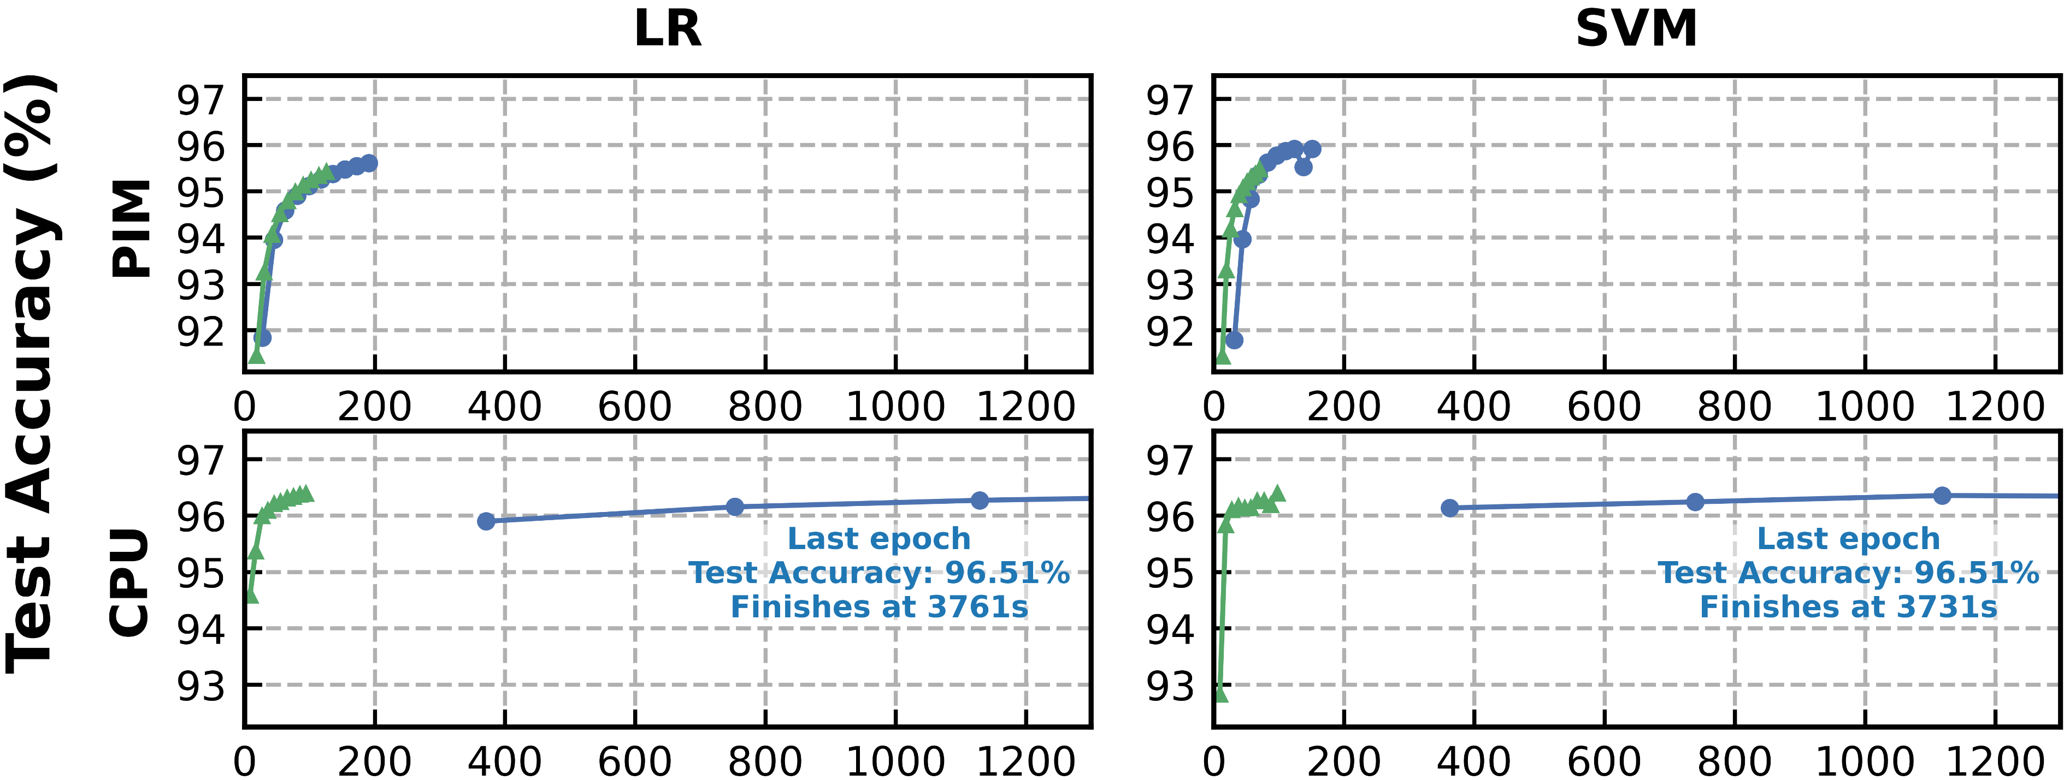
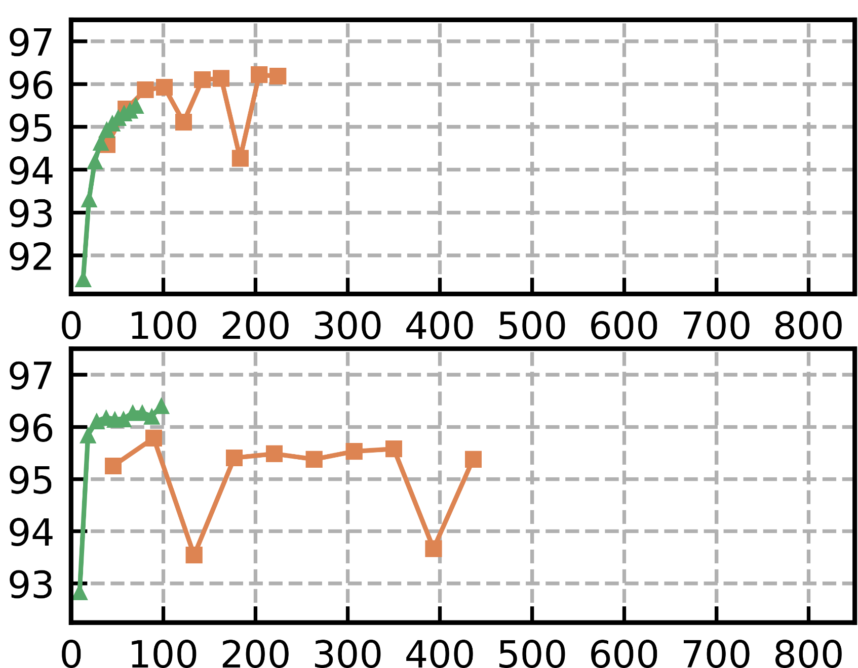

PIM Performance Comparison
1.5x higher
3.2x higher
39.8x higher
4.5x higher
Difference in total training time between MA-SGD and ADMM is significantly lower on the UPMEM PIM compared to the CPU
GA-SGD is slower than ADMM for all configurations of LR, SVM, the UPMEM PIM, and the CPU

Slide 49
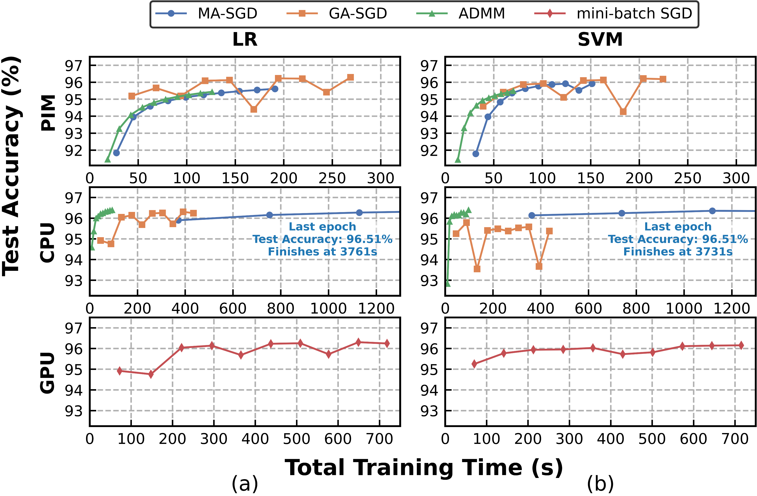
YFCC100M: Performance Comparison

Slide 50
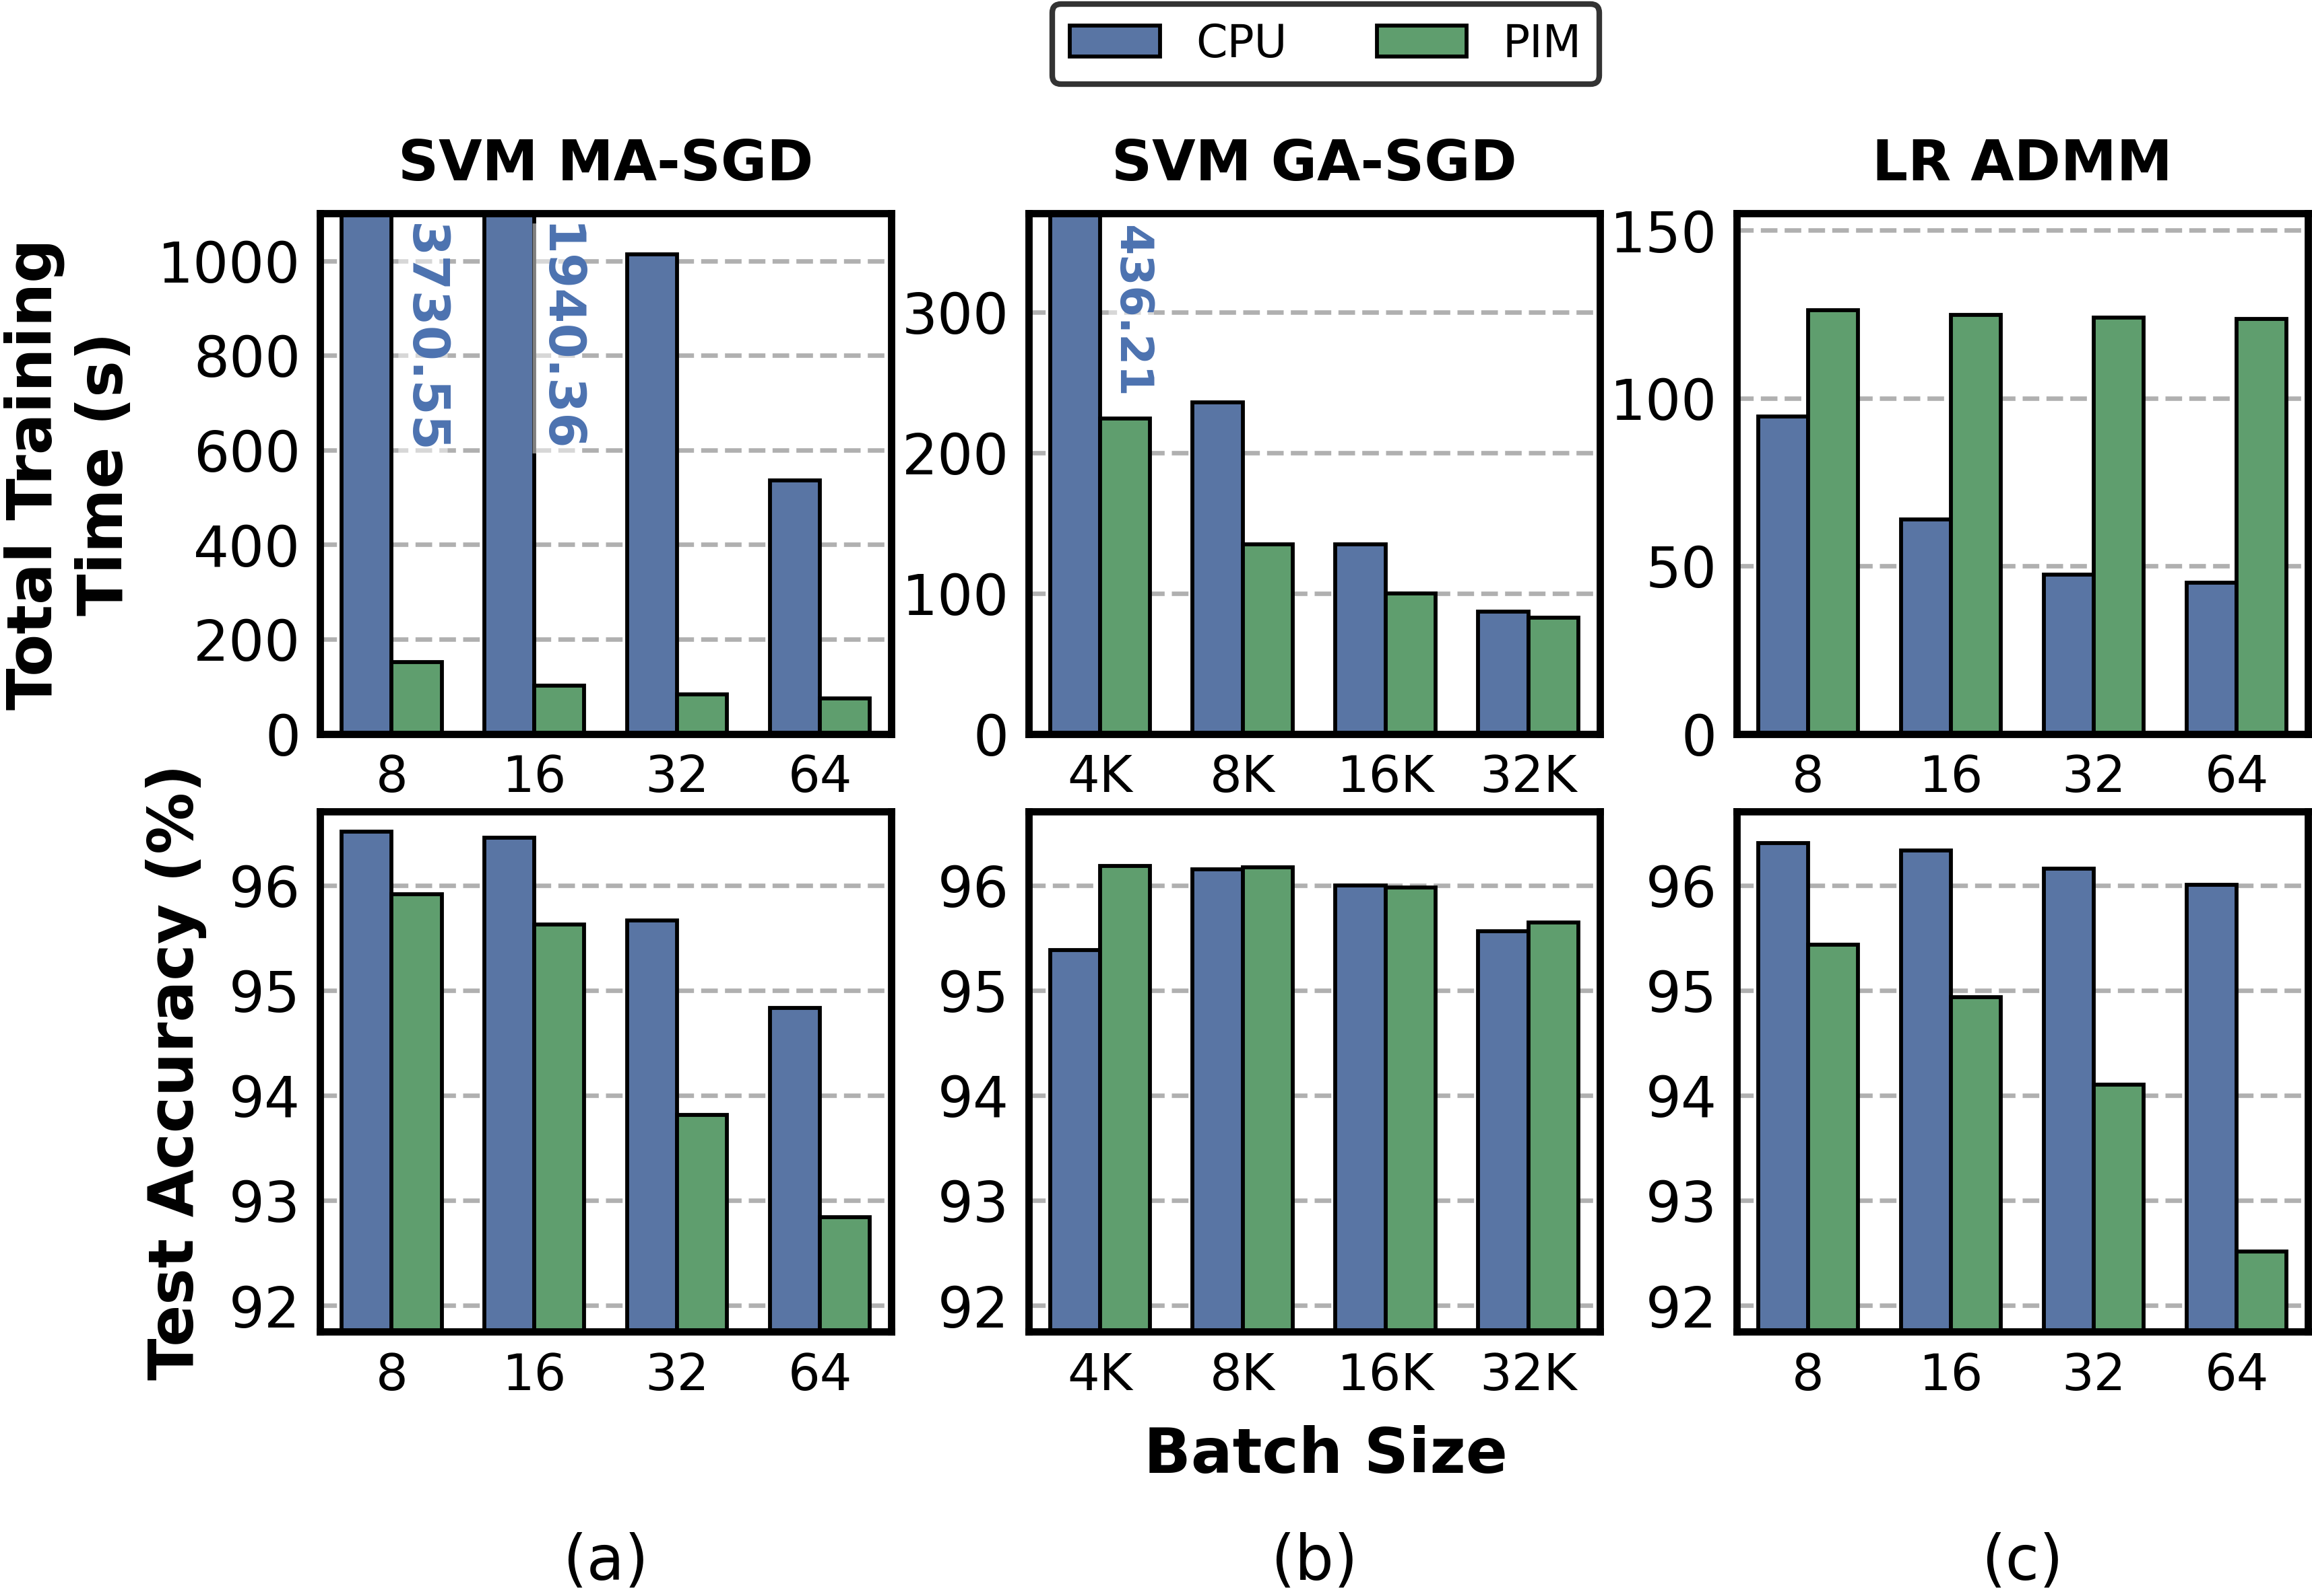
YFCC100M: Batch Size

Slide 51
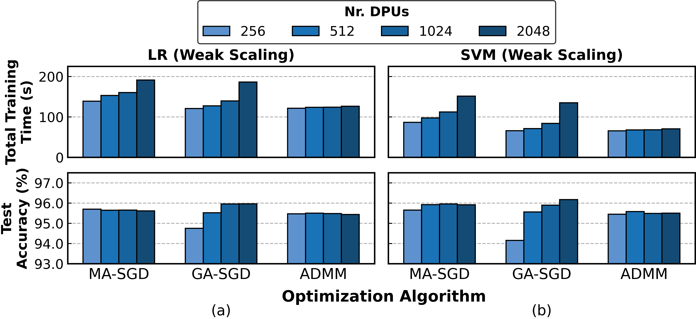
YFCC100M: Weak Scaling

Slide 52
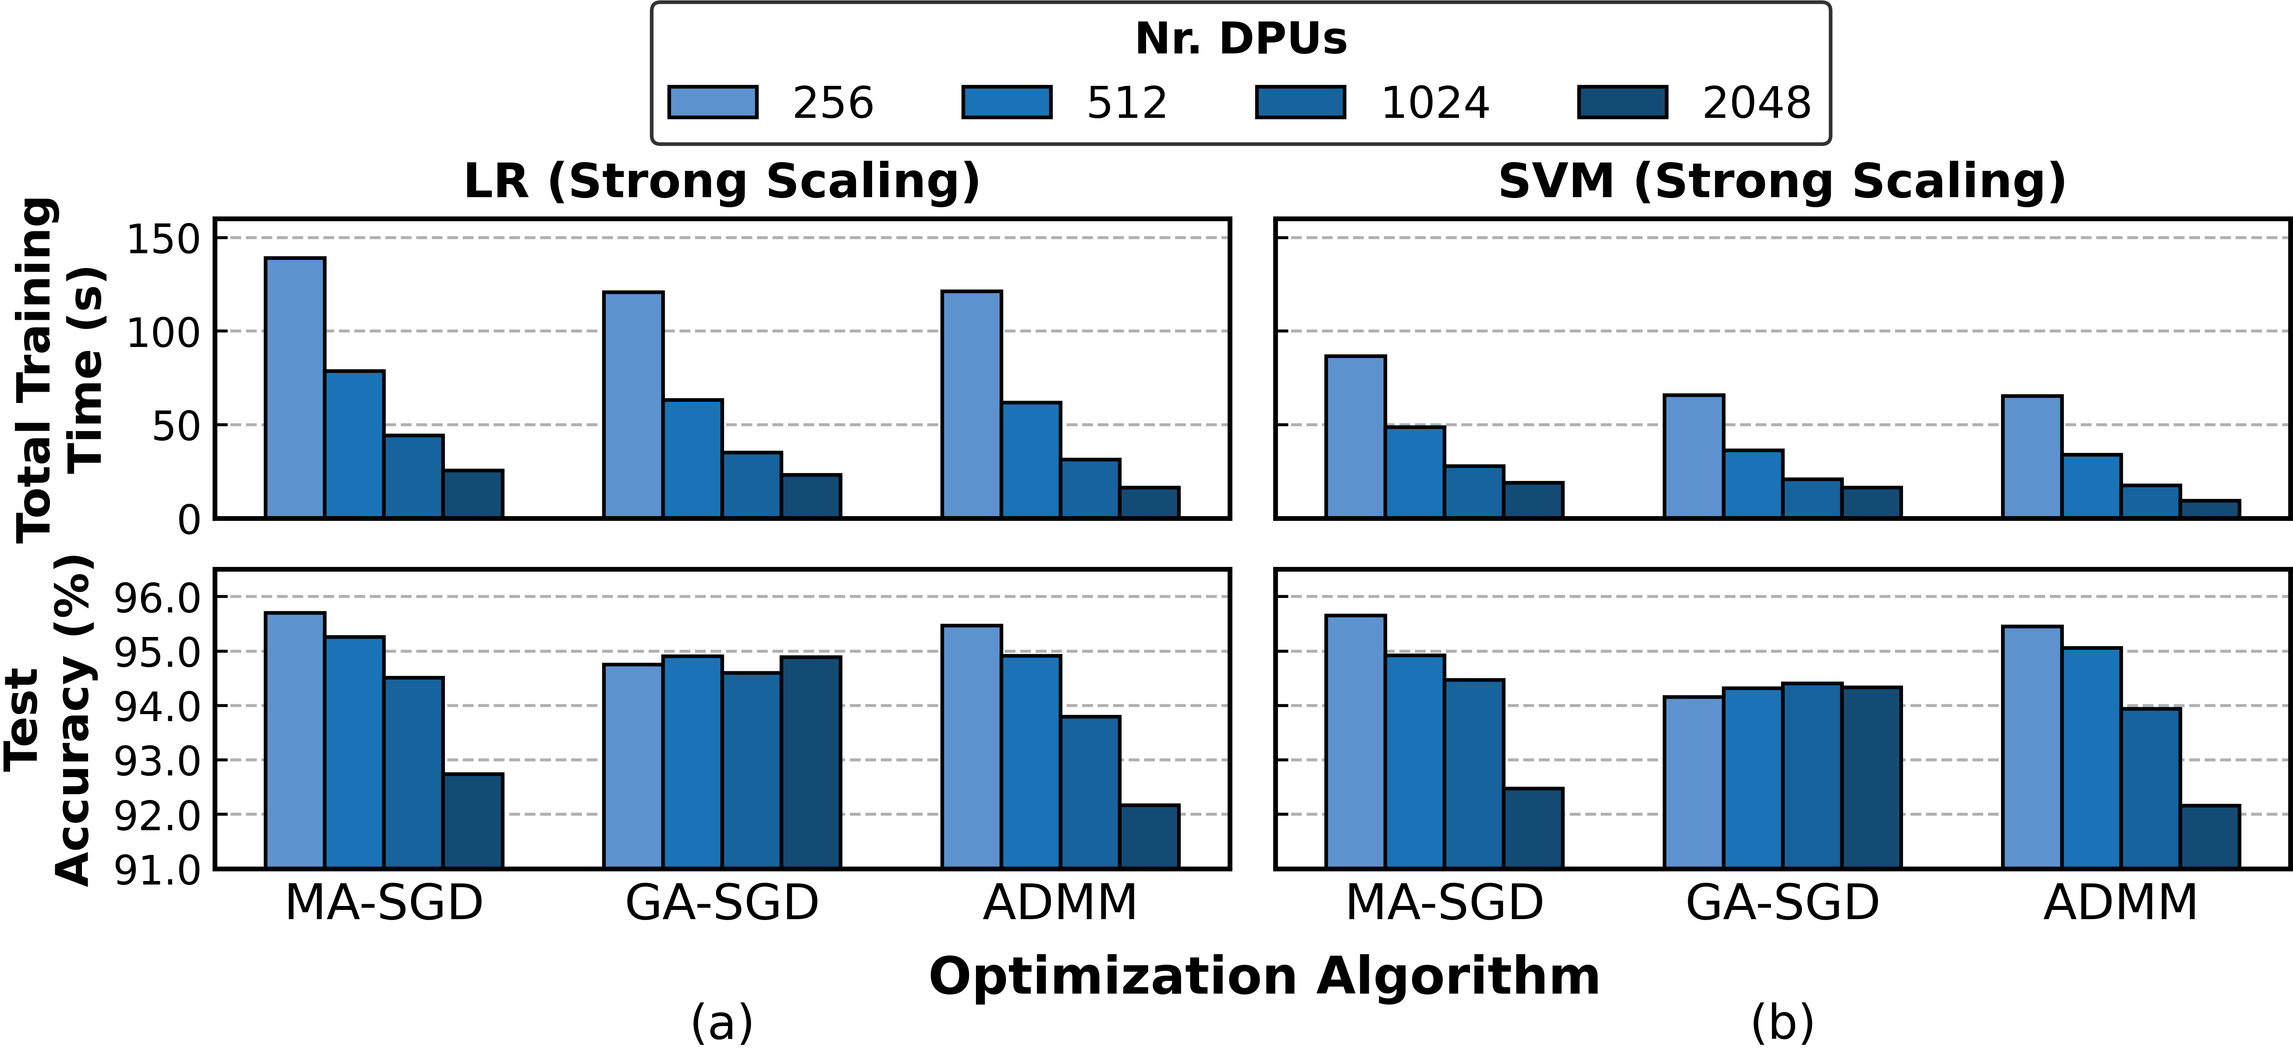
YFCC100M: Strong Scaling

Slide 53
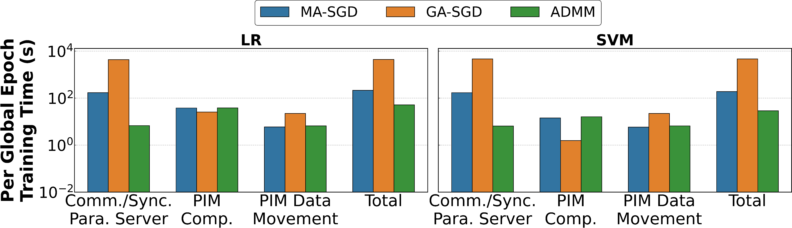
Criteo: PIM Performance Breakdown

Slide 54
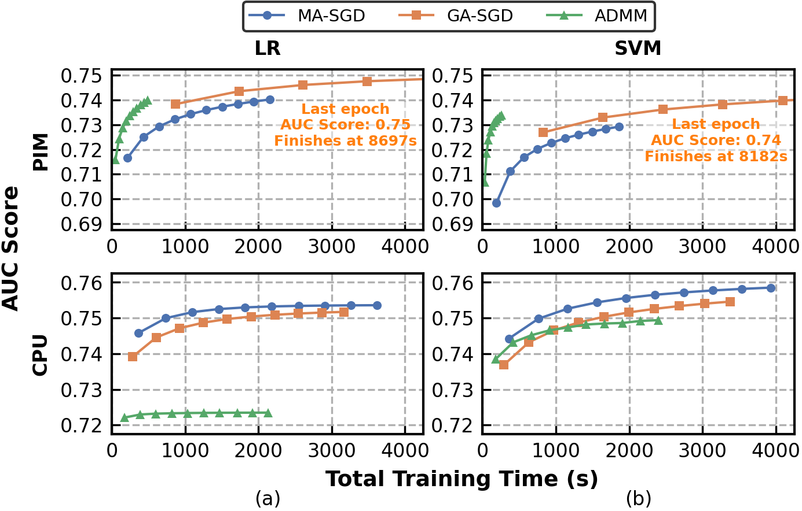
Criteo: PIM Performance Comparison

Slide 55
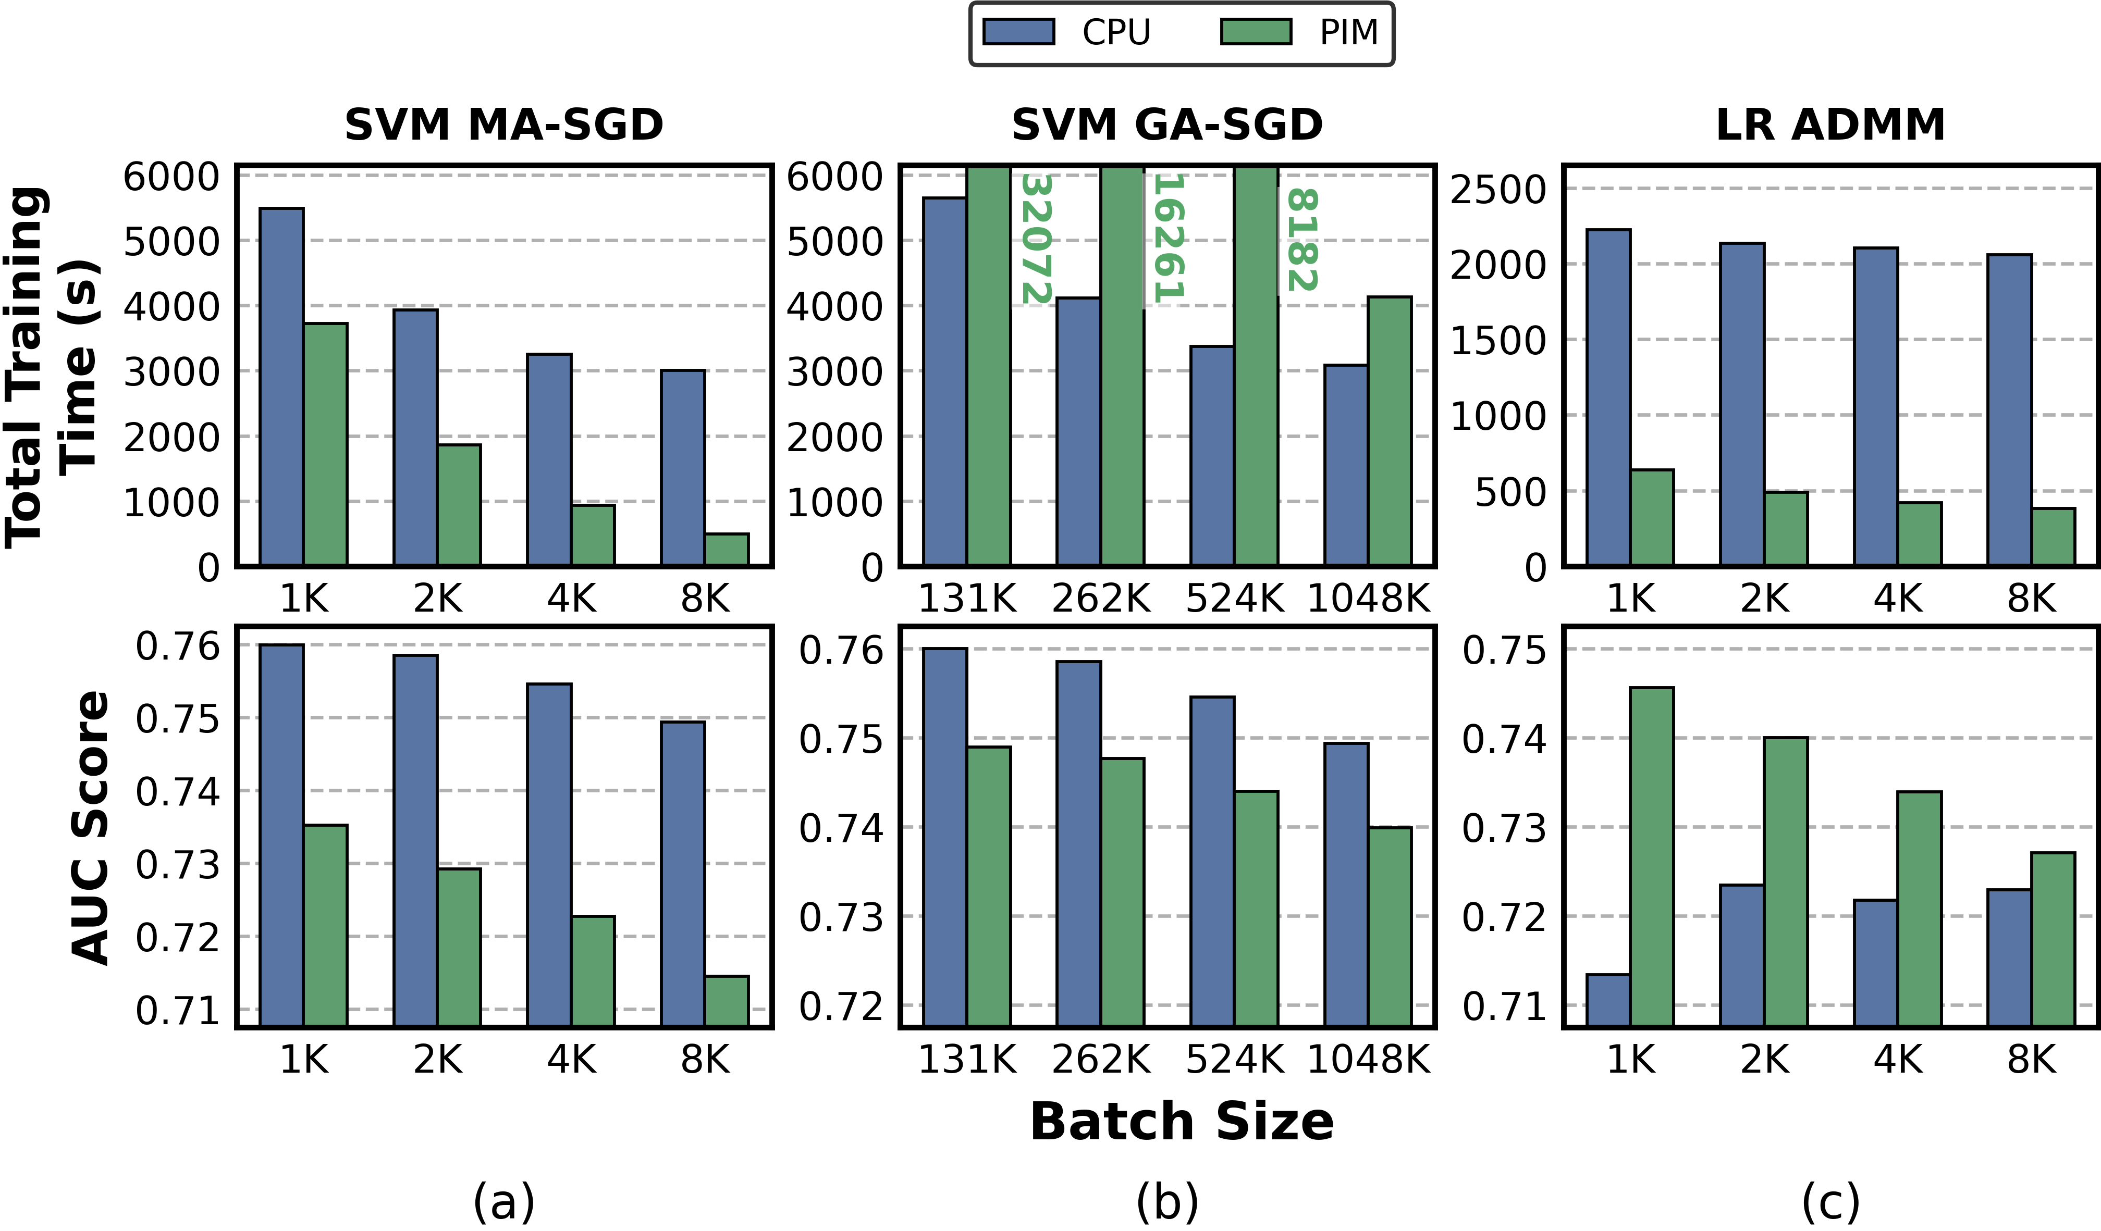
Criteo: Batch Size

Slide 56
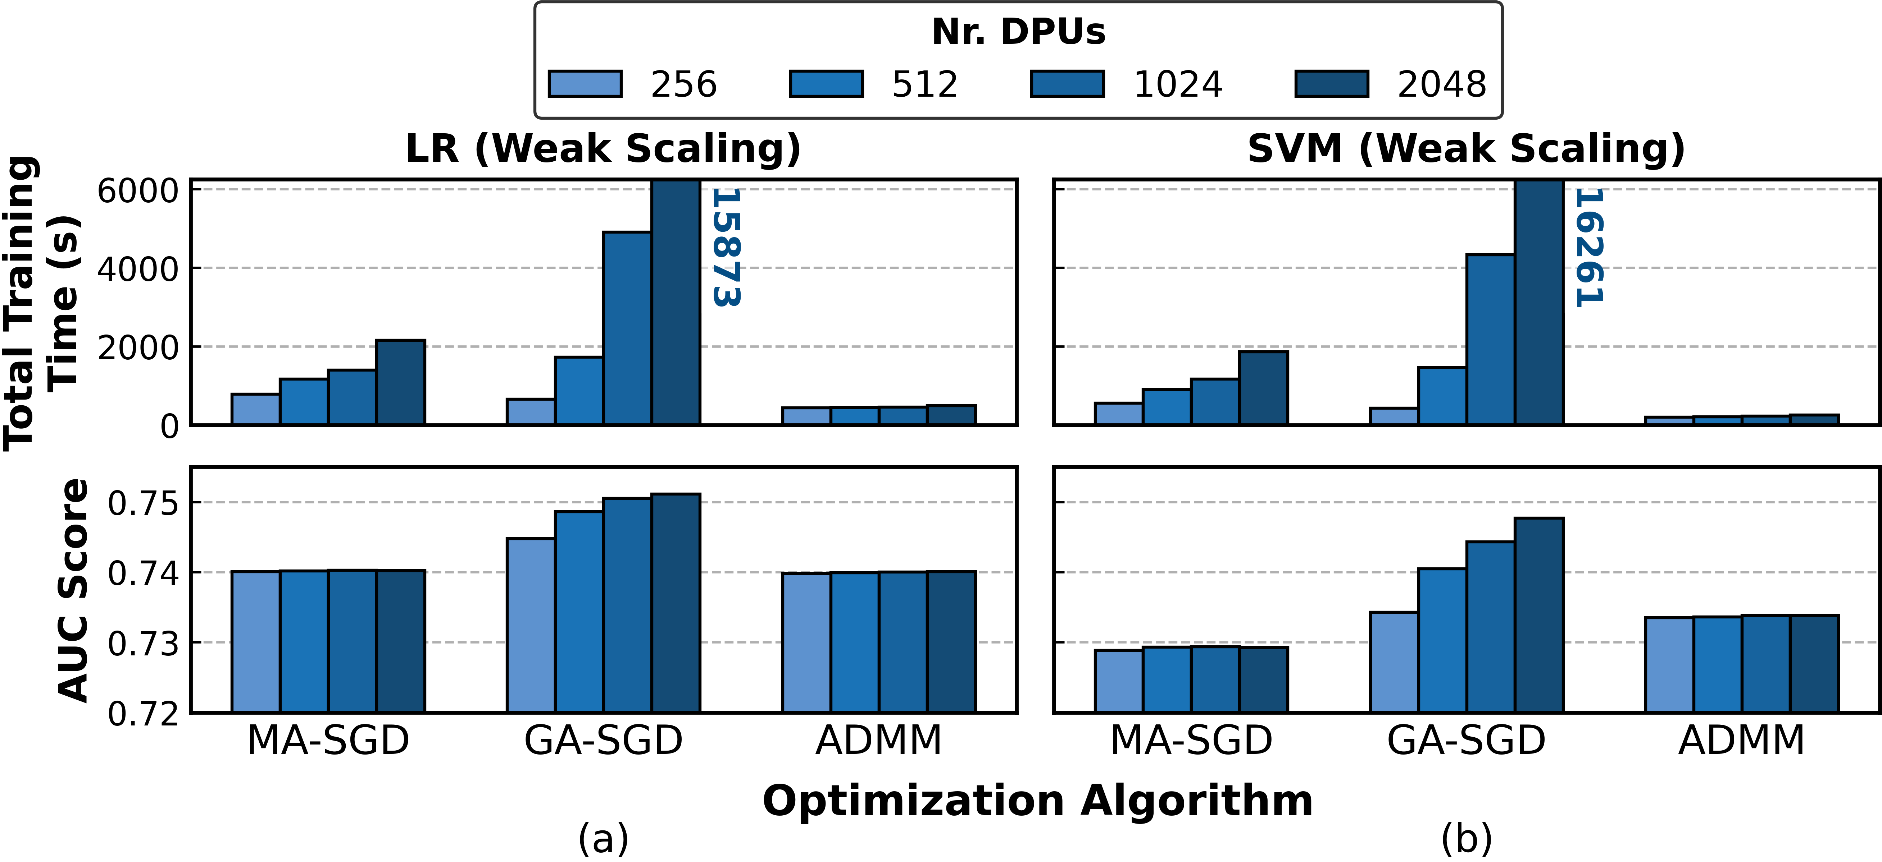
Criteo: Weak Scaling

