Slide 1






Understanding RowHammer
Under Reduced Refresh Latency:
Experimental Analysis of Real DRAM Chips and Implications on Future Solutions
Yahya Can Tuğrul
A. Giray Yağlıkçı İsmail Emir Yüksel
Ataberk Olgun Oğuzhan Canpolat Nisa Bostancı
Mohammad Sadrosadati Oğuz Ergin Onur Mutlu

Slide 2
Executive Summary
Problem:
Read disturbance in DRAM (e.g. RowHammer) worsens with technology node scaling
Existing solutions perform preventive refresh, inducing significant overheads
Motivation: Reducing preventive refresh latency to reduce its overheads.
No prior work studies i) the effect of preventive refresh latency on RowHammer or
ii) the implications of reducing preventive refresh latency on existing solutions
Goal:
To understand the impact of preventive refresh latency on RowHammer
To leverage this understanding to reduce the overheads of existing solutions
Experimental Characterization: 388 DDR4 DRAM chips from three major vendors
The latency of a vast majority of preventive refresh can be significantly reduced
without jeopardizing the data integrity of a DRAM chip
PaCRAM: Partial Charge Restoration for Aggressive Mitigation
Reduces the latency of preventive refreshes issued by the existing solution
Adjusts the aggressiveness of the existing solution
Evaluation: By reducing the existing solutions’ performance and energy overheads, improves system performance and energy efficiency with small additional area cost

Slide 3
Outline
Background
Problem and Motivation
Experimental Characterization of Real DRAM Chips
PaCRAM: Partial Charge Restoration for Aggressive Mitigation
Evaluation
Conclusion

Slide 4
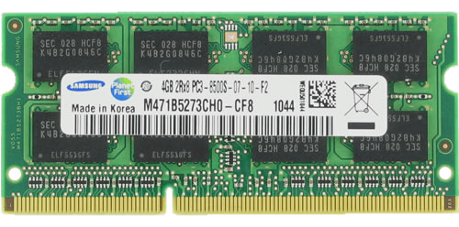
DRAM Organization
DRAM Bank
DRAM Cell
Memory
Channel
DRAM Row
CPU
Memory Controller
Sense Amplifier

Slide 5

DRAM Access
DRAM Bank
Activate
DRAM Cell
Precharge
Read/Write
Sense Amplifier

Slide 6
DRAM Cell Leakage
Each cell encodes information in leaky capacitors
wordline
access
transistor
charge
leakage
paths
capacitor
bitline
Stored data is corrupted if too much charge leaks
(i.e., the capacitor voltage degrades too much)

Slide 7
DRAM Refresh
Refresh
Window
Periodic Refreshes
100%
V_{min}
Capacitor voltage (V_{DD})
0%
REF
REF
REF
time
Periodic refreshes preserve stored data

Slide 8
RowHammer Vulnerability
DRAM Bank
Row 0
Row 0
Victim Row
Row 1
Row 1
Row 1
Victim Row
Row 2
Row 2
Row 2
Row 2
Row 2
Row 2
open
open
open
closed
closed
Aggressor Row
Row 3
Row 3
Row 3
Victim Row
Row 4
Row 4
Victim Row
Repeatedly opening (activating) and closing (precharging)
a DRAM row causes RowHammer bitflips in nearby cells

Slide 9
RowHammer Bitflips
RowHammer
Bitflip
100%
V_{min}
Capacitor voltage (V_{DD})
0%
time
RowHammer Attack

Slide 10
RowHammer-Preventive Refresh
Preventive Refreshes
100%
V_{min}
Capacitor voltage (V_{DD})
0%
REF
REF
REF
time
RowHammer Attack
Preventively refreshing potential victim rows
mitigates RowHammer bitflips

Slide 11
A Closer Look
Charge
Sharing
Charge
Restoration
Precharge
100%
V_{min}
Capacitor voltage (V_{DD})
50%
Preventive Refresh Latency
0%
Preventive Refresh
time
Preventive Refresh has a non-negligible latency

Slide 12
Outline
Background
Problem and Motivation
Experimental Characterization of Real DRAM Chips
PaCRAM: Partial Charge Restoration for Aggressive Mitigation
Evaluation
Conclusion

Slide 13
Problem
RowHammer worsens as DRAM chip density increases
RowHammer bitflips occur at much lower activation counts
The minimum activation count needed to induce the first bitflip (N_{RH})
139K
[Kim+, ISCA’14]
9.6K
[Kim+, ISCA’20]
<1K
[Luo+, ISCA’23]
Mitigation mechanisms against RowHammer attacks
induce higher overheads as RowHammer worsens

Slide 14
Reducing Mitigation Overhead
Reduced Charge Restoration Latency
Reduced Preventive Refresh Latency
Reduced Preventive Refresh Overhead

Slide 15

Reducing Charge Restoration Latency
Charge
Sharing
Charge
Restoration
Precharge
100%
<100%
V_{min}
Capacitor voltage (V_{DD})
50%
0%
Preventive Refresh
time
time
The charge of the cell are partially restored

Slide 16
Partial Charge Restoration
Partial charge restoration
might affect the voltage level of the cell
and thus affect the RowHammer vulnerability
To robustly perform partial charge restoration,
we need to understand the DRAM chip’s limit
with rigorous characterization

Slide 17
Our Goal
To understand the impact of
charge restoration latency on RowHammer
To leverage this understanding to
reduce the overheads of existing solutions

Slide 18
Outline
Background
Problem and Motivation
Experimental Characterization of Real DRAM Chips
PaCRAM: Partial Charge Restoration for Aggressive Mitigation
Evaluation
Conclusion

Slide 19
DRAM Testing Infrastructure
DRAM Bender* on a Xilinx Alveo U200
Fine-grained control over DRAM commands,
timing parameters (±1.5ns), and temperature (±0.5°C )

Slide 20
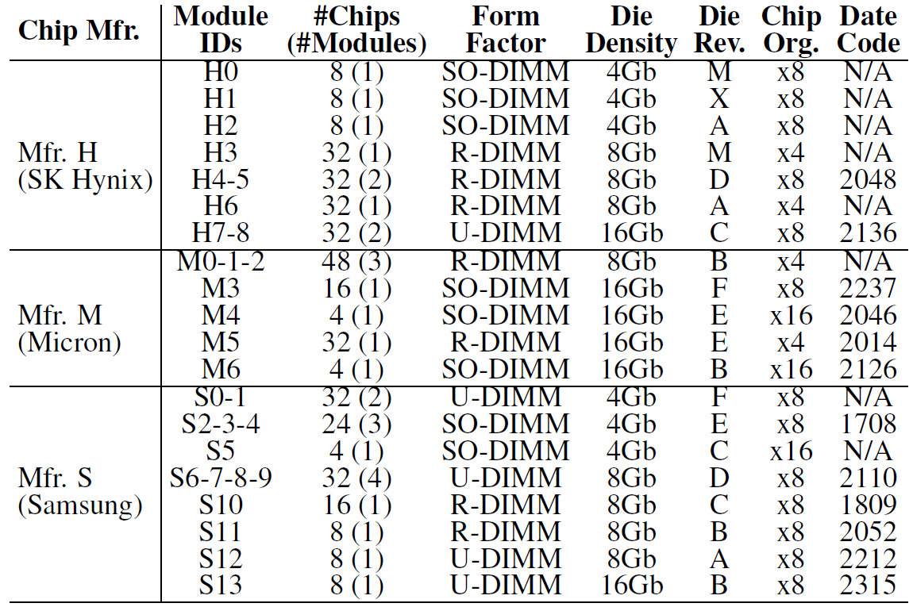
Tested DRAM Chips
388 DDR4 DRAM chips from SK Hynix, Micron, and Samsung

Slide 21
Key Takeaway from Real Chip Experiments
Charge restoration latency
can be significantly reduced
for a vast majority of preventive refreshes

Slide 22
Experiment Algorithm
Partial
Charge
Restoration
Check
Bitflips
Initialize
RowHammer
time
Refresh
Window

Slide 23
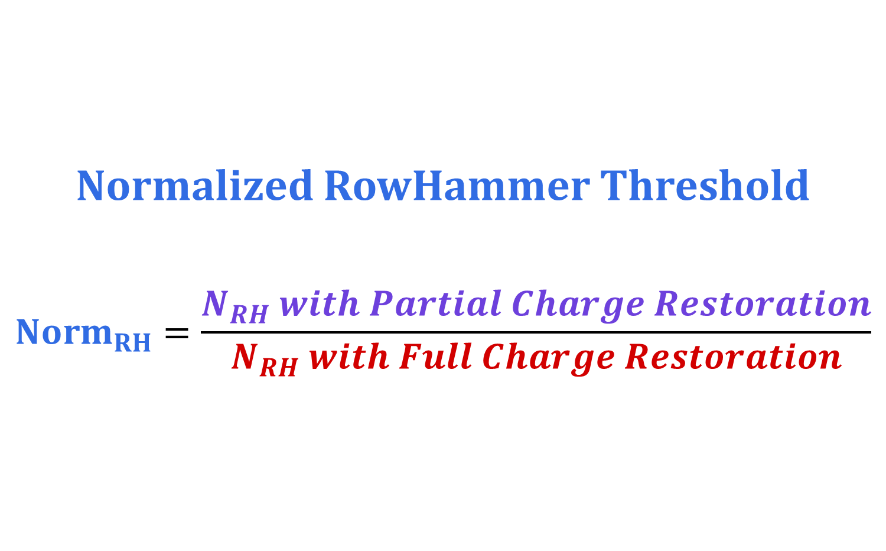
RowHammer Vulnerability Metric
Normalized RowHammer Threshold
$${Norm}_{RH}=\frac{N_{RH} with Partial Charge Restoration}{N_{RH} with Full Charge Restoration}$$

Slide 24
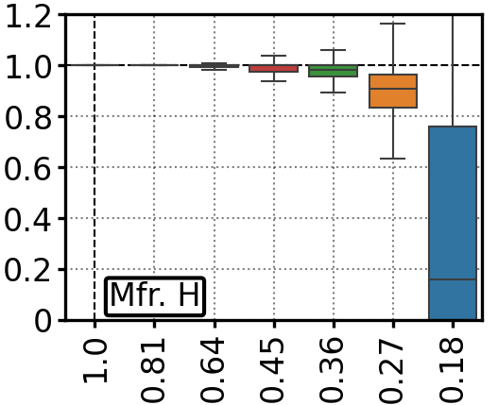
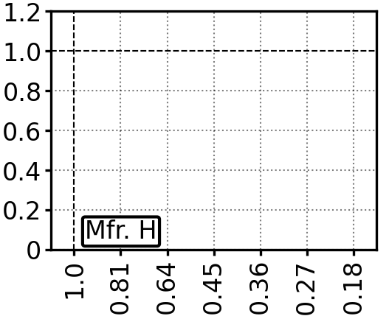
Effect of Partial Charge Restoration
N_{RH} reduces more
(becomes more vulnerable)
Normalized
RowHammer Threshold
Data
Retention
Bitflip
Charge Restoration Latency
lower latency

Slide 25
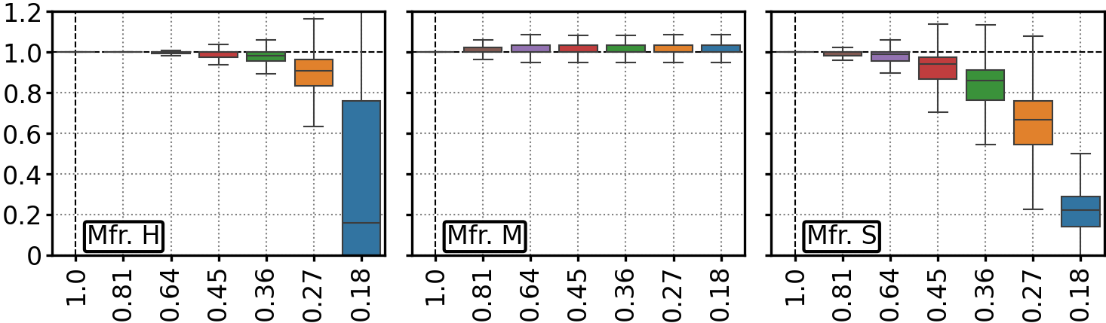
Effect of Partial Charge Restoration
64%
82%
36%
Normalized
RowHammer Threshold
Charge Restoration Latency
Data
Retention Bitflips
Charge restoration latency
can be significantly reduced

Slide 26
Repeated Partial Charge Restorations
Partial Charge Restoration causes
cells to be partially restored
Repeated Partial Charge Restorations
might induce bitflips
N Partial
Charge
Restorations
Check
Bitflips
Initialize
RowHammer
time
Refresh
Window
N → 15K

Slide 27
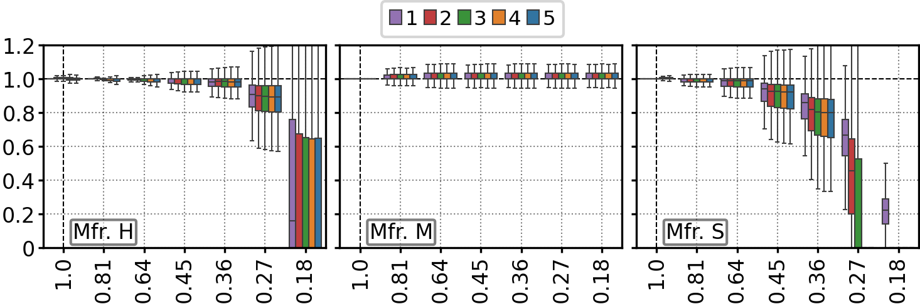
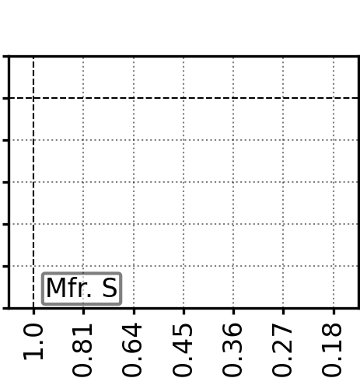
Repeated Partial Charge Restorations
Number of Restorations
Normalized
RowHammer Threshold
Charge Restoration Latency

Slide 28
Repeated Partial Charge Restorations
Numbers of Restorations
Normalized
RowHammer Threshold
Charge Restoration Latency
Partial charge restoration
can be consecutively performed many times

Slide 29
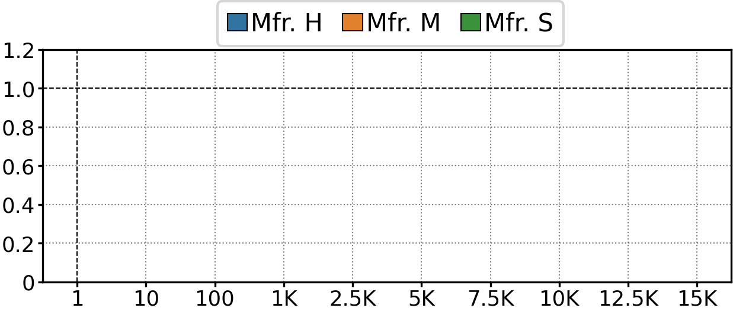
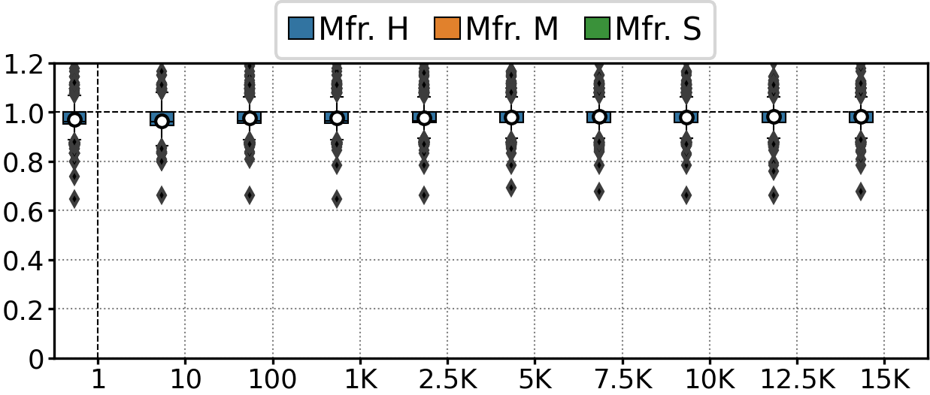
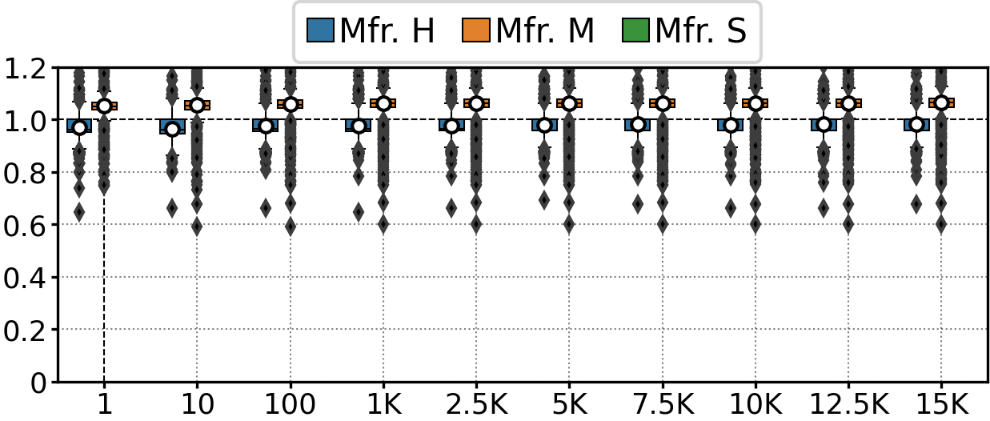
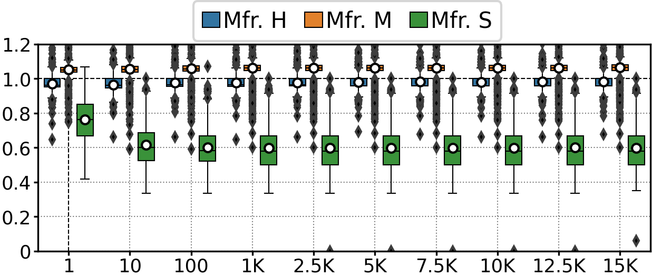
Repeated Partial Charge Restorations
Normalized
RowHammer Threshold
Number of Restorations
Data
Retention Bitflips
After 15K/15K/1K partial charge restoration,
a single full charge restoration is needed

Slide 30
Key Takeaway from Real Chip Experiments
Charge restoration latency
can be significantly reduced
for a vast majority of preventive refreshes

Slide 31
Outline
Background
Problem and Motivation
Experimental Characterization of Real DRAM Chips
PaCRAM: Partial Charge Restoration for Aggressive Mitigation
Evaluation
Conclusion

Slide 32
PaCRAM:
Partial Charge Restoration for Aggressive Mitigation
Key Experimental Takeaway: Charge restoration latency can be significantly reduced for a vast majority of preventive refreshes
Key Idea: Reduce preventive refresh overhead
by reducing charge restoration latency of preventive refreshes
PaCRAM: Partial Charge Restoration for Aggressive Mitigation
  Reduces the latency of preventive refreshes issued by the existing solution
  Configures the existing solution with the reduced RowHammer threshold
  Guarantees that any victim is not refreshed by more than a safe number of consecutive partial charge restorations
PaCRAM significantly reduces the performance and energy overhead of existing solutions

Slide 33
PaCRAM:
Partial Charge Restoration for Aggressive Mitigation
PaCRAM is implemented in the memory controller
Memory Controller
DRAM
Chip
(or module)
Memory
Request
Scheduler
DRAM Commands, Address
Reduced
Preventive
Refresh
Activated
Row Address
Activated
Row Address
Existing RowHammer Mitigation Solution
N_{RH}
PaCRAM
Preventive
Refresh
Latency
Preventive
Refresh

Slide 34
Outline
Background
Problem and Motivation
Experimental Characterization of Real DRAM Chips
PaCRAM: Partial Charge Restoration for Aggressive Mitigation
Evaluation
Conclusion

Slide 35
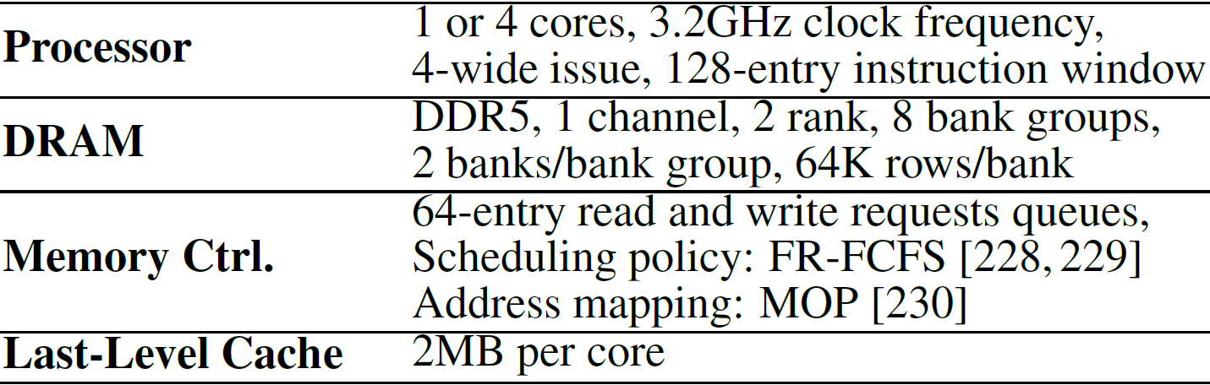
Evaluation Methodology
Cycle-level simulations using Ramulator 2.0 [Luo+, CAL 2023]
System Configuration:
Workloads: 62 single-core and 60 four-core multiprogrammed workloads from 5 benchmark suites
N_{RH}: {1K, 512, 256, 128, 64, 32} hammers
The minimum hammer count needed to induce the first bitflip

Slide 36



Configurations
Paired with 5 state-of-the-art solutions
  PARA [Kim+, ISCA’14]
  RFM [JEDEC 2020]
  PRAC [JEDEC 2024]
  Hydra [Qureshi+, ISCA’22]
  Graphene [Park+, MICRO’20]
Configured using experimental characterization data
Mfr. S | → | PaCRAM-S
Mfr. H | → | PaCRAM-H
Mfr. M | → | PaCRAM-M

Slide 37
Configurations
Paired with 5 state-of-the-art solutions
  PARA [Kim+, ISCA’14]
  RFM [JEDEC 2020]
  PRAC [JEDEC 2024]
  Hydra [Qureshi+, ISCA’22]
  Graphene [Park+, MICRO’20]
Configured using experimental characterization data
Mfr. S | → | PaCRAM-S
Mfr. H | → | PaCRAM-H
Mfr. M | → | PaCRAM-M
55%
64%
82%

Slide 38
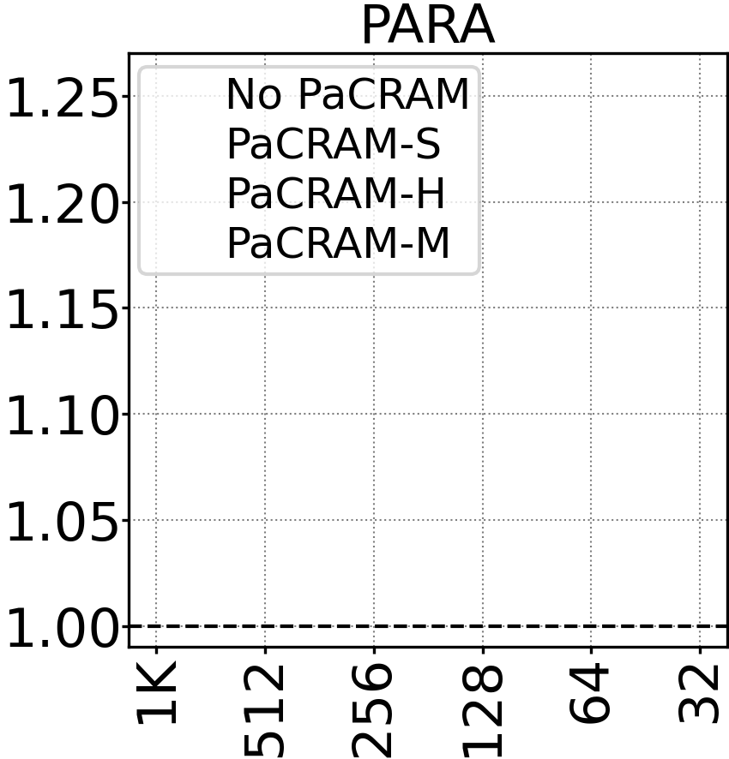
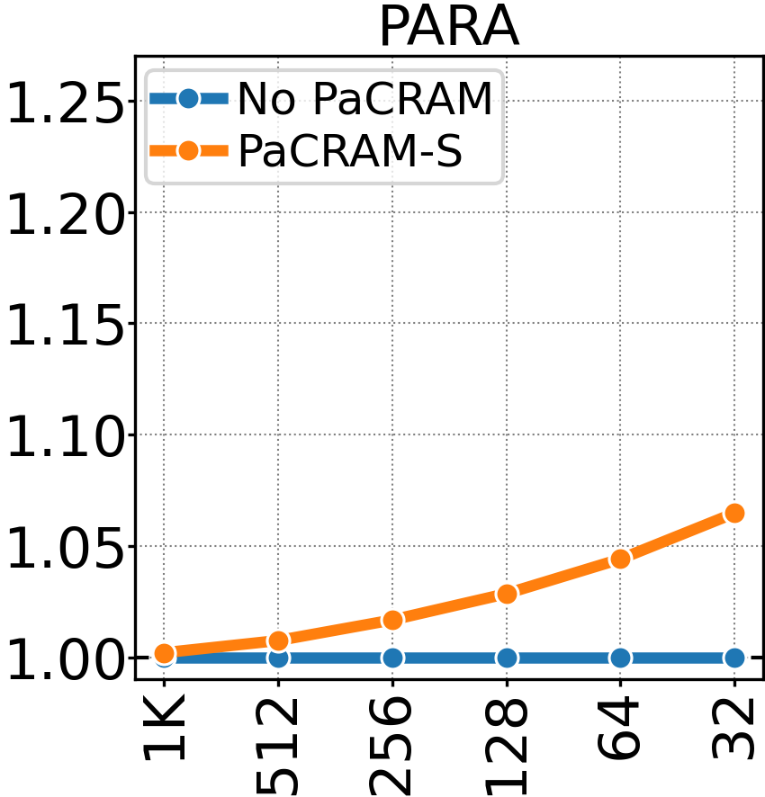
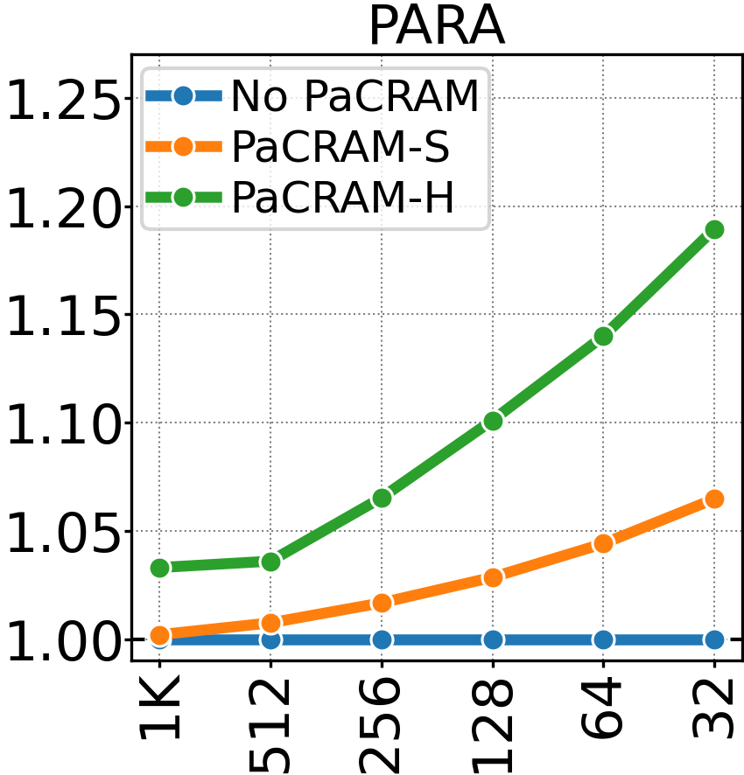
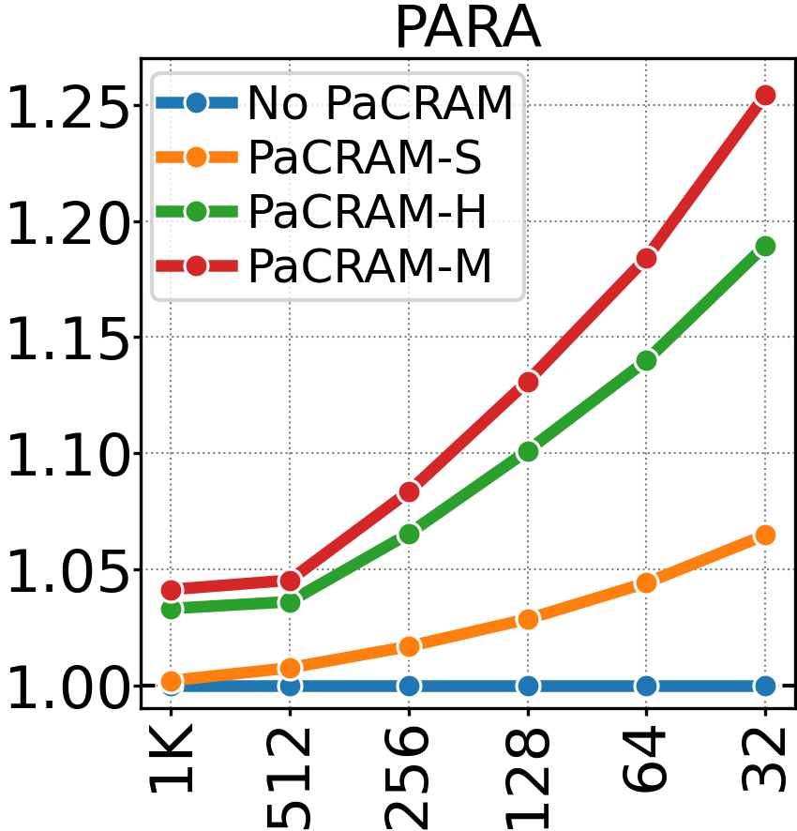
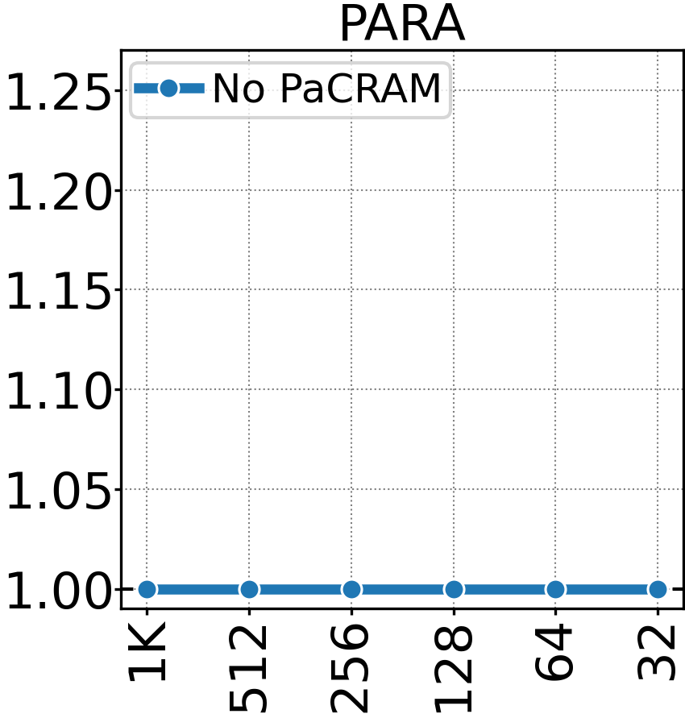
Implication on Future Solutions
PaCRAM’s benefits increase as N_{RH} reduces
Reduction in mitigation overhead
25.43% Speedup
System Performance
(Norm. to No PaCRAM)
lower overhead
RowHammer Threshold
more vulnerable

Slide 39
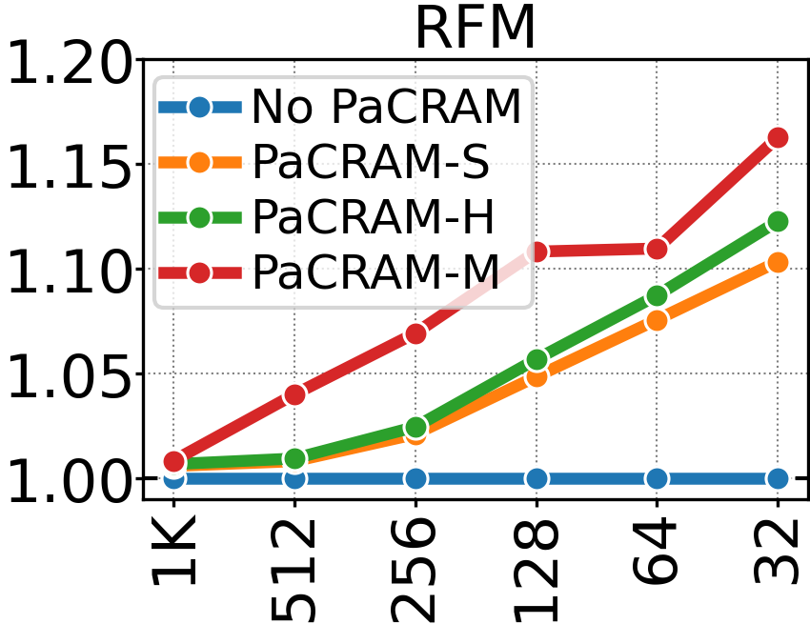
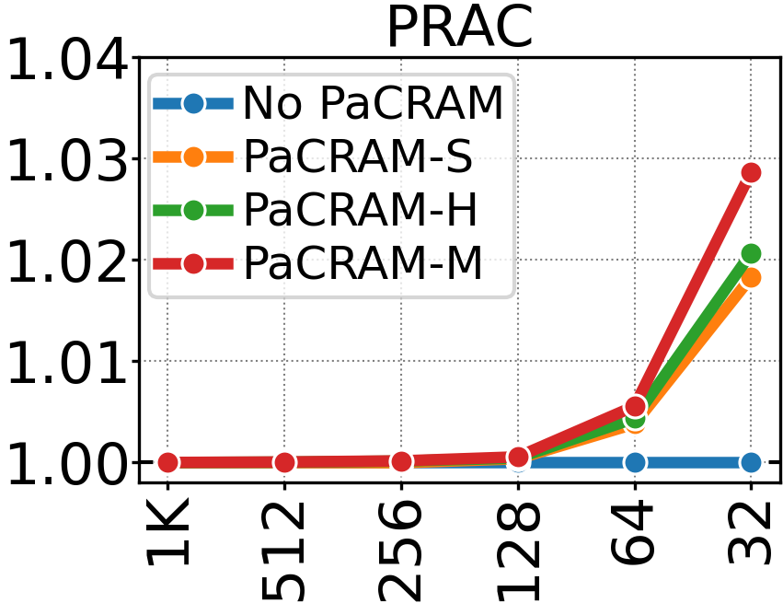
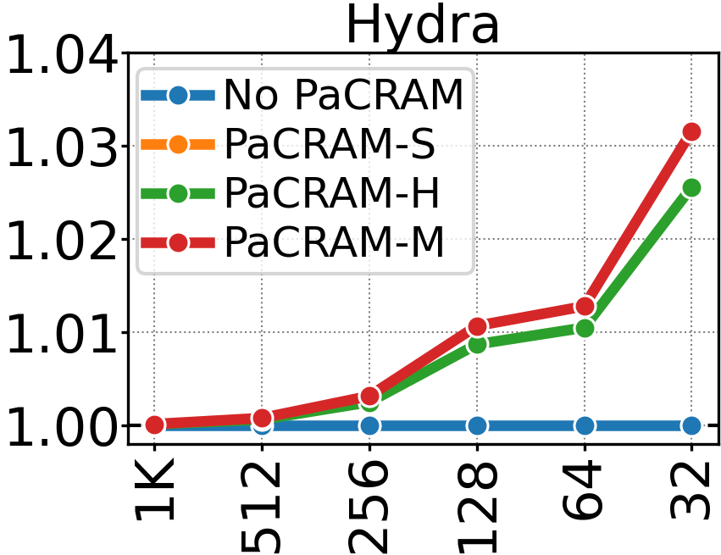
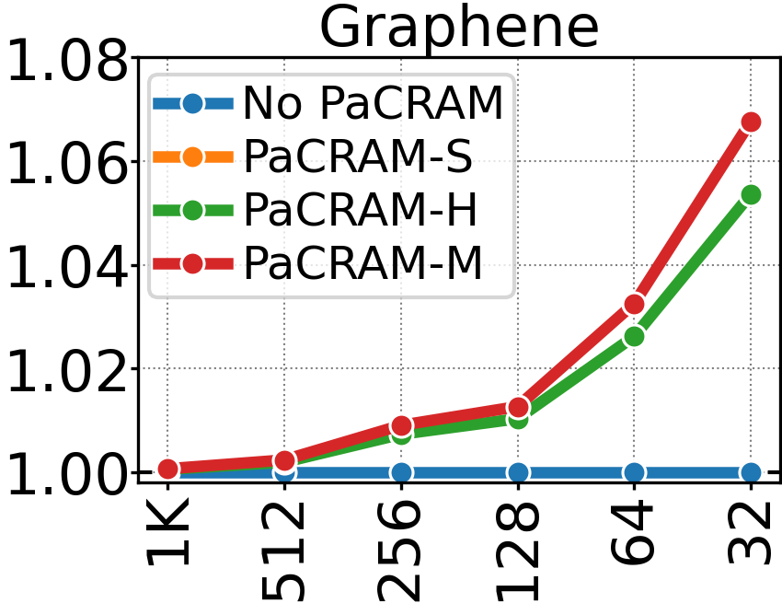
Implication on Future Solutions
16.28% Speedup
2.87% Speedup
PaCRAM significantly reduces (11% on average)
the performance overhead of existing solutions
System Performance
(Norm. to No PaCRAM)
3.16% Speedup
6.77% Speedup
RowHammer Threshold

Slide 40
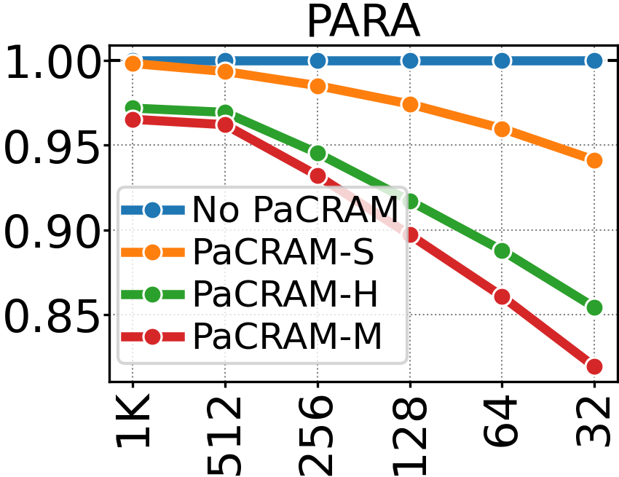
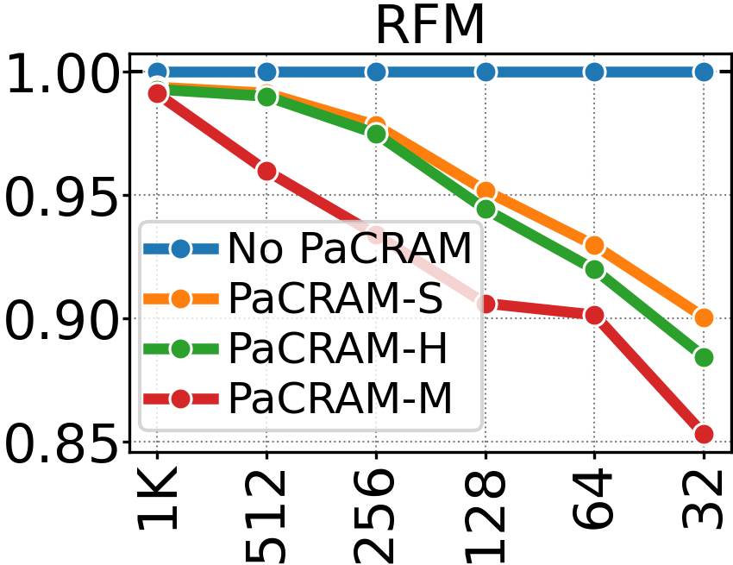
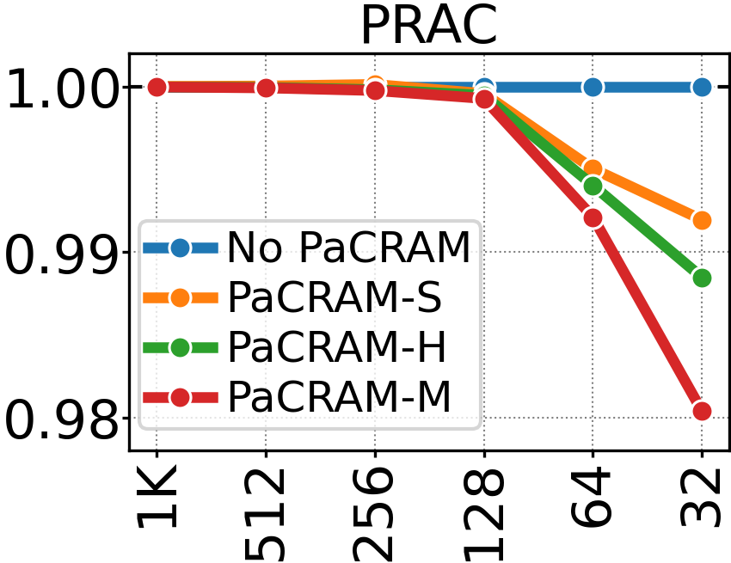
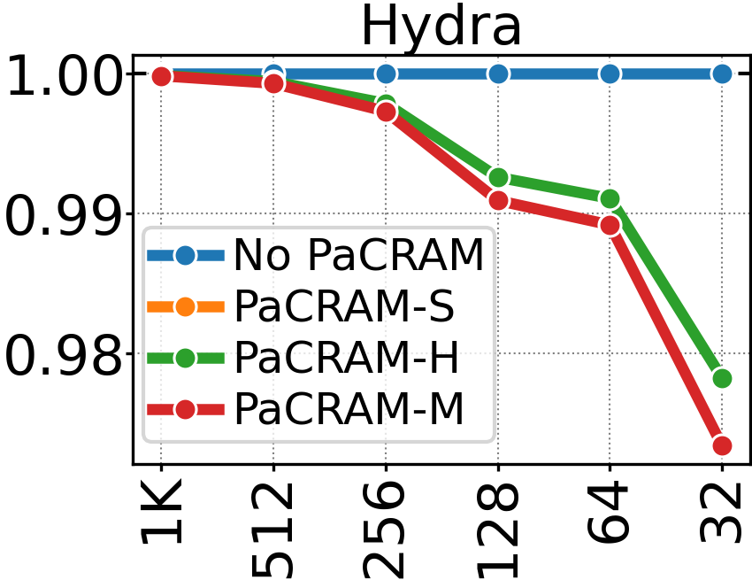
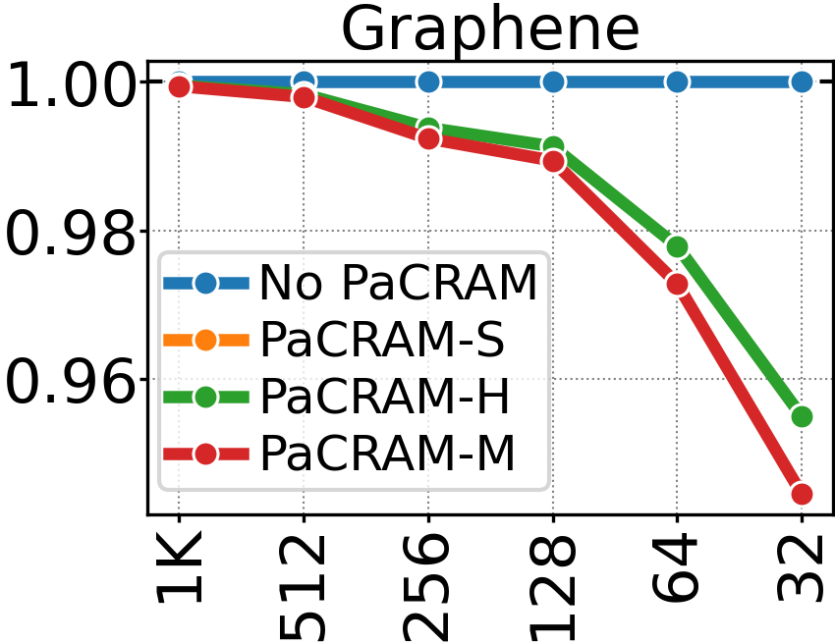
Implication on Future Solutions
18.10% Reduction
14.71% Reduction
1.96% Reduction
PaCRAM significantly reduces (9% on average)
the energy overhead of existing solutions
Energy Consumption
(Norm. to No PaCRAM)
2.66% Reduction
5.55% Reduction
RowHammer Threshold

Slide 41
More in the Extended Version
Effect of partial charge restoration on
  Lowest observed N_{RH} of DRAM modules
  RowHammer Bit-Error-Rate
  Half-Double access pattern
  Data retention time
Combined effect of partial charge restoration and temperature
Algorithms and details of our experiments
Detailed implementation of PaCRAM
  Hardware complexity analysis
  (0.09% area overhead on a high-end Intel Xeon Processer)
  Profiling cost analysis
Reducing charge restoration latency for
periodic refreshes

Slide 42
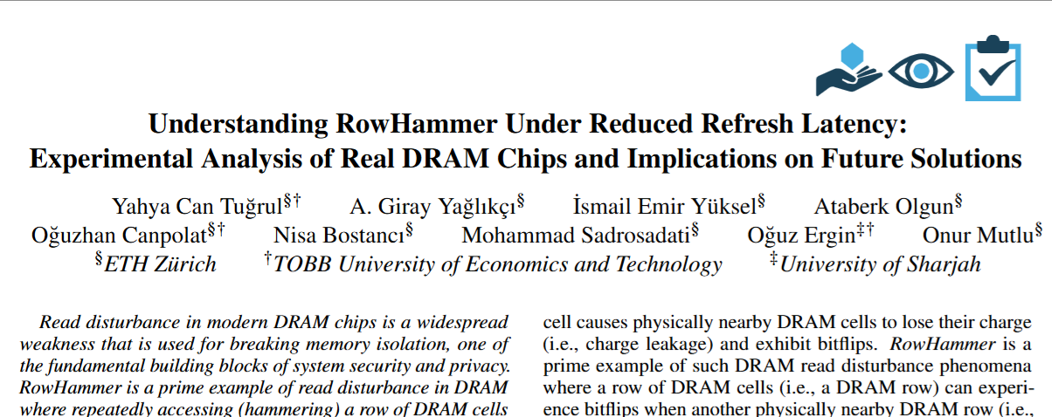

More in the Extended Version
https://arxiv.org/pdf/2502.11745

Slide 43
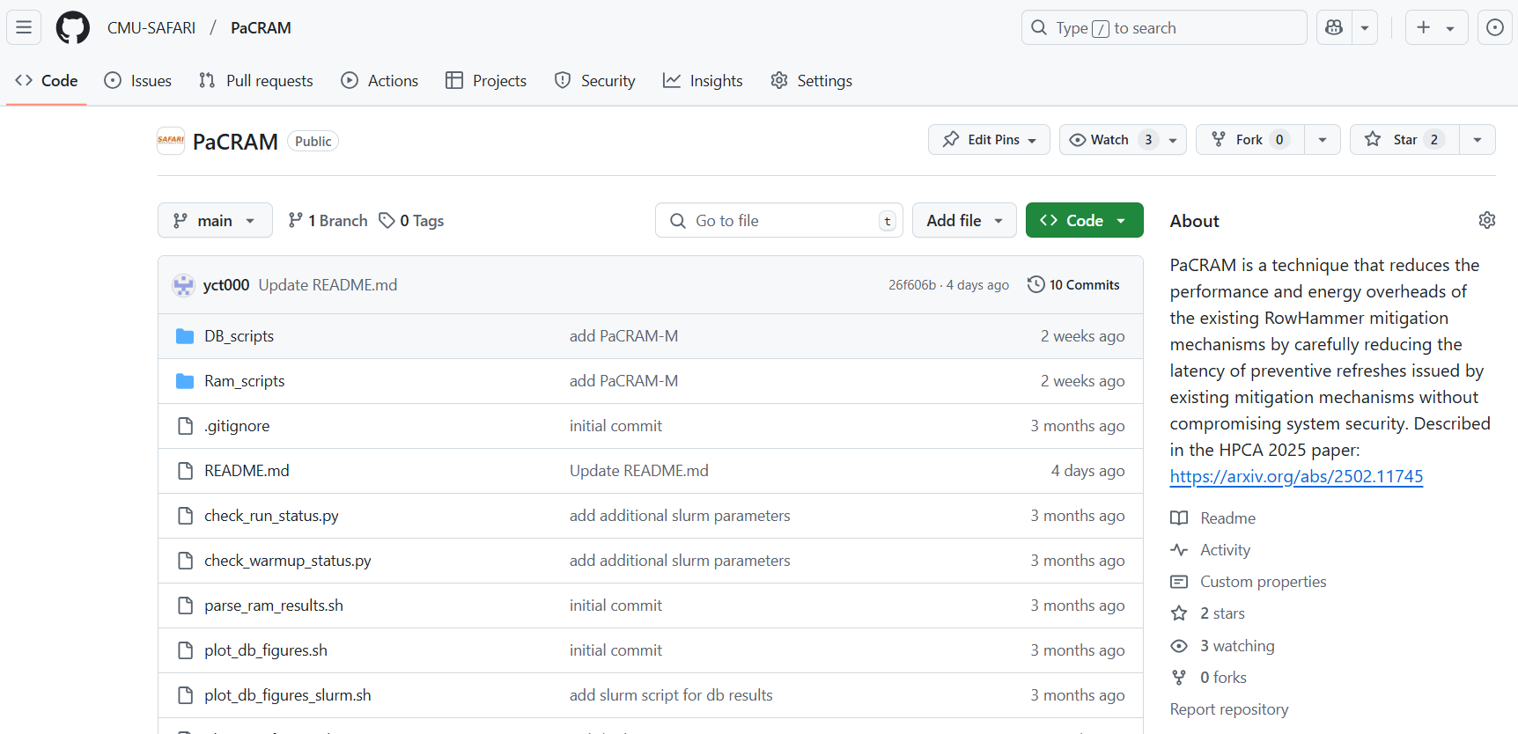


PaCRAM is Open Source and Artifact Evaluated
https://github.com/CMU-SAFARI/PaCRAM

Slide 44
Outline
Background
Problem and Motivation
Experimental Characterization of Real DRAM Chips
PaCRAM: Partial Charge Restoration for Aggressive Mitigation
Evaluation
Conclusion

Slide 45
Conclusion
The first rigorous experimental characterization
on the effect of preventive refresh latency on RowHammer
388 DDR4 DRAM chips from three major vendors
The latency of a vast majority of preventive refresh
can be significantly reduced without jeopardizing
the data integrity of a DRAM chip
PaCRAM: Partial Charge Restoration for
Aggressive Mitigation
Reduces the latency of preventive refreshes issued by the existing solution
Adjusts the aggressiveness of the existing solution
PaCRAM significantly reduces the performance
and energy overheads of existing solutions

Slide 46
Understanding RowHammer
Under Reduced Refresh Latency:
Experimental Analysis of Real DRAM Chips and Implications on Future Solutions
Yahya Can Tuğrul
A. Giray Yağlıkçı İsmail Emir Yüksel
Ataberk Olgun Oğuzhan Canpolat Nisa Bostancı
Mohammad Sadrosadati Oğuz Ergin Onur Mutlu

Slide 47
Backup Slides
Yahya Can Tuğrul
A. Giray Yağlıkçı İsmail Emir Yüksel
Ataberk Olgun Oğuzhan Canpolat Nisa Bostancı
Mohammad Sadrosadati Oğuz Ergin Onur Mutlu

Slide 48
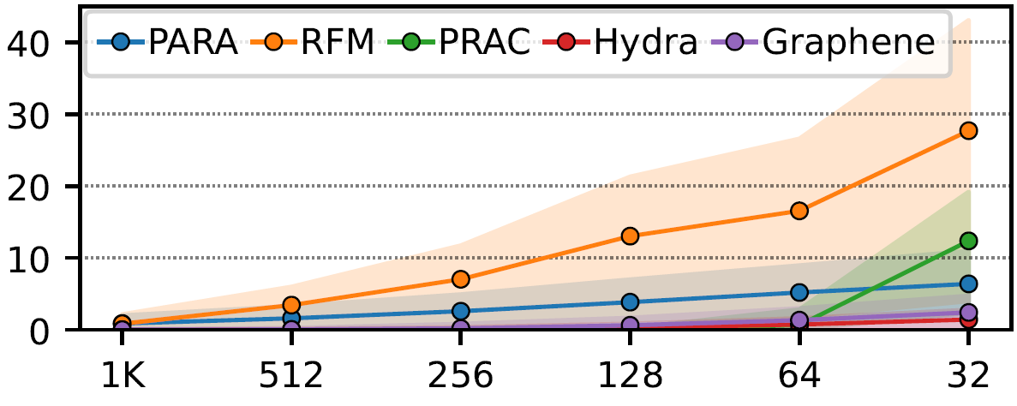
Preventive Refresh Overhead
Fraction of Exec. Time Spent on Preventive Refresh (%)
higher overhead
RowHammer Threshold
more vulnerable
Mitigation mechanisms against RowHammer attacks
induce higher overheads as RowHammer worsens

Slide 49
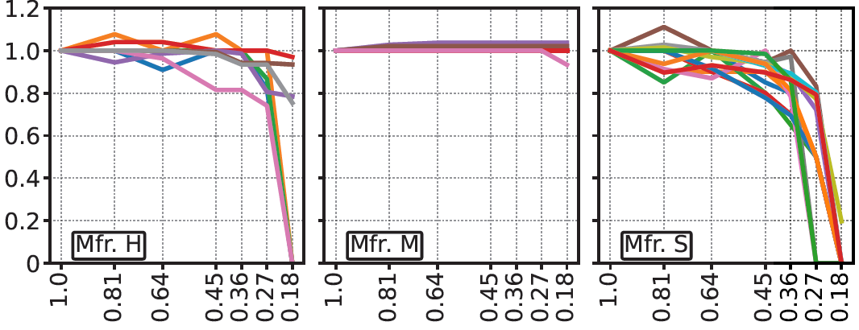
Effect of Partial Charge Restoration on Lowest Observed N_{RH} of DRAM Modules
Normalized
RowHammer Threshold
Charge Restoration Latency
Charge restoration latency
can be reduced without significantly affecting
the Lowest Observed N_{RH} of DRAM Modules

Slide 50
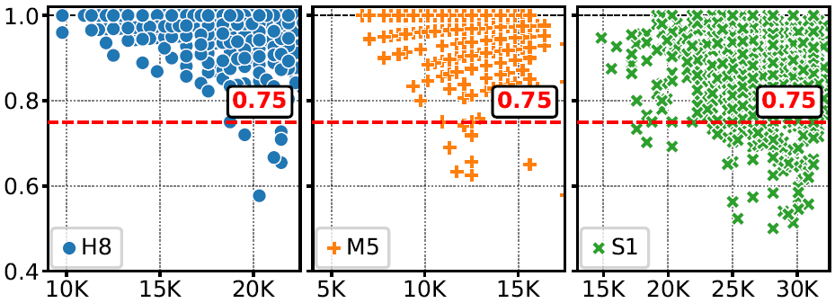
N_{RH} Reduction Distribution
Normalized
RowHammer Threshold
RowHammer Threshold with
Full Charge Restoration
Rows that are highly vulnerable with full charge restoration
do not exhibit the largest N_{RH} reductions
with partial charge restoration

Slide 51
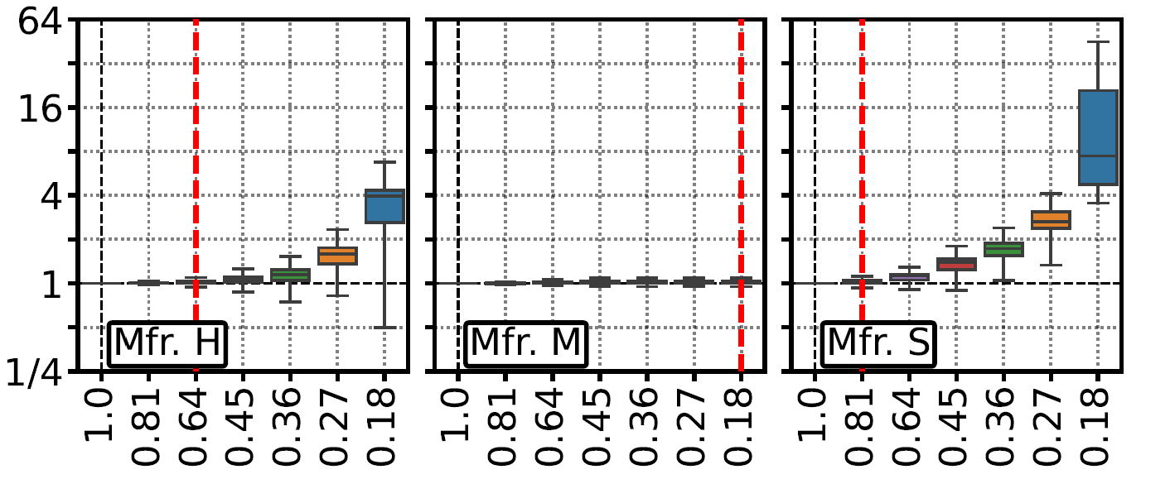
Effect of Partial Charge Restoration on RowHammer Bit-Error-Rate (BER)
Normalized
RowHammer BER
Charge Restoration Latency
Charge restoration latency
can be reduced without significantly affecting
RowHammer Bit-Error-Rate

Slide 52
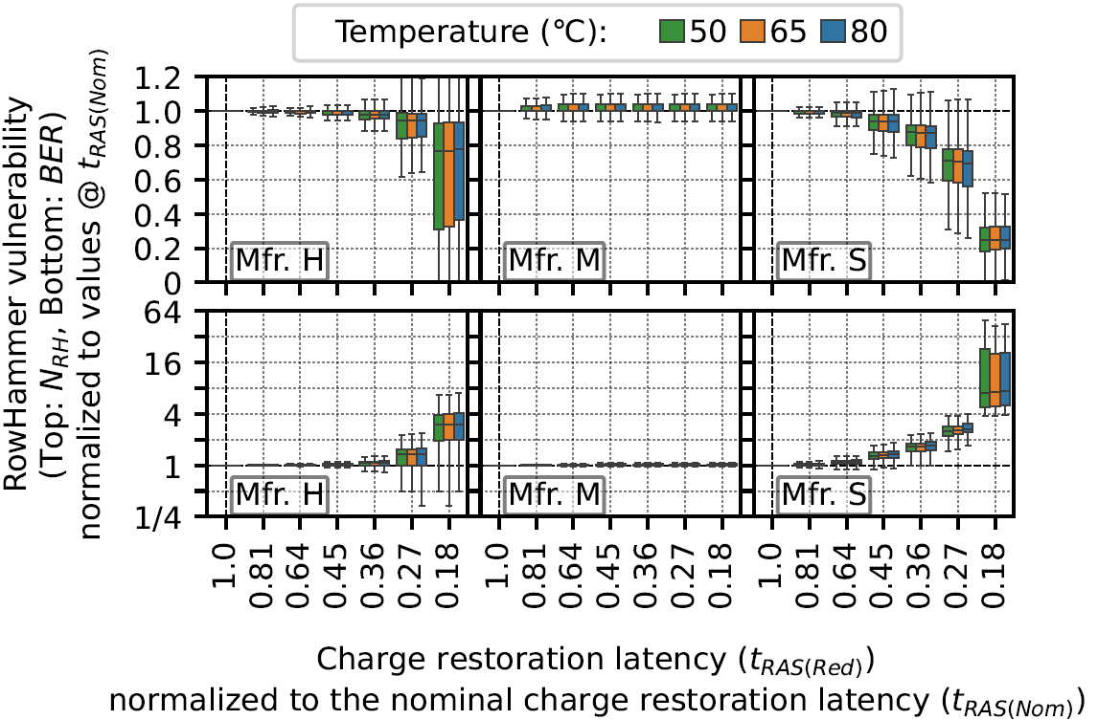
Combined Effect of Partial Charge Restoration and Temperature
Normalized
RowHammer Threshold
Charge Restoration Latency
No significant impact of temperature
on the effect of charge restoration latency
on RowHammer vulnerability

Slide 53
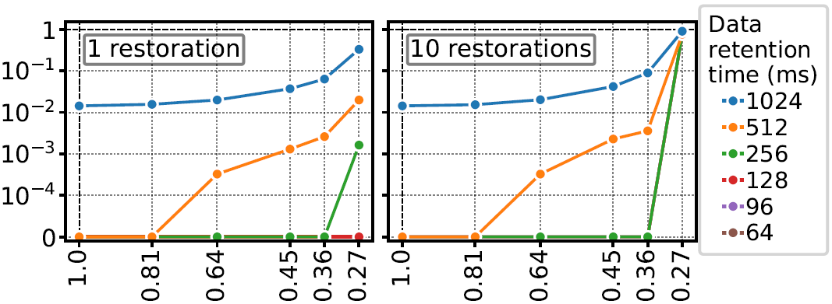
Effect of Partial Charge Restoration on Data Retention Time
Fraction of Rows with
Data Retention Bitflips
Charge Restoration Latency
Charge restoration latency can be significantly reduced
to a safe minimum value
without causing data retention failures

Slide 54
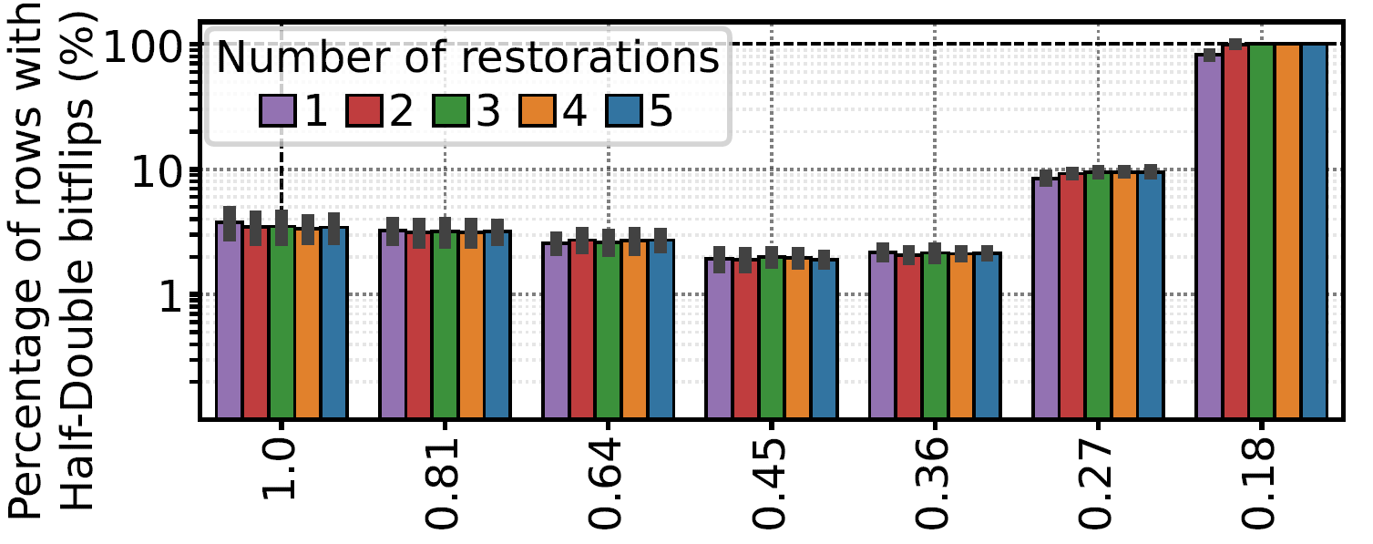
Effect of Partial Charge Restoration on Half-Double Access Pattern
Fraction of Rows with
Half-Double Bitflips (%)
Charge Restoration Latency
Charge restoration latency
can be significantly reduced

Slide 55
Detailed Implementation of PaCRAM
Memory Controller
DRAM
Chip
(or module)
Memory
Request
Scheduler
DRAM Commands, Address
Activated
Row Address
Activated
Row Address
Existing RowHammer Mitigation Solution
N_{RH}
PaCRAM
Preventive
Refresh
Latency
Preventive
Refresh

Slide 56
Detailed Implementation of PaCRAM
PaCRAM
Number of Rows
Fully Restored Bit Vector (FR)
F | P | P | F | P | F | … | F | F | P
F State: the row has to be refreshed
using full charge restoration
P State: the row can be refreshed
using partial charge restoration

Slide 57
Determining Preventive Refresh Latency
Activated
Row Address
PaCRAM
Fully Restored Bit Vector (FR)
F | P | P | F | P | F | … | F | F | P
F → Full Charge Restoration Latency
P → Partial Charge Restoration Latency

Slide 58
PaCRAM’s Row State Transition
F State → P State
  When the row is refreshed
  using full charge restoration
  After fully restoring a row,
  PaCRAM uses partial charge restoration
P State → F State
  PaCRAM periodically resets each rows state to F state
  Full Charge Restoration Interval

Slide 59
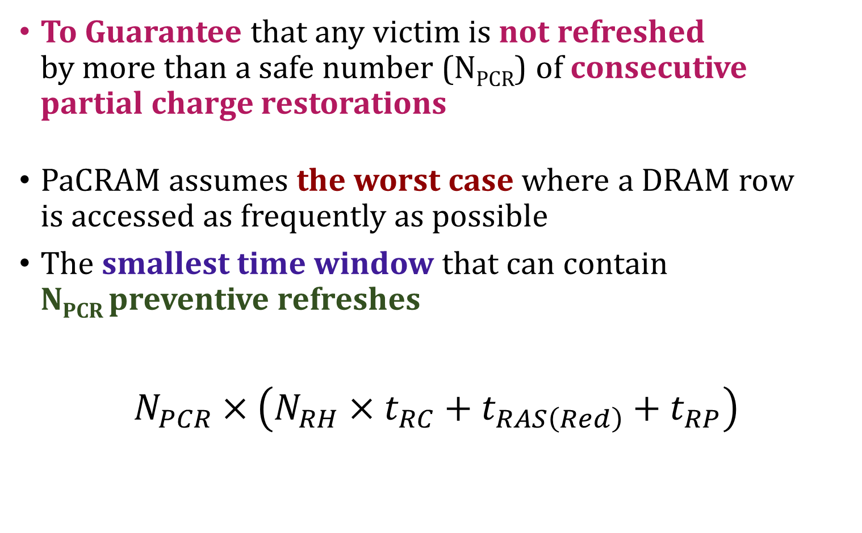
Full Charge Restoration Interval
To Guarantee that any victim is not refreshed
by more than a safe number (N_{PCR}) of consecutive
partial charge restorations
PaCRAM assumes the worst case where a DRAM row
is accessed as frequently as possible
The smallest time window that can contain
N_{PCR} preventive refreshes
$$N_{PCR}×\left(N_{RH}×t_{RC}+t_{RAS\left(Red\right)}+t_{RP}\right)$$
Time to Receive One Preventive Refresh
Attack Time
Preventive
Refresh Latency

Slide 60
Hardware Complexity Analysis of PaCRAM
Chip area and access latency analysis using CACTI
PaCRAM requires 1 bit for each DRAM row
(Fully Restored Bit Vector)
For a DRAM module with 32 banks and 64K row/bank,
  256 KB of SRAM
  0.09% of a high-end Intel Xeon processor
  1.35% of the memory controller area
  Access latency of 0.27ns (<< row activation latency)
PaCRAM introduces a small additional area overhead

Slide 61
PaCRAM with on-DRAM-die
RowHammer Mitigation Mechanisms
On-DRAM-die mitigation mechanism
  PRAC
  Chronus
  …
PaCRAM can be implemented inside DRAM chip
  On-DRAM-die mitigation mechanism inserts
  a Back-Off signal to request a preventive refresh
  PaCRAM stores the preventive refresh latency
  in the mode register (MR)
  Memory controller checks the latency value in MR
  and issues a preventive refresh with the latency
  provided by PaCRAM

Slide 62
Profiling Cost Analysis
For PaCRAM to work robustly,
  How much charge restoration latency can be reduced
  How RowHammer threshold changes
  with partial charge restoration
  How many partial charge restorations
  we can perform consecutively
Profiling
  The system perform profiling
  the very first time DRAM is initialized
  DRAM manufacturers perform profiling
  and store metadata in SPD
  The system can perform online profiling

Slide 63
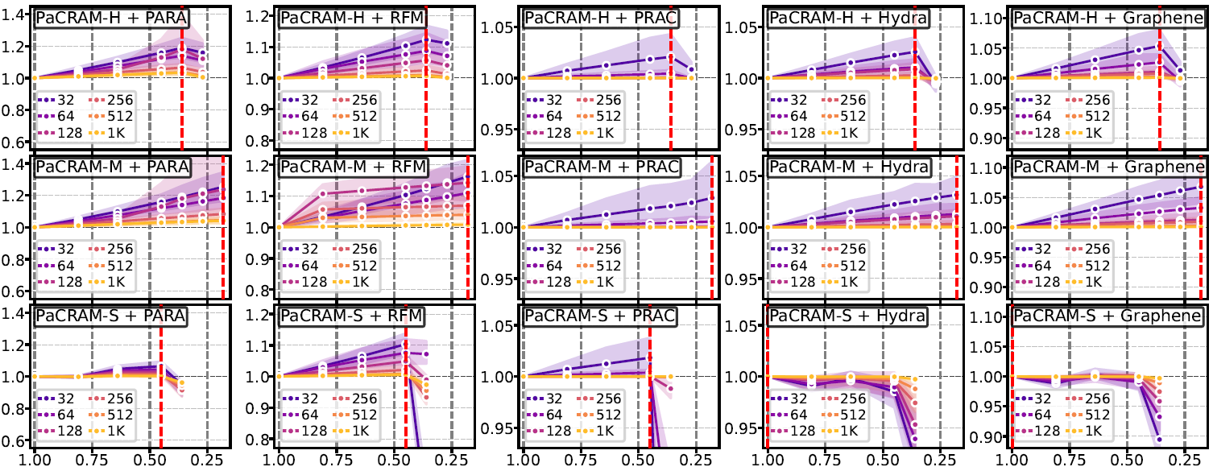
Effect of Charge Restoration Latency on System Performance
System Performance
(Norm. to No PaCRAM)
Charge Restoration Latency
System performance first increases, then decreases
as charge restoration latency decreases

Slide 64
Effect of Charge Restoration Latency on System Performance
System Performance
(Norm. to No PaCRAM)
Charge Restoration Latency

Slide 65
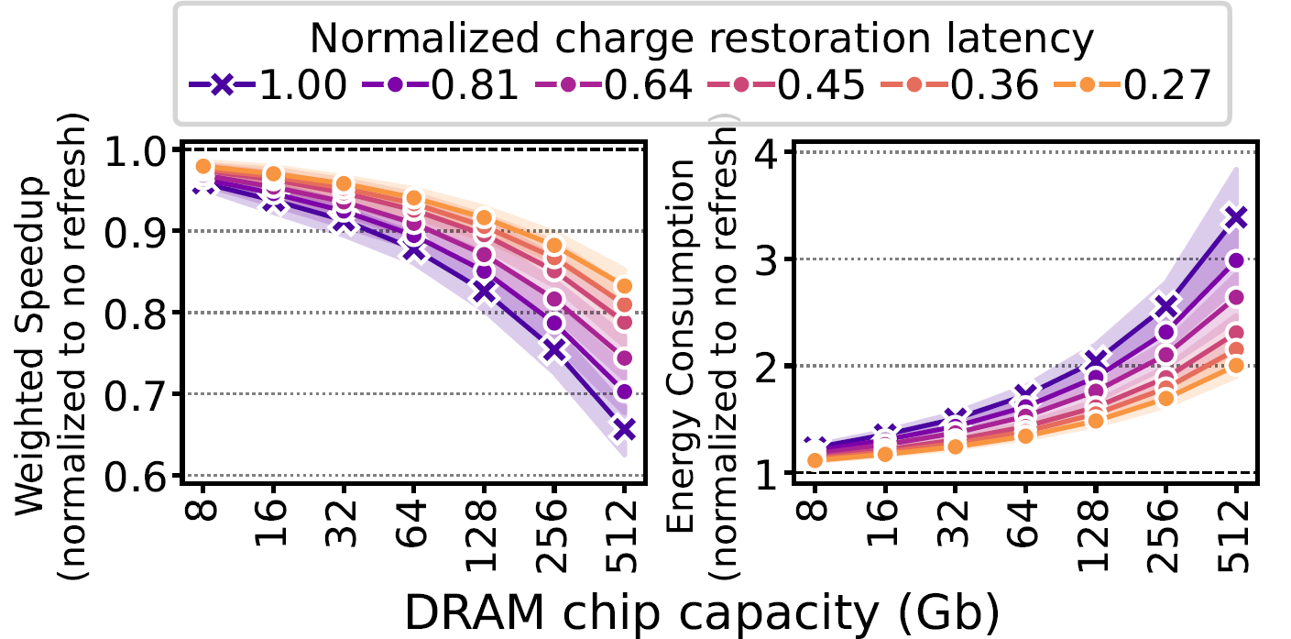
Reducing Periodic Refresh Latency
PaCRAM improves the system performance and energy efficiency by reducing periodic refresh overhead

Slide 66
Understanding RowHammer
Under Reduced Refresh Latency:
Experimental Analysis of Real DRAM Chips and Implications on Future Solutions
Yahya Can Tuğrul
A. Giray Yağlıkçı İsmail Emir Yüksel
Ataberk Olgun Oğuzhan Canpolat Nisa Bostancı
Mohammad Sadrosadati Oğuz Ergin Onur Mutlu

Slide 67
BANNERS
AAAAAAA
AAAAAAA
AAAAAAA
AAAAAAA
AAAAAAA
AAAAAAA
AAAAAAA

