Slide 1
Project PBerry: FPGA Acceleration for Remote Memory
Irina Calciu, Ivan Puddu, Aasheesh Kolli
Andreas Nowatzyk, Jayneel Gandhi, Onur Mutlu
Pratap Subrahmanyam
HotOS 2019

Slide 2
Recent remote memory systems
Systems: Infiniswap, HotPot, Remote regions
Same goal: pool remote memory
Different interfaces: swapping, dspm, file system
Same mechanism: page faults

Slide 3
Use cache coherence traffic to track application memory accesses
Problem
Solution
Impact
Remote memory systems use page faults
Overheads:
1. Page faults overheads
2. Page granularity
Use cache coherence (w/ FPGA)
Implications:
1. Reduce page faults
2. Cache line granularity
1. Remote memory
2. Live migration
3. Code analysis
4. Security
5. …

Slide 4


Remote memory
1. Demand paging (fetch pages)
Local
2. Evict pages
Remote
2’. Dirty data tracking
APP1
APP2
APP3
OS
OS
Memory
Memory
1
2
1
2
3
X
X
4
3
4
Microsecond network
Application host
(Local)
Memory host
(Remote)

Slide 5
How to track dirty data?
APP1
OS
Current solution:
1. Write-protect page
2. On page fault: mark page dirty
Memory
1
2
3
X
4
Application host

Slide 6
Overheads in current remote memory systems
1. Dirty data amplification (4KB, 2MB, 1GB)
  Breaking large pages to 4KB pages
[Smarduch et al., CloudOpen-Japan 2015]
Application | Amplification (4KB pages) | Amplification (2MB pages) | Amplification (64B cache-line)
Redis-random | 96.82 % (3.87 KB) | 99.99 % (1.99 MB) | 31.70 % (20.29 B)
Redis-seq | 82.91 % (3.32 KB) | 99.83 % (1.99 MB) | 17.18 % (10.99 B)

Slide 7
Overheads in current remote memory systems
1. Dirty data amplification (4KB, 2MB, 1GB)
  Breaking large pages to 4KB pages
2. Application slowdown due to (write) page faults
3. Cost of write-protecting pages
[Smarduch et al., CloudOpen-Japan 2015]

Slide 8
Use cache coherence traffic to track application memory accesses
Problem
Solution
Impact
Remote memory systems use page faults
Overheads:
1. Page faults overheads
2. Page granularity
Use cache coherence (w/ FPGA)
Implications:
1. Reduce page faults
2. Cache line granularity
1. Remote memory
2. Live migration
3. Code analysis
4. Security
5. …

Slide 9
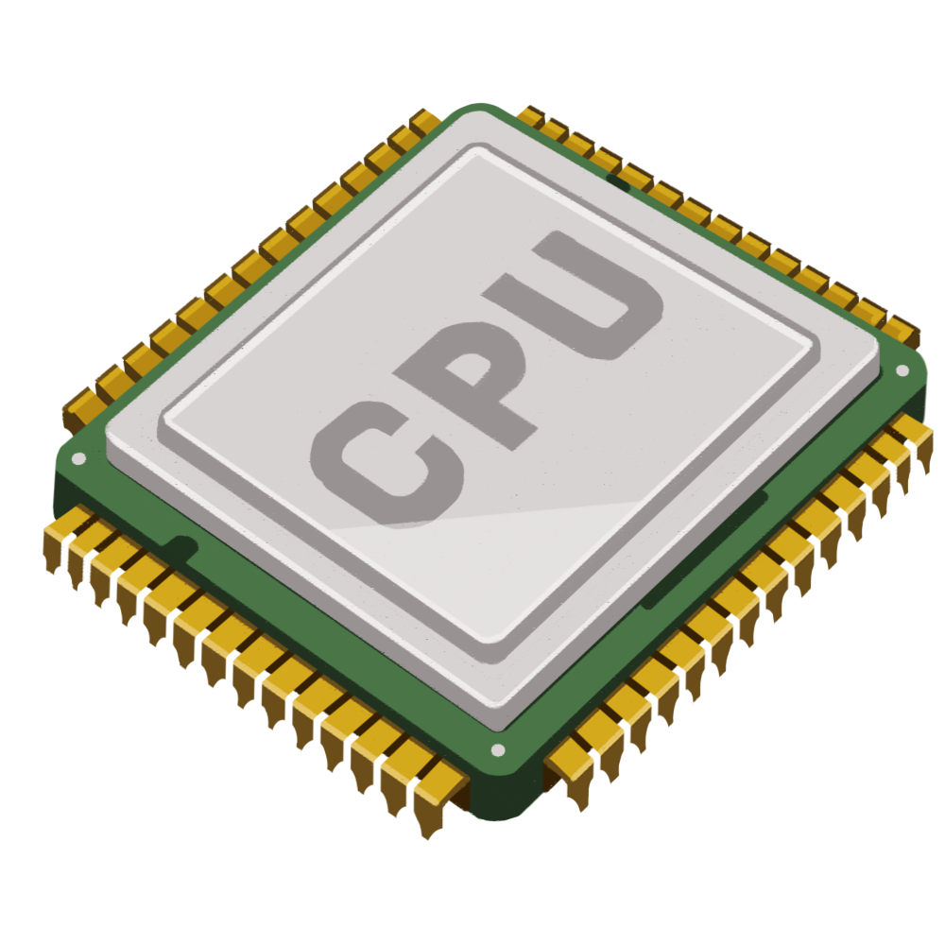
Key idea: use cache coherence for tracking memory accesses
MESI protocol
Modified
CPU Caches
Write
Flush
FlushX
M
Write
Write
Exclusive
Memory
Read
Shared
Read
Invalid

Slide 10
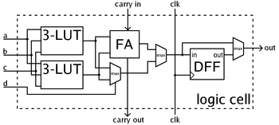
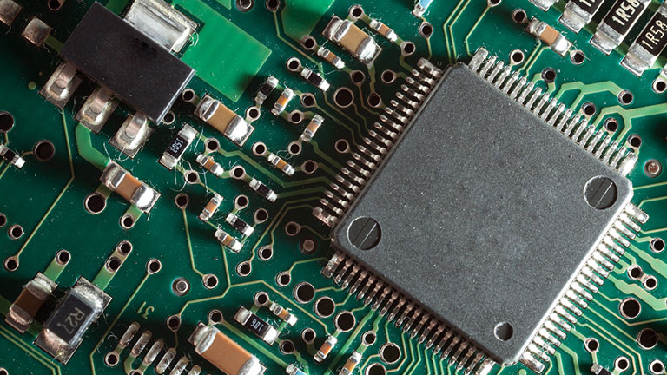
Field Programmable Gate Array (FPGA)
Integrated circuit
Reconfigured after manufacturing
“Program the hardware”

Slide 11
Key idea: use cache coherence for tracking memory accesses
CPU
FPGA
Coherent
interconnect
CPU Caches
S
Memory
Memory

Slide 12
Key idea: use cache coherence for tracking memory accesses
CPU
FPGA
Coherent
interconnect
CPU Caches
M
Memory
Memory

Slide 13
FPGA primitives
Read and write tracking using cache coherence
  Data pages
  Code pages
  OS pages (page tables)
Local and remote copy
In-place transform

Slide 14
Remote memory using a cache coherent FPGA
1. Demand paging (fetch pages)
Local
2. Evict pages
Remote
APP1
2’. Dirty data tracking
OS
OS
DRAM cache for remote memory
Memory
Memory
Memory
Microsecond network
Application host
Memory host

Slide 15
1. “Demand paging” using a cache coherent FPGA
Fake physical address space
APP1
OS
1
OS
Memory
1
Memory
Memory
1
Microsecond network
Application host
Memory host

Slide 16
1. “Demand paging” optimization: translation triggered prefetching
Fake physical address space
APP1
OS
1
OS
Memory
1
Memory
Memory
1
Microsecond network
Application host
Memory host

Slide 17
Use cache coherence traffic to track application memory accesses
Problem
Solution
Impact
Remote memory systems use page faults
Overheads:
1. Page faults overheads
2. Page granularity
Use cache coherence (w/ FPGA)
Implications:
1. Reduce page faults
2. Cache line granularity
1. Remote memory
2. Live migration
3. Code analysis
4. Security
5. …

Slide 18
Benefits
Reduce (write) page faults
Reduce dirty data amplification (cache-line)
Determine access pattern, smart prefetching
Downside: FPGA memory slower than CPU memory

Slide 19
Preliminary results (emulated)
1. Demand paging (fetch pages)
Local
2. Evict pages
Remote
2’. Dirty data tracking
Redis-random:
  89% less dirty data (cache-line vs. page granularity)
  27% faster than WP
Redis-seq:
  50% less dirty data (cache-line vs. page granularity)
  4% faster than WP

Slide 20
Other use cases
Use case | Page type | Primitive
Live migration | Data, page tables | Read/write tracking, remote copy
Compression, Encryption | Data | Read/write tracking, in-place transform
Replication, Checkpointing | Data | Write tracking, local/remote copy
Near-memory compute | Data | Read/write tracking, in-place transform
Code analysis | Code | Read tracking
Security | Data | Read/write tracking

Slide 21
Use cache coherence traffic to track application memory accesses
Problem
Solution
Impact
Remote memory systems use page faults
Use cache coherence (w/ FPGA)
Other use cases
Thank you!
Contact: icalciu@vmware.com

