Slide 1
Understanding a Modern Processing-in-Memory Architecture:
Benchmarking and Experimental Characterization
Juan Gómez Luna, Izzat El Hajj,
Ivan Fernandez, Christina Giannoula,
Geraldo F. Oliveira, Onur Mutlu
https://arxiv.org/pdf/2105.03814.pdf
https://github.com/CMU-SAFARI/prim-benchmarks

Slide 2
Executive Summary
Data movement between memory/storage units and compute units is a major contributor to execution time and energy consumption
Processing-in-Memory (PIM) is a paradigm that can tackle the data movement bottleneck
  Though explored for +50 years, technology challenges prevented the successful materialization
UPMEM has designed and fabricated the first publicly-available real-world PIM architecture
  DDR4 chips embedding in-order multithreaded DRAM Processing Units (DPUs)
Our work:
  Introduction to UPMEM programming model and PIM architecture
  Microbenchmark-based characterization of the DPU
  Benchmarking and workload suitability study
Main contributions:
  Comprehensive characterization and analysis of the first commercially-available PIM architecture
  PrIM (Processing-In-Memory) benchmarks:
    16 workloads that are memory-bound in conventional processor-centric systems
    Strong and weak scaling characteristics
  Comparison to state-of-the-art CPU and GPU
Takeaways:
  Workload characteristics for PIM suitability
  Programming recommendations
  Suggestions and hints for hardware and architecture designers of future PIM systems
  PrIM: (a) programming samples, (b) evaluation and comparison of current and future PIM systems

Slide 3
System Organization
A UPMEM DIMM contains 8 or 16 chips
  Thus, 1 or 2 ranks of 8 chips each
Inside each PIM chip there are:
  8 64MB banks per chip: Main RAM (MRAM) banks
  8 DRAM Processing Units (DPUs) in each chip, 64 DPUs per rank

Slide 4
Key Takeaway 1
The throughput saturation point is as low as ¼ OP/B,
i.e., 1 integer addition per every 32-bit element fetched
Memory-bound region
Compute-bound region
KEY TAKEAWAY 1
The UPMEM PIM architecture is fundamentally compute bound.
As a result, the most suitable workloads are memory-bound.

Slide 5
Key Takeaway 2
KEY TAKEAWAY 2
The most well-suited workloads for the UPMEM PIM architecture use no arithmetic operations or use only simple operations (e.g., bitwise operations and integer addition/subtraction).

Slide 6
Key Takeaway 3
KEY TAKEAWAY 3
The most well-suited workloads for the UPMEM PIM architecture require little or no communication across DPUs (inter-DPU communication).

Slide 7
Key Takeaway 4
KEY TAKEAWAY 4
• UPMEM-based PIM systems outperform state-of-the-art CPUs in terms of performance and energy efficiency on most of PrIM benchmarks.
• UPMEM-based PIM systems outperform state-of-the-art GPUs on a majority of PrIM benchmarks, and the outlook is even more positive for future PIM systems.
• UPMEM-based PIM systems are more energy-efficient than state-of-the-art CPUs and GPUs on workloads that they provide performance improvements over the CPUs and the GPUs.

Slide 8
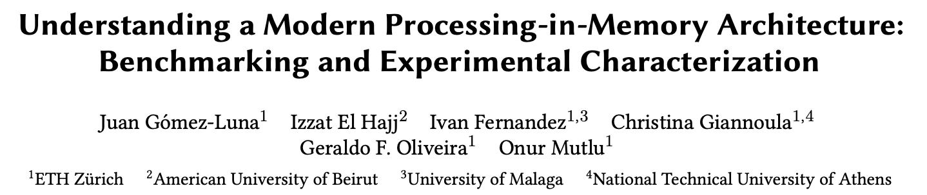
Understanding a Modern PIM Architecture
https://arxiv.org/pdf/2105.03814.pdf
https://github.com/CMU-SAFARI/prim-benchmarks

Slide 9
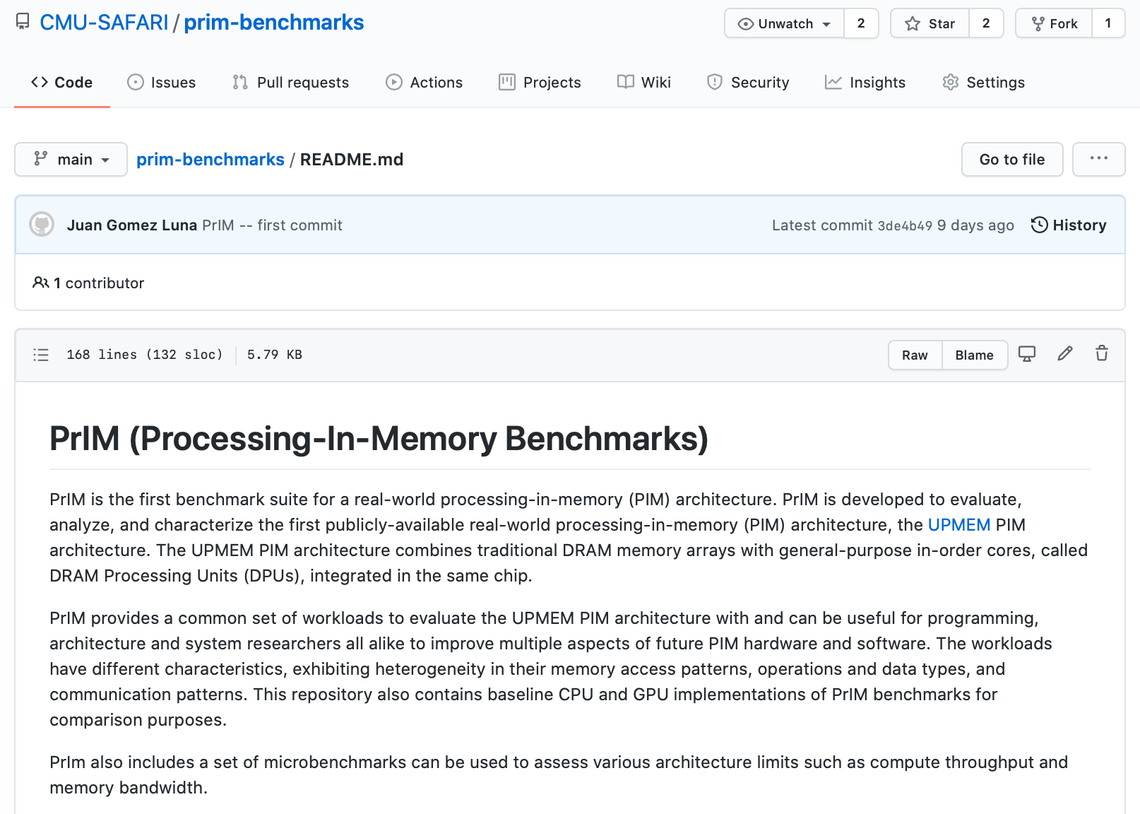
PrIM Repository
All microbenchmarks, benchmarks, and scripts
https://github.com/CMU-SAFARI/prim-benchmarks

Slide 10
Understanding a Modern Processing-in-Memory Architecture:
Benchmarking and Experimental Characterization
Juan Gómez Luna, Izzat El Hajj,
Ivan Fernandez, Christina Giannoula,
Geraldo F. Oliveira, Onur Mutlu
el1goluj@gmail.com
https://arxiv.org/pdf/2105.03814.pdf
https://github.com/CMU-SAFARI/prim-benchmarks

