Slide 1
Understanding a Modern Processing-in-Memory Architecture:
Benchmarking and Experimental Characterization
Juan Gómez Luna, Izzat El Hajj,
Ivan Fernandez, Christina Giannoula,
Geraldo F. Oliveira, Onur Mutlu
https://arxiv.org/pdf/2105.03814.pdf
https://github.com/CMU-SAFARI/prim-benchmarks

Slide 2
Executive Summary
Data movement between memory/storage units and compute units is a major contributor to execution time and energy consumption
Processing-in-Memory (PIM) is a paradigm that can tackle the data movement bottleneck
  Though explored for +50 years, technology challenges prevented the successful materialization
UPMEM has designed and fabricated the first publicly-available real-world PIM architecture
  DDR4 chips embedding in-order multithreaded DRAM Processing Units (DPUs)
Our work:
  Introduction to UPMEM programming model and PIM architecture
  Microbenchmark-based characterization of the DPU
  Benchmarking and workload suitability study
Main contributions:
  Comprehensive characterization and analysis of the first commercially-available PIM architecture
  PrIM (Processing-In-Memory) benchmarks:
    16 workloads that are memory-bound in conventional processor-centric systems
    Strong and weak scaling characteristics
  Comparison to state-of-the-art CPU and GPU
Takeaways:
  Workload characteristics for PIM suitability
  Programming recommendations
  Suggestions and hints for hardware and architecture designers of future PIM systems
  PrIM: (a) programming samples, (b) evaluation and comparison of current and future PIM systems

Slide 3
Data Movement in Computing Systems
Data movement dominates performance and is a major system energy bottleneck
Total system energy: data movement accounts for
  62% in consumer applications✻,
  40% in scientific applications★,
  35% in mobile applications☆
Data Movement
SoC
DRAM
CPU
CPU
L2
GPU
Video Encoder
Video Decoder
Audio
Display Engine
✻ Boroumand et al., “Google Workloads for Consumer Devices: Mitigating Data Movement Bottlenecks,” ASPLOS 2018
★ Kestor et al., “Quantifying the Energy Cost of Data Movement in Scientific Applications,” IISWC 2013
☆ Pandiyan and Wu, “Quantifying the energy cost of data movement for emerging smart phone workloads on mobile platforms,” IISWC 2014

Slide 4
Data Movement in Computing Systems
Data movement dominates performance and is a major system energy bottleneck
Total system energy: data movement accounts for
  62% in consumer applications✻,
  40% in scientific applications★,
  35% in mobile applications☆
Compute systems should be more data-centric
Data Movement
SoC
CPU
Processing-In-Memory proposes
computing where it makes sense
(where data resides)
CPU
L2
DRAM
GPU
Video Encoder
Video Decoder
Audio
Display Engine
✻ Boroumand et al., “Google Workloads for Consumer Devices: Mitigating Data Movement Bottlenecks,” ASPLOS 2018
★ Kestor et al., “Quantifying the Energy Cost of Data Movement in Scientific Applications,” IISWC 2013
☆ Pandiyan and Wu, “Quantifying the energy cost of data movement for emerging smart phone workloads on mobile platforms,” IISWC 2014

Slide 5
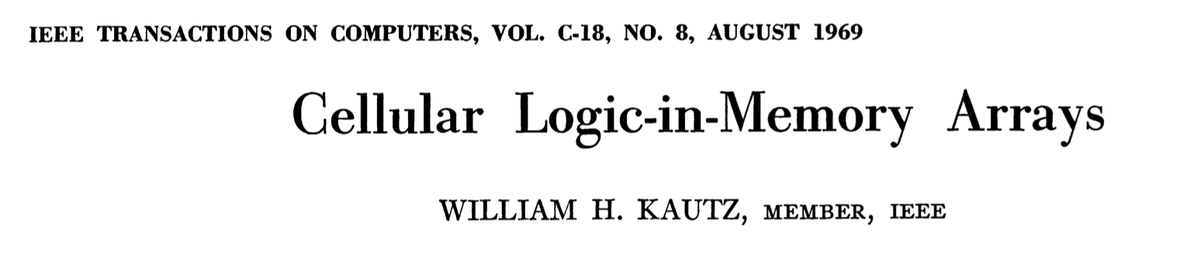
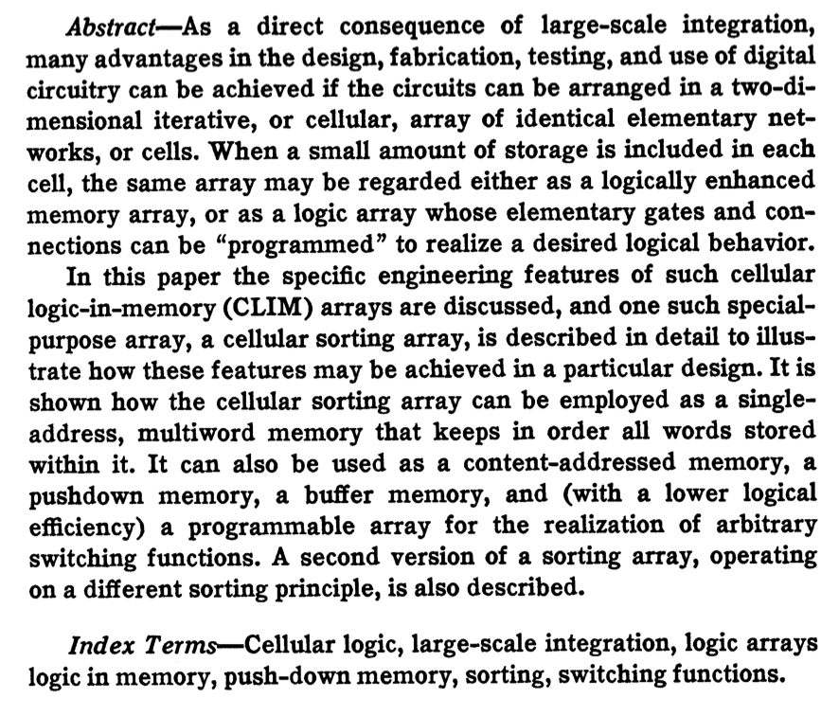
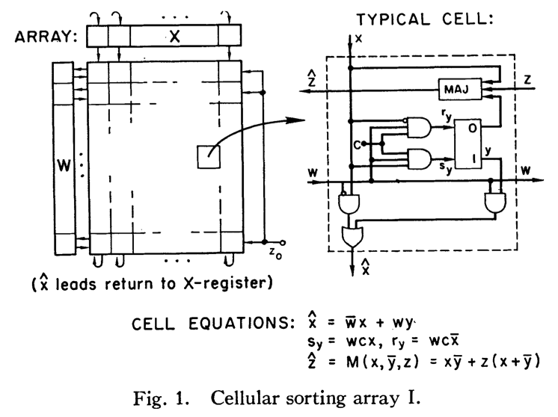
A +50-Year-Old Paradigm
Kautz, “Cellular Logic-in-Memory Arrays”, IEEE TC 1969
https://doi.org/10.1109/T-C.1969.222754

Slide 6
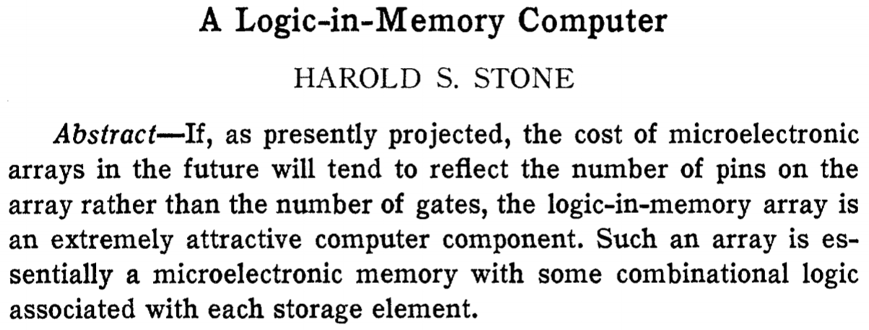
Processing in/near Memory: An Old Idea
Stone, “A Logic-in-Memory Computer,” IEEE TC 1970.
https://doi.org/10.1109/TC.1970.5008902
https://people.inf.ethz.ch/omutlu/pub/onur-MiM-Talk-IntelligentArchitecturesForIntelligentMachines-May-3-2021.pptx

Slide 7
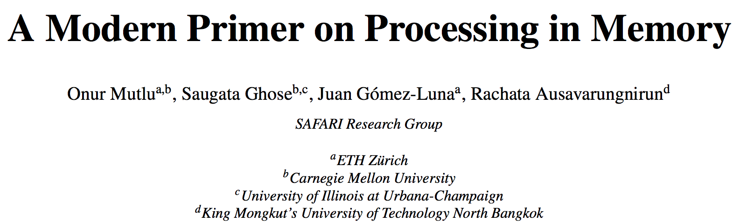
PIM Review and Open Problems
Onur Mutlu, Saugata Ghose, Juan Gomez-Luna, and Rachata Ausavarungnirun,
"A Modern Primer on Processing in Memory"
Invited Book Chapter in Emerging Computing: From Devices to Systems - Looking Beyond Moore and Von Neumann, Springer, to be published in 2021.
https://arxiv.org/pdf/1903.03988.pdf

Slide 8
UPMEM Processing-in-DRAM Engine (2019)
Processing in DRAM Engine
Includes standard DIMM modules, with a large number of DPU processors combined with DRAM chips.
Replaces standard DIMMs
  DDR4 R-DIMM modules
    8GB+128 DPUs (16 PIM chips)
    Standard 2x-nm DRAM process
  Large amounts of compute & memory bandwidth
CPU
(x86, ARM, RV…)
DDR
Data bus
https://www.anandtech.com/show/14750/hot-chips-31-analysis-inmemory-processing-by-upmem
https://www.upmem.com/video-upmem-presenting-its-true-processing-in-memory-solution-hot-chips-2019/

Slide 9
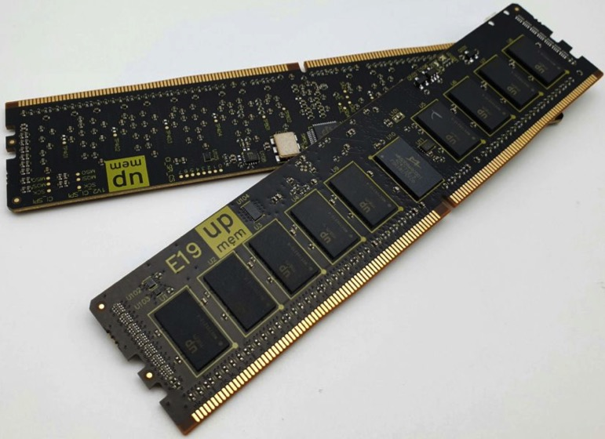
UPMEM DIMMs
E19: 8 chips/DIMM (1 rank). DPUs @ 267 MHz
P21: 16 chips/DIMM (2 ranks). DPUs @ 350 MHz
www.upmem.com

Slide 10
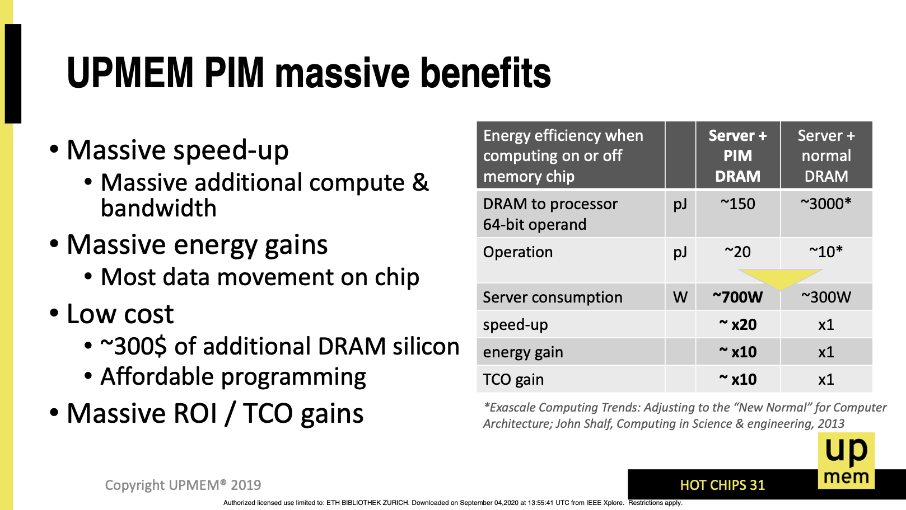
PIM’s Promises
F. Devaux, "The true Processing In Memory accelerator," HotChips 2019. doi: 10.1109/HOTCHIPS.2019.8875680

Slide 11
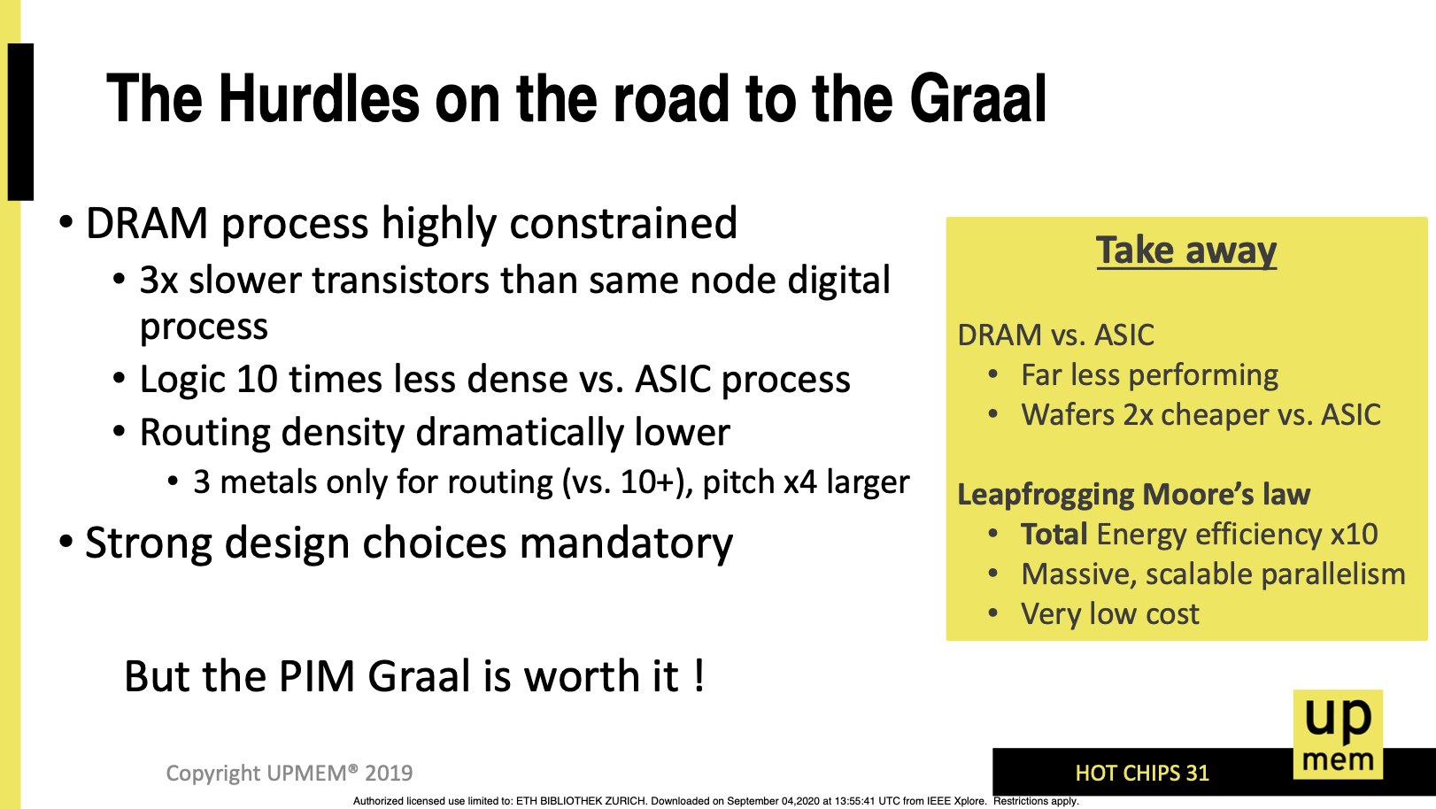
Technology Challenges
F. Devaux, "The true Processing In Memory accelerator," HotChips 2019. doi: 10.1109/HOTCHIPS.2019.8875680

Slide 12
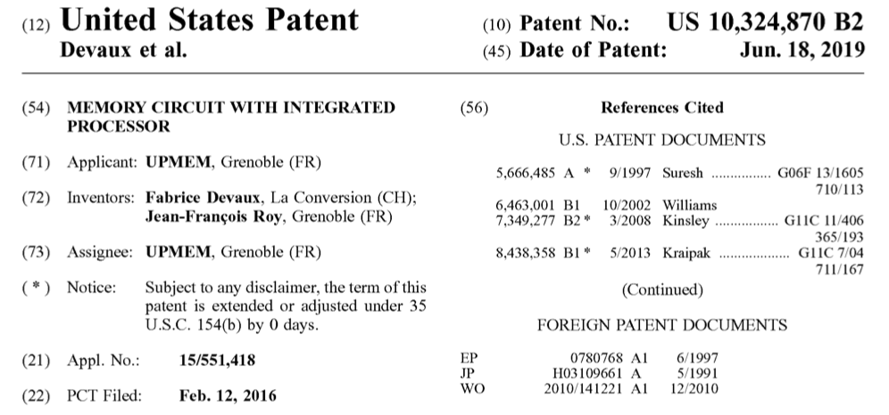
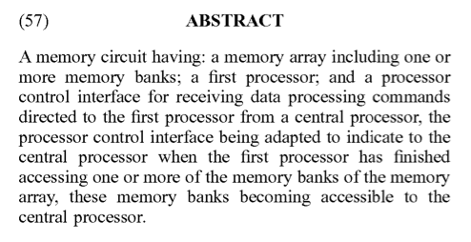
UPMEM Patent
Fabrice Devaux, Jean-François Roy. “Memory circuit with integrated processor.” US 10,324,870 B2.

Slide 13
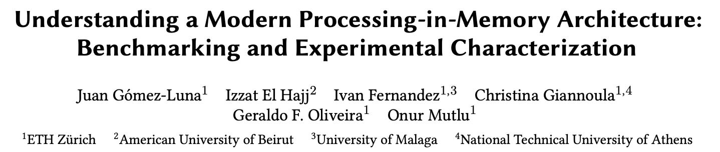
Understanding a Modern PIM Architecture
https://arxiv.org/pdf/2105.03814.pdf
https://github.com/CMU-SAFARI/prim-benchmarks

Slide 14
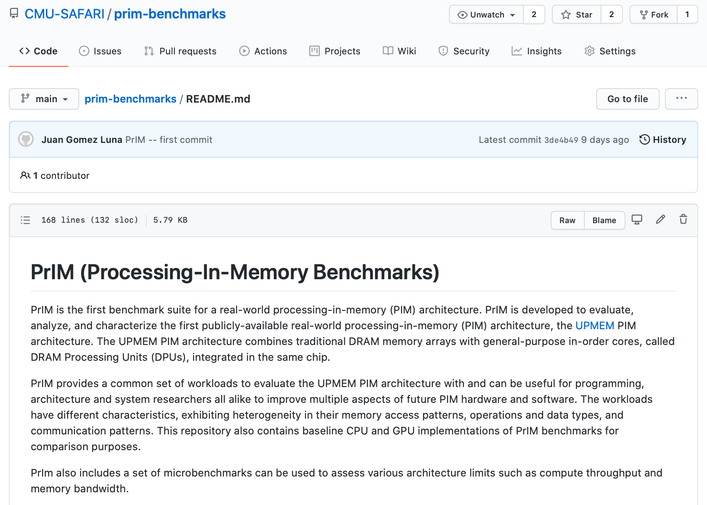
PrIM Repository
All microbenchmarks, benchmarks, and scripts
https://github.com/CMU-SAFARI/prim-benchmarks

Slide 15
Outline
Introduction
  Accelerator Model
  UPMEM-based PIM System Overview
UPMEM PIM Programming
  Vector Addition
  CPU-DPU Data Transfers
  Inter-DPU Communication
  CPU-DPU/DPU-CPU Transfer Bandwidth
DRAM Processing Unit
  Arithmetic Throughput
  WRAM and MRAM Bandwidth
PrIM Benchmarks
  Roofline Model
  Benchmark Diversity
Evaluation
  Strong and Weak Scaling
  Comparison to CPU and GPU
Key Takeaways

Slide 16
Observations, Recommendations, Takeaways
GENERAL PROGRAMMING RECOMMENDATIONS
Execute on the DRAM Processing Units (DPUs) portions of parallel code that are as long as possible.
Split the workload into independent data blocks, which the DPUs operate on independently.
Use as many working DPUs in the system as possible.
Launch at least 11 tasklets (i.e., software threads) per DPU.
PROGRAMMING RECOMMENDATION 1
For data movement between the DPU’s MRAM bank and the WRAM, use large DMA transfer sizes when all the accessed data is going to be used.
KEY OBSERVATION 7
Larger CPU-DPU and DPU-CPU transfers between the host main memory and the DRAM Processing Unit’s Main memory (MRAM) banks result in higher sustained bandwidth.
KEY TAKEAWAY 1
The UPMEM PIM architecture is fundamentally compute bound. As a result, the most suitable work- loads are memory-bound.

Slide 17
Outline
Introduction
  Accelerator Model
  UPMEM-based PIM System Overview
UPMEM PIM Programming
  Vector Addition
  CPU-DPU Data Transfers
  Inter-DPU Communication
  CPU-DPU/DPU-CPU Transfer Bandwidth
DRAM Processing Unit
  Arithmetic Throughput
  WRAM and MRAM Bandwidth
PrIM Benchmarks
  Roofline Model
  Benchmark Diversity
Evaluation
  Strong and Weak Scaling
  Comparison to CPU and GPU
Key Takeaways

Slide 18
Accelerator Model (I)
UPMEM DIMMs coexist with conventional DIMMs
Integration of UPMEM DIMMs in a system follows an accelerator model
UPMEM DIMMs can be seen as a loosely coupled accelerator
  Explicit data movement between the main processor (host CPU) and the accelerator (UPMEM)
  Explicit kernel launch onto the UPMEM processors
This resembles GPU computing

Slide 19
GPU Computing
Computation is offloaded to the GPU
Three steps
  CPU-GPU data transfer (1)
  GPU kernel execution (2)
  GPU-CPU data transfer (3)
https://www.youtube.com/watch?v=y40-tY5WJ8A
https://safari.ethz.ch/digitaltechnik/spring2018/lib/exe/fetch.php?media=digitaldesign-2018-lecture22-gpuprogramming-afterlecture.pdf

Slide 20
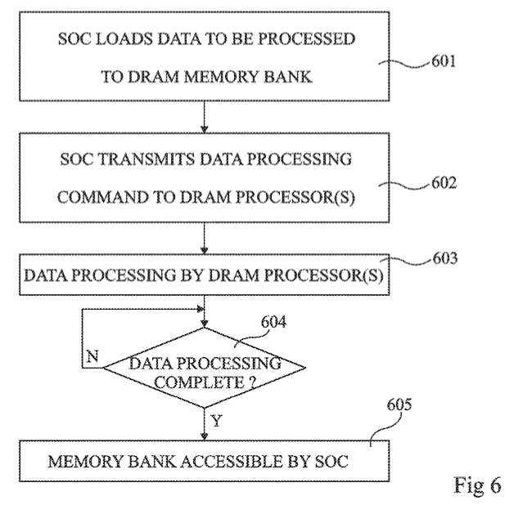
Accelerator Model (II)
FIG. 6 is a flow diagram representing operations in a method of delegating a processing task to a DRAM processor according to an example embodiment
Fabrice Devaux, Jean-François Roy. “Memory circuit with integrated processor.” US 10,324,870 B2.

Slide 21
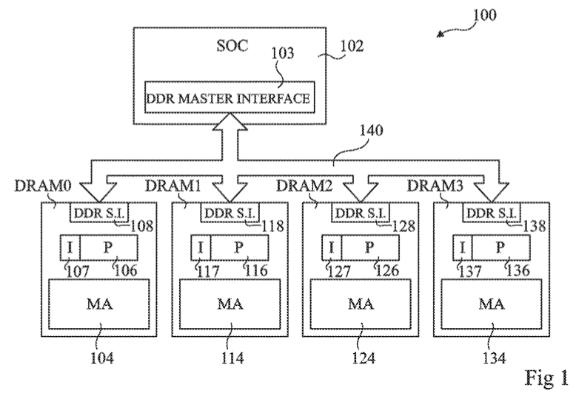
System Organization (I)
FIG. 1 schematically illustrates a computing system comprising DRAM circuits having integrated processors according to an example embodiment
Fabrice Devaux, Jean-François Roy. “Memory circuit with integrated processor.” US 10,324,870 B2.

Slide 22
System Organization (II)
In a UPMEM-based PIM system UPMEM DIMMs coexist with regular DDR4 DIMMs
Notes:
P21 DIMMs.
DPUs cannot be shared. There is a large number of DPUs.
No need for OS.
This simplifies security implications. No side channels.

Slide 23
System Organization (III)
A UPMEM DIMM contains 8 or 16 chips
  Thus, 1 or 2 ranks of 8 chips each
Inside each PIM chip there are:
  8 64MB banks per chip: Main RAM (MRAM) banks
  8 DRAM Processing Units (DPUs) in each chip, 64 DPUs per rank

Slide 24
2,560-DPU System (I)
UPMEM-based PIM system with 20 UPMEM DIMMs of 16 chips each (40 ranks)
  P21 DIMMs
  Dual x86 socket
    UPMEM DIMMs coexist with regular DDR4 DIMMs
    2 memory controllers/socket (3 channels each)
    2 conventional DDR4 DIMMs on one channel of one controller
2560 DPUs*
160 GB
* There are 4 faulty DPUs in the system that we use in our experiments. Thus, the maximum number of DPUs we can use is 2,556.

Slide 25
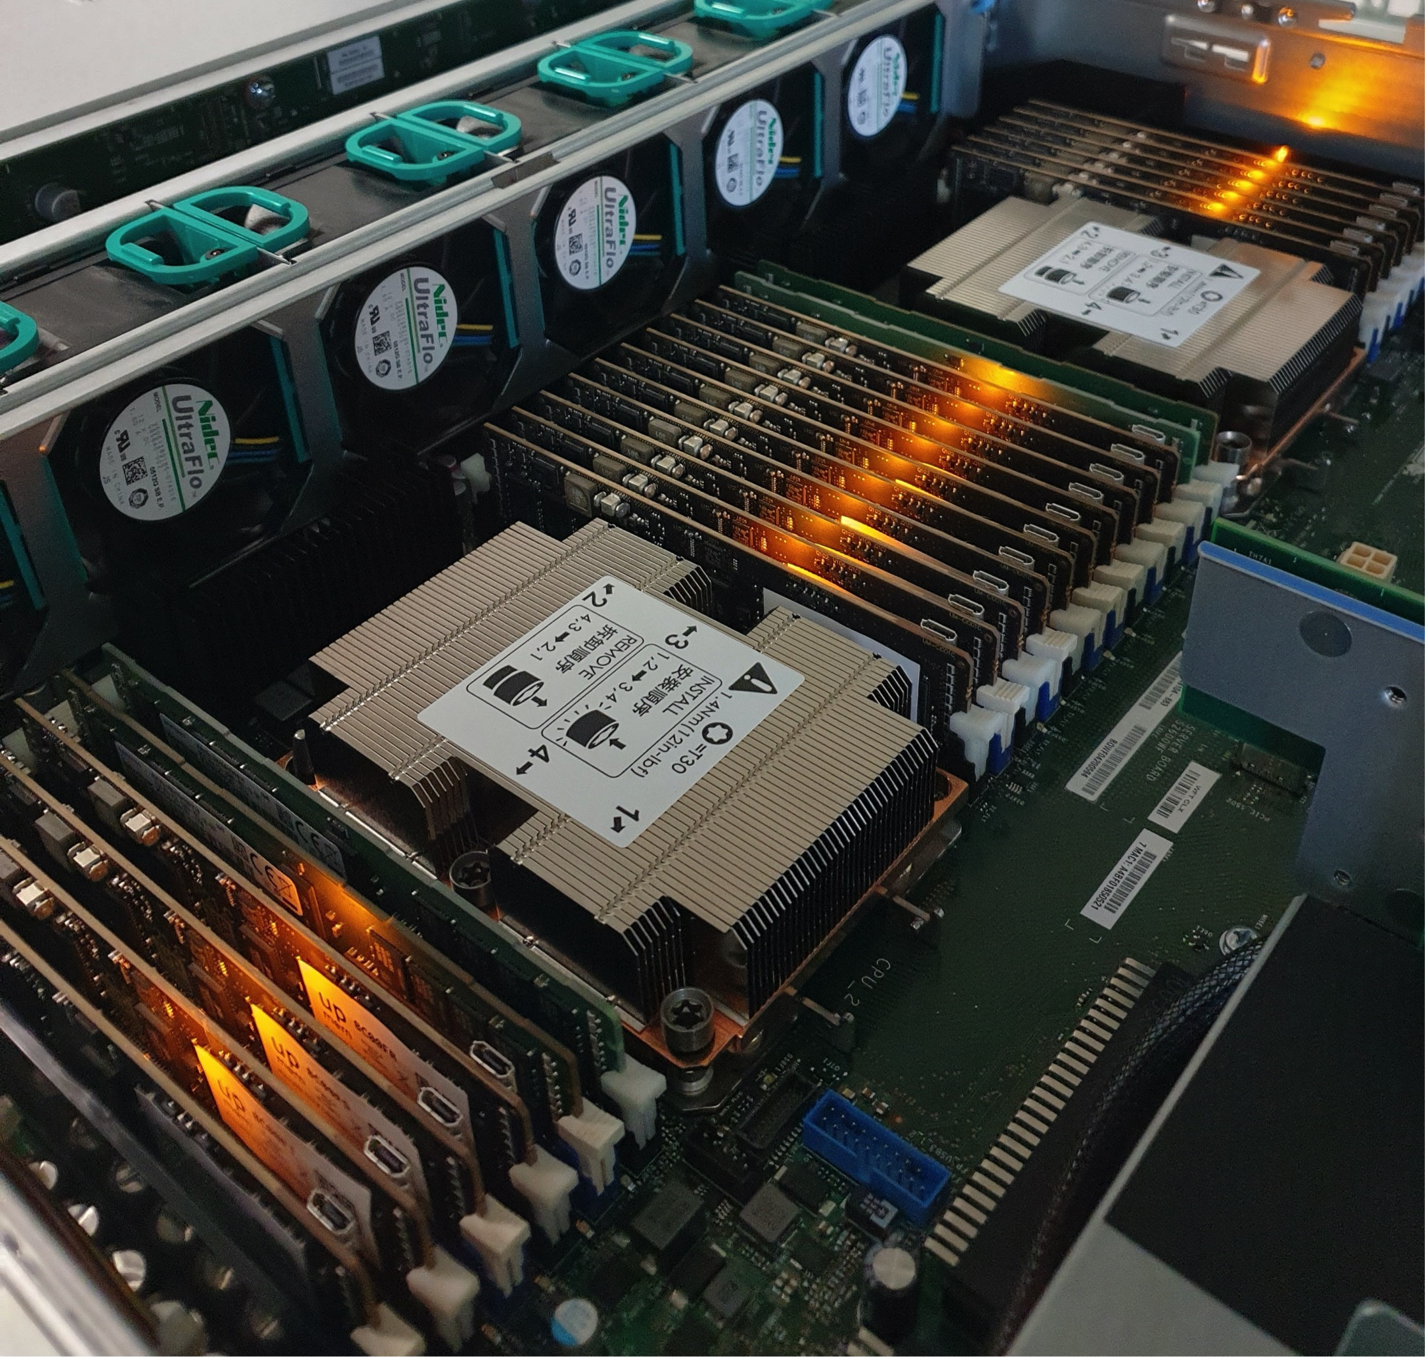
2,560-DPU System (II)

Slide 26
640-DPU System
UPMEM-based PIM system with 10 UPMEM DIMMs of 8 chips each (10 ranks)
  E19 DIMMs
  x86 socket
    2 memory controllers (3 channels each)
    2 conventional DDR4 DIMMs on one channel of one controller
640 DPUs
40 GB

Slide 27
DPU Sharing? Security Implications?
DPUs cannot be shared across multiple CPU processes
  There are so many DPUs in the system that there is no need for sharing
According to UPMEM, this assumption makes things simpler
  No need for OS
  Simplified security implications: No side channels

Slide 28
Outline
Introduction
  Accelerator Model
  UPMEM-based PIM System Overview
UPMEM PIM Programming
  Vector Addition
  CPU-DPU Data Transfers
  Inter-DPU Communication
  CPU-DPU/DPU-CPU Transfer Bandwidth
DRAM Processing Unit
  Arithmetic Throughput
  WRAM and MRAM Bandwidth
PrIM Benchmarks
  Roofline Model
  Benchmark Diversity
Evaluation
  Strong and Weak Scaling
  Comparison to CPU and GPU
Key Takeaways

Slide 29
Vector Addition (VA)
Our first programming example
We partition the input arrays across:
  DPUs
  Tasklets, i.e., software threads running on a DPU
Tasklet 0
Tasklet 1
Tasklet 0
Tasklet 1
Tasklet 0
Tasklet 1
Tasklet 0
Tasklet 1
DPU 0
DPU 1
DPU 2
DPU 3

Slide 30
General Programming Recommendations
From UPMEM programming guide✻, presentations★, and white papers☆
GENERAL PROGRAMMING RECOMMENDATIONS
Execute on the DRAM Processing Units (DPUs) portions of parallel code that are as long as possible.
Split the workload into independent data blocks, which the DPUs operate on independently.
Use as many working DPUs in the system as possible.
Launch at least 11 tasklets (i.e., software threads) per DPU.
✻ https://sdk.upmem.com/2021.1.1/index.html
★ F. Devaux, "The true Processing In Memory accelerator," HotChips 2019. doi: 10.1109/HOTCHIPS.2019.8875680
☆ UPMEM, “Introduction to UPMEM PIM. Processing-in-memory (PIM) on DRAM Accelerator,” White paper

Slide 31
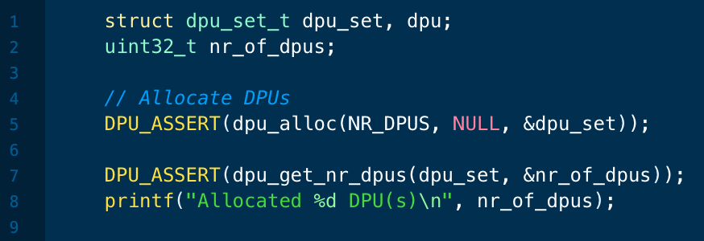
DPU Allocation
dpu_alloc() allocates a number of DPUs
  Creates a dpu_set
Can we allocate different DPU sets
over the course of a program?
Yes, we can. We show an example next
We deallocate a DPU set with dpu_free()

Slide 32
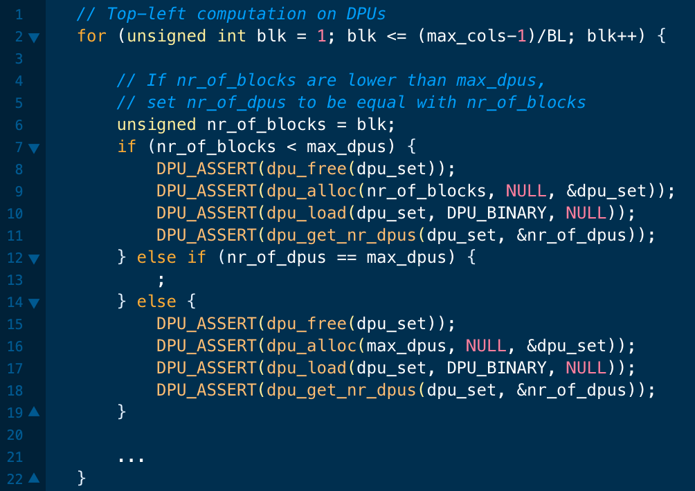
DPU Allocation: Needleman-Wunsch (NW)
In NW we change the number of DPUs in the DPU set as computation progresses

Slide 33
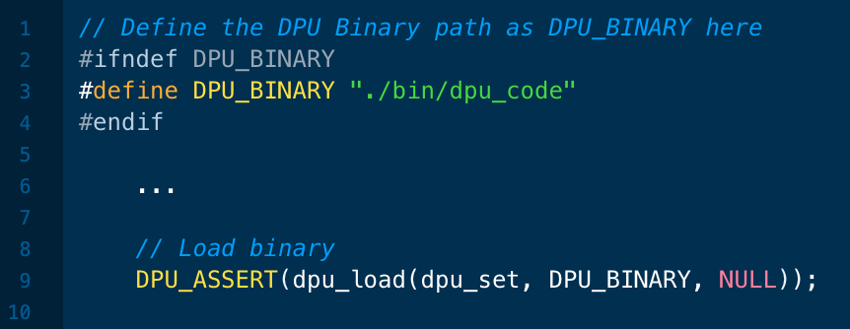
Load DPU Binary
dpu_load() loads a program in all DPUs of a dpu_set
Is it possible to launch different kernels onto different DPUs?
Yes, it is possible. This enables:
Workloads with task-level parallelism
Different programs using different DPU sets

Slide 34
CPU-DPU/DPU-CPU Data Transfers
CPU-DPU and DPU-CPU transfers
  Between host CPU’s main memory and DPUs’ MRAM banks
Serial CPU-DPU/DPU-CPU transfers:
  A single DPU (i.e., 1 MRAM bank)
Parallel CPU-DPU/DPU-CPU transfers:
  Multiple DPUs (i.e., many MRAM banks)
Broadcast CPU-DPU transfers:
  Multiple DPUs with a single buffer

Slide 35
Serial Transfers
dpu_copy_to();
dpu_copy_from();
We transfer (part of) a buffer to/from each DPU in the dpu_set
DPU_MRAM_HEAP_POINTER_NAME: Start of the MRAM range that can be freely accessed by applications
  We do not allocate MRAM explicitly
Offset within MRAM
Pointer to main memory
Transfer size

Slide 36
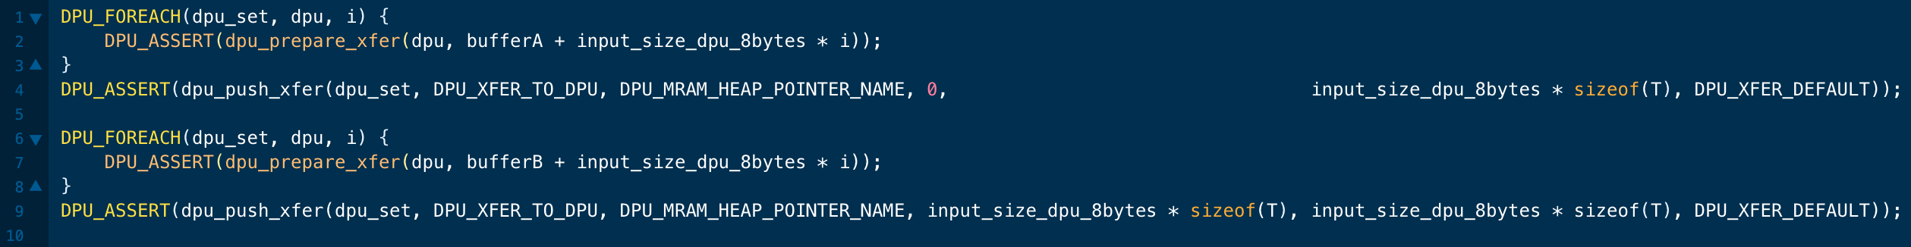
Parallel Transfers
We push different buffers to/from a DPU set in one transfer
  All buffers need to be of the same size
First, prepare (dpu_prepare_xfer);
then, push (dpu_push_xfer)
Direction:
  DPU_XFER_TO_DPU
  DPU_XFER_FROM_DPU
Pointer to main memory
Offset within MRAM
Transfer size
Direction

Slide 37
Broadcast Transfers
dpu_broadcast_to();
  Only CPU to DPU
We transfer the same buffer to all DPU in the dpu_set
Pointer to main memory
Transfer size

Slide 38
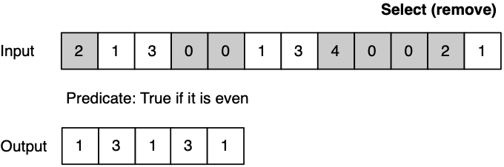
Different Types of Transfers in a Program
An example benchmark that uses both parallel and serial transfers
Select (SEL)
  Remove even values
Parallel transfers
DPU 0
DPU 1
DPU 2
Serial transfers
DPU 0
DPU 1
DPU 2

Slide 39
Inter-DPU Communication
There is no direct communication channel between DPUs
Inter-DPU communication takes places via the host CPU using CPU-DPU and DPU-CPU transfers
Example communication patterns:
  Merging of partial results to obtain the final result
    Only DPU-CPU transfers
  Redistribution of intermediate results for further computation
    DPU-CPU transfers and CPU-DPU transfers

Slide 40
How Fast are these Data Transfers?
With a microbenchmark, we obtain the sustained bandwidth of all types of CPU-DPU and DPU-CPU transfers
Two experiments:
  1 DPU: variable CPU-DPU and DPU-CPU transfer size (8 bytes to 32 MB)
  1 rank: 32 MB CPU-DPU and DPU-CPU transfers to/from a set of 1 to 64 MRAM banks within the same rank
We do not experiment with more than one rank
  Preliminary experiments show that the UPMEM SDK* only parallelizes transfers within the same rank
DDR4 bandwidth bounds the maximum transfer bandwidth
The cost of the transfers can be amortized,
if enough computation is run on the DPUs
* UPMEM SDK 2021.1.1

Slide 41
CPU-DPU/DPU-CPU Transfers: 1 DPU
Data transfer size varies between 8 bytes and 32 MB
KEY OBSERVATION 7
Larger CPU-DPU and DPU-CPU transfers between the host main memory and the DRAM Processing Unit’s Main memory (MRAM) banks result in higher sustained bandwidth.

Slide 42
CPU-DPU/DPU-CPU Transfers: 1 Rank (I)
CPU-DPU (serial/parallel/broadcast) and DPU-CPU (serial/parallel)
The number of DPUs varies between 1 and 64
KEY OBSERVATION 8
The sustained bandwidth of parallel CPU-DPU and DPU-CPU transfers between the host main memory and the DRAM Processing Unit’s Main memory (MRAM) banks increases with the number of DRAM Processing Units inside a rank.

Slide 43
CPU-DPU/DPU-CPU Transfers: 1 Rank (II)
CPU-DPU (serial/parallel/broadcast) and DPU-CPU (serial/parallel)
The number of DPUs varies between 1 and 64
KEY OBSERVATION 9
The sustained bandwidth of parallel CPU-DPU transfers is higher than the sustained bandwidth of parallel DPU-CPU transfers due to different implementations of CPU-DPU and DPU-CPU transfers in the UPMEM runtime library.
The sustained bandwidth of broadcast CPU-DPU transfers (i.e., the same buffer is copied to multiple MRAM banks) is higher than that of parallel CPU-DPU transfers (i.e., different buffers are copied to different MRAM banks) due to higher temporal locality in the CPU cache hierarchy.
Notes:
Load uses AVX write instructions, which are asynchronous.
However, AVX read instructions are synchronous

Slide 44
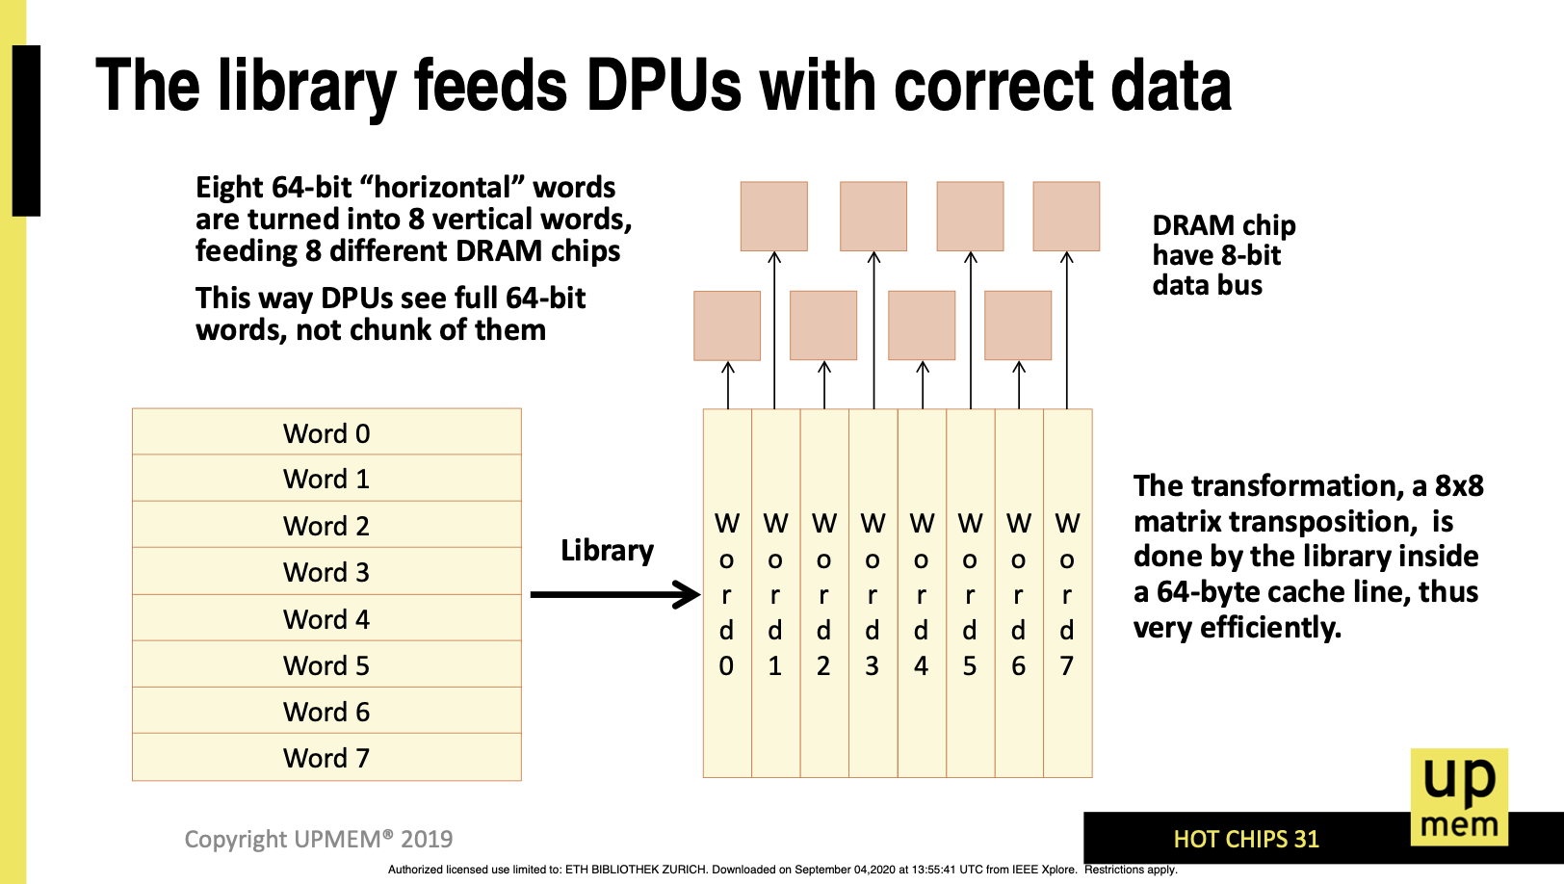
“Transposing” Library
F. Devaux, "The true Processing In Memory accelerator," HotChips 2019. doi: 10.1109/HOTCHIPS.2019.8875680

Slide 45
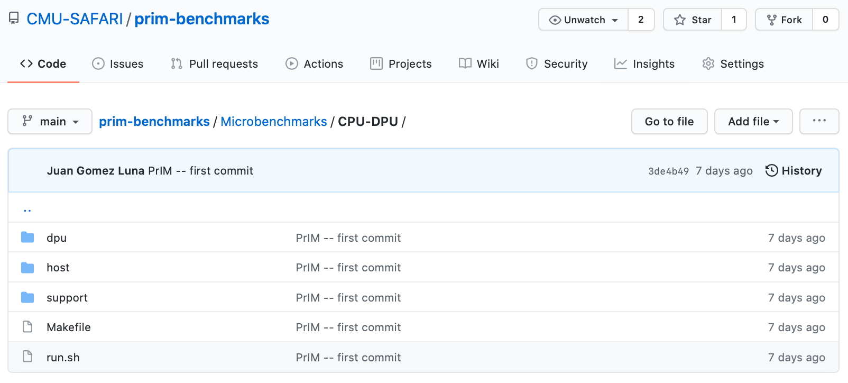
Microbenchmark: CPU-DPU
CPU-DPU (serial/parallel/broadcast) and DPU-CPU (serial/parallel)

Slide 46

DPU Kernel Launch
dpu_launch() launches a kernel on a dpu_set
  DPU_SYNCHRONOUS suspends the application until the kernel finishes
  DPU_ASYNCHRONOUS returns the control to the application
    dpu_sync or dpu_status to check kernel completion
What does the asynchronous execution enable?
Some ideas:
Task-level parallelism: concurrent execution of different kernels on different DPU sets
Concurrent heterogeneous computation on CPU and DPUs

Slide 47
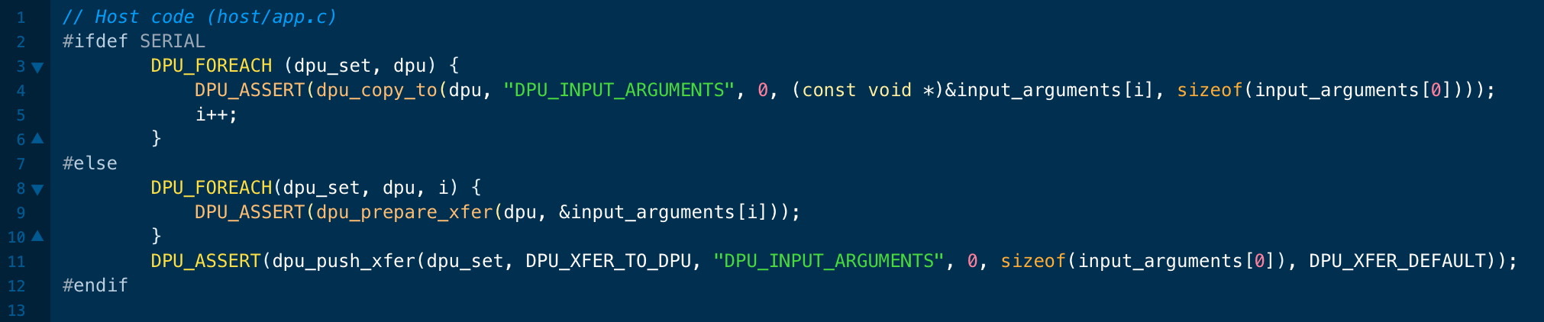
How to Pass Parameters to the Kernel?
We can use serial and parallel transfers
We pass them directly to the scratchpad memory of the DPU
  Working RAM (WRAM): We introduce it in the next slides
This is useful for input parameters and some results

Slide 48
Outline
Introduction
  Accelerator Model
  UPMEM-based PIM System Overview
UPMEM PIM Programming
  Vector Addition
  CPU-DPU Data Transfers
  Inter-DPU Communication
  CPU-DPU/DPU-CPU Transfer Bandwidth
DRAM Processing Unit
  Arithmetic Throughput
  WRAM and MRAM Bandwidth
PrIM Benchmarks
  Roofline Model
  Benchmark Diversity
Evaluation
  Strong and Weak Scaling
  Comparison to CPU and GPU
Key Takeaways

Slide 49
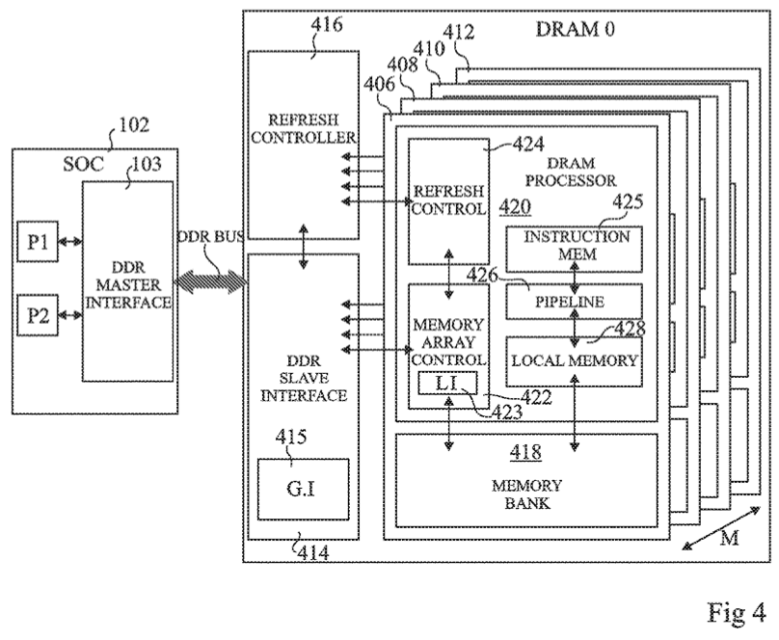
DRAM Processing Unit (I)
FIG. 4 schematically illustrates part of the computing system of FIG. 1 in more detail according to an example embodiment
Fabrice Devaux, Jean-François Roy. “Memory circuit with integrated processor.” US 10,324,870 B2.

Slide 50
DRAM Processing Unit (II)

Slide 51
DPU Pipeline
In-order pipeline
  Up to 350 MHz
Fine-grain multithreaded
  24 hardware threads
14 pipeline stages
  DISPATCH: Thread selection
  FETCH: Instruction fetch
  READOP: Register file
  FORMAT: Operand formatting
  ALU: Operation and WRAM
  MERGE: Result formatting
To the DMA engine

Slide 52
Arithmetic Throughput: Microbenchmark
Goal
  Measure the maximum arithmetic throughput for different datatypes and operations
Microbenchmark
  We stream over an array in WRAM and perform read-modify-write operations
  Experiments on one DPU
  We vary the number of tasklets from 1 to 24
  Arithmetic operations: add, subtract, multiply, divide
  Datatypes: int32, int64, float, double
We measure cycles with an accurate cycle counter that the SDK provides
  We include WRAM accesses (including address calculation) and arithmetic operation

Slide 53
Microbenchmark for INT32 ADD Throughput
1 #define SIZE 256
2 int* bufferA = mem_alloc(SIZE * sizeof(int));
3 for(int i = 0; i < SIZE; i++){
4 int temp = bufferA[i];
5 temp += scalar;
6 bufferA[i] = temp;
7 }
1 move r2, 0
2 .LBB0_1: // Loop header
3 lsl_add r3, r0, r2, 2 // Address calculation
4 lw r4, r3, 0 // Load from WRAM
5 add r4, r4, r1 // Add
6 sw r3, 0, r4 // Store to WRAM
7 add r2, r2, 1 // Index update
8 jneq r2, 256, .LBB0_1 // Conditional jump
C-based code
Compiled code (UPMEM DPU ISA)

Slide 54
Arithmetic Throughput: 11 Tasklets
KEY OBSERVATION 1
The arithmetic throughput of a DRAM Processing Unit saturates at 11 or more tasklets.
This observation is consistent for different datatypes (INT32, INT64, UINT32, UINT64, FLOAT, DOUBLE) and operations (ADD, SUB, MUL, DIV).

Slide 55
Arithmetic Throughput: ADD/SUB
17%
INT32 ADD/SUB are 17% faster than INT64 ADD/SUB
Can we explain the peak throughput?
Peak throughput at 11 tasklets.
One instruction retires every cycle when the pipeline is full
$$Arithmetic Throughput \left(in OPS\right)=\frac{frequencyDPU}{\#instructions}$$

Slide 56
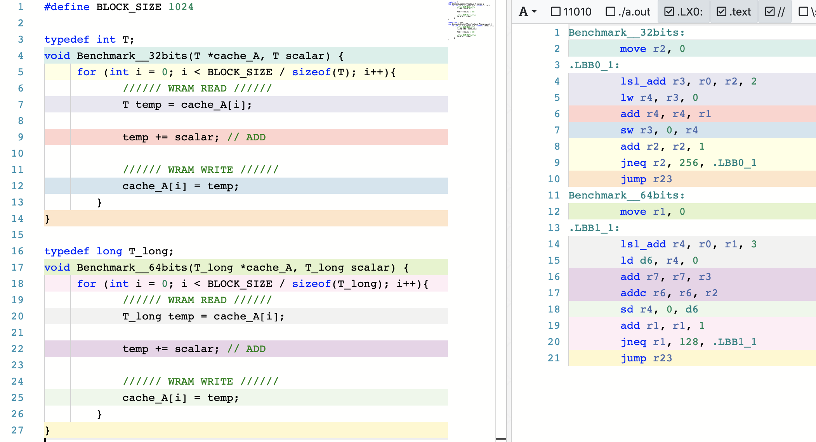
Arithmetic Throughput: #Instructions
Compiler explorer: https://dpu.dev
6 instructions in the 32-bit ADD/SUB microbenchmark
7 instructions in the 64-bit ADD/SUB microbenchmark

Slide 57
Arithmetic Throughput: ADD/SUB
17%
INT32 ADD/SUB are 17% faster than INT64 ADD/SUB
Can we explain the peak throughput?
Peak throughput at 11 tasklets.
One instruction retires every cycle when the pipeline is full
$$Arithmetic Throughput \left(in OPS\right)=\frac{frequencyDPU}{\#instructions}$$
32-bit ADD/SUB: 6 instructions → 58.33 MOPS
64-bit ADD/SUB: 7 instructions → 50.00 MOPS
at frequency_{DPU} = 350 MHz

Slide 58
Arithmetic Throughput: MUL/DIV
Huge throughput difference between ADD/SUB and MUL/DIV
DPUs do not have
a 32-bit multiplier
MUL/DIV implementation is based on an instruction that performs bit shifting and addition in 1 cycle
(MUL/DIV take a maximum of 32 instructions)

Slide 59
Arithmetic Throughput: Native Support
KEY OBSERVATION 2
DPUs provide native hardware support for 32- and 64-bit integer addition and subtraction, leading to high throughput for these operations.
DPUs do not natively support 32- and 64-bit multiplication and division, and floating point operations. These operations are emulated by the UPMEM runtime library, leading to much lower throughput.

Slide 60
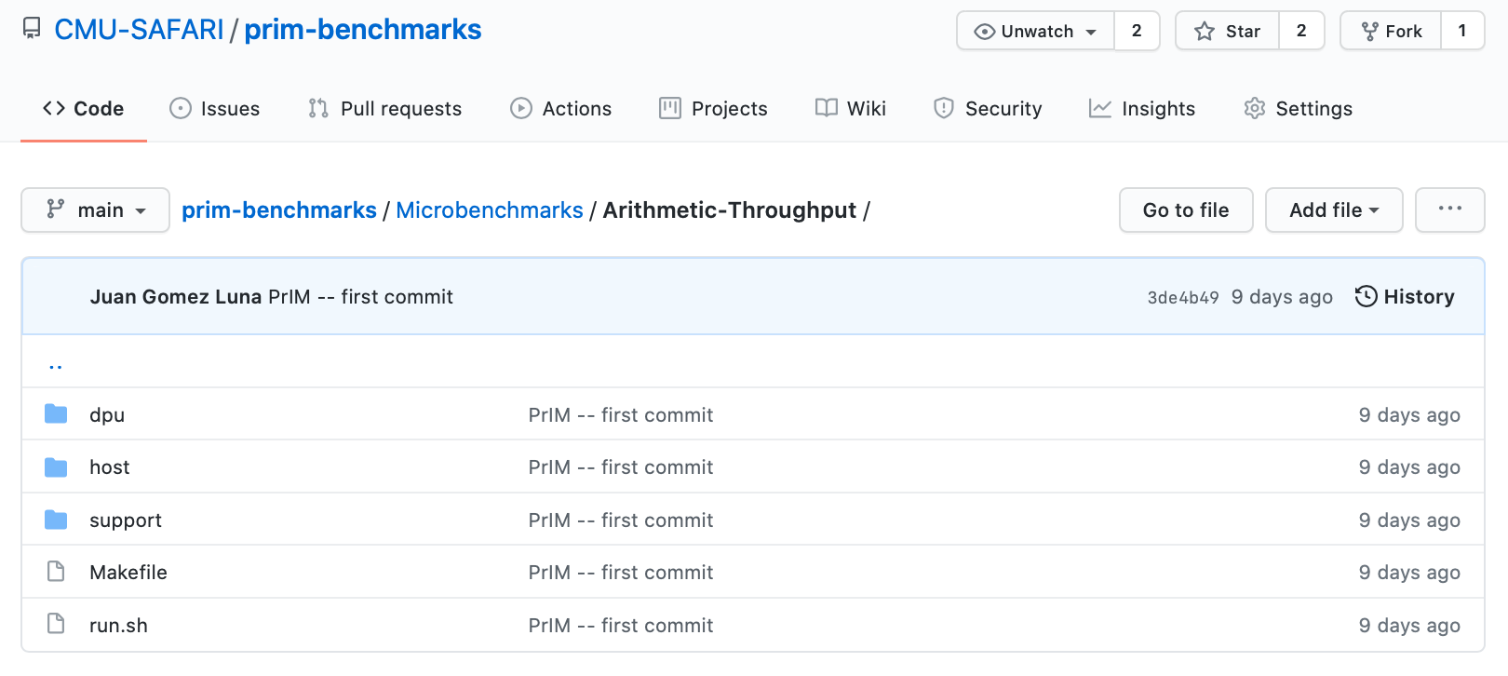
Microbenchmark: Arithmetic Throughput
Arithmetic throughput for different operations and datatypes

Slide 61
DPU: WRAM Bandwidth

Slide 62
WRAM Bandwidth: Microbenchmark
Goal
  Measure the WRAM bandwidth for the STREAM benchmark
Microbenchmark
  We implement the four versions of STREAM: COPY, ADD, SCALE, and TRIAD
  The operations performed in ADD, SCALE, and TRIAD are addition, multiplication, and addition+multiplication, respectively
  We vary the number of tasklets from 1 to 16
  We show results for 1 DPU
We do not include accesses to MRAM

Slide 63
STREAM Benchmark in WRAM
// COPY
for(int i = 0; i < SIZE; i++){
bufferB[i] = bufferA[i];
}
// ADD
for(int i = 0; i < SIZE; i++){
bufferC[i] = bufferA[i] + bufferB[i];
}
// SCALE
for(int i = 0; i < SIZE; i++){
bufferB[i] = scalar * bufferA[i];
}
// TRIAD
for(int i = 0; i < SIZE; i++){
bufferC[i] = bufferA[i] + scalar * bufferB[i];
}
8 bytes read, 8 bytes written,
no arithmetic operations
16 bytes read, 8 bytes written,
ADD
8 bytes read, 8 bytes written,
MUL
16 bytes read, 8 bytes written,
MUL, ADD

Slide 64

WRAM Bandwidth: STREAM
How can we estimate the bandwidth?
Assuming that the pipeline is full, and Bytes is the number of bytes read and written:
$$WRAM Bandwidth \left(in\frac{B}{S}\right)= \frac{Bytes × frequencyDPU}{\#instructions}$$

Slide 65

WRAM Bandwidth: COPY
COPY executes 2 instructions (WRAM load and store).
With 11 tasklets, 11 × 16 bytes in 22 cycles:
$$WRAM Bandwidth \left(in\frac{B}{S}\right)= \frac{Bytes × frequencyDPU}{\#instructions}$$
$$WRAM Bandwidth \left(in\frac{B}{S}\right)=2,800\frac{MB}{s}at 350 MHz$$

Slide 66


WRAM Bandwidth: ADD
$$WRAM Bandwidth \left(in\frac{B}{S}\right)= \frac{Bytes × frequencyDPU}{\#instructions}$$
ADD executes 5 instructions (2 ld, add, addc, sd).
With 11 tasklets, 11 × 24 bytes in 55 cycles:
$$WRAM Bandwidth \left(in\frac{B}{S}\right)=1,680\frac{MB}{s}at 350 MHz$$

Slide 67
WRAM Bandwidth: Access Patterns
All 8-byte WRAM loads and stores take one cycle when the DPU pipeline is full
Microbenchmark: c[a[i]]=b[a[i]];
  Unit-stride: a[i]=a[i-1]+1;
  Strided: a[i]=a[i-1]+stride;
  Random: a[i]=rand();
KEY OBSERVATION 3
The sustained bandwidth provided by the DPU’s internal Working memory (WRAM) is independent of the memory access pattern (either streaming, strided, or random access pattern).
All 8-byte WRAM loads and stores take one cycle, when the DPU’s pipeline is full (i.e., with 11 or more tasklets).

Slide 68

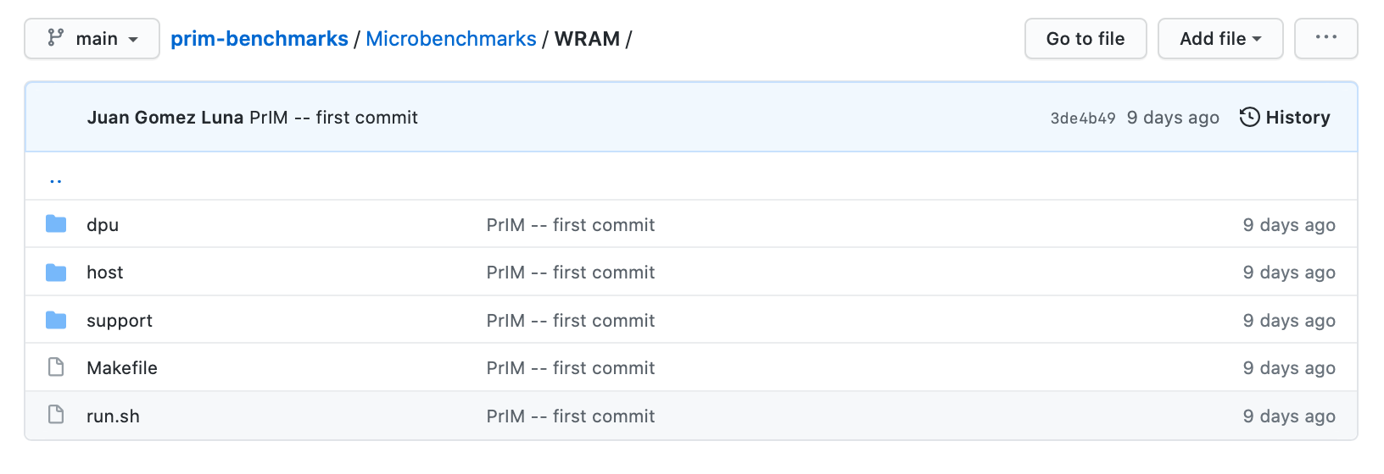
Microbenchmark: STREAM and WRAM
STREAM benchmark and WRAM access patterns

Slide 69
DPU: MRAM Latency and Bandwidth

Slide 70
MRAM Bandwidth
Goal
  Measure MRAM bandwidth for different access patterns
Microbenchmarks
  Latency of a single DMA transfer for different transfer sizes
    mram_read(); // MRAM-WRAM DMA transfer
    mram_write(); // WRAM-MRAM DMA transfer
  STREAM benchmark
    COPY, COPY-DMA
    ADD, SCALE, TRIAD
  Strided access pattern
    Coarse-grain strided access
    Fine-grain strided access
  Random access pattern (GUPS)
We do include accesses to MRAM

Slide 71

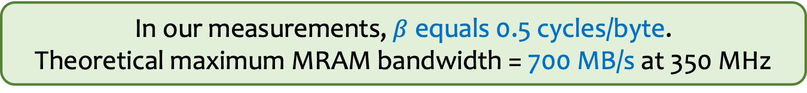
MRAM Read and Write Latency (I)
$$MRAM Bandwidth \left(in\frac{B}{S}\right)=\frac{size × frequencyDPU}{MRAM Latency}$$
We can model the MRAM latency with a linear expression
$$MRAM Latency \left(in cycles\right)=α+β×size$$
In our measurements, $β$ equals 0.5 cycles/byte.
Theoretical maximum MRAM bandwidth = 700 MB/s at 350 MHz

Slide 72
MRAM Read and Write Latency (II)
KEY OBSERVATION 4
The DPU’s Main memory (MRAM) bank access latency increases linearly with the transfer size.
The maximum theoretical MRAM bandwidth is 2 bytes per cycle.
$$MRAM Latency \left(in cycles\right)=α+β×size$$

Slide 73
MRAM Read and Write Latency (III)
Read and write accesses to MRAM are symmetric
The sustained MRAM bandwidth increases
with data transfer size
PROGRAMMING RECOMMENDATION 1
For data movement between the DPU’s MRAM bank and the WRAM, use large DMA transfer sizes when all the accessed data is going to be used.

Slide 74
MRAM Read and Write Latency (IV)
MRAM latency changes slowly between 8 and 128 bytes
For small transfers, the fixed cost ($α$) dominates the variable cost ($β×size$)
PROGRAMMING RECOMMENDATION 2
For small transfers between the MRAM bank and the WRAM, fetch more bytes than necessary within a 128-byte limit. Doing so increases the likelihood of finding data in WRAM for later accesses (i.e., the program can check whether the desired data is in WRAM before issuing a new MRAM access).

Slide 75
MRAM Read and Write Latency (V)
2,048-byte transfers are only 4% faster than 1,024-byte transfers
Larger transfers require more WRAM, which may limit the number of tasklets
PROGRAMMING RECOMMENDATION 3
Choose the data transfer size between the MRAM bank and the WRAM based on the program’s WRAM usage, as it imposes a tradeoff between the sustained MRAM bandwidth and the number of tasklets that can run in the DPU (which is dictated by the limited WRAM capacity).

Slide 76
MRAM Bandwidth
Goal
  Measure MRAM bandwidth for different access patterns
Microbenchmarks
  Latency of a single DMA transfer for different transfer sizes
    mram_read(); // MRAM-WRAM DMA transfer
    mram_write(); // WRAM-MRAM DMA transfer
  STREAM benchmark
    COPY, COPY-DMA
    ADD, SCALE, TRIAD
  Strided access pattern
    Coarse-grain strided access
    Fine-grain strided access
  Random access pattern (GUPS)
We do include accesses to MRAM

Slide 77
STREAM Benchmark in MRAM
// COPY
// Load current MRAM block to WRAM
mram_read((__mram_ptr void const*)mram_address_A, bufferA,
SIZE * sizeof(uint64_t));
for(int i = 0; i < SIZE; i++){
bufferB[i] = bufferA[i];
}
// Write WRAM block to MRAM
mram_write(bufferB, (__mram_ptr void*)mram_address_B,
SIZE * sizeof(uint64_t));
// COPY-DMA
// Load current MRAM block to WRAM
mram_read((__mram_ptr void const*)mram_address_A, bufferA,
SIZE * sizeof(uint64_t));
// Write WRAM block to MRAM
mram_write(bufferB, (__mram_ptr void*)mram_address_B,
SIZE * sizeof(uint64_t));

Slide 78
STREAM Benchmark: COPY-DMA
The sustained bandwidth of COPY-DMA is close to
the theoretical maximum (700 MB/s): ~1.6 TB/s for 2,556 DPUs
COPY-DMA saturates with two tasklets, even though
the DMA engine can perform only one transfer at a time
Using two or more tasklets guarantees that there is always
a DMA request enqueued to keep the DMA engine busy

Slide 79
STREAM Benchmark: Bandwidth Saturation (I)
COPY and ADD saturate at 4 and 6 tasklets, respectively
SCALE and TRIAD saturate at 11 tasklets
The latency of MRAM accesses becomes longer than the pipeline latency after 4 and 6 tasklets for COPY and ADD, respectively
The pipeline latency of SCALE and TRIAD is longer than the MRAM latency for any number of tasklets (both use costly MUL)

Slide 80
STREAM Benchmark: Bandwidth Saturation (II)
KEY OBSERVATION 5
When the access latency to an MRAM bank for a streaming benchmark (COPY-DMA, COPY, ADD) is larger than the pipeline latency (i.e., execution latency of arithmetic operations and WRAM accesses), the performance of the DPU saturates at a number of tasklets smaller than 11. This is a memory-bound workload.
When the pipeline latency for a streaming benchmark (SCALE, TRIAD) is larger than the MRAM access latency, the performance of a DPU saturates at 11 tasklets. This is a compute-bound workload.

Slide 81
MRAM Bandwidth
Goal
  Measure MRAM bandwidth for different access patterns
Microbenchmarks
  Latency of a single DMA transfer for different transfer sizes
    mram_read(); // MRAM-WRAM DMA transfer
    mram_write(); // WRAM-MRAM DMA transfer
  STREAM benchmark
    COPY, COPY-DMA
    ADD, SCALE, TRIAD
  Strided access pattern
    Coarse-grain strided access
    Fine-grain strided access
  Random access pattern (GUPS)
We do include accesses to MRAM

Slide 82
Strided and Random Access to MRAM
// COARSE-GRAINED STRIDED ACCESS
// Load current MRAM block to WRAM
mram_read((__mram_ptr void const*)mram_address_A, bufferA,
SIZE * sizeof(uint64_t));
mram_read((__mram_ptr void const*)mram_address_B, bufferB,
SIZE * sizeof(uint64_t));
for(int i = 0; i < SIZE; i += stride){
bufferB[i] = bufferA[i];
}
// Write WRAM block to MRAM
mram_write(bufferB, (__mram_ptr void*)mram_address_B,
SIZE * sizeof(uint64_t));
// FINE-GRAINED STRIDED & RANDOM ACCESS
for(int i = 0; i < SIZE; i += stride){
int index = i * sizeof(uint64_t);
// Load current MRAM element to WRAM
mram_read((__mram_ptr void const*)(mram_address_A + index), bufferA, sizeof(uint64_t));
// Write WRAM element to MRAM
mram_write(bufferA, (__mram_ptr void*)(mram_address_B + index), sizeof(uint64_t));
}
Notes:
For random accesses we implement the GUPS benchmark.

Slide 83
Strided and Random Accesses (I)
Large difference in maximum sustained bandwidth between coarse-grained and fine-grained DMA
Coarse-grained DMA uses 1,024-byte transfers,
while fine-grained DMA uses 8-byte transfers
Random access achieves very similar maximum sustained bandwidth to fine-grained strided approach

Slide 84
Strided and Random Accesses (II)
The sustained MRAM bandwidth of coarse-grained DMA decreases as the stride increases
The effective utilization of the transferred data decreases
as the stride becomes larger (e.g., a stride 4 means that only one fourth of the transferred data is used)

Slide 85
Strided and Random Accesses (III)
For a stride of 16 or larger, the fine-grained DMA approach achieves higher bandwidth
With stride 16, only one sixteenth of the maximum sustained bandwidth (622.36 MB/s) of coarse-grained DMA
is effectively used, which is lower than
the bandwidth of fine-grained DMA (72.58 MB/s)

Slide 86
Strided and Random Accesses (IV)
PROGRAMMING RECOMMENDATION 4
For strided access patterns with a stride smaller than 16 8-byte elements, fetch a large contiguous chunk (e.g., 1,024 bytes) from a DPU’s MRAM bank.
For strided access patterns with larger strides and random access patterns, fetch only the data elements that are needed from an MRAM bank.

Slide 87
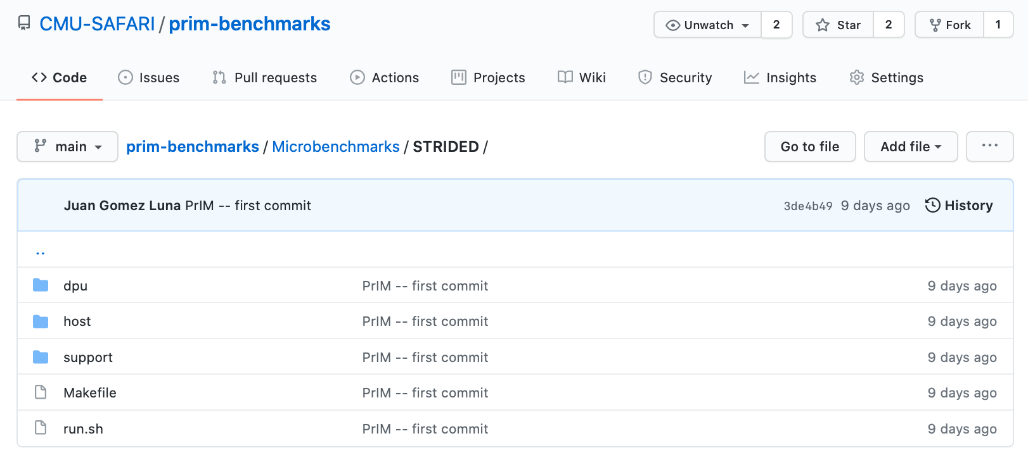
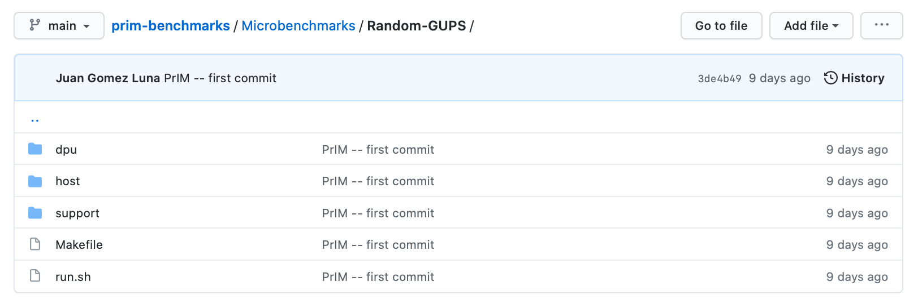
Microbenchmark: Strided and Random
Strided and random accesses to MRAM

Slide 88
DPU: Arithmetic Throughput vs. Operational Intensity

Slide 89
Arithmetic Throughput vs. Operational Intensity (I)
Goal
  Characterize memory-bound regions and compute-bound regions for different datatypes and operations
Microbenchmark
  We load one chunk of an MRAM array into WRAM
  Perform a variable number of operations on the data
  Write back to MRAM
The experiment is inspired by the Roofline model*
We define operational intensity (OI) as the number of arithmetic operations performed per byte accessed from MRAM (OP/B)
The pipeline latency changes with the operational intensity, but the MRAM access latency is fixed
*S. Williams et al., “Roofline: An Insightful Visual Performance Model for Multi-core Architectures,” CACM, 2009

Slide 90
Arithmetic Throughput vs. Operational Intensity (II)
int repetitions = input_repeat >= 1.0 ? (int)input_repeat : 1;
int stride = input_repeat >= 1.0 ? 1 : (int)(1 / input_repeat);
// Load current MRAM block to WRAM
mram_read((__mram_ptr void const*)mram_address_A, bufferA, SIZE * sizeof(T));
// Update
for(int r = 0; r < repetitions; r++){
for(int i = 0; i < SIZE; i+=stride){
#ifdef ADD
bufferA[i] += scalar; // ADD
#elif SUB
bufferA[i] -= scalar; // SUB
#elif MUL
bufferA[i] *= scalar; // MUL
#elif DIV
bufferA[i] /= scalar; // DIV
#endif
}
}
// Write WRAM block to MRAM
mram_write(bufferA, (__mram_ptr void*)mram_address_B, SIZE * sizeof(T));
input_repeat greater or equal to 1 indicates the (integer) number of repetitions per input element
input_repeat smaller than 1 indicates the fraction of elements that are updated

Slide 91
Arithmetic Throughput vs. Operational Intensity (III)
We show results of arithmetic throughput vs. operational intensity for
(a) 32-bit integer ADD, (b) 32-bit integer MUL,
(c) 32-bit floating-point ADD, and (d) 32-bit floating-point MUL
(results for other datatypes and operations show similar trends)

Slide 92
Arithmetic Throughput vs. Operational Intensity (IV)
In the memory-bound region, the arithmetic throughput increases with the operational intensity
Memory-bound region
Compute-bound region
In the compute-bound region, the arithmetic throughput is flat at its maximum
The throughput saturation point is the operational intensity
where the transition between
the memory-bound region and the compute-bound region happens
The throughput saturation point is as low as ¼ OP/B,
i.e., 1 integer addition per every 32-bit element fetched

Slide 93
Arithmetic Throughput vs. Operational Intensity (V)
KEY OBSERVATION 6
The arithmetic throughput of a DRAM Processing Unit (DPU) saturates at low or very low operational intensity (e.g., 1 integer addition per 32-bit element). Thus, the DPU is fundamentally a compute-bound processor.
We expect most real-world workloads be compute-bound in the UPMEM PIM architecture.

Slide 94
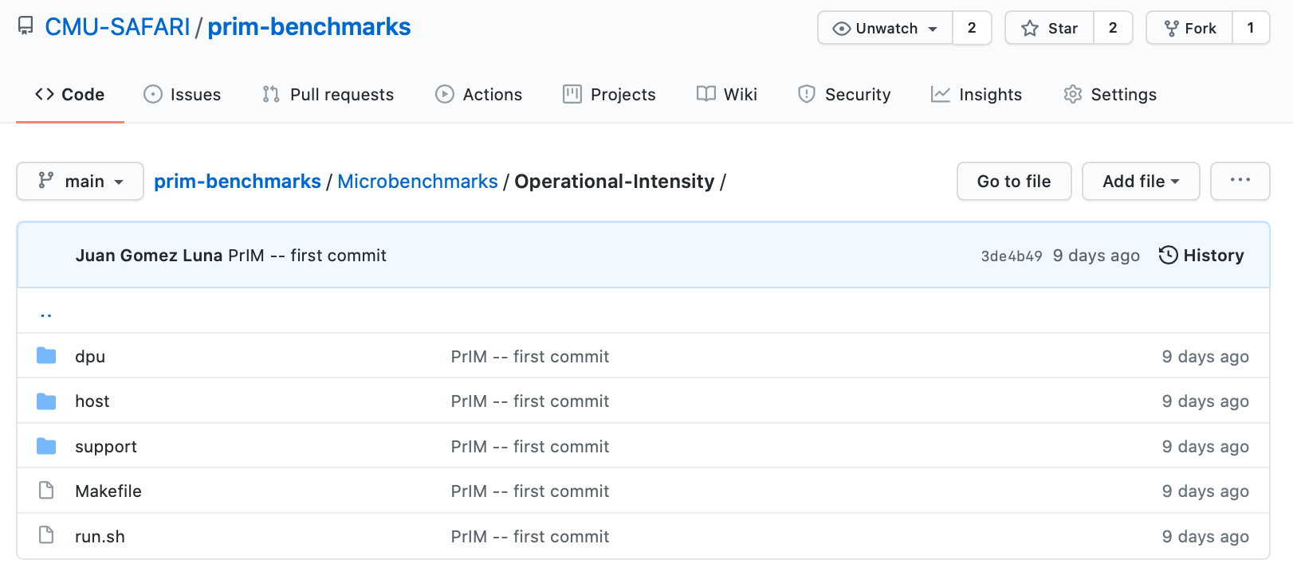
Microbenchmark: Arithmetic Throughput vs. Operational Intensity
Arithmetic Throughput versus Operational Intensity

Slide 95
Outline
Introduction
  Accelerator Model
  UPMEM-based PIM System Overview
UPMEM PIM Programming
  Vector Addition
  CPU-DPU Data Transfers
  Inter-DPU Communication
  CPU-DPU/DPU-CPU Transfer Bandwidth
DRAM Processing Unit
  Arithmetic Throughput
  WRAM and MRAM Bandwidth
PrIM Benchmarks
  Roofline Model
  Benchmark Diversity
Evaluation
  Strong and Weak Scaling
  Comparison to CPU and GPU
Key Takeaways

Slide 96
PrIM Benchmarks
Goal
  A common set of workloads that can be used to
    evaluate the UPMEM PIM architecture,
    compare software improvements and compilers,
    compare future PIM architectures and hardware
Two key selection criteria:
  Selected workloads from different application domains
  Memory-bound workloads on processor-centric architectures
14 different workloads, 16 different benchmarks*
*There are two versions for two of the workloads (HST, SCAN).

Slide 97
PrIM Benchmarks: Application Domains
Domain | Benchmark | Short name
Dense linear algebra | Vector Addition | VA
 | Matrix-Vector Multiply | GEMV
Sparse linear algebra | Sparse Matrix-Vector Multiply | SpMV
Databases | Select | SEL
 | Unique | UNI
Data analytics | Binary Search | BS
 | Time Series Analysis | TS
Graph processing | Breadth-First Search | BFS
Neural networks | Multilayer Perceptron | MLP
Bioinformatics | Needleman-Wunsch | NW
Image processing | Image histogram (short) | HST-S
 | Image histogram (large) | HST-L
Parallel primitives | Reduction | RED
 | Prefix sum (scan-scan-add) | SCAN-SSA
 | Prefix sum (reduce-scan-scan) | SCAN-RSS
 | Matrix transposition | TRNS

Slide 98
Roofline Model
Intel Advisor on an Intel Xeon E3-1225 v6 CPU
Peak compute performance
L3
DRAM
All workloads fall in the memory-bound area of the Roofline

Slide 99
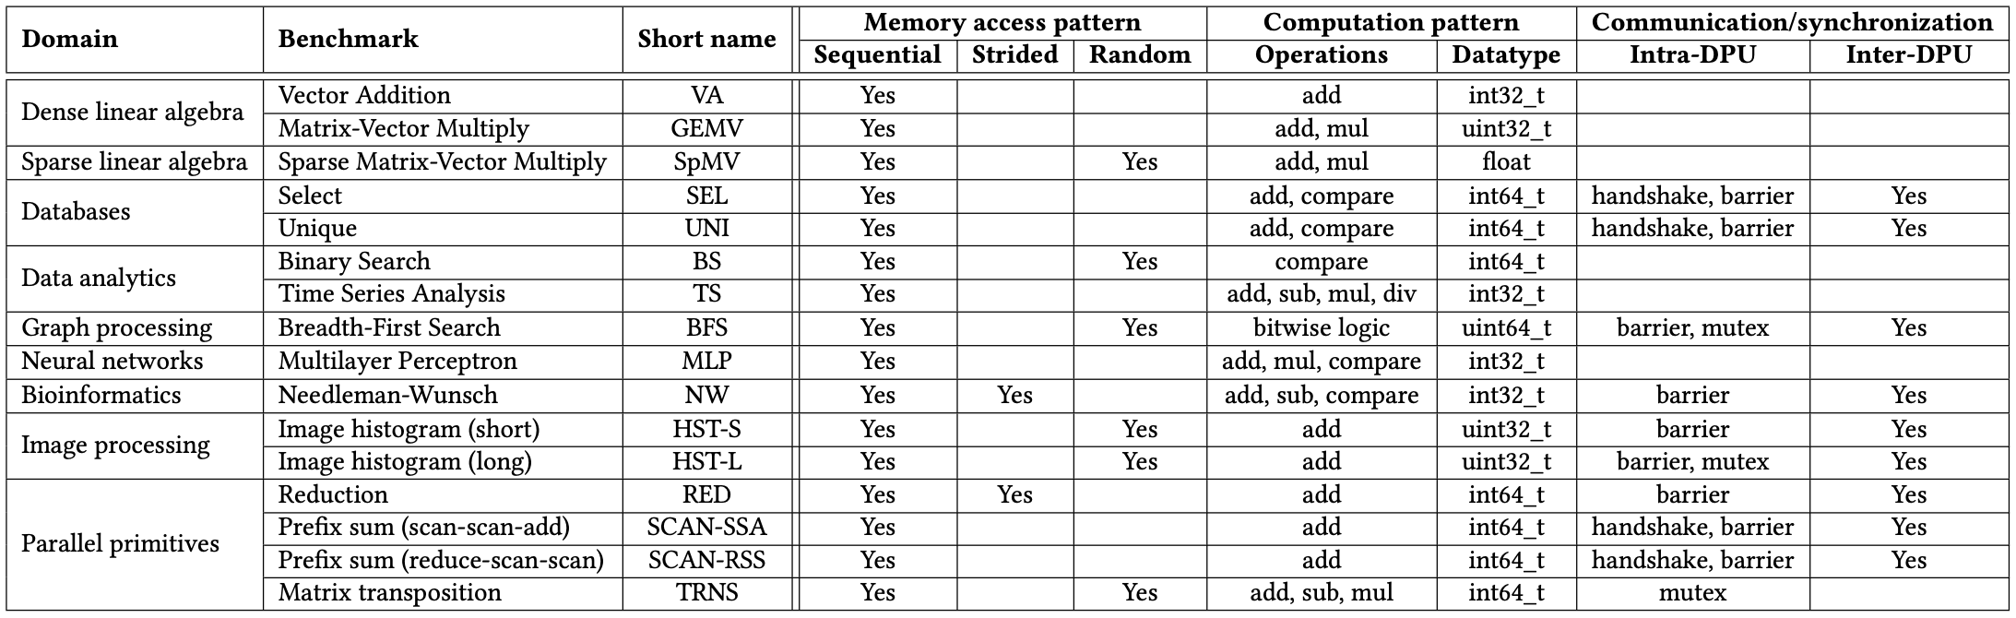
PrIM Benchmarks: Diversity
PrIM benchmarks are diverse:
  Memory access patterns
  Operations and datatypes
  Communication/synchronization

Slide 100
PrIM Benchmarks: Inter-DPU Communication
Inter-DPU communication
  Result merging:
    SEL, UNI, HST-S, HST-L, RED
    Only DPU-CPU transfers
  Redistribution of intermediate results:
    BFS, MLP, NW, SCAN-SSA, SCAN-RSS
    DPU-CPU and CPU-DPU transfers

Slide 101
Recall: Vector Addition (VA)
Our first programming example
We partition the input arrays across:
  DPUs
  Tasklets, i.e., software threads running on a DPU
Tasklet 0
Tasklet 1
Tasklet 0
Tasklet 1
Tasklet 0
Tasklet 1
Tasklet 0
Tasklet 1
DPU 0
DPU 1
DPU 2
DPU 3

Slide 102
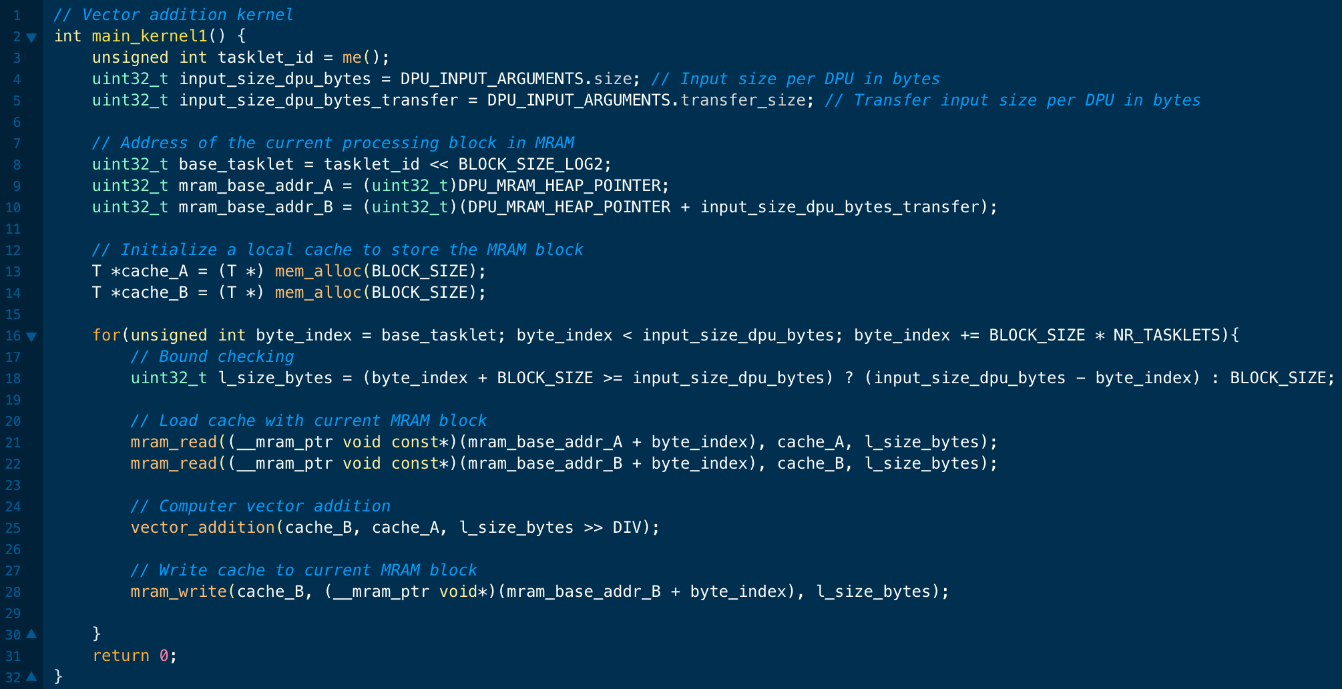
Programming a DPU Kernel (I)
Vector addition
Tasklet ID
Size of vector tile processed by a DPU
MRAM addresses of arrays A and B
WRAM allocation
MRAM-WRAM DMA transfers
Vector addition (see next slide)
WRAM-MRAM DMA transfer

Slide 103
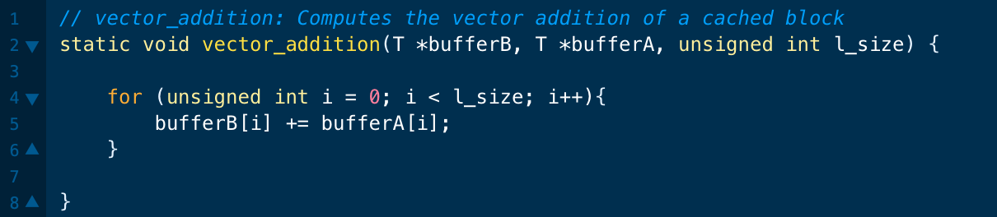
Programming a DPU Kernel (II)
Vector addition

Slide 104
Programming a DPU Kernel (III)
A tasklet is the software abstraction of a hardware thread
Each tasklet can have its own memory space in WRAM
  Tasklets can also share data in WRAM by sharing pointers
Tasklets within the same DPU can synchronize
  Mutual exclusion
    mutex_lock(); mutex_unlock();
  Handshakes
    handshake_wait_for(); handshake_notify();
  Barriers
    barrier_wait();
  Semaphores
    sem_give(); sem_take();

Slide 105
Parallel Reduction (I)
Tasklets in a DPU can work together on a parallel reduction
Tasklet 0
Tasklet 1
Tasklet 2
Tasklet 3

Slide 106
Parallel Reduction (II)
Each tasklet computes a local sum
Tasklet 0
Tasklet 1
Tasklet 2
Tasklet 3

Slide 107
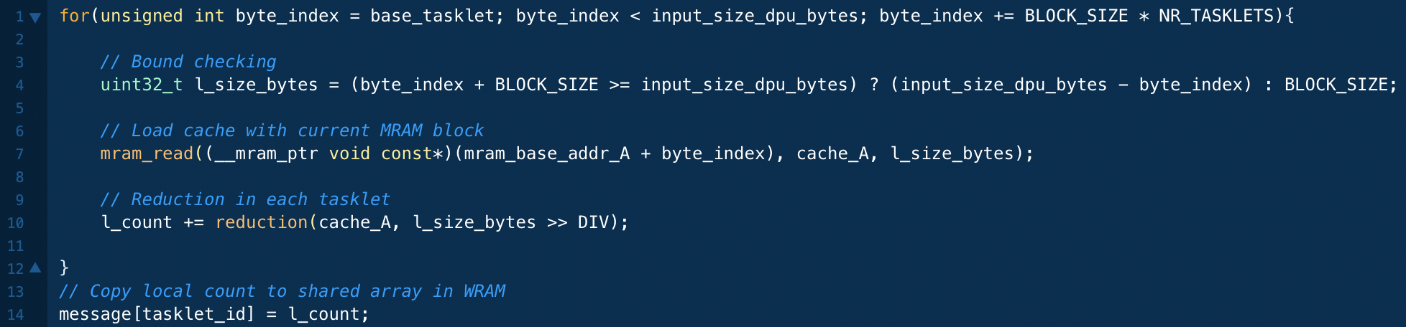
Parallel Reduction (III)
Each tasklet computes a local sum
Accumulate in a local sum
Copy local sum into WRAM

Slide 108
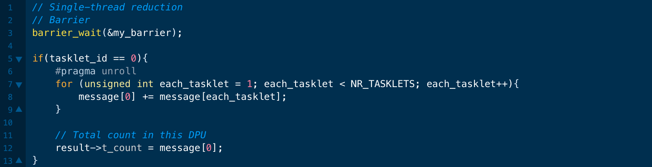
Final Reduction
A single tasklet can perform the final reduction
Accumulate in a local sum
Copy local sum into WRAM
Barrier synchronization
Sequential accumulation

Slide 109
Vector Reduction: Naïve Mapping
Thread 0
Thread 2
Thread 4
Thread 6
Thread 8
Thread 10
0
1
2
3
4
5
6
7
8
9
10
11
1
0+1
2+3
4+5
6+7
8+9
10+11
2
0...3
4..7
8..11
iterations
3
0..7
8..15
Slide credit: Hwu & Kirk
https://www.youtube.com/watch?v=y40-tY5WJ8A
https://safari.ethz.ch/digitaltechnik/spring2018/lib/exe/fetch.php?media=digitaldesign-2018-lecture22-gpuprogramming-afterlecture.pdf

Slide 110
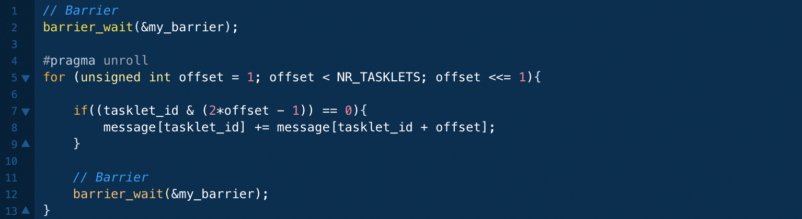
Using Barriers: Tree-Based Reduction
Multiple tasklets can perform a tree-based reduction
  After every iteration tasklets synchronize with a barrier
  Half of the tasklets retire at the end of an iteration
“offset” tasklets working
Barrier synchronization
PrIM also includes a handshake-based tree-based reduction.
We compare single-tasklet, barrier-based, and handshake-based versions in the Appendix of the paper

Slide 111
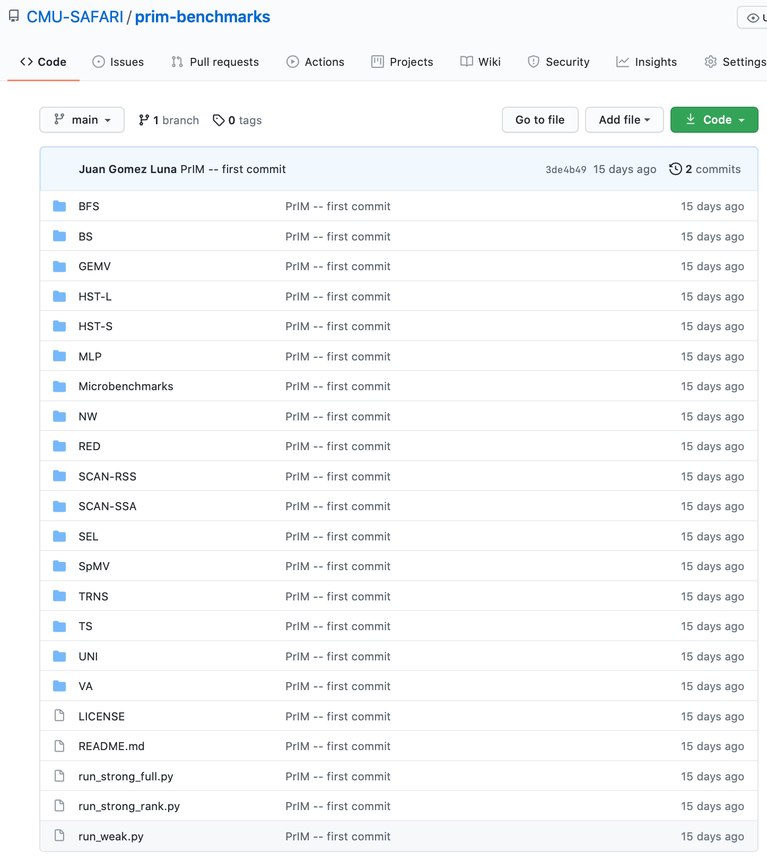
PrIM Benchmarks
16 benchmarks and scripts for evaluation

Slide 112
Outline
Introduction
  Accelerator Model
  UPMEM-based PIM System Overview
UPMEM PIM Programming
  Vector Addition
  CPU-DPU Data Transfers
  Inter-DPU Communication
  CPU-DPU/DPU-CPU Transfer Bandwidth
DRAM Processing Unit
  Arithmetic Throughput
  WRAM and MRAM Bandwidth
PrIM Benchmarks
  Roofline Model
  Benchmark Diversity
Evaluation
  Strong and Weak Scaling
  Comparison to CPU and GPU
Key Takeaways

Slide 113
Evaluation Methodology
We evaluate the 16 PrIM benchmarks on two UPMEM-based systems:
  2,556-DPU system
  640-DPU system
Strong and weak scaling experiments on the 2,556-DPU system
  1 DPU with different numbers of tasklets
  1 rank (strong and weak)
  Up to 32 ranks
Strong scaling refers to how the execution time of a program solving a particular problem varies with the number of processors for a fixed problem size
Weak scaling refers to how the execution time of a program solving a particular problem varies
with the number of processors for a fixed problem size per processor

Slide 114
Evaluation Methodology
We evaluate the 16 PrIM benchmarks on two UPMEM-based systems:
  2,556-DPU system
  640-DPU system
Strong and weak scaling experiments on the 2,556-DPU system
  1 DPU with different numbers of tasklets
  1 rank (strong and weak)
  Up to 32 ranks
Comparison of both UPMEM-based PIM systems to state-of-the-art CPU and GPU
  Intel Xeon E3-1240 CPU
  NVIDIA Titan V GPU

Slide 115
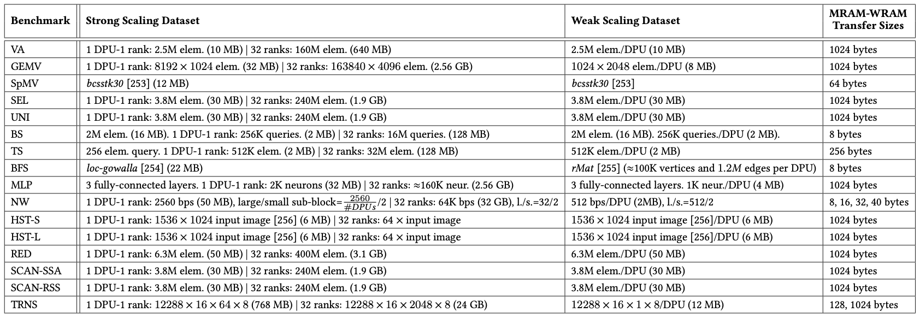
Datasets
Strong and weak scaling experiments
The PrIM benchmarks repository includes
all datasets and scripts used in our evaluation
https://github.com/CMU-SAFARI/prim-benchmarks

Slide 116
Strong Scaling: 1 DPU (I)
Strong scaling experiments on 1 DPU
  We set the number of tasklets to 1, 2, 4, 8, and 16
  We show the breakdown of execution time:
    DPU: Execution time on the DPU
    Inter-DPU: Time for inter-DPU communication via the host CPU
    CPU-DPU: Time for CPU to DPU transfer of input data
    DPU-CPU: Time for DPU to CPU transfer of final results
  Speedup over 1 tasklet

Slide 117
Strong Scaling: 1 DPU (II)
VA, GEMV, SpMV, SEL, UNI, TS, MLP, NW, HST-S, RED, SCAN-SSA (Scan kernel), SCAN-RSS (both kernels), and TRNS (Step 2 kernel), the best performing number of tasklets is 16
Speedups 1.5-2.0x as we double the number of tasklets from 1 to 8.
Speedups 1.2-1.5x from 8 to 16, since the pipeline throughput saturates at 11 tasklets
KEY OBSERVATION 10
A number of tasklets greater than 11 is a good choice for most real-world workloads we tested (16 kernels out of 19 kernels from 16 benchmarks), as it fully utilizes the DPU’s pipeline.

Slide 118
Strong Scaling: 1 DPU (III)
VA, GEMV, SpMV, BS, TS, MLP, HST-S do not use intra-DPU synchronization primitives
In SEL, UNI, NW, RED, SCAN-SSA (Scan kernel), SCAN-RSS (both kernels), synchronization is lightweight
BFS, HST-L, TRNS (Step 3) use mutexes, which cause contention when accessing shared data structures

Slide 119
Strong Scaling: 1 DPU (IV)
VA, GEMV, SpMV, BS, TS, MLP, HST-S do not use synchronization primitives
In SEL, UNI, NW, RED, SCAN-SSA (Scan kernel), SCAN-RSS (both kernels), synchronization is lightweight
BFS, HST-L, TRNS (Step 3) use mutexes, which cause contention when accessing shared data structures
KEY OBSERVATION 11
Intensive use of intra-DPU synchronization across tasklets (e.g., mutexes, barriers, handshakes) may limit scalability, sometimes causing the best performing number of tasklets to be lower than 11.

Slide 120
Strong Scaling: 1 DPU (V)
SCAN-SSA (Add kernel) is not compute-intensive. Thus, performance saturates with less that 11 tasklets (recall STREAM ADD).
BS shows similar behavior
KEY OBSERVATION 12
Most real-world workloads are in the compute-bound region of the DPU (all kernels except SCAN-SSA (Add kernel) and BS), i.e., the pipeline latency dominates the MRAM access latency.

Slide 121
Strong Scaling: 1 DPU (VI)
The amount of time spent on CPU-DPU and DPU-CPU transfers is low compared to the time spent on DPU execution
TRNS performs step 1 of the matrix transposition via the CPU-DPU transfer.
Using small transfers (8 elements) does not exploit full CPU-DPU bandwidth
KEY OBSERVATION 13
Transferring large data chunks from/to the host CPU is preferred for input data and output results due to higher sustained CPU-DPU/DPU-CPU bandwidths.
Notes:
Fifth
TRNS

Slide 122
Strong Scaling: 1 Rank (I)
Strong scaling experiments on 1 rank
  We set the number of tasklets to the best performing one
  The number of DPUs is 1, 4, 16, 64
  We show the breakdown of execution time:
    DPU: Execution time on the DPU
    Inter-DPU: Time for inter-DPU communication via the host CPU
    CPU-DPU: Time for CPU to DPU transfer of input data
    DPU-CPU: Time for DPU to CPU transfer of final results
  Speedup over 1 DPU

Slide 123
Strong Scaling: 1 Rank (II)
VA, GEMV, SpMV, SEL, UNI, BS, TS, MLP, HST-S, HSTS-L, RED, SCAN-SSA (both kernel), SCAN-RSS (both kernels), and TRNS (both kernels) scale linearly with the number of DPUs
Scaling is sublinear for BFS and NW
BFS suffers load imbalance due to irregular graph topology
NW computes a diagonal of a 2D matrix in each iteration.
More DPUs does not mean more parallelization in shorter diagonals.

Slide 124
Strong Scaling: 1 Rank (III)
VA, GEMV, SpMV, BS, TS, TRNS do not need inter-DPU synchronization
SEL, UNI, HST-S, HST-L, RED, SCAN-SSA, SCAN-RSS need inter-DPU synchronization but 64 DPUs still obtain the best performance
BFS, MLP, NW require heavy inter-DPU synchronization, involving DPU-CPU and CPU-DPU transfers

Slide 125
Strong Scaling: 1 Rank (IV)
VA, GEMV, TS, MLP, HST-S, HST-L, RED, SCAN-SSA, SCAN-RSS, TRNS use parallel transfers.
CPU-DPU and DPU-CPU transfer times decrease as we increase the number of DPUs
BS, NW use parallel transfers but do not reduce transfer times:
BS transfers a complete array to all DPUs.
NW does not use all DPUs in all iterations
SpMV, SEL, UNI, BFS cannot use parallel transfers, as the transfer size per DPU is not fixed
PROGRAMMING RECOMMENDATION 5
Parallel CPU-DPU/DPU-CPU transfers inside a rank of DPUs are recommended for real-world workloads when all transferred buffers are of the same size.

Slide 126
Strong Scaling: 32 Ranks (I)
Strong scaling experiments on 32 rank
  We set the number of tasklets to the best performing one
  The number of DPUs is 256, 512, 1024, 2048
  We show the breakdown of execution time:
    DPU: Execution time on the DPU
    Inter-DPU: Time for inter-DPU communication via the host CPU
    We do not show CPU-DPU/DPU-CPU transfer times
  Speedup over 256 DPUs

Slide 127
Strong Scaling: 32 Ranks (II)
VA, GEMV, SEL, UNI, BS, TS, MLP, HST-S, HSTS-L, RED, SCAN-SSA (both kernel), SCAN-RSS (both kernels), and TRNS (both kernels) scale linearly with the number of DPUs
SpMV, BFS, NW do not scale linearly due to load imbalance
KEY OBSERVATION 14
Load balancing across DPUs ensures linear reduction of the execution time spent on the DPUs for a given problem size, when all available DPUs are used (as observed in strong scaling experiments).

Slide 128
Strong Scaling: 32 Ranks (III)
SEL, UNI, HST-S, HST-L, RED only need to merge final results
KEY OBSERVATION 15
The overhead of merging partial results from DPUs in the host CPU is tolerable across all PrIM benchmarks that need it.
BFS, MLP, NW, SCAN-SSA, SCAN-RSS have more complex communication
KEY OBSERVATION 16
Complex synchronization across DPUs (i.e., inter-DPU synchronization involving two-way communication with the host CPU) imposes significant overhead, which limits scalability to more DPUs.

Slide 129
Weak Scaling: 1 Rank
KEY OBSERVATION 17
Equally-sized problems assigned to different DPUs and little/no inter-DPU synchronization lead to linear weak scaling of the execution time spent on the DPUs (i.e., constant execution time when we increase the number of DPUs and the dataset size accordingly).
KEY OBSERVATION 18
Sustained bandwidth of parallel CPU-DPU/DPU-CPU transfers inside a rank of DPUs increases sublinearly with the number of DPUs.

Slide 130
CPU/GPU: Evaluation Methodology
Comparison of both UPMEM-based PIM systems to state-of-the-art CPU and GPU
  Intel Xeon E3-1240 CPU
  NVIDIA Titan V GPU
We use state-of-the-art CPU and GPU counterparts of PrIM benchmarks
  https://github.com/CMU-SAFARI/prim-benchmarks
We use the largest dataset that we can fit in the GPU memory
We show overall execution time, including DPU kernel time and inter DPU communication

Slide 131
CPU/GPU: Performance Comparison (I)
The 2,556-DPU and the 640-DPU systems outperform the CPU for all benchmarks except SpMV, BFS, and NW
The 2,556-DPU and the 640-DPU are, respectively, 93.0x and 27.9x faster than the CPU for 13 of the PrIM benchmarks

Slide 132
CPU/GPU: Performance Comparison (II)
The 2,556-DPU outperforms the GPU
for 10 PrIM benchmarks with an average of 2.54x
The performance of the 640-DPU is within 65%
the performance of the GPU for the same 10 PrIM benchmarks

Slide 133
CPU/GPU: Performance Comparison (III)
KEY OBSERVATION 19
The UPMEM-based PIM system can outperform a state-of-the-art GPU on workloads with three key characteristics:
Streaming memory accesses
No or little inter-DPU synchronization
No or little use of integer multiplication, integer division, or floating point operations
These three key characteristics make a workload potentially suitable to the UPMEM PIM architecture.

Slide 134
CPU/GPU: Energy Comparison (I)
The 640-DPU system consumes on average 1.64x less energy than the CPU for all 16 PrIM benchmarks
For 12 benchmarks, the 640-DPU system provides energy savings
of 5.23x over the CPU

Slide 135
CPU/GPU: Energy Comparison (II)
KEY OBSERVATION 20
The UPMEM-based PIM system provides large energy savings over a state-of-the-art CPU due to higher performance (thus, lower static energy) and less data movement between memory and processors.
The UPMEM-based PIM system provides energy savings over a state-of-the-art CPU/GPU on workloads where it outperforms the CPU/GPU.
This is because the source of both performance improvement and energy savings is the same: the significant reduction in data movement between the memory and the processor cores, which the UPMEM-based PIM system can provide for PIM-suitable workloads.

Slide 136
Outline
Introduction
  Accelerator Model
  UPMEM-based PIM System Overview
UPMEM PIM Programming
  Vector Addition
  CPU-DPU Data Transfers
  Inter-DPU Communication
  CPU-DPU/DPU-CPU Transfer Bandwidth
DRAM Processing Unit
  Arithmetic Throughput
  WRAM and MRAM Bandwidth
PrIM Benchmarks
  Roofline Model
  Benchmark Diversity
Evaluation
  Strong and Weak Scaling
  Comparison to CPU and GPU
Key Takeaways

Slide 137
Key Takeaway 1
The throughput saturation point is as low as ¼ OP/B,
i.e., 1 integer addition per every 32-bit element fetched
Memory-bound region
Compute-bound region
KEY TAKEAWAY 1
The UPMEM PIM architecture is fundamentally compute bound.
As a result, the most suitable workloads are memory-bound.

Slide 138
Key Takeaway 2
KEY TAKEAWAY 2
The most well-suited workloads for the UPMEM PIM architecture use no arithmetic operations or use only simple operations (e.g., bitwise operations and integer addition/subtraction).

Slide 139
Key Takeaway 3
KEY TAKEAWAY 3
The most well-suited workloads for the UPMEM PIM architecture require little or no communication across DPUs (inter-DPU communication).

Slide 140
Key Takeaway 4
KEY TAKEAWAY 4
• UPMEM-based PIM systems outperform state-of-the-art CPUs in terms of performance and energy efficiency on most of PrIM benchmarks.
• UPMEM-based PIM systems outperform state-of-the-art GPUs on a majority of PrIM benchmarks, and the outlook is even more positive for future PIM systems.
• UPMEM-based PIM systems are more energy-efficient than state-of-the-art CPUs and GPUs on workloads that they provide performance improvements over the CPUs and the GPUs.

Slide 141
Executive Summary
Data movement between memory/storage units and compute units is a major contributor to execution time and energy consumption
Processing-in-Memory (PIM) is a paradigm that can tackle the data movement bottleneck
  Though explored for +50 years, technology challenges prevented the successful materialization
UPMEM has designed and fabricated the first publicly-available real-world PIM architecture
  DDR4 chips embedding in-order multithreaded DRAM Processing Units (DPUs)
Our work:
  Introduction to UPMEM programming model and PIM architecture
  Microbenchmark-based characterization of the DPU
  Benchmarking and workload suitability study
Main contributions:
  Comprehensive characterization and analysis of the first commercially-available PIM architecture
  PrIM (Processing-In-Memory) benchmarks:
    16 workloads that are memory-bound in conventional processor-centric systems
    Strong and weak scaling characteristics
  Comparison to state-of-the-art CPU and GPU
Takeaways:
  Workload characteristics for PIM suitability
  Programming recommendations
  Suggestions and hints for hardware and architecture designers of future PIM systems
  PrIM: (a) programming samples, (b) evaluation and comparison of current and future PIM systems

Slide 142
Understanding a Modern PIM Architecture
https://arxiv.org/pdf/2105.03814.pdf
https://github.com/CMU-SAFARI/prim-benchmarks

Slide 143
PrIM Repository
All microbenchmarks, benchmarks, and scripts
https://github.com/CMU-SAFARI/prim-benchmarks

Slide 144
Understanding a Modern Processing-in-Memory Architecture:
Benchmarking and Experimental Characterization
Juan Gómez Luna, Izzat El Hajj,
Ivan Fernandez, Christina Giannoula,
Geraldo F. Oliveira, Onur Mutlu
el1goluj@gmail.com
https://arxiv.org/pdf/2105.03814.pdf
https://github.com/CMU-SAFARI/prim-benchmarks

Slide 145
Resources
UPMEM SDK documentation
  https://sdk.upmem.com/master/00_ToolchainAtAGlance.html
Fabrice Devaux’s presentation at HotChips 2019
  https://ieeexplore.ieee.org/stamp/stamp.jsp?tp=&arnumber=8875680
Onur’s lectures and talks

Slide 146
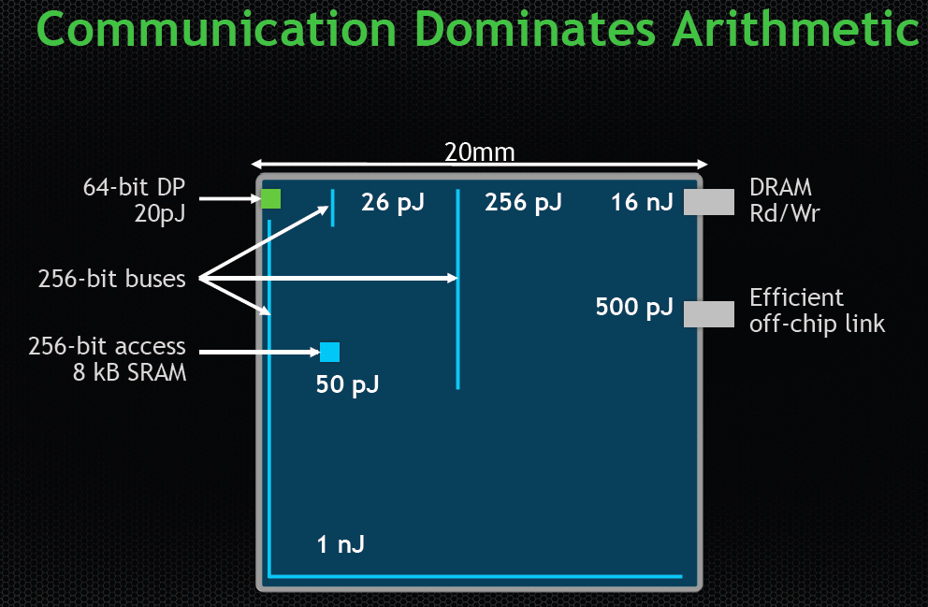
Data Movement vs. Computation Energy
Dally, HiPEAC 2015
A memory access consumes ~100-1000X
the energy of a complex addition
O. Mutlu, “Processing Data Where It Makes Sense: Enabling In-Memory Computation,” keynote talk at MST 2017
https://people.inf.ethz.ch/omutlu/pub/onur-MST-Keynote- EnablingInMemoryComputation-October-27-2017-unrolled-FINAL.pptx

Slide 147
Characterization of UPMEM PIM
Microbenchmarks
  Pipeline throughput
  STREAM benchmark: WRAM, MRAM
  Strided accesses and GUPS
  Throughput vs. Operational intensity
  CPU-DPU data transfers
Real-world benchmarks
  Dense linear algebra
  Sparse linear algebra
  Databases
  Graph processing
  Bioinformatics
  Etc.

Slide 148
Banner Colors
This is a question or an observation
This is an answer from, e.g., UPMEM documentation or our own research
This is an idea or a discussion starter, an opportunity for brainstorming

Slide 149
DPU Sharing? Security Implications?
DPUs cannot be shared across multiple CPU processes
  There are so many DPUs in the system that there is no need for sharing
According to UPMEM, this assumption makes things simpler
  No need for OS
  Simplified security implications: No side channels
Is it possible to perform RowHammer bit flips?
Can we attack the previous or the next application
that runs on a DPU?
RowHammer patents and Giray’s paper?

Slide 150
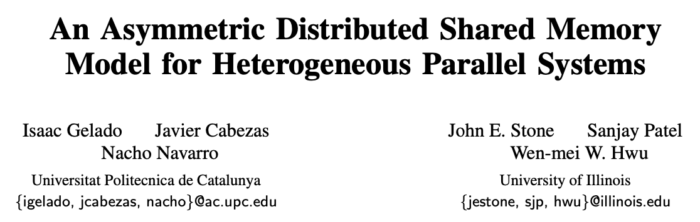
More Questions and Ideas?
How do we handle memory coherence,
memory oversubscription, etc.?
They are programmer’s responsibility
A software library to handle
memory management transparently to programmers
ASPLOS 2010

Slide 151
Arithmetic Throughput (II)
Huge throughput difference between add/sub and mul/div
DPUs do not have a 32-bit multiplier.
mul/div implementation is based on bit shifting and addition: maximum of 32 cycles (instructions) to complete
There is an 8-bit multiplier in the pipeline.
Would it be possible to use it for more efficient implementation?

Slide 152
Arithmetic Throughput (III)
Huge throughput difference between
int32/int64 and float/double
DPUs do not have floating point units.
Software emulation for floating point computations
More efficient algorithms based on other formats?
E.g., posit, TF32?

Slide 153
Strong Scaling: 32 Ranks
VA
GEMV
SpMV
VA
GEMV
SpMV
SEL
SEL
BS
BS
TS
BFS
UNI
TS
BFS
UNI
NW
NW
HST-S
HSt-L
MLP
HST-S
HSt-L
MLP
SCAN-SSA
SCAN-SSA
SCAN-RSS
TRNS
RED
SCAN-RSS
TRNS
RED

Slide 154
DSLs, High-level Programming
Tangram

Slide 155
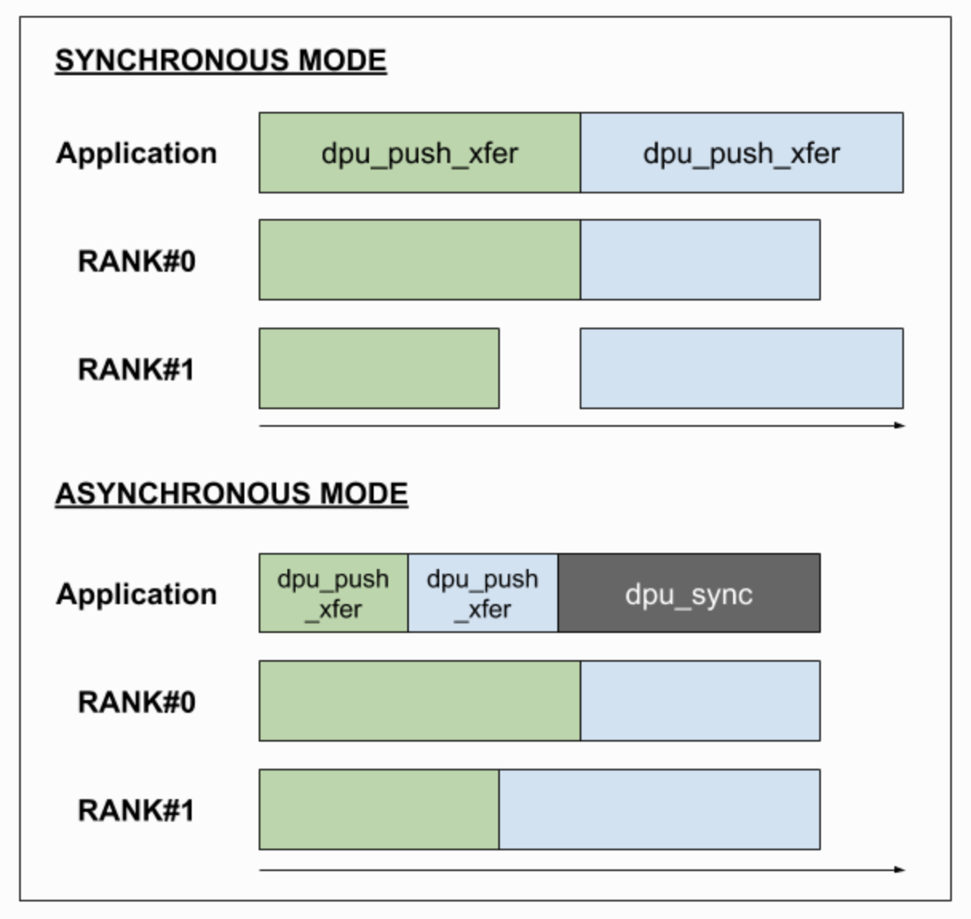
Backup: CPU-DPU Data Transfers
Parallel asynchronous mode
  Two transfers to a set of two ranks
https://sdk.upmem.com/master/032_DPURuntimeService_HostCommunication.html#dpu-rank-transfer-interface-label

Slide 156
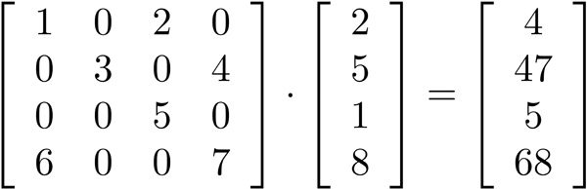
GEMV: Parallelization Approach
GEMV (general matrix-vector multiplication)
Workload distribution
  chunk_size = (num_rows / (nr_ranks * nr_dpus)), to each DPU
  chunk_size / NR_TASKLETS, to each tasklet

Slide 157
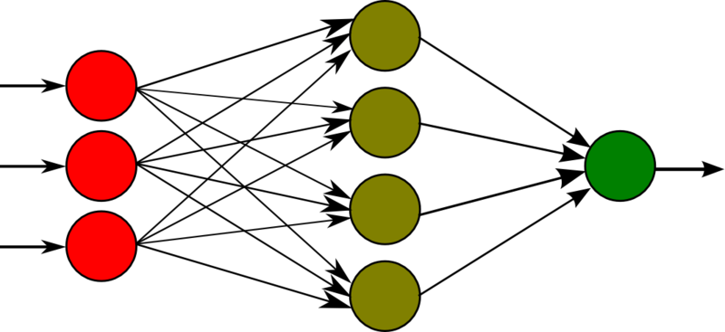
MLP: Parallelization Approach
MLP (multi-layer perceptron), based on GEMV
Workload distribution
  chunk_size = (num_rows / (nr_ranks * nr_dpus)), to each DPU
  chunk_size / NR_TASKLETS, to each tasklet

Slide 158
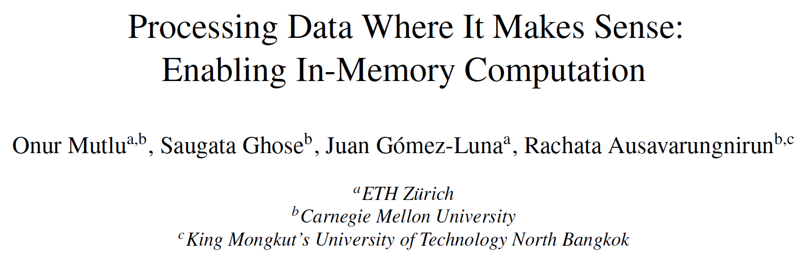
PIM Review and Open Problems
Onur Mutlu, Saugata Ghose, Juan Gomez-Luna, and Rachata Ausavarungnirun,
"Processing Data Where It Makes Sense: Enabling In-Memory Computation"
Invited paper in Microprocessors and Microsystems (MICPRO), June 2019.
[arXiv version]
https://arxiv.org/pdf/1903.03988.pdf

Slide 159
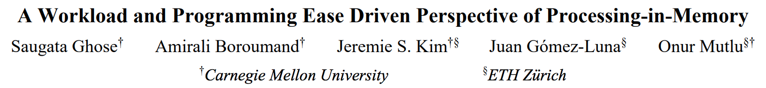
PIM Review and Open Problems (II)
Saugata Ghose, Amirali Boroumand, Jeremie S. Kim, Juan Gomez-Luna, and Onur Mutlu,
"Processing-in-Memory: A Workload-Driven Perspective"
Invited Article in IBM Journal of Research & Development, Special Issue on Hardware for Artificial Intelligence, to appear in November 2019.
[Preliminary arXiv version]
https://arxiv.org/pdf/1907.12947.pdf

