Slide 1






Pythia
A Customizable Hardware Prefetching Framework Using Online Reinforcement Learning
Rahul Bera, Konstantinos Kanellopoulos, Anant V. Nori,
Taha Shahroodi, Sreenivas Subramoney, Onur Mutlu
https://github.com/CMU-SAFARI/Pythia
Notes:
Hi I am Rahul. Today, I’m going to present our work “…”
This work is done by researchers from SAFARI research group at ETH Zurich, in collaboration with Intel Labs and TU Delft.

Slide 2
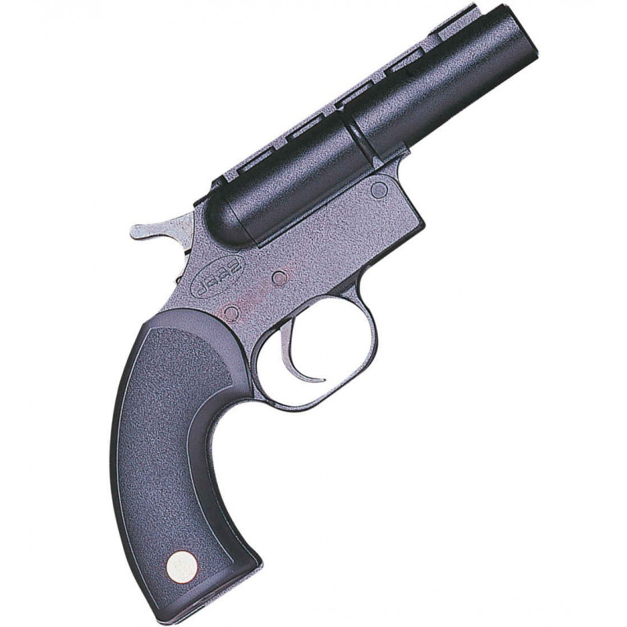
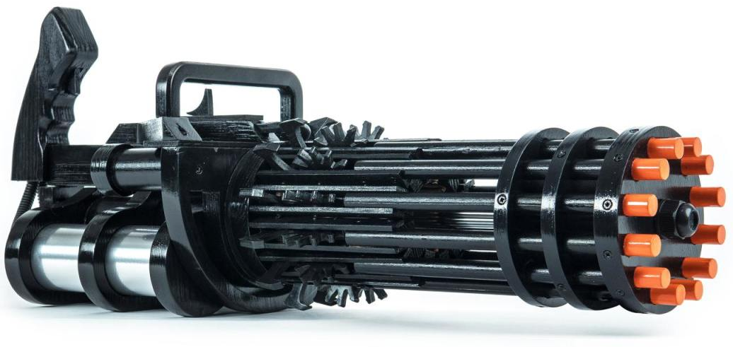

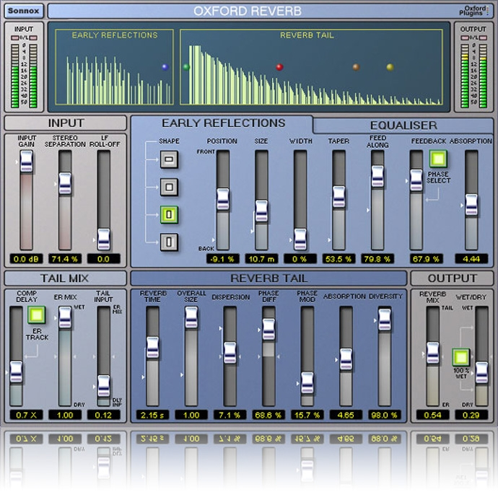


1
2
3
Mainly use one program context info. for prediction
Lack inherent system awareness
Lack in-silicon customizability
Why do prefetchers not perform well?
Notes:
We analyze many prior prefetchers and observe three key shortcomings that significantly limits their performance.
[CLICK] First, they use mainly a single program context for prefetch prediction
[CLICK] Second, they lack system awareness
[CLICK] Third, they lack in-silicon customizability

Slide 3
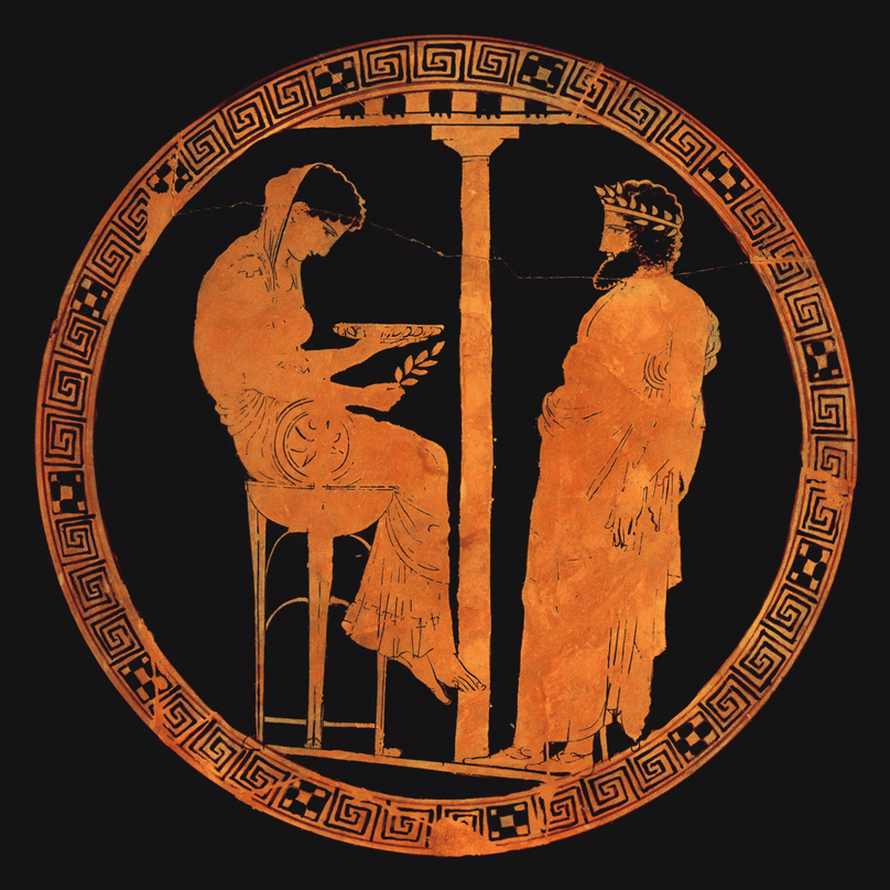


Pythia
Autonomously learns to prefetch using multiple program context information
and system-level feedback
Can be customized in silicon to change program context information or prefetching objective on the fly
Notes:
To alleviate these challenges, we introduce Pythia that:
[CLICK] autonomously learns to prefetch using multiple program context information and system-level feedback
[CLICK] and can be customizable in silicon to alter the program context information or the objective of the prefetcher

Slide 4
Brief Overview of Pythia
Pythia formulates prefetching as a reinforcement learning problem
Notes:
Pythia formulates prefetching as a reinforcement learning problem where,
[CLICK] the prefetcher acts as the agent, ….

Slide 5

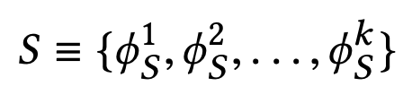
What is State?
k-dimensional vector of features
Feature = control-flow + data-flow
Control-flow examples
  PC
  Branch PC
  Last-3 PCs, …
Data-flow examples
  Cacheline address
  Physical page number
  Delta between two cacheline addresses
  Last 4 deltas, …
Notes:
We define the state as a k-dimensional vector of program features.
[CLICK] Each feature is composed of …
[CLICK] Some examples of control-flow information are …
[CLICK] Some examples of data-flow information are …
Though Pythia can theoretically learn from any number of such program features, we limit the size k as per storage budget.

Slide 6
What is Action?
Given a demand access to address A
the action is to select prefetch offset “O”
Action-space: 127 actions in the range [-63, +63]
  For a machine with 4KB page and 64B cacheline
Upper and lower limits ensure prefetches do not cross physical page boundary
A zero offset means no prefetch is generated
We further prune action-space by design-space exploration
Notes:
We define the action as the selection of a prefetch offset. Pythia adds this offset to the demanded cacheline to get the prefetched cacheline address.
[CLICK] Note that a zero offset is also a valid action for Pythia, which means no prefetch is generated.
[CLICK] As every post-L1 prefetcher …, the list of actions are limited to the range from -63 to +63 for a traditionally-sized …
[CLICK] However, we can prune the action list by automatic design-space exploration, as we show in the paper.

Slide 7
What is Reward?
Defines the objective of Pythia
Encapsulates two metrics:
  Prefetch usefulness (e.g., accurate, late, out-of-page, …)
  System-level feedback (e.g., mem. b/w usage, cache pollution, energy, …)
We demonstrate Pythia with memory bandwidth usage as the system-level feedback in the paper
Notes:
The reward defines the objective of Pythia
[CLICK] A reward encapsulates two metrics: …
[CLICK] Though Pythia can learn from any …, in this paper we demonstrate Pythia using a major system-level feedback: mem b/w usage

Slide 8
What is Reward?
Seven distinct reward levels
  Accurate and timely (R_{AT})
  Accurate but late (R_{AL})
  Loss of coverage (R_{CL})
  Inaccurate
    With low memory b/w usage (R_{IN}-L)
    With high memory b/w usage (R_{IN}-H)
  No-prefetch
    With low memory b/w usage (R_{NP}-L)
    With high memory b/w usage(R_{NP}-H)
Values are set at design time via automatic design-space exploration
  Can be customized further in silicon for higher performance
Notes:
We define reward in five distinct levels mentioned as follows [CLICK].
Each reward level corresponds to various usefulness of a prefetch request. The inaccurate and no-prefetch reward levels are further categorized based on the system memory bandwidth usage.
[CLICK] The values of each of these reward levels are set at design time via automatic design-space exploration.
[CLICK] However, one can customize the rewards in silicon via simple configuration registers to specify a dfferent objective for Pythia for extracting higher performance benefits in target workload suites.

Slide 9
Simulation Methodology
Champsim [3] trace-driven simulator
150 single-core memory-intensive workload traces
  SPEC CPU2006 and CPU2017
  PARSEC 2.1
  Ligra
  Cloudsuite
Homogeneous and heterogeneous multi-core mixes
Five state-of-the-art prefetchers
  SPP [Kim+, MICRO’16]
  Bingo [Bakhshalipour+, HPCA’19]
  MLOP [Shakerinava+, 3rd Prefetching Championship, 2019 ]
  SPP+DSPatch [Bera+, MICRO’19]
  SPP+PPF [Bhatia+, ISCA’20]
[3] https://github.com/ChampSim/ChampSim

Slide 10
Performance with Varying Core Count
Pythia
3.4%
7.7%
SPP
MLOP
Bingo

Slide 11
Performance with Varying Core Count
1. Pythia consistently provides the highest performance in all core configurations
Pythia
7.7%
3.4%
SPP
2. Pythia’s gain increases with core count
MLOP
Bingo

Slide 12
Performance with Varying DRAM Bandwidth
3%
Pythia
Bingo
MLOP
Baseline
SPP
~Intel Xeon 6258R (Cascade Lake, 28C/6ch)
~AMD EPYC Rome 7702P (Zen 2, 64C/8ch)
17%
~AMD Threadripper 3990x (Zen 2, 64C/4ch)

Slide 13
Performance with Varying DRAM Bandwidth
3%
Pythia
Bingo
MLOP
Baseline
SPP
~Intel Xeon 6258R (Cascade Lake, 28C/6ch)
Pythia outperforms prior best prefetchers for
a wide range of DRAM bandwidth configurations
~AMD EPYC Rome 7702P (Zen 2, 64C/8ch)
17%
~AMD Threadripper 3990x (Zen 2, 64C/4ch)

Slide 14
Performance Improvement via Customization
Reward value customization
Strict Pythia configuration
  Increasing the rewards for no prefetching
  Decreasing the rewards for inaccurate prefetching
Strict Pythia is more conservative in generating prefetch requests than the basic Pythia
Evaluate on all Ligra graph processing workloads
Notes:
Next, we analyze performance improvement of Pythia via customization.
[CLICK] We show an example of reward value customization, where,
[CLICK] We devise a strict Pythia configuration by increasing the reward level values for no prefetching, while decreasing the rewards values for inaccurate prefetching.
In short, strict Pythia is more conservative than the basic Pythia and strongly prefers not to prefetch, rather than prefetching inaccurately.
We evaluate both basic Pythia and strict Pythia on Ligra workload suite.

Slide 15
Performance Improvement via Customization
5.2%
7.8%
2%
2.8%
3.4%
3.1%
Notes:
[CLICK] As you can see, strict Pythia outperforms the basic Pythia configuration as much as 7.8% and
[CLICK] 2% on average over the entire Ligra workload suite.

Slide 16
Performance Improvement via Customization
5.2%
7.8%
Pythia can extract even higher performance via customization without changing hardware
2%
2.8%
3.4%
3.1%
Notes:
[CLICK] As you can see, strict Pythia outperforms the basic Pythia configuration as much as 7.8% and
[CLICK] 2% on average over the entire Ligra workload suite.

Slide 17

Pythia’s Overhead
25.5 KB of total metadata storage per core
  Only simple tables
We also model functionally-accurate Pythia with full complexity in Chisel [4] HDL
1.03% area overhead
0.4% power overhead
Satisfies prediction latency
of a desktop-class 4-core Skylake processor (Xeon D2132IT, 60W)
[4] https://www.chisel-lang.org
Notes:
All of Pythia’s performance benefits comes at a modest cost of 25.5KB of metadata storge, which is invested only in simple storage, without any need to complex structures.
[CLICK] We also model a fully-functionally-accurate Pythia with its full complexity in Chisel and show that, Pythia incurs
[CLICK] a modest area overhead of 1.03%
[CLICK] a power overhead of half-a-percent
[CLICK] while simultaneously satisfying the prediction latency at L2 cache frequency
Of a desktop-class …

Slide 18
More in the Paper
Performance comparison with unseen traces
  Pythia provides equally high performance benefits
Comparison against multi-level prefetchers
  Pythia outperforms prior best multi-level prefetchers
Understanding Pythia’s learning with a case study
  We reason towards the correctness of Pythia’s decision
Performance sensitivity towards different features and hyperparameter values
Detailed single-core and four-core performance
Notes:
We have many more exciting results including, ….
We encourage everyone to read it.

Slide 19
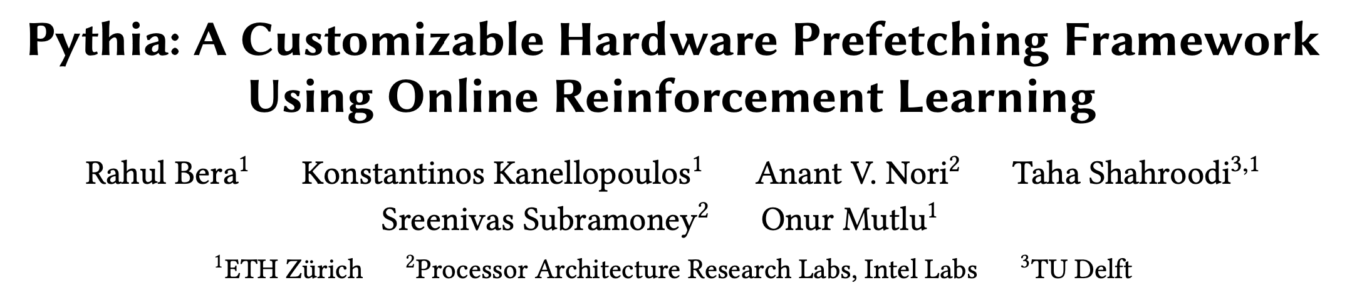
More in the Paper
Performance comparison with unseen traces
  Pythia provides equally high performance benefits
Comparison against multi-level prefetchers
  Pythia outperforms prior best multi-level prefetchers
Understanding Pythia’s learning with a case study
  We reason towards the correctness of Pythia’s decision
Performance sensitivity towards different features and hyperparameter values
Detailed single-core and four-core performance
https://arxiv.org/pdf/2109.12021.pdf
Notes:
We have many more exciting results including, ….
We encourage everyone to read it.

Slide 20
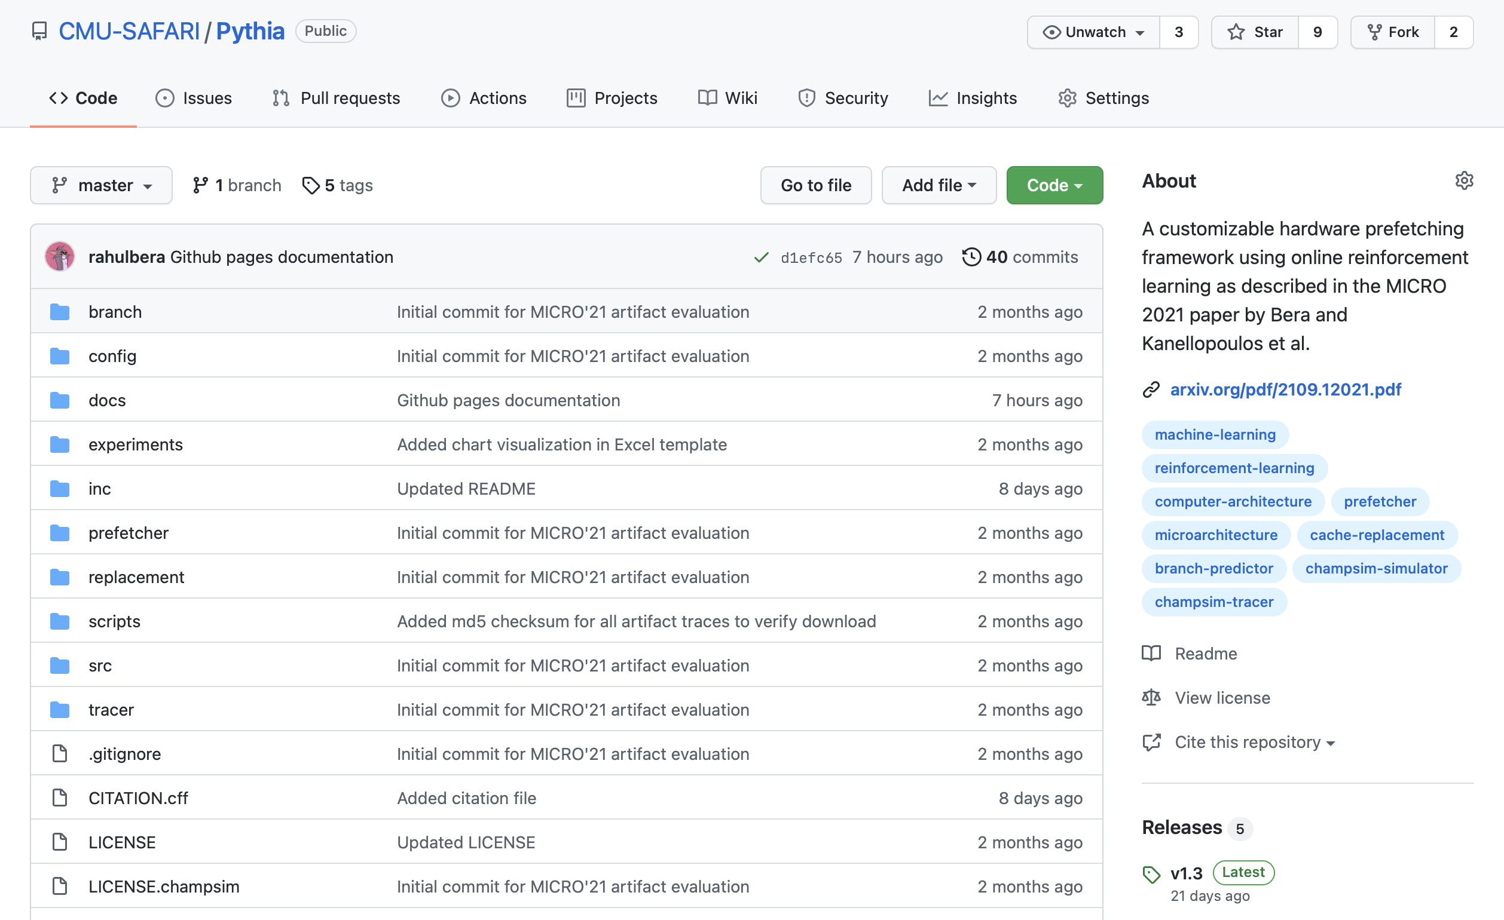
Pythia is Open Source
https://github.com/CMU-SAFARI/Pythia
MICRO’21 artifact evaluated
Champsim source code + Chisel modeling code
All traces used for evaluation

Slide 21
Pythia
A Customizable Hardware Prefetching Framework Using Online Reinforcement Learning
Rahul Bera, Konstantinos Kanellopoulos, Anant V. Nori,
Taha Shahroodi, Sreenivas Subramoney, Onur Mutlu
https://github.com/CMU-SAFARI/Pythia
Notes:
Hi I am Rahul. Today, I’m going to present our work “…”
This work is done by researchers from SAFARI research group at ETH Zurich, in collaboration with Intel Labs and TU Delft.

Slide 22
Discussion
FAQs
  Why RL?
  What about large page?
  What’s the prefetch degree?
  Can customization happen during workload execution?
  Can runtime mixing create problem?
Simulation and Methodology
  Basic Pythia configuration
  System parameters
  Configuration of prefetchers
  Evaluated workloads
  Feature selection
Detailed Design
  Reward structure
  Design overview
  QVStore Organization
More Results
  Comparison against other adaptive prefetchers
  Comparison against Context prefetcher
  Feature combination sensitivity
  Hyperparameter sensitivity
  Comparison with multi-level prefetchers
  Performance in unseen workloads
  Single-core s-curve
  Four-core s-curve
  Detailed performance analysis
  Benefit of bandwidth awareness
  Case study
  Customizing rewards
  Customizing features

Slide 23
FAQs

Slide 24

Why RL? Why Not Supervised Learning?
Determining the benefits of prefetching (i.e., whether a decision was good for performance or not) is not easy
  Depends on a complex set of metrics
    Coverage, accuracy, timeliness
    Effects on system: b/w usage, pollution, cross-application interference, …
  Dynamically-changing environmental conditions change the benefit
  Delayed feedback due to long latency (might not receive feedback at all for inaccurate prefetches!)
Differs from classification tasks (e.g., branch prediction)
  Performance strongly correlates mainly to accuracy
  Does not depend on environment
  Bounded feedback delay

Slide 25
What About Large Pages?
Pythia’s framework can be easily extended to incorporate additional prefetch actions (i.e., possible prefetch offsets for the page size)
To decrease the storage overhead
  Prune action space via automatic design-space exploration
  Hash action values to retrieve Q-values

Slide 26
What is the Prefetch Degree? Is It Managed by the RL Agent?
Pythia employs a simple degree selector, separate from the RL agent
  If the agent has selected the same prefetch action (O) multiple times in a row, Pythia increases the degree (A+2O, A+3O, …)
  At most degree 4
Future works on managing degree by the RL agent

Slide 27
Can the Customization Be Done While the Workload is Running?
Certainly.
Pythia, being an online learning technique, will autonomously adapt (and optimize) its policy to use the new program features or the modified reward values

Slide 28
Can Runtime Workload Mix Create an Issue?
We implement the bandwidth usage feedback using a counter in the memory controller. Thus Pythia already has a global view of the memory bandwidth usage that incorporates all workloads running on a multi-core system
We evaluate a diverse set (300 of each category) of four-core, eight-core, twelve-core random workload mixes
Based on our evaluation, we observe that Pythia dynamically adapts itself to varying workload demands

Slide 29
How does Pythia Compare Against Other Adaptive Prefetching Solutions?
We compare Pythia against IBM POWER7[5] prefetcher
  Adaptively selects prefetcher degree/configuration by monitoring program IPC
4.5%
(a) single-core
6.4%
(b) four-core
[5] Jimenez et al., TOPC’14

Slide 30
How Does Pythia Compare Against the Context Prefetcher?
Pythia widely differs from the Context Prefetcher (CP)[6] in all three aspects: state, action, and reward. The key differences are:
  CP does not consider system-level feedback
  CP models the agent as a contextual bandit which takes myopic prefetch decisions as compared to Pythia
  CP requires compiler support to extract software-level features
Pythia outperforms CP-HW by 5.3% in single-core and 7.6% in four-core system
[6] Leeor et al., ISCA’15

Slide 31
How Pythia’s Performance Changes With Various State Definitions You Have Swept?
In total we evaluate state defined as any-one, any-two, and any-three combinations of 32 features
Performance gain ranges from 20.7% to 22.4%
Coverage ranges from 66.2% to 71.5%
Overprediction ranges from 26.7% to 32.2%

Slide 32
Is Pythia Sensitive to Hyperparameter?
Not setting hyperparameters can significantly impact the overall performance improvement
Changing 𝜀 from 0.002 to 1.0 drops perf. by 16%
Changing 𝛼 from 0.0065 to 1.0 drops perf. by 5.4%

Slide 33
How Does Pythia Compare Against Commercial Multi-level Prefetchers?
Pythia outperforms IPCP [7] by 14.2% on average in 150-MTPS
[6] Prakalapati et al., ISCA’20

Slide 34
Does Pythia Perform Equally Well for Unseen Workloads also?
Evaluated with 500 traces from value prediction championship
  No prefetcher has been trained on these traces
Pythia outperforms MLOP and Bingo by
8.3% and 3.5% in single-core
And 9.7% and 5.4% in four-core

Slide 35
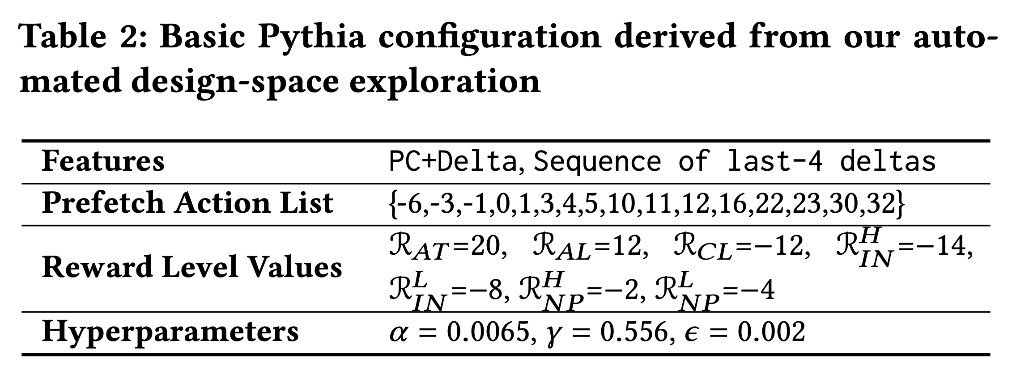
Basic Pythia Configuration

Slide 36
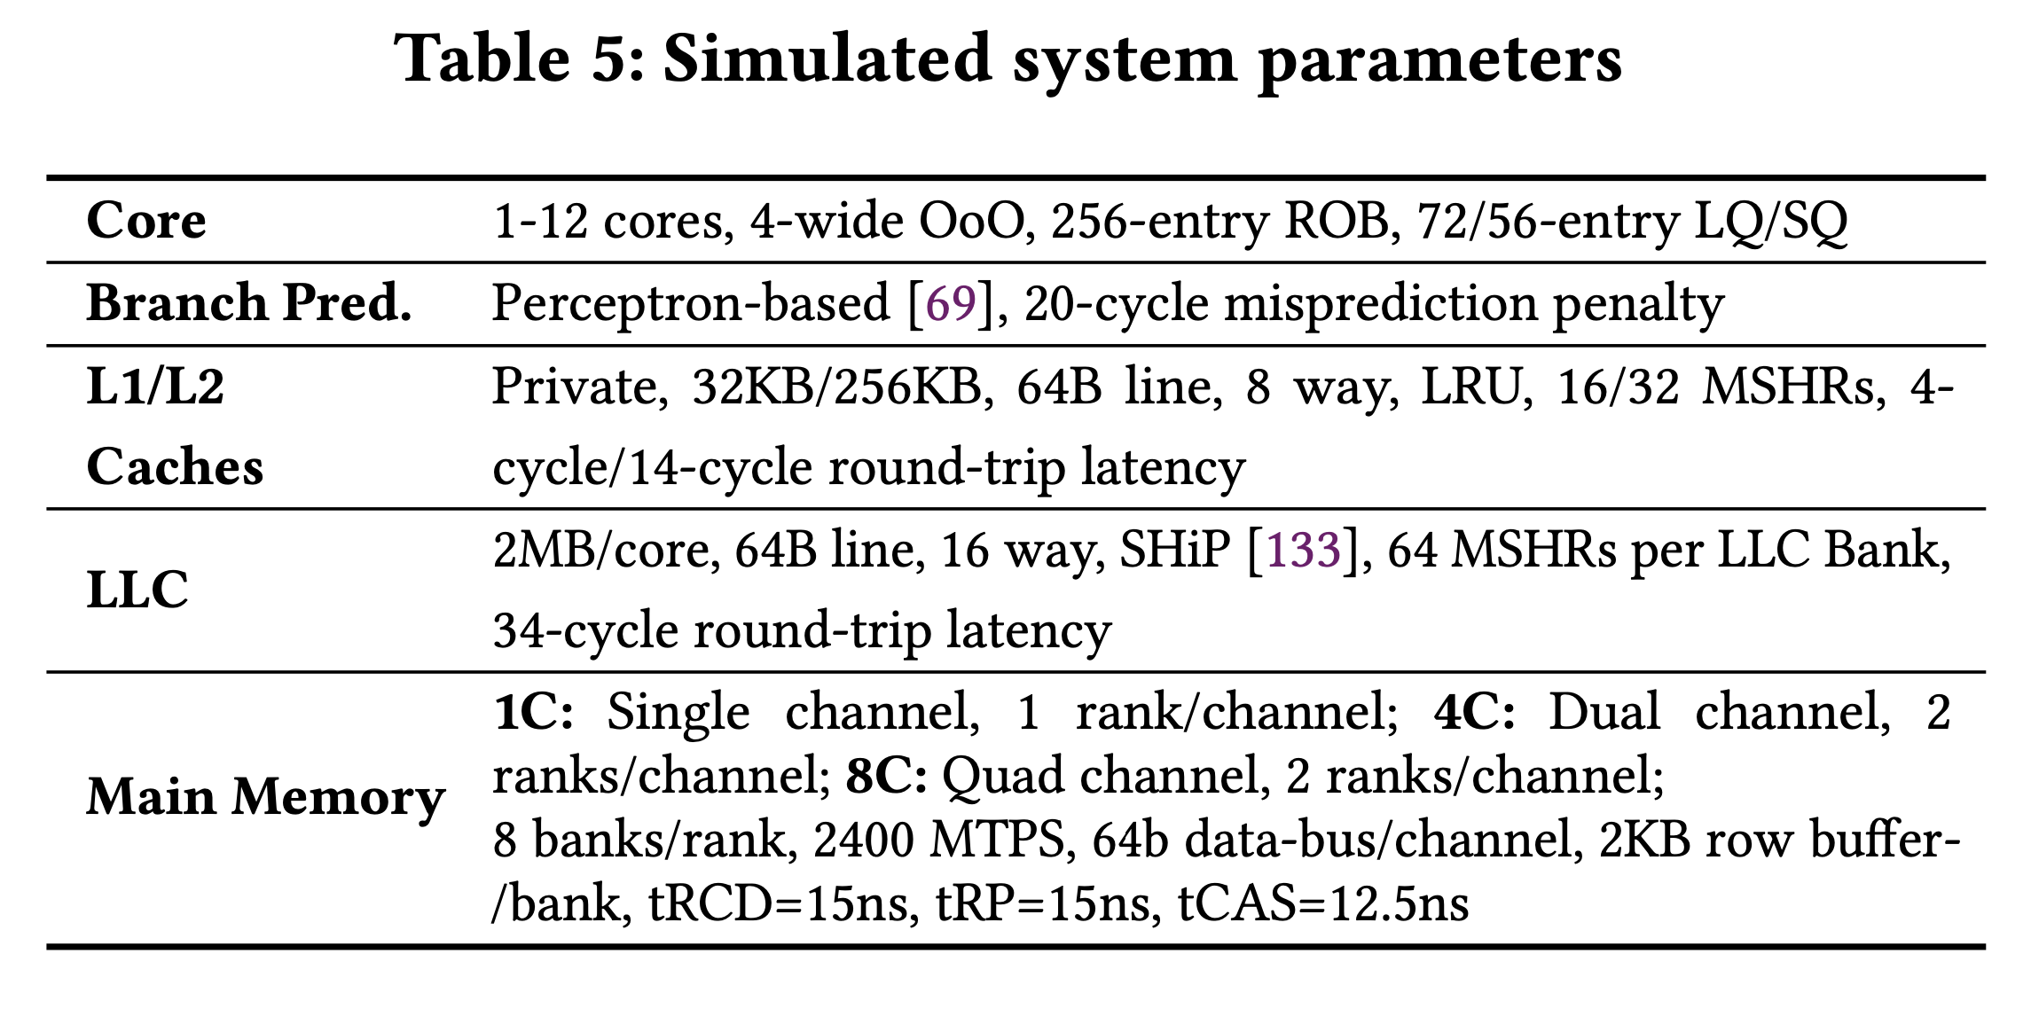
System Parameters

Slide 37
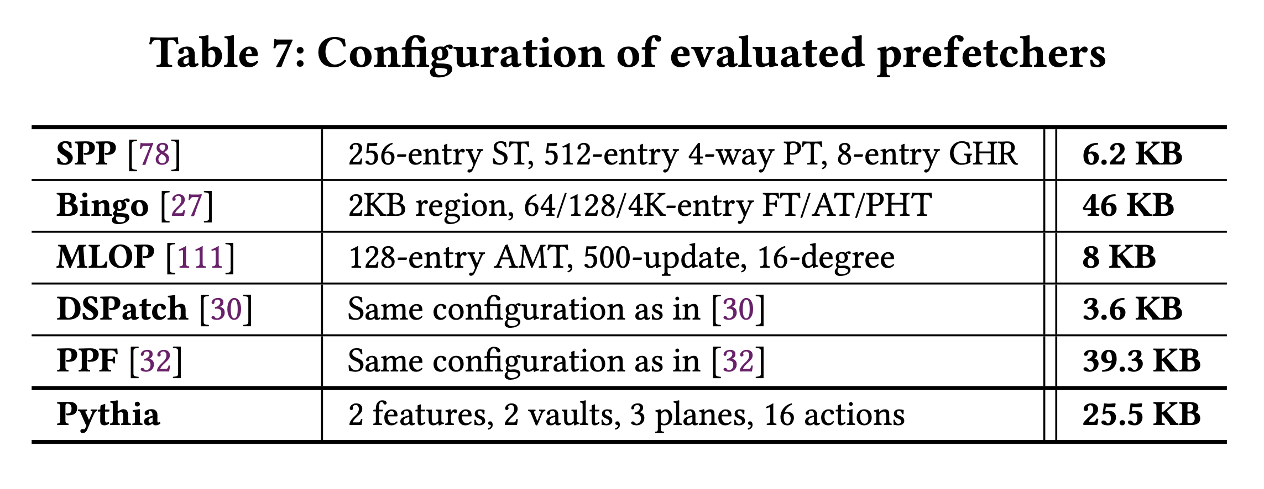
Configuration of Prefetchers

Slide 38
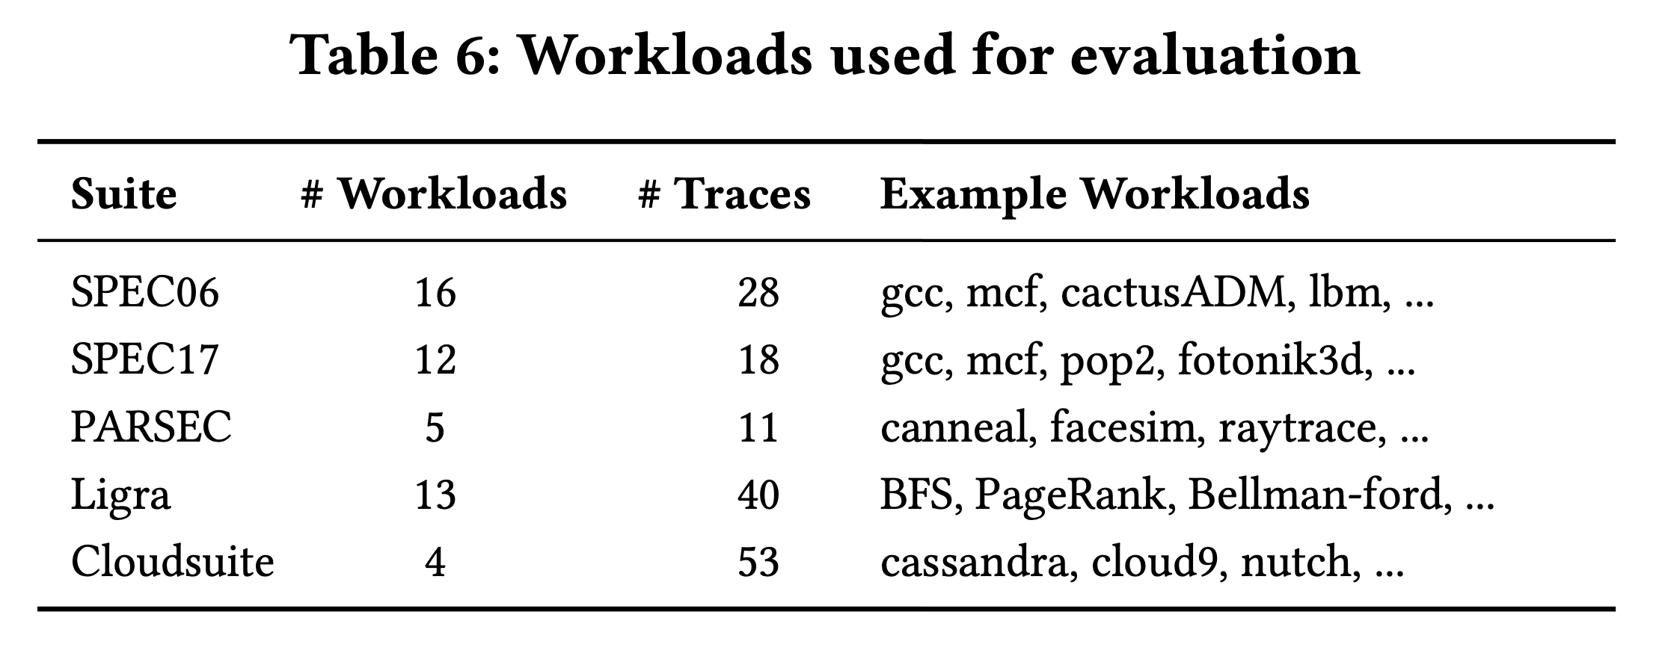
Evaluated Workloads

Slide 39
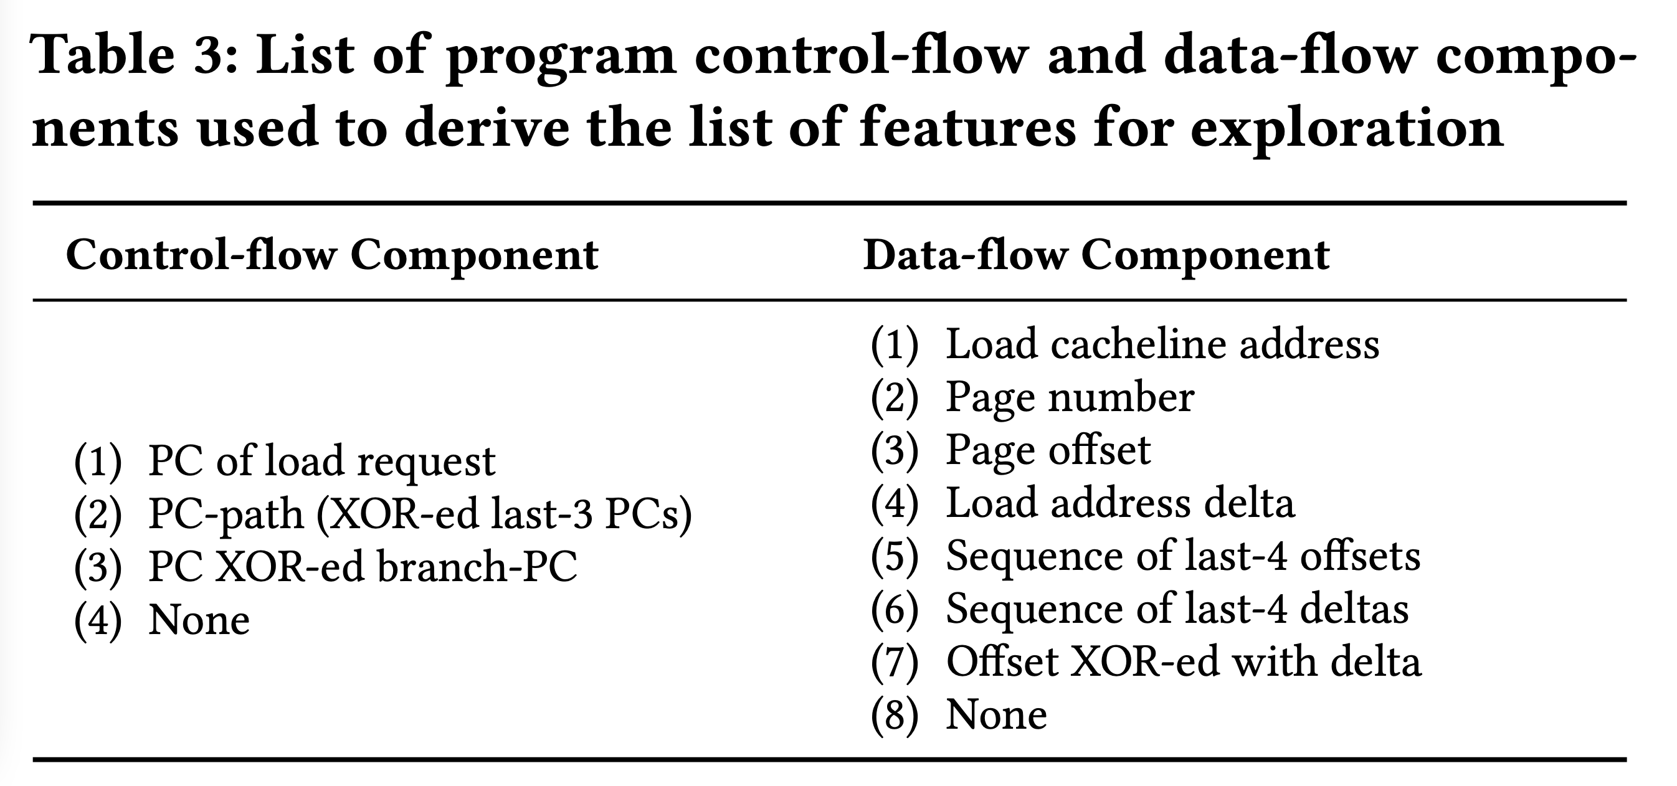
List of Evaluated Features

Slide 40
MORE RESULTS

Slide 41
Performance S-curve: Single-core
603.bwaves_s-2931B
462.libquantum
streamcluster
fluidanimate-9500M
623.xalancbmk_s-592B
BFSCC-22B
pagerank-51B
429.mcf

Slide 42
Performance S-curve: Four-core
437.leslie3d-271B
462.libquantum-1343B
raytrace-23.75B
429.mcf-184B
Mix-59
pagerank
Mix-240

Slide 43
Single-core Coverage & Overprediction

Slide 44
Detailed Performance

Slide 45
Benefit of Bandwidth Awareness

Slide 46
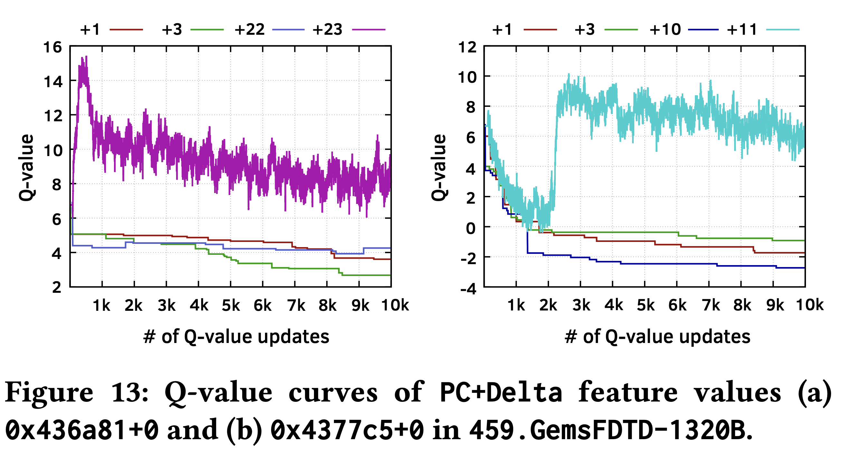
Case Study

Slide 47
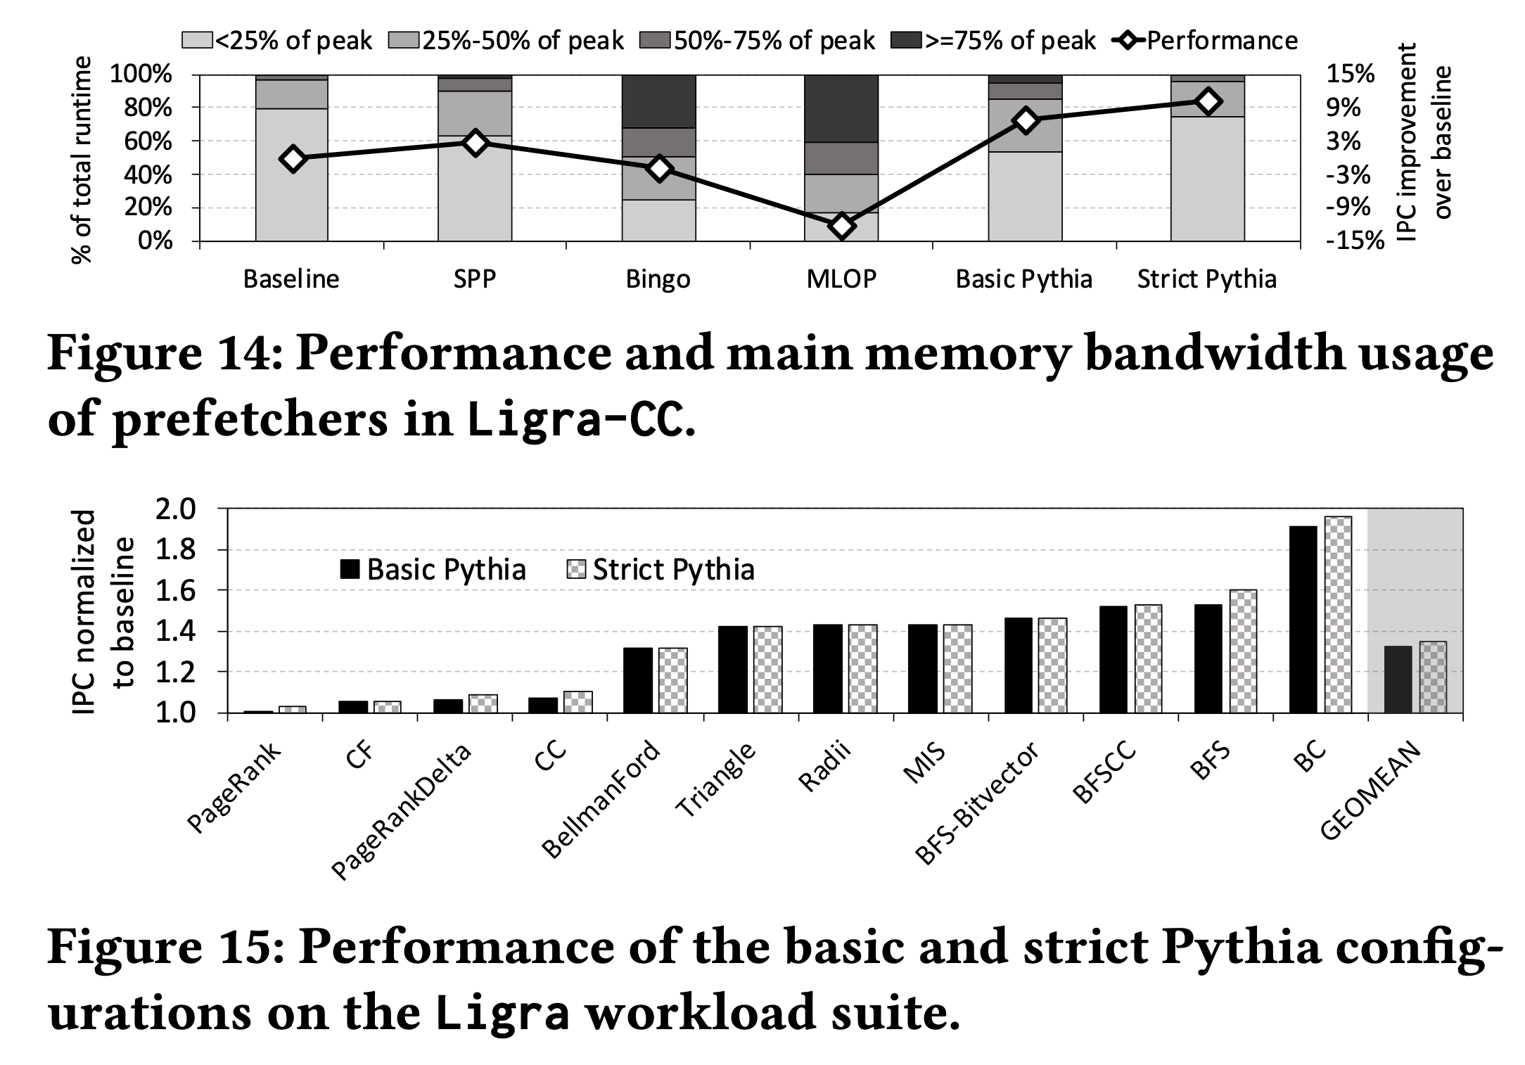
Customizing Rewards

Slide 48
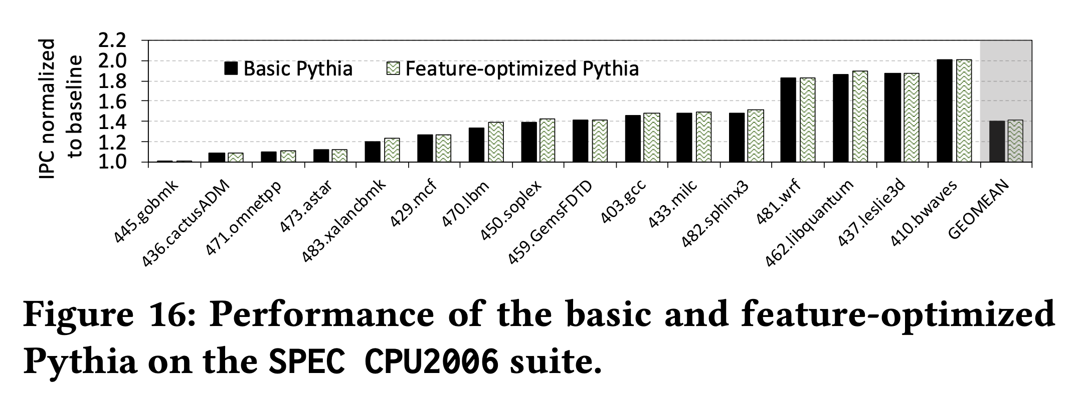
Customizing Features

Slide 49
BACKUP

Slide 50
Executive Summary
Background: Prefetchers predict addresses of future memory requests by associating memory access patterns with program context (called feature)
Problem: Three key shortcomings of prior prefetchers:
  Predict mainly using a single program feature
  Lack inherent system awareness (e.g., memory bandwidth usage)
  Lack in-silicon customizability
Goal: Design a prefetching framework that:
  Learns from multiple features and inherent system-level feedback
  Can be customized in silicon to use different features and/or prefetching objectives
Contribution: Pythia, which formulates prefetching as reinforcement learning problem
  Takes adaptive prefetch decisions using multiple features and system-level feedback
  Can be customized in silicon for target workloads via simple configuration registers
  Proposes a realistic and practical implementation of RL algorithm in hardware
Key Results:
  Evaluated using a wide range of workloads from SPEC CPU, PARSEC, Ligra, Cloudsuite
  Outperforms best prefetcher (in 1-core config.) by 3.4%, 7.7% and 17% in 1/4/bw-constrained cores
  Up to 7.8% more performance over basic Pythia across Ligra workloads via simple customization
https://github.com/CMU-SAFARI/Pythia
Notes:
First, I am going to start with an executive summary.
[CLICK] Prefetching is a speculative technique that predicts address of future memory requests by associating patterns in memory addresses with some program context. We call this context a feature.
[CLICK] We observe three key shortcomings in prior prefetchers:
First, they mainly use a single program feature for prediction.
Second, they lack inherent system awareness
Third, they also lack any customizability in silicon
[CLICK] Our goal in this work is to design a prefetching framework that
– can learn from multiple program features and inherent system-level feedback
-- and can be customized in silicon to change the features or the objective of the prefetcher
[CLICK] Towards this we propose Pythia, that formulates …
Pythia makes adaptive and autonomous …
Pythia also proposes a realistic and practical …
[CLICK] We extensively evaluate Pythia using …
We show that Pythia outperforms prior state-of-the-art …
Pythia is freely available in our GitHub repository.

Slide 51
Talk Outline
Key Shortcomings of Prior Prefetchers
Formulating Prefetching as Reinforcement Learning
Pythia: Overview
Evaluation of Pythia and Key Results
Conclusion
Notes:
This is the outline of my talk.
First, I am going to start by discussing key shortcomings of prior prefetchers.

Slide 52
Prefetching Basics
Predicts addresses of long-latency memory requests and fetches data before the program demands it
Associates access patterns from past memory requests with program context information
Example program features
  Program counter (PC)
  Page number
  Page offset
  Cacheline delta
  …
  Or a combination of these attributes
Program Feature
Program context → Access Pattern
Notes:
Prefetching is a speculative technique that predicts …
[CLICK] To predict addresses, a prefetcher typically associates …
[CLICK] We call these context information as program feature.
[CLICK] Some examples of program features are … or any combination of these information

Slide 53
Key Shortcomings in Prior Prefetchers
We observe three key shortcomings that significantly limit performance benefits of prior prefetchers
Predict mainly using a single program feature
1
Lack inherent system awareness
2
Lack in-silicon customizability
3
Notes:
We observe three key shortcomings in prior prefetchers that significantly limits their performance improvement
[CLICK] First, they predict mainly …
[CLICK] Second, they lack any inherent …
[CLICK] Third, the also lack any online in-silicon customizability
Let’s take a closer look at each of these shortcomings.
[NEXT]

Slide 54
(1) Single-Feature Prefetch Prediction
Provides good performance gains mainly on workloads where the feature-to-pattern correlation exists
15.4%
4.6%
5.5%
3.5%
Bingo [1] performs better
SPP [2] performs better
[1] Bakshalipour et al., HPCA’19
[2] Kim et al., MICRO’16
Notes:
Due to the use of a single program feature for prefetch prediction, a prefetcher typically provides performance benefits …
In other types of workloads, the same prefetcher fails to provide performance gains.
To illustrate this [CLICK], we show the coverage, overprediction, and performance improvement of two prior prefetchers SPP and Bingo for six sample workloads.
The top figure shows …
The bottom figure shows …
As we can see, for workloads like [CLICK], … Bingo performs better than SPP, as the program feature exploited by Bingo has stronger correlation with the access pattern than SPP.
On the other hand, for workloads like … [CLICK], SPP’s program feature provides better correlation, and thus performs better than Bingo.

Slide 55
(1) Single-Feature Prefetch Prediction
Provides good performance gains mainly on workloads where the feature-to-pattern correlation exists
Relying on a single feature for prediction leaves significant performance improvement on table
15.4%
4.6%
5.5%
3.5%
Bingo [1] performs better
SPP [2] performs better
[1] Bakshalipour et al., HPCA’19
[2] Kim et al., MICRO’16
Notes:
Due to the use of a single program feature for prefetch prediction, a prefetcher typically provides performance benefits …
In other types of workloads, the same prefetcher fails to provide performance gains.
To illustrate this [CLICK], we show the coverage, overprediction, and performance improvement of two prior prefetchers SPP and Bingo for six sample workloads.
The top figure shows …
The bottom figure shows …
As we can see, for workloads like [CLICK], … Bingo performs better than SPP, as the program feature exploited by Bingo has stronger correlation with the access pattern than SPP.
On the other hand, for workloads like … [CLICK], SPP’s program feature provides better correlation, and thus performs better than Bingo.

Slide 56
(2) Lack of Inherent System Awareness
Little understanding of undesirable effects (e.g., memory bandwidth usage, cache pollution, …)
  Performance loss in resource-constrained configurations
368%
574%
Similar coverage
Lower overpredictions
Yet, lower performance
Notes:
The second shortcoming is that, all prior prefetchers have …, which often leads to …
To illustrate this, let revisit the previous figure and focus on Bingo’s performance in PARSEC-Canneal and Ligra-CC.
Bingo in Ligra-CC has similar coverage to PARSEC-Canneal with significantly …
The reason is that, in baseline without prefetching, Ligra-CC consumes much higher main memory …
As a result, even a smaller amount of overprediction hurts more performance in Ligra-CC than in PARSEC-Canneal.
This is only happening as Bingo does not take its undesirable effects into account while prefetching.
Thus the key takeaway is that, [CLICK] …

Slide 57
(2) Lack of Inherent System Awareness
Little understanding of undesirable effects (e.g., memory bandwidth usage, cache pollution, …)
  Performance loss in resource-constrained configurations
368%
574%
Prefetchers often lose performance due to lack of inherent system awareness
Similar coverage
Lower overpredictions
Yet, lower performance
Notes:
The second shortcoming is that, all prior prefetchers have …, which often leads to …
To illustrate this, let revisit the previous figure and focus on Bingo’s performance in PARSEC-Canneal and Ligra-CC.
Bingo in Ligra-CC has similar coverage to PARSEC-Canneal with significantly …
The reason is that, in baseline without prefetching, Ligra-CC consumes much higher main memory …
As a result, even a smaller amount of overprediction hurts more performance in Ligra-CC than in PARSEC-Canneal.
This is only happening as Bingo does not take its undesirable effects into account while prefetching.
Thus the key takeaway is that, [CLICK] …

Slide 58



(3) Lack of In-silicon Customizability
Feature statically selected at design time
  Rigid hardware designed specifically to exploit that feature
No way to change program feature and/or change prefetcher’s objective in silicon
  Cannot adapt to a wide range of workload demands
Design from scratch
Verify
Fabricate
Notes:
The third key shortcoming is that, all prior prefetcher lack in-silicon customizability.
These prefetchers statically selects the feature to exploit at design time and design a rigid hardware to specifically …
[CLICK] There is no way …
In order to exploit a new program feature, architects need to design a prefetcher from scratch …
[CLICK] and this cycle goes on for every new prefetcher. This wastes precious design time and human resource.

Slide 59
Our Goal
A prefetching framework that can:
Learn to prefetch using multiple features and inherent system-level feedback information
Be easily customized in silicon to use different features and/or change prefetcher’s objectives
Notes:
So our goal in this work is to … that
[CLICK] …
[CLICK] …

Slide 60

Our Proposal
Pythia
Formulates prefetching as a reinforcement learning problem
Pythia is named after the oracle of Delphi, who is known for her accurate prophecies
https://en.wikipedia.org/wiki/Pythia

Slide 61
Talk Outline
Key Shortcomings of Prior Prefetchers
Formulating Prefetching as Reinforcement Learning
Pythia: Overview
Evaluation of Pythia and Key Results
Conclusion
Notes:
To this end, we propose Pythia, which formulates …

Slide 62
Basics of Reinforcement Learning (RL)
Algorithmic approach to learn to take an action in a given situation to maximize a numerical reward
Agent stores Q-values for every state-action pair
  Expected return for taking an action in a state
  Given a state, selects action that provides highest Q-value
Notes:
First, let me briefly describe the basics of reinforcement learning.
Reinforcement learning, in its simplest form, is the ...
A RL system contains two components: [CLICK] the agent and the environment.
The agent observes the state of the environment in every timestep [CLICK], takes an action based on the state [CLICK], and receives a reward for that action [CLICK].
[CLICK] The agent stores …
Given a state, the agent …

Slide 63
Formulating Prefetching as RL
Notes:
In Pythia, we formulate prefetching as a reinforcement learning problem.
[CLICK] The prefetcher acts as the agent, while [CLICK] the processor and memory subsystem acts as the environment.
[CLICK] Pythia extracts the program features from every demand request and use it as a state information to take a prefetch action [CLICK]
[CLICK] For every prefetch action, Pythia receives a numerical reward that evaluates the usefulness of the prefetch request, while considering various system-level feedbacks.
Not let’s concretely define the state, action, and the reward for Pythia.

Slide 64
What is State?
k-dimensional vector of features
Feature = control-flow + data-flow
Control-flow examples
  PC
  Branch PC
  Last-3 PCs, …
Data-flow examples
  Cacheline address
  Physical page number
  Delta between two cacheline addresses
  Last 4 deltas, …
Notes:
We define the state as a k-dimensional vector of program features.
[CLICK] Each feature is composed of …
[CLICK] Some examples of control-flow information are …
[CLICK] Some examples of data-flow information are …
Though Pythia can theoretically learn from any number of such program features, we limit the size k as per storage budget.

Slide 65
What is State?
Example of a state information
S = {PC+Delta, Sequence of last-4 deltas}
Feature-1 (ɸ₁)
Feature-2 (ɸ₂)
PC
(Control-flow info.)
Cacheline Delta
(Data-flow info.)
Seq. of last-4 deltas
(Data-flow info.)
Notes:
We define the state as a k-dimensional vector of program features.
[CLICK] Each feature is composed of …
[CLICK] Some examples of control-flow information are …
[CLICK] Some examples of data-flow information are …
Though Pythia can theoretically learn from any number of such program features, we limit the size k as per storage budget.

Slide 66
What is Action?
Given a demand access to address A
the action is to select prefetch offset “O”
Action-space: 127 actions in the range [-63, +63]
  For a machine with 4KB page and 64B cacheline
Upper and lower limits ensure prefetches do not cross physical page boundary
A zero offset means no prefetch is generated
We further prune action-space by design-space exploration
Notes:
We define the action as the selection of a prefetch offset. Pythia adds this offset to the demanded cacheline to get the prefetched cacheline address.
[CLICK] Note that a zero offset is also a valid action for Pythia, which means no prefetch is generated.
[CLICK] As every post-L1 prefetcher …, the list of actions are limited to the range from -63 to +63 for a traditionally-sized …
[CLICK] However, we can prune the action list by automatic design-space exploration, as we show in the paper.

Slide 67
What is Reward?
Defines the objective of Pythia
Encapsulates two metrics:
  Prefetch usefulness (e.g., accurate, late, out-of-page, …)
  System-level feedback (e.g., mem. b/w usage, cache pollution, energy, …)
We demonstrate Pythia with memory bandwidth usage as the system-level feedback in the paper
Notes:
The reward defines the objective of Pythia
[CLICK] A reward encapsulates two metrics: …
[CLICK] Though Pythia can learn from any …, in this paper we demonstrate Pythia using a major system-level feedback: mem b/w usage

Slide 68
What is Reward?
Seven distinct reward levels
  Accurate and timely (R_{AT})
  Accurate but late (R_{AL})
  Loss of coverage (R_{CL})
  Inaccurate
    With low memory b/w usage (R_{IN}-L)
    With high memory b/w usage (R_{IN}-H)
  No-prefetch
    With low memory b/w usage (R_{NP}-L)
    With high memory b/w usage(R_{NP}-H)
Values are set at design time via automatic design-space exploration
  Can be customized further in silicon for higher performance
Notes:
We define reward in five distinct levels mentioned as follows [CLICK].
Each reward level corresponds to various usefulness of a prefetch request. The inaccurate and no-prefetch reward levels are further categorized based on the system memory bandwidth usage.
[CLICK] The values of each of these reward levels are set at design time via automatic design-space exploration.
[CLICK] However, one can customize the rewards in silicon via simple configuration registers to specify a dfferent objective for Pythia for extracting higher performance benefits in target workload suites.

Slide 69
Steering Pythia’s Objective via Reward Values
Example reward configuration for
  Generating accurate prefetches
  Making bandwidth-aware prefetch decisions
-14
-8
-4
-2
+12
+20
R_{IN}-H
R_{IN}-L
R_{NP}-L
R_{NP}-H
R_{AL}
R_{AT}
AT = Accurate & timely; AL = Accurate & late; NP = No-prefetching; IN = Inaccurate;
H = High mem. b/w; L = Low mem. b/w
1
Highly prefers to generate accurate prefetches
2
Prefers not to prefetch if memory bandwidth usage is low
3
Strongly prefers not to prefetch if memory bandwidth usage is high
Notes:
Now, let’s take a concrete example of reward values and how they specify the objectives for Pythia.
[CLICK] These are the reward level values in basic Pythia configuration.
Pythia sets three key objectives for prefetching by this reward configuration.
[CLICK] First, we provide much higher perks to Pythia for prefetching accurately, either timely or untimely. Thus, Pythia prefers to generate accurate prefetches.
[CLICK] Second, in case of low memory bandwidth usage, Pythia has higher perks in no prefetching, rather that prefetching inaccurately.
Thus, if the memory bandwidth usage is low, Pythia prefers not to prefetch, rather than prefetching inaccurately.
[CLICK] Third, in case of high memory bandwidth usage, Pythia has much higher perks in no prefetching than prefetching accurately.
Thus, if the memory bandwidth usage is low, Pythia strongly prefers not to prefetch, rather than prefetching inaccurately.
[] Let’s take a look at a reward values to steer Pythia to generate accurate prefetches and make fine-tuned decisions based on b/w usage.

Slide 70
Steering Pythia’s Objective via Reward Values
Customizing reward values to make Pythia conservative towards prefetching
-22
-20
+1
+2
+12
+20
R_{IN}-H
R_{IN}-L
R_{NP}-L
R_{NP}-H
R_{AL}
R_{AT}
AT = Accurate & timely; AL = Accurate & late; NP = No-prefetching; IN = Inaccurate;
H = High mem. b/w; L = Low mem. b/w
1
Highly prefers to generate accurate prefetches
2
Otherwise prefers not to prefetch
Notes:
Now, if we increase the reward for no prefetching while significantly decreasing the rewards for inaccurate prefetching, we set a different prefetching objective for Pythia.
[CLICK] We still provide much higher perks for prefetching accurately. Thus Pythia strives to generate accurate prefetches.
[CLICK] Otherwise, we provide much higher perks for no prefetching as compared to inaccurate prefetching, irrespective of the memory bandwidth usage. Thus, Pythia becomes conservative and simply do not prefetch at all.
This is particularly useful if we are repurposing Pythia for server-class processors which have modest per-core memory bandwidth
or workloads like Ligra whose performance improvement is sensitive to memory bandwidth usage.

Slide 71

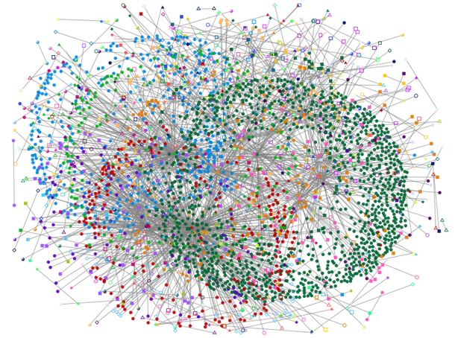
Steering Pythia’s Objective via Reward Values
Customizing reward values to make Pythia conservative towards prefetching
Strict Pythia configuration
-22
-20
+2
+4
+12
+20
R_{IN}-H
R_{IN}-L
R_{NP}-L
R_{NP}-H
R_{AL}
R_{AT}
AT = Accurate & timely; AL = Accurate & late; NP = No-prefetching; IN = Inaccurate;
H = High mem. b/w; L = Low mem. b/w
1
Highly prefers to generate accurate prefetches
2
Bandwidth-sensitive workloads
Otherwise prefers not to prefetch
Server-class processors
Notes:
Now, if we increase the reward for no prefetching while significantly decreasing the rewards for inaccurate prefetching, we set a different prefetching objective for Pythia.
[CLICK] We still provide much higher perks for prefetching accurately. Thus Pythia strives to generate accurate prefetches.
[CLICK] Otherwise, we provide much higher perks for no prefetching as compared to inaccurate prefetching, irrespective of the memory bandwidth usage. Thus, Pythia becomes conservative and simply do not prefetch at all.
This is particularly useful if we are repurposing Pythia for server-class processors which have modest per-core memory bandwidth
or workloads like Ligra whose performance improvement is sensitive to memory bandwidth usage.

Slide 72
Talk Outline
Key Shortcomings of Prior Prefetchers
Formulating Prefetching as Reinforcement Learning
Pythia: Overview
Evaluation of Pythia and Key Results
Conclusion
Notes:
We now provide a brief overview and design of Pythia.

Slide 73
Pythia Overview
Q-Value Store: Records Q-values for all state-action pairs
Evaluation Queue: A FIFO queue of recently-taken actions
Find the Action with max Q-Value
A1
A2
A3
4
2
Look up
QVStore
Generate
prefetch
Demand Request
State
Vector
Memory
Hierarchy
S1
3
S2
Max
S3
S4
Q-Value Store
(QVStore)
6
Evict EQ entry and update QVStore
5
Evaluation Queue (EQ)
Insert prefetch action &
State-Action pair in EQ
1
7
Set filled bit
Assign reward to
corresponding EQ entry
Prefetch Fill
Notes:
Pythia consists of two key components:
[CLICK] Q-value store, which is responsible for …
[CLICK] Evaluation queue, which is a first-in-first-out queue that stores the recently taken action.
As Pythia cannot always immediately assign a reward to a taken action
because the usefulness of the corresponding prefetch request is known, Pythia stores the action
in evaluation queue to properly assign rewards to them.
[CLICK] For every demand request, Pythia first checks EQ with deamdned address. If a matching entry is found in EQ, it means the corresponding action in EQ entry has generated a useful prefetch, and Pythia assigns a reward accordingly.
[CLICK] Then Pythia extracts features from the attributes of the demand request to create the state-vector and uses the state-vector to lookup QVStore [CLICK]
[CLICK] For the given state-vector, Pythia finds the action that has the highest Q-value and generates prefetch request accordingly to the memory hierarchy [CLICK]
[CLICK] Next, Pythia inserts the action in the EQ along with the state-action pair.
[CLICK] Pythia uses the reward stored in the evicted EQ entry to update the QVStore.

Slide 74
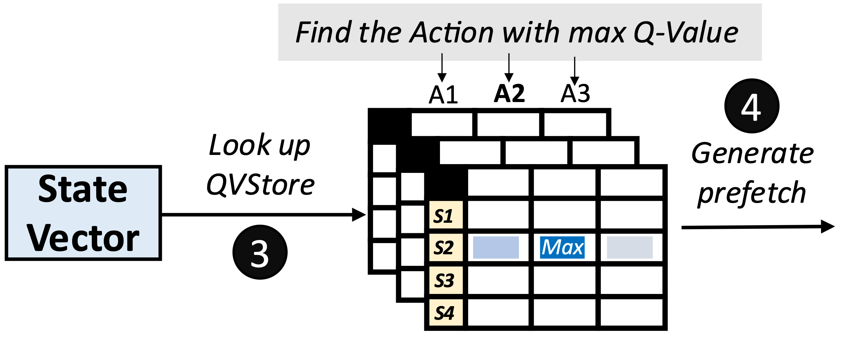
Architecting QVStore
+1
+2
+3
…
S = {PC+Delta,
Sequence of last-4 deltas}
Q-Value Store
(QVStore)
Notes:
Now let’s take a closer look at how Pythia makes a prefetch prediction.
For every prefetch prediction, Pythia has to look up the QVStore using the state vector, [CLICK] for example, a vector of features: PC+Delta, and seq. of last-4 deltas.
For the given state-vector, Pythia has to retrieve the Q-value for each prefetch action, e.g., [CLICK] prefetch offsets +1, +2, +3 and so on, to find the action that has the maximum Q-value.
Thus, it is necessary to store all state-action Q-values in an efficient way for a fast Q-value retrieval.

Slide 75
Architecting QVStore
Fast prefetch prediction
+1
+2
+3
…
Fast retrieval of Q-values from QVStore
S = {PC+Delta,
Sequence of last-4 deltas}
Q-Value Store
(QVStore)
Efficient storage organization of Q-values in QVStore
Notes:
Now let’s see an example of how QVStore works.
For every prefetch decision, Pythia looks up the QVStore using the state vector, which in this case …
For the state-vector, Pythia retrieves the Q-value for each prefetch action, e.g., +1, +2, +3 ... to find the action that has the maximum Q-value.
Thus, it is necessary to store all state-action Q-values in an efficient way for a fast Q-value retrieval.

Slide 76

Organization of QVStore
A monolithic two-dimensional table?
  Indexed by state and action values
State-space increases exponentially with #bits
S = {PC+Delta, Sequence of last-4 deltas}
32b
+
7b
+
4x7b
= 67 bits
127 actions
 | A1 | A2 | A3 | A4 | A5 | A6 | A7 | A8 | A9
S1
S2
S3
S4
S5
S6
S7
2⁶⁷ states
Design complexity
Access latency
Notes:
[CLICK] Now, a naïve choice for designing the QVStore is to organize as a monolithic two-dimensional table, which is indexed by the state and the action values
[CLICK] However, the state-space increases exponentially with the number of bits used to represent the state.
[CLICK] As you can see, the state information considered in our example requires 67 bits to represent
[CLICK] Which requires an impractically-sized monolithic table to store Q-values for every state-action pairs.
[CLICK] but also significantly increases the access latency.

Slide 77
Organization of QVStore
We partition QVStore into k vaults [k = number of features in state]
  Each vault corresponds to one feature and stores the Q-values of feature-action pairs
To retrieve Q(S,A) for each action
Query each vault in parallel with feature and action
Retrieve feature-action Q-value from each vault
Compute MAX of all feature-action Q-values
MAX ensures the Q(S,A) is driven by the constituent feature that has highest Q(ɸ,A)
Notes:
[CLICK] Thus, we partition the QVStore into k vaults, where k is the number of features in a state information
[CLICK] Each vault corresponds to …
[CLICK] To retrieve the Q-value of a state-action pair …
[CLICK] We do this…
[CLICK] Then we do this …
[CLICK] Then we do this …
[CLICK] The maximum operation ensures that …

Slide 78
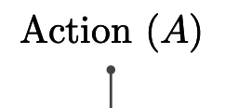
Organization of QVStore
We further partition each vault into multiple planes
  Each plane stores a partial Q-value of a feature-action pair
To retrieve Q(ɸ,A) for each action
Query each plane in parallel with hashed feature and action
Retrieve partial feature-action Q-value from each plane
Compute SUM of all parital feature-action Q-values
Notes:
[CLICK] We further partition …
[CLICK] Where each plane stores …
[CLICK] To retrieve the feature-action Q-value,
[CLICK] We query each plane …
[CLICK] We retrieve the partial Q-value from each plane
[CLICK] and finally compute a sum …

Slide 79
Organization of QVStore
We further partition each vault into multiple planes
  Each plane stores a partial Q-value of a feature-action pair
To retrieve Q(ɸ,A) for each action
1. Enables sharing of partial Q-values between similar feature values, shortens prefetcher training time
Query each plane in parallel with hashed feature and action
Retrieve partial feature-action Q-value from each plane
Compute SUM of all parital feature-action Q-values
2. Reduces chances of sharing partial Q-values
across widely different feature values
Notes:
[CLICK] We further partition …
[CLICK] Where each plane stores …
[CLICK] To retrieve the feature-action Q-value,
[CLICK] We query each plane …
[CLICK] We retrieve the partial Q-value from each plane
[CLICK] and finally compute a sum …

Slide 80
More in the Paper
Pipelined search operation for QVStore
Reward assignment and QVStore update
Automatic design-space exploration
  Feature types
  Action
  Reward and Hyperparameter values
Notes:
We have much more detailed description of Pythia’s design in our paper including …

Slide 81
More in the Paper
Pipelined search operation for QVStore
Reward assignment and QVStore update
Automatic design-space exploration
  Feature types
  Action
  Reward and Hyperparameter values
https://arxiv.org/pdf/2109.12021.pdf
Notes:
We have much more detailed description of Pythia’s design in our paper including …

Slide 82
Talk Outline
Key Shortcomings of Prior Prefetchers
Formulating Prefetching as Reinforcement Learning
Pythia: Overview
Evaluation of Pythia and Key Results
Conclusion

Slide 83
Simulation Methodology
Champsim [3] trace-driven simulator
150 single-core memory-intensive workload traces
  SPEC CPU2006 and CPU2017
  PARSEC 2.1
  Ligra
  Cloudsuite
Homogeneous and heterogeneous multi-core mixes
Five state-of-the-art prefetchers
  SPP [Kim+, MICRO’16]
  Bingo [Bakhshalipour+, HPCA’19]
  MLOP [Shakerinava+, 3rd Prefetching Championship, 2019 ]
  SPP+DSPatch [Bera+, MICRO’19]
  SPP+PPF [Bhatia+, ISCA’20]
[3] https://github.com/ChampSim/ChampSim

Slide 84
Basic Pythia Configuration
Derived from automatic design-space exploration
State: 2 features
  PC+Delta
  Sequence of last-4 deltas
Actions: 16 prefetch offsets
  Ranging between -6 to +32. Including 0.
Rewards:
  R_{AT} = +20; R_{AL} = +12; R_{NP}-H=-2; R_{NP}-L=-4;
  R_{IN}-H=-14; R_{IN}-L=-8; R_{CL}=-12
Notes:
This is the basic Pythia configuration that we are going to evaluate, which is derived from the automatic design-space exploration.

Slide 85
Performance with Varying Core Count
Pythia
3.4%
7.7%
SPP
MLOP
Bingo

Slide 86
Performance with Varying Core Count
1. Pythia consistently provides the highest performance in all core configurations
Pythia
7.7%
3.4%
SPP
2. Pythia’s gain increases with core count
MLOP
Bingo

Slide 87
Performance with Varying DRAM Bandwidth
3%
Pythia
Bingo
MLOP
Baseline
SPP
~Intel Xeon 6258R
~AMD EPYC Rome 7702P
17%
~AMD Threadripper 3990x

Slide 88
Performance with Varying DRAM Bandwidth
3%
Pythia
Bingo
MLOP
Baseline
SPP
~Intel Xeon 6258R
Pythia outperforms prior best prefetchers for
a wide range of DRAM bandwidth configurations
~AMD EPYC Rome 7702P
17%
~AMD Threadripper 3990x

Slide 89
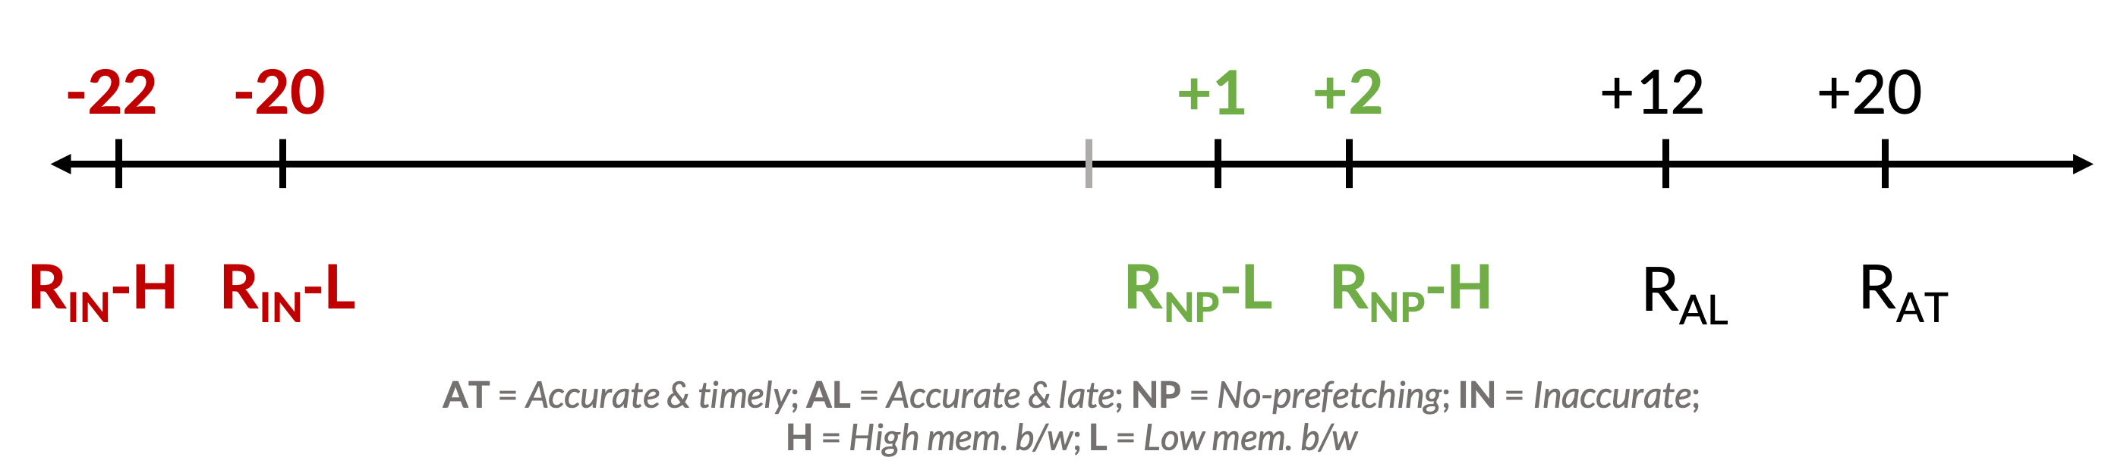
Performance Improvement via Customization
Reward value customization
Strict Pythia configuration
  Increasing the rewards for no prefetching
  Decreasing the rewards for inaccurate prefetching
Strict Pythia is more conservative in generating prefetch requests than the basic Pythia
Evaluate on all Ligra graph processing workloads
Notes:
Next, we analyze performance improvement of Pythia via customization.
[CLICK] We show an example of reward value customization, where,
[CLICK] We devise a strict Pythia configuration by increasing the reward level values for no prefetching, while decreasing the rewards values for inaccurate prefetching.
In short, strict Pythia is more conservative than the basic Pythia and strongly prefers not to prefetch, rather than prefetching inaccurately.
We evaluate both basic Pythia and strict Pythia on Ligra workload suite.

Slide 90
Performance Improvement via Customization
5.2%
7.8%
2%
2.8%
3.4%
3.1%
Notes:
[CLICK] As you can see, strict Pythia outperforms the basic Pythia configuration as much as 7.8% and
[CLICK] 2% on average over the entire Ligra workload suite.

Slide 91
Performance Improvement via Customization
5.2%
7.8%
Pythia can extract even higher performance via customization without changing hardware
2%
2.8%
3.4%
3.1%
Notes:
[CLICK] As you can see, strict Pythia outperforms the basic Pythia configuration as much as 7.8% and
[CLICK] 2% on average over the entire Ligra workload suite.

Slide 92
Pythia’s Overhead
25.5 KB of total metadata storage per core
  Only simple tables
We also model functionally-accurate Pythia with full complexity in Chisel [4] HDL
1.03% area overhead
0.4% power overhead
Satisfies prediction latency
of a desktop-class 4-core Skylake processor (Xeon D2132IT, 60W)
[4] https://www.chisel-lang.org
Notes:
All of Pythia’s performance benefits comes at a modest cost of 25.5KB of metadata storge, which is invested only in simple storage, without any need to complex structures.
[CLICK] We also model a fully-functionally-accurate Pythia with its full complexity in Chisel and show that, Pythia incurs
[CLICK] a modest area overhead of 1.03%
[CLICK] a power overhead of half-a-percent
[CLICK] while simultaneously satisfying the prediction latency at L2 cache frequency
Of a desktop-class …

Slide 93
More in the Paper
Performance comparison with unseen traces
  Pythia provides equally high performance benefits
Comparison against multi-level prefetchers
  Pythia outperforms prior best multi-level prefetchers
Understanding Pythia’s learning with a case study
  We reason towards the correctness of Pythia’s decision
Performance sensitivity towards different features and hyperparameter values
Detailed single-core and four-core performance
Notes:
We have many more exciting results including, ….
We encourage everyone to read it.

Slide 94
More in the Paper
Performance comparison with unseen traces
  Pythia provides equally high performance benefits
Comparison against multi-level prefetchers
  Pythia outperforms prior best multi-level prefetchers
Understanding Pythia’s learning with a case study
  We reason towards the correctness of Pythia’s decision
Performance sensitivity towards different features and hyperparameter values
Detailed single-core and four-core performance
https://arxiv.org/pdf/2109.12021.pdf
Notes:
We have many more exciting results including, ….
We encourage everyone to read it.

Slide 95
Pythia is Open Source
https://github.com/CMU-SAFARI/Pythia
MICRO’21 artifact evaluated
Champsim source code + Chisel modeling code
All traces used for evaluation

Slide 96
Talk Outline
Key Shortcomings of Prior Prefetchers
Formulating Prefetching as Reinforcement Learning
Pythia: Overview
Evaluation of Pythia and Key Results
Conclusion

Slide 97
Executive Summary
Background: Prefetchers predict addresses of future memory requests by associating memory access patterns with program context (called feature)
Problem: Three key shortcomings of prior prefetchers:
  Predict mainly using a single program feature
  Lack inherent system awareness (e.g., memory bandwidth usage)
  Lack in-silicon customizability
Goal: Design a prefetching framework that:
  Learns from multiple features and inherent system-level feedback
  Can be customized in silicon to use different features and/or prefetching objectives
Contribution: Pythia, which formulates prefetching as reinforcement learning problem
  Takes adaptive prefetch decisions using multiple features and system-level feedback
  Can be customized in silicon for target workloads via simple configuration registers
  Proposes a realistic and practical implementation of RL algorithm in hardware
Key Results:
  Evaluated using a wide range of workloads from SPEC CPU, PARSEC, Ligra, Cloudsuite
  Outperforms best prefetcher (in 1-core config.) by 3.4%, 7.7% and 17% in 1/4/bw-constrained cores
  Up to 7.8% more performance over basic Pythia across Ligra workloads via simple customization
https://github.com/CMU-SAFARI/Pythia
Notes:
First, I am going to start with an executive summary.
[CLICK] Prefetching is a speculative technique that predicts address of future memory requests by associating patterns in memory addresses with some program context. We call this context a feature.
[CLICK] We observe three key shortcomings in prior prefetchers:
First, they mainly use a single program feature for prediction.
Second, they lack inherent system awareness
Third, they also lack any customizability in silicon
[CLICK] Our goal in this work is to design a prefetching framework that
– can learn from multiple program features and inherent system-level feedback
-- and can be customized in silicon to change the features or the objective of the prefetcher
[CLICK] Towards this we propose Pythia, that formulates …
Pythia makes adaptive and autonomous …
Pythia also proposes a realistic and practical …
[CLICK] We extensively evaluate Pythia using …
We show that Pythia outperforms prior state-of-the-art …
Pythia is freely available in our GitHub repository.

Slide 98
Reward Assignment to EQ Entry
Every action gets inserted into EQ
Reward is assigned to each EQ entry before or during the eviction
During EQ insertion: for actions
  Not to prefetch
  Out-of-page prefetch

Slide 99
Reward Assignment to EQ Entry
Every action gets inserted into EQ
Reward is assigned to each EQ entry before or during the eviction
During EQ insertion: for actions
  Not to prefetch
  Out-of-page prefetch
During EQ residency:
  In case address of a demand matches with address in EQ (signifies accurate prefetch)

Slide 100
Reward Assignment to EQ Entry
Every action gets inserted into EQ
Reward is assigned to each EQ entry before or during the eviction
During EQ insertion: for actions
  Not to prefetch
  Out-of-page prefetch
During EQ residency:
  In case address of a demand matches with address in EQ (signifies accurate prefetch)
During EQ eviction:
  In case no reward is assigned till eviction (signifies inaccurate prefetch)

