Slide 1



ISMB/ECCB 2023
RawHash
Enabling Fast and Accurate Real-Time Analysis
of Raw Nanopore Signals for Large Genomes
Can Firtina
Nika Mansouri Ghiasi |  | Joel Lindegger |  | Gagandeep Singh
Meryem Banu Cavlak |  | Haiyu Mao |  | Onur Mutlu
Paper
Code

Slide 2


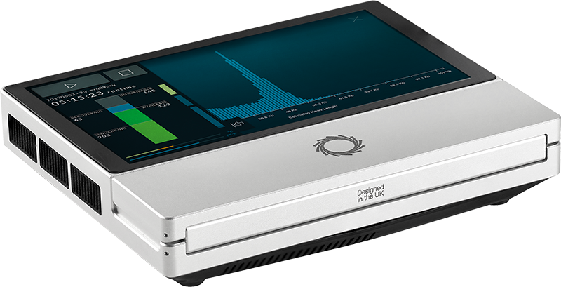
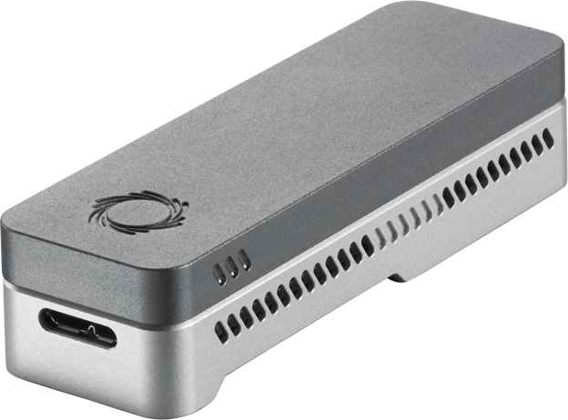
Nanopore Sequencing
Nanopore Sequencing: a widely used sequencing technology
  Can sequence large fragments of nucleic acid molecules (up to >2Mbp)
  Offers high throughput
  Cost-effective
  Enables real-time genome analysis

Slide 3


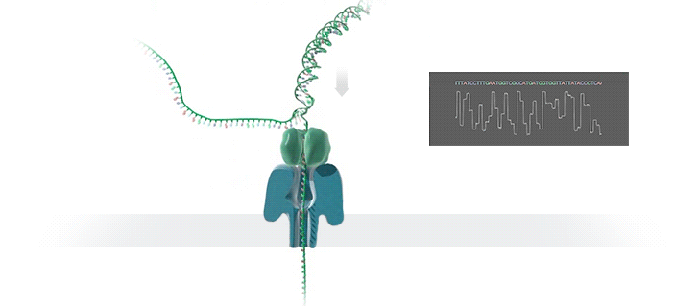



Real-Time Analysis with Nanopore Sequencing
Nanopore Sequencing
Raw Signals
Real-Time Analysis
Current
Raw Signals: Ionic current measurements generated at a certain throughput
Real-Time Analysis: Analyzing all raw signals by matching the throughput
Real-Time Decisions: Stopping sequencing early based on real-time analysis

Slide 4

Benefits of Real-Time Genome Analysis
Reducing latency by overlapping the sequencing and analysis steps
Time
Sequencing
Analysis
Reduced Latency
Sequencing & Real-Time Analysis
Reducing sequencing time and cost by stopping sequencing early
Completely Sequenced Read
Reduced Sequencing Time (and Cost)
Partially Sequenced Read
Sequencing is stopped early with a real-time decision

Slide 5




Challenges in Real-Time Genome Analysis
Rapid analysis to match the nanopore sequencer throughput
Timely decisions to stop sequencing as early as possible
Accurate analysis from noisy raw signal data
Power-efficient computation for scalability and portability

Slide 6
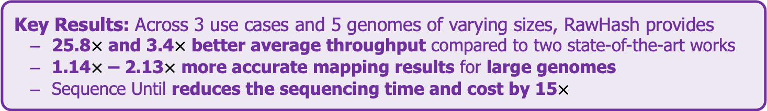
Executive Summary
Problem: Real-time analysis of nanopore raw signals is inaccurate and inefficient for large genomes
Goal: Enable fast and accurate real-time analysis of raw signals for large genomes
Key Contributions:
1) The first hash-based mechanism that can quickly and accurately analyze raw nanopore signals for large genomes
2) The novel Sequence Until technique can accurately and dynamically stop
the entire sequencing of all reads at once if further sequencing is not necessary
Key Results: Across 3 use cases and 5 genomes of varying sizes, RawHash provides
  25.8$×$ and 3.4$×$ better average throughput compared to two state-of-the-art works
  1.14$×$ – 2.13$×$ more accurate mapping results for large genomes
  Sequence Until reduces the sequencing time and cost by 15$×$

Slide 7
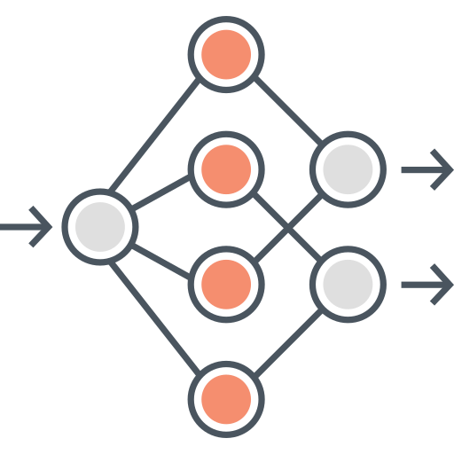

Existing Solutions
Deep neural networks (DNNs) for translating signals to bases
Mapping signals to reference genomes without basecalling
Real-Time Analysis
Real-Time Analysis
Basecalling
Read Mapping
Mapping Raw Signals
A
T
G
G
Less noisy analysis from basecalled sequences
Raw signals contain richer information than bases
Costly and power-hungry computational requirements
Efficient analysis with better scalability and portability

Slide 8
The Problem – Mapping Raw Signals
Raw Signal
Small Reference Genome
Large Reference Genome (Human)
Fewer candidate regions in small genomes
Substantially larger number of regions to check per read as the genome size increases
Problem: Probabilistic mechanisms
on many regions ➔ inaccurate mapping
Accurate mapping
Problem: Distance calculation
on many regions ➔ reduced throughput
High throughput

Slide 9
The Problem – Mapping Raw Signals
Raw Signal
Existing solutions are
inaccurate or inefficient
for large genomes
Small Reference Genome
Large Reference Genome (Human)
Fewer candidate regions in small genomes
Substantially larger number of regions to check per read as the genome size increases
Problem: Probabilistic mechanisms
on many regions ➔ inaccurate mapping
Accurate mapping
Problem: Distance calculation
on many regions ➔ reduced throughput
High throughput

Slide 10
Outline
Background
Motivation and Goal
Experimental Methodology
Temperature Analysis
Aggressor Row Active Time Analysis
Spatial Variation Analysis
Implications on Attacks and Defenses
Conclusions
RawHash
Evaluation
Conclusion

Slide 11
Goal
Enable fast and accurate real-time analysis
of raw nanopore signals for large genomes

Slide 12
RawHash
The first hash-based search mechanism
to quickly and accurately map raw nanopore signals
to reference genomes
Sequence Until can accurately and dynamically stop the entire sequencing run at once
if further sequencing is unnecessary

Slide 13
RawHash
The first hash-based search mechanism
to quickly and accurately map raw nanopore signals
to reference genomes
Sequence Until can accurately and dynamically stop the entire sequencing run at once
if further sequencing is unnecessary

Slide 14
RawHash – Key Idea
Key Observation: Identical nucleotides generate similar raw signals
Raw Signal #1
Distance Calculation
Raw Signal #2
Hash
Hash
Fast Match
0x01
0x01
Challenge #1: Generating the same hash value for similar enough signals
Challenge #2: Accurately finding similar regions as few as possible

Slide 15
RawHash Overview
Reference Genome
Raw Nanopore Signal
…GCTATTACCTTAATGTG…
Reference-to-Event Conversion
Signal-to-Event Conversion
2.21
-0.9
1.15
2.22
-0.91
1.18
Indexing (Offline)
Quantization
Quantization
Mapping (Real-Time)
28
6
18
28
6
18
Hashing
Hashing
Store
Hash Table
Query
0x01
0x01
Matching Regions
Chaining & Mapping
Mapping Positions

Slide 16
RawHash Overview
Reference Genome
Raw Nanopore Signal
…GCTATTACCTTAATGTG…
Reference-to-Event Conversion
Signal-to-Event Conversion
2.21
-0.9
1.15
2.22
-0.91
1.18

Slide 17
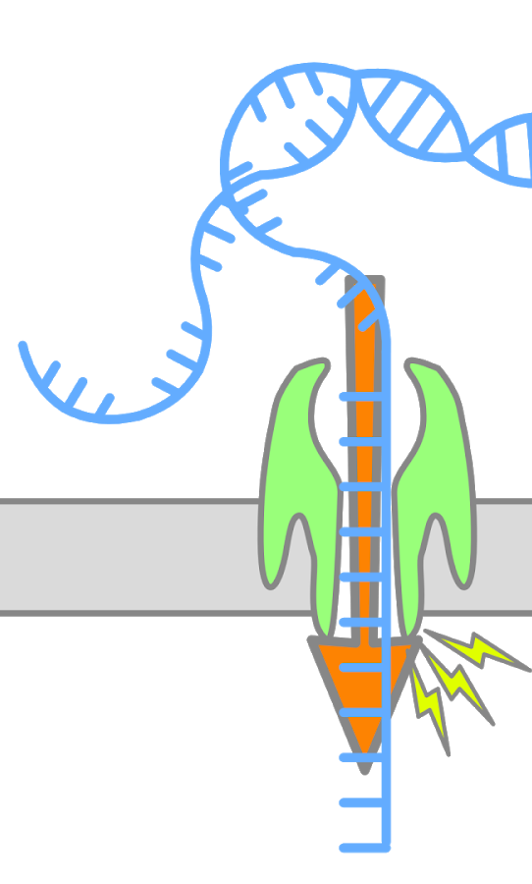
Events in Raw Nanopore Signals
Event: A segment of the raw signal
  Corresponds to a particular k-mer
Event detection finds these segments to identify k-mers
  Start and end positions are marked by abrupt signal changes
  Statistical methods identify these abrupt changes
  Event value: average of signals within an event
Event
k many nucleotides
105.71
Event Value (picoampere)

Slide 18

Reference-to-Event Conversion
K-mer model: Provides expected event values for each k-mer
  Preconstructed based on nanopore sequencer characteristics
Use the k-mer model to convert all k-mers
of a reference genome to their expected event values
Reference Genome
Expected Event Values
Normalized Event Values
..GCTATTACC..
GCTATT
K-mer Model
(Lookup Table)
105.757390
Normalize
2.21
CTATTA
81.740642
-0.09
k-mers ($k=6$)
TATTAC
103.170091
1.15
ATTACC
101.082485
1.11

Slide 19
Signal-to-Event Conversion
Event detection: Identifies signal regions corresponding to specific k-mers
  Uses statistical test (segmentation) to spot abrupt signal changes
Consecutive events ➔ consecutive k-mers
Raw Nanopore Signal
Event
Event Value
Normalize
2.21
Segment
Calculate
Means
105.71
0.08
1.18
1.14

Slide 20
Signal-to-Event Conversion
Event detection: Identifies signal regions corresponding to specific k-mers
  Uses statistical test (segmentation) to spot abrupt signal changes
Consecutive events ➔ consecutive k-mers
Can we match events (k-mers) between reference genome and raw signals?
Raw Nanopore Signal
Event
Event Value
Normalize
2.21
Segment
Calculate
Means
105.71
0.08
1.18
1.14

Slide 21
RawHash Overview
Reference Genome
Raw Nanopore Signal
…GCTATTACCTTAATGTG…
Reference-to-Event Conversion
Signal-to-Event Conversion
2.21
-0.9
1.15
2.22
-0.91
1.18
Quantization
Quantization
28
6
18
28
6
18

Slide 22
Quantizing the Event Values
Observation: Slight differences in raw signals from identical k-mers
  Challenge: Direct event value matching is not feasible and accurate
Key Idea: Quantize the event values
  Enables assigning identical quantized values to similar event values
Normalized event values from the same k-mer
Quantized event values (in binary)
-0.091
Quantize
1
1
0
0
1
-0.084
Quantize
1
1
0
0
1
CTATTA
-0.09
Quantize
1
1
0
0
1
-0.086
Quantize
1
1
0
0
1

Slide 23
RawHash Overview
Reference Genome
Nanopore Raw Signal
…GCTATTACCTTAATGTG…
Reference-to-Event Conversion
Signal-to-Event Conversion
2.21
-0.9
1.15
2.22
-0.91
1.18
Quantization
Quantization
28
6
18
28
6
18
Hashing
Hashing
Store
Hash Table
Query
0x01
0x01

Slide 24
Hashing for Fast Similarity Search
Each event usually represents a very small k-mer (6 to 9 characters)
  Challenge: Short k-mers are likely to appear in many locations
Key Idea: Create longer k-mers from many consecutive events
Key Benefit: Directly match hash values to quickly identify similarities
Consecutive k-mers
Consecutive events
CTATTA
-0.09
Quantize
1
1
0
0
1
TATTAC
1.15
Quantize
0
0
1
1
0
…
…
…
…
Pack
ATTACC
1.11
Quantize
0
0
1
0
1
1
1
0
0
1
0
0
1
1
0
…
0
1
0
0
1
Hash value of consecutive events
0x400D70A4
Hash

Slide 25
RawHash Overview
Reference Genome
Raw Nanopore Signal
…GCTATTACCTTAATGTG…
Reference-to-Event Conversion
Signal-to-Event Conversion
2.21
-0.9
1.15
2.22
-0.91
1.18
Indexing (Offline)
Quantization
Quantization
Mapping (Real-Time)
28
6
18
28
6
18
Hashing
Hashing
Store
Hash Table
Query
0x01
0x01
Matching Regions
Chaining & Mapping
Mapping Positions

Slide 26
Real-Time Mapping using Hash-based Indexing
Indexing (Offline)
Mapping (Real-time)
Reference Genome
Raw Nanopore Signal
…GCTATTACCTTAATGTG…
Reference-to-Event Conversion
Signal-to-Event Conversion
Quantization
Quantization
Hashing
Hashing
Store
Hash
Table
Query
0x01
0x01
Matching Positions
Chaining & Mapping
Yes: Process the next chunk
Read Until
or
Run Until
No: Stop mapping
Continue
Mapping?

Slide 27
RawHash
The first hash-based search mechanism
to quickly and accurately map raw nanopore signals
to reference genomes
Sequence Until can accurately and dynamically stop the entire sequencing run at once
if further sequencing is unnecessary

Slide 28
RawHash
The first hash-based search mechanism
to quickly and accurately map raw nanopore signals
to reference genomes
Sequence Until can accurately and dynamically stop the entire sequencing run at once
if further sequencing is unnecessary

Slide 29
The Sequence Until Mechanism
Problem:
  Unnecessary sequencing waste time, power and money
Key Idea:
  Dynamically decide if further sequencing of the entire sample is necessary to achieve high accuracy
  Stop sequencing early without sacrificing accuracy
Potential Benefits:
  Significant reduction in sequencing time and cost
Example real-time genome analysis use case:
  Relative abundance estimation

Slide 30





The Sequence Until Mechanism
Key Steps:
  Continuously generate relative abundance estimation after every $n$ reads
  Keep the last $t$ estimation results
  Detect outliers in the results via cross-correlation of the recent $t$ results
  Absence of outliers indicates consistent results
    Further sequencing is likely to generate consistent results ➔ Stop the sequencing
Relative Abundance Estimation
Keep Sequencing
$n$ Reads Sequenced
Estimation #1
Yes
Relative Abundance Estimation
$2n$ Reads Sequenced
Estimation #2
Outlier?
…
…
…
No
Relative Abundance Estimation
$t×n$ Reads Sequenced
Estimation #$t$
Stop Sequencing

Slide 31
Outline
Background
Motivation and Goal
Experimental Methodology
Temperature Analysis
Aggressor Row Active Time Analysis
Spatial Variation Analysis
Implications on Attacks and Defenses
Conclusions
RawHash
Evaluation
Conclusion

Slide 32
Evaluation Methodology
Compared to UNCALLED [Kovaka+, Nat. Biotech. 2021]
and Sigmap [Zhang+, ISMB/ECCB 2021]
  CPU baseline: AMD EPYC 7742 @2.26GHz
  32 threads for each tool
Use cases for real-time genome analysis:
  Read mapping
  Relative abundance estimation
    Benefits of Sequence Until
  Contamination analysis

Slide 33
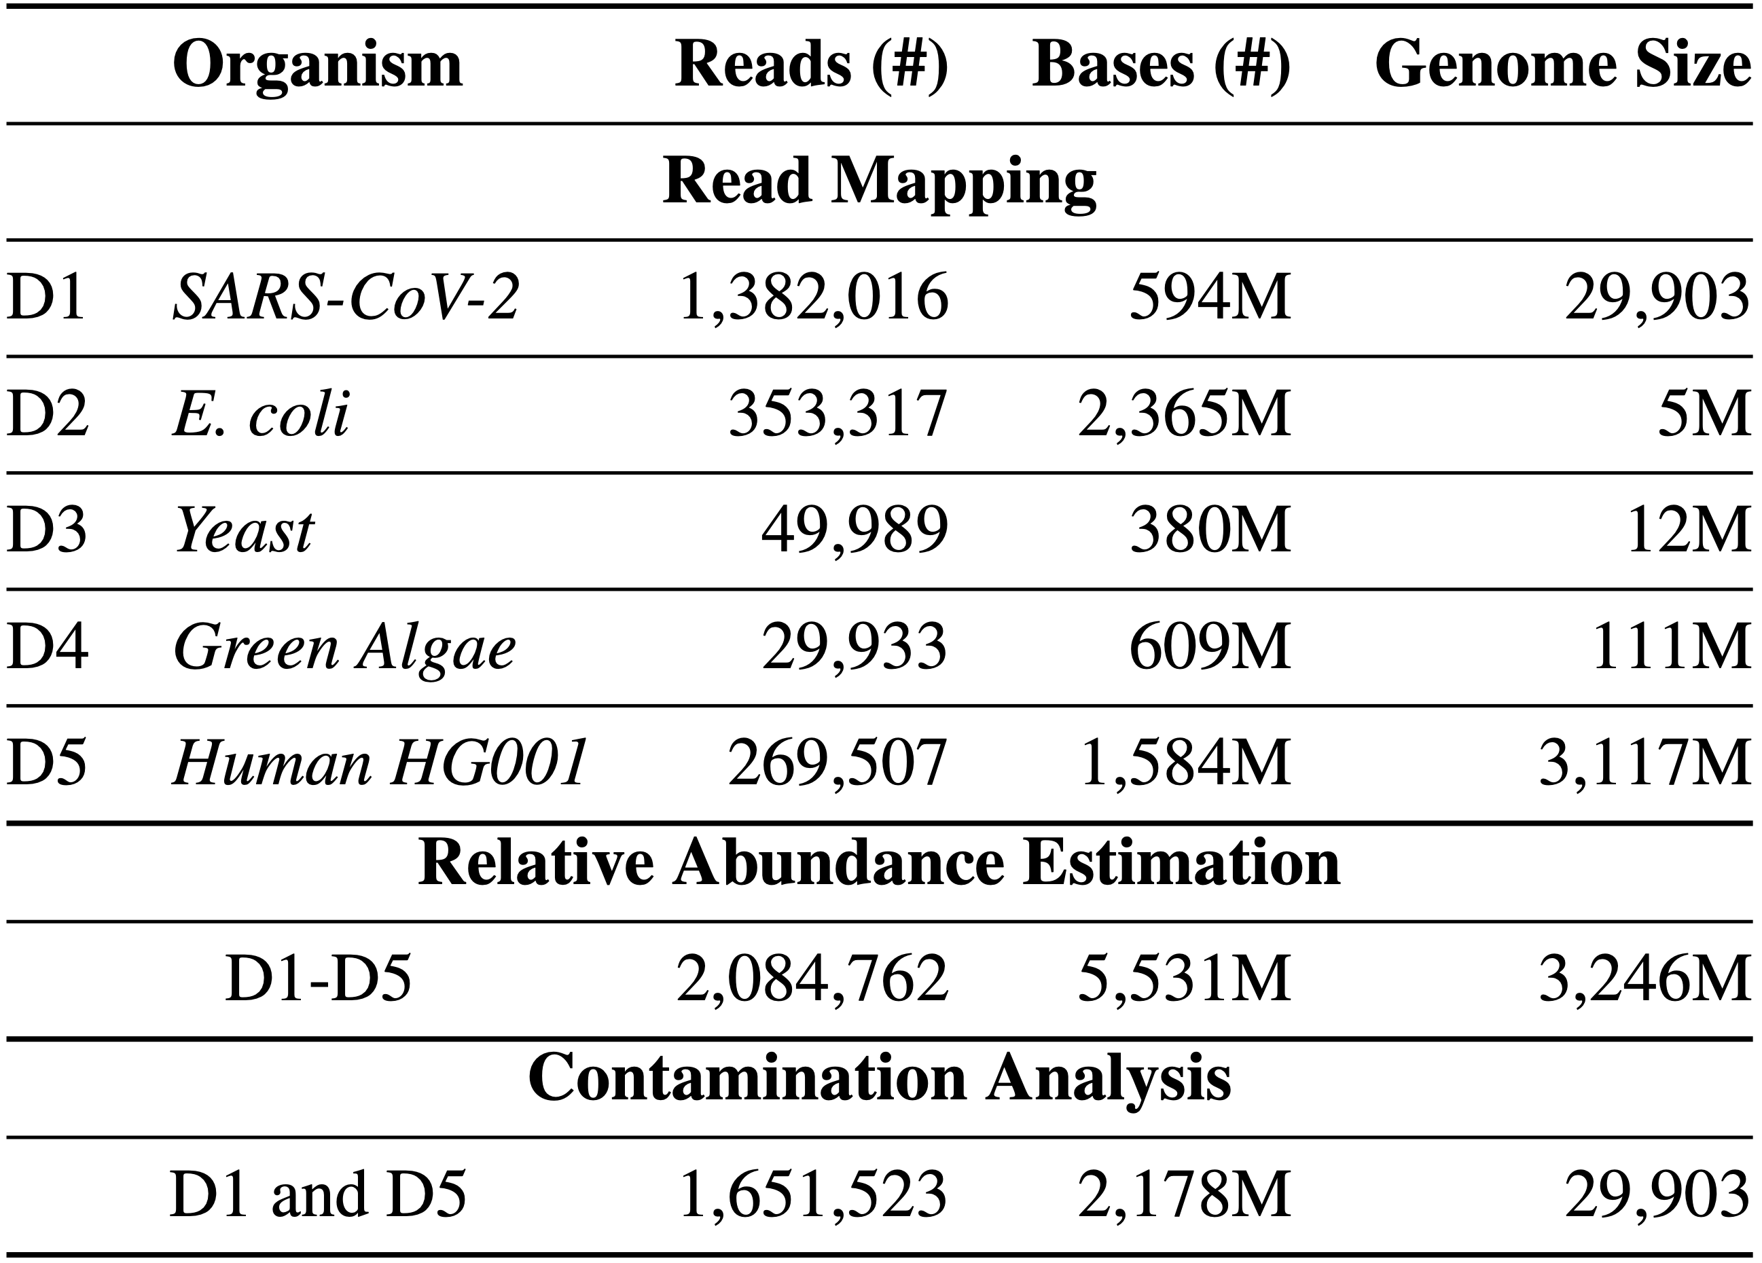
Evaluation Methodology
Evaluation metrics:
  Throughput (bases processed per second)
  Potential reduction in sequencing time and cost
  Accuracy
    Baseline: Mapping basecalled reads using minimap2
    Precision, recall, and F1 scores
    Relative abundance estimation distance to ground truth
Datasets:

Slide 34

Throughput
Real-time analysis requires faster throughput than sequencer
  Throughput of a nanopore sequencer: ~450 bp/sec (data generation speed)
Real-Time Analysis
No Real-Time
Analysis
25.8$×$ and 3.4$×$ better average throughput compared to
UNCALLED and Sigmap, respectively
Sigmap cannot perform real-time analysis for large genomes

Slide 35
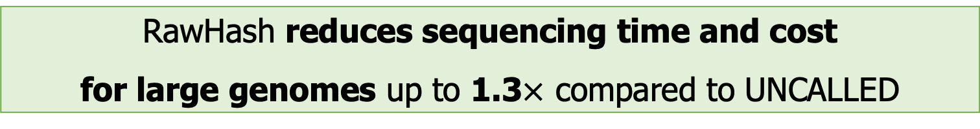
Sequencing Time
Fewer bases to sequence ➔
  Reduction in sequencing time and cost
Lower is better
RawHash reduces sequencing time and cost
for large genomes up to 1.3$×$ compared to UNCALLED

Slide 36
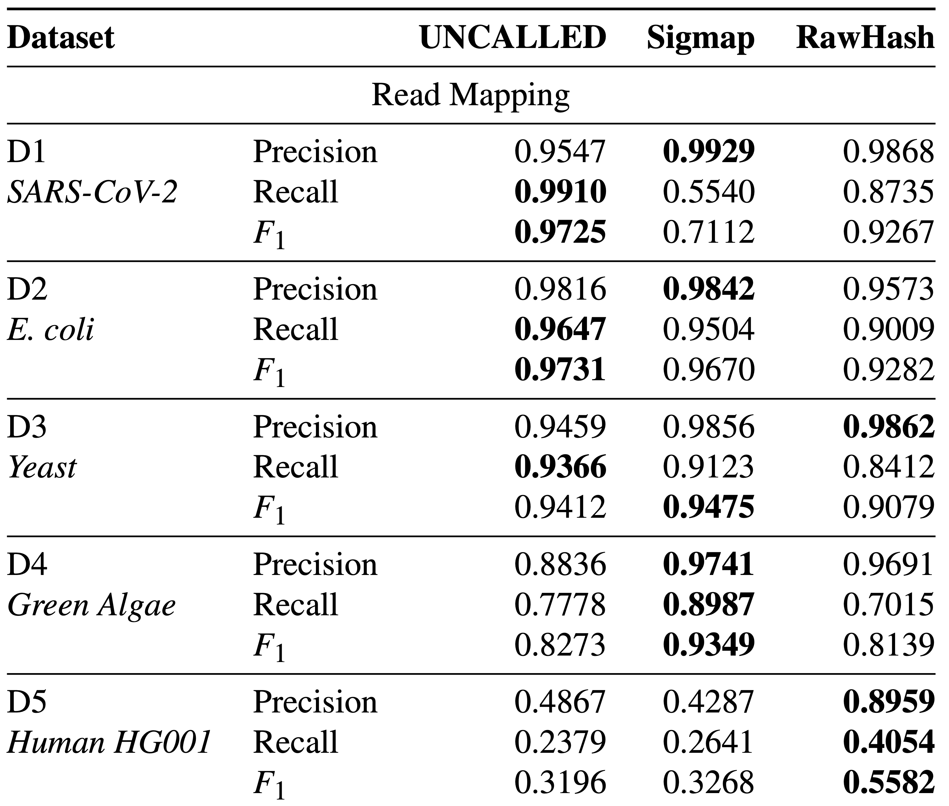
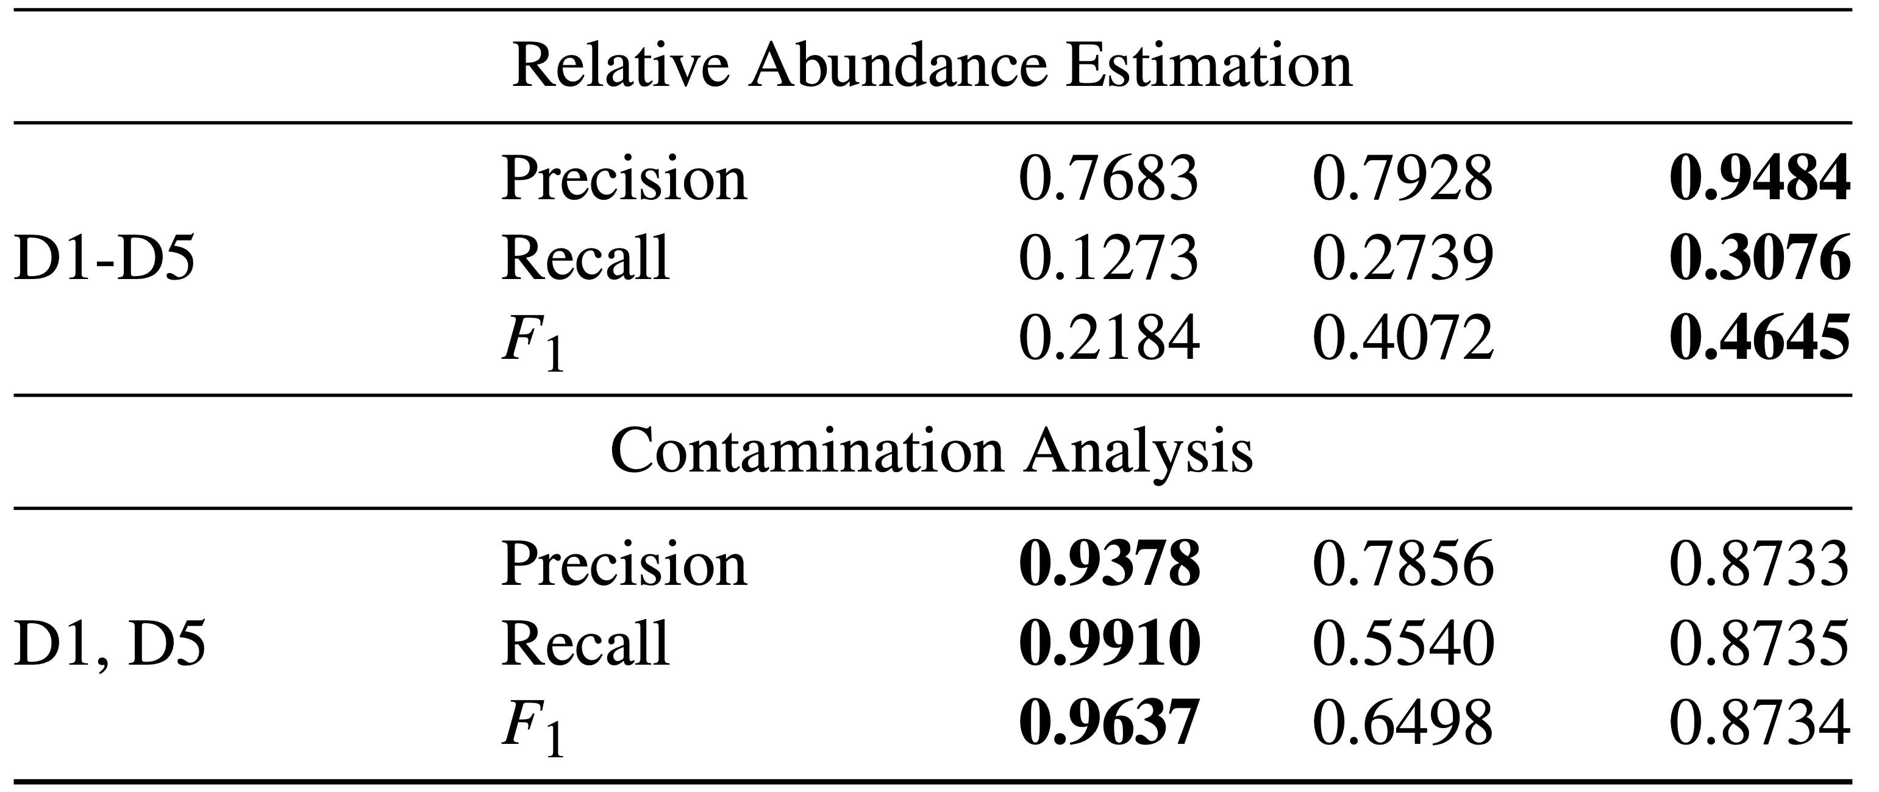
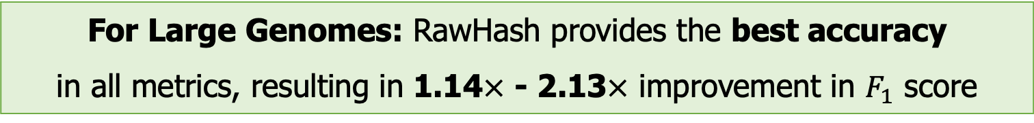
Mapping Accuracy
Read mapping accuracy of each tool and each use case
For Large Genomes: RawHash provides the best accuracy
in all metrics, resulting in 1.14$×$ - 2.13$×$ improvement in $F_{1}$ score

Slide 37
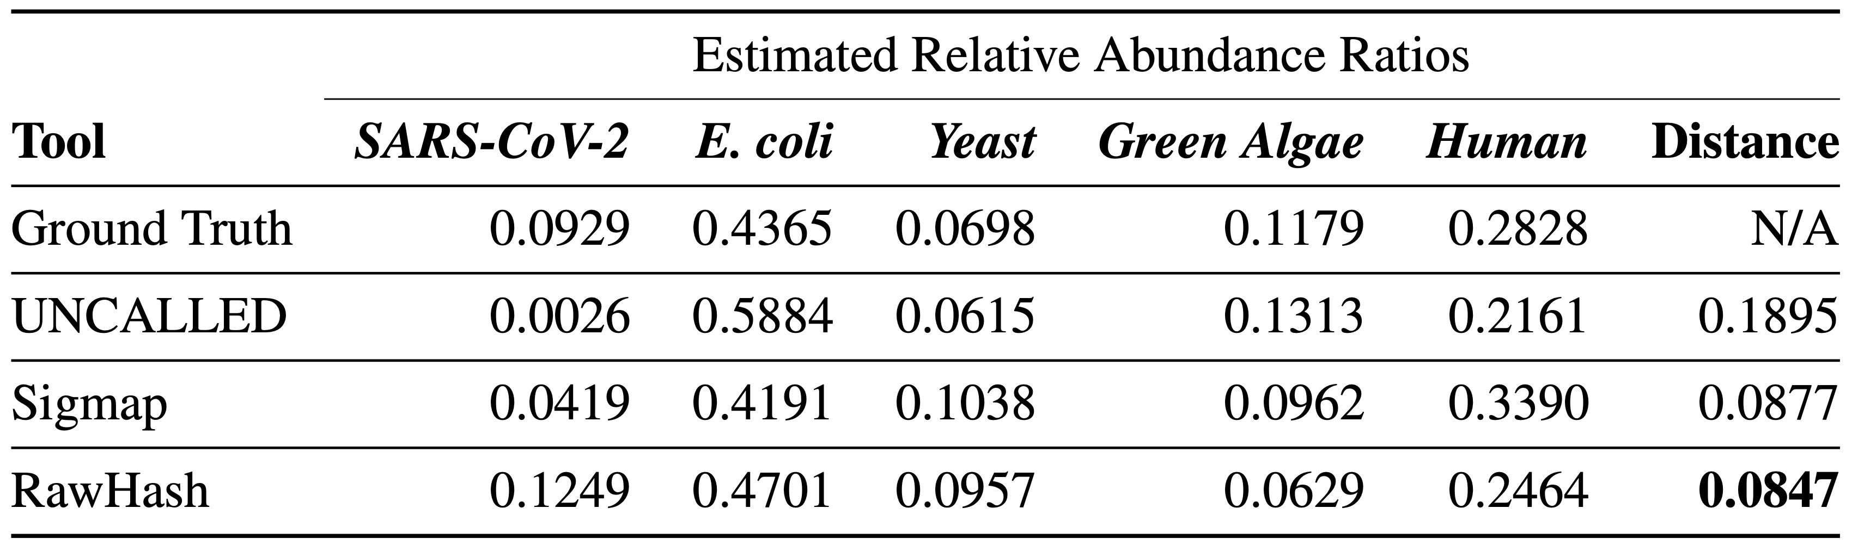
Relative Abundance Estimation Accuracy
Estimating the ratio of genomes in a sample in real-time
  Distance: Euclidean distance compared to the ground truth distance
  The dataset includes a large reference genome
RawHash provides the best relative abundance estimation
closest to the ground truth estimation

Slide 38
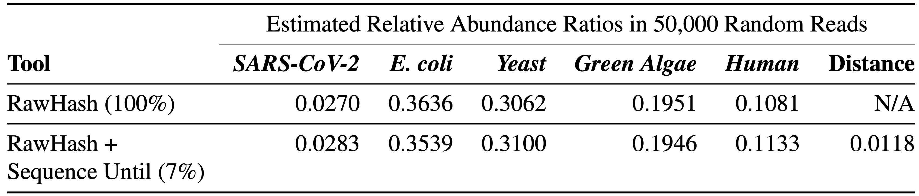
Real Implementation of Sequence Until
Running RawHash by using
  RawHash (100%): The entire sample without Sequence Until
  RawHash (7%): RawHash with Sequence Until where Sequence Until dynamically stops the entire sequencing after sequencing 7% of the sample
Sequence Until enables sequencing only 7% (~1/15)
of the entire sample with high accuracy

Slide 39
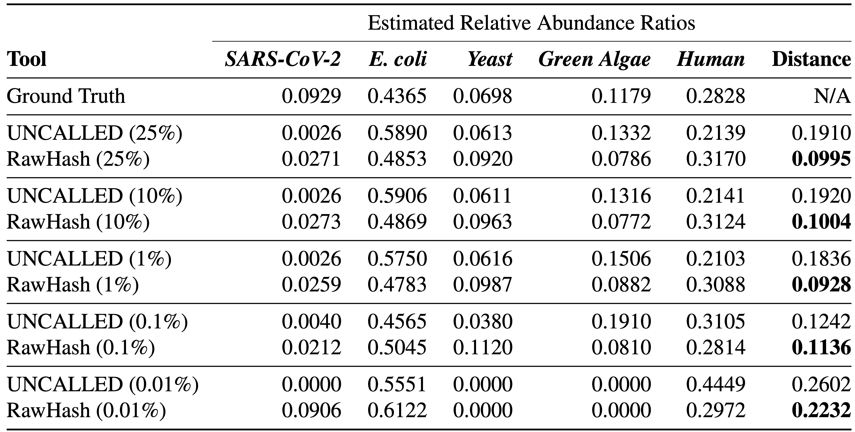
Simulating Sequence Until
Real relative abundance results using the entire set of reads
Simulating the benefits of Sequence Until by
  Using a random portion (25%, 10%, 1%, …) of the sample

Slide 40
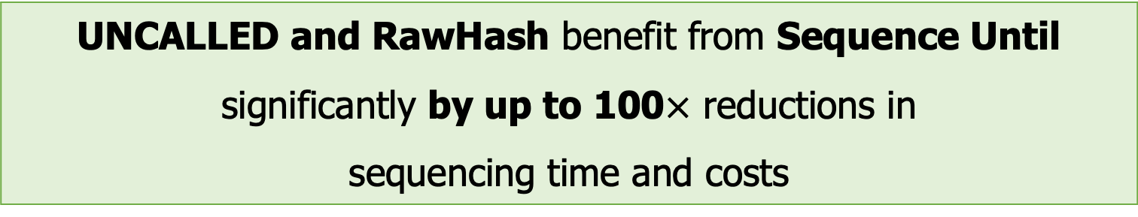
Simulating Sequence Until
Real relative abundance results using the entire set of reads
Simulating the benefits of Sequence Until by
  Using a random portion (25%, 10%, 1%, …) of the sample
UNCALLED and RawHash benefit from Sequence Until significantly by up to 100$×$ reductions in
sequencing time and costs

Slide 41
More in the Paper
More Results
  Mapping time per read
  Overall computational resources required by each tool
    Peak memory usage, CPU time and real time in the indexing and mapping steps
  Performance breakdown of the steps in RawHash
Details of all mechanisms and configurations
  Details of the quantization and hashing mechanism
  Details of the parameter configurations
  Trade-offs between the DNN-based approaches and raw signal mapping approaches

Slide 42
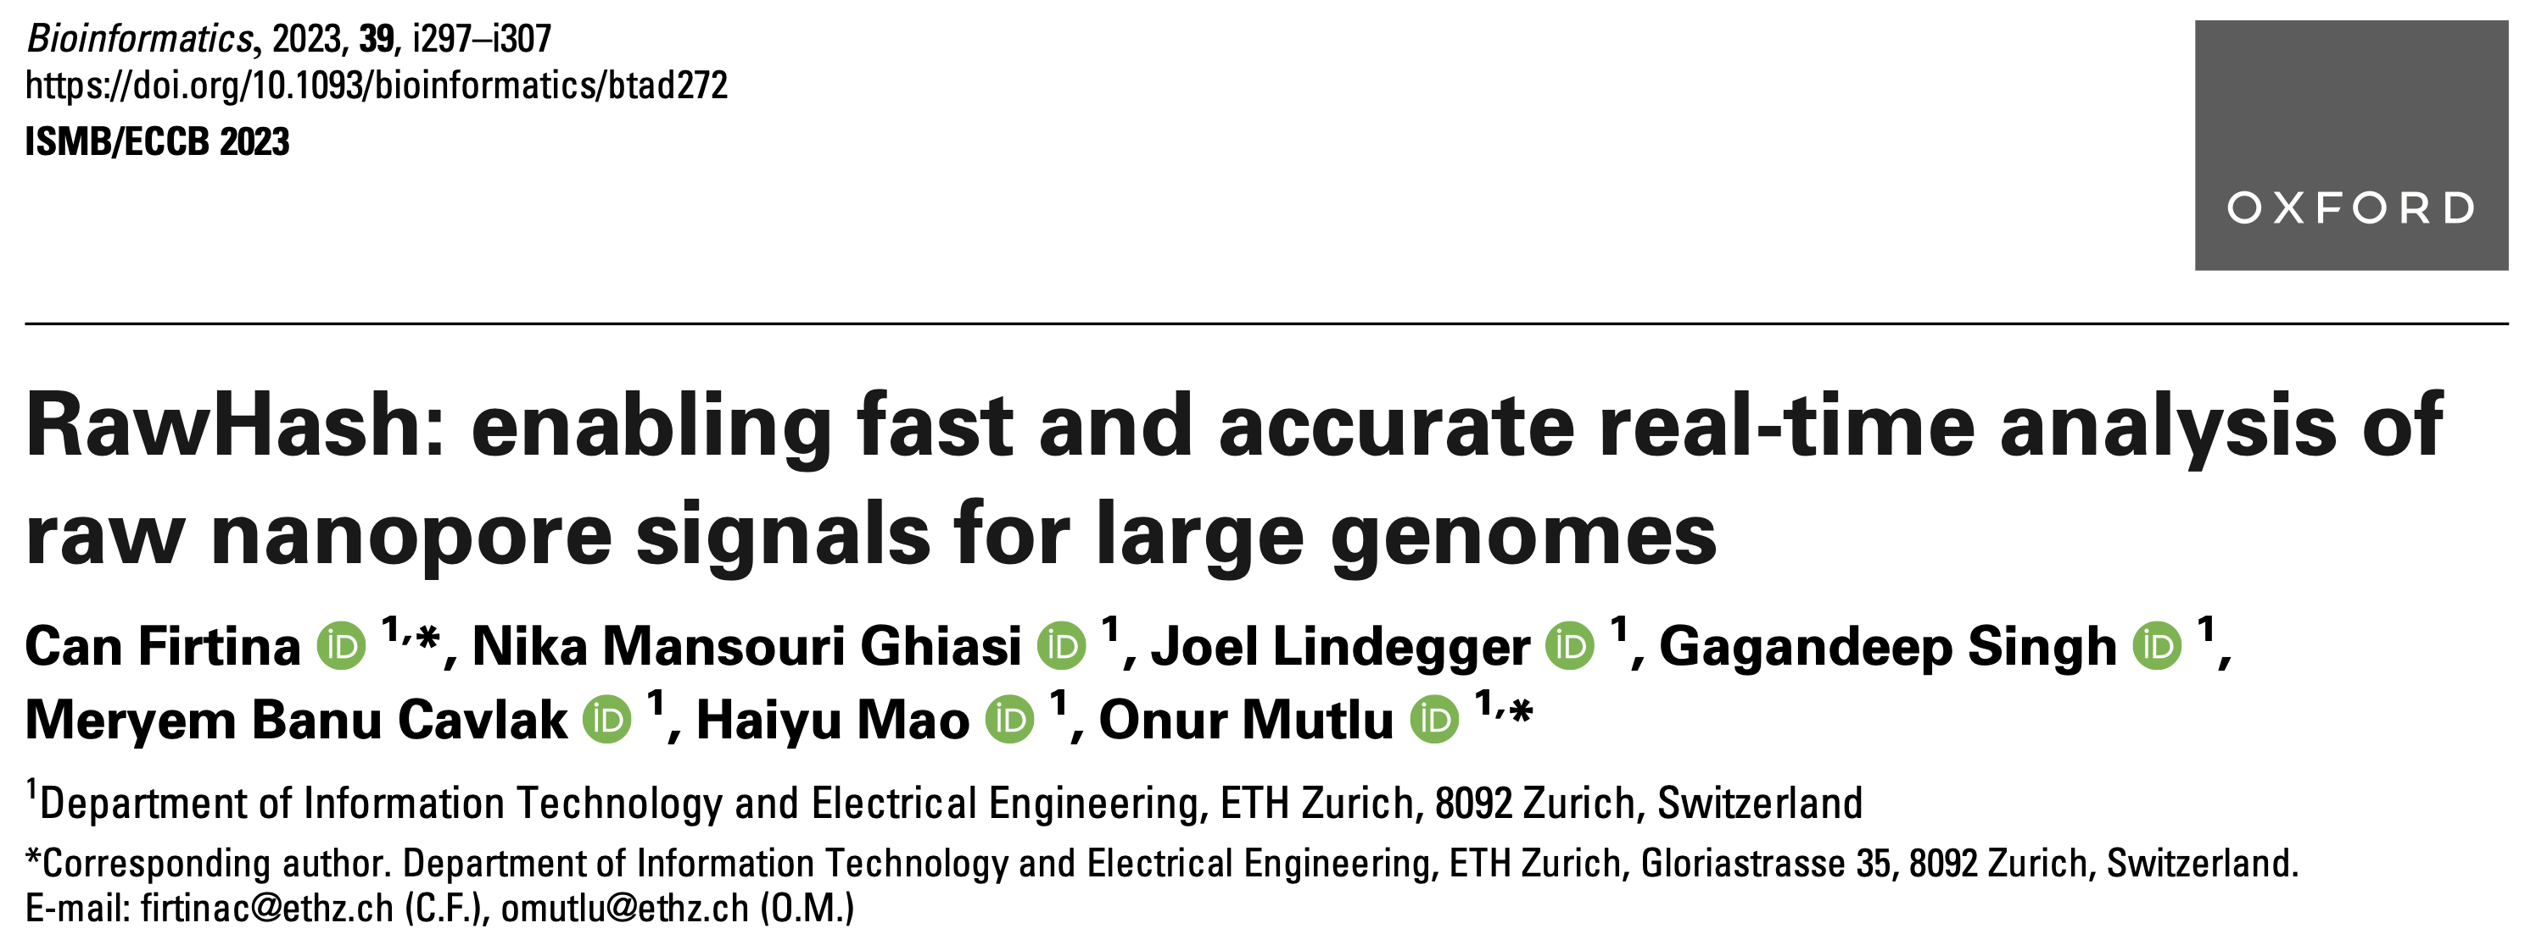
RawHash
Can Firtina, Nika Mansouri Ghiasi, Joel Lindegger, Gagandeep Singh,
Meryem Banu Cavlak, Haiyu Mao, and Onur Mutlu,
"RawHash: Enabling Fast and Accurate Real-Time Analysis of Raw Nanopore Signals for Large Genomes"
Proceedings of the 31st Annual Conference on Intelligent Systems for Molecular Biology (ISMB) and the 22nd European Conference on Computational Biology (ECCB), Jul 2023
[arXiv preprint]
[Source Code]

Slide 43
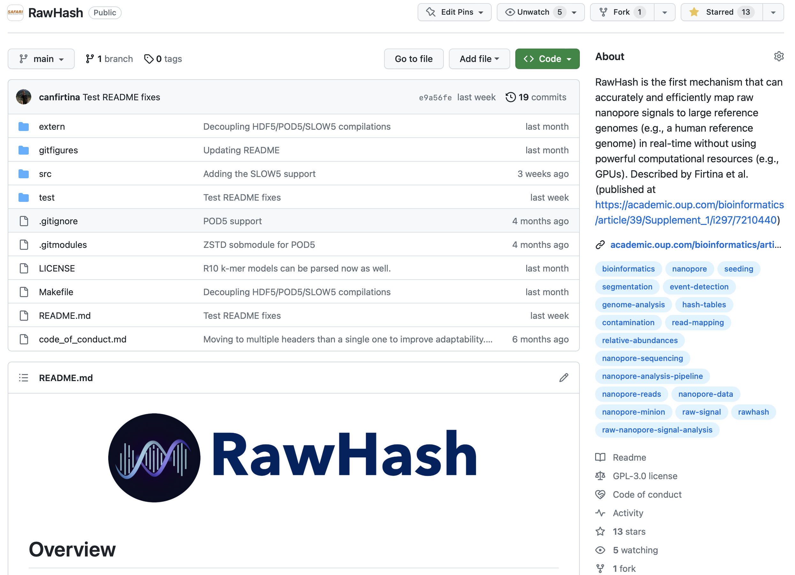
RawHash Source Code
Supports all major
raw signal file formats
and flow cell versions
  FAST5, POD5, S/BLOW5 file formats
Easy-to-use scripts
  To download all the datasets
  To reproduce all of our results
You can write your outlier function for Sequence Until
  Easily integrate Sequence Until
Upcoming Feature:
  Integrating the MinKNOW API
https://github.com/CMU-SAFARI/RawHash

Slide 44
Sketching with Hash-based Indexing
Indexing (Offline)
Mapping (Real-time)
Reference Genome
Raw Nanopore Signal
…GCTATTACCTTAATGTG…
Reference-to-Event Conversion
Signal-to-Event Conversion
Quantization
Quantization
Hashing
Hashing
All k-mers,
Minimizers,
Strobemers,
BLEND,
…
Sketch
Sketch
Store
Hash
Table
Query
0x01
0x01
Matching Positions
Chaining & Mapping
Yes: Process the next chunk
Read Until
or
Run Until
No: Stop mapping
Continue
Mapping?

Slide 45
Outline
Background
Motivation and Goal
Experimental Methodology
Temperature Analysis
Aggressor Row Active Time Analysis
Spatial Variation Analysis
Implications on Attacks and Defenses
Conclusions
RawHash
Evaluation
Conclusion

Slide 46
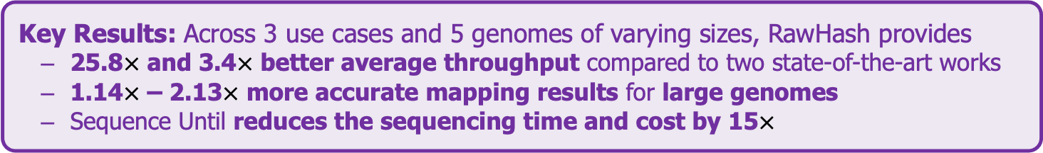
Conclusion
Key Contributions:
1) The first hash-based mechanism that can quickly and accurately analyze raw nanopore signals for large genomes
2) The novel Sequence Until technique can accurately and dynamically stop
the entire sequencing of all reads at once if further sequencing is not necessary
Key Results: Across 3 use cases and 5 genomes of varying sizes, RawHash provides
  25.8$×$ and 3.4$×$ better average throughput compared to two state-of-the-art works
  1.14$×$ – 2.13$×$ more accurate mapping results for large genomes
  Sequence Until reduces the sequencing time and cost by 15$×$
Many opportunities for analyzing raw nanopore signals in real-time:
  Many hash-based sketching techniques can now be used for raw signals
  Indexing is very cheap: Many future use cases with the on-the-fly index construction
  We should rethink the algorithms to perform downstream analysis fully using raw signals

Slide 47
ISMB/ECCB 2023
RawHash
Enabling Fast and Accurate Real-Time Analysis
of Raw Nanopore Signals for Large Genomes
Can Firtina
Nika Mansouri Ghiasi |  | Joel Lindegger |  | Gagandeep Singh
Meryem Banu Cavlak |  | Haiyu Mao |  | Onur Mutlu
Paper
Code

Slide 48
Motivation and Goal
Experimental Methodology
Temperature Analysis
Aggressor Row Active Time Analysis
Spatial Variation Analysis
Implications on Attacks and Defenses
Conclusions
Backup Slides

Slide 49
Practical Similarity Identification
Seeds
> 3 billion characters
Reference
…CAATTTGCCCATATGGTTAAGCTTCCATGGAAATGGGCTTTCGCTTTG…
…
K-mers
Locations
Read
GCCCAAATGGTT
GCC | 7
CCC | 8
CAA | 1
AAA | 31 | 101
CCA | 25 | 230 | 400
… | … | … | …
K-mers
GCC
CCC
…
Index (Hash Table)
Seeding
Determine potential matching regions (seeds) in the reference genome
Seed Filtering
(e.g., Chaining)
Prune some seeds in the reference genome
Alignment
Determine the exact differences between the read and the reference genome

Slide 50
Existing Solutions – Real-time Basecalling
Deep neural networks (DNNs) for translating signals to bases
Nanopore sequencing
Raw Signal
Real-time Analysis
Basecalling
Read mapping
A
T
G
G
Current
DNNs provide less noisy analysis from basecalled sequences
Costly and power-hungry computational requirements

Slide 51
The Problem
The existing solutions are ineffective for large genomes
Real-time Analysis
Real-time Analysis
Basecalling
Read mapping
Signal mapping
A
T
G
G
Costly and energy-hungry computations to basecall each read:
Portable sequencing becomes challenging with
resource-constrained devices
Larger number of reference regions cannot be handled accurately or quickly, rendering existing solutions ineffective for large genomes

Slide 52
Applications of Read Until
Depletion: Reads mapping to a particular reference genome is ejected
Removing contaminated reads from a sample
Relative abundance estimation
Controlling low/high-abundance genomes in a sample
Controlling the sequencing of depth of a genome
Enrichment: Reads not mapping to a particular reference genome is ejected
Purifying the sample to ensure it contains only the selected genomes
Removing the host genome (e.g., human) in contamination analysis

Slide 53
Applications of Run Until and Sequence Until
Run Until: Stopping the sequencing without informative decision from analysis
Stopping when reads reach to a particular depth of coverage
Stopping when the abundance of all genomes reach a particular threshold
Sequence Until: Stopping the sequencing based on information decision
Stopping when relative abundance estimations do not change substantially (for high-abundance genomes)
Stopping when finding that the sample is contaminated with a particular set of genomes
…

Slide 54




Details: Quantizing the Event Values
Observation: Identical k-mers generate similar raw signals
  Challenge: Their corresponding event values can be slightly different
Key Idea: Quantize the event values
  To enable assigning the same quantized value to the similar event values
Slightly Different (Normalized) Event Values
-0.091 in binary:
-0.084 in binary:
1
0
1
1
1
1
0
1
1
0
1
1
…
1
0
1
1
1
1
0
1
1
0
1
0
…
Most significant $Q=9$ bits:
Most significant $Q=9$ bits:
1
0
1
1
1
1
0
1
1
1
0
1
1
1
1
0
1
1
Pruning $p=4$ bits:
Pruning $p=4$ bits:
Matching Quantized
Event Values
1
0
0
1
1
1
0
0
1
1

Slide 55
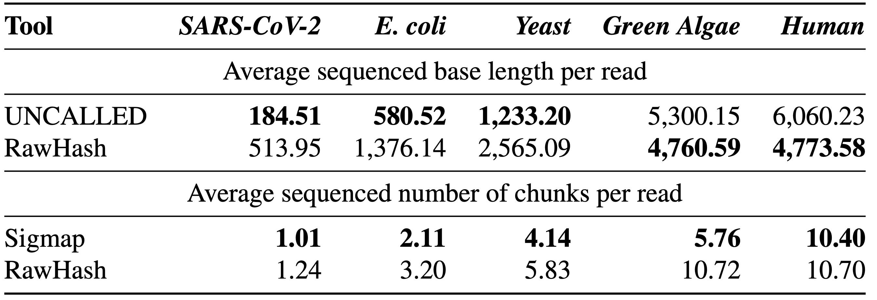
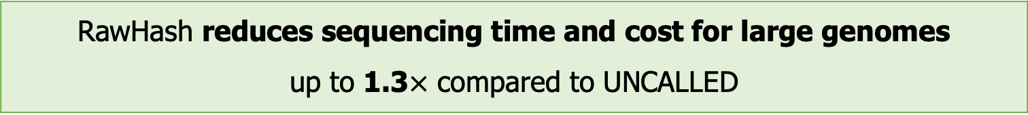
Average Sequenced Bases and Chunks
RawHash reduces sequencing time and cost for large genomes
up to 1.3$×$ compared to UNCALLED
Although Sigmap processes less number of chunks than RawHash, it fails to provide real-time analysis capabilities for large genomes

Slide 56
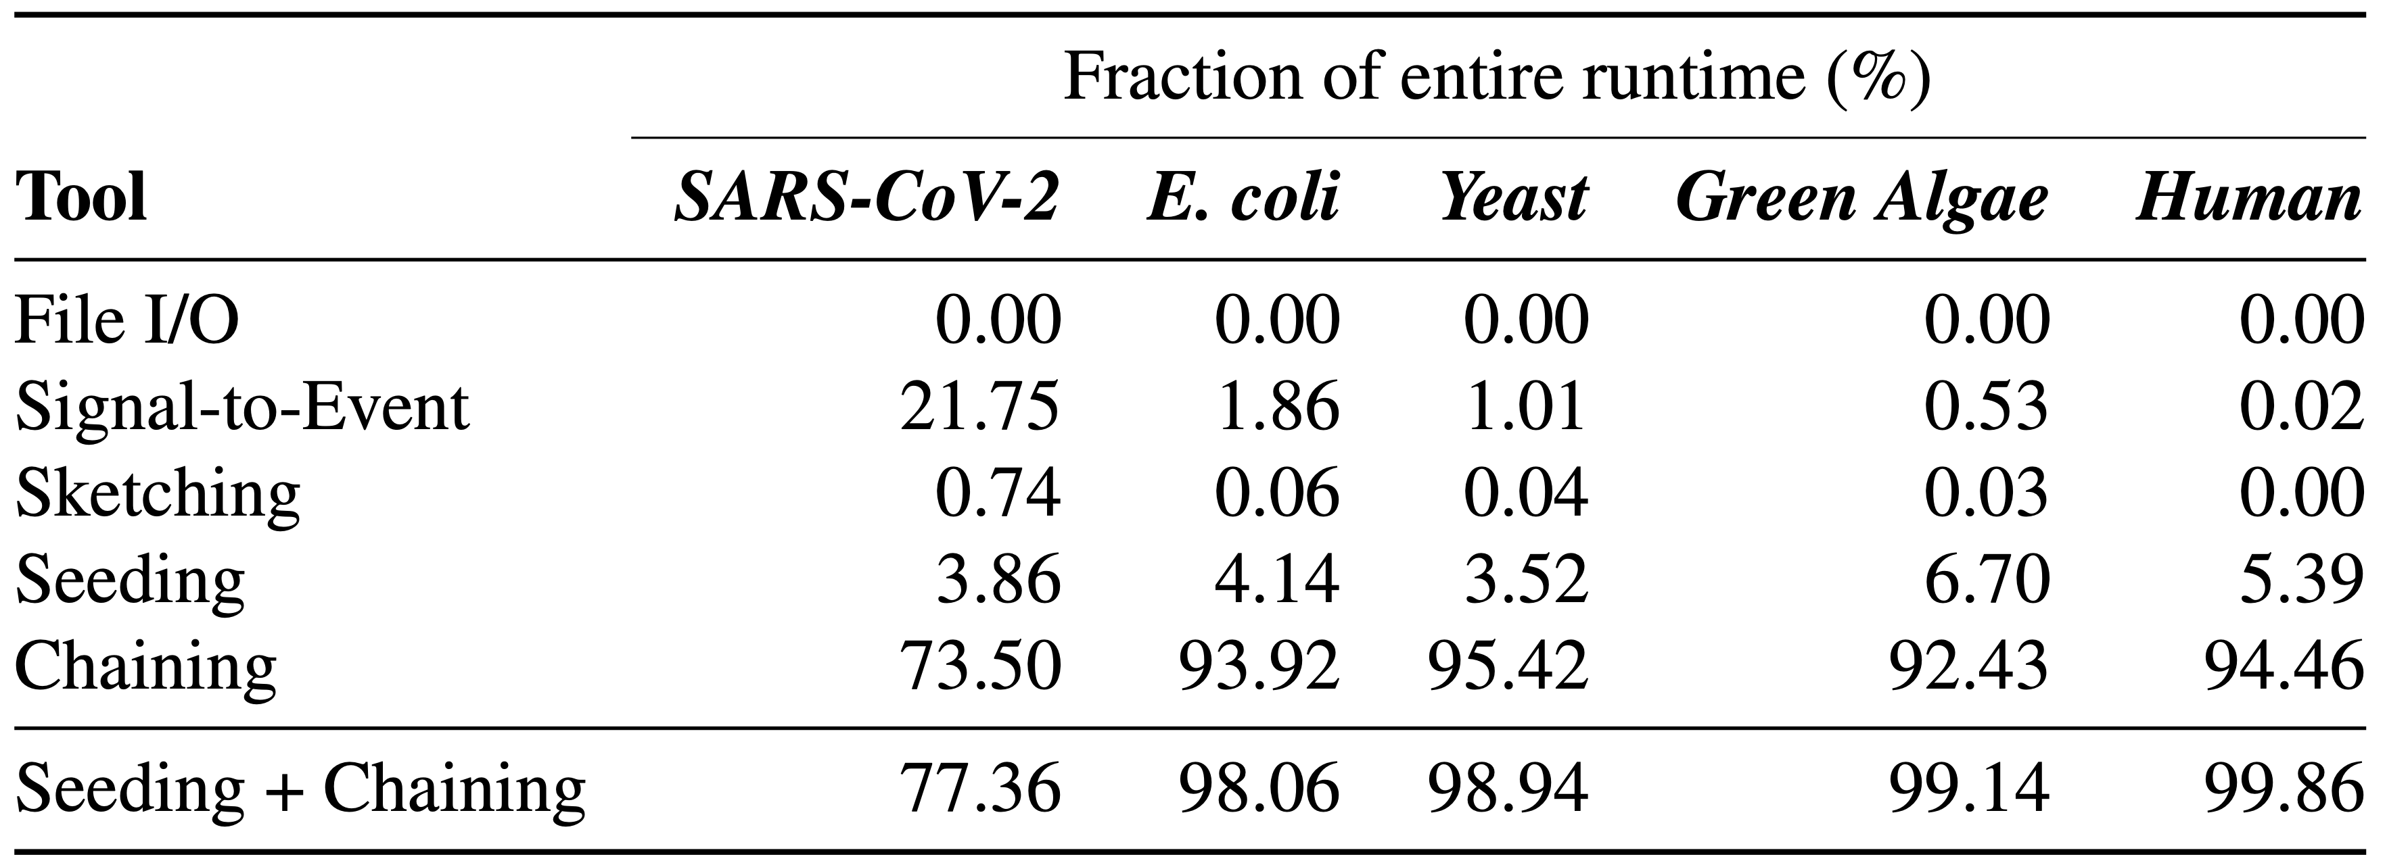
Breakdown Analysis of the RawHash Steps
The entire runtime is bottlenecked by the chaining step

Slide 57
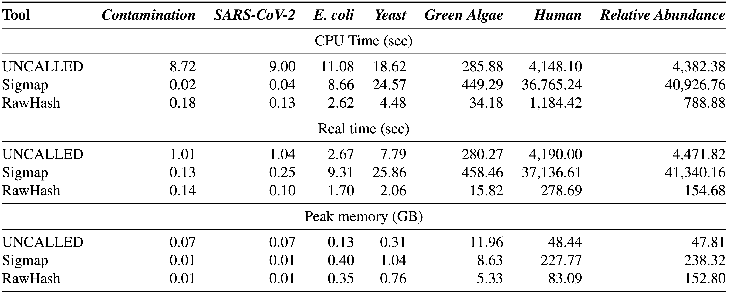
Required Computation Resources in Indexing
The indexing step of RawHash is orders of magnitude faster than
the indexing steps of UNCALLED and Sigmap, especially for large genomes
RawHash requires larger memory space than UNCALLED

Slide 58
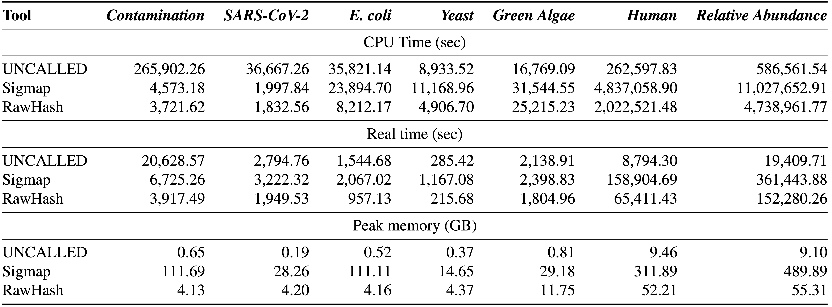
Required Computation Resources in Mapping
The mapping step of RawHash is significantly faster than Sigmap
for all genomes, and faster than UNCALLED for small genomes
RawHash requires larger memory space than UNCALLED

Slide 59
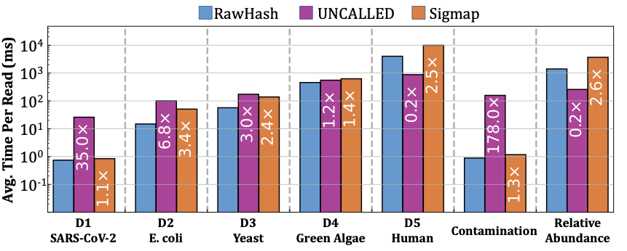
Average Mapping Time per Read
The mapping step of RawHash is significantly faster than Sigmap
for all genomes, and faster than UNCALLED for small genomes

Slide 60
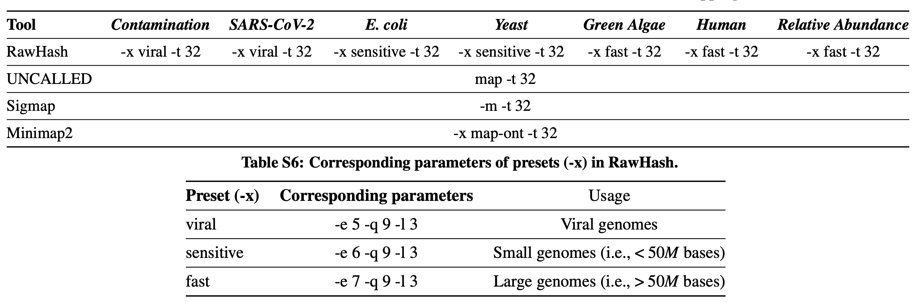
Parameter Configurations

Slide 61
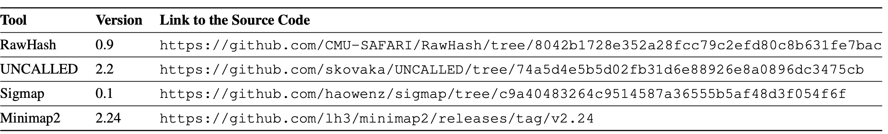
Versions

Slide 62
ISMB/ECCB 2023
RawHash
Enabling Fast and Accurate Real-Time Analysis
of Raw Nanopore Signals for Large Genomes
Can Firtina
Nika Mansouri Ghiasi |  | Joel Lindegger |  | Gagandeep Singh
Meryem Banu Cavlak |  | Haiyu Mao |  | Onur Mutlu
Paper
Code

