Slide 1






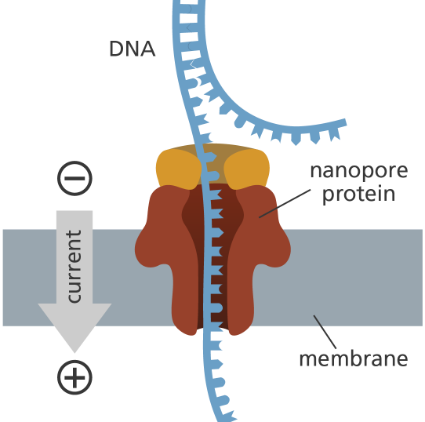












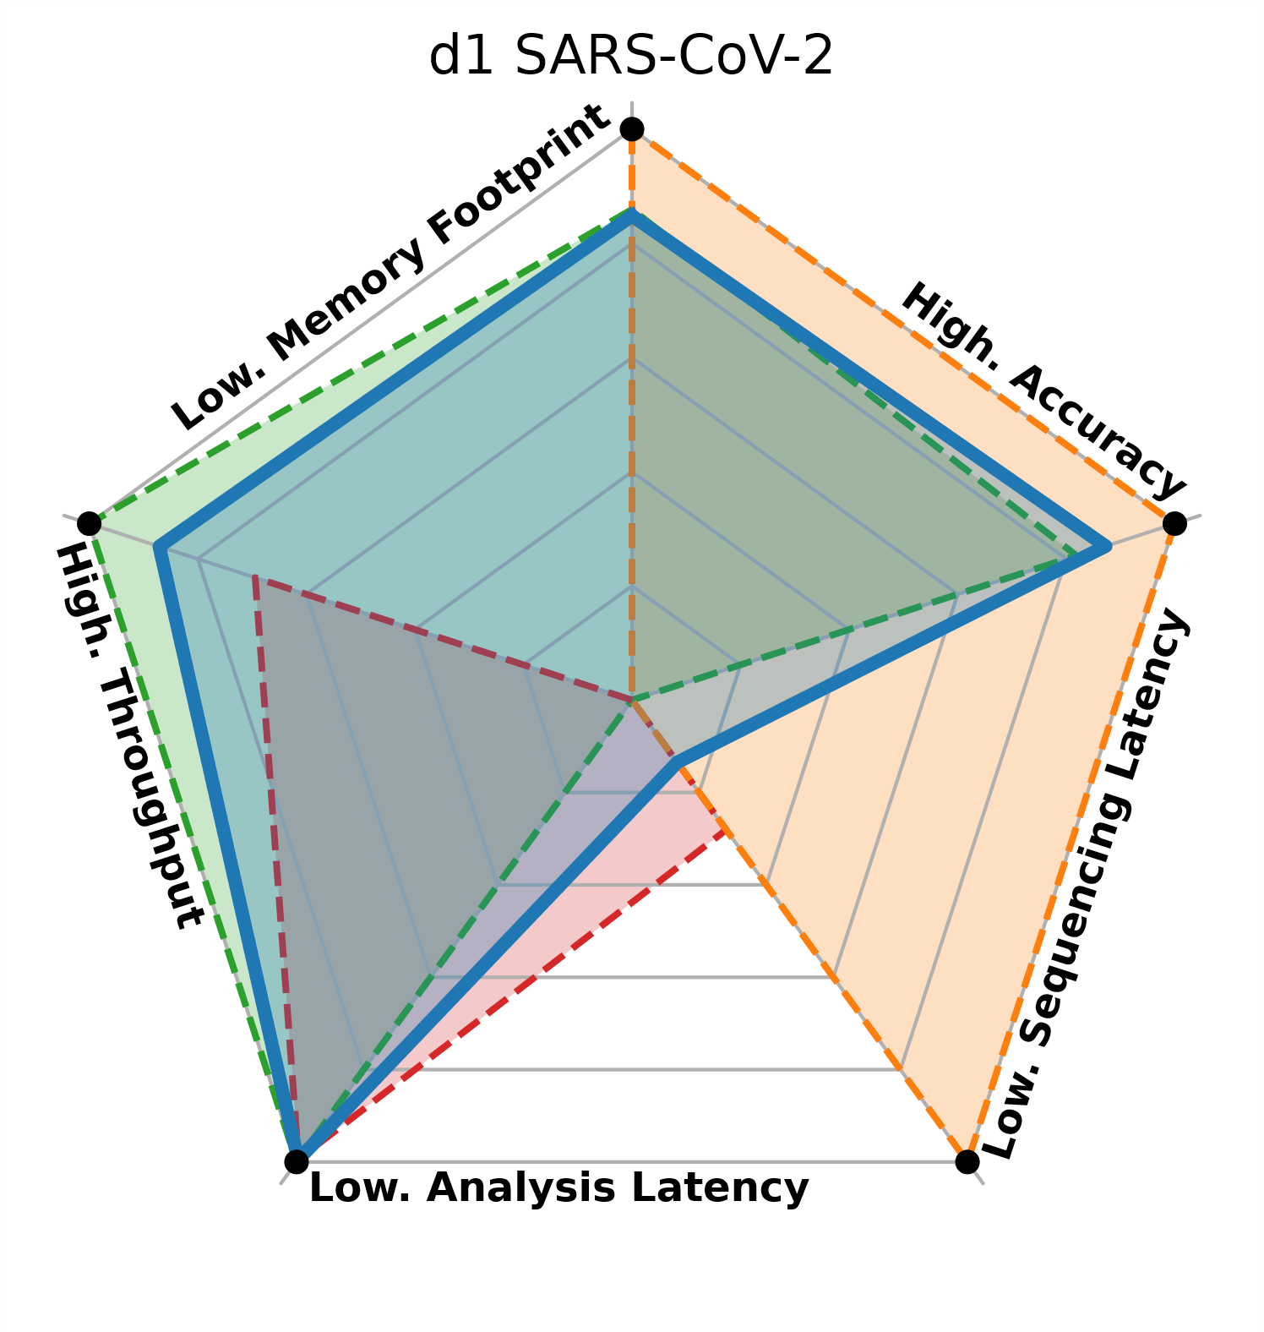
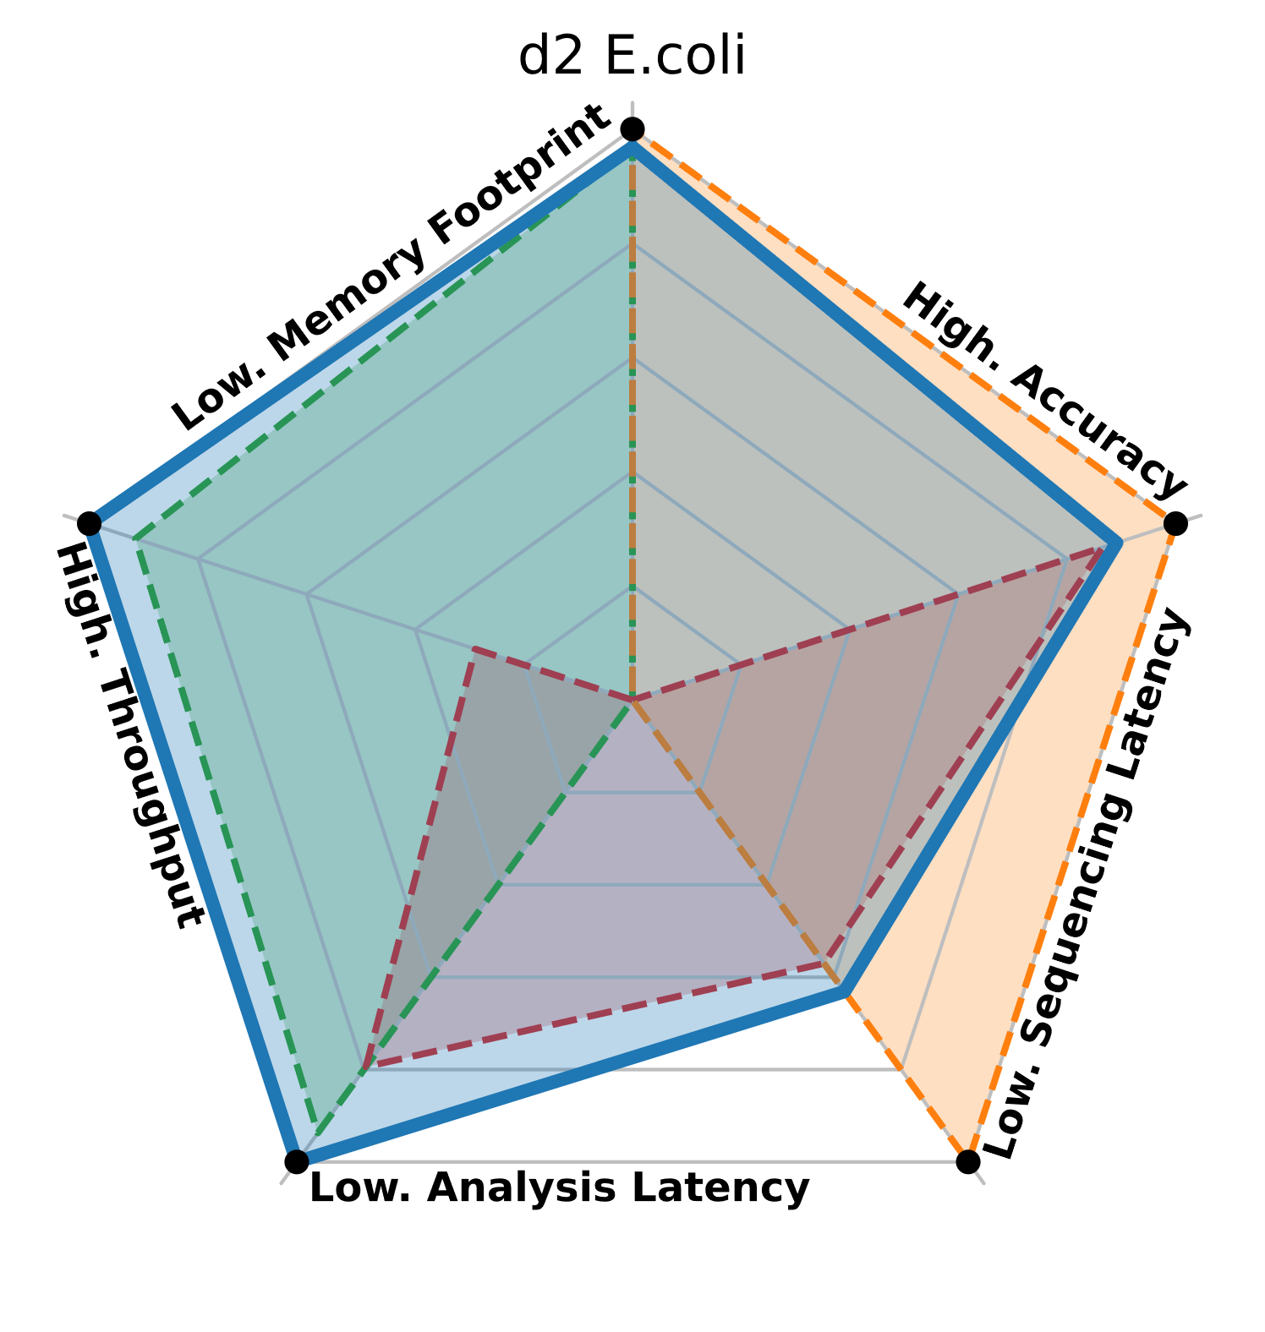
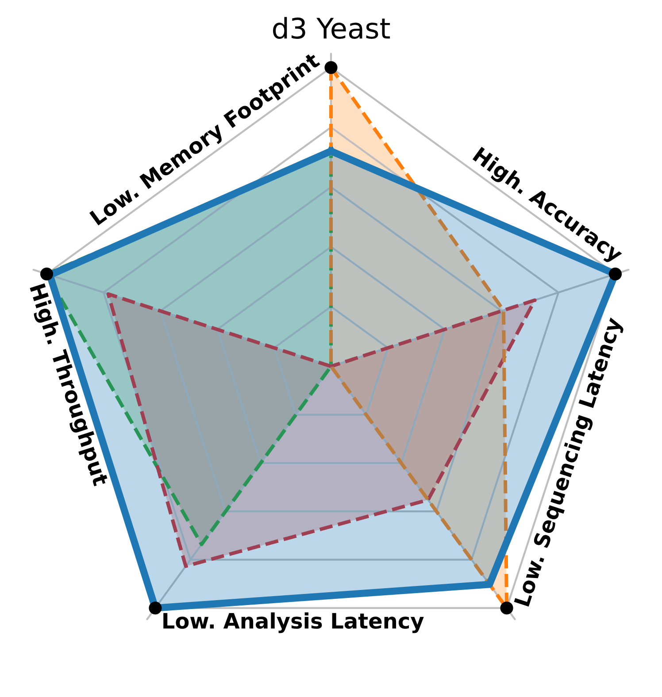
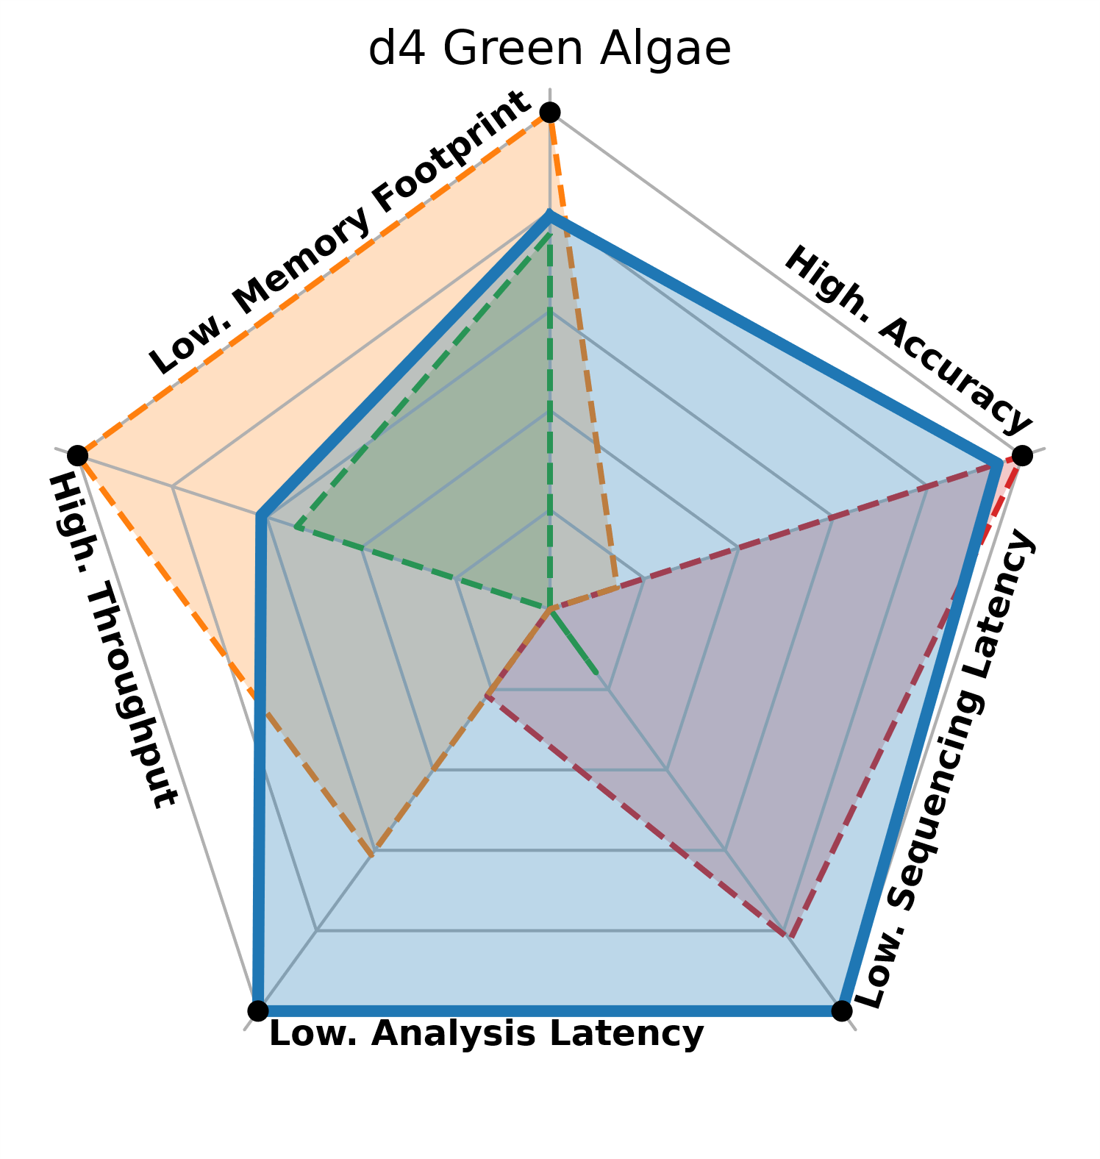
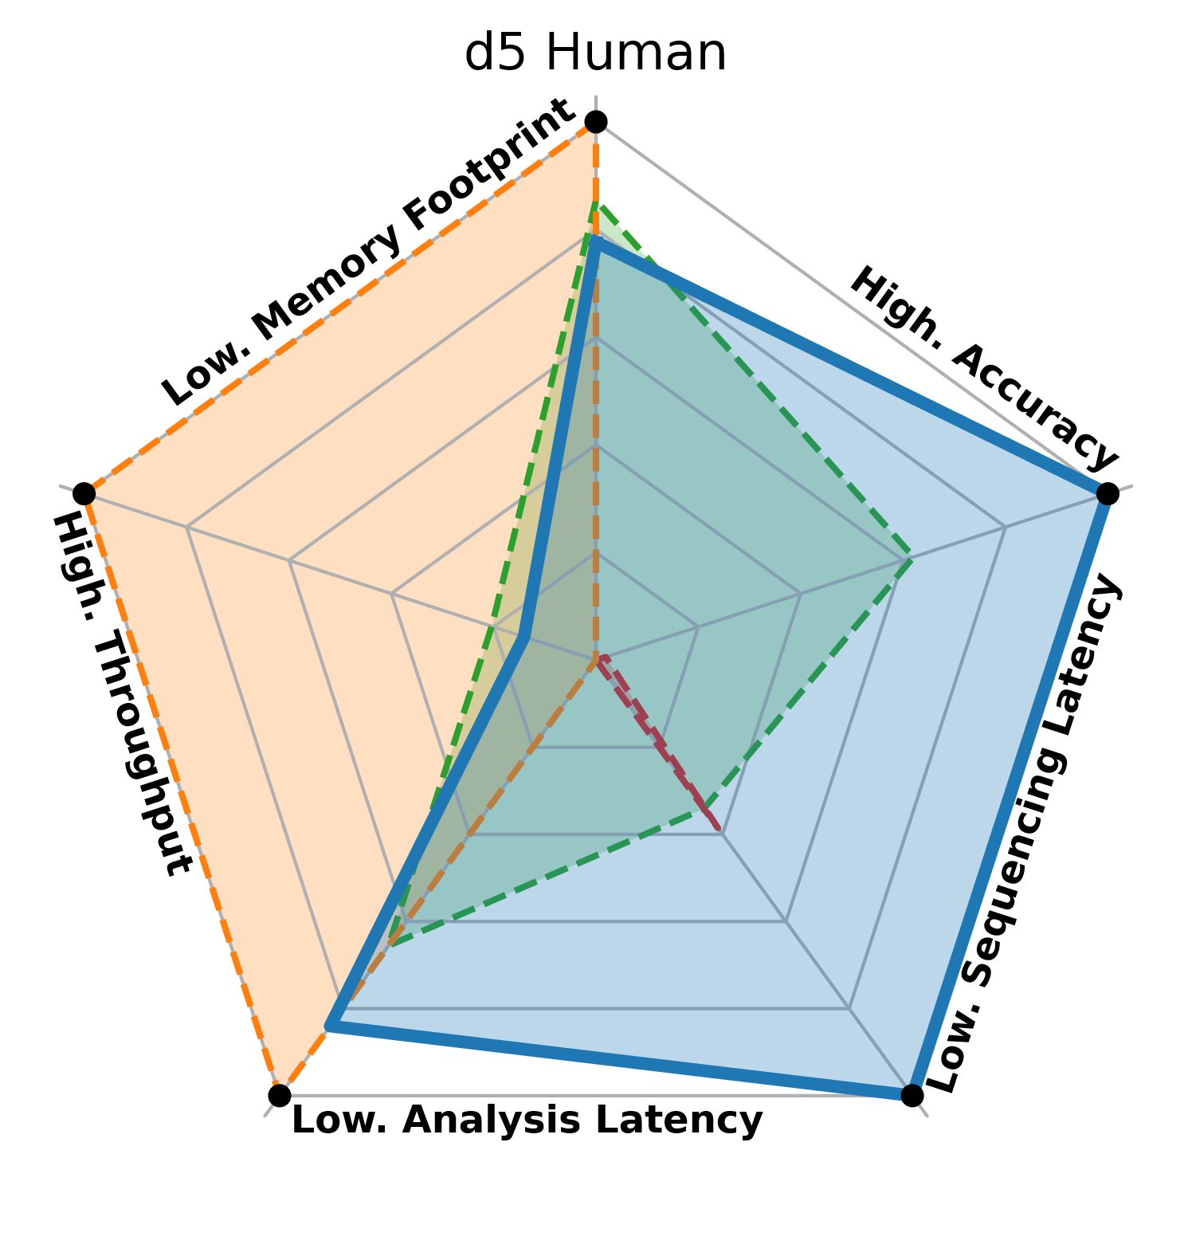
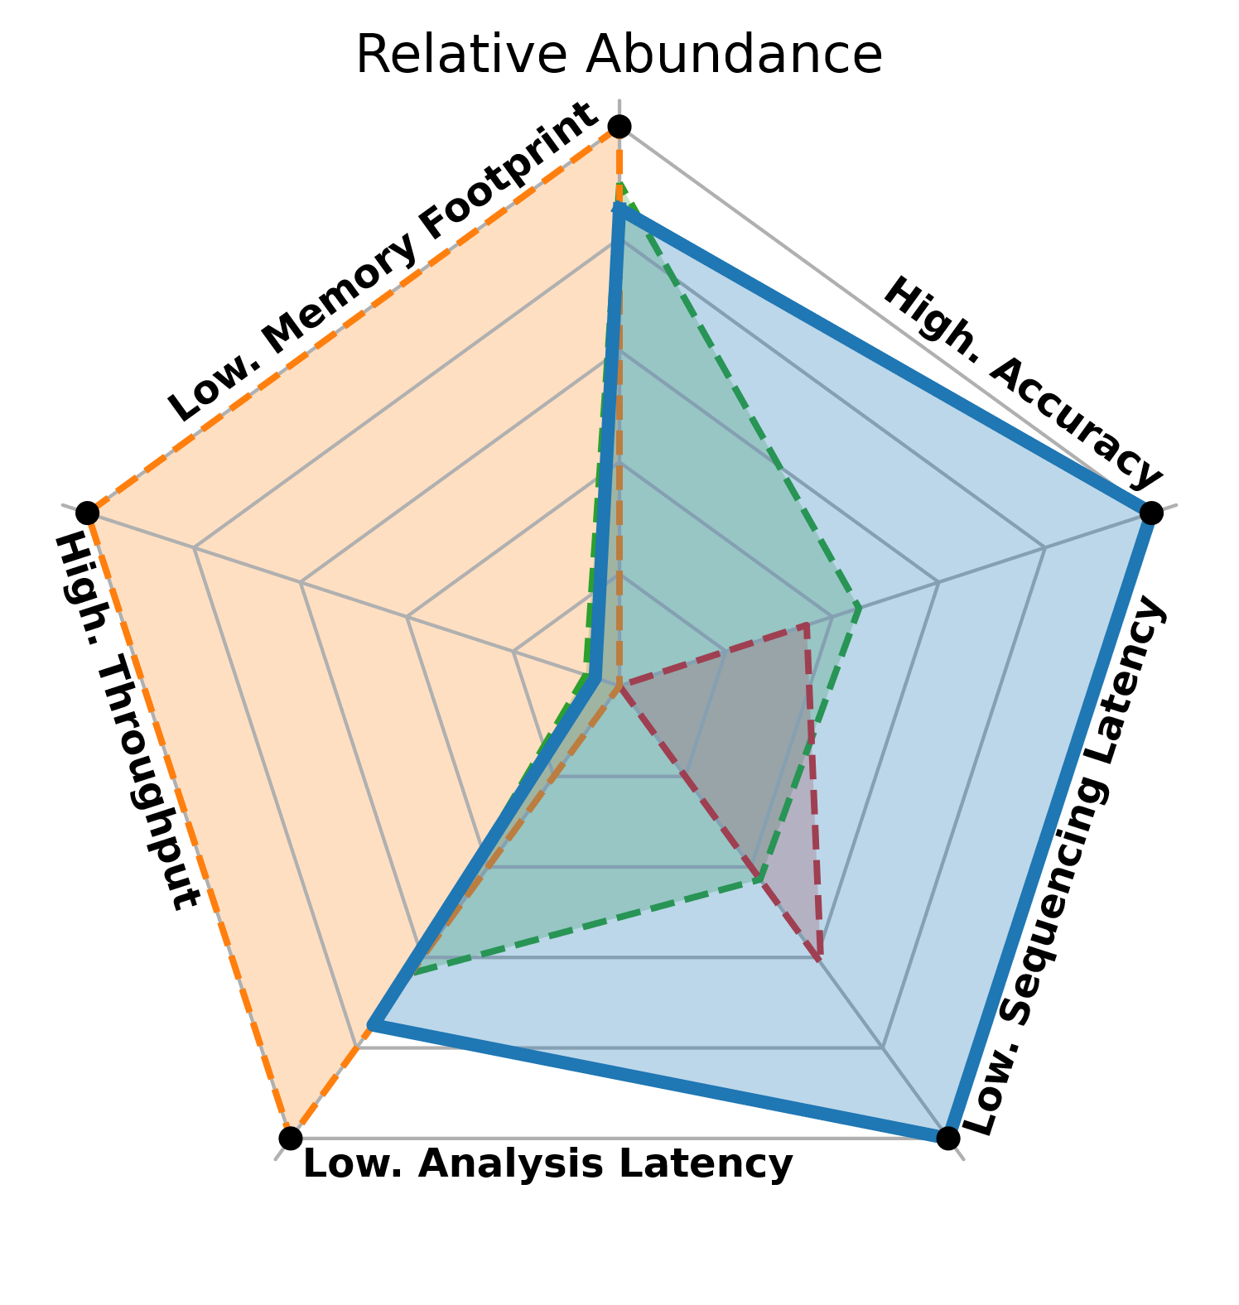
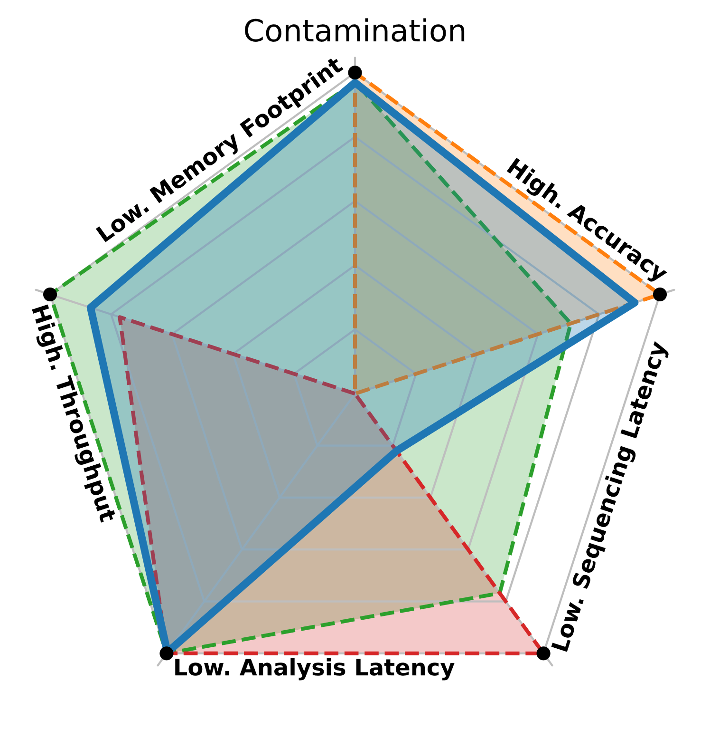
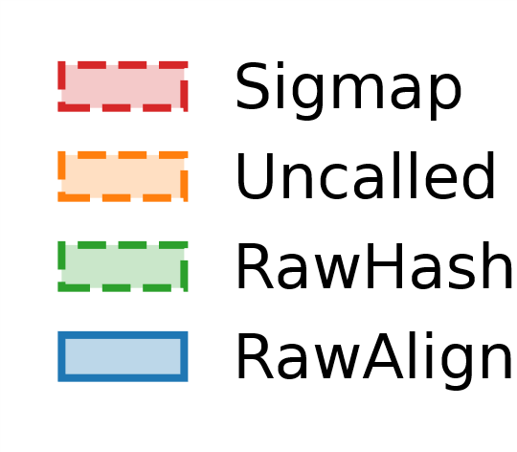
Accurate, Fast, and Scalable Real-Time Analysis of Raw Nanopore Signals
Can Firtina, Joel Lindegger, Nika Mansouri Ghiasi, Melina Soysal, Gagandeep Singh,
Meryem Banu Cavlak, Haiyu Mao, Mohammad Sadrosadati, Mohammed Alser and Onur Mutlu
RawHash
RawHash2
RawAlign
Source Code
1: Real-Time Genome Analysis with Adaptive Sampling
2: Challenges in Real-Time Genome Analysis
3: Problem
1. Genome Sequencing
Fast analysis that can match the throughput of sequencer
Efficient tools (UNCALLED and Sigmap) cannot provide either
1. Fast analysis or
2. Accurate analysis for large genomes
2. Raw Nanopore Signal
3. Real-Time Analysis
Low latency to reduce the sequencing time and cost with effective use of adaptive sampling
Ejects the read from nanopore
4. Adaptive Sampling
Accurate analysis from noisy raw signal data
Accurate tools (e.g., ReadFish) cannot provide
1. Efficient analysis
without fully sequencing it
Stop Sequencing the Read?
Efficient analysis to enable portable sequencing on devices with low computational power
4: Goal
6: RawHash
7: RawAlign
Fast analysis that can scale to large genomes
Low latency to make quick decisions on adaptive sampling
Raw Signal #1
Distance Calculation
Raw Signal #2
Accurate analysis for large genomes
Hash
Hash
Efficient analysis that can be used with portable devices
5: Key Contributions
0x01
Fast Match
0x01
The first mechanism to efficiently and accurately map raw signals
to large reference genomes
Hashing raw signals enables fast comparison between long raw signal sequences
Alignment after seeding and chaining enables fine-grained and accurate comparison between subregions of long raw signal sequences
A novel mechanism “SequenceUntil” to stop the entire sequencing run by dynamically deciding if further sequencing of reads is unnecessary
RawHash preprocesses the inherently noisy raw signals with Signal-to-Event Conversion and Quantization
RawAlign uses dynamic time warping (DTW) for signal alignment
The first mechanism use a weighted combination of multiple metrics for mapping decisions
11: Results
Read Mapping Overview
Read Mapping Throughput
Wide range of supported file formats, including FAST5, POD5, SLOW5, and BLOW5
Nanopore
RawHash2
RawHash2-Minimizer
RawHash
UNCALLED
Sigmap
Wide range of supported nanopore chemistries, including ONT’s R 9.4.1 and R10.4.1
10⁶
10⁵
Real-Time Analysis
10⁴
10: Evaluation Methodology
Throughput (bp/sec)
10³
No
Real-Time
Analysis
10²
Datasets from very small (viral) to large genomes (human and metagenomics)
Compared with UNCALLED and Sigmap
Use cases
  Read mapping
  Relative abundance estimation
  Contamination analysis
Evaluation Metrics
  Throughput (bp/sec)
  Overall Runtime (sec)
  Memory usage (GB)
  Number of sequenced bases before ejecting reads (bases)
  Accuracy (baseline: minimap2 mappings)
  Sequence Until benefits
10¹
D1
SARS-CoV-2
D2
E. coli
D3
Yeast
D4
Green Algae
D5
Human
Contamination
RawHash2’s seed filtering further improves throughput on top of RawHash
Relative Abundance
RawHash’s seeding and chaining effect high throughput and accuracy
RawAlign’s alignment further improves accuracy on top of RawHash across all datasets
RawAlign can calculate relative abundances with high accuracy, similar to the state-of-the-art basecalling-based analysis tool minimap2

