Slide 1
RowPress Amplifying Read Disturbance in Modern DRAM Chips
Haocong Luo
Ataberk Olgun A. Giray Yağlıkçı Yahya Can Tuğrul
Steve Rhyner Meryem Banu Cavlak Joël Lindegger
Mohammad Sadrosadati Onur Mutlu
Notes:
Hello, I am Haocong Luo. I will be presenting our work, RowPress, amplifying read disturbance in modern DRAM chips

Slide 2
High-Level Summary
We demonstrate and analyze RowPress, a new read disturbance phenomenon that causes bitflips in real DRAM chips
We show that RowPress is different from the RowHammer vulnerability
We demonstrate RowPress using a user-level program on a real Intel system with real DRAM chips
We provide effective solutions to RowPress
Notes:
In this work, we demonstrate and analyze RowPress, a new read disturbance phenomenon in real DRAM chips
[Click]
We show that RowPress is different from RowHammer
[Click]
demonstrate RowPress in a real system
[Click]
And provide effective solutions to mitigate RowPress

Slide 3
Outline
DRAM Background
What is RowPress?
Real DRAM Chip Characterization
Characterization Methodology
Key Characteristics of RowPress
Real-System Demonstration
Mitigating RowPress
Conclusion
Notes:
Here is the outline of my talk. I will start with some background in DRAM

Slide 4
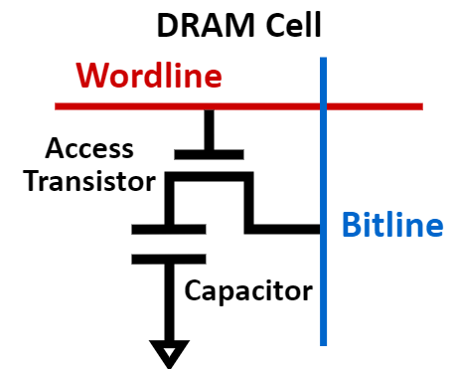
DRAM Organization
DRAM is the prevalent technology for main memory
A DRAM cell stores 1 bit of information in a leaky capacitor
DRAM cells are organized into DRAM rows
DRAM Row
…
Wordline
…
Notes:
DRAM is the prevalent technology for main memory
A DRAM cell stores 1 bit of information in a leaky capacitor
And DRAM cells are organized into DRAM rows

Slide 5
Read Disturbance in DRAM
Read disturbance in DRAM breaks memory isolation
Prominent example: RowHammer
DRAM Chip
Row 1
Row 1
Row 1
Victim Row
Row 2
Row 2
Row 2
Row 2
Row 2
Row 2
closed
open
open
Aggressor Row
closed
open
Row 3
Row 3
Row 3
Victim Row
Repeatedly opening (activating) and closing a DRAM row many times causes RowHammer bitflips in adjacent rows
Notes:
Read disturbance has significant system-level implications because it breaks memory isolation. A prominent example of this is RowHammer, where Repeatedly activating and closing a DRAM row many times causes RowHammer bitflips in adjacent rows

Slide 6
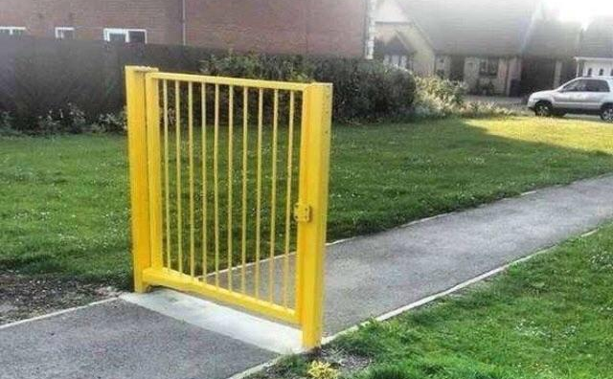
Are There Other Read-Disturb Issues in DRAM?
RowHammer is the only studied read-disturb phenomenon
Mitigations work by detecting high row activation count
What if there is another read-disturb phenomenon
that does NOT rely on high row activation count?
https://www.reddit.com/r/CrappyDesign/comments/arw0q8/now_this_this_is_poor_fencing/
Notes:
RowHammer is the only studied read-disturb effect, and various mitigations work by detecting high row activation count.
This raises the following question, what if there is another read-disturb phenomenon that does not rely on high activation count?

Slide 7
Outline
DRAM Background
What is RowPress?
Real DRAM Chip Characterization
Characterization Methodology
Key Characteristics of RowPress
Real-System Demonstration
Mitigating RowPress
Conclusion
Notes:
We find that RowPress is indeed such a phenomenon

Slide 8
What is RowPress?
Keeping a DRAM row open for a long time causes bitflips in adjacent rows
These bitflips do NOT require many row activations
Only one activation is enough in some cases!
☞
Now, let’s see how this is different from RowHammer
Notes:
So, what is RowPress?
[Click]
RowPress is the read disturbance caused by keeping a DRAM row open for a long time, causing bitflips in adjacent rows
[Click]
These bitflips do not require many row activations,
[Click]
and we find in some cases only one row activation is enough.
[Click]
Now, lets delve into some background and see how this is different from RowHammer

Slide 9
RowPress vs. RowHammer
Instead of using a high activation count,
☞ increase the time that the aggressor row stays open
RowHammer
Aggressor Row
Open
Close
36ns, 47K activations to induce bitflips
RowPress
Aggressor Row
Open
Close
7.8µs, only 5K activations to induce bitflips
We observe bitflips even with ONLY ONE activation in extreme cases where the row stays open for 30ms
Notes:
Instead of a high activation count, RowPress increases the time the that aggressor stays open.
Doing disturbs adjacent rows enough to cause bitflips without having very high activation count.
We observe bitflips even with only one activation in extreme cases.

Slide 10
Outline
DRAM Background
What is RowPress?
Real DRAM Chip Characterization
Characterization Methodology
Key Characteristics of RowPress
Real-System Demonstration
Mitigating RowPress
Conclusion
Notes:
Now let us look at our detailed characterization of RowPress

Slide 11
Major Takeaways from Real DRAM Chips
RowPress significantly amplifies DRAM’s vulnerability to read disturbance
RowPress has a different underlying failure mechanism from RowHammer
Notes:
The two most important takeaways from our characterization are:
First,
Second,
Now let us see how we come to these

Slide 12
Outline
DRAM Background
What is RowPress?
Real DRAM Chip Characterization
Characterization Methodology
Key Characteristics of RowPress
Real-System Demonstration
Mitigating RowPress
Conclusion
Notes:
Now, let us see how we get to these conclusions
I will start with our characterization methodology

Slide 13
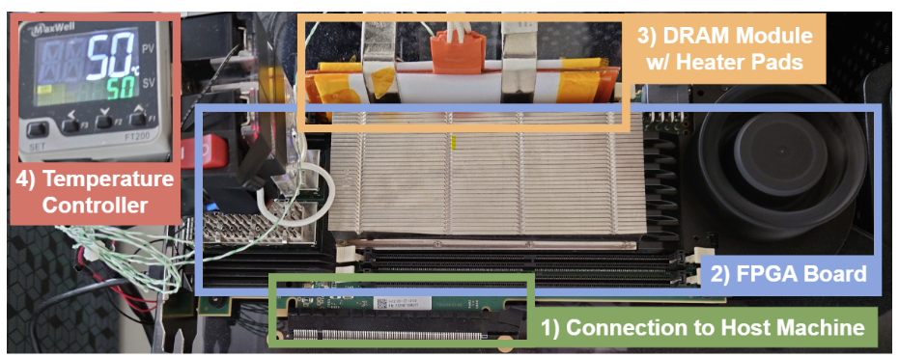
Characterization Methodology (I)
FPGA-based DDR4 testing infrastructure
Developed from SoftMC [Hassan+, HPCA’17] and DRAM Bender [Olgun+, TCAD’23]
Fine-grained control over DRAM commands, timings, and temperature
Notes:
We use a FPGA based DDR4 testing infrastructure developed from DRAM bender that enables fine-grained control over DRAM commands, timings, and temperature to characterize RowPress

Slide 14
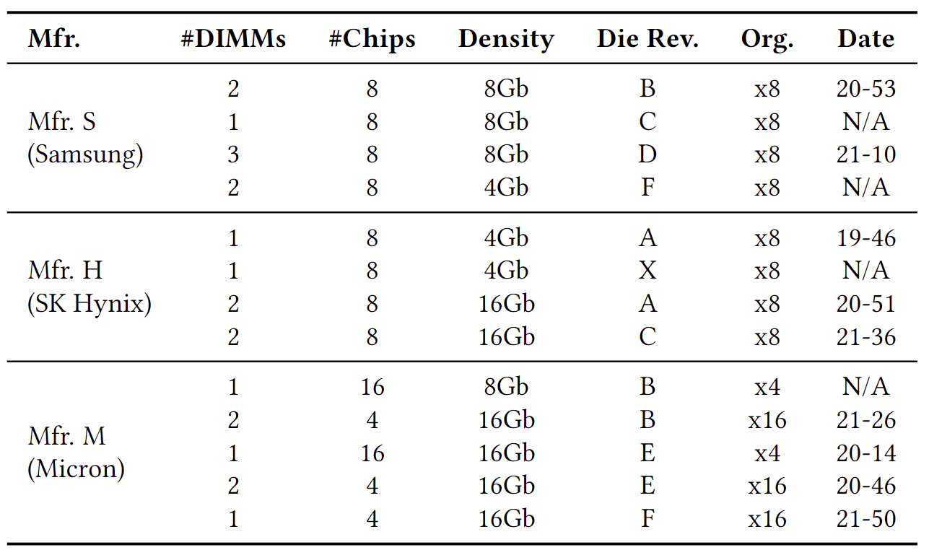
Characterization Methodology (II)
DRAM chips tested
164 DDR4 chips from all 3 major DRAM manufacturers
Covers different die densities and revisions
Notes:
We test 164 DDR4 chips from all 3 major DRAM manufacturers, covering different die densities and revisions

Slide 15
Characterization Methodology (III)
Metric: The minimum number of aggressor row activations in total to cause at least one bitflip (ACmin)
Access Pattern: Single-sided (i.e., only one aggressor row). Sweep aggressor row on time (tAggON) from 36ns to 30ms
Data Pattern: Checkerboard (0xAA in aggressor and 0x55 in victim)
Temperature: 50°C
Algorithm: Bisection-based ACmin search
Each search iteration is capped at 60ms (<64ms refresh window)
Repeat 5 times and report the minimum ACmin value observed
Sample 3072 DRAM rows per chip
[More sensitivity studies in the paper]
Notes:
The key metric we are looking at is the minimum number of aggressor row activations in total to cause at least one bitflip, or ACmin
We look at a single-sided RowPress pattern where we only activate one aggressor row. We sweep the the time that the aggressor stays open, or tAggON, from 36ns to 30ms
We only cover what is necessary to understand the results that we will present soon here, and we have many more sensitivity studies in the paper

Slide 16
Outline
DRAM Background
What is RowPress?
Real DRAM Chip Characterization
Characterization Methodology
Key Characteristics of RowPress
Real-System Demonstration
Mitigating RowPress
Conclusion
Notes:
Next, let us see the key characteristics of RowPress

Slide 17
Major Takeaways from Real DRAM Chips
RowPress significantly amplifies DRAM’s vulnerability to read disturbance
RowPress has a different underlying failure mechanism from RowHammer
Notes:
I have already showed the two major takeaways,
Now let us see some details

Slide 18
Key Characteristics of RowPress
Amplifying read disturbance in DRAM
Reduces the minimum number of row activations needed to induce a bitflip (ACmin) by 1-2 orders of magnitude
In extreme cases, activating a row only once induces bitflips
Gets worse as temperature increases
Different from RowHammer
Affects a different set of cells compared to RowHammer and retention failures
Behaves differently as access pattern or temperature changes compared to RowHammer

Slide 19
Key Characteristics of RowPress
Amplifying read disturbance in DRAM
Reduces the minimum number of row activations needed to induce a bitflip (ACmin) by 1-2 orders of magnitude
In extreme cases, activating a row only once induces bitflips
Gets worse as temperature increases
Different from RowHammer
Affects a different set of cells compared to RowHammer and retention failures
Behaves differently as access pattern or temperature changes compared to RowHammer
Notes:
Now, let us see some detailed characterization results to understand how RowPress amplifies read disturbance

Slide 20
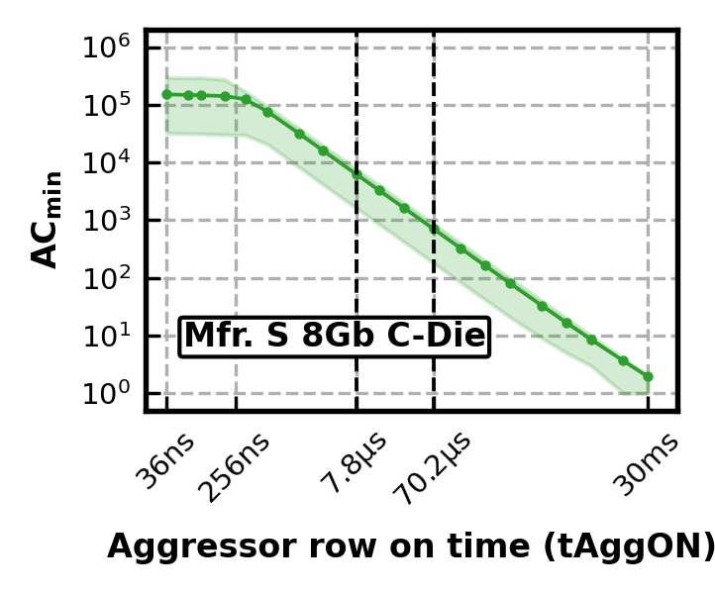
Amplifying Read Disturbance (I)
How minimum activation count to induce a bitflip (ACmin) changes as aggressor row on time (tAggON) increases
RowHammer
RowPress
[min, max]
tREFI
9x tREFI
ACmin = 1
Notes:
First, we look at how the minimum activation count to induce a bitflip, or Acmin, changes as aggressor row on time increases
We show Acmin on the y-axis and aggressor row on time on the x-axis, both in log scale. Each data point shows the average Acmin across all tested rows, and the error band shows the minimum and maximum Acmin values we observe.
When aggressor row on time is 36ns, our access pattern is identical to RowHammer. As aggressor row on time increases, we start to see the effect of RowPress
We highlight two potential upperbounds of aggressor row on time as indicated by the JEDEC standard on the x-axis, which are the refresh interval and 9 times of that
We highlight Acmin = 1 on the y-axis
We observe that as aggressor row on time increases, Acmin significantly decreases, and in extreme cases, only one activation causes bitflips

Slide 21
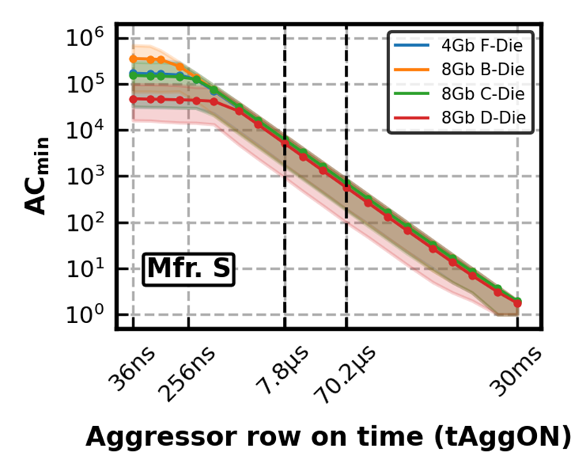
Amplifying Read Disturbance (II)
How minimum activation count to induce a bitflip (ACmin) changes as aggressor row on time (tAggON) increases
RowHammer
RowPress
Notes:
We observe the same trend for all other dies we test for Mfr. S

Slide 22
Amplifying Read Disturbance (III)
How minimum activation count to induce a bitflip (ACmin) changes as aggressor row on time (tAggON) increases
ACmin reduces by 21X on average when tAggON increases from 36ns to 7.8µs
191X
70.2µs
RowPress significantly reduces ACmin as tAggON increases
Notes:
and the same goes for all three manufacturers.
We observe that Acmin reduces by 21X on average when aggressor row on time increases from 36ns to 70.2us for almost all chips we test from all three manufacturers. When aggressor row on time increases from 36ns to 70.2us, Acmin reduces by 191X on average
We conclude that RowPress significantly reduces the minimum activation count to induce a bitflip when aggressor row on time increases

Slide 23
Amplifying Read Disturbance (IV)
ACmin @ 80°C normalized to ACmin @ 50°C
Data point below 1 means fewer activations to cause bitflips @ 80°C compared to 50°C
When tAggON is 7.8 μs, RowPress requires about 50% fewer activations to induce bitflips at 80°C compared to 50°C
RowPress gets worse as temperature increases
Notes:
Next, We investigate how RowPress behaves at a higher temperature, 80C, by looking at the ACmin at 80C normalized to 50C, which we show on the y-axis.
We observe that as aggressor row on time increases, much fewer activations are required to induce bitflips at 80C compared to 50C
We conclude that RowPress gets worse as temperature increases

Slide 24
Key Characteristics of RowPress
Amplifying read disturbance in DRAM
Reduces the minimum number of row activations needed to induce a bitflip (ACmin) by 1-2 orders of magnitude
In extreme cases, activating a row only once induces bitflips
Gets worse as temperature increases
Different from RowHammer
Affects a different set of cells compared to RowHammer and retention failures
Behaves differently as access pattern or temperature changes compared to RowHammer
Notes:
Now, let us see in detail how RowPress differs from RH

Slide 25
Difference Between RowPress and RowHammer (I)
Cells vulnerable to RowPress vs. RowHammer
Cells vulnerable to RowPress (RowHammer) are those that flip @ ACmin
Overlap = $\frac{Number of Cells Vulnerable to Both RowPress and RowHammer}{Number of Cells Vulnerable to RowPress}$
On average, only 0.013% of DRAM cells vulnerable to RowPress are also vulnerable to RowHammer, when tAggON ≥ 7.8us
Notes:
We first look at the relationship between the cells vulnerable to RowPress versus RwHammer
We define the cells vulnerable to RowPress or RowHammer as those that experience bitflips with the minimum activation count.
The overlap is then the number of cells vulnerable to both RowPress and RowHammer over the number of cells only vulnerable to RowPress, which we show on the y-axis
We observe that as aggressor row on time increases, only a negligible amount of DRAM cells vulnerable to RowPress are also vulnerable to RowHammer

Slide 26
Difference Between RowPress and RowHammer (II)
Cells vulnerable to RowPress vs. RowHammer
Cells vulnerable to RowPress (RowHammer) are those that flip @ ACmin
Overlap = $\frac{Number of Cells Vulnerable to Both RowPress and RowHammer}{Number of Cells Vulnerable to RowPress}$
Most cells vulnerable to RowPress are NOT vulnerable to RowHammer
Notes:
We conclude that

Slide 27
Difference Between RowPress and RowHammer (III)
Directionality of RowHammer and RowPress bitflips
The majority of RowHammer bitflips are 0 to 1 The majority of RowPress bitflips are 1 to 0
RowPress and RowHammer bitflips have opposite directions
Notes:
We also look at the directionality of RowHammer and RowPress bitflips and find that they have opposite directions

Slide 28
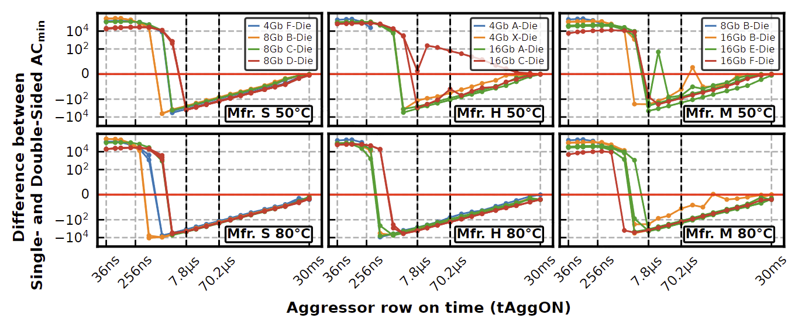
Difference Between RowPress and RowHammer (IV)
Effectiveness of single-sided vs. double-sided RowPress
Data point below 0 means fewer activations to cause bitflips with single-sided RowPress compared to double-sided RowPress
As tAggON increases beyond a certain level, single-sided RowPress becomes more effective compared to double-sided
Different from RowHammer where double-sided is more effective
Notes:
Next, we find that as aggressor row on time increases beyond a certain level, single-sided RowPress requires less activations to induce bitflips compared to double-sided RowPress, which is very different from RowHammer where double-sided is strictly more effective.

Slide 29
Difference Between RowPress and RowHammer (V)
Sensitivity to temperature
Data point below 1 means fewer activations to cause bitflips @ 80°C compared to 50°C
RowPress gets worse as temperature increases,
which is very different from RowHammer
Notes:
I already showed that RowPress gets worse as temperature increases, which is also very different compared to RowHammer

Slide 30
Outline
DRAM Background
What is RowPress?
Real DRAM Chip Characterization
Characterization Methodology
Key Characteristics of RowPress
Real-System Demonstration
Mitigating RowPress
Conclusion
Notes:
Now, lets see our real system demonstration of RowPress

Slide 31
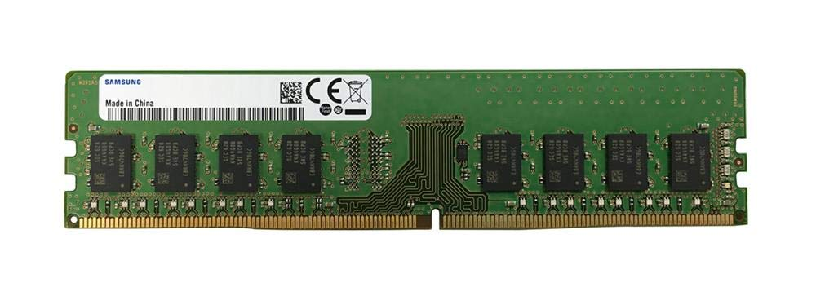
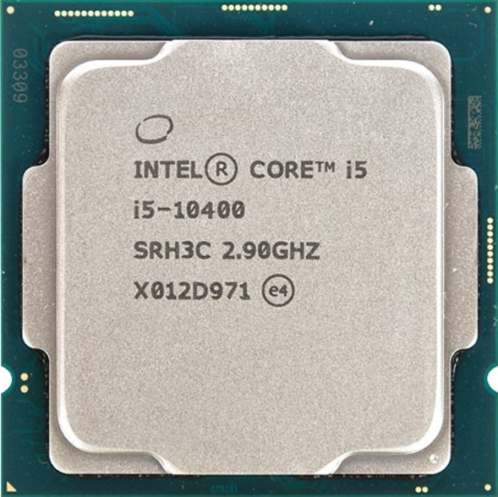
Real-System Demonstration (I)
Samsung DDR4 Module M378A2K43CB1-CTD
(Date Code: 20-10)
w/ TRR RowHammer Mitigation
Intel Core i5-10400 (Comet Lake)
Key Idea: A proof-of-concept RowPress program keeps a DRAM row open for a longer period by keeping on accessing different cache blocks in the row
// Sync with Refresh and Loop Below
for (k = 0; k < NUM_AGGR_ACTS; k++)
for (j = 0; j < NUM_READS; j++) ∗AGGRESSOR1[j];
for (j = 0; j < NUM_READS; j++) ∗AGGRESSOR2[j];
for (j = 0; j < NUM_READS; j++)
clflushopt(AGGRESSOR1[j]);
clflushopt(AGGRESSOR2[j]);
mfence();
activate_dummy_rows();
Number of Cache Blocks Accessed
Per Aggressor Row ACT
(NUM_READS=1 is Rowhammer)
Notes:
We demonstrate RowPress on a real system with a recent Intel processor and a Samsung DDR4 module with TRR rowhammer mitigation. The key idea of our RowPress program is to keep a DRAM row open for a longer period by keeping accessing different cache blocks in the row.
Here is the key part of our program, where we can change the number of cache blocks read per aggressor row activation. If we only read 1 cache block, then the program does the same as RowHammer

Slide 32
Real-System Demonstration (II)
On 1500 victim rows
Leveraging RowPress, our user-level program
induces bitflips when RowHammer cannot
Notes:
We run the program on 1500 arbitrarily selected victim rows, and we show the total number of bitflips we observe on the left, and the number of rows with bitflips on the right.
Leveraging RowPress, our program induces bitflips when RowHammer cannot

Slide 33
Outline
DRAM Background
What is RowPress?
Real DRAM Chip Characterization
Characterization Methodology
Key Characteristics of RowPress
Real-System Demonstration
Mitigating RowPress
Conclusion
Notes:
Now let us see how to mitigate RowPress

Slide 34
Mitigating RowPress (I)
We propose a methodology to adapt existing RowHammer mitigations to also mitigate RowPress
Key Idea:
Limit the maximum row open time (tmro)
Configure the RowHammer mitigation to account for the RowPress-induced reduction in ACmin
Original
RowHammer
Mitigation
tmro
RowPress-Induced
ACmin Reduction
ACmin
Adapted
Mitigation
Row Open Time
Less
Row Buffer Locality
More RowPress Read Disturbance
Notes:
We propose a methodology to adapt existing RH mitigations to also mitigate RowPress
They key idea is, based on characterization results, first limit the maximum row open time to strike a balance between row buffer locality and row press vulnerability, and then configure the RowHammer mitigation to account for the RowPress induced reduction in Acmin.
Our evaluation of the proposed methodology on two RowHammer mitigations, PARA and Graphene, shows that they can be adapted to also mitigate RowPress at low addition performance overhead.

Slide 35
Mitigating RowPress (II)
Evaluation methodology
Adapted RowHammer Mitigations: Graphene (Graphene-RP) and PARA (PARA-RP)
Cycle-accurate DRAM simulator: Ramulator [Kim+, CAL’15]
4 GHz Out-of-Order Core, dual-rank DDR4 DRAM
FR-FCFS scheduling
Open-row policy (with limited maximum row open time)
58 four-core multiprogrammed workloads from SPEC CPU2017, TPC-H, and YCSB
Metric: Additional performance overhead of Graphene-RP (PARA-RP) over Graphene (PARA)
Measured by weighted speedup
Notes:
We evaluate our methodology on two RowHammer mitigations, Graphene and PARA using Ramulator
The key metric we are looking at is the additional performance overhead of the adapted mitigation over the original one.

Slide 36
Mitigating RowPress (III)
Key evaluation results
Avg. -0.63%
Max. 6.4%
Avg. 4.5%
Max. 13.1%
Our solutions mitigate RowPress at low additional performance overhead
Notes:
Our evaluation results show that we can mitigate RowPress with low additional performance overhead

Slide 37
Outline
DRAM Background
What is RowPress?
Real DRAM Chip Characterization
Characterization Methodology
Key Characteristics of RowPress
Real-System Demonstration
Mitigating RowPress
Conclusion
Notes:
Now let me conclude my talk

Slide 38
Conclusion
We demonstrate and analyze RowPress, a widespread read disturbance phenomenon that causes bitflips in real DRAM chips
We characterize RowPress on 164 DDR4 chips from all 3 major DRAM manufacturers
RowPress greatly amplifies read disturbance: minimum activation count reduces by 1-2 orders of magnitude
RowPress has a different mechanism from RowHammer & retention failures
We demonstrate RowPress using a user-level program
Induces bitflips when RowHammer cannot
We provide effective solutions to RowPress
Low additional performance overhead
Notes:
In this work, we demonstrate and analyze RowPress, a widespread read disturbance phenomenon that causes bitflips in real DRAM chips
We characterize RowPress using DRAM chips from all 3 major manufacturers, and find that first, RowPress greatly amplifies read disturbance by reducing the minimum activation count to cause bitflfips by 1-2 orders of magnitude, in extreme cases only one activation causes bitflips, and second, RowPress has a different mechanism compared to RowHammer
We demonstrate RowPress in a real system with a user level program, which induces bitflips when RowHammer cannot
We provde effective solutions to RowPress with low additional performance overhead

Slide 39
More Results & Source Code
Many more results & analyses in the paper
6 major takeaways
19 major empirical observations
3 more potential mitigations
Fully open source and artifact evaluated
https://github.com/CMU-SAFARI/RowPress
Notes:
We have more results in the paper, and our work is fully open-source and artifact evaluated.

Slide 40
RowPress Amplifying Read Disturbance in Modern DRAM Chips
Haocong Luo
Ataberk Olgun A. Giray Yağlıkçı Yahya Can Tuğrul
Steve Rhyner Meryem Banu Cavlak Joël Lindegger
Mohammad Sadrosadati Onur Mutlu
https://github.com/CMU-SAFARI/RowPress
Notes:
Hello, I am Haocong Luo. I will be presenting our work, RowPress, amplifying read disturbance in modern DRAM chips

Slide 41
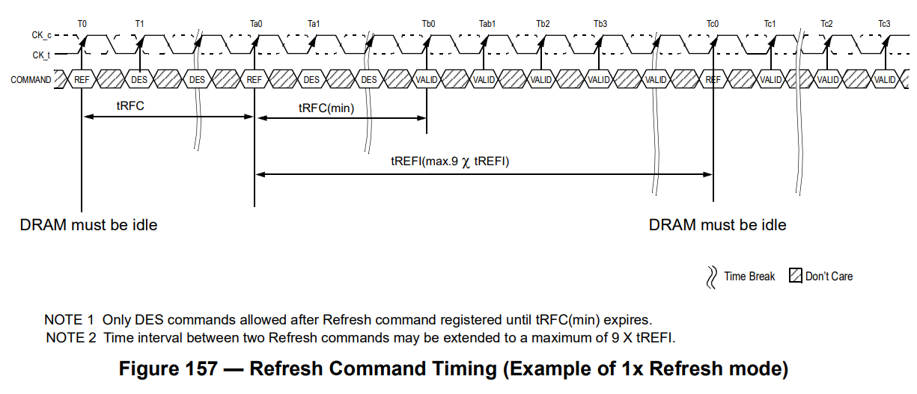
Backup Slide
Potential tAggON upper bounds
tREFI: Interval between two REF commands
9tREFI:
JESD79-4C
Notes:
RowPress amplifies read disturbance because
First, it reduces the minimum number of row activations needed to induce a bitflip (or ACmin) by 1-2 orders of magnitude
Second, activating a row only once induces bitflips in extreme cases

Slide 42
Backup Slide
Cells vulnerable to RowPress vs RowHammer
Cells vulnerable to RowPress (RowHammer) are those that flip @ ACmax
Overlap = $\frac{Number of Cells Vulnerable to Both RowPress and RowHammer}{Number of Cells Vulnerable to RowPress}$
Notes:
RowPress amplifies read disturbance because
First, it reduces the minimum number of row activations needed to induce a bitflip (or ACmin) by 1-2 orders of magnitude
Second, activating a row only once induces bitflips in extreme cases

Slide 43
Backup Slide
Directionality of RowHammer and RowPress bitflips
The majority of RowHammer bitflips are 1 to 0 The majority of RowPress bitflips are 0 to 1
RowPress and RowHammer bitflips have opposite directions
Notes:
RowPress amplifies read disturbance because
First, it reduces the minimum number of row activations needed to induce a bitflip (or ACmin) by 1-2 orders of magnitude
Second, activating a row only once induces bitflips in extreme cases

Slide 44
Backup Slide
Effectiveness of single-sided vs double-sided RowPress
Data point below 0 means fewer activations to cause bitflips with single-sided RowPress compared to double-sided RowPress
As tAggON increases beyond a certain level, single-sided RowPress becomes more effective compared to double-sided
Different from RowHammer where double-sided is more effective
Notes:
We also show that

Slide 45
Backup Slide
Sensitivity to temperature
Data point below 1 means fewer activations to cause bitflips @ 80°C compared to 50°C
RowPress gets worse as temperature increases,
which is very different from RowHammer
Notes:
RowPress amplifies read disturbance because
First, it reduces the minimum number of row activations needed to induce a bitflip (or ACmin) by 1-2 orders of magnitude
Second, activating a row only once induces bitflips in extreme cases

Slide 46
Backup Slide
RowPress significantly reduces ACmin as tAggON increases
Most Cells Vulnerable to RowPress are NOT vulnerable to RowHammer
RowPress and RowHammer bitflips have opposite directions
As tAggON increases beyond a certain level, single-sided RowPress becomes more effective compared to double-sided
Notes:
We have more results in the paper, and our work is fully open-source and artifact evaluated.

