Slide 1
Self-Managing DRAM (SMD) A Low-Cost Framework for Enabling Autonomous and Efficient DRAM Maintenance Operations
Hasan Hassan, Ataberk Olgun, A. Giray Yaglikci, Haocong Luo, Onur Mutlu
https://arxiv.org/pdf/2207.13358
https://github.com/CMU-SAFARI/SelfManagingDRAM
Notes:
Hello everyone. I am Ataberk and I am happy to (finally) present Self-Managing DRAM: A Low-Cost Framework for Enabling Autonomous and Efficient DRAM Maintenance Operations

Slide 2
Self-Managing DRAM (SMD) Summary
Problem: Implementing new in-DRAM maintenance operations requires modifications in the DRAM interface and other system components
Modifying the DRAM interface requires a multi-year effort by JEDEC
Goal: Ease and accelerate the process of implementing new in-DRAM maintenance operations and enable more efficient maintenance operations
Key Idea: With a single, simple DRAM interface modification:
The DRAM chip can reject memory accesses that target an under-maintenance DRAM region (e.g., a subarray)
Implement and modify maintenance operations without future changes
Use Cases: Demonstrate the usefulness and versatility of SMD
In-DRAM refresh, RowHammer protection, and memory scrubbing
Evaluation: Demonstrate that SMD performs maintenance operations with high performance and high energy efficiency at relatively small DRAM chip and memory controller area costs
https://github.com/CMU-SAFARI/SelfManagingDRAM
Notes:
Here is a summary of our work.
[CLICK] Implementing new in-DRAM maintenance operations such as better RowHammer protection implies changes in the DRAM interface and other system components like the memory controller
[CLICK] Modifying the interface, however, is quite an involved process that typically takes multiple years
[CLICK] Our goal is to ease and accelerate the process of implementing new efficient in-DRAM maintenance operations
[CLICK] Our key idea is to propose a simple change in the DRAM interface such that
[CLICK] the DRAM chip can reject memory accesses that target an under-maintenance region in DRAM.
[CLICK] This single change in the interface allows DRAM designers to implement new maintenance mechanisms without any further changes to the interface and to other system components but the DRAM chips themselves.
[CLICKx2] We implement three in-DRAM maintenance mechanisms in SMD to show that SMD is useful and versatile
[CLICK] Our evaluations show that SMD enables performance and energy efficient maintenance operations at small area cost.
[CLICK] All our sources and data is open sourced at the link on the bottom
====
Revise script

Slide 3
SMD Outline
Motivation
Self-Managing DRAM (SMD)
Use Cases
Evaluations
Conclusion and Takeaways
Notes:
Here is the outline of my talk.

Slide 4
SMD Outline
Motivation
Self-Managing DRAM (SMD)
Use Cases
Evaluations
Conclusion and Takeaways
Notes:
I will with some background and motivation.

Slide 5
DRAM Interface Status Quo
Memory Controller (MC)
DRAM command
DRAM Chip
data
DDRx interface
Notes:
Let’s see at a very high level what the DRAM interface looks like today
[CLICK] A DRAM chip communicates with [CLICK] the memory controller over [CLICK] the DDRx interface,
where the memory controller issues [CLICK] DRAM commands over the unidirectional DRAM command bus and
[CLICK] the memory controller and the DRAM chip exchange data over the data bus.

Slide 6
DRAM Interface is Rigid
Memory Controller (MC)
DRAM command
DRAM Chip
Cmd.
data
orchestrates all DRAM operations
executes all DRAM commands
- by issuing DRAM commands
DRAM interface is completely controlled by one side
Notes:
Using this interface, [CLICK] the memory controller orchestrates all DRAM operations by [CLICK] sending commands to the DRAM chip.
[CLICK] and the DRAM chip executes all DRAM commands without question.
[CLICK] Thus, today’s DRAM interface is completely controlled by one side.

Slide 7
DRAM Maintenance Mechanisms
Data Retention
Read Disturbance (e.g., RowHammer)
Variable
Retention Time
DRAM failure modes necessitate maintenance mechanisms
Perform operations to maintain DRAM data integrity
A prominent example is periodic refresh
Memory Controller (MC)
DRAM command
DRAM Chip
REF
data
Notes:
One important type of DRAM operation are those performed by maintenance mechanisms
[CLICK] DRAM is subject to many error modes such as the ones that I show here that necessitate maintenance mechanisms
[CLICK] DRAM maintenance mechanisms maintain DRAM data integrity.
[CLICK] One prominent example is periodic refresh where the memory controller periodically issues refresh commands to prevent data retention failures.

Slide 8
New Maintenance Mechanisms are Needed
Density scaling increases memory error rates
Data Retention
Read Disturbance (e.g., RowHammer)
Variable
Retention Time
shrinking capacitance
shrinking capacitance
worsening leakage
increasing interference
worsening leakage
Continued DRAM process scaling necessitates new efficient maintenance mechanisms
[Patel+, MICRO’21]
Notes:
As manufacturers scale storage densities, these error [CLICK] modes cause memory error rates to increase
[CLICK] The key point I want to make here is that continued process scaling necessitates new efficient maintenance mechanisms

Slide 9
DRAM Standard Interface Specification
DRAM Standard
DDRx Interface Specification
Maintenance Mechanisms
Notes:
Maintenance mechanisms are defined as part of the standard DRAM specifications

Slide 10
DRAM Standard Body – JEDEC*
DRAM Standard
DDRx Interface Specification
Maintenance Mechanisms
Obey
Define
*
390+ companies
DRAM manufacturers
parts manufacturers
. . .
system manufacturers
foundries
*Joint Electron Device Engineering Council
Notes:
JEDEC, composed of more than 300 companies, [CLICK] defines the DRAM standard and [CLICK] produces devices that obey the standard

Slide 11
Barrier to New Maintenance Mechanisms
DRAM Standard
DDRx Interface Specification
Maintenance Mechanisms
Adding new or modifying existing maintenance mechanisms requires lengthy modifications to
DRAM specifications and
other system components that obey the specifications
DRAM interface is rigid
Notes:
The DRAM standard poses a barrier to entry for new efficient maintenance mechanisms
because [CLICK] adding new or modifying existing maintenance mechanisms
[CLICK] require modifying the DRAM specifications and other system components such as the memory controller that obey the specifications.
[CLICK] the key reason for the barrier to entry is that the DRAM interface is rigid

Slide 12
DRAM Specifications Evolve Slowly
DDR5 Specification
DDR4 Specification
DDR3 Specification
5 years
8 years
Multi-year effort by the JEDEC committee
Introducing new maintenance operations takes a long time
Notes:
It is also not easy to release a new DRAM specification because
[CLICK] doing so requires a multi-year effort by a JEDEC committee
[CLICK] and thus introducing new maintenance operations takes a long time
==================================
The reason that it takes time is that it takes time???
A big update is not needed to change the specification, but the point still holds, it typically takes a multi-year effort
Why would it take less than N years to implement a new maintenance operation? Do you have a breakdown of time spent on things moving from one standard to the other?

Slide 13
Recently-Introduced Maintenance Mechanisms
DDR5 introduces three maintenance techniques
1
Same Bank Refresh
improve bank-level parallelism
DDR4
DDR5
2
Refresh Management (RFM)
improve robustness
3
In-DRAM ECC scrubbing
8 years
improve error tolerance
These improvements could have been released earlier
Notes:
For example, the recently released DDR5 standard introduces three maintenance techniques.
[CLICKx3] That improve bank-level parallelism and performance, improve system robustness and error tolerance.
[CLICK] Introducing these mechanisms was only possible after the 8-year time duration between DDR4 and DDR5.
[CLICK] However, if new maintenance mechanisms could have been more rapidly released, these improvements could have been released much earlier or at different times.
=========
Released → Introduced
Argue it is easier to implement rather than released earlier

Slide 14
Problem and Our Goal
Problem
Introducing new maintenance operations takes a long time
Our Goal
Ease and accelerate the process of implementing new efficient in-DRAM maintenance operations
Notes:
Let me reiterate the problem and our goal based on what I already explained…
[CLICK] Introducing new maintenance operations or mechanisms take a long time
[CLICK] Our goal is to ease and accelerate the process of implementing new efficient in-DRAM maintenance operations.

Slide 15
DRAM Access and Maintenance
Categorize DRAM operations into two classes:
1
Access
Performed to serve memory requests
Uses information available only to the memory controller
e.g., load address, store data
2
Maintenance
Performed to maintain DRAM data integrity
Uses information available only to the DRAM chip
e.g., in-DRAM row activation counter
Notes:
Before I explain you our solution approach, let me quickly categorize DRAM operations into two classes:
[CLICK] access and [CLICK] maintenance
[CLICK] access operations serve memory requests [CLICK] typically relying on information available only to the memory controller
[CLICK] whereas maintenance operations maintain DRAM data integrity [CLICK] typically using information available only to the DRAM chip
====

Slide 16
DRAM Access and Maintenance
Categorize DRAM operations into two classes:
1
Access
Key observation:
A DRAM chip could “maintain” itself
Performed to serve memory requests
Uses information available only to the memory controller
E.g., load address, store data
2
Maintenance
Performed to maintain DRAM data integrity
Uses information available only to the DRAM chip
e.g., in-DRAM row activation counter
Notes:
[CLICK] A key observation we make is that a DRAM chip has all the information it requires to maintain itself
====
Power-down and self-refresh is somewhere in between, which is why we do not relinquish control completely to DRAM

Slide 17
A DRAM Chip Should Maintain Itself
Two benefits of DRAM chip “autonomously” performing maintenance operations
1
Maintenance mechanisms can be implemented more easily and rapidly
DRAM interface modifications are not required
Enable DRAM manufacturers with breathing room to perform architectural optimizations without exposing DRAM-internal proprietary information
2
Notes:
A DRAM chip should maintain itself due to two other reasons
[CLICK] First, you can implement maintenance mechanisms more easily and possibly faster
[CLICK] because doing so would not require changes in the DRAM interface
[CLICK] and second it enables DRAM manufacturers with breathing room to perform architectural optimizations
without exposing DRAM-internal proprietary information to other parties

Slide 18
Solution Approach
Enable autonomous maintenance operations
Key Challenge: DRAM interface is too rigid to accommodate autonomous in-DRAM maintenance operations
Goal: Make a simple, one-time change to the DRAM interface that enables autonomous maintenance operations
DRAM Interface Design “Scale”
DRAM Chip
Processor
Processor-Centric Control
give breathing room to DRAM to perform its operations autonomously
DRAM-Centric Control
(we are here)
Notes:
Our solution approach is to enable autonomous maintenance operations in DRAM chips
[CLICK] However the DRAM interface definition is too rigid to accommodate autonomous in-DRAM maintenance operations
[CLICK] In particular, the DRAM interface is designed in a way that yields all control [CLICK] to the processor, whatever is on the other end of the DRAM interface than DRAM chip, basically.
[CLICK] Our goal is to make a simple, one-time change to the DRAM interface and enable autonomous maintenance operations
[CLICK] Another way to look at this is we aim to give breathing room to DRAM chips such that they can perform their operations, autonomously.

Slide 19
SMD Outline
Motivation
Self-Managing DRAM (SMD)
Use Cases
Evaluations
Conclusion and Takeaways
Notes:
To that end, we develop Self-Managing DRAM.

Slide 20
SMD Key Idea: Autonomous Maintenance
DRAM chip controls in-DRAM maintenance operations
do maintenance
Memory Controller (MC)
DRAM command
DRAM Chip
data
Enable implementing new maintenance mechanisms without modifying the standard and exposing DRAM-internal proprietary information
Notes:
In our work, we introduce autonomous in-DRAM maintenance operations
[CLICK] in which the DRAM chip has full control over in-DRAM maintenance operations
[CLICK] This allows us to add new maintenance mechanisms inside a DRAM chip without modifying the standard and without
Exposing DRAM-internal proprietary informatino

Slide 21
Access-Maintenance Conflicts
Problem: Access-maintenance conflict
do maintenance
Memory Controller (MC)
DRAM command
DRAM Chip
Cmd.
data
access-maintenance conflict
Notes:
One problem that autonomous in-DRAM operations introduce [CLICK] is access-maintenance conflicts that [CLICK] happen when the memory controller accesses a DRAM region undergoing maintenance

Slide 22
SMD Key Mechanism
Problem: Access-maintenance conflict
Key mechanism: Reject access (activate) commands
Memory Controller (MC)
DRAM command
DRAM Chip
Cmd.
data
access-maintenance conflict
negative acknowledgment (nack)
Notes:
Our solution to this problem is to make a simple change [CLICK] in the DRAM interface that allows the DRAM chip to reject access commands (specifically activate commands) that target under-maintenance regions.

Slide 23
SMD Key Contribution
DRAM chip controls in-DRAM maintenance operations
with a single, simple interface change
Memory Controller (MC)
DRAM command
DRAM Chip
data
negative acknowledgment (nack)
orchestrates all access operations
can now perform its own maintenance autonomously
Partition the work nicely between the memory controller and the DRAM chip
Notes:
In summary, SMD enables [CLICK] autonomous in-DRAM maintenance operations with [CLICK] a simple change in the interface.
[CLICK] SMD divides the work nicely between the memory controller and the DRAM chip such that new maintenance mechanisms can be implemented without modifying the DRAM standard

Slide 24
Deeper Look at SMD
1
SMD Bank Organization
Notes:
Let’s now take a deeper look at SMD starting with “SMD Bank Organization."
To better understand SMD bank organization…

Slide 25
DRAM Chip Organization
64-256 subarrays in a bank
DRAM Bank
DRAM Chip
DRAM Subarray
DRAM Bank
…
DRAM Bank
…
…
…
…
…
…
…
…
Row
Subarray
Chip I/O
Row
512-1024 rows in a subarray
Notes:
… We will first look at a high-level depiction of DRAM chip organization
[CLICK] A DRAM chip contains multiple banks
[CLICK] that share a common interface
[CLICK] inside a bank are multiple DRAM subarrays
[CLICK] each of which contain rows of DRAM cells

Slide 26
DRAM Bank with SMD
SMD Bank
indicate regions undergoing maintenance (1 bit per lock region)
Lock Controller
Lock Region Bitvector (LRB)
Lock Region
DRAM Subarray
granularity of a maintenance operation (multiple subarrays)
…
…
…
…
…
…
Lock Region
Row
Subarray
Row
Notes:
Here is what a DRAM bank with SMD looks like.
[CLICK] we introduce the concept of lock regions
[CLICK] lock regions define the granularity of maintenance operations
[CLICK] the lock region bitvector [CLICK] indicates the regions undergoing maintenance
[CLICK] and the lock controller orchestrates the locking and releasing of DRAM regions

Slide 27
Locking Regions for Maintenance
SMD Bank
indicate regions undergoing maintenance (1 bit per lock region)
Lock Controller
Lock Region Bitvector (LRB)
Lock Region
DRAM Subarray
granularity of a maintenance operation (multiple subarrays)
…
…
…
…
…
…
Lock Region
Row
Subarray
Row
Lock a region before starting maintenance
Notes:
With support for SMD in a DRAM bank, we lock a region before starting maintenance operations in that region

Slide 28
Deeper Look at SMD
1
SMD Bank Organization
2
Region Locking Mechanism
Notes:
Let’s see how exactly regions are locked and released

Slide 29
Summary of Region Locking Mechanism
1
Maintenance operation “locks” a region
2
Memory controller can access “not locked” regions
3
Access to locked region receives negative ack
4
Locked region released at the end of maintenance
Notes:
In summary there are four key steps
First, a maintenance operation locks the region it targets
[CLICK] Second, the memory controller can access regions that are not locked
[CLICK] Third, if the memory controller accesses a locked region, it receives a negative acknowledgment (or nack)
[CLICK] Fourth, the maintenance operation releases the lock

Slide 30
Summary of Region Locking Mechanism
1
Maintenance operation “locks” a region
2
Memory controller can access “not locked” regions
3
Access to locked region receives negative ack
4
Locked region released at the end of maintenance
Notes:
Let’s take a deeper look starting with the first step now
=====
Consider removing this slide until the end of region locking mechanism

Slide 31
Locking a Region
Lock Region 0
Lock Controller
Lock Region 1
. . .
Lock Region N-1
0
0
. . .
0
logic-0 == “not locked” logic-1 == “locked”
Lock Region Bitvector
Notes:
We have our lock regions on the right, [CLICK] the Lock Controller on the left, and [CLICK] and the lock region bitvector on the bottom
[CLICK] All regions are in the not-locked state currently, so the lock region bitvector has all zeros.
To preserver our collective sanity, I will refer to lock regions simply as regions.

Slide 32
Locking a Region
Maint. Op. on Lock Region 0
Lock Region 0
Lock Region 0
Lock Controller
Lock Region 1
. . .
Lock Region N-1
0
0
. . .
0
Lock Region Bitvector
Notes:
A maintenance operation attempts to lock region 0 and the region is not locked

Slide 33
Locking a Region
Maint. Op. on Lock Region 0
maintenance operation
can proceed
Lock Region 0
Lock Region 0
Lock Controller
Lock Region 1
. . .
Lock Region N-1
set to “locked’’ (logic-1)
1
0
. . .
0
Lock Region Bitvector
Notes:
In this case, the lock controller acquires the lock for region 0 by setting the corresponding bit in the bitvector
[CLICK] and the maintenance operation proceeds in region 0
======
What happens if you want to do maintenance on a locked region?
What happens if you want to do a maintenance on a currently-accessed region? → the MC has to close the row after some time anyways.

Slide 34
Accessing a Not Locked Region
Maint. Op. on Lock Region 0
access can proceed
Lock Region 0
Access Lock Region 1
Lock Controller
Lock Region 1
Lock Region 1
. . .
Lock Region N-1
region 1 is not locked
1
0
. . .
0
Lock Region Bitvector
Notes:
If the memory controller wants to access a not-locked region, [CLICK] such as region 1, it checks the corresponding bit in the bitvector.
[CLICK] Region 1 is not locked, [CLICK] so the access can proceed

Slide 35
Accessing a Locked Region
Maint. Op. on Lock Region 0
negative acknowledgment
Lock Region 0
Access Lock Region 0
Lock Controller
Lock Region 1
Lock Region 0
. . .
Lock Region N-1
region 0 is locked
1
0
. . .
0
Lock Region Bitvector
Notes:
Had the [CLICK] memory controller tried to access [CLICK] region 0, [CLICKx3] it would receive a negative acknowledgment because that region is locked.
We will discuss how the memory controller deals with nacks later.

Slide 36
Releasing a Region
Maint. Op. on Lock Region 0
Release Lock Region 0
Lock Region 0
Lock Controller
Lock Region 1
. . .
Lock Region N-1
1
0
. . .
0
Lock Region Bitvector
Notes:
[CLICK] Once the maintenance operation ends,
[CLICKx2] the lock controller [CLICK] releases the lock by…

Slide 37
Releasing a Region
Maint. Op. on Lock Region 0
Release Lock Region 0
Lock Region 0
Lock Controller
Lock Region 1
. . .
Lock Region N-1
set to “not locked’’ (logic-0)
0
0
. . .
0
Lock Region Bitvector
Notes:
setting the corresponding bit in the bitvector to 0.

Slide 38
Releasing a Region
Lock Region 0
Lock Controller
Lock Region 1
. . .
Lock Region N-1
0
0
. . .
0
Lock Region Bitvector
Notes:
And that is how SMD locks and releases regions

Slide 39
Deeper Look at SMD
1
SMD Bank Organization
2
Region Locking Mechanism
3
Controlling an SMD Chip
Notes:
Let’s see how we control an SMD chip

Slide 40
Summary of SMD Chip Control
1
Activate commands can get rejected (negative ack)
2
Memory controller retries rejected commands
3
Memory controller can
attempt to access other lock regions
4
SMD chip and memory controller
ensure forward progress for memory requests
Notes:
All access operations work like they would in today’s DRAM interface,
with the exception that activate commands may get rejected
[CLICK] The memory controller needs to retry these rejected commands
[CLICK] it can attemp to access other lock regions that are not undergoing maintenance
And [CLICK] the SMD chip and the memory controller ensures no request is rejected forever.
=========
a lot of rewording required here

Slide 41
Summary of SMD Chip Control
1
Activate commands can get rejected (negative ack)
2
Memory controller retries rejected commands
3
Memory controller can
attempt to access other lock regions
4
SMD chip and memory controller
ensure forward progress for memory requests
Notes:
Let’s look at how SMD handles command rejections…

Slide 42
DRAM Control – The “Activate” Command
access this row (read or write)
Row
Subarray
Row
Row
Lock Region 0
Subarray
Row
Lock Region 1
…
…
…
. . .
Row
ready a DRAM row for access
Subarray
Row
Lock Region N-1
DRAM Command Sequence
ACT*
time
*activate
Notes:
… right after I introduce a key DRAM access command: that is the Activate command
[CLICK] Here we have our DRAM rows
[CLICK] we want to access this row
[CLICK] and we have a timeline for DRAM commands on the bottom
[CLICK] this is the activate command [CLICK] its function is to ready a DRAM row for access

Slide 43
DRAM Control – Timing Parameters
Timing parameter: Minimum delay between two commands
access this row (read or write)
Row
Subarray
Row
Row
Lock Region 0
Subarray
Row
Lock Region 1
…
…
…
. . .
Row
Subarray
Row
Lock Region N-1
DRAM Command Sequence
ACT
RD
WR
time
a timing parameter
another timing parameter
Notes:
[CLICK] An activate command is typically followed by read and write commands.
[CLICK] The memory controller obeys what we call timing parameters that impose a minimum delay between two DRAM commands
[CLICK] For example you’d have a timing parameter between ACT to READ and between READ to WRITE

Slide 44
SMD Control – Handling a Rejection
Lock Region 0
ACT
NACK
do maintenance
Memory Controller (MC)
DRAM command
DRAM Chip
Cmd.
data
access-maintenance conflict
negative acknowledgment (nack)
Notes:
OK now let’s go back to activate command rejections that happen when we have access-maintenance conflicts
[CLICK] Here is an example command sequence that target region 0 leading to such a conflict. Now what does the memory controller do?
=========
Explain the timeline better.

Slide 45
SMD Control – Handling a Rejection
Key idea: Introduce a new timing parameter
Lock Region 0
ACT
NACK
ACT
Retry Interval (RI)
Retry ACT every retry interval until ACT is not rejected
do maintenance
Memory Controller (MC)
DRAM command
DRAM Chip
Cmd.
data
access-maintenance conflict
negative acknowledgment (nack)
Notes:
It has to retry the rejected ACT command sometime ideally near in the future
[CLICK] the memory controller is already used to working with timing parameters … so we simply introduce a new timing parameter
[CLICK] called Retry Interval (RI) after
Which the memory controller retries a rejected ACT command. We determine this parameter empirically.
======

Slide 46
Maintenance-Access Parallelization
Key idea: Introduce a new timing parameter
Lock Region 0
ACT
NACK
ACT
Retry Interval (RI)
undergoing maintenance
Lock Region 1
ACT
Overlap RI latency with a useful operation to another lock region
building on basic design in SALP [Kim+, ISCA’12] [Zhang+, HPCA’14] [Chang+, HPCA’14]
More details in our paper
https://arxiv.org/pdf/2207.13358
Notes:
While the memory controller [CLICK] waits for retry interval to pass,
[CLICK] it can issue an ACT command to another lock region and
[CLICK] overlap the latency of maintenance in one lock region with a useful operation in another lock region
[CLICK] the design component in SMD that enables maintenance-access parallelization builds on the basic design proposed in prior work, in particular in SALP, subarray-level parallelism paper,
Please see our paper for more details

Slide 47
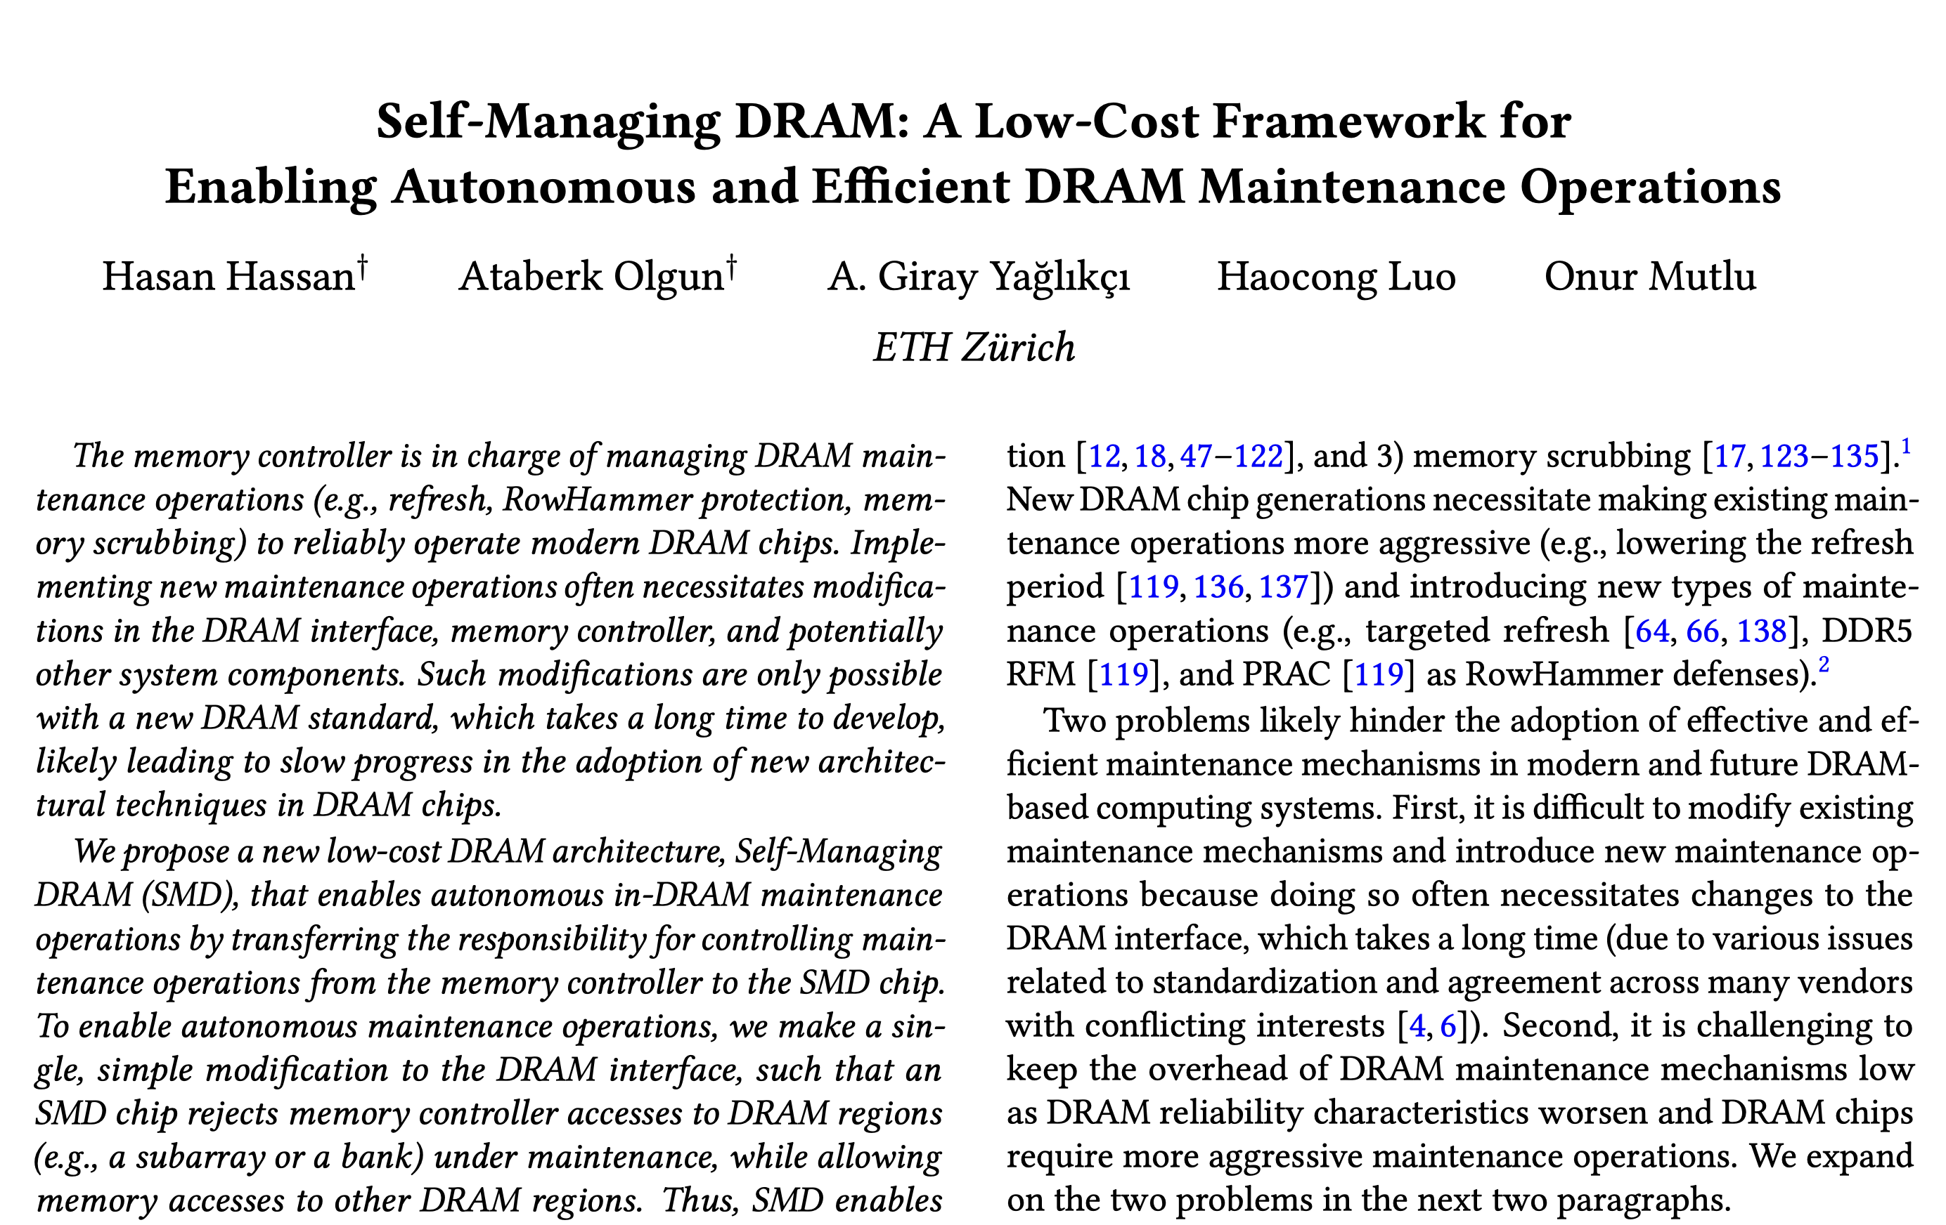
Proof of Forward Progress
https://arxiv.org/pdf/2207.13358
SMD breaks the chain of ACT commands and rejections
because:
Lock Region 0
locked for maintenance
ACT
NACK
i
MC issues the rejected ACT at the end of every RI
ii
SMD locks the same region after at least one RI
Notes:
You might be thinking about repetitive rejections leading to resource starvation issues. I won’t go into details of how, in the interest of time, but we prove that SMD ensures forward progress for memory requests in the paper.

Slide 48
SMD Outline
Motivation
Self-Managing DRAM (SMD)
Use Cases
Evaluations
Conclusion and Takeaways
Notes:
Now I’ll describe how we use SMD to implement efficient in-DRAM maintenance mechanisms

Slide 49
SMD-Based Maintenance Mechanisms
Demonstrate the usefulness and versatility of SMD
1
Fixed-Rate Refresh (SMD-FR)
2
Deterministic RowHammer Protection (SMD-DRP)
3
Memory Scrubbing (SMD-MS)
https://arxiv.org/pdf/2207.13358
Evaluate
Discuss
Variable-Rate Refresh Probabilistic RowHammer Protection
Online Error Profiling Power Management Processing in/near Memory …
Notes:
We describe and evaluate three use cases in our conference paper to demonstrate SMD’s usefulness and versatility
These are namely
[CLICK] Fixed-rate refresh
[CLICK] deterministic rowhammer protection
And [CLICK] memory scrubbing
[CLICK] The extended version of our conference paper evaluates two additional maintenance mechanisms
[CLICK] and discusses how SMD can be beneficial for many other applications. We also discuss all these mechanisms in our conference paper.

Slide 50
SMD-Based Maintenance Mechanisms
Demonstrate the usefulness and versatility of SMD
1
Fixed-Rate Refresh (SMD-FR)
2
Deterministic RowHammer Protection (SMD-DRP)
3
Memory Scrubbing (SMD-MS)
https://arxiv.org/pdf/2207.13358
Evaluate
Discuss
Variable-Rate Refresh Probabilistic RowHammer Protection
Online Error Profiling Power Management Processing in/near Memory …
Notes:
I will talk briefly about fixed rate refresh…

Slide 51
SMD-Based Maintenance Mechanisms
Demonstrate the usefulness and versatility of SMD
1
Fixed-Rate Refresh (SMD-FR)
2
Deterministic RowHammer Protection (SMD-DRP)
3
Memory Scrubbing (SMD-MS)
https://arxiv.org/pdf/2207.13358
Evaluate
Discuss
Variable-Rate Refresh Probabilistic RowHammer Protection
Online Error Profiling Power Management Processing in/near Memory …
Notes:
For other mechanisms, please check our paper.

Slide 52
DRAM Periodic Refresh
REF
DRAM encodes data
in leaky capacitors
Necessitates periodic refresh operations
Memory Controller (MC)
DRAM command
DRAM Chip
REF
data
[Patel+, DSN’19]
Notes:
DRAM stores data in leaky capacitors and [CLICK] today we periodically restore lost charge back to the capacitor
[CLICK] by [CLICK] issuing Refresh commands from the memory controller

Slide 53
Alleviating the Drawbacks of Periodic Refresh
i
Refresh commands spend command bus energy
e.g., 8192 REF commands in 64 milliseconds in DDR4
ii
Entire chip or bank inaccessible during refresh
e.g., for 350 nanoseconds in DDR4
Memory Controller (MC)
DRAM command
DRAM Chip
REF
data
Notes:
This method of performing refresh has two drawbacks
[CLICK] First, issuing commands to perform this operation induces energy overheads and creates contention on the memory bus
[CLICK] Second, during refresh, an entire chip or a bank is inaccessible
==========
Keep animating refresh commands on the bottom

Slide 54
Alleviating the Drawbacks of Periodic Refresh
i
Refresh commands spend command bus energy
e.g., 8192 REF commands in 64 milliseconds in DDR4
ii
Entire chip or bank inaccessible during refresh
e.g., for 350 nanoseconds in DDR4
i
No refresh commands sent over the command bus
ii
Allow access to most of the chip that is not under maintenance
Notes:
[CLICK] SMD gets rid of the first drawback [CLICK] by autonomously performing refresh inside the DRAM chip
[CLICK] and second drawback [CLICK], to some extent, by allowing access to lock regions that are not undergoing maintenance
======
Work with the commands figure more

Slide 55
SMD-FR – Implementation
Pending Refresh Counter (PRC)
Lock Region Counter (LRC)
Row Address Counter (RAC)
increment every refresh period
Increment LRC and RAC
Decrement PRC
PRC>0?
Release the locked region
YES
Lock the region corresponding to LRC
YES
Locked?
Refresh rows [RAC, RAC+RG)
NO
Refresh Granularity (RG) number of rows refreshed every time a region is locked
Notes:
In the interest of time, I must skip the implementation details of SMD-FR.

Slide 56
SMD-Based Maintenance Mechanisms
Demonstrate the usefulness and versatility of SMD
i
Fixed-Rate Refresh (SMD-FR)
ii
Deterministic RowHammer Protection (SMD-DRP)
iii
Memory Scrubbing (SMD-MS)
https://arxiv.org/pdf/2207.13358
Evaluate
Discuss
Variable-Rate Refresh Probabilistic RowHammer Protection
Online Error Profiling Power Management Processing in/near Memory …
Notes:
… for those implementation details and for other mechanisms, please check our paper.

Slide 57
SMD Outline
Motivation
Self-Managing DRAM (SMD)
Use Cases
Evaluations
Conclusion and Takeaways
Notes:
Moving on to SMD’s evaluations

Slide 58
Hardware Implementation and Overhead (I)
1
DRAM interface modifications
Two options:
Use existing alert_n signal at no additional pin cost OR
Add a new pin for each rank of DRAM chips (~1.6% processor pin count)
Memory Controller (MC)
DRAM Chip
negative acknowledgment (nack)
One interface change to end all interface changes for new in-DRAM maintenance mechanisms
Notes:
We’ll look at SMD’s hardware implementation and overhead first.
[CLICK] SMD requires one modification in the DRAM interface
[CLICK] that is the addition of the negative acknowledgment signal
[CLICK] we describe two options. The first one is to use a signal called alert_n that already exists in the DDR4 and DDR5 interfaces.
This comes at no additional pin cost. The second option is to add a new pin for each rank of DRAM chips in the system which comes
down to about 1.6% pin count for a modern many-channel system
[CLICK] again, SMD proposes this one-time change in the interface to hopefully prevent future modifications from implementing
new maintenance mechanisms

Slide 59
Hardware Implementation and Overhead (II)
2
DRAM chip modifications
i
Lock Region Bitvector (LRB)
0.001%* of a 45.5 mm² DRAM chip
Maintenance-access parallelization
ii
1.1%* of a 45.5 mm² DRAM chip
Maintenance mechanisms (orthogonal to SMD)
iii
https://arxiv.org/pdf/2207.13358
*modeled using CACTI 6.0
Notes:
We find that the DRAM chip modifications introduced by SMD are relatively small…

Slide 60
Hardware Implementation and Overhead (III)
3
Memory controller modifications
288 bytes of storage to keep track of locked regions
Leverage existing memory request scheduling logic for handling rejected ACT commands
Detailed explanation:
https://arxiv.org/pdf/2207.13358
Notes:
… and the memory controller needs small additional storage to track regions undergoing maintenance
=====
288 bytes per memory channel (2-rank module)

Slide 61
Evaluation Methodology
Cycle-level simulations using Ramulator [Kim+, CAL’15]
Baseline system configuration
Processor: 4GHz, 4-wide issue, 8 MSHRs/core
Last-Level Cache: 8-way associative, 4 MiB/core
Memory Controller: 64-entry read/write request queue FR-FCFS-Cap with Cap = 7
DRAM: DDR4-3200, 32 ms refresh period 4 channels, 2 ranks, 16 banks, 128K rows
SMD parameters
16 lock regions in a DRAM bank
16 subarrays in one lock region
Retry Interval (RI) = 62.5 nanoseconds
62 single-core and 60 four-core workloads
SPEC CPU2006/2017, TPC, STREAM, MediaBench
https://github.com/CMU-SAFARI/SelfManagingDRAM
Notes:
We use Ramulator to evaluate the performance and energy efficiency of SMD
[CLICK] This is our baseline system configuration for your reference and please check [CLICK] our github repo for more details.
[CLICK] We configure SMD with 16 lock regions in a DRAM bank, with 16 subarrays in each lock region, and with a retry interval of 62.5 nanoseconds. These are determined empirically.
[CLICK] We use 62 single core and 60 four-core workloads from major benchmark suites.
======
Either run simulations or retrieve data

Slide 62
Evaluated System Configurations
Baseline DDR4 system
refresh window = 32 millisecond
Fixed-Rate Refresh (SMD-FR)
refresh window = 32 millisecond, refresh granularity = 8
Deterministic RowHammer Protection (SMD-FR + SMD-DRP)
refresh neighbor rows of a row that gets activated 512 times
Memory Scrubbing (SMD-FR + SMD-MS)
5-minute scrubbing period
SMD-Combined combines SMD-FR + SMD-DRP + SMD-MS
No-Refresh DDR4 system that does not do maintenance
Notes:
We evaluate the Baseline DDR4 system shown in the previous slide
[CLICK] SMD-based fixed-rate refresh
[CLICK] SMD-based deterministic rowhammer
[CLICK] SMD-based memory scrubbing
[CLICK] SMD-Combined that combines all three mechanisms
[CLICK] and the hypothetical No-Refresh configuration that does not do any maintenance

Slide 63
Single-Core Performance
Average Speedup over Baseline
DDR4 Baseline
SMD provides 4.8% to 5.0% average speedup
Notes:
This plot shows the average speedup across all single core workloads over the baseline system for the tested system configurations.
We make two key observations. [CLICK] First, all SMD configurations provides substantial speedups.

Slide 64
Single-Core Performance
Average Speedup over Baseline
SMD-Combined provides 84.7% the speedup of No-Refresh
Notes:
Second, SMD-Combined provides a comparable average speeduxp to No-Refresh that does not do any maintenance operations.
=======
Add horizontal dashed lines from smd-combined and no-refresh and put the arrow below the green bar

Slide 65
Four-Core Performance
SMD-FR
SMD-FR+SMD-DRP
SMD-FR+SMD-MS
SMD-Combined
No-Refresh
Average Speedup over Baseline
Four-core workload misses per kilo instruction category
SMD provides higher speedups with increasing workload memory intensity
Notes:
This plot shows SMD’s performance in the same terms for four-core workloads.
[CLICK] The x-axis shows three classes of four-core workloads categorized based on their last level cache misses per kilo instruction statistics as a measure for their memory intensity.
[CLICKx8] Here is the full plot.
We observe that [CLICK] SMD provides higher speedups as memory intensity increases
======
DO NOT ANIMATE. GET TO THE POINT FASTER. Describe low/high intensity part.
Why no numbers here?

Slide 66
DRAM Energy
SMD-FR
SMD-FR+SMD-DRP
SMD-FR+SMD-MS
SMD-Combined
No-Refresh
Average DRAM Energy Normalized to Baseline
Four-core
All SMD configurations provide energy savings
Notes:
We show the [CLICK] average DRAM energy across all tested workloads normalized to the [CLICK] baseline. The lower the bar, the better in this case.
[CLICK] The x-axis shows single core workloads on the left and four core workloads on the right.
[CLICKx5] [CLICK] We observe that all SMD configurations provide substantial energy savings…

Slide 67
DRAM Energy
SMD-FR
SMD-FR+SMD-DRP
SMD-FR+SMD-MS
SMD-Combined
No-Refresh
Average DRAM Energy Normalized to Baseline
Four-core
SMD-Combined provides 59.6% of the energy savings of No-Refresh
Notes:
And we find that SMD-Combined provides more than half the energy savings provided by No-Refresh.

Slide 68
Performance and Energy Summary
SMD provides performance and energy benefits comparable to a hypothetical system without maintenance while improving system robustness
Benefits over the baseline system attributed to:
1
Overlapping the latency of maintenance operations with useful access operations
2
Reduced command interference and energy use: MC does not issue maintenance commands
Notes:
To summarize, SMD enables performance and energy efficient maintenance mechanisms and
provides comparable benefits to a hypothetical system without maintenance while increasing system robustness
[CLICK] we attribute these benefits to [CLICK] SMD overlapping the latency of maintenance operations with useful access operations
[CLICK] and to reduced command bus interference and energy use as the memory controller does not issue maintenance commands

Slide 69
More in the Paper
Proof of forward progress for memory requests
Discussion of more use cases
Variable rate refresh, RowHammer defenses, online error profiling…
Power management, processing-near-memory
Design choices
Evaluation of a policy that pauses maintenance operations
Discussion of a predictable SMD interface
Sensitivity analyses
Performance improves with number of lock regions
Benefits increase with reducing refresh period
Provide similar benefits across 1-, 2-, 4-, 8-core workloads
SMD-based scrubbing vs. MC-based scrubbing
SMD induces ~8X less overhead at a very high scrubbing rate
Notes:
There is much more about SMD in the paper that I could not cover in my talk. I already mentioned these bunch. We also have…
Pmp can improve performance
SMD can be designed to be more predictable
========
You spend more than what I expected.

Slide 70
More in the Paper
https://arxiv.org/pdf/2207.13358
Design choices
evaluation of a policy that pauses maintenance operations
discussion of a predictable SMD interface
Sensitivity analyses
performance improves with number of lock regions
benefits increase with reducing refresh period
provide similar benefits across 1-, 2-, 4-, 8-core workloads
SMD-based scrubbing vs. MC-based scrubbing
SMD induces ~8X less overhead at a very high scrubbing rate
Notes:
… please check our paper for those

Slide 71
SMD Outline
Motivation
Self-Managing DRAM (SMD)
Use Cases
Evaluations
Conclusion and Takeaways
Notes:
Let me quickly conclude

Slide 72
Self-Managing DRAM Conclusion
DDRx
Maintenance Mechanisms
Memory Controller (MC)
DRAM Chip
negative acknowledgment (nack)
New maintenance mechanisms require changes to DRAM standards
With a simple, single modification to the DRAM interface, SMD enables implementing new in-DRAM maintenance mechanisms with no further changes to the DRAM interface and other components
We showcase three high-performance and energy-efficient SMD-based in-DRAM maintenance mechanisms
Our Hope
SMD enables practical adoption of innovative ideas in DRAM design and inspires better ways of partitioning work between processor and DRAM

Slide 73
Extended Version on ArXiv
https://arxiv.org/pdf/2207.13358
Notes:
An extended version of our conference publication is available on arXiv

Slide 74
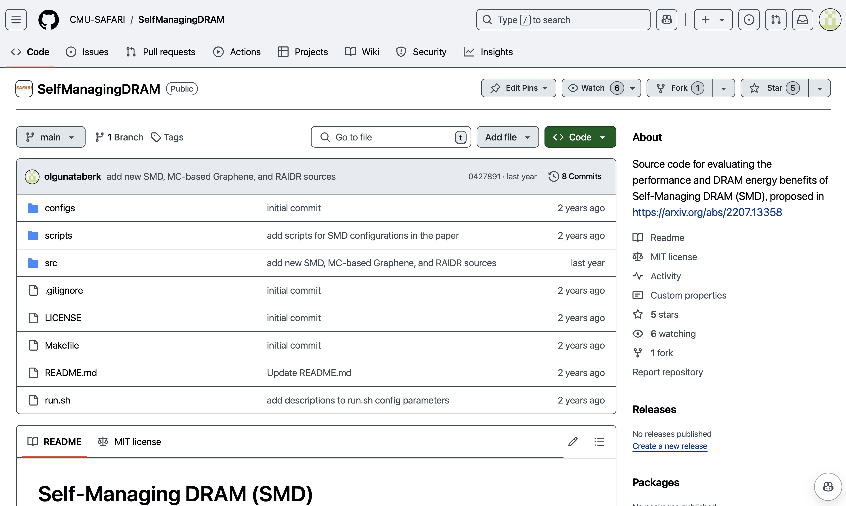
SMD is Open-Sourced
https://github.com/CMU-SAFARI/SelfManagingDRAM
Notes:
All data and code for SMD is open sourced

Slide 75
Self-Managing DRAM (SMD) A Low-Cost Framework for Enabling Autonomous and Efficient DRAM Maintenance Operations
Hasan Hassan, Ataberk Olgun, A. Giray Yaglikci, Haocong Luo, Onur Mutlu
https://arxiv.org/pdf/2207.13358
https://github.com/CMU-SAFARI/SelfManagingDRAM
Notes:
Hello everyone. I am Ataberk and I am happy to (finally) present Self-Managing DRAM: A Low-Cost Framework for Enabling Autonomous and Efficient DRAM Maintenance Operations

Slide 76
Backup Slides

Slide 77
Ensuring Forward Progress
SMD breaks the chain of ACT commands and rejections
because:
Lock Region 0
locked for maintenance
ACT
NACK
i
MC issues the rejected ACT at the end of every RI
ii
region is not locked for at least one RI after maintenance ends
Notes:
Lastly, we ensure forward progress for memory requests such that what you see on this slide, that is, a neverending chain of act commands and rejections, [CLICK] do not happen:
[CLICK] the memory controller retries a rejected ACT precisely at the end of every RI
[CLICK] and SMD waits for at least one full retry interval before locking the same lock region.
========
Add timelines et al., to explain this better

Slide 78
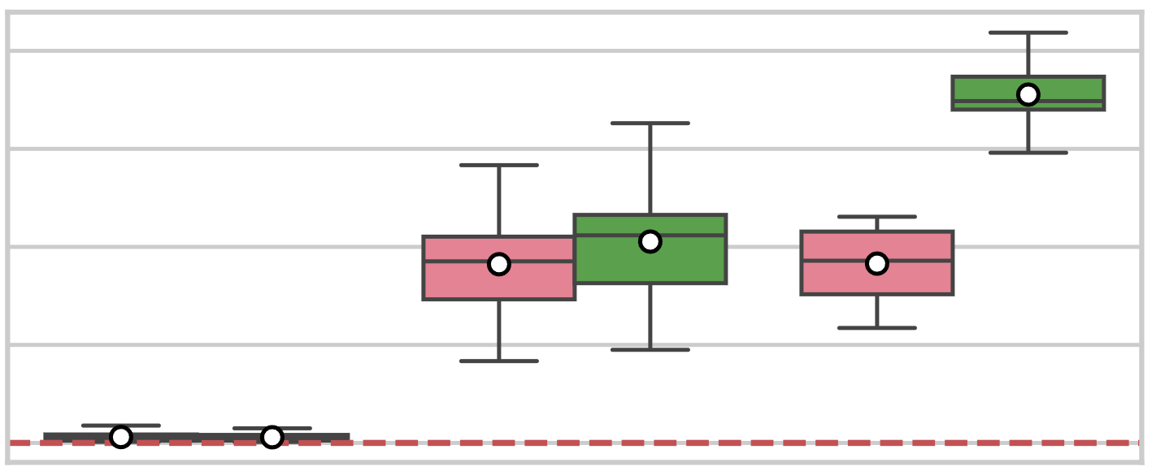
Performance Comparison
DSARP [Chang+, HPCA’14]
MC-based maintenance-access parallelization
DSARP-Combined
SMD-Combined
1.100
1.075
4.1%
Speedup over Baseline
1.050
1.025
1.000
Low (<1) MPKI
Medium (<10) MPKI
High (>=10) MPKI
SMD outperforms DSARP
Notes:
We also compare SMD to DSARP which is a memory-controller-based mechanism that allows maintenance-access parallelization.
[CLICK] We observe that SMD outperforms this mechanism for medium and high mpki four-core workloads.
=====
Why are you showing me this?
Animation bug

Slide 79
Pause Maintenance Policy

Slide 80
Sensitivity to Number of Lock Regions

Slide 81
SMD-based vs. MC-based Scrubbing

Slide 82
SMD-DRP

Slide 83
SMD-FR – Implementation
Pending Refresh Counter (PRC)
Lock Region Counter (LRC)
Row Address Counter (RAC)
increment every refresh period
Notes:
SMD-based fixed rate refresh has three main components:
The pending refresh counter counts indicates the number of refresh operations we have waiting to be done
[CLICK] lock region counter points to the lock region we must refresh next
[CLICK] and the row address counter points to the DRAM row we should start refresh operations from in the lock region
[CLICK] we increment the pending refresh counter every refresh period, that happens typically approximately every 8 microseconds
======
What do you do to make sure the region is not locked?

Slide 84
SMD-FR – Implementation
Pending Refresh Counter (PRC)
Lock Region Counter (LRC)
Row Address Counter (RAC)
increment every refresh period
Increment LRC and RAC
Decrement PRC
PRC>0?
Release the locked region
YES
Lock the region corresponding to LRC
YES
Locked?
Refresh rows [RAC, RAC+RG)
NO
Refresh Granularity (RG) number of rows refreshed every time a region is locked
Notes:
SMD-FR tries to do a refresh operation whenever PRC is greater than 0
[CLICK] it attempts to lock the region pointed by LRC
[CLICK] if the region is [CLICK] not locked, SMD-FR tries again
[CLICK] if the region is locked, SMD-FR refreshes RG number of rows [CLICK] where RG is the number of rows refreshed every time SMD-FR locks a region
[CLICK] after the operation completes, SMD-FR releases the lock region [CLICK] increments LRC and RAC, and [CLICK] decrements PRC
That is it for SMD-FR, again…
======
Flash this and put the paper on top and refer to the paper
Probably remove this.
What do you do to make sure the region is not locked?

Slide 85
Single-Core Performance
Average Speedup over Baseline
Notes:
[CLICK] This plot shows [CLICK] average speedup over [CLICK] baseline across all evaluated single-core workloads. A higher bar indicates better performance. Note that the y-axis starts at 0.9.
[CLICK] The x-axis shows the tested system configuration…
[CLICKx5] and here is how they perform
========
Put an arrow to the baseline DDR4. Consider removing animations
Based on the fact that I don’t have much time → shorten the description and just get to the point. “Single-core speedup over baseline ddr4 of all configurations”

Slide 86
“PRAC already does this?”

