Slide 1




SPARTA
Spatial Acceleration for Efficient and
Scalable Horizontal Diffusion
Weather Stencil Computation
Gagandeep Singh, Alireza Khodamoradi, Kristof Denolf,
Jack Lo, Juan Gómez-Luna, Joseph Melber, Andra Bisca,
Henk Corporaal, and Onur Mutlu
37th International Conference on Supercomputing (ICS)
Orlando, Florida

Slide 2
Talk Outline
Background and Motivation
SPARTA: Design and Implementation
Evaluation of SPARTA and Key Results
Summary

Slide 3
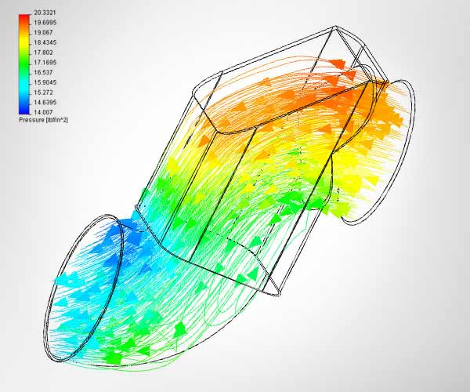

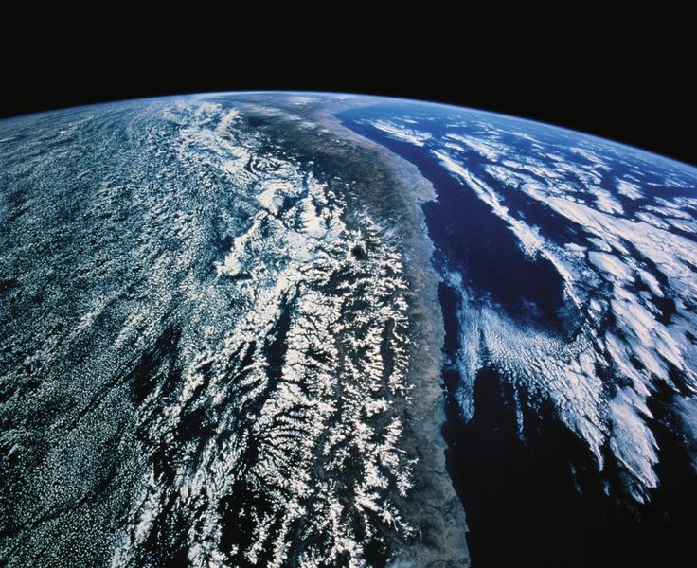
Stencil Computations and Applications
z
Stencil computations update values in a grid using a fixed pattern of grid points
Stencils are used in ~30% of high-performance computing applications
x
y
-,+,*
-,+,*
e.g., 7-point Jacobi in 3D plane
Fluid Dynamics
Image Processing
Climate/Weather Simulations
Image sources: http://www.flometrics.com/fluid-dynamics/computational-fluid-dynamics
Naoe, Kensuke et al., "Secure Key Generation for Static Visual Watermarking by Machine Learning in Intelligent Systems and Services," IJSSOE, 2010

Slide 4
Stencil Computations in Weather Applications
COSMO (Consortium for Small-Scale Modeling) weather prediction application [Thaler+, PASC’19]
The essential part of the weather prediction models is called the dynamical core (dycore)
Around 80 different stencil compute motifs
~30 variables and ~70 temporary arrays
Complex stencil computation
Stencil LH
2 arrays
Stencil VDP
18 arrays
Stencil VDT
14 arrays
VDQ
6 arrays
VDTuvw
17 arrays
HAW
10 arrays
Bound
Bound
C5 arrays
Halo Exchange
HAuv
8 arrays
Bound
VAuvw
13 arrays
Halo Exchange
HApptp
10 arrays
FWSCvdh
14 arrays
Bound
Bound
VApptp
9 arrays
FWSCuv
14 arrays
Section of
COSMO CDAG
(Courtesy CSCS/ETH
and Ronald Luijten)

Slide 5
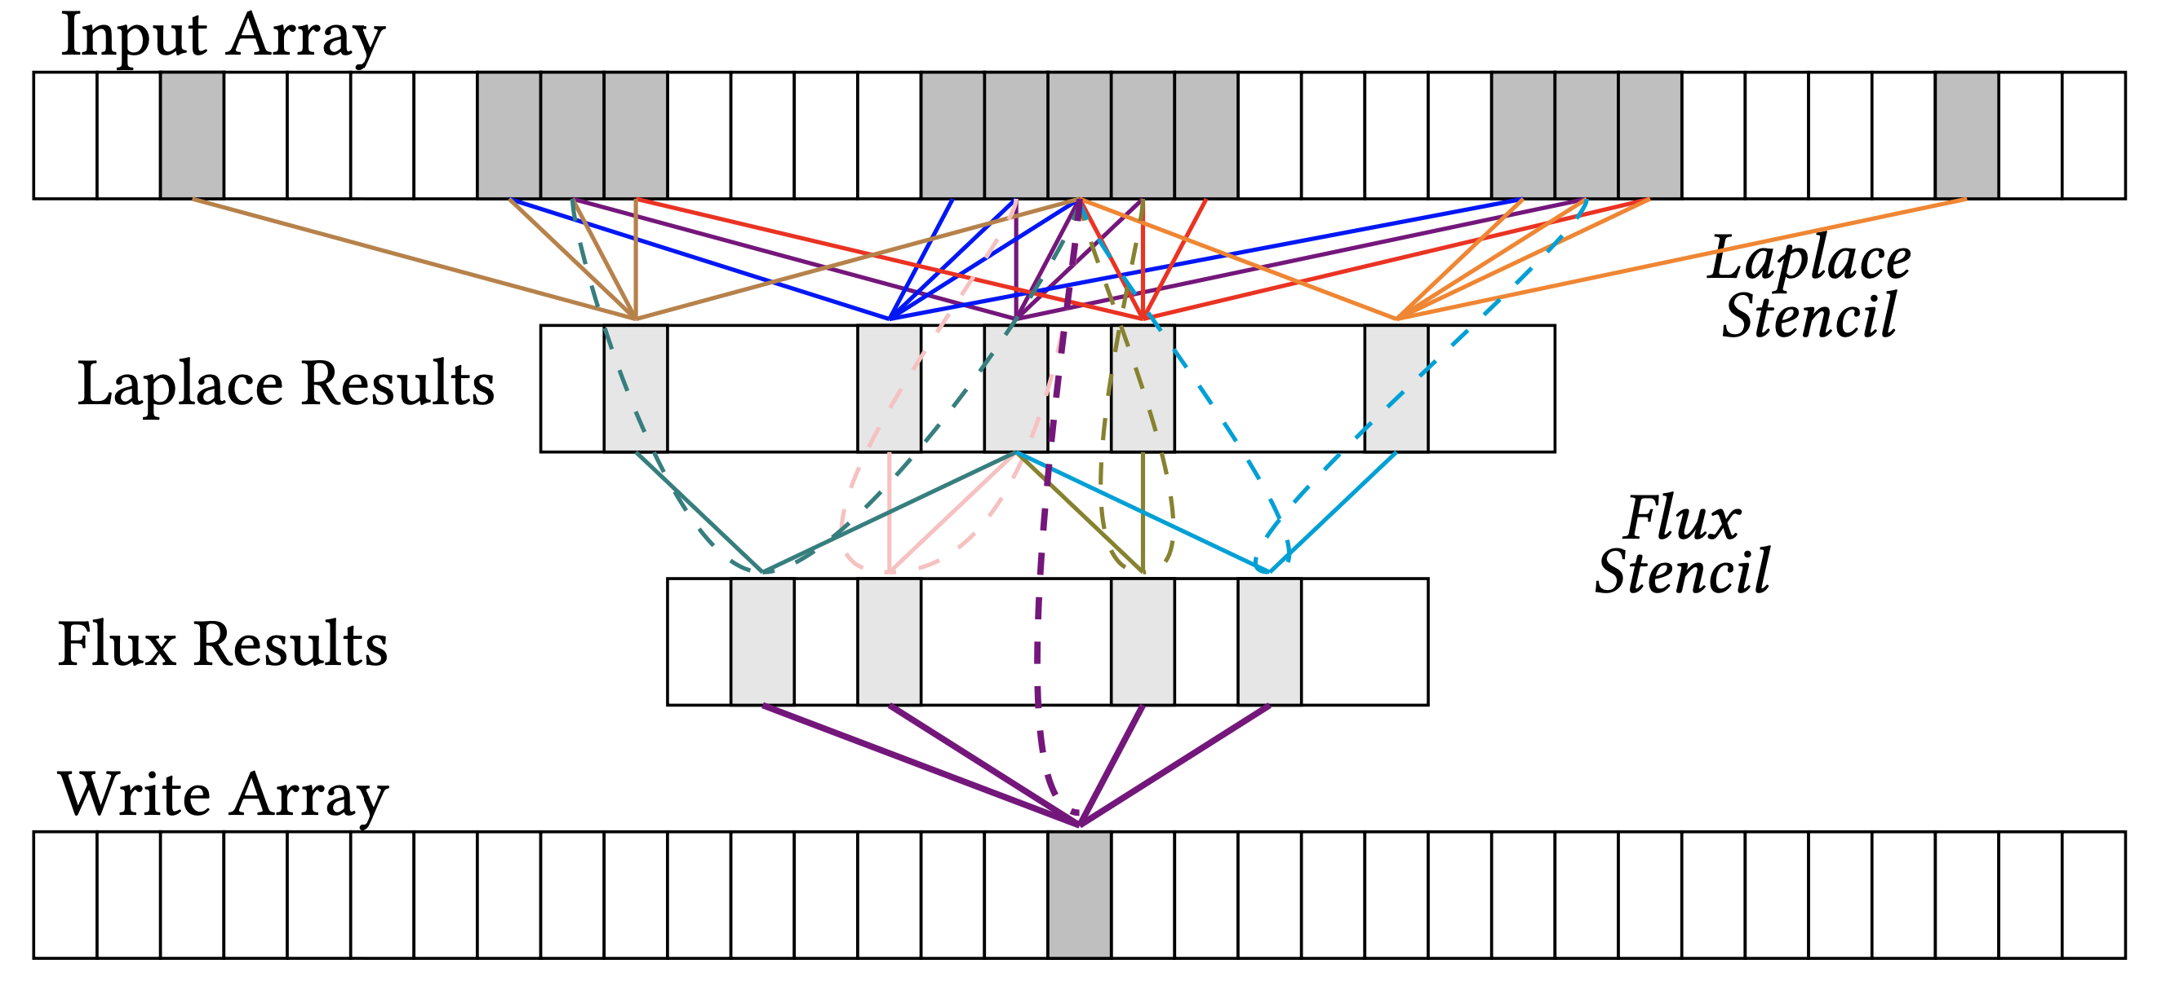
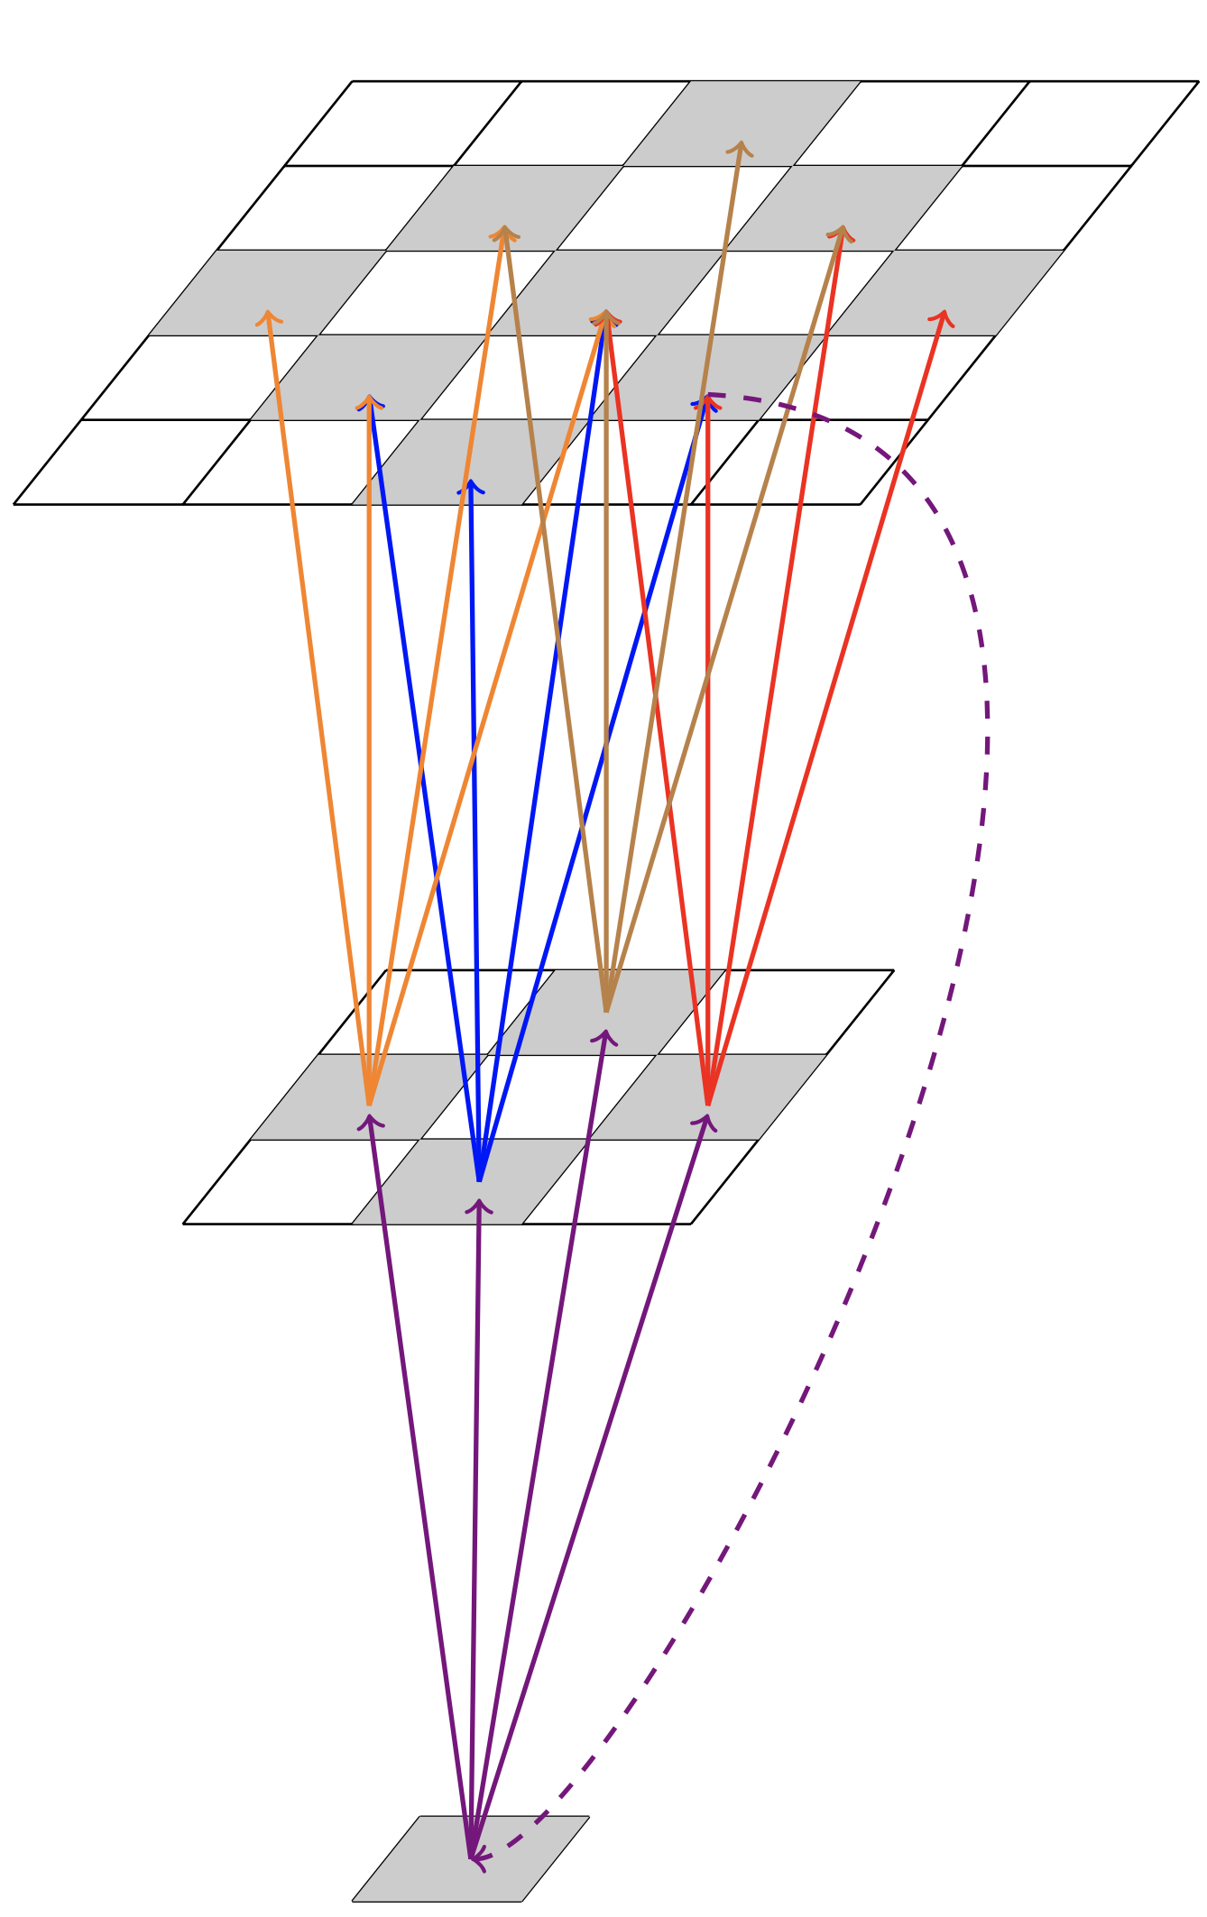
Fundamental Complex Stencil: Horizontal Diffusion
Compound stencil kernel consists of a collection of elementary stencil kernels
Iterates over a 3D grid performing Laplacian and flux operations
Complex memory access behavior with low arithmetic intensity
Laplacian Stencil
Flux Stencil
Output
Memory layout of horizontal diffusion
Kernel composition of
horizontal diffusion

Slide 6
Fundamental Complex Stencil: Horizontal Diffusion
Compound stencil kernel consists of a collection of elementary stencil kernels
Iterates over a 3D grid performing Laplacian and flux operations
Complex memory access behavior with low arithmetic intensity
Performance bottleneck
Laplacian Stencil
Flux Stencil
Output
Memory layout of horizontal diffusion
Kernel composition of
horizontal diffusion

Slide 7
Roofline Analysis
V100 GPU (14.1 TFLOPS/s, 900GBps HBM2)
AD9H7 FPGA (3.6 TFLOPS/s, 410GBPs HBM, 400MHz)
485.4 GFLOPS/s
POWER9 CPU (486.4 GFLOPS/s/socket)
485.4 GFLOPS/s
58.5 GFLOPS/s
<13.5% peak floating-point performance
on current computing systems

Slide 8
Spatial Architecture: AI Engine
High compute density
Allows for tailoring of the dataflow to optimize data movement
Direct Memory Access
AXI4 Stream
Cascade Stream
AIE
Core
Memory
AIE
Core
Memory
AIE
Core
Memory
Memory
AIE
Core
AIE
Core
AIE
Core
Memory
Memory
AIE
Core
Memory
AIE
Core
Memory
AIE
Core
Memory
Shim
DMA0
…
Shim
DMA15

Slide 9
Spatial Architecture: AI Engine
High compute density
Allows for tailoring of the dataflow to optimize data movement
2D layout of spatial architectures maps well to processing multi-dimensional stencil grids
Direct Memory Access
AXI4 Stream
Cascade Stream
AIE
Core
Memory
AIE
Core
Memory
AIE
Core
Memory
Memory
AIE
Core
AIE
Core
AIE
Core
Memory
Memory
AIE
Core
Memory
AIE
Core
Memory
AIE
Core
Memory
16KB
Program
Memory
Pre-Add
Unit
MAC/
MUL
Locks
DMA
Floating-Point Vector Unit
32 KB Multi-bank
Data memory
Load/Store Unit
32b
Scalar
Unit
Pre-Add
Unit
MAC/
MUL
Fixed-Point Vector Unit
AI Engine (AIE) Core

Slide 10
Our Goal
Mitigate the performance bottleneck of
compound weather prediction kernels
by taking advantage of the characteristics
of spatial computing systems

Slide 11
Our Proposal
SPARTA
Novel spatial accelerator for
efficient and scalable
horizontal diffusion
weather stencil computation

Slide 12
Talk Outline
Background and Motivation
SPARTA: Design and Implementation
Evaluation of SPARTA and Key Results
Summary

Slide 13
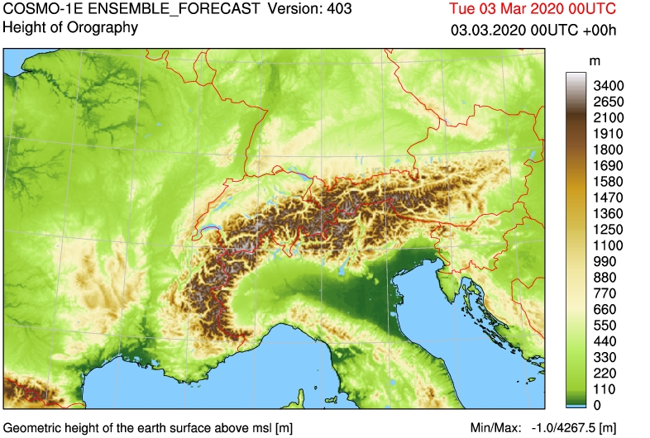
SPARTA Design: Single AIE Core Mapping
Weather Data in the DRAM
©MeteoSwiss
Input Plane
Input
Plane
128-bit AXI Interface
Local Memory (32-KB)
Transfer a tile consisting of elements from five grid rows
Vector Register File (256-bit)
Permute & Shuffle Network
Single plane
(
x
)
+
(
x
)
+
(
x
)
+
(
x
)
+
(
x
)
=
Shift
Round Saturate
srs()
acc0_{CR}
(
x
)
+
(
x
)
+
(
x
)
+
(
x
)
+
(
x
)
=
acc1_{CRm}
Vector Multiplier Unit
AI Engine Core
Lap_{CR}
Lap_{CRm}

Slide 14
SPARTA Design: Single AIE Core Mapping
Weather Data in the DRAM
©MeteoSwiss
Input Plane
Input
Plane
Imbalanced computation and memory demands
128-bit AXI Interface
Local Memory (32-KB)
Vector Register File (256-bit)
Permute & Shuffle Network
Flux stencils have lower compute-to-memory ratio
than Laplacian stencils
Single plane
(
x
)
+
(
x
)
+
(
x
)
+
(
x
)
+
(
x
)
=
Shift
Round Saturate
srs()
acc0_{CR}
(
x
)
+
(
x
)
+
(
x
)
+
(
x
)
+
(
x
)
=
acc1_{CRm}
Vector Multiplier Unit
AI Engine Core
Lap_{CR}
Lap_{CRm}

Slide 15

SPARTA Design: Multi-AIE Core Mapping
Divide computation over multiple AIE Cores: dual-AIE and tri-AIE design
ShimDMA0
Read Channel 0
Write Channel 0
Output Results
Broadcast Input
Laplacian
AIE Core
(0,1)
Flux
AIE Core 1
(1,1)
Flux
AIE Core 2
(2,1)
Memory
Memory
Memory
Data
Forward
Data
Forward
Multiplications and subtractions computed using MAC unit
Flux MAC operations
Flux non-MAC operations (select and compare)
Compute-bound distributed among multiple cores
Parallel execution of multiple AIE cores per shimDMA

Slide 16
SPARTA Design: Scaling Challenges
Balancing computation and memory resources
Limited external memory channels
Gathering and ordering of calculated results before sending them back to the external memory
Placing input and output cores close to the external memory interface to optimize data transfer

Slide 17
SPARTA Design: Scaling Accelerator Mapping
Broadcast Input
Read Channel 0
ShimDMA0
Laplacian
AIE Core
(0,1)
Memory
Flux
AIE Core 1
(1,1)
Memory
Flux
AIE Core 2
(2,1)
Memory
Laplacian
AIE Core
(0,2)
Memory
Flux
AIE Core 1
(1,2)
Memory
Flux
AIE Core 2
(2,2)
Memory
Laplacian
AIE Core
(0,3)
Memory
Flux
AIE Core 1
(1,3)
Memory
Flux
AIE Core 2
(2,3)
Memory
Laplacian
AIE Core
(0,4)
Memory
Flux
AIE Core 1
(1,4)
Memory
Flux
AIE Core 2
(2,4)
Memory

Slide 18
SPARTA Design: Scaling Accelerator Mapping
Broadcast Input
Read Channel 0
ShimDMA0
Write Channel 0
Laplacian
AIE Core
(0,1)
Memory
Flux
AIE Core 1
(1,1)
Memory
Flux
AIE Core 2
(2,1)
Memory
Laplacian
AIE Core
(0,2)
Memory
Flux
AIE Core 1
(1,2)
Memory
Flux
AIE Core 2
(2,2)
Memory
Gather Core
B-Block
Bundle of 12 AIE cores
Laplacian
AIE Core
(0,3)
Memory
Flux
AIE Core 1
(1,3)
Memory
Flux
AIE Core 2
(2,3)
Memory
Laplacian
AIE Core
(0,4)
Memory
Flux
AIE Core 1
(1,4)
Memory
Flux
AIE Core 2
(2,4)
Memory
Balance compute and memory resources
Maximize the usage of shimDMA channels
Efficient gathering and reordering of output
Exploit data-reuse by broadcasting input data to multiple cores

Slide 19
SPARTA Design: Scaling Accelerator Mapping
Read Channel 1
Write Channel 1
Broadcast Input
Read Channel 0
ShimDMA0
Write Channel 0
Laplacian
AIE Core
(0,1)
Memory
Flux
AIE Core 1
(1,1)
Memory
Flux
AIE Core 2
(2,1)
Memory
Laplacian
AIE Core
(0,2)
Memory
Flux
AIE Core 1
(1,2)
Memory
Flux
AIE Core 2
(2,2)
Memory
Gather Core
B-Block 1
Bundle of 12 AIE cores
Laplacian
AIE Core
(0,3)
Memory
Flux
AIE Core 1
(1,3)
Memory
Flux
AIE Core 2
(2,3)
Memory
Laplacian
AIE Core
(0,4)
Memory
Flux
AIE Core 1
(1,4)
Memory
Flux
AIE Core 2
(2,4)
Memory
Laplacian
AIE Core
(0,5)
Memory
Flux
AIE Core 1
(1,5)
Memory
Flux
AIE Core 2
(2,5)
Memory
Laplacian
AIE Core
(0,6)
Memory
Flux
AIE Core 1
(1,6)
Memory
Flux
AIE Core 2
(2,6)
Memory
B-Block 2
Bundle of 12 AIE cores
Laplacian
AIE Core
(0,7)
Memory
Flux
AIE Core 1
(1,7)
Memory
Flux
AIE Core 2
(2,7)
Memory
Laplacian
AIE Core
(0,8)
Memory
Flux
AIE Core 1
(1,8)
Memory
Flux
AIE Core 2
(2,8)
Memory

Slide 20
SPARTA Design: Scaling Accelerator Mapping
Read Channel 1
Write Channel 1
Read Channel 1
Write Channel 1
Read Channel 1
Write Channel 1
Read Channel 0
ShimDMA0
Write Channel 0
Read Channel 0
ShimDMA7
Write Channel 0
Read Channel 0
ShimDMA15
Write Channel 0
Laplacian
AIE Core
(0,1)
Memory
Flux
AIE Core 1
(1,1)
Memory
Flux
AIE Core 2
(2,1)
Memory
Laplacian
AIE Core
(21,1)
Memory
Flux
AIE Core 1
(22,1)
Memory
Flux
AIE Core 2
(23,1)
Memory
Laplacian
AIE Core
(45,1)
Memory
Flux
AIE Core 1
(46,1)
Memory
Flux
AIE Core 2
(47,1)
Memory
Laplacian
AIE Core
(0,2)
Memory
Flux
AIE Core 1
(1,2)
Memory
Flux
AIE Core 2
(2,2)
Memory
Laplacian
AIE Core
(21,2)
Memory
Flux
AIE Core 1
(22,2)
Memory
Flux
AIE Core 2
(23,2)
Memory
Laplacian
AIE Core
(45,2)
Memory
Flux
AIE Core 1
(46,2)
Memory
Flux
AIE Core 2
(47,2)
Memory
Laplacian
AIE Core
(0,3)
Memory
Flux
AIE Core 1
(1,3)
Memory
Flux
AIE Core 2
(2,3)
Memory
Laplacian
AIE Core
(21,3)
Memory
Flux
AIE Core 1
(22,3)
Memory
Flux
AIE Core 2
(23,3)
Memory
Laplacian
AIE Core
(45,3)
Memory
Flux
AIE Core 1
(46,3)
Memory
Flux
AIE Core 2
(47,3)
Memory
Laplacian
AIE Core
(0,4)
Memory
Flux
AIE Core 1
(1,4)
Memory
Flux
AIE Core 2
(2,4)
Memory
Laplacian
AIE Core
(21,4)
Memory
Flux
AIE Core 1
(22,4)
Memory
Flux
AIE Core 2
(23,4)
Memory
Laplacian
AIE Core
(45,4)
Memory
Flux
AIE Core 1
(46,4)
Memory
Flux
AIE Core 2
(47,4)
Memory
…
…
Laplacian
AIE Core
(0,5)
Memory
Flux
AIE Core 1
(1,5)
Memory
Flux
AIE Core 2
(2,5)
Memory
Laplacian
AIE Core
(21,5)
Memory
Flux
AIE Core 1
(22,5)
Memory
Flux
AIE Core 2
(23,5)
Memory
Laplacian
AIE Core
(45,5)
Memory
Flux
AIE Core 1
(46,5)
Memory
Flux
AIE Core 2
(47,5)
Memory
Laplacian
AIE Core
(0,6)
Memory
Flux
AIE Core 1
(1,6)
Memory
Flux
AIE Core 2
(2,6)
Memory
Laplacian
AIE Core
(21,6)
Memory
Flux
AIE Core 1
(22,6)
Memory
Flux
AIE Core 2
(23,6)
Memory
Laplacian
AIE Core
(45,6)
Memory
Flux
AIE Core 1
(46,6)
Memory
Flux
AIE Core 2
(47,6)
Memory
Laplacian
AIE Core
(0,7)
Memory
Flux
AIE Core 1
(1,7)
Memory
Flux
AIE Core 2
(2,7)
Memory
Laplacian
AIE Core
(21,7)
Memory
Flux
AIE Core 1
(22,7)
Memory
Flux
AIE Core 2
(23,7)
Memory
Laplacian
AIE Core
(45,7)
Memory
Flux
AIE Core 1
(46,7)
Memory
Flux
AIE Core 2
(47,7)
Memory
Laplacian
AIE Core
(0,8)
Memory
Flux
AIE Core 1
(1,8)
Memory
Flux
AIE Core 2
(2,8)
Memory
Laplacian
AIE Core
(21,8)
Memory
Flux
AIE Core 1
(22,8)
Memory
Flux
AIE Core 2
(23,8)
Memory
Laplacian
AIE Core
(45,8)
Memory
Flux
AIE Core 1
(46,8)
Memory
Flux
AIE Core 2
(47,8)
Memory

Slide 21
SPARTA Design: Scaling Accelerator Mapping
Read Channel 1
Write Channel 1
Read Channel 1
Write Channel 1
Read Channel 1
Write Channel 1
Read Channel 0
ShimDMA0
Write Channel 0
Read Channel 0
ShimDMA7
Write Channel 0
Read Channel 0
ShimDMA15
Write Channel 0
Laplacian
AIE Core
(0,1)
Memory
Flux
AIE Core 1
(1,1)
Memory
Flux
AIE Core 2
(2,1)
Memory
Laplacian
AIE Core
(21,1)
Memory
Flux
AIE Core 1
(22,1)
Memory
Flux
AIE Core 2
(23,1)
Memory
Laplacian
AIE Core
(45,1)
Memory
Flux
AIE Core 1
(46,1)
Memory
Flux
AIE Core 2
(47,1)
Memory
Laplacian
AIE Core
(0,2)
Flux
AIE Core 1
(1,2)
Flux
AIE Core 2
(2,2)
Laplacian
AIE Core
(21,2)
Flux
AIE Core 1
(22,2)
Flux
AIE Core 2
(23,2)
Laplacian
AIE Core
(45,2)
Flux
AIE Core 1
(46,2)
Flux
AIE Core 2
(47,2)
Highly scalable design that is expanded
to utilize 384 AIE cores
while maintaining
efficient resource allocation
Memory
Memory
Memory
Memory
Memory
Memory
Memory
Memory
Memory
Laplacian
AIE Core
(0,3)
Memory
Flux
AIE Core 1
(1,3)
Memory
Flux
AIE Core 2
(2,3)
Memory
Laplacian
AIE Core
(21,3)
Memory
Flux
AIE Core 1
(22,3)
Memory
Flux
AIE Core 2
(23,3)
Memory
Laplacian
AIE Core
(45,3)
Memory
Flux
AIE Core 1
(46,3)
Memory
Flux
AIE Core 2
(47,3)
Memory
Laplacian
AIE Core
(0,4)
Memory
Flux
AIE Core 1
(1,4)
Memory
Flux
AIE Core 2
(2,4)
Memory
Laplacian
AIE Core
(21,4)
Memory
Flux
AIE Core 1
(22,4)
Memory
Flux
AIE Core 2
(23,4)
Memory
Laplacian
AIE Core
(45,4)
Memory
Flux
AIE Core 1
(46,4)
Memory
Flux
AIE Core 2
(47,4)
Memory
…
…
Laplacian
AIE Core
(0,5)
Memory
Flux
AIE Core 1
(1,5)
Memory
Flux
AIE Core 2
(2,5)
Memory
Laplacian
AIE Core
(21,5)
Memory
Flux
AIE Core 1
(22,5)
Memory
Flux
AIE Core 2
(23,5)
Memory
Laplacian
AIE Core
(45,5)
Memory
Flux
AIE Core 1
(46,5)
Memory
Flux
AIE Core 2
(47,5)
Memory
Laplacian
AIE Core
(0,6)
Memory
Flux
AIE Core 1
(1,6)
Memory
Flux
AIE Core 2
(2,6)
Memory
Laplacian
AIE Core
(21,6)
Memory
Flux
AIE Core 1
(22,6)
Memory
Flux
AIE Core 2
(23,6)
Memory
Laplacian
AIE Core
(45,6)
Memory
Flux
AIE Core 1
(46,6)
Memory
Flux
AIE Core 2
(47,6)
Memory
Laplacian
AIE Core
(0,7)
Memory
Flux
AIE Core 1
(1,7)
Memory
Flux
AIE Core 2
(2,7)
Memory
Laplacian
AIE Core
(21,7)
Memory
Flux
AIE Core 1
(22,7)
Memory
Flux
AIE Core 2
(23,7)
Memory
Laplacian
AIE Core
(45,7)
Memory
Flux
AIE Core 1
(46,7)
Memory
Flux
AIE Core 2
(47,7)
Memory
Laplacian
AIE Core
(0,8)
Memory
Flux
AIE Core 1
(1,8)
Memory
Flux
AIE Core 2
(2,8)
Memory
Laplacian
AIE Core
(21,8)
Memory
Flux
AIE Core 1
(22,8)
Memory
Flux
AIE Core 2
(23,8)
Memory
Laplacian
AIE Core
(45,8)
Memory
Flux
AIE Core 1
(46,8)
Memory
Flux
AIE Core 2
(47,8)
Memory

Slide 22
SPARTA Application Toolflow
MLIR (Multi-Level Intermediate Representation) to separate the AIE core computation optimization and the effective dataflow management
AIE Kernel Source Code
(*.cc)
B-block Description
SPARTA Generator
Vitis AIE Compiler
AIE Kernel Headers
(*.h)
MLIR Dataflow
(aie.mlir)
Object files (*.o)
MLIR-AIE
Host Code
Tools
User Code
core_1_2.elf
ARM Core Executable (host.elf)
core_1_2.elf
AIE Core Executable
(aie_core*.elf)
Generated
Output
https://github.com/Xilinx/mlir-aie

Slide 23
Talk Outline
Background and Motivation
SPARTA: Design and Implementation
Evaluation of SPARTA and Key Results
Summary

Slide 24
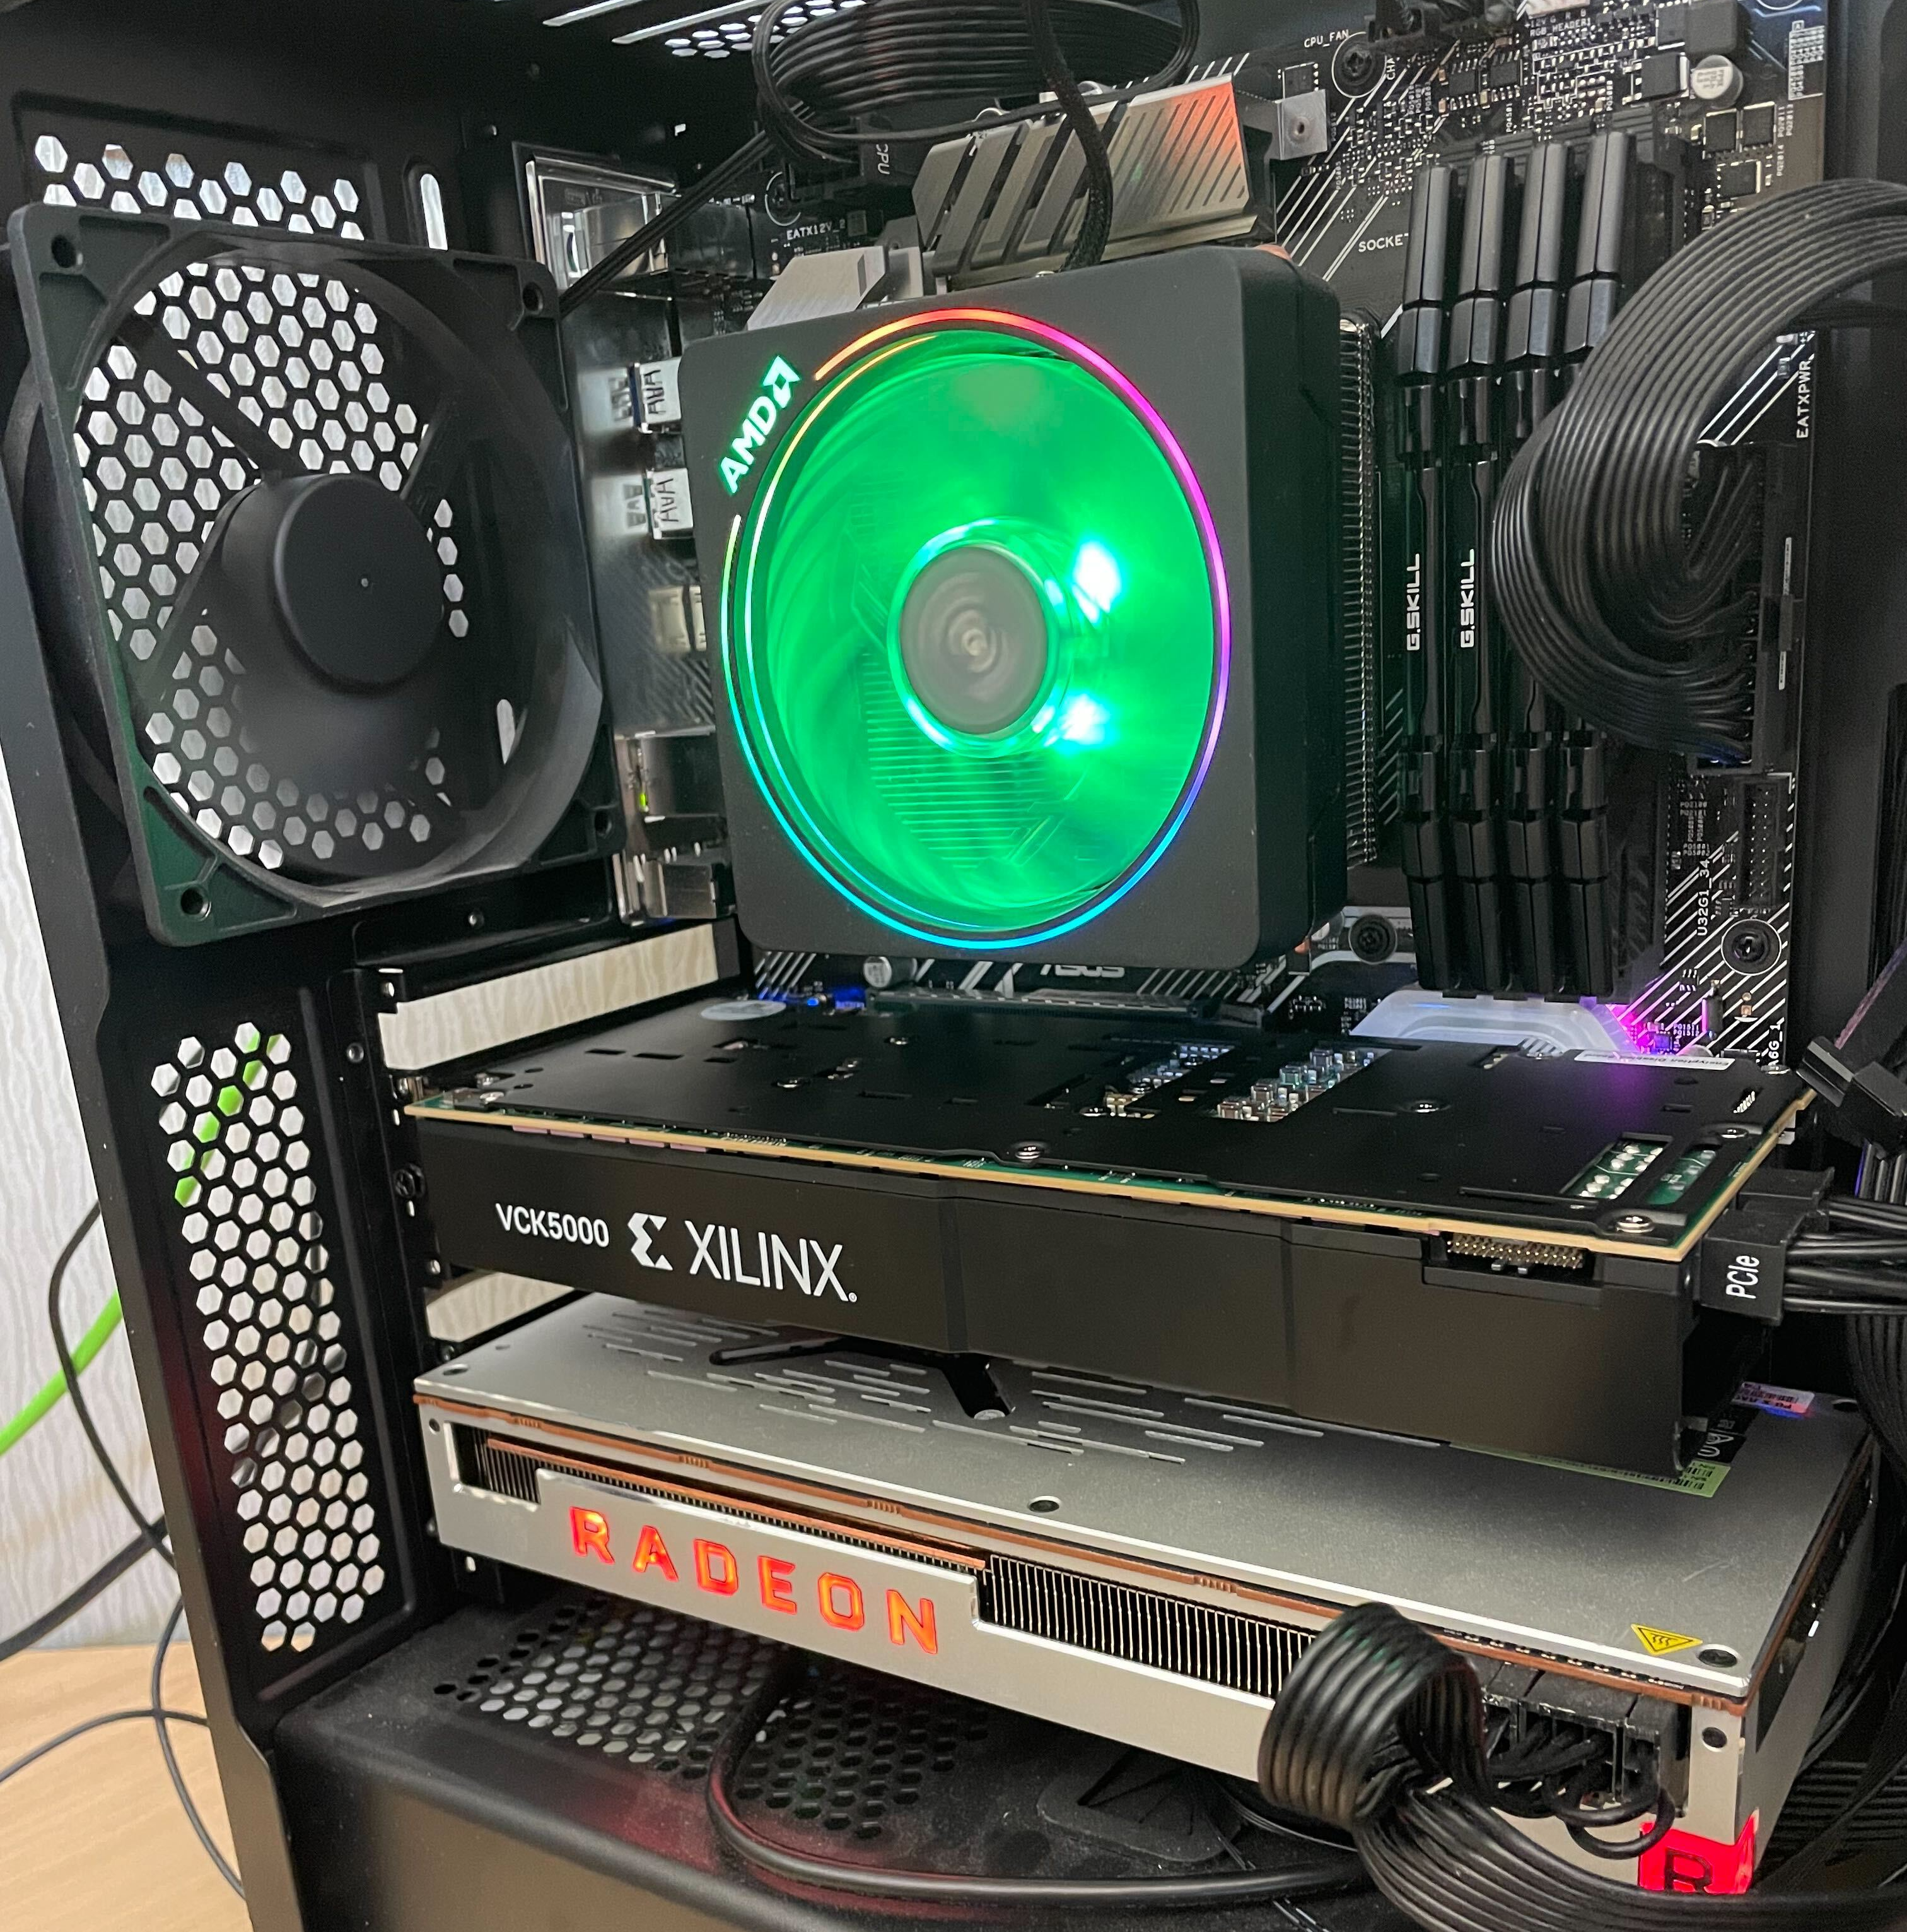
Evaluation Methodology (1/2)
Real system evaluation
Versal AIE Configuration
  Frequency: 1 GHz
  Cores: 400
AMD-Xilinx Versal AI Engine
AMD
MI50
GPU

Slide 25
Evaluation Methodology (2/2)
State-of-the-art baselines on all major computing platforms
  CPU [Singh+, FPL’21]
  GPU [Licht+, CGO’21]
  FPGA [Singh+, FPL’21]
Programming tools
  MLIR-AIE
  Vitis Chess Compiler v2022.2
Elementary stencil benchmarks
  jacobi-1d
  jacobi-2d-3pt
  Laplacian
  jacobi-2d-9pt
  seidel-2d
https://github.com/Xilinx/mlir-aie

Slide 26
SPARTA Performance: Single and Multi-AIE Design (1/2)
Single AIE
ShimDMA0
Read Channel 0
Write Channel 0
HDIFF
AIE Core
(0,1)
Memory
Output Results
All Laplacian and Flux Computations
Dual-AIE
Tri-AIE
Write Channel 0
Write Channel 0
ShimDMA0
ShimDMA0
Read Channel 0
Output Results
Read Channel 0
Output Results
Broadcast Input
Broadcast Input
Laplacian
AIE Core
(0,1)
Flux
AIE Core 1
(1,1)
Laplacian
AIE Core
(0,1)
Flux
AIE Core 1
(1,1)
Flux
AIE Core 2
(2,1)
Memory
Data
Forward
Memory
Memory
Data
Forward
Memory
Memory
Data
Forward
Multiplications and subtractions computed using MAC unit
Flux MAC and non-MAC operations
Multiplications and subtractions computed using MAC unit
Flux MAC operations
Flux non-MAC operations (select and compare)

Slide 27
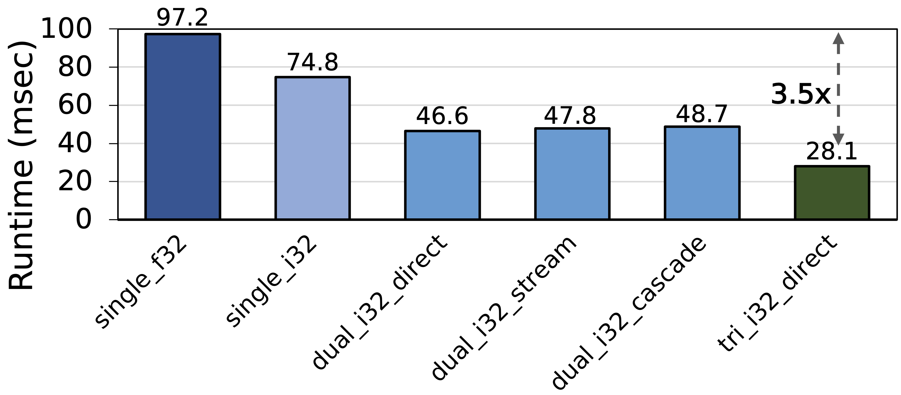
SPARTA Performance: Single and Multi-AIE Design (1/2)

Slide 28
SPARTA Performance: Single and Multi-AIE Design (1/2)
Tri-AIE design is 3.5x faster compared to a single-AIE design with floating-point implementation
Dual-AIE designs provide 1.9x-2.1x performance
than a single-AIE design depending upon
the data forwarding interface

Slide 29
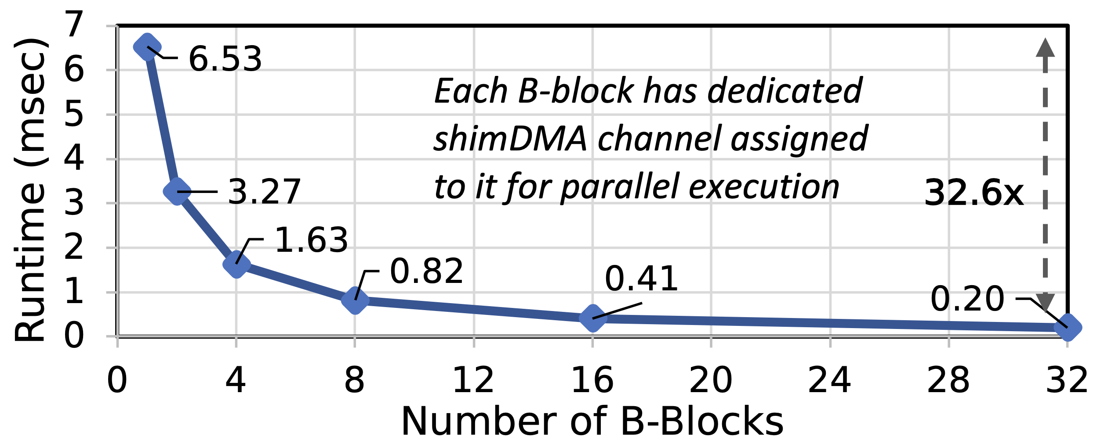
SPARTA Performance: Scaling Accelerator Design

Slide 30
SPARTA Performance: Scaling Accelerator Design
SPARTA is 32.6x faster than single-B-block-based design
Single B-block provides 4.3x higher performance
compared to a single-tri-AIE-based design
Performance scales linearly with the number of B-blocks

Slide 31
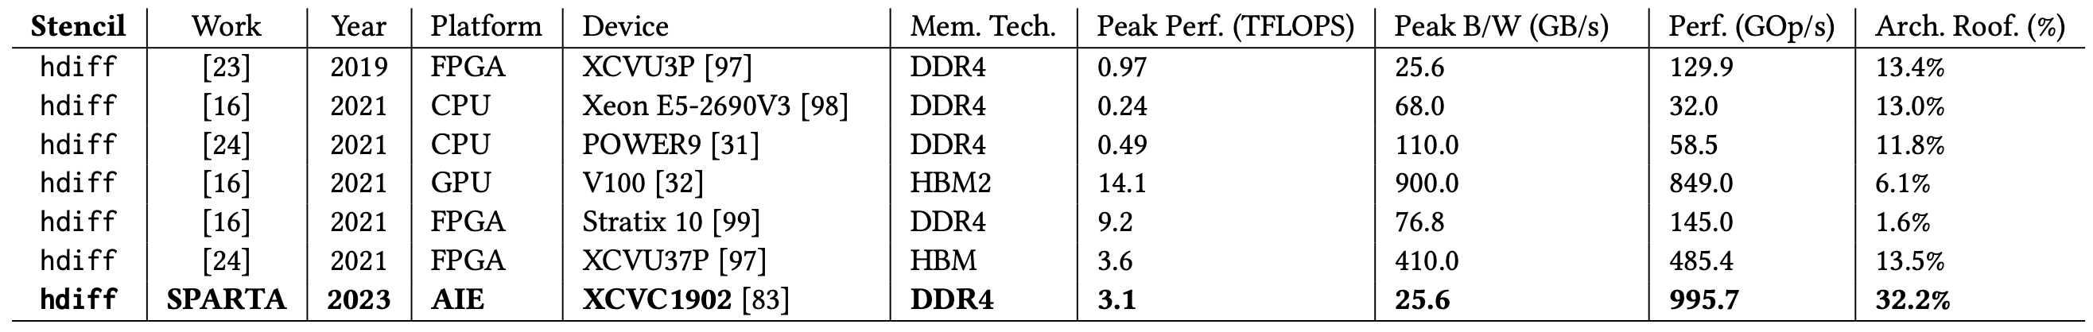
SPARTA Performance: Comparison to SOTA
SPARTA outperforms state-of-the-art CPU, GPU, and FPGA implementations by 17.1x, 1.2x, and 2.1x, respectively

Slide 32
SPARTA Performance: Comparison to SOTA
State-of-the-art implementations achieve only 1.6%-13.5%
of the peak theoretical performance of a platform
SPARTA achieves the highest
peak roofline performance of 32.2%

Slide 33
SPARTA Performance: Comparison to SOTA
SPARTA is 2.4x more energy-efficient with 42.2 GOps/Watt than the state-of-the-art FPGA design

Slide 34
More in the Paper
Results for elementary stencil benchmarks
Analytical modeling for computation and memory requirements
Implementation details for single and multi-AIE core mapping
Managing data transfer using MLIR
Discussion and key takeaways

Slide 35

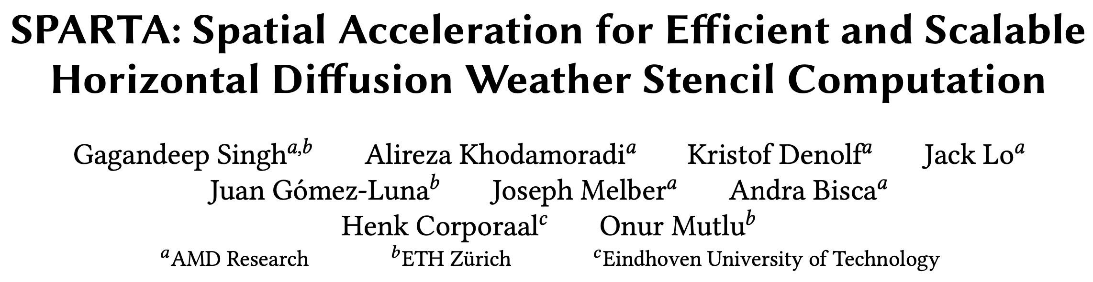
More in the Paper
Results for elementary stencil benchmarks
Analytical modeling for computation and memory requirements
Implementation details on single and tri-AIE core mapping
Managing data transfer using MLIR
Discussion and key takeaways
Full Paper
https://arxiv.org/pdf/2303.03509.pdf

Slide 36
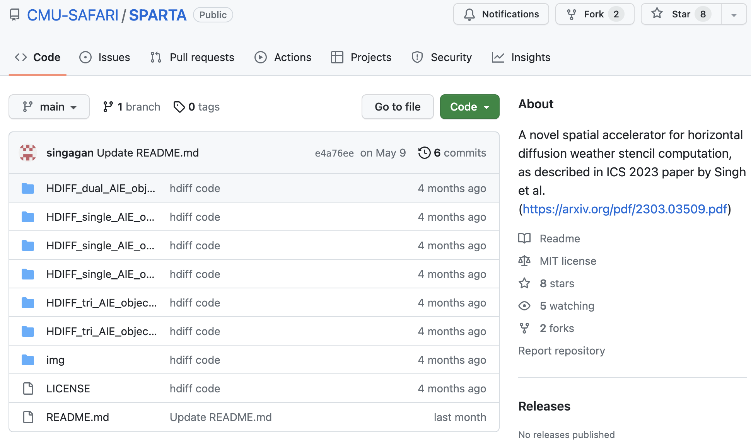

SPARTA is Open Sourced
SPARTA Code
https://github.com/CMU-SAFARI/SPARTA
https://github.com/Xilinx/mlir-aie

Slide 37
Talk Outline
Background and Motivation
SPARTA: Design and Implementation
Evaluation of SPARTA and Key Results
Summary

Slide 38
Summary
Mitigate the performance bottleneck
of compound weather prediction kernels
by taking advantage of the characteristics
of spatial computing systems
SPARTA is a novel spatial accelerator
for efficient and scalable
horizontal diffusion
weather stencil computation
SPARTA outperforms state-of-the-art CPU, GPU,
and FPGA horizontal diffusion implementations
by 17.1x, 1.2x, and 2.1x, respectively
https://github.com/CMU-SAFARI/SPARTA

Slide 39
SPARTA
Spatial Acceleration for Efficient and
Scalable Horizontal Diffusion
Weather Stencil Computation
Gagandeep Singh, Alireza Khodamoradi, Kristof Denolf,
Jack Lo, Juan Gómez-Luna, Joseph Melber, Andra Bisca,
Henk Corporaal, and Onur Mutlu
37th International Conference on Supercomputing (ICS)
Orlando, Florida

