Slide 1





Formal Supervisory Control and Coordination for Many-core Systems Resource Management
SPECTR
Amir M. Rahmani Bryan Donyanavard Tiago Mück Kasra Moazzemi
Axel Jantsch Onur Mutlu Nikil Dutt
23rd ACM International Conference on Architectural Support for Programming Languages and Operating Systems Williamsburg, VA, March 2018
Notes:
Thank you for the introduction. Today, I will present our work about …

Slide 2
Motivation
Formal supervisory control theory (SCT) can combine the strengths of classical control theory and heuristics to
  meet changing runtime goals (Autonomy)
  offer a systematic design flow for hierarchical control (Scalability)
 | Methods | Robustness | Formalism | Efficiency | Coordination | Scalability | Autonomy
A | Machine learning |  | ✔ | ✔ | ✔
B | Estimation/Model based heuristics |  |  | ✔ | ✔
C | SISO Control Theory | ✔ | ✔ | ✔ |  | ✹
D | MIMO Control Theory | ✔ | ✔ | ✔ | ✔
E | Supervisory Control Theory [SPECTR] | ✔ | ✔ | ✔ | ✔ | ✔ | ✔
Major on-chip resource management approaches and the key questions they address (∗ = partially addressed)

Slide 3
Motivation
Formal supervisory control theory (SCT) can combine the strengths of classical control theory and heuristics to
  meet changing runtime goals (Autonomy)
  offer a systematic design flow for hierarchical control (Scalability)
 | Methods | Robustness | Formalism | Efficiency | Coordination | Scalability | Autonomy
A | Machine learning |  | ✔ | ✔ | ✔
B | Estimation/Model based heuristics |  |  | ✔ | ✔
C | SISO Control Theory | ✔ | ✔ | ✔ |  | ✹
D | MIMO Control Theory | ✔ | ✔ | ✔ | ✔
E | Supervisory Control Theory [SPECTR] | ✔ | ✔ | ✔ | ✔ | ✔ | ✔
Major on-chip resource management approaches and the key questions they address (∗ = partially addressed)

Slide 4
Motivation
Formal supervisory control theory (SCT) can combine the strengths of classical control theory and heuristics to
  meet changing runtime goals (Autonomy)
  offer a systematic design flow for hierarchical control (Scalability)
 | Methods | Robustness | Formalism | Efficiency | Coordination | Scalability | Autonomy
A | Machine learning |  | ✔ | ✔ | ✔
B | Estimation/Model based heuristics |  |  | ✔ | ✔
C | SISO Control Theory | ✔ | ✔ | ✔ |  | ✹
D | MIMO Control Theory | ✔ | ✔ | ✔ | ✔
E | Supervisory Control Theory [SPECTR] | ✔ | ✔ | ✔ | ✔ | ✔ | ✔
Major on-chip resource management approaches and the key questions they address (∗ = partially addressed)

Slide 5
SPECTR overview
User inputs
Variable Goals and Policies
SPECTR
Con_hi
Supervisory Controller
Supervisory Controller
Inf_hi
High-level Plant Model
Gains₁
Gains₂
Gains_{N}
Refs₁
Refs₂
…
…
Refs_{N}
Leaf Controllers
Classic Controller 1
Classic Controller 2
Classic Controller N
System events
Inf_lo_hi
Con_lo₁
Con_lo₂
Con_lo_{N}
Inf_lo₁
Inf_lo₂
…
…
Inf_lo_{N}
Physical Plant
Sub-plant 1
Sub-plant 2
Sub-plant N
Notes:
Our technique SPECTR which is based on Supervisory
The supervisory controller in our appraoch called SPECTR, expoits a high-level model to orcestrate several low-level controllers while providing garantees for controlabilioty and non-blockingness of the control approach.

Slide 6
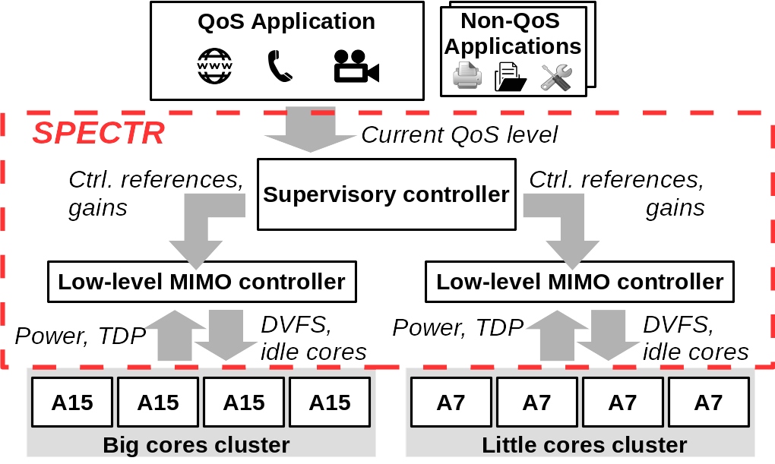
Case Study
ODROID-XU3 platform contains an Exynos 5422 Octa-core SoC
System goals:
  Meet the QoS requirement of the foreground application
  Ensure the total system power always remains below the Thermal Design Power (TDP)
  Minimize energy consumption
Notes:
We implemented spectr on an ODROID-XU3 platform containing and OCTA-core big-little SoC and dominstrate that it can navigate and meet compeeting goals such as power capping, energy-efficiency, and meeting QoS dynamically

Slide 7
Case Study
ODROID-XU3 platform contains an Exynos 5422 Octa-core SoC
System goals:
  Meet the QoS requirement of the foreground application
  Ensure the total system power always remains below the Thermal Design Power (TDP)
  Minimize energy consumption
SPECTR achieves up to 8x and 6x better target QoS and power tracking over state-of-the-art, respectively (in our case study)
Notes:
Tiago

Slide 8
Formal Supervisory Control and Coordination for Many-core Systems Resource Management
SPECTR
Amir M. Rahmani Bryan Donyanavard Tiago Mück Kasra Moazzemi
Axel Jantsch Onur Mutlu Nikil Dutt
23rd ACM International Conference on Architectural Support for Programming Languages and Operating Systems Williamsburg, VA, March 2018
Notes:
Thank you for the introduction. Today, I will present our work about …

