Slide 1
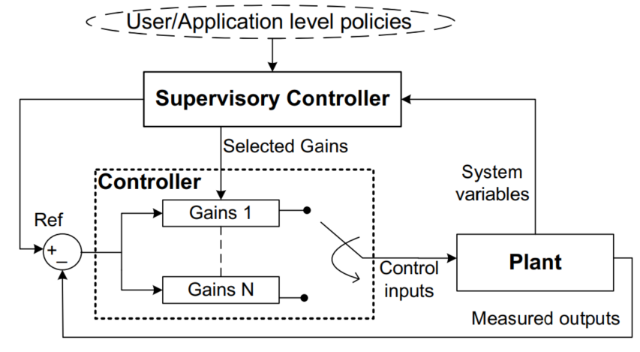
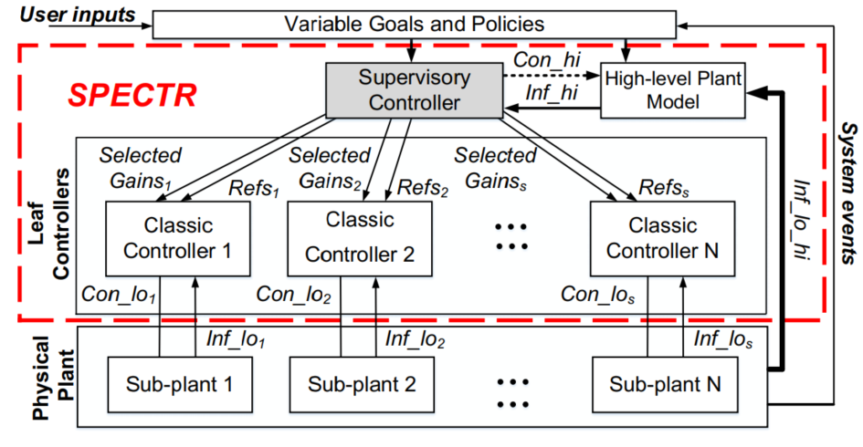
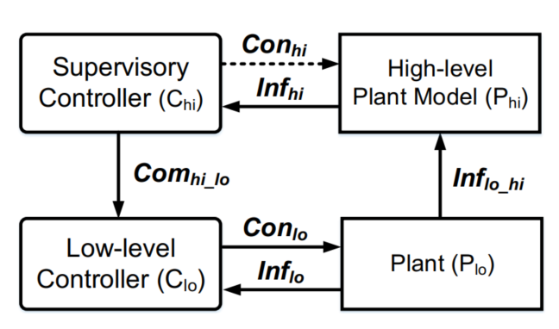
SPECTR: Formal Supervisory Control and Coordination for Many-core Systems Resource Management
Amir M. Rahmani†‡, Bryan Donyanavard†, Tiago Mück†, Kasra Moazzemi†, Axel Jantsch‡, Onur Mutlu§, Nikil Dutt† †University of California, Irvine, USA ‡TU Wien, Austria §ETH Zurich, Switzerland
{amirr1,bdonyana,tmuck,moazzemi,dutt}@uci.edu, axel.jantsch@tuwien.ac.at, onur.mutlu@inf.ethz.ch
Problem
Challenges in resource management of many-cores systems
Several conflicting goals/constraints
Heterogeneous resources
Multiple tunable knobs
Current resource management solutions use Ad hoc heuristics
Can be sub-optimal
Hard to add learning
No guarantees
No formal methodology
Lack of flexibility
MIMO Control Theory
Formal methodology
Provides guarantees
Fixed policies/goals
Not scalable
Supports only continuous
systems dynamics
✓
✓
✖
✖
✖
Solution
Scalability via Supervisory control
Autonomy via Supervisory control
SPECTR
Models discrete system dynamics
Hierarchical system decomposition
Automatic synthesis and verification
High-level policy management
Allows gain scheduling and dynamic references
low computational complexity
Integrate logic with continuous dynamics
Formal methodology
Provides guarantees
Adds Scalability
Dynamically adapts policies
Combines discrete
and continuous logic
✓
✓
✓
✓
✓
Results
System goals
Meet the QoS requirement of foreground app
Stay below Thermal Design Power (TDP) and save energy
QoS task: x264
3-phase execution scenario:
Only foreground app runs
Thermal emergency (max power decreases)
Background apps triggered
MIMO Power
Full System Controller
MIMO Performance
SPECTR
ASPLOS2018

