Slide 1





Formal Supervisory Control and Coordination for Many-core Systems Resource Management
SPECTR
Amir M. Rahmani Bryan Donyanavard Tiago Mück Kasra Moazzemi
Axel Jantsch Onur Mutlu Nikil Dutt
23rd ACM International Conference on Architectural Support for Programming Languages and Operating Systems Williamsburg, VA, March 2018
Notes:
Thank you for the introduction. Today, I will present our work about …

Slide 2
Executive Summary
  Motivation:
    Formal supervisory control theory (SCT) can combine the strengths of classical control theory with heuristic approaches to efficiently meet changing runtime goals.
    SCT enables hierarchical control and facilitates automatic synthesis of the high-level supervisory controller and its property verification.
Problem: Current resource management techniques do not offer 1) robustness, 2) formalism, 3) efficiency, 4) coordination, 5) scalability, and 6) autonomy all together.
Goal: Address all six key challenges in heterogeneous multiprocessors (HMPs) resource management, in particular scalability and autonomy
Our Proposal: SPECTR uses SCT techniques such as gain scheduling to allow autonomy for individual controllers, and modular decomposition of control problems to manage complexity.
Evaluation:
    We implement SPECTR on an Exynos platform containing ARM’s big.LITTLE-based HMP
    SPECTR can manage multiple interacting resources (e.g., chip power and processing cores) in the presence of competing objectives (e.g., satisfying QoS vs. power capping)
    SPECTR achieves up to 8x and 6x better target QoS and power tracking over state-of-the-art, respectively (in our case study).
Notes:
To begin, I will give a brief overview. [CLICK] Our motivation is that we can [CLICK] authenticate a system via unique signatures if we can evaluate a Physical Unclonable Function (PUF) on it. [CLICK] These signatures or PUF responses reflect inherent properties of a device making it unique to the DRAM device generating it. [CLICK] DRAM memory technology is widely used today and has significantly many units that can be used in PUF evaluation, which makes it a promising substrate to evaluate PUFs on. A DRAM PUF would enable you to authenticate any system with a DRAM device on it. [CLICK] The main problem is that current DRAM PUFs are either slow, taking on the order of minutes to evaluate, require a DRAM reboot, or require additional custom hardware and cannot be used on commodity DRAM devices. [CLICK] To this end the goal of this work is to develop a novel and effective PUF for commodity DRAM devices that can be evaluated with low latency and low system interference across all operating temperatures. [CLICK] Our key idea is to reduce DRAM read access latency below the reliable datasheet specifications using software-only system calls in order to exploit the resulting error patterns as unique identifiers. We can do this because we observe that we get reliable and consistent error patterns as a result that can be used as a PUF responses [CLICK] We experimentally characterize 223 real LPDDR4 DRAM devices, and show that DRAM latency PUFs satisfy the requirements of an effective PUF [CLICK] We also find that the DRAM latency PUF can be evaluated in 88.2 ms on average regardless of temperature. Since the evaluation time of prior DRAM PUFs depends on temperature, there is a large tradeoff space. However, we determine that we still achieve a speedup orders of magnitude larger than the prior DRAM PUF proposals at common operating temperatures.

Slide 3
SPECTR Outline
Motivation
MIMO Control Theory for Coordinated Management
Unaddressed Challenges in Resource Management
  Autonomy
  Scalability
Supervisory Control Theory (SCT) via SPECTR
  Scalability and Autonomy through SCT
  SPECTR Overview
  Case Study
Case Study
Results
Summary
Supervisor Synthesis Process
Results
Summary

Slide 4
SPECTR Outline
Motivation
MIMO Control Theory for Coordinated Management
Unaddressed Challenges in Resource Management
  Autonomy
  Scalability
Supervisory Control Theory (SCT) via SPECTR
  Scalability and Autonomy through SCT
  SPECTR Overview
  Case Study
Case Study
Results
Summary
Supervisor Synthesis Process
Results
Summary

Slide 5



Resource Management in Many-core Systems
Several conflicting goals/constraints
Multiple tunable knobs
Ad hoc heuristics
  Can be sub-optimal
  No formal methodology
  No guarantees
Notes:
Amir

Slide 6
Challenges in Resource Management
  Can we offer a systematic design flow for hierarchical control (Scalability)?
Guaranteed coordination of multiple conflicting goals has been recently addressed for single-core systems via MIMO control theory [ISCA’16].
  What if goal changes at runtime (Autonomy)?
The Goal
 | Methods | Robustness | Formalism | Efficiency | Coordination | Scalability | Autonomy
A | Machine learning |  | ✔ | ✔ | ✔
B | Estimation/Model based heuristics |  |  | ✔ | ✔
C | SISO Control Theory | ✔ | ✔ | ✔ |  | ✹
D | MIMO Control Theory | ✔ | ✔ | ✔ | ✔
E | Supervisory Control Theory [SPECTR] | ✔ | ✔ | ✔ | ✔ | ✔ | ✔
Major on-chip resource management approaches and the key questions they address (∗ = partially addressed)
Notes:
[CLICK] A PUF is a function that generates a signature that is unique to a given device. [CLICK] PUFs are often used in a challenge-response protocol where [CLICK] a trusted server issues a set of input parameters to a device, and the device generates the PUF response depending on the input parameters. [CLICK] The trusted server then receives the PUF response and can authenticate the device.

Slide 7
SPECTR Outline
Motivation
MIMO Control Theory for Coordinated Management
Unaddressed Challenges in Resource Management
  Autonomy
  Scalability
Supervisory Control Theory (SCT) via SPECTR
  Scalability and Autonomy through SCT
  SPECTR Overview
  Case Study
Case Study
Results
Summary
Supervisor Synthesis Process
Results
Summary

Slide 8
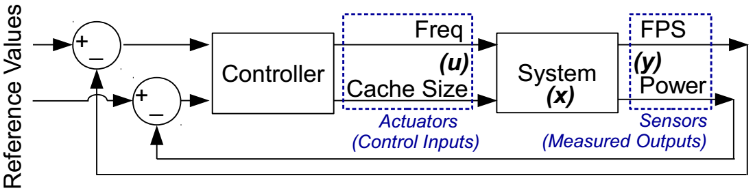
MIMO Control Theory for Coordination
Benefits:
Simultaneously and robustly track multiple objectives
Notes:
Amir

Slide 9
MIMO Control Theory for Coordination
Benefits:
Simultaneously and robustly track multiple objectives
Shortcomings:
The goal is fixed at design-time
The weighted Tracking Error Cost matrix is fixed.
FPS:Power <= 1:10
when Maximizing FPS under a Power cap
Notes:
Amir

Slide 10
MIMO Control Theory for Coordination
Benefits:
Simultaneously and robustly track multiple objectives
Shortcomings:
The goal is fixed at design-time
Does NOT scale when having several control inputs and measured outputs.
Notes:
Amir

Slide 11
SPECTR Outline
Motivation
MIMO Control Theory for Coordinated Management
Unaddressed Challenges in Resource Management
  Autonomy
  Scalability
Supervisory Control Theory (SCT) via SPECTR
  Scalability and Autonomy through SCT
  SPECTR Overview
  Case Study
Case Study
Results
Summary
Supervisor Synthesis Process
Results
Summary

Slide 12
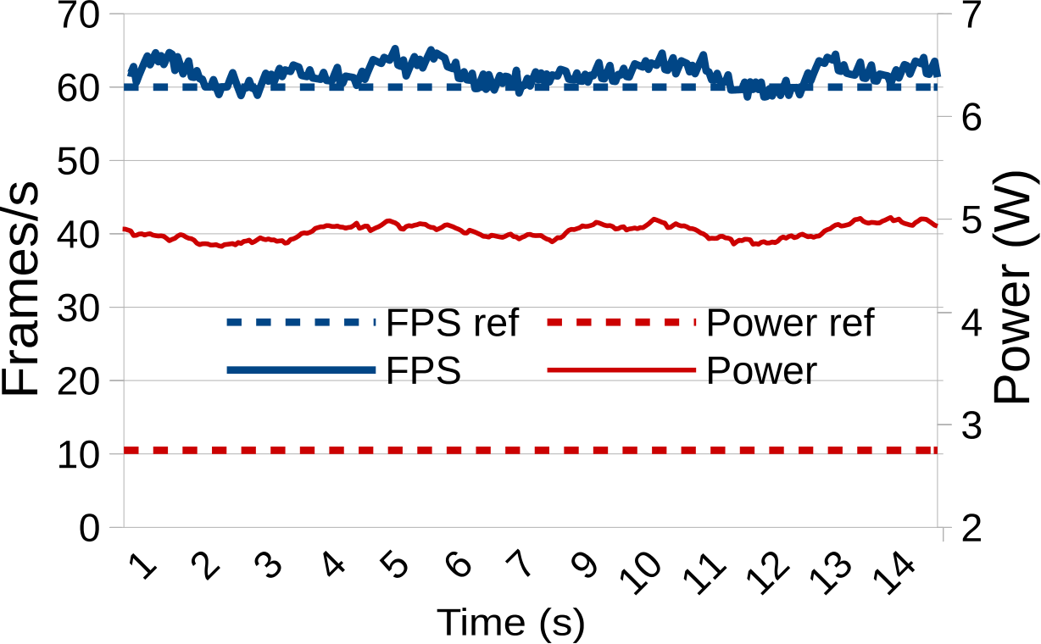
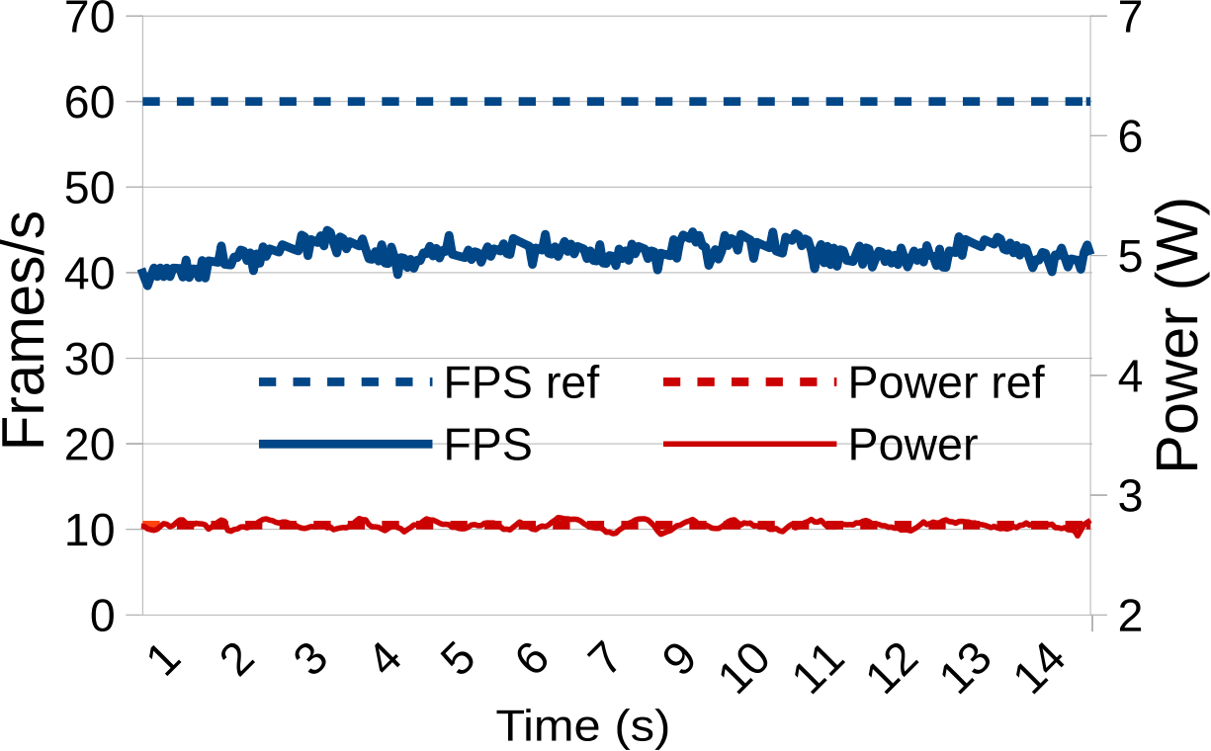
The Autonomy Challenge: An Example
QoS is met.
Power violation!
Power is capped.
QoS is not met!
A MIMO controller designed with higher priority on QoS over power
A MIMO controller designed with higher priority on power over QoS
What if the goal changes at runtime?
We need the ability to switch modes at runtime
Notes:
Amir

Slide 13
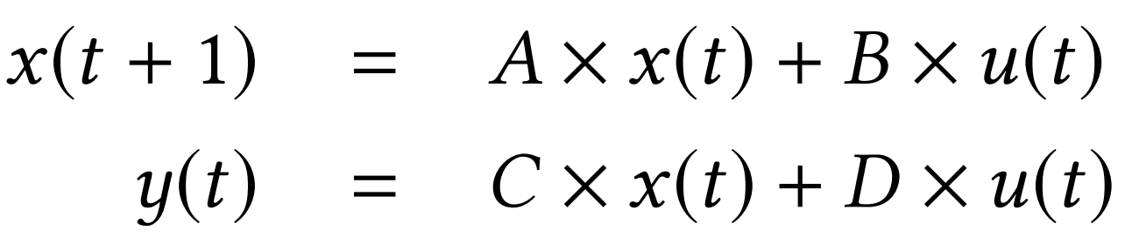
The Scalability Challenge: Example 1
Black-box Identification of System Dynamics
System
(x)
What if the # control inputs and measured outputs is large?
Notes:
Amir

Slide 14
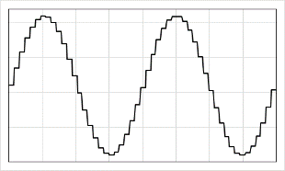
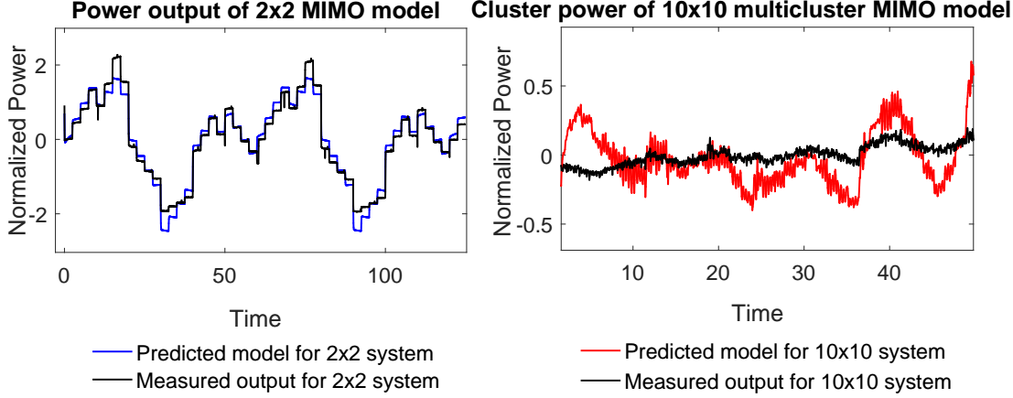
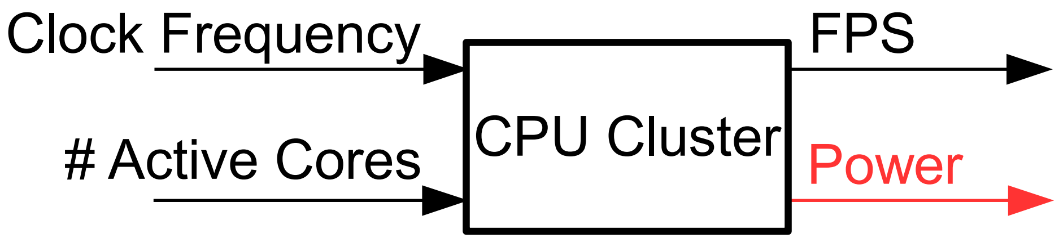
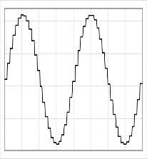
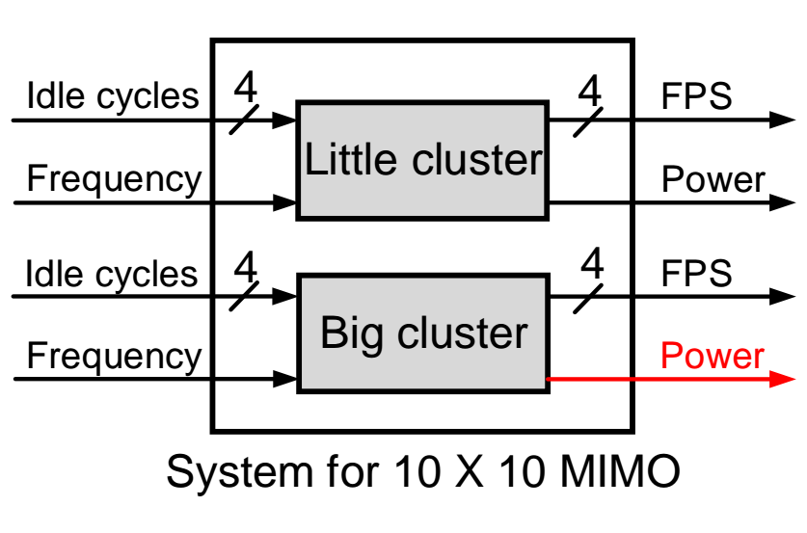
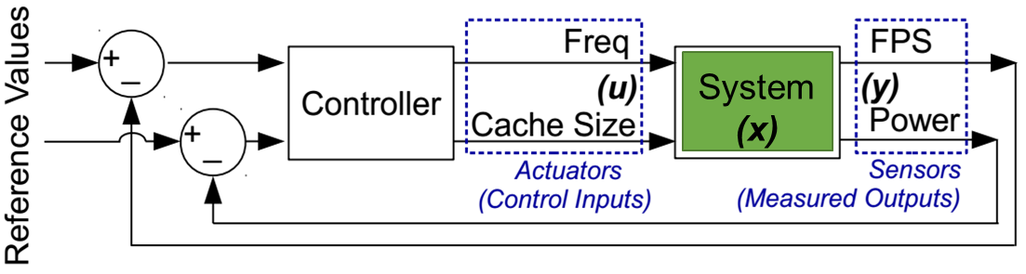
The Scalability Challenge: Example 1
F level N
A set of workloads
F level 1
All cores are active
System for 2 x 2 MIMO
A set of workloads
1 core is active
Prediction is very accurate
Prediction greatly diverges from reality
We need to limit the system size
Notes:
Amir

Slide 15
The Scalability Challenge: Example 2
Controller Design Complexity
Controller
System
(x)
What if the # control inputs and measured outputs is large?
Notes:
Amir

Slide 16
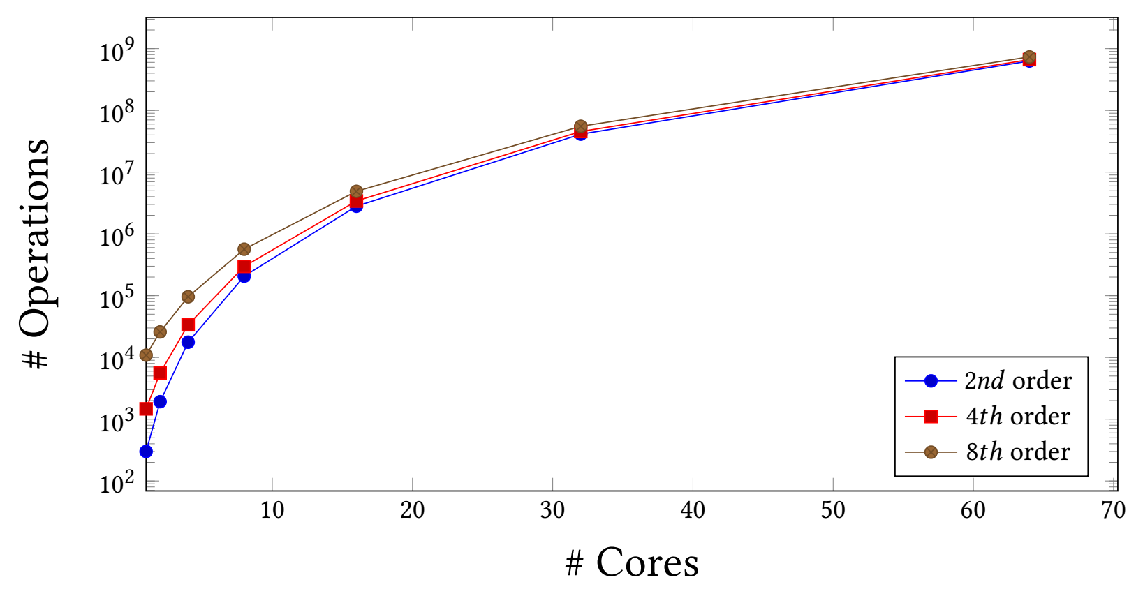
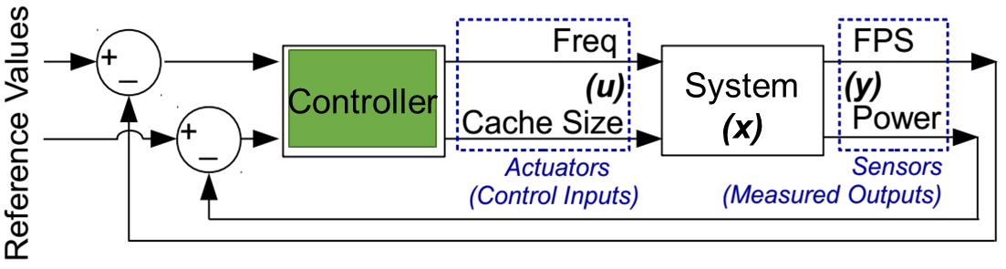
The Scalability Challenge: Example 2
How many operations are executed in each control epoch for a single large MIMO controlling N cores?
Using one large controller is not feasible!
Notes:
Amir

Slide 17
SPECTR Outline
Motivation
MIMO Control Theory for Coordinated Management
Unaddressed Challenges in Resource Management
  Autonomy
  Scalability
Supervisory Control Theory (SCT) via SPECTR
  Scalability and Autonomy through SCT
  SPECTR Overview
  Case Study
Case Study
Results
Summary
Supervisor Synthesis Process
Results
Summary

Slide 18
SPECTR
Using Supervisory Control Theory, we…
Provide autonomy via adaptation in response to changes in policy
  Compute control parameters for different policies offline
Provide scalability via decomposition of system into multiple subsystems organized in a hierarchy
  Supervisor provides high-level management
Notes:
Amir

Slide 19
Scalability via Supervisory Control
Supervisory Controller uses this channel to control the high-level model
The actual control happens via discrete event-based commands
Combining logic with discrete dynamics
Information channel to update the high-level model
Represents an abstraction of the Plant
High-level Virtual Control
Con_{hi}
Supervisory Controller (C_{hi})
High-level
Plant Model (P_{hi})
Inf_{hi}
Com_{hi_lo}
Inf_{lo_hi}
Con_{lo}
Low-level Controller (C_{lo})
Plant (P_{lo})
Inf_{lo}
Low-level Traditional Control Loop
Notes:
Amir

Slide 20
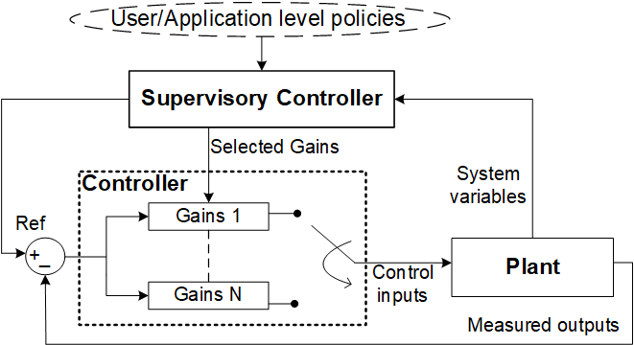
Autonomy via Supervisory Control
Control parameters pre-designed to prioritize one measured output over the other(s)
Tracking power is 10x more important than tracking QoS
FPS:Power <= 1:10
FPS:Power <= 10:1
Tracking QoS is 10x more important than tracking power
This SCT technique is called Gain Scheduling
Notes:
Amir

Slide 21
SPECTR Outline
Motivation
MIMO Control Theory for Coordinated Management
Unaddressed Challenges in Resource Management
  Autonomy
  Scalability
Supervisory Control Theory (SCT) via SPECTR
  Scalability and Autonomy through SCT
  SPECTR Overview
  Case Study
Case Study
Results
Summary
Supervisor Synthesis Process
Results
Summary

Slide 22
SPECTR overview
Putting hierarchical control
and gain scheduling together!
User inputs
Variable Goals and Policies
SPECTR
Con_hi
Supervisory Controller
Inf_hi
High-level Plant Model
Gains₁
Gains₂
Gains_{N}
Refs₁
Refs₂
…
…
Refs_{N}
Leaf Controllers
Classic Controller 1
Classic Controller 2
Classic Controller N
System events
Inf_lo_hi
Con_lo₁
Con_lo₂
Con_lo_{N}
Inf_lo₁
Inf_lo₂
…
…
Inf_lo_{N}
Physical Plant
Sub-plant 1
Sub-plant 2
Sub-plant N
The supervisor updates goals
and allocates resources at runtime
Notes:
Kasra

Slide 23
SPECTR Outline
Motivation
MIMO Control Theory for Coordinated Management
Unaddressed Challenges in Resource Management
  Autonomy
  Scalability
Supervisory Control Theory (SCT) via SPECTR
  Scalability and Autonomy through SCT
  SPECTR Overview
  Case Study
Case Study
Results
Summary
Supervisor Synthesis Process
Results
Summary

Slide 24
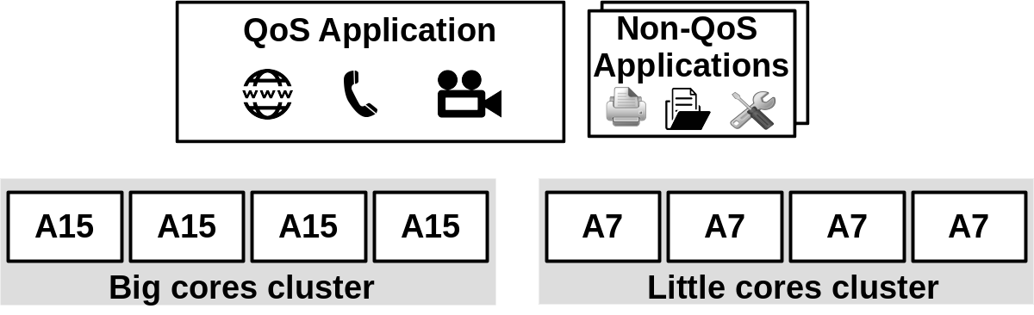
Case Study
ODROID-XU3 platform contains an Exynos 5422 Octa-core SoC
8-core big.Little HMP
Two set of applications:
  A foreground application with QoS requirements (e.g., FPS)
  A number of background applications with no QoS requirements
Notes:
Tiago

Slide 25
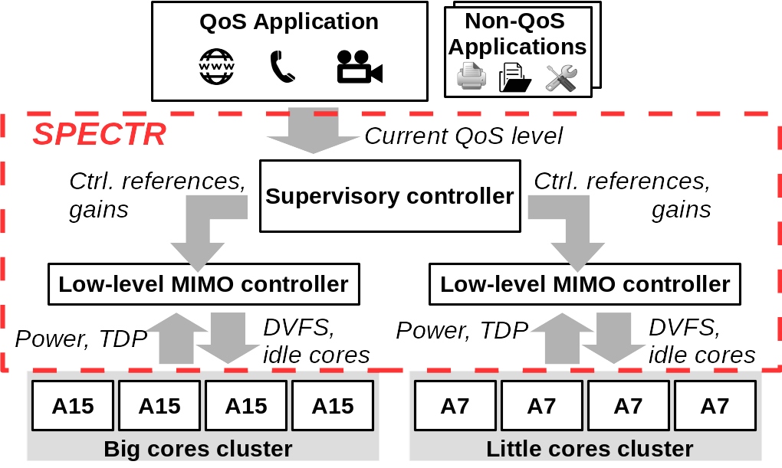
Case Study
Control knobs: per-cluster DVFS, number of idle cores
System goals:
  Meet the QoS requirement of the foreground application
  Ensure the total system power always remains below the Thermal Design Power (TDP)
  Minimize energy consumption
Notes:
Tiago

Slide 26
SPECTR Outline
Motivation
MIMO Control Theory for Coordinated Management
Unaddressed Challenges in Resource Management
  Autonomy
  Scalability
Supervisory Control Theory (SCT) via SPECTR
  Scalability and Autonomy through SCT
  SPECTR Overview
  Case Study
Case Study
Results
Summary
Supervisor Synthesis Process
Results
Summary

Slide 27
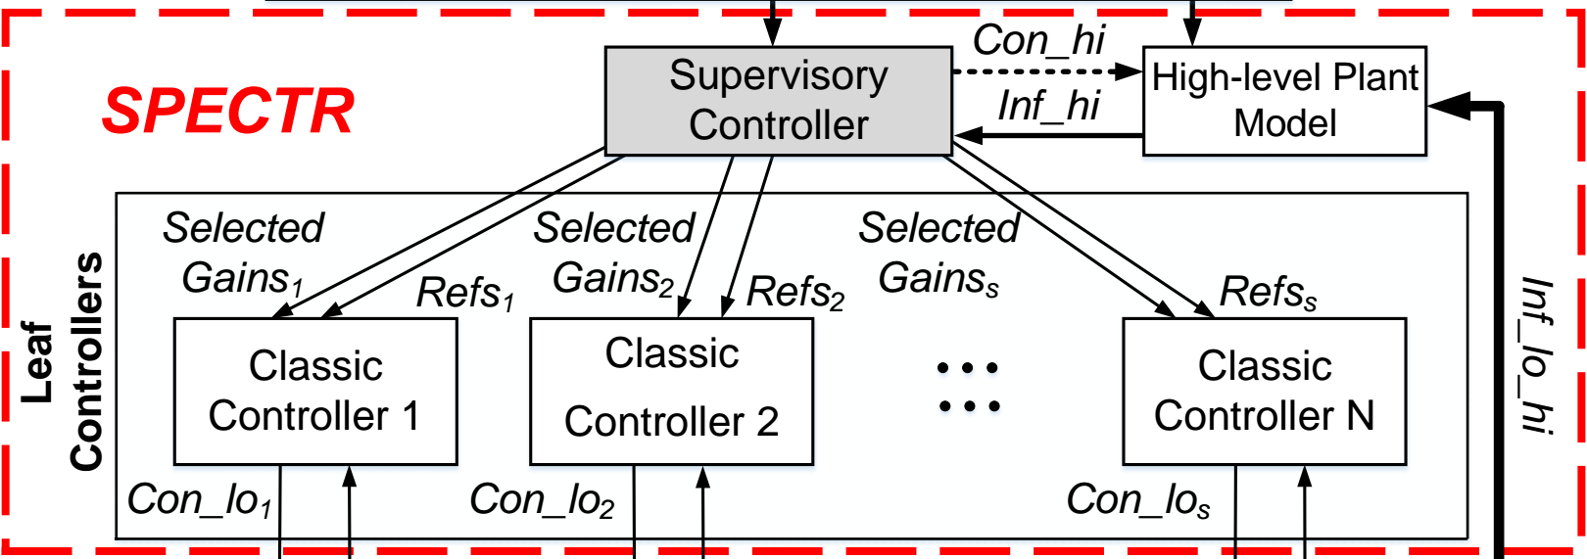
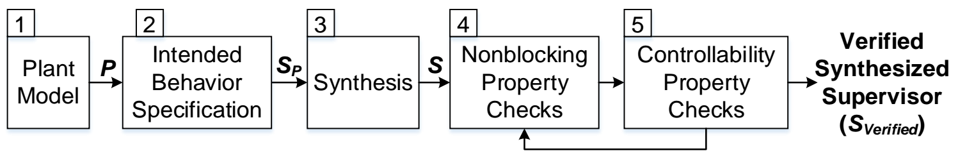
Supervisor Synthesis Process
Supervisory
Controller
5 steps to design and verify a supervisor:
Notes:
Donny

Slide 28
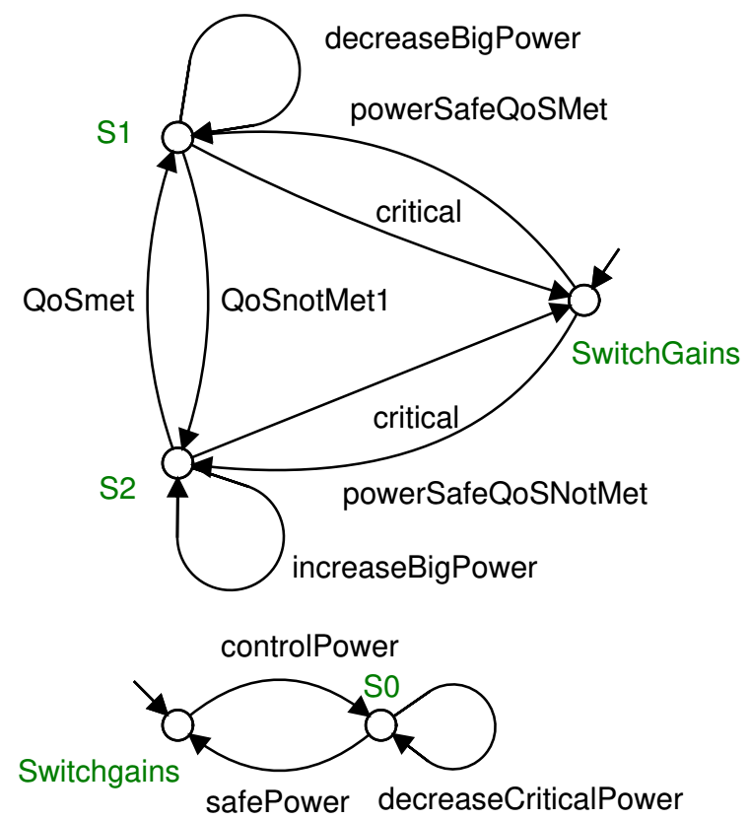
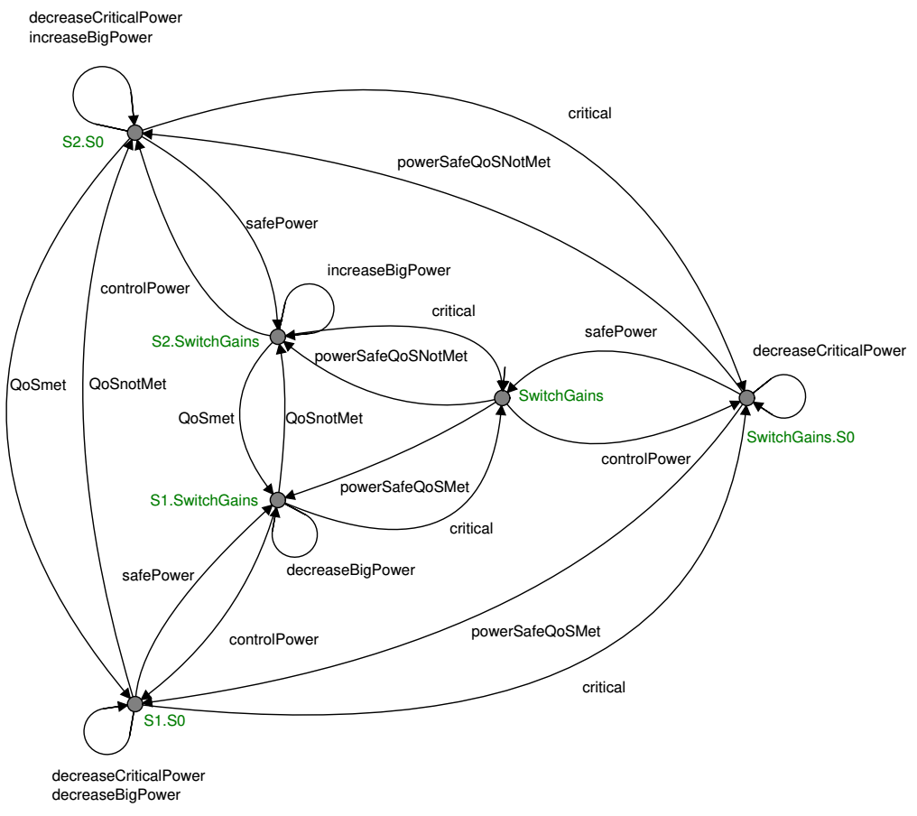
Step 1: Plant Model
Power budget violation generates a critical event and results in gain switching towards the power-driven goal.
Prioritize QoS: The power reference is updated to meet the QoS reference in an energy-efficient manner.
To develop possible actions in high-level plant model in a form of discrete-event dynamics
Supervisory
Controller
Multiple characteristics are automatically synthesized using SCT tools
E.g. Supremica
Manually modeled sub-plants
Synthesized plant
Notes:
Donny

Slide 29
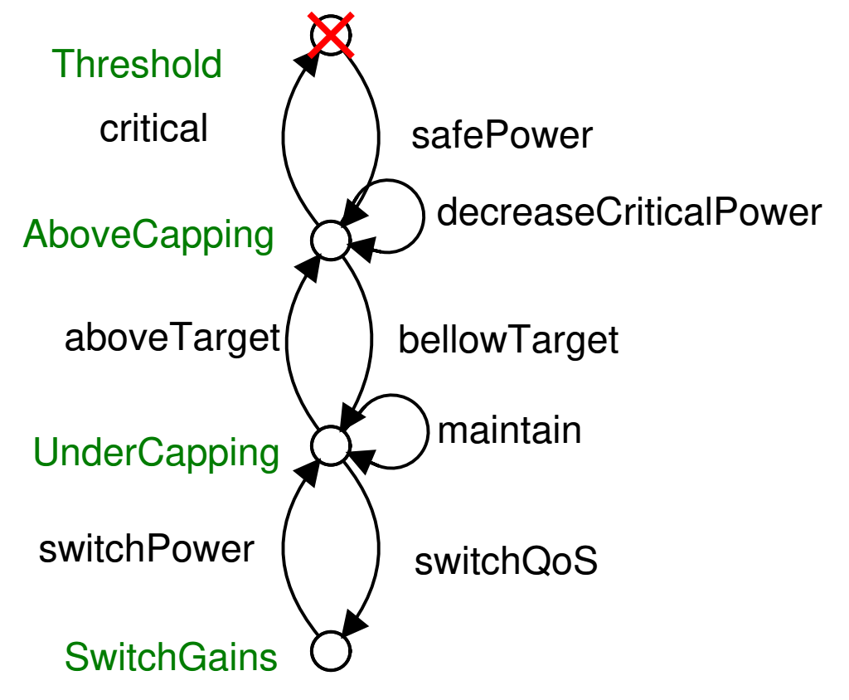
Step 2: Intended Behavior Specification
A specification defines the accepted and forbidden states via restrictions on the behavior of the plant model.
Supervisory
Controller
Forbidden State
This example specification prevents exceeding the power budget for no more than three control intervals.
Note: The model in Step 1 has no limitations!
(e.g., on exceeding the power budget)
Notes:
Donny

Slide 30
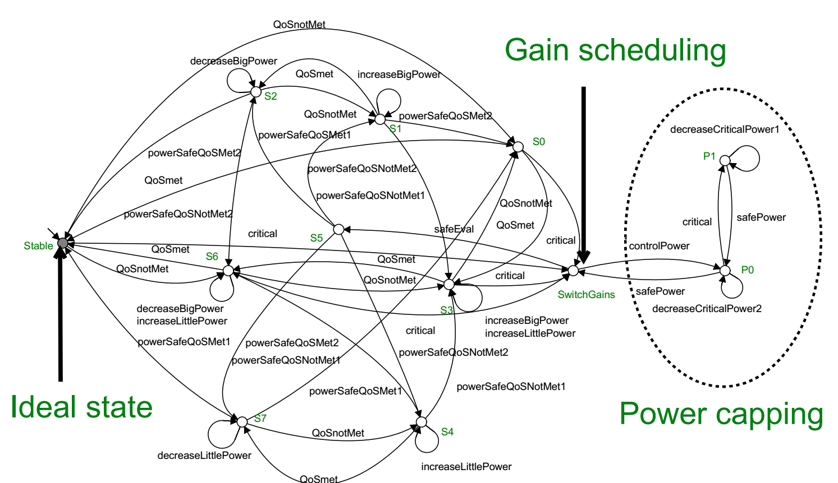
Steps 3-5: Synthesis and Verification
Automatically generated and verified using synchronous composition operations in Supremica SCT tool.
The synthesizer generates a minimally-restrictive controller for the given plant model and specifications.
Supervisory
Controller
Notes:
Donny

Slide 31
Steps 3-5: Synthesis and Verification
SCT tools (e.g., Supremica) also verify the non-blocking and controllability properties of the synthezied controller.
Supervisory
Controller
Non-blocking: Accepted states (e.g., ideal states) can always be reached.
Stable
Controllability: There is a path to the accepted states from every other valid state.
Notes:
Donny

Slide 32
SPECTR Outline
Motivation
MIMO Control Theory for Coordinated Management
Unaddressed Challenges in Resource Management
  Autonomy
  Scalability
Supervisory Control Theory (SCT) via SPECTR
  Scalability and Autonomy through SCT
  SPECTR Overview
  Case Study
Case Study
Results
Summary
Supervisor Synthesis Process
Results
Summary

Slide 33
Evaluated resource manager configurations
Compared SPECTR with three alternative resource managers
  MM-Pow: 2x2 MIMOs (one per cluster) with gains optimized to track power
  MM-Perf: 2x2 MIMOs (one per cluster) with gains optimized to track performance/QoS
  FS: single system-wide 4x2 MIMO with gains optimized towards power
Fixed-Objective
QoS applications:
  PARSEC applications: x264, bodytrack, canneal, streamcluster
  Data-intensive machine learning workloads: k-means, KNN, least squares, linear regression
Notes:
Tiago

Slide 34
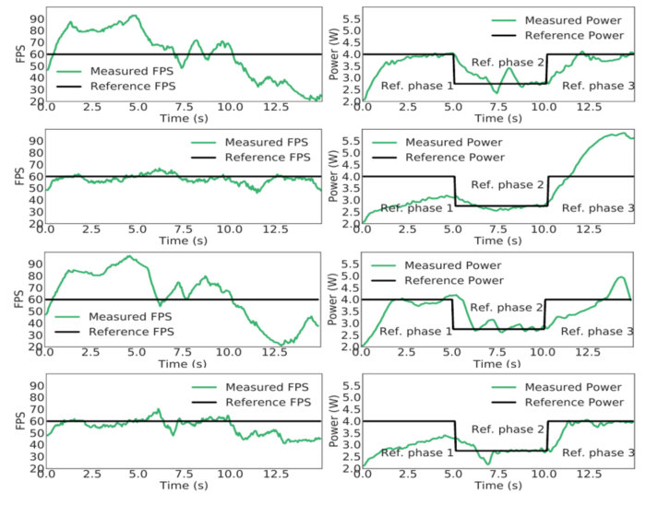
Experimental Results – Contoller Evaluation
Execution scenario with three phases (x264):
Phase 1 - Safe Phase:
  only the QoS application runs; power limited by TDP
Phase 2 - Emergency phase:
  power limit set to 1W below TDP to emulate a thermal emergency
Phase 3 - Workload disturbance phase:
  power limit restored to TDP, but now several background tasks start, interfering with the QoS application
Track QoS under a power cap
Only feasible to track power
Enough power to track QoS
MM-Pow
MM-Perf
MM-FS
SPECTR
Notes:
Tiago

Slide 35
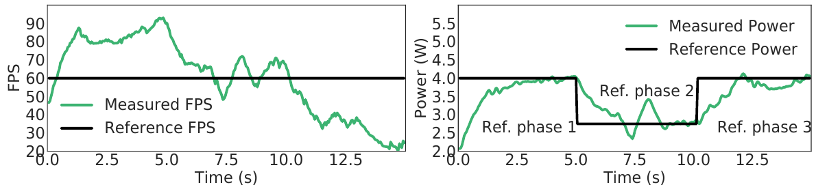
Experimental Results -- Contoller Evaluation
QoS task: x264
Controller: MM-Pow (power-oriented)
  2x2 MIMOs (one per cluster) with gains optimized to track power
Wasted performance
Under a power cap
~ 40% more then necessary FPS in Phase 1
Wasting energy !
It works fine in Phase 2 and 3 by focusing on power capping!
Notes:
Tiago

Slide 36
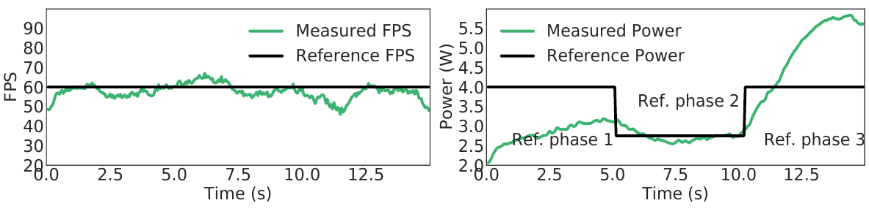
Experimental Results -- Contoller Evaluation
QoS task: x264
Controller: MM-Perf (performance-oriented)
  2x2 MIMOs (one per cluster) with gains optimized to track QoS
Tracking FPS
Exceeding power limit
Exceeds TDP by ~30% in Phase 3!
It works fine in Phase 1 and 2 by focusing on QoS tracking!
Notes:
Tiago

Slide 37
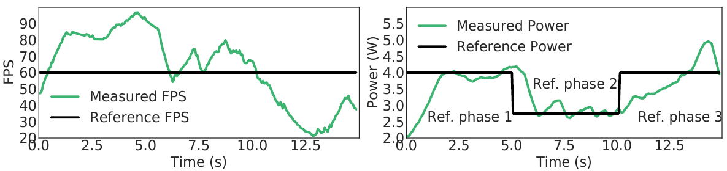
Experimental Results -- Contoller Evaluation
QoS task: x264
Controller: FS (large 4x2 power-oriented)
  Single system-wide 4x2 MIMO with gains optimized towards power
Wasted performance
Sluggish response
~ 40% more than necessary FPS in phase 1 (akin to MM-POW)
Longer settling time due to large MIMO controller.
Notes:
Tiago

Slide 38
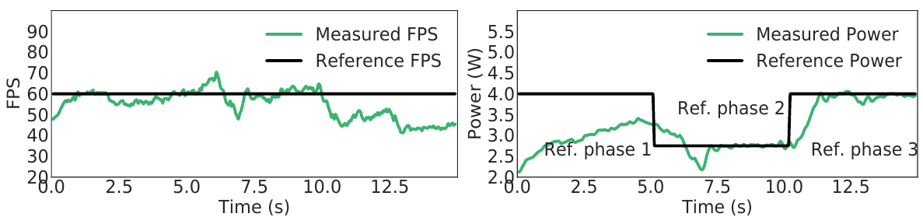
Experimental Results -- Contoller Evaluation
QoS task: x264
Controller: SPECTR
Let’s Take a closer look at each phase
Notes:
Tiago

Slide 39
Experimental Results -- Contoller Evaluation
Safe Phase: QoS App only
SPECTR focuses on satisfying FPS with the minimum power
<5% FPS steady state error (minimal wasted perfomance)
Power below TDP
Notes:
Tiago

Slide 40
Experimental Results -- Contoller Evaluation
Emergency Phase: TDP reduced in response to thermal event
SPECTR satisfies the reference FPS and power
<5% FPS steady state error
Notes:
Tiago

Slide 41
Experimental Results -- Contoller Evaluation
Disturbance Phase: TDP returned to normal, background tasks added
SPECTR focuses on power capping
No TDP violations, but ~23% FPS steady state error
(impossible to track without violating TDP)
Notes:
Tiago

Slide 42
Other Results in the Paper
A detailed Contoller Evaluation on:
  PARSEC applications: bodytrack, canneal, streamcluster
  Data-intensive machine learning workloads: k-means, KNN, least squares, linear regression
Model Accuracy Analysis of different sized MIMO controllers:
  2x2 -> feasible and efficient
  4x2 -> feasible but sluggish
  10x10 -> not feasible
Further discussion on:
  Controller responsiveness (settling time)
  Controller stability

Slide 43
SPECTR Outline
Motivation
MIMO Control Theory for Coordinated Management
Unaddressed Challenges in Resource Management
  Autonomy
  Scalability
Supervisory Control Theory (SCT) via SPECTR
  Scalability and Autonomy through SCT
  SPECTR Overview
  Case Study
Case Study
Results
Summary
Supervisor Synthesis Process
Results
Summary

Slide 44
Summary
Resource managers need to offer 1) robustness, 2) formalism, 3) efficiency, 4) coordination, 5) scalability, and 6) autonomy all together
SPECTR offers them all!
  SPECTR adapts to changing goals at rutime
  SPECTR decomposes the control problems to manage its complexity
SPECTR achieves up to 8x and 6x better target QoS and power tracking over state-of-the-art, respectively (in our case study)
SPECTR is applicable to any resource type and objective as long as the management problem can be modeled using dynamical systems theory
Notes:
Amir

Slide 45
Formal Supervisory Control and Coordination for Many-core Systems Resource Management
SPECTR
Amir M. Rahmani Bryan Donyanavard Tiago Mück Kasra Moazzemi
Axel Jantsch Onur Mutlu Nikil Dutt
23rd ACM International Conference on Architectural Support for Programming Languages and Operating Systems Williamsburg, VA, March 2018
Notes:
Thank you for the introduction. Today, I will present our work about …

Slide 47
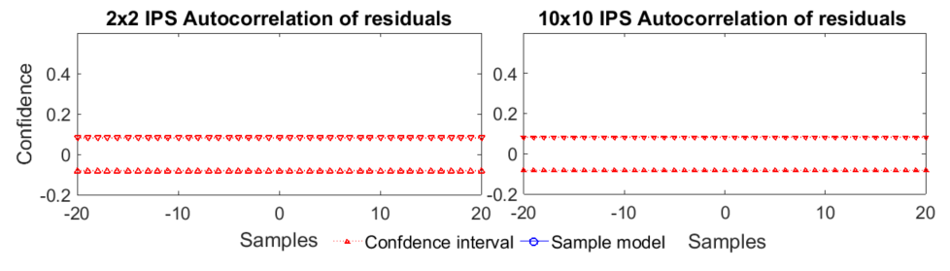
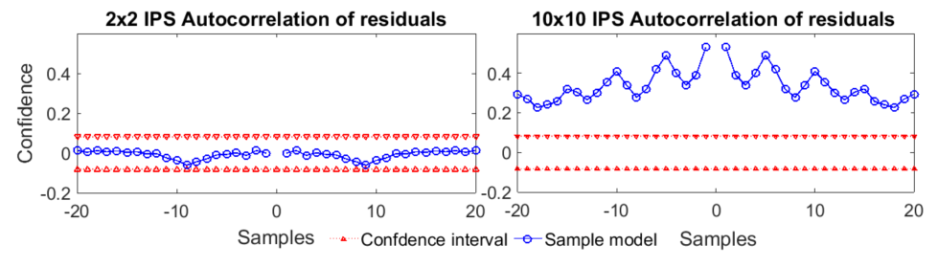
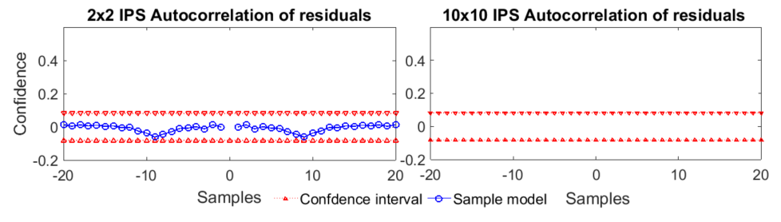


Experimental Results -- Scalability
Accuracy of the identified system models of different sized MIMO controllers
A model output within the confidence interval indicates that the deterministic component of the model output will be near the true output.
Within the confidence interval
Outside the confidence interval
Confidence level of 99%
Confidence level of 99%
Black-box system identification is not feasible
for large and complex MIMO systems!
Notes:
Kasra

Slide 48
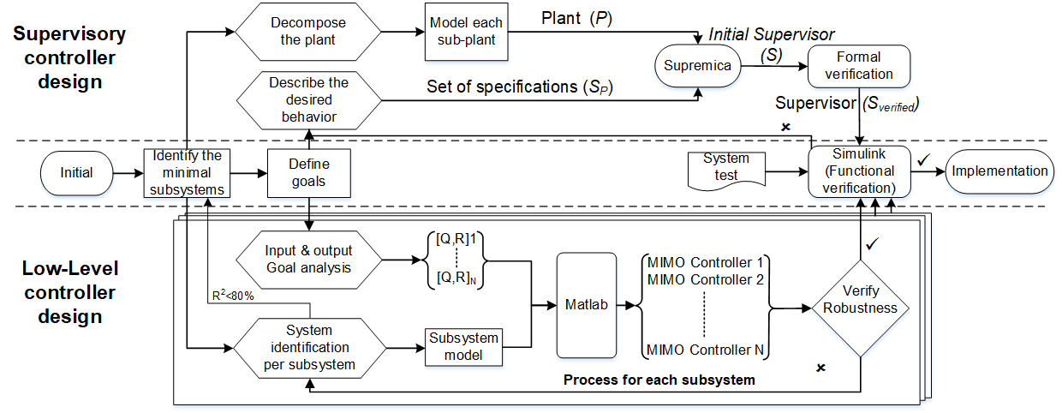
SPECTR Design Flow
Step 2
Step 4
Step 3
Step 1
Step 9
Step 7
Step 8
Step 6
Step 5
Notes:
Kasra

Slide 49
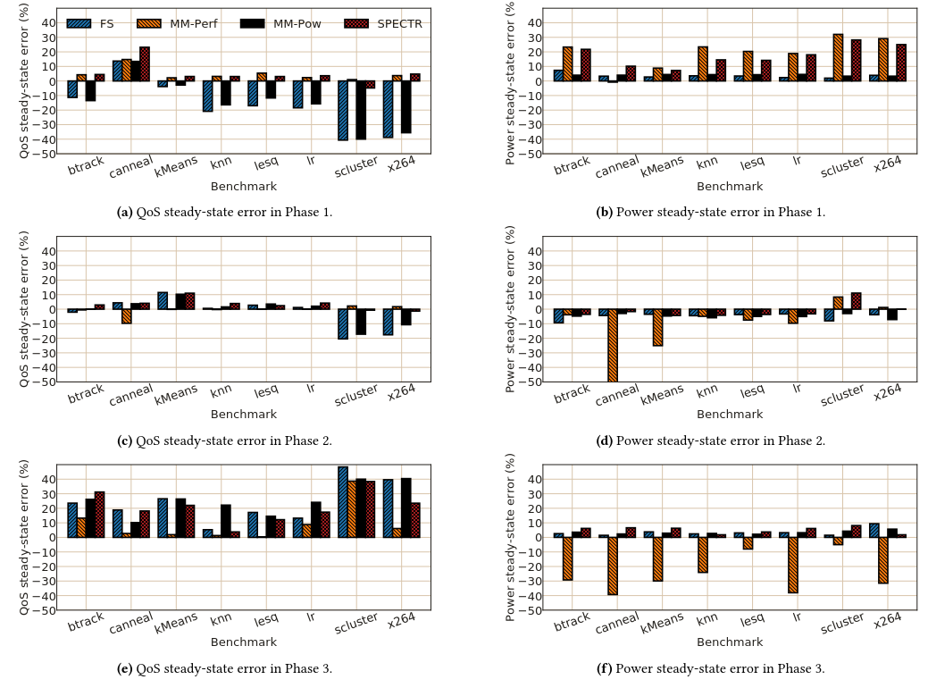
Steady-state Error for All Benchmarks
Steady-state error for all benchmarks, grouped by phase. A negative value indicates the amount of power/QoS exceeding the reference value (bad), a positive value indicates the amount of power saved (good) or QoS degradation (bad)

Slide 50
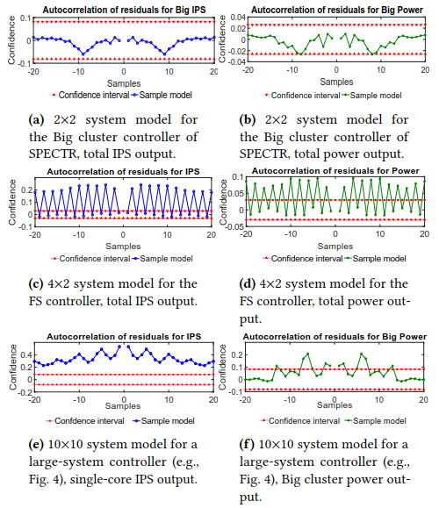
Model Accuracy
Autocorrelation of residuals for identified system models of different sized MIMO controllers.
We show a single performance and power output for each modeled system across multiple sample inputs.

