Slide 1



Sectored DRAM
A Practical Energy-Efficient and High-Performance
Fine-Grained DRAM Architecture
Ataberk Olgun
olgunataberk@gmail.com
F. Nisa Bostanci Geraldo F. Oliveira Yahya Can Tugrul Rahul Bera
A. Giray Yaglikci Hasan Hassan Oguz Ergin Onur Mutlu
Notes:
=============
Did you compare Sectored DRAM against smaller cache block sizes?

Slide 2
Sectored DRAM Summary
Problem: DRAM-based systems suffer from two sources of energy inefficiency
Coarse-grained cache-block-sized (typically 64-byte) data transfer
Coarse-grained DRAM-row-sized (typically 8-kilobyte) activation
A workload does not use all data fetched from DRAM
Goal: Design a fine-grained, low-cost, and high-throughput DRAM substrate
Mitigate excessive energy consumption from coarse-grained DRAM
Key Ideas: Small modifications to memory controller and DRAM chip enable
Transferring sub-cache-block-sized data in a variable number of clock cycles
Activating relatively small physically isolated regions of a DRAM row
based on the workload memory access pattern
Key Results: For the evaluated memory-intensive workloads, Sectored DRAM
Improves system energy consumption by 14%, system performance by 17%
Incurs 0.39 mm² (1.7%) DRAM chip area overhead
Performs within 11% of a state-of-the-art prior work (Half-DRAM),
with 12% smaller DRAM energy and 34% smaller area overhead
Notes:
I will start with an executive summary
[CLICK] DRAM-based systems suffer from energy wasted by coarse-grained data transfer and [CLICK] coarse-grained DRAM row activation
[CLICK] because applications use a relatively smaller fraction of all data that is fetched from DRAM
[CLICK] Our goal is to design a new, fine-grained, low-cost, and high-throughput DRAM substrate and mitigate the problem with coarse-grained DRAM systems.
[CLICK] Our design has two key ideas. With small modifications to the memory controller and the DRAM chip, we enable: [CLICK] data transfers that are smaller than a cache block’s size in a variable number of DRAM interface clock cycles
[CLICK] and activating small portions of a DRAM row
[CLICK] based on the workload memory access pattern
[CLICK] The integration of Sectored DRAM into a modern computing system provides [CLICK] significant energy savings and system performance improvement
[CLICK] Sectored DRAM incurs a relatively small DRAM chip area overhead
[CLICK] and performs within 11% of a high-performance and high-area overhead state-of-the-art fine-grained DRAM architecture while consuming significantly smaller DRAM energy.

Slide 3
Outline
1. Background & Motivation
2. Sectored DRAM: Design
3. Sectored DRAM: System Integration
4. Evaluation
5. Conclusion
Notes:
This is the outline of my talk…

Slide 4
Outline
1. Background & Motivation
2. Sectored DRAM: Design
3. Sectored DRAM: System Integration
4. Evaluation
5. Conclusion
Notes:
I will start with a brief background on DRAM and motivate our work

Slide 5
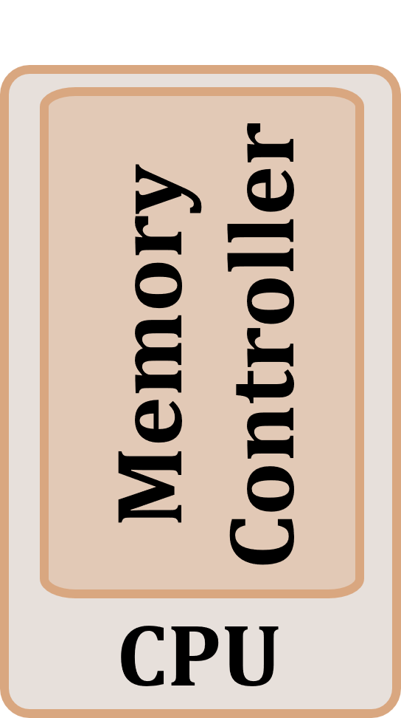
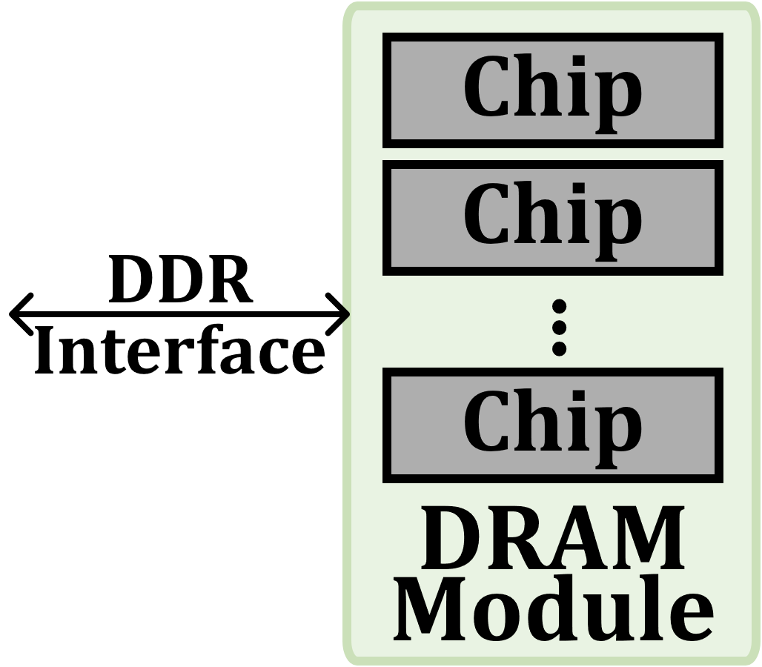
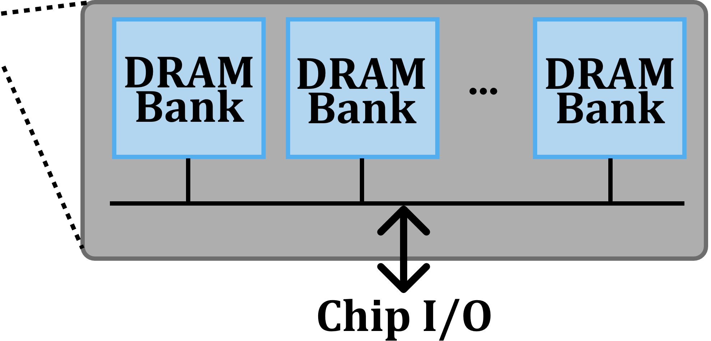
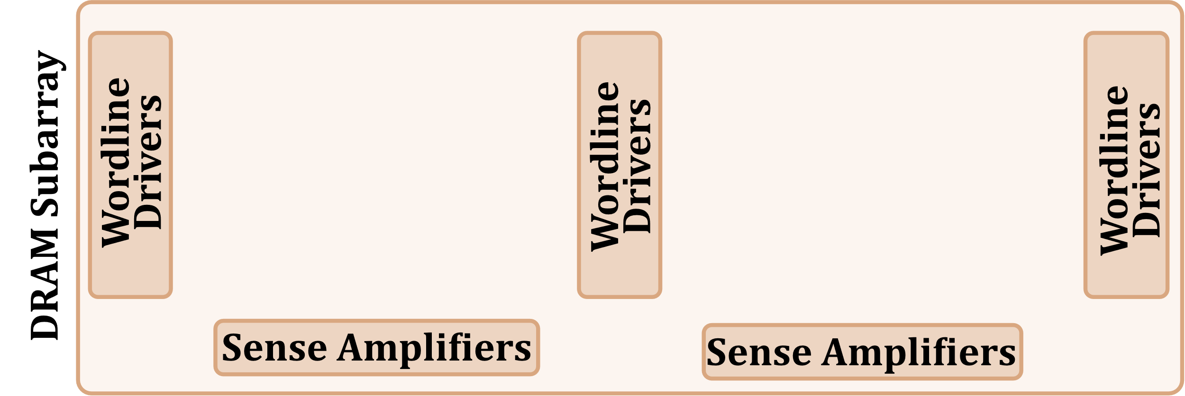
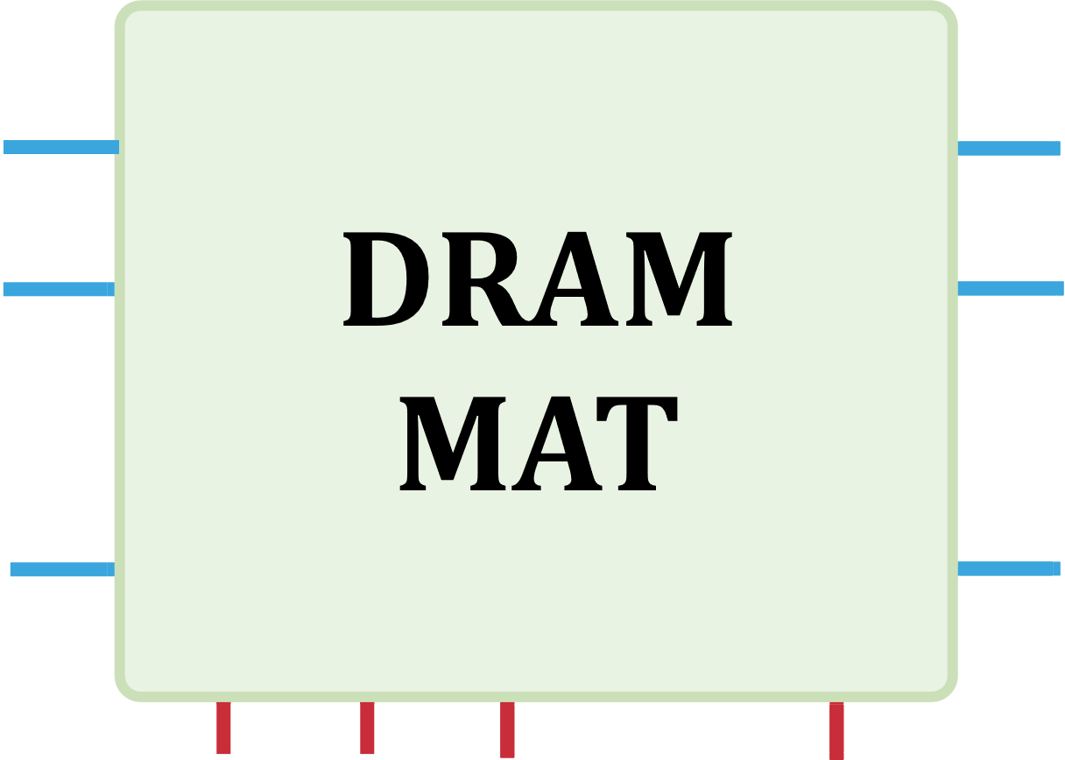
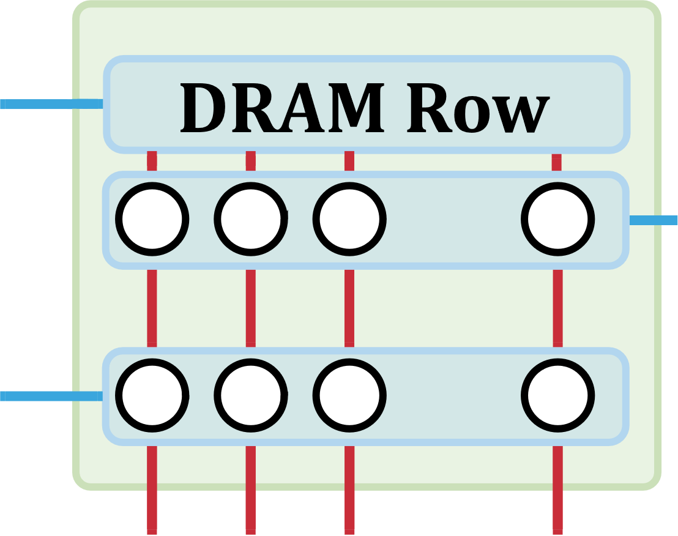
DRAM is Organized Hierarchically
…
…
…
Notes:
A processor’s memory controller
[CLICK] communicates with a set of DRAM chips within a DRAM module through a memory channel.
[CLICK] Each DRAM chip contains multiple banks that share a common chip I/O interface.
[CLICK] DRAM banks are organized into subarrays that consists of a set of wordline drivers and sense amplifiers
[CLICK] Subarrays are partitioned into DRAM MATs which are collections of DRAM cells that are separated from each other by wordline drivers.
[CLICK] DRAM cells are laid out onto a two-dimensional array of wordlines and bitlines within
a DRAM MAT. A row of DRAM cells is a DRAM row.

Slide 6
DRAM Row Activate Operation
Wordline driver
global wordline
row decoder
global sense amplifier
Sense amplifier
64 bits
IO interface
8 bits
[Oliveira+, HPCA’24]
Notes:
This is a different and a more detailed view of the previous DRAM subarray which we will look at to understand how DRAM row activate and DRAM read operations work
[CLICK] The global wordline spans the whole subarray and controls the local wordline drivers
[CLICK] The local sense amplifiers are connected to a global sense amplifier
[CLICK] and the global sense amplifiers are further connected to the IO interface

Slide 7
DRAM Row Activate Operation
global wordline
row decoder
global sense amplifier
64 bits
IO interface
8 bits
[Oliveira+, HPCA’24]
Notes:
[CLICK] To access a DRAM row, the memory controller issues an ACTIVATE command to DRAM. On receiving an ACT, the global and local row decoder enables the wordline of the target row, connecting the DRAM cells to the bitlines
[CLICK] Then, the sense amplifier senses the perturbation caused in the bitline, amplifying and latching the data from the DRAM cells

Slide 8
DRAM Column Read Operation
global wordline
row decoder
global sense amplifier
64 bits
IO interface
8 bits
column
to memory controller
[Oliveira+, HPCA’24]
Notes:
To read out the data in the sense amplifiers, the memory controller sends a READ command with a column address
[CLICK] The selected column is then transferred to outside the DRAM chip over global sense amplifiers and the IO interface

Slide 9
DRAM Data Transfer (I)
DRAM data transfer happens in cache block granularity
Cache Block (64 bytes)
B56
B57
B58
B59
B60
B61
B62
B63
…
…
…
…
Byte 0
B8
B9
B10
B11
B12
B13
B14
B15
Data
B0
B1
B2
B3
B4
B5
B6
B7
[Seshadri+, MICRO’13]
Notes:
That was inside a single subarray, now we look at data transfers at the granularity of a DRAM module.
[CLICK] Each chip transmits or receives [CLICK] one byte of data from its data interface
[CLICK] and 64 bytes make up [CLICK] a cache block.

Slide 10
DRAM Data Transfer (I)
DRAM data transfer happens in cache block granularity
Using data transfer bursts (or bursts)
B56
B57
B58
B59
B60
B61
B62
B63
Beat counter
…
…
…
…
Burst length = 8
B8
B9
B10
B11
B12
B13
B14
B15
0
B0
B1
B2
B3
B4
B5
B6
B7
[Seshadri+, MICRO’13]
Notes:
A DRAM chip transmits or receives multiple bytes of the cache block in a data transfer burst
[CLICK] The burst length for this transfer is 8 because each chip transmits or receives 8 bytes
[CLICKx2] A chip transmits a byte in each DRAM interface clock cycle, also referred to as a beat. [CLICK to make things disappear]

Slide 11
DRAM Data Transfer (I)
DRAM data transfer happens in cache block granularity
Using data transfer bursts (or bursts)
Beat counter
1
B0
B1
B2
B3
B4
B5
B6
B7
[Seshadri+, MICRO’13]
Notes:
In the first beat [CLICK], each chip transmits its corresponding byte

Slide 12
DRAM Data Transfer (I)
DRAM data transfer happens in cache block granularity
Using data transfer bursts (or bursts)
Beat counter
2
B0
B1
B2
B3
B4
B5
B6
B7
B8
B9
B10
B11
B12
B13
B14
B15
[Seshadri+, MICRO’13]
Notes:
The next beat [CLICK], the next 8 bytes

Slide 13
DRAM Data Transfer (I)
DRAM data transfer happens in cache block granularity
Using data transfer bursts (or bursts)
Beat counter
8
B8
B9
B10
B11
B12
B13
B14
B15
B0
B1
B2
B3
B4
B5
B6
B7
B56
B57
B58
B59
B60
B61
B62
B63
[Seshadri+, MICRO’13]
Notes:
And so on [CLICK] until the last 8 bytes are transferred

Slide 14
Coarse-Grained DRAM Data Transfer
Wastes Energy
Retrieve more bytes than necessary
with each word (e.g., 8 bytes) access
Exploit spatial locality
Not all words in a cache block
are referenced by CPU load/store instructions
Retrieved Cache Block (64 bytes)
Used Bytes
(e.g., 8 bytes)
B56
B57
B58
B59
B60
B61
B62
B63
…
…
…
…
B14
B15
B8
B9
B10
B11
B12
B13
B14
B15
B11
B12
B13
B0
B1
B2
B3
B4
B5
B6
B7
B8
B9
B10
Less than 60% of words used on average
(e.g., [Qureshi+, HPCA’07])
Notes:
A key problem with this coarse grained DRAM data transfer is that it wastes energy
Even if the processor wants to access only one word, for example, [CLICK] the second word in the cache block
[CLICK] the system retrieves the whole cache block of this word, with the hope of exploiting spatial locality
[CLICK] However, the processor only ends up accessing 8 out of the 64 words in our example.
[CLICK] On average across many workloads, the fraction of used words are relatively low.

Slide 15
Coarse-Grained DRAM Row Activation
Wastes Energy
Activate more mats than necessary
with each DRAM row activation
Transfer all words of a cache block in one burst
Not all mats need to be read or updated
…
…
Chips 0-7
row decoder
row decoder
row decoder
…
Bytes 0-7
Bytes 8-15
Bytes 24-31
Notes:
Coarse-grained activation of DRAM rows also cause energy waste.
[CLICK] The DRAM chip activates all mats with every activate command…
[CLICK] to transfer all words of a cache block in one data transfer burst at high throughput
[CLICK] However, activating all mats is not required as the processor does not use all words, and the unused words lead to activation energy waste

Slide 16
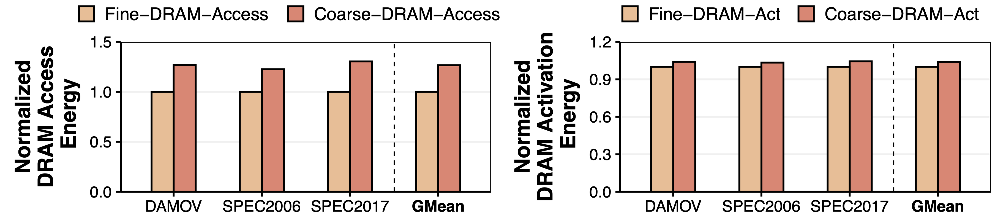
Fine-Grained DRAM Can Greatly Improve System Energy Efficiency
Fine-DRAM-Access: Enable word-sized (8-byte) data transfers
Fine-DRAM-Activation: Enable per-mat DRAM row activation
Fine-Grained DRAM can improve READ/WRITE (ACTIVATE)
energy by 27% (4%)
Notes:
We investigate the potential energy savings Fine-Grained DRAM can provide using 41 single-core workloads with an evaluation methodology I will describe later in the slides.
[CLICK] This is fine-grained DRAM access’s and [CLICK] this is fine-grained DRAM activation’s benefits
[CLICK] We observe that Fine-Grained DRAM can provide substantial READ/WRITE and activation energy benefits

Slide 17
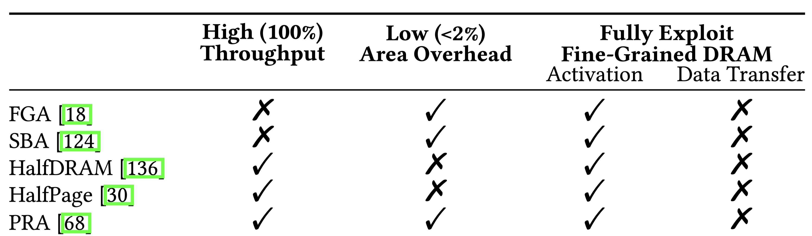
Challenges of Enabling Fine-Grained DRAM
Prior works
1
Maintaining high DRAM data transfer throughput
2
Incurring low DRAM area overhead
3
Fully exploiting fine-grained DRAM
Notes:
However, enabling Fine-DRAM-Access and –Activation [CLICK] has three key challenges. We describe them here and provide a classification of *only* the relatively low area overhead, prior fine-grained DRAM architectures.
[CLICK] The first challenge is maintaining high DRAM data transfer throughput. Some fine-grained DRAM architectures reduce DRAM data transfer throughput by 8 times, which incurs prohibitive performance penalties.
[CLICK] The second challenge is incurring a relatively low DRAM area overhead. We find that prior works that maintain high data transfer throughput induce large area overheads
[CLICK] The last challenge is to exploit fine-grained DRAM, both for DRAM access (that is, READ AND WRITE) and for DRAM activation.
=========
SBA = Selective Bit- line Activation
Talk less before showing challenges

Slide 18
Problem and Goal
1
Maintaining high DRAM data transfer throughput
2
Incurring low DRAM area overhead
3
Fully exploiting fine-grained DRAM
Problem
Problem
No prior work overcomes all three challenges
Goal
Develop a new, low-cost, and high-throughput DRAM substrate that can mitigate the excessive energy consumption
of coarse-grained DRAM
Notes:
We observe that no prior work overcomes all three challenges.
[CLICK] Therefore, our goal is to develop a new fine-grained DRAM architecture that can mitigate the energy waste of coarse-grained DRAM, while overcoming all three challenges of enabling fine-grained DRAM architectures.

Slide 19
Outline
1. Background & Motivation
2. Sectored DRAM: Design
3. Sectored DRAM: System Integration
4. Evaluation
5. Conclusion
Notes:
Let’s now see how Sectored DRAM mitigates energy waste

Slide 20
Two Key Design Components
Two key observations regarding DRAM chip design
enable Sectored DRAM at low cost
Observation: DRAM mats naturally split DRAM rows
into small fixed-size portions
Observation: DRAM I/O circuitry can already transfer a small portion of a cache block in one beat
1
Sectored Activation (SA)
2
Variable Burst Length (VBL)
Notes:
Sectored DRAM has two key design components
[CLICK] First, we find that modern high-performance high-yield DRAM architectures already split DRAM rows into *physically-isolated* small fixed-size mats.
[CLICK] Leveraging this observation, the Sectored Activation component enables fine-grained DRAM activation at low cost
[CLICK] Second, we observe that DRAM I/O circuitry already has a way of transmitting arbitrary words or bytes of a cache block in each data transfer beat
[CLICK] We slightly modify transmitted byte selection criteria to enable fine-grained DRAM data transfer at low cost using Variable Brust Length

Slide 21
Component 1: Sectored Activation
Observation: DRAM mats naturally split DRAM rows
into small fixed-size portions
To select and activate one or multiple mats:
  Isolate the global wordline from local wordline drivers
global wordline
row decoder
local wordline driver
Notes:
Let’s look at Sectored Activation in a bit more detail. This is our example DRAM subarray.
[CLICK] For example, we want to enable the first two mats and not enable the last two mats in this picture.
[CLICK] To do so, we first isolate the global wordline from local wordline drivers.

Slide 22
Component 1: Sectored Activation
Observation: DRAM mats naturally split DRAM rows
into small fixed-size portions
To select and activate one or multiple mats:
  Isolate the global wordline from local wordline drivers
  Add a control signal (1 bit) for each mat
sector latch
1 bit
1 bit
1 bit
1 bit
row decoder
sector
sector transistor
Notes:
We do this by adding isolation transistors that we call sector transistors between the global wordline and the local wordline drivers
[CLICK] Next we need a way of controlling the sector transistor, so we add a new control signal that we call sector latch, for each mat.
[CLICK] By doing so, we transformed the mats in our subarray into sectors, each of which can be individually activated.

Slide 23
Component 2: Variable Burst Length
Observation: DRAM I/O circuitry can already transfer a small portion of a cache block in one beat
sector
8
8
8
8
8
8
8
8
64
Read FIFO
. . . . .
burst
counter
3
8
Chip I/O
Notes:
Let’s look at the second component now.
[CLICK] We have eight sectors in a DRAM bank
[CLICK] Each sector sends 8 bits with a READ command
[CLICK] To a buffer that we call the READ FIFO
[CLICK] A relatively simple circuitry selects 8 bits from this buffer to transfer over the DRAM chip’s I/O with each beat of the data transfer burst
[CLICK] The selection process is [CLIKC] controlled by a burst counter that gets incremented with every beat

Slide 24
Component 2: Variable Burst Length
Observation: DRAM I/O circuitry can already transfer a small portion of a cache block in one beat
Replace the burst counter with an encoder
that selects only the open/activated sectors
8
8
8
8
8
8
8
8
activated sectors
64
8
Read FIFO
. . . . .
8x3
Encoder
3
8
Chip I/O
Notes:
To enable variable burst length data transfers, we simply replace the burst counter with an encoder that selects data sent by only the open or activated sectors to the READ FIFO

Slide 25
Component 2: Variable Burst Length
Observation: DRAM I/O circuitry can already transfer a small portion of a cache block in one beat
Replace the burst counter with an encoder
that selects only the open/activated sectors
8
8
8
8
8
8
8
8
activated sectors
64
8
Read FIFO
. . . . .
8x3
Encoder
3
8
Chip I/O
Notes:
For example, if only the first and last sectors were activated, [CLICK] the encoder selects only these two sectors’ data

Slide 26
Exposing Sectored DRAM to the Memory Controller
Goal: Give memory controller (MC) control over sectors
  E.g., activate 3 out of 8 sectors in a subarray
Modifications to the standard interface not required
More than 10 unused bits in PRE command encoding
The previously unused bits now determine the sectors opened by the next activate (ACT) command
Precharge (PRE) command closes the open DRAM row
PRE
8 sector bits
ACT
Notes:
I will briefly describe how a memory controller can take advantage of Sectored DRAM and exercise control over sectors.
[CLICK] Integrating Sectored DRAM chips into a system does not require any changes to today’s standard DRAM interfaces.
[CLICK] To explain our reasoning better, let me introduce you to the [CLICK] Precharge command, which is used by the memory controller to close the open DRAM row.
[CLICK] A precharge command will typically be immediately followed by another activate command.
[CLICK] We see that there are more than 10 unused bits in the precharge command’s encoding in the JEDEC DDR4 standard.
[CLICK] We use 8 of these unused bits to determine [CLICK] the sectors that the next activate command will open.

Slide 27
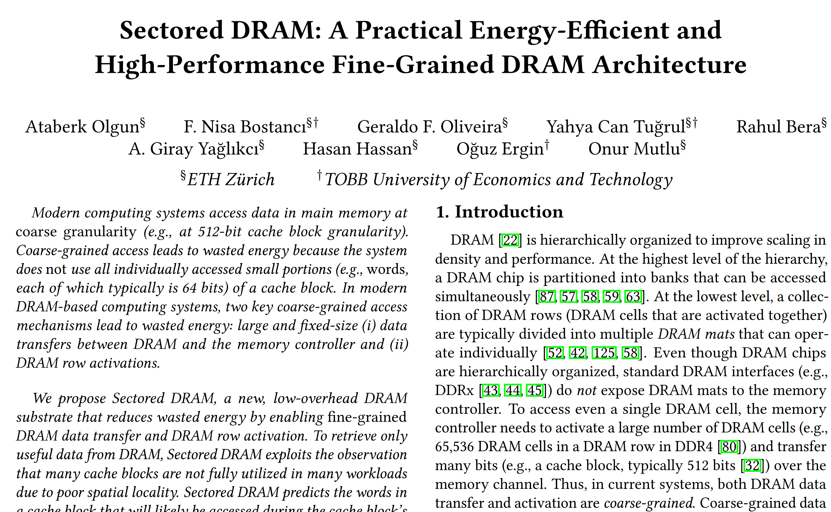
A memory controller can leverage Sectored DRAM without any physical DRAM interface modifications
1
Sectored Activation (SA)
More than 10 unused bits in precharge (PRE) command encoding
Determine the sectors opened for the next activate (ACT) command
PRE
8 sector bits
ACT
2
Variable Burst Length (VBL)
DRAM and memory controller must agree on burst length
DRAM and memory controller store sector bits for each bank
Low overhead popcount circuitry to count set (logic-1) sector bits
https://arxiv.org/pdf/2207.13795.pdf
Notes:
I described how we can expose *Sectored Activation* to the memory controller with no interface modifications. Variable burst length can also be exposed to the memory controller with no DRAM interface modifications. I invite you to read our paper for more details.

Slide 28
Outline
1. Background & Motivation
2. Sectored DRAM: Design
3. Sectored DRAM: System Integration
4. Evaluation
5. Conclusion
Notes:
I will now describe how a modern DRAM-based computing system can effectively leverage Sectored DRAM

Slide 29
Efficient System Integration of
Sectored DRAM is Challenging (I)
Challenge 1: Requires system-wide modifications to enable
sub-cache-block (e.g., word) granularity data transfers
Solution: Use sector caches (e.g., [Liptay+,1968])
Extend a cache block with 1 bit for each word
A bit indicates if its corresponding word is valid
Cache Block
Tag
Data (64 bytes)
Sector Cache Block
…
Tag
Valid Words
Word
(8 bytes)
Word
(8 bytes)
…
Word
(8 bytes)
Notes:
Effectively integrating Sectored DRAM into a system has two challenges.
[CLICK] First, today’s systems transfer data between components of the memory hierarchy in cache block granularity. However, we must enable sub-cache-block granularity data transfers for Sectored DRAM to mitigate energy waste.
[CLiCK] We use sector caches whereby we extend each cache block with 1 bit of metadata for each word. Each bit then indicates if its corresponding word in the cache block is valid.
This way, data can be transferred between components of the memory hierarchy at word granularity.

Slide 30
Efficient System Integration of
Sectored DRAM is Challenging (II)
Challenge 2: Missing words (sectors) in a cache block cause
additional performance overhead
Solution: Develop two prediction techniques
A technique to exploit the spatial locality
in subsequent load/store (LD/ST) instructions
A spatial pattern predictor (e.g., [Kumar+,1998])
tailored for predicting useful words (similar to [Yoon+, 2012])
Load Instruction Target Memory Word
…
Tag
Valid Words
Word
(8 bytes)
Missing
Word
…
Word
(8 bytes)
Notes:
Because we now retrieve a word with each memory access and not the complete cache block that contains that word, missing words in a cache block cause performance overheads as we induce additional memory accesses.
[CLICK] Our solution to the second challenge is to develop two prediction techniques. The first one exploits the spatial locality in subsequent load/store instructions’ word addresses
[CLICK] The second one is a spatial pattern predictor that we tailor for predicting useful words in a cache block.

Slide 31
Efficient System Integration of
Sectored DRAM is Challenging (II)
Challenge 2: Missing words (sectors) in a cache block cause
additional performance overhead
Solution: Develop two prediction techniques
A technique to exploit the spatial locality
in subsequent load/store (LD/ST) instructions
A spatial pattern predictor (e.g., [Kumar+,1998])
tailored for predicting useful words (similar to [Yoon+, 2012])
Load Instruction Target Memory Word
…
Tag
Valid Words
Word
(8 bytes)
Missing
Word
…
Word
(8 bytes)
Notes:
Let’s continue with the first technique

Slide 32
Load/Store Queue (LSQ) Lookahead
One load/store instruction references one word in main memory
Key Mechanism: 1) Collect references from
younger load/store instructions
2) store the collected references in the oldest load/store instr.
LSQ Lookahead has two key drawbacks
LSQ is not large enough to store many LD/ST instructions
Dependencies prevent computation of future LD/ST instruction addresses
A load/store instruction retrieves all words in a cache block
that will be referenced in the near future to the L1 cache
with only one cache access
Notes:
We call this technique load/store queue lookahead.
One load/store instruction typically references or accesses one word in main memory.
[CLICK] Our key idea is to collect memory references from younger load store instructions in the load/store queue and put the collected references in the oldest load/store instruction.
[CLICK] The outcome we expect is that when a load/store instruction executes, it will retrieve all words in its cache block that will be used by other load/store instructions in the near future. Thereby we expect to eliminate some of the additional memory accesses from sector misses.
[CLICK] However, LSQ Lookahead suffers from two key drawbacks, which in summary, prevent it from identifying all useful words in a cache block

Slide 33
Sector Predictor (SP)
Key Idea: Complement LSQ Lookahead and minimize sector misses
Used (referenced) words in a cache block form a signature
Reuse this signature when the same cache block misses in the cache
Tag
Valid Words
Data
Used Words
Table Index
Cache
Block
. . .
. . .
. . .
Previously Used Words
History Table
Notes:
We develop Sector Predictor (SP) to complement LSQ Lookahead and minimize sector misses. The key idea of sector predictor is to maintain cache block signatures [CLICK] that describe which words are likely to be useful based on current word use characteristics in the L1 cache.
[CLICK] Then, we reuse these signatures when a cache block misses [CLICK] in the L1 cache to retrieve all potentially useful words from lower levels in the memory hierarchy.

Slide 34
Outline
1. Background & Motivation
2. Sectored DRAM: Design
3. Sectored DRAM: System Integration
4. Evaluation
5. Conclusion
Notes:
Let’s switch gears and see how Sectored DRAM performs

Slide 35
Evaluation Methodology
Performance and energy consumption evaluation:
Cycle-level simulations using Ramulator
Rambus Power Model and DRAMPower for DRAM energy
CACTI & McPAT for processor energy estimation
System Configuration:
  Processor 1-16 cores, 3.6GHz clock frequency, 4-wide issue, 128-entry instruction window
  32 KiB L1, 256 KiB L2, and 8 MiB L3 caches
  DRAM DDR4, 1-4 channel, 4 rank/channel, 4 bank groups,
  4 banks/bank group, 32K rows/bank, 3200 MT/s
  Memory Ctrl. 64-entry read and write requests queues, FR-FCFS with a column cap of 16
Sectored DRAM Policies: Always-On and Dynamic
  Always-On: Never disable Sectored DRAM
  Dynamic: Dynamically turn on Sectored DRAM based on workload memory intensity
Comparison Points: 3 state-of-the-art fine-grained DRAM mechanisms
  HalfDRAM [Zhang+, ISCA’14] (best performing),
  Fine-Grained Activation [Cooper-Balis+, IEEE MICRO’10] (lowest area overhead),
  Partial Row Activation [Lee+, HPCA’17]
Workloads: 41 1-,2-,4-,8-,16-core (multiprogrammed) workloads
  SPEC CPU2006, SPEC CPU2017, DAMOV benchmark suites
Notes:
We use a variety of simulation frameworks to evaluate the performance and energy efficiency of Sectored DRAM
[CLiCK] with the baseline system configuration that I show you here
[CLICK] We evaluate two sectored DRAM policies where always-on keeps sectored dram on all the time, and Dynamic dynamically turns Sectored DRAM on if the workload is memory intensive
[CLICK] We compare Sectored DRAM to 3 state-of-the-art fine-grained DRAM mechanisms, namely HalfDRAM, Fine-Grained Activation, and Partial Row Activation
[CLICK] We simulate 41, 1 to 16 core multiprogrammed workloads from major benchmark suites.

Slide 36
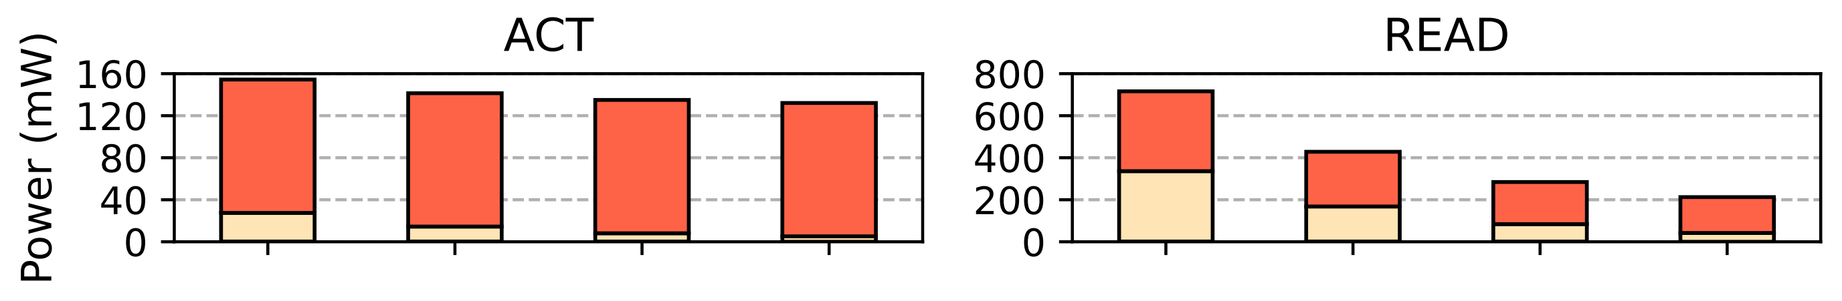
Sectored DRAM Can Greatly
Reduce DRAM ACT and READ Power
Number of sectors
Notes:
We investigate the DRAM activate and READ power improvements of Sectored DRAM. Write power improvements closely resemble that of READ power’s, so we exclude it from this slide.
The x-axis shows the number of activated or read sectors and the y-axis shows power.
[CLICK] Here is the power consumption broken down to dram array and dram periphery power for activating or reading 8 sectors.
[CLICK] and here is the rest of the plot.

Slide 37
Sectored DRAM Can Greatly
Reduce DRAM ACT and READ Power
13%
70%
Number of sectors
Reading from (activating) one sector
takes 70% (13%) less power than
reading from (activating) all 8 sectors
ACT power is dominated by periphery power
not affected by the number of sectors activated
Notes:
[CLICK] We make two key observations. First, reading or activating one sector can greatly reduce power consumption compared to reading or activating all 8 sectors.
[CLICK] Second, we observe that ACTIVATE power is dominated by periphery power, which is marginally affected by the number of sectors activated.

Slide 38
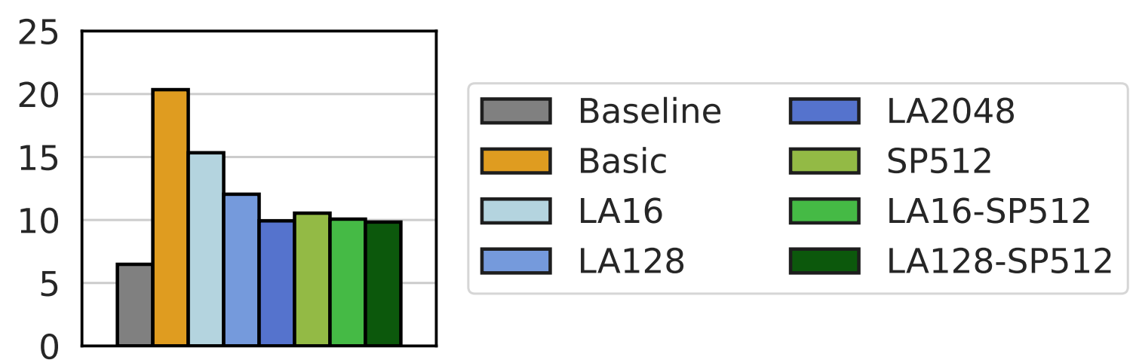
Number of Sector Misses
Basic = Sectored DRAM without any sector prediction
LA<N> = LSQ Lookahead with N LSQ entries
SP512 = Sector Predictor with a history table size of 512
3.1X
System Configuration
52%
Average
LLC Misses (MPKI)
System Configuration
LSQ Lookahead 128 with SP 512
minimizes the LLC misses caused by sector misses
Notes:
Then we look at the performance of our sector prediction techniques. [CLICK]
We show different Sectored DRAM configurations and [CLICK] the number of their last level cache misses averaged across 41 single-core workloads.
[CLICK] Basic has no prediction,
[CLiCK] These are different LSQ Lookahead configurations that look ahead N entries in the load store queue where N is the number following LA
[CLICK] SP512 is the sector predictor configured with 512 table entries.
[CLICK] Sectored DRAM with no prediction significantly increases the LLC misses as it induces many sector misses
[CLICK] However, LSQ Lookahead with 128 lookahead size and sector predictor with 512 entries can minimize the LLC misses caused by sector misses
=====
Put in backup. Maybe not.
Put the legend’s name on the x-axis.

Slide 39
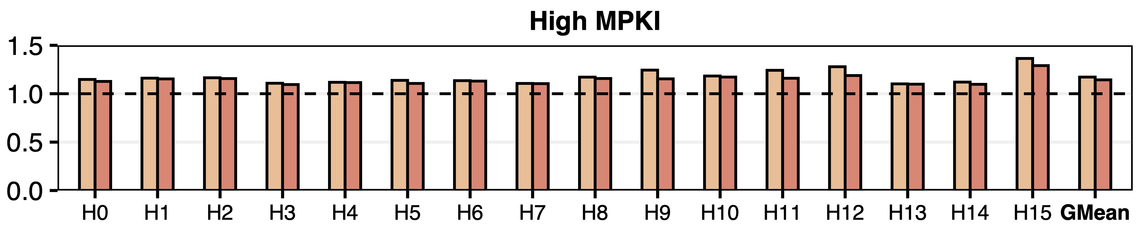
Speedup
High Memory Intensity (MPKI ≥ 10)
Normalized
Weighted Speedup
8-Core Workload Mix
17%
14%
Sectored DRAM provides significant speedups
for highly memory intensive workloads
Notes:
This figure shows [CLICK] normalized weighted speedup for [CLICK] heavily memory intensive [CLICK] 8-core workload mixes using [CLICK] the always on and the Dynamic policies that I described earlier.
[CLICK] (Slowly) We observe that Sectored DRAM provides significant speedups for highly memory intensive workloads.

Slide 40
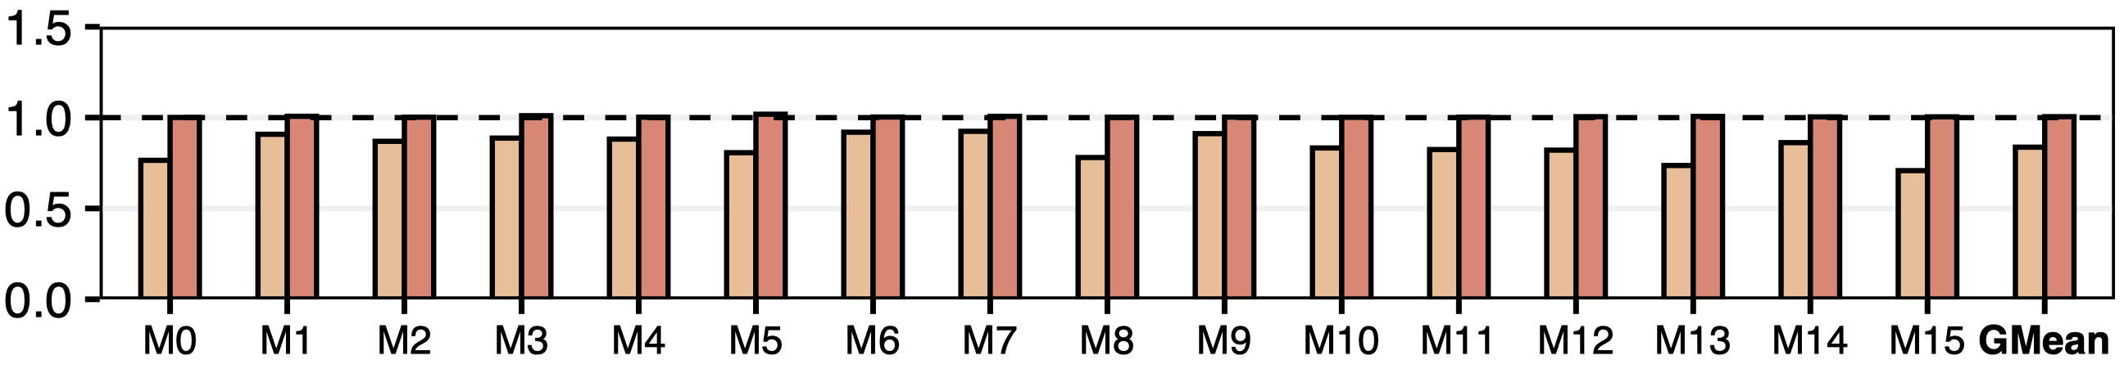
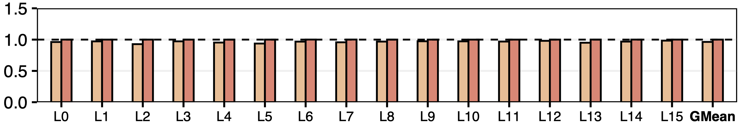
Performance Degradation for
Non-Memory-Intensive Workloads
Medium Memory Intensity (MPKI < 10)
Normalized Weighted Speedup
Low Memory Intensity (MPKI < 2)
8-Core Workload Mix
Dynamic policy overcomes the performance degradation
in non-memory-intensive workloads
Notes:
[CLICK] We show the weighted speedup for heterogeneous workload mixes for [CLICK] medium and [CLICK] low memory intensity categories.
[CLICK] We observe that the dynamic policy overcomes the performance degradation in non-memory-intensive workloads as it achieves a weighted speedup very close to that of the baseline’s.

Slide 41
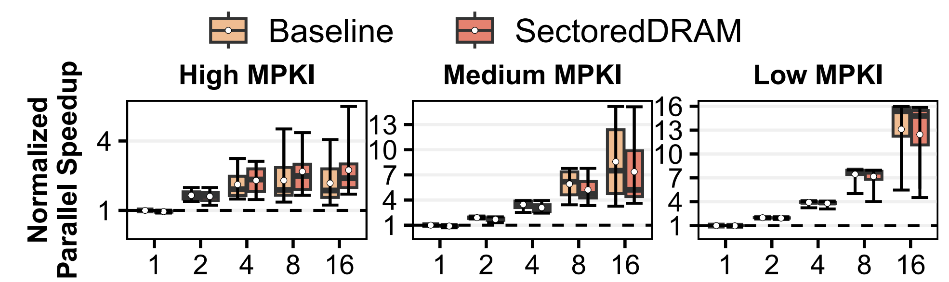
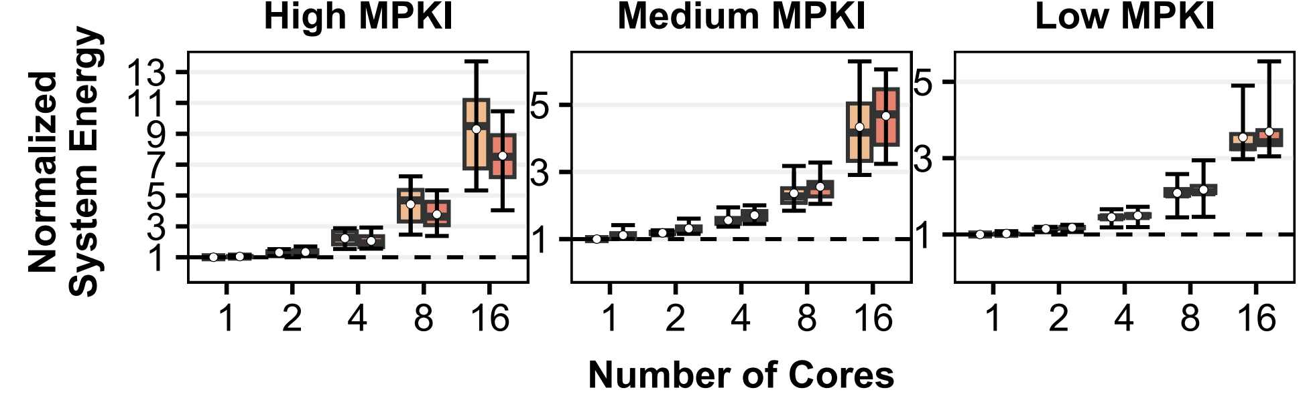
System Energy
20%
Number of Cores
Sectored DRAM provides significant system energy savings
for highly memory intensive workloads at core count > 2
Notes:
We show the distribution of system energy consumption across all tested workloads [CLICK] categorized according to their memory intensities.
[CLICK] The boxes on the left show the performance of Baseline and the boxes on the right show the performance of Sectored DRAM with the always on policy.
[CLICK] the x axis shows the number of cores. The lower a point in this plot, the better the system energy consumption for that workload.
[CLICK] We observe that Sectored DRAM provides significant energy savings for highly memory intensive workloads at core counts higher than 2.

Slide 42
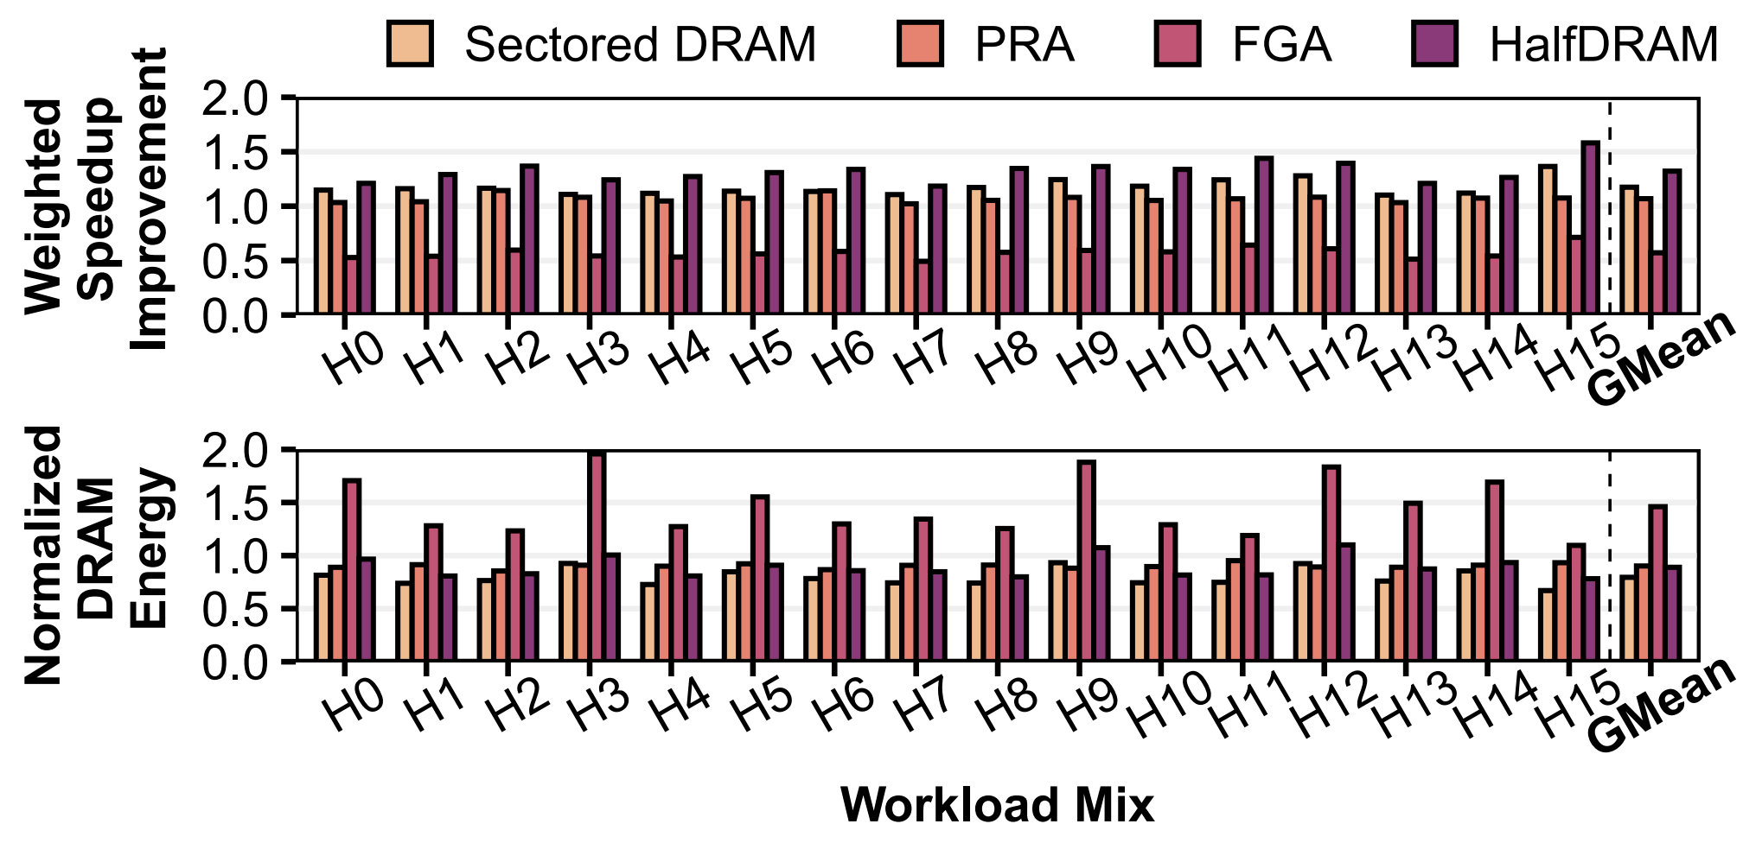

Workload Mix Performance Comparison
Notes:
We compare Sectored DRAM’s performance to the [CLICK] 3 state-of-the-art techniques for highly-memory intensive 16 workload mixes shown on the x-axis.

Slide 43
Workload Mix Performance Comparison
2.1X
Outperforms fine-grained activation by 2.1X
Notes:
Sectored DRAM greatly improves performance over basic fine-grained DRAM mechanisms because it does not reduce DRAM throughput.

Slide 44
Workload Mix Performance Comparison
10%
Outperforms fine-grained activation by 2.1X
Outperforms Partial Row Activation by 10%
Notes:
Outperforms Partial Row Activation by 10% because Sectored DRAM leverages fine-grained DRAM for READ accesses as well as WRITE accesses.

Slide 45
Workload Mix Performance Comparison
11%
Outperforms fine-grained activation by 2.1X
Outperforms Partial Row Activation by 10%
Performs within 11% of HalfDRAM
Notes:
And Sectored DRAM performs within 11% of HalfDRAM because HalfDRAM does not incur any additional memory accesses due to sector misses and HalfDRAM benefits from a higher rate of activation commands.

Slide 46
Workload Mix DRAM Energy Comparison
13%
84%
12%
Sectored DRAM enables larger DRAM energy savings
compared to prior works
Savings are attributed to
i) finer-grained data transfer and activation than HalfDRAM
ii) background power reduction compared to PRA and FGA
Notes:
We compare Sectored DRAM’s energy savings to the state-of-the-art techniques.
[CLICK] Sectored DRAM outperforms all three techniques in energy savings because [CLICK] it enables finer-grained data transfer and activation than HalfDRAM, and reduces background energy consumption by reducing workload runtimes over Partial Row Activation and Fine-Grained DRAM.

Slide 47
Area Overhead Estimation
DRAM
Sector transistors, sector latches, wiring
8 additional local wordline driver stripes
Model DRAM chip using CACTI
  Sectored DRAM: 1.7% of DRAM chip area
  Partial Row Activation and Fine Grained Activation: 1.7%
  HalfDRAM: 2.6%
Processor
Sector bits (indicate valid words): 1 byte/cache block
Sector predictor: 1088 bytes/core
Model processor storage area overhead using CACTI
  8-core processor area increases by 1.2%
Notes:
Finally, we estimate Sectored DRAM’s DRAM and processor area overheads. I’ll summarize these and invite you to read our paper for more details.
[CLICK] We find that Sectored DRAM’s DRAM components take up 1.7% of a DDR4 chip’s area
[CLICKx2] And the sector caches and the sector predictor take up 1.2% of an 8-core processor’s area

Slide 48
More in the Paper
Microbenchmark performance evaluation
  Sectored DRAM greatly benefits random access workloads
    Provides 1.87x parallel speedup over Baseline
  Adversarial access patterns can reduce performance
    Incurs 33% performance overhead for a strided access single-core workload
Performance & energy sensitivity analysis
  Number of DRAM channels
  Performance with prefetching enabled
Discussion on
  Finer-granularity sector support (i.e., >8 sectors)
  Compatibility with DRAM Error Correcting Codes
Notes:
We have more details in the paper such as:
[CLICK] A microbenchmark performance evaluation study that shows that Sectored DRAM greatly improves random access workload performance. It almost doubles performance for 4, 8, and 16 core random access workloads.
Conversely, for a workload with adversarial access patterns, Sectored DRAM has 33% performance overhead. However, this overhead can be negated with Sectored-DRAM’s dynamic on/off policy.
[CLICK] We have sensitivity studies on the effects of the number of DRAM channels and prefetching. Both the baseline system and the sectored dram system have increasing performance with number of channels. Nothing surprising here.
As for prefetching, Sectored DRAM with a simple region-based single-stride prefetcher provides performance benefits compared to Sectored DRAM without one.
[CLICK] We discuss and describe how we support finer-grained sectors and Sectored DRAM’s compatibility with DRAM error correcting codes

Slide 49
More in the Paper
Sectored DRAM implementation
and system integration details
Microbenchmark performance evaluation
  Sectored DRAM greatly benefits random access workloads
System throughput and energy per workload
DRAM energy breakdown
Performance & energy sensitivity analysis
  Number of DRAM channels
  Performance with prefetching enabled
Discussion on
  Finer-granularity sector support (i.e., >8 sectors)
  Compatibility with DRAM Error Correcting Codes
https://arxiv.org/pdf/2207.13795.pdf
Notes:
I invite you to read our paper for those details

Slide 50
Outline
1. Background & Motivation
2. Sectored DRAM: Design
3. Sectored DRAM: System Integration
4. Evaluation
5. Conclusion
Notes:
Let me quickly conclude

Slide 51
Sectored DRAM Conclusion
Designed a fine-grained, low-cost, and high-throughput DRAM substrate
Mitigates excessive energy consumption of coarse-grained DRAM
Key Ideas: Small modifications to memory controller and DRAM chip enable
Key Results: For the evaluated memory-intensive workloads, Sectored DRAM
Improves system energy consumption by 14%, system performance by 17%
Incurs 0.39 mm² (1.7%) DRAM chip area overhead
Performs within 11% of a state-of-the-art prior work (Half-DRAM),
with 12% less DRAM energy and 34% less area overhead
Variable Burst Length
Sectored Activation
sector latch
1 bit
1 bit
1 bit
1 bit
8
8
8
8
8
8
8
8
activated sectors
64
row decoder
sector
8
Read FIFO
8x3
Encoder
. . . . .
3
8
Chip I/O
sector transistor
Notes:
In this work, we designed a fine-grained, low-cost, and high-throughput DRAM substrate to mitigate the excessive energy consumption of coarse-grained DRAM
[CLICK] With small modifications to the memory controller and the DRAM chip, we enabled [CLICK] variable sized data transfer bursts, and [CLICK] activating smaller-sized regions in DRAM chips.
[CLICK] Our results showed that an effective system integration of Sectored DRAM provides significant energy savings and performance improvements at low DRAM chip area cost.

Slide 52
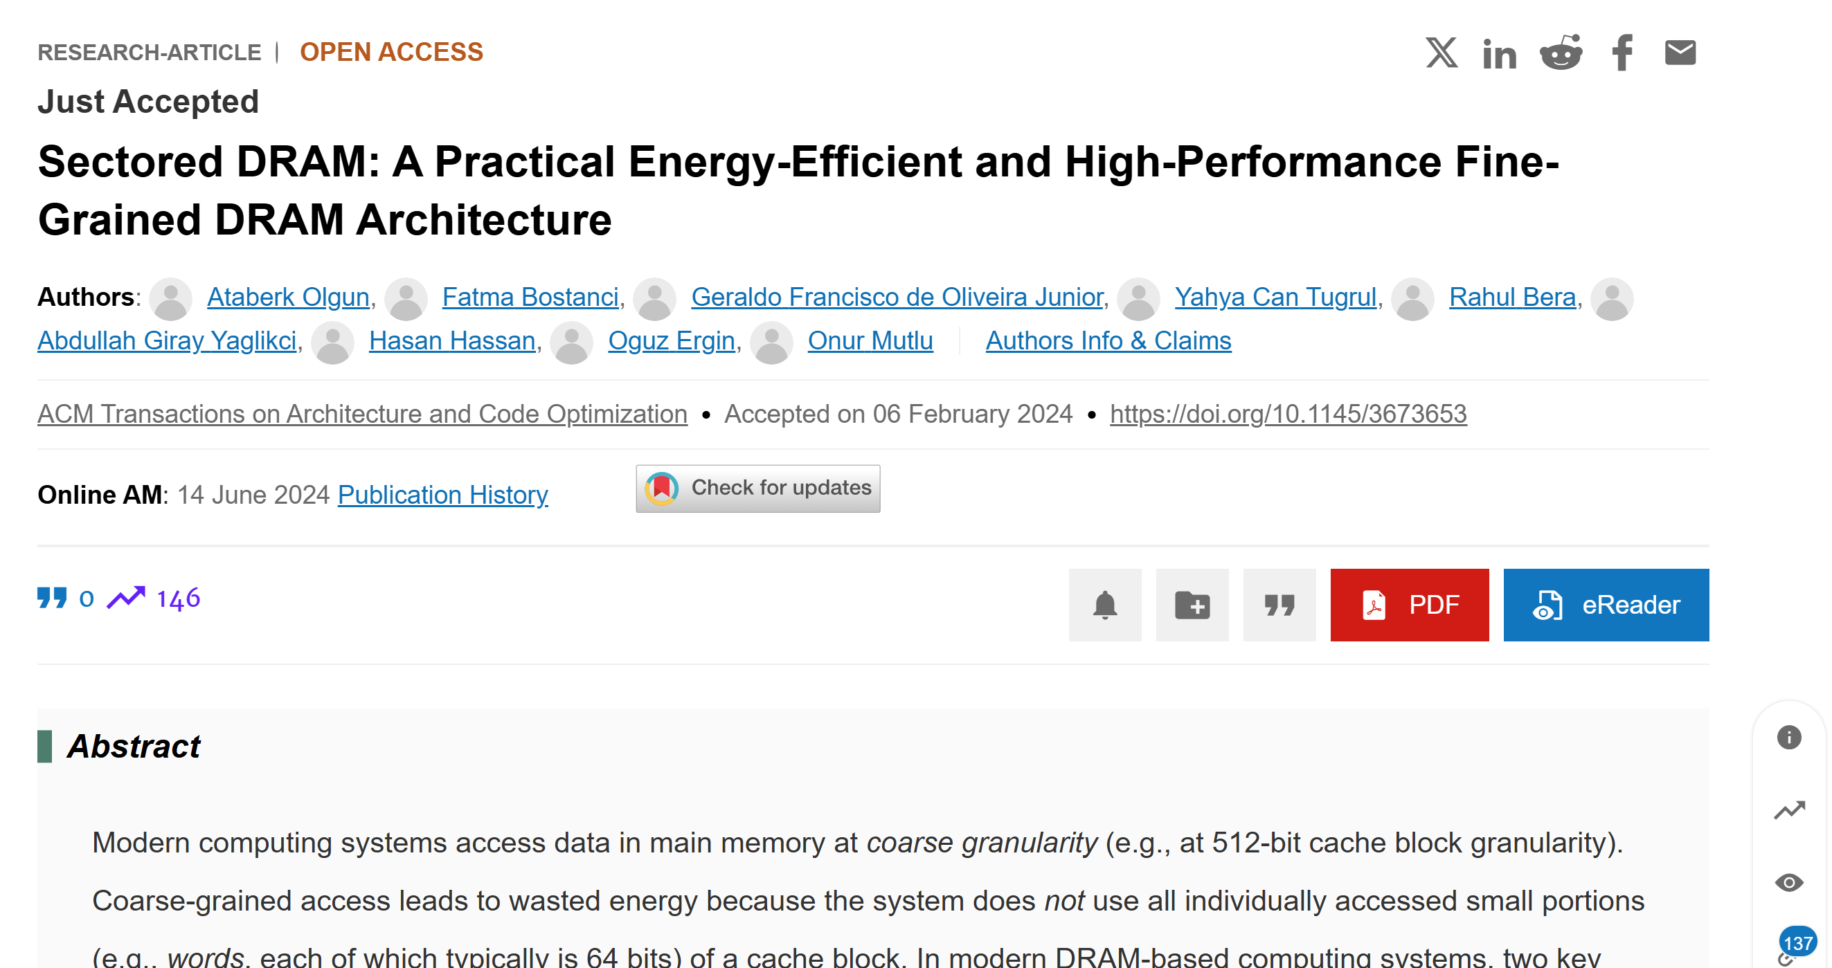
Sectored DRAM is Published in ACM TACO
https://dl.acm.org/doi/abs/10.1145/3673653
Notes:
This work was published in ACM Transactions on Architecture and Code Optimization

Slide 53
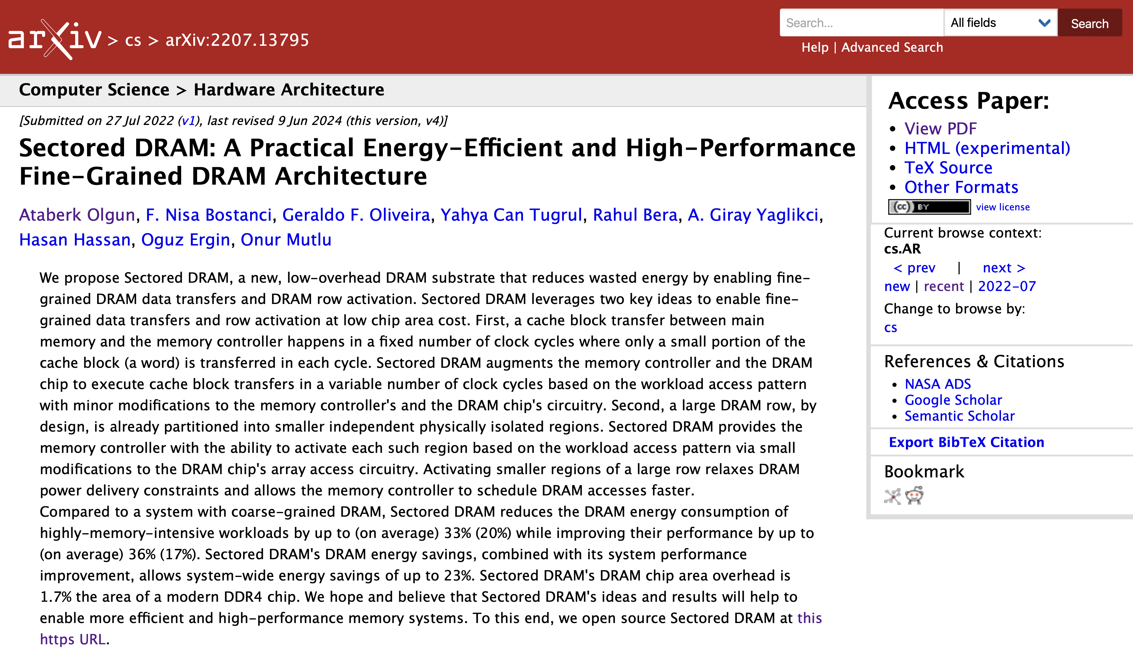
Extended Version on Arxiv
https://arxiv.org/pdf/2207.13795.pdf

Slide 54
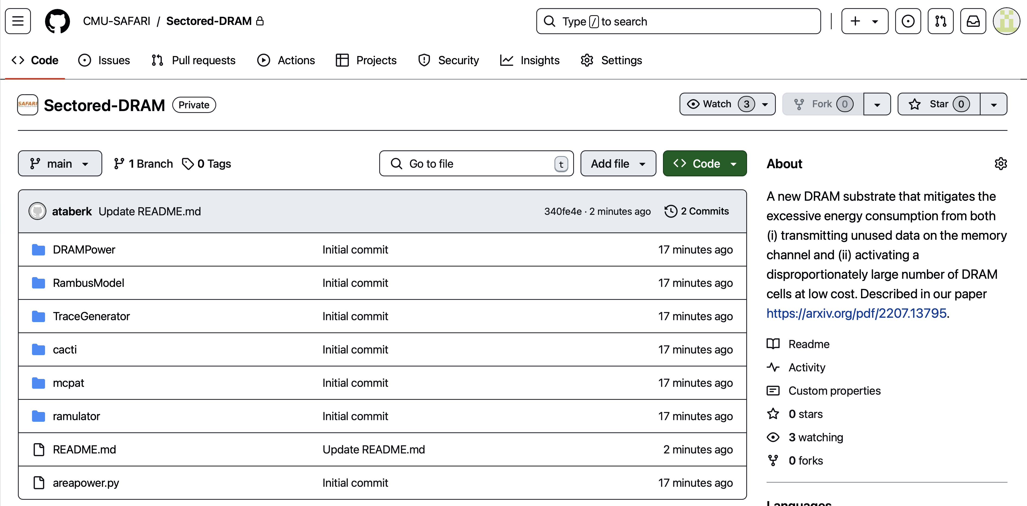
Sectored DRAM is Open Source
https://github.com/CMU-SAFARI/Sectored-DRAM

Slide 55


Sectored DRAM
A Practical Energy-Efficient and High-Performance
Fine-Grained DRAM Architecture
Paper
GitHub
Ataberk Olgun
olgunataberk@gmail.com
F. Nisa Bostanci Geraldo F. Oliveira Yahya Can Tugrul Rahul Bera
A. Giray Yaglikci Hasan Hassan Oguz Ergin Onur Mutlu
Notes:
=============
Did you compare Sectored DRAM against smaller cache block sizes?

Slide 56
Backup Slides

Slide 57
DRAM Data Transfer (II)
Bits of a burst split across DRAM mats
global wordline
row decoder
global sense amplifier
64 bits
IO interface
column
8 bits
B56
from memory controller
[Oliveira+, HPCA’24]
Notes:
[CLICK] … bits of a burst is eventually split across DRAM mats. Just like we have seen in one of the previous slides but in the other direction.

Slide 58
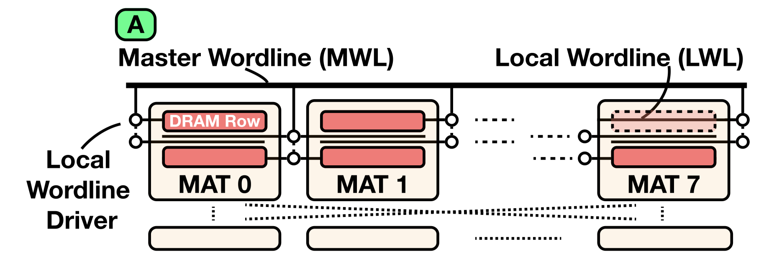
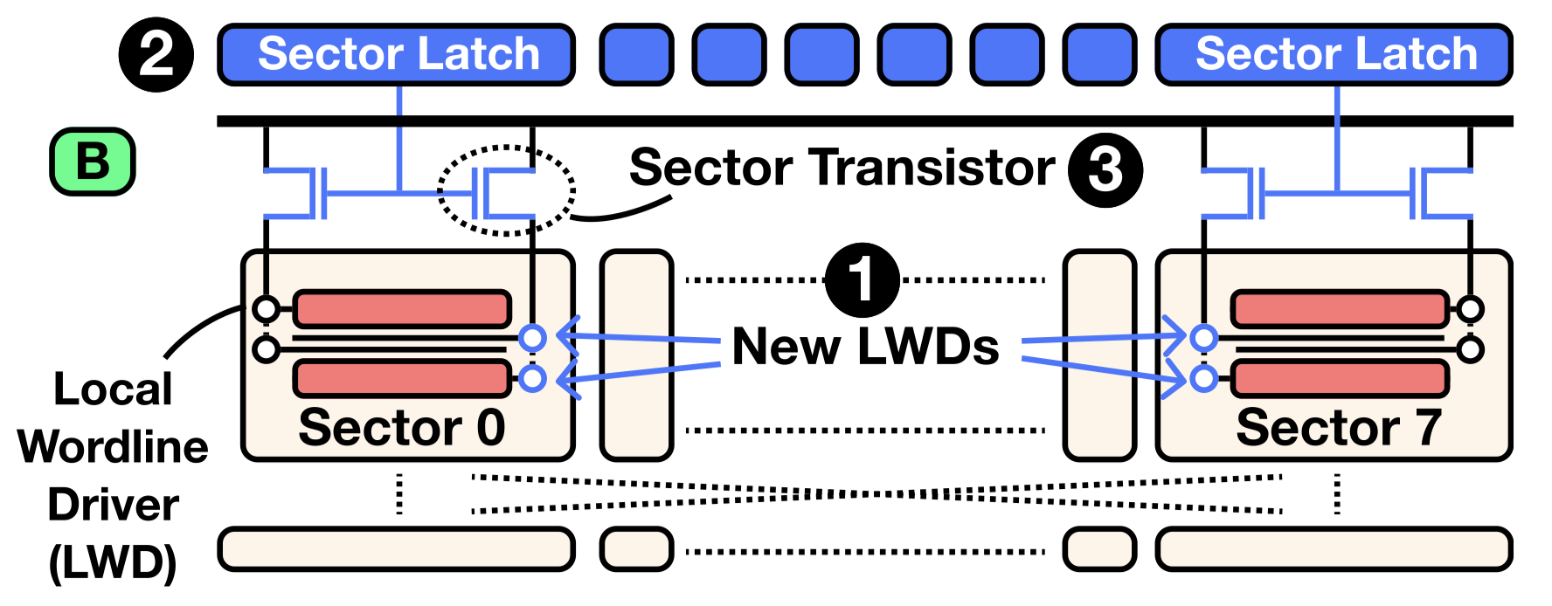
Sectored DRAM Subarray Organization

Slide 59
Exposing Sectored DRAM to the Memory Controller with No Interface Modifications
1
Sectored Activation (SA)
More than 10 unused bits in precharge (PRE) command encoding
Determine the sectors opened for the next activate (ACT) command
PRE
8 sector bits
ACT
Activating fewer than all 8 sectors relaxes power constraints
allows for higher ACT command throughput
2
Variable Burst Length (VBL)
DRAM and memory controller must agree on burst length
DRAM and memory controller store sector bits for each bank
Low overhead popcount circuitry to count set (logic-1) sector bits
Notes:
We expose the two components to the memory controller with no DRAM interface modifications
[CLICK] There are more than 10 unused bits in the precharge command’s encoding in the DDR4 standard. This command is used to close the open DRAM row in a bank before activating another DRAM row.
[CLICK] So the memory controller uses these unused bits to transmit sector bits for the next activate command
[CLICK] When the memory controller chooses to activate fewer than all 8 sectors, the memory controller can issue activate commands at a higher rate, which enables the performance improvements that I will describe later in the slides.
[CLICK] For variable burst length to work properly…
[CLICK] … the memory controller and the DRAM chip must agree on the burst length before each burst.
[CLICK] Since both the memory controller and the DRAM chip store sector bits for each bank, they can determine the burst length by counting the number of set sector bits using a low overhead popcount circuitry of only 34 logic gates.
============
Ugly and Crowded. Maybe split.

Slide 60
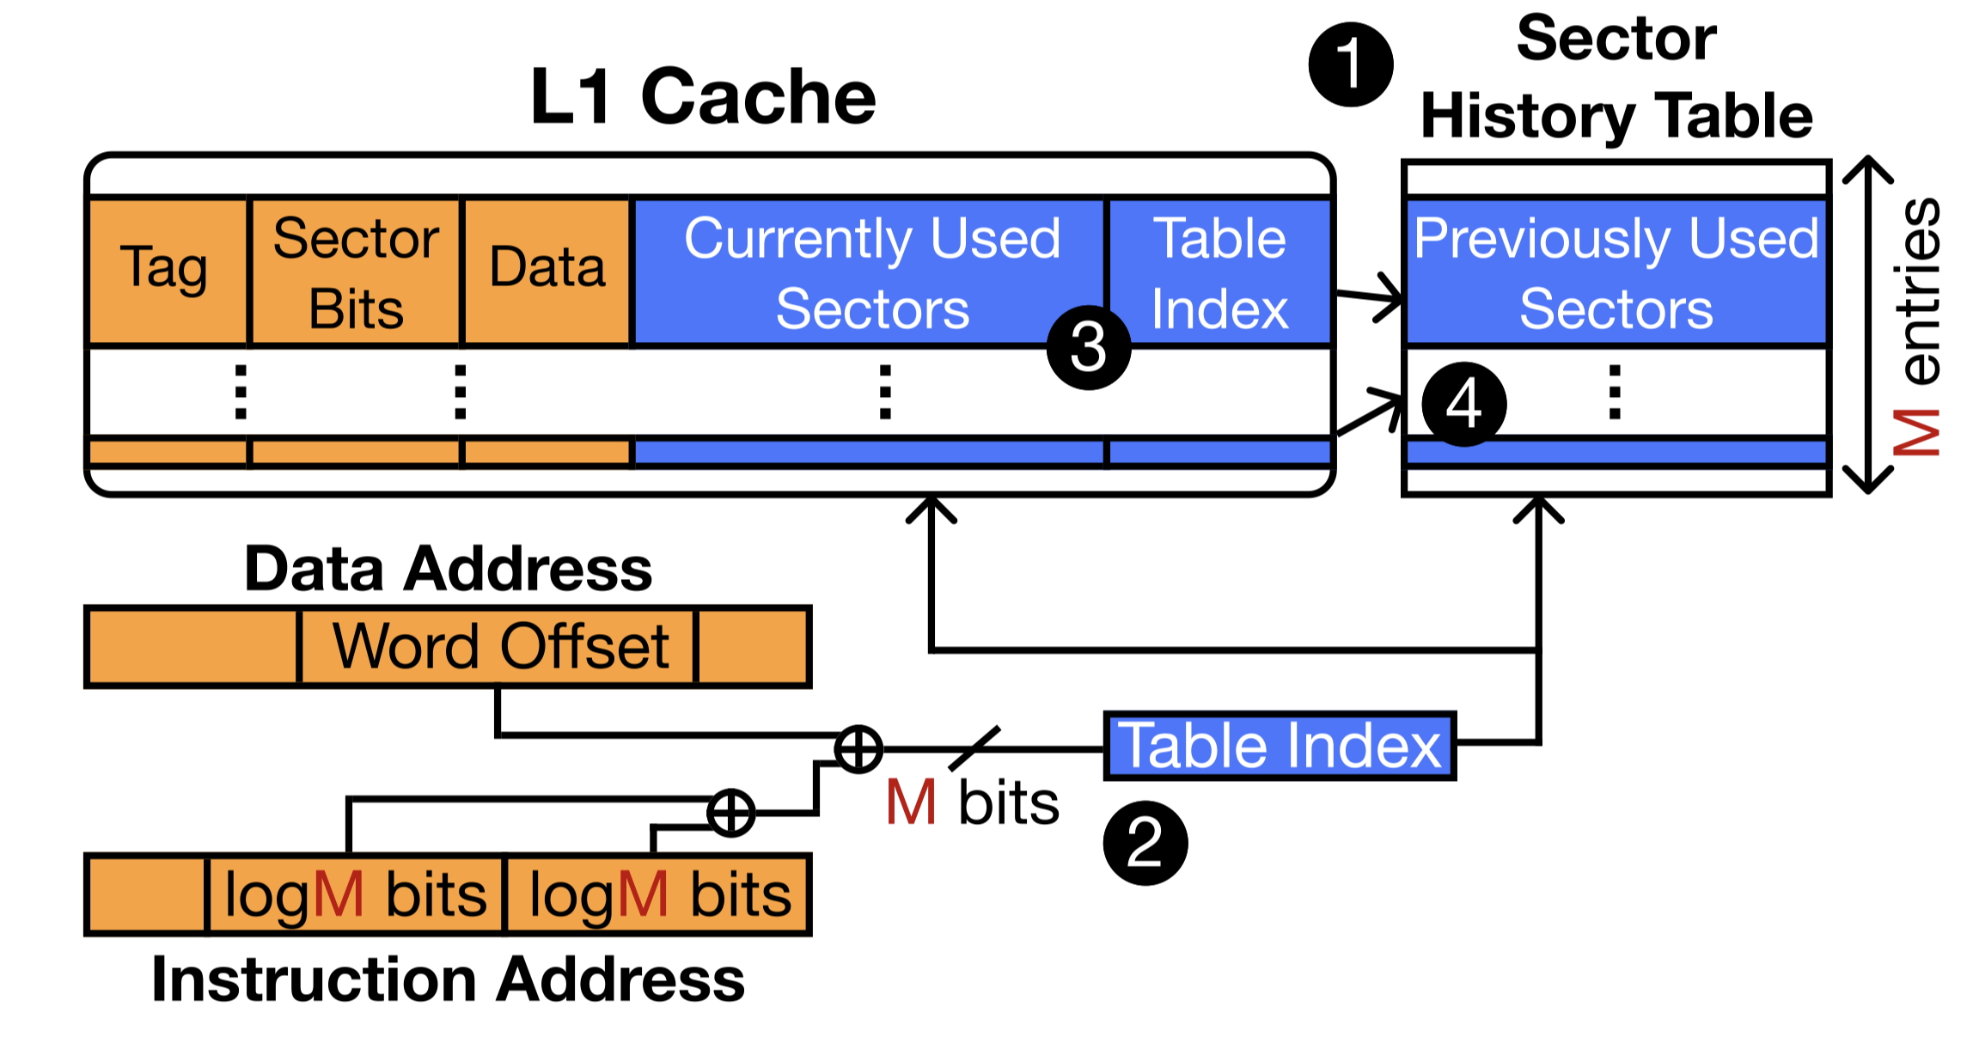
Sector Predictor

Slide 61
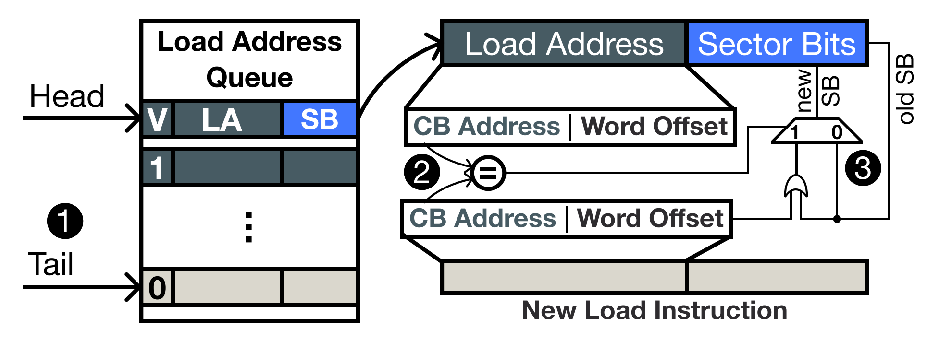
Load/Store Queue (LSQ) Lookahead
One load/store instruction references one word in main memory
Key Mechanism: 1) Collect references from
younger load/store instructions
2) store the collected references in the oldest load/store instr.
A load/store instruction retrieves all words in a cache block
that will be referenced in the near future to the L1 cache
with only one cache access
Notes:
We call this technique load/store queue lookahead.
One load/store instruction typically references or accesses one word in main memory.
[CLICK] Our key idea is to collect memory references from younger load store instructions in the load/store queue and put the collected references in the oldest load/store instruction.
[CLICK] The outcome we expect is that when a load/store instruction executes, it will retrieve all words in its cache block that will be used by other load/store instructions in the near future. Thereby we expect to eliminate some of the additional memory accesses from sector misses.
============
Save time by quickly describing the two techniques
IF figure no describe no figure

Slide 62
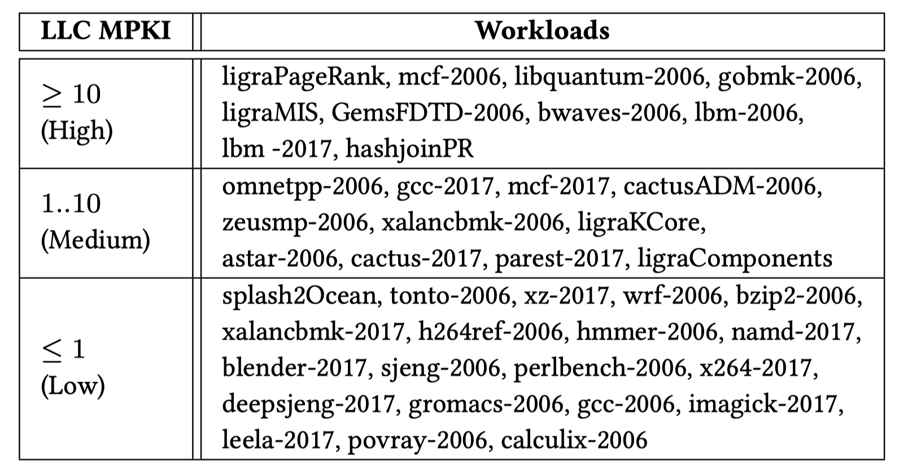
Evaluated Workloads

Slide 63
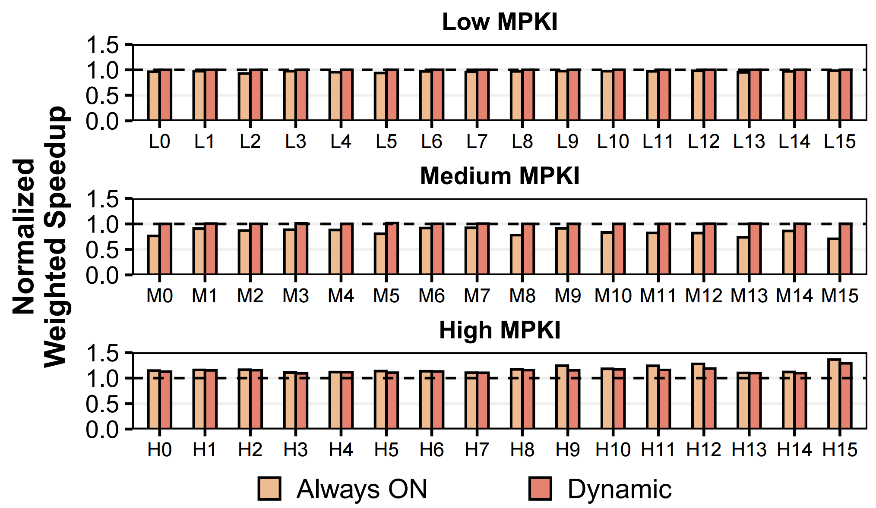
Performance Degradation for
Non-Memory-Intensive Workloads
Fetch all sectors of a cache block if the workload access pattern
does not favor sub-cache-block data transfers
  Based on average MPKI and thresholding
Dynamic policy overcomes the performance degradation
in non-memory-intensive workloads
Notes:
However, we have a way of alleviating the performance degradation for those non-memory-intensive workloads.
[CLICK] Our key idea is to fetch all sectors of a cache block, that is, disable Sectored DRAM, for workloads with access patterns that do not favor Sectored DRAM.
[CLICK] At a very high level, we measure the average number of requests in the memory controller’s read request queue as a proxy to indicate the memory intensiveness of the workload, and if the occupancy is higher than a threshold, we enable Sectored DRAM.
[CLICK] We show the weighted speedup for heterogeneous workload mixes for three [CLICK] memory intensity categories using Sectored DRAM (always on) and the Dynamic policy that I just described.
[CLICK] We observe that the dynamic policy overcomes the performance degradation in non-memory-intensive workloads.
==========================
Fix slide: split into two

Slide 64
Speedup
Notes:
We show the distribution of speedup across all tested workloads categorized according to the number of their last level cache misses, that is high MPKI, [CLICK] medium MPKI, [CLICK] and low MPKI. The boxes on the left show the performance of Baseline and the boxes on the right show the performance of Sectored DRAM.
[CLICK] the x axis shows the number of cores and the [CLICK] y-axis is the parallel speedup normalized to the baseline system executing the same workload on a single core. The higher a point in this plot, the better the performance for that workload.
[CLICK] Here are the speedups provided for dual-core homogeneous multiprogrammed workloads
[CLICK] and this is the full plot
===========================================
Show one figure first and then the others

Slide 65
Speedup
26%
Sectored DRAM provides significant speedups
for highly memory intensive workloads at core count > 2
Notes:
[CLICK] First, we observe that Sectored DRAM provides significant speedups for highly memory intensive workloads when core count is higher than 2. That is, for workloads that create high contention in the memory system.
====================================================
Show one figure first and then the others

Slide 66
Speedup
Sectored DRAM provides significant speedups
for highly memory intensive workloads at core count > 2
Sectored DRAM provides smaller parallel speedup than Baseline
for non-memory-intensive workloads
Notes:
Second, Sectored DRAM provides smaller parallel speedup than Baseline for non-memory-intensive workloads because the higher rate of activation cannot amortize the overheads of additional memory accesses due to sector misses.
===========================================
Show one figure first and then the others

Slide 67
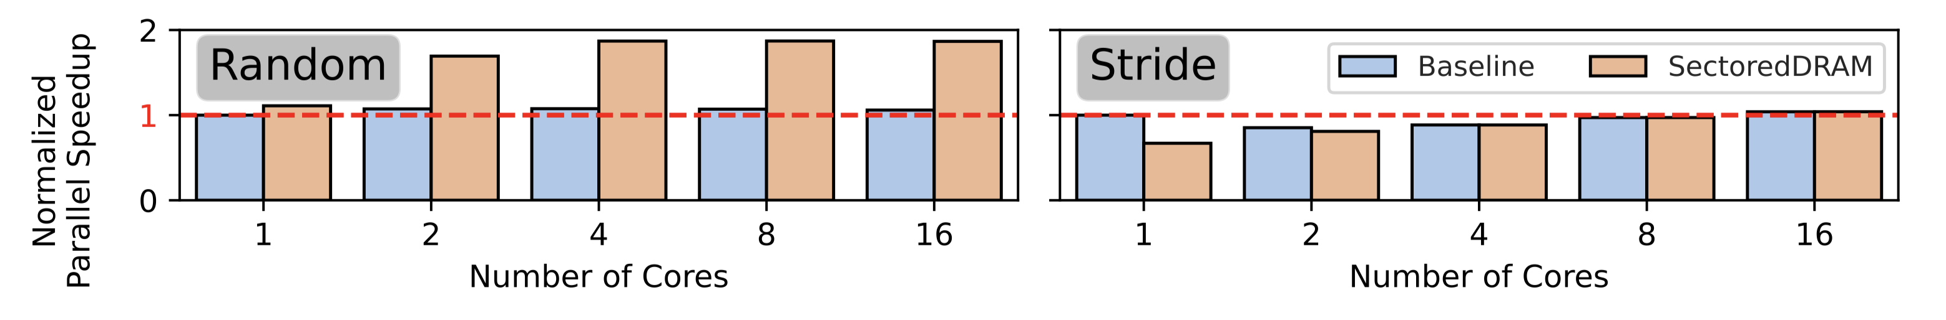
Microbenchmark Performance

Slide 68
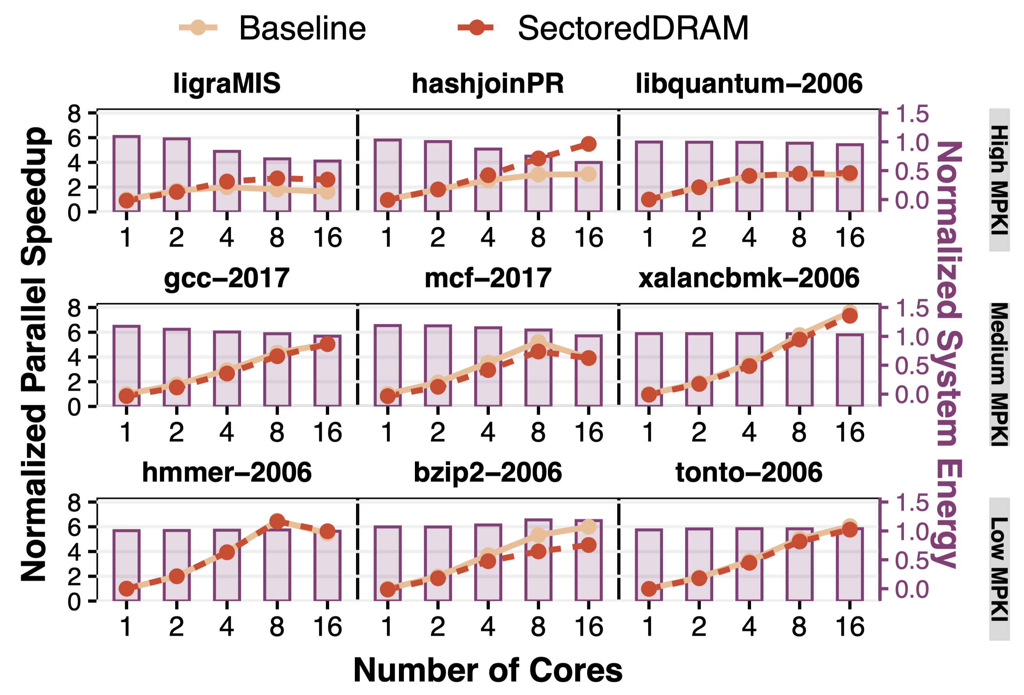
Parallel Speedup and System Energy per Workload

Slide 69
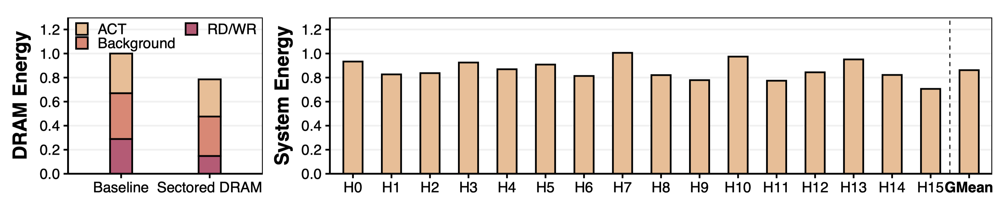
DRAM Energy Breakdown and System Energy

Slide 70
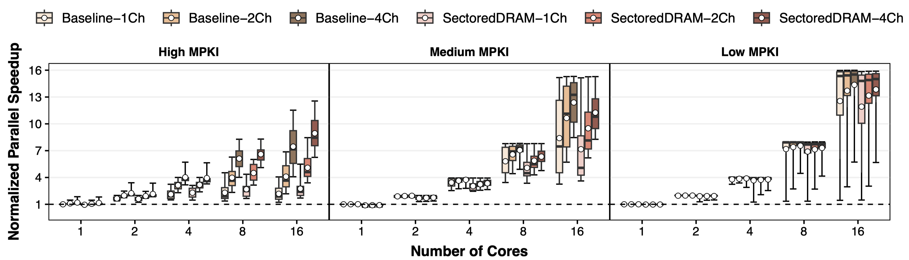
Performance Sensitivity to
Number of Channels

Slide 71
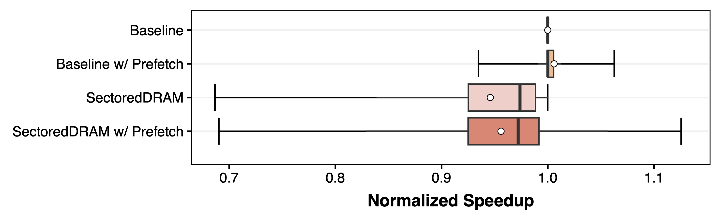
Sectored DRAM with Prefetching

Slide 72
Enabling Higher Row Activation Rate
tFAW = 25 nanoseconds (ns)
32 sectors can be activated in a tFAW
Only 10 activate commands can be issued in 25 ns
due to tRRD_L and tRRD_S
10 ACT, each of which activate one sector
takes 20% less power than
4 ACT, each of which activates 8 sectors

Slide 73
Sectored DRAM vs
Module-Level Mechanisms
DRAM interface modifications vs. DRAM chip modifications
Low overhead module-level mechanism
induces 23% overhead
where Sectored DRAM provides 17% speedup
  Command bus becomes the bottleneck
  Alleviating command bus bottleneck is area expensive
System integration heavily inspired by DGMS

