Slide 1


Evaluating Homomorphic Operations on a Real-World
Processing-In-Memory System
Harshita Gupta* Mayank Kabra*
Juan Gómez-Luna Konstantinos Kanellopoulos
Onur Mutlu

Slide 2
Homomorphic Encryption
2

Slide 3




Homomorphic Encryption
Encrypts data
Data
User
Host System
Encrypted data
3

Slide 4




Homomorphic Encryption
Encrypts data
Data
Encrypted data
User
Host System
Encrypted data
Performs operations on the encrypted data without decrypting it
Central/Cloud Server
4

Slide 5


Homomorphic Encryption
Encrypts data
Data
Encrypted data
User
Host System
Encrypted data
Performs operations on the encrypted data without decrypting it.
Central/Cloud Server
Result
Encrypted result
Decrypts result
5

Slide 6
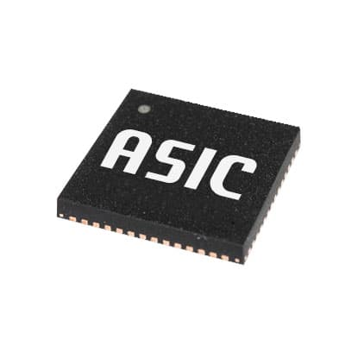
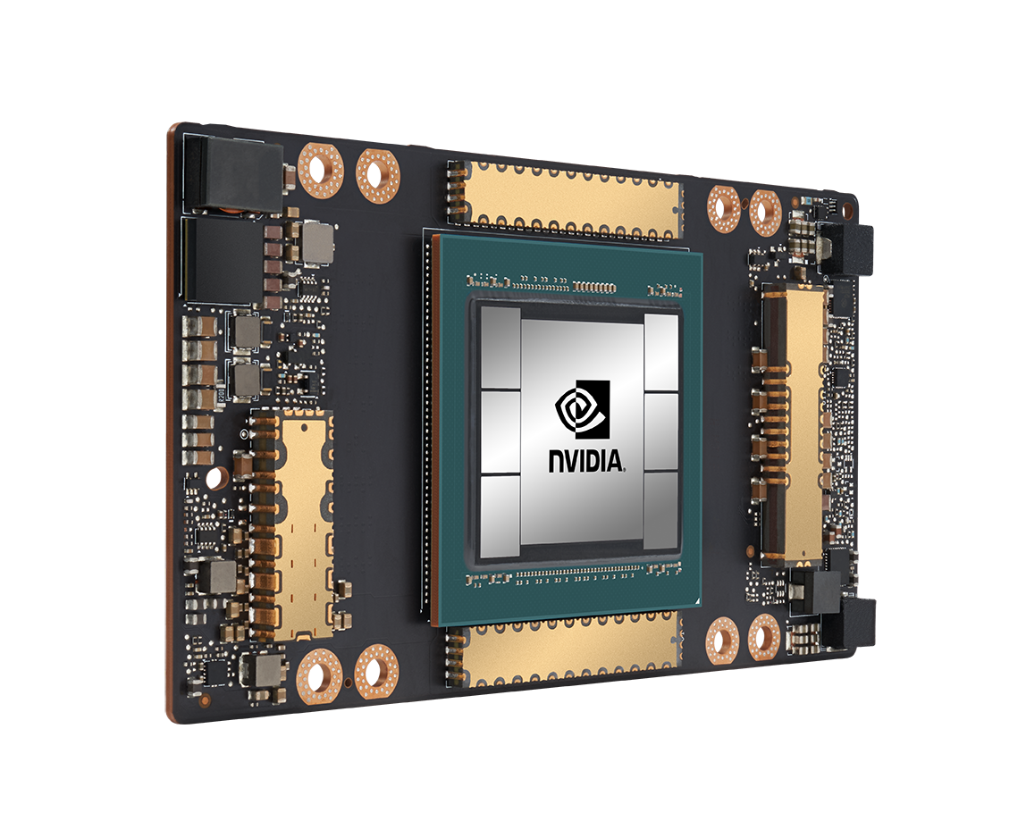
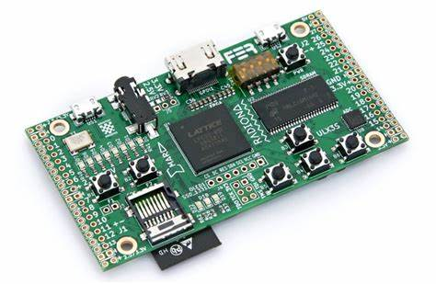
Motivation
Homomorphic operations suffer from
large memory capacity and data movement bottlenecks
Acceleration Techniques

Slide 7
Motivation
These approaches face challenges in resource limitations, data movement, and practical implementation
Acceleration Techniques

Slide 8
Our Goal
Evaluate the suitability of real-world general-purpose processing-in-memory (PIM) architectures to perform homomorphic operations.

Slide 9
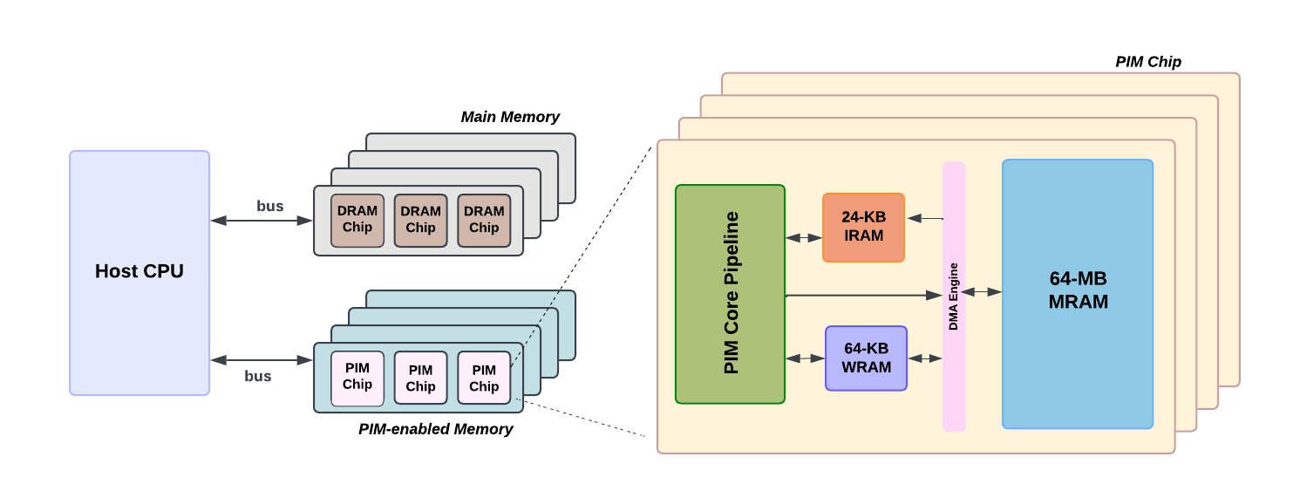
Our Goal
Evaluate the suitability of real-world general-purpose processing-in-memory (PIM) architectures to perform homomorphic operations.
UPMEM: First Real World PIM Architecture

Slide 10
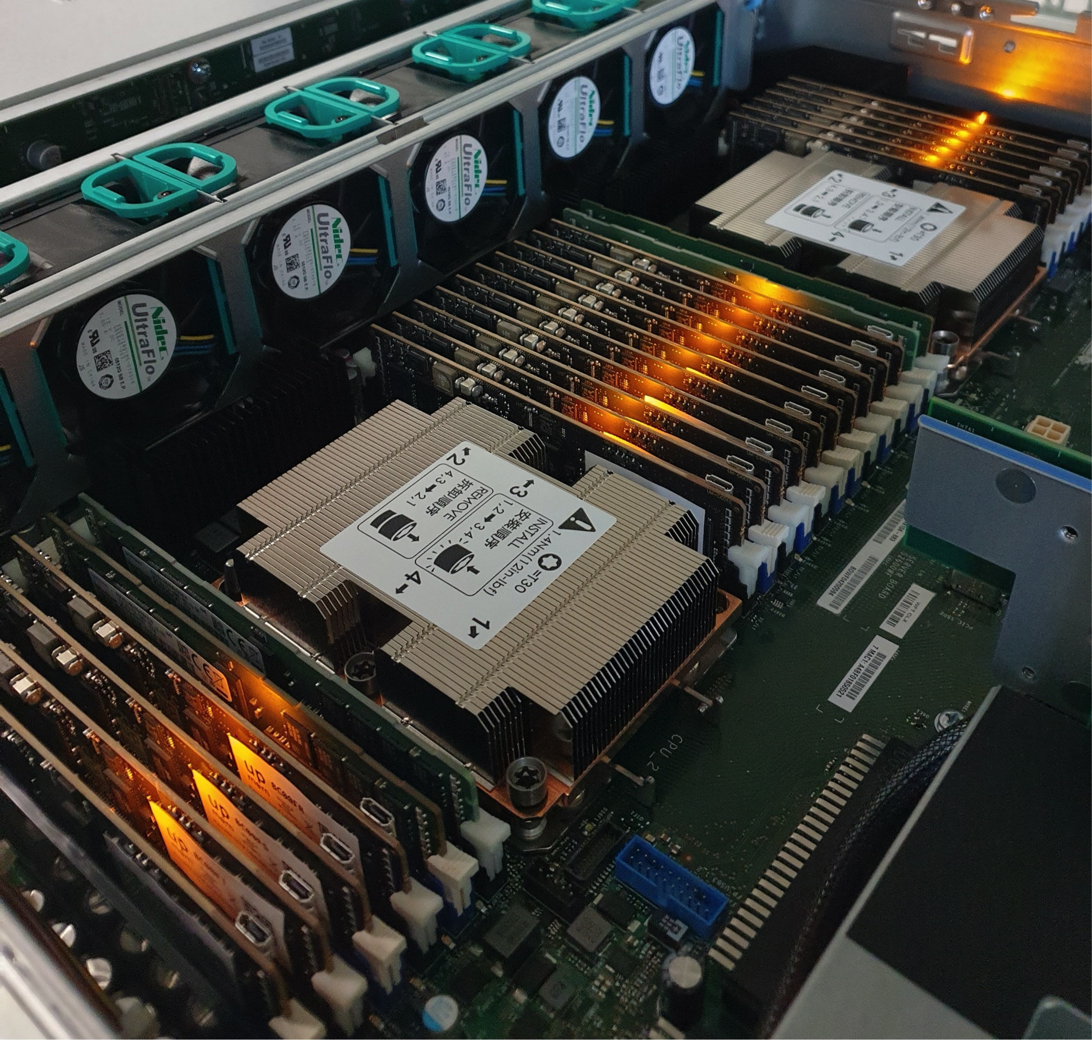
Our Goal
Evaluate the suitability of real-world general-purpose processing-in-memory (PIM) architectures to perform homomorphic operations.
UPMEM: First Real World PIM Architecture

Slide 11
Evaluation Methodology​
1
Evaluation of homomorphic addition and multiplication on UPMEM PIM system
11

Slide 12
Evaluation Methodology​
1
Evaluation of homomorphic addition and multiplication on UPMEM PIM system
2
Evaluation with statistical workloads
(mean, variance, linear regression)

Slide 13
Evaluation Methodology​
1
Evaluation of homomorphic addition and multiplication on UPMEM PIM system
2
Evaluation with statistical workloads
(mean, variance, linear regression)
3
Comparison with custom CPU and GPU libraries
and an optimized CPU library (SEAL)

Slide 14
Evaluation: Homomorphic Addition

Slide 15
Evaluation: Homomorphic Addition
50 − 100× speedup provided by PIM over CPU
2 − 15× speedup over GPU

Slide 16
Evaluation: Homomorphic Multiplication

Slide 17
Evaluation: Homomorphic Multiplication
PIM lags 10 − 15× behind the GPU
due to the lack of native multiplication support

Slide 18
Evaluation: Linear Regression

Slide 19
Evaluation: Linear Regression
PIM is 6.4-7.5x faster than the
custom CPU implementation
CPU-SEAL and GPU are faster than PIM

Slide 20
Key Takeaways
UPMEM PIM system natively supports
32-bit integer addition and outperforms
CPU and GPU for homomorphic addition
1

Slide 21
Key Takeaways
UPMEM PIM system natively supports
32-bit integer addition and outperforms
CPU and GPU for homomorphic addition
1
The lack of native support for 32-bit integer multiplication hampers the performance of PIM for homomorphic multiplication.
2

Slide 22
Key Takeaways
UPMEM PIM system natively supports
32-bit integer addition and outperforms
CPU and GPU for homomorphic addition
1
The lack of native support for 32-bit integer multiplication hampers the performance of PIM for homomorphic multiplication.
2
The computational power of PIM scales with memory capacity via the addition of more memory banks and PIM cores
3

Slide 23
Executive Summary
PROBLEM
Homomorphic encryption (HE) enables computation on encrypted data, however it suffers from memory usage and data movement bottlenecks.

Slide 24
Executive Summary
PROBLEM
Homomorphic encryption (HE) enables computation on encrypted data, however it suffers from memory usage and data movement bottlenecks.
GOAL
Our goal is to extensively evaluate homomorphic operations on real-world general-purpose processing-in-memory architectures.

Slide 25
Executive Summary
PROBLEM
Homomorphic encryption (HE) enables computation on encrypted data, however it suffers from memory usage and data movement bottlenecks.
GOAL
Our goal is to extensively evaluate homomorphic operations on real-world general-purpose processing-in-memory architectures.
CONTRIBUTIONS
Novel Implementation: First to implement homomorphic addition and multiplication on a real PIM system.
Performance Evaluation: Evaluated the performance of PIM across different HE security levels with real-world workloads: (i) mean, (ii) variance, (iii) linear regression.
Key Insights: Revealed PIM system capabilities and trade-offs for cryptography.

Slide 26
Executive Summary
PROBLEM
Homomorphic encryption (HE) enables computation on encrypted data, however it suffers from memory usage and data movement bottlenecks.
GOAL
Our goal is to extensively evaluate homomorphic operations on real-world general-purpose processing-in-memory architectures.
CONTRIBUTIONS
Novel Implementation: First to implement homomorphic addition and multiplication on a real PIM system.
Performance Evaluation: Evaluated the performance of PIM across different HE security levels with real-world workloads: (i) mean, (ii) variance, (iii) linear regression.
Key Insights: Revealed PIM system capabilities and trade-offs for cryptography.
EVALUATIONS
PIM is 50-100× faster than CPU and 2-15× faster than GPU in vector addition.
PIM outperforms CPU by 40-50× in vector multiplication but lags 10-15× behind GPU.
For statistical operations, PIM achieves 30× to 300× improvement over CPU and 10× to 30× over GPU.

