Slide 1
Slim NoC: A Low-Diameter On-Chip Network Topology for High Energy Efficiency and Scalability
Maciej Besta, Syed Minhaj Hassan, Sudhakar Yalamanchili, Rachata Ausavarungnirun, Onur Mutlu, Torsten Hoefler

Slide 2
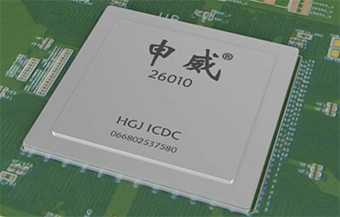
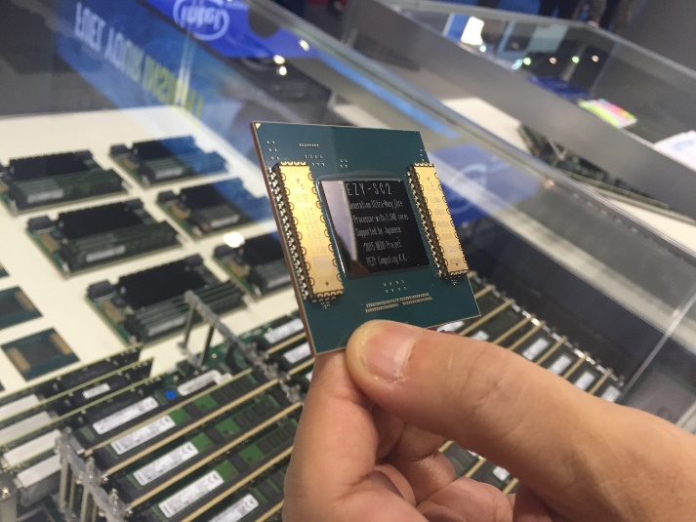
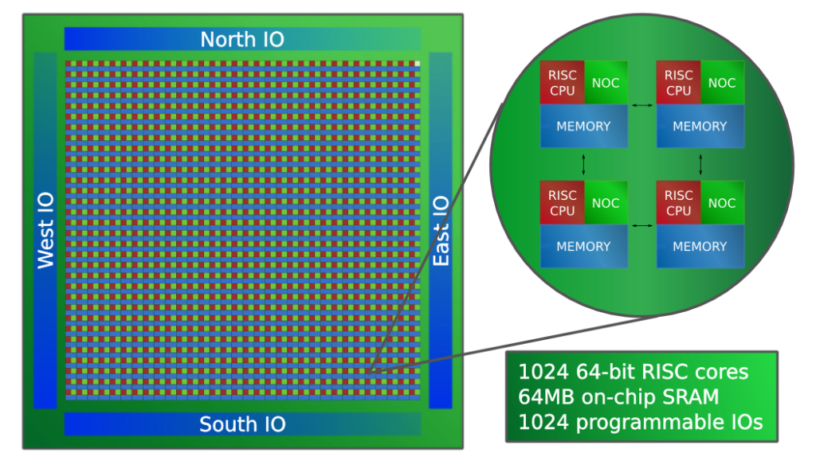
Massively Parallel Manycores
SW26010: 260 cores
PEZY-SC2: 2048 cores
Adapteva Epiphany: 1024 cores
Notes:
Can I call a network` ’efficient’ ??
- can I add ‘using thorough mathematical optimization’ ??

Slide 3
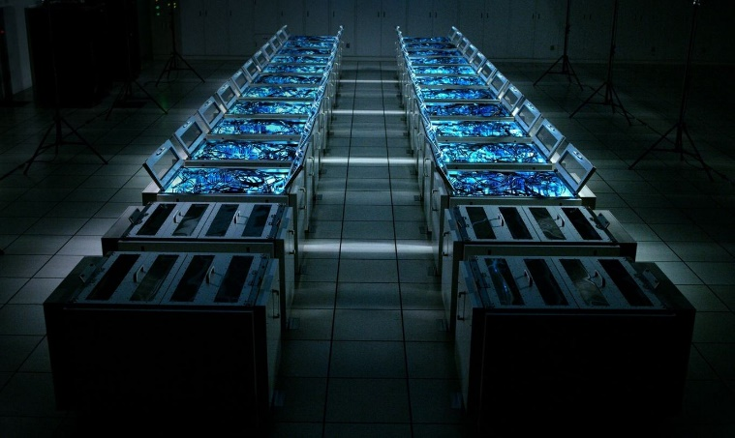
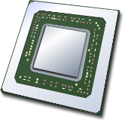
Massively Parallel Manycores
SW26010: 260 cores
PEZY-SC2: 2048 cores
Adapteva Epiphany: 1024 cores
...
Notes:
Can I call a network` ’efficient’ ??
- can I add ‘using thorough mathematical optimization’ ??

Slide 4
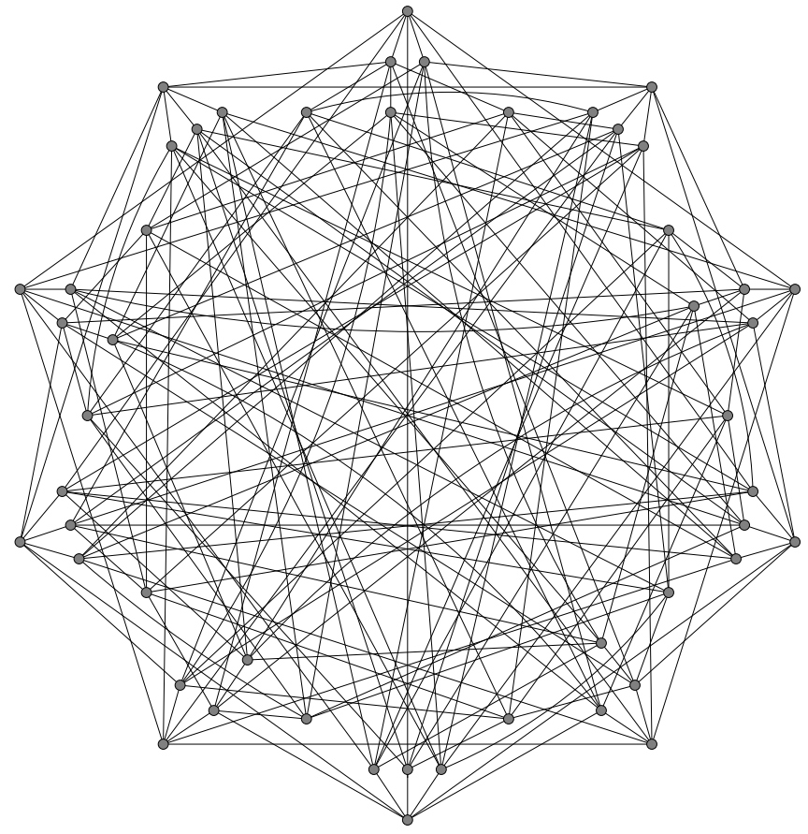
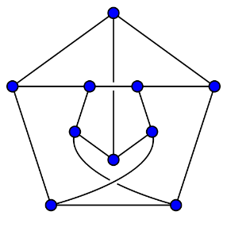
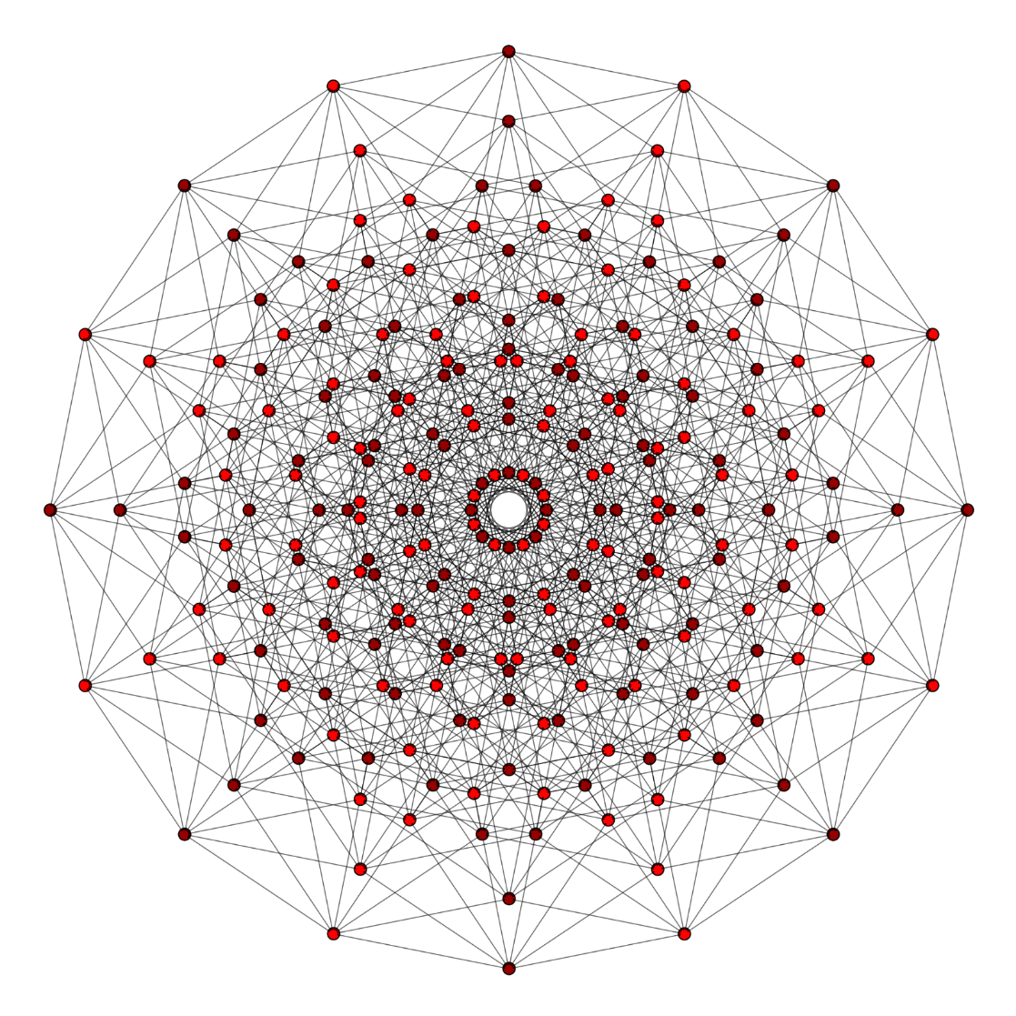
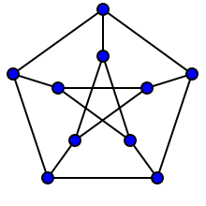
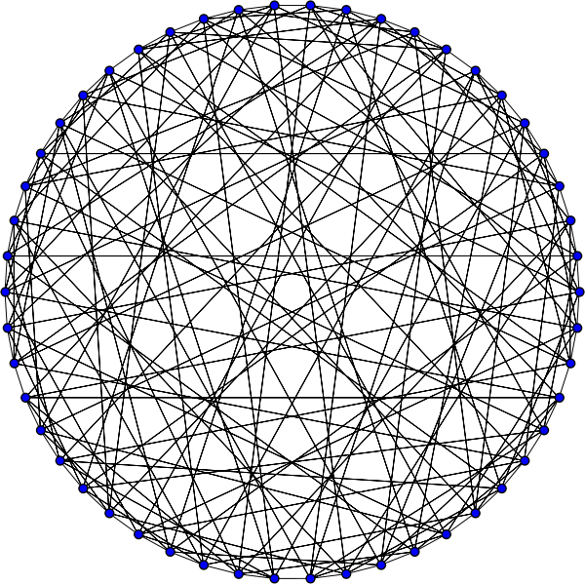
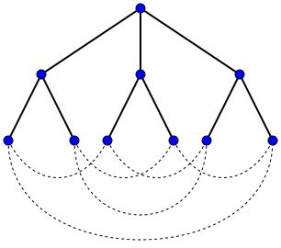
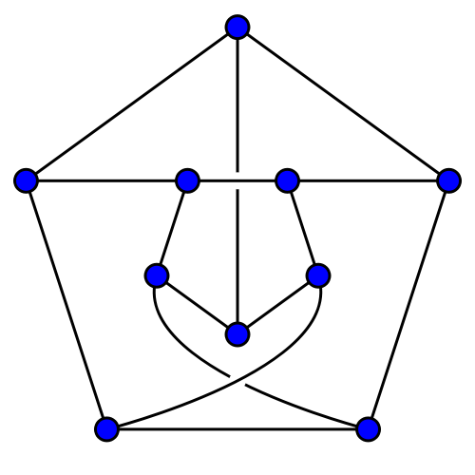
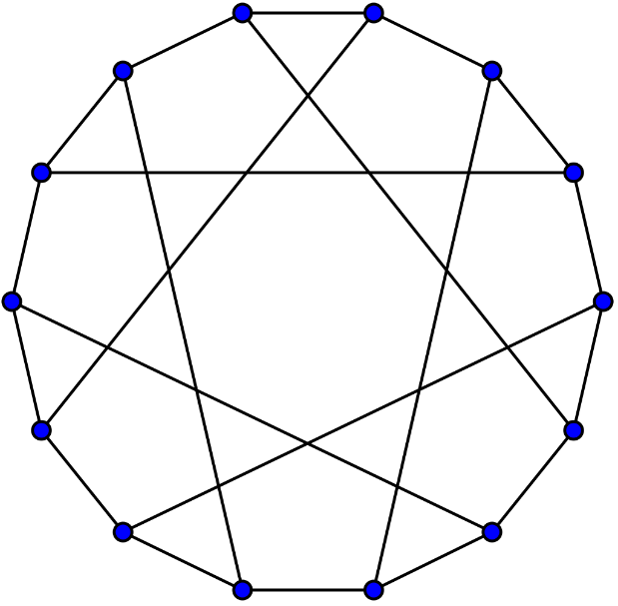
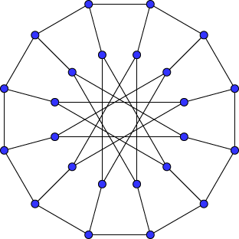
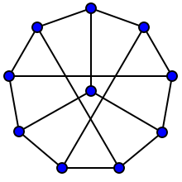
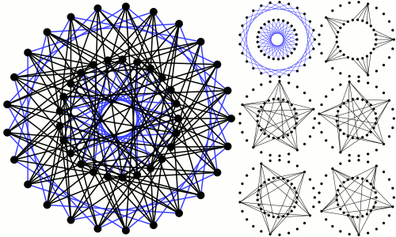
Massively Parallel Manycores
SW26010: 260 cores
PEZY-SC2: 2048 cores
Adapteva Epiphany: 1024 cores
...
Notes:
Can I call a network` ’efficient’ ??
- can I add ‘using thorough mathematical optimization’ ??

Slide 5
Massively Parallel Manycores
SW26010: 260 cores
PEZY-SC2: 2048 cores
Adapteva Epiphany: 1024 cores
...
Notes:
Can I call a network` ’efficient’ ??
- can I add ‘using thorough mathematical optimization’ ??

Slide 6
Massively Parallel Manycores
SW26010: 260 cores
PEZY-SC2: 2048 cores
Adapteva Epiphany: 1024 cores
...
Notes:
Can I call a network` ’efficient’ ??
- can I add ‘using thorough mathematical optimization’ ??

Slide 7
Massively Parallel Manycores
SW26010: 260 cores
PEZY-SC2: 2048 cores
Adapteva Epiphany: 1024 cores
...
Notes:
Can I call a network` ’efficient’ ??
- can I add ‘using thorough mathematical optimization’ ??

Slide 8
Massively Parallel Manycores
SW26010: 260 cores
PEZY-SC2: 2048 cores
?
Adapteva Epiphany: 1024 cores
...
Notes:
Can I call a network` ’efficient’ ??
- can I add ‘using thorough mathematical optimization’ ??

Slide 9
Notes:
Can I call a network` ’efficient’ ??
- can I add ‘using thorough mathematical optimization’ ??

Slide 10
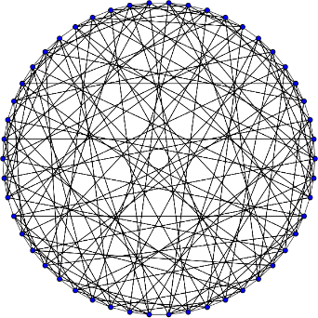
Slim Fly [1] ensures the lowest radix
(port count) for a given node count and for a fixed diameter (we use two)... Sounds ideal for an on-chip setting?
[1] M. Besta and T. Hoefler. Slim Fly: A Cost Effective Low-Diameter Network Topology. SC14.
Notes:
Can I call a network` ’efficient’ ??
- can I add ‘using thorough mathematical optimization’ ??

Slide 11
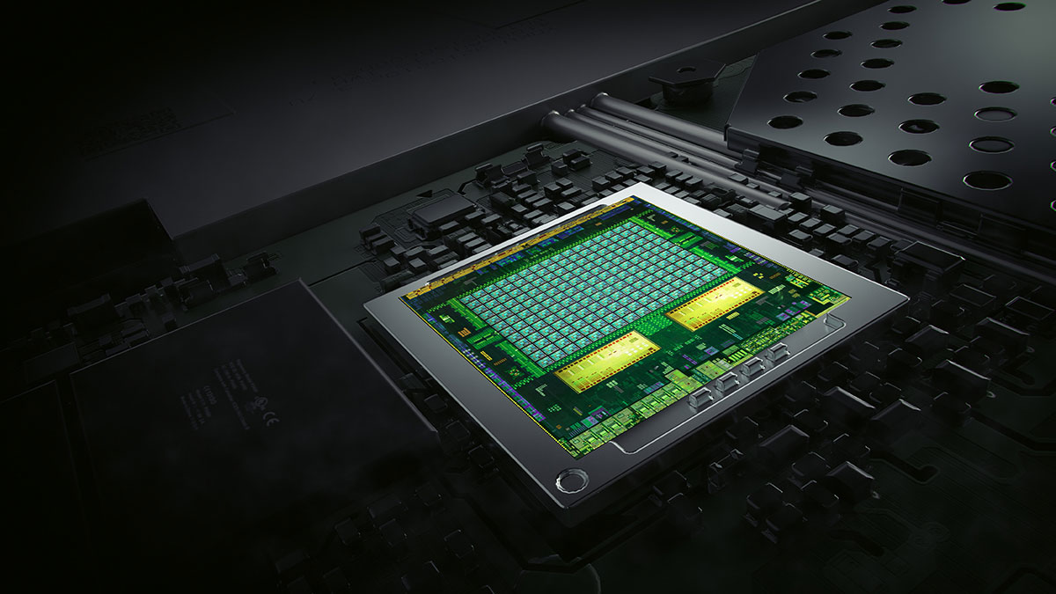
Why not just use Slim Fly as an on-chip network?
Notes:
What does “fewer groups/router” mean?
[fixed]

Slide 12
Why not just use Slim Fly as an on-chip network?
Bad! No clear advantages
Notes:
What does “fewer groups/router” mean?
[fixed]

Slide 13
Solution: Slim NoC

Slide 14
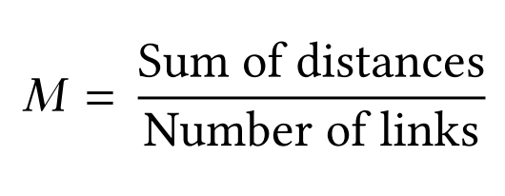
Solution: Slim NoC
New cost and layout models
Minimize the average wire length (M) :

Slide 15
Solution: Slim NoC
New cost and layout models
Minimize the average wire length (M) :
Minimize the total buffer area (Δ):

Slide 16
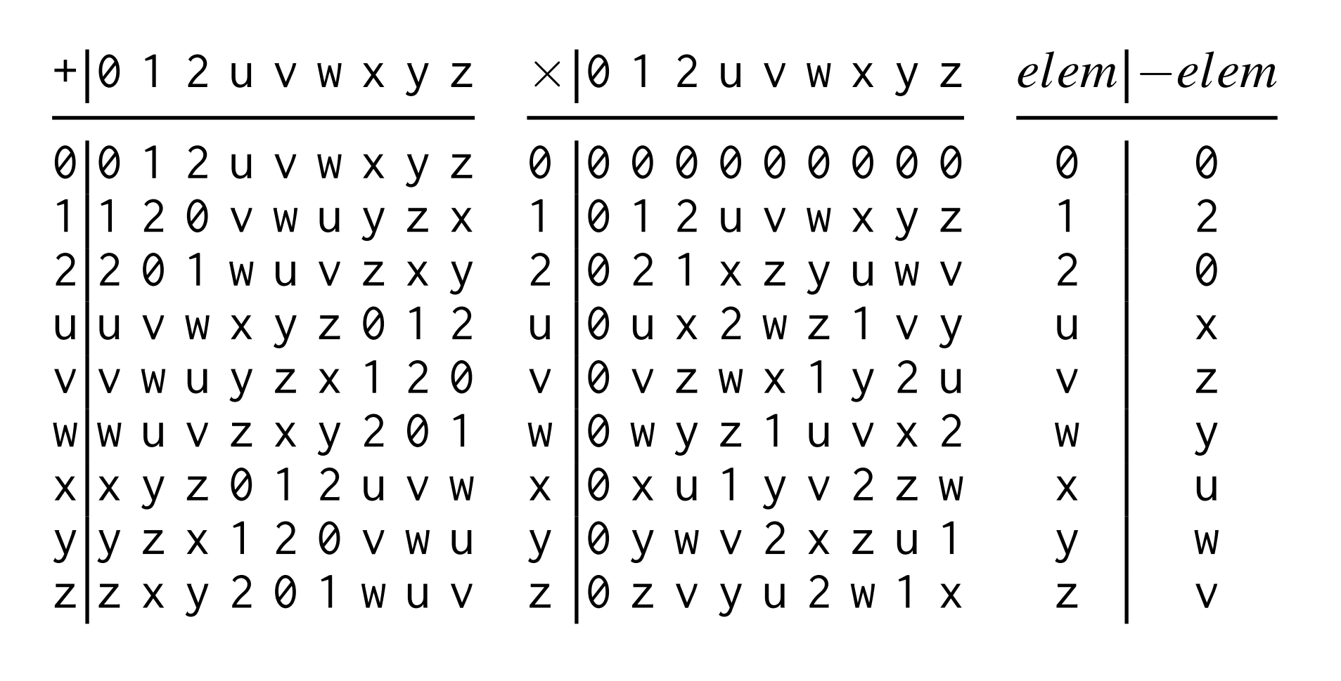
Solution: Slim NoC
Non-prime finite fields
New cost and layout models
$$ℱ_{q}=ℤ/qℤ$$
$$=\{x_{0}, x_{1},…,x_{q−1}\}$$
Minimize the average wire length (M) :
Minimize the total buffer area (Δ):
Addition
Multiplication
Inverse

Slide 17
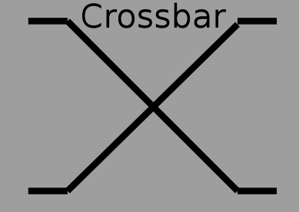
Slim NoC Router Microarchitecture
...
Notes:
- Introduce cost model

Slide 18
Slim NoC Router Microarchitecture
Enhancement 1: Elastic Buffer links [1] + ElastiStore [2]
No deadlock
...
[1] G. Michelogiannakis et al. Elastic-Buffer Flow Control for On-Chip Networks. HPCA’09.
[2] I. Seitanidis et al. ElastiStore: An Elastic Buffer Architecture for Network-on-Chip Routers. DATE’14.
Notes:
- Introduce cost model

Slide 19
Slim NoC Router Microarchitecture
Enhancement 1: Elastic Buffer links [1] + ElastiStore [2]
No deadlock
...
[1] G. Michelogiannakis et al. Elastic-Buffer Flow Control for On-Chip Networks. HPCA’09.
[2] I. Seitanidis et al. ElastiStore: An Elastic Buffer Architecture for Network-on-Chip Routers. DATE’14.
Notes:
- Introduce cost model

Slide 20
Slim NoC Router Microarchitecture
Enhancement 1: Elastic Buffer links [1] + ElastiStore [2]
No deadlock
Lower latency, smaller buffers
Enhancement 2: SMART Links [3]
...
[1] G. Michelogiannakis et al. Elastic-Buffer Flow Control for On-Chip Networks. HPCA’09.
[2] I. Seitanidis et al. ElastiStore: An Elastic Buffer Architecture for Network-on-Chip Routers. DATE’14.
[3] C.-H. O. Chen et al. SMART: A Single-Cycle Reconfigurable NoC for SoC Applications. DATE’13.
Notes:
- Introduce cost model

Slide 21
Slim NoC Router Microarchitecture
Enhancement 1: Elastic Buffer links [1] + ElastiStore [2]
No deadlock
Lower latency, smaller buffers
Enhancement 2: SMART Links [3]
...
[1] G. Michelogiannakis et al. Elastic-Buffer Flow Control for On-Chip Networks. HPCA’09.
[2] I. Seitanidis et al. ElastiStore: An Elastic Buffer Architecture for Network-on-Chip Routers. DATE’14.
[3] C.-H. O. Chen et al. SMART: A Single-Cycle Reconfigurable NoC for SoC Applications. DATE’13.
Notes:
- Introduce cost model

Slide 22
Slim NoC Router Microarchitecture
Enhancement 1: Elastic Buffer links [1] + ElastiStore [2]
No deadlock
Lower latency, smaller buffers
Enhancement 2: SMART Links [3]
...
Enhancement 3: Central Buffers [4]
Smaller buffer area
[1] G. Michelogiannakis et al. Elastic-Buffer Flow Control for On-Chip Networks. HPCA’09.
[2] I. Seitanidis et al. ElastiStore: An Elastic Buffer Architecture for Network-on-Chip Routers. DATE’14.
[3] C.-H. O. Chen et al. SMART: A Single-Cycle Reconfigurable NoC for SoC Applications. DATE’13.
[4] S. Hassan and S. Yalamanchili. Centralized Buffer Router: A Low Latency, Low Power Router for High Radix NoCs. NOCS’13.
Notes:
- Introduce cost model

Slide 23
Slim NoC Router Microarchitecture
Enhancement 1: Elastic Buffer links [1] + ElastiStore [2]
No deadlock
Lower latency, smaller buffers
Enhancement 2: SMART Links [3]
...
Enhancement 3: Central Buffers [4]
Smaller buffer area
[1] G. Michelogiannakis et al. Elastic-Buffer Flow Control for On-Chip Networks. HPCA’09.
[2] I. Seitanidis et al. ElastiStore: An Elastic Buffer Architecture for Network-on-Chip Routers. DATE’14.
[3] C.-H. O. Chen et al. SMART: A Single-Cycle Reconfigurable NoC for SoC Applications. DATE’13.
[4] S. Hassan and S. Yalamanchili. Centralized Buffer Router: A Low Latency, Low Power Router for High Radix NoCs. NOCS’13.
Notes:
- Introduce cost model

Slide 24
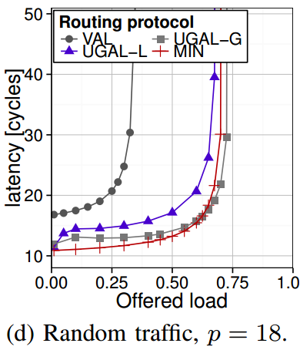
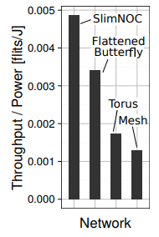
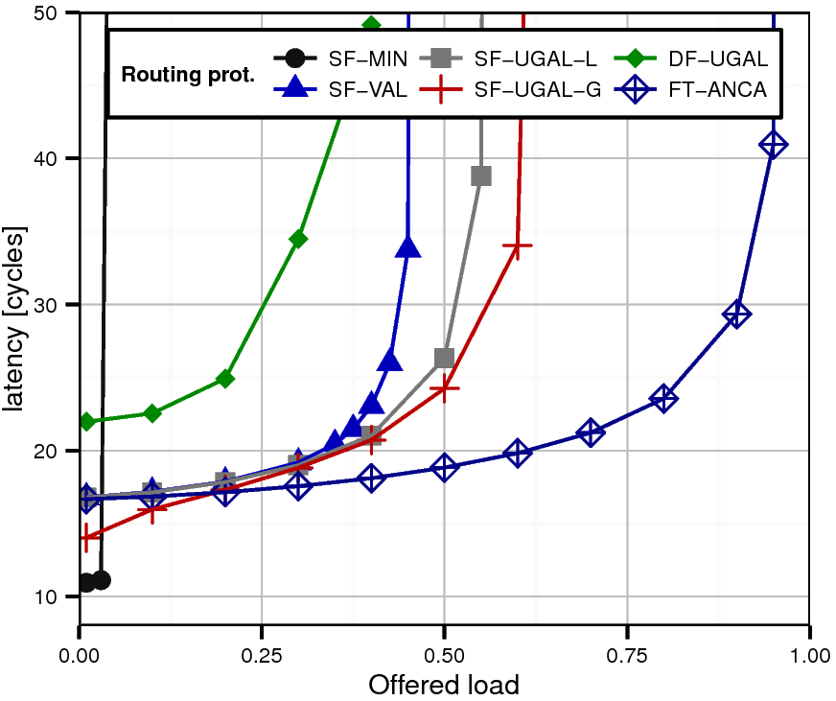
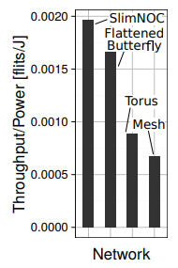
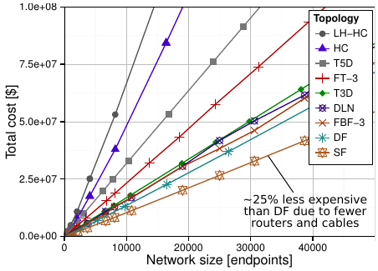
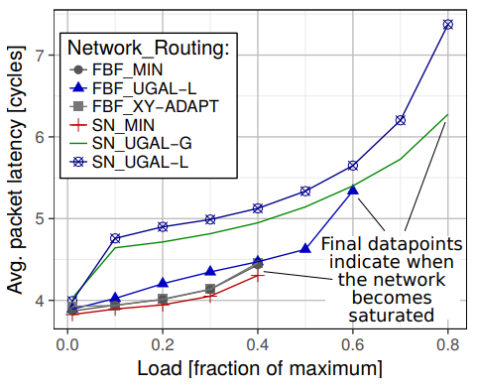
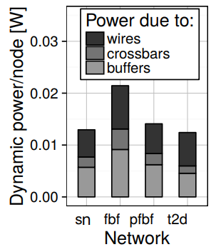
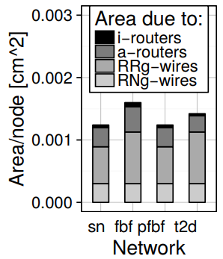
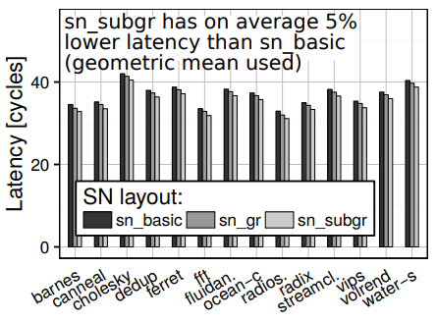
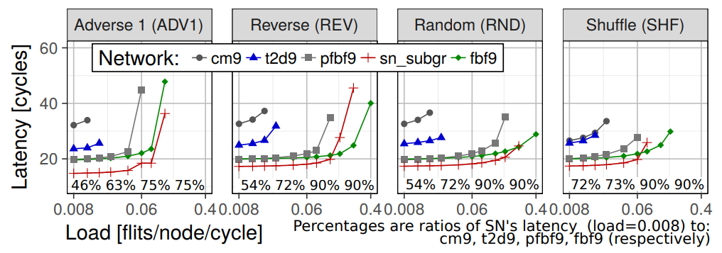
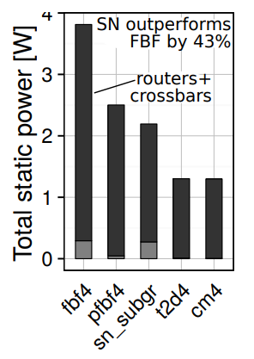
Results
Notes:
Say what these patterns are
Maybe show pictures ?

Slide 25
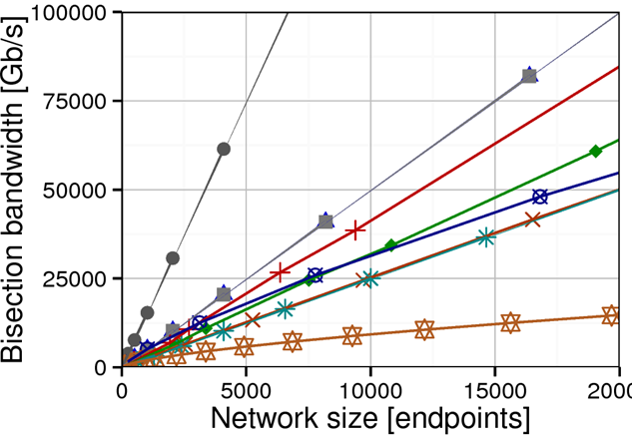
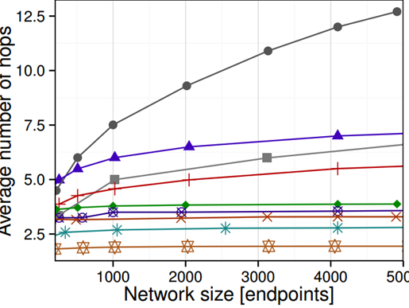
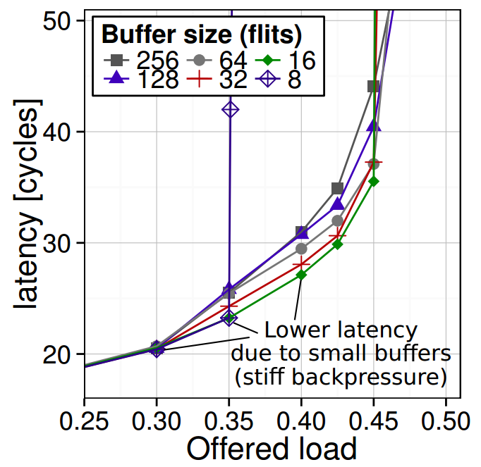
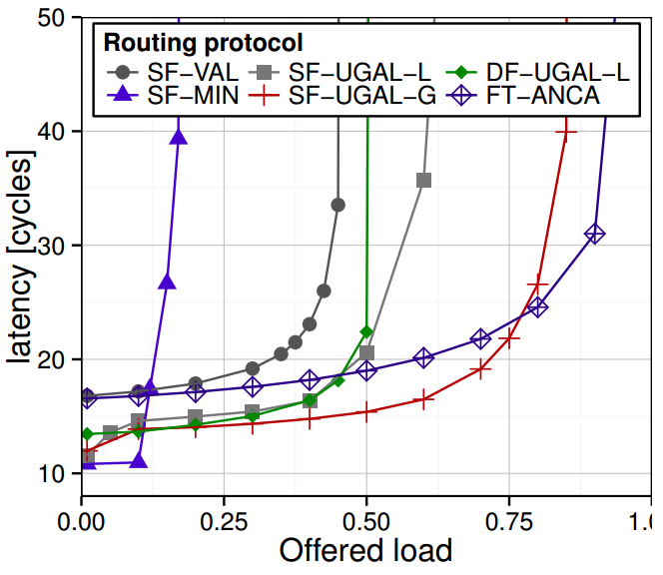
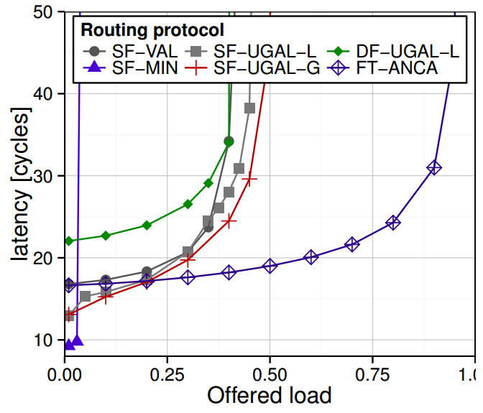
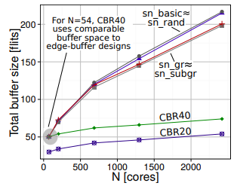
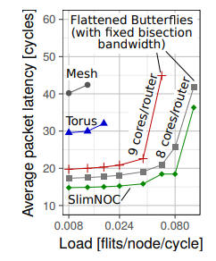
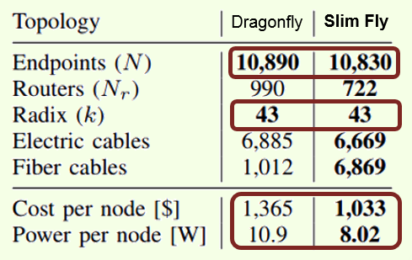
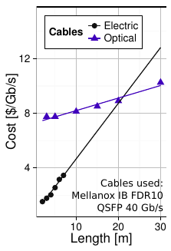
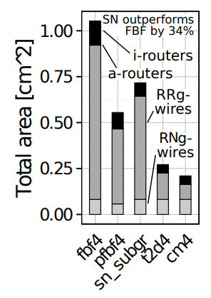
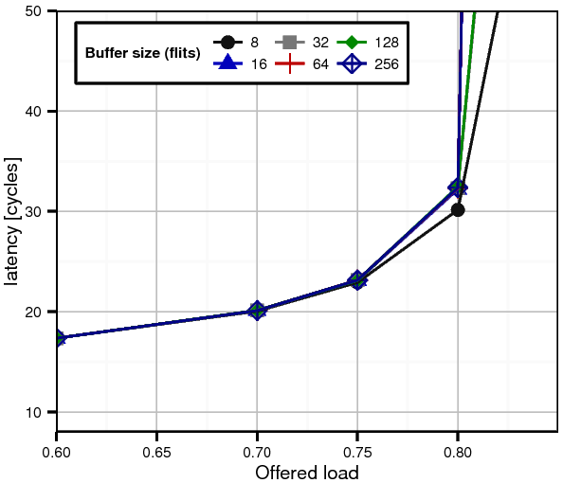
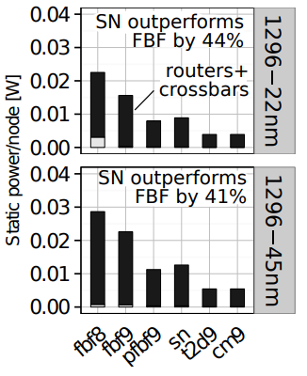
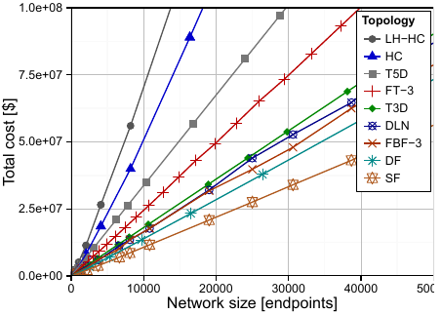
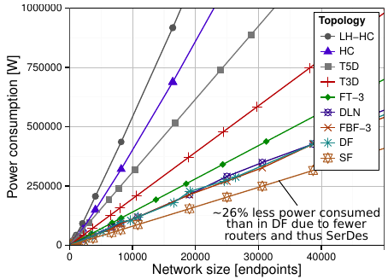
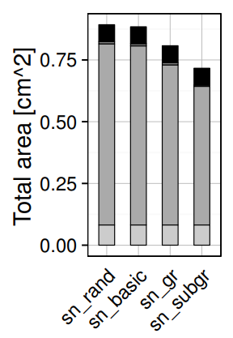
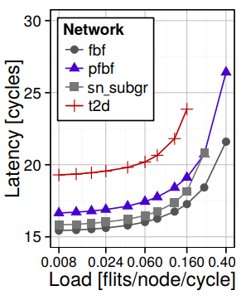
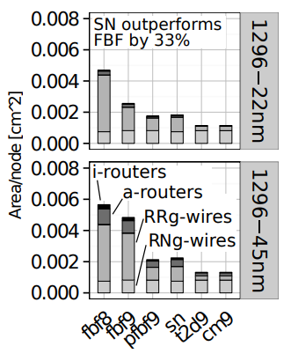
Results
Notes:
Say what these patterns are
Maybe show pictures ?

Slide 26
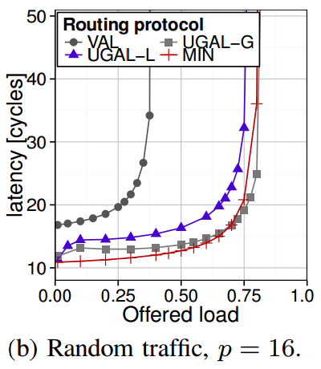
Results
Notes:
Say what these patterns are
Maybe show pictures ?

Slide 27
Results
A low-latency topology
Notes:
Say what these patterns are
Maybe show pictures ?

Slide 28
Results
A low-latency topology
An area- and energy-efficient topology
Notes:
Say what these patterns are
Maybe show pictures ?

Slide 29
Results
A low-latency topology
An area- and energy-efficient topology
A power-performance-sweetspot topology
Notes:
Say what these patterns are
Maybe show pictures ?

Slide 30
Results
A low-latency topology
An area- and energy-efficient topology
A power-performance-sweetspot topology
A highly-scalable topology
200 nodes
1296 nodes
Notes:
Say what these patterns are
Maybe show pictures ?

Slide 31
Slim NoC: A Low-Diameter On-Chip Network Topology for High Energy Efficiency and Scalability
Maciej Besta, Syed Minhaj Hassan, Sudhakar Yalamanchili, Rachata Ausavarungnirun, Onur Mutlu, Torsten Hoefler

