Slide 1
Slim NoC: A Low-Diameter On-Chip Network Topology for High Energy Efficiency and Scalability
Maciej Besta, Syed Minhaj Hassan, Sudhakar Yalamanchili, Rachata Ausavarungnirun, Onur Mutlu, Torsten Hoefler

Slide 2
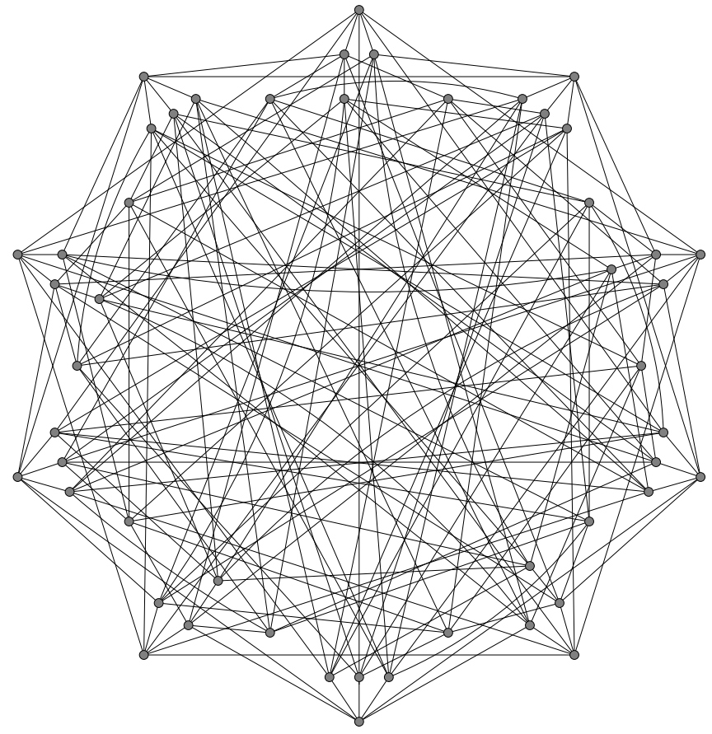
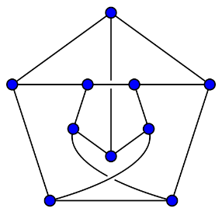
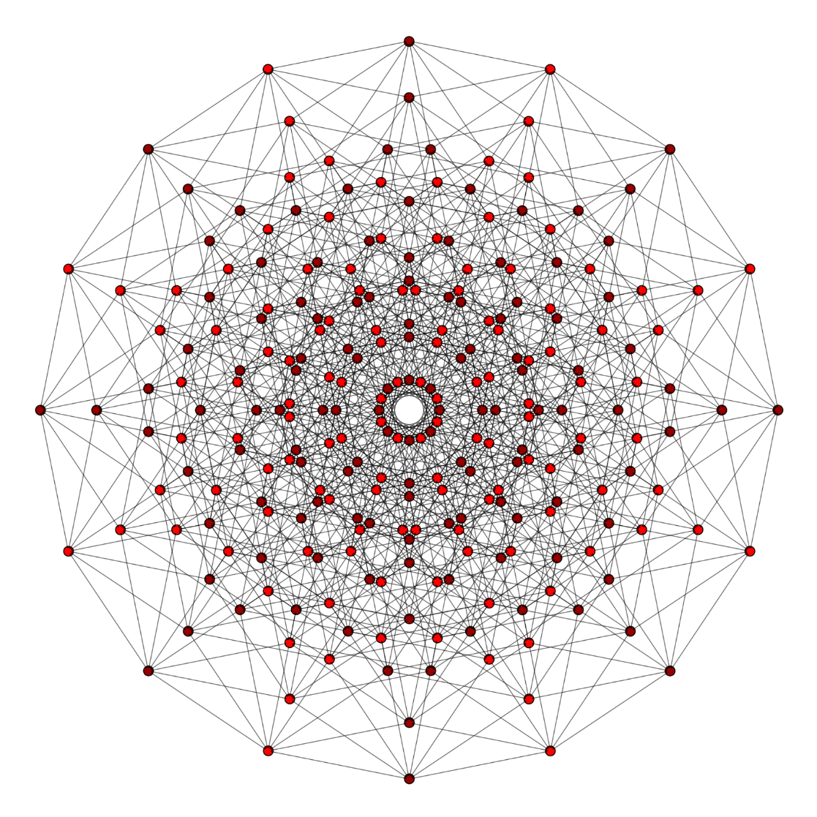
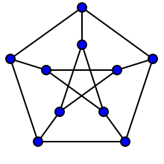
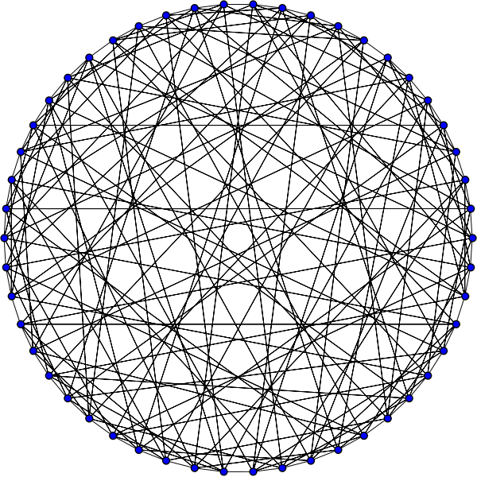
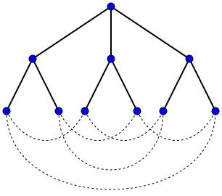
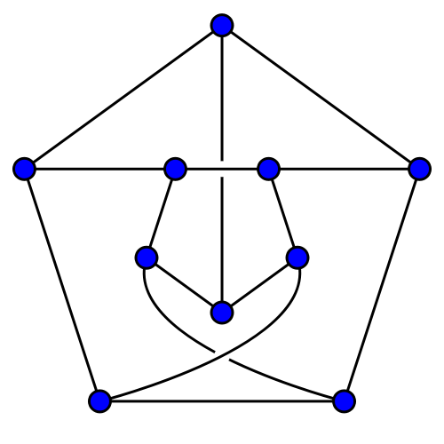
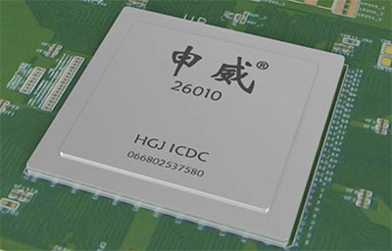
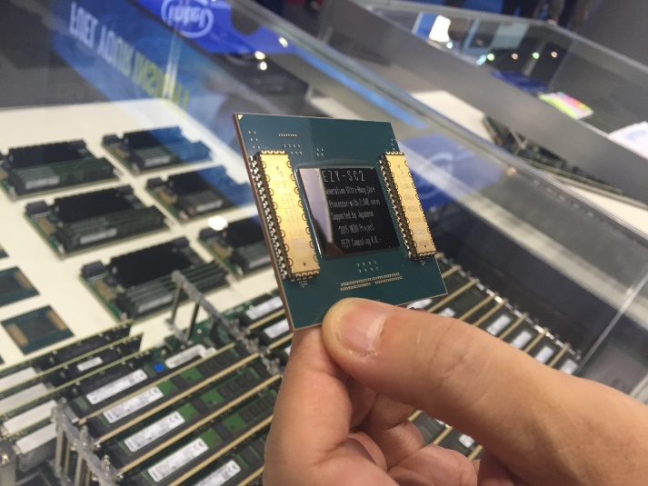
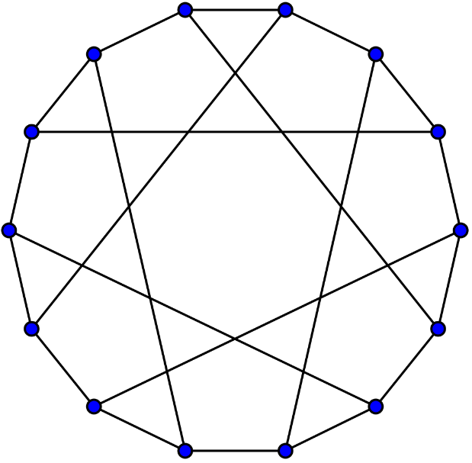
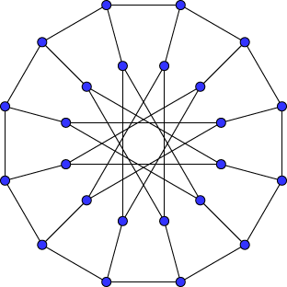
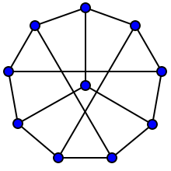
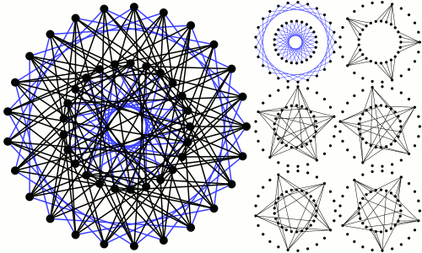
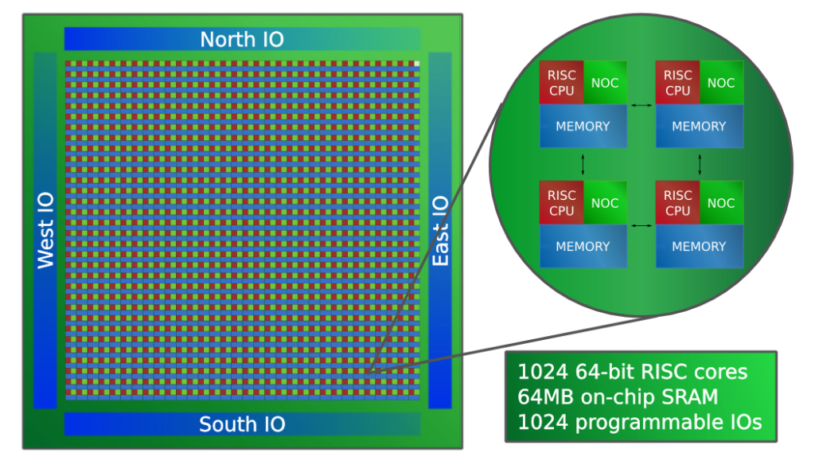
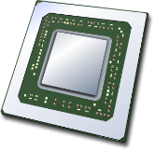
Massively Parallel Manycores
SW26010: 260 cores
PEZY-SC2: 2048 cores
?
Adapteva Epiphany: 1024 cores
...
Notes:
Can I call a network` ’efficient’ ??
- can I add ‘using thorough mathematical optimization’ ??

Slide 3
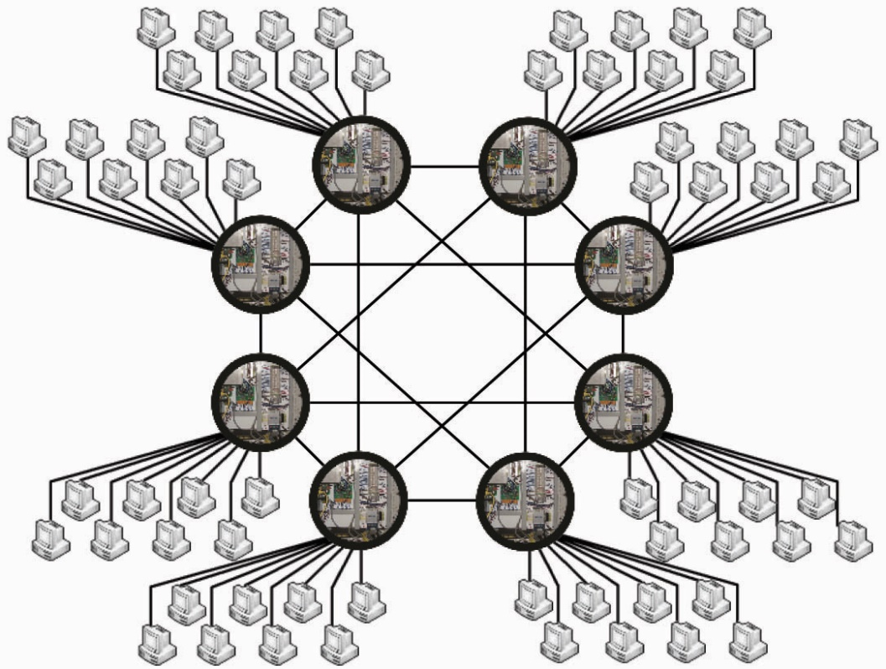
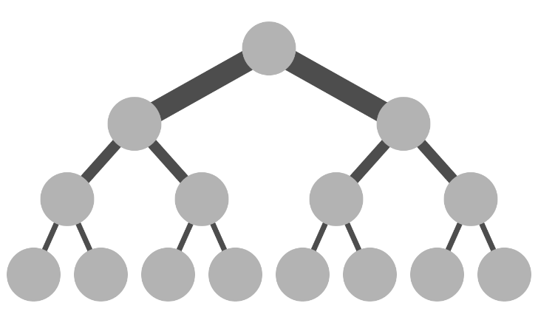
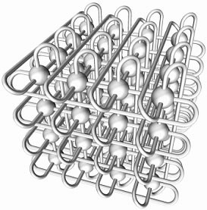
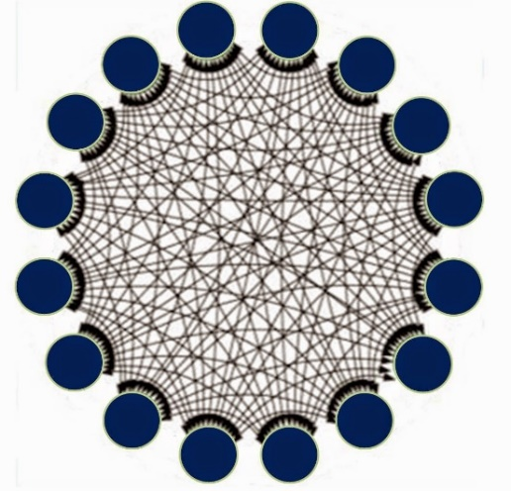
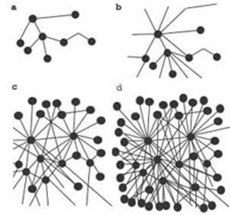
Networks in Compute Clusters
Notes:
Can I call a network` ’efficient’ ??
- can I add ‘using thorough mathematical optimization’ ??

Slide 4
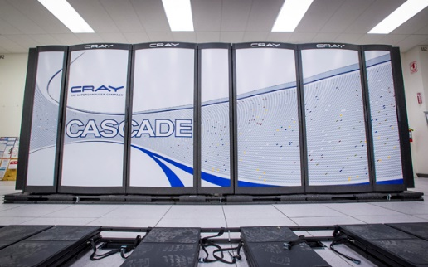
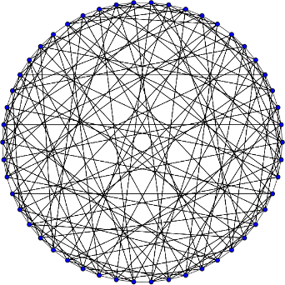
Dragonfly, Slim Fly
Dragonfly [2]
Fat tree [1]
diameter = 4
TSUBAME2.0
diameter = 3
Slim Fly [3] based on the Hoffman-Singleton Graph [4]:
> ~50% fewer routers than Fat tree
> ~30% fewer cables than Fat tree
diameter = 2
Cray Cascade
[1] C. E. Leiserson. Fat-trees: Universal Networks for Hardware-Efficient Supercomputing. IEEE Transactions on Computers. 1985.
[2] J. Kim et al. Technology-Driven, Highly-Scalable Dragonfly Topology. ISCA’08.
[3] M. Besta and T. Hoefler. Slim Fly: A Cost Effective Low-Diameter Network Topology. SC14.
[4] A. J. Hoffman and R. R. Singleton. Moore graphs with diameter 2 and 3, IBM Journal of Research and Development. 1960.
Notes:
Can I call a network` ’efficient’ ??
- can I add ‘using thorough mathematical optimization’ ??

Slide 5
Inspiration: Diameter-2 Slim Fly
Key method
Optimize towards the Moore Bound [1]: the upper bound on the number of vertices in a graph with given diameter D and radix k.
Key idea:
Lower diameter and thus average path length: fewer needed links / routers.
$$MooreBound(D,k)$$
$$=1$$
$$+ k$$
$$+ k(k−1)$$
routers
$${+ k(k−1)}^{2}+…$$
Thus, Slim Fly ensures the lowest radix (port count) for a given node count and for a fixed diameter... Sounds ideal for an on-chip setting?
$$=1+k\sum_{i=0}^{D−1}{{(k−1)}^{i}}$$
endpoints
[1] M. Miller, J. Siráň. Moore graphs and beyond: A survey of the degree/diameter problem, Electronic Journal of Combinatorics, 2005.
Notes:
Can I call a network` ’efficient’ ??
- can I add ‘using thorough mathematical optimization’ ??

Slide 6
Why not just use Slim Fly as an on-chip network?
Notes:
What does “fewer groups/router” mean?
[fixed]

Slide 7
Slim Fly on Chip – First Attempt
Structure Intuition
Example design for diameter = 2
A subgraph with
identical groups of routers
A subgraph with
identical groups of routers
Notes:
What does “fewer groups/router” mean?
[fixed]

Slide 8
Slim Fly on Chip – First Attempt
Structure Intuition
Groups form a fully-connected bipartite graph
Notes:
What does “fewer groups/router” mean?
[fixed]

Slide 9
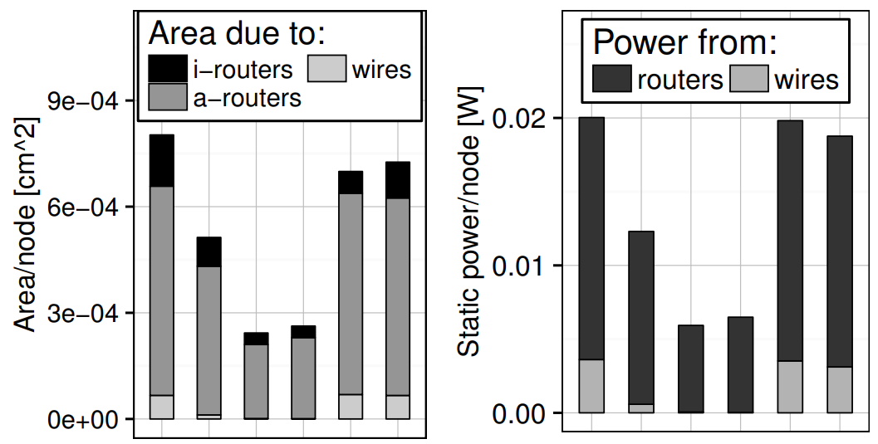
Slim Fly on Chip – First Attempt
So how does it Fare?
Bad! No clear advantages from a topology that is close-to-optimal in the radix-size-diameter tradeoff
Why?
2D torus
2D torus
Conc. mesh
Flatt. Butterfly [1]
Conc. mesh
Flatt. Butterfly [1]
variant 1, variant 2
variant 1, variant 2
Dragonfly on chip
Dragonfly on chip
Slim Fly on chip
Slim Fly on chip
[1] J. Kim, W. J. Dally, D. Abts. Flattened butterfly: a cost-efficient topology for high-radix networks. ISCA’07

Slide 10
What are the problems with the simple on-chip Slim Fly?

Slide 12
Problems with Simple On-Chip Slim Fly, Part 1
Short wire: small input buffers
Near-best radix-size-diameter tradeoff, but...
Long wire: traversing the whole die requires large input buffers for full link utilization

Slide 13
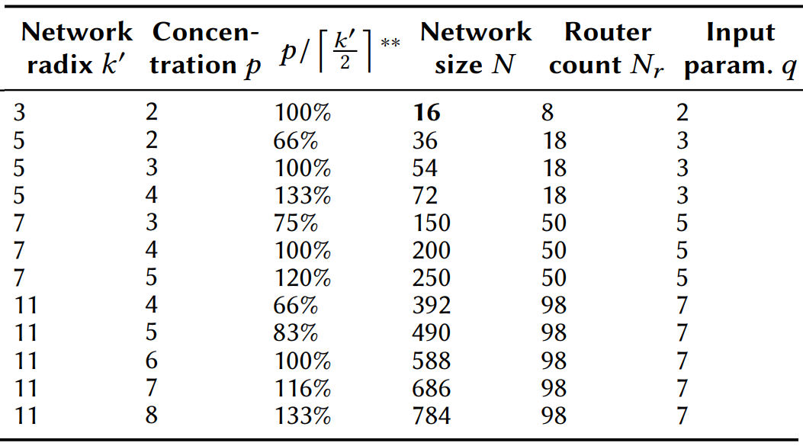
Problems with Simple On-Chip Slim Fly, Part 2
…number of nodes/routers being a power of two?
Various Slim Fly configurations
Are there
configurations with…
…equally many cores on each die side?
…equally many routers on each die side?
…equally many router groups on each die side?
There are few Slim Flies that satisfy various on-chip technological constraints
No need to pay attention to all these numbers ☺

Slide 14
How to solve these problems?

Slide 15
Solution: Slim NoC
Part I
The model must be generic
to allow for arbitrary layouts.
Short wire: small input buffers
New cost and area models, new layouts
Different mappings (“sets of arrows”) enable different layouts
Near-best radix-size-diameter tradeoff, but...
Long wire: traversing the whole die requires large input buffers for full link utilization

Slide 16
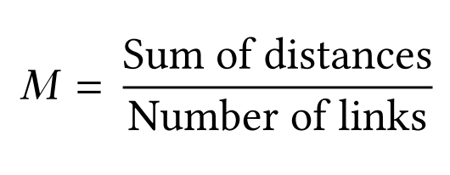
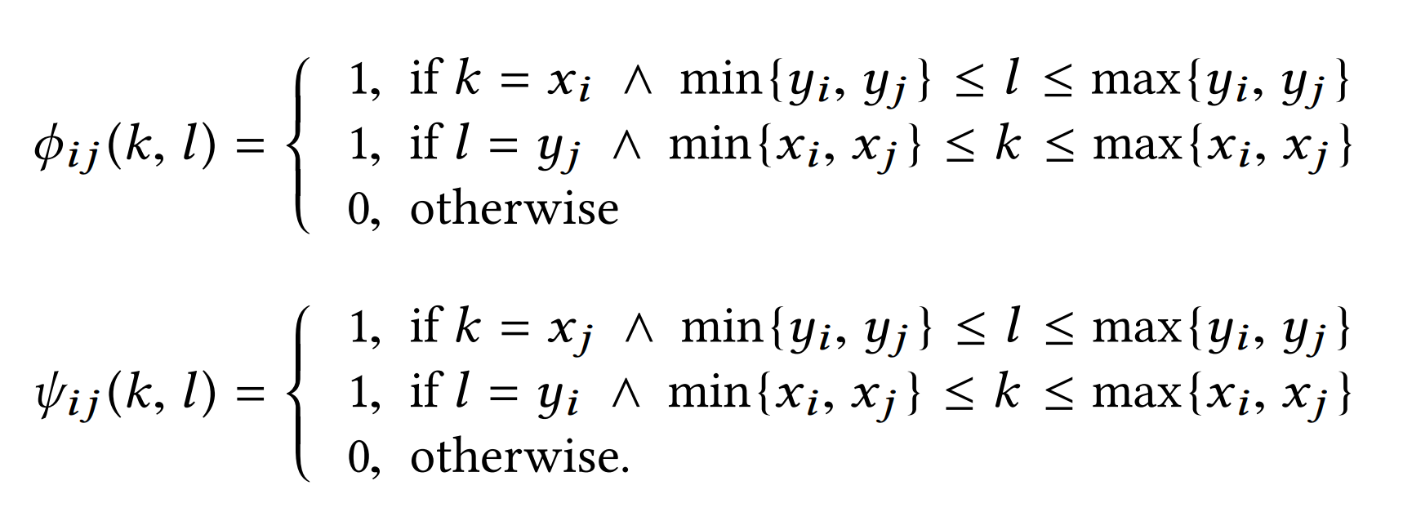
Solution: Slim NoC
Part I
ILP formulation: many more details for reproducibility and genericness, check the paper ☺
Minimize the average wire length (M) :
New cost and area models, new layouts
How to select a mapping?
Minimize the total buffer area (Δ):

Slide 17
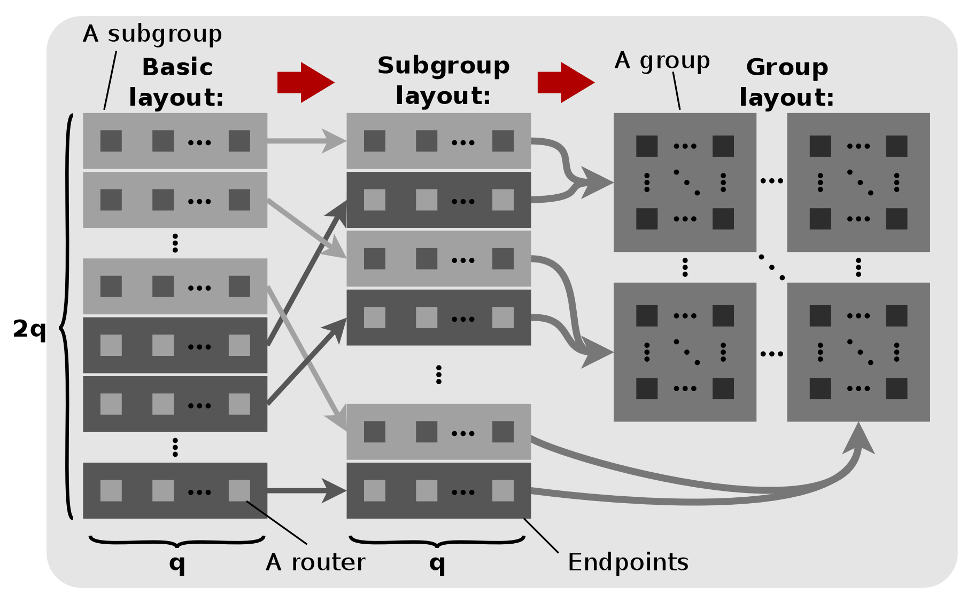
Solution: Slim NoC
Part I
New cost and area models, new layouts
Let us see some layouts
What difference do they make for lengths of wires?

Slide 18
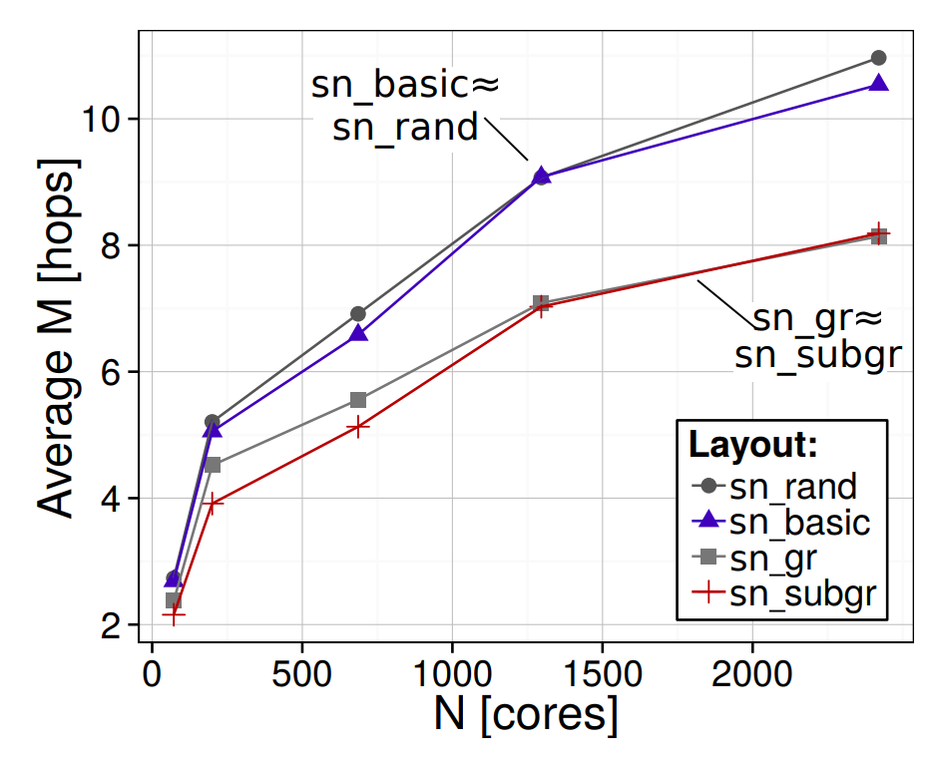
Solution: Slim NoC
Part I
New cost and area models, new layouts
Let us see some layouts
Average wire length
sn_subgr
What difference do they make for lengths of wires?
The “subgroup layout” (sn_subgr) is best for 200 nodes
The “group layout” (sn_gr) is best for 1296 nodes (it reduces wiring complexity)

Slide 19
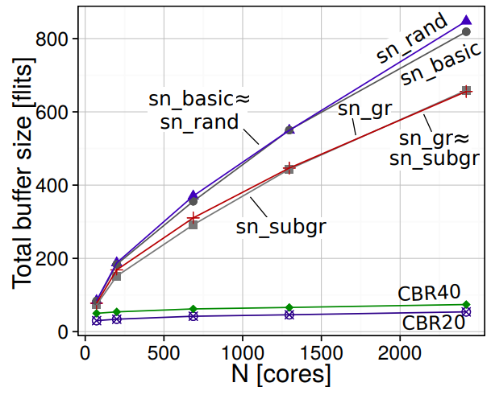
Solution: Slim NoC
Part I
New cost and area models, new layouts
Let us see some layouts
What difference do they make for lengths of wires?
The “group layout” (sn_gr) is best for 1296 nodes The “subgroup layout” (sn_subgr) is best for 200 nodes

Slide 20
Now let’s move to the second problem...

Slide 21
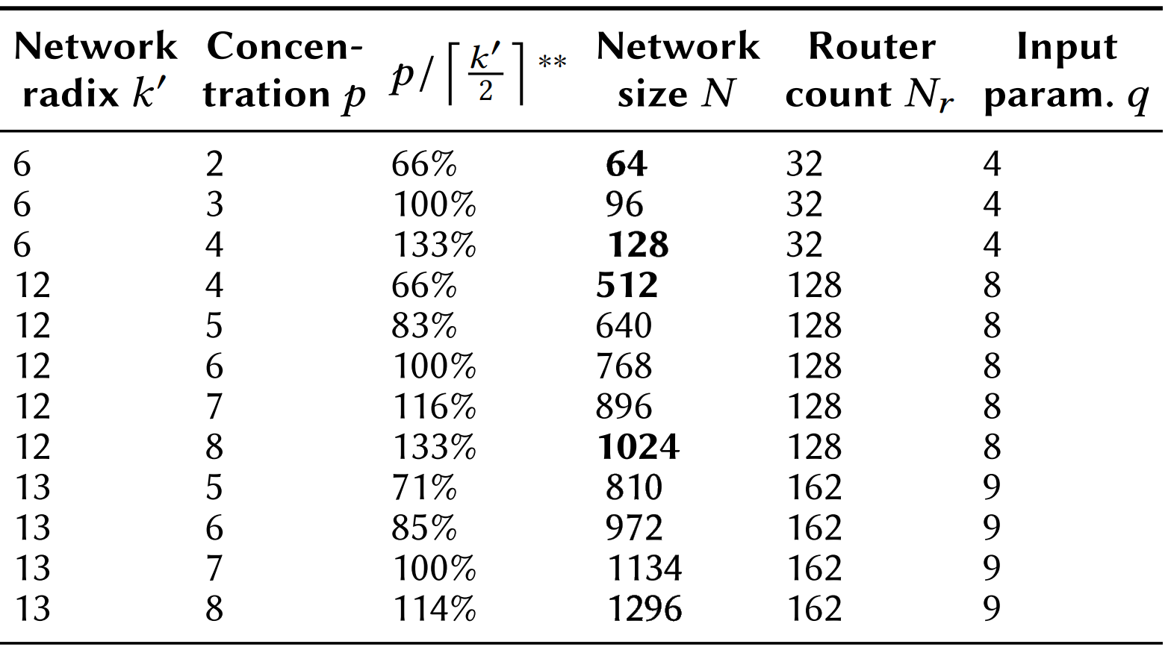
Solution: Slim NoC
Part II
…number of nodes/routers being a power of two?
Are there
configurations with…
Non-Prime Finite Fields
Various Slim Fly configurations
…equally many cores on each die side?
…equally many routers on each die side?
…equally many router groups on each die side?
There are few Slim Flies that satisfy various on-chip technological constraints
How to develop such a finite field?
No need to pay attention to all these numbers ☺

Slide 22
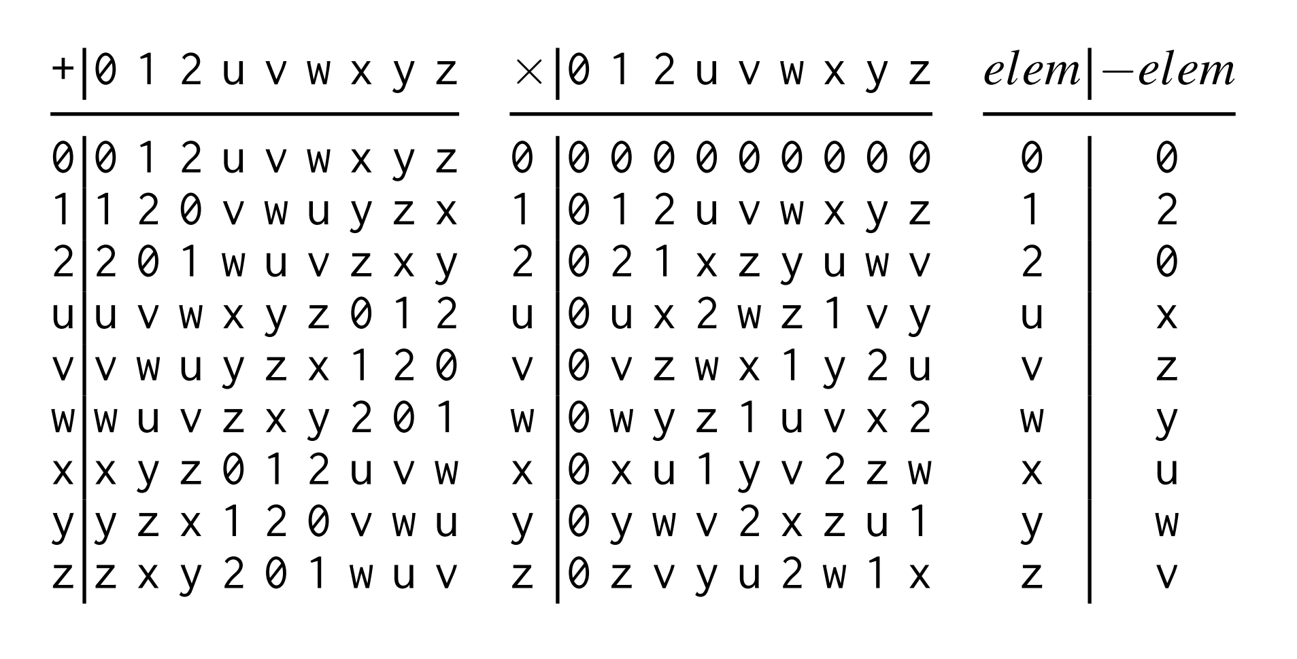
Solution: Slim NoC
How to develop such a finite field?
Non-Prime Finite Fields
Assuming q is non-prime:
$$ℱ_{q}=ℤ/qℤ$$
$$=\{x_{0}, x_{1},…,x_{q−1}\}$$
Recap: a finite field
$$ℱ_{q}$$
...with instruction tables that define operations on the field.
Assuming q is prime:
Example:
162 routers
$$q=9$$
$$ℱ_{q}=ℤ/qℤ$$
$$ℱ_{9}=\{0,1,2,u,v,w,x,y,z\}$$
Check the paper for details ☺
$$=\{0,1,…,q−1\}$$
(with modular arithmetic).
Example:
$$q=5$$
50 routers
$$ℱ_{5}=\{0,1,2,3,4\}$$
Addition
Multiplication
Inverse

Slide 23
How do we optimize the router microarchitecture for Slim NoC
to provide high performance and high efficiency?

Slide 24
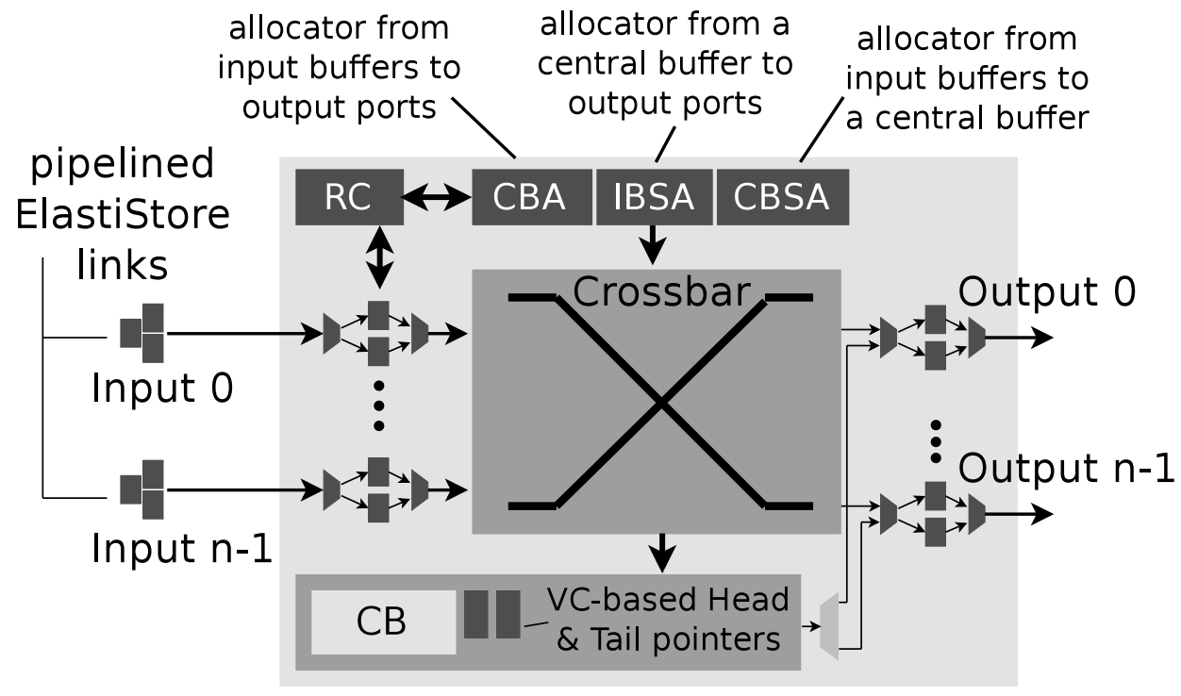
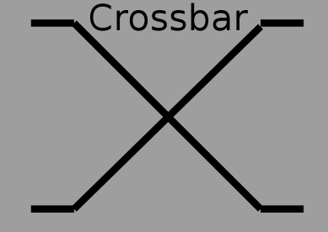
Let’s leave the details for the paper and just focus on the core aspects ☺
Slim NoC Router Microarchitecture Performance Optimizations
Part III
Enhancement 1: Elastic Buffer links [1] + ElastiStore [2]
Provide deadlock-freedom
Drive links asynchronously and use repeaters
for single-cycle wires
Enhancement 2: SMART Links [3]
...
Enhancement 3: Central Buffers [4]
Replace multi-flit input buffers with single-flit stating input buffers and add a central buffer
[1] G. Michelogiannakis et al. Elastic-Buffer Flow Control for On-Chip Networks. HPCA’09.
[2] I. Seitanidis et al. ElastiStore: An Elastic Buffer Architecture for Network-on-Chip Routers. DATE’14.
[3] C.-H. O. Chen et al. SMART: A Single-Cycle Reconfigurable NoC for SoC Applications. DATE’13.
[4] S. Hassan and S. Yalamanchili. Centralized Buffer Router: A Low Latency, Low Power Router for High Radix NoCs. NOCS’13.
Notes:
- Introduce cost model

Slide 25
Let’s Summarize…
Notes:
- Introduce cost model

Slide 26
Evaluation

Slide 27
Evaluation Methodology: Sensitivity Analyses
2D Torus (T2D)
Flattened Butterfly [1] (FBF)
Metrics:
Latency
Throughput
Buffer area
Buffer size
Static/dynamic power consumption
Throughput/power
Energy-delay product
Topology:
Concentrated Mesh (CM)
Flattened Butterfly [1], A „Partitioned” Variant (PFBF)
Traffic / workload:
Uniform Random
Bit Shuffle
Bit Reversal
Adversarial patterns
Parsec/Splash traces
(Briefly) hierarchical NoCs
[1] J. Kim, W. J. Dally, D. Abts. Flattened butterfly: a cost-efficient topology for high-radix networks. ISCA’07

Slide 28
Evaluation Methodology: Sensitivity Analyses
Routing
Minimum static
Non-minimum adaptive
Layout:
Group
Subgroup
Random
Naive
Router cycle time:
0.4ns
0.5ns
0.6ns
?
?
Injection rate:
0.01 – 0.95
Technology node:
22nm
45nm
Wire type:
Intermediate
Global
Concentration:
3
4
8
9
Network size (Node count):
200
1024
1296
Buffer type:
Central
Edge
Microarchitecture enhancement:
SMART ON/OFF
Central Buffers ON/OFF

Slide 29
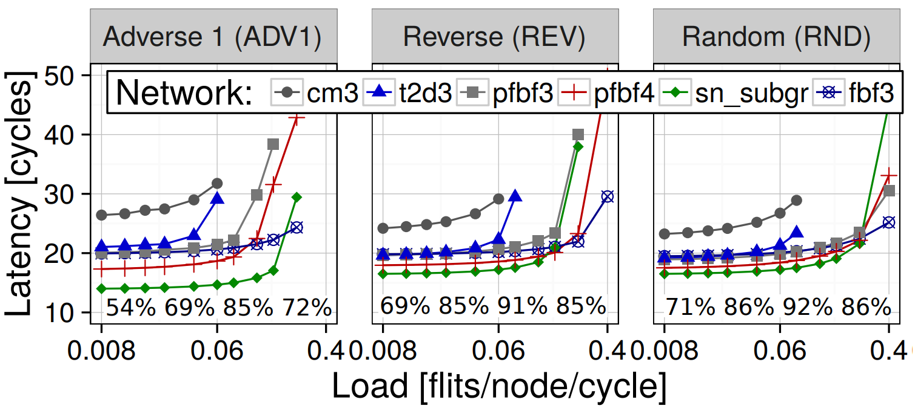
Results: Performance
cm3: concentrated mesh, t2d3: torus,
pfbf3, pfbf4, fbf3: variants of Flattened Butterfly,
sn_subgr: Slim NoC (the subgroup layout)
SMART links: ON
Central Buffers: ON
Node count: 192/200
in-house simulator [1]
Slim NoC provides the lowest latency
[1] S. Hassan and S. Yalamanchili. Centralized Buffer Router: A Low Latency, Low Power Router for High Radix NoCs. NOCS’13.

Slide 30
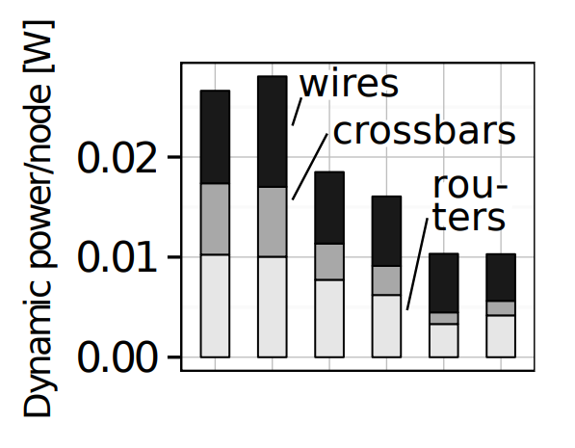
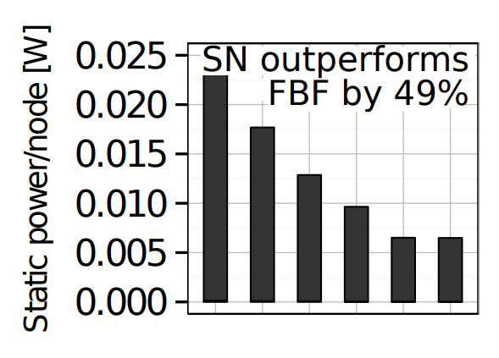
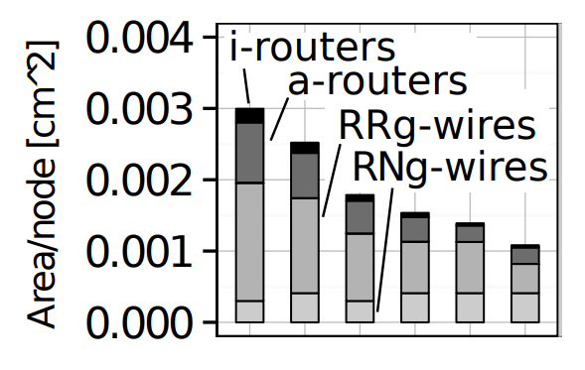
Results: Area and Power Consumption
SMART links: ON Central Buffers: ON
Node count: 192/200, Technology node: 45nm
DSENT power simulator [1]
Slim NoC is more efficient than high-radix designs
2D torus
2D torus
2D torus
Variants of
Slim NoC
Conc. mesh
Variants of
Slim NoC
Conc. mesh
Variants of
Slim NoC
Conc. mesh
Flatt. Butterfly
Flatt. Butterfly
Flatt. Butterfly
i-routers: routers (intermediate layer), a-routers: routers (active layer),
RRg-wires: router-router wires (global layer), RNg-wires: router-node wires (global layer).
[1] C. Sun et al. DSENT - A Tool Connecting Emerging Photonics with Electronics for Opto-Electronic Networks-on-Chip Modeling. NOCS’12.

Slide 31
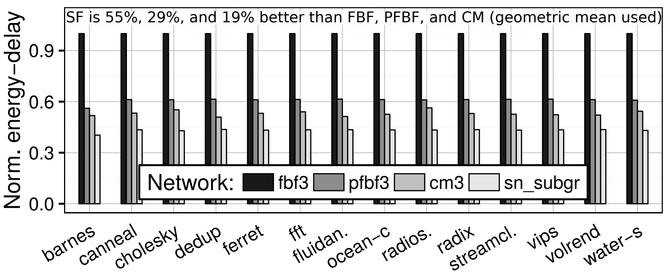
Results: Throughput / Power (PARSEC/SPLASH)
SMART links: ON
Central Buffers: ON
Node count: 192/200
in-house simulator [1]
Slim NoC provides a power-performance sweetspot
[1] S. Hassan and S. Yalamanchili. Centralized Buffer Router: A Low Latency, Low Power Router for High Radix NoCs. NOCS’13.

Slide 32
Results: Scalability
Slim NoC is similarly advantageous
when we move
from 200 nodes to 1296 nodes
(check the paper for details ☺)

Slide 33
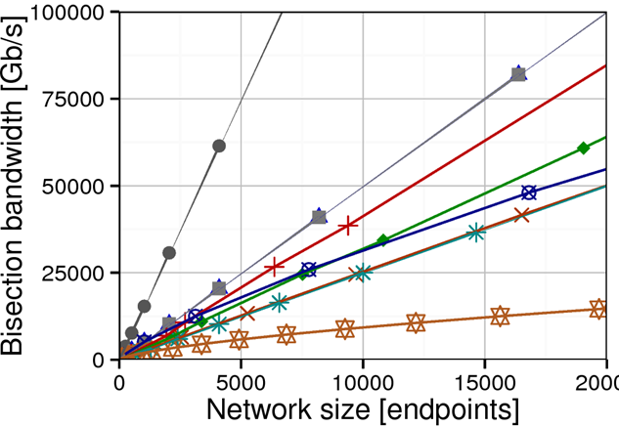
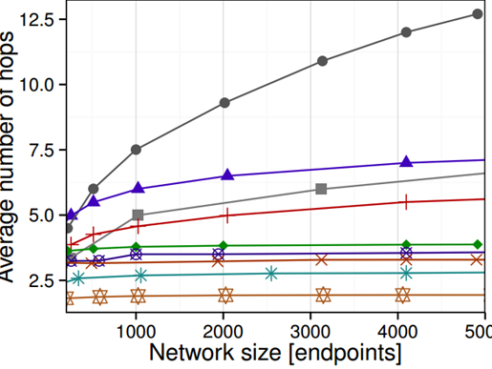
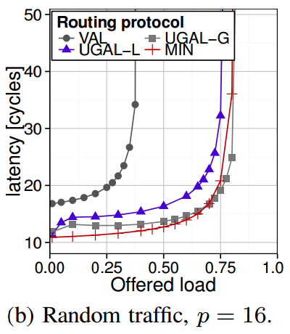
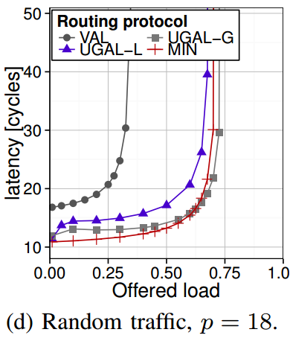
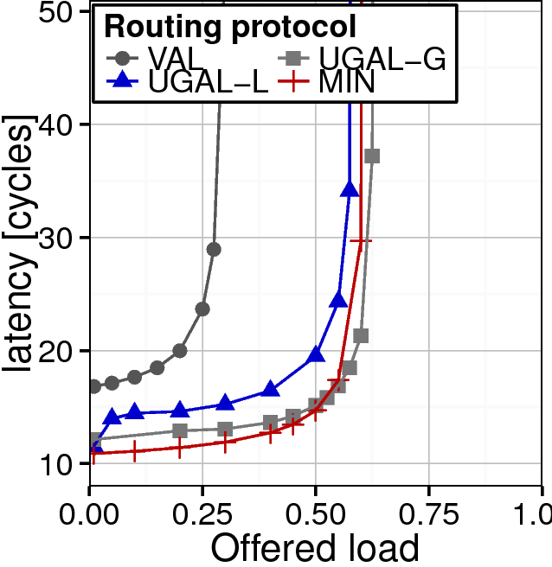
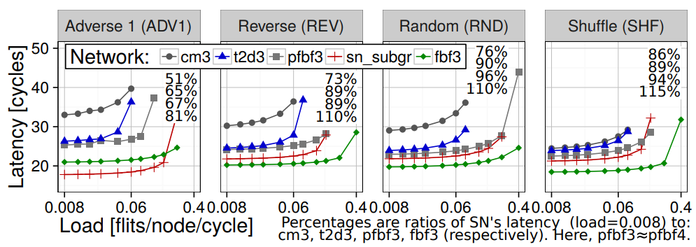
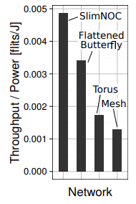
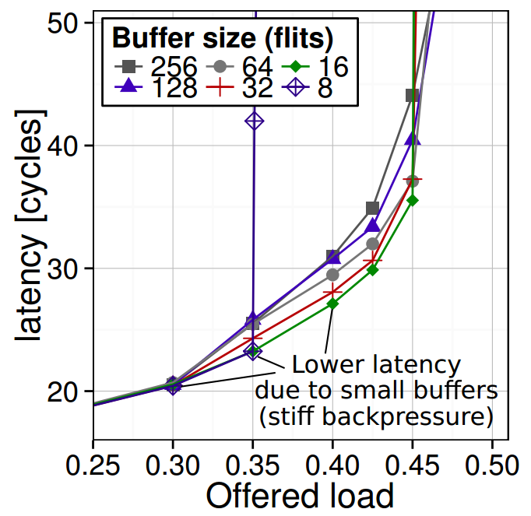
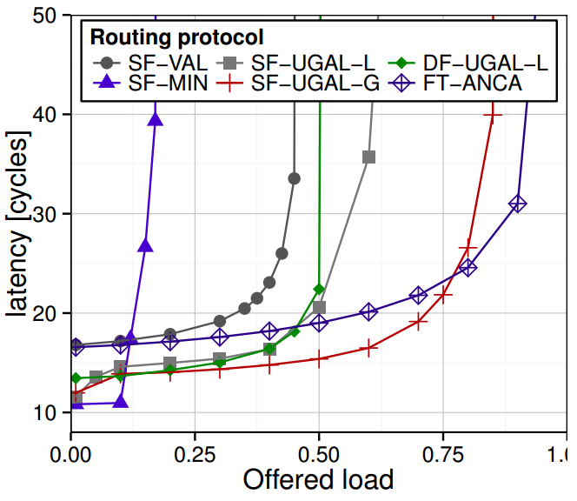
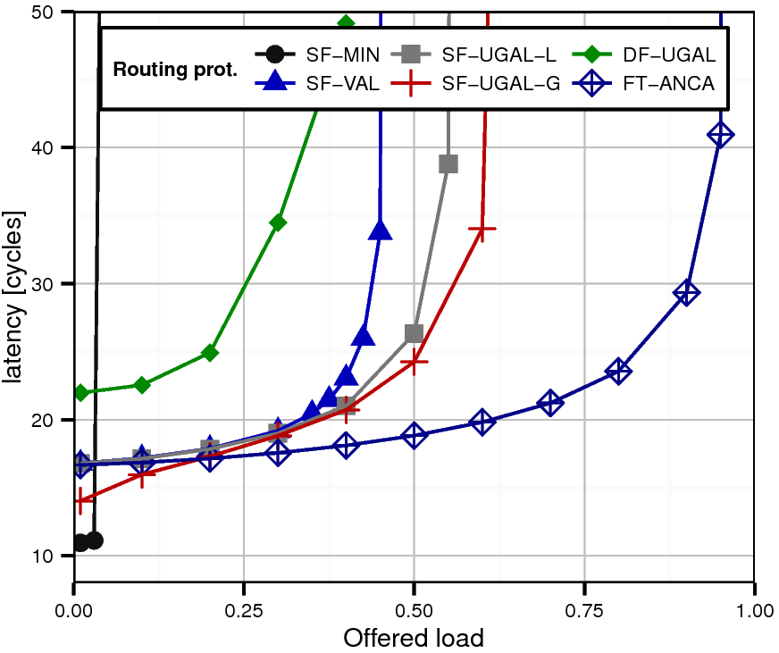
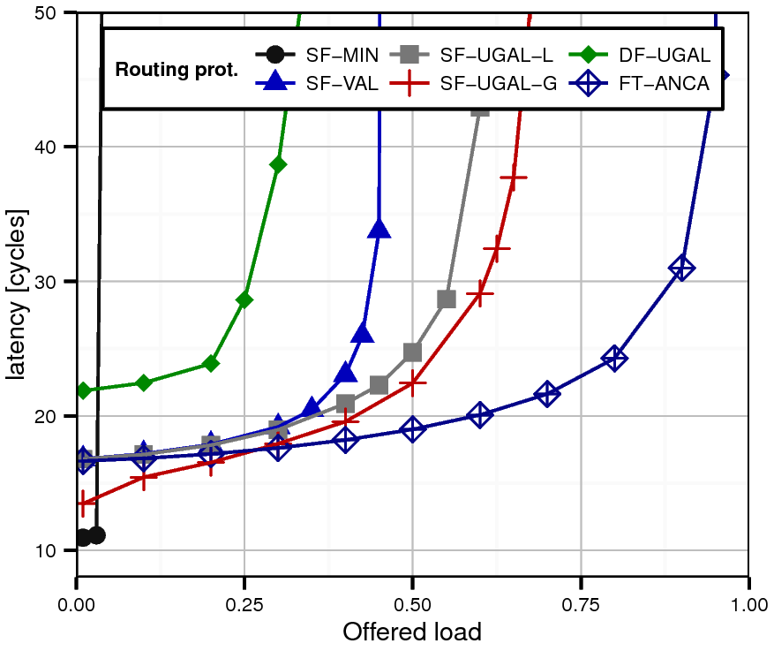
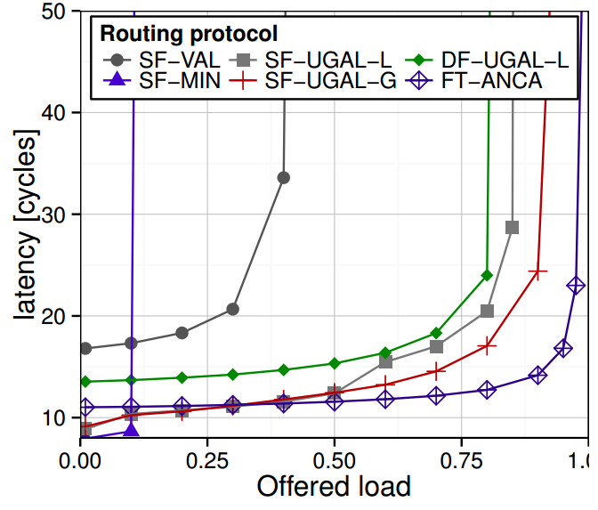
Other results
Notes:
Say what these patterns are
Maybe show pictures ?

Slide 34
What is Slim NoC?
A low-latency topology
An area- and energy-efficient topology
Website:
http://spcl.inf.ethz.ch/ Research/
Scalable_Networking/
SlimNoC
Thank you
for your attention
A power-performance-sweetspot topology
A highly-scalable topology
200 nodes
1296 nodes
Notes:
- Where is the promised case study?

Slide 35
Slim NoC: A Low-Diameter On-Chip Network Topology for High Energy Efficiency and Scalability
Maciej Besta, Syed Minhaj Hassan, Sudhakar Yalamanchili, Rachata Ausavarungnirun, Onur Mutlu, Torsten Hoefler

Slide 36
Analysis: Diameter-2 Slim Fly
~25-30% cost reduction vs. second-best topology (Dragonfly)
Lowest latency
Better throughput than Dragonfly
Almost-the-best throughput
Notes:
Say what these patterns are
Maybe show pictures ?

Slide 37
Analysis: Diameter-2 Slim Fly
Cost of network construction
100
75
~25-30% cost reduction vs. second-best topology (Dragonfly)
50
Total cost [millions of $]
25
0
0
10
20
30
40
50
Number of endpoints [thousands]

Slide 38
Analysis: Diameter-2 Slim Fly
Performance (Uniform Random)
Lowest latency
Better throughput than Dragonfly
Almost-the-best throughput
Notes:
Say what these patterns are
Maybe show pictures ?

Slide 39
Slim Fly on Chip – First Attempt
Structure Intuition
Slim Fly:
Dragonfly:
~50% fewer intra-group wires
“q”: the input parameter
that determines
the network structure. Formally, the base
of a finite field
(Slim Fly uses prime q; the corresponding field: {0, 1, …, q-1}.
~33% higher endpoint density
2(q-1) inter-group wires between two groups
One inter-group cable between
two groups
~25% fewer routers
Notes:
What does “fewer groups/router” mean?
[fixed]

Slide 40
Solution: Slim NoC
New cost and area models, new layouts
Let us see some layouts
What difference do they make for lengths of wires?
The “group layout” (sn_gr) is best for 1296 nodes The “subgroup layout” (sn_subgr) is best for 200 nodes

Slide 41
Solution: Slim NoC
How to develop such a finite field?
Non-Prime Finite Fields
Assuming q is non-prime:
$$ℱ_{q}=ℤ/qℤ$$
$$=\{x_{0}, x_{1},…,x_{q−1}\}$$
Recap: a finite field
$$ℱ_{q}$$
...with instruction tables that define operations on the field.
Assuming q is prime:
Generate with
an exhaustive search, or use a construction based on polynomials
Example:
162 routers
$$q=9$$
$$ℱ_{q}=ℤ/qℤ$$
$$ℱ_{9}=\{0,1,2,u,v,w,x,y,z\}$$
$$=\{0,1,…,q−1\}$$
(with modular arithmetic).
Example:
$$q=5$$
50 routers
$$ℱ_{5}=\{0,1,2,3,4\}$$
Addition
Multiplication
Inverse

Slide 42
Evaluation Methodology
Simulation Infrastructure
Power consumption
Performance
Cycle-accurate simulations (in-house simulator [1], Booksim [2])
Routing protocols:
Minimum static routing
Valiant routing [3]
Universal Globally-Adaptive Load-Balancing routing [4]
UGAL-L: each router has access to its local output queues
UGAL-G: each router has access to the sizes of all the queues
DSENT power simulator [5]
Considered elements for leakage: Router-router wires, Router-node wires, Routers.
Considered elements for dynamic power: Buffers, Crossbars, Wires.
[1] S. Hassan and S. Yalamanchili. Centralized Buffer Router: A Low Latency, Low Power Router for High Radix NoCs. NOCS’13.
[2] N. Jiang et al. A detailed and flexible cycle-accurate Network-on-Chip simulator. ISPASS’13.
[3] L. Valiant. A scheme for fast parallel communication. SIAM journal on computing, 1982.
[4] A. Singh. Load-Balanced Routing in Interconnection Networks. PhD thesis, Stanford University, 2005.
[5] C. Sun et al. DSENT - A Tool Connecting Emerging Photonics with Electronics for Opto-Electronic Networks-on-Chip Modeling. NOCS’12.
3
1
2
4

Slide 43
Results: Area and Power Consumption
SMART links: ON
Central Buffers: ON
Node count: 192/200
Slim NoC is more efficient than high-radix designs

Slide 44
Results: Performance
SMART links: ON
Central Buffers: ON
Node count: 192/200
Slim NoC ensures the lowest latency

Slide 45
Evaluation
SMART links: ON
Central Buffers: ON
Selected other insights
Node count: 54
Node count: 192/200

Slide 46
Performance & routing
Minimum routing
1
Intra-group connections
2
Inter-group connections
(different types of groups)
3
Inter-group connections
(identical types of groups)
Path of length 1 or 2 between two routers
$$∃$$
Path of length 1 or 2 between two routers
$$∃$$
Path of length 2 between two routers
$$∃$$

Slide 47
Diameter-2 Slim Fly
$$ℱ_{q}$$
Select a prime power q
2
Construct a finite field .
1
Example:
$$q=4w+δ;$$
Assuming q is prime:
E
$$q=5$$
$$w∈ℕ$$
$$δ∈\left\{−1,0,1\right\},$$
$$ℱ_{q}=ℤ/qℤ$$
$$=\{0,1,…,q−1\}$$
50 routers
network radix: 7
$$q$$
with modular arithmetic.
A Slim Fly based on :
Number of routers:
$$ℱ_{5}=\{0,1,2,3,4\}$$
$$2q^{2}$$
Network radix:
$$(3q−δ)/2$$
$$q$$
$$5$$
$$q$$
$$5$$
$$5$$
$$q$$
$$q$$
$$5$$

Slide 48
Diameter-2 Slim Fly
3
Label the routers
E
Example:
$$q=5$$
Set of routers:
$$\{0,1\}×ℱ_{q}×ℱ_{q}$$
…
Routers (0,.,.)
Routers (1,.,.)
(0,0,.)
(0,1,.)
(0,2,.)
(0,3,.)
(0,4,.)
(1,0,.)
(1,1,.)
(1,2,.)
(1,3,.)
(1,4,.)
(0,0,0)
(1,4,0)
(0,0,1)
(1,4,1)
(0,0,2)
(1,4,2)
(0,0,3)
(1,4,3)
(0,0,4)
(1,4,4)

Slide 49
Diameter-2 Slim Fly
Example:
E
$$q=5$$
$$ℱ_{5}=\{0,1,2,3,4\}$$
$$ξ$$
4
Find primitive element
5
Build Generator Sets
$$ξ=2$$
$$ℱ_{q}$$
$$ξ∈ℱ_{q}$$
generates :
$$X=\{1,ξ^{2},…,ξ^{q−3}\}$$
$$1=ξ^{4} mod 5=$$
$$2^{4} mod 5=16 mod 5$$
$$ℱ_{q}$$
All non-zero elements of can be written as
$$X′=\{ξ,ξ^{3},…,ξ^{q−2}\}$$
$$ξ^{i}; i∈ℕ$$
$$X=\left\{1,4\right\}$$
$$X′=\left\{2,3\right\}$$

Slide 50
Diameter-2 Slim Fly
6
Intra-group connections
Example:
E
$$q=5$$
Two routers in one group are connected iff their “vertical Manhattan distance” is an element from:
Take Routers
$$(0,0,.)$$
$$X=\{1,ξ^{2},…,ξ^{q−3}\}$$
(for subgraph 0)
$$X=\left\{1,4\right\}$$
$$X′=\{ξ,ξ^{3},…,ξ^{q−2}\}$$
(for subgraph 1)
(0,0,0)
(0,0,1)
(0,0,2)
(0,0,3)
(0,0,4)

Slide 51
Diameter-2 Slim Fly
6
Intra-group connections
Example:
E
$$q=5$$
Two routers in one group are connected iff their “vertical Manhattan distance” is an element from:
Take Routers
$$(1,4,.)$$
$$X=\{1,ξ^{2},…,ξ^{q−3}\}$$
(for subgraph 0)
$$X′=\left\{2,3\right\}$$
$$X′=\{ξ,ξ^{3},…,ξ^{q−2}\}$$
(for subgraph 1)

Slide 52
Diameter-2 Slim Fly
Example:
E
$$q=5$$
$$m=0,c=0$$
Take Router
Take Router
Inter-group connections
$$(1,0,0)$$
7
$$(1,0,0)⟷(0,x,0)$$
Router
$$(0,x,y)⟷(1,m,c)$$
Take Router
$$(1,1,0)$$
$$m=1,c=0$$
iff
$$y=mx+c$$
$$(1,0,0)⟷(0,x,x)$$
(1,0,0)
(1,1,0)

Slide 53
Designing An Efficient Network Topology
Attaching endpoints: Diameter 2
1
Get load l per router-router channel (average number of routes per channel)
$$l=\frac{total number of routes}{total number of channels}$$
network radix = 67% of router radix
2
Make the network balanced, i.e.,:
each endpoint can inject at full capacity
$$local uplink load=number of endpoints$$
$$=l$$
concentration = 33% of router radix
Notes:
- Equations without derivation ok?

Slide 54
Deadlock Freedom
Minimum Static Routing
Assign two virtual channels (VC0 and VC1) to each link
For a 1-hop path use VC0
For a 2-hop path use VC0 (hop 1) and VC1 (hop 2)
One can also use the DFSSSP scheme [1]
VC0
VC0
VC1
[1] J. Domke, T. Hoefler, and W. Nagel. Deadlock-Free Oblivious Routing for Arbitrary Topologies. IPDPS’11

Slide 55
Deadlock Freedom
Adaptive Routing
Simple generalization of the previous scheme
Assign four virtual channels (VC0 – VC3) to each link
For hop k path use VCk, 0 <= k <= 3
VC0
VC1
VC2
VC3

Slide 56
Performance
Bit permutation traffic
11010
11110
01111
01011
Notes:
Say what these patterns are
Maybe show pictures ?

Slide 57
Performance
source id
dest id
$$\left(s mod\frac{N}{2}\right)+\frac{N}{2}$$
Shift traffic
$$d=$$
$$d=$$
$$s mod \frac{N}{2}$$
Notes:
Say what these patterns are
Maybe show pictures ?

Slide 58
Performance
Worst-case traffic
Notes:
What is this d stuff?
[done]

Slide 59
Performance
Buffer sizes (UGAL-L, worst-case traffic)
Oversubscription (64 flits)
p=16
p=18

Slide 60
Structure Analysis
Uniform random traffic using minimum path routing
Average Distance
Notes:
- check, fix

Slide 61
Structure Analysis
*BB approximated with
the Metis partitioner [1]
Bisection Bandwidth (BB)
*
*
[1] G. Karypis, V. Kumar. A fast and high quality multilevel scheme for partitioning irregular graphs. ICPP’95

Slide 62
Designing An Efficient Network Topology
Connecting routers: Diameter 2
Example:
E
$$q=5$$
6
Intra-group connections
$$X=\left\{1,4\right\}$$
Take Routers
$$(0,0,.)$$
Router
$$(0,x,y)⟷(0,x,y^{′})$$
(0,0,0), (0,0,1):
$$y−y^{′}=1∈X$$
iff
$$y−y^{′}∈X$$
(0,0,0), (0,0,2):
$$y−y^{′}=2∉X$$
(0,0,1), (0,0,2):
Router
$$(0,m,c)⟷(0,m,c′)$$
$$y−y^{′}=1∈X$$
iff
$$…$$
$$c−c^{′}∈X′$$
(0,0,0), (0,0,4):
$$y−y^{′}=4∈X$$
(0,0,0)
(0,0,1)
(0,0,2)
(0,0,3)
(0,0,4)

Slide 63
Designing An Efficient Network Topology
Connecting routers: Diameter 2
Example:
E
$$q=5$$
6
Intra-group connections
$$X′=\left\{2,3\right\}$$
Take Routers
$$(1,4,.)$$
Router
$$(0,x,y)⟷(0,x,y^{′})$$
(1,4,0), (1,4,1):
$$y−y^{′}=1∉X′$$
iff
$$y−y^{′}∈X$$
(0,0,0), (0,0,2):
$$y−y^{′}=2∈X′$$
(0,0,1), (0,0,4):
Router
$$(0,m,c)⟷(0,m,c′)$$
$$y−y^{′}=3∈X′$$
iff
$$…$$
$$c−c^{′}∈X′$$
(0,0,0), (0,0,4):
$$y−y^{′}=4∉X′$$
(0,0,0)
(1,4,0)
(0,0,1)
(1,4,1)
(0,0,2)
(1,4,2)
(0,0,3)
(1,4,3)
(0,0,4)
(1,4,4)

Slide 64
Designing An Efficient Network Topology
Connecting routers: Diameter 2
Example:
E
$$q=5$$
7
Inter-group connections
Take Router
$$(1,1,0)$$
Router
$$(0,x,y)⟷(1,m,c)$$
$$y=0$$
$$mx+c=0$$
(0,0,0):
$$y=1$$
$$mx+c=1$$
(0,1,1):
iff
$$y=mx+c$$
(0,2,2):
$$y=2$$
$$mx+c=2$$
$$…$$
(0,4,4):
$$y=4$$
$$mx+c=4$$
(1,1,0)
(0,0,0)
(0,1,1)
(0,2,2)
(0,3,3)
(0,4,4)

