Slide 1
Transparent Offloading and Mapping (TOM) Enabling Programmer-Transparent Near-Data Processing in GPU Systems
Kevin Hsieh
Eiman Ebrahimi, Gwangsun Kim, Niladrish Chatterjee,
Mike O’Connor, Nandita Vijaykumar,
Onur Mutlu, Stephen W. Keckler

Slide 2
Opportunity
3D-stacked memory
(memory stack)
SM (Streaming Multiprocessor)
Logic layer
Logic layer SM
Main GPU
Crossbar switch
Vault Ctrl
….
Vault Ctrl
Processing data directly in 3D-stacked memories is a promising direction

Slide 3
The Problem
3D-stacked memory
(memory stack)
SM (Streaming Multiprocessor)
Logic layer
Logic layer SM
Main GPU
Crossbar switch
Vault Ctrl
….
Vault Ctrl
However, it requires
significant programmer effort

Slide 4
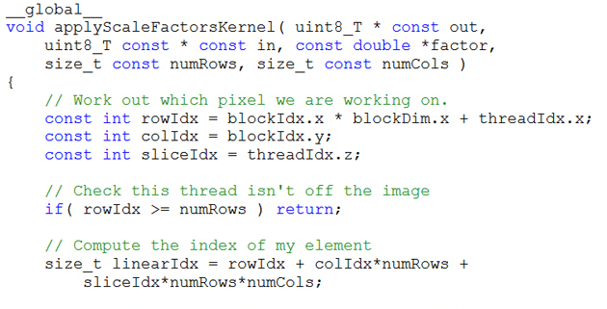
Key Challenge 1
3D-stacked memory
(memory stack)
SM (Streaming Multiprocessor)
Logic layer
Logic layer SM
Main GPU
Crossbar switch
Vault Ctrl
….
Vault Ctrl

Slide 5
Key Challenge 1
Challenge 1: Which operations should be executed on the logic layer SMs?
?
3D-stacked memory
(memory stack)
SM (Streaming Multiprocessor)
?
Logic layer
Logic layer SM
Main GPU
Crossbar switch
Vault Ctrl
….
Vault Ctrl

Slide 6
Key Challenge 2
Challenge 2: How should data be mapped to different 3D memory stacks?
3D-stacked memory
(memory stack)
SM (Streaming Multiprocessor)
Logic layer
Logic layer SM
Main GPU
Crossbar switch
Vault Ctrl
….
Vault Ctrl

Slide 7
Our Approach: TOM
Component 1: A new programmer-transparent mechanism to identify and decide what code portions to offload

Slide 8
Our Approach: TOM
Component 1: A new programmer-transparent mechanism to identify and decide what code portions to offload
The compiler identifies code portions to potentially offload based on memory profile.

Slide 9
Our Approach: TOM
Component 1: A new programmer-transparent mechanism to identify and decide what code portions to offload
The compiler identifies code portions to potentially offload based on memory profile.
The runtime system decides whether or not to offload each code portion based on runtime characteristics.

Slide 10
Our Approach: TOM
Component 1: A new programmer-transparent mechanism to identify and decide what code portions to offload
The compiler identifies code portions to potentially offload based on memory profile.
The runtime system decides whether or not to offload each code portion based on runtime characteristics.
Component 2: A new, simple, programmer-transparent data mapping mechanism to maximize code/data co-location

Slide 11
Our Approach: TOM
Component 1: A new programmer-transparent mechanism to identify and decide what code portions to offload
The compiler identifies code portions to potentially offload based on memory profile.
The runtime system decides whether or not to offload each code portion based on runtime characteristics.
Component 2: A new, simple, programmer-transparent data mapping mechanism to maximize code/data co-location
Key Results: 30% average (76% max) performance improvement in GPU workloads

Slide 12
Transparent Offloading and Mapping (TOM)
Talk at Monday 2:50pm (Session 3B)
Kevin Hsieh
Eiman Ebrahimi, Gwangsun Kim, Niladrish Chatterjee,
Mike O’Connor, Nandita Vijaykumar,
Onur Mutlu, Stephen W. Keckler

