Slide 1
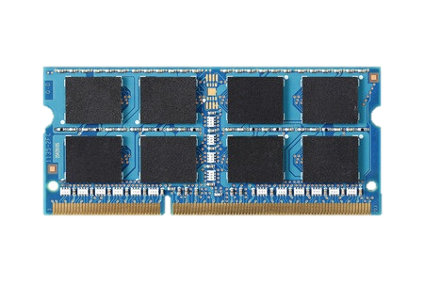
PERSISTENT MEMORY
FAST
BYTE ADDR
NVM
NONVOLATILE
Notes:
The emerging fast, byte addressable non-volatile memories provide a new opportunity to manipulate persistent data directly in the main memory.

Slide 2

PERSISTENT MEMORY
CPU
Ld/St
FAST
PERSISTENTMEMORY
BYTE ADDR
NVM
NONVOLATILE
Provides an opportunity to manipulate persistent data directly

Slide 3
WHAT HAPPENS WHEN
WE RUN AN APPLICATION?
void hashtable_update (hashtable_t* ht,
void *key, void *data)
{
list_t* chain = get_chain (ht, key);
pair_t* pair;
pair_t updatePair;
updatePair.first = key;
pair = (pair_t*) list_find (chain,
&updatePair);
pair->second = data;
}
Notes:
So let’s see what happens when we run an application in such a persistent memory system..

Slide 4

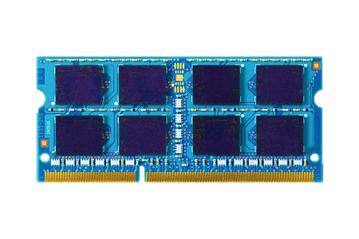

RUN THE CODE…
void hashtable_update(hashtable_t* ht,
void *key, void *data){
list_t* chain = get_chain(ht, key);
pair_t* pair;
pair_t updatePair;
updatePair.first = key;
pair = (pair_t*) list_find(chain,
&updatePair);
pair->second = data;
}
Persistent Memory System
System crash can result in
permanent data corruption in NVM
Notes:
If we run the application as it is, a power crash may introduce a permanent data corruption in NVM, leading to an inconsistent memory state.

Slide 5
CURRENT SOLUTION
void TMhashtable_update (TMARCGDECL
hashtable_t* ht, void *key, void*data){
list_t* chain = get_chain (ht, key);
pair_t* pair;
pair_t updatePair;
updatePair.first = key;
pair = (pair_t*) TMLIST_FIND (chain,
&updatePair);
pair->second = data;
}
Notes:
The current solutions propose to use specific transactional interface to protect data from crashes

Slide 6
CURRENT SOLUTION
Manual declaration of persistent components
void TMhashtable_update (TMARCGDECL
hashtable_t* ht, void *key, void*data){
list_t* chain = get_chain (ht, key);
pair_t* pair;
pair_t updatePair;
updatePair.first = key;
pair = (pair_t*) TMLIST_FIND (chain,
&updatePair);
pair->second = data;
}
Needs a new implementation
Prohibited
Operation
Third party code
can be inconsistent
Notes:
However, the programmers need to rewrite the code with a with clear partition between volatile and non-volatile data, which is a burden on he programmers

Slide 7
CURRENT SOLUTION
Manual declaration of persistent components
void TMhashtable_update (TMARCGDECL
hashtable_t* ht, void *key, void*data){
list_t* chain = get_chain (ht, key);
pair_t* pair;
pair_t updatePair;
updatePair.first = key;
pair = (pair_t*) TMLIST_FIND (chain,
&updatePair);
pair->second = data;
}
Needs a new implementation
Prohibited
Operation
Third party code
can be inconsistent
Burden on the programmers

Slide 8
Our Solution:
ThyNVM
Notes:
In this work we propose ThynNVM

Slide 9
NO MODIFICATION IN THE CODE
void hashtable_update (hashtable_t* ht,
void *key, void *data)
{
list_t* chain = get_chain (ht, key);
pair_t* pair;
pair_t updatePair;
updatePair.first = key;
pair = (pair_t*) list_find (chain,
&updatePair);
pair->second = data;
}
Notes:
Which does not require any modification in the code.

Slide 10

RUN THE EXACT SAME CODE…
void hashtable_update(hashtable_t* ht,
void *key, void *data){
list_t* chain = get_chain(ht, key);
pair_t* pair;
pair_t updatePair;
updatePair.first = key;
pair = (pair_t*) list_find(chain,
&updatePair);
pair->second = data;
}
Persistent Memory System
Software transparent
memory crash consistency
Notes:
But still provides crash consistency support which is completely transparent to the software.

Slide 11
ThyNVM
A new hardware-based
checkpointing mechanism
Checkpoints at multiple granularities to minimize both latency and metadata
Overlaps checkpointing and execution
Adapts to DRAM and NVM characteristics
Performs within 4.9% of an idealized DRAM with zero cost consistency

Slide 12
Enabling Software-Transparent
Crash Consistency in Persistent Memory
WEDNESDAY 10:20 am
ThyNVM
Jinglei Ren, Jishen Zhao, Samira Khan,
Jongmoo Choi, Yongwei Wu, and Onur Mutlu

