Slide 1
2023 IEEE International Symposium on Performance Analysis of Systems and Software
TransPimLib:
Efficient Transcendental Functions for Processing-in-Memory Systems
Maurus Item, Juan Gómez Luna, Yuxin Guo,
Geraldo F. Oliveira, Mohammad Sadrosadati, Onur Mutlu
https://arxiv.org/pdf/2304.01951.pdf
https://github.com/CMU-SAFARI/transpimlib
juang@ethz.ch
Tuesday, April 25, 2023

Slide 2
Executive Summary
Processing-in-Memory (PIM) promises to alleviate the data movement bottleneck
However, current real-world PIM systems have very constrained hardware, which results in limited instruction sets
  Difficulty/impossibility of computing complex operations, such as transcendental functions (e.g., trigonometric, exp, log) and other hard-to-calculate functions (e.g., square root)
  These functions are important for modern workloads, e.g., activation functions in machine learning applications
TransPimLib is the first library for transcendental and other hard-to-calculate functions on general-purpose PIM systems
  CORDIC-based and LUT-based methods for trigonometric functions, hyperbolic functions, exponentiation, logarithm, square root, etc.
  Source code: https://github.com/CMU-SAFARI/transpimlib
We implement TransPimLib for the UPMEM PIM architecture and evaluate its methods in terms of performance, accuracy, memory requirements, and setup time
  Three real workloads (Blackscholes, Sigmoid, Softmax)
Notes:
Transcendental functions are functions that do not satisfy a polynomial equation.

Slide 3
Outline
Processing-in-memory
and transcendental functions
TransPimLib:
A library for transcendental
and other hard-to-calculate functions
Evaluation

Slide 4
Processing-in-Memory (PIM)
PIM is a computing paradigm that advocates for memory-centric computing systems, where processing elements are placed near or inside the memory arrays
Real-world PIM architectures are becoming a reality
  UPMEM PIM, Samsung HBM-PIM, Samsung AxDIMM, SK Hynix AiM, Alibaba HB-PNM
These PIM systems have some common characteristics:
  There is a host processor (CPU or GPU) with access to (1) standard main memory, and (2) PIM-enabled memory
  PIM-enabled memory contains multiple PIM processing elements (PEs) with high bandwidth and low latency memory access
  PIM PEs run only at a few hundred MHz and have a small number of registers and small (or no) cache/scratchpad
  PIM PEs may need to communicate via the host processor

Slide 5
A State-of-the-Art PIM System
In our work, we use the UPMEM PIM architecture
  General-purpose processing cores called DRAM Processing Units (DPUs)
    Up to 24 PIM threads, called tasklets
    32-bit integer arithmetic, but multiplication/division are emulated*, as well as floating-point operations
  64-MB DRAM bank (MRAM), 64-KB scratchpad (WRAM)
* 8-bit integer multiplication is natively supported

Slide 6
How to Calculate Transcendental Functions in a PIM System?
Three possible alternatives

Slide 7
How to Calculate Transcendental Functions in a PIM System?
Three possible alternatives
TransPimLib
An open-source library with CORDIC- and LUT-based methods for trigonometric functions, hyperbolic functions, exponentiation, logarithm…
https://github.com/CMU-SAFARI/transpimlib

Slide 8
Outline
Processing-in-memory
and transcendental functions
TransPimLib:
A library for transcendental
and other hard-to-calculate functions
Evaluation

Slide 9
TransPimLib: Implementation
Various methods to calculate transcendental functions:
  Taylor approximation, minimax polynomials, CORDIC, LUTs
CORDIC is an iterative method that uses bit-shifts, additions, and table lookups
  In rotation mode, CORDIC computes the function value for an input θ by rotating a vector [1, 0] iteratively
  The rotation is done by multiplying the vector and a matrix
  The matrix represents the rotation angle, which decreases in each iteration
Fuzzy Lookup Tables (LUTs) return an (approximate) output f(x) for each input x
  A function a(x) returns an address to access the LUT
  The table returns LUT(a(x)) ≃ f(x)
  To generate the LUT, we need a helper function a⁻¹(), such that x = a(a⁻¹(x))
  LUTs’ accuracy improves with interpolation:
  f(x) ≃ LUT(a(x)) + LUT(a(x)+1) - LUT(a(x))·Δ
Notes:
We avoid methods that require multiplication, which is costly in the target architecture.
Interpolation: Δ represents where the input resides between two lookup table entries.

Slide 10
TransPimLib: CORDIC-based Methods
TransPimLib contains CORDIC implementations of trigonometric (sin, cos, tan) and hyperbolic (sinh, cosh, tanh) functions, exponentiation, logarithm, and square root
Example: Sine function

Slide 11
TransPimLib: LUT-based Methods
Multiplication-based LUT (M-LUT)
  Regular spacing between table entries
  a(x) = round((x - p) · k), where k represents the LUT density
LDEXP-based LUT (L-LUT)
  Multiplication is cheaper if we multiply by 2^{n}
  ldexp(arg, exp) to perform arg · 2^{exp}
  a(x) = round((x - p) · 2^{n})
    k is a power-of-two, which results in less precision but avoids multiplication
Direct Float Conversion-based LUT (D-LUT)
  a(x) uses the last n bits of the exponent and p bits of the mantissa
  Piece-wise linear density: 2^{n} steps of 2^{p} addresses
Map interval [0, 5] to a 12-entry LUT
Notes:
p defines what input value x corresponds to address 0 of the LUT.

Slide 12
TransPimLib: Combined Methods
Direct Float Conversion + LDEXP-based LUT (DL-LUT)
  Uses an L-LUT between 0 and the smallest exponent and a D-LUT for larger inputs
M-LUT
L-LUT
D-LUT
CORDIC+L-LUT (CORDIC+LUT)
  Replaces the first few iterations of CORDIC with a LUT
  Flexible tradeoff between computing cost, table size, and precision

Slide 13
TransPimLib: Supported Functions
 | Supported Functions
Implementation Method | sin | cos | tan | sinh | cosh | tanh | exp | log | sqrt | GELU
CORDIC | ✔️ | ✔️ | ✔️ | ✔️ | ✔️ | ✔️ | ✔️ | ✔️ | ✔️
M-LUT | ✔️ | ✔️ | ✔️ |  |  |  | ✔️ | ✔️ | ✔️
M-LUT+Interp. | ✔️ | ✔️ | ✔️ |  |  |  | ✔️ | ✔️ | ✔️
L-LUT | ✔️ | ✔️ | ✔️ |  |  |  | ✔️ | ✔️ | ✔️
L-LUT+Interp. | ✔️ | ✔️ | ✔️ |  |  |  | ✔️ | ✔️ | ✔️
D-LUT+Interp. | ✔️ |  |  |  |  | ✔️ |  |  |  | ✔️
DL-LUT+Interp. | ✔️ |  |  |  |  | ✔️ |  |  |  | ✔️
CORDIC+LUT | ✔️ | ✔️ | ✔️ | ✔️ | ✔️ | ✔️ | ✔️
Based on our preliminary analysis, we provide the most suitable methods for each of the supported functions (other than sine).

Slide 14
Outline
Processing-in-memory
and transcendental functions
TransPimLib:
A library for transcendental
and other hard-to-calculate functions
Evaluation

Slide 15
Evaluation Methodology
Evaluated systems
  UPMEM PIM system with 2,545 PIM cores @ 350 MHz and 159 GB of DRAM
  2-socket Intel Xeon CPU (32 cores)
Microbenchmarks
  Performance evaluation
    We measure execution cycles
  Accuracy evaluation
    Root-mean-square absolute error (RMSE) with respect to the CPU with the standard math library
  Setup time
    Generation on the host CPU and transfers to the PIM side
  Memory consumption
    All tables and variables allocated in the DRAM bank of a PIM core
  We use sine, as a representative function
Real-world Benchmarks
  Blackscholes: exp, log, sqrt, cumulative normal distribution (CNDF)
  Sigmoid
  Softmax

Slide 16
Microbenchmark Results: Performance (I)
We measure the execution cycles for an accuracy range between 10⁻⁴ and 10⁻⁹
LUT-based versions place the LUT in either the PIM core’s DRAM bank (MRAM) or the scratchpad (WRAM)
Performance of LUT-based methods is independent of the accuracy
Execution cycles depend on the number of multiplications:
Interp. M-LUT: 2 FP multiplications
Non-interp. M-LUT and inter. L-LUT: 1 FP multiplication
Non-interp. L-LUT: No FP multiplication
Fixed-point version of the L-LUT
Interp. Fix. L-LUT doubles the performance of inter. L-LUT due to faster fixed-point multiplication

Slide 17
Microbenchmark Results: Performance (II)
We measure the execution cycles for an accuracy range between 10⁻⁴ and 10⁻⁹
CORDIC-based methods take more execution cycles to provide higher accuracy
CORDIC accuracy increases with each iteration of the CORDIC algorithm
CORDIC+LUT runs faster than CORDIC, as it replaces the initial iterations with an
L-LUT query
At some point (~10⁻⁹), further increasing the LUT size or CORDIC iterations does not improve accuracy
Little benefit from placing LUTs in the scratchpad (WRAM) instead of the DRAM bank (MRAM)
Notes:
We also measure the maximum absolute error to be around 1e-7. Intuitively, this is due to the precision of floating-point values being limited.

Slide 18
Microbenchmark Results: Performance (III)
We measure the execution cycles for an accuracy range between 10⁻⁴ and 10⁻⁹
CORDIC-based methods take more execution cycles to provide higher accuracy
Key Takeaway 1
Interpolated L-LUT methods (lookup table with LDEXP operation)
offer the best tradeoff in terms of performance and accuracy
CORDIC accuracy increases with each iteration of the CORDIC algorithm
CORDIC+LUT runs faster than CORDIC, as it replaces the initial iterations with an
L-LUT query
At some point (~10⁻⁹), further increasing the LUT size or CORDIC iterations does not improve accuracy
Little benefit from placing LUTs in the scratchpad (WRAM) instead of the DRAM bank (MRAM)

Slide 19
Microbenchmark Results: Setup Time (I)
The setup time can also impact the decision of what method to use
For LUT-based methods, setup times increase with LUT size
CORDIC methods have flat setup times
CORDIC methods can provide higher overall performance
(i.e., setup time + PIM kernel time) than LUT-based methods
when the total number of transcendental functions in a workload is low.
For example, we estimate ~40 sine operations (see paper)

Slide 20
Microbenchmark Results: Setup Time (II)
The setup time can also impact the decision of what method to use
Key Takeaway 2
CORDIC-based methods are preferable when a PIM kernel needs to execute just a few transcendental functions due to their low setup time in the host CPU
For LUT-based methods, setup times increase with LUT size
CORDIC methods have flat setup times
CORDIC methods can provide higher overall performance
(i.e., setup time + PIM kernel time) than LUT-based methods
when the total number of transcendental functions in a workload is low.
For example, we estimate ~40 sine operations (see paper)

Slide 21
Microbenchmark Results: Memory (I)
We also obtain the memory consumption (in bytes) in the DRAM bank of a PIM core
Accuracy of non-interp. LUT methods is limited by the available memory
Memory consumption of CORDIC methods does not increase exponentially
Interpolation is an effective way of increasing accuracy without increasing LUT size
Notes:
CORDIC methods are recommended for applications where not much memory is available for the LUTs.

Slide 22
Microbenchmark Results: Memory (II)
We also obtain the memory consumption (in bytes) in the DRAM bank of a PIM core
Key Takeaway 3
Interpolated L-LUT methods offer a good tradeoff in terms of accuracy, execution cycles, and memory consumption.
However, CORDIC and CORDIC+LUT methods are recommended for applications that require high accuracy, where the available memory is limited (e.g., needed for large datasets)
Accuracy of non-interp. LUT methods is limited by the available memory
Memory consumption of CORDIC methods does not increase exponentially
Interpolation is an effective way of increasing accuracy without increasing LUT size

Slide 23
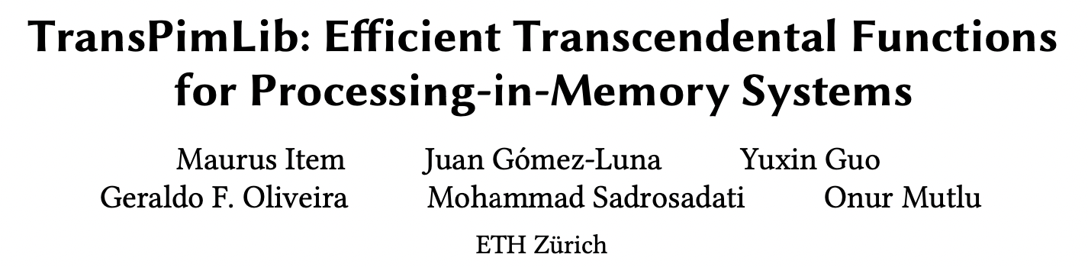
More in the Paper
Analysis of other supported functions
Evaluation of range reduction/extension
Discussion and takeaway about D-LUT and DL-LUT methods

Slide 24
Real-world Benchmark Results (I)
1 & 32 CPU cores
PIM baseline: Polynomial
Blackscholes
For Blackscholes, TransPimLib is 5-12x faster than the PIM baseline
Fixed-point L-LUT is 92% faster than the 32-thread CPU baseline
Sigmoid
For Sigmoid and Softmax, TransPimLib outperforms the PIM baseline and shows that it can save data movement from executing activation functions in the host CPU
Softmax

Slide 25
Real-world Benchmark Results (II)
1 & 32 CPU cores
PIM baseline: Polynomial
Key Takeaway 4
TransPimLib can reduce data movement from PIM cores to the CPU (Fig. (b)) for applications running on the PIM cores.
As a result, the execution of transcendental functions in the PIM cores (Fig. (c)) could be 6−8× faster than the execution in the host CPU.
Blackscholes
For Blackscholes, TransPimLib is 5-12x faster than the PIM baseline
Fixed-point L-LUT is 92% faster than the 32-thread CPU baseline
Sigmoid
For Sigmoid and Softmax, TransPimLib outperforms the PIM baseline and shows that it can save data movement from executing activation functions in the host CPU
Softmax

Slide 26

TransPimLib: arXiv Version
https://arxiv.org/pdf/2304.01951.pdf

Slide 27
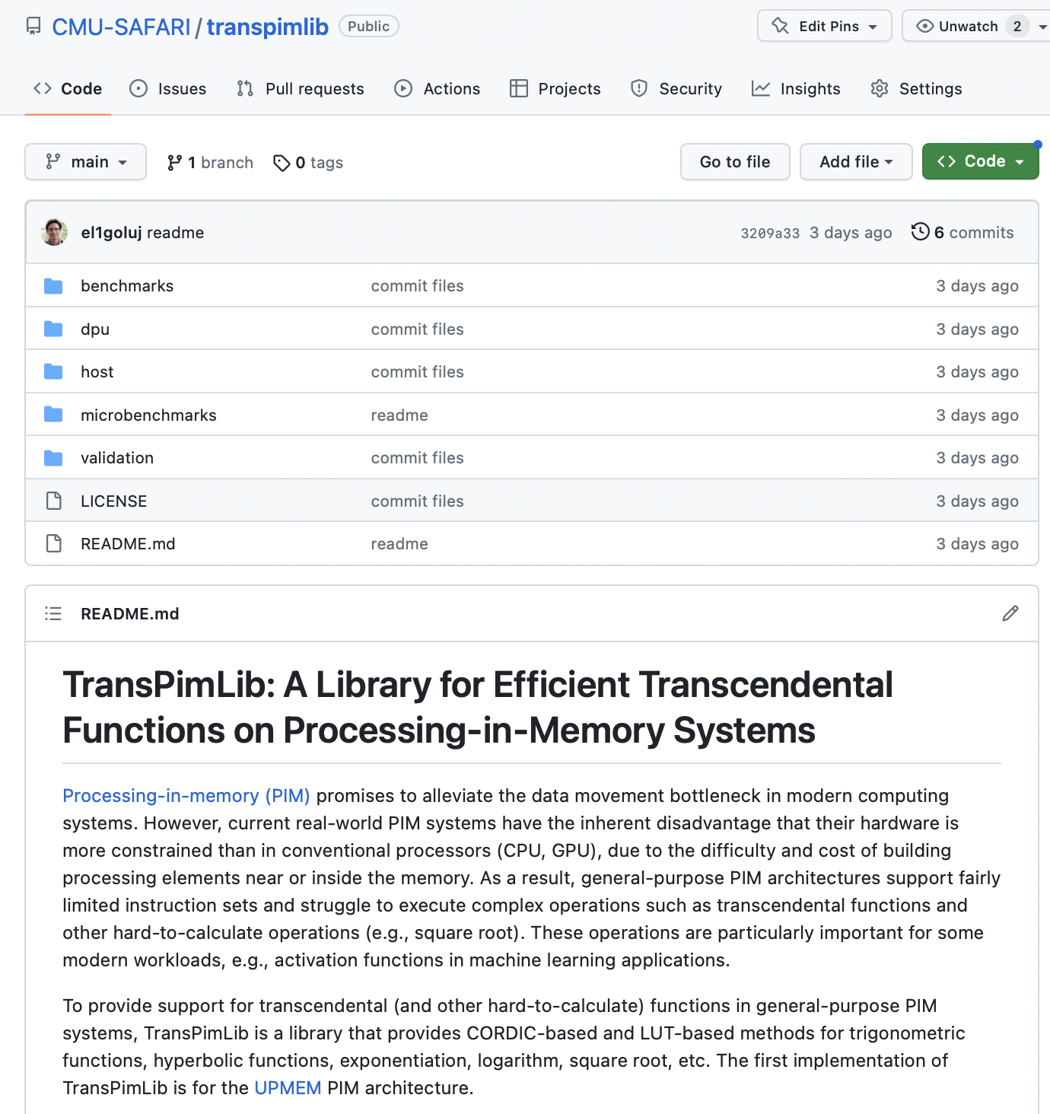
Source Code
https://github.com/CMU-SAFARI/transpimlib

Slide 28
Executive Summary
Processing-in-Memory (PIM) promises to alleviate the data movement bottleneck
However, current real-world PIM systems have very constrained hardware, which results in limited instruction sets
  Difficulty/impossibility of computing complex operations, such as transcendental functions (e.g., trigonometric, exp, log) and other hard-to-calculate functions (e.g., square root)
  These functions are important for modern workloads, e.g., activation functions in machine learning applications
TransPimLib is the first library for transcendental and other hard-to-calculate functions on general-purpose PIM systems
  CORDIC-based and LUT-based methods for trigonometric functions, hyperbolic functions, exponentiation, logarithm, square root, etc.
  Source code: https://github.com/CMU-SAFARI/transpimlib
We implement TransPimLib for the UPMEM PIM architecture and evaluate its methods in terms of performance, accuracy, memory requirements, and setup time
  Three real workloads (Blackscholes, Sigmoid, Softmax)
Notes:
Transcendental functions are functions that do not satisfy a polynomial equation.

Slide 29
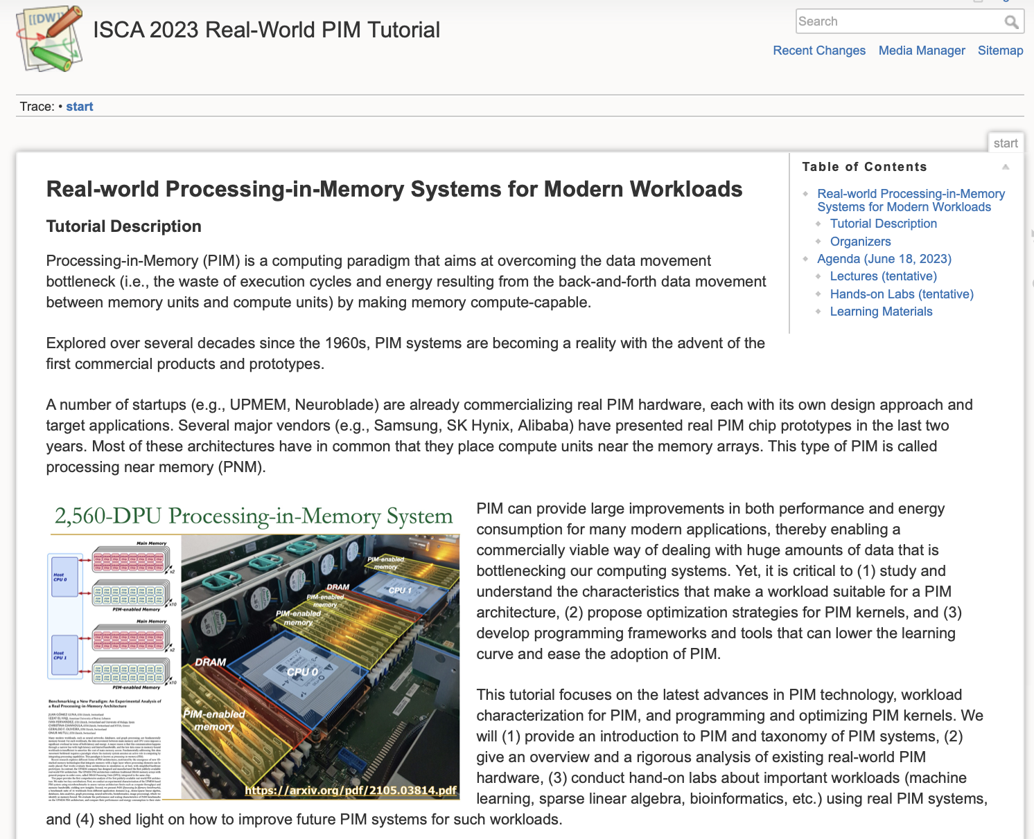
Real PIM Tutorial (ISCA 2023)
June 18th: Lectures + Hands-on labs + Invited lectures
https://events.safari.ethz.ch/isca-pim-tutorial/doku.php?id=start

Slide 30
2023 IEEE International Symposium on Performance Analysis of Systems and Software
TransPimLib:
Efficient Transcendental Functions for Processing-in-Memory Systems
Maurus Item, Juan Gómez Luna, Yuxin Guo,
Geraldo F. Oliveira, Mohammad Sadrosadati, Onur Mutlu
https://arxiv.org/pdf/2304.01951.pdf
https://github.com/CMU-SAFARI/transpimlib
juang@ethz.ch
Tuesday, April 25, 2023

