Slide 1



U-TRR
Uncovering in-DRAM RowHammer Protection Mechanisms:
A New Methodology, Custom RowHammer Patterns, and Implications
Hasan Hassan
Yahya Can Tugrul Jeremie S. Kim Victor van der Veen
Kaveh Razavi Onur Mutlu
Notes:
Hi, my name is Hasan.
I will be presenting our work on uncovering the operation of in-DRAM RowHammer Protection mechanisms.

Slide 2
The RowHammer Vulnerability
DRAM Chip
Row 0
Row 0
Row 1
Row 1
Row 1
Row 2
Row 2
Row 2
Row 2
Row 2
Row 2
closed
open
open
closed
open
Row 3
Row 3
Row 3
Row 4
Row 4
Repeatedly opening (activating) and closing (precharging)
a DRAM row causes RowHammer bit flips in nearby cells
Notes:
The RowHammer vulnerability of modern DRAM is a critical reliability and security threat.
[CLICK] When a DRAM row is repeatedly activated and precharged many times, nearby rows may experience RowHammer bit flips.

Slide 3


Current RowHammer Protection Mechanisms
DRAM vendors implement in-DRAM Target Row Refresh (TRR)
Key Idea: TRR refreshes nearby rows upon detecting an aggressor row
DRAM Chip
TRR
Row 0
TRR-induced REF
Row 1
open
closed
TRR-induced REF
Row 2
Row 3
Aggressor detected: Row 2
Row 4
Refresh neighbor rows
Notes:
[CLICK] To protect their DRAM chips against RowHammer, DRAM vendors currently implement RowHammer mitigation mechanisms typically called Target Row Refresh or (TRR)
[CLICK] The key idea of TRR is to refresh nearby rows upon detecting an aggressor row

Slide 4
Problem
TRR is obscure, undocumented, and proprietary
We cannot easily study the security properties of TRR
Notes:
However, different vendors implement TRR differently and the exact operation of these TRR mechanisms is unknown. Therefore, TRR is obscure, undocumented, and proprietary
[CLICK] Because of this, today, we cannot easily study the security properties of TRR and make sure it is fully secure

Slide 5
Goal
Study in-DRAM TRR mechanisms to
understand how they operate
1
assess their security
2
secure DRAM completely against RowHammer
3
Notes:
Our goal is to study in-DRAM TRR mechanisms to [CLICK] understand how they operate, [CLICK] asses their security, [CLICK] and enable fully-secure DRAM against RowHammer

Slide 6
U-TRR (Uncovering TRR)
U-TRR: A new methodology to
uncover the inner workings of TRR
Key idea: Use data retention failures as a side channel
to detect when a row is refreshed by TRR
Notes:
To this end, we propose U-TRR, a new methodology to uncover the inner workings of TRR.
[CLICK] The key idea of U-TRR is to use data retention failures in DRAM as a side channel to detect when a certain row is refreshed by TRR

Slide 7
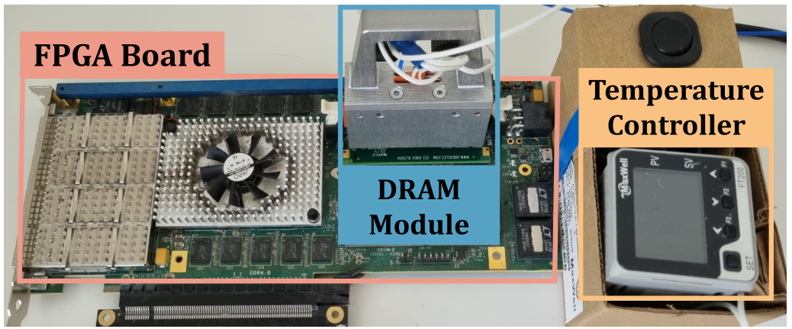
U-TRR: Experimental Setup
* SoftMC [Hassan+, HPCA’17] enhanced for DDR4
Notes:
We implement U-TRR using SoftMC, an FPGA-based infrastructure with precise temperature control which we enhanced for DDR4

Slide 8





U-TRR Analysis Summary
15x Vendor A
DDR4 DRAM modules
15x Vendor B
DDR4 DRAM modules
15x Vendor C
DDR4 DRAM modules
U-TRR
new RowHammer access patterns
that circumvent TRR
Notes:
Using U-TRR, [CLICK] we analyze 45 DDR4 modules from three major DRAM vendors. [CLICK] Based on the understanding we develop from our analysis, we craft new RowHammer access patterns that circumvent the TRR mechanisms implemented today.

Slide 9
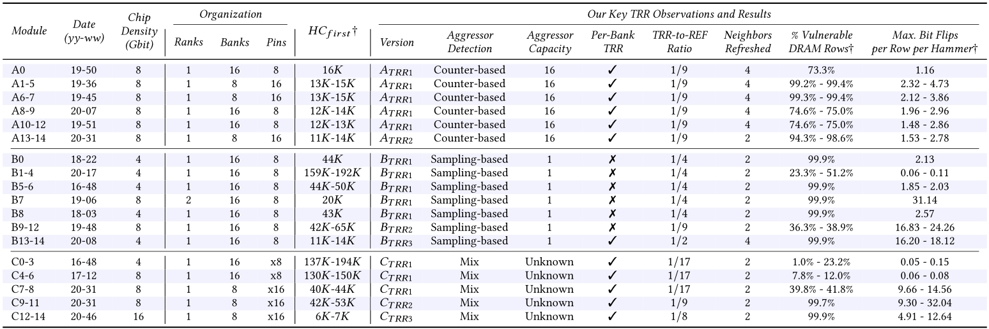
Key Takeaways
All 45 modules we test are vulnerable
99.9% of rows in a DRAM bank
experience at least one RowHammer bit flip
Up to 7 RowHammer bit flips
in an 8-byte dataword, making ECC ineffective
Notes:
In summary, we find that all 45 modules we test are vulnerable to our new RowHammer access patterns
[CLICK] almost all rows in a DRAM bank experience at least one RowHammer bit flip
[CLICK] a single 8-byte dataword experiences up to 7 Rowhammer bit flips, making ECC ineffective against our RowHammer access patterns.
[CLICK] Our paper has detailed descriptions and analyses of each of the 45 modules and we encourage you to read it and attend our full talk

Slide 10
U-TRR
Uncovering in-DRAM RowHammer Protection Mechanisms:
A New Methodology, Custom RowHammer Patterns, and Implications
Hasan Hassan
Yahya Can Tugrul Jeremie S. Kim Victor van der Veen
Kaveh Razavi Onur Mutlu
Notes:
Thank you for your time. I invite you to listen to our full talk and read our paper for more details.

