Slide 1


U-TRR
Uncovering in-DRAM RowHammer Protection Mechanisms:
A New Methodology, Custom RowHammer Patterns, and Implications
Hasan Hassan
Yahya Can Tugrul Jeremie S. Kim Victor van der Veen
Kaveh Razavi Onur Mutlu
Notes:
Hi, my name is Hasan.
I will be presenting our work on uncovering the operation of in-DRAM RowHammer Protection mechanisms.

Slide 2
The RowHammer Vulnerability
DRAM Chip
Row 0
Row 0
Victim Row
Row 1
Row 1
Row 1
Victim Row
Row 2
Row 2
Row 2
Row 2
Row 2
Row 2
closed
open
open
Aggressor Row
closed
open
Row 3
Row 3
Row 3
Victim Row
Row 4
Row 4
Victim Row
Repeatedly opening (activating) and closing (precharging)
a DRAM row causes RowHammer bit flips in nearby cells
Notes:
Let me first briefly explain the RowHammer vulnerability.
In order to access data from a DRAM row, the memory controller must activate the row [CLICK] and later [CLICK] precharge it.
[CLICK] However, [CLICK] rapidly activating and [CLICK] precharging a DRAM row can result in bit flips in nearby rows [CLICK]
[CLICK] [CLICK]. This phenomenon is known as RowHammer. [CLICK]
We refer to the rapidly accessed row as an aggressor row and the rows containing bit flips as victim rows.

Slide 3


Target Row Refresh (TRR)
DRAM vendors equip their DRAM chips with a proprietary
mitigation mechanisms known as Target Row Refresh (TRR)
Key Idea: TRR refreshes nearby rows upon detecting an aggressor row
TRR-equipped DRAM Chip
Memory
Controller
REF
Row 0
TRR
Row 1
open
closed
Row 2
Row 3
Aggressor detected: Row 2
Row 4
Refresh neighbor rows
TRR-induced refreshes
Notes:
To protect their DRAM chips against RowHammer, DRAM vendors currently implement proprietary RowHammer mitigation mechanisms typically called Target Row Refresh or (TRR)
[CLICK] The key idea of TRR is to refresh nearby rows upon detecting an aggressor row
[CLICK] We demonstrate how TRR operates at a high-level.
[CLICK] The TRR mechanism detects [CLICK] an aggressor row as a result of [CLICK] repeatedly activating and precharging the same row. [CLICK]
[CLICK] To protect the neighbor victim rows from experiencing RowHammer bit flips, [CLICK] TRR refreshes the victim rows by performing TRR-induced refresh operations. TRR refreshes victim rows by piggybacking TRR-induced refreshes to the REFRESH commands that the memory controller periodically issues.

Slide 4
The Problem with TRR
TRR is obscure, undocumented, and proprietary
We cannot easily study the security properties of TRR
Notes:
Although this is how TRR operates at a high level, different vendors implement TRR differently and the exact operation of these TRR mechanisms is unknown. Therefore, TRR is obscure, undocumented, and proprietary
[CLICK] Because of this, today, we cannot easily study the security properties of TRR and make sure it is fully secure

Slide 5
Goal
Study in-DRAM TRR mechanisms to
understand how they operate
1
assess their security
2
secure DRAM completely against RowHammer
3
Notes:
Our goal is to study in-DRAM TRR mechanisms to [CLICK] understand how they operate, [CLICK] asses their security, [CLICK] and secure DRAM completely against RowHammer

Slide 6
Overview of U-TRR
U-TRR: A new methodology to
uncover the inner workings of TRR
Key idea: Use data retention failures as a side channel
to detect when a row is refreshed by TRR
Notes:
We propose U-TRR, a new methodology to uncover the inner workings of TRR.
[CLICK] The key idea of U-TRR is to use data retention failures in DRAM as a side channel to detect when a certain row is refreshed by TRR

Slide 7
High-Level U-TRR Operation
U-TRR has two main components:
Row Scout (RS) and TRR Analyzer (TRR-A)
Row Scout: finds a set of DRAM rows that meet certain requirements as needed by TRR-A and identifies the data retention times of these rows
TRR Analyzer: uses RS-provided rows to distinguish between
TRR-induced and regular refreshes, and thus builds an understanding of the underlying TRR mechanism
Notes:
U-TRR consists of two main components: Row Scout and TRR Analyzer.
[CLICK] Row Scout finds a set of DRAM rows that meet certain requirements [CLICK], as needed by TRR Analyzer, and identifies [CLICK] the data retention times of these rows
[CLICK] TRR Analyzer uses the rows that Row Scout provides [CLICK] to distinguish between TRR-induced and regular refreshes, and [CLICK] thus builds an understanding of the underlying TRR mechanism

Slide 8
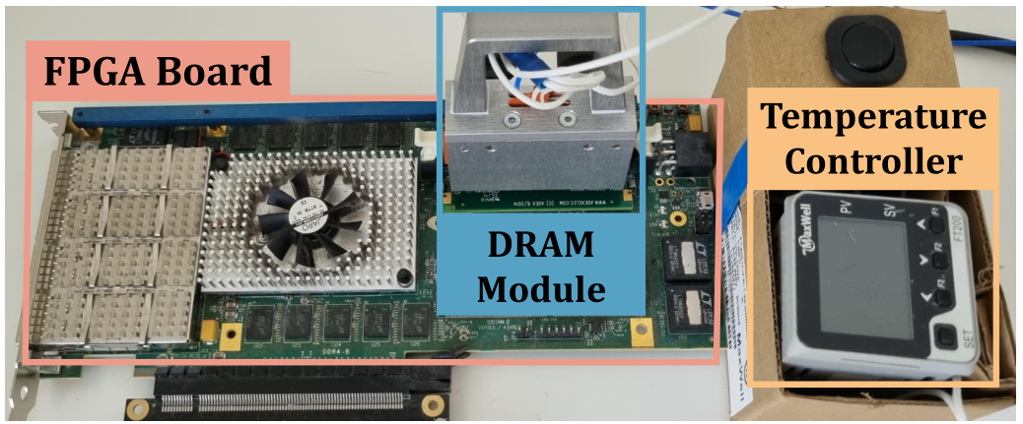
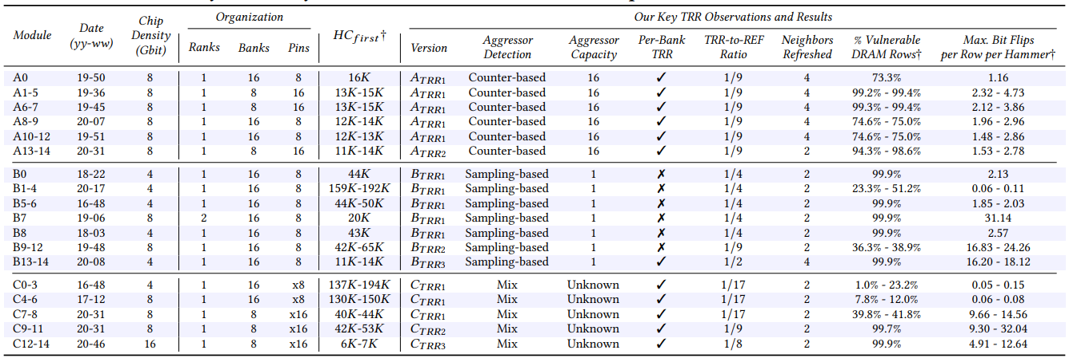




DRAM Testing Infrastructure
We implement U-TRR using
FPGA-based SoftMC [Hassan+, HPCA’17]
modified to support DDR4 DRAM
SoftMC provides fine-grained control over DRAM commands,
timing parameters and temperature
15x Vendor A
DDR4 modules
We analyze 45 DDR4 DRAM modules
from three vendors
15x Vendor B
DDR4 modules
Table 1 in our paper provides more information about the analyzed modules
15x Vendor C
DDR4 modules
Notes:
To implement U-TRR and conduct the DRAM experiments, we use SoftMC, an FPGA-based DRAM testing infrastructure.
[CLICK] In our study, we analyzed 15 DDR4 DRAM modules from each of the three major DRAM vendors.
[CLICK] In the paper, we have a table that provides detailed information about the tested modules and here is a glimpse of the table

Slide 9
Key Observations: Vendor A
Observation 1: TRR tracks potentially aggressor rows using a Counter Table
Observation 2: The Counter Table has 16 entries
TREF₁: Refreshes the victims of row ID with the largest counter value
Counter Table
TREF₂
pointer
row ID
counter value
row ID
counter value
…
16 entries
TREF ₂: Refreshes the victims of
row ID that TREF₂ pointer refers to
row ID
counter value
Notes:
Starting with vendor A, let me summarize the key observations we make using U-TRR.
[CLICK] Vendor A’s TRR implements a Counter Table to keep track of repeatedly activated, potentially aggressor, rows. [CLICK] The table has 16 entries where each entry contains a row address and a counter value to indicate the accumulated hammer count of the corresponding row.
The TRR mechanism performs two types of TRR-capable refresh operations, which we refer to as TREF1 and TREF2.
[CLICK] When performing TREF1, the TRR mechanism refreshes the neighbor rows of the row ID that corresponds to the largest value in the table.
[CLICK] On the other hand, TREF2 uses a pointer that indicates the row ID from the table to refresh its neighbors. After performing TREF2, the TREF2 pointer advances to the next entry in the table in circular manner.

Slide 10
Key Observations: Vendor B
Observation 1: TRR probabilistically samples the address of an activated row
Observation 2: A newly-sampled row overwrites the previously-sampled one
TREF: Refreshes the victims of the last sampled row
Notes:
Now, let’s look at Vendor B’s TRR operation.
We make two key observations.
[CLICK] First, TRR probabilistically samples the address of an activated row as a potential aggressor row.
[CLICK] Second, a newly-sampled row overwrites the previously-sampled one, even if the neighbors of the previously-sampled row were not refreshed by TRR-induced refresh yet.
[CLICK] Basically, a TRR-capable refresh command targets the row address that has been last sampled by the TRR mechanism.

Slide 11
Key Observations: Vendor C
Observation 1: TRR detects an aggressor row only among the first 2K ACT commands issued after a TREF
Observation 2: Rows activated earlier within the 2K ACT commands are more likely to be detected by TRR
TREF: Detects an aggressor row only among the first 2K ACT commands while favoring the earlier activations more
Notes:
Let’s move on to Vendor C.
[CLICK] We observe that TRR detects an aggressor row across only the first 2K row activations. Row activations performed after the first 2K activations evade the TRR mechanism.
[CLICK] We also observe that rows activated earlier within the 2K ACT commands are more likely to be detected by TRR
[CLICK] Basically, TRR probabilistically detects an aggressor row within the first 2K activations while favoring the earlier activations more.

Slide 12
Bypassing TRR with New RowHammer Access Patterns
We craft new RowHammer access patterns
that circumvent TRR of three major DRAM vendors
On the 45 DDR4 modules we test, the new access patterns cause a large number of RowHammer bit flips
Notes:
Leveraging the understanding we develop using U-TRR, we craft new RowHammer access patterns that circumvent the TRR mechanisms of three major DRAM vendors. We explain how we craft those access patterns in the paper and in the full talk video.
[CLICK] We evaluate the effectiveness of these patterns on 45 DDR4 DRAM modules, and we find that the new RowHammer access patterns cause a large number of RowHammer bit flips.

Slide 13
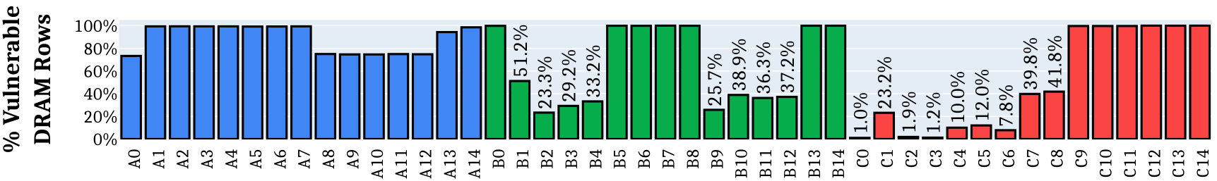
Effect on Individual Rows
All 45 modules we tested are vulnerable
to our new RowHammer access patterns
Our RowHammer access patterns
cause bit flips in more than 99.9% of the rows
Notes:
[CLICK] We find that all 45 modules we tested are vulnerable to our new RowHammer access patterns
[CLICK] Further, in 20 of the modules, our RowHammer access patterns cause bit flips in almost all of the rows

Slide 14
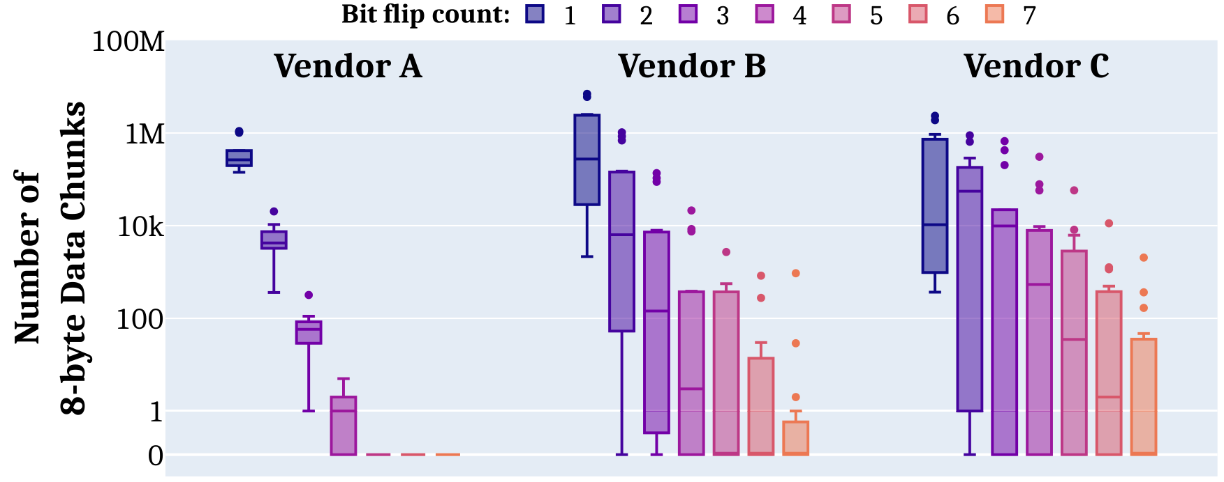
Bypassing ECC with New RowHammer Patterns
Vendor A
Vendor B
Vendor C
Modules from all three vendors have many 8-byte data chunks with 3 and more (up to 7) RowHammer bit flips
Conventional DRAM ECC cannot protect
against our new RowHammer access patterns
Notes:
The new RowHammer access patterns cause a lot of RowHammer bit flips. But can conventional DRAM ECC protect against those bit flips?
When we look at how RowHammer bit flips are distributed across 8-byte data chunks, we find that [CLICK] our RowHammer access patterns can cause at least 3 bit flips in modules of all three vendors. Further, [CLICK] we see up to 7 bit flips in many datawords, which the conventional SECDED ECC cannot correct or detect
[CLICK] We conclude that conventional DRAM ECC cannot protect against our new RowHammer patterns

Slide 15
Other Observations and Results in the Paper
More observations on the TRRs of the three vendors
Detailed description of the crafted access patterns
Hammers per aggressor row sensitivity analysis
Observations and results for individual modules
…
Notes:
For many other observations and results, we invite you to read our paper.

Slide 16


Summary
DRAM RowHammer vulnerability leads to critical reliability and security issues
Target Row Refresh (TRR):
a set of obscure, undocumented, and proprietary RowHammer mitigation techniques
Is TRR fully secure? How can we validate its security guarantees?
U-TRR
A new methodology that leverages data retention failures to
uncover the inner workings of TRR and study its security
15x Vendor A
DDR4 modules
All 45 modules we test are vulnerable
15x Vendor B
DDR4 modules
99.9% of rows in a DRAM bank
experience at least one RowHammer bit flip
New RowHammer access patterns
15x Vendor C
DDR4 modules
U-TRR
Up to 7 RowHammer bit flips in
an 8-byte dataword, making ECC ineffective
U-TRR can facilitate the development of new RowHammer attacks
and more secure RowHammer protection mechanisms
Notes:
In summary, we propose U-TRR, a new methodology that leverages data retention failures in DRAM to uncover the inner workings of TRR and study its security.
[CLICK] Using U-TRR, we analyze 45 DDR4 DRAM modules and [CLICK] craft new custom RowHammer access patterns that circumvent the TRR mechanisms
[CLICK] Our results show that: First, all 45 modules that we test across three vendors are vulnerable to our new RowHammer access patterns.
[CLICK] Second, our access pattern cause at least one bit flip in almost all DRAM rows in many modules
[CLICK] Third, we observe that our access patterns cause up to 7 RowHammer bit flips in an 8-byte dataword, making ECC ineffective and systems equipped with ECC also susceptible to RowHammer attacks
[CLICK] We believe and hope that U-TRR will facilitate future research by enabling rigorous and open analysis of RowHammer mitigation mechanisms, leading to the development of both new RowHammer attacks and more secure RowHammer protection mechanisms.

Slide 17
U-TRR
Uncovering in-DRAM RowHammer Protection Mechanisms:
A New Methodology, Custom RowHammer Patterns, and Implications
Hasan Hassan
Yahya Can Tugrul Jeremie S. Kim Victor van der Veen
Kaveh Razavi Onur Mutlu
Notes:
Thank you for your time and I am happy to answer your questions now

Slide 18
U-TRR
BACKUP SLIDES

Slide 19
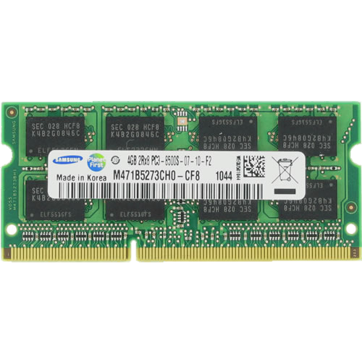
DRAM Organization
DRAM Bank
DRAM Cell
DRAM Row
Memory
Bus
CPU
Memory Controller
Sense Amplifier
Notes:
Here I show a typical system with a CPU and a DRAM module that has several DRAM chips.
Inside a DRAM chip, [CLICK] there are multiple banks, which contain many DRAM cells organized as a two-dimensional array. [CLICK] A DRAM cell stores a single bit of information as electrical charge. In a bank, [CLICK]
the cells are vertically connected to sense amplifiers, which can read the data from the cells and update it if needed. [CLICK] And cells are organized horizontally as DRAM rows.

Slide 20

Accessing DRAM
DRAM Bank
DRAM Cell
Activate
DRAM Row
Precharge
Read/Write
Sense Amplifier
Notes:
Now, lets look at DRAM commands that the memory controller issues to access the DRAM.
To perform an access, [CLICK] the memory controller first activates (or opens) a row by issuing an activate command.
[CLICK] The activate command loads row’s data into the sense amplifiers, where the data can be accessed.
[CLICK] After the row is accessed, the memory controller issues [CLICK] a precharge command to close an open row so that a new row can be activated.
This is basically how DRAM is accessed.

Slide 21
DRAM Cell Leakage
Each cell encodes information in leaky capacitors
wordline
access
transistor
charge
leakage
paths
capacitor
bitline
Stored data is corrupted if too much charge leaks (i.e., the capacitor voltage degrades too much)
[Patel+, ISCA’17]
Notes:
Each DRAM cell encodes data in fundamentally leaky capacitors [CLICK] Here is a simplified diagram of a DRAM cell, where the capacitor in red stores the data and the access transistor gates access to the data
[CLICK]
There are a number of leakage paths by which charge can enter or exit the capacitor.
[CLICK]
The important thing to note is that stored data can be corrupted if too much charge leaks
Which is the same as saying if the capacitor voltage degrades too much

Slide 22
DRAM Refresh
Refresh Operations
Refresh Window
100%
Vmin
Capacitor voltage (Vdd)
0%
REF
time
REF
REF
Periodic refresh operations preserve stored data
[Patel+, ISCA’17]
Notes:
Here, we have a simplified diagram of the capacitor voltage over time
[CLICK] We see that the voltage decreases over time in an exponential decay.
There’s a threshold Vmin under which we can no longer guarantee that we will correctly read the data that was originally stored in the cell.
[CLICK]
As long as a cell’s voltage remains above this line, we consider this a retention success.
[CLICK]
However, as soon as the voltage drops below Vmin, we consider this a retention failure
In order to prevent failures from charge leakage known as retention failures, [CLICK] periodic refresh operations are issued to recharge the capacitor voltage. [CLICK] The interval between refresh commands are referred to as the refresh window.

Slide 23
Row Scout (RS)
Goal: Identify a list of useful DRAM rows and their retention times
Row Scout must find:
Rows with consistent* retention times
  To correctly infer whether a row has been refreshed
Multiple rows that are located at certain configurable distances and have the same retention time (i.e., Row Group)
  To observe whether TRR can refresh multiple rows at the same time
* The retention time of a DRAM row may change over time due to Variable Retention Time (VRT) effects
Notes:
I will describe the two components of U-TRR in more detail.
[CLICK] The goal of Row Scout is to identify a list of DRAM rows, which must be useful for TRR Analyzer, and the retention times of these rows
[CLICK] Row Scout must find [CLICK] rows with consistent retention times. This is critical for U-TRR to correctly infer whether or not a row has been refreshed by a TRR-induced refresh operation. Row Scout must find DRAM rows whose retention time do not change over time due to Variable Retention Time (VRT) effects
[CLICK] Row Scout must also find multiple rows, or a row group, that are located at certain configurable distances and have the same retention time.
This is required so U-TRR can observe whether or not a TRR mechanism can refresh multiple potentially victim rows at the same time

Slide 24
Row Scout (RS) Operation
Profiling the retention time of a DRAM row:
write data
wait for T
check for retention bit flips
V
V
V
Row Group:
Notes:
I will now explain the Row Scout operation using a flow chart.
[CLICK] First, Row Scout searches for DRAM rows that have retention time T.
[CLICK] Row Scout profiles the retention time of a DRAM row by simply initializing a row with known data pattern (such as all ones) and measuring for how long the row correctly retains its data without being refreshed for time interval T.
Step 1 outputs addresses of rows with retention time T, which is initially set to a small value, for example 100 ms, with the aim to minimize how long U-TRR experiments take. This is because the time that U-TRR experiments take largely depends on the retention times of the rows that Row Scout finds.
[CLICK] Second, Row Scout puts together rows that have certain row address distances among them, as indicated [CLICK] by the configuration parameter we call row group layout. Here is an example of a row group that has three rows indicated by V that are one row address apart. Depending on how many rows are found in step 1 and how many of them can be combined to match the row group layout, step 2 outputs a set of candidate row groups.
[CLICK] Next, if the candidate row groups are fewer than needed, [CLICK] Row Scout increases T by a certain amount and returns to step 1. If the candidate row groups are enough, [CLICK] Row Scout repeatedly profiles the retention times of the rows in the candidate row groups for many iterations. This is to verify that all rows in a row group have consistent retention times and do not experience Variable Retention Time effects. Candidate row groups that have consistent retention times are output as row groups and the rest of the candidate row groups are discarded.
[CLICK] If the number of retention time verified rows is not enough, [CLICK] Row Scout returns to step 1 to find rows with increased retention time T.
[CLICK] These steps repeat as I explained until Row Scout finds a sufficient number of row groups and finally Row Scout outputs a list of the retention profiled rows to be used by the TRR Analyzer

Slide 25
TRR Analyzer (TRR-A)
Goal: Use RS-provided rows to determine when TRR refreshes a victim row
High-level Operation:
  Run a certain DRAM access pattern (i.e., RowHammer attack)
  Monitor retention failures in RS-provided rows to determine when TRR refreshes any of these rows
  Develop an understanding of the underlying TRR operation
Notes:
I will now describe the operation of TRR Analyzer
[CLICK] The goal of TRR Analyzer is to use Row Scout provided rows to determine when TRR refreshes a victim row
[CLICK] At a high-level, TRR Analyzer operates in three steps. It runs a certain DRAM access pattern or we can call it a RowHammer attack. [CLICK] Second, TRR Analyzer monitors the retention failures that Row Scout-provided rows experience to determine when TRR refreshes any of these rows.
[CLICK] Third, based on when and which of the Row Scout provided rows are refreshed by TRR, the user develops an understanding of the underlying TRR operation.

Slide 26


TRR Analyzer (TRR-A) Operation
Expecting no
retention failures in V
Expecting retention failures in V
T/2
T
V
V
A
V
Row Group:
A
V: victim (RS-provided) rows
A: aggressor rows
D: dummy rows
TRR-A helps to understand how TRR operates based on when Retention Profiled Rows are refreshed by TRR
Notes:
I will now describe a general TRR Analyzer experiment.
[CLICK] As the first step, TRR Analyzer initializes the retention profiled rows with known data. In this step, TRR Analyzer also initializes the aggressor rows that the user can specify to hammer in later steps of the experiment.
The user specifies aggressor rows in locations relative to the retention profiled rows. For example, [CLICK] assume a row group with three retention profiled rows denoted as victim rows using V, where the victim rows are one row apart. [CLICK] The user may specify an aggressor row between the first two victim rows. Hammering the aggressor row would mostly disturb the two victim rows immediately adjacent to the aggressor row. This is called single-sided RowHammer. Or, [CLICK] the user can specify two aggressor rows, to perform double-sided rowhammer as shown, and hammering both aggressor rows would disturb all three victim rows while having the greatest effect on the middle victim row.
[CLICK] Second, TRR Analyzer performs a set of operations to reset the internal state of the TRR mechanism so that it isolates the experiment about to be run from the prior experiments that could have potentially changed TRR mechanism’s state. This step is optional and we provide more details in the paper on why this step is sometimes needed and how we reset TRR’s internal state.
[CLICK] If TRR Analyzer does not activate any of the victim rows for their profiled retention time T, [CLICK] we expect to see bit flips due to retention failures in these rows once we read their data back.
[CLICK] In order to make TRR perform a TRR-induced refresh operation, the DRAM has to receive a REFRESH command. TRR Analyzer issues REFRESH commands when the victim rows [CLICK] are not refreshed for half of T. This is to ensure that [CLICK] a victim row retains its data correctly until it is potentially refreshed by a TRR-induced refresh and similarly [CLICK] it correctly retains its data after a TRR-induced refresh until TRR Analyzer reads row’s data.
[CLICK] To analyze how accessing the aggressor rows affect the rows that TRR detects as aggressors, TRR Analyzer activates and precharges (or simply hammers) the aggressor rows. By hammering an aggressor row with individual hammer count, TRR Analyzer can understand how the hammers affect the decisions of TRR on which rows to refresh. Along with the aggressor rows, TRR Analyzer can also hammer dummy rows to analyze how to make the aggressors undetected by TRR. A dummy row is simply a randomly selected row in the same bank that is not an aggressor or a victim row.
[CLICK] TRR Analyzer provides various configuration parameters to study different access patterns. We discuss these parameters in our paper.
[CLICK] Overall, the TRR Analyzer user understands how a certain TRR mechanism operates based on when the TRR mechanism refreshes which of the Retention-profiled rows.

Slide 27
Key Observations: Vendor A
Refresh Types:
Regular Refresh (RR)
TRR-capable Refresh (TREF₁ and TREF₂)
TREF₁
TREF₂
…
time
RR
RR
RR
RR
RR
RR
RR
RR
RR
RR
RR
RR
RR
RR
RR
RR
8x regular refresh
8x regular refresh
Observation: TRR tracks potentially aggressor rows using a Counter Table
TREF₁: Refreshes the victims of row ID with the largest counter value
Counter Table
TREF₂
pointer
row ID
counter value
row ID
counter value
…
16 entries
TREF ₂: Refreshes the victims of
row ID that TREF₂ pointer refers to
row ID
counter value
Notes:
Let’s look one-by-one at the key observations we make regarding each vendor’s TRR implementation. In this talk, I will omit the details about how we used U-TRR to make these observation but you can find those in the paper. I will also talk about one particular TRR mechanism from each vendor, but we found small differences in the TRR mechanism of modules manufactured at different times by the same vendor.
Let’s start with Vendor A.
[CLICK] Vendor A performs 3 types of refresh operations. It performs regular refresh that every DDR4 DRAM does. In addition, the TRR mechanism performs two variation of TRR-capable Refresh commands, we refer to these as TREF1 and TREF2.
[CLICK] In this timeline, each tick represents a REFRESH command that the memory controller periodically issues. [CLICK] During the first 8 REFRESH commands, the DRAM chip performs regular refresh operation. [CLICK] On the 9th REFRESH command, the TRR mechanism performs TRR-capable refresh TREF1, which I will explain shortly. [CLICK] The next 8 REFRESH commands are again used to perform regular refresh and [CLICK] they are followed by TREF2. Overall, the TRR mechanism uses every 9th REFRESH command to perform TREF1 and TREF2 in interleaved manner.
Let me explain the difference between TREF1 and TREF2.
[CLICK] We suspect that Vendor A’s TRR implements a Counter Table to keep track of repeatedly activated, potentially aggressor, rows. The table has 16 entries where each entry contains a row address and a counter value to indicate the accumulated hammer count of the corresponding row.
[CLICK] When performing TREF1, the TRR mechanism refreshes the neighbor rows of the row ID that corresponds to the largest value in the table.
[CLICK] On the other hand, TREF2 uses a pointer that indicates the row ID from the table to refresh its neighbors. After performing TREF2, the TREF2 pointer advances to the next entry in the table in circular manner.

Slide 28
Circumventing Vendor A’s TRR
Counter Table
Approach: Ensure an aggressor row
is discarded from the Counter Table
prior to a REF command
A₁
row ID
counter value
A₂
row ID
counter value
…
16 entries
row ID
counter value
RR
TREF₁
TREF₂
…
REF
ACT ([A₁, A₂])
ACT(D₁)
ACT(D₂)
ACT(D₁₆)
REF
N times
N+1 times
N+1 times
N+1 times
A_{i}: aggressor row
D_{i}: dummy row
[A1, A2] not refreshed by TRR
This RowHammer access pattern requires
synchronizing accesses with REF commands
Circumventing Vendor A’s TRR by discarding the actual aggressor rows from the Counter Table
Notes:
Based on these observations, we craft new RowHammer access patterns that circumvent the TRR mechanism of Vendor A.
[CLICK] Our approach in crafting a RowHammer access pattern is to aim for having the attacked aggressor row discarded from the Counter Table prior to a DRAM REFRESH command. With this, our goal is to let TREF1 and TREF2 pick any other row from the Counter Table but not the aggressor row that we actually hammer such that TRR cannot refresh these rows.
To this end, we craft the following access pattern. [CLICK] immediately after a REFRESH command, [CLICK] we hammer two rows A1 and A2 that are one row apart to perform double-sided RowHammer attack. We hammer each row N times.
[CLICK] Then, to discard A1 and A2 from the Counter Table, we hammer 16 different dummy rows N+1 times each. By hammering the dummy rows more than the aggressor rows, we make the TRR replace A1 and A2 in the Counter Table with the dummy rows. The maximum value of N depends on how many hammers can be performed during the time interval between two REFRESH commands.
[CLICK] Doing so, we prevent the TRR mechanism from detecting the aggressor rows since both TREF1 and TREF2 can detect a row from the Counter Table, which contains only dummy rows.
[CLICK] To execute this RowHammer access pattern, it is important to synchronize the accesses with the REFRESH commands to perform aggressor and dummy row hammers at the right time.
[CLICK] We conclude that one can circumvent Vendor A’s TRR mechanism by discarding the actual aggressor rows from the Counter Table by sufficiently hammering a set of dummy rows.

Slide 29
Key Observations: Vendor B
Refresh Types:
Regular Refresh (RR)
TRR-capable Refresh (TREF)
TREF
TREF
TREF
TREF
…
time
RR
RR
RR
RR
RR
RR
RR
RR
RR
RR
RR
RR
3x regular refresh
3x regular refresh
3x regular refresh
3x regular refresh
Observation 1: TRR probabilistically samples the address of an activated row
Observation 2: A newly-sampled row overwrites the previously-sampled one
TREF: Refreshes the victims of the last sampled row
Notes:
Now, let’s look at Vendor B’s TRR operation.
[CLICK] Different from Vendor A, here we observe a single type of TRR-capable refresh.
[CLICK] We observe that TRR-capable refresh commands are more frequent than those in Vendor A. A TRR-capable refresh happens on every 4th REFRESH command.
We make two key observations regarding how the TRR mechanism of Vendor B operates.
[CLICK] First, TRR probabilistically samples the address of an activated row as a potential aggressor row.
[CLICK] Second, a newly-sampled row overwrites the previously-sampled one, even if the neighbors of the previously-sampled row were not refreshed by TRR-induced refresh yet.
These two are the most relevant observations, but in the paper, we present more observations that helped circumvent the TRR mechanism of Vendor B.
[CLICK] Basically, a TRR-capable refresh command targets the row address that has been last sampled by the TRR mechanism.
This mechanism seems to assume that an aggressor row will be activated frequently enough such that TRR will sample the aggressor row with high probability, even if the probability of a single activation being sampled is relatively low.

Slide 30
Circumventing Vendor B’s TRR
Approach: Maximize the dummy row hammers after hammering the aggressor rows and before the next TREF
TREF
ACT ([A₁, A₂])
ACT(D₁)
TREF
N times
M times
[A1, A2] not refreshed by TRR
Circumventing Vendor B’s TRR by making it replace a sampled aggressor row by sampling a dummy row
Notes:
To circumvent the TRR mechanism of vendor B, [CLICK] our approach is to maximize the probability of having a sampled dummy row by hammering a dummy row as many times as possible before the subsequent TRR-capable refresh.
[CLICK] After a TRR-capable REFRESH command, [CLICK] we start with hammering the aggressor rows A1 and A2. Because the TRR mechanism could have sampled one of the aggressor rows, TRR could detect one of them if it gets the chance to perform a TRR-capable refresh. At this point, [CLICK] we hammer a dummy row many times in order to get the TRR mechanism sample another row activation and overwrite the previous sample which potentially includes one of the rows A1 and A2. As we hammer the dummy row more, we increase the probability of having the dummy row sampled, [CLICK] and detected by the following TRR-capable refresh. We sweep the hammer counts N and M to find the values that maximize the rowhammer bit flip count.
[CLICK] In conclusion, one can circumvent vendor B’s TRR by overwriting a sampled aggressor row by making the TRR mechanism sample a dummy row prior to a TRR-capable REFRESH command.

Slide 31
Key Observations: Vendor C
Refresh Types:
Regular Refresh (RR)
TRR-capable Refresh (TREF)
…
TREF
…
TREF
…
time
RR
RR
RR
RR
RR
RR
RR
RR
16x regular refresh
16x regular refresh
Observation 1: TRR detects an aggressor row only among the first 2K ACT commands issued after a TREF
Observation 2: Rows activated earlier within the 2K ACT commands are more likely to be detected by TRR
TREF: Detects an aggressor row only among the first 2K ACT commands while favoring the earlier activations more
Notes:
Let’s move on to Vendor C.
[CLICK] Vendor C performs regular refresh and one type of TRR-induced refresh.
[CLICK] Every 17th REFRESH command is TRR-capable.
Based on our analysis, we suspect that this TRR mechanism is more sophisticated compared to the other two vendors. It potentially uses a combination of both counter-based and sampler-based approaches. However, we make two key observations that helps us craft an effective RowHammer pattern.
[CLICK] We observe that TRR detects a row across only the first 2K row activations. Row activations performed after the first 2K activations evade the TRR mechanism.
[CLICK] We also observe that rows activated earlier within the 2K ACT commands are more likely to be detected by TRR
[CLICK] Basically, TRR probabilistically detects an aggressor row within the first 2K activations while favoring the earlier activations more.

Slide 32
Circumventing Vendor C’s TRR
Approach: Hammer dummy rows before aggressor rows to maximize the probability of TRR detecting a dummy row
TREF
ACT(D₁)
ACT([A₁, A₂])
TREF
N times
M times
[A1, A2] not refreshed by TRR
Circumventing Vendor C’s TRR by first hammering dummy rows to make aggressor rows less likely to be detected
Notes:
To circumvent the TRR mechanism of vendor C, [CLICK] our approach is to first activate dummy rows to maximize the probability of making TRR detect a dummy row instead of the aggressor rows that we hammer later.
In our access pattern [CLICK], after a TRR-capable refresh, [CLICK] we first hammer a dummy row. [CLICK] Then, we hammer the two aggressor rows A1 and A2 until the next TRR-capable refresh. [CLICK] The aggressor rows are less likely to be detected than the dummy rows, especially when we first perform a large number of dummy hammers.
[CLICK] In conclusion, one can circumvent Vendor C’s TRR by first hammering dummy rows to make the actual aggressor rows less likely to be detected by TRR

Slide 33
Can ECC Protect Against Our Access Patterns?
ECC DRAM Module
DATA
ECC METADATA
16 bits
16 bits
16 bits
16 bits
16 bits
2-byte
ECC symbol
10-byte
codeword
8-byte
dataword
corrects 1 bit/symbol
ECC Engine
detects 2 bits/symbols
Memory Controller
Notes:
The new RowHammer access patterns cause a lot of RowHammer bit flips. But can conventional DRAM ECC protect against those bit flips?
[CLICK] This is a simplified diagram of a DRAM module with ECC.
[CLICK] In this example, in addition to four DRAM chips that store data, a fifth chip stores redundant ECC data
[CLICK] Each chip provides 16 bits (or 2 bytes) data per cycle.
[CLICK] A 2-byte data chunk is called a symbol, [CLICK] all data symbols constitute an 8-byte dataword, and all symbols, [CLICK] including the ECC symbol, constitute a 10-byte codeword
[CLICK] The memory controller uses its ECC engine to decode incoming codewords.
[CLICK] When there are bit flips in the codeword, the conventional DRAM ECC can correct a single bit or it can be designed to correct a single symbol
[CLICK] The ECC engine can detect two bit errors (or 2 symbol errors), and the ECC engine cannot correct or detect 3 or more bit or symbol errors.

Slide 34
Conclusion
Target Row Refresh (TRR):
a set of obscure, undocumented, and proprietary RowHammer mitigation techniques
We cannot easily study the security properties of TRR
Is TRR fully secure? How can we validate its security guarantees?
U-TRR
A new methodology that leverages data retention failures to
uncover the inner workings of TRR and study its security
15x Vendor A
DDR4 modules
All 45 modules we test are vulnerable
15x Vendor B
DDR4 modules
99.9% of rows in a DRAM bank
experience at least one RowHammer bit flip
New RowHammer access patterns
15x Vendor C
DDR4 modules
U-TRR
Up to 7 RowHammer bit flips in
an 8-byte dataword, making ECC ineffective
TRR does not provide security against RowHammer
U-TRR can facilitate the development of new RowHammer attacks
and more secure RowHammer protection mechanisms
Notes:
CLICK] The RowHammer vulnerability of modern DRAM is a critical reliability and security threat.
[CLICK] The security guarantees of TRR, which is the commonly used RowHammer protection mechanism, cannot be easily studied as TRR is obscure, undocumented, and proprietary.
[CLICK] In this work, our main goal is to answer the following questions. Is TRR fully secure? How can we validate the security guarantees of different TRR mechanisms?
[CLICK] To this end, we propose U-TRR, a new methodology that leverages data retention failures in DRAM to uncover the inner workings of TRR and study its security.
[CLICK] Using U-TRR, we analyze 15 DDR4 DRAM modules from each of the three major DRAM vendors.
[CLICK] Through these analyses, we make several observations regarding the TRR mechanisms implemented in these modules and craft new custom RowHammer access patterns that cause RowHammer bit flips in TRR-protected DRAM modules.
[CLICK] Our results show that: First, all 45 modules that we test across three vendors are vulnerable to our new RowHammer access patterns.
[CLICK] Second, our access pattern cause at least one bit flip in almost all DRAM rows in many modules. This makes system-level RowHammer attacks easier to mount as the attacker would have the ability to cause bit flips in almost any DRAM row
[CLICK] Third, we observe that our access patterns cause up to 7 RowHammer bit flips in an 8-byte dataword, making ECC ineffective and systems equipped with ECC also susceptible to RowHammer attacks
[CLICK] We conclude that TRR does not provide security against RowHammer and can be easily circumvented using the new understanding provided by U-TRR.
[CLICK] We believe and hope that U-TRR will facilitate future research by enabling rigorous and open analysis of RowHammer mitigation mechanisms, leading to the development of both new RowHammer attacks and more secure RowHammer protection mechanisms.

Slide 35
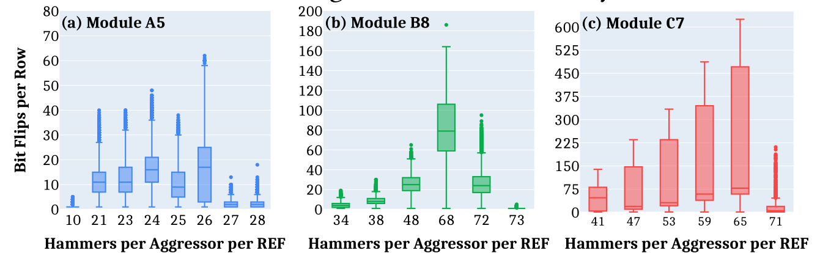
Hammer Count Sweep

Slide 36
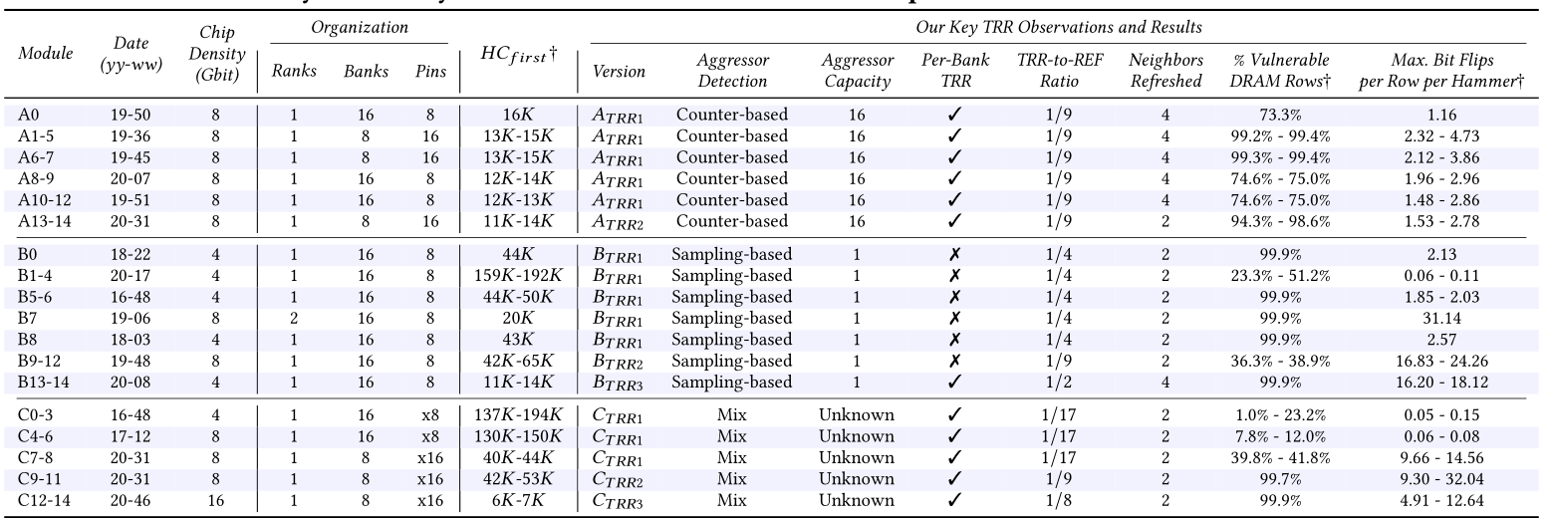
Summary of 45 DDR4 Modules

