Slide 1
Fast and Efficient Address Translation via Hybrid Restrictive & Flexible Virtual-to-Physical Address Mappings
UTOPIA
Konstantinos Kanellopoulos
Rahul Bera, Kosta Stojiljkovic, Nisa Bostanci, Can Firtina,
Rachata Ausavarungnirun, Rakesh Kumar, Nastaran Hajinazar,
Mohammad Sadrosadati, Nandita Vijaykumar, and Onur Mutlu

Slide 2
Executive Summary
Problem: Conventional virtual memory (VM) frameworks enable a virtual address to flexibly map to any physical address. This flexibility necessitates large translation structures leading to:
(1) high translation latency and (2) large translation-induced interference in the memory hierarchy
Motivation: Restricting the address mapping leads to compact translation structures and reduces the overheads of address translation. Doing so across the entire memory has two major drawbacks:
Limits core VM functionalities (e.g., data sharing)
Increases swapping activity in the presence of free physical memory
Key Idea: Utopia is a new hybrid virtual-to-physical address mapping scheme that allows both flexible and restrictive hash-based address mappings to harmoniously co-exist in the system
Utopia manages physical memory using two types of physical memory segments:
Restrictive Segment
Flexible Segment
Modulo Hash
X86-64 Radix PT
Page
Hash Function
Page
Page
Table
Fast Translation
Limited VM features
Slow Translation
Supports all VM features
Key Results: Outperforms (i) the state-of-the-art contiguity-aware translation scheme by 13%, and (ii) achieves 95% of the performance of an ideal perfect-TLB
https://github.com/CMU-SAFARI/Utopia

Slide 3
Talk Outline
Virtual Memory Background
Address Translation Overheads
Utopia: Hybrid Address Mappings
Utopia: Key Challenges
Evaluation Results

Slide 4
Talk Outline
Virtual Memory Background
Address Translation Overheads
Utopia: Hybrid Address Mappings
Utopia: Key Challenges
Evaluation Results

Slide 5
Virtual Memory Basics
A core feature of virtual memory management is that the mapping between virtual-to-physical pages is fully-associative
Virtual Address Space
Physical Address Space
Page Table
Perform Page Table Walk (PTW) to retrieve the mapping

Slide 6
Page Table Walk in x86-64
Virtual Address
PL3
PL4
PL2
PL1
9 bits
9 bits
9 bits
9 bits
CR3
Physical Frame Number

Slide 7
Page Table Walk in x86-64
Virtual Address
9 bits
9 bits
9 bits
9 bits
12 bits
1
2
3
4
Physical Frame Number
12 bits
Four sequential memory accesses
during a page table walk in x86-64

Slide 8
Architectural Support for VM
To send a memory request to the memory hierarchy, the processor needs to translate the virtual address to the corresponding physical
Resolving an address translation request requires accessing the Page Table
Modern processors employ a specialized hardware unit called Memory Management Unit (MMU) to accelerate address translation

Slide 9
Address Translation Flow (I)
Core
Memory Hierarchy
Page Table
Virtual
Address
Memory
Management Unit

Slide 10
Address Translation Flow (II)
Memory Management Unit
Memory Hierarchy
Unified
L2 TLB
L1 I-TLB
Miss
Page Walk Caches
Miss
Page Table
Virtual
Address
L1 D-TLB
Miss
Miss
Page Table Walker
Notes:
[1] There is a two level TLB-hierarchy.
[2] If we miss in the TLB, we trigger the page table walk
[3] We search in the page walk caches for intermediate levels

Slide 11
Address Translation Flow (III)
Physical Address Space
Memory
Management Unit
DRAM
Swap in
Page Table Entry
Swap
Space
Notes:
[1] If the physical page resides in the swap space, then it first needs be to be swapped into the DRAM before fetching it inside the cache hierarchy

Slide 12
Address Translation Flow (IV)
Core
Memory Hierarchy
Physical
Address
Memory
Management Unit

Slide 13
Talk Outline
Virtual Memory Background
Address Translation Overheads
Utopia: Hybrid Address Mappings
Utopia: Key Challenges
Evaluation Results

Slide 14
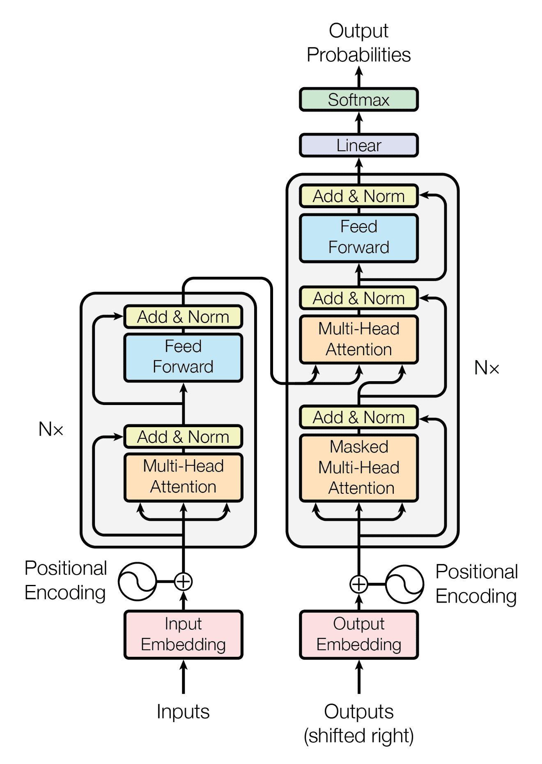
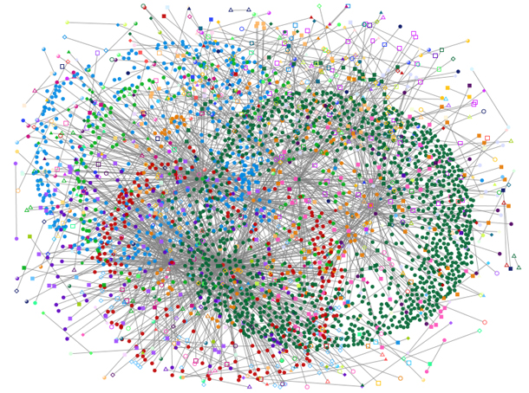
Data-Intensive Workloads
Generative AI
Graph Analytics
Bioinformatics
High address translation overheads

Slide 15
Address Translation Overhead
High-latency page table walks
Frequent page table walks

Slide 16
Address Translation Overhead
High latency
PTWs
Frequent
PTWs
+
High performance overheads
High interference in memory hierarchy

Slide 17
High Performance Overhead
State-of-the-art Page Table¹
Perfect TLB
31%
Completely avoiding address translation
leads on average to 31% higher performance
[1] Skarlatos et al. “Elastic Cuckoo Page Tables: Rethinking Virtual Memory
Translation for Parallelism” ASPLOS 2020

Slide 18
High Interference in Main Memory
30%
Completely avoiding address translation
leads to 30% fewer DRAM row buffer conflicts
[1] Skarlatos et al. “Elastic Cuckoo Page Tables: Rethinking Virtual Memory
Translation for Parallelism” ASPLOS 2020

Slide 19
Idea: Restricting VA-to-PA Mapping
Restrict the VA-to-PA mapping to
perform fast address translation^{1,2}
Virtual Address Space
Physical Address Space
..
0 0 0 0 0
0 0 1 0 1
Hash Mask 11100
0 0 0 0 0
Hash Function
0 0 1 1 0
0 0 0 1 0
0 0 1 1 1
..
..
..
[1] Picorel et al. “Near-Memory Address Translation” PACT 2017
[2] Gosakan et al. “Mosaic Pages: Big TLB Reach with Small Pages” ASPLOS 2023

Slide 20
Idea: Restricting VA-to-PA Mapping
Restrict the VA-to-PA mapping to
perform fast address translation^{1,2}
Virtual Address Space
Physical Address Space
..
0 0 1 0 1
Hash Mask 11100
Hash Function
0 0 1 1 0
0 0 0 1 0
0 0 1 1 1
..
[1] Picorel et al. “Near-Memory Address Translation” PACT 2016
[2] Gosakan et al. “Mosaic Pages: Big TLB Reach with Small Pages” ASPLOS 2023

Slide 21
Drawbacks of Restricting VA-to-PA Mapping
Employing a restrictive mapping across the entire memory comes with two key drawbacks:
Limits core VM functionalities such as data sharing
Increases swapping activity since the system cannot map virtual pages to free physical pages

Slide 22
Effect on Swapping Activity
Sole use of restrictive mapping leads to 2.37x higher swapping activity over the baseline

Slide 23
Our Goal
Design a virtual-to-physical address mapping scheme that:
Provides fast and efficient translation using a restrictive hash-based address mapping
Enjoys the benefits of the conventional fully-flexible address mapping

Slide 24
Talk Outline
Virtual Memory Background
Address Translation Overheads
Utopia: Hybrid Address Mappings
Utopia: Key Challenges
Evaluation Results

Slide 25
Utopia: Key Idea
We propose Utopia, a new virtual-to-physical mapping scheme that enables both:
Restrictive Mapping
Flexible Mapping
Harmoniously co-exist in the system

Slide 26
Utopia: Key Idea
Manage physical memory using two types of
physical memory segments:
Restrictive Segments
Flexible Segments

Slide 27
Utopia: Key Idea (I)
Restrictive Segment (RestSeg)
Restrictive Segments
Page
Page
Page
Page
Hash function
Flexible Segments
Virtual Page Number
Fast address translation
Limited VM functionalities

Slide 28
Utopia: Key Idea (II)
Flexible Segment (FlexSeg)
Flexible Segments
Page
Page
Page
Page
Page Table
Restrictive Segments
Virtual Page Number
Supports all conventional VM features
High-latency
address translation

Slide 29
RestSeg Properties
Structural Properties
Address Translation for Data in RestSeg

Slide 30
RestSeg Properties
Structural Properties
RestSeg is organized in
a set-associative manner
similar to how hardware caches operate

Slide 31
RestSeg: Structural Properties
Example: 2-way associative RestSeg with 2 sets
Set 0
Set 1
4KB
Page
4KB
Page
4KB
Page
4KB
Page
Way 0
Way 1
Way 0
Way 1
Set-associative design offers high flexibility

Slide 32
Multiple RestSegs in the System
RestSeg #1
RestSeg #2
4KB
Page
4KB
Page
4KB
Page
4KB
Page
2MB
Page
2MB
Page
Backward compatible with
large page mechanisms

Slide 33
RestSeg Properties
Structural Properties
Address Translation for Data in RestSeg

Slide 34
Restrictive Segment Walk (RSW)
RestSeg
Page
Page
Page
Page
Way 0
Way 1
Way 0
Way 1
Set 0
Set 1
Virtual Page

Slide 35
Restrictive Segment Walk (RSW)
RestSeg
Page
Page
Page
Page
Way 0
Way 1
Way 0
Way 1
Set 0
Set 1
How can we find out the physical location of the virtual page?
Virtual Page

Slide 36
RSW Operations
Tag Matching
1
Set Filtering
2

Slide 37
RestSeg: Tag Matching
Tag matching requires comparing the tags of all ways with the tag of the virtual page
Tag Array (TAR): Array that stores the tag of each entry
TAR
Tag
TAG
Virtual Address
Hash Function
Set 0
N/A
Set #
N/A
Set 1
N/A
Do we always have to do tag matching?

Slide 38
RestSeg: Set Filtering
Set Filtering: quickly discover if a set in the RestSeg is empty or not and filter tag mismatches
Set Filter (SF): Array of counters that keep track of the number of pages inside each set
SF
1
Virtual Address
Hash Function
Set #
Set 0
Tag Matching
0
Set 1

Slide 39
Address Translation in Utopia
System employs:
2 RestSegs, one for 4KB and one for 2MB pages
1 FlexSeg
RestSeg Walks
L1 TLB Miss
Page Table Walk
L2 TLB Access

Slide 40
Talk Outline
Virtual Memory Background
Address Translation Overheads
Utopia: Hybrid Address Mappings
Utopia: Key Challenges
Evaluation Results

Slide 41
Utopia: Key Challenges
Which data should be placed in the RestSeg?
How to maintain RestSegs in the system
How to integrate Utopia in the address translation pipeline

Slide 42
Utopia: Key Challenges
Which data should be placed in the RestSegs?
How to maintain RestSegs in the system
How to integrate Utopia in the address translation pipeline

Slide 43
Page Placement in RestSeg
Our goal is to place costly-to-translate pages into a RestSeg
We propose two techniques to perform data placement in Utopia:
Page-Fault-based Allocation Policy
PTW-Tracking-based Migration Policy

Slide 44
Page-Fault-Based Allocation Policy
On a page fault
the page is directly allocated in a RestSeg
Page Fault
What about costly-to-translate pages
that reside in a FlexSeg?
Allocate
RestSeg

Slide 45
PTW-Tracking-Based Migration Policy
Use unused bits of each PTE as a counter that tracks the number and cost of PTWs for each page
Page Table Entry
Unused bits
Physical Frame #
Metadata
PTE Counters
> Threshold
Migrate
RestSeg

Slide 46
Utopia: Three Key Challenges
Which data should be placed in the RestSegs?
How to maintain RestSegs in the system
How to integrate Utopia in the address translation pipeline

Slide 47
OS Support for Utopia
OS supports Utopia in three ways by handling:
Allocations in a RestSeg
Replacements in a RestSeg
Migrations to/from a RestSeg
Detailed description in the paper

Slide 48
Utopia: 3 Key Challenges
Which data should be placed in the RestSegs?
How to maintain RestSegs in the system
How to integrate Utopia in the address translation pipeline

Slide 49
RestSeg Walker in MMU
RestSeg Walker
Memory
Hierarchy
FSM
TAR Cache
SF Cache

Slide 50
MMU: Page inside RestSeg (I)
RestSeg Walker
FSM
TAR Cache
L1 TLB
Miss
SF Cache

Slide 51
MMU: Page inside RestSeg (I)
RestSeg Walker
FSM
TAR Cache
L1 TLB
Miss
SF Cache
L2
Unified
TLB

Slide 52
MMU: Page inside RestSeg (I)
RestSeg Walker
FSM
TAR Cache
L1 TLB
Miss
SF Cache
Stall
L2
Unified
TLB

Slide 53
MMU: Page inside RestSeg (I)
RestSeg Walker
FSM
Data in RestSeg
TAR Cache
L1 TLB
Miss
SF Cache
Stall

Slide 54
MMU: Page inside RestSeg (I)
RestSeg Walker
FSM
Data in RestSeg
TAR Cache
L1 TLB
Miss
SF Cache
FlexSeg Walker
Stall
FSM
PWCs

Slide 55
MMU: Page inside RestSeg (I)
RestSeg Walker
FSM
Data in RestSeg
TAR Cache
L1 TLB
Miss
SF Cache
FlexSeg Walker
Stall
FSM
PWCs

Slide 56
MMU: Page inside FlexSeg (II)
RestSeg Walker
FSM
TAR Cache
L1 TLB
Miss
SF Cache

Slide 57
MMU: Page inside FlexSeg (II)
RestSeg Walker
FSM
TAR Cache
L1 TLB
Miss
SF Cache
L2
Unified
TLB

Slide 58
MMU: Page inside FlexSeg (II)
RestSeg Walker
FSM
TAR Cache
L1 TLB
Miss
SF Cache
Stall
L2
Unified
TLB

Slide 59
MMU: Page inside FlexSeg (II)
RestSeg Walker
Data is not here
FSM
TAR Cache
L1 TLB
Miss
SF Cache
Stall
L2
Unified
TLB

Slide 60
MMU: Page inside FlexSeg (II)
RestSeg Walker
Data is not here
FSM
TAR Cache
L1 TLB
Miss
SF Cache
FlexSeg Walker
Stall
L2
Unified
TLB
FSM
PWCs

Slide 61
MMU: Page inside FlexSeg (II)
RestSeg Walker
Data is not here
FSM
TAR Cache
L1 TLB
Miss
SF Cache
Page Table Walker
Data is in FlexSeg
L2
Unified
TLB
FSM
PWCs

Slide 62
Area & Power Overhead
Area and power overhead evaluation using McPat
Comparison to a high-end Intel Raptor Lake
Utopia incurs 0.64% area and 0.72% power overhead per core

Slide 63
Talk Outline
Virtual Memory Background
Address Translation Overheads
Utopia: Hybrid Address Mappings
Utopia: Key Challenges
Evaluation Results

Slide 64
Evaluation Methodology
Sniper Multicore Simulator extended with:
Page table walker & page walk caches
Buddy allocator
Migration Latency
Our poster at MICRO 2023 SRC introduces
a new open-source simulation
framework for VM research
https://github.com/CMU-SAFARI/Virtuoso

Slide 65
Evaluation Methodology
Sniper Multicore Simulator extended with:
Page table walker & page walk caches
Buddy allocator
Migration Latency
Workloads: Executed for 500M instructions
GraphBIG: PR, BFS, BC, GC, CC
HPCC: Randacc
XSBench: Particle Simulation with 15K grid
DLRM: SLS-like
GenomicsBench: k-mer count

Slide 66
Evaluated Mechanisms
Baseline with Radix PT and Transparent Huge Pages enabled
POM-TLB¹: State-of-the art large software-managed TLB
ECH²: State-of-the-art hash-based page table
RMM³: Contiguity-aware address translation
Utopia: 512MB RestSegs (one for 4KB and one for 2MB pages)
P-TLB: Perfect L1 TLB (translation requests always hit in L1 TLB)
[1] Ryoo et al. “Rethinking TLB designs in virtualized environments: A very large part-of-memory TLB” ISCA ’17
[2] Skarlatos et al. “Elastic Cuckoo Page Tables: Rethinking Virtual Memory Translation for Parallelism” ASPLOS ‘20
[3] Karakostas et al. “Redundant memory mappings for fast access to large memories” ISCA ’15

Slide 67
Performance Results
13%
Utopia outperforms the second-best performing scheme (RMM) by 13% and Radix by 24%

Slide 68
Performance Results
Utopia outperforms the second-best performing scheme (RMM) by 13% and Radix by 24%
Utopia’s performance is within 95% of P-TLB

Slide 69
Translation Latency
Utopia reduces average translation latency by 63% over Radix and 14% over RMM

Slide 70
Main Memory Interference
Utopia reduces row buffer conflicts by 20%
over Radix and 9% less than P-TLB

Slide 71
More Results and Details in the Paper
Sensitivity across different hash functions
Sensitivity to parallel/serial TLB access and RSW
Sensitivity to RestSeg size
Reuse-level distribution of 4KB pages
Effect of migration to memory requests
TAR & SF cache hit rate
Overhead across different context-switch quanta
https://arxiv.org/abs/2211.12205

Slide 72
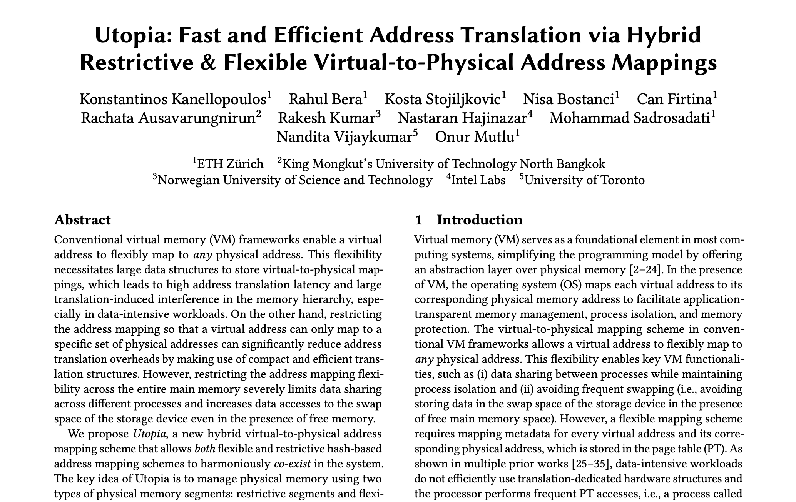
More Results and Details in the Paper
Sensitivity across different hash functions
Sensitivity to parallel/serial TLB access and RSW
Sensitivity to RestSeg size
Reuse-level distribution of 4KB pages
Effect of migration to memory requests
TAR & SF cache hit rate
Overhead across different context-switch quanta
https://arxiv.org/abs/2211.12205

Slide 73
Conclusion
We propose Utopia, a new virtual-to-physical mapping scheme that enables both:
Restrictive Mapping
Flexible Mapping
Harmoniously co-exist in the system
Utopia achieves (i) 13% higher performance than the state-of-the-art contiguity-aware translation scheme and (ii) 95% of the performance of an ideal perfect-TLB
Utopia is open source
https://github.com/CMU-SAFARI/Utopia

Slide 74
Fast and Efficient Address Translation via Hybrid Restrictive & Flexible Virtual-to-Physical Address Mappings
UTOPIA
https://github.com/CMU-SAFARI/Utopia
Konstantinos Kanellopoulos
Rahul Bera, Kosta Stojiljkovic, Nisa Bostanci, Can Firtina,
Rachata Ausavarungnirun, Rakesh Kumar, Nastaran Hajinazar,
Mohammad Sadrosadati, Nandita Vijaykumar, and Onur Mutlu

Slide 75
Address Translation Flow (III)
Translation Latency
Core
Memory Hierarchy
Hit in TLBs
Page Table
Virtual
Address
Memory
Management Unit

Slide 76
Virtual Memory Basics
Virtual Memory (VM) is one of the cornerstones
of most modern computing systems
Conventional VM designs provide :
Application-transparent memory management
Data sharing
Process isolation

Slide 77
Address Translation Flow (III)
Translation Latency
Core
TLB Miss
Memory Hierarchy
Page Table
Virtual
Address
Cache/DRAM Access
Memory
Management Unit

Slide 78
High Latency PTWs
Irregular Memory Access Patterns
Large
Datasets
Large and costly-to-access PT

Slide 79
Frequent PTWs
Even the largest 64K-entry L2 TLB
experiences 24 MPKI on average

Slide 80
High Latency PTWs
86 cycles on average to access
the state-of-the-art hash-based PT

Slide 81
OS: Allocation in RestSeg
VPN
Hash Function
Tag Array
There is a free way!
Store data there

Slide 82
OS: Allocation in RestSeg
VPN
Hash Function
Tag Array
Discover if there is a
free way in the set

Slide 83
OS: Replacement in RestSeg
VPN
Hash Function
Tag Array
No way is free!
If no page-fault,
evict a page!

Slide 84
OS: Migration to/from RestSeg
DMA engine is responsible for migrating data between RestSegs and FlexSegs
FlexSeg
Migration
RestSeg
DMA Engine

Slide 85
Architectural Support for Utopia
New hardware components to support Utopia:
Specialized hardware circuitry to perform the tag matching and the set filtering
- Avoid expensive software-based accesses to translation structures
Small caches for the the Tag Array and Set Filter
- Accesses to Permissions Filter and Tag Array may exhibit high spatial and temporal locality
Minor modifications in the address translation pipeline:
- RSW occurs in parallel with L2 TLB access

