Slide 1
Variable Read Disturbance (VRD) An Experimental Analysis of Temporal Variation in DRAM Read Disturbance
Ataberk Olgun, F. Nisa Bostancı, İsmail Emir Yüksel Oğuzhan Canpolat, Haocong Luo, Geraldo F. Oliveira A. Giray Yağlıkçı, Minesh Patel, Onur Mutlu
https://arxiv.org/pdf/2502.13075
Notes:
Hello everyone. I am Ataberk and I am very happy to present our work: “Variable Read Disturbance: An Experimental Analysis of Temporal Variation in DRAM Read Disturbance”

Slide 2
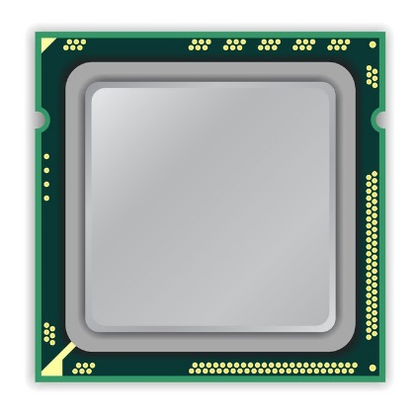
A Typical DRAM-Based Computing System
DRAM Chip
CPU
DRAM Module
Notes:
This is a typical DRAM-based computing system with a CPU [CLICK] and a DRAM module with multiple DRAM chips.

Slide 3
DRAM Organization
Subarray
Bitline
DRAM Cell
Bank
Wordline
…
Chip I/O
. . .
DRAM Row
…
…
…
…
…
Row Buffer
DRAM Chip
DRAM Bank
DRAM Subarray
Notes:
Each DRAM chip contains multiple banks
Each bank is composed of many subarrays [CLICK]
And within each subarray, there is a two dimensional array of DRAM cells. [CLICK]
These cells are organized into rows that are selected using wordlines [CLICK]
And the cells are connected to a row buffer via bitlines [CLICK]
To access data in a row, you need to activate the row and too many repeated activations can lead to

Slide 4
Read Disturbance in DRAM (I)
Read disturbance in DRAM breaks memory isolation
Prominent example: RowHammer
DRAM Subarray
Row 1
Row 1
Row 1
Victim Row
Row 2
Row 2
Row 2
Row 2
Row 2
Row 2
open
open
Aggressor Row
closed
open
closed
Row 3
Row 3
Row 3
Victim Row
Repeatedly opening (activating) and closing a DRAM row many times causes RowHammer bitflips in adjacent rows
[Kim+, ISCA’14]
Notes:
… read disturbance bitflips. Read disturbance bitflips have significant system-level implications because they break memory isolation.
[CLICK] A prominent example of read disturbance is RowHammer.
[CLICKx9] Repeatedly activating and closing a DRAM row many times causes RowHammer bitflips in adjacent rows
We call the repeatedly activated row the aggressor row and the rows that have bitflips victim rows.
That’s RowHammer…

Slide 5
Read Disturbance in DRAM (II)
Read disturbance in DRAM breaks memory isolation
A new read disturbance phenomenon: RowPress
DRAM Subarray
Row 1
Row 1
Row 1
Victim Row
Row 2
Row 2
Row 2
Row 2
Row 2
Row 2
open
open
Aggressor Row
closed
open
keep open
Row 3
Row 3
Row 3
Victim Row
Keeping a DRAM row open for a long time causes bitflips in adjacent rows
[Luo+, ISCA’23]
Notes:
…, but there is also RowPress.
[Click]
RowPress induces bitflips by keeping the aggressor row open for a very long time.

Slide 6
Read Disturbance Solutions
There are many solutions to mitigate read disturbance bitflips
More robust DRAM chips and/or error-correcting codes
Increased refresh rate
Physical isolation
Row remapping
Preventive refresh
Proactive throttling
Each solution offers a different system design point in reliability, performance, energy, and area tradeoff space
Notes:
[CLICKx6 as you talk] Prior works proposed many techniques to mitigate read disturbance bitflips and maintain system robustness and security.
[CLICK] Many different techniques are valuable as each technique comes with a different reliability, performance, energy, and area tradeoff.

Slide 7
The Read Disturbance Threshold (RDT)
Many secure read disturbance solutions take a preventive action before a bitflip manifests
E.g., preventively refresh a victim row
Must accurately quantify the amount of disturbance that a row can withstand before experiencing a bitflip
Typically identified by testing for read disturbance failures
Read Disturbance Threshold (RDT): The number of aggressor row activations needed to induce the first bitflip
Notes:
Regardless, a *common* operation pattern across many different solutions is that they take *an action* before a bitflip manifests. For example, refreshing a victim row.
[CLICK] To do so, they *must accurately quantify* the amount of disturbance a row can withstand before it experiences a bitflip. [CLICK] This is typically quantified by time-intensive testing for read disturbance failures.
[CLICK] The read disturbance threshold, or RDT for short, quantifies the amount of disturbance a row can withstand before it experiences a bitflip. This metric is typically expressed in terms of an activation count.

Slide 8
Accurate Identification of Read Disturbance Threshold is Critical for System Security and Performance
RDT underestimated High overhead Secure
(e.g., 20)
RDT overestimated Insecure Low overhead (e.g., 10,000)
Ground truth RDT (e.g., 1,000)
Performance and Energy Overhead
Configured RDT for the Mitigation Technique
To securely prevent bitflips at low overhead RDT must be accurately identified and carefully configured
Notes:
Now I will try to illustrate [CLICK] why it is important to *accurately identify RDT*.
[CLICK] The x-axis shows increasing RDT values in arbitrary units
[CLICK] and the y-axis shows performance and energy overheads in arbitrary units.
[CLICK] This is a curve you’d expect to see: as the RDT becomes smaller, read disturbance solutions induce more performance and energy overheads, for example by more frequently performing time- and energy-intensive preventive refresh operations.
[CLICK] If you have this ground truth RDT value for the row, you want to configure your solution with that exact RDT value, why?
[CLICK] because if you configure it with a higher value you cannot mitigate bitflips and your system is no longer secure
[CLICK] and if you are overly conservative you incur unnecessary performance and energy overheads
[CLICK] In summary, we must accurately identify RDT to securely prevent bitflips at low overhead

Slide 9
Variable Read Disturbance (VRD) Summary
Research Question
How accurately and efficiently can we measure the read disturbance threshold (RDT) of each DRAM row?
Experimental Characterization
Record >100M RDT measurements across 3750 rows and many test parameters (e.g., temperature, data pattern) in 160 DDR4 and 4 HBM2 chips
Key Observations
RDT changes significantly and unpredictably over time: VRD
Maximum observed RDT is 3.5X higher than minimum (for a row)
Smallest RDT (for a row) may appear after 94,467 measurements
Implications for System Security and Robustness
RDT cannot be accurately identified quickly
Given our limited dataset, guardbands (>10%) and ECC (SECDED or Chipkill) may prevent VRD-induced bitflips at significant performance cost
More data and analyses needed to make definitive conclusion
Call for future work on understanding and efficiently mitigating VRD
Notes:
[CLICK] Our work tries to answer a key question about the read disturbance threshold: “How accurately and efficiently can we measure the read disturbance threshold of each DRAM row?”
[CLICK] We record more than a hundred million read disturbance threshold measurements across many rows in many DRAM chips
[CLICK] We find that the read disturbance threshold of a DRAM row varies significantly and unpredictably over time.
[CLICK] The largest RDT observed for a DRAM row can be 3.5 times the smallest observed for the same row, and
[CLICK] a row’s smallest RDT may appear after 94 thousand measurements We call this new phenomenon Variable Read Disturbance.
[CLICK] Variable read disturbance has implications for system security and robustness because the RDT of a row cannot be quickly and accurately identified.
[CLICK] We evaluate using guardbands for RDT and error-correcting codes as a solution for VRD-induced bitflips: **Given our limited dataset of bitflip locations** we find that relatively large guardbands and ECC could prevent VRD-induced bitflips at significant performance cost.
[CLICK] But more data and analyses are needed to make a definitive conclusion
[CLICK] Our results call for future work on understanding and efficiently mitigating VRD.

Slide 10
Talk Outline
Motivation
Experimental Characterization Methodology
Foundational Results
In-Depth Analysis of VRD
Implications for System Security and Robustness
Conclusion
Notes:
Here is the outline for the rest of the talk

Slide 11
Talk Outline
Motivation
Experimental Characterization Methodology
Foundational Results
In-Depth Analysis of VRD
Implications for System Security and Robustness
Conclusion
Notes:
I will continue by motivating our study

Slide 12
Motivation
Technology Scaling
DRAM chips are increasingly more vulnerable to read disturbance with technology scaling
[Yaglikci+, HPCA’24]
Notes:
Read disturbance bitflips happen in more DRAM cells with fewer activations as DRAM technology scales to smaller sizes to satisfy our memory requirements.
[CLICK] We see more than 10X reduction in the read disturbance threshold between chips manufactured approximately 7 years apart.
[CLICK] Thus, DRAM chips become more vulnerable to read disturbance with technology scaling.

Slide 13
Motivation
DRAM read disturbance worsens as DRAM chip density increases
Existing solutions become more aggressive
Aggressive preventive actions make existing solutions prohibitively expensive
Notes:
Reducing read disturbance thresholds, or, worsening read disturbance [CLICK] causes existing mitigations to become more aggressive, [CLICK] and in turn, induce higher overheads

Slide 14
Motivation
RDT underestimated High overhead Secure
(e.g., 20)
RDT overestimated Insecure Low overhead (e.g., 10,000)
Ground truth RDT (e.g., 1,000)
Performance and Energy Overhead
Configured RDT for the Mitigation Technique
Prior works assume that the ground truth Read Disturbance Threshold (RDT) can be identified
Notes:
Moreover [CLICKx2], prior works assume that the ground truth read disturbance threshold can be identified
In our work, we challenge this assumption…

Slide 15
Problem
No prior work rigorously studies
temporal variation of
DRAM read disturbance threshold
&
implications for future solutions
Notes:
And we see that no prior work studies the temporal variation of DRAM read disturbance
and its implications for future solutions

Slide 16
Our Goal
Answer two research questions:
Analyze implications for read disturbance solutions
1
Does RDT change over time?
2
How reliably and efficiently can RDT be measured?
Notes:
Our goal is twofold:
First we’d like to answer two research questions: [CLICK] Does the read disturbance threshold change over time? [CLICK] If so, how reliably and efficiently can we measure it?
[CLICK] Second, we’d like to analyze implications of temporal variation of read disturbance threshold for read disturbance solutions.

Slide 17
Talk Outline
Motivation
Experimental Characterization Methodology
Foundational Results
In-Depth Analysis of VRD
Implications for System Security and Robustness
Conclusion
Notes:
To achieve our goals, we experimentally characterize DRAM chips

Slide 18
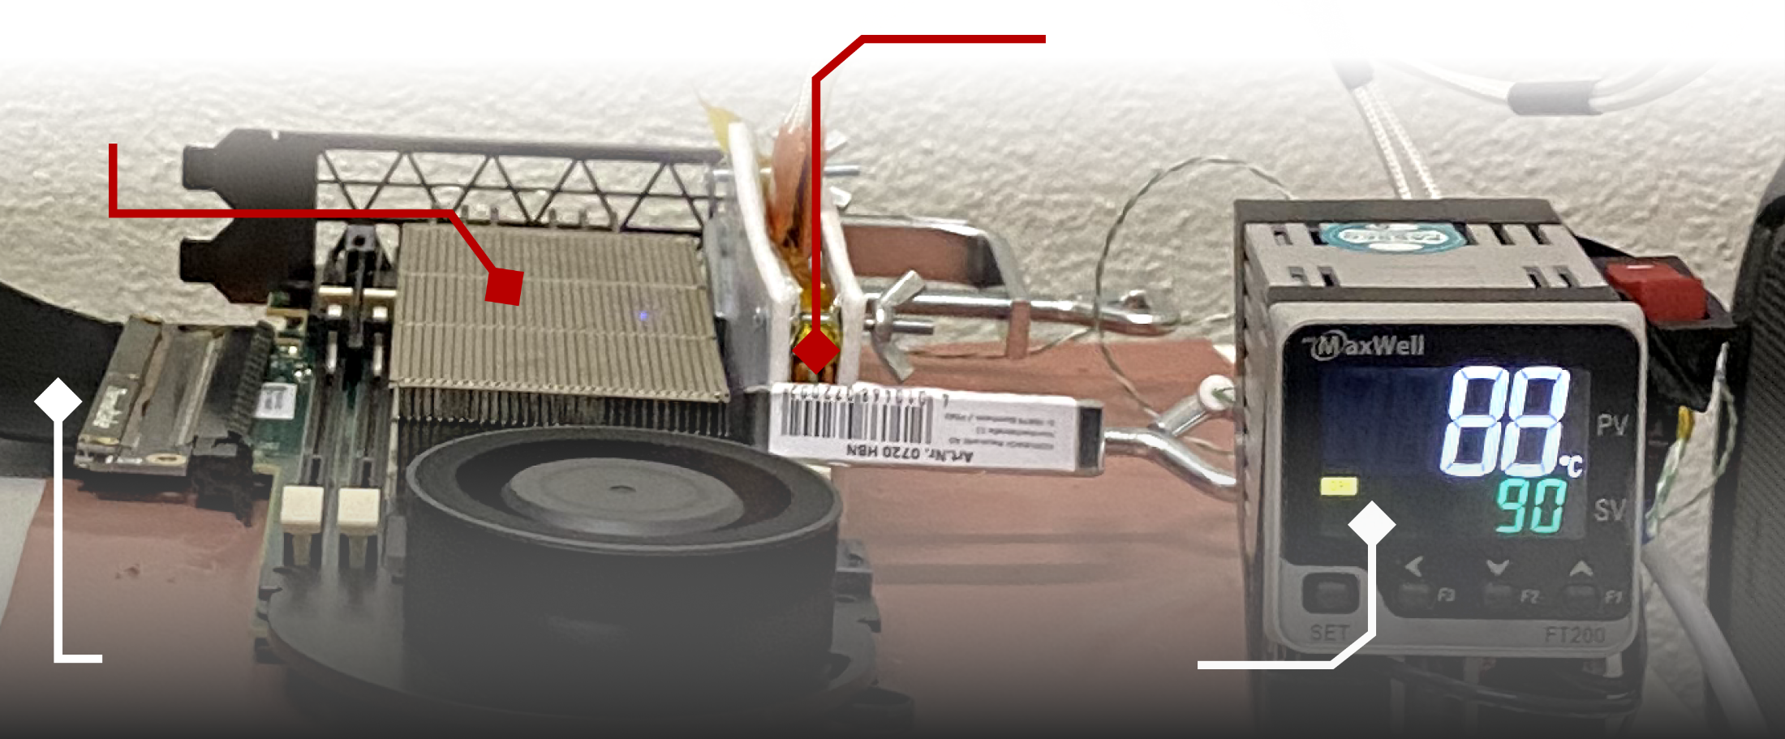
DDR4 DRAM Testing Infrastructure
DRAM Bender on a Xilinx Virtex UltraScale+ XCU200
Xilinx Alveo U200 FPGA Board (programmed with DRAM Bender*)
DRAM Module with Heaters
PCIe
Host Interface
MaxWell FT200 Temperature Controller
Fine-grained control over DRAM commands,
timing parameters (±1.5ns), and temperature (±0.5°C )
*Olgun et al., "DRAM Bender: An Extensible and Versatile FPGA-Based Infrastructure to Easily Test State-of-the-Art DRAM Chips,” TCAD, 2023. [GitHub: https://github.com/CMU-SAFARI/DRAM-Bender]
Notes:
We use DRAM Bender to test DDR4 DRAM modules [CLICK]
This infrastructure provides us with fine-grained control over DRAM commands, timing parameters, and temperature

Slide 19
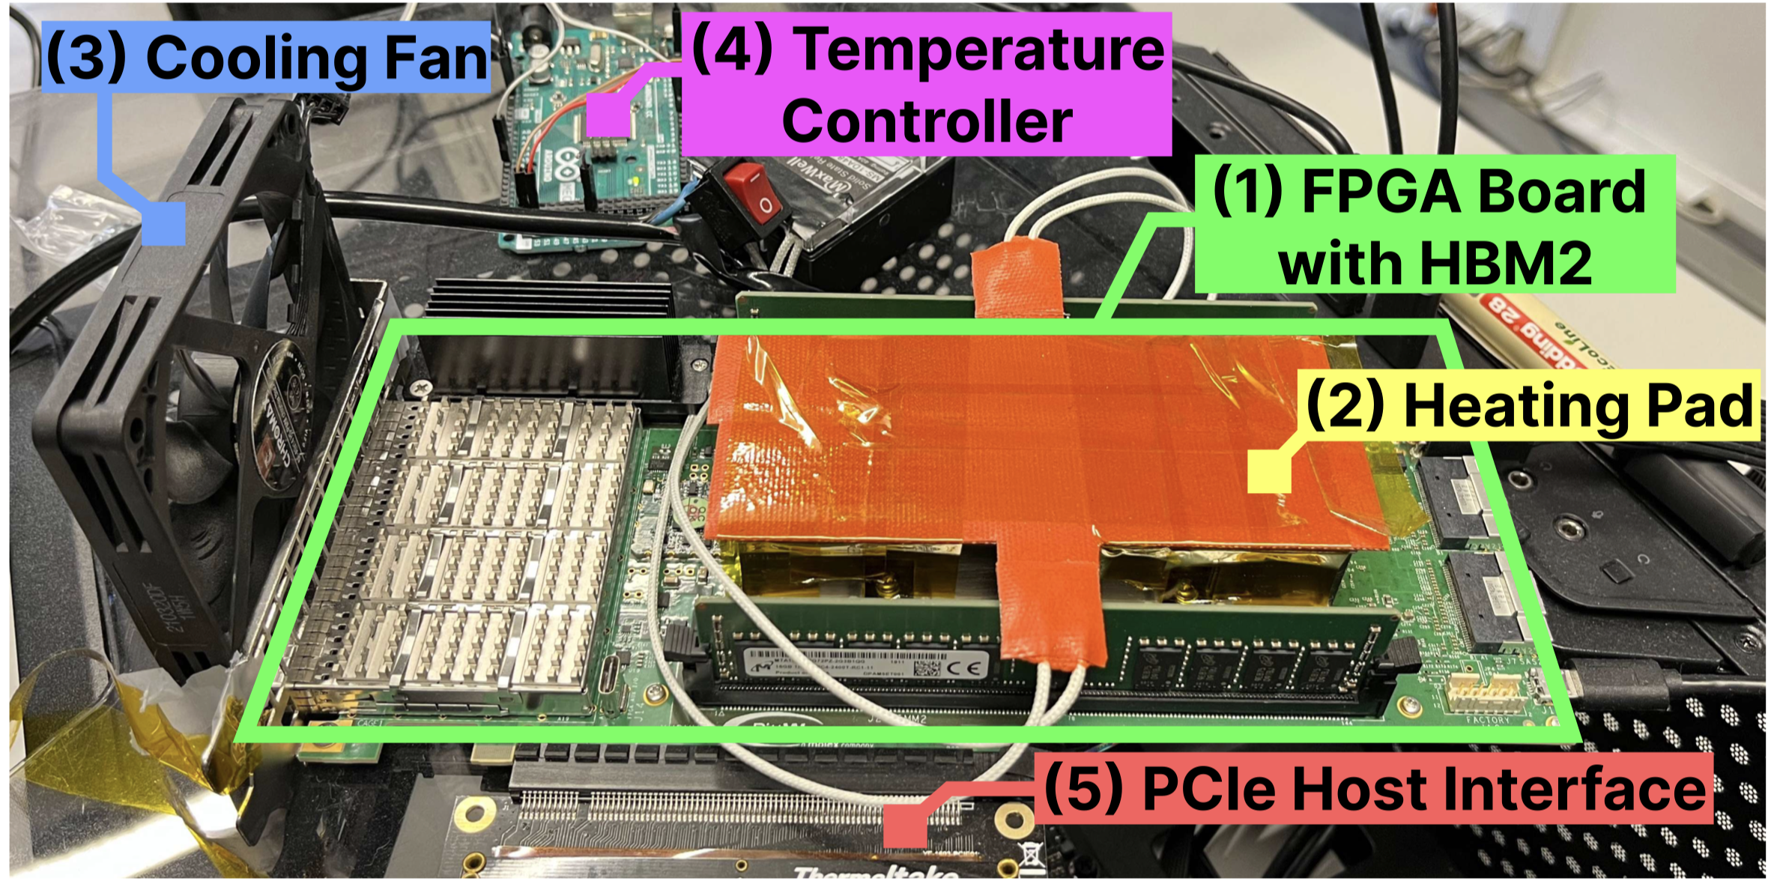
HBM2 DRAM Testing Infrastructure
DRAM Bender on a Bittware XUPVVH
Fine-grained control over DRAM commands,
timing parameters (±1.67ns), and temperature (±0.5°C )
*Olgun et al., "DRAM Bender: An Extensible and Versatile FPGA-Based Infrastructure to Easily Test State-of-the-Art DRAM Chips,” TCAD, 2023. [GitHub: https://github.com/CMU-SAFARI/DRAM-Bender]
Notes:
This is another version of the same infrastructure we use to test HBM2 DRAM chips.

Slide 20
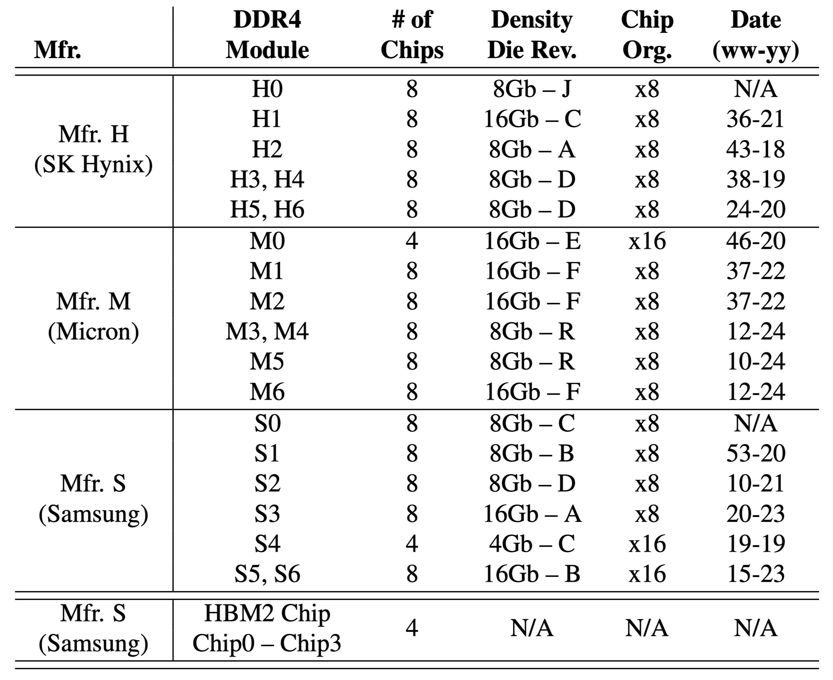
Tested DRAM Chips
160 DDR4 and 4 HBM2 Chips from SK Hynix, Micron, Samsung
Notes:
We test many DRAM chips from three major DRAM manufacturers spanning
[CLICK] various die density and die revisions and chip organizations.

Slide 21
Testing Methodology
To characterize our DRAM chips at worst-case conditions:
Prevent sources of interference during core test loop
No DRAM refresh: to avoid refreshing victim row
No read disturbance mitigation mechanisms: to observe circuit-level effects
No error correcting codes (ECC): to observe all bitflips
Test for less than a refresh window (32ms) to avoid retention failures
Worst-case read disturbance access sequence
We use worst-case read disturbance access sequence based on prior works’ observations
Double-sided read disturbance: repeatedly access the two physically-adjacent rows
1 hammer
Aggressor Row 1
Open-close
Record bitflips in victim
Victim Row
Aggressor Row 2
Open-close
Notes:
[CLICK x7 as you say below]
We carefully re-use the rigorous read disturbance characterization methodology as done by prior work where we prevent sources of interference and use the worst-case double-sided read disturbance access patterns.
The bottom figure depicts [CLICK] one hammer. Opening and closing the two neighbors of a victim row constitutes one hammer.

Slide 22
Talk Outline
Motivation
Experimental Characterization Methodology
Foundational Results
In-Depth Analysis of VRD
Implications for System Security and Robustness
Conclusion
Notes:
Now, I will describe our major results…

Slide 23
Foundational Results: Key Takeaway
Key Takeaway
The Read Disturbance Threshold (RDT) of a row changes randomly and unpredictably over time
Accurately identifying RDT is challenging
Notes:
… starting with this takeaway message.
We find that the read disturbance threshold of a row changes randomly and unpredictably over time.
This makes accurately identifying RDT very challenging.

Slide 24
Read Disturbance Threshold Changes Over Time
Read Disturbance Threshold
37360 hammers
Measurement Number
Notes:
[CLICKx2] We plot the read disturbance threshold values observed
[CLICK] across many read disturbance threshold measurements (or samples, or observations) for one DRAM row
[CLICK] Here is an example point in the plot describing a measurement [CLICK] that yields a read disturbance threshold value of 37K hammers

Slide 25
Read Disturbance Threshold Changes Over Time
Read Disturbance Threshold
Measurement Number
Notes:
Here are the RDT values across 5 measurements

Slide 26
Read Disturbance Threshold Changes Over Time
Read Disturbance Threshold
Measurement Number
Notes:
Here is across 1000. To expand the x-axis further and still make sense out of the plot…

Slide 27
Read Disturbance Threshold Changes Over Time
Maximum
Read Disturbance Threshold
Average
Minimum
Measurement Number
Notes:
We “compress” a series of 1000 measurements into this form: circle shows the average across 1000 measurements and error bars show the range of values

Slide 28
Read Disturbance Threshold Changes Over Time
Read Disturbance Threshold
Measurement Number
Notes:
Now, here is RDT across one hundred thousand measurements for one DRAM row.

Slide 29
Read Disturbance Threshold Changes Over Time
Read Disturbance Threshold
Minimum RDT at 16926th measurement
Measurement Number
Notes:
We observe that for this series of RDT measurements, the minimum RDT appears at around 17 thousand measurements.

Slide 30
Read Disturbance Threshold Changes Over Time
Read Disturbance Threshold
Read Disturbance Threshold of a DRAM row varies over time: Variable Read Disturbance (VRD)
Notes:
This is a key result that demonstrates the variable read disturbance phenomenon

Slide 31
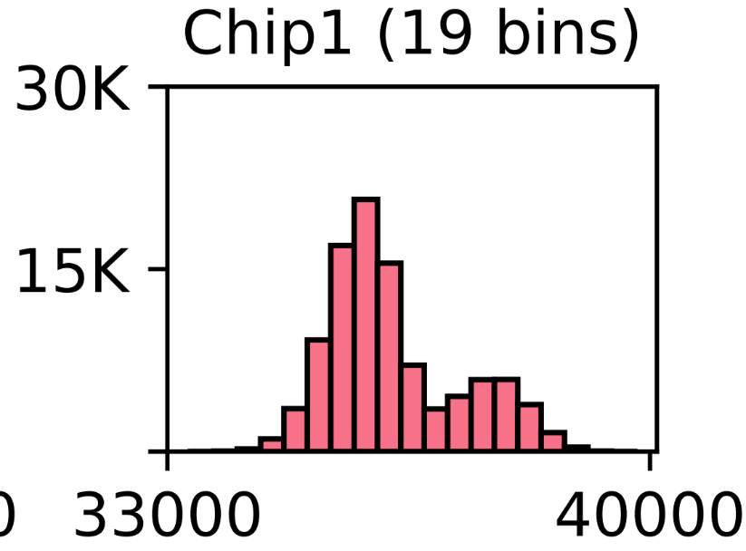
The RDT of a Row Has Multiple States
# of Measurements
Read Disturbance Threshold
The RDT of a row takes various different values across 100,000 measurements
Notes:
We also investigate the distribution of observed RDT values: [CLICK] Here we show a [CLICK] histogram of the RDT values where a bar’s height indicates the number of measurements that yield the RDT value shown on the x-axis.
[CLICK] We observe that [CLICK] the read disturbance threshold of a row takes various different values across one hundred thousand measurements

Slide 32
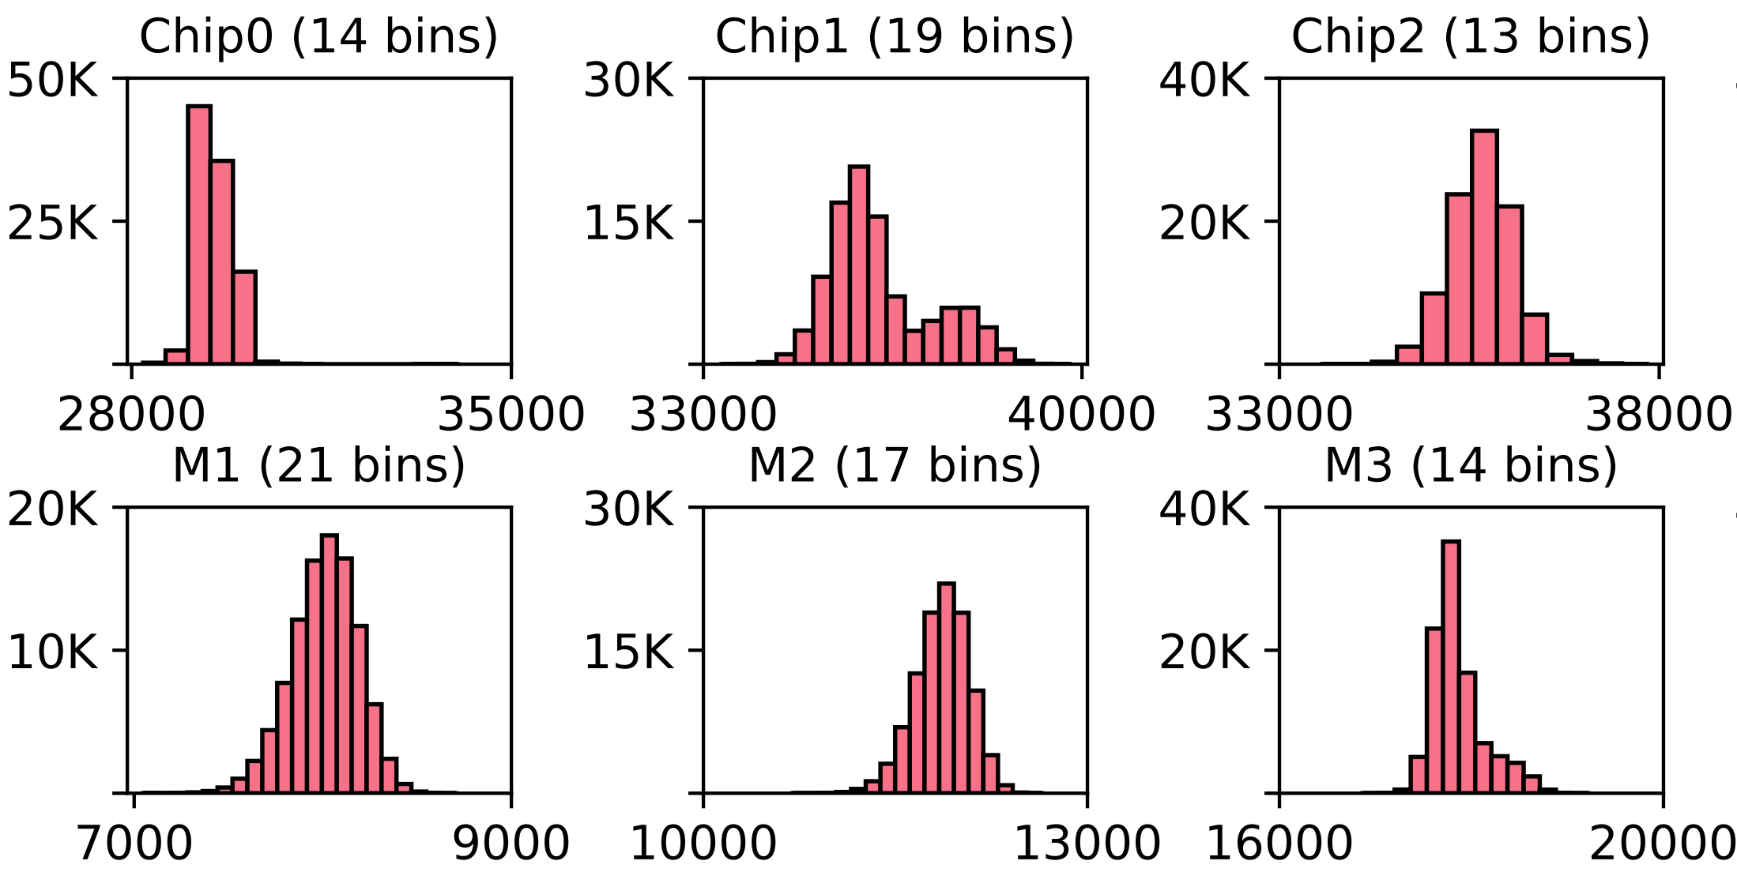
Variable Read Disturbance Across DRAM Chips
# of Measurements
Read Disturbance Threshold
RDT consistently varies over time across all tested DRAM chips
Notes:
Here we show data for one tested row each from 6 tested chips [CLICK].
This observation is consistent across all tested chips…

Slide 33
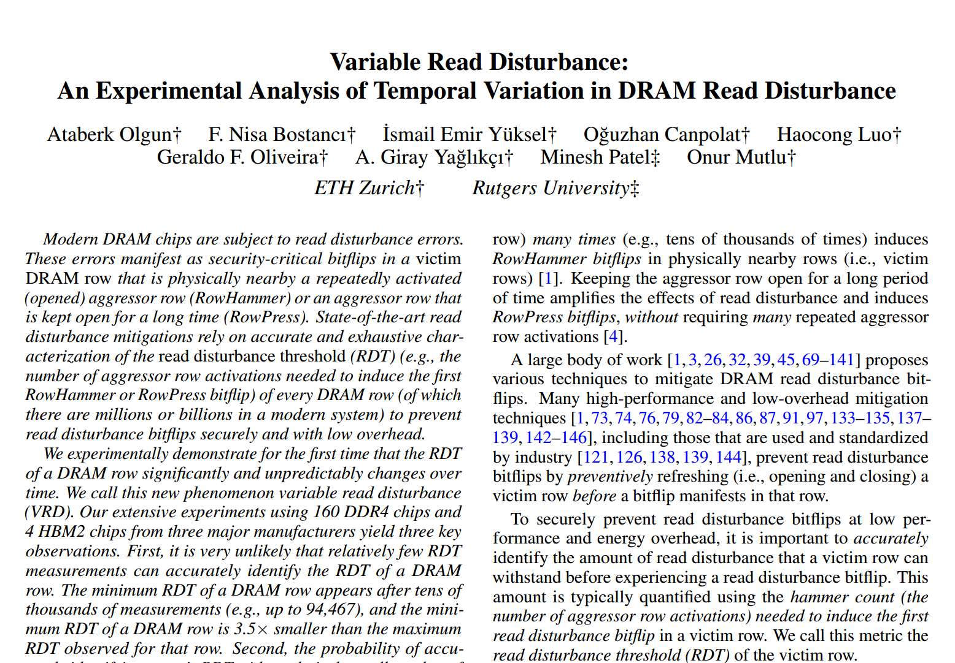
Variable Read Disturbance Across DRAM Chips
https://arxiv.org/pdf/2502.13075
# of Measurements
RDT
RDT consistently varies over time across all tested DRAM chips
Notes:
… and I refer you to our paper for results for other chips that we couldn’t fit in that previous slide

Slide 34
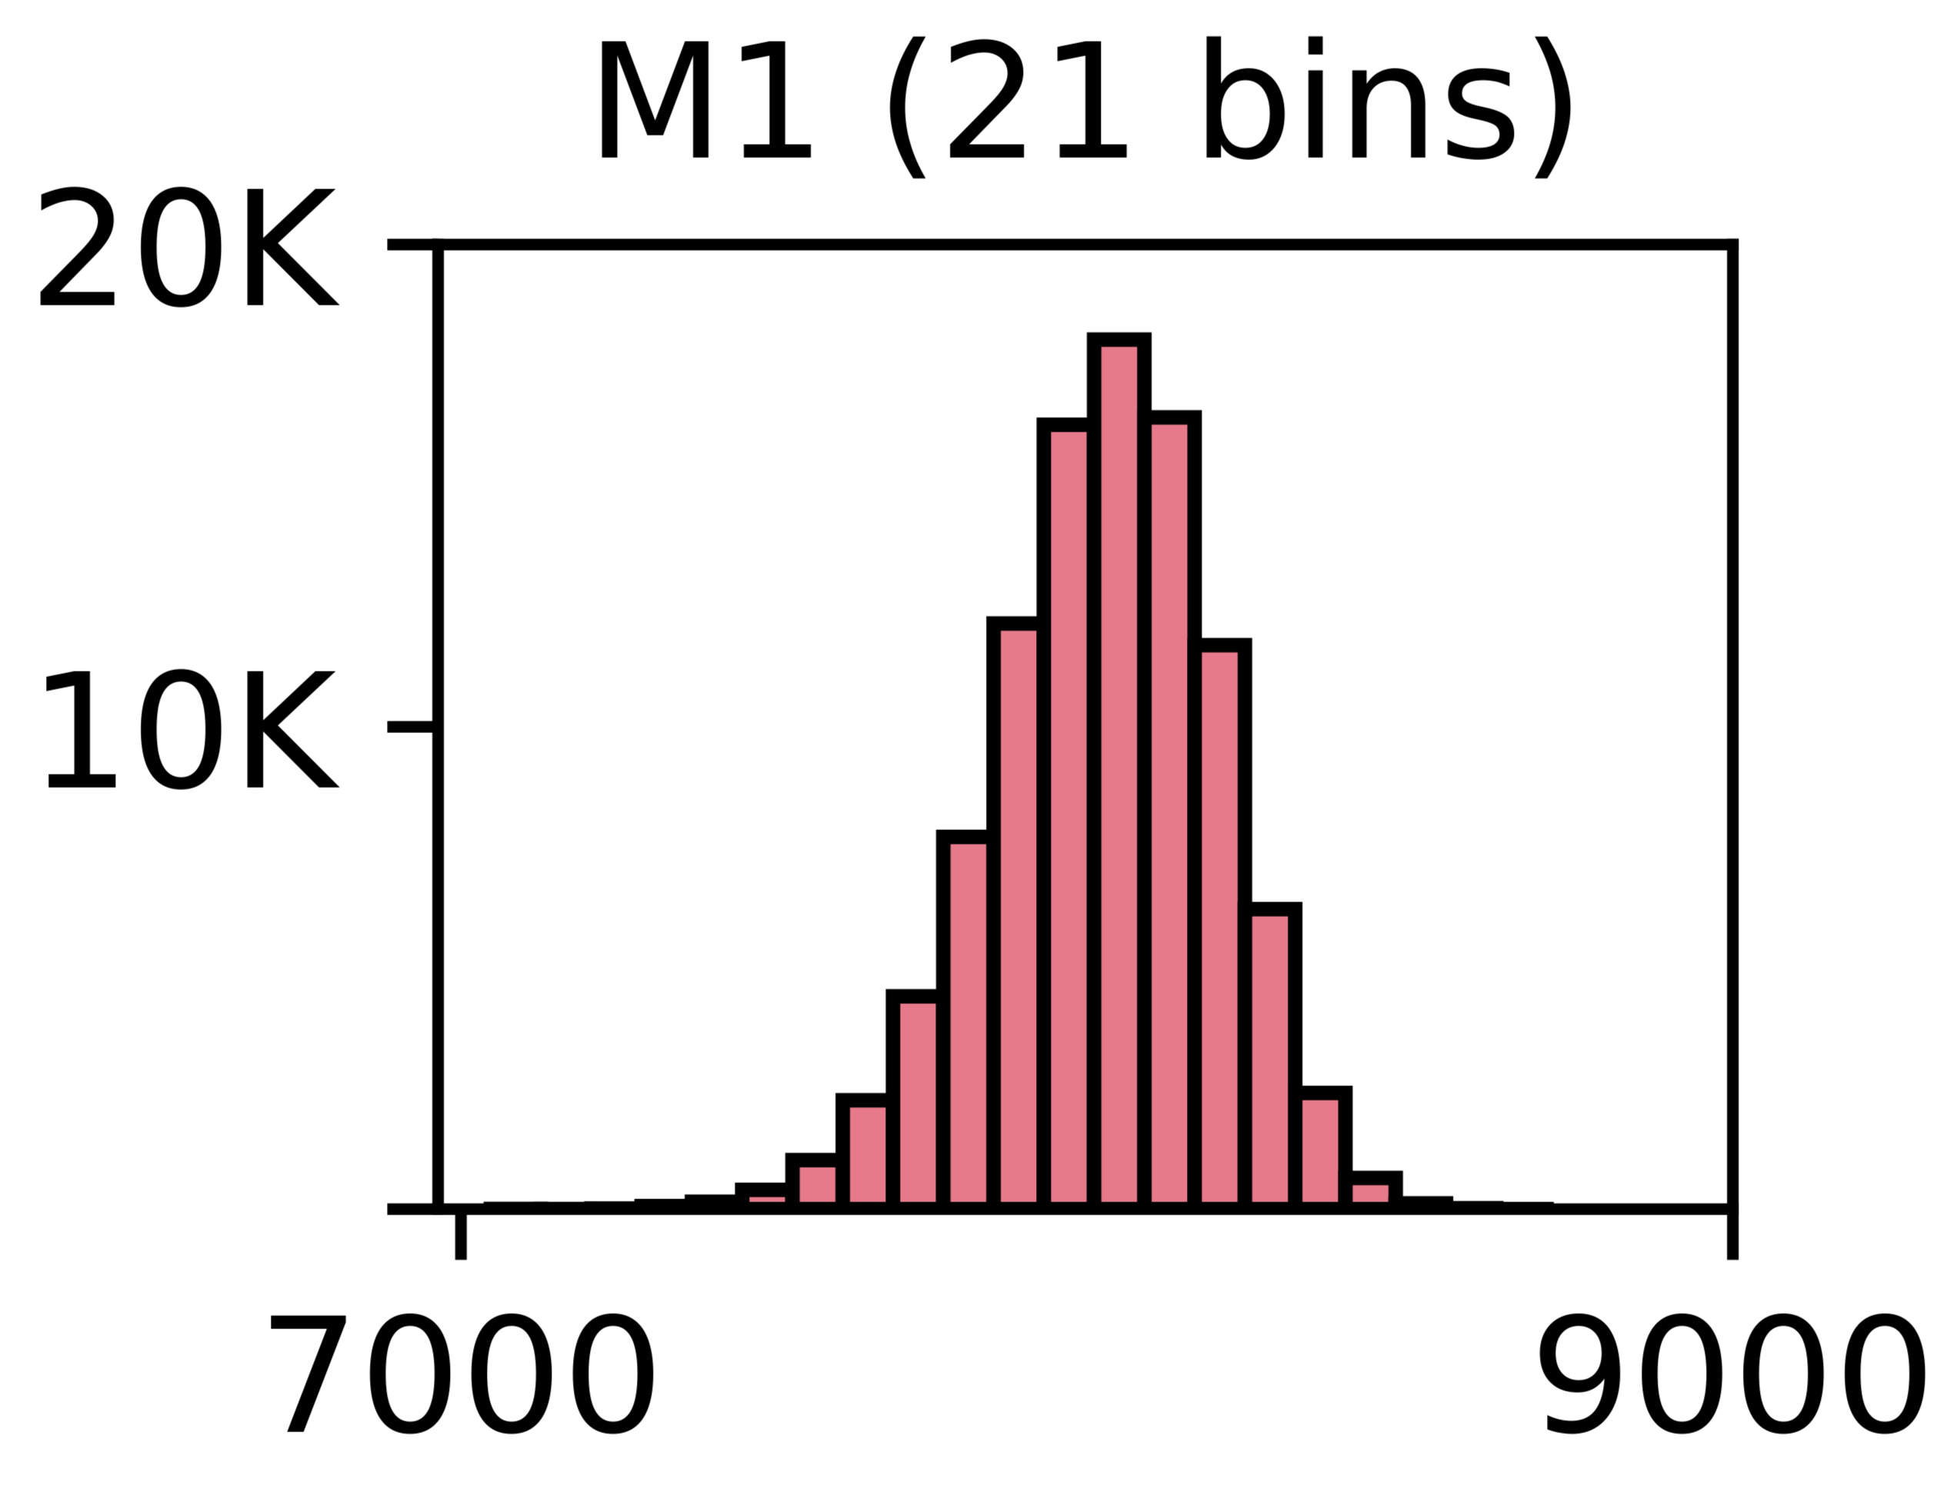
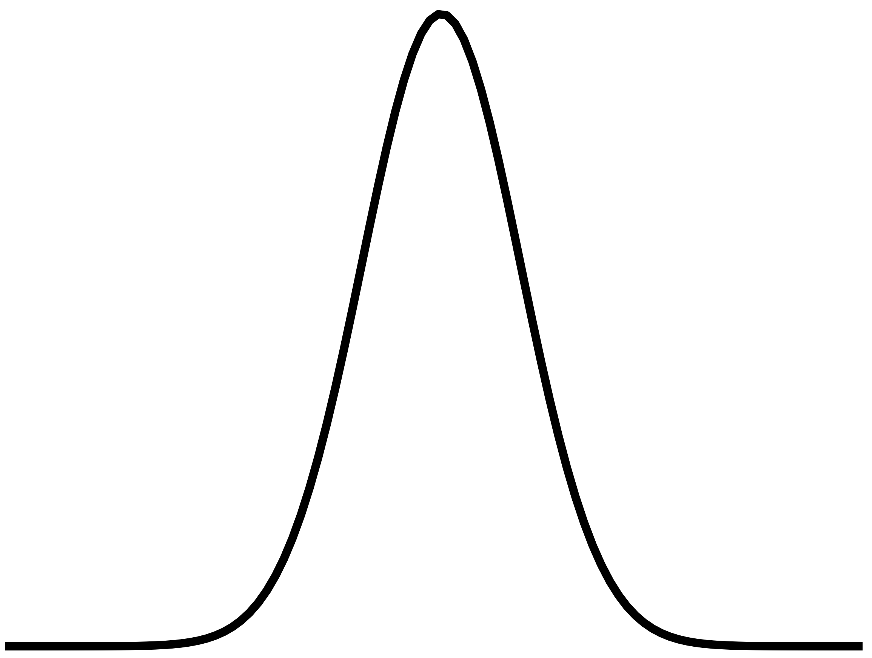
VRD is (Likely) Unpredictable
The outcome of the next read disturbance threshold (RDT) measurement cannot be predicted given past measurements
1
RDT histograms well resemble* random probability distributions e.g., normal distribution
2
Analyze and find no repeating patterns in the series of consecutively measured RDT values using the autocorrelation function
* Resemblance quantified using statistical tests in the paper
Notes:
We analyze the predictability of the next RDT value given past RDT measurements and we find that it is likely unpredictable.
[CLICK] First, we find that the RDT histograms well resemble prominent random probability distributions
[CLICK] Second, we use the autocorrelation function to try and identify repeating patterns in a series of 100000 measurements and we cannot identify any repeating patterns

Slide 35
VRD is (Likely) Unpredictable
https://arxiv.org/pdf/2502.13075
The outcome of the next RDT measurement cannot be predicted given past measurements
1
RDT histograms well resemble* random probability distributions e.g., normal distribution
2
Analyze and find no repeating patterns using the autocorrelation function
Notes:
For more details on our methodology, please check the paper

Slide 36
Talk Outline
Motivation
Experimental Characterization Methodology
Foundational Results
In-Depth Analysis of VRD
Implications for System Security and Robustness
Conclusion
Notes:
Now we take an in-depth look at VRD in many DRAM rows by sweeping various test parameters

Slide 37
In-Depth Analysis: Parameter Space
Four data patterns
Three temperature levels: 50°C, 65°C, 80°C
Three aggressor row on time values (RowPress):
Minimum t_{RAS} = ~35ns
Interval between two periodic refresh commands t_{REFI} = 7.8µs (DDR4)
Maximum interval between two refresh 9 ⨉ t_{REFI} = 70.2µs (DDR4)
Test 3750 rows and measure RDT 1000 times per row
Aside: what would happen if we measure >1M times?
Notes:
We use four data patterns
[CLICK] Three temperature levels
[CLICK] Three aggressor row on time values (to investigate RowPress and VRD)
[CLICK] and we test many rows in total across all chips and measure RDT 1000 times for each tested row
[CLICK] We test 1000 times for time constraints. It is good to think about what you’d see if you did 1 million or 10 million or more measurements.

Slide 38
In-Depth Analysis: Key Takeaways
Takeaway 1
All tested DRAM rows exhibit VRD
Takeaway 2
Relatively few (<500) RDT measurements are unlikely to yield the minimum RDT of a row
Takeaway 3
Data patterns, temperature, and aggressor row on time affect VRD
Notes:
Here are the three key takeaways from our in-depth study

Slide 39
In-Depth Analysis: Key Takeaways
Takeaway 1
All tested DRAM rows exhibit VRD
Takeaway 2
Relatively few (<500) RDT measurements are unlikely to yield the minimum RDT of a row
Takeaway 3
Data patterns, temperature, and aggressor row on time affect VRD
Notes:
First, all tested DRAM rows exhibit variable read disturbance, to *varying* degrees

Slide 40
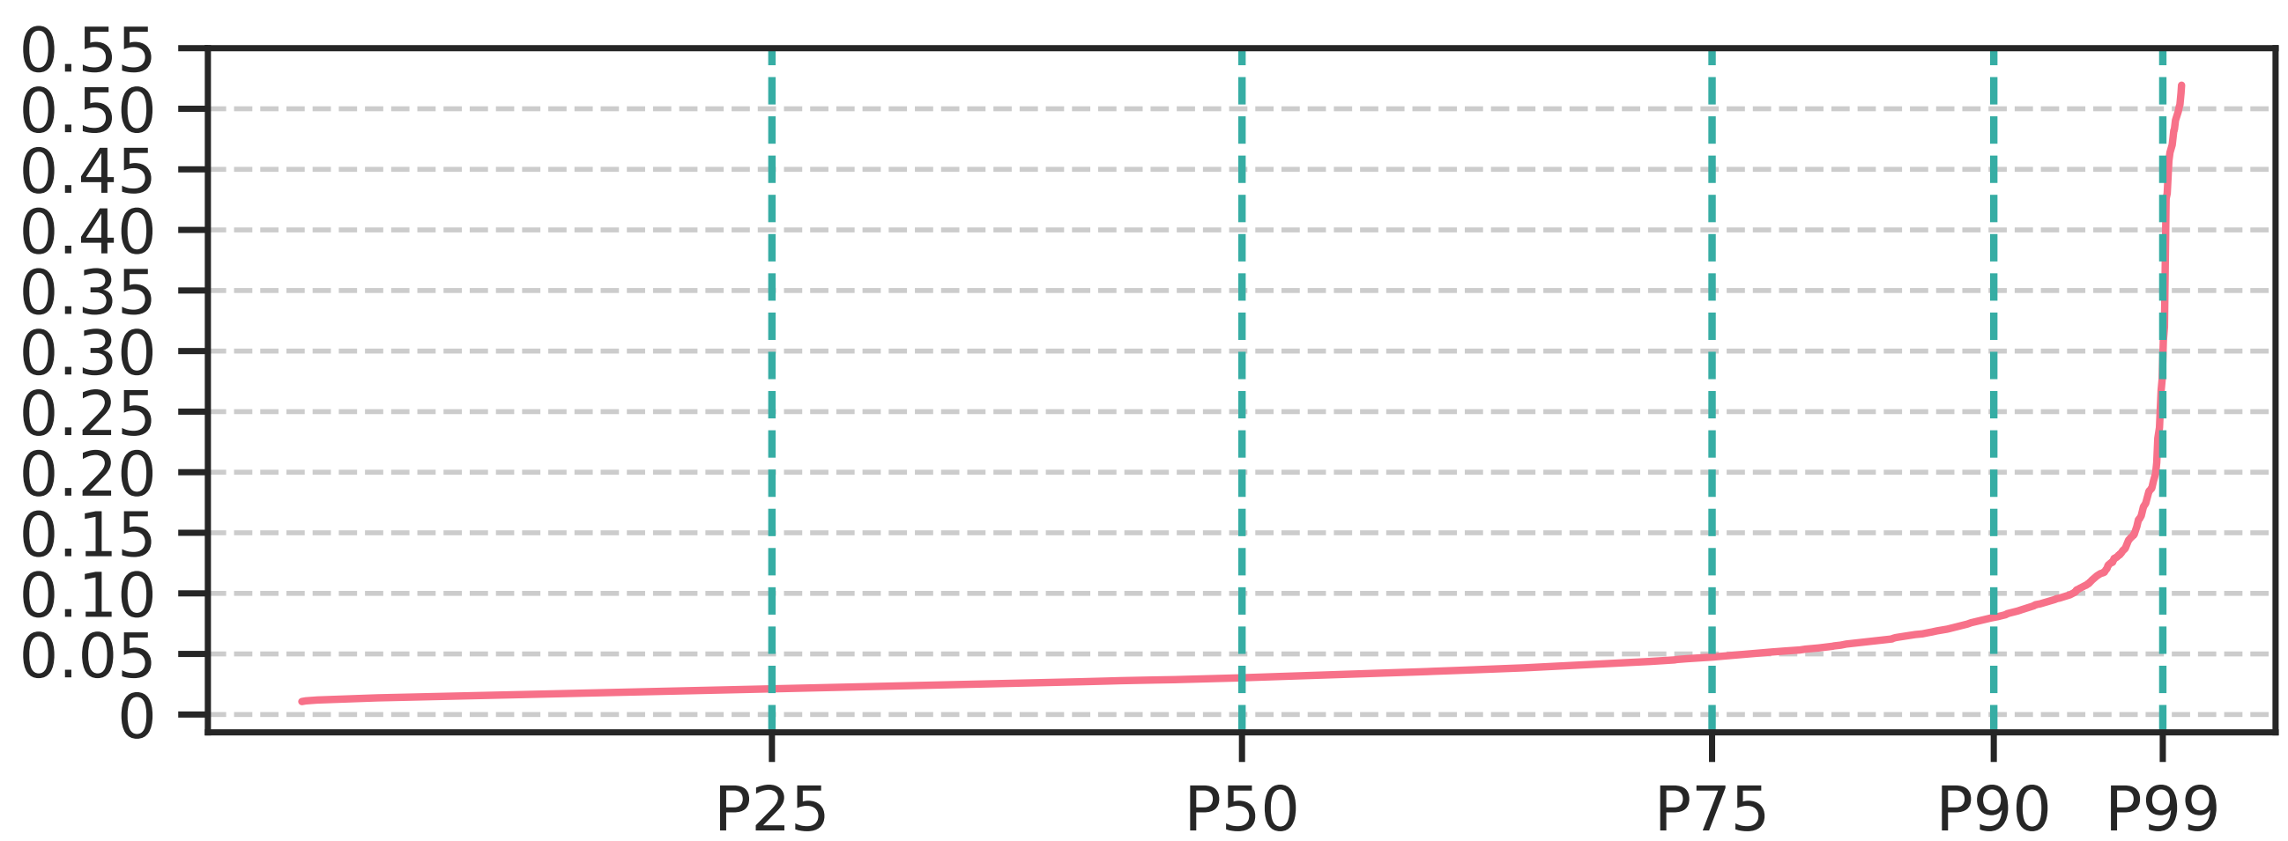
VRD Across DRAM Rows
A row with small variance in RDT distribution across 1000 measurements
Coefficient of Variation
DRAM Rows Sorted by Increasing Coefficient of Variation of RDT
Across 1000 RDT Measurements
Notes:
Here we show the coefficient of variation in the distribution of 1000 read disturbance threshold measurements for each tested row.
[CLICK] The circled tiny pink dot stands for the DRAM row with the smallest coefficient of variation in its RDT distribution. Another way to look at this is that this row’s RDT values are very close to each other.
[CLICK] We show the rows sorted in increasing coefficient of variation on the x-axis

Slide 41
VRD Across DRAM Rows
Row with the greatest variance in RDT distribution
Median row
Coefficient of Variation
DRAM Rows Sorted by Increasing Coefficient of Variation of RDT
Across 1000 RDT Measurements
All tested rows exhibit VRD
Notes:
We observe that all tested rows exhibit VRD: no row has 0 variation in its RDT measurements
[CLICKx2] We highlight two points in this plot: the median row, and the row with the greatest variance in its read disturbance threshold distribution

Slide 42
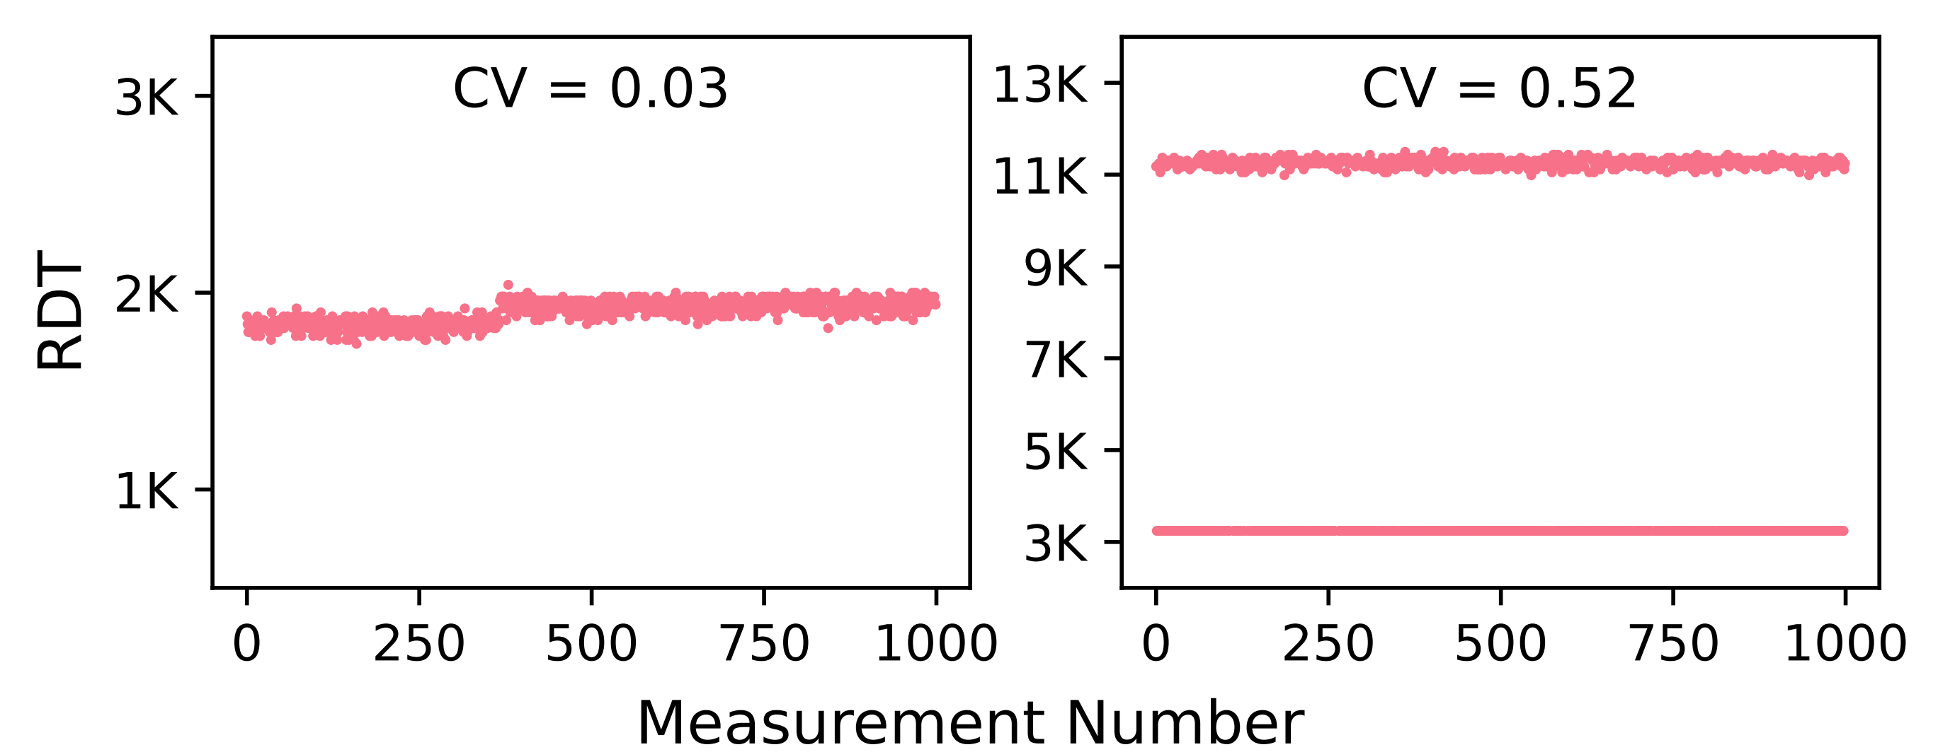
VRD in Two Example Rows
3.5⨉
1.2⨉
Variation in read disturbance threshold can reach 3.5⨉
Notes:
Here is a look at those two rows. We see their RDT values across 1000 successive measurements on the x-axis
[CLICK] For the median row, we see that the maximum observed RDT is 1.2 times higher than the minimum
[CLICK] and we observe that the variation in RDT can reach a high factor: it is 3.5 times for the row with the greatest RDT variation

Slide 43
In-Depth Analysis: Key Takeaways
Takeaway 1
All tested DRAM rows exhibit VRD
Takeaway 2
Relatively few (<500) RDT measurements are unlikely to yield the minimum RDT of a row
Takeaway 3
Data patterns, temperature, and aggressor row on time affect VRD
Notes:
Now moving onto the second takeaway: Relatively few measurements are unlikely to yield the minimum read disturbance threshold of a row

Slide 44
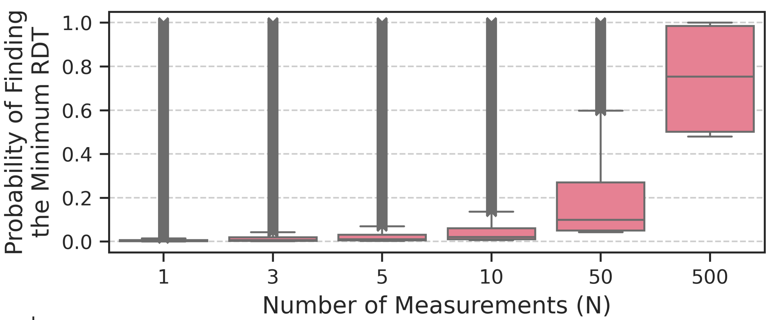
Probability of Identifying the Minimum RDT
How likely is it that N < 1000 measurements yield the minimum RDT value across 1000 measurements?
N = 1, 3, 5, 10, 50, and 500
Monte Carlo simulations for 10K iterations
Notes:
We try to answer this question: how likely is it for us to find the minimum observed RDT across 1000 measurements, using
[CLICK] only N measurements where N is smaller than 1000? [CLICK]
We use monte carlo simulations and [CLICK] plot the probability of identifying the minimum RDT value over varying N [CLICK] for all tested rows

Slide 45
Probability of Identifying the Minimum RDT
only 0.2% for the median row
Very unlikely to find the minimum RDT of a DRAM row with N = 1 measurement
Notes:
[CLICK] N = 1 measurement has a very low probability of yielding the minimum RDT across 1000 measurements, only 0.2%... and

Slide 46
Probability of Identifying the Minimum RDT
0.2%
0.7%
1.1%
2.1%
10.0%
75.3%
Probability values for the median row
Probability of finding the minimum read disturbance threshold increases with N (i.e., with more and more testing)
Notes:
(SLOWLY) we observe that the probability increases with N
goes up to 75% for the median row - but does not reach 100% -, for N = 500 measurements
====
TODO: spend more time here

Slide 47
Expected Value of the Minimum RDT
With only N < 1000 RDT measurements how far are we from the minimum RDT across 1000 measurements
Read Disturbance Threshold
Minimum across 1000 measurements
Measurement Number
Notes:
To gain more insight into VRD, we devise another metric called the expected value of the minimum RDT to quantify how higher of an RDT value we expect to find with N smaller than 1000 measurements.
[CLICK] I’ll describe this pictorially. [CLICK] This line depicts the minimum RDT value across 1000 measurements

Slide 48
Expected Value of the Minimum RDT
With only N < 1000 RDT measurements how far are we from the minimum RDT across 1000 measurements
5 random samples
Minimum across 5 samples
Read Disturbance Threshold
Expected value of the minimum RDT
Minimum across 1000 measurements
Measurement Number
Notes:
Here are 5 random samples from the set of 1000 measurements
[CLICK] and the minimum across those 5 samples
[CLICK] this metric quantifies the distance between the two minimums

Slide 49
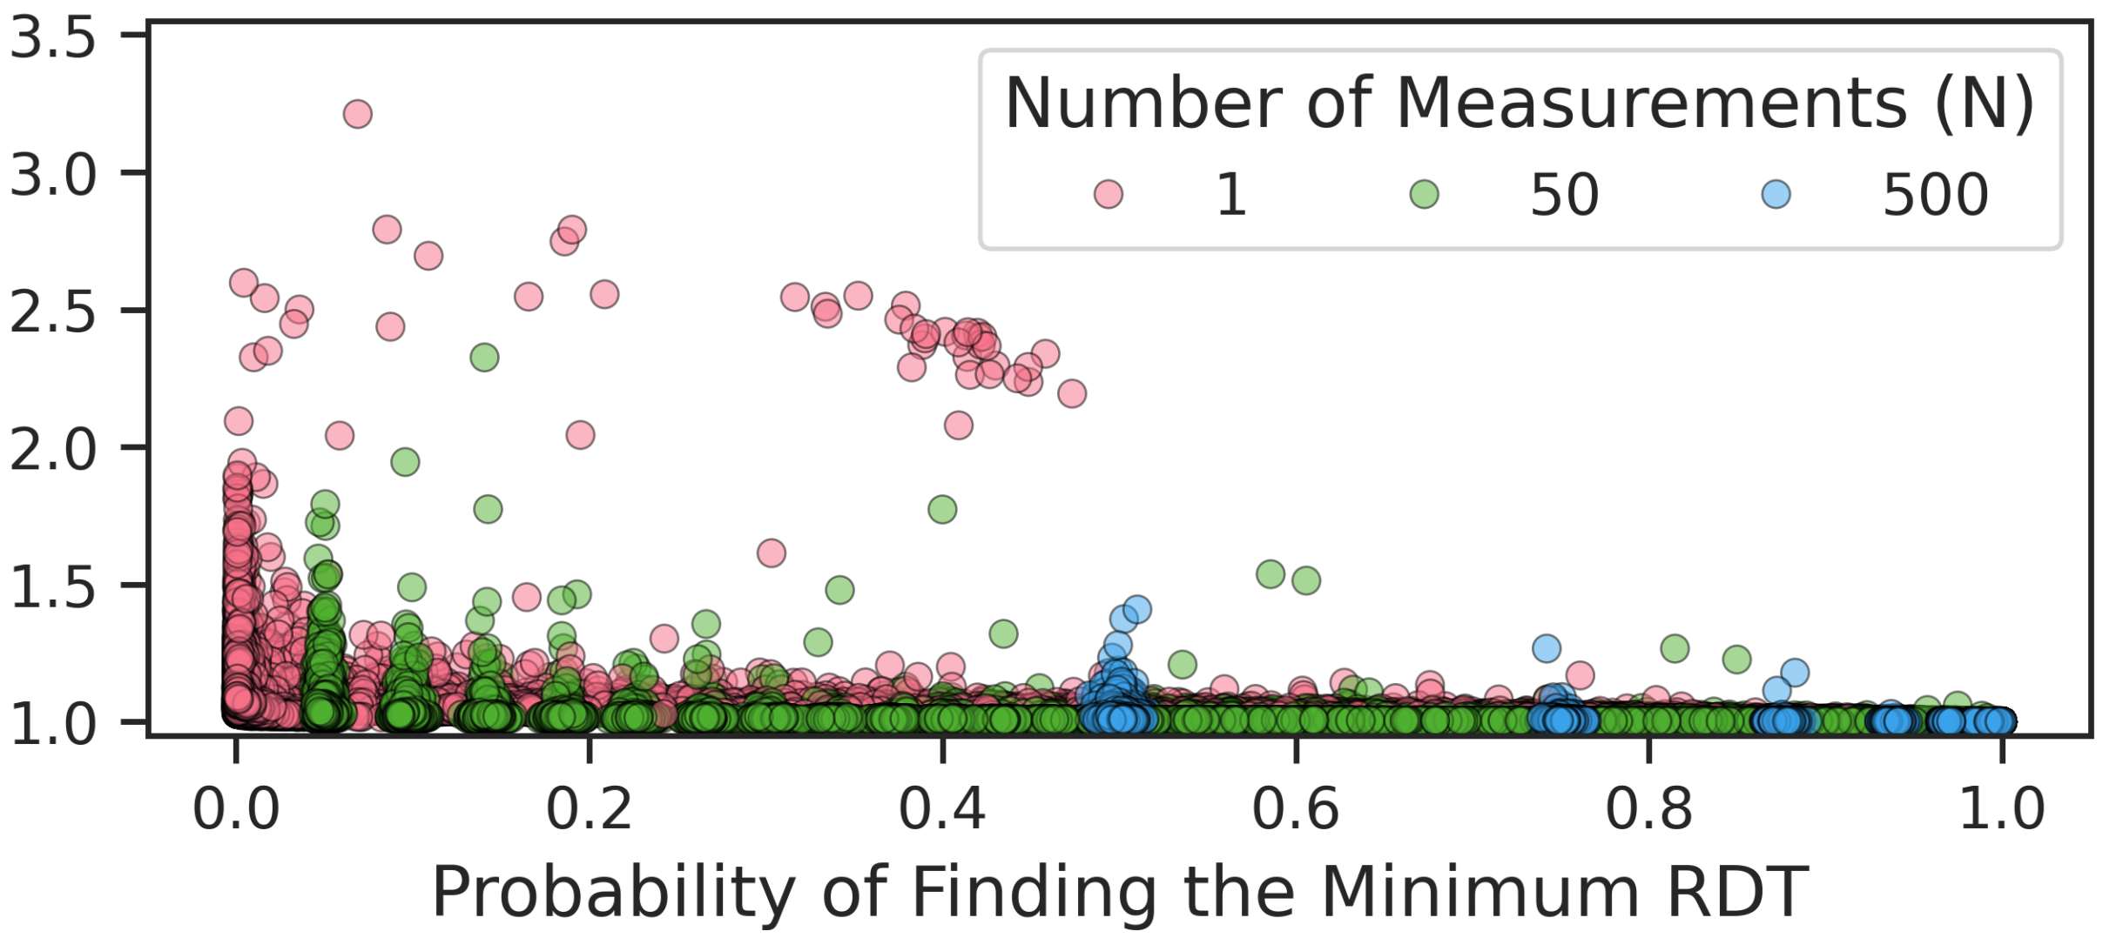
Expected Value of the Minimum RDT
Expected Normalized Value of the Minimum RDT
Notes:
We plot the new metric on the [CLICK] y-axis and the probability of finding the minimum RDT on x-axis.

Slide 50
Expected Value of the Minimum RDT
Expected Normalized Value of the Minimum RDT
RDT found by 1 measurement 3.21⨉ greater than minimum RDT across 1000 measurements
Notes:
Each point on this plot stands for one row [CLICK]. [CLICK] This point shows you that there is a row where we expect to find an RDT value using one measurement 3.21 times greater than the one we would find if we were to test for 1000 times

Slide 51
Expected Value of the Minimum RDT
Expected Normalized Value of the Minimum RDT
“Better” for testing
tight RDT distribution
Plot interpretation
“Better” for testing == as tight an RDT distribution as possible
Notes:
A good way to interpret this plot is that we want to have small y-axis values. Small y-axis values indicate *tighter* RDT distributions and you want RDT distributions as tight as possible.

Slide 52
Expected Value of the Minimum RDT
Expected Normalized Value of the Minimum RDT
RDT expected to be found by 1 measurement is 1.9⨉ greater than minimum RDT across 1000 measurements
The minimum RDT is significantly smaller than the one expected to be found with N = 1 measurement
Notes:
This is the full plot.
[CLICK] Now we highlight the rows with smaller than 0.1% probability of finding the minimum RDT: for these rows the minimum RDT appears only once in the series of 1000 measurements
[CLICK] They can have up to 1.9 times expected normalized value of the minimum RDT
[CLICK] We conclude that the minimum RDT across 1000 measurements is significantly smaller than the one expected to be found by N = 1 measurement

Slide 53
Expected Value of the Minimum RDT
Expected Normalized Value of the Minimum RDT
With increasing N (number of measurements) we expect to identify an RDT value closer to the minimum across 1000 measurements
Notes:
With increasing N, we expect to identify an RDT value closer to the minimum value across 1000 measurements

Slide 54
In-Depth Analysis: Key Takeaways
Takeaway 1
All tested DRAM rows exhibit VRD
Takeaway 2
Relatively few (<500) RDT measurements are unlikely to yield the minimum RDT of a row
Takeaway 3
Data patterns, temperature, and aggressor row on time affect VRD
Notes:
Finally, data patterns, temperature, and aggressor row on time all affect VRD and you can find the detailed analyses in the paper, but I am not going to cover these details in the presentation.

Slide 55
Talk Outline
Motivation
Experimental Characterization Methodology
Foundational Results
In-Depth Analysis of VRD
Implications for System Security and Robustness
Conclusion
Notes:
The observations I presented have implications for system security and robustness

Slide 56
Implications Summary
Security guarantees provided by mitigation techniques rely on accurately identified minimum read disturbance threshold (RDT)
Accurate identification of minimum RDT (for each row) is extremely challenging (even with 1000s measurements) because RDT unpredictably changes over time
We analyze the use of a guardband and ECC
May prevent VRD-induced bitflips
Large guardbands induce performance overhead
Call for future work on online RDT profiling and runtime configurable read disturbance mitigations
Notes:
Security guarantees provided by read disturbance mitigation techniques or solutions rely on an accurately identified RDT
[CLICK] Our results show that accurate identification of RDT is extremely challenging
[CLICK] We evaluate a short-term solution: combining a guardband for RDT and error-correcting codes. [CLICK] Given our limited empirical bitflip dataset, we show that this combined solution could prevent VRD-induced bitflips at performance cost.
[CLICK] Our results call for future work on online read disturbance profiling and runtime configurable read disturbance mitigations

Slide 57
Important Caveat
VRD solution analysis based on 1K or 10K read disturbance threshold measurements per row
More measurements could yield worse results
Read disturbance threshold distribution tail could expand
What results would millions or billions of RDT measurements yield?
Notes:
I’d like to stress an important caveat. The results I presented in the last slide and that I am going to present next are based on only a limited number of read disturbance threshold measurements.
[CLICK] More RDT measurements could yield worse results
[CLICK] and it is good to think about what millions of or billions of or more RDT measurements would yield.

Slide 58
Challenges of Accurately Identifying RDT
Variation in read disturbance threshold across 1000 measurements can reach 3.5⨉ and may not be bounded
VRD is affected by data pattern, temperature, aggressor row on time
Comprehensive RDT profiling is time-intensive
RDT
3.5⨉
Measurement Number
Measuring RDT of each row only once with 8000 hammers using four data patterns, at three temperature levels takes 39 minutes in a bank of 256K rows
Notes:
That, was a summary. I will do a deep dive by explaining why it’s challenging to accurately identify the minimum RDT
[CLICK] The variation in RDT can reach 3.5X and it may not be bounded.
[CLICK] RDT distribution is affected by many parameters and comprehensive RDT testing is time intensive
[CLICK] Measuring the RDT of each row in a bank of 256K rows *only once* can take 39 minutes

Slide 59
RDT Profiling is Time-Intensive
Comprehensive RDT testing can take tens of hours (only 1000 measurements, one data pattern, one temperature level, one aggressor row on time)
Notes:
In fact, we show that comprehensive read disturbance threshold testing for a DRAM chip can take tens of hours to complete if you want to measure RDT multiple times

Slide 60
RDT Profiling is Time-Intensive
https://arxiv.org/pdf/2502.13075
Comprehensive RDT testing can take hours (1000 measurements, one data pattern, one temperature level, one aggressor row on time)
Notes:
I refer you to our paper for more details on that

Slide 61
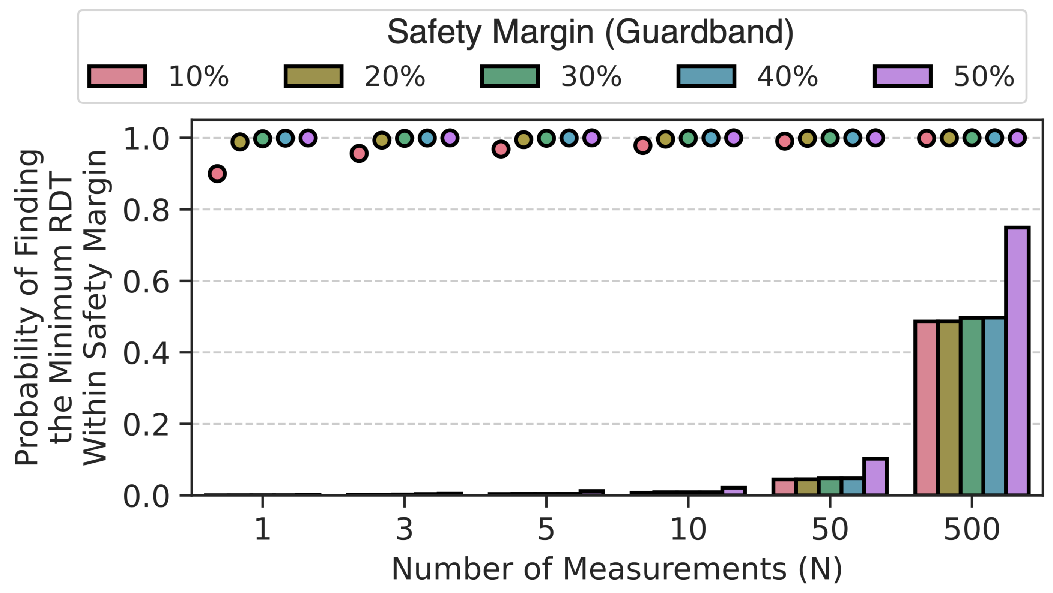
Making Do With Few RDT Measurements
A system designer might measure RDT a few times and apply a safety margin (guardband) to the minimum observed value
Notes:
Because it is so time consuming to comprehensively test for read disturbance bitflips, a system designer might measure RDT a few times, take the minimum across those few measurements, and apply a guardband to it with the hope of covering a not yet observed minimum RDT value
[CLICK] This plot shows you the probability that N measurements displayed on the x-axis + the guardband shown above will cover the minimum RDT value across 1,000 measurements.

Slide 62
Making Do With Few RDT Measurements
A system designer might measure RDT a few times and apply a safety margin (guardband) to the minimum observed value
Average across all tested rows
Minimum across all tested rows
Notes:
We show both the average value across all tested rows using circles and the minimum across all tested rows using bars.
What that pink bar means is there is a row where you *don’t* expect to find the minimum read disturbance threshold across 1K measurements with 100% probability, even with 500 measurements.
[CLICK] Here is the full plot.

Slide 63
Making Do With Few RDT Measurements
A large guardband does not guarantee that the minimum RDT is always identified
Using guardbands alone is likely not effective
Notes:
We observe that a large guardband does not guarantee that the minimum RDT is always identified and conclude that guardbands alone are likely not effective.

Slide 64
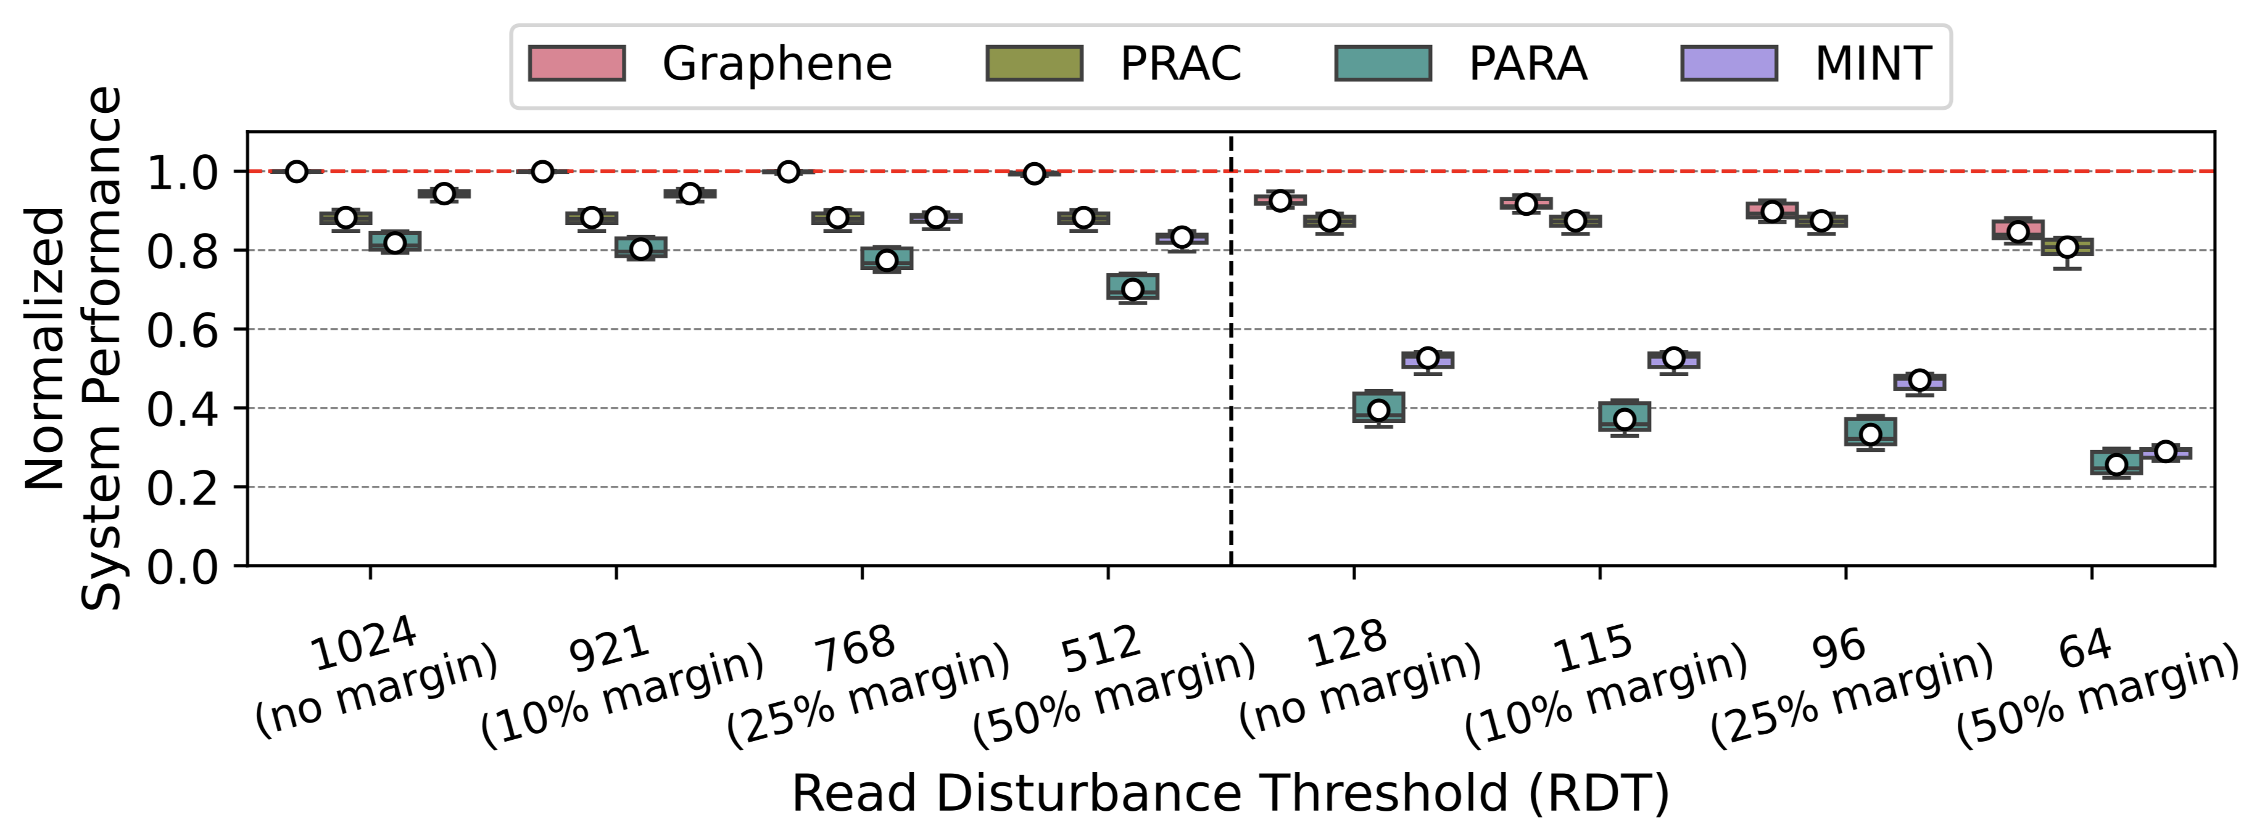
RDT Guardband Increases Performance Overheads
45%
35%
50% RDT safety margin can induce 45% additional overhead (over no margin)
Relying solely on guardbands not recommended
Notes:
Moreover, large guardbands can [CLICK] introduce significant performance overhead.
[CLICK] Thereby we do not recommend relying solely on guardbands.

Slide 65
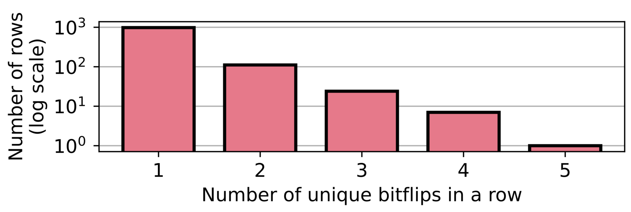
Combining ECC and Guardbands (I)
Single-error correcting double-error detecting (SECDED) or Chipkill ECC combined with guardbands could mitigate VRD-induced bitflips
Unique bitflips when 10% RDT guardband applied
10% guardband combined w/ ECC is likely unsafe
Notes:
We evaluate error-correcting codes as a complementary technique to using a guardband for RDT
[CLICK] The plot shows you a histogram of the number of unique bitflips in a row when we use a 10% RDT guardband.
[CLICK] The bitflip rate we observe suggests that widely-used ECC schemes combined with 10% guardband for RDT is likely unsafe, depending on how the bitflips are located.

Slide 66
Combining ECC and Guardbands (II)
RDT guardbands ≥20% yield 1 unique bitflip in a row
Given our limited measurement dataset (10K measurements) RDT guardbands ≥20% combined with ECC may prevent VRD-induced read disturbance bitflips
More detailed analysis (following a large-scale study) needed to make a definitive conclusion
Notes:
However, guardbands greater than or equal to 20% yield only 1 unique bitflip in a row
[CLICK] The bitflip patterns *we* observe could be prevented with larger than or equal to 20% guardband combined with widely-used ECC schemes.
[CLICK] But more detailed analysis likely following a large-scale study is needed to make a definitive conclusion about the effectiveness of guardbands and ECC.

Slide 67
More in the Paper
Hypothetical explanation for VRD
Effect of True- and Anti-Cell Layout
Presence of true- and anti-cells in the victim row does not significantly affect the RDT distribution
Read disturbance mitigation evaluation methodology
Probability of errors at the worst observed bitflip rate for 10% RDT guardband
SEC, SECDED, and Chipkill-like (SSC)
Read disturbance testing time and energy consumption
Detailed information on tested modules and chips
Notes:
There are many more things in the paper that I cannot talk about now
In the interest of time, I’ll refer you to…

Slide 68
More in the Paper
https://arxiv.org/pdf/2502.13075
Hypothetical explanation for VRD
Effect of True- and Anti-Cell Layout
Presence of true- and anti-cells in the victim row does not significantly affect the RDT distribution
Read disturbance mitigation evaluation methodology
Probability of errors at the worst observed bitflip rate for 10% safety margin
SEC, SECDED, and Chipkill-like (SSC)
Read disturbance testing time and energy consumption
Detailed information on tested modules and chips
Notes:
… our paper for those details

Slide 69
Talk Outline
Motivation
Experimental Characterization Methodology
Foundational Results
In-Depth Analysis of VRD
Implications for System Security and Robustness
Conclusion
Notes:
I’ll quickly conclude my talk

Slide 70
VRD Conclusion
Variable Read Disturbance (VRD)
The read disturbance threshold changes unpredictably over time
Minimum RDT (of a row) may appear after many measurements
RDT for a DRAM row can vary by 3.5X
Identifying the minimum RDT is challenging and time-intensive
Given our limited read disturbance bitflip dataset, guardbands combined with error-correcting codes may be a solution for VRD-induced bitflips. More data and analyses needed to make definitive conclusion
Future work could alleviate the shortcomings of existing mitigations & develop better understanding of inner workings of VRD
Notes:
We demonstrate Variable Read Disturbance, showing that the read disturbance threshold of a row changes unpredictably over time.
[CLICK] We show VRD’s interesting characteristics through detailed experimental characterization.
[CLICK] VRD has implications for system robustness and security. Thus, we evaluate short-term solutions for VRD induced bitflips. *Given our limited bitflip dataset*, relatively large guardbands and ECC may prevent VRD-induced failures. However, more data and analyses are necessary to make a definitive conclusion
[CLICK] We call for future work on efficient solutions for VRD and future work that will develop our understanding of inner workings of VRD.

Slide 71
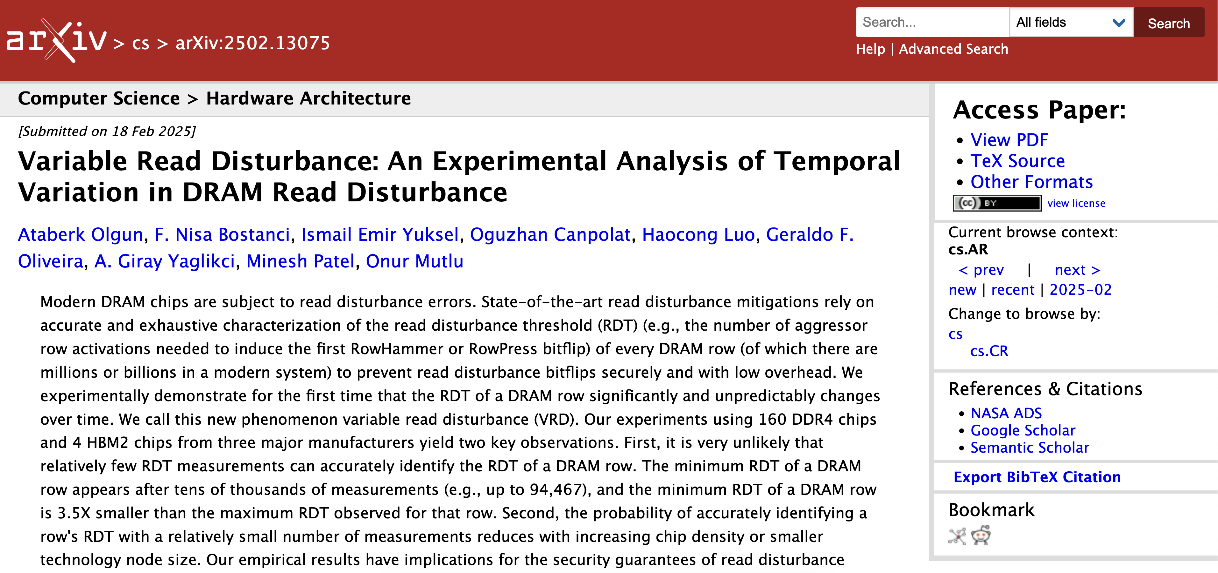
Extended Version on arXiv
https://arxiv.org/pdf/2502.13075
Notes:
An extended version of our conference paper is on arXiv.

Slide 72
Variable Read Disturbance (VRD) An Experimental Analysis of Temporal Variation in DRAM Read Disturbance
Ataberk Olgun, F. Nisa Bostancı, İsmail Emir Yüksel Oğuzhan Canpolat, Haocong Luo, Geraldo F. Oliveira A. Giray Yağlıkçı, Minesh Patel, Onur Mutlu
https://arxiv.org/pdf/2502.13075
Notes:
And that’s all. I am happy to take your questions.

Slide 73
Variable Read Disturbance Backup Slides

Slide 74
Is this Experiment Noise?
Short answer: no
Hypothetical explanation for VRD: Randomly changing charge trap state in the active region
Long answer: We cannot identify any independent variables within our control that allow reliably predicting the minimum RDT despite extensive testing
Device-level studies should confirm our hypotheses

Slide 75
Hypothetical Explanation for VRD
No device-level study shows temporal variations in read disturbance vulnerability
Electron migration and injection into victim cell is a major read disturbance failure mechanism
This mechanism is assisted by charge traps in the shared active region of the victim and aggr. cell
Temporal variation attributed to randomly changing occupied/unoccupied states of charge traps

Slide 76
RDT Distribution Across Chips

Slide 77
# of Consecutive Measurements That Yield the Same RDT Value

Slide 78
Autocorrelation Function Tests

Slide 79
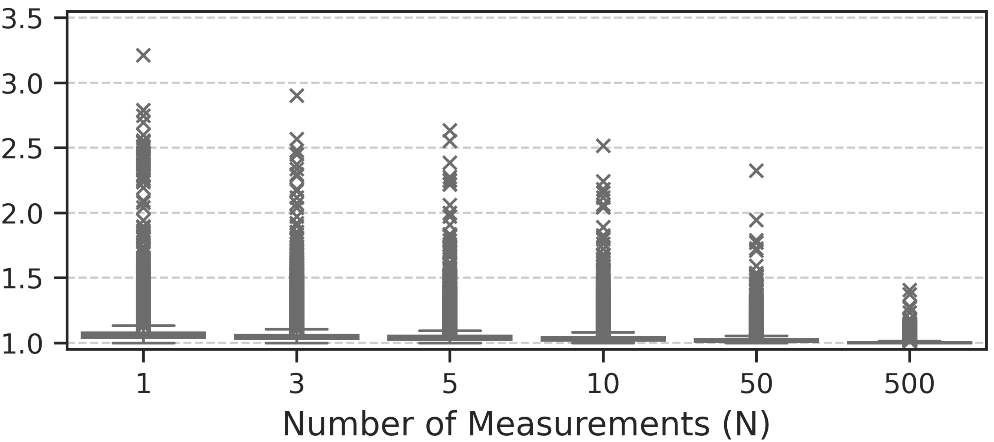
Expected Value of the Minimum RDT
Expected Normalized Value of the Minimum RDT

Slide 80
Expected Value of the Minimum RDT
Min. RDT found by 1 measurement 3.21⨉ greater than min. RDT found by 1000 measurements
Expected Normalized Value of the Minimum RDT

Slide 81
Expected Value of the Minimum RDT
Expected Normalized Value of the Minimum RDT

Slide 82
Effect of Die Density and Die Revision (I)
Expected Normalized Value of the Minimum RDT
Number of Measurements (N)
RDT distribution worsens with increasing die density and with advanced DRAM technology
Notes:
We plot the expected normalized value of the minimum RDT [CLICK] for three die revision and die density combinations
[CLICK] We observe that the RDT distribution worsens: that is, we expect to find a larger RDT with N < 1000 measurements, with increasing die density

Slide 83
Effect of Die Density and Die Revision (II)
The effect of die density and die revision is consistent across all tested modules
Notes:
[CLICK] We consistently make this observation across all tested modules

Slide 84
Effect of Data Pattern (I)
Expected Normalized Value of the Minimum RDT
Number of Measurements (N)
Notes:
Here we show the expected normalized value of the minimum RDT for four tested data patterns

Slide 85
Effect of Data Pattern (I)
Expected Normalized Value of the Minimum RDT
Number of Measurements (N)
1.04⨉
1.06⨉
expected normalized value for the median row
RDT distribution changes with data pattern
Notes:
We observe that the RDT distribution [CLICK] changes with the data pattern. Here we show the y-axis values for the median rows to quantify the change.

Slide 86
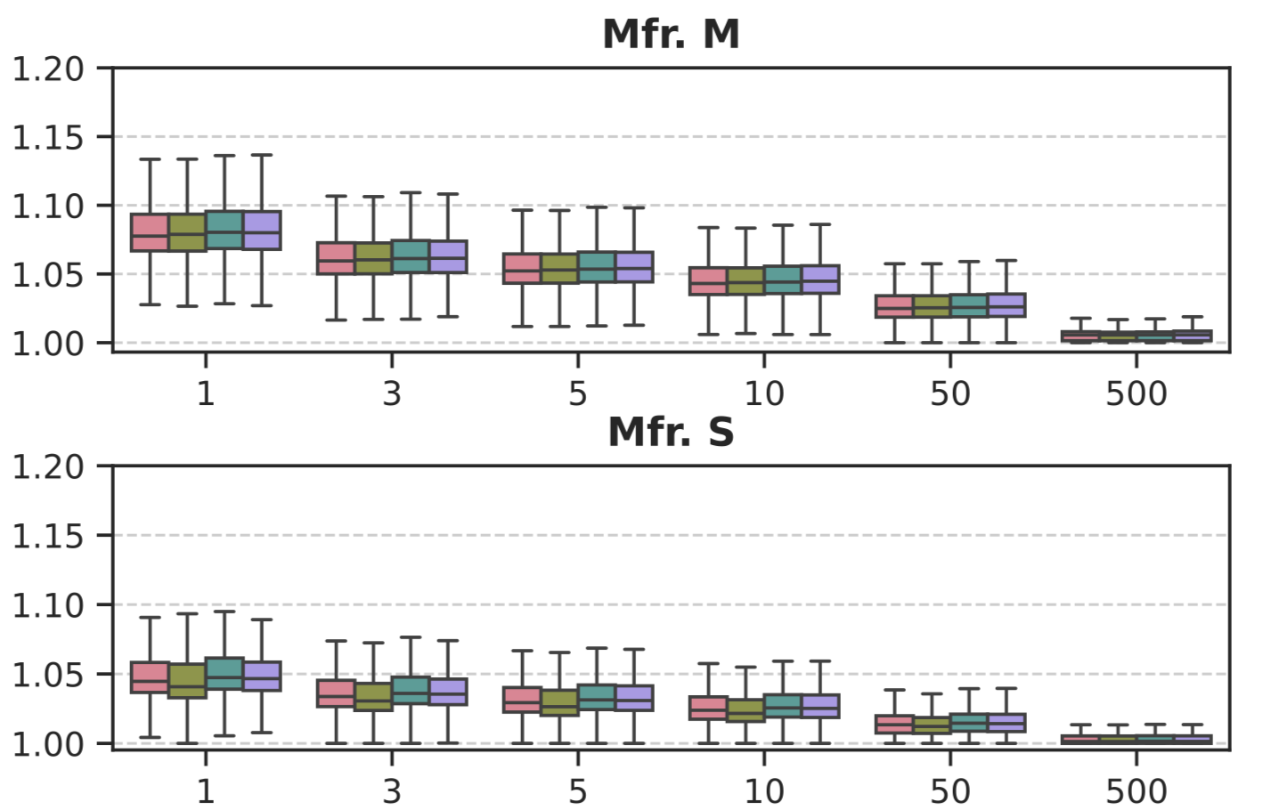
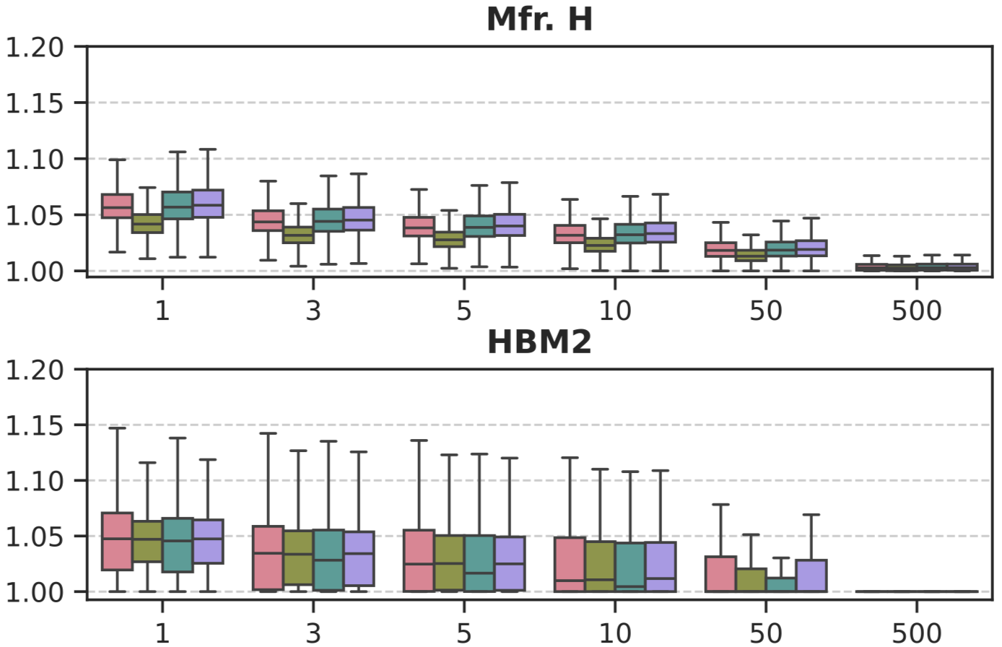
Effect of Data Pattern (II)
Expected Normalized Value of the Minimum RDT
Number of Measurements (N)
No single data pattern causes the worst RDT distribution across all tested DRAM chips
Notes:
We look at the effect of data pattern across all tested modules. We observe that [CLICK] no single data pattern causes the worst RDT distribution across all tested DRAM chips

Slide 87
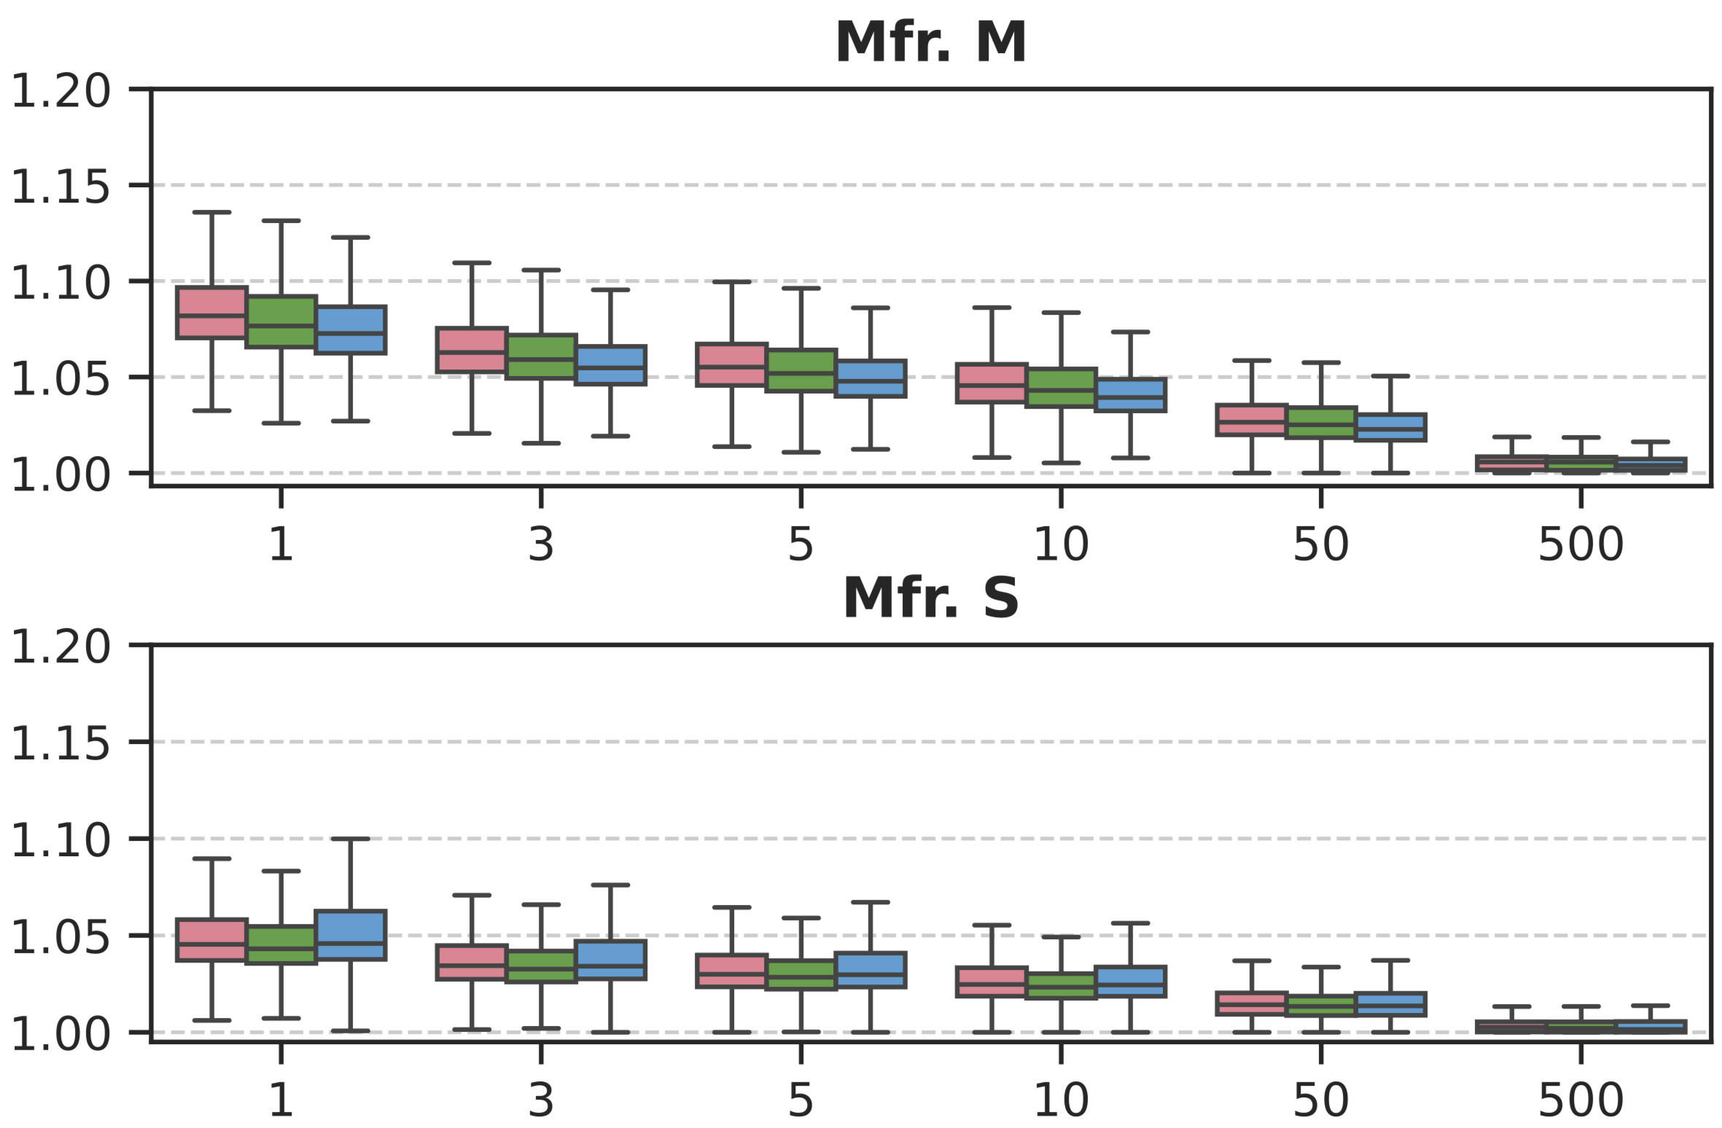
Effect of Aggressor Row On Time
Expected Normalized Value of the Minimum RDT
RDT distribution changes with aggressor row on time
RDT distribution can become better or worse with increasing row on time
Notes:
This shows the effect of aggressor row on time.
[CLICK] We see that the RDT distribution changes with aggressor row on time
[CLICK] It can become better or worse with increasing row on time

Slide 88
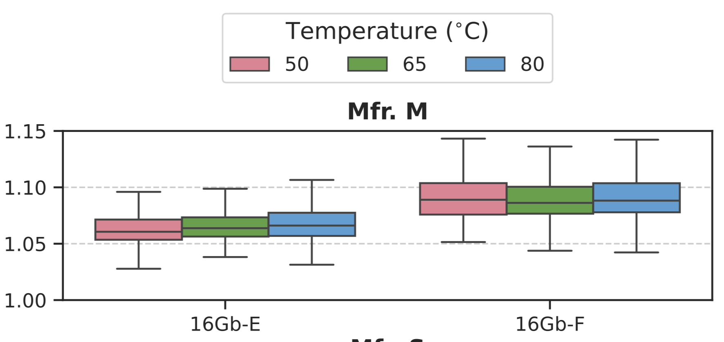
Effect of Temperature
Expected Normalized Value of the Minimum RDT
Number of Measurements (N) = 1
RDT distribution tends to change with temperature
Notes:
We look at the effect of temperature
[CLICK] and we see that the RDT distribution tends to change with temperature

Slide 89
Effect of True- and Anti-Cell Layout
The presence of true- and anti-cells in the victim row does not significantly affect the RDT distribution

Slide 90
Error Probability Analysis

Slide 91
DRAM Operation: Activate and Precharge
Access data in Row 1
DRAM Subarray
Row 1
Row 1
Row 2
Row 3
Row Buffer
Row 1 is closed
Notes:
To access a cell we use activate and precharge operations.
[CLICK] If we want to access data in Row 1, [CLICK] we must first activate Row 1, or open it

Slide 92
DRAM Operation: Activate and Precharge
Access data in Row 1
Activate command
DRAM Subarray
Row 1
Row 1
Row 2
Row 3
Row Buffer
Row 1 is open
Row 1 is closed
Notes:
We do that [CLICK] using an ACTIVATE [CLICK] command.

Slide 93
DRAM Operation: Activate and Precharge
Access data in Row 3
DRAM Subarray
Row 1
Row 2
Row 3
Precharge command
Row Buffer
Row 1
Row 3 is closed
Notes:
If, in this opened state, we [CLICK] want to access data in Row 3, [CLICK] we close the open row [CLICK] using the PREcharge command.

Slide 94
DRAM Operation: Activate and Precharge
Access data in Row 3
DRAM Subarray
Row 1
Activate command
Row 2
Row 3
Row 3
Row Buffer
Row 3 is open
Row 3 is closed
Notes:
[CLICK] Now we can activate Row 3 and access data in Row 3.
Repeatedly performing activate and precharge operations can lead to…

Slide 95
DRAM Cell Leakage
Each cell encodes information in leaky capacitors
wordline
access
transistor
charge
leakage
paths
capacitor
bitline
Stored data is corrupted if too much charge leaks (i.e., the capacitor voltage degrades too much)
[Patel+, ISCA’17]
Notes:
Each cell encodes data in fundamentally leaky capacitors [CLICK] Here is a simplified diagram of a DRAM cell, where the capacitor in red stores the data and the access transistor gates access to the data
[CLICK]
There are a number of leakage paths by which charge can enter or exit the capacitor.
[CLICK]
The important thing to note is that stored data can be corrupted if too much charge leaks
Which is the same as saying if the capacitor voltage degrades too much
[END]

Slide 96
DRAM Refresh
Refresh Operations
Refresh Window
100%
Vmin
Capacitor voltage (Vdd)
0%
REF
REF
REF
time
Periodic refresh operations preserve stored data
[Kim+, ISCA’20]
Notes:
Here, we have a simplified diagram of the capacitor voltage over time
We see that the voltage decreases over time in an exponential decay.
There’s a threshold Vmin under which we can no longer guarantee that we will correctly read the data that was originally stored in the cell.
[CLICK]
As long as a cell’s voltage remains above this line, we consider this a retention success.
[CLICK]
However, as soon as the voltage drops below Vmin, we consider this a retention failure
In order to prevent charge leakage failures, also known as retention failures, [CLICK] we issue periodic refresh operations to restore the charge in the cell. [CLICK] The interval between refresh commands are referred to as the refresh window.

Slide 97
Read Disturbance Bitflips
Read Disturbance
Bitflip
100%
Vmin
Capacitor voltage (Vdd)
0%
REF
REF
REF
time
Accesses to nearby row
[Kim+, ISCA’20]
Notes:
Now lets take a look at this diagram in the context of a read disturbance access pattern.
[CLICK] If enough activations are issued to a nearby row within a refresh window, the charge leakage rate can be accelerated such that we end up with a bitflip.

