Slide 1
VICTIMA Drastically Increasing Address Translation Reach by Leveraging Underutilized Cache Resources
Konstantinos Kanellopoulos
Hong Chul Nam, Nisa Bostanci, Rahul Bera, Mohammad Sadrosadati,
Rakesh Kumar, Davide Basilio Bartolini and Onur Mutlu

Slide 2
Executive Summary
Problem: Address translation is a major performance bottleneck in data-intensive workloads
Large datasets and irregular memory access patterns lead to frequent L2 TLB misses (e.g., 20-50 MPKI) and frequent high-latency (e.g., 100-150 cycles) page table walks (PTW)
Motivation: Increasing the translation reach (i.e., memory covered by the TLBs) reduces PTWs. However, employing large TLBs leads to increased area, power and latency overheads.
Opportunity: Increase the translation reach of the TLB hierarchy by storing the existing TLB entries within the existing cache hierarchy
Victima: New software-transparent scheme that drastically increases the address translation reach of the processor’s TLB hierarchy by leveraging the underutilized cache resources
L2 Cache
Key Idea:
Key Benefits:
+ Efficient in native/virtualized environments
+ Fully transparent to application/OS software
+ Compatible with huge page schemes
Transform L2 cache blocks that store PTEs into blocks that store TLB entries
PTEs
TLB Entries
Key Results: Victima (i) outperforms by 5.1% a state-of-the-art large TLB design and (ii) achieves similar performance to an optimistically fast 128K-entry L2 TLB
https://github.com/CMU-SAFARI/Victima
Notes:
[1] Let’s discuss quickly the problem:
Data intensive workloads experience high address translation overheads:
Many data-intensive workloads use large datasets and experience irregular memory access patterns
Frequent L2 TLB misses and frequent high-latency PTW overheads.

Slide 3
Talk Outline
Background & Motivation
Opportunity: Leverage Caches
Victima: Overview
Victima: Detailed Design
Evaluation Results
Notes:
No need to discuss the whole outline – it took 25 seconds

Slide 4
Talk Outline
Background & Motivation
Opportunity: Leverage Caches
Victima: Overview
Victima: Detailed Design
Evaluation Results

Slide 5
Virtual Memory Basics
The Page Table (PT) stores all virtual-to-physical address mappings
The x86-64 PT is organized as a 4/5-level radix tree
To access the PT, the system performs a Page Table Walk (PTW)
Notes:
Align and add more space.

Slide 6
Page Table Walk in x86-64
Virtual Address
PL3
PL4
PL2
PL1
9 bits
9 bits
9 bits
9 bits
CR3
Physical Frame Number

Slide 7
Page Table Walk in x86-64
Virtual Address
PL3
PL4
PL2
PL1
9 bits
9 bits
9 bits
9 bits
Four sequential memory accesses
during a page table walk in x86-64
CR3
Physical Frame Number

Slide 8
Address Translation Flow (I)
Core
Memory Hierarchy
Page Table
Virtual
Address
Memory
Management Unit

Slide 9
Address Translation Flow (II)
Memory Management Unit
Memory Hierarchy
Unified
L2 TLB
L1 I-TLB
Miss
Page Walk Caches
Miss
Page Table
Virtual
Address
L1 D-TLB
Miss
Miss
Page Table Walker

Slide 10
Address Translation Overhead
Mean: 137 cycles
Core spends 137 cycles on average
to perform a PTW
Notes:
Number of occurences of different page table walk latencies across 500M instructions
The average page table walk latency is 137 cycles

Slide 11
Address Translation Overhead
High latency
PTWs
Frequent
PTWs
+
High performance overheads

Slide 12
Potential Solution
High latency
PTWs
Frequent
PTWs
+
Reduce PTW frequency by
increasing address translation reach
High performance overheads

Slide 13
Address Translation Reach: Definition
Amount of VA-to-PA mappings
stored by the processor’s TLB hierarchy
Example Modern Processors:
Maximum 3-4GB
Increase Reach
4KB
4KB
4KB
2MB
4KB
Reduce PTWs
2MB
2MB
4KB

Slide 14
Increasing Address Translation Reach
Large Hardware TLBs

Slide 15
Scaling Hardware L2 TLB (I)
1.5K-Entry L2 TLB
64K-Entry L2 TLB
Employing a 64K-entry L2 TLB
reduces MPKI from 39 to 24
Notes:
- Baseline config with 1.5 K entries L2 TLB and a much larger 64K-entry L2 TLB

Slide 16
Scaling Hardware L2 TLB (II)
64K-Entry L2 TLB Optimistic 12-cycle access latency
5.4%
64K-entry L2 TLB with optimistic access latency provides 5.4% speedup over baseline
Notes:
- We assume the 64K entry L2 TLB has an optimistic access latency of 12 cycles – same as the baseline system

Slide 17
Scaling Hardware L2 TLB (II)
64K-Entry L2 TLB Optimistic 12-cycle access latency
5.4%
64K-entry L2 TLB with optimistic access latency provides 5.4% speedup over baseline
Benefits come for free?

Slide 18
Scaling Hardware L2 TLB (III)
64K-Entry L2 TLB Realistic 39-cycle access latency
0.8%
64K-entry L2 TLB with realistic access latency provides only 0.8% speedup over baseline
Notes:
[1] We tuned the latency of the same large 64K L2 TLB, based on CACTI, to 39 cycles which represents a more realistic scenario

Slide 19
Increasing Translation Reach
Large Hardware TLBs
Large Software-Managed TLBs

Slide 20
Large Software-Managed L3 TLB
Main Memory
MMU
Software L3 TLB
L2 TLB
Miss
Contiguous

Slide 21
Drawbacks of Software-Managed TLB
High Latency
1
Contiguous Physical Allocations
2
OS Modifications
3
Notes:
L3 TLB to L2 TLB??

Slide 22
Increasing Translation Reach
Large
Hardware
TLBs
Large
Software-Managed TLBs
Both approaches come with
major drawbacks
Notes:
[1] Large hardware TLBs come with increased access latency area and power overheads
[2] Software managed TLBs complicate memory management while incurring high latency – similar to the PTW latency – in native execution environments
[3] Both approaches come with major drawbacks which hinder their adoption

Slide 23
Talk Outline
Background & Motivation
Opportunity: Leverage Caches
Victima: Overview
Victima: Detailed Design
Evaluation Results

Slide 24
Opportunity: Leverage Caches
Store TLB entries in hardware caches
Notes:
Make everything appear

Slide 25
Leverage Cache Hierarchy
MMU
L2 TLB
TLB Entry
Miss
L2 Cache
PT
Walker
TLB Entry

Slide 26
Where is the Benefit?
2MB L2 Cache
L2 TLB
Fits 36x more
TLB entries
1.5K entries
12-cycle latency
Low latency
(e.g., 16 cycles)
PTW takes 137 cycles on average

Slide 27
Interference with Program Data?
L2 cache is heavily underutilized

Slide 28
Talk Outline
Background & Motivation
Opportunity: Leverage Caches
Victima: Overview
Victima: Detailed Design
Evaluation Results

Slide 29
Our Goal
Leverage cache resources
to store TLB entries
Drastically increase
the address translation reach of the processor

Slide 30
Victima: Key Idea
Repurpose L2 cache blocks
to store clusters of TLB entries
Low-latency and high-capacity component
to back up the L2 TLB

Slide 31
Victima: Overview
Costly-to-translate page?
MMU
L2 Cache
Miss
PTW Cost
Estimator
L2 TLB
PTE Block
Eviction
Transform
Miss
TLB Block
Low latency

Slide 32
Victima Benefits
+ Drastic increase in address translation reach
+ Fully transparent to application/OS software
+ No need for contiguous physical allocations
+ Compatible with huge pages

Slide 33
Talk Outline
Background & Motivation
Opportunity: Leverage Caches
Victima: Overview
Victima: Detailed Design
Evaluation Results

Slide 34
Victima: Detailed Design
L2 Cache Modifications
1
Allocation of TLB Entries in L2 Cache
2
Page Table Walk Cost Predictor
3

Slide 35
Victima: L2 Cache Modifications
Access TLB blocks using virtual address
1
Perform tag matching for TLB blocks
2

Slide 36
Example: Cache Configuration
L2 Cache
1MB
16-way associative
Set index
10 bits
Notes:
[1] We are going to be using an example cache configuration where the L2 cache is 1MB large and 16-way associative
[2] Thus, the set index is 10 bits large

Slide 37
Data Blocks vs. TLB Blocks in Caches
Data Block
TLB Block
TLB Entry
Tag
TLB Entry
Tag
ASID/Size
0
36 bits
1
23 bits
13 bits
Data
PTEs (8 bytes per PTE)
64 bytes
0
1
2
3
4
5
6
7
52-bit Physical Address
36-bit Virtual Page Number (4KB)
Tag
Set index
Offset
Tag
Set index
Offset
36 bits
10 bits
6 bits
23 bits
10 bits
3 bits
Notes:
First, let’s see the structure of a conventional data block
We extend the metadata of the Data Block with an additional bit to distinguish between Data Blocks and TLB Blocks. In the Data Block, the TLB Entry bit is set to 0.
The conventional data block stores 64 bytes – we need 6 bits for the offset
As we showed before, the set index is 10 bits, and the rest 36 bits of the physical address constitute the tag.
Now, let’s see the structure of a TLB block – The TLB entry bit is set to 1. We use a virtual page number to access the TLB Block. The TLB block contains 8 page table entries from the last level of the page table – these correspond to 8 contiguous virtual pages – Thus 3 bits constitute the offset with which we can select onf of the 8 PTEs inside the cache line.
Set index remains the same and we see that the remaining bits for the tag are 23 – 13 less compared to the physical address tag.
Hence, we use the additional bits to store the ASID of the process and the page size of the TLB entries in the block

Slide 38
Tag Matching for TLB Block
TLB Block
TLB
Entry
Tag
ASID
PTEs
1
23 bits
9 bits
0
1
2
3
4
5
6
7
=
=
Tag
ASID
Offset
Virtual
Address
23 bits
9 bits
3 bits

Slide 39
Victima: L2 Cache Modifications
L2 Cache Modifications
1
Allocation of TLB Entries in L2 Cache
2
Page Table Walk Cost Predictor
3

Slide 40
Allocation of TLB Entries in L2 Cache
On L2 TLB Miss
1
On L2 TLB Eviction
2

Slide 41
Allocation of TLB Entries in L2 Cache
On L2 TLB Miss
1
On L2 TLB Eviction
2

Slide 42
Allocating TLB Blocks – L2 TLB Miss
MMU
L2 Cache
L2 TLB
PTE Block
Miss
PTW Cost
Estimator
Transform
TLB Block
Page Table
Walker

Slide 43
Allocation of TLB Entries in L2 Cache
On L2 TLB Miss
1
On L2 TLB Eviction
2

Slide 44
Allocating TLB Blocks – L2 TLB Eviction
MMU
L2 Cache
L2 TLB
PTE Block
Eviction
PTW Cost
Estimator
Transform
TLB Block
Page Table
Walker

Slide 45
Address Translation in Victima (I)
MMU
L2 Cache
L2 TLB
Miss
TLB Block
Hit
Page Table
Walker

Slide 46
Address Translation in Victima (II)
MMU
L2 Cache
L2 TLB
Miss
Miss
Page Table
Walker

Slide 47
Victima: Detailed Design
L2 Cache Modifications
1
Allocation of TLB Blocks in L2 Cache
2
Page Table Walk Cost Predictor
3

Slide 48
PTW Cost Predictor: Objective
Predict which pages are costly-to-translate
Insert only those TLB blocks in L2 cache
Notes:
Add banner explaining the benefits it brings

Slide 49
Tracking Costly-to-Translate Pages
Page Table Entry
..
Frequency
Cost
..
Counters
Update Counters
Page Table Walker

Slide 50
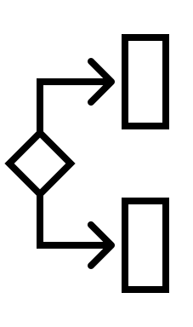
PTW Cost Predictor (PTW-CP)
Comparator Tree
PTW Frequency
Costly-to-translate
page ?
PTW Cost
Costly-to-translate
page !
Bypassing Logic
based on L2 cache MPKI
Notes:
If MPKI is smaller than X, just fetch all inside the cache

Slide 51
PTW-CP Details in the Paper
Feature engineering to find
minimal set of useful features
2-feature comparator predicts costly-to-translate pages with 82% accuracy

Slide 52
Talk Outline
Background & Motivation
Opportunity: Leverage Caches
Victima: Overview
Victima: Detailed Design
Evaluation Results

Slide 53
Evaluation Methodology
Sniper Multicore Simulator extended with:
TLB Hierarchy with multiple page sizes
Radix page table walker
Page walk caches
Workloads: Executed for 500M instructions
GraphBIG: PR, BFS, BC, GC, CC
HPCC: Randacc
XSBench: Particle Simulation
DLRM: Sparse-length sum
GenomicsBench: k-mer counting
https://github.com/CMU-SAFARI/Victima
Notes:
Add description of workloads from the paper
Add correct configurations

Slide 54
Configurations – Native Execution
Radix: Baseline system with 1.5K-entry L2 TLB and Transparent Huge pages enabled
Optimistic L2 TLB-64K: System with 64K-entry L2 TLB (optimistic 12-cycle access latency)
Optimistic L2 TLB-128K: System with 128K-entry L2 TLB (optimistic 12-cycle access latency)
POM-TLB¹: System with 64K-entry software-managed L3 TLB
Victima
[1] Ryoo et al. “Rethinking TLB designs in virtualized environments: A very large part-of-memory TLB” ISCA 2017

Slide 55
Performance Speedup
1.28x
Victima achieves similar performance to the optimistically fast 128K-entry L2 TLB
Notes:
Rewrite this..

Slide 56
Reduction of Page Table Walks
50%
Victima reduces PTWs by 50%
on average compared to the baseline

Slide 57
Effect of L2 Cache Size on Victima
63%
Employing an 8MB L2 cache with Victima
reduces PTWs by 63%

Slide 58
Performance in Virtualized Environments
Victima outperforms 64K-entry
software-managed TLB by 12%
Notes:
Add discussion about performance results

Slide 59
Area & Power Overhead
Area and power overhead evalution using McPAT
Comparison to a high-end Intel Raptor Lake
Victima incurs 0.04% area and 0.08% power overheads

Slide 60
More in the paper
Victima integration in virtualized environments
Maintenance operations to handle TLB shootdowns
TLB-Block-aware replacement policy
Implementation details of PTW cost estimator
Translation reach provided by Victima
https://arxiv.org/abs/2310.04158

Slide 61
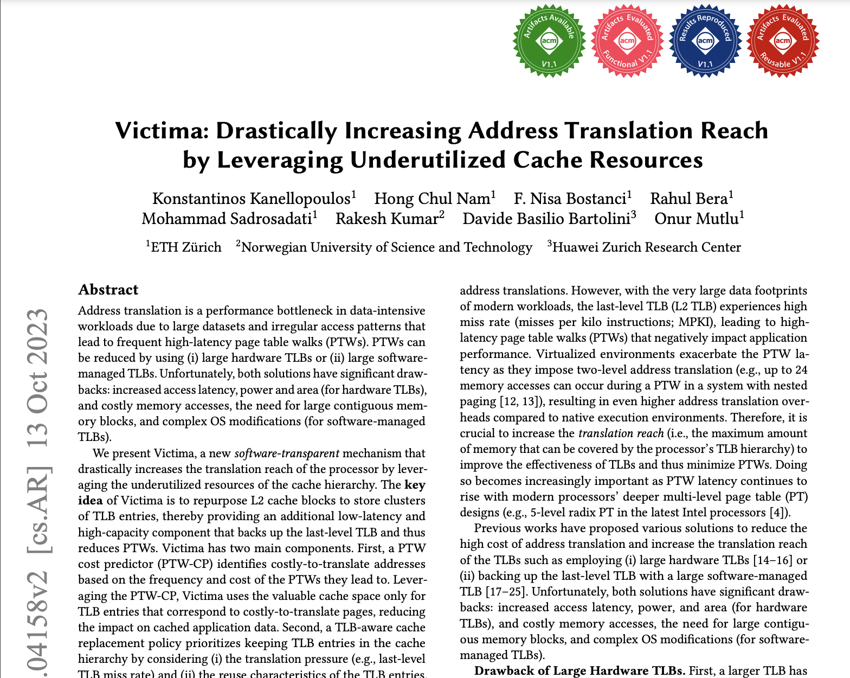
More in the paper
Victima integration in virtualized environments
Maintenance operations to handle TLB shootdowns
TLB-Block-aware replacement policy
Implementation details of PTW cost estimator
Translation reach provided by Victima
https://arxiv.org/abs/2310.04158

Slide 62
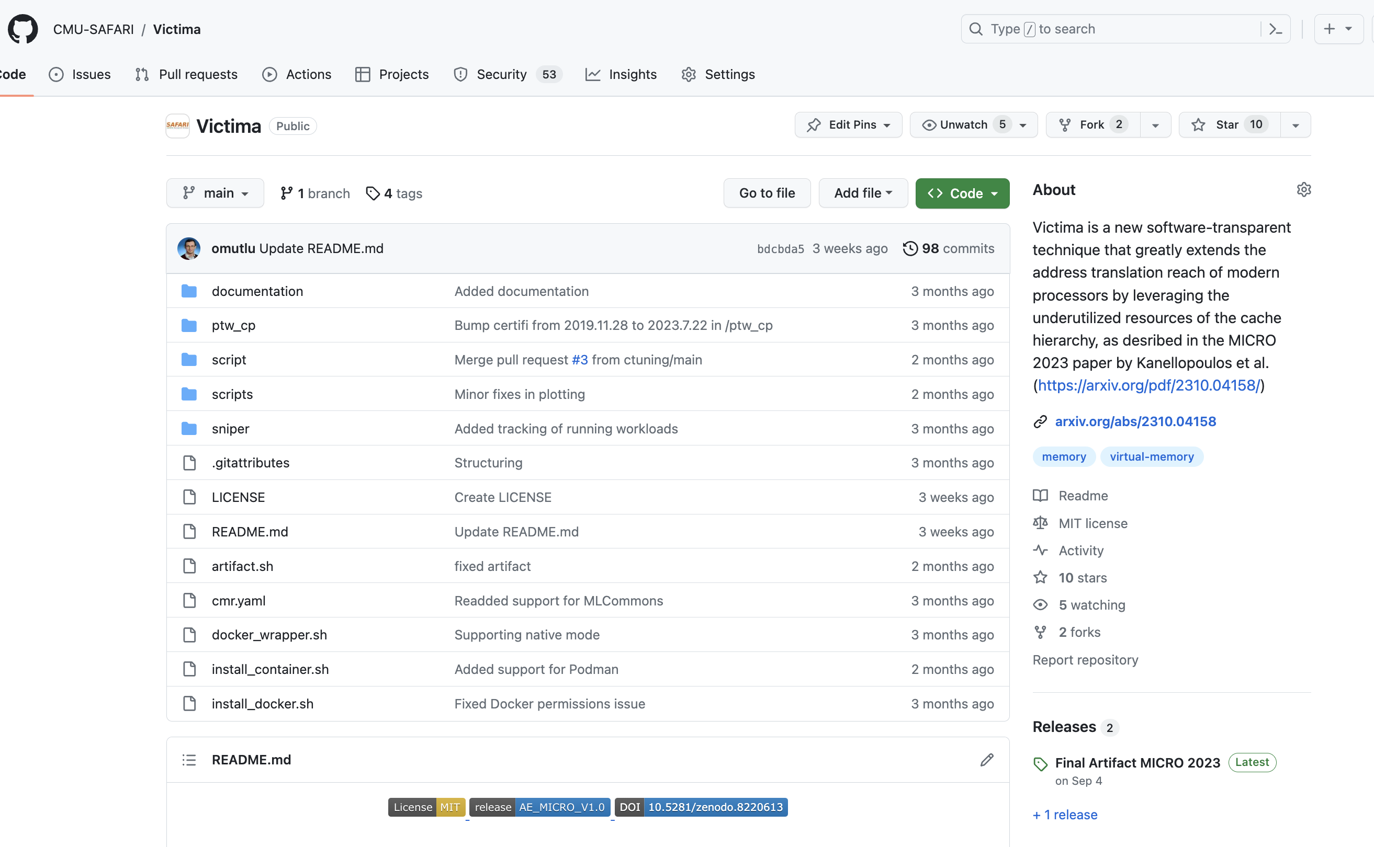
Victima is Open Source
https://github.com/CMU-SAFARI/Victima

Slide 63
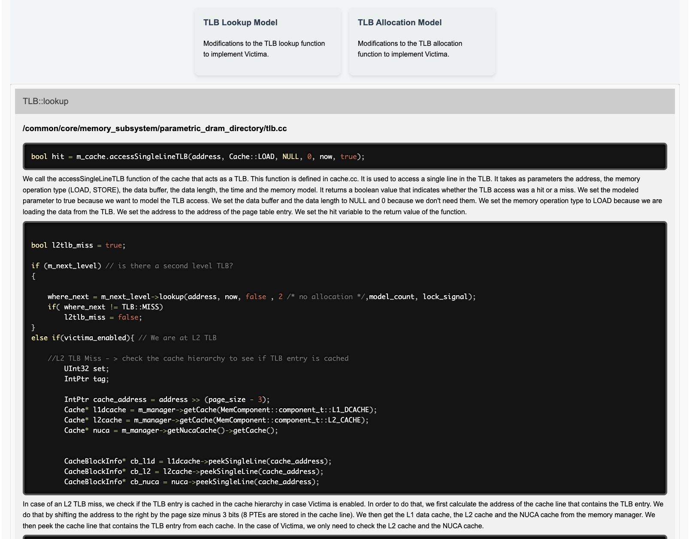
Victima is Open Source
Documentation is available

Slide 64
Conclusion
We present Victima, a new software-transparent scheme that drastically increases the translation reach of the processor’s TLB hierarchy by leveraging the underutilized cache resources
L2 Cache
Key idea: Transform L2 cache blocks that store PTEs into blocks that store TLB entries
PTEs
TLB Entries
Key Results: Victima (i) outperforms by 5.1% a state-of-the-art software-managed TLB and (ii) achieves similar performance to an optimistically fast 128K-entry L2 TLB design without the associated area and power overheads
https://github.com/CMU-SAFARI/Victima
Notes:
Translation reach = memory coverage
Check the paper to see the right number of percents

Slide 65
VICTIMA Drastically Increasing Translation Reach by Leveraging Underutilized Cache Resources
https://github.com/CMU-SAFARI/Victima
Konstantinos Kanellopoulos
Hong Chul Nam, Nisa Bostanci, Rahul Bera, Mohammad Sadrosadati,
Rakesh Kumar, Davide Basilio Bartolini and Onur Mutlu

Slide 66
Adding Hardware-based L3 TLB
Cacti7.0 Estimation
High access latency offsets the potential performance gains of hardware L3 TLB

Slide 67
Reuse of TLB Blocks in L2 Cache
More than 60% of TLB blocks
experience reuse higher than 20
Notes:
Add area comparisons and remove this plot

Slide 68
Sensitivity to L2 Cache Replacement Policy
Employing the TLB-aware DRRIP leads to 1.8% higher performance compared to the conventional DDRIP

Slide 69
Page Table Walk in X86-64
VIRTUAL ADDRESS
9-bit
9-bit
9-bit
9-bit
Four sequential memory accesses
during a page table walk in x86-64
CR3
Up to 24 memory accesses in
virtualized environments
Physical Frame Number
Notes:
Remove virtualized environments banner

Slide 70
Virtualized Environments
Two-level address translation
Guest
Virtual
Host
Virtual
Host
Physical
1
2

Slide 71
Virtualized Environments
L2 TLB
Guest-Virtual
Host-Physical
Nested
TLB
Guest-Virtual
Host-Virtual

Slide 72
Virtualized Environments
MMU
L2 TLB
TLB Entry
L2 Cache
Nested
TLB
Nested TLB Entry
Notes:
- Remove discussion about virtualized environments

Slide 73
PTW-CP Feature Set
Feature (per PTE) | Bits | Description
Page Size | 1 | The size of the page (4KB or 2MB)
Page Table Walk Cost | 3 | DRAM accesses during a PTW
Page Table Walk Frequency | 3 | The number of PTWs
LLPWC Hits | 5 | The number of third-level PWC hits
L1 TLB Misses | 5 | The number of L1 TLB misses
L2 TLB Misses | 5 | The number of L2 TLB hits
L2 Cache Hits | 5 | The number of L2 cache hits
L1 TLB Evictions | 5 | The number of L1 TLB evictions
L2 TLB Evictions | 6 | The number of L2 TLB evictions
Accesses | 6 | The number of accesses to the page
Feature engineering to find
minimal set of useful features
Notes:
Make the table more visible

Slide 74
PTW-CP Exploration
 | NN-10 | NN-5 | NN-2 | Comparator
Feature Size | 10 | 5 | 2 | 2
Number of Layers | 4 | 4 | 6 | N/A
Size of Hidden Layers | 16 | 64 | 4 | N/A
Number of Neurons | 737 | 8769 | 97 | N/A
Size (B) | 5896 | 70152 | 776 | 24
Recall | 0.9334 | 0.9244 | 0.8962 | 0.8961
Accuracy | 0.9213 | 0.9172 | 0.8290 | 0.8290
Precision | 0.8768 | 0.8747 | 0.7333 | 0.7334
F1-score | 0.9042 | 0.8989 | 0.8066 | 0.8066
2-feature comparator predicts costly-to-translate pages with 82% accuracy
Notes:
Move to backup slides

Slide 75
Configurations in Virtualized Environments
Nested Paging¹: Baseline system that performs Nested PTWs
POM-TLB²: System with 64K-entry software-managed L3 TLB
Ideal Shadow Paging³: System that employs an ideal version of Shadow Paging
Victima: Caching both TLB and Nested TLB entries in the L2 cache
[1] Bhargava et al. “Accelerating two-dimensional page walks for virtualized systems” ASPLOS 2008
[2] Ryoo et al. “Rethinking TLB designs in virtualized environments: A very large part-of-memory TLB” ISCA 2017
[3] “Agile paging: Exceeding the best of Nested and Shadow Paging” ISCA 2016

Slide 76
Reduction in Host and Guest PTWs

