Slide 1





Virtuoso
Enabling Fast and Accurate Virtual Memory Research with an Imitation-based
Operating System Simulation Methodology
Konstantinos Kanellopoulos Konstantinos Sgouras F. Nisa Bostanci
Andreas Kosmas Kakolyris Berkin Kerim Konar Rahul Bera
Mohammad Sadrosadati Rakesh Kumar Nandita Vijaykumar Onur Mutlu
https://github.com/CMU-SAFARI/Virtuoso

Slide 2



GPUs
CPUs
NICs
Virtual
Memory

Slide 3
Accelerator
GPUs
Virtual Memory
is a cornerstone of
modern computing systems
CPUs
NICs

Slide 4
Does Virtual Memory come for free?

Slide 5
Memory Allocation
Virtual memory causes high performance overheads
Address
Translation
1
2

Slide 6




Memory Allocation Overheads
1
Emerging Workloads
Function-as-a-Service
Short-input Short-output
Large Language Model Inference
Short Running (<1s)
High spawning throughput
Time spent in OS cannot be amortized due to short execution
OS Memory
Allocation Routines
Execution
Time

Slide 7
Physical Memory Allocation Overheads
On average 32% of execution time (measured
in a real system) spent on physical memory allocation

Slide 8


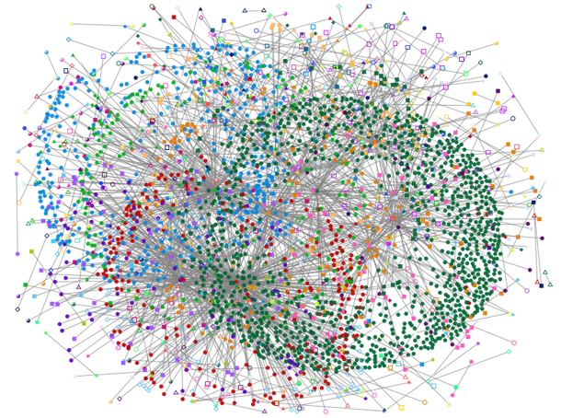

Address Translation Overheads
2
Emerging Workloads
Sparse Machine
Learning
Bioinformatics
Graph Analytics
Databases
Long Running (>100s)
Irregular Memory Accesses
High Latency Address Translation
TLB Miss
Page Table Walk
Data Fetching
Time

Slide 9
Address Translation Overheads
On average 26% of execution time (measured
in a real system) is spent on address translation

Slide 10
High VM Overheads
VM causes high overheads
in diverse emerging workloads

Slide 11
Virtual Memory overheads are
expected to increase as we transition
to larger physical address spaces

Slide 12
Going into the Future
1
Unified Virtual Memory
GPU Memory
CPU Memory
High Bandwidth
Limited Capacity
High Capacity
Low cost/bit

Slide 13

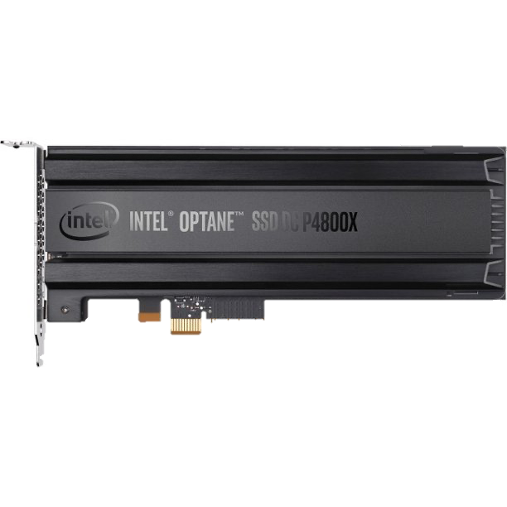
Going into the Future
1
Unified Virtual Memory
GPU Memory
CPU Memory
High Bandwidth
Limited Capacity
High Capacity
Low cost/bit
2
Direct Storage Access
High-end SSD
Byte-addressable interface

Slide 14
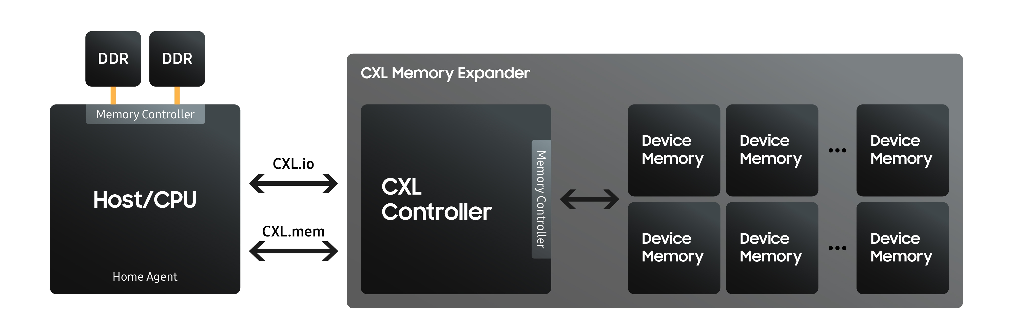
Going into the Future
1
Unified Virtual Memory
GPU Memory
CPU Memory
High Bandwidth
Limited Capacity
High Capacity
Low cost/bit
2
Direct Storage Access
Memory Disaggregation
3
High-end SSD
Access to both local and remote memory modules
Byte-addressable interface

Slide 15

Researchers try to save the day

Slide 16
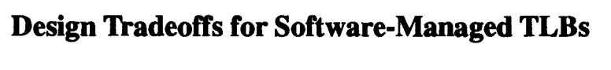
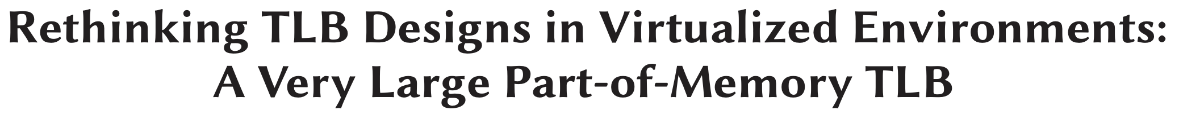
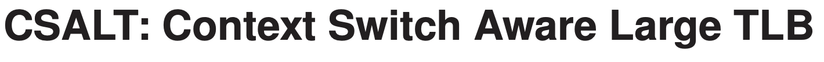
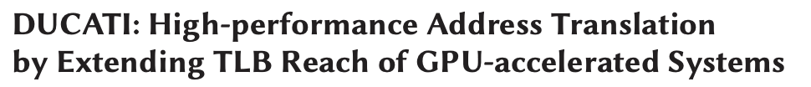
Co-design the hardware and the OS
to reduce VM overheads
Software-managed TLB Subsystem
Nagle+ ISCA 1993
Ryoo+ ISCA 2017
Marathe+ MICRO 2017
Jaleel+ TACO 2019

Slide 17

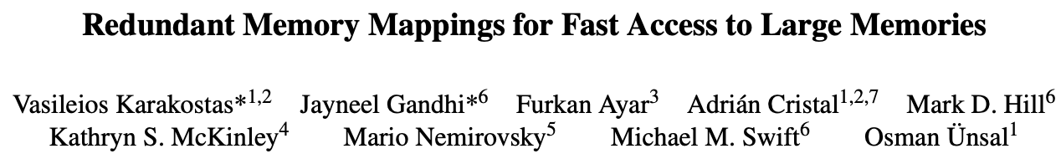
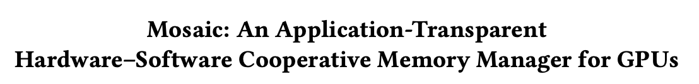
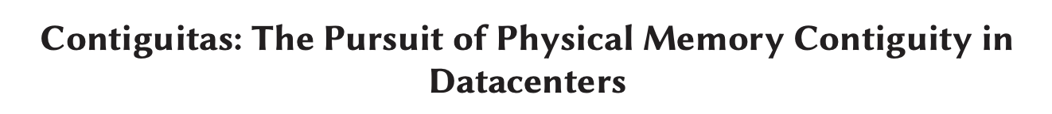
Co-design the hardware and the OS
to reduce VM overheads
Leveraging VA-to-PA Contiguity
Pham+ MICRO 2012
Karakostas*,Ghandhi*+ ISCA 2015
Ausavarungnirun+ MICRO 2017
Zhao+ ISCA 2022
Software-managed TLB Subsystem

Slide 18
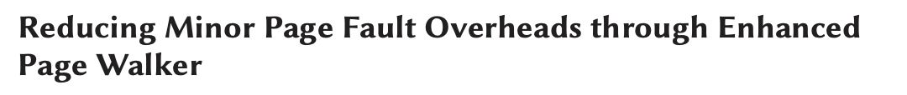
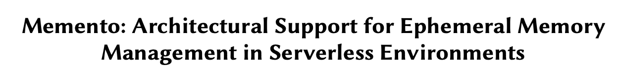
Co-design the hardware and the OS
to reduce VM overheads
Accelerating Memory Allocation
Lee+ ISCA 2020
Tirumalasetty+ TACO 2022
Wang+ MICRO 2023
Software-managed TLB Subsystem
Leveraging VA-to-PA Contiguity

Slide 19

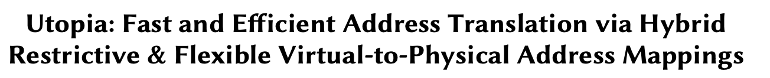
Co-design the hardware and the OS
to reduce VM overheads
Alternative Address Mappings
Picorel+ PACT 2016
Gosakan+ ASPLOS 2023
Kanellopoulos+ MICRO 2023
Software-managed TLB Subsystem
Leverage VA-to-PA Contiguity
Accelerating Memory Allocation

Slide 20
Co-design the hardware and the OS
to reduce VM overheads
Rethinking the Page Table Design
Employing Multiple Page Sizes
and more...
Software-managed TLB Subsystem
Leverage VA-to-PA Contiguity
Accelerating Memory Allocation
Alternative Address Mappings

Slide 21

Co-design the hardware and the OS
to reduce VM overheads
Rethinking the Page Table Design
Employing multiple page sizes
Software-managed TLB Subsystem
Leverage VA-to-PA Contiguity
Accelerate Memory Allocation
Alternative Address Mappings
Wide range of hardware-OS co-design
techniques that aim to improve virtual memory

Slide 22
Effectively evaluating VM techniques
is crucial for progress in the domain

Slide 23
Challenges in Evaluation
Interplay between system components
Software-level Memory Management
Hardware MMU
System Components

Slide 24


Example: Page Table and Large Pages
Page Table
Size
OS Allocation Policy
Size of the page table depends on the number of large pages provided by the OS

Slide 25
Example: Page Table and Large Pages
OS Kernel
Page Table
”I can provide plenty
of large pages”
# Entries
Free
2MB Pages

Slide 26
Example: Page Table and Large Pages
OS Kernel
“Fragmentation is rising so
I cannot allocate 2MB pages”
Page Table
# Entries
4KB Pages

Slide 27


Page Table and Memory Interference
DRAM Bank
App 1
Page Table Entries
Rows
.
.
.
.
.
.
App 2
Program
Data
Row Buffer
App 2
Program
Data

Slide 28
Page Table and Memory Interference
DRAM Bank
App 1
Rows
.
.
.
.
.
.
App 2
Conflict
Row Buffer
App 2

Slide 29
Page Table and Memory Interference
DRAM Bank
App 1
Rows
.
.
.
.
.
.
App 2
Row Buffer
App 1

Slide 30

Page Table and Memory Interference
DRAM Bank
App 1
Rows
.
.
.
.
.
.
App 2
Conflict
Row Buffer
App 1

Slide 31
Page Table and Memory Interference
DRAM Bank
App 1
Rows
Frequent accesses
to page table entries cause
high interference in main memory
.
.
.
.
.
.
App 2
Conflict
Row Buffer
App 1

Slide 32
Challenges in Evaluation
Software-level Memory Management
Hardware MMU
System Components

Slide 33
Challenges in Evaluation
Software-level Memory Management
Evaluating the interplay between components is critical when assessing current and new VM techniques
Hardware MMU
System Components

Slide 34
Researchers have architectural simulators at their disposal

Slide 35
Existing Architectural Simulators
Two main classes of simulators
1
Emulation-based
2
Full-system

Slide 36
Emulation-based Simulators
Ramulator
ZSim
Sniper
ChampSim
High simulation speed with a focus on modeling microarchitectural features
Limited support for OS primitives
Analytically estimate
VM Overheads

Slide 37
Analytical Estimation of VM Overheads
First-order Models
Simple mathematical or algorithmic approximation
Example
Page Table Walk Latency = 100 cycles (fixed)
Minor Page Fault Latency = 2000 cycles (fixed)
Is this good enough?

Slide 38
Variable PTW Latency
Low Memory Intensity
High Memory
Intensity
Average PTW Latency (measured in a real system) ranges from 33 up to 184 cycles

Slide 39
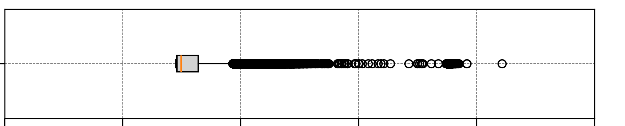
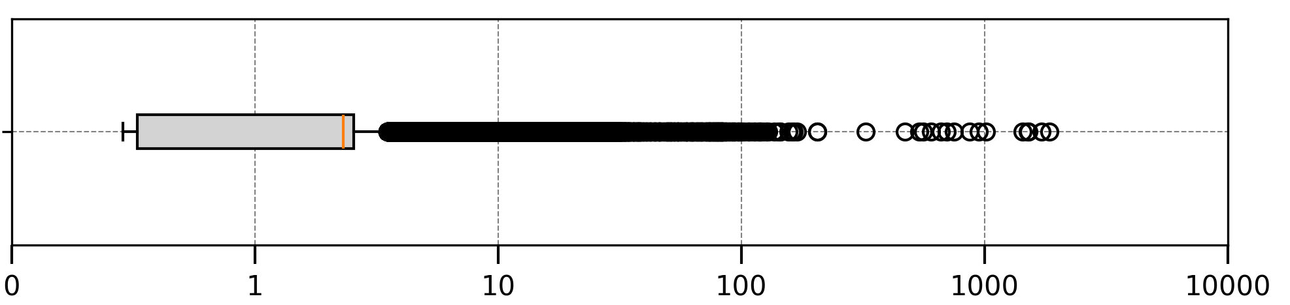
Variable Memory Allocation Latency
Contribution of outliers to total memory allocation latency: 67%
THP
Enabled
Median
Contribution of outliers to total minor page fault latency: 25%
THP
Disabled
25th
percentile
75th percentile
Physical Memory Allocation Latency (μs) in Log Scale
Notes:
In this experiment, we measured the memory allocation latency using ftrace with THP disabled and enabled.

Slide 40
Variable Memory Allocation Latency
Contribution of outliers to total memory allocation latency: 67%
THP
Enabled
Contribution of outliers to total minor page fault latency: 25%
THP
Disabled
Physical Memory Allocation Latency (μs) in Log Scale
The latency of handling memory allocation
(measured in a real system)
exhibits high variability
Notes:
The contribution of the outlier values (above seventy-fifth percentile) is 67% of the total latency.

Slide 41
Variable Memory Allocation Latency
Contribution of outliers to total memory allocation latency: 67%
THP
Enabled
Contribution of outliers to total minor page fault latency: 25%
THP
Disabled
Physical Memory Allocation Latency (μs) in Log Scale
The latency of handling memory allocation
(measured in a real system)
exhibits high variability
Notes:
In contrast, outliers with THP disabled, contribute only by 25% to the total latency.

Slide 42
Analytical Estimation of VM Overheads
Use of First-order Models
First-order models do not accurately
capture the dynamic nature of VM overheads

Slide 43
Full-System Simulators
gem5-FS
QFlex
PTLsim
Enable the execution of a full-blown OS
on top of a hardware simulator
Low simulation speed
Hard to develop

Slide 44
Existing Architectural Simulators
Two main classes of simulators
1
Emulation-based
2
Full-System

Slide 45
Existing Architectural Simulators
Emulation-based
Dichotomy
Simulation Speed
Full-System
Accuracy in Estimating VM overheads

Slide 46

Existing Architectural Simulators
Emulation-based
Our goal
Simulation Speed
Full-System
Accuracy in Estimating VM overheads

Slide 47
Enabling Fast and Accurate VM Research
Virtuoso
New simulation framework that enables
fast and accurate prototyping and evaluation of
the software and hardware components of VM

Slide 48


Imitation-based Simulation Methodology
Lightweight Userspace Kernel
written in a high-level programming language
“I will try to imitate
the full-blown OS”
Choose OS modules only related
to the desired research

Slide 49
Imitation-based Simulation Methodology
Monitoring
Full-blown Kernel
Interrupts
Thread Scheduler
Managing NUMA
Data Sharing Support
Transparent Huge Pages
Swapping
Virtual Memory Area Handling
Cgroups
Boot process
Protection
Block device driver
SLAB Allocator
hugetlbfs

Slide 50
Imitation-based Simulation Methodology
Lightweight Userspace Kernel
Swapping
Virtual Memory Area Handling
Transparent Huge Pages

Slide 51
Imitation-based Simulation Methodology
Rapid development and prototyping
1
High simulation speed by executing
only the desired OS kernel functionality
2
Accurate evaluation by integrating
Virtuoso with an architectural simulator
3

Slide 52

Imitation-based Simulation Methodology
Lightweight Userspace Kernel
Desired Memory Management modules written in a high-level language
Binary Instrumentation
Userspace Kernel Instruction Stream
+ Imitates the OS-level
Overhead
add R1, R1 ,R2
load R1, [0xA]
Simulator
Core Model

Slide 53
Imitation-based Simulation Methodology
Lightweight Userspace Kernel
Desired Memory Management modules written in a high-level language
Functional Outcome
Binary Instrumentation
Userspace Kernel Instruction Stream
+ Enables emulation of kernel modules
add R1, R1 ,R2
load R1, [0xA]
Simulator
Core Model

Slide 54
Workflow: Page Fault Handling Example
Example Userspace Kernel
Transparent Huge Pages
Buddy Allocator
Page Fault Handler

Slide 55
Workflow: Page Fault Handling Example
Example Userspace Kernel
1
Page Fault Handler
6
Workload
2
Binary Instrumentation
Memory
Access
7
Page Fault
5
3
MMU
Model
Core
Model
Translation Request
4
8
Example: Sniper Simulator [Carlson+ TACO 12]

Slide 56
Workflow: Page Fault Handling Example
Example Userspace Kernel
Page Fault Handler
Workload
Page Fault
Outcome
Memory
Access
MMU
Model
Core
Model
Translation Request
Example: Sniper Simulator [Carlson+ TACO 12]

Slide 57
MimicOS: Imitating the Linux Kernel
MimicOS modules written in C++
Buddy Allocator
Radix-based page table
hugetlbfs
Transparent Huge Pages
Swap Space
Page Cache
More details in the paper
https://arxiv.org/pdf/2403.04635

Slide 58

VirTool: State-of-the-art VM techniques
Toolset encompassing the HW/SW components
of multiple state-of-the-art VM techniques
4 page table designs
Software-Managed TLB
Page-Size Prediction
2 Memory Tagging Schemes
Nested MMU
Support
2 Hash-based address mapping schemes
2 Contiguity-aware Schemes
2 THP Policies
2 Intermediate Address Space Schemes
Speculative Translation
TLB Prefetching

Slide 59
VirTool: State-of-the-art VM techniques
Toolset encompassing multiple state-of-the-art VM techniques
4 page table designs
Software-Managed TLB
Page-Size Prediction
2 Memory Tagging Schemes
Enables researchers to evaluate
and prototype current and
brand new VM techniques
2 Hash-based mapping schemes
Nested MMU
Support
2 Contiguity-aware Schemes
2 THP Policies
2 Intermediate Address Space Schemes

Slide 60
VirTool: State-of-the-art VM techniques
Toolset encompassing multiple state-of-the-art VM techniques
4 page table designs
Software-Managed TLB
Page-Size Prediction
2 Memory Tagging Schemes
Virtuoso is a highly versatile
simulation framework
2 Hash-based mapping schemes
Nested MMU
Support
2 Contiguity-aware Schemes
2 THP Policies
2 Intermediate Address Space Schemes

Slide 61
Integrated Virtuoso with 5 Diverse
Architectural Simulators
gem5-SE
System-call emulation
mode of gem5
[Lowe-Power+ arXiv 2020]
[Binkert+ SIGARCH News 2011]
http://gem5.org/

Slide 62
Integrated Virtuoso with 5 Diverse
Architectural Simulators
gem5-SE
Ramulator
Focus on main memory subsystem
[Luo+ CAL 2023]
https://github.com/CMU-SAFARI/ramulator2

Slide 63
Integrated Virtuoso with 5 Diverse
Architectural Simulators
gem5-SE
Ramulator
Sniper
Focus on
multicore systems
[Carlson+ TACO 2012]
https://github.com/snipersim/snipersim

Slide 64
Integrated Virtuoso with 5 Diverse
Architectural Simulators
gem5-SE
Ramulator
Sniper
ChampSim
Focus on
microarchitecture
[Gober+ arXiv 2022]
https://github.com/ChampSim/ChampSim

Slide 65
Integrated Virtuoso with 5 Diverse
Architectural Simulators
gem5-SE
Ramulator
Sniper
ChampSim
Focus on
storage devices
MQSim
[Tavakkol+ FAST 2018]
https://github.com/CMU-SAFARI/MQSim

Slide 66
Validation against a Real System
Virtuoso
Sniper
Against
Linux Kernel
High-end
Server-grade
CPU

Slide 67
Validation: Instructions Per Cycle (IPC)
Virtuoso integrated with Sniper improves
IPC modeling accuracy by 21%
compared to baseline Sniper

Slide 68
Validation: Instructions Per Cycle (IPC)
Virtuoso integrated with Sniper achieves IPC modeling accuracy within 9% of gem5-FS

Slide 69
Validation: Page Fault Handling Latency
Virtuoso integrated with Sniper models the
page fault handling latency with 66% accuracy,
within 15% of gem5-FS

Slide 70
Simulation Speed Comparison
ChampSim
Sniper
Ramulator
gem5
GMEAN
MimicOS leads to an average 20% simulation time overhead over the baseline version of the simulator

Slide 71
Simulation Speed Comparison
ChampSim
Sniper
Ramulator
gem5
GMEAN
Enabling full-system execution mode in gem5
leads to 77% simulation time overhead

Slide 72
Virtuoso’s Versatility
We showcase Virtuoso’s
versatility by evaluating multiple
different use cases
Demonstrate new insights on
state-of-the-art VM techniques
5 use cases in the paper
https://arxiv.org/pdf/2403.04635

Slide 73
Virtuoso Example Use Cases
Evaluating Different
Page Table Designs
Evaluating Physical Memory
Allocation Policies

Slide 74
Virtuoso Example Use Cases
Evaluating Different
Page Table Designs
Evaluating Physical Memory
Allocation Policies

Slide 75
Evaluation Methodology
Radix: Baseline radix-based page table
ECH¹: Elastic Cuckoo Hash-based Page Table
Fragmentation: Number of available 2MB pages
compared to the total number of 2MB pages
Workloads: GraphBIG, XSBench, HPCC
[1] Skarlatos et al. “Elastic Cuckoo Page Tables: Rethinking Virtual Memory Translation for Parallelism” ASPLOS 2020

Slide 76
Reduction in PTW Latency
11%
6%
As memory fragmentation decreases, the PTW
latency reduction of ECH compared to Radix increases

Slide 77
Main Memory Interference
2.5x
2.7x
52%
ECH leads to an average 52% increase
in DRAM row buffer conflicts over Radix

Slide 78
Virtuoso Example Use Cases
Evaluating Different
Page Table Designs
Evaluating Physical Memory
Allocation Policies

Slide 79
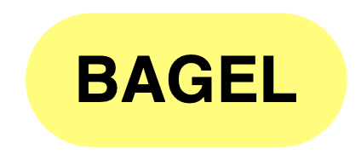

Evaluation Methodology
Buddy: Baseline allocator with the buddy system
Utopia:¹ Part of memory is organized using a hash-based mapping
Workloads: Short-input Short-output LLM inference
Mistral-7B
Llama-2-7B
Bagel-2.8B
[1] Kanellopoulos et al. “Utopia: Fast and Efficient Address Translation via Hybrid Restrictive & Flexible Virtual-to-Physical Address Mappings” MICRO 2023

Slide 80
Accelerating Memory Allocation
Restricting the virtual-to-physical mapping speeds up memory allocation by up to 2.17x

Slide 81
More Details in the Paper
- Detailed description of communication primitives
- Detailed description of MimicOS modules
- Integration methodology with different simulators
- Integration with heterogeneous system simulation
- Evaluation of intermediate address space schemes
- Evaluation of swapping activity and translation latency in hash-based address mapping schemes
- Evaluation of two additional hash-based page tables
and more to come …

Slide 82
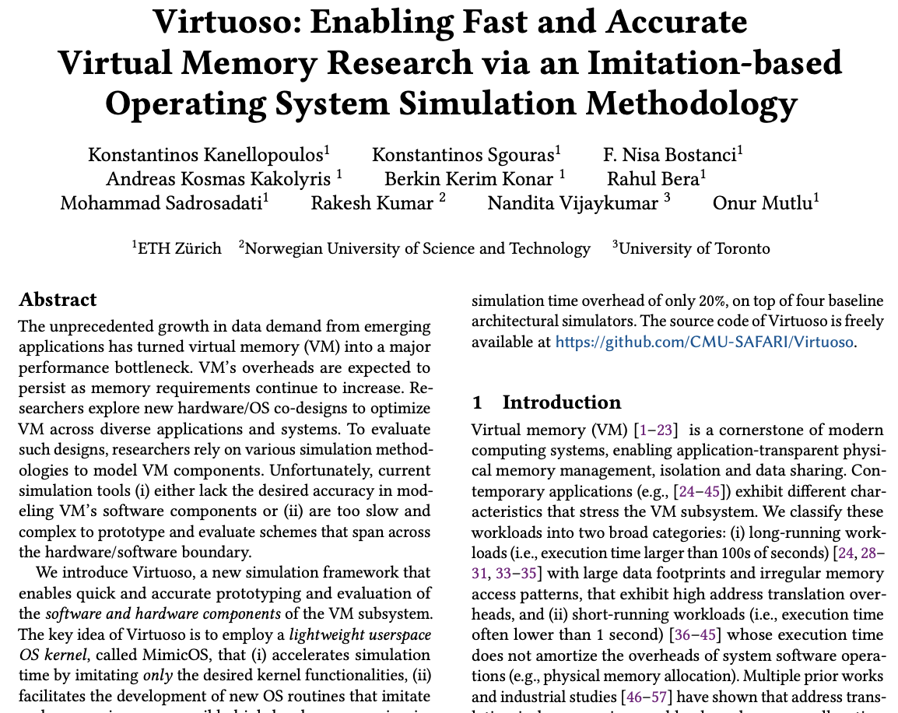
More Details in the Paper
- Detailed description of communication primitives
- Detailed description of MimicOS modules
- Integration methodology with different simulators
- Evaluation of intermediate address space schemes
- Evaluation of swapping activity and translation latency in hash-based address mapping schemes
- Evaluation of two additional hash-based page tables
https://arxiv.org/pdf/2403.04635

Slide 83
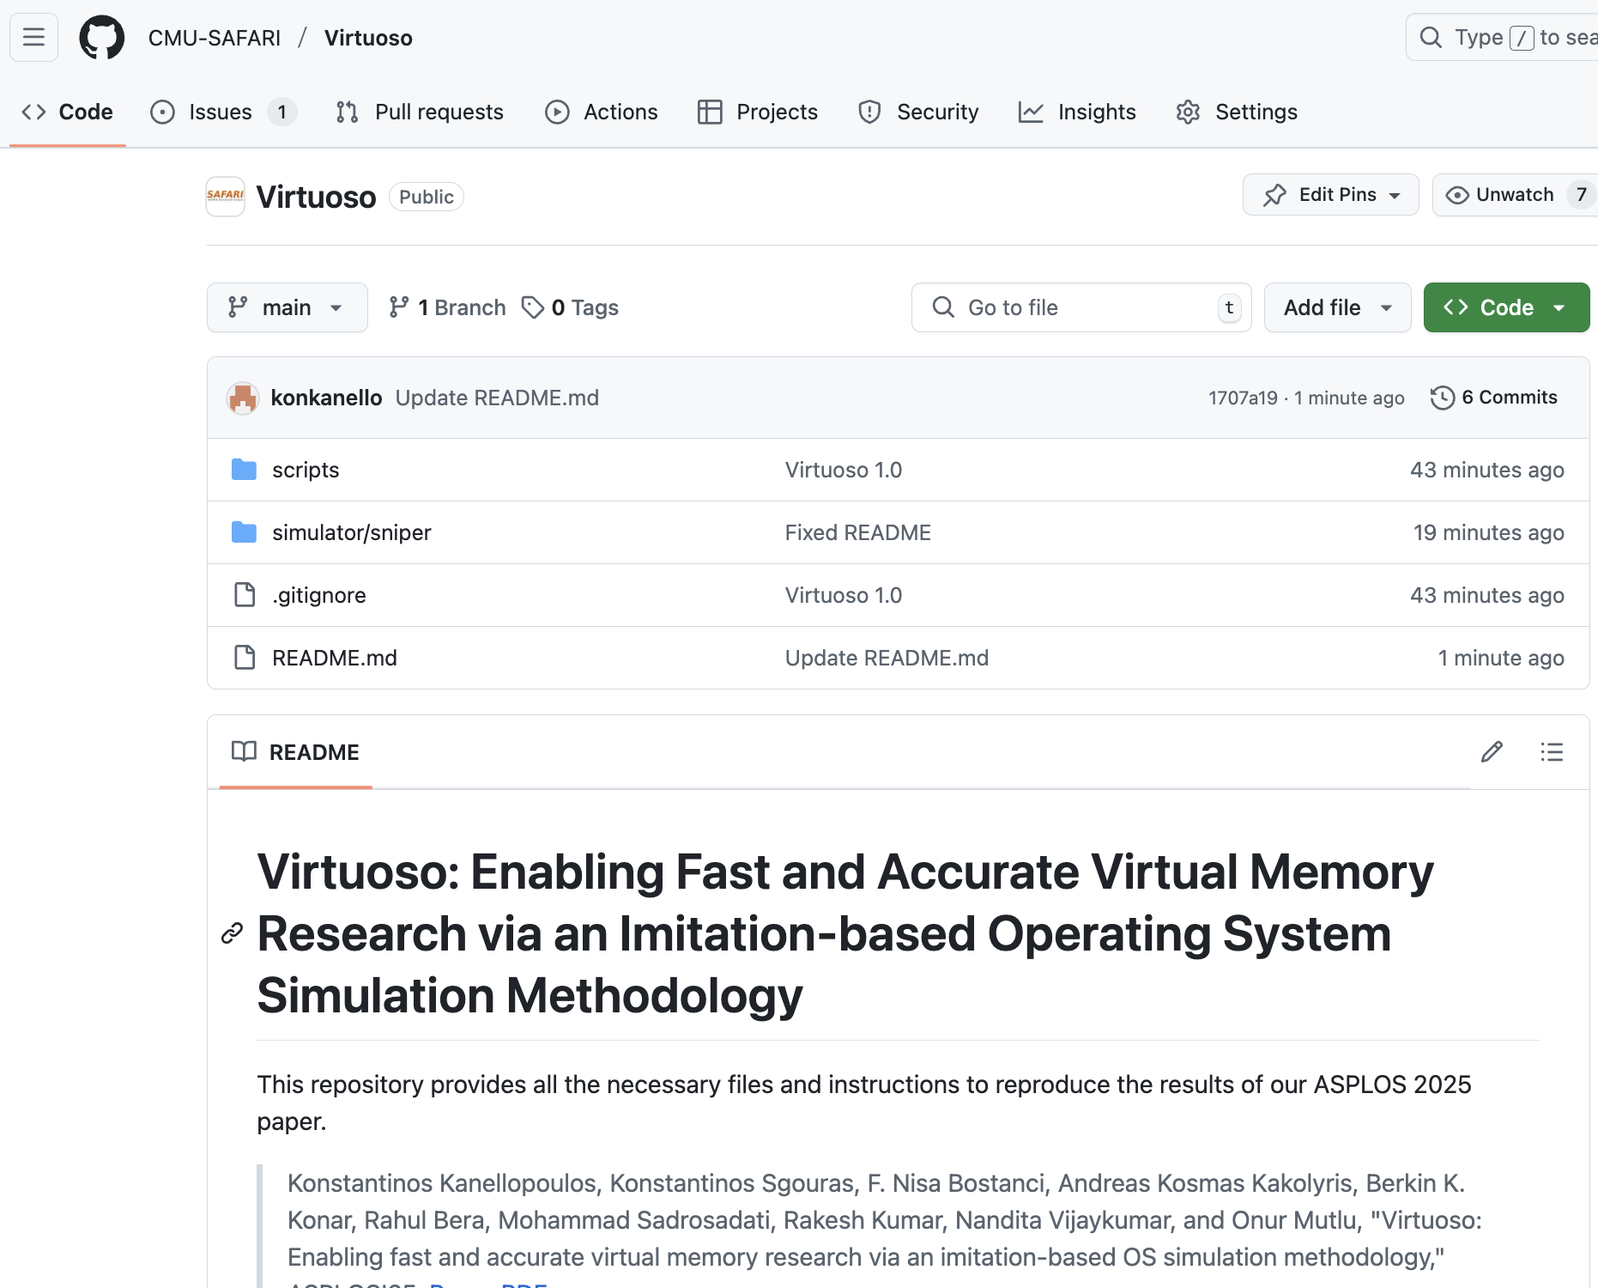
Virtuoso is Open-Source
https://github.com/CMU-SAFARI/Virtuoso

Slide 84
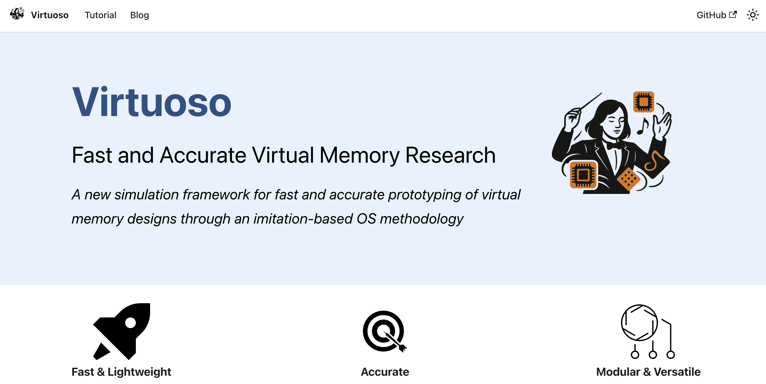
Virtuoso Website – Getting Started
https://github.com/CMU-SAFARI/Virtuoso/website

Slide 85
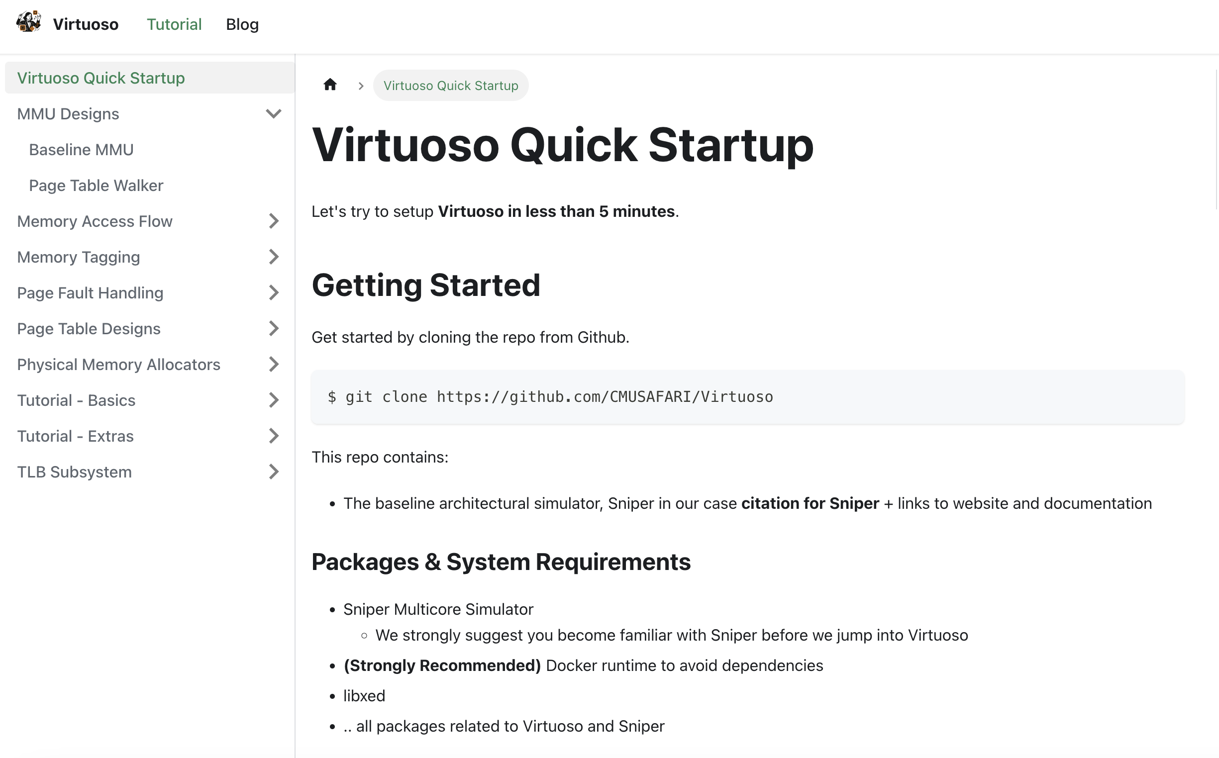
Virtuoso Website - Documentation
https://safari.ethz.ch/virtuoso

Slide 86
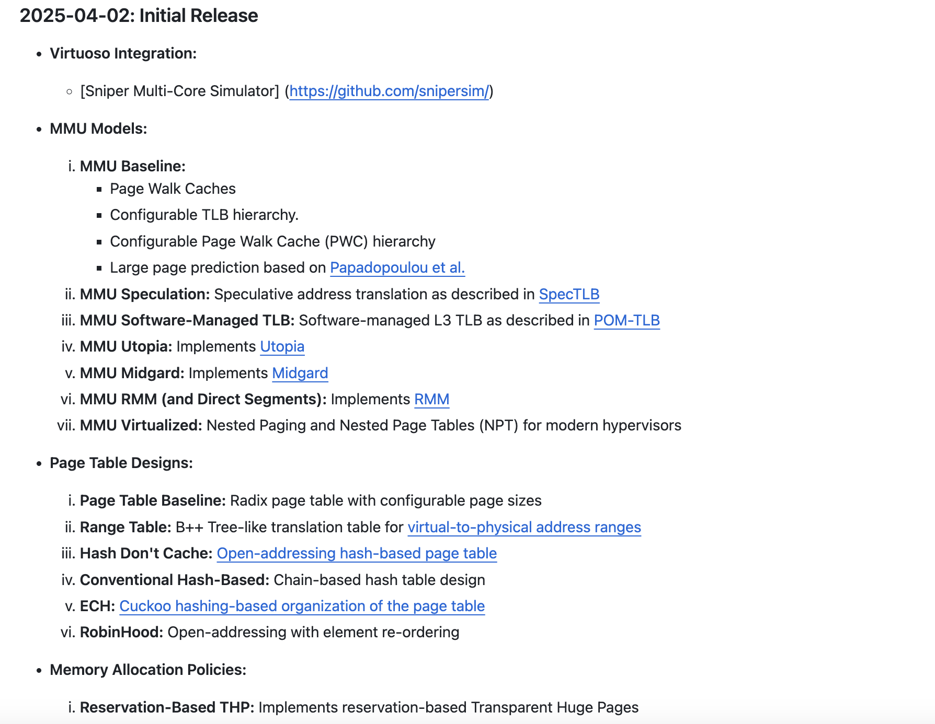
Virtuoso Website – Incoming Features
https://safari.ethz.ch/virtuoso

Slide 87
Conclusion

Slide 88
VM causes high overheads
in emerging workloads

Slide 89
Virtuoso
New simulation framework that enables
fast and accurate prototyping and evaluation of
the software and hardware components of VM
https://github.com/CMU-SAFARI/Virtuoso

Slide 90
Imitation-based
Simulation Methodology
Rapid development and versatility
1
High simulation speed
2
Accurate simulation
3

Slide 91

Integration with 5 simulators
VirTool
Toolset encompassing multiple state-of-the-art VM techniques
gem5-SE
Ramulator
Sniper
MQSim
ChampSim
Validation against high-end server-grade CPU
Implemented 5 diverse use cases to
showcase Virtuoso’s versatility
https://github.com/CMU-SAFARI/Virtuoso

Slide 92
We hope Virtuoso establishes a
common ground for VM research

Slide 93


Virtuoso
Github
arXiv
Enabling Fast and Accurate Virtual Memory Research with an Imitation-based
Operating System Simulation Methodology
Konstantinos Kanellopoulos Konstantinos Sgouras F. Nisa Bostanci
Andreas Kosmas Kakolyris Berkin Kerim Konar Rahul Bera
Mohammad Sadrosadati Rakesh Kumar Nandita Vijaykumar Onur Mutlu
https://github.com/CMU-SAFARI/Virtuoso

Slide 94
Why do we need
Virtual Memory?

Slide 95
Virtual Memory Benefits
Programmer-transparent
memory management
1
Process isolation
2
Data sharing between processes
3

Slide 96
How does Virtual Memory work?

Slide 97

App 1
App 2
Virtual Address Space #1
Virtual Address Space #2
Physical Address Space (e.g., physical memory)

Slide 98
App 1
App 2
Virtual Address Space #1
Virtual Address Space #2
Page
Page
Page
Page
(e.g., 4KB)
Page
Page
Page
Page
Page
Physical Address Space (e.g., physical memory)

Slide 99
App 1
App 2
Virtual Address Space #1
Virtual Address Space #2
Physical Address Space

Slide 100
App 1
App 2
Virtual Address Space #1
Virtual Address Space #2
Virtual-to-Physical Address Mapping
Physical Address Space

Slide 101
Who establishes virtual-to-physical address mappings?

Slide 102

App
Virtual Address Space
Map virtual addresses
to physical memory
Physical Memory

Slide 103
Virtual Address Space
Fault
Virtual address
not mapped to
physical memory
Physical Address Space

Slide 104
App
Virtual Address Space
Operating
System
Handles memory allocation
Physical Memory

Slide 105

Application is stalled
Operating System
Minor Fault
Major Fault
Finds free space in
physical memory
Fetches data
from the disk

Slide 106
Virtual Address Space
Store/Update the
virtual-to-physical address mapping
Operating
System
Page Table
Physical Memory

Slide 107
How does the CPU discover the virtual-to-physical mapping?

Slide 108
Address Translation
Core
Memory Hierarchy
Page
Table
Virtual
Address
Memory
Management Unit
Hardware unit responsible
for address translation

Slide 109
Address Translation
Memory Management Unit
Memory Hierarchy
TLB Hierarchy
Page Table Walker
Page
Table
Miss
Notes:
[1] There is a two level TLB-hierarchy.
[2] If we miss in the TLB, we trigger the page table walk
[3] We search in the page walk caches for intermediate levels

Slide 110
Validation against a Real System
Virtuoso
Sniper
Validation Metrics
MMU Performance
InstructionsPer Cycle
Page Fault Latency
High-end
Server-grade
CPU

Slide 111
Validation: L2 TLB MPKI
82%
Virtuoso integrated with Sniper models
the L2 TLB misses per kilo instructions
of a real high-end CPU with 82% accuracy

Slide 112
Validation: Page Table Walk Latency
86%
Virtuoso integrated with Sniper models the
Page Table Walk latency of a real high-end CPU
with 86% accuracy

Slide 113
Instructions vs Simulation Time
y
Normalized
Simulation Time
y=1.5x
x
Fraction of Instructions Executed by MimicOS
Linear relationship between instructions
executed by MimicOS and simulation time

