Slide 1
Demystifying Complex
Workload–DRAM Interactions:
An Experimental Study
Saugata Ghose, Tianshi Li,
Nastaran Hajinazar, Damla Senol Cali, Onur Mutlu
June 27, 2019

Slide 2
Why Study Workload–DRAM Interactions?
Manufacturers are developing many new types of DRAM
  DRAM limits performance, energy improvements:
  new types may overcome some limitations
  Memory systems now serve a very diverse set of applications:
  can no longer take a one-size-fits-all approach
So which DRAM type works best with which application?
  Difficult to understand intuitively due to the complexity of the interaction
  Can’t be tested methodically on real systems: new type needs a new CPU
We perform a wide-ranging experimental study to uncover
the combined behavior of workloads and DRAM types
  115 prevalent/emerging applications and multiprogrammed workloads
  9 modern DRAM types: DDR3, DDR4, GDDR5, HBM, HMC, LPDDR3, LPDDR4, Wide I/O, Wide I/O 2

Slide 3
Insights From Our Extensive Experimental Study
DDR4 worse than DDR3 for most desktop/scientific applications
HMC worse than DDR3 for apps with high spatial locality
HMC good for highly memory intensive multiprogrammed workloads
LPDDRx performance gap over DDRx worsens as the intensity increases
LPDDR4 saves power over DDR3 without losing much performance for
high-intensity multiprogrammed workloads
Multithreaded programs with irregular accesses become throughput-bound as the input problem size increases
Server/cloud applications don’t benefit from high-throughput DRAM
LPDDRx saves energy for server/cloud apps without a large performance penalty
Intensive multimedia apps benefit from high-throughput DRAM with wide rows
Network accelerators experience high queuing latencies, benefit from parallelism
GDDR5 is more energy efficient than DDR3 for high-throughput accelerators
OS routines benefit most from low-latency DRAM that exploits spatial locality

Slide 4
Insights From Our Extensive Experimental Study
12 key observations on the combined DRAM–workload behavior
Most significant experimental observations
  Newer is not always better:
  DDR4, HMC (newer DRAM types) do not outperform the older DDR3 type for many families of applications
  Power savings don’t always sacrifice performance:
  Some low-power DRAM types perform close to or better than standard-power DRAM types when bandwidth demand is very high
  Heterogeneous systems cannot rely on a single DRAM type:
  The ideal DRAM for a heterogeneous system depends heavily on the predominant functions performed by the system (e.g., multimedia, network processing, compute)
  Increasing memory latency to increase parallelism can be harmful:
  OS routines exhibit extremely high spatial locality, and can’t benefit from the high parallelism provided by many newer DRAM types
Notes:
HMC performs 5.8% worse than DDR3 for single-thread desktop/scientific applications, despite 87% more bandwidth

Slide 5
Background: DRAM Basics
Characterization Methodology & Metrics
Major Observations from Our Study
Key Takeaways and Conclusion
Outline

Slide 6
Simplified View: DRAM Organization & Operation
A memory channel connects the processor with DRAM
  Controller issues commands
  Many systems have multiple independent channels
DRAM has multiple banks
  Conceptually: 2D array of data
  Banks can operate in parallel
  Many banks share one channel
Data is stored in DRAM cells
  A cell stores charge in a capacitor to represent a one-bit data value
  Before reading/writing, a full row of cells (e.g., 8kB in DDR3) must be activated (opened)
Processor
DRAM Module
Core
Core
Rank
. . .
Memory Controller
Bank
Bank
memory
channel
Bank
DRAM cell
activation
Row Buffer

Slide 7
Modern DRAM Types: Comparison to DDR3
DRAM Type | Banks per Rank | Bank Groups | 3D-Stacked | Low-Power
DDR3 | 8
DDR4 | 16 | ✓
GDDR5 | 16 | ✓
HBM High-Bandwidth Memory | 16 |  | ✓
HMC Hybrid Memory Cube | 256 |  | ✓
Wide I/O | 4 |  | ✓ | ✓
Wide I/O 2 | 8 |  | ✓ | ✓
LPDDR3 | 8 |  |  | ✓
LPDDR4 | 16 |  |  | ✓
DRAM Type | Banks per Rank | Bank Groups | 3D-Stacked | Low-Power
DDR3 | 8
DDR4 | 16 | ✓
GDDR5 | 16 | ✓
HBM High-Bandwidth Memory | 16 |  | ✓
HMC Hybrid Memory Cube | 256 |  | ✓
Wide I/O | 4 |  | ✓ | ✓
Wide I/O 2 | 8 |  | ✓ | ✓
LPDDR3 | 8 |  |  | ✓
LPDDR4 | 16 |  |  | ✓
Bank groups
3D-stacked DRAM
Bank Group
Bank Group
Bank
Bank
Bank
Bank
increased latency
increased area/power
memory channel
high bandwidth with
Through-Silicon
Vias (TSVs)
narrower rows, higher latency
Memory
Layers
dedicated Logic Layer

Slide 8
Background: DRAM Basics
Characterization Methodology & Metrics
Major Observations from Our Study
Key Takeaways and Conclusion
Outline

Slide 9
Characterization Methodology
Modified version of Ramulator
  New shared cache model: comes within 6.1% of gem5 (a detailed, rigorously validated out-of-order processor simulator)
  New HMC model (to be released in July)
  Open source: available at https://github.com/CMU-SAFARI/ramulator/
Energy: modeled for available memories using DRAMPower
Applications
  87 different applications, which we group into six diverse families
    Desktop/scientific » Network acceleration
    Server/cloud » General-purpose GPU (GPGPU)
    Multimedia acceleration » Common OS routines
  Includes single-threaded and multi-threaded workloads
  28 multiprogrammed workloads
  Open source: available at https://github.com/CMU-SAFARI/MemBen/
Notes:
TODO: figure out how much faster

Slide 10
Architectural Parameters
9 DRAM types
  Standard power • Low power
    DDR3-2133 » LPDDR3-2133
    DDR4-3200 » LPDDR4-3200
    GDDR5-7000 » Wide I/O
    HBM » Wide I/O 2
    HMC 2.0
4GB of DRAM total, typically distributed across 4 channels
Processor cores
  Single-thread/multiprogrammed: 4 cores, 4.0 GHz
  Multithreaded: 20 cores, 2 threads per core, 2.2 GHz
  Out-of-order cores, 128-entry ROB, 4-wide issue
64kB/256kB private L1/L2 caches
2MB of shared last-level cache (LLC) per core

Slide 11
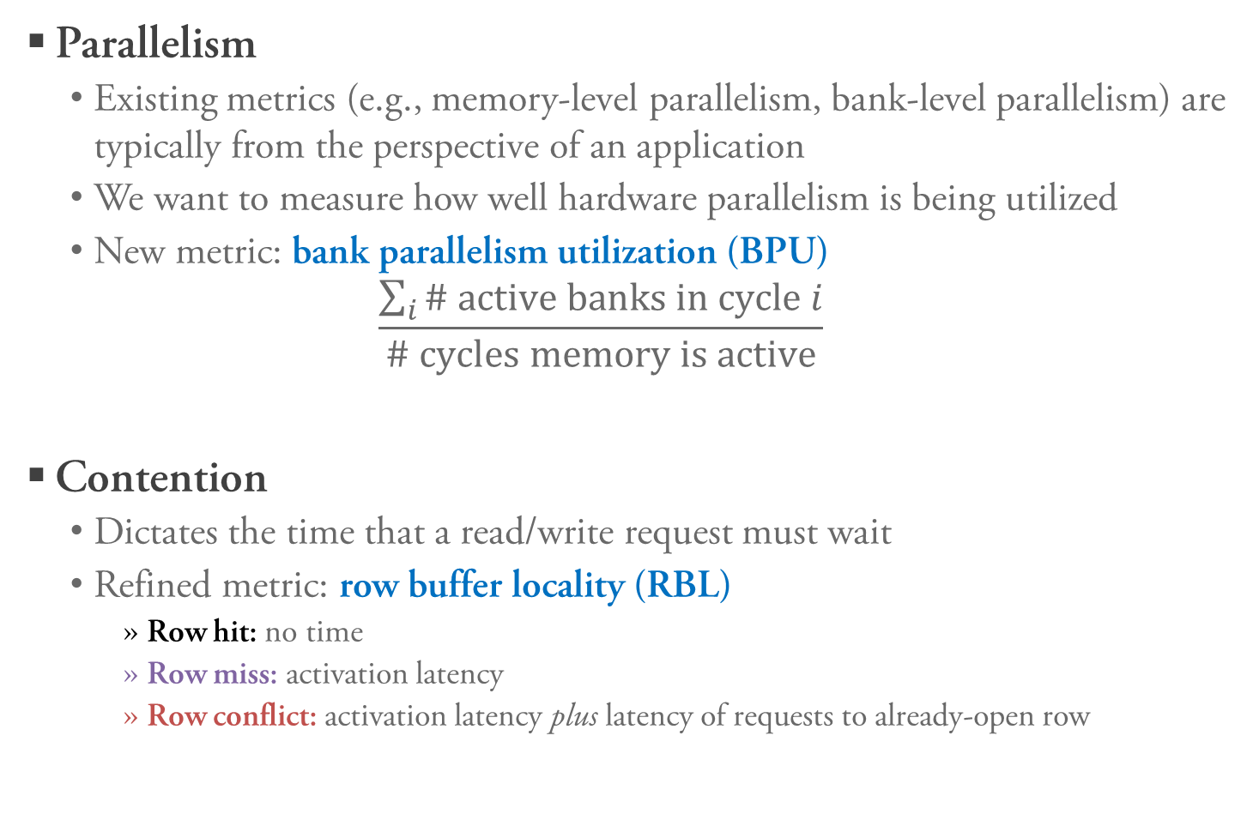
Metrics to Capture Parallelism and Contention
Parallelism
  Existing metrics (e.g., memory-level parallelism, bank-level parallelism) are typically from the perspective of an application
  We want to measure how well hardware parallelism is being utilized
  New metric: bank parallelism utilization (BPU)
  $\frac{\sum_{i}{\text{\# }\text{active} \text{banks} \text{in} \text{cycle} i}}{\text{\# }\text{cycles} \text{memory} \text{is} \text{active}}$
Contention
  Dictates the time that a read/write request must wait
  Refined metric: row buffer locality (RBL)
    Row hit: no time
    Row miss: activation latency
    Row conflict: activation latency plus latency of requests to already-open row
Notes:
TODO: add animation

Slide 12
Background: DRAM Basics
Characterization Methodology & Metrics
Major Observations from Our Study
Key Takeaways and Conclusion
Outline

Slide 13
1. Newer Is Not Always Better: Desktop/Scientific
DDR4 performs near identically to DDR3 most of the time
HMC performs worse than DDR3 in many (but not all) cases
Why? Let’s focus on three representative applications

Slide 14
1. Newer Is Not Always Better: BPU
Performance does not improve when BPU is constant
libquantum (HMC slower): cannot even take advantage of the 32 banks available in DDR3 – additional banks don’t help
mcf (HMC faster): makes use of more banks due to its much higher memory intensity (70 LLC misses per kiloinstruction)
namd (HMC same): HMC has higher BPU due to the shorter rows, but increased latency cancels out performance benefits

Slide 15
1. Newer Is Not Always Better: Row Buffer Locality
HMC works best when there are not many row hits
HMC’s poor spatial locality means that read/write requests are rarely row hits – leads to higher latency
HMC only benefits applications that exhibit few row hits and high memory intensity

Slide 16
When Does HMC Perform Better?
D19
D16
D17
D18
D14
D12
D11
D13
D15
D8
D5
D6
D9
D2
D10
D4
D7
D0
D1
D3
Multiprogrammed workloads
(e.g., desktop/scientific: average speedup of 17.0% over DDR3)
Multithreaded applications
with large problem sizes
and high thread counts
(right: miniFE, 64x64x64)
Network accelerators

Slide 17
2. Low Power Does Not Always Hurt Performance
For many families of applications, using low-power DRAM types can hurt the performance significantly
Some exceptions, such as multiprogrammed desktop/scientific workloads (below) and multimedia accelerators
LPDDR4: 68.2% less energy than DDR3, only 7.0% slower
D19
D16
D17
D18
D14
D12
D11
D13
D15
D8
D5
D6
D9
D2
D10
D4
D7
D0
D1
D3
Some low-power DRAM types perform well when
the bandwidth demand is very high

Slide 18
3. No One Best Type for Heterogeneous Systems
Multimedia Accelerators
Network Accelerators
General-Purpose GPU (GPGPU)
GDDR5 for multimedia acceleration, GPGPU
HMC for network acceleration

Slide 19
3. Heterogeneous Systems: Energy
GDDR5 is much more energy efficient than DDR3 for accelerators with high memory throughput
Example applications
  Network accelerator workloads
  Several GPGPU applications: sc, bfs, sp

Slide 20
4. Need for Lower Access Latency: Performance
New DRAM types often increase access latency in order to provide more banks, higher throughput
Many applications can’t make up for the increased latency
  Especially true of common OS routines (e.g., file I/O, process forking)
  A variety of desktop/scientific, server/cloud, GPGPU applications
Several applications don’t benefit from more parallelism

Slide 21
4. Need for Lower Access Latency: Insight
Many applications still exhibit high spatial locality
We can see an example of this from the row buffer locality of the common OS routines
Requests often go to a single open row:
few opportunities to exploit bank parallelism

Slide 22
Background: DRAM Basics
Characterization Methodology & Metrics
Major Observations from Our Study
Key Takeaways and Conclusion
Outline

Slide 23
Key Takeaways
DRAM latency remains a critical bottleneck for
many applications
Bank parallelism is not fully utilized by a wide variety
of our applications
Spatial locality continues to provide significant performance benefits if it is exploited by the memory subsystem
For some classes of applications, low-power memory
can provide energy savings without sacrificing
significant performance

Slide 24
Conclusion
Manufacturers are developing many new types of DRAM
  DRAM limits performance, energy improvements:
  new types may overcome some limitations
  Memory systems now serve a very diverse set of applications:
  can no longer take a one-size-fits-all approach
  Difficult to intuitively determine which DRAM–workload pair works best
We perform a wide-ranging experimental study to uncover
the combined behavior of workloads, DRAM types
  115 prevalent/emerging applications and multiprogrammed workloads
  9 modern DRAM types
12 key observations on DRAM–workload behavior
Open-source tools: https://github.com/CMU-SAFARI/ramulator
Full paper: https://arxiv.org/pdf/1902.07609

Slide 25
Demystifying Complex
Workload–DRAM Interactions:
An Experimental Study
Saugata Ghose, Tianshi Li,
Nastaran Hajinazar, Damla Senol Cali, Onur Mutlu
June 27, 2019
Open-source tools: https://github.com/CMU-SAFARI/ramulator
Full paper: https://arxiv.org/pdf/1902.07609

Slide 26
Backup Slides

Slide 27
Simplified DRAM Organization and Operation
DRAM Chip
Bank 0
. . .
Bank 7
Processor Chip
DRAM
Cell Array
Core
Core
. . .
activation
Row Buffer
Shared Last-Level Cache
Column Select
. . .
Memory Controller
Bank Select
I/O Drivers
I/O Drivers
memory channel
Fundamental DRAM commands: activate, read, write, precharge
One row of DRAM: 8 kB
One cache line of data: 64 B

Slide 28
Modern DRAM Types: Double Data Rate DRAM
DDR3
  Double Data Rate: bursts of data sent on memory channel at both positive and negative clock edge
  8 banks per rank
DDR4
  More banks per rank using bank groups – results in 11-14% higher latency
  16 banks per rank
GDDR5
  Also uses bank groups, but consumes more area/energy instead of increasing latency
  Sends double the data per cycle compared to DDR3 using a faster clock
  16 banks per rank
Notes:
TODO: add animation for bank groups

Slide 29
Modern DRAM Types: 3D-Stacked DRAM
3D die stacking enables
new DRAM types with
high capacity, much
higher bandwidth
High-Bandwidth Memory (HBM)
  Instead of GDDR5’s faster clocks, HBM uses multiple channels per module to increase throughput
  16 banks per rank
Hybrid Memory Cube (HMC)
  Partitions 3D-stacked DRAM into vaults: small vertical slices of DRAM with multiple banks
  Contains many more banks, but a row is 97% narrower than in DDR3: cannot exploit as much spatial locality
  256 banks per rank
high bandwidth with
Through-Silicon
Vias (TSVs)
Memory
Layers
dedicated Logic Layer

Slide 30
Modern DRAM Types: Low-Power DRAM
LPDDR3 and LPDDR4
  Low-power variants of DDR3/DDR4
  Increased memory latency, limited capacity
  LPDDR3: 8 banks per rank
  LPDDR4: 16 banks per rank
Wide I/O and Wide I/O 2
  Low-power 3D-stacked DRAM
  Fewer channels than HBM
  Wide I/O: 4 banks per rank
  Wide I/O 2: 8 banks per rank

Slide 31
Key DRAM Properties

Slide 32
Detailed Methodology Details
Workload traces collected using Pin, Bochs
  Private caches fully modeled
  Bochs captures all system calls – important for OS routines, server/cloud
  Multithread traces capture per-trace interactions
  (based on [Pelley+ ISCA 2014])
GPGPU results run on a full GPGPU-Sim+Ramulator platform

Slide 33
Validating a Trace-Based Ramulator Approach
We compare
  gem5 (full-system, cycle accurate CPU simulator) + unmodified Ramulator
  Modified Ramulator with shared cache model (trace-driven)
Run all SPEC CPU2006 applications
Checking trends: normalize each performance value to one application (gamess)
Average error of Ramulator vs. gem5+Ramulator: 6.1%

Slide 34
Desktop/Scientific: Single-Thread IPC/MPKI

Slide 35
Desktop/Scientific: Single-Thread Performance

Slide 36
Desktop/Scientific: Single-Thread DRAM Latency

Slide 37
Desktop/Scientific: DDR3 BPU/RBL

Slide 38
Desktop/Scientific: Multiprogrammed Performance

Slide 39
Desktop/Scientific: Multiprogrammed RBL/BPU

Slide 40
Desktop/Scientific: Energy and Power Breakdown

Slide 41
Desktop/Scientific: Multithreaded IPC/MPKIs

Slide 42
Desktop/Scientific: quicksilver Performance

Slide 43
Desktop/Scientific: facesim Performance

Slide 44
Desktop/Scientific: miniFE Performance
Input size:
32x32x32
Input size:
64x64x64

Slide 45
Desktop/Scientific: Multithreaded RBL

Slide 46
Server/Cloud: Single-Thread IPC

Slide 47
Server/Cloud: Single-Thread Performance

Slide 48
Server/Cloud: workload A server BPU/RBL

Slide 49
Server/Cloud: Multiprogrammed Performance

Slide 50
Server/Cloud: Energy

Slide 51
Heterogeneous: Multimedia Accel. Performance

Slide 52
Heterogeneous: Network Accel. Performance

Slide 53
Heterogeneous: GPGPU Performance

Slide 54
OS Routines: Performance

Slide 55
OS Routines: Energy

